Slide 1
Evaluation of the stability of EPIC oxygen channels with observations and radiative transfer model simulations over South Pole
Yaping Zhou, Yuekui Yang, Pengwang Zhai
DSCOVR EPIC and NISTAR STM
Sep 27-29, 2022

Slide 2
Objective
EPIC’s O₂ bands: A-band (764nm, 780nm) and B-band (688nm, 680nm) play significant roles in EPIC cloud products
Cloud effective pressure (CEP)
Cloud mask over snow/ice surface
Cloud mask over Sun-glint regions over ocean
Due to lack of inflight calibration, 680nm and 780nm calibration uses other well-calibrated instruments such as MODIS, MISR, and VIIRS. The 688nm and 764nm uses lunar observations assuming pairs of O₂ bands have the same reflectance.
Monitoring O₂ band measurements over South Pole (SP) as a way of monitoring their stability.

Slide 3
O₂ band clear sky measurements over South Pole
South Pole location is chosen because of its uniform surface snow type and thinner layer of atmosphere. Ground and in-situ air measurements are available at the Amundsen–Scott South Pole (SP) Station.
Data are for the months of December and January from 2015 to 2022, except Dec. 2019 and Jan. 2020.
EPIC pixels are chosen within 0.25hr of ground observation and 0.1º to 90ºS.
Only clear sky observations are selected based on visual surface sky reports and EPIC cloud mask.
Small fluctuations and small but significant trends in all reflectance (except 764nm) are found. Both ratios have a significant positive trend.

Slide 4
Comparison of EPIC observations with RTM (EPIC simulator) simulations over South Pole
Clear sky measurements coincident with available radiosonde measurement (~12UTC)
Total 92 profiles available from Dec 2015 – Jan 2022 (missing Dec 2019-Dec. 2020).
Basic model input:
Mean SZA from EPIC pixels converted to TOA SZA.
Ground albedo: spectrally varying albedo from SP (Hudson et al. 2006)
Ground height: lowest sounding layer (2.836 km ASL)
4 columns of base profile (subarctic summer) is replaced with sounding measurements (pres, temp, total air density, H₂O density from surface to ~15 km). O₂ and CO₂ changed in proportion to total air density.
Sensitivities on surface albedo, O₃, O₂ amount, boundary layer ice crystal/cloud, w/o improved pseudospherical shell (IPSS) approximation for earth curvature in the model

Slide 5
Observations versus simulations
Simulations > observations for all 4 bands
R680 and R780 overestimate ~ 3%
R688 overestimate 5.3%
R764 overestimate 13.5%
B-band ratio overestimate 1.7%
A-band ratio overestimate 10.%

Slide 6
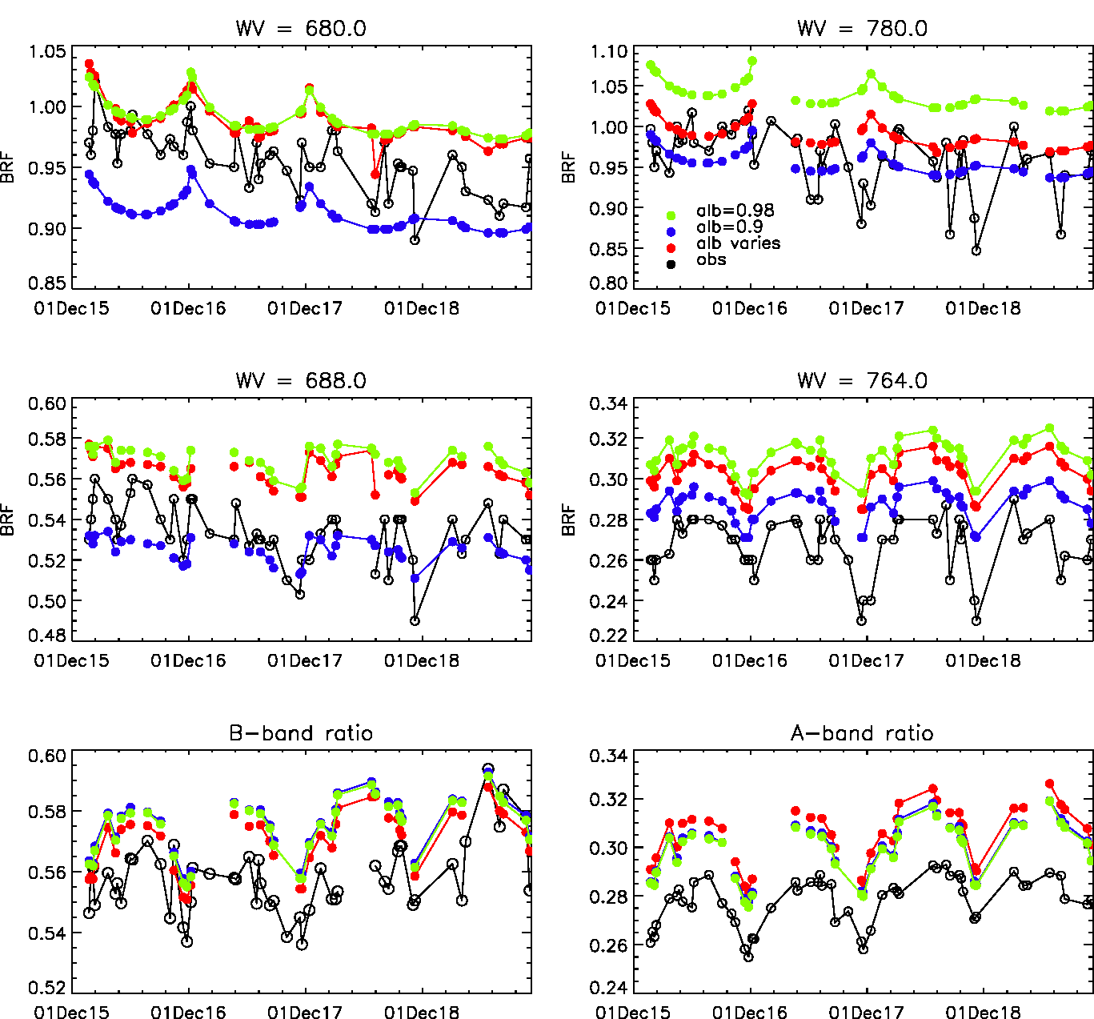
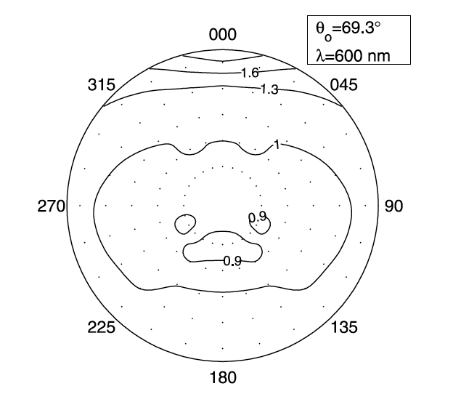
Surface albedo sensitivity
SP spectral albedos in 4 channels:
680nm: 0.965 688nm: 0.96
764nm: 0.93 780nm: 0.921
BRDF from SP
AF in SP direction: 1.3
Hudson et al. 2006

Slide 7
B-band ratio:
0.553
0.577
0.571
0.570
0.570
0.564
0.574
0.589
0.552
A-band ratio:
0.280 (obs)
0.302
0.295
0.294
0.303
0.301
0.301
0.325
0.284 (110% O2)

Slide 8
Account for
boundary aerosol and ice crystal

Slide 9
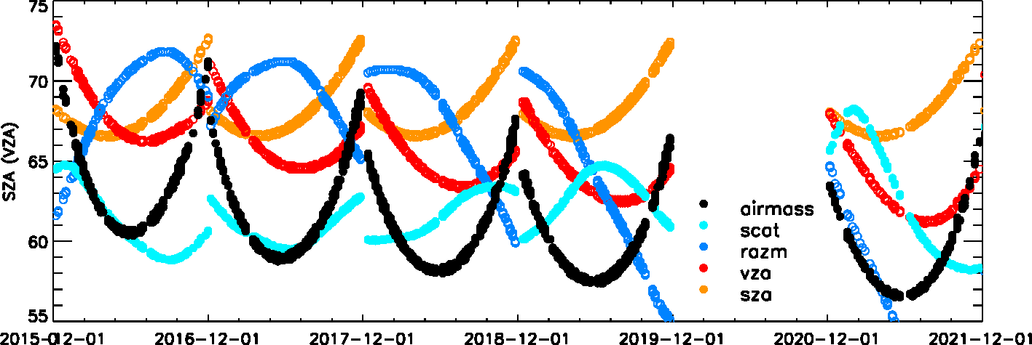
Changing Orbits/Geometry

Slide 10
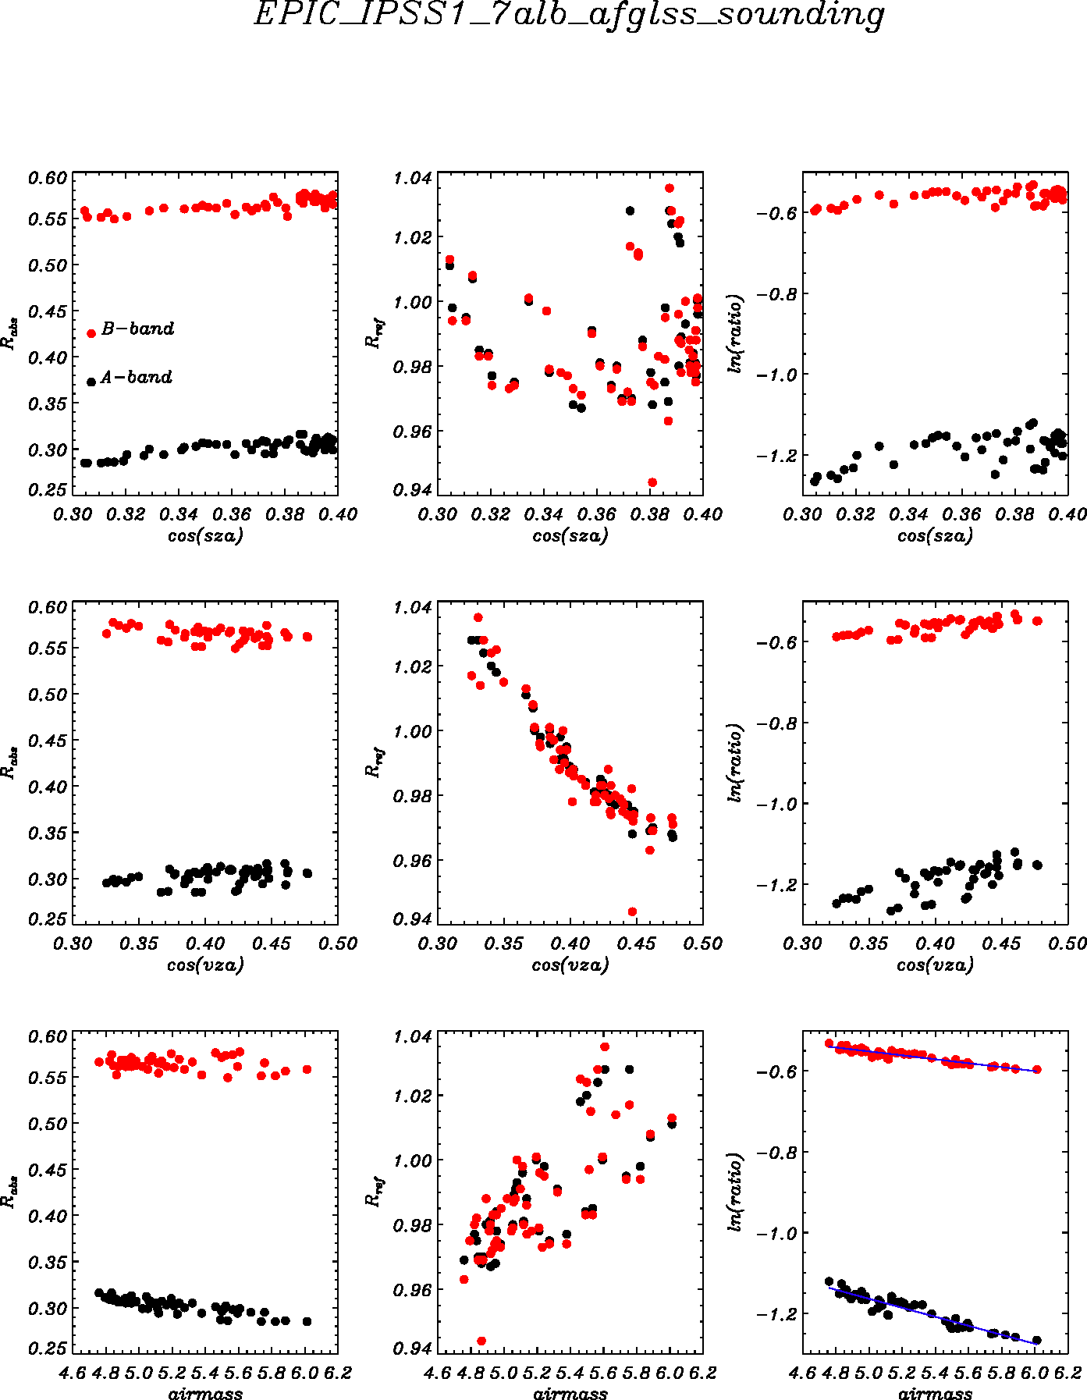
Reflectance as a function of angles - Simulations
Rabs
Rref
Ratio
$m=\frac{1}{μ}+\frac{1}{μ_{0}}=\frac{1}{\cos{θ}}+\frac{1}{\cos{θ_{0}}}$(1)
$\frac{R_{abs}}{R_{ref}}=e^{−τ(z, ρ(z))\left(\frac{1}{μ}+\frac{1}{μ_{0}}\right)}$ (2)
$ln⁡(\frac{R_{abs}}{R_{ref}})= −τ(ρ(z)) (\frac{1}{μ}+\frac{1}{μ_{0}})$ (3)
Zhou et al. 2020

Slide 11
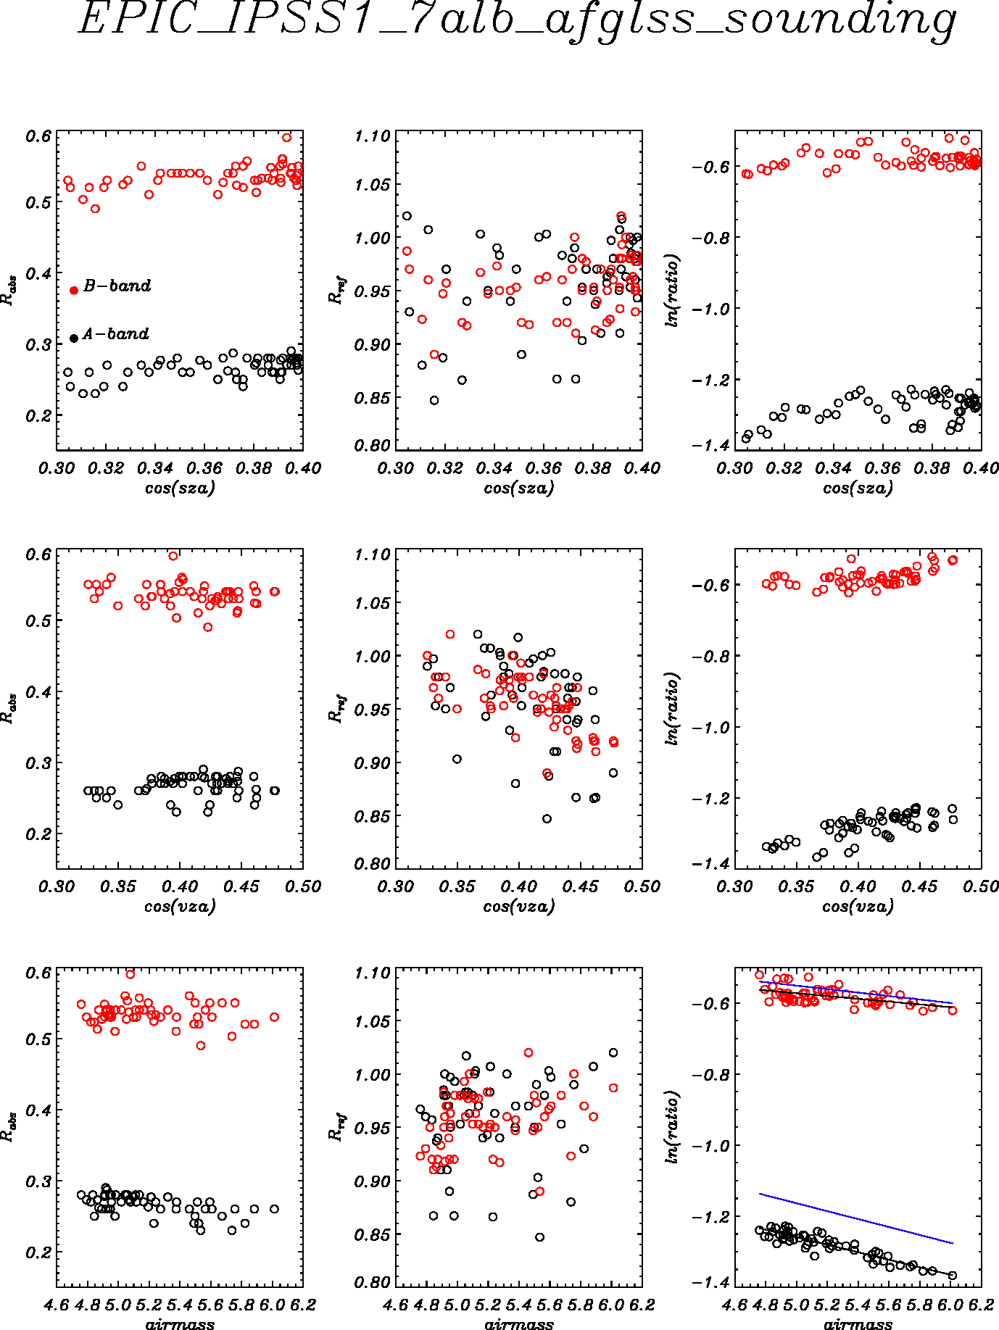
Reflectance as a function of angles - observations

Slide 12
A-band and B-band ratio trend (Dec. 15- Jan.22), Regression with time.
How much variation (trend) of observation can be explained by geometry (orbit) variation?
Variable | offset | slope | r | confidence
Aband_obs | -7.75e-03 | 6.43e-05 | 0.31 | 97.8
Aband_sim | -5.25e-03 | 4.36e-05 | 0.52 | 81.6
Aband_obs_res | -2.85e-04 | 2.37e-06 | 0.01 | 53.4
Bband_obs | -9.68e-03 | 8.07e-05 | 0.39 | 99.9
Bband_sim | -8.60e-03 | 6.53e-05 | 0.53 | 94.2
Bband_obs_res | -3.57e-03 | 2.98e-05 | 0.15 | 85.8
Most of observed trend in A-band and B-band can be attributed to orbit (geometry) change. Residual trend is insignificant.

Slide 13
Summary
South Pole provides a good monitoring site for O₂ band because of its uniform, high surface albedo and available ground and in-situ atmospheric observations. The O2 band reflectance has shown small but significant trends over the past 7 austral summers among other small fluctuations.
RTM simulations and sensitivities have been conducted to understand these trends and fluctuations. Among all factors, surface albedo (BRDF)and total O₂ amount might be responsible for the unclosed bias of O₂ ratios between the simulations and observations.
Earth curvature treatment is important in TOA reflectance at high sun/view angles.
Observed variability in BRF and O₂ band ratios can be mostly explained by orbital (geometry) change. After removing the trend due to angle/orbit change, the residual trends in ratios are insignificant, indicating that instrument/calibration is stable.
There are remaining puzzles in the UV bands.

