Slide 1
EPIC Cloud Products:
Applications of the O₂ Bands
Yuekui Yang, Yaping Zhou, Pengwang Zhai, Anthony Davis, Alexander Marshak
Meng Gao, Alfonso Delgado-Bonal, Galina Wind, Kerry Meyer, Qilong Min
DSCOVR EPIC&NISTAR Science Team Meeting
Sep. 27-29, 2022, GSFC

Slide 2
Status updates (since last STM in Oct. 2021)
Version 3 cloud product file compression with h5repack. File size reduced to < 40mb from the original ~300mb.
Study of EPIC O₂ A- and B-band stability using observations over the Amundsen–Scott South Pole Station.
Continuous assessment of version 3 products, including comparison with the GOES 16 and 17 cloud products

Slide 3
EPIC Standard L2 Cloud Product System
EPIC L1B Products
Ancillary Data
Cloud Mask
Effective Height/Pressure
Cloud Optical Thickness
EPIC L2 Cloud Products

Slide 4
EPIC Channels Used for Cloud Retrievals
Product | Resolution | Description | EPIC Data Used
Cloud Mask | Original pixel size | Each EPIC pixel is classified as clear/cloudy with high/low confidence. | 388 nm, 680 nm, and the 780 nm reflectance, the 764/780 nm and the 688/680 nm ratios.
CEP/CEH | Original pixel size | Cloud effective pressure (CEP) is retrieved for both O2 A- and B-bands | O₂ A-band (780 nm and 764 nm), and B-band (680 nm and 688 nm), EPIC cloud mask
COT | Original pixel size | Cloud optical thickness is retrieved using a single-channel approach (680 nm over land and 780 nm over ocean) | 680 nm, 780nm, EPIC cloud mask, EPIC CEP
Observation time for each EPIC channel starting from the 443 nm channel. Red dots are the channels used for cloud retrievals.
EPIC cloud products and required EPIC observations
Yang, et al., 2019,, Atmos. Meas. Tech.

Slide 5
Research and Applications of EPIC O₂ A- and B-band observations
“EPIC’s two oxygen absorption channels that 1) are unique in their spectral sampling and 2) have stimulated deep innovation in cloud remote sensing using Differential Oxygen Absorption Spectroscopy (DO2AS)”
--Davis et al., 2022, Front. Remote Sens.
9) Davis, A. B., Y. Yang, A. Marshak, 2022: EPIC/DSCOVR as a Pathfinder in Cloud Remote Sensing using Differential Oxygen Absorption Spectroscopy. Front. Remote Sens. 3:796273. doi: 10.3389/frsen.2022.796273.
9) Davis, A. B., Y. Yang, A. Marshak, 2022: EPIC/DSCOVR as a Pathfinder in Cloud Remote Sensing using Differential Oxygen Absorption Spectroscopy. Front. Remote Sens. 3:796273. doi: 10.3389/frsen.2022.796273.
8) Zhou, Y., Y. Yang, P. Zhai, M. Gao, 2021: Cloud Detection over Sunglint Regions with Observations from the Earth Polychromatic Imaging Camera (EPIC), Front. Remote Sens. 2:690010. doi: 10.3389/frsen.2021.690010
7) Yin, B., Min, Q., Morgan, E., Yang, Y., Marshak, A., and Davis, A. B., 2020: Cloud-top pressure retrieval with DSCOVR EPIC oxygen A- and B-band observations, Atmos. Meas. Tech., 13, 5259–5275, https://doi.org/10.5194/amt-13-5259-2020.
6) Zhou, Y., Y. Yang, M. Gao, P. Zhai, 2020: Cloud Detection over Snow and Ice with Oxygen A- and B-band Observations from the Earth Polychromatic Imaging Camera (EPIC), Atmos. Meas. Tech., 13, 1575–1591, https://doi.org/10.5194/amt-13-1575-2020.
5) Gao, M. P.-W. Zhai, Y. Yang, Y. Hu, 2019: Cloud remote sensing with EPIC/DSCOVR observations: a sensitivity study with radiative transfer simulations, J. Quant. Spectrosc. Radiat. Trans., 230, 56-60, doi: https://doi.org/10.1016/j.jqsrt.2019.03.022
4) Davis A., N. Ferlay, Q. Libois, A. Marshak, Y. Yang and Q. Min, 2018: Cloud information content in EPIC/DSCOVR's oxygen A- and B-band channels: A physics-based approach, J. Quant. Spectrosc. Radiat. Trans., 220, 84-96, https://doi.org/10.1016/j.jqsrt.2018.09.006
3) Davis, A. B., G. Merlin, C. Cornet, L. C. Labonnote, J. Riedi, N. Ferlay, P. Dubuisson, Q. Min, Y. Yang, and A. Marhsak, 2018: Cloud information content analysis of EPIC/DSCOVR’s oxygen A- and B-band channels: an optimal estimation approach, J. Quant. Spectrosc. Radiat. Trans. 216, 6-16, https://doi.org/10.1016/j.jqsrt.2018.05.007.
2) Xu, X., J., Wang, Y., Wang, J., Zeng, O., Torres, Y., Yang, A., Marshak, J., Reid, and S., Miller, 2017: Passive remote sensing of altitude and optical depth of dust plumes using the oxygen A and B bands: first results from EPIC/DSCOVR at Lagrange-1 point, Geophys. Res. Lett., 44, doi:10.1002/2017GL073939.
Yang, Y., A. Marshak, J. Mao, A. Lyapustin, J. Herman, 2013: A Method of Retrieving Cloud Top Height and Cloud Geometrical Thickness with Oxygen A and B bands for the Deep Space Climate Observatory (DSCOVR) Mission: Radiative Transfer Simulations. J. Quant. Spectrosc. Radiat. Trans. 122, 141-149, http://dx.doi.org/10.1016/j.jqsrt.2012.09.017.

Slide 6
Research and Applications of
EPIC O₂ A- and B-band observations
“EPIC’s two oxygen absorption channels that 1) are unique in their spectral sampling and 2) have stimulated deep innovation in cloud remote sensing using Differential Oxygen Absorption Spectroscopy (DO2AS)”
--Davis et al., 2022, Front. Remote Sens.
The remainder of the talk focuses on the applications of O₂ A- and B-band on the EPIC L2 Cloud Products, including:
EPIC cloud pressure retrievals
Cloud detection over snow and ice surfaces
Cloud detection over ocean sun glint regions
Note that EPIC cloud mask and cloud height are the input for cloud optical thickness retrieval; hence observations from the O₂ A- and B-band are essential for all the EPIC cloud products.

Slide 7
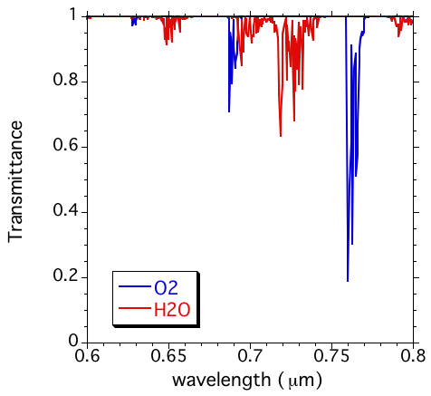
EPIC O2 A- and B-bands
Before EPIC, cloud height retrieval with O2 absorption has been successfully applied to several missions, such as GOME, MERIS, POLDER, OMI, SCIAMACHY etc., as well as many other studies.
B-band
reference
A-band
reference
B-band
e.g., Daniel et al., 2003, Ferlay et al. 2010, Fischer and Grassl, 1991, Koelemeijer et al. 2001, , Kokhanovsky et al., 2005, Lindstrot et al. 2006, Stephens and Heidinger, 2000, Vanbauce et al. 2003, Vasilkov et al. 2008, Wang et al. 2008.
A-band
EPIC A-band absorption and reference channels: 764nm and 780nm, respectively.
EPIC B-band absorption and reference channels: 688nm and 680nm, respectively.
For the reference channels, only slight absorption from O3 and water vapor.
Yang et al., 2013

Slide 8
EPIC O2 A- and B-band filter functions

Slide 9
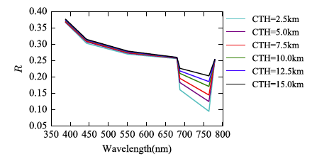
EPIC radiative transfer simulator
An EPIC radiative transfer simulator was built for studying cloud information content of all the EPIC channels, with a focus on the A- and B-bands.
The simulator performs line-by-line simulations inside the measurement bands and then convolutes the radiance at the top of the atmosphere with the EPIC instrument filter functions.
CGT and COD are 2 km and 5.05, respectively. The scattering particles as water cloud droplets, which follow the gamma size distribution, with the effective radius of 10 μm and the effective variance of 0.1.
Gao et al. 2019

Slide 10
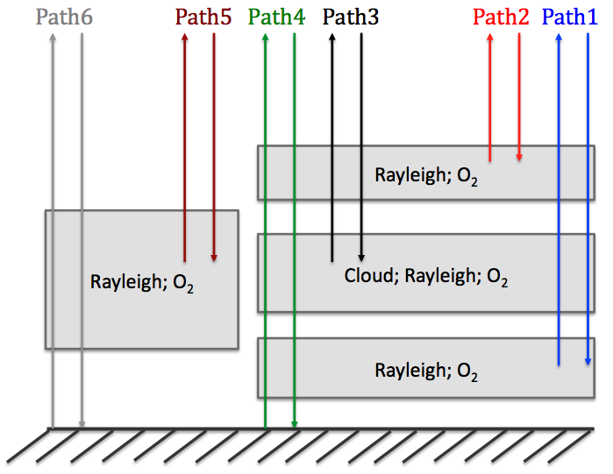
The cloud top height problem:
Complexity of photon pathways makes cloud top retrievals difficult; EPIC retrieves cloud effective pressure
A- and B-band radiances are functions of:
Cloud top height
Cloud geometrical thickness
Cloud fraction
Unknowns
Available
Cloud phase
Cloud optical depth
Atmosphere profile
Surface albedo
Sun-view geometry
Not considered
Cloud particle size and shape
Aerosol loading
Clear part
Cloudy part
Yang et al., 2013

Slide 11
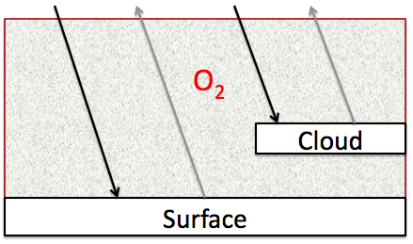
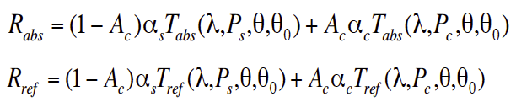
EPIC retrieves cloud effective pressure using the Mixed Lambertian-Equivalent Reflectivity (MLER) method
A pixel contains two Lambertian reflectors, the surface and the cloud;
Clouds are opaque; no photon penetration and transmission.
Variables:
R_{abs}: absorption channel radiance
R_{ref}: reference channel radiance
A_{c}: cloud fraction
α_{s}: surface albedo
α_{c}: cloud albedo
T_{abs} : absorption channel transmittance
T_{ref} : absorption channel transmittance
Cloud effective pressure is retrieved through iteration.
For EPIC, cloud pressures are retrieved for each pair of A- and B-band observations: two cloud pressures (p_{A} and p_{B})

Slide 12
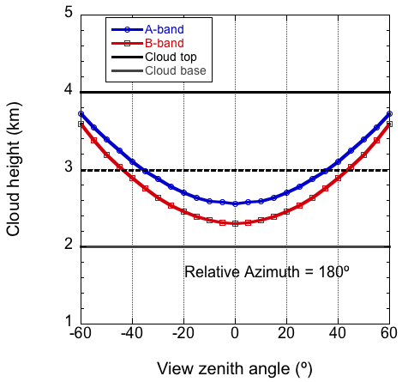
EPIC cloud effective pressure from Oxygen A- and B-band
Cloud pressure can be converted to cloud height based on the atmospheric profiles
SZA=VZA; COT=30
Black Surface
Due to photon penetration, retrievals from a single band (h_{A,} h_{B}) are lower than the cloud top. (e.g., Yang et al., 2013, Vanbauce et al. 2003; Sneep et al. 2008, Vasilkov et al. 2008, and Ferlay et al. 2010).
h_{A}
h_{B}
Due to different absorption and different effective depth of light penetration into a cloud, h_{B} is generally lower than h_{A}
Yang et al., 2013

Slide 13
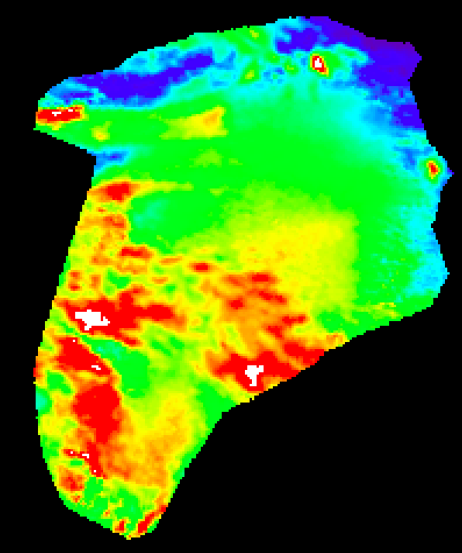
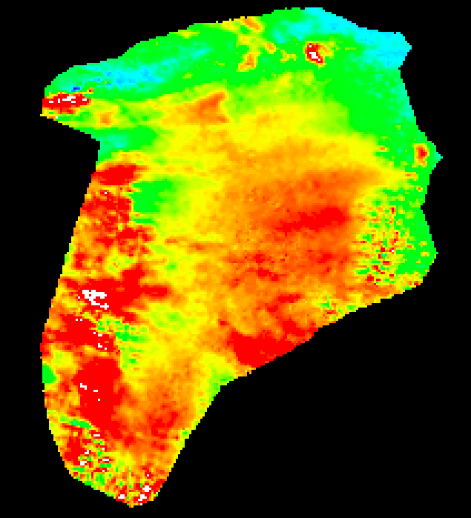
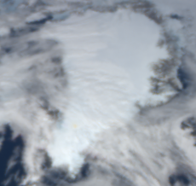

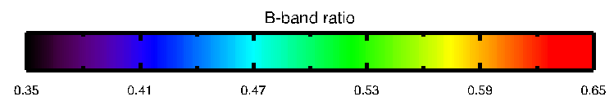
Cloud detection problem over snow and ice: the O₂ A- and B-band solution
EPIC image time 06/23/2016 14:56:55 GMT
A-Band Ratio
B-Band Ratio

Slide 14
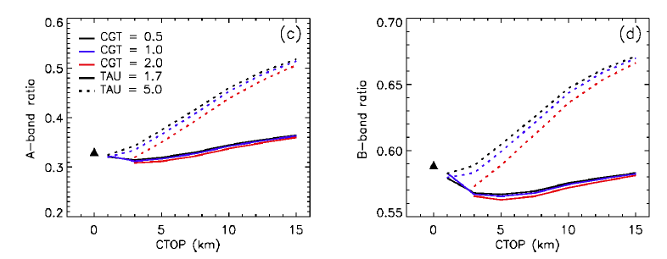
Cloud detection over snow/ice with O₂ bands
Thresholds are developed as a function of surface height, solar zenith and view zenith angles.
Zhou et al., AMT, 2020
EPIC simulator results on oxygen band ratios at solar zenith angle 30 degree as a function of CTOP with CGT of 0.5 km (black), 1.0 km (blue), and 2.0 km (red) as well as COT of 1.7 (solid) and 5.0 (dotted line) for the A band and B band, respectively.
View zenith angle is the same as the solar zenith angle and relative azimuth angle is 160 for the simulations.
simulations used standard US atmosphere and zero ground elevation. Surface albedo is set at 0.8 to represent snow and ice surface.

Slide 15
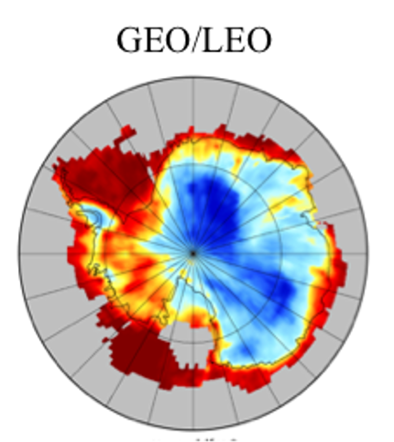
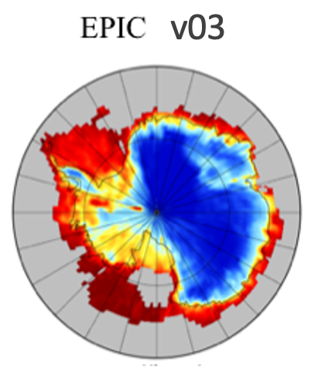

Improvements of cloud mask over snow/ice
Cloud Fractions derived from (a) composite GEO/LEO retrievals, (b) original EPIC cloud mask, (c) new EPIC cloud mask over Antarctic in January 2017
Langley Composite
Cloud Fraction
Zhou et al., AMT, 2020

Slide 16
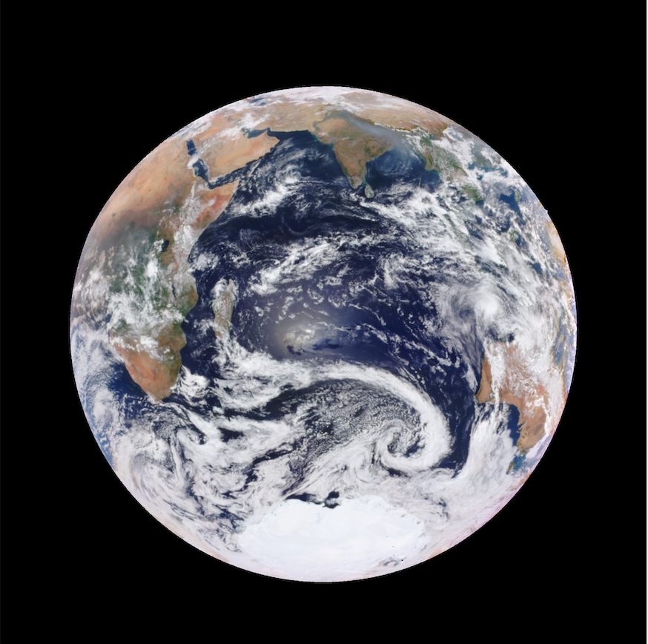
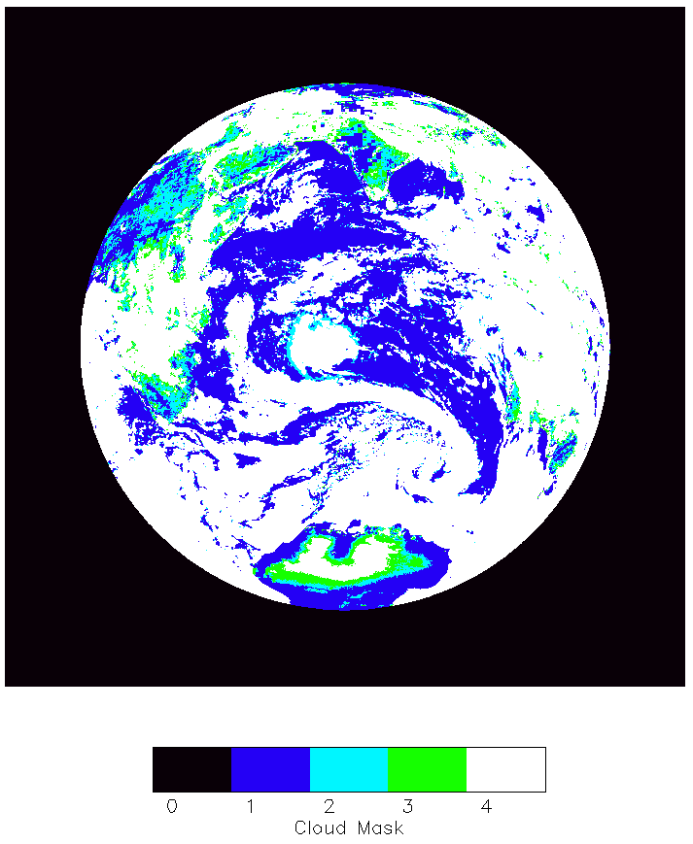
Example: DSCOVR_EPIC_L2_CLOUD_03_20161222075806_03.nc4
Cloud Version 2
Cloud detection problem over sun glint:
the O₂ A- and B-band solution
Earlier Cloud mask Without Sun Glint Algorithm

Slide 17
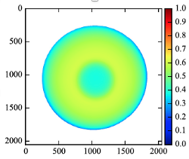
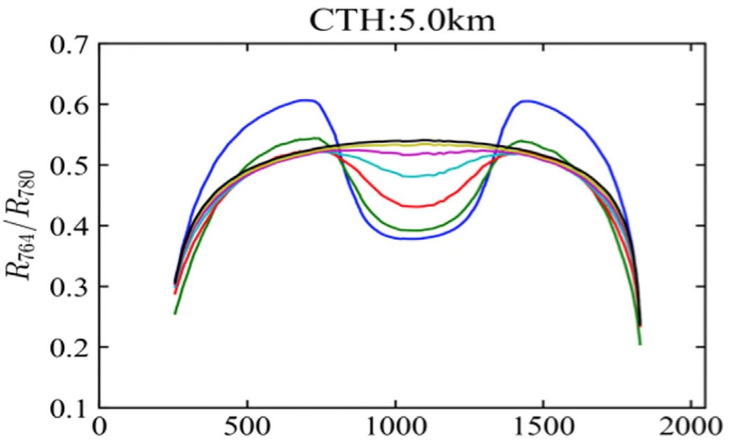
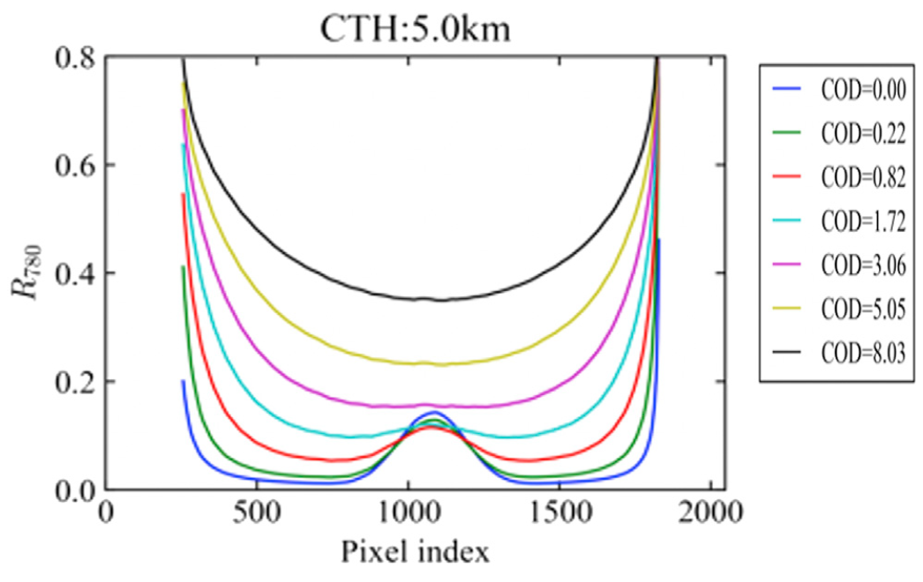
Cloud detection over sun glint
(a)
(a) R 764 / R 780 of a clear sky case for a typical Earth viewing geometry from EPIC. (b) R 764 / R 780 as a function of the pixel index on the horizontal line which intercept the image at y = 1024, where y is the vertical pixel index. Cloud geometrical thickness (CGT) is 1 km. (c) R 780 on the same horizontal line.
(b)
(c)
Thresholds are derived as a function of glint angle using O₂ A-band ratio and 780nm reflectance
Zhou et al. 2021

Slide 18
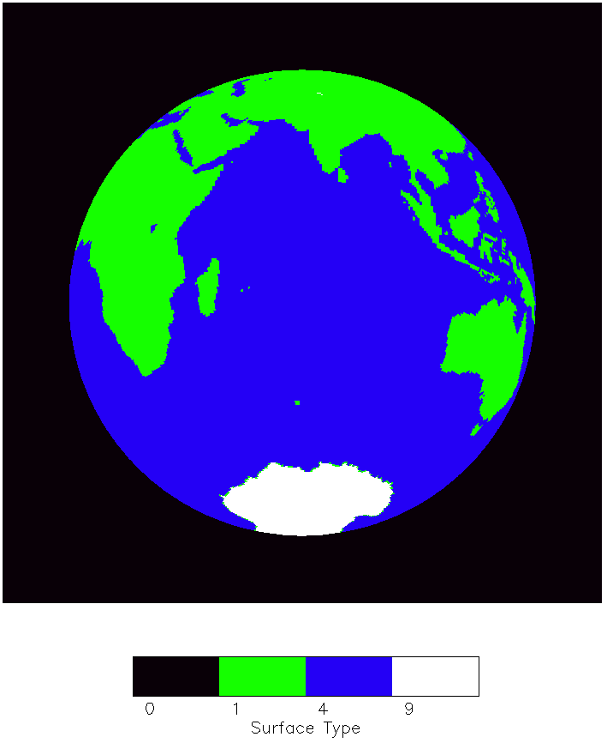
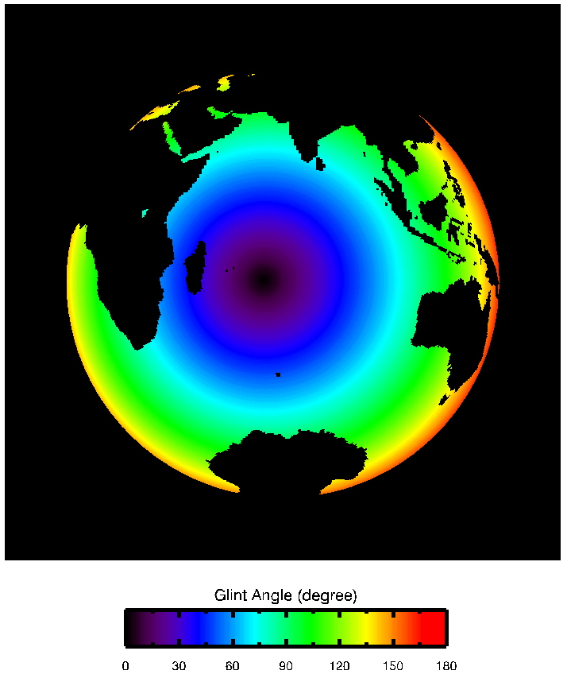
Example: DSCOVR_EPIC_L2_CLOUD_03_20161222075806_03.nc4

Slide 19
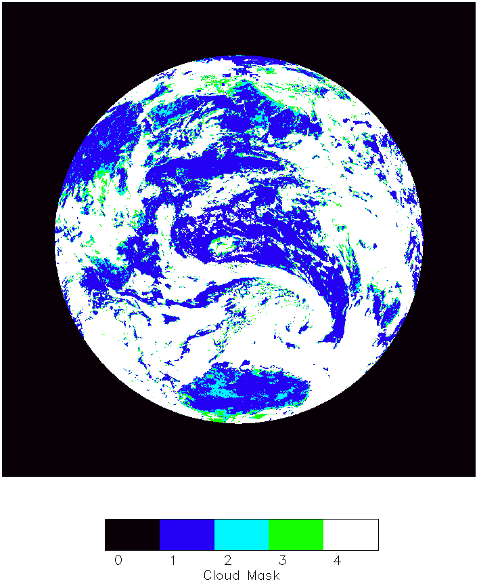
Example: DSCOVR_EPIC_L2_CLOUD_03_20161222075806_03.nc4
Cloud Version 3

Slide 20
Summary
The O2 A- and B-band channels are the basis for EPIC cloud pressure/height retrievals and “have stimulated deep innovation in cloud remote sensing using Differential Oxygen Absorption Spectroscopy (DO2AS)” .
An EPIC radiative transfer simulator was built for studying cloud information content of all the EPIC channels, with a focus on the A- and B-band channels.
A- and B-band observations provide a solution to cloud detection over snow/ice surfaces, and over sun glint areas, where the contrast between surface and clouds are minimal over other EPIC channels.
Future work include:
-- Implement new look-up tables that take into account of the Earth’s curvature by adopting the improved pseudospherical shell (IPSS) approximation in the radiative transfer calculations.
-- complete Oxygen A- and B-band performance and stability analysis using observations co-located with the South Pole Station.

Slide 21
Backup

Slide 22
EPIC L2 Major Cloud Product List
EPIC Cloud Mask
Oxygen A-band Cloud Effective Pressure
Oxygen A-band Cloud Effective Height
Oxygen B-band Cloud Effective Pressure
Oxygen B-band Cloud Effective Height
Cloud Optical Thickness – assuming liquid phase
Cloud Optical Thickness – assuming ice phase
Cloud Effective Temperature
Most likely cloud thermodynamic phase
Yang, Y., K. Meyer, G. Wind, Y. Zhou, A. Marshak, S. Platnick, Q. Min, A. B. Davis, J. Joiner, A. Vasilkov, D. Duda, and W. Su, 2019: Cloud Products from Earth Polychromatic Imaging Camera (EPIC) observations: Algorithm and Initial Evaluation, Atmos. Meas. Tech., 12, 2019-2031, https://doi.org/10.5194/amt-12-2019-2019.

Slide 23
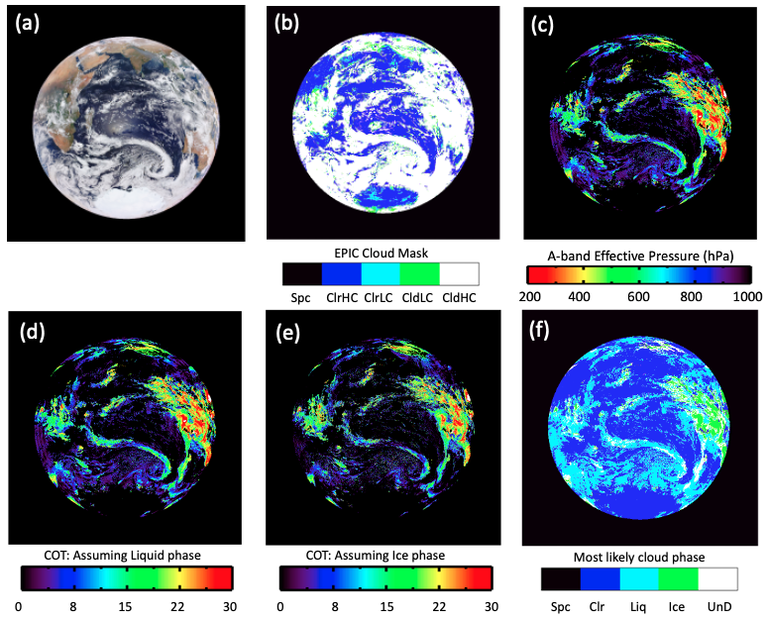
Cloud product example
Example: DSCOVR_EPIC_L2_CLOUD_03_20161222075806_03.nc4
ClrHC 30.3
ClrLC 5.8
CldLC 2.2
CldHC 61.7

Slide 24
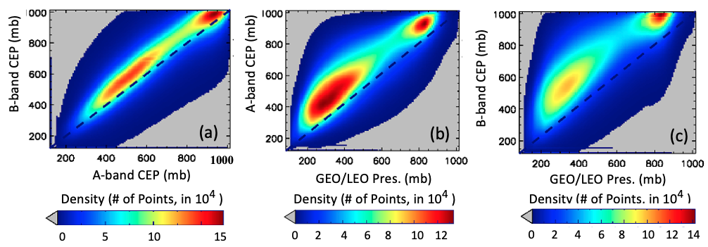
v3 A- and B-band Cloud Effective Pressure
Scatterplots for (a) EPIC A- vs. B-band CEP; (b) the Langley GEO/LEO composite cloud pressure vs EPIC A-band CEP; and (c) the Langley GEO/LEO composite cloud pressure vs EPIC B-band CEP. Data are from the year 2016.

Slide 25
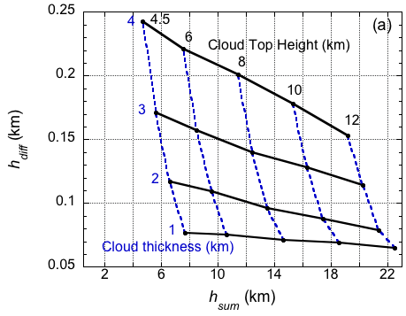
Retrieving cloud top height and geometrical thickness simultaneously
Cloud centroid height from A-band: h_{A}
Cloud centroid height from B-band: h_{B}
Generally,
h_{sum} = h_{A} + h_{B} more sensitive to cloud top height
h_{diff} = h_{A} - h_{B} more sensitive to cloud geometrical thickness
h_{sum} vs h_{diff} diagram
COD = 30
SZA = VZA = 40º
RAZ = 172º
surface albedo = 0.05

