Slide 1
DSCOVR EPIC and NISTAR 2022 Science Team Meeting
A new generation UV-VIS aerosol retrieval algorithm: Application to EPIC observations
Omar Torres, Changwoo Ahn, Hiren Jethva and Vinay Kayetha
NASA GSFC, Code 614
September 27-29, 2022
NASA-GSFC visitor center

Slide 2
Presentation Outline:
EPIC UV aerosol products: Current Status
EPIC view of 2022 relevant aerosol events
A new generation EPIC UV-VIS aerosol algorithm

Slide 3
EPIC UV Aerosol Products
Aerosol Optical Depth
Single Scattering Albedo
Aug15, 2017
, 2017
, 2017
EPIC Detection and Characterization of the August 2017 British Columbia PyroCb
Above Cloud Aerosol Optical Depth (ACAOD)

Slide 4
EPIC UV Aerosol Products Evaluation
Ahn et al., JGR, 2021

Slide 5
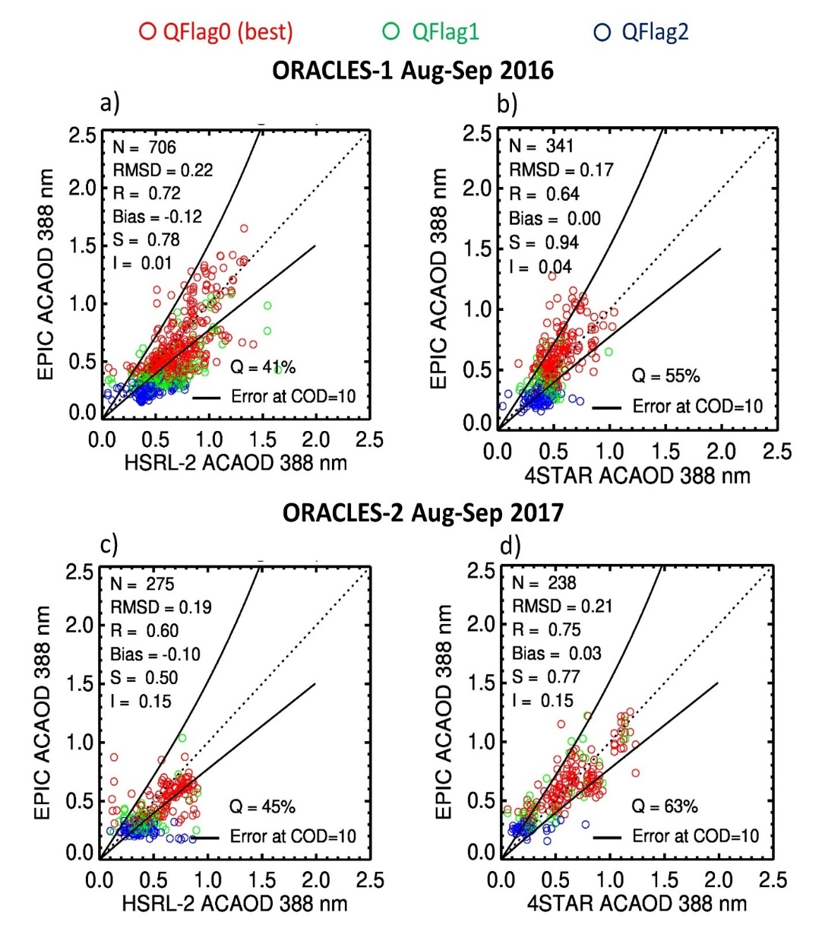
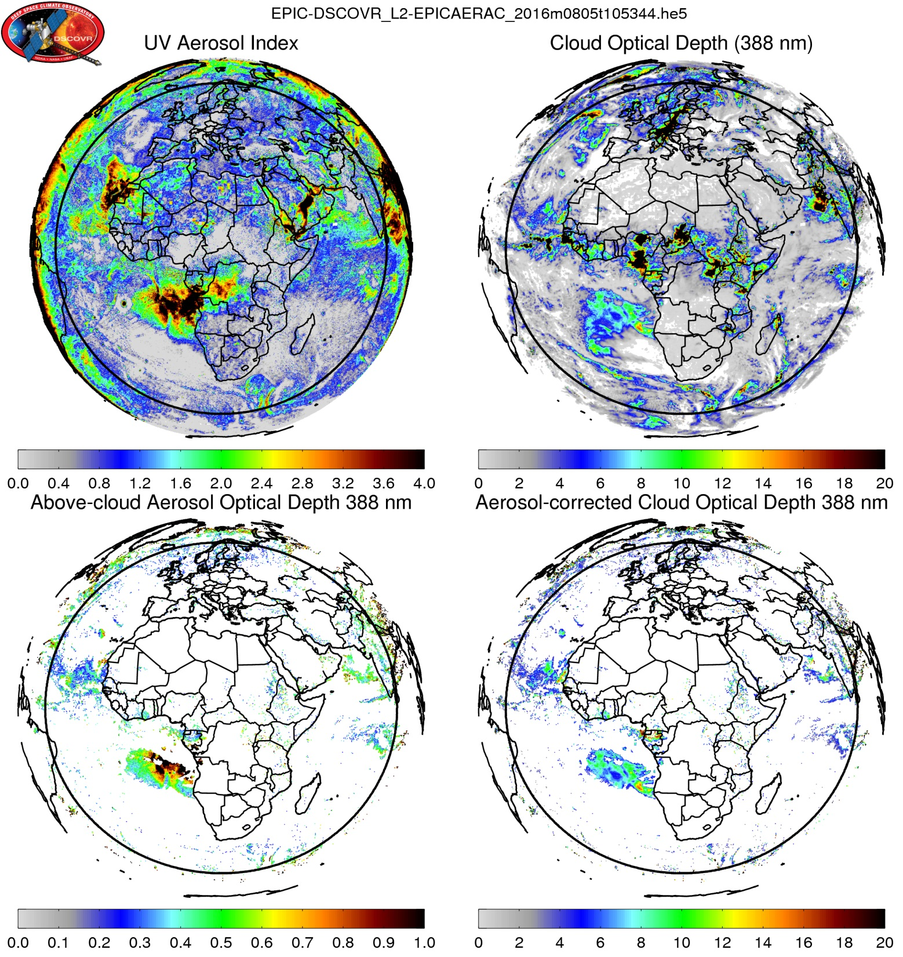
EPIC UV Aerosol Products Evaluation (2)
EPIC ACAOD validation during ORACLES 1 and 2 airborne campaigns
Ahn et al., JGR, 2021
The EPIC ACAOD product has been used in the estimation of radiative forcing effect of above cloud absorbing aerosols. Stay tuned for presentation by Hiren Jethva.

Slide 6
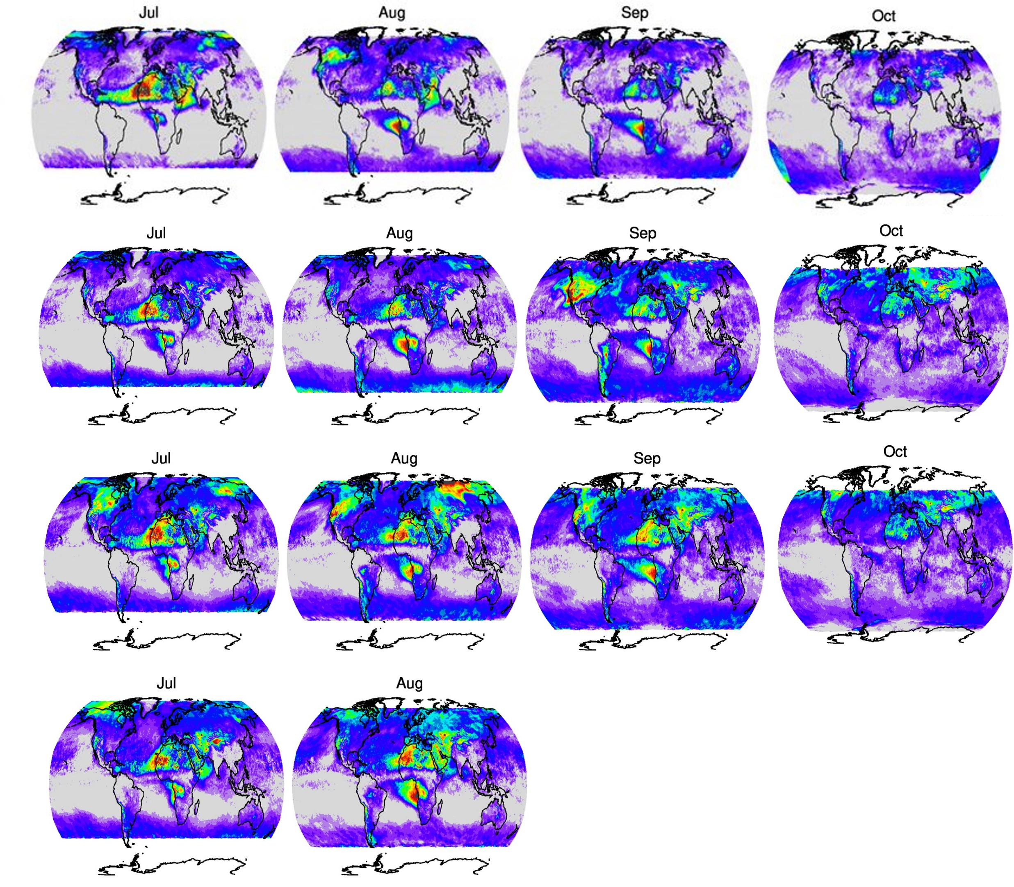
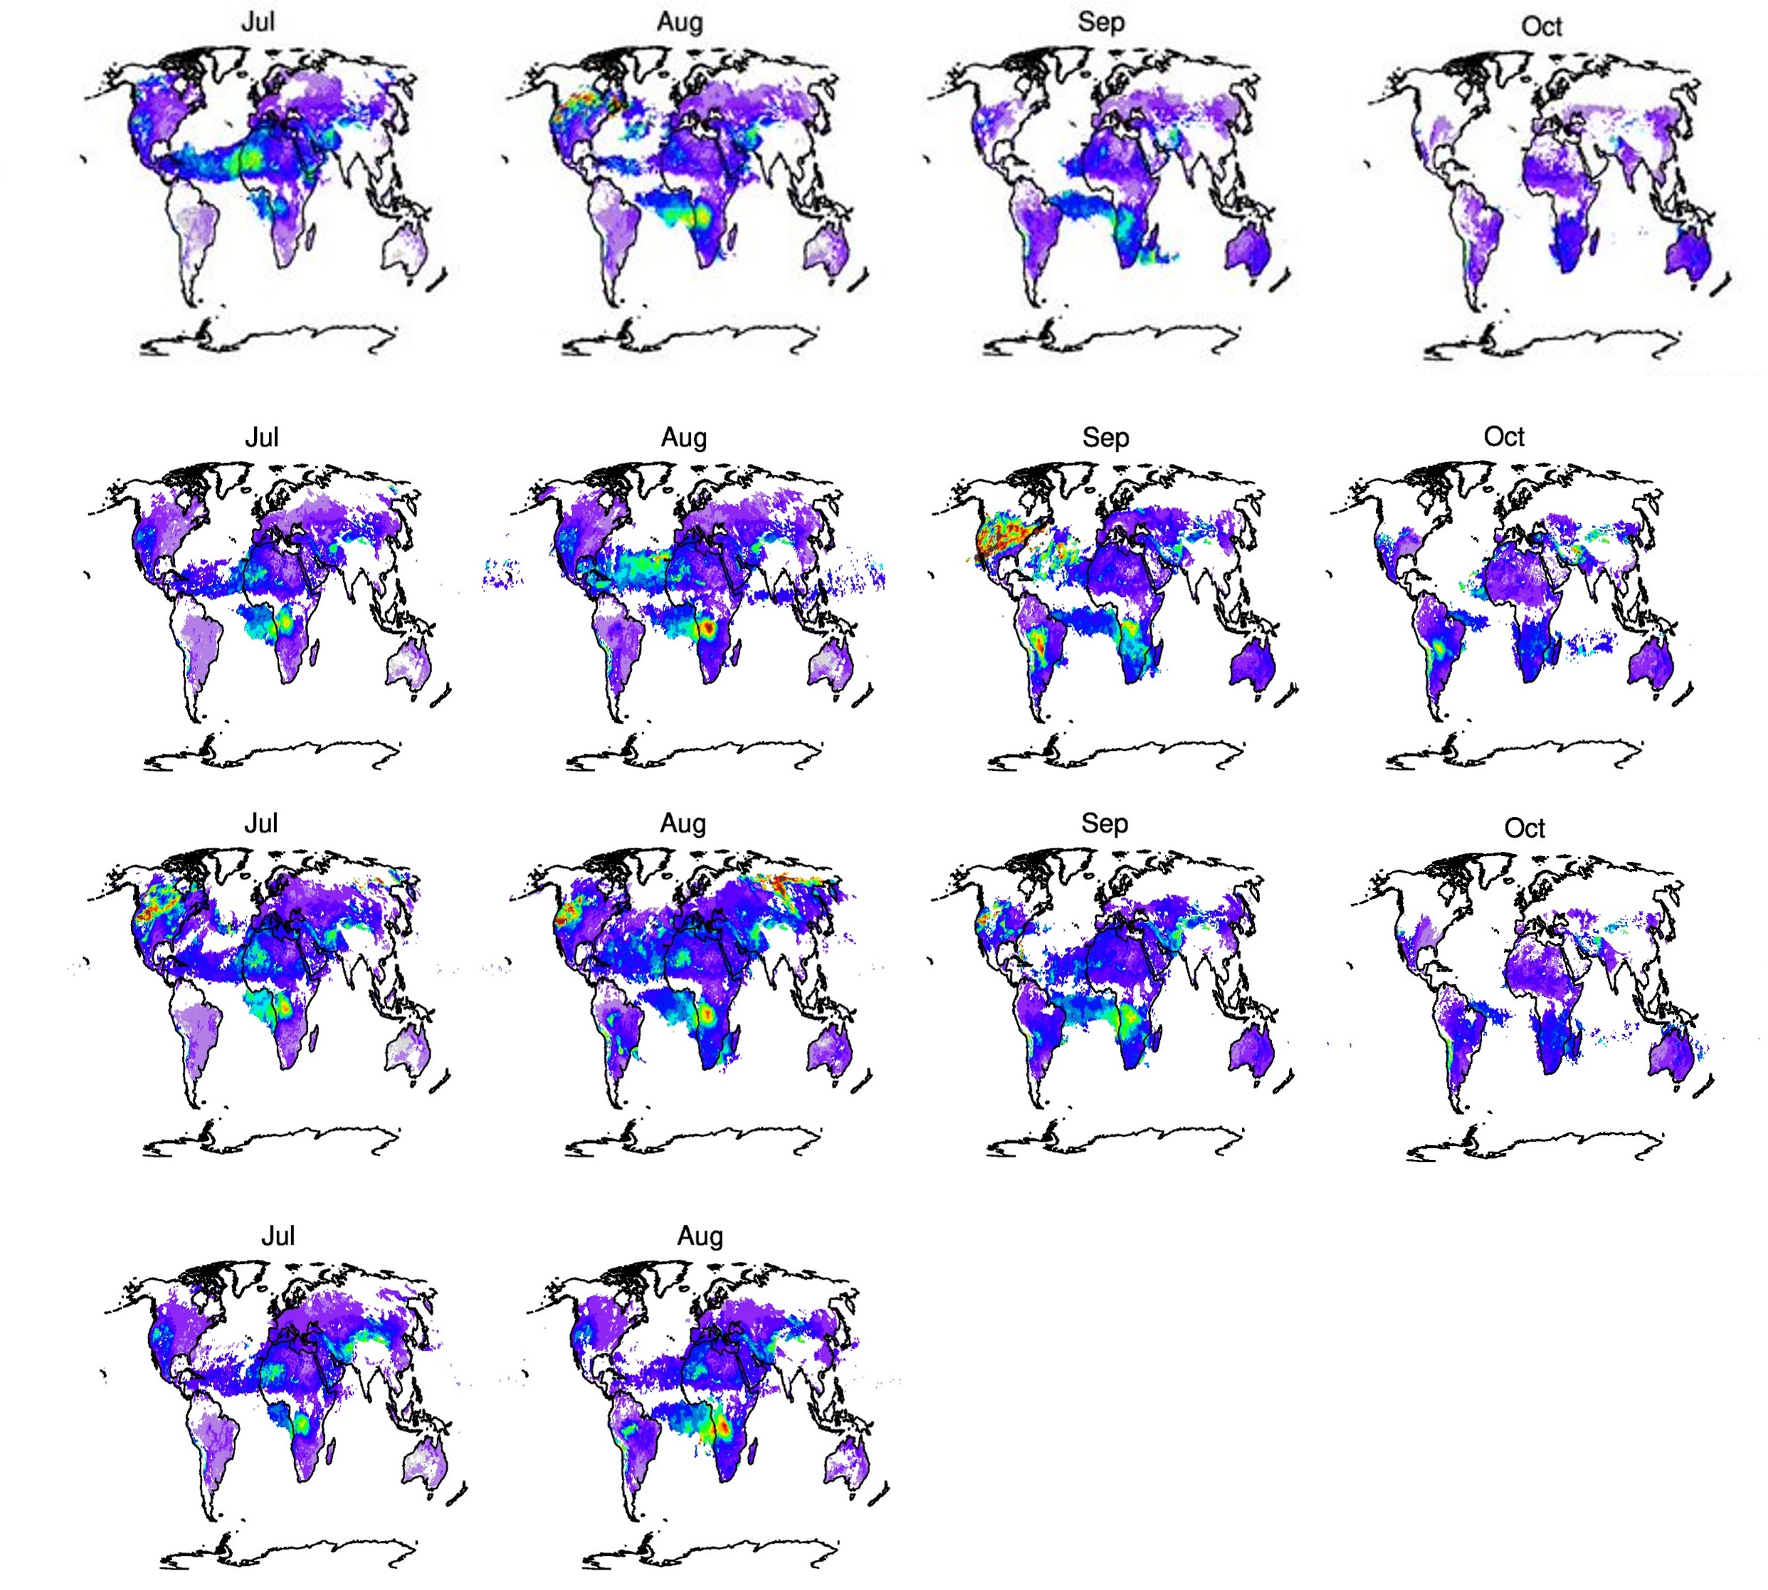
EPIC UV Aerosol Products: Multi-year Global Monthly Averages
UV Aerosol Index
Aerosol Absorption Optical Depth (388 nm)
2018
2020
2021
2022
The post-2019 EPIC aerosol world seems quite different in relation to previous years.

Slide 7
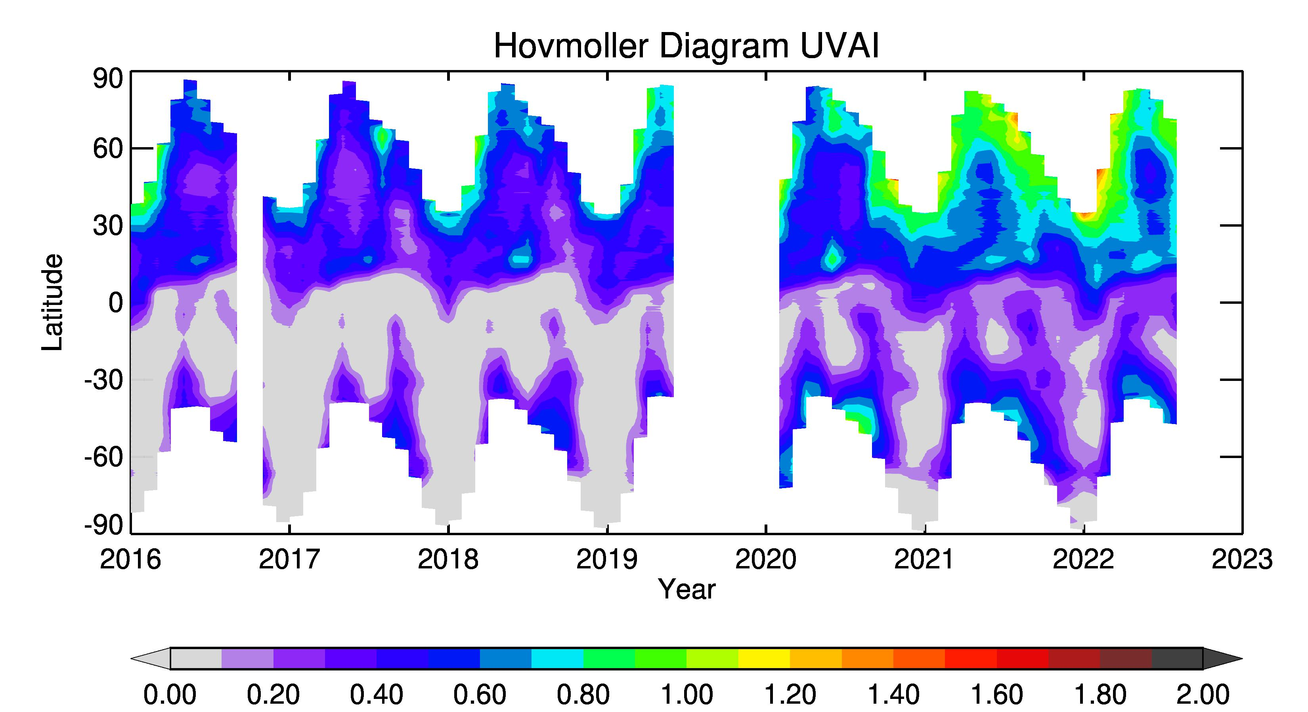
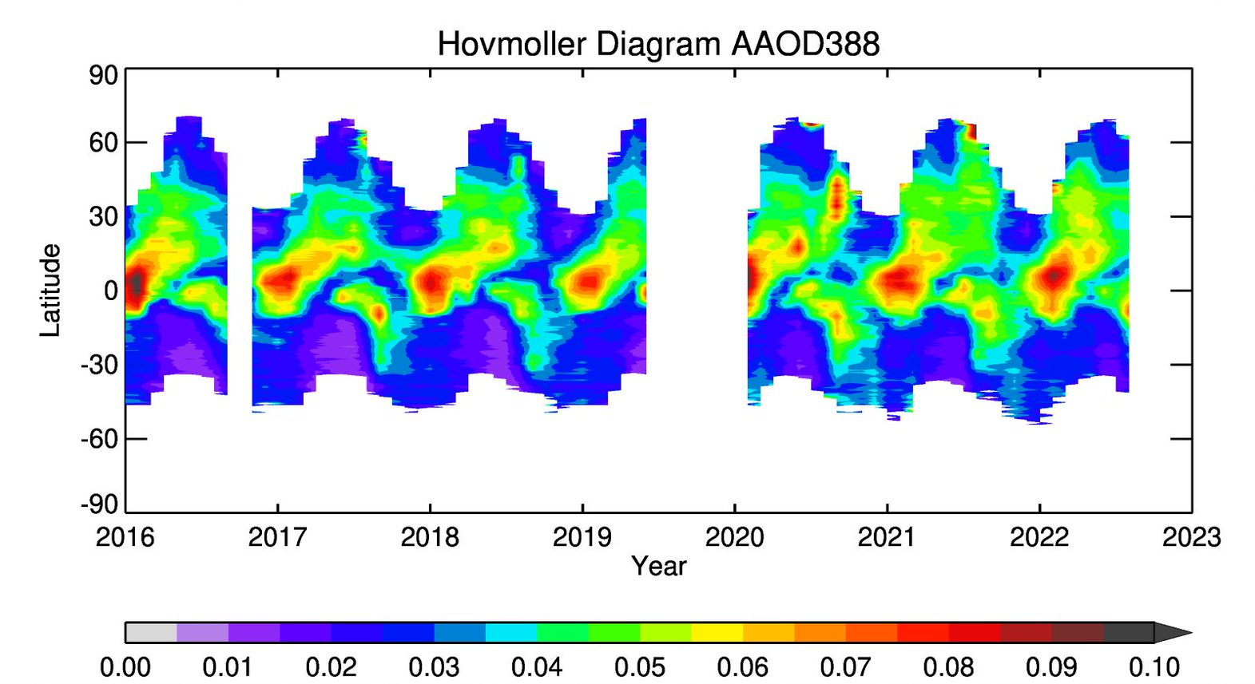
EPIC UV Aerosol Products: The long-term record
A striking difference in the UVAI timeseries is observed before and after 2019 in both hemispheres but seemingly stronger in the SH.
Australia fires (2020) in the SH and increased fire activity in the NH may explain these results.
Instrumental change after a long time ( about 6 months) in safe mode is a possibility that will be investigated.

Slide 8
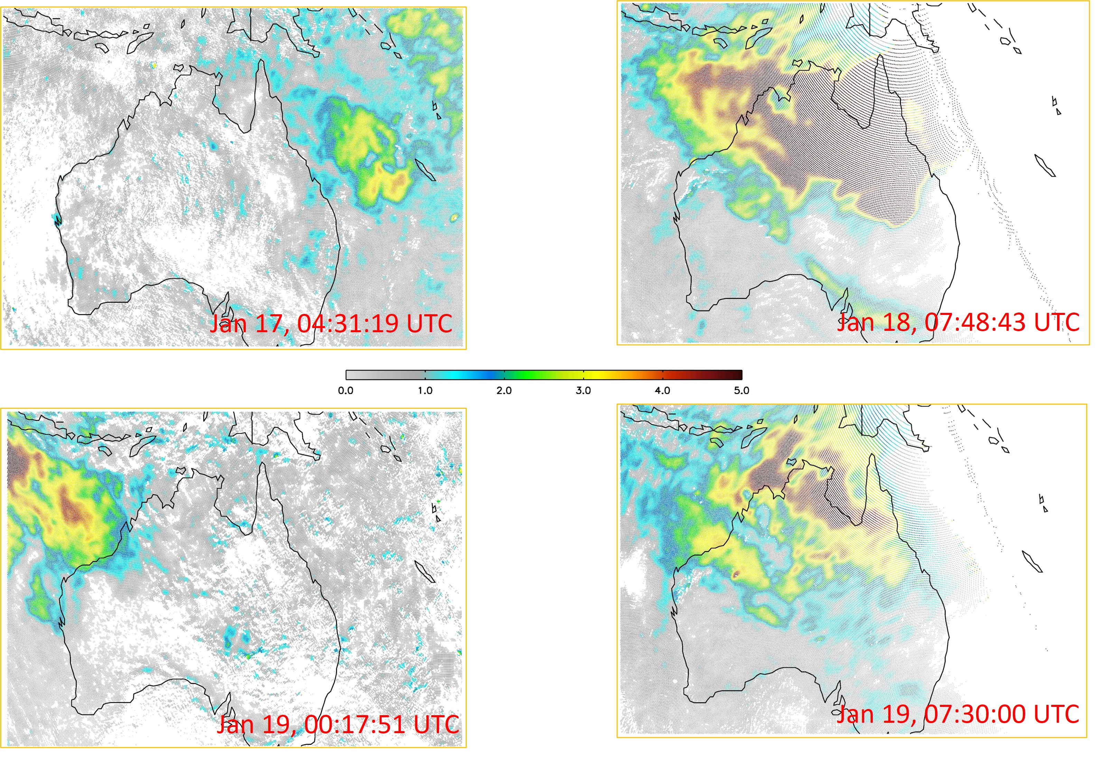
EPIC’s view of relevant 2022 Aerosol Events
The January 14-15 Tonga-Hunga Ha'apai volcanic eruption
An unusually weak volcanic ash signal was picked up by EPIC UVAI. The submarine nature of this eruption may have produced a lower altitude ash layer than those associated with typical terrestrial eruptions.

Slide 9
EPIC’s view of relevant 2022 Aerosol Events (2)
Russia-Ukraine Armed Conflict
UVAI & AAOD April 2o21 and 2022 averages
2021
2022
UVAI
AAOD

Slide 10
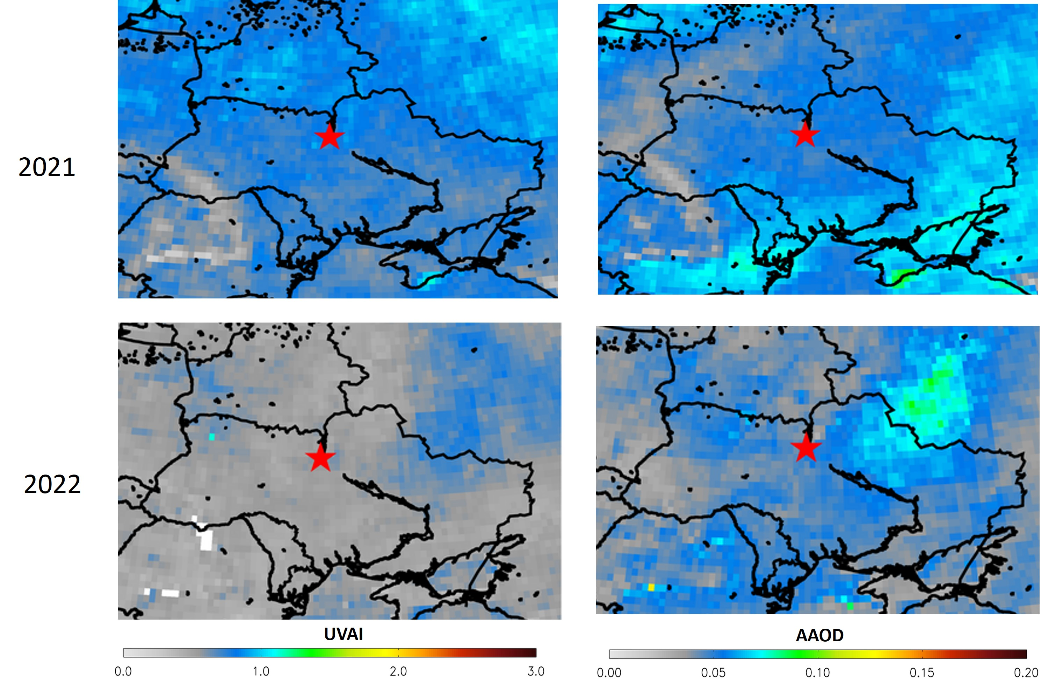
EPIC’s view of relevant 2022 Aerosol Events (2)
Russia-Ukraine Armed Conflict
UVAI & AAOD April 2o21 and 2022 averages
The 2021-to-2022 reduction of the overall background signal may be related to reduced biomass burning associated
with decreases in agricultural biomass burning practices, whereas the localized aerosol signal increase NE of Ukraine
may be the result of war-related activities.

Slide 11
A new generation UV-VIS aerosol retrieval algorithm
Sensors with combined UV-VIS (including O₂B) observing capabilities
Agency | Sensor | Satellite | Spectral range of observations (nm) | Resolution | Period
NASA EU (Copernicus) NASA-SAO NASA | EPIC TROPOMI TEMPO OCI | DSCOVR Sentinel 5 P. TBD (GEO) PACE | 318,340, 388, 443,551,680,688,764,780 270-500; 675-775 & 2305-2385 (Hyp.) 290-490 & 540-740 (Hyp.) 340-890 nm (5nm steps) | ~ 18 km 3.5X7 km 2.1x4.7 1 km | 2015-Present 2018-Present 2023 (Sched.) 2024?
EPIC is one of several recently deployed sensors with UV-VIS spectral observing capability at moderate spatial resolution,
including O2A/B that enables expanded use of visible observations including aerosol layer height retrieval capability.

Slide 12
Use of UV-VIS Satellite Observations for retrieving aerosol properties
Observations in the 340-400 nm has been used to derive aerosol properties over the last 40-years
Advantages:
Low surface albedo at all terrestrial surfaces (.01 to .03 for vegetation; .08 - .12 deserts)
Sensitivity to aerosol absorption.
Negligible gas absorption interference.
UV aerosol absorption detection is aerosol layer height (ALH) sensitive.
Recent Advances:
-Availability of 466 nm GLER Surface Albedo Product (Qin et al., 2019; Fasnacht et al., 2019)
-Oxygen-B band observations in the latest generation of hyper-spectral sensors offers, for the first time, the possibility of a complete characterization of the aerosol load in terms of AOD, SSA, and ALH (Xu et al., 2017; Xu et al., 2019)
- Climatological data set of UV–visible aerosol absorption using AERONET and OMI–MODIS synergy (Kayetha et al., 2022)
These advances are currently being integrated into a second-generation algorithm that retrieves aerosol properties
at UV and visible wavelengths along with aerosol layer height.

Slide 13
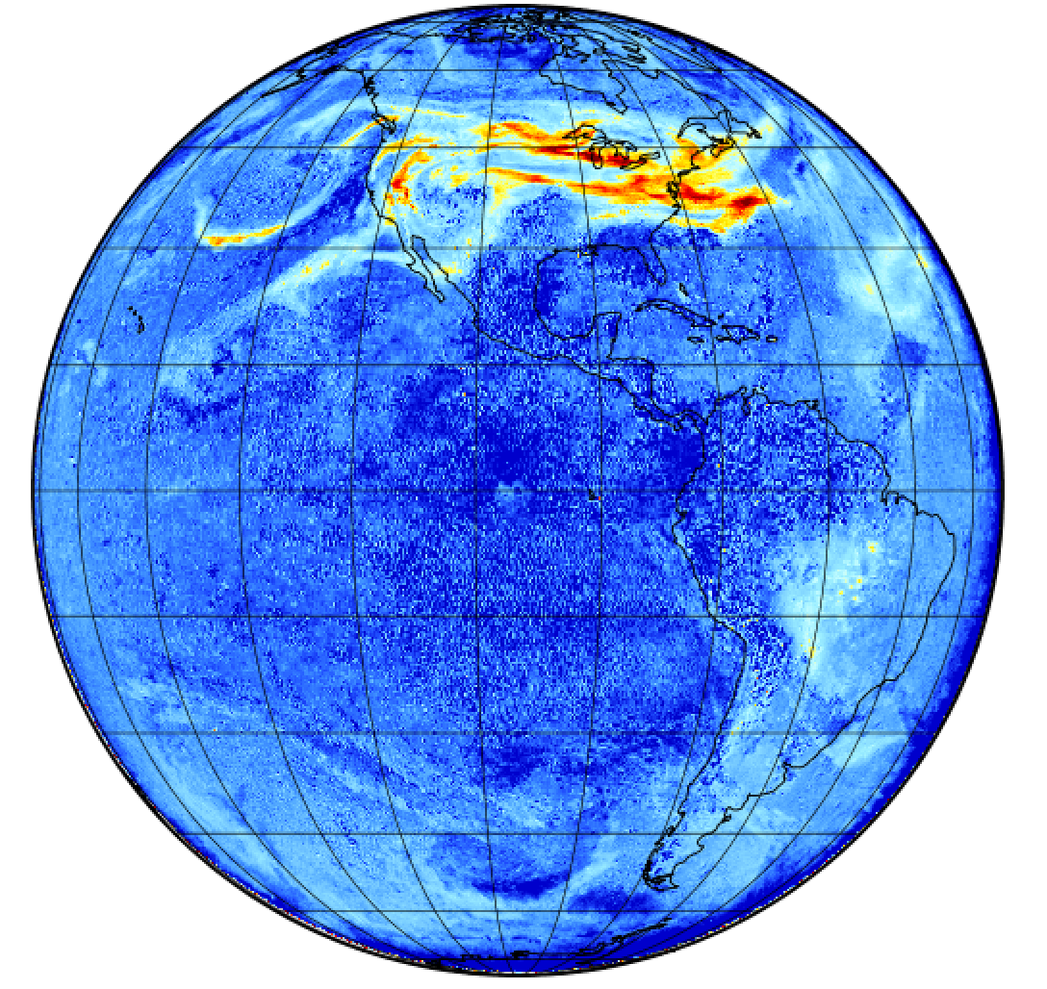
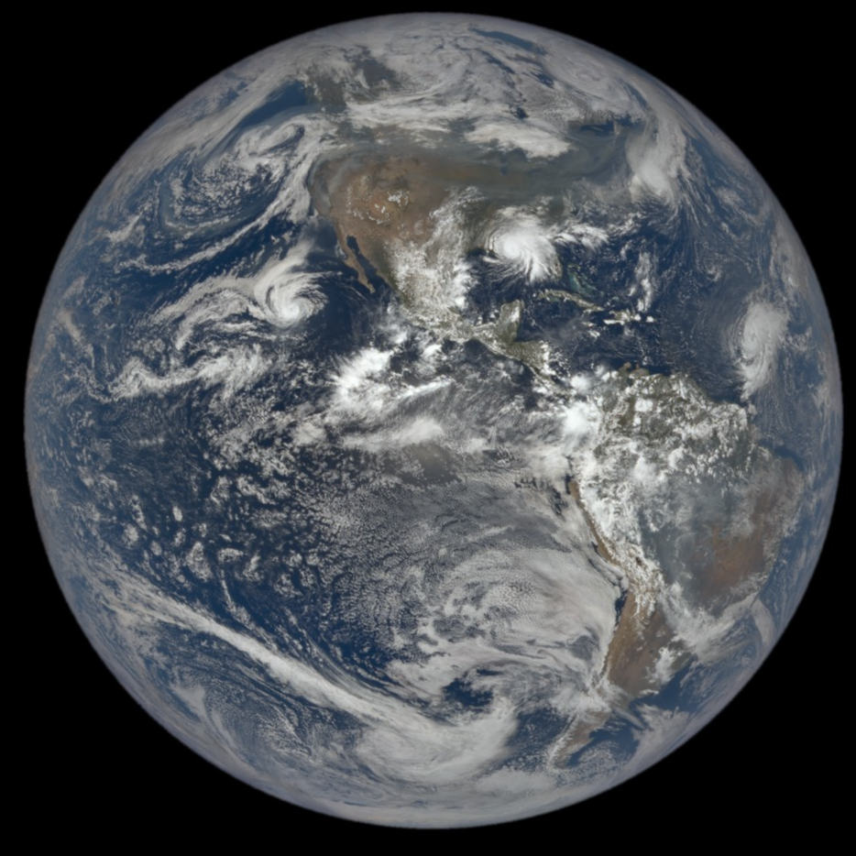
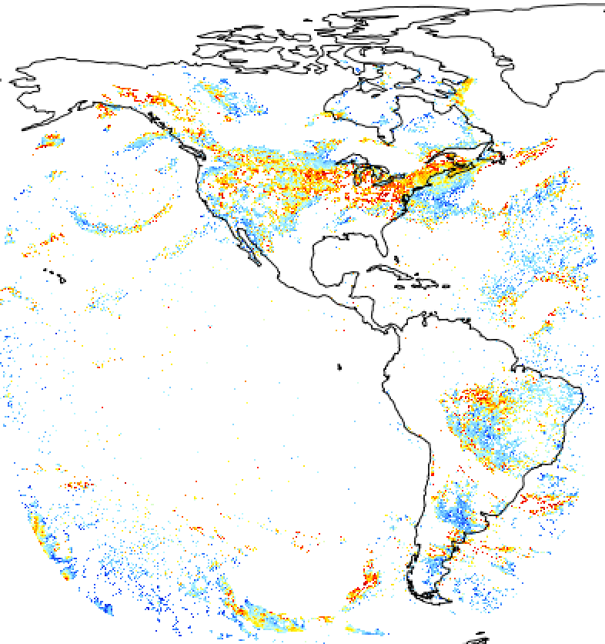
EPIC Characterization of Smoke Plume over North America
EPIC observations on 2020-09-15 (18:37:00 UTC)
Aerosol Layer Height (km)
Aerosol layer height retrieval results under cloud-free conditions

Slide 14
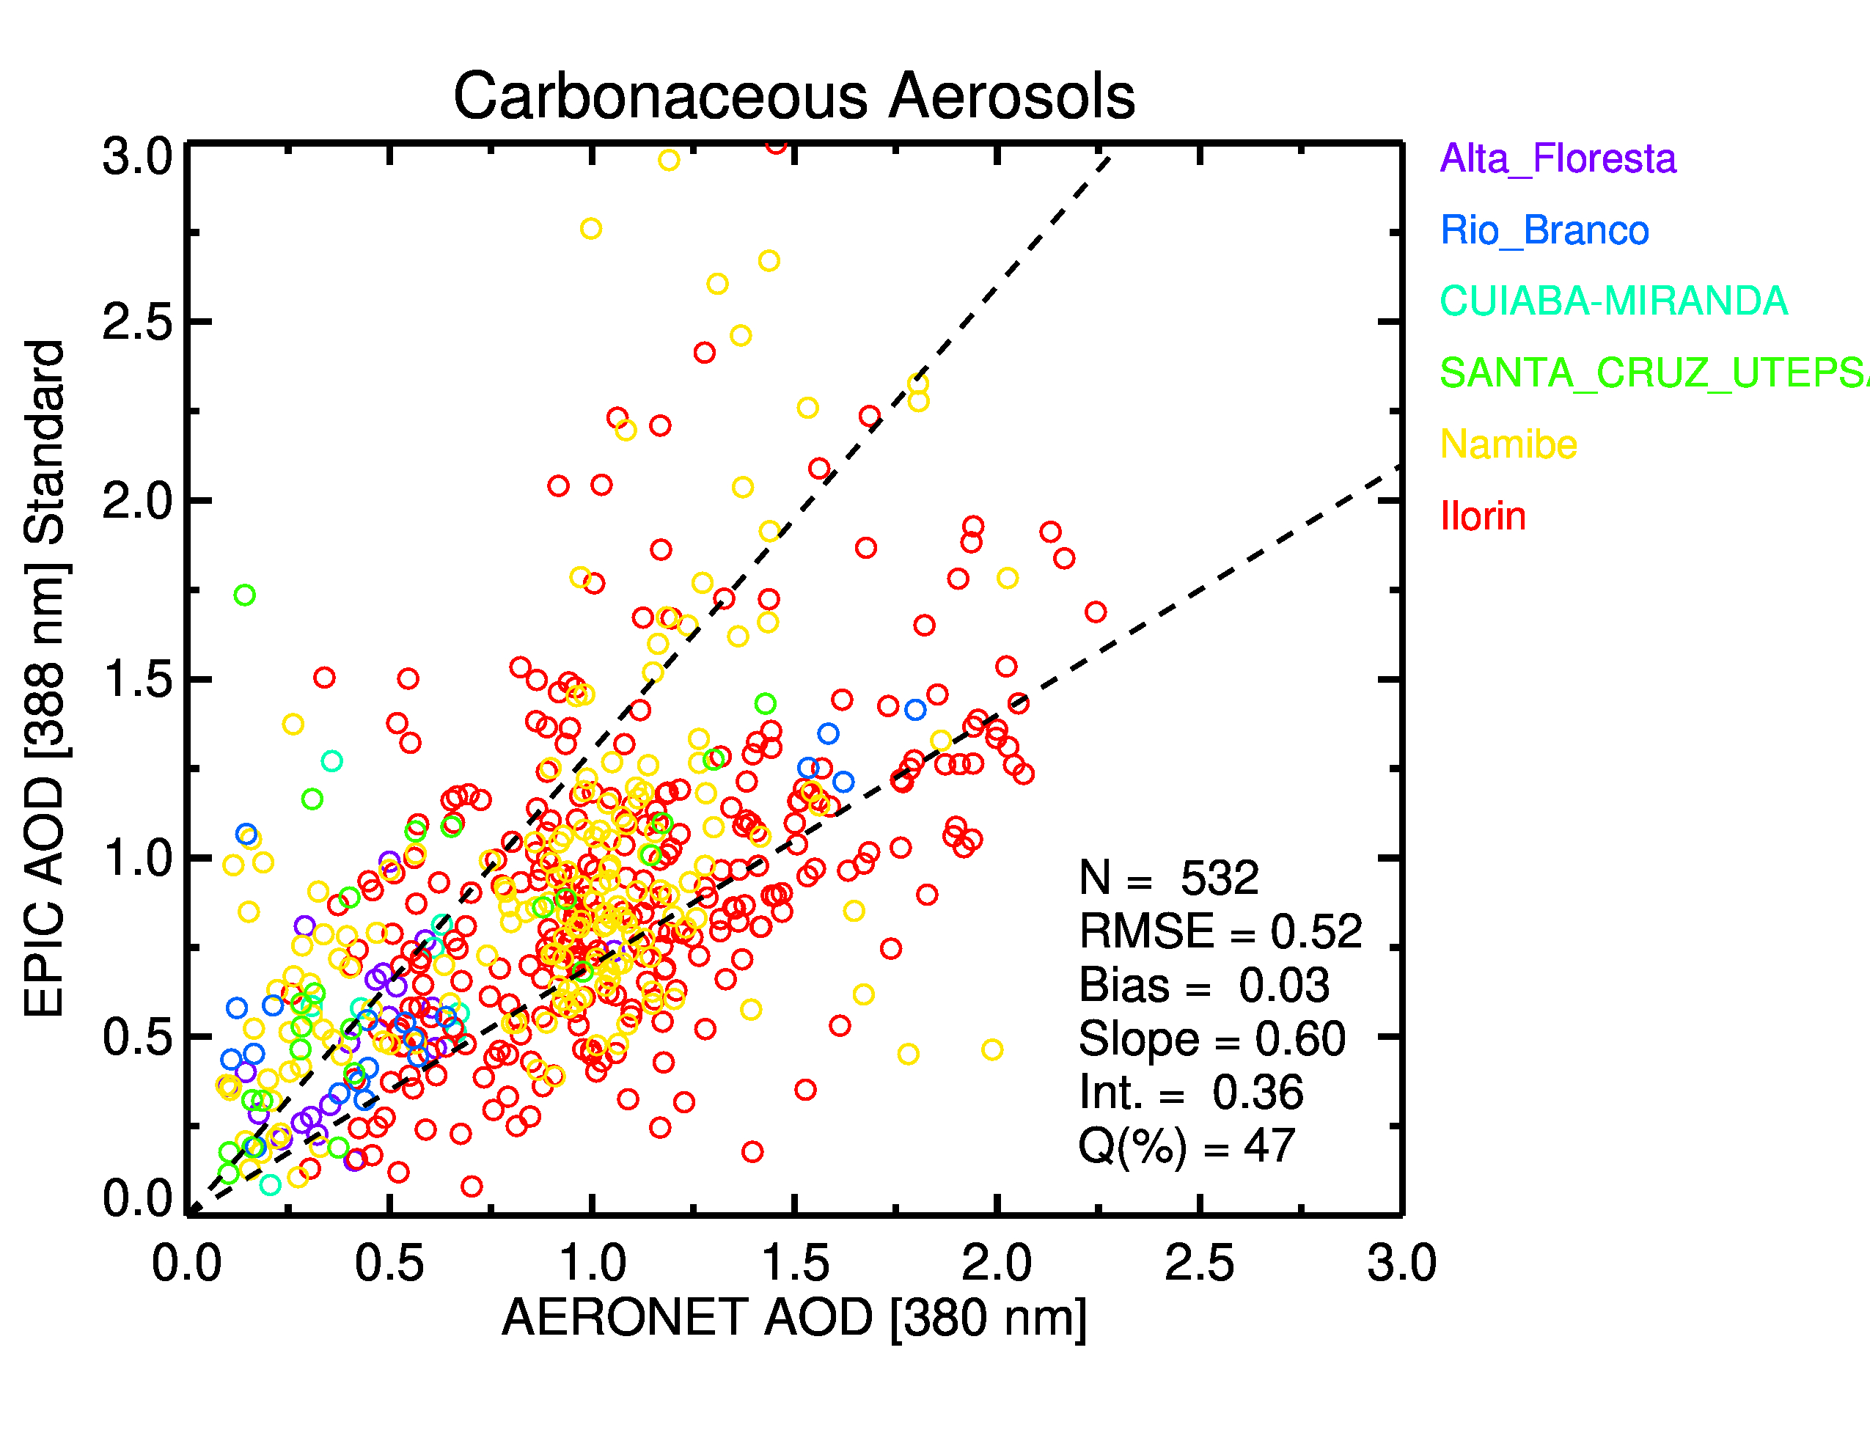
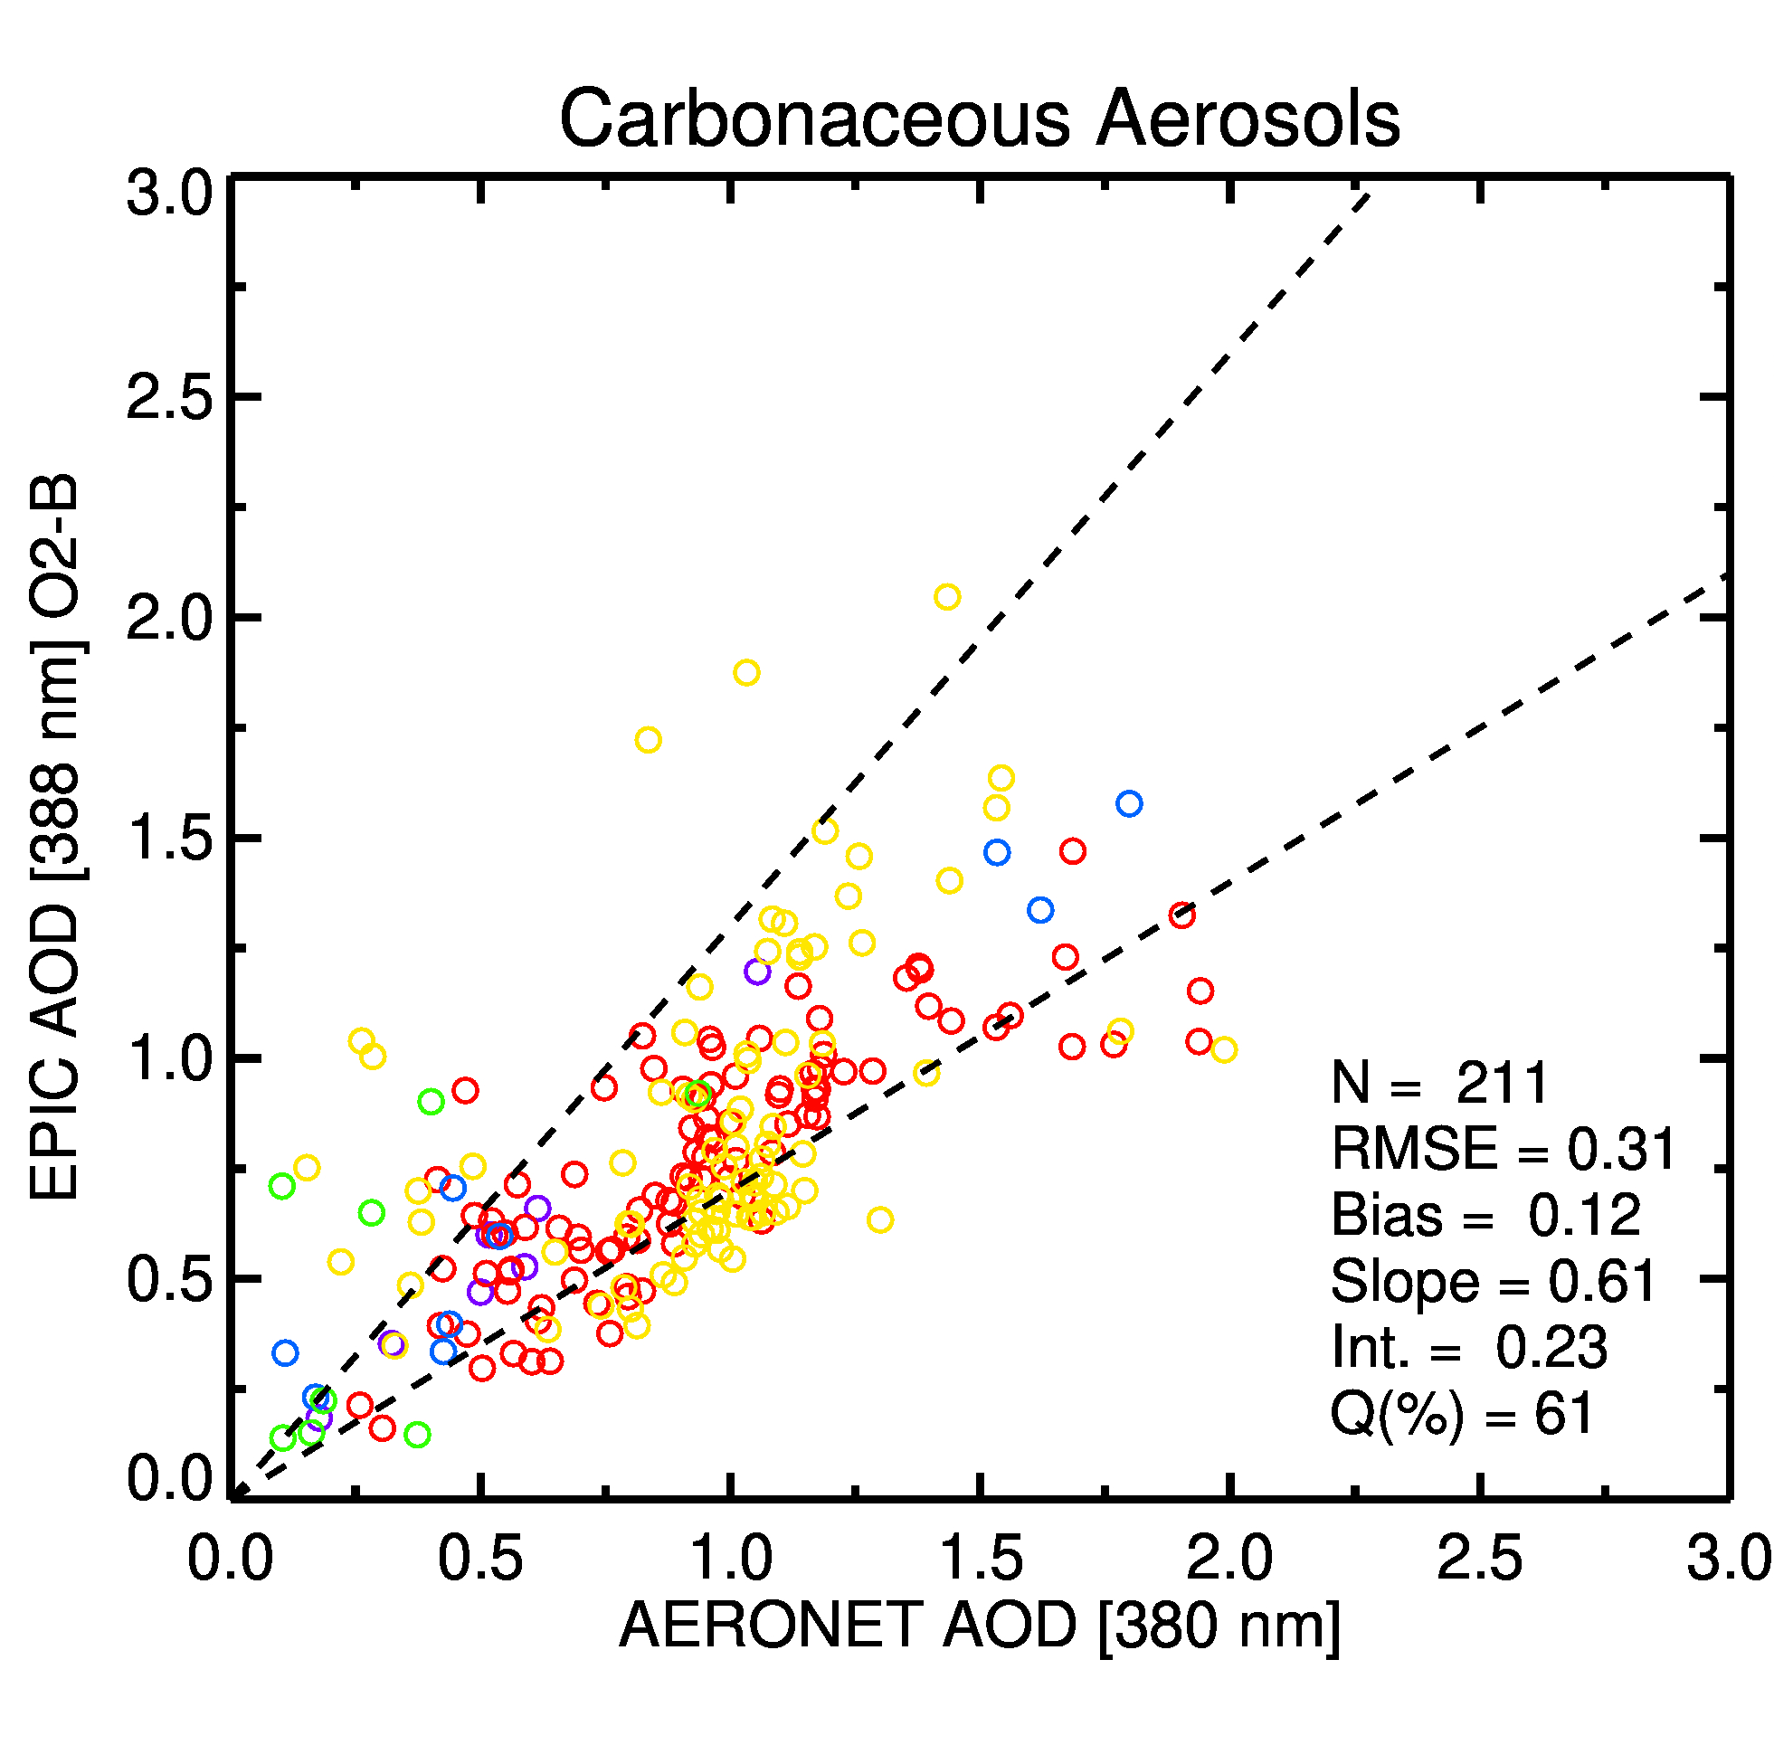
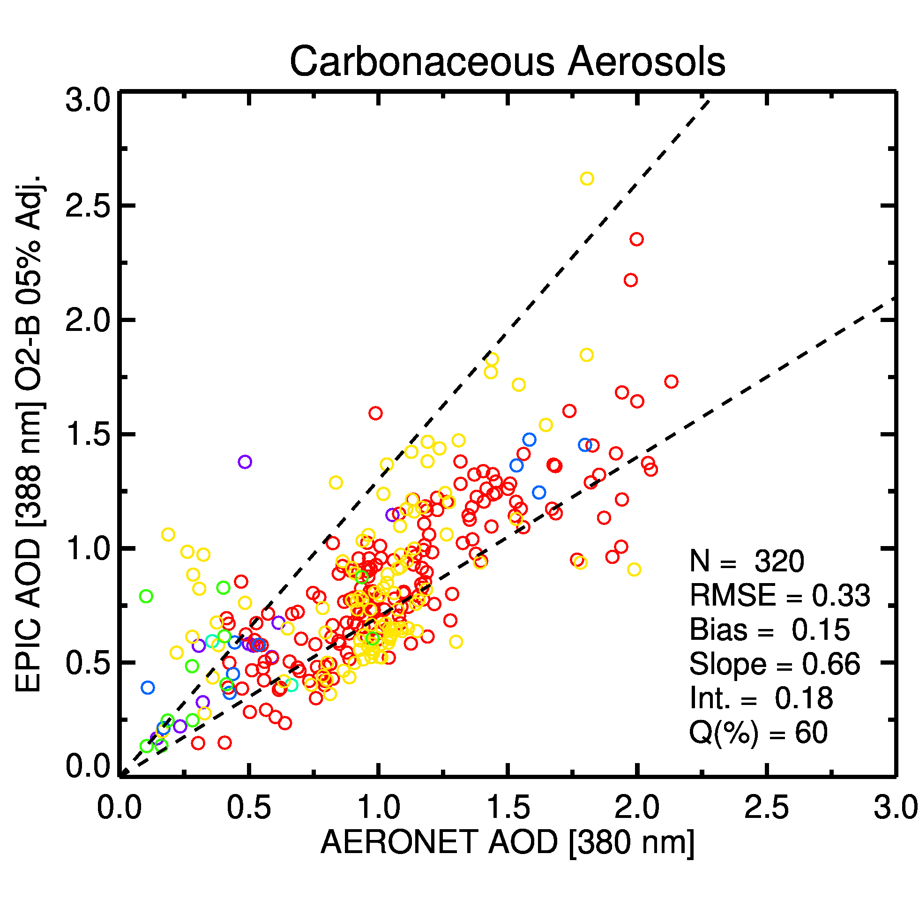
Effect of using O₂B derived ALH on retrieved 380 nm aerosol optical depth
ALH given by CALIOP-based
climatology
ALH derived from EPIC O₂B
original observations
ALH derived from EPIC O₂B calibration
adjusted (5%) observations
250 points with expected accuracy
129 points with expected accuracy
192 points with expected accuracy
An unexpected result of deriving ALH using the 688/680 ratio is a significant decrease in cloud contamination.
Similar results (not shown) are observed in retrieved 380 nm single scattering albedo.

Slide 15
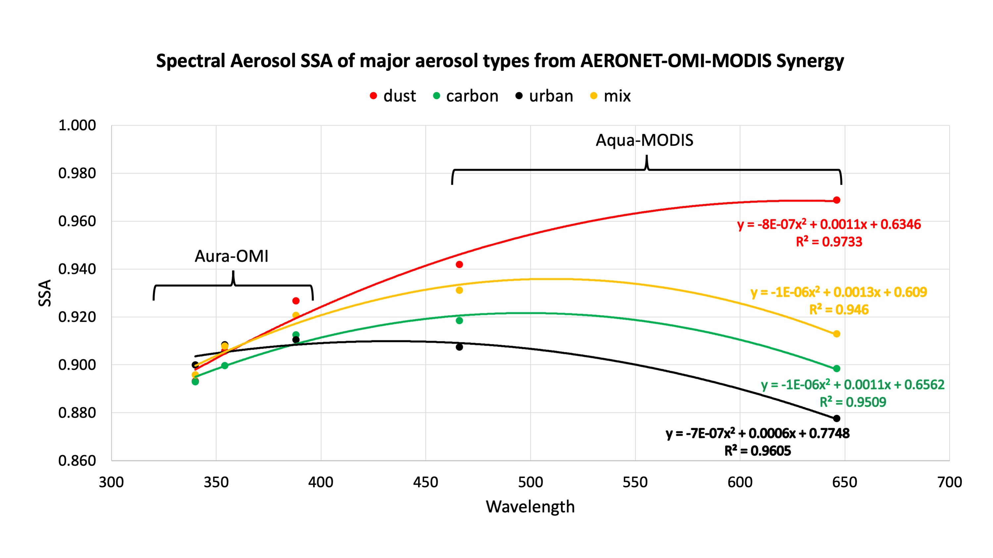
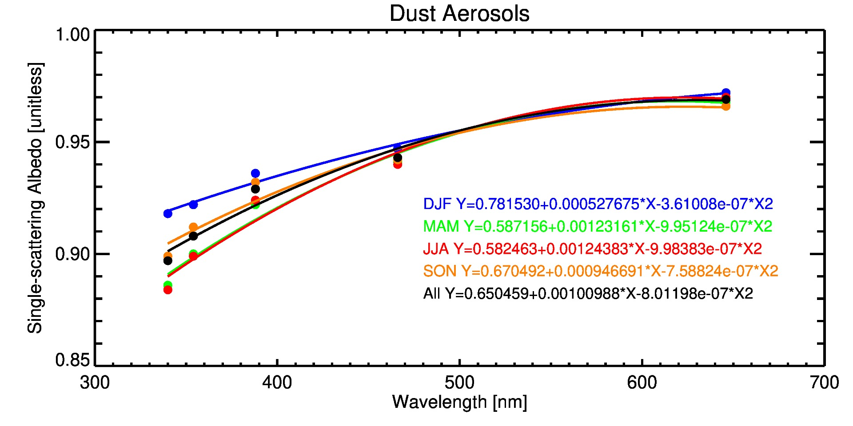
Inferring aerosol absorption in the visible from UV-retrieved single scattering albedo
Kayetha et al., 2022

