Slide 1
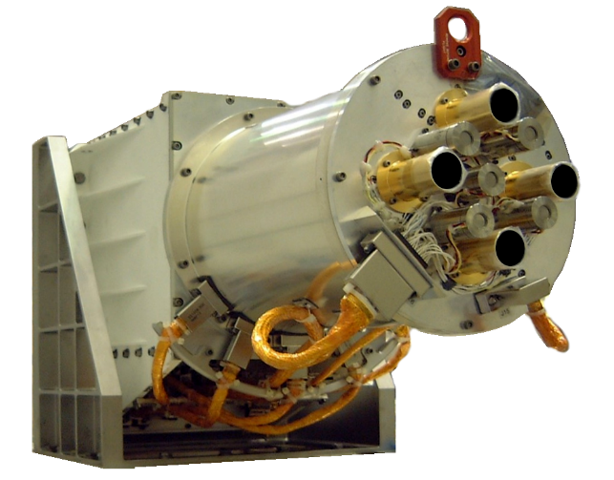
NISTAR Update
Allan Smith, Yinan Yu, and Steven Lorentz
L-1 Standards and Technology
Band | Band (μm) | Description
Photodiode | 0.2 to 1.1 | UV-Vis-NIR
Band A | 0.2 to 100 | Total
Band B | 0.2 to 4 | Short-Wave
Band C | 0.7 to 4 | Near-IR SW

Slide 2
Outline
Intrusion of the Moon into the NISTAR Field-of-Regard (FOR)
  Frequent enough to impact Earth observation time (11%)
  A correction for the contaminating moonlight for most intrusions with the shortwave channel has been completed.
Minor changes in L1A and L1B processing
NISTAR SW and Photodiode Comparisons
  Orbital Evolution and Low Backscattering Angles
  Instrument has demonstrated a high degree of stability
Current NISTAR Uncertainties
Future Activities
  The out-of-phase component of the demodulated radiometer signals continues to be investigated
  It is an offset component, unaffected by Earth light—allows continuous tracking while observing the Earth

Slide 3
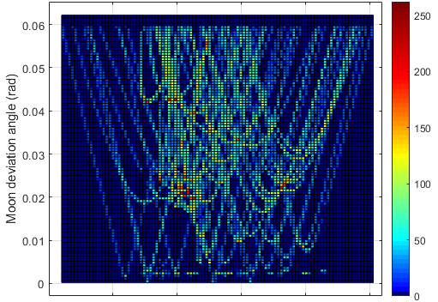
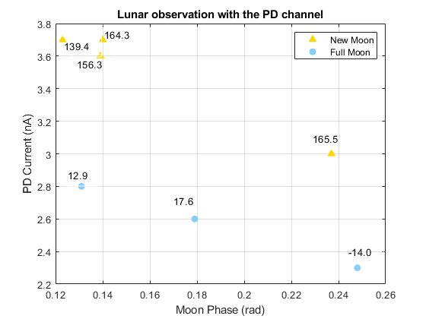
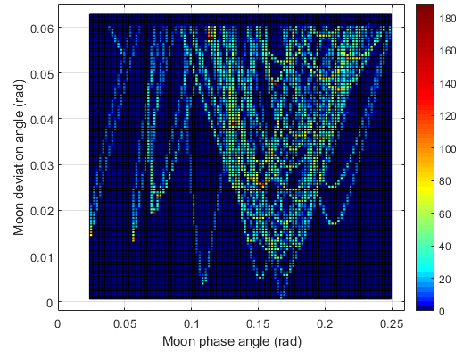
Correction Coverage of Moon Intrusion
Frequency of Intrusion
Lunar phase of most intrusions fall within 0.10 to 0.25 radians—a range spanned by direct lunar observations made in 2015, see plot below
Note: lunar PD currents are much smaller than during the 70 nA during Earth observations
Full moon
New moon

Slide 4
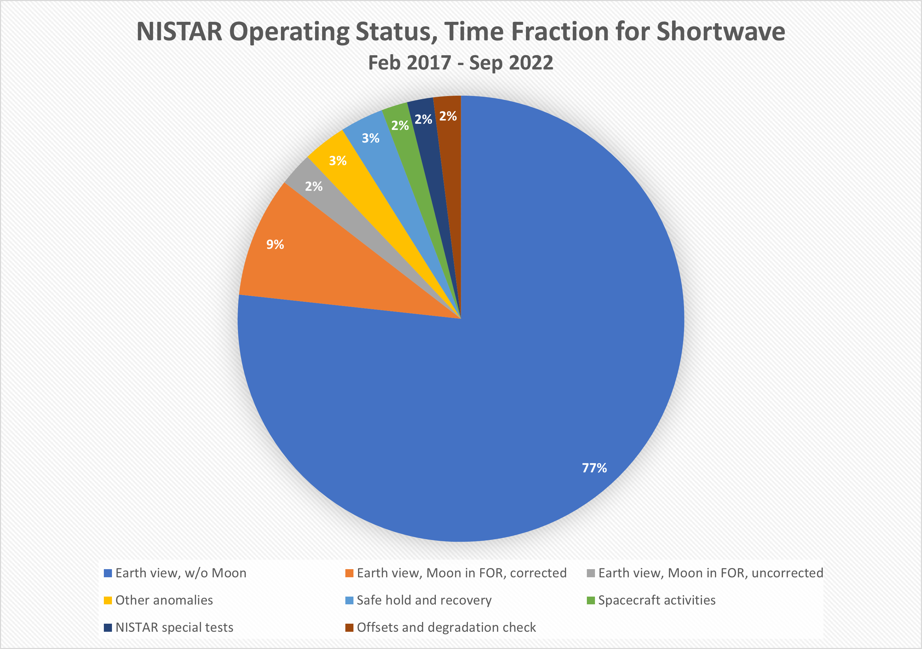
Moonlight Corruption of NISTAR Data
The Moon enters the NISTAR Field-of-Regard twice monthly
The resulting data loss is significant, see chart on below
Correction for the SW channel has increased available data by 9%

Slide 5
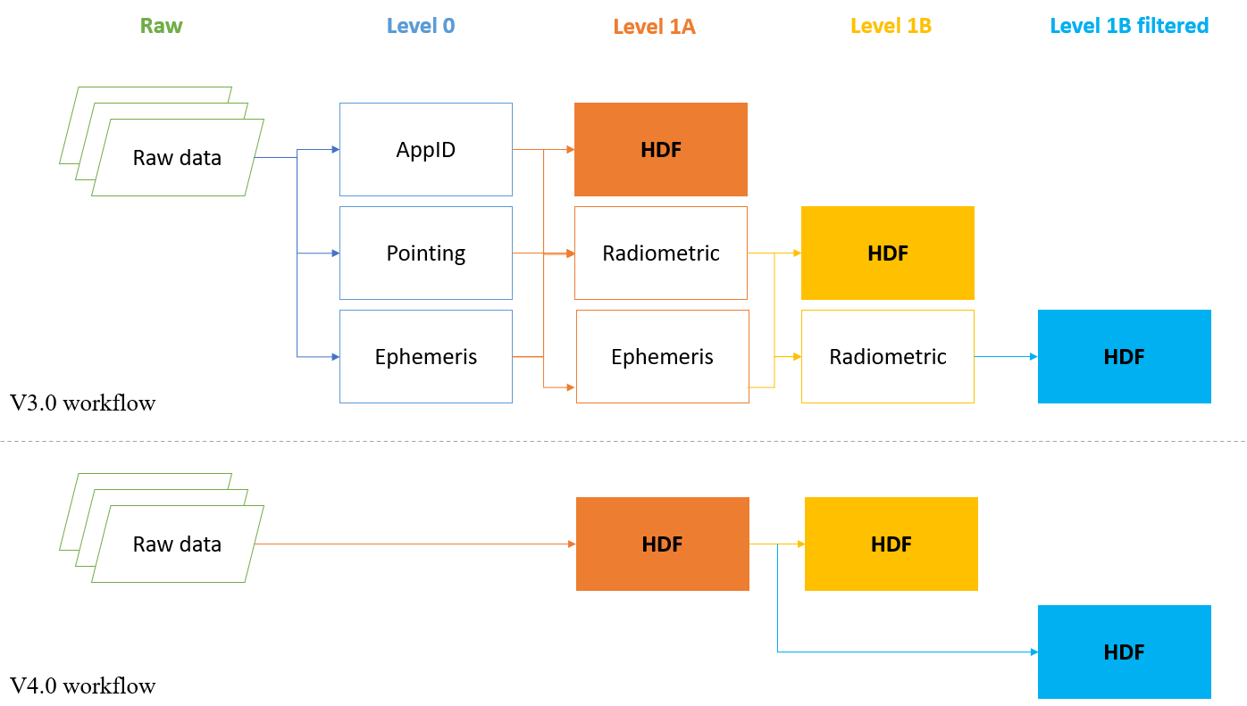
Ground Processing Software Updates
Transition to Version 4 processing
  Enhanced background power data to capture the long-term variability for filtered channels
  Correction for Lunar intrusions of the shortwave Earth radiance
  Redesign of the source code to improve runtime efficiency and reliability
  The beta version has been developed and delivered to DSOC for testing
Auxiliary software packages
  Schedule to release an open-source software package together with Version 4 product
  Written in two versions, Python and MATLAB respectively
  To help DSCOVR community users read and visualize Level 1 data
  A test version of the MATLAB source package is already released publicly on GitHub: https://github.com/L-1-Rad/nistar-l1-matlab

Slide 6
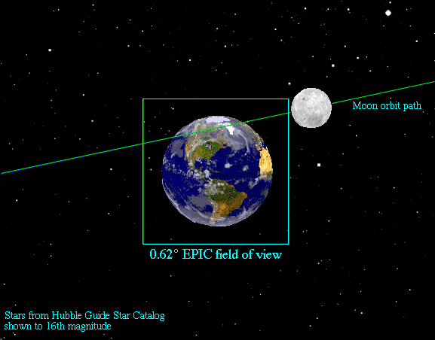
View of the Earth from L1
L1 is the neutral gravity point located 1.6 million km from Earth. The DSCOVR orbit spans ~200k km, tilts along the Sun-Earth line, and evolves over time.
NISTAR views the entire Earth from a synoptic vantage point; integrating flux from the entire disk in four separate bands.
NISTAR: FOV 1º
FOR 7º

Slide 7
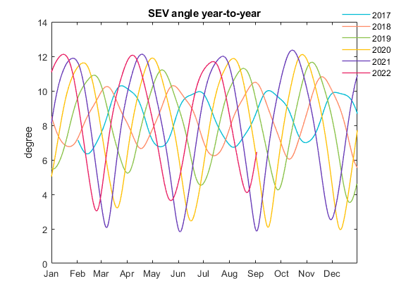

Evolution of NISTAR View Angle over Time
The 6-month period Lissajous orbit of DSCOVR has continually evolved over time. The plot below shows the backscattering angle as seen by NISTAR over the last 6 years.
In 2017, the DSCOVR sun-earth-vehicle (SEV) angle varied from 6.4 to 10 degrees. While in 2020 and 2021 the SEV angle varied from 2 to 12.1 degrees, which produces backscattering angles of 168 to 178 degrees.
August 2021, a spacecraft maneuver changed the orbit so that it will not approach 178 degrees again until 2027—too small an angle results in solar blinding the downlink stations.

Slide 8
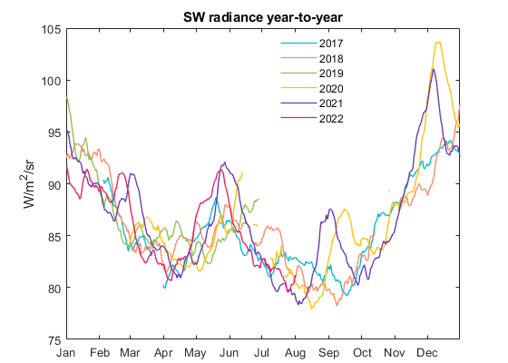
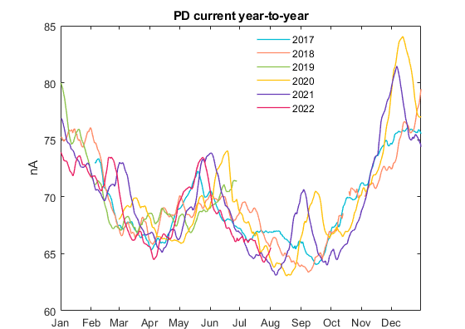
NISTAR Shortwave & PD Intercomparison
Daily average SW radiance (top panel) indicates a 10% increase in the SW radiance as the backscattering angle approaches 178 degrees in December 2020. A 6% increase is noted in September.
The middle panel shows the scaled current of the PD channel. The signal to noise in this channel is <0.1%. All of the fine structure is real daily variability of the Earth’s SW radiance.
The bottom panel show the backscattering angle viewed by NISTAR year to year. This plot is included to make it easier to see the correlation between backscattering angle and the measured radiance.

Slide 9
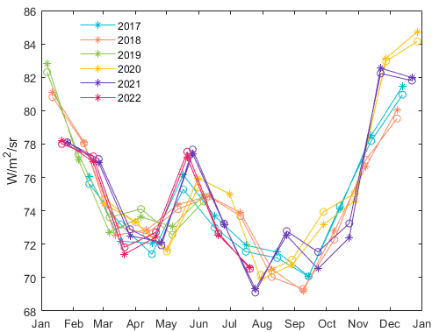
NISTAR Shortwave & PD Intercomparison
Comparison of SW to itself year-to-year and PD channel indicates variability in NISTAR SW offset is erroneous
Year-to-Year NISTAR Radiance
SW radiance (circles) are most consistent year-to-year with a constant background (bottom panel) vs monthly measurements (top panel)—note that each year is a different color
A relative comparison with the scaled PD channel (stars) implies long-term agreement below a percent with a constant background
→NISTAR is a very stable instrument, however, measurements of the offsets have measurement errors

Slide 10
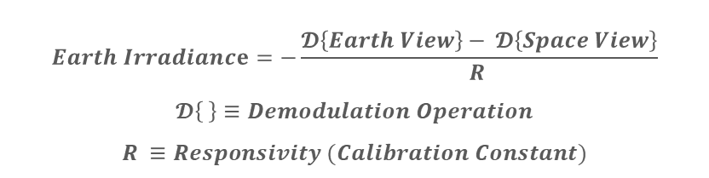
NISTAR Uncertainty Estimates
$$Earth Irradiance=−\frac{𝓓\left\{Earth View\right\}− 𝓓\left\{Space View\right\}}{R }$$
$$𝓓\left\{ \right\}≡Demodulation Operation$$
$$R ≡Responsivity (Calibration Constant)$$
All uncertainties are calculated at k = 1
Instrument noise is normalized to the Earth signal.
Noise reduced for the NIR and SW channels by averaging over 3 consecutive dark observations.
Averaged, separately over 4- and 24-hour time periods—source variability ignored.
Uncertainty components are from both the ESR receiver and the filter transmission. For the two filtered channels, SW and NIR, the uncertainty of the filter transmission dominates.
Estimate based from on-orbit inter-comparison between filters and receivers during Earth view.
Total uncertainties of daily averages is the quadrature sum of all listed components.

Slide 11
Future Activities – Imaginary Data
The out-of-phase component of the demodulated radiometer signals continues to be investigated
Using a constant offset does not capture real changes over time.
Offset changes over time track the heatsink power, as expected with stable shutter-modulated radiative coupling between heatsink and housing
There are some significant deviations between Band C and the heatsink power that are unexplained.
Time-dependent real offset corrections are possible—work is underway.

Slide 12
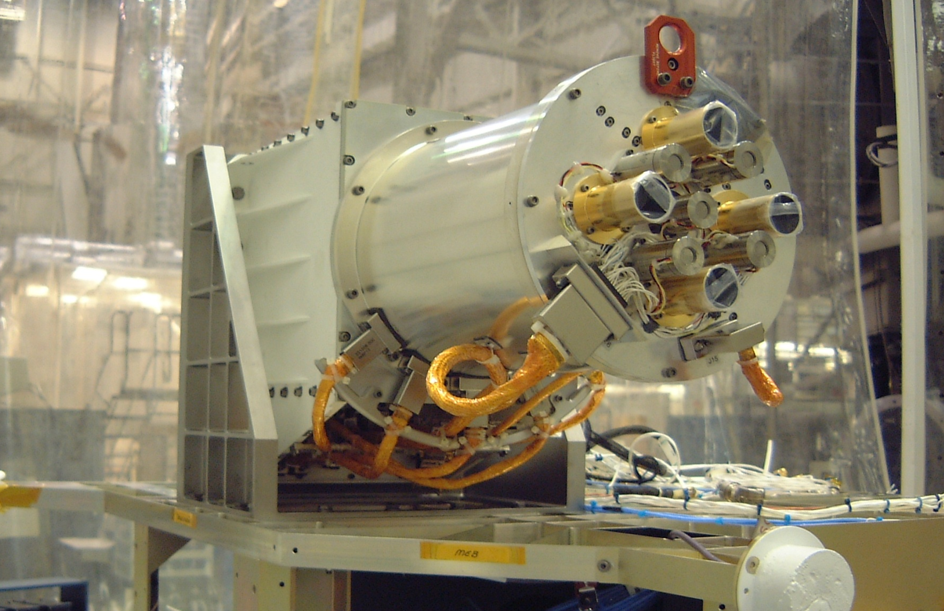
Thank you.

