Slide 1
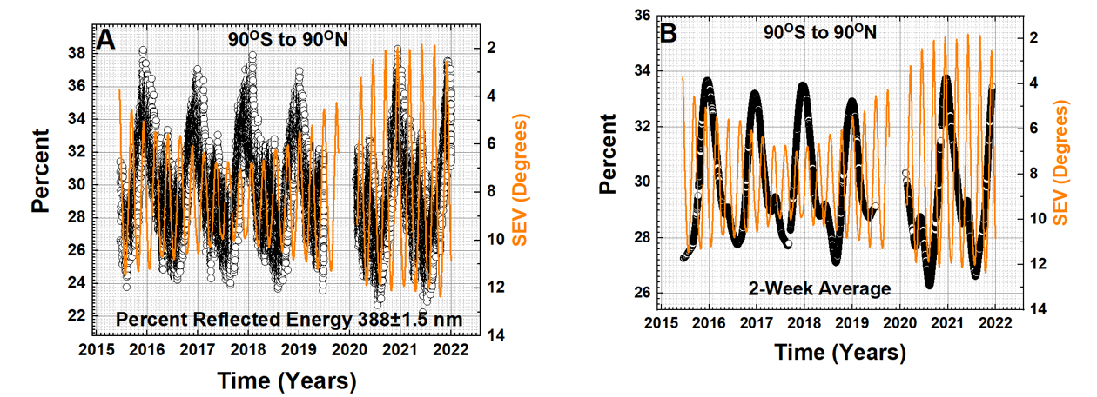
Solar Energy Reflected from Clouds at 388 nm
Is there enhanced cloud reflected energy at large backscatter angles > 88^{O}?
Jay Herman, Liang Huang, Adam Szabo
Percent reflected solar energy P_{SE} for the Earth from 90^{O}S to 90^{O}N

Slide 2
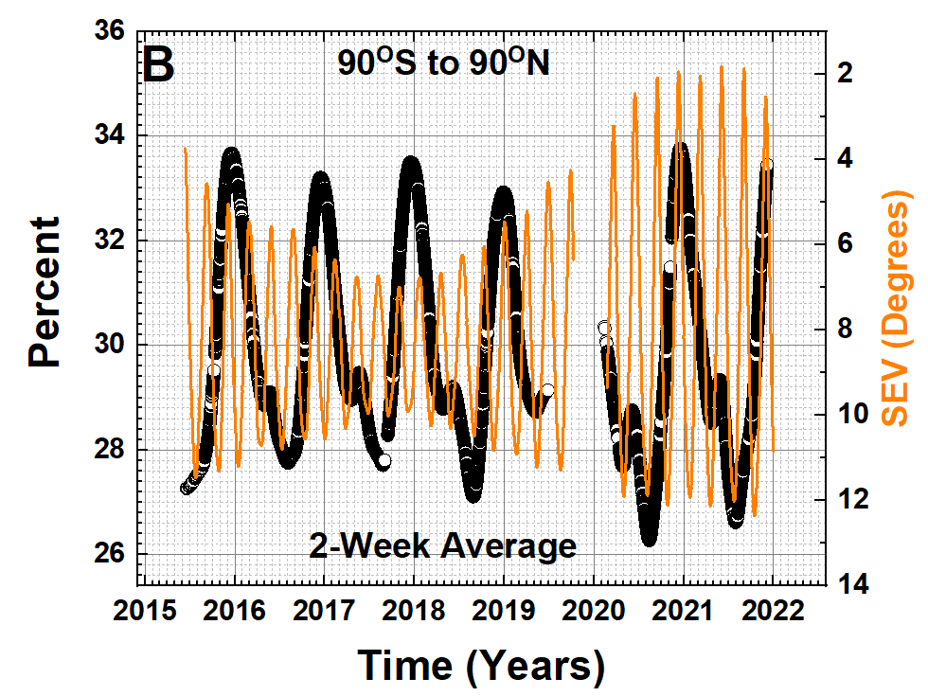
Minimum Sun-Earth View Angles
Table 1 Minimum SEV angles (Marshak et al.)
Date | SEV (Deg)
19 March 2020 | 3.25
16 June 2020 | 2.46
15 September 2020 | 2.10
11 December 2020 | 1.95
7 March 2021 | 2.05
3 June 2021 | 1.83
2 September 2021 | 1.88
29 November 2021 | 2.53
Percent 388 ± 1.5 nm reflected solar energy

Slide 3
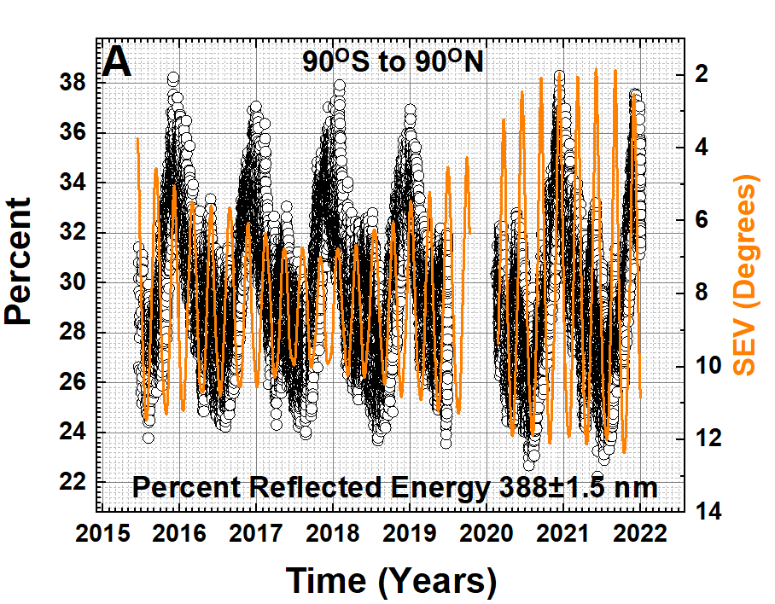
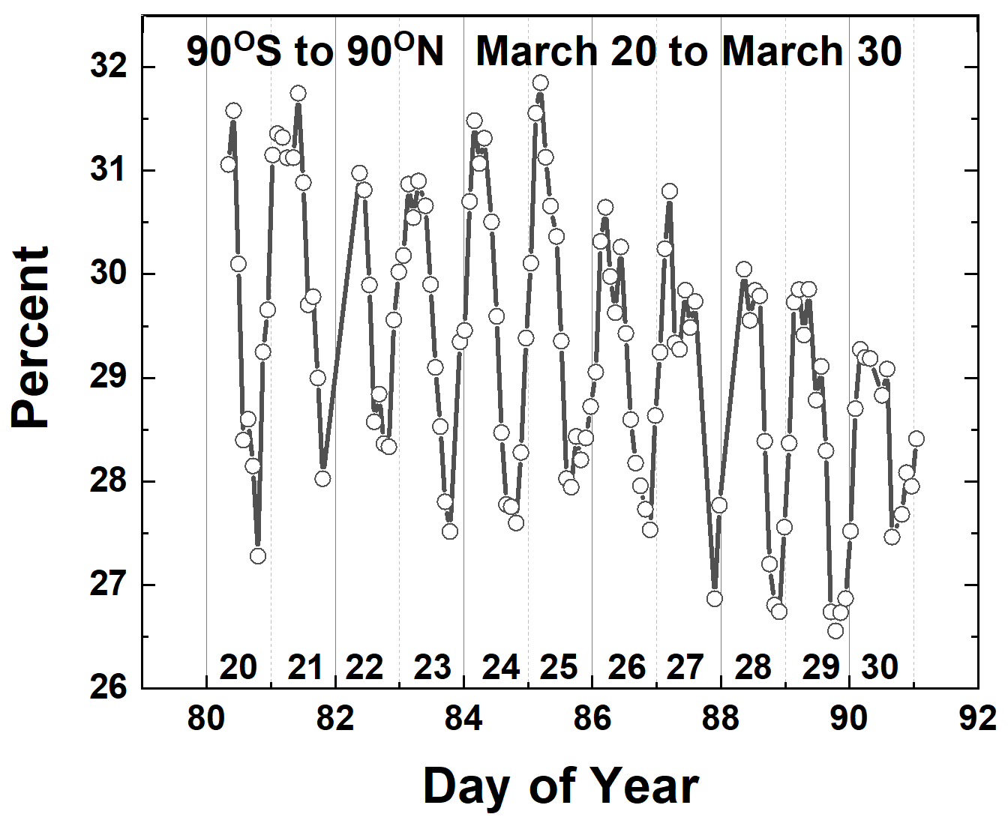
EPIC 388 nm Reflected Energy Data Contains Little Scatter
EPIC’s daily variation of P(t) is caused by the Earth’s rotation
Successive maxima occur over the Pacific Ocean and the minima over Africa.

Slide 4
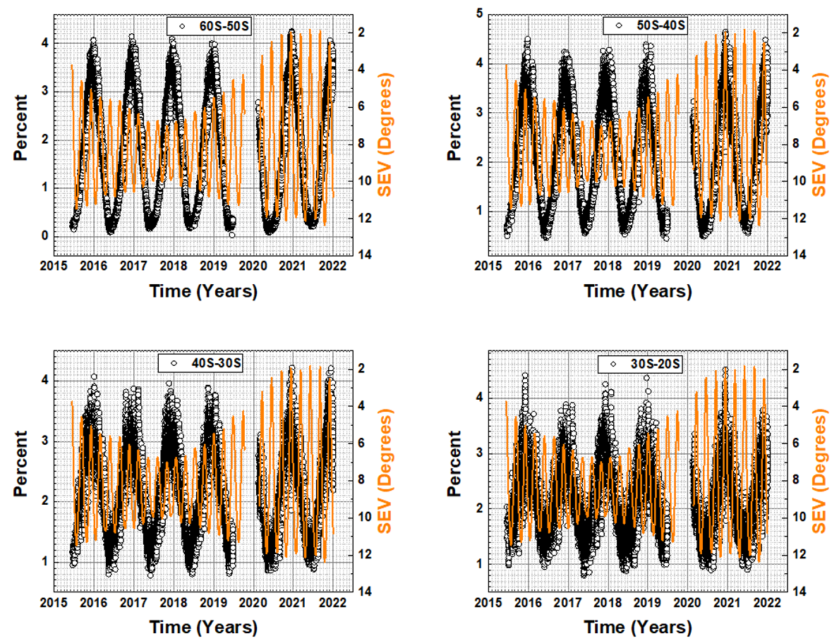
An Apparent Small Increase in the SH
Largest at 45^{O}S

Slide 5
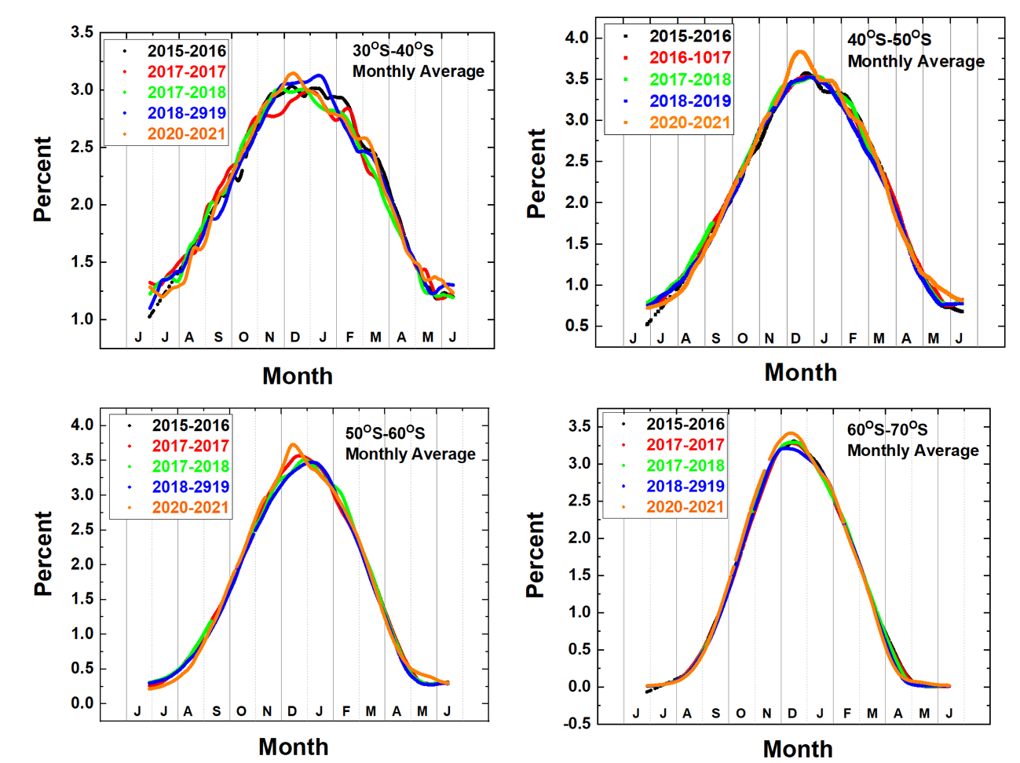
Same Data: Alternate View by Year
Largest at 45^{O}S
Monthly average of SH annual time series of percent reflected energy at 388±1.5 nm

Slide 6
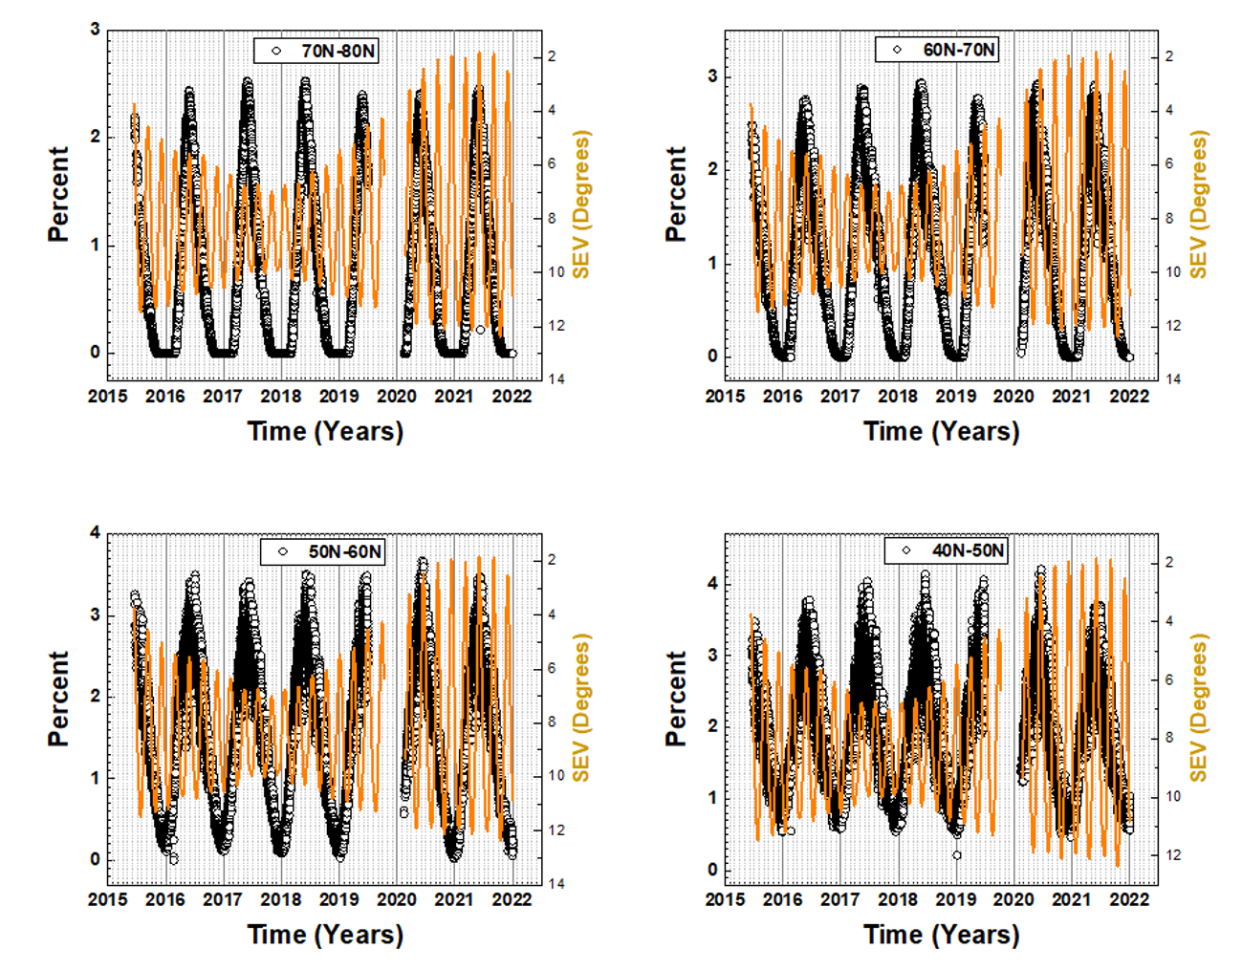
Now, Let’s Look At The Northern Hemisphere During June
Table 1 Minimum SEV angles
Date | SEV (Deg)
19 March 2020 | 3.25
16 June 2020 | 2.46
15 September 2020 | 2.10
11 December 2020 | 1.95
7 March 2021 | 2.05
3 June 2021 | 1.83
2 September 2021 | 1.88
29 November 2021 | 2.53

Slide 7
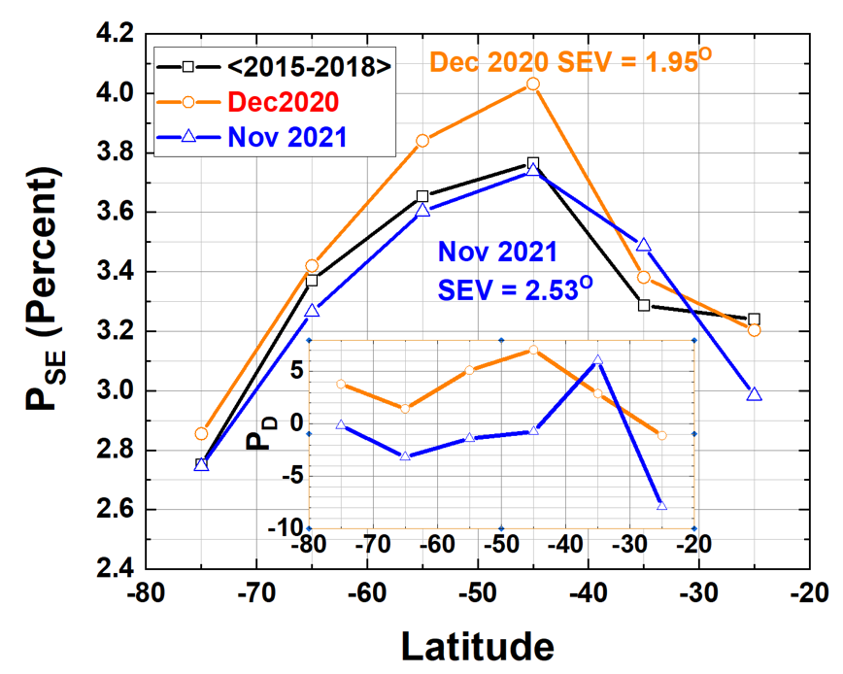
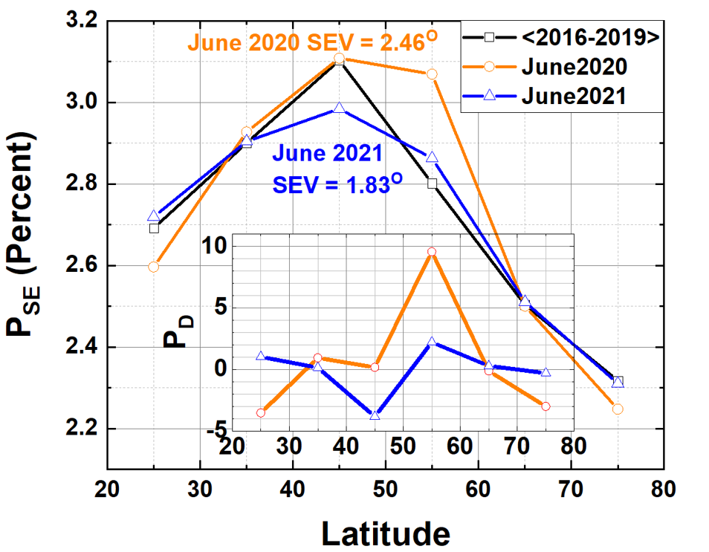
Compare Northern and Southern Hemispheres
Southern Hemisphere Northern Hemisphere
Biggest difference when SEV = 2.46^{O}
Nothing much when SEV = 1.83^{O}
Biggest difference when SEV = 1.95^{O}

Slide 8
Summary: Comparing NH with SH
Both hemispheres have a small summer solstice SEV angles SH 1.95^{O} in December 2020 NH 1.83^{O} in June 2021
There is increased reflected energy in the SH in December 2020
There is no increased reflected energy in the NH in June 2021
It is most likely that the increase in the SH corresponded to an increase in cloud amount and not to enhanced reflectivity because of a small SEV angle

