Slide 1
Earth Observations From the Moon Surface Using EPIC-Like Camera
Nick Gorkavyi (SSAI/GSFC), Nickolay Krotkov (GSFC), Alexander Marshak (GSFC)
We propose to deploy a wide-angle camera and a multi-slit spectrometer on the Moon surface for whole Earth hyperspectral observations. These observations will complement DSCOVR/EPIC observations limited to near-backscatter directions for the full range of Earth phases. In addition, a wide-angle camera can be used as the first webcam on the Moon surface to provide continuous images of the Earth phases. The libration of the Moon in latitude and longitude causes the center of the Earth to move in the Moon’s sky within the fixed angular field of view 13.4°× 15.8° with periods of ~27 days and 6 years.
References:
1. Marshak A. et al. “Whole Earth imaging from the Moon South Pole (EPIC-Moon)”,
WhitePaper #2054 in Artemis III Science Definition Team Report, 2020.
2. Gorkavyi N. et al. “Earth Imaging From the Surface of the Moon With a DSCOVR/EPIC-Type Camera” Front. Remote Sens. 2:724074. https://doi:10.3389/frsen.2021.724074 , 2021.
3. Boyd P. T. et al. “EarthShine: Observing our world as an exoplanet from the surface of the Moon” J. Astr. Telesc. Inst. and Syst., 8(1), 014003, https://doi.org/10.1117/1.JATIS.8.1.014003, 2022.
4. Gorkavyi N., Krotkov N., Marshak A. “Earth Observations from the Moon surface: dependence on lunar libration”, Atmospheric Measurement Techniques, 2022 (submitted), https://amt.copernicus.org/preprints/amt-2022-158/
DSCOVR STM, September 29, 2022

Slide 2
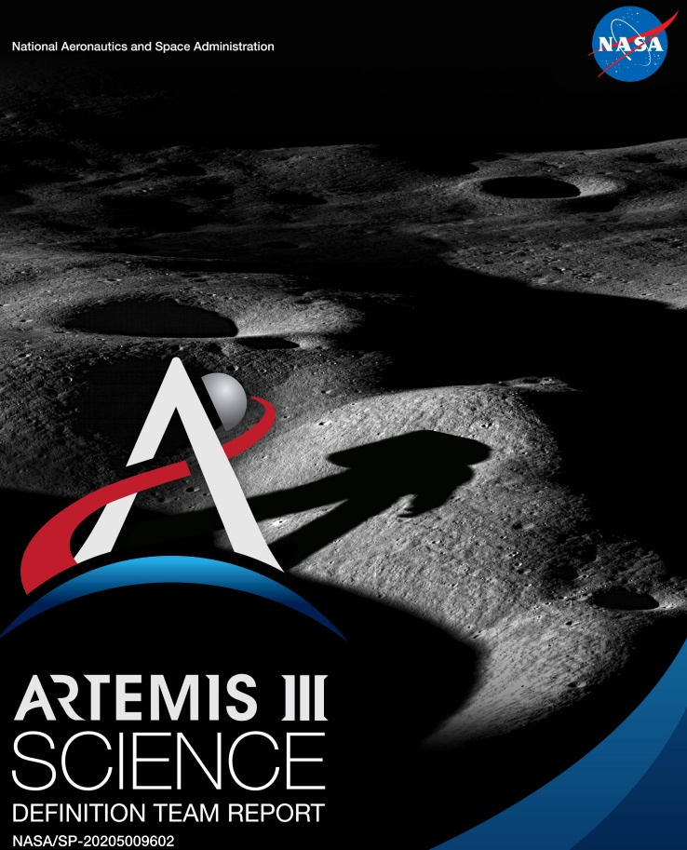
Artemis III Science:
Goal 5c:
Use the Moon as a platform for Earth-observing studies… the Moon supplies a convenient platform for Earth science.
The observations from the Moon will have higher resolution than would similar observations made at L1.
Myriad science investigations targeting topics such as lightning, Earth’s albedo, atmosphere, and exosphere…, the oceans, infrared emission, and radar interferometry may be accomplished from the surface of the Moon.
The Moon also offers a unique vantage point for full-disk observations that can help advance investigations of Earth as an exoplanet…

Slide 3
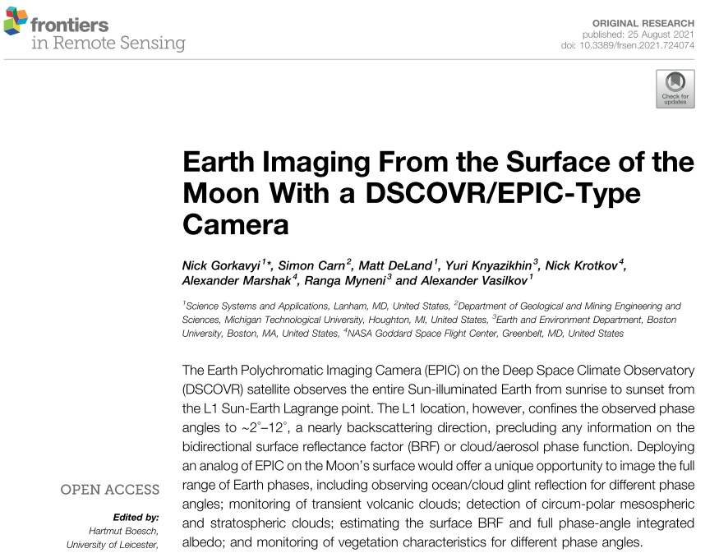

Slide 4
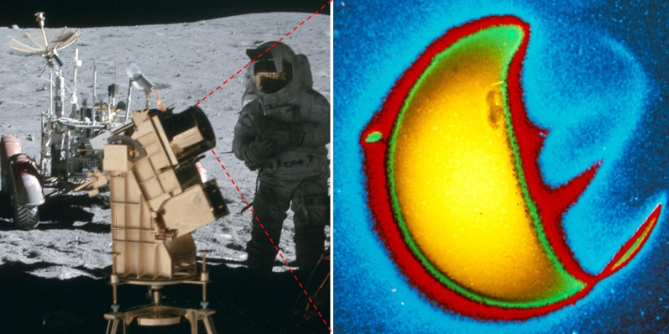
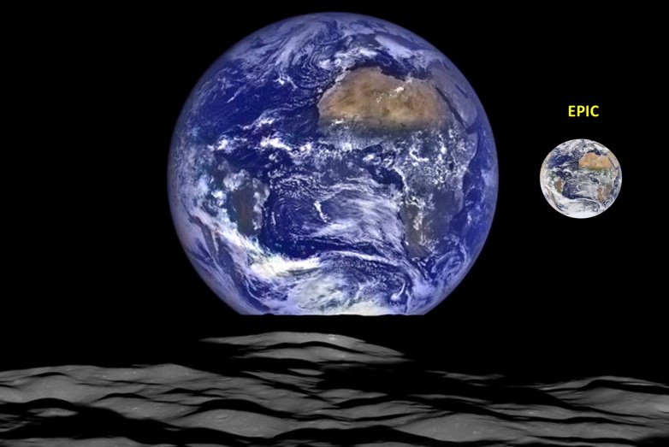
A Far-Ultraviolet Camera/Spectrograph was operated on the lunar surface during the Apollo 16 mission, April 1972 (NASA).
The Earth’ UV photo (1304 angstroms) from the Moon (NASA/G. Carruthers
et al.)
A unique view of Earth from the LRO's vantage point in orbit around the Moon (October 12, 2015) (NASA/GSFC/ Arizona Univ.).
LRO
How good is
the Moon as
a platform for
Earth observation?
LRO was about 134 km above the Moon's crater Compton
Insert shows an image of the same part of the Earth taken by DSCOVR/EPIC on the same day.
From:
Gorkavyi N., Krotkov N., Marshak A. “Earth Observations from the Moon surface:
dependence on lunar libration”, AMT, 2022, https://amt.copernicus.org/preprints/amt-2022-158/

Slide 5
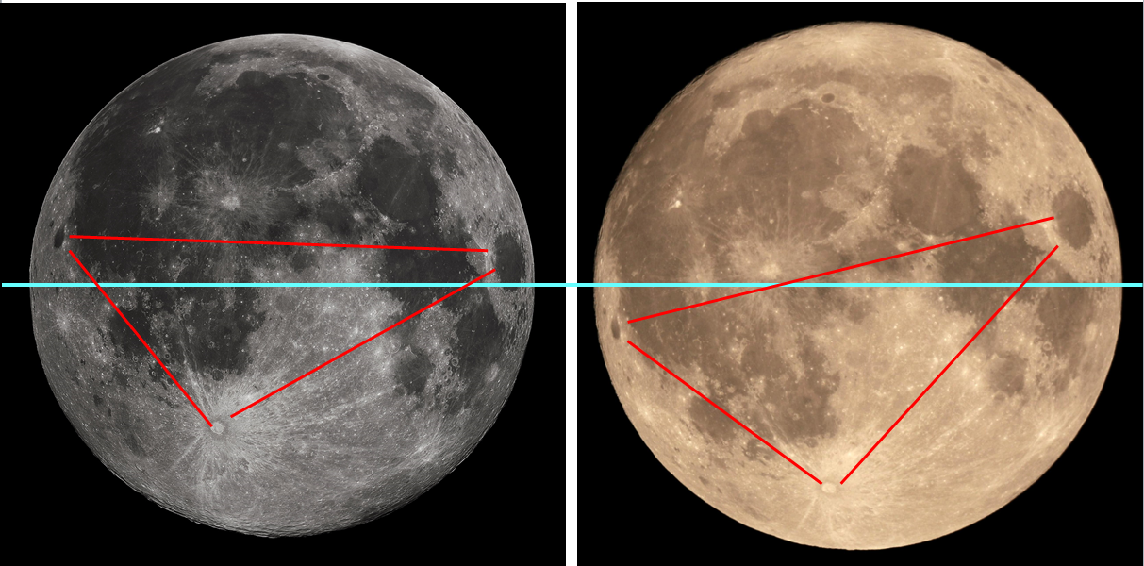
Lunar librations
Libration
in latitude
Libration in
longitude
10-22-2010 (Wiki/G.H.Revera)
11-14-2016, Wiki
The angular diameter of the Earth as seen from the Moon surface is $1.9°±0.1°$(the angular size varies due to the change in the distance between the Earth and the Moon).
The libration of the Moon in latitude reach an amplitude of 6.68° and have a main period of 27.21 days.
The libration of the Moon in longitude, reaching 7.9°, have a period of 27.55 days.
This causes the center of the Earth move in the Moon’s sky in a rectangle measuring 13.4°× 15.8°. The trajectory of the Earth's motion in this rectangle changes its shape with a period of 6 years.
This apparent librational movement of the Earth in the Moon’s sky complicates observations of the Earth. We propose to turn this disadvantage into an advantage and place a multi-slit spectrometer on the Moon surface on a fixed platform. The libration motion and the daily rotation of the Earth will act as a natural replacement for the scanning mechanism.

Slide 6
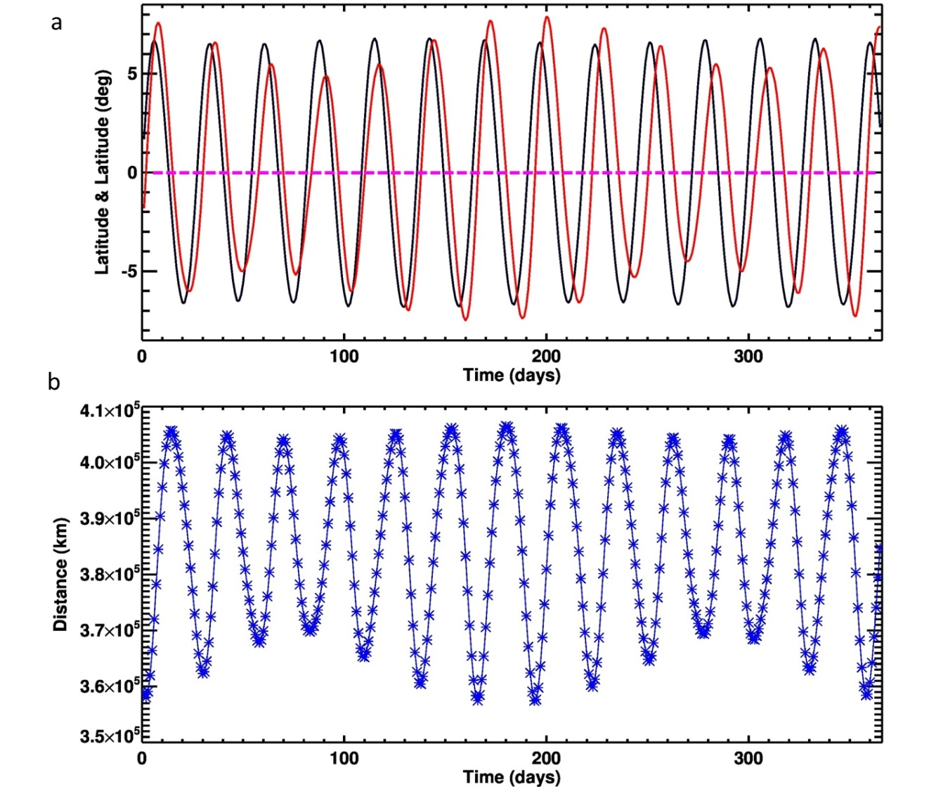
Lunar librations
Lunar latitude
Libration = 0
Lunar longitude
2022
Earth-Moon distance
Variability of the Moon orientation and orbit during the 2022. (a) longitude libration (red) and latitude libration (black); (b) the Earth-Moon distance. The time-averaged distance between the centers of Earth and the Moon is 385,000 km; the minimal distance is 356,500 km and the maximal distance 406,700 km.

Slide 7
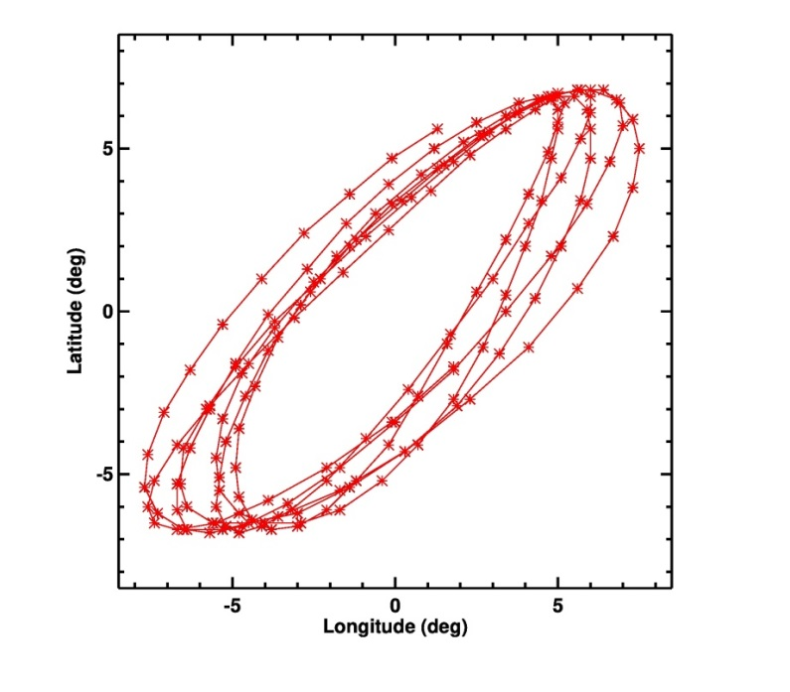
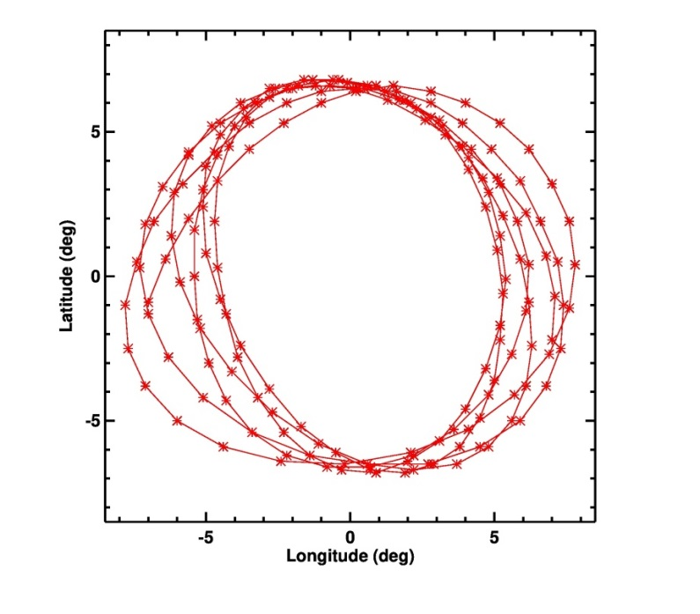
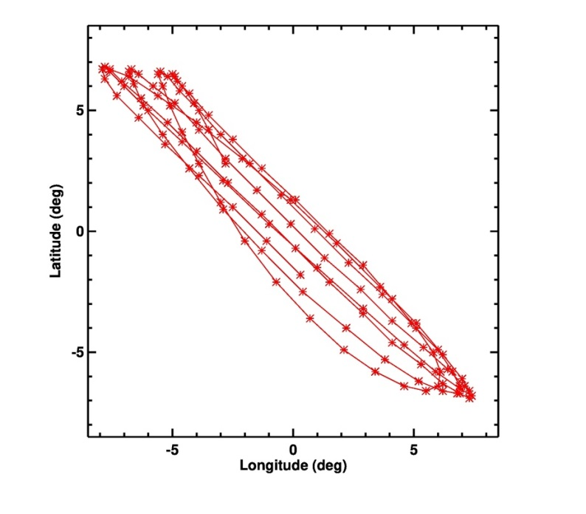
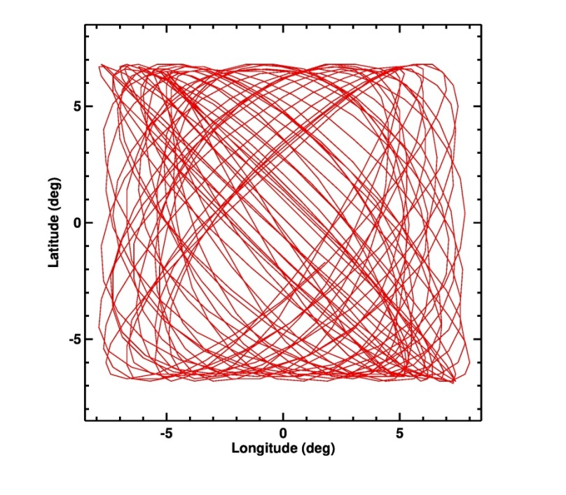
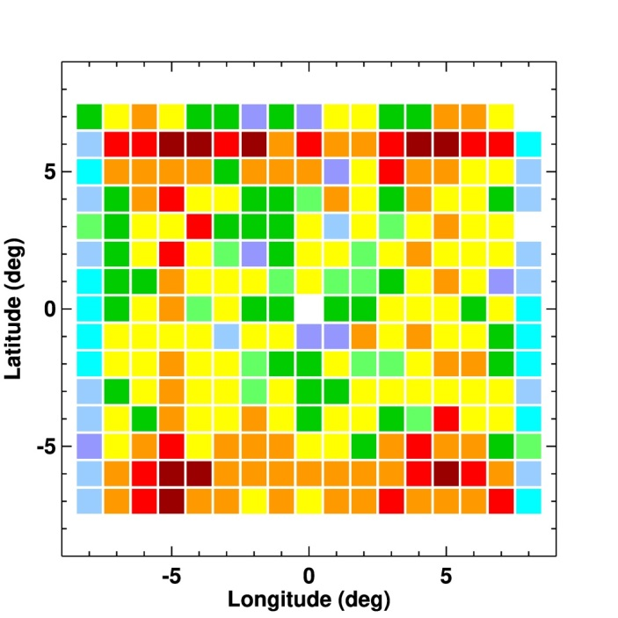
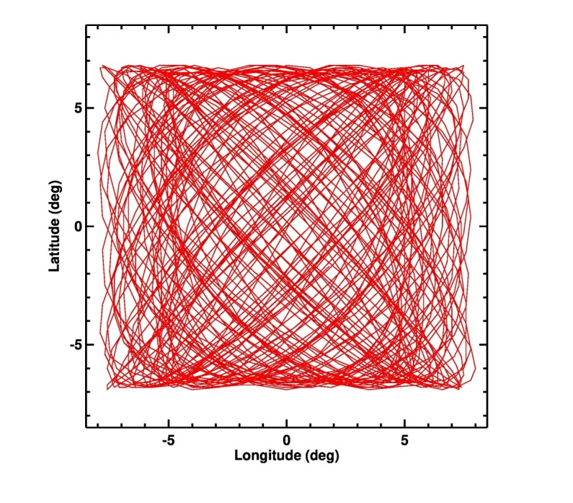
Lunar librations
a
1/2022-6/2022
b
1/2023-6/2023
c
7/2024-10/2024
1 day step
d
2022-2024
e
2022-2027
f
2022-2027
d
Librations of Earth in the Moon sky (from North Pole of the Moon) during first 6 months 2022 (a) and 2023 (b); (c) July-September 2024; (d) 2022-2024 (3 years); (e) 2022-2027
(6 years or 2191 days = positions); (f) Distribution of the 2191 positions into
each 1°×1° grid’ cell for this period. The black dot = zero librations.
0 1 2 3 4 ≥5 ≥7 ≥10 ≥15 ≥ 20 N

Slide 8
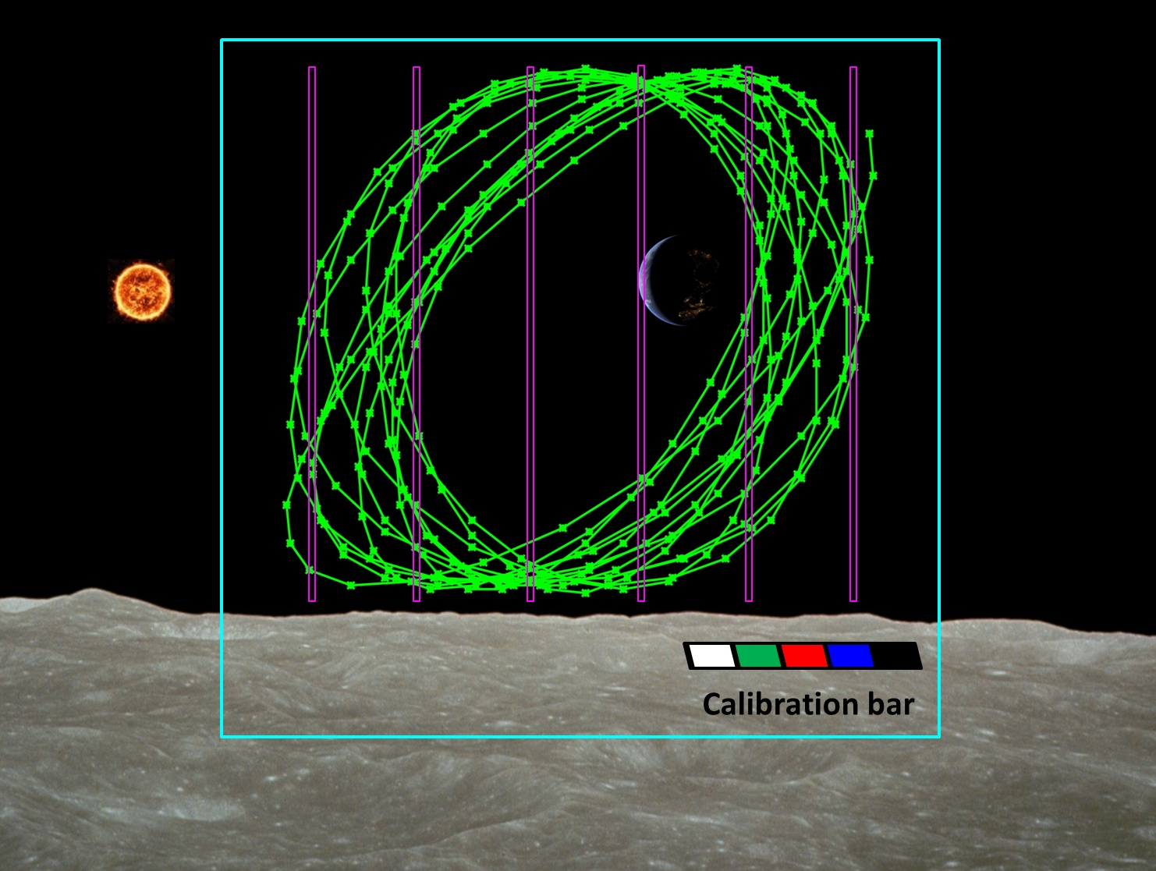
Lunar librations
The librations of the Moon and the daily rotation of the Earth serve as a natural scanning (or guiding) mechanism for a spectrometer with vertical slits. This greatly simplifies the design of the spectrometer and makes it reliable and cheap.
Visual positions of the Earth’ center during 2026 (green line) from the South Pole of the Moon (point S on Slide. 10) and possible positions of slits of the spectrometer (violet). Blue square is ~18°-20° FOV of fixed mount camera (~10³ photos per day). The calibration bar is used to calibrate color images from a wide-angle camera. Lunar surface is from the photo taken by NASA/Apollo.

Slide 9
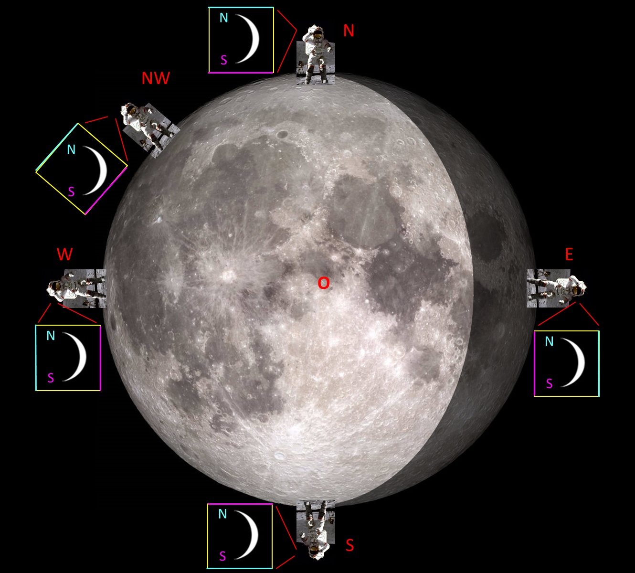
The orientation of the Earth (and the trajectory of its movement through the sky of the Moon) depends on the position of the observer on the Moon, who sees the Earth inside the square window of his camera or telescope.
Observers in different points of the Moon’s visible hemisphere.
Image of the Moon – LRO (NASA/GSFC/Arizona State University). Observer: photo of John W. Young, commander of the Apollo 16 lunar landing mission (NASA).

Slide 10
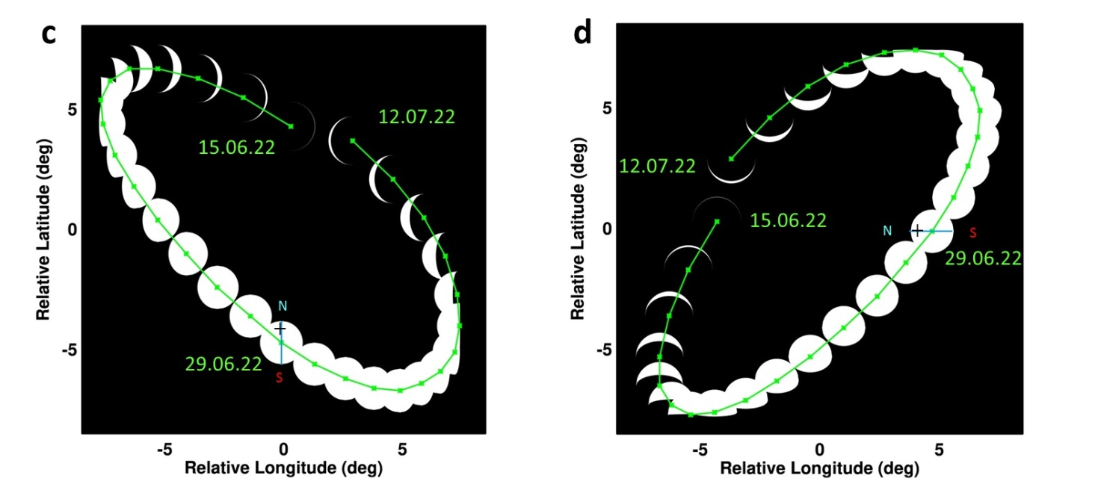
Lunar librations
View from lunar North Pole
View from lunar equator
(c) Position of the Earth center and Earth’ phases during June 15-July 12, 2022 (28 points, green line) for an observer located on the lunar North Pole (the point N on Slide 9). The Earth's North Pole marked with a cross and the letter N.
(d) Earth’ phases and visible trajectory for same period for an observer on the lunar equator near longitude 90°E (the point E on Slide 9).

Slide 11
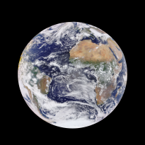
Lunar dust environment and light scattering around the Earth image
FOV=5°x5°
Lunar
dust cloud
Accumulation of lunar dust on the lens
The wide-field of view (WFOV) camera and the spectrometer can be installed inside of the lander or on the surface of the Moon. The project can use existing high TRL spectrometer and WFOV camera or develop new ones in GSFC.
Resolution =km/pixel | 1000 pixels | 2000 pixels | 4000 pixels
FOV = 15x15° | 50.7 km/pix | 25.4 km/pix | 12.7 km/pix
FOV = 5x5° | 16.8 km/pix | 8.4 km/pix | 4.2 km/pix
Velocity of Earth surface
~ 0.5 km/sec;
time between
measurement
~ 10-100 sec

Slide 12
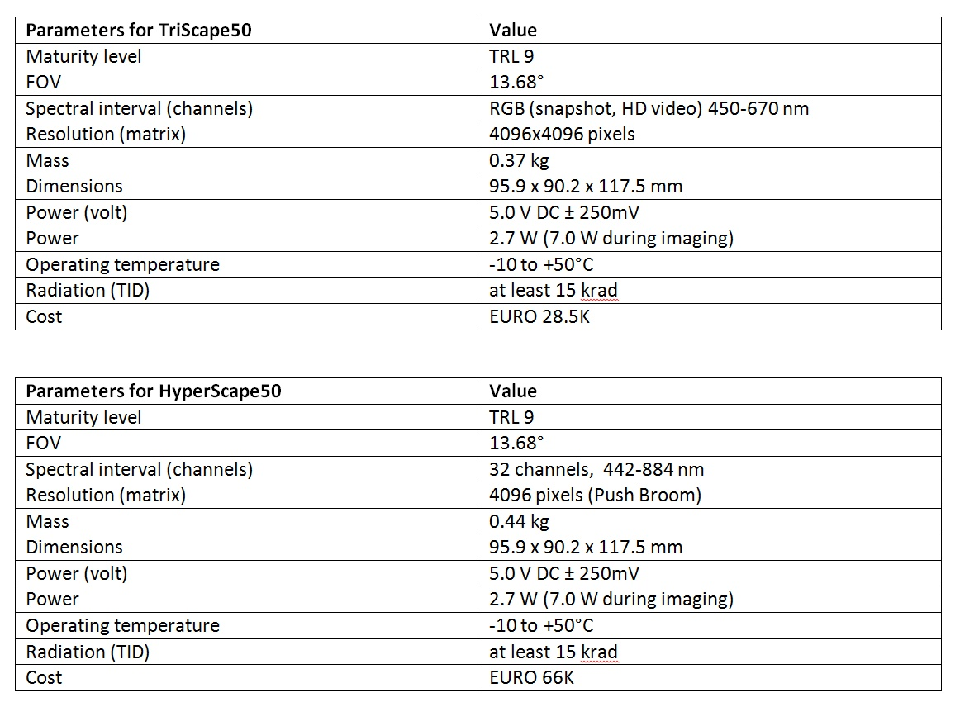
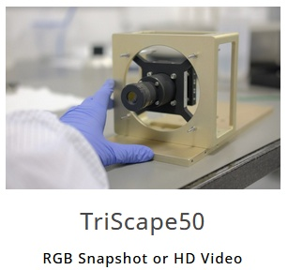
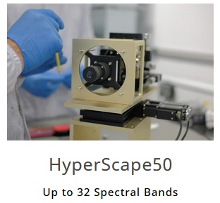
Possible off-the-shelf choice of RGB and hyperspectral cameras:
https://simera-sense.com/products/xscape50/hyperscape50/
https://simera-sense.com/products/xscape50/#
Other off-the-shelf choice:
https://dragonflyaerospace.com/chameleon/
https://dragonflyaerospace.com/gecko/
Teledyne
4096×4096 pixel HAWAII-4RG™ (H4RG)
https://www.teledyneimaging.com/en/aerospace-and-defense/products/sensors-overview/infrared-hgcdte-mct/hawaii-4rg/
UV (300-500 nm)
VIS (500-1800 nm)
https://www.teledyne-si.com/research-and-development/imaging-sensors

Slide 13
Conclusion
No one had previously conducted systematic observations of the Earth from the Moon. This project will demonstrate the prospects of Earth observations from the Moon spectroscopically and in the imaging mode. We believe that proposed lightweight instruments on a fixed platform will provide a unique information for Earth science, as well as whole Earth true-color imagery to the public (the WFOV camera could be the first webcam on the Moon and this will generate significant interest to the project).
The system uses the Moon as a free mechanical platform to scan the Earth. This means that there is no expensive mechanical platform and no system to control it. This improves system reliability in the harsh conditions of harmful lunar dust. The experience of operating such a system will be invaluable for further scientific observations on the Moon.
Additional studies
Degradation of optical system due to lunar dust accumulation;
Scattered light from floating lunar and interplanetary dust;
Radiation/UV degradation of matrix and optics on lunar surface (in daylight and in nightlight/shadow).

Slide 14
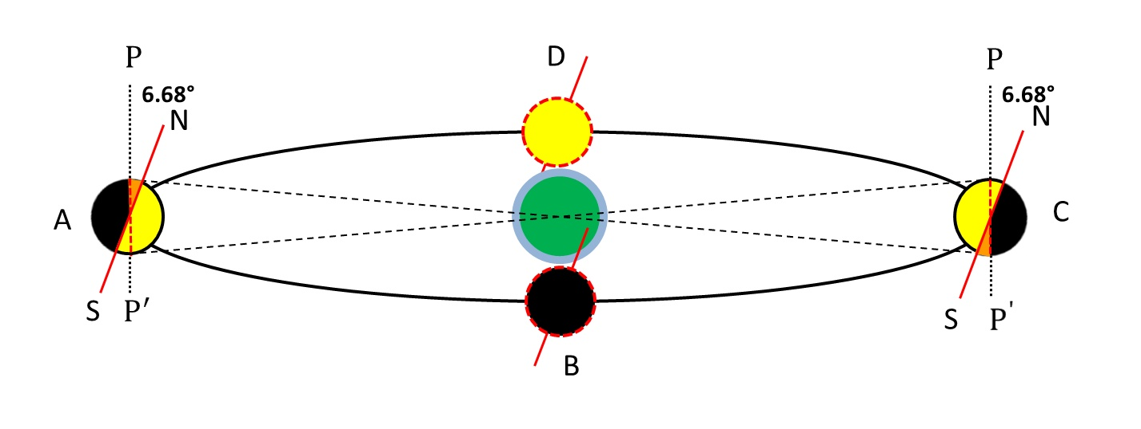
Backup
Libration in latitude results from an inclination 6.68° between the Moon's axis of rotation (NS) and the normal to the plane of its orbit around Earth ($PP′$). The hemisphere of the Moon that is visible from Earth is marked in yellow; black is invisible hemisphere. Additional areas of the lunar surface that become available for observation at points A and C are marked in orange.

Slide 15
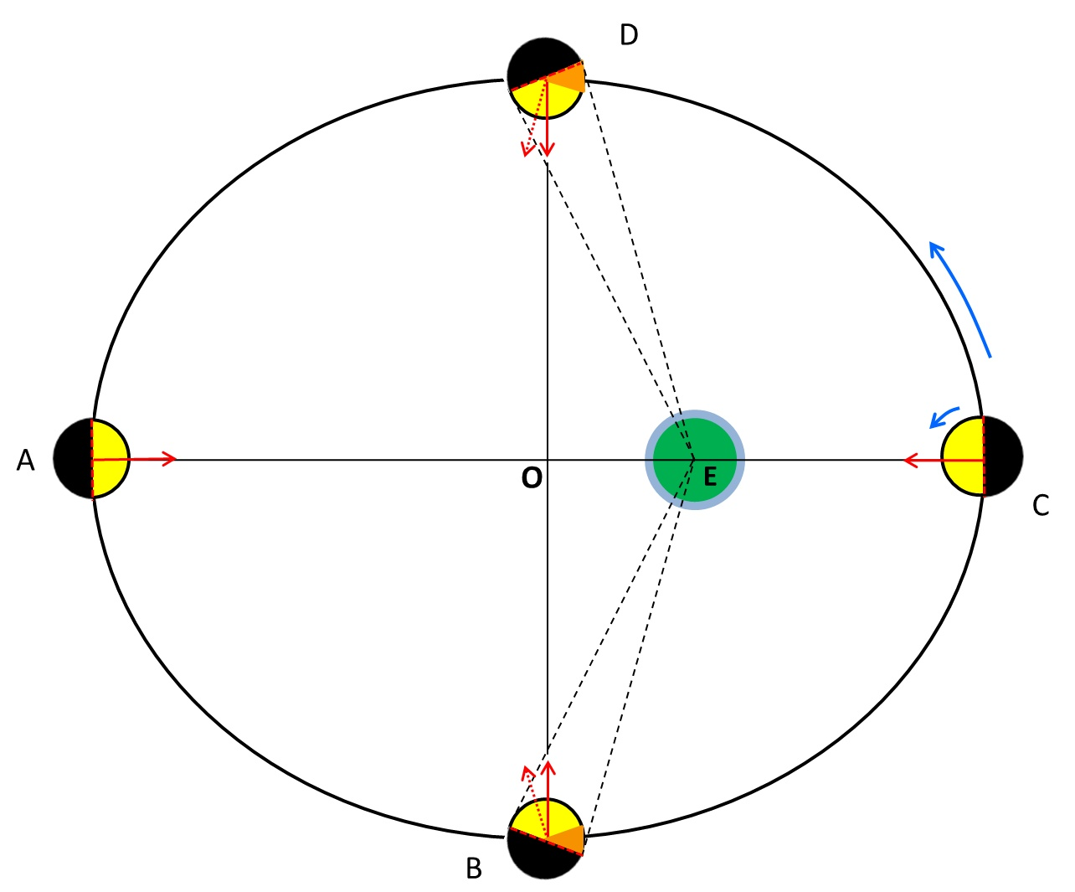
Orbital
V_{C}>V_{A}
Libration in longitude results from the eccentricity of the Moon's orbit. It can reach 7.9° in amplitude. The point A is the apogee of the lunar orbit; C – the perigee; $AO=a$; $OE=ae.$Additional areas of the lunar surface that become available for observation are marked in orange. View from N pole.

Slide 16
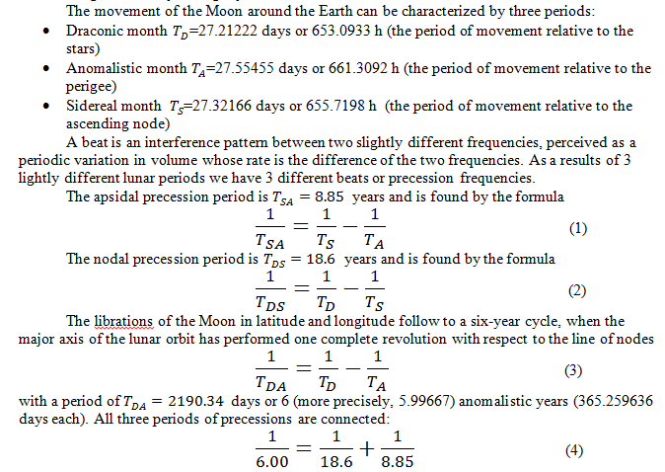
Lunar librations in simple math

Slide 17
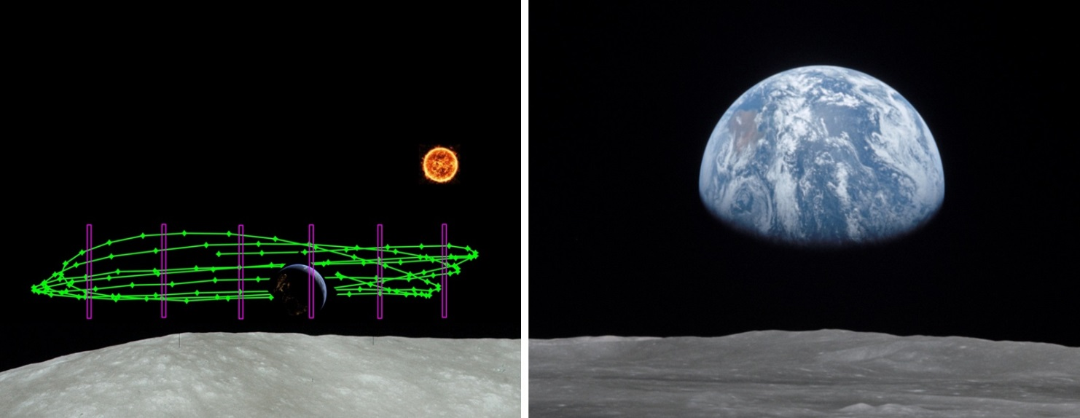
Left: Position of the Earth center during July-September 2024 (green line) for an observer located on the edge of the visible hemisphere of the Moon in the region of middle ~45°N latitudes (point NW on Slide 9). Violet lines are positions of slits of the spectrometer. Lunar surface is from the photo taken by NASA/Apollo.
Right: View of Moon limb with Earth on the horizon, Mare Smythii region (3°N,85°E), July 20, 1969. NASA/JSC/Apollo 11, AS11-44-6551.

