Slide 1
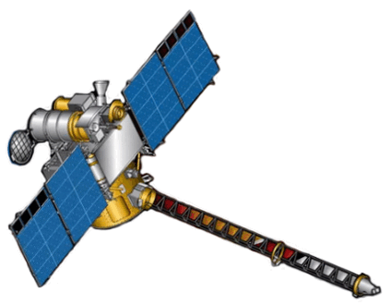
DSCOVR EPIC and NISTAR STM
Sep 27-29, 2022
Diurnal evolution of cloud properties with DSCOVR/EPIC
Alfonso Delgado-Bonal, Alexander Marshak, Yuekui Yang, Lazaros Oreopoulos

Slide 2
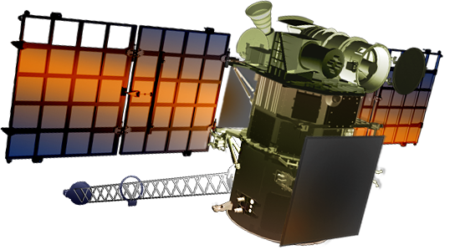
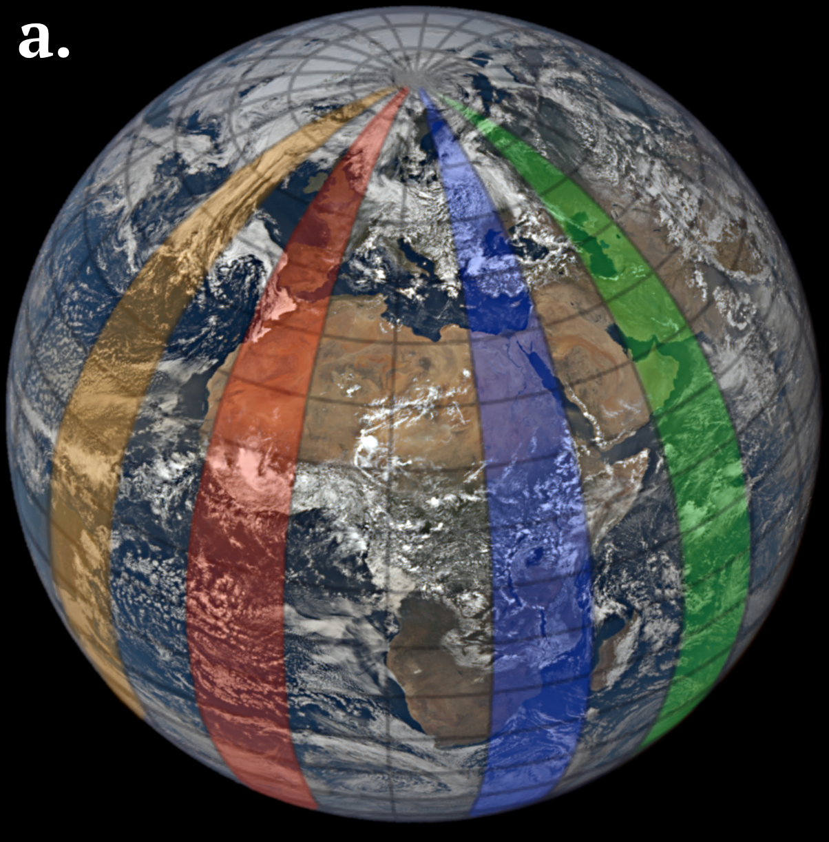
Seen from DSCOVR
DSCOVR is the only satellite capable of capture the sunlit side of the planet
EPIC captures daytime evolution of cloud properties:
Cloud Fraction
Cloud Height
Cloud Optical Thickness

Slide 3
LAND
OR
OCEAN
Liquid
Ice
Most Likely thermodynamic phase is liquid
Under 3000 meters
Most Likely thermodynamic phase is ice
Over 7000 meters

Slide 4
Seen from Earth
Land
Ice: Lower cloud fraction around noon and increasing altitude throughout the day
Liquid: higher cloud fraction with lower altitudes around noon

Slide 5
Seen from Earth
Ocean
Ice: Lower cloud fraction around noon and increasing altitude throughout the day (i.e. independent of underlying surface)
Liquid: lower cloud fraction with lower altitudes around noon

Slide 6
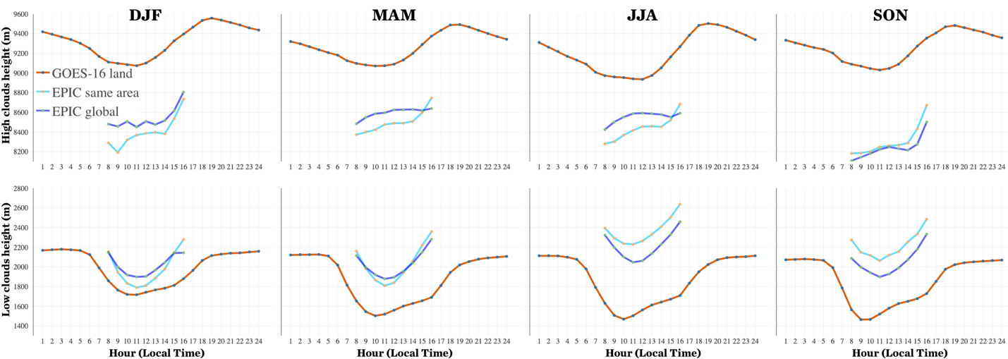
Diurnal cloud top height cycles over land
High clouds exhibit a steady increase from morning to evening of approximately 500 m
For low clouds, cloud top height exhibits a minimum in the morning with amplitudes between 250 and 600 meters

Slide 7
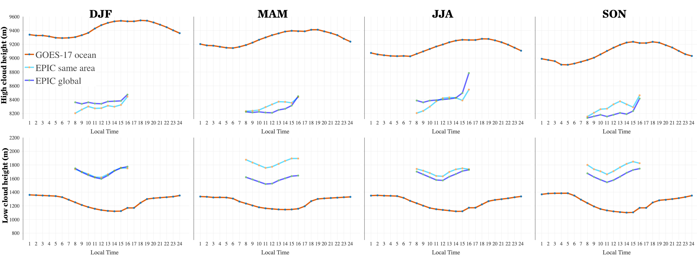
Diurnal cloud top height cycles over ocean
The amplitude of the diurnal cycles is smaller over ocean than over land for both high and low clouds
Low clouds are 500 to 800 m lower over ocean than over land

Slide 8
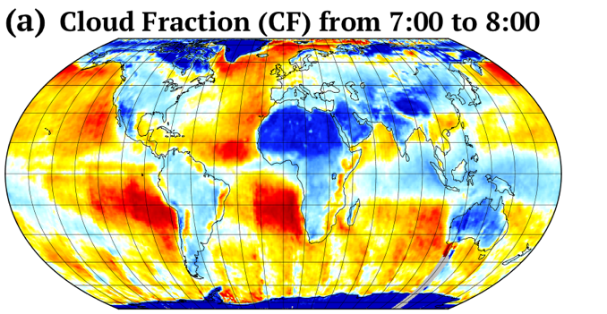
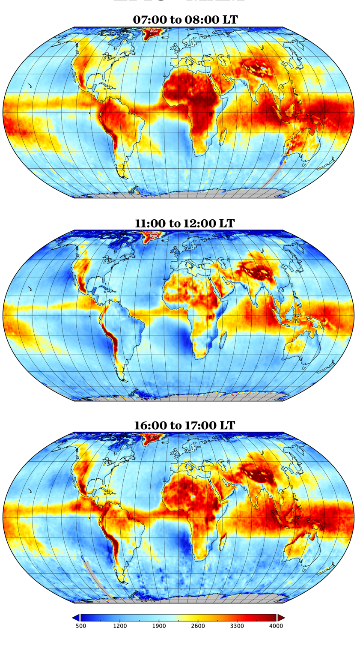
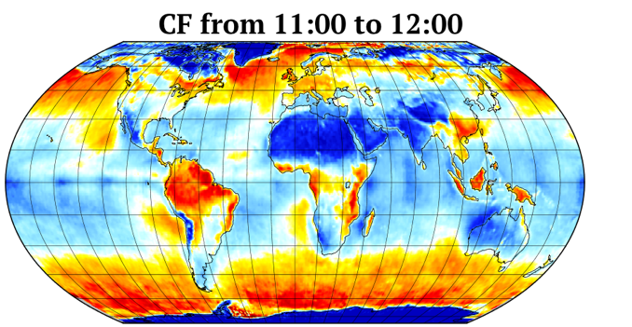
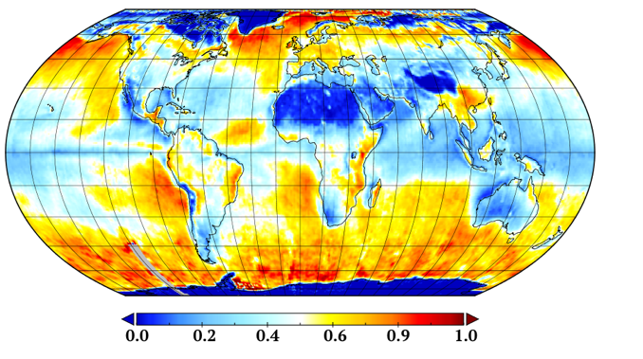
Cloud Fraction and
Cloud Height
Liquid clouds for MAM
Cloud Height
CF from 16:00 to 17:00

Slide 9
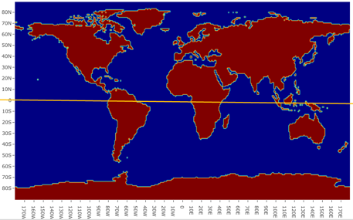
Cloud Optical Thickness
Retrieved using a single-channel approach (680 nm over land and 780 nm over ocean)
Dismissed latitudes over ±60°
Zonal analysis of 15°

Slide 10
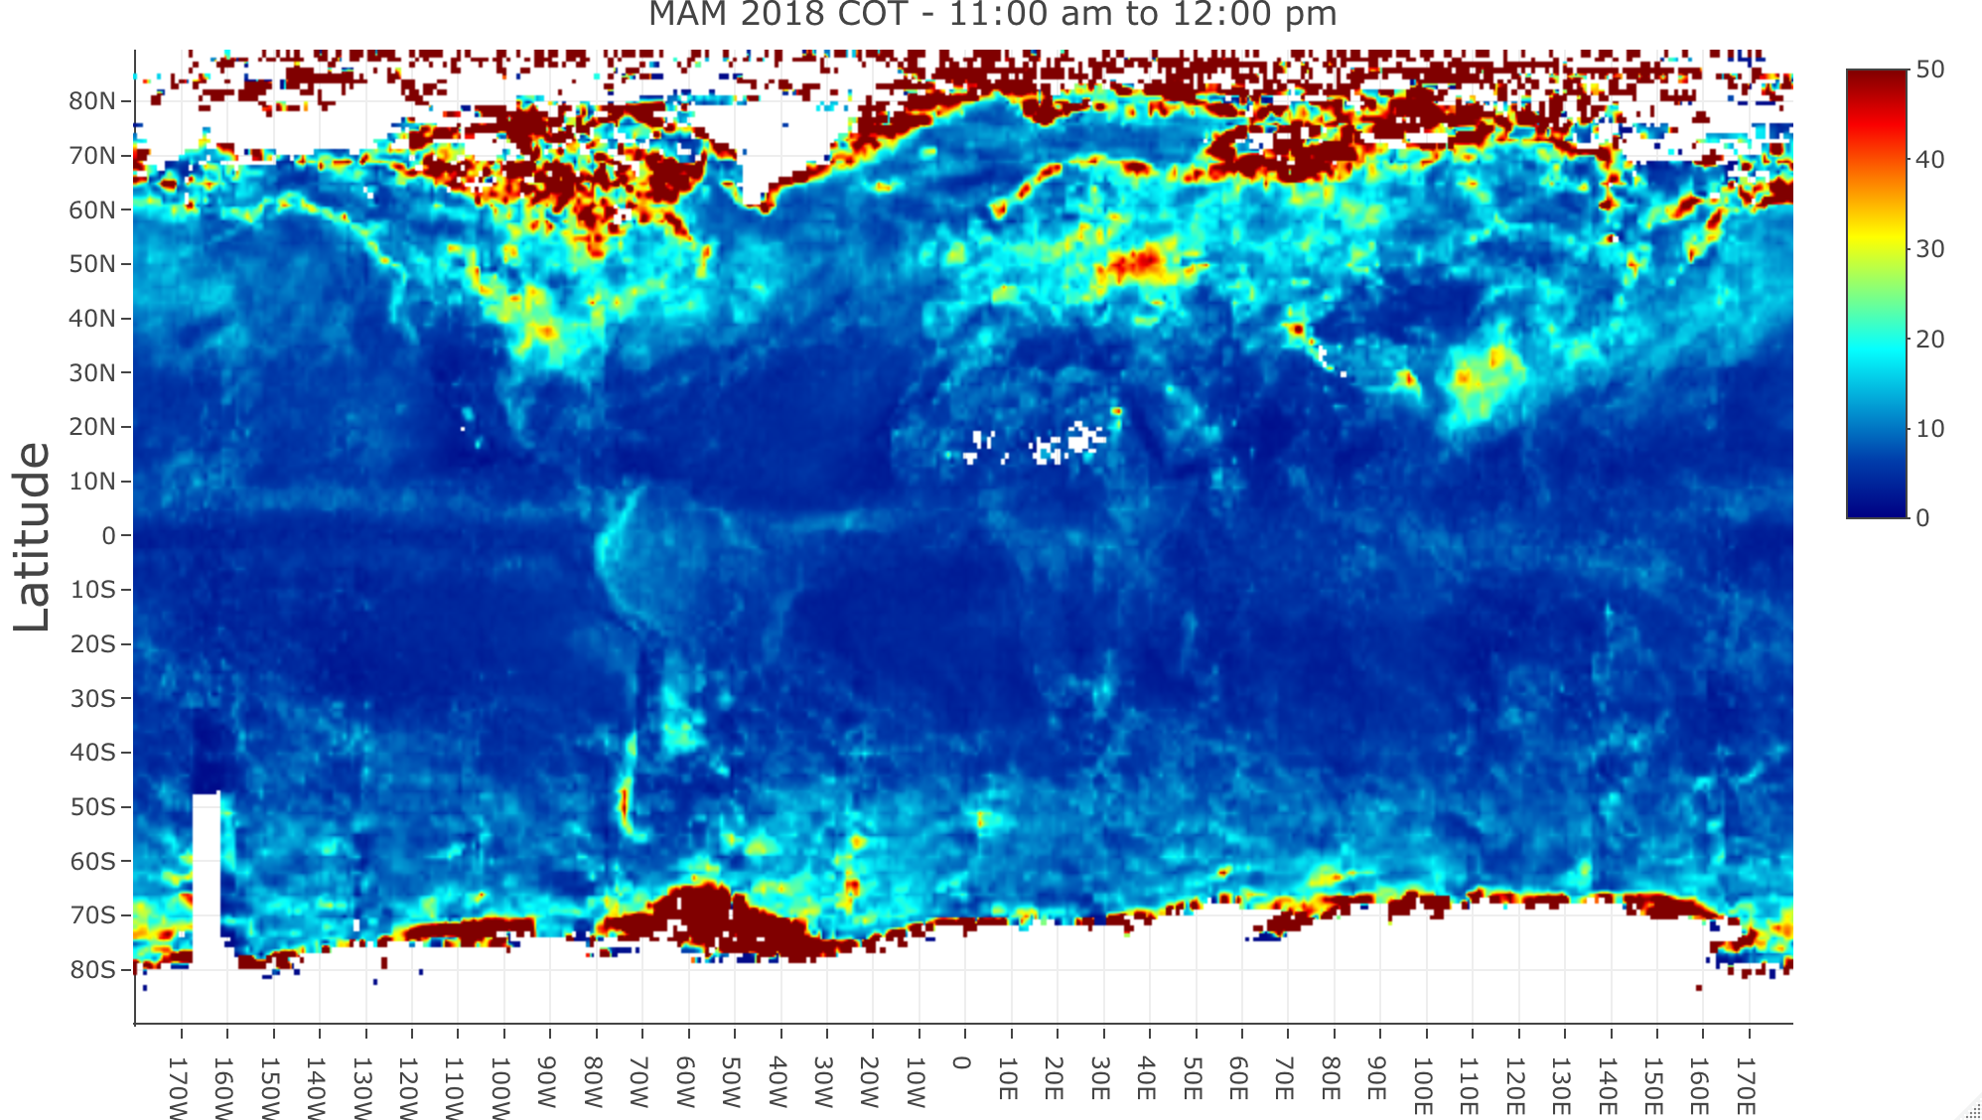
Liquid clouds

Slide 11
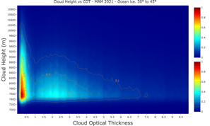
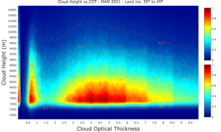
- Cloud Height vs COT
30° to 45°
Normalized histogram of pixel values of Cloud Height and COT
Latitudinal zones of 15 degrees
Distribution is always wider over land, and clouds are thicker over land
Liquid clouds: distribution spreads as we go north
Ice clouds: distribution is wider around equator
Ocean
Example for ICE clouds
30° to 45°
LAND

Slide 12
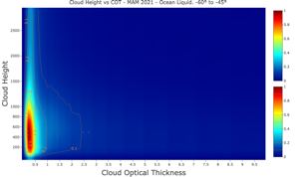
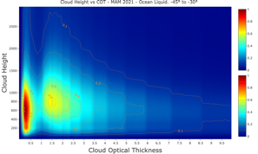
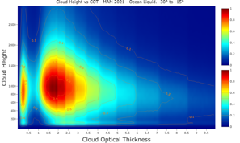
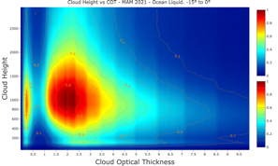
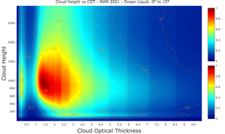
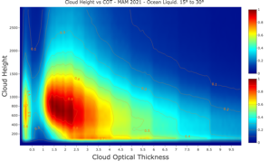
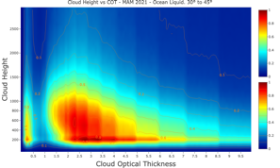
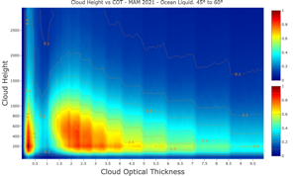
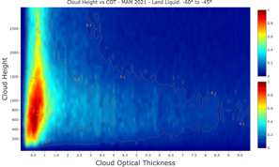
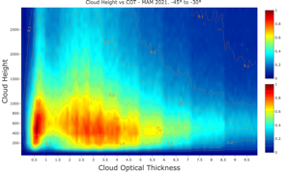
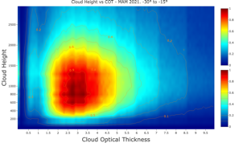
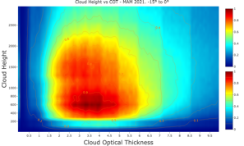
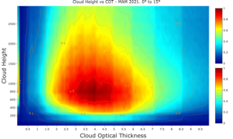
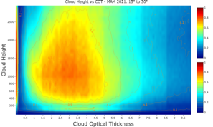
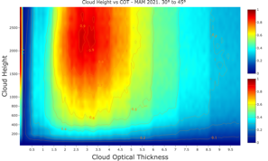
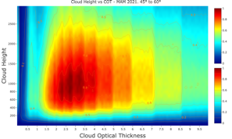
-60° to -45°
-45° to -30°
-30° to -15°
-15° to 0°
Ocean
0° to 15°
15° to 30°
30° to 45°
45° to 60°
Liquid clouds
-60° to -45°
-45° to -30°
-30° to -15°
-15° to 0°
LAND
30° to 45°
45° to 60°
0° to 15°
15° to 30°

Slide 13
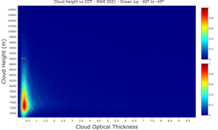
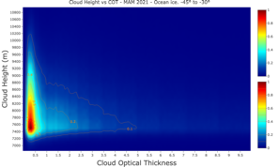
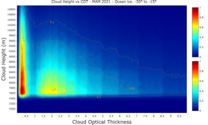
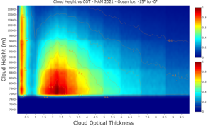
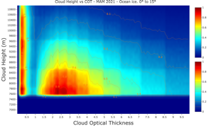
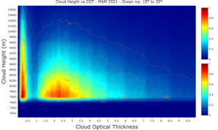
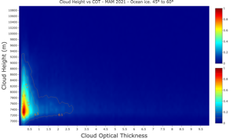
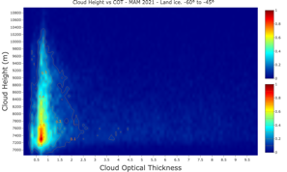
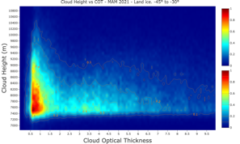
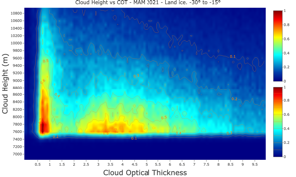
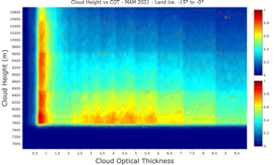
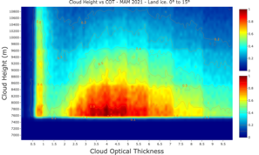
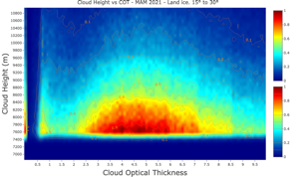
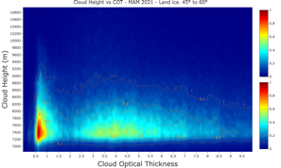
-60° to -45°
-45° to -30°
-30° to -15°
-15° to 0°
Ocean
0° to 15°
15° to 30°
30° to 45°
45° to 60°
ICE clouds
-60° to -45°
-45° to -30°
-30° to -15°
-15° to 0°
LAND
30° to 45°
45° to 60°
0° to 15°
15° to 30°

Slide 14
- Diurnal cycles
Mean:
Shows different diurnal cycles for cloud fraction, height and optical thickness
Optical thickness values are too high, affected by extreme values in higher and lower latitudes
Median:
Provides a more significant view
Also shows diurnal cycles but Optical Thickness values are more reasonable
When compared with MODIS, EPIC optical thickness values are too small

Slide 15
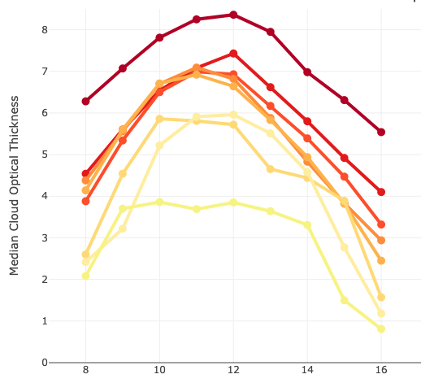
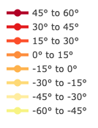
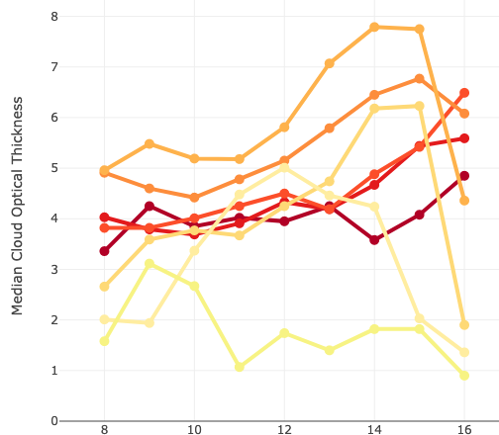
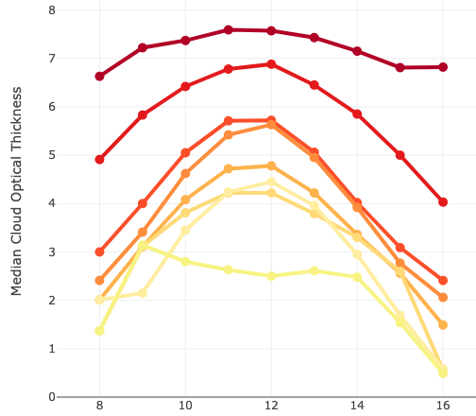
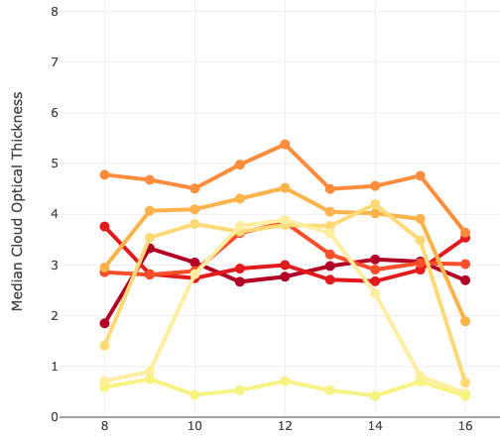
Optical Thickness
Median
Land liquid
Land Ice
Liquid
Concave vs daytime
Opt. thicker for higher latitudes for both land & ocean
Ice
Peaks afternoon for land but flat for ocean
Opt. thicker in tropics
Local Time
Local Time
Ocean liquid
Ocean Ice
Local Time
Local Time

Slide 16
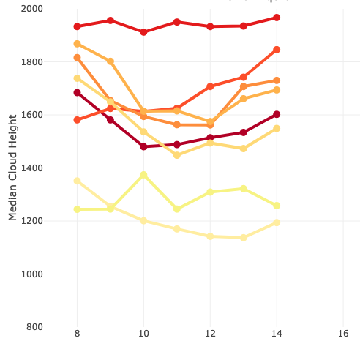
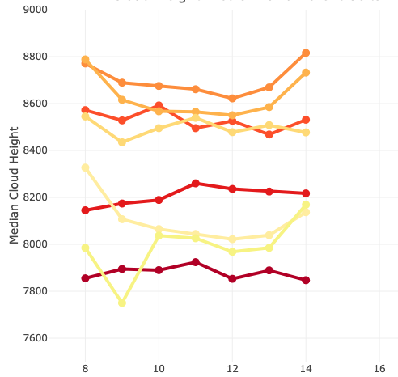
Cloud Height
Median
Land liquid
Land Ice
Liquid
Convex vs daytime for liquid
Clouds over land are higher than over ocean
Clouds are higher at high latitudes over land but at tropics over ocean
Ice
No changes vs daytime for clouds over land. The lowest at noon over ocean
Higher in tropics at the morning
Local Time
Local Time
Ocean liquid
Ocean Ice
Local Time
Local Time

Slide 17
Correlation between COT and Cloud Height
Land liquid
Land Ice
Strong differences in latitudinal zones
For each latitudinal zone, higher COT corresponds to lower cloud height
Ocean liquid
Ocean Ice

Slide 18
Conclusions
DSCOVR EPIC allows us to study daytime variability with a single sensor
Cloud properties evolve throughout the day (as well as aerosols and other physicochemical magnitudes)
Diurnal patterns are different over land and ocean, but also dependent on the latitudinal zones
COT:
Liquid: Higher COT around noon independently of the underlying surface. Higher at higher latitudes
Ice: Peaks in the afternoon over land and remains constant over ocean. Higher in the tropics

Slide 21
Liquid Land
Cloud Fraction
Cloud Height
Optical Thickness

Slide 22
Liquid Ocean
Cloud Fraction
Cloud Height
Optical Thickness

Slide 23
Land Ice
Cloud Fraction
Cloud Height
Optical Thickness

Slide 24
Ocean Ice
Cloud Fraction
Cloud Height
Optical Thickness

Slide 26
Liquid at 8:00 am

Slide 27
Liquid at 12:00 pm

Slide 28
Liquid at 4:00 pm

Slide 29
Ice at 8:00 am

Slide 30
Ice at 12:00 pm

Slide 31
Ice at 4:00 pm

