Slide 1
An investigation on seasonal and diurnal cycles of TOA shortwave radiation from DSCOVR/EPIC, CERES, MERRA-2 and ERA5
Young-Kwon Lim^{1,2}, Kyu-Myong Kim³, Dong Wu³ and Jae N. Lee^{3,4}
¹Universities Space Research Association,
²NASA GSFC / Global Modeling and Assimilation Office (GMAO),
³NASA GSFC / Climate and Radiation Laboratory,
⁴University of Maryland, Baltimore County

Slide 2
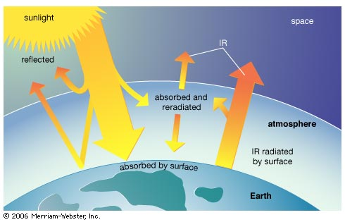
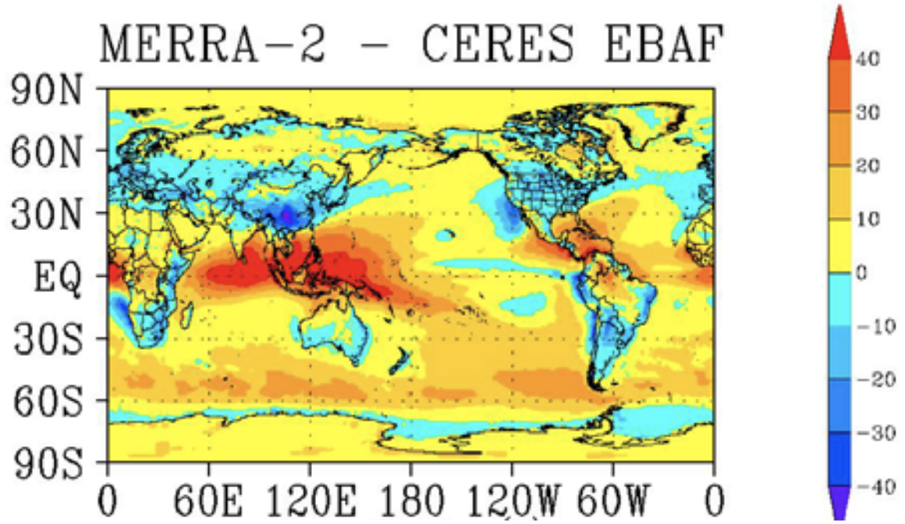
Introduction
Absorption and reflection of solar radiation are key factors in determining the Earth’s energy budget. It is important to identify how accurately they are represented currently in the observations and reanalysis models.
CERES SW flux has uncertainties that can be caused by changes in accompanying imager and errors in cloud properties (Hinkelman and Marchand 2020; Su et al. 2020), aerosol optical depths (Su et al. 2021), and limited number of daytime measurements.
MERRA-2 reduced the bias of the net TOA radiative energy through improvement in OLR, but little improvement was made for the reflected SW energy due to overestimation of SW cloud forcing → more global-mean energy leaving the Earth than observed (Bosilovich et al. 2015).
ERA5 still shows underestimated annual mean TOA net radiation and net energy loss of the atmosphere, although the global mean energy budgets are improved over ERA-Interim (Hersbach et al. 2020).

Slide 3
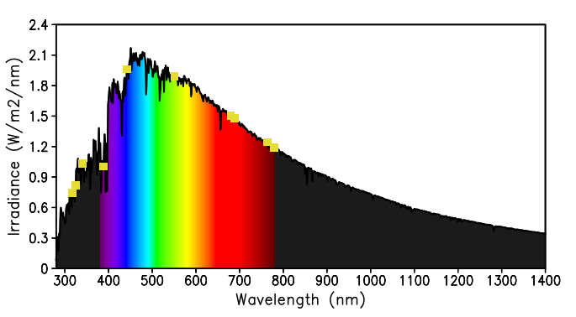
DSCOVR EPIC SW radiances
In this study, we utilize the observed SW radiances from DSCOVR EPIC to quantify the spatial and temporal (seasonal and diurnal cycle time scale) variations of the SW radiances estimated from CERES, MERRA-2, and ERA5.
Spectral solar irradiance at TOA as a function of wavelength. Yellow rectangles indicate the wavelength of the peak spectral response functions in each ten EPIC channels.

Slide 4
Construction of broadband DSCOVR EPIC SW radiances from ten channels
The EPIC measures the Earth’s radiances in 10 spectral narrowband channels. We construct the broadband SW radiances by regression using 10 channels.
$$I_{sw}(i)=r_{0}+r_{1}{EI}_{1}(i)+r_{2}{EI}_{2}(i)+r_{3}{EI}_{3}(i)+…+r_{10}{EI}_{10}(i)$$
where $r_{0}$is the interception and $r_{1}… r_{10}$ are regression coefficients from EPIC radiances for each channel. Predictor: EPIC from individual 10 channels, Predictand ($I_{sw}(i)$): radiance from CERES, MERRA-2, or ERA5
Note: The radiances from three channels could well represent the CERES SW flux and its variabilities (e.g., Su et al. 2020). But we use the entire 10 channels for regression in this study.
Fitting with smaller residual (regression error) indicates a more consistent spatial distribution between EPIC and predictand dataset. Difference (regression error) between EPIC and CERES may be viewed as the observation uncertainty, whereas the differences between EPIC and MERRA-2/ERA5 may be considered as the observation-model differences.

Slide 5
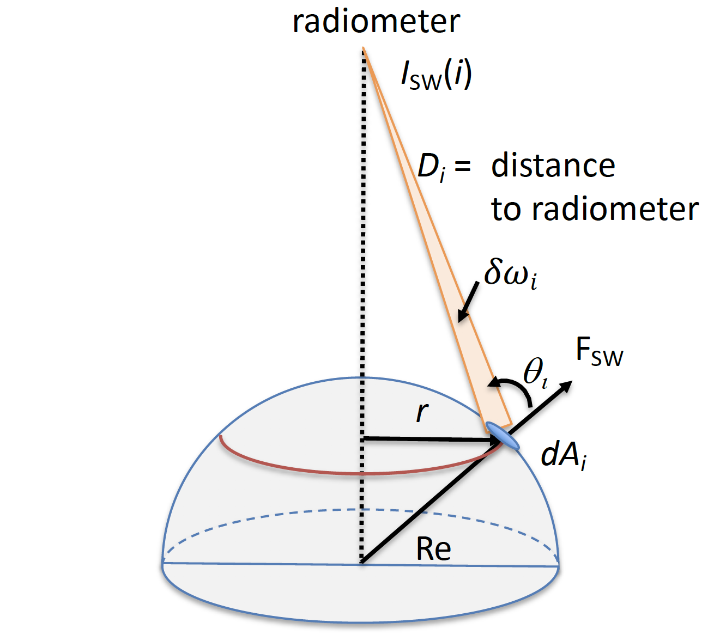
Conversion of the SW flux (CERES, MERRA-2, ERA5) to Earth’s radiance
(DSCOVR EPIC)
Assuming the Lambertian reflection for Earth’s surfaces and clouds, the radiance observed by a radiometer (I_{sw})at the L-1 point (e.g., DSCOVR) is given by
$$I_{sw}\left(i\right)={\frac{F_{sw}\left(i\right)}{π}}_{ }cosθ_{i}δω_{i}$$
$$δω_{i}=\frac{dA_{i}cosθ_{i}}{D_{i}^{2}}$$
dAi : area of radiation on Earth to radiometer,
$δω_{i}$: solid angle of dA_{i} to radiometer,
Θ : angle between radiometer and Earth’s surface normal, F_{sw} (i) : TOA upward SW flux at location (i),
I_{sw} (i) : Earth’s broadband radiance at location (i), [W/m²/sr]
D_{i} : distance of dA_{i} to radiometer (DSCOVR EPIC)
Diagram that illustrates how the radiance (I_{sw} (i)) is related to the upward flux (F_{sw} (i)).

Slide 6
Earth’s radiance to irradiance
While Earth’s radiances at each location (i) provide horizontal distribution, one needs to integrate all the radiances at each location (i) over the globe to obtain the Earth irradiance. [W m⁻²]
$I_{sw}=\sum_{i}{\frac{F_{sw}(i)}{πD_{i}^{2}}}cos^{2}θ_{i}dA_{i}$
After conversion of the upward SW fluxes from CERES and reanalyses to the TOA radiances, we estimate the broadband EPIC’s radiance by regression described earlier.

Slide 7
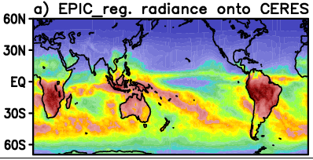
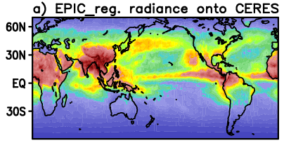
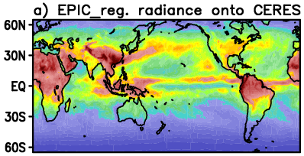
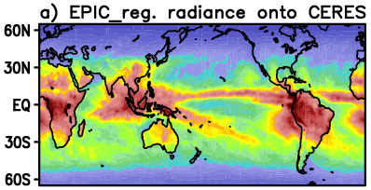
Broadband EPIC SW radiances by regression onto CERES radiance (2017)
DJF
JJA
MAM
SON
10⁻⁸ W/m²/Sr
Seasonal change in the reflected SW radiance is produced. From the residuals between target field (CERES) and regressed field (EPIC), we assess the consistency of CERES in representing the spatial distribution of the TOA EPIC radiances. Error examination in the next slide.

Slide 8
Distributions of radiance differences (DJF, 2017)
The differences between CERES and regressed EPIC are apparently smaller than the case for “MERRA-2 vs. EPIC” and “ERA5 vs. EPIC”. For MERRA-2 and ERA5, the positive differences are prevalent over SH including the SPCZ and the maximum rainfall regions over land.
Quantitatively, the spatial average of the absolute values of differences between CERES and EPIC over 0°−360°E and 50°S−0°, where the major distribution of radiances is seen, is 2.1% of the EPIC radiance. The results for MERRA-2 and ERA5 are found to be 9.7% and 7.4%.

Slide 9
Distributions of radiance differences (JJA, 2017)
The largest positive differences for MERRA-2, with respect to regressed EPIC, are found over the tropical western Pacific. MERRA-2 and ERA5 show opposite signs of differences over Himalaya/Tibetan Plateau and south of 45°S in SH. Across the Western Hemisphere, the largest magnitude of negative differences is present over the west of the US from both reanalyses.
The spatial average of the absolute values of differences (three products vs. EPIC) over 0°−360°E and 0°−50°N are, respectively, 2.6%, 15.5%, and 8.2% of the spatial average of the EPIC radiance. (Performance of three products is not better than winter)

Slide 10
Mean absolute values of differences (MAVD) in percentage
MAVD= Ʃ [abs (A – regressed EPIC) / regressed EPIC ]
A = radiance from CERES, MERRA-2, or ERA5 at each location
 | DJF (0-360, 50S-0) | MAM (0-360, 15S-50N) | JJA (0-360, 0-50N) | SON (0-360, 50S-30N)
CERES | 2.1 | 2.4 | 2.6 | 2.5
MERRA-2 | 9.7 | 11.6 | 15.5 | 13.3
ERA5 | 7.4 | 7.8 | 8.2 | 8.1
MAVD between CERES and EPIC are 2-3% in four seasons. Reanalyses have the differences in the range of 7-15%, with respect to EPIC, with the maximum in boreal summer. MERRA-2 shows larger differences than ERA5.

Slide 11
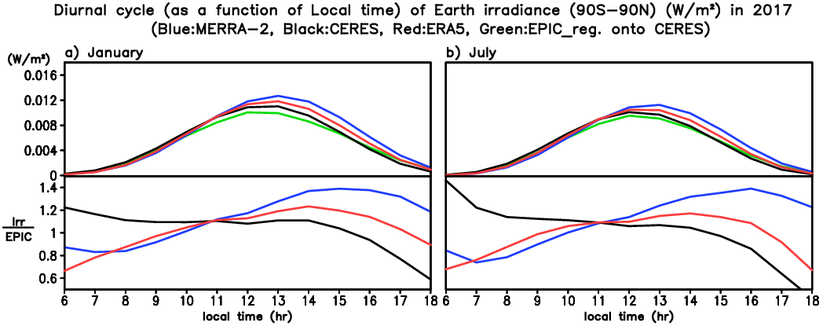
Diurnal cycle of Earth’s irradiance from EPIC, CERES, MERRA-2, and ERA5
January
July
CERES: black, MERRA-2: blue,
ERA5: red, EPIC: green
X-axis: local time,
y-axis: Irradiance (upper panel), ratio (lower panel): irradiance from CERES and reanalyses to the EPIC irradiance
CERES is quite close to EPIC, but two reanalyses lag the maximum peak by an hour. The exaggeration of diurnal amplitude lasts through afternoon: ratio > 1 in the afternoon more clearly for MERRA-2 (lower panel).
The ratio increases with time for reanalyses while it decreases with time for CERES. The ratio from CERES is closer to 1 from ~10am through 2pm, possibly due to two CERES measurements that occur at 10:30am and 1:30pm local time every day. Consistency of CERES irradiance with EPIC is relatively low beyond this 10am-2pm time range.

Slide 12
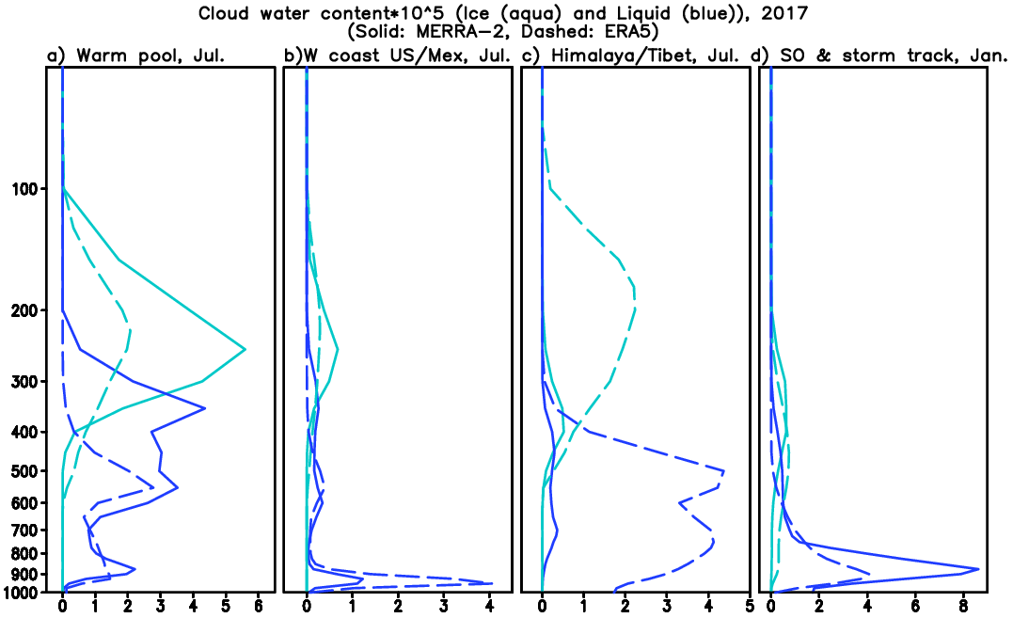
Vertical structure of ice/liquid water contents from reanalyses
Unit:10⁻² g kg⁻¹
Solid: MERRA-2, Dashed: ERA5,
Ice water: aqua, liquid water: blue
Tropical W Pacific: MERRA-2 > ERA5
Off the W coast of US/Mexico: MERRA-2 < ERA5 at lower troposphere
Himalaya/Tibetan Plateau: MERRA-2 << ERA5
Sothern Ocean and SH storm track: MERRA-2 > ERA5 at lower troposphere
These relative differences in water contents between two reanalyses are consistent with the pattern of their radiance errors, in terms of sign, in those four regions.
Tropical W Pacific
W coast of US/Mexico
Himalaya / Tibetan
SO & SH storm track

Slide 13
Conclusions
As the independent two observations (CERES vs. DSCOVR EPIC), the reflected SW radiances in each season from CERES matches well with the broadband DSCOVR EPIC radiances, with 2-3% mean absolute error over the tropical-midlatitudes.
Comparison between reanalyses and DSCOVR EPIC reveals that the SW radiance error in reanalyses is largest in boreal summer (smallest in winter). Relatively poor performance over the tropical western Pacific and low-cloud region over off the W coast of US in summer is responsible for that larger error.
Vertical structure of ice/liquid water contents needed for cloud formation explain well the SW radiance errors in reanalyses, emphasizing the cloud problem in reanalyses.
Comparison of the diurnal cycle (as a function of local time) of Earth irradiance from CERES, MERRA-2 and ERA5 with that from EPIC demonstrates that the irradiance from CERES is nearly identical to EPIC from ~10AM through ~2PM, when the CERES measurements (10:30AM and 1:30PM) occur, but the ratio of CERES to EPIC is larger than 1 in the early morning and smaller in the late afternoon, while the opposite is true for reanalyses.

