Slide 1
Identification and Analysis of Southern Ocean Cyclones with DSCOVR-EPIC Observations
Joy Song, Montgomery Blair High School
Dr. Yuekui Yang, Code 613
Thanks to the NASA Internship Program

Slide 2
Introduction and Background

Slide 3
Goals
Use DSCOVR-EPIC images to identify summertime Southern Ocean cyclones (below 30 degrees south), which are important components of the Earth’s climate system.
Visually inspect 3 months (Dec. 2020, Jan. and Feb. 2021) of EPIC images, label each identified cyclone, and save the center geolocation and pressure.
Conduct statistical analysis of the cyclone occurrence and strength.
Cyclone images will serve as the truth in a cyclone identification machine learning model under development.

Slide 4
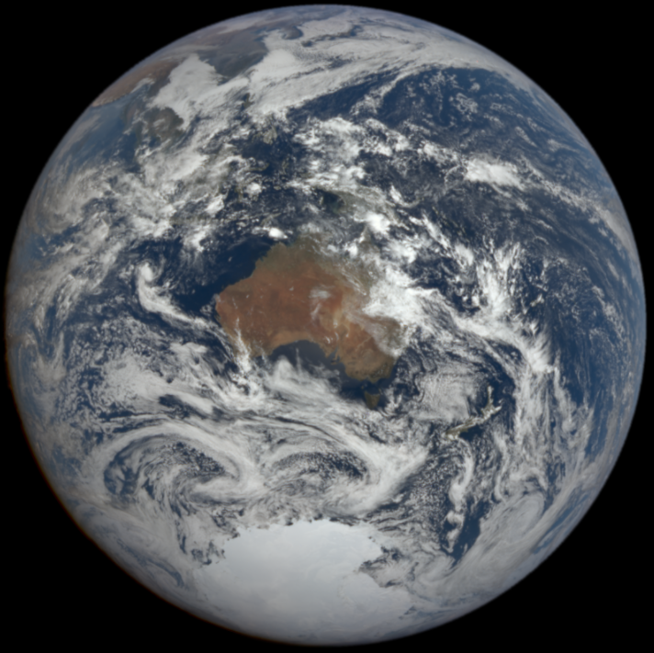
Identification of a Cyclone
Cyclonic cloud system visible on an EPIC image.
Rotation center is the center of the cyclone.
MERRA-2 sea surface pressure maps are used for comparison/corroboration purposes.
The cyclones identified on an EPIC image usually correspond to a low-pressure system in the appropriate MERRA-2 map.

Slide 5
Merra-2 Model – Sea Level Pressure

Slide 6
Methods

Slide 7
Tracking a Cyclone
Saving/Tracking Cyclone
Locating Cyclones
Name and number cyclone
Giovanni – Merra-2 Model
DSCOVR: EPIC satellite images
Retrieving Cyclone Information
Indicate center and region on map for each cyclone
Call program to retrieve Sea level pressures

Slide 8
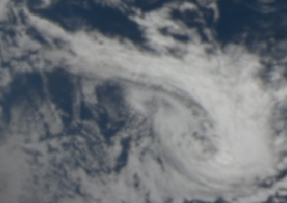
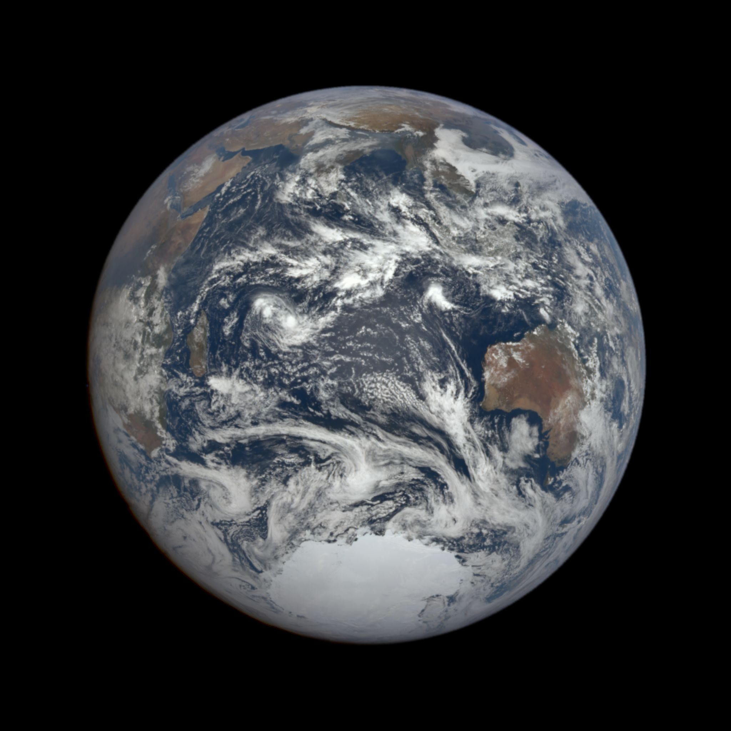
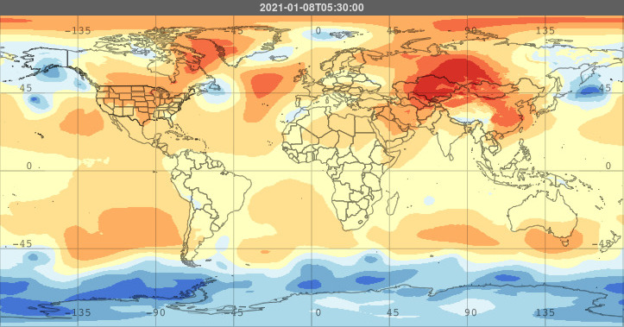
1/8/2021 5:51

Slide 9
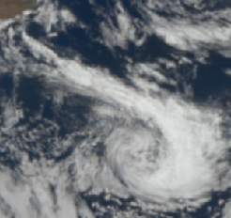
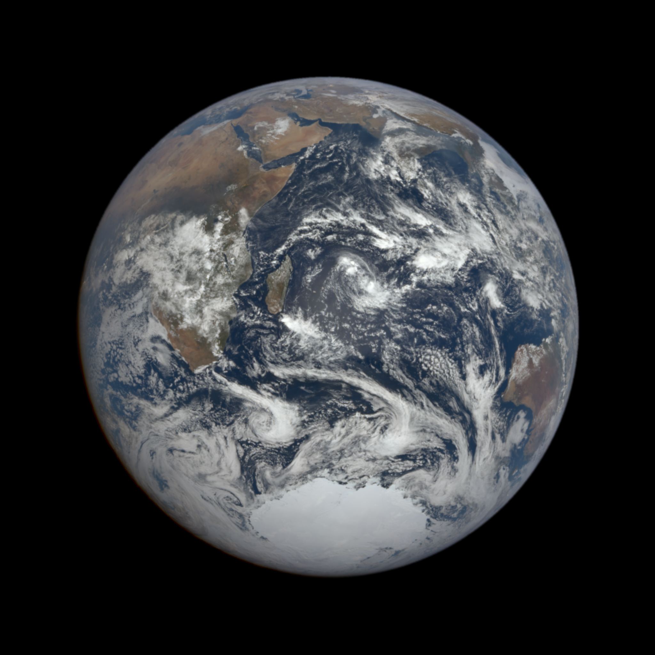
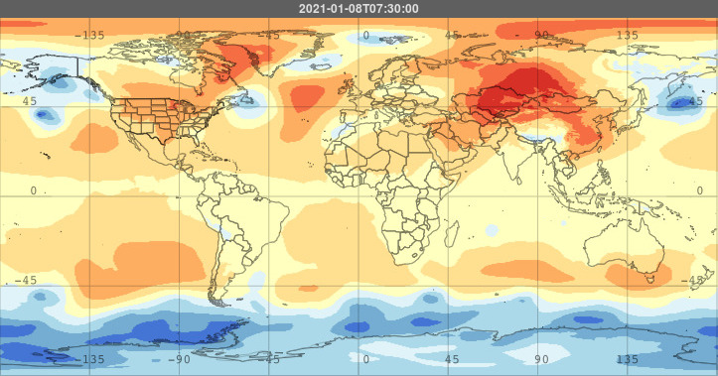
1/8/2021 7:39

Slide 10
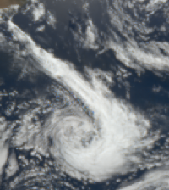
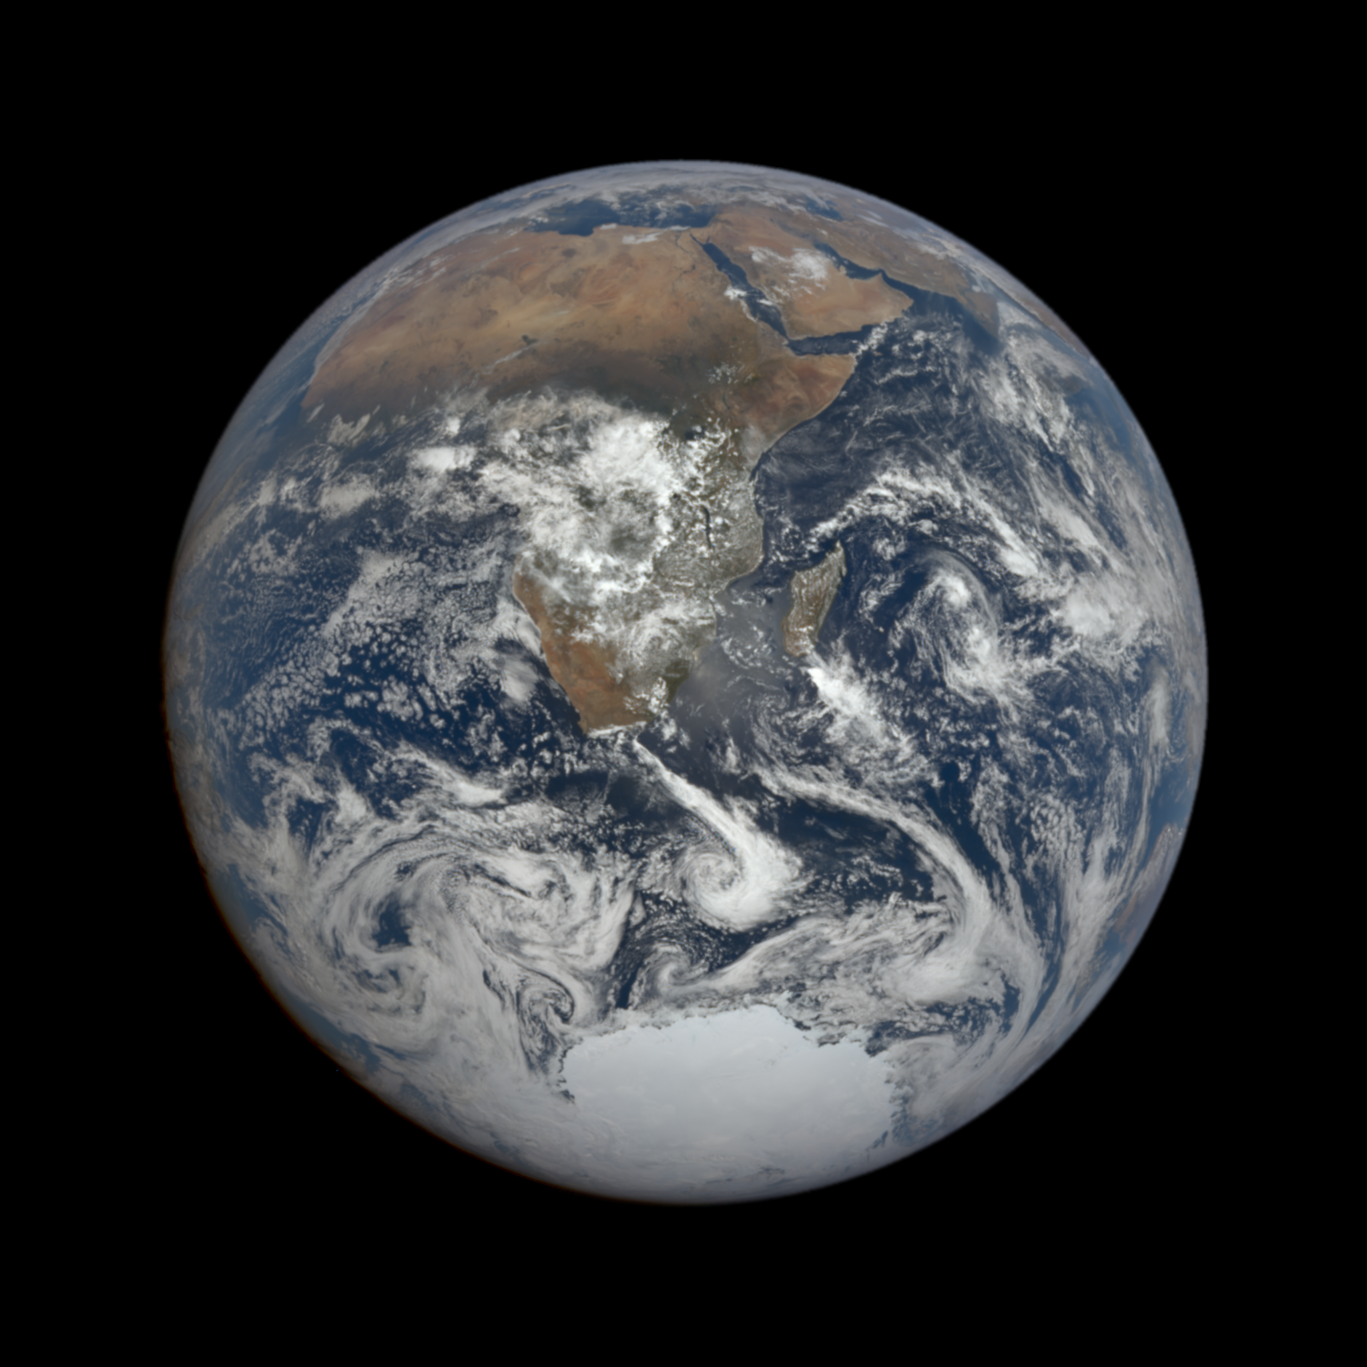
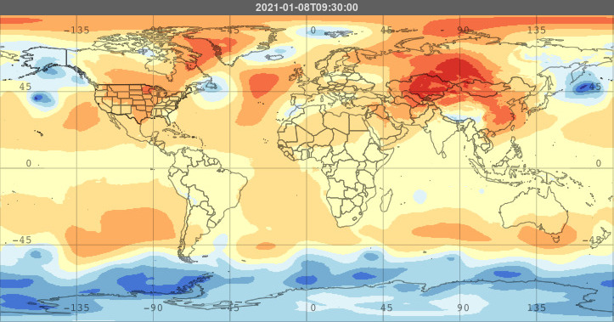
1/8/2021 9:27

Slide 11
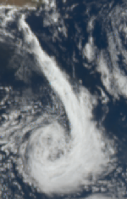
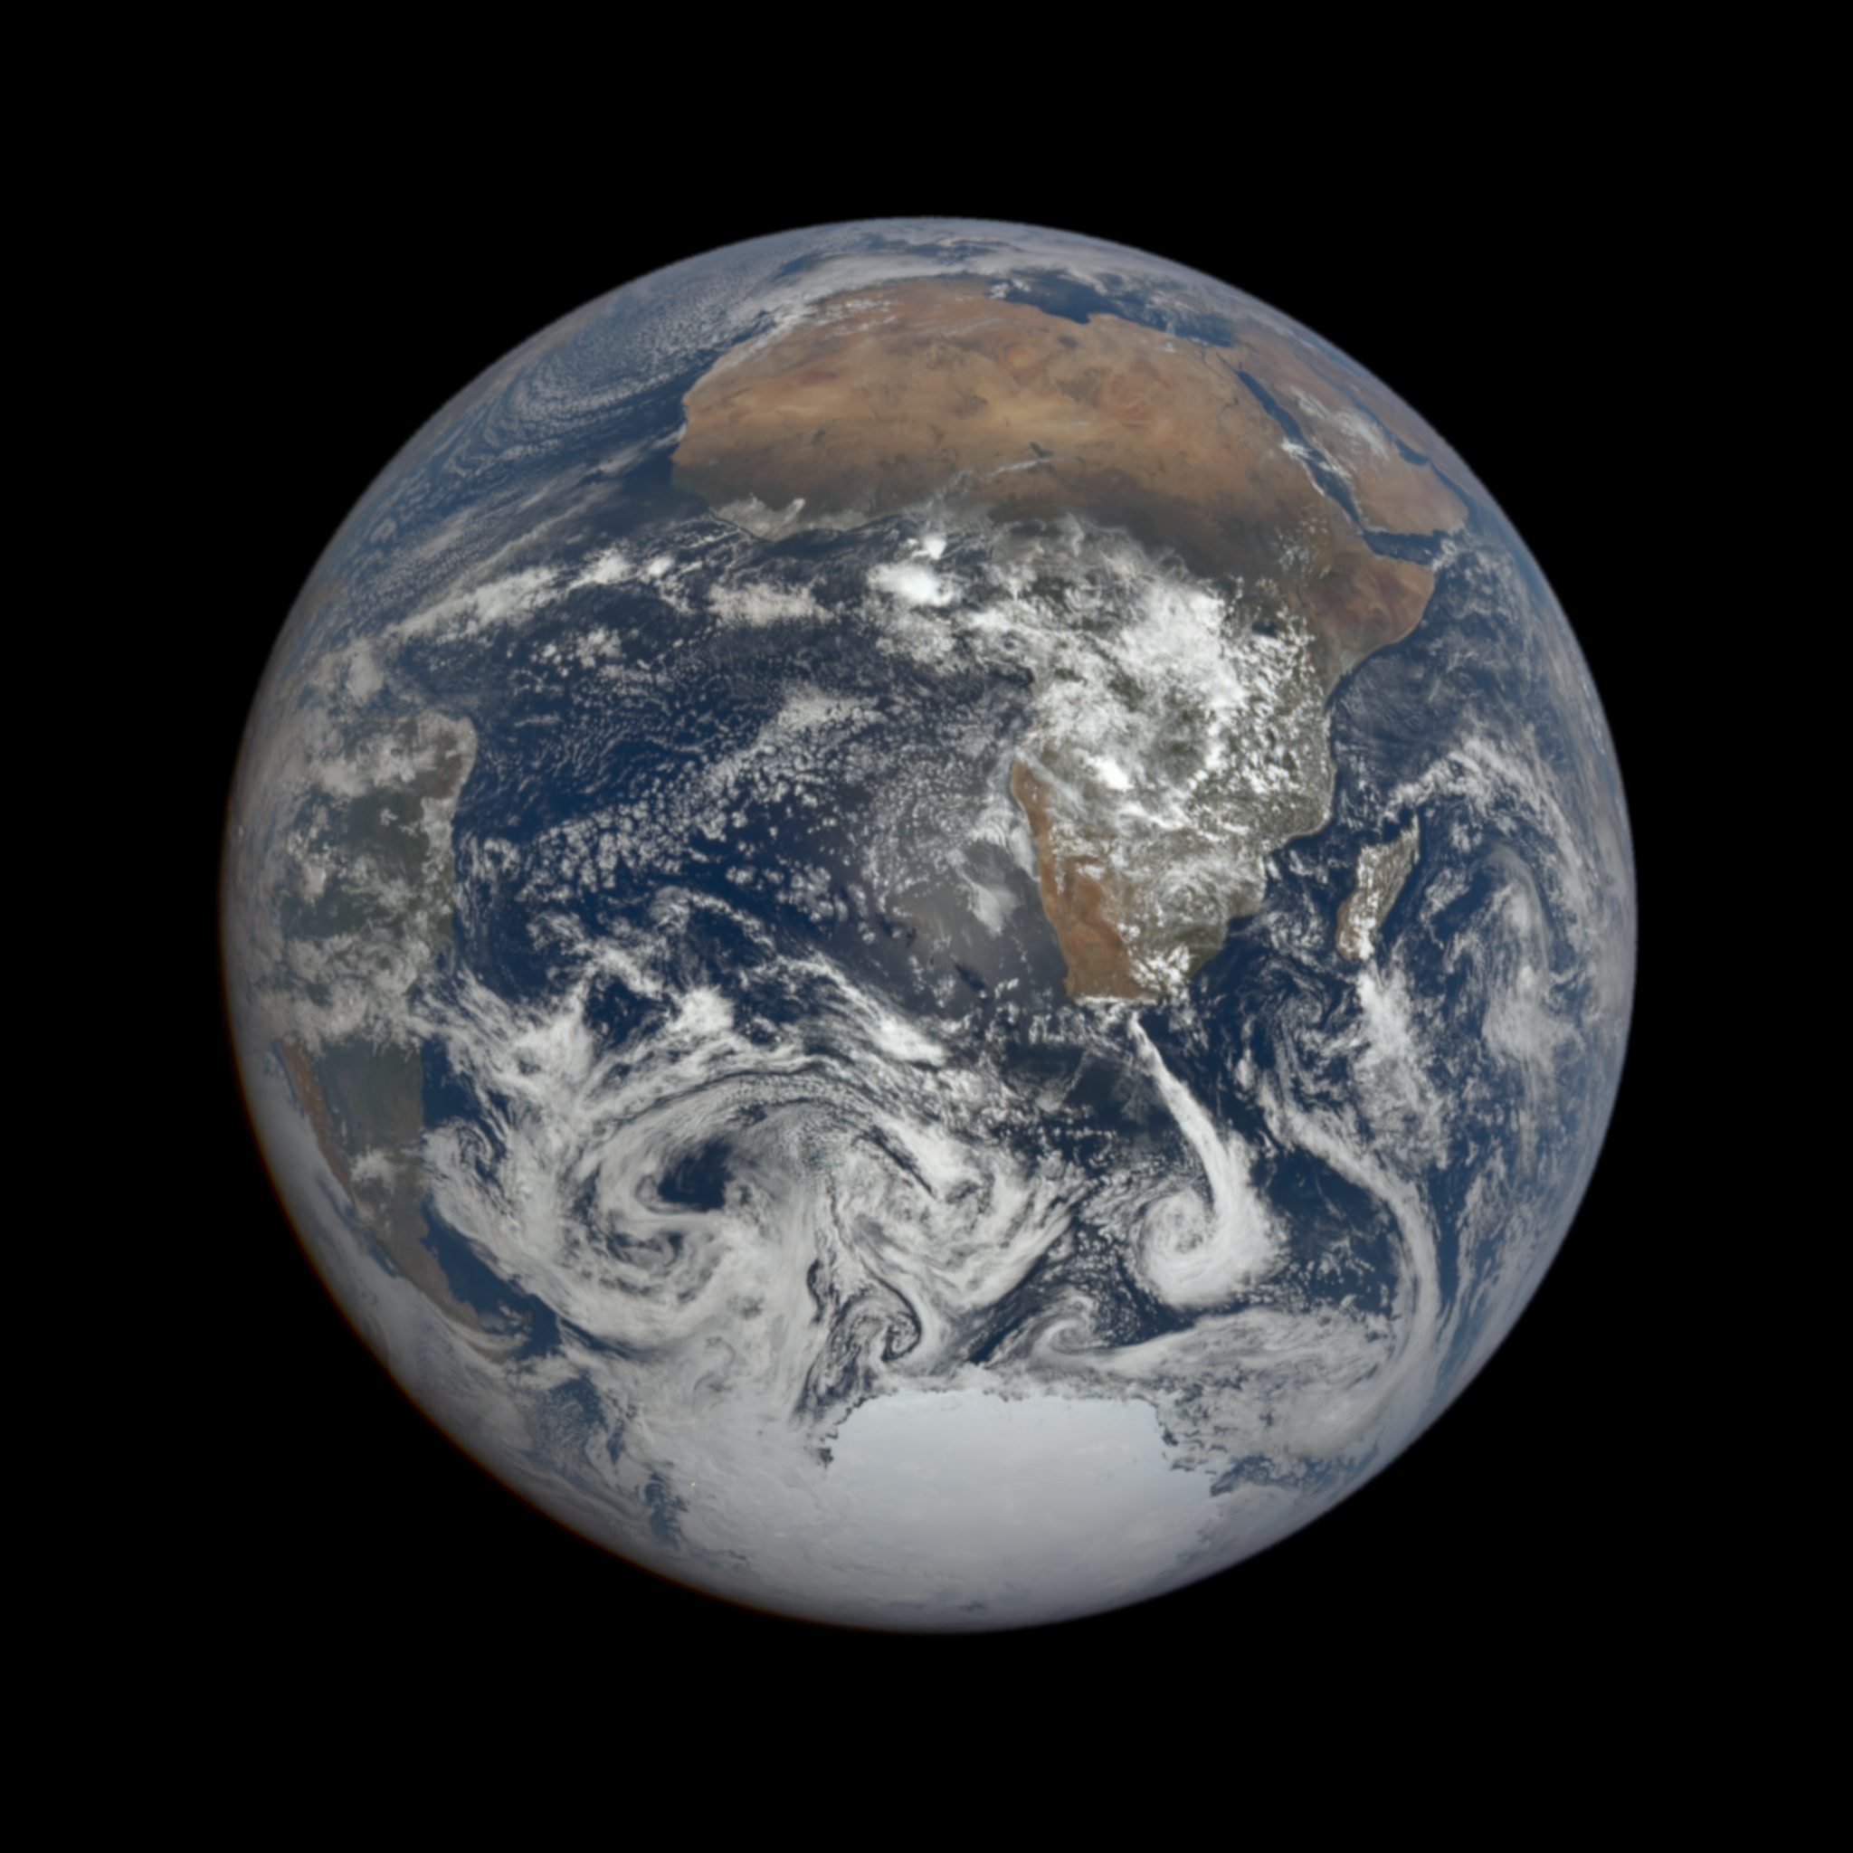
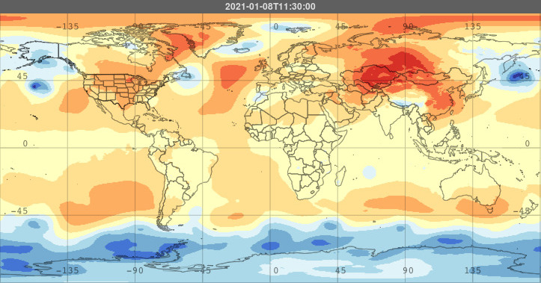
1/8/2021 11:15

Slide 12
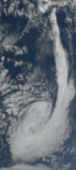
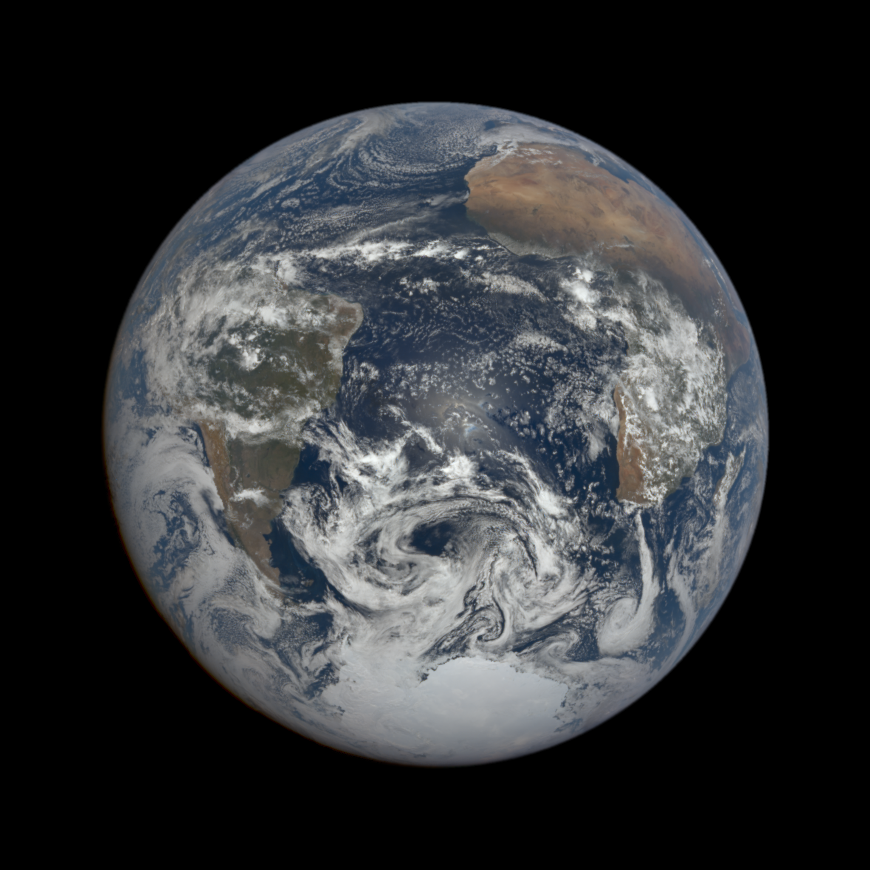
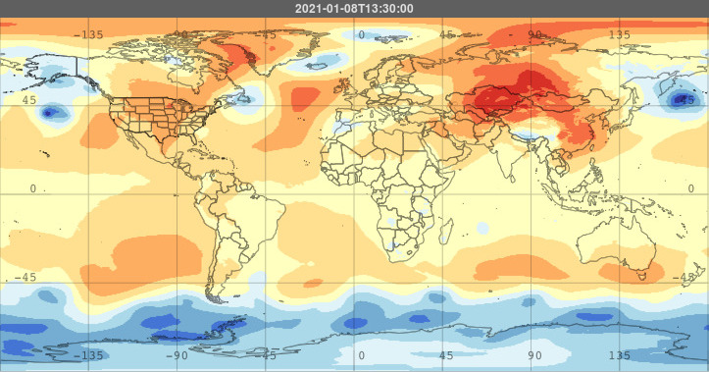
1/8/2021 13:03

Slide 13
Tracking a Cyclone
7:39
11:15
5:51
9:27
13:03

Slide 14
Results

Slide 15
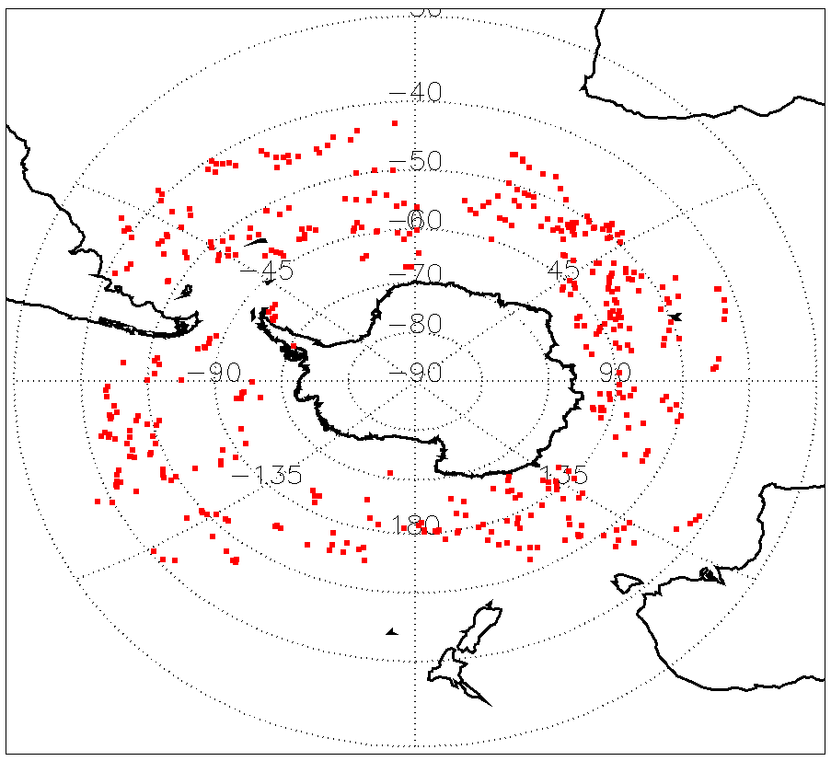
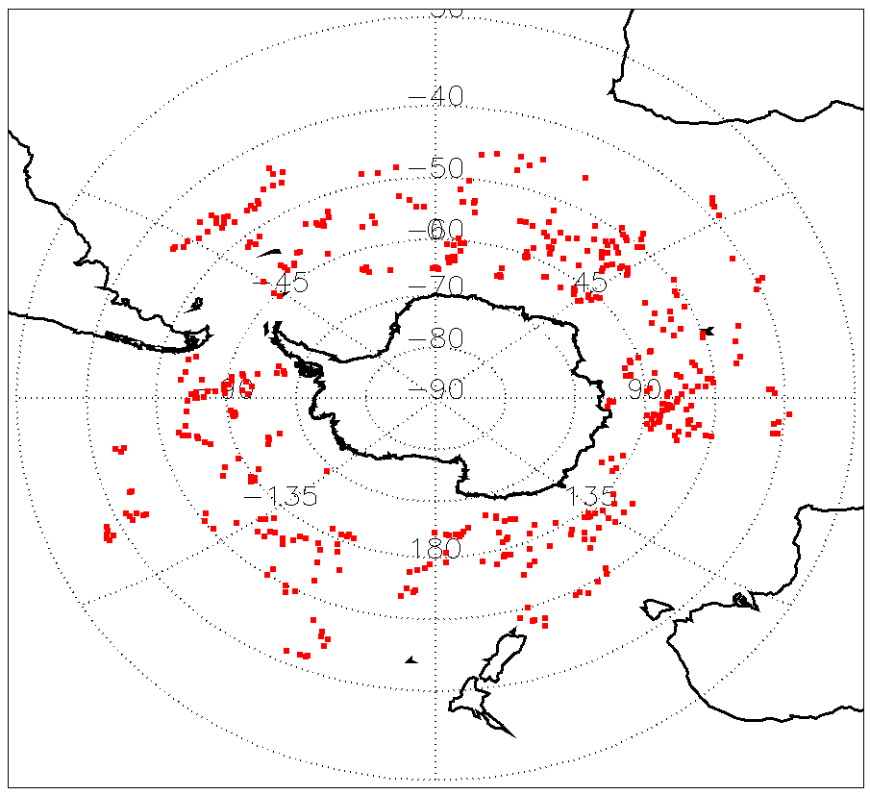
Cyclone Spatial Distribution Comparison
Dec. 2020; 443 points
Jan. 2021; 460 points
Feb. 2021; 409 points
Weddell Sea
Indian Ocean
Ross Sea
Western Pacific Ocean

Slide 16
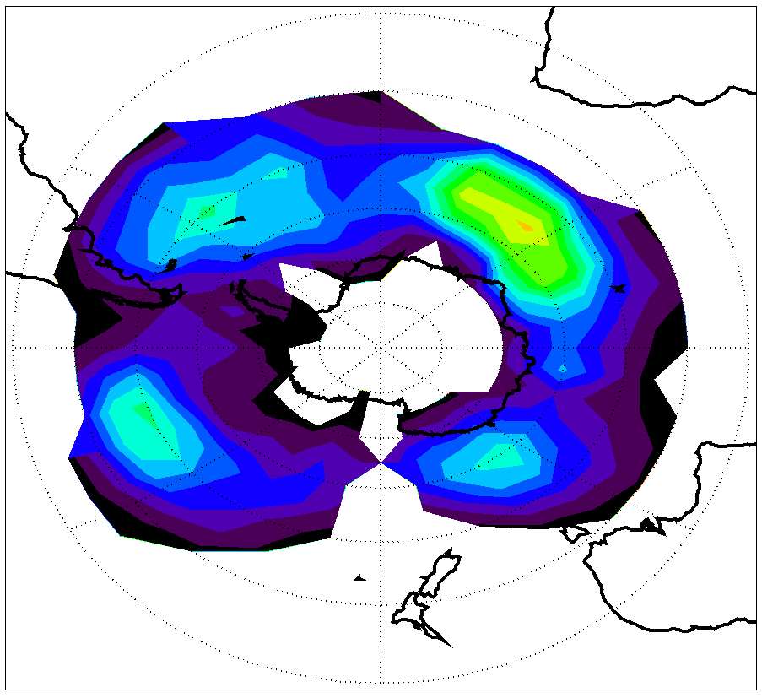
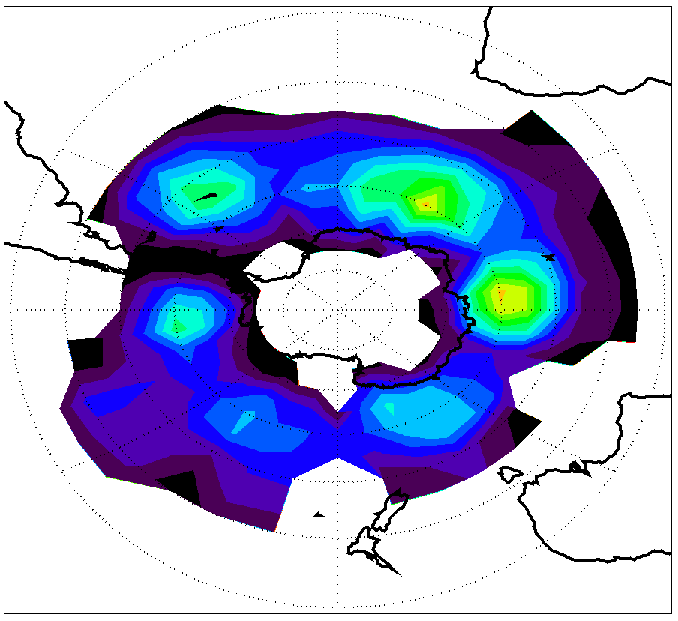
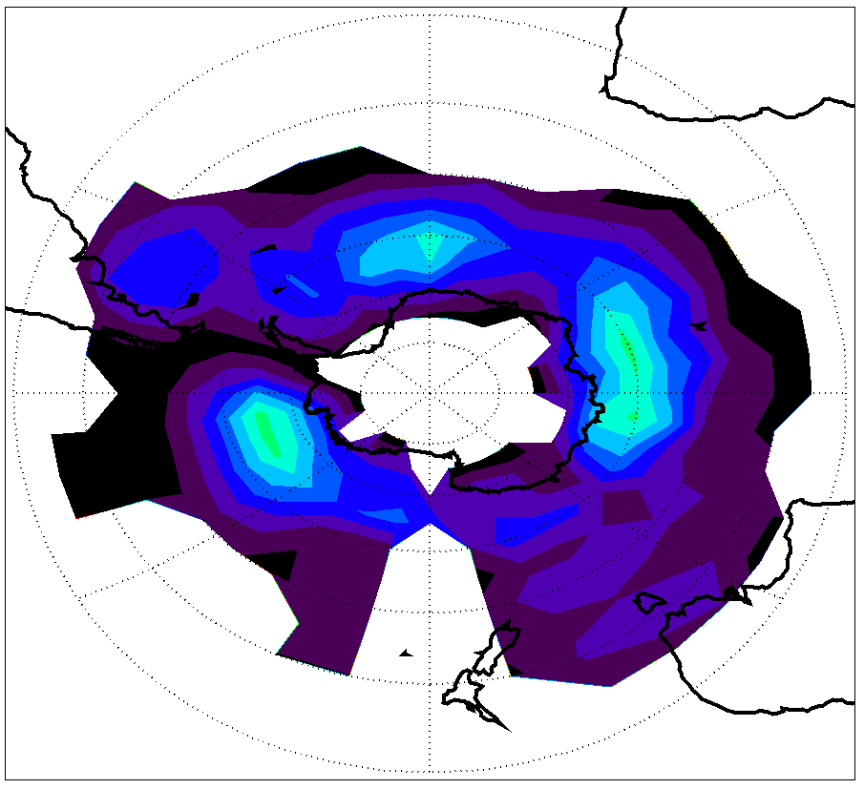
Cyclone Spatial Distribution Comparison
Dec. 2020; 443 points
Jan. 2021; 460 points
Feb. 2021; 409 points
Weddell Sea
Indian Ocean
Ross Sea
Western Pacific Ocean

Slide 17
Cyclone Center Pressure Distribution Comparison
Dec. 2020; 443 points
Jan. 2021; 460 points
Feb. 2021; 409 points

Slide 18
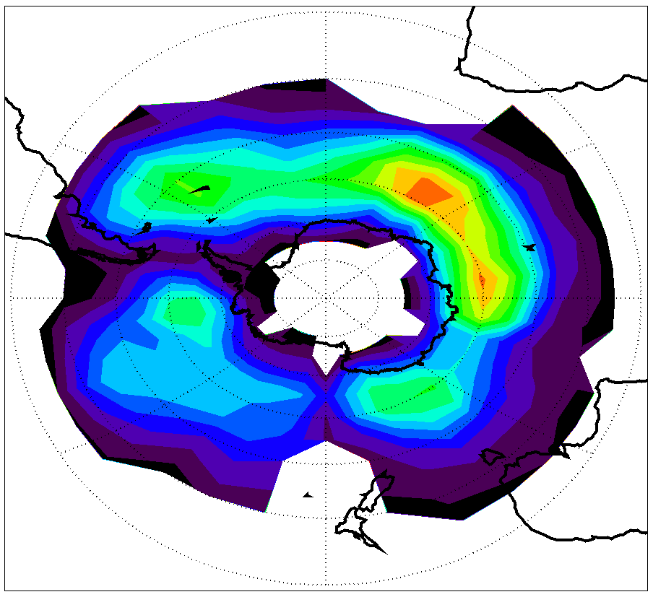
2020/12-2021/02: all summer; 1312 points
Weddell Sea
Indian Ocean
Ross Sea
Western Pacific Ocean

Slide 19
Discussions & Conclusions

Slide 20
Conclusions
Southern Ocean cyclones during a full summer season (Dec. 2020 to Feb. 2021) are identified and analyzed with DSCOVR-EPIC observations
Previous studies on Southern Ocean cyclones mostly used modeled or reanalysis data. EPIC provides a unique opportunity to study these large-scale weather systems with satellite observations.
Results show that the cyclone center pressures during this season range from 930 hPa to 1000 hPa, centered at around 970 hPa.
Most cyclones are distributed around the 60°S belt, and the highest cyclone density area is in the Indian Ocean sector.
Results consistent across three months and similar to previous conclusions from models.
Cyclone images will serve as the truth in a cyclone identification machine learning model under development.

Slide 21
Discussions
Limitations:
One summer vs. many years
Human error in data collection
Practical Applications:
Study changing weather systems
Future Research:
Expand timeline
Train Machine Learning algorithm

Slide 22
References
DSCOVR: EPIC (https://epic.gsfc.nasa.gov)
Giovanni Merra-2 Models (https://giovanni.gsfc.nasa.gov/)
(P). global scale circulation of the atmosphere. 7(p) Global Scale Circulation of the Atmosphere. (n.d.). http://www.physicalgeography.net/fundamentals/7p.html.
Neu, U., Akperov, M. G., Bellenbaum, N., Benestad, R., Blender, R., Caballero, R., Cocozza, A., Dacre, H. F., Feng, Y., Fraedrich, K., Grieger, J., Gulev, S., Hanley, J., Hewson, T., Inatsu, M., Keay, K., Kew, S. F., Kindem, I., Leckebusch, G. C., … Wernli, H. (2013). IMILAST: A community effort To INTERCOMPARE extratropical cyclone detection and tracking algorithms. Bulletin of the American Meteorological Society, 94(4), 529–547. https://doi.org/10.1175/bams-d-11-00154.1
Papritz, L., Pfahl, S., Rudeva, I., Simmonds, I., Sodemann, H., & Wernli, H. (2014). The role of extratropical cyclones and fronts for Southern Ocean Freshwater Fluxes. Journal of Climate, 27(16), 6205–6224. https://doi.org/10.1175/jcli-d-13-00409.1

