Slide 1


Update on
Vegetation Hot Spot Signatures from Synergy of EPIC/DSCOVR and EOS/SUOMI Sensors to Monitor Changes in Global Forests
R.B. Myneni, Y. Knyazikhin, Y. Sun and X. Ni
rmyneni@bu.edu
Department of Earth and Environment
Boston University, Boston, MA, USA
DSCOVR EPIC and NISTAR STM
Sep 28-30, 2021

Slide 2
Outline
Motivation and Objectives
Congolian Rainforests
  Seasonal variations
  Long-term trends
  Conclusions
Modeling Angular Signatures
  Model description
  Model assessment
  Model applications
  Conclusions
Status of Papers
2
DSCOVR EPIC and NISTAR STM
Sep 28-30, 2021

Slide 3
Motivation and Objectives
Tropical forests host significant biodiversity, provide habitat to animals, support to indigenous peoples, play a prominent role in the terrestrial carbon cycle and climate.
Our first study is focused on Congolian Forests with the goal of:
  Understanding the seasonal patterns of leaf area
  Whether there are any long-term trends in the same
Our second study is focused on modeling angular signatures of vegetation with the goal of:
  Understanding the physical mechanisms behind seasonal patterns of leaf area
3
DSCOVR EPIC and NISTAR STM
Sep 28-30, 2021

Slide 4
1. Update on our Congo Rainforests study
The following paper reporting results of our analyses has been submitted for publication to the journal “Remote Sensing of Environment”
  Sun, Y., Knyazikhin, Y., Myneni R. et al., Seasonal and long-term variations in leaf area of Congolese rainforest,
The article is in round two of reviews-revisions
Highlights from this article are briefly presented in the following slides
DSCOVR EPIC and NISTAR STM
Sep 28-30, 2021

Slide 5
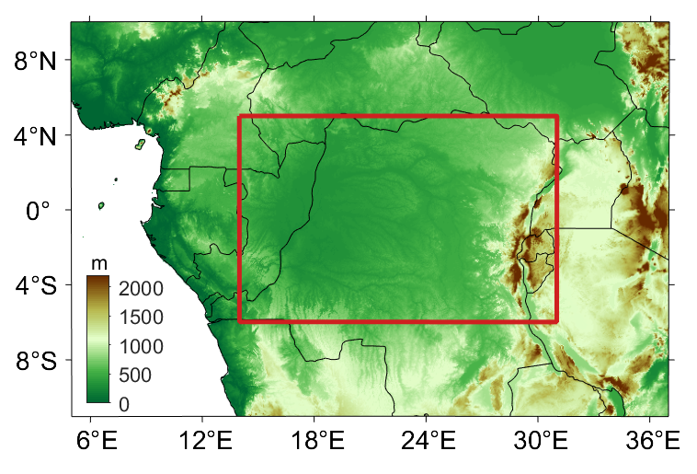
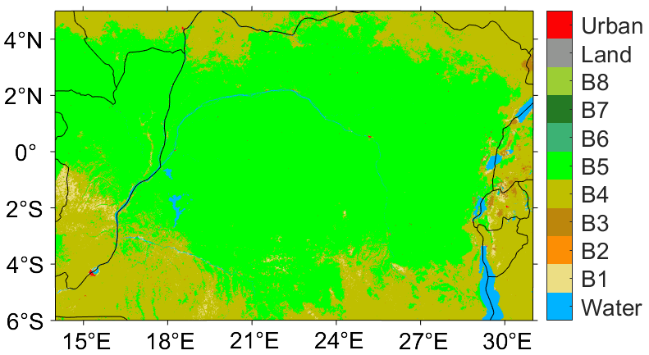
1.A. Update on our Congo Rainforests study
The forests cover southeastern Cameroon, Gabon, the Republic of Congo, the northern and central Democratic Republic of the Congo, and portions of southern and southwestern Central African Republic.
To the north, south, and southwest, the forests transition to drier forest-savanna mosaic
To the east, the forests transition to the highland Albertine Rift montane forests (the rift is a branch of the East African Rift system)
Second-largest tropical forest
Contains a quarter of the world's remaining tropical forest
Lowest deforestation rate of any major tropical forest zone
cf. Wikipedia
Landcover
DSCOVR EPIC and NISTAR STM
Sep 28-30, 2021

Slide 6
1.B. Bimodal Seasonal Cycle
Bimodal seasonality of LAI & precipitation
These generally overlap (i.e., large precipitation corresponds to large LAI)
DSCOVR EPIC and NISTAR STM
Sep 28-30, 2021

Slide 7
1.C. Seasonality confirmation with Angular Signatures
EPIC
MISR
MISR and EPIC NIR angular signatures are higher in wet season (more leaf area) than in dry season for all 3 regions.
DSCOVR EPIC and NISTAR STM
Sep 28-30, 2021

Slide 8
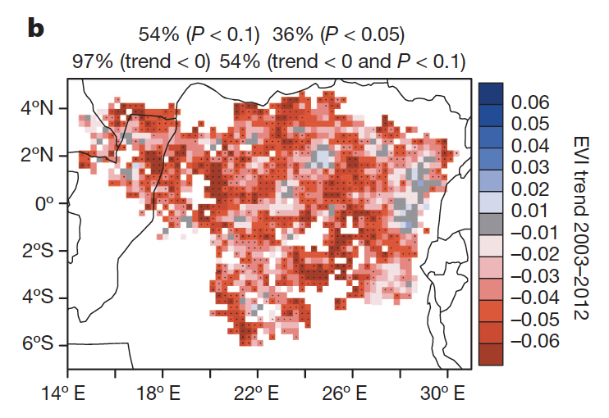
1.D. Long Term Decline?
MODIS EVI C5
2003-2012
Zhou et al., 2014
MODIS EVI C6
2000-2012
MODIS EVI C6
2000-2019
No widespread decline of leaf area is observed with MODIS C6
Remarkable difference exists between MODIS C5 and C6
Wet season (AMJ)
DSCOVR EPIC and NISTAR STM
Sep 28-30, 2021

Slide 9
1.E. Conclusions
Congolian Forests
Seasonal Variations
  Leaf area in Congolian forests exhibits bimodal seasonality
  Leaf area strongly linked to precipitation patterns (larger LAI in wet season)
  Bimodality gets stronger from N to S
    Seasonality of LAI in cycle 1 is mainly controlled by precipitation in regions 1 and 2, and controlled by radiation in region 3
    Seasonality of LAI in cycle 2 is controlled by both precipitation and radiation
Long Term Trends
  No long-term trends were observed in the latest version of multiple satellite products
DSCOVR EPIC and NISTAR STM
Sep 28-30, 2021

Slide 10
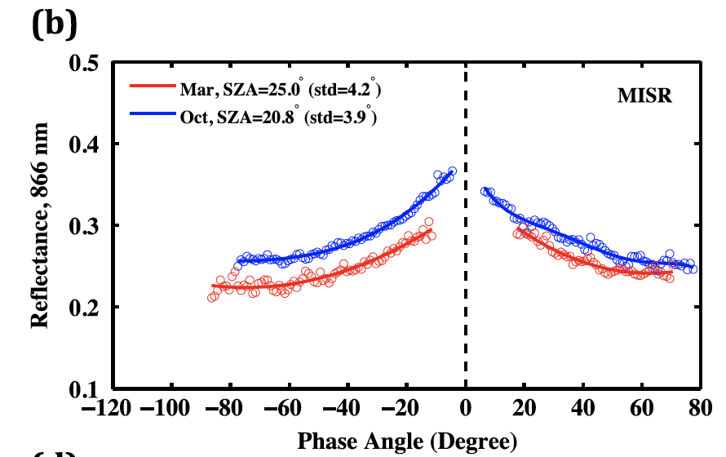
2. Angular Signatures
Powerful tools to argue for changes in vegetation structure underlying seasonal and long-term changes in leaf area
Require simultaneous, or near-simultaneous, multi-directional spectral reflectance measurements
Understanding the physics underlying these signatures helps unpack the embedded information content
Congolian Rainforests
Amazonian Rainforests
Transform of
Spectral BRFs
MISR+DSCOVR
Wet season
Dry season
Dry season
Wet season
Angle between solar
& View directions
Bi et al., ERL, 2015
DSCOVR EPIC and NISTAR STM
Sep 28-30, 2021

Slide 11
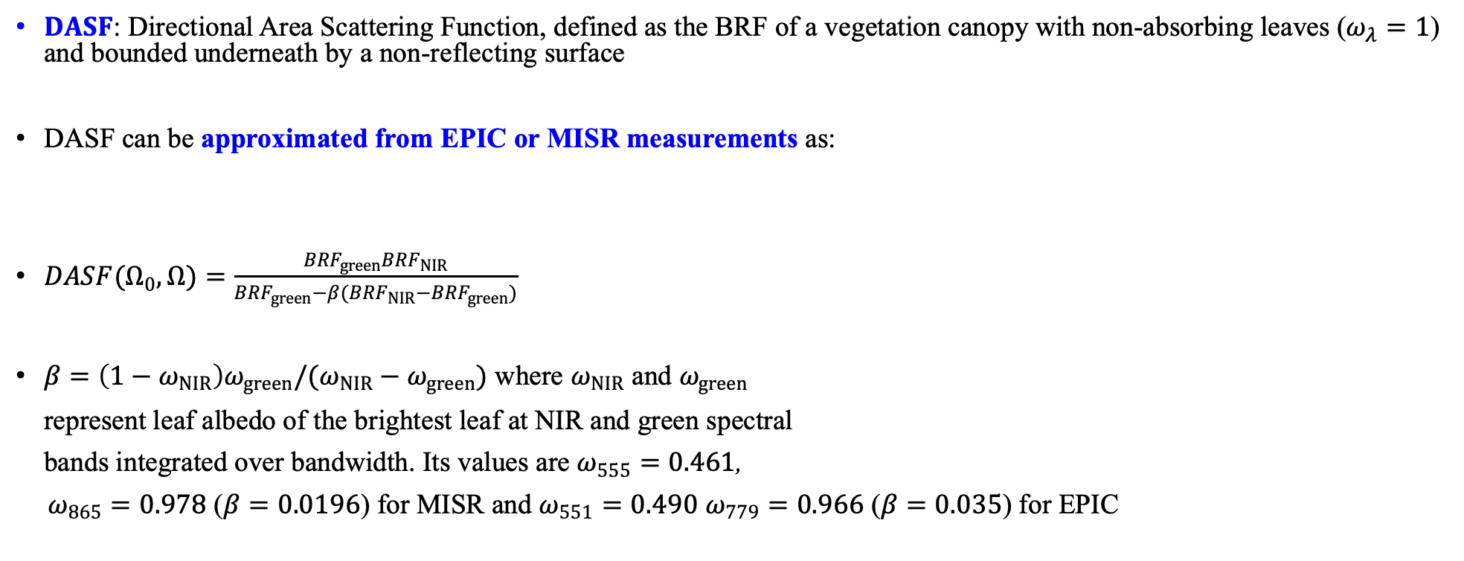
2.A. DASF from Measurements
$DASF$: Directional Area Scattering Function, defined as the BRF of a vegetation canopy with non-absorbing leaves ($ω_{λ}=1$) and bounded underneath by a non-reflecting surface
DASF can be approximated from EPIC or MISR measurements as:
$DASF(Ω_{0},Ω)=\frac{{BRF}_{green}{BRF}_{NIR}}{{BRF}_{green}−β({BRF}_{NIR}−{BRF}_{green})}$
$β=\left(1−ω_{NIR}\right)ω_{green}/(ω_{NIR}−ω_{green})$ where $ω_{NIR}$ and $ω_{green}$
represent leaf albedo of the brightest leaf at NIR and green spectral
bands integrated over bandwidth. Its values are $ω_{555}=0.461$,
$ω_{865}=0.978$ ($β=0.0196$) for MISR and $ω_{551}=0.490$ $ω_{779}=0.966$ ($β=0.035$) for EPIC
DSCOVR EPIC and NISTAR STM
Sep 28-30, 2021

Slide 12
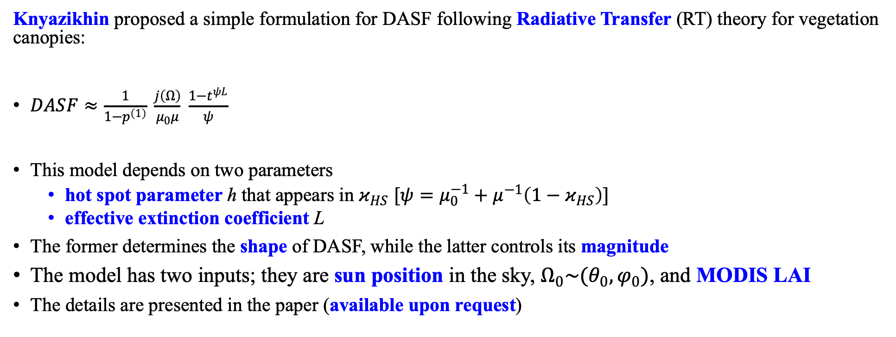
2.A. DASF from Models
Knyazikhin proposed a simple formulation for DASF following Radiative Transfer (RT) theory for vegetation canopies:
$DASF≈\frac{1}{1−p^{\left(1\right)}} \frac{j\left(Ω\right)}{μ_{0}μ} \frac{1−t^{ψL}}{ψ}$
This model depends on two parameters
  hot spot parameter h that appears in $κ_{HS}$ $[ψ=μ_{0}^{−1}+μ^{−1}\left(1−κ_{HS}\right)]$
  effective extinction coefficient L
The former determines the shape of DASF, while the latter controls its magnitude
The model has two inputs; they are sun position in the sky, $Ω_{0}\sim (θ_{0},φ_{0})$, and MODIS LAI
The details are presented in the paper (available upon request)
DSCOVR EPIC and NISTAR STM
Sep 28-30, 2021

Slide 13

2.A. DASF Parameter Estimation
The two unknown parameters of the DASF model can be estimated by fitting the model to DASF values calculated from measurements:
$h\left(SZA\right)=−5.8986∙\cos{SZA}+5.9587, L=2.9272∙{LAI}_{MODIS}−8.525$
Left panel: Hot spot parameter h vs. cos(SZA). Right panel: The effective extinction coefficient vs MODIS LAI
derived from monthly MISR DASF for the period between 2017 and 2019.
DSCOVR EPIC and NISTAR STM
Sep 28-30, 2021

Slide 14
2.B. DASF Model Assessment
We used MISR data from 2017 to 2019 to estimate the two parameters of the model. The parameterized model is tested by comparing simulated DASF to measured DASF for year 2016
Left panel: MISR DASF of Amazonian forests in April-2016 (hollow circles) and its simulation. The dashed line
is a polynomial fit to the modeled DASF. Right Panel: MISR DASF vs. modeled DASF. NRMSE=4%.
DSCOVR EPIC and NISTAR STM
Sep 28-30, 2021

Slide 15
2.B. DASF Model Assessment
Test the model to reproduce diurnal variations in measured DASF in three tropical forests
Left panel: Diurnal courses of measured monthly EPIC DASF, modeled DASF and SZA in three tropical forests. NRMSE
values for Southeast Asian, Congo and Amazonian forests are 3.9%, 3.6% and 16.3%, respectively.
Right Panel: Correlation between diurnal courses of modeled and EPIC DASFs over three tropical forests during the 2017
to 2019 period.
DSCOVR EPIC and NISTAR STM
Sep 28-30, 2021

Slide 16
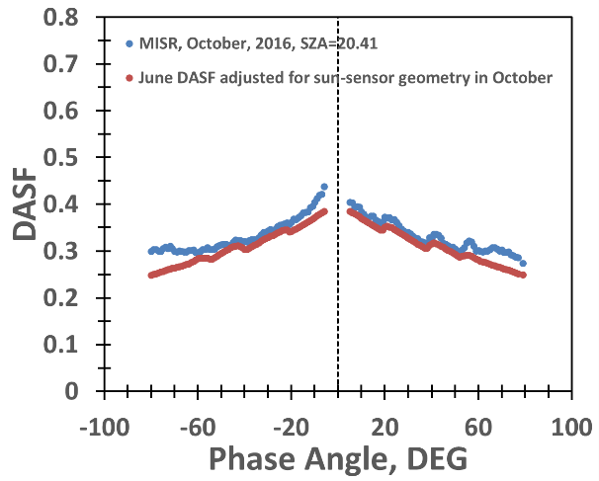
2.C. DASF Model Application – Amazonian Rainforests
Leaf Area Index (LAI) increases during the light-rich dry season – is this an artifact of measurement geometry? The model is used to adjust for measurement geometry. The result show that seasonal LAI changes in Amazonian rainforests are light, rather than precipitation, driven.
Left panel: Annual courses of precipitation and LAI over the central Amazonian rainforests (February 2000 to December 2019).
Right panel: Changes in MISR (circles) and EPIC (triangle) DASFs of Amazonian central rainforests. The EPIC DASF signature
in June is transformed to sun-sensor geometry in October using the model.
DSCOVR EPIC and NISTAR STM
Sep 28-30, 2021

Slide 17
2.C. DASF Model Application – Congolian Rainforests
Leaf Area Index (LAI) displays a bi-modal variation over a 12-month period – is this an artifact? The model is used to adjust for measurement geometry. The result show that this seasonal LAI variation is precipitation, driven.
Left panel: Annual courses of precipitation and LAI over the Congolian rainforests (February 2000 to December 2019).
Right panel: Time series of LAI (circles), observed (diamonds) and transformed (dashed line) EPIC DASF at SZA=30⁰ for the
period from 2015 to 2018.
DSCOVR EPIC and NISTAR STM
Sep 28-30, 2021

Slide 18
2.E. Conclusions
Angular Signatures
Continuing progress on modelling angular signatures shows promise
The goal is to help attribute changes in angular signatures to changes in canopy structure
This rigorous attribution will help
  diagnose ongoing changes in tropical forests
  prognose future changes
Guide future field data sampling to test model generated hypotheses
DSCOVR EPIC and NISTAR STM
Sep 28-30, 2021

Slide 19
Status of Papers
Two papers status as of September 2021
  Sun, Knyazikhin, Myneni et al., Seasonal and long-term variations in leaf area of Congolian forests inferred from NASA’s Earth observation satellites, Remote Sensing of Environment (in 2nd round of revision)
  Ni, Knyazikhin, Myneni et al., Modeling angular signatures of tropical forests with data from EPIC-DSCOVR and MISR sensors, Frontiers in Remote Sensing (special issue), accepted for publication after minor revisions, Sep 2021.
DSCOVR EPIC and NISTAR STM
Sep 28-30, 2021

