Slide 1
Evaluation of EPIC Version 3 total ozone columns: comparisons with ground-based and satellite measurements
Natalya A. Kramarova¹, Jerald R. Ziemke², Liang-Kang Huang³, Jay R. Herman⁴, Krzysztof Wargan^{3,1}, Colin J. Seftor³, Gordon J. Labow³, Luke D. Oman¹
¹NASA Goddard Space Flight Center, Greenbelt, Maryland, USA
²Goddard Earth Sciences Technology and Research (GESTAR)/Morgan State University, Baltimore, Maryland, USA
³Science Systems and Applications, Inc. (SSAI), Lanham, Maryland, USA
⁴University of Maryland, Baltimore County, Baltimore, Maryland, USA
Natalya.a.Kramarova@nasa.gov
DSCOVR EPIC and NISTAR Science Team Meeting, Sep. 28-30, 2021, Virtual

Slide 2
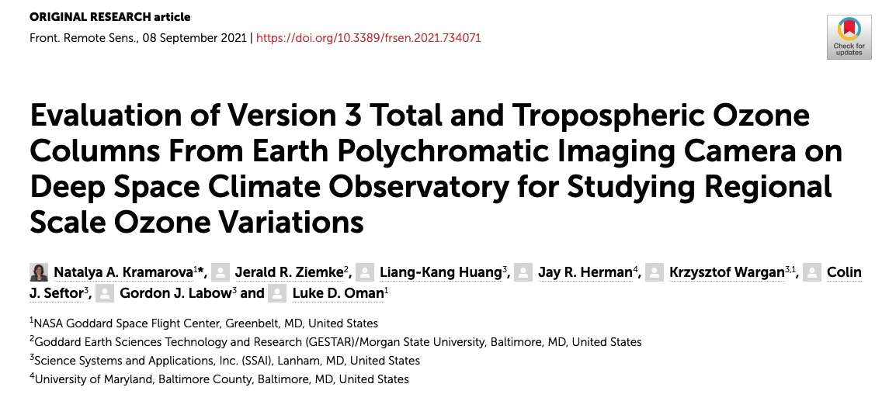
EPIC Version 3 Ozone Products

Slide 3
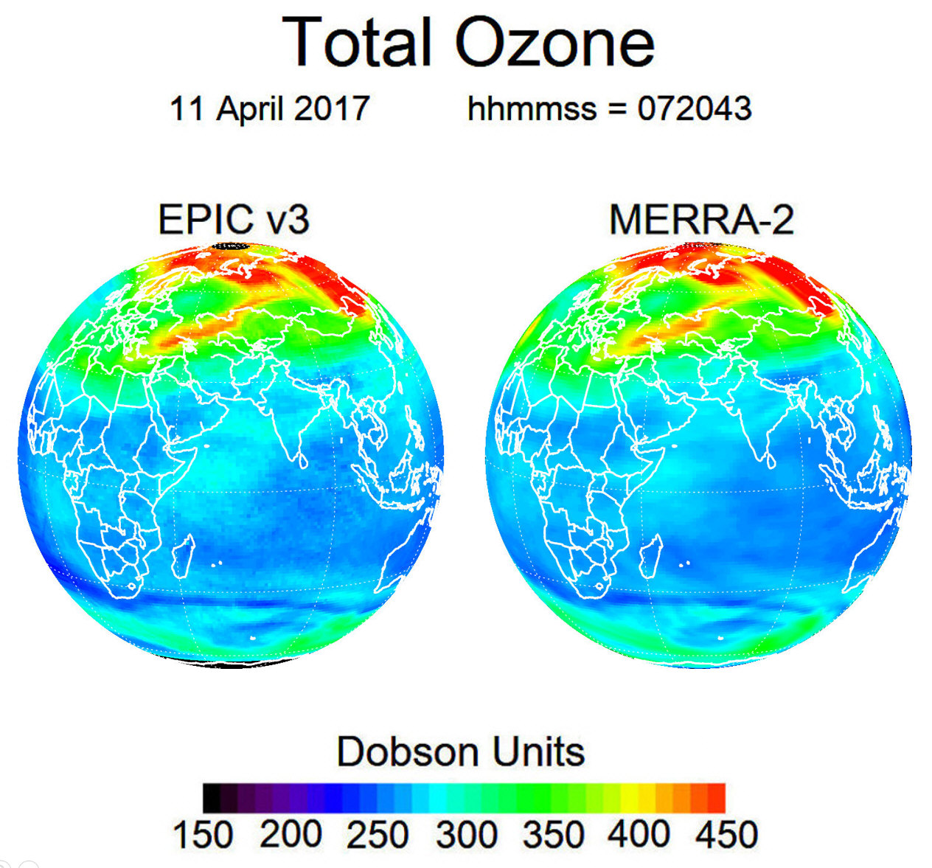
EPIC Version 3 Total Ozone Column
Key changes in Version 3:
a) Switch to Version 3 Level 1 with improved geolocation registration, flat field and dark counts corrections;
b) Switch to the simultaneous EPIC A-Band cloud height;
c) update absolute calibrations using SNPP OMPS;
d) added corrections for ozone profile shape and temperature;
e) update algorithm and error flags to filter data;
f) add column weighting functions for each observation to facilitate error analysis.
EPIC Total ozone data are available at https://eosweb.larc.nasa.gov/project/DSCOVR/DSCOVR_EPIC_L2_TO3_03

Slide 4
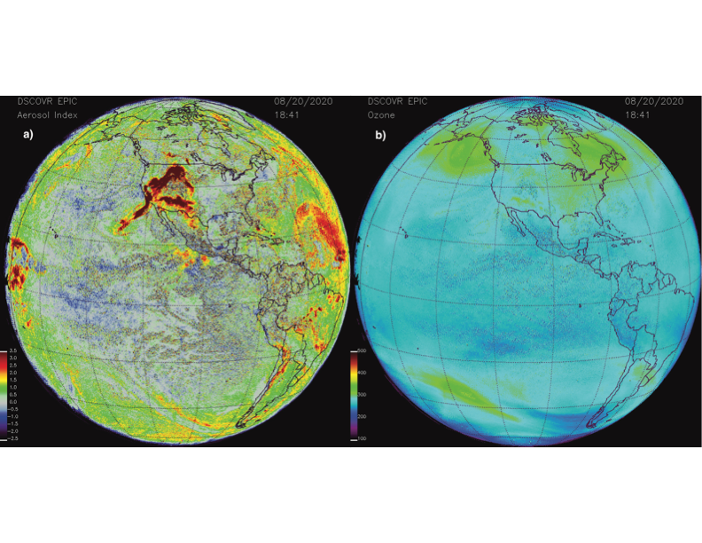
Correction for aerosol
EPIC Aerosol Index
EPIC retrieved total ozone
Wildfires over Western USA
[24N-35N, 122W-135W]
AI | >5 | <0.75
TOZ [DU] | 282.4 | 280.13
Notes:
The triplet algorithm with wavelength-dependent reflectivity $R_{λ}$ permits adjusting both the total ozone amount and the reflectivity at the ozone absorption wavelengths to account for the presence of aerosols. In cases with elevated aerosol amounts, the spectral slope in reflectivity can be significant, leading to an increase in reported residuals at ozone absorption channels that are computed with the 388 nm surface reflectivity. It is difficult to validate total ozone measurements over aerosol contaminated areas because the ground-based sensors like Dobson, Brewer and to a lesser extent Pandora are sensitive to aerosol contamination. To check for effectiveness of the implemented aerosol correction, we analyze EPIC ozone maps by comparing ozone values sampled over aerosol contaminated areas with the surrounding aerosol-free airmasses. Our analysis indicated that the EPIC retrieved TOZ over contaminated regions (caused by large smoke plumes or desert dust storm events) are consistent with those in the surrounding area. Figure 1 shows an example of wildfires that occurred in the western USA in summer 2020. The aerosol index (AI) (Fig. 1a) was elevated over the western coast of USA on August 8, 2020. The aerosol corrected EPIC retrieved TOZ maps over the affected area are very smooth without apparent aerosol-driven features. The TOZ value averaged over the aerosol contaminated area (24°N-35°N and 122°W-135°W) with the AI> 5 was 282.4 DU and agreed well with 280.13 DU, the average over the same area but for aerosol-free pixels with AI<0.75. The triplet algorithm with a simple linear model for surface reflectivity, implemented for EPIC, provides an effective aerosol correction mechanism for background aerosol and sun glint (near the image center) as well.

Slide 5
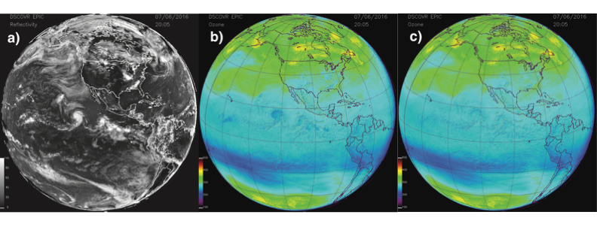
Cloud Height from EPIC A-Band
to adjust the scene surface pressure to properly simulate EPIC radiances;
to estimate the unretrieved amount of ozone beneath clouds.
Notes:
The EPIC simultaneous cloud-height product is now used in version 3 EPIC ozone algorithm for two purposes: 1) to adjust the scene surface pressure to properly simulate EPIC radiances; and 2) to estimate the unretrieved amount of ozone beneath clouds.

Slide 6
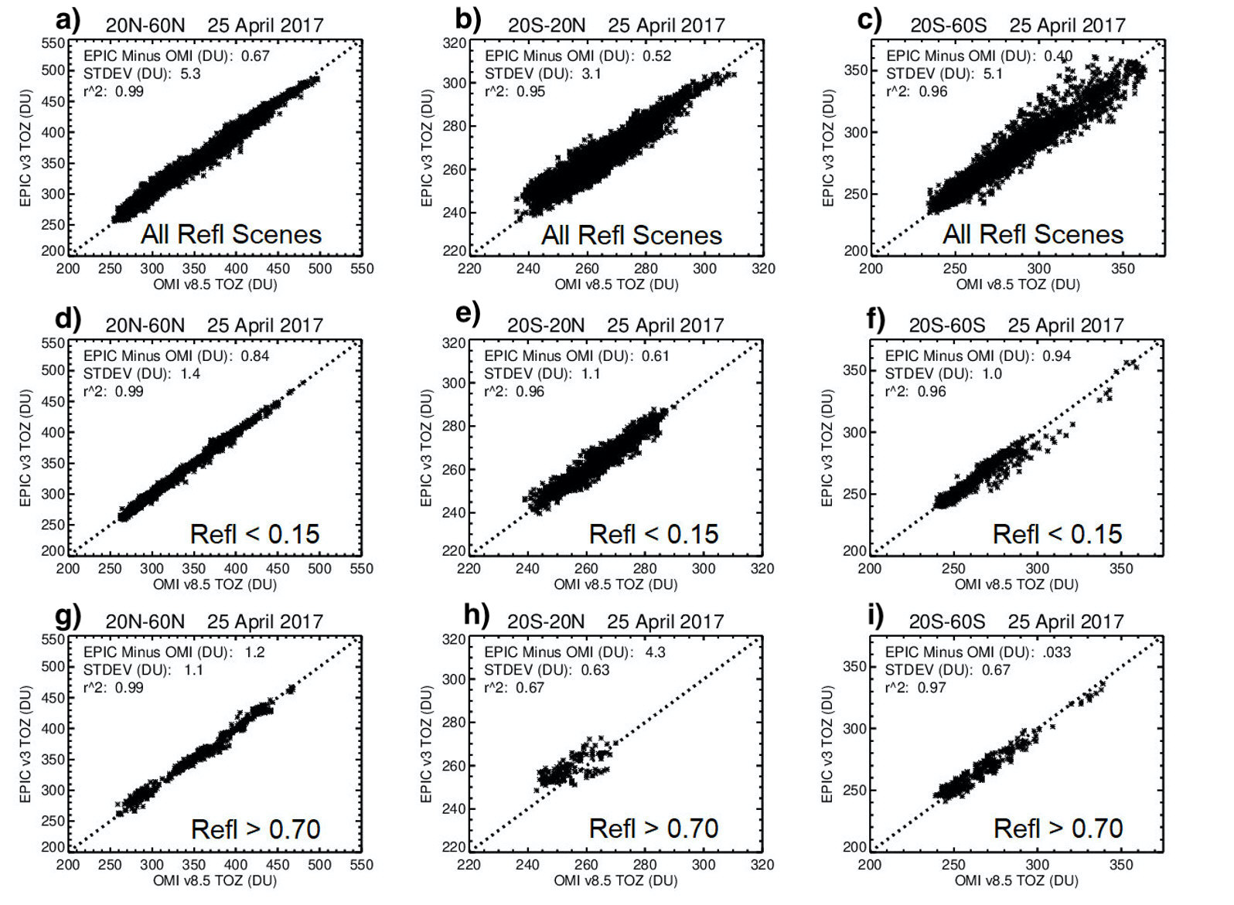
Cloud Height from EPIC A-Band
Notes:
To evaluate the effect of the EPIC cloud correction implemented in version 3 by utilizing simultaneous cloud height retrievals from the EPIC oxygen A-band channel, we compared EPIC and OMI TOZ retrievals for different conditions: all coincident cases with reflectivity 0 < R < 1, low-reflectivity cases R < 0.15, and cases with large reflectivity R > 0.7 (see Fig. 7). The cloud height correction in the OMI algorithm uses the Optical Centroid Pressure (OCP) approach (Vasilkov et al., 2008) that utilizes OMI measurements in visible range between 460-490 nm. This algorithm is completely independent from the EPIC A-Band cloud heigh retrievals (Yang et al., 2019). There is a very good agreement between the two methods with differences less than 50 hPa over a broad range of cloud fraction values (see Supplementary Figure 2), which would result in an offset of less than 1 DU. The offset between two cloud height algorithms is larger at very low cloud fraction (<0.1), but it has almost no effect on retrieved ozone.
Our analysis has revealed that the mean biases between EPIC and OMI TOZ remain the same for two subsets (R < 0.15 and 0 < R < 1, see Fig. 7 a-f). That means the cloud correction implemented in version 3 does not produce systematic errors in the EPIC TOZ retrievals. There is an increase in standard deviations of differences for the subset where all conditions (0 < R < 1) were included (Fig. 7 a-c). This is consistent with our expectations that the cloud correction would produce random noise in the retrieved ozone fields but not a systematic bias. When the scene reflectivity exceeds 0.7 it typically corresponds to conditions with large cloud fraction and high-altitude, convective clouds. The biases increase in the tropics between the two instruments for R > 0.7, but there is no change in mid-latitudes. A fraction of these increased biases in the tropics might be due to consistently larger cloud heights derived from the A-Band for high cloud fractions (see Supplementary Figure 2). Additionally, differences in cloud coverage at the time of satellite measurements and satellites FOVs can contribute as well.

Slide 7
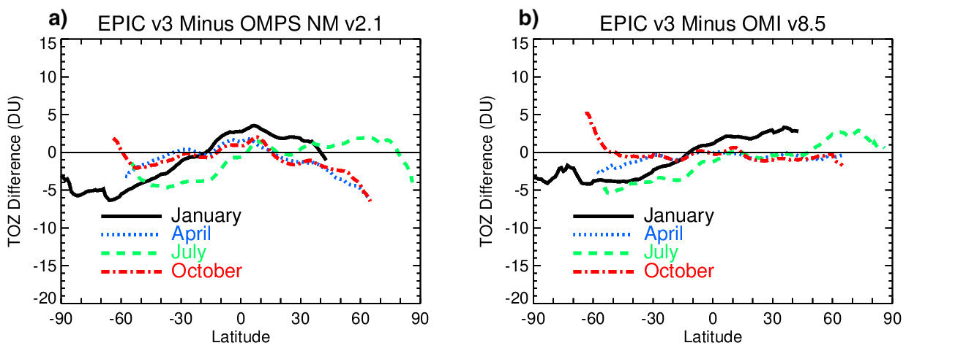
Evaluation of EPIC version 3 Total Ozone:
comparisons with OMPS NM and OMI
Mean seasonal biases over Jun 2015 – Dec 2020
Agreement within +/- 5 DU or ~ +/-2%
EPIC:
AlgorithmFlag= 1 or 101 or 111
ErrorFlag =0
EPIC: Solar Zenith and Satellite
View Angles < 70º
Notes:
To evaluate the accuracy of EPIC calibrations, we compared EPIC version 3 TOZ retrievals with correlative satellite observations from OMPS NM and OMI. Fig. 6 shows mean differences in Dobson Units (DU) between EPIC version 3 and OMPS and OMI as a function of latitude for different seasons (color lines). The mean differences were calculated over a period from the beginning of the EPIC mission in June 2015 up to the end of 2020. The EPIC data have been filtered as described in Sec. 2.1. The data in Fig. 6 were first averaged monthly and zonally prior to calculating these 6-year differences. The mean biases are mostly within ±5-7 DU (or 1.5-2.5%). The biases between EPIC and OMI and EPIC and OMPS are smaller and mostly positive in the tropical region (30°S-30°N). Outside the tropics, biases are larger and vary seasonally. In the SH biases are mostly negative with stronger biases during SH summer in January (Fig. 6, black lines). The biases are somewhat smaller between EPIC and OMI particularly in the tropics and NH (Fig. 6b), while differences with OMPS in the NH tend to be larger and negative in April and October (Fig. 6a). During NH summer in July the biases between EPIC and OMPS rapidly change at higher latitudes turning from positive to negative. Differences between Fig. 6a and 6b indicate the magnitude of differences between OMI and OMPS TOZ.

Slide 8
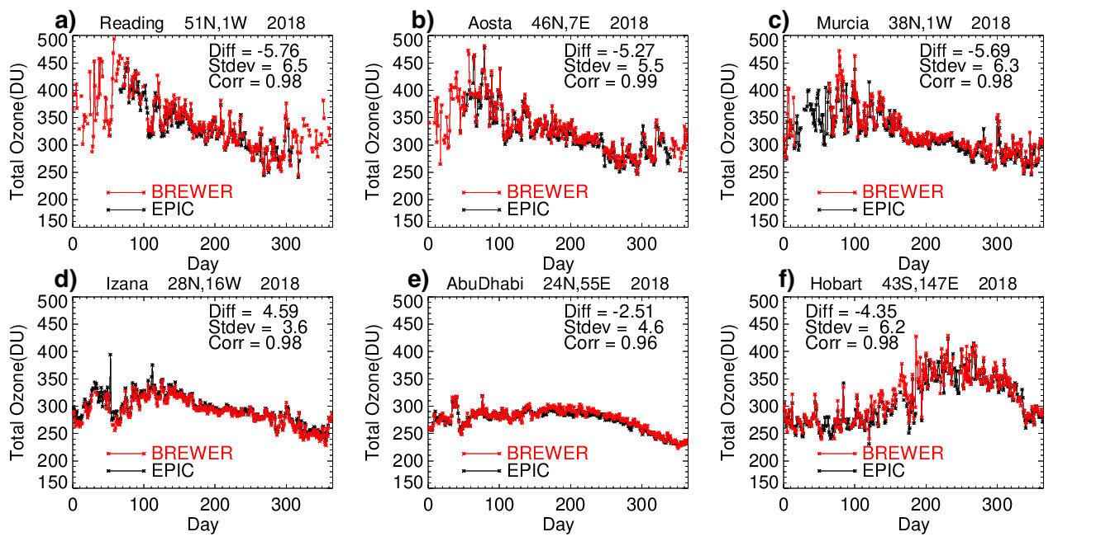
Evaluation of EPIC version 3 Total Ozone:
comparisons with ground-based Brewers
Notes:
We also examined the relative degree of agreement between EPIC TOZ and ground-based measurements obtained from Brewer and Pandora instruments. The list of Brewer, Pandora and sonde stations used in this study is provided in Supplementary Table 1. Figure 8 shows time series of daily mean Brewer and EPIC TOZ measurements at six locations in 2018. These stations represent a wide range of latitudes with a long available record of daily Brewer measurements in 2015-2020. We did not include stations at high latitudes to avoid EPIC measurements at SZA and SLA that exceed 70°. These plots show sub-seasonal changes in TOZ as measured by EPIC and Brewers. The observed biases with Brewer measurements are within the range of differences found with satellite observations. There is a consistently high correlation between EPIC and Brewer measurements (r²>0.96), indicating that EPIC can accurately capture day-to-day variations in TOZ.

Slide 9
Evaluation of EPIC version 3 Total Ozone:
analysis of small-scale variations
2018
Time series of TOZ measurements derived by fitting the Local-Linear Least-Squares (LOESS) (equivalent to a 3-week moving average) to all available EPIC (black lines), Pandora (orange) and OMI (blue) measurements at both locations
Notes:
To evaluate EPIC performance at short time scales, we have compared EPIC with ground-based Pandora and coincident OMI measurements at two ground-based locations over one-year period (Fig. 10). There is a lot of variability in TOZ during winter and spring at the mid-latitude station in Greenbelt, Maryland (Fig. 10a), showing that EPIC agrees well with both Pandora and OMI. TOZ is lower in summer and autumn months as a part of the TOZ seasonal cycle. Pandora in Greenbelt seems to underestimate TOZ in summer months compared to both OMI and EPIC. Measurements at Fairbanks, Alaska show a significant seasonal change where TOZ is close to 400-450 DU in winter and then gradually dropping to ~ 250 DU in the late summer - early autumn (Fig. 10b). EPIC captures these seasonal as well as smaller scale changes in TOZ compared to both Pandora and OMI. However, at high SZA (> 70°) EPIC tends to underestimate TOZ compared to OMI. The two instruments also see ozone variability differently at high SZA conditions: OMI measurements are showing more small-scale variations (blue line in Fig. 10b), while the EPIC curve (black line in Fig. 10b) is smoother. This is partly because we considered all EPIC measurements at Fairbanks, including those from 325 nm triplet to cover winter months. These results suggest that retrievals from the 325 nm triplet, used at high SZA, are not just biased, but might also have less sensitivity to real changes in ozone. Further investigations are needed to understand the reason for reduced quality of 325 nm EPIC retrievals. Pandora measurements in Alaska also show low biases in summer months compared to EPIC and OMI.

Slide 10
Column Weighting Functions
UV measurements have reduced sensitivity to the boundary layer;
CWFs represent the weight of measurements in each layer;
CWFs are determined by Jacobians (or sensitivity of measurements to O3 changes in each layer);
Important for tropospheric ozone product.
Notes:
CWF depend on:
Terrain height
Viewing geometry
Surface reflectivity/cloud height

Slide 11
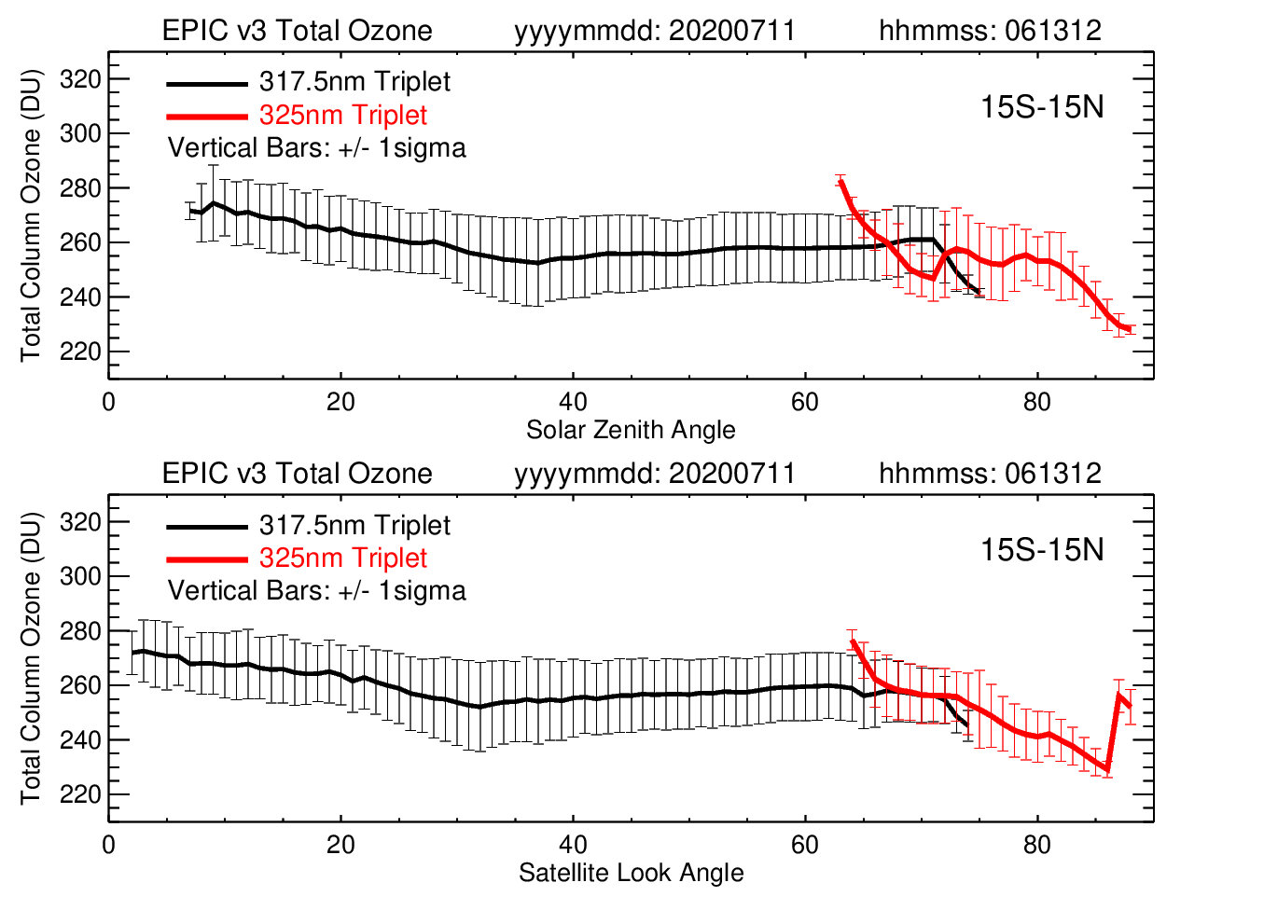
Total Ozone in tropics:
comparing retrievals from two EPIC triplets
The retrieval algorithm uses two triplets:
318 nm, 340 nm & 388 nm at low optical path (<1.5)
325 nm, 340 nm & 388 nm at high optical path (>1.5)
The current exclusion of EPIC 325 nm retrievals limits applications of EPIC data for studying ozone variability in early morning and late afternoon hours or at polar latitudes in months with high SZAs.
errors in radiance simulations at high SZAs and SVAs with a pseudo-spherical correction;
uncertainties in absolute calibrations of EPIC UV channels.

Slide 12
Proposed future work
Improve radiance simulations and calibrations at high SZA.
1. Uncertainties in absolute calibrations of EPIC UV channels.
Improving flat-field calibrations;
Updating absolute calibrations for EPIC UV channels using Suomi OMPS NM;
Evaluate errors in radiance simulations at high SZA/SVA
II. Evaluation of EPIC ozone maps for studying regional scale ozone transport
Use GEOS-Replay model simulations in conjunction with available ozone sonde and aircraft missions to evaluate EPIC ozone synoptic maps. In addition, we will use co-located satellite observations of aerosol, nitrogen dioxide (NO₂), carbon monoxide (CO) etc. from EPIC, Suomi NPP and TROPOMI platforms to help with attribution of the observed EPIC TCO anomalies.
In our evaluation we plan to consider several case studies:
reduced regional emissions in 2020 due to COVID-19 restriction measures;
large wildfire events (Australia 2019/2020; West Coast US 2020).
Notes:
EPIC prelaunch laboratory calibrations did not provide sufficient information on CCD pixel sensitivities that can vary from pixel to pixel. A flat field calibration is aimed to account for variable pixel-to-pixel sensitivity of the EPIC CCD detector. For UV channels, a flat field correction matrix (a multiplication factor to the prelaunch flat field calibration) was developed and implemented in EPIC version 3 Level 1 processing. This correction is based on comparisons of EPIC and OMPS albedos for each CCD Level 1 pixel obtained by averaging 18 months in orbit measurements. To compare EPIC and OMPS measured albedos, the differences in instrument’s footprints and spectral bandpass need to be considered. Differences in SZA/SLA between EPIC and OMPS are corrected using the TOMRAD radiative transfer model. While this technique can determine most of the pixel-to-pixel changes and has improved the version 3 EPIC image quality significantly, it is insufficient to determine gradual changes at large SZA/SLA near the edges of the Earth disk image due to limitations of the pseudo-spherical geometry approximation in the radiative transfer model. The residual errors in version 3 Level-1 flat-field calibration increase with the distance from the CCD center toward the edges. Lunar EPIC measurements were used to evaluate the quality of EPIC’s flat-field corrections. Lunar measurements were collected by EPIC in 2015 and recently in May 2021. An initial estimate of the flat field residual errors demonstrated a maximum offset of ~5% near the edge of the Earth image. More lunar measurements are scheduled for September 2021 that will help to improve the accuracy of the flat-field calibrations. We expect that updated flat-filed calibrations, based on lunar measurements, will be used in the next release of EPIC Level 1 data.
Absolute calibrations for EPIC UV channels are updated annually (see Sec. 2.2.1) by comparing measured EPIC albedo with coincident and collocated measurements from Suomi NPP OMPS. Small errors in geolocation produce a large amount of noise in albedo comparisons. For example, improved EPIC geolocation led to reduction of noise in derived albedo calibration coefficients from 10% in previous version 2 to 3% in the current version 3. Recently, the Suomi NPP OMPS instrumental team found an error in their geolocation assignment that mostly affects off-nadir OMPS pixels (Glen Jaross, personal communication, 2021). This error results in incorrect assignment of spatial coordinates and SZA/SLA. Level 1 OMPS data will be reprocessed in the next few months to remove that error. Since EPIC relies on the quality of OMPS calibrations, we expect to see improvements in EPIC calibrations after the OMPS geolocation error is corrected. These improvements in EPIC sensitivity calibration – both updated flat-field calibration and corrected geolocation of OMPS - will certainly make EPIC ozone product more accurate, including measurements at high SZA/SLA.
The TOMRAD radiative transfer model uses a pseudo-spherical geometry correction for radiance simulations at large SZA and SLA (Caudill et al., 1997). Larger errors in ozone retrievals at high SZA/SLA are partially related to limitations of this approximation for atmospheric sphericity. We plan to evaluate TOMRAD radiance simulations at high SZA/SLA by comparing them with simulations derived from fully spherical models to understand the magnitude of the errors (Korkin et al., 2020). We will also compare simulated radiances with EPIC measured radiances to see if the correction for sphericity can reduce the residuals (differences between measured and calculated radiances). Such analysis will help to isolate errors in forward model simulations from remaining errors in EPIC calibrations (like the flat-field correction) at high SZA/SLA. It is not feasible to use accurate radiance simulations with a fully spherical model in the real-time, operational code because these calculations are very time-consuming for the large amount of EPIC measurements. Based on results of our analysis, we will explore ways to improve the existing pseudo-spherical correction.

Slide 13
Conclusions
We evaluated EPIC Version 3 total ozone column product that includes several key changes:
We demonstrated that improved geolocation of EPIC scenes (Blank et al, 2021) ensures the filters are viewing the same geographic scene and SZA/SVA are accurately estimated for each EPIC pixel reducing errors in ozone retrievals;
The inclusion of simultaneous cloud-height information from EPIC A-Band (Yang et al., 2019) improves the scene pressure and the estimated ozone amount below the cloud.
Finally, in V3 we calculate and report Column Weighting Function for each pixel to facilitate measurement interpretation and error analysis.
Comparisons of EPIC total ozone columns with satellite instruments (SNPP OMPS and Aura OMI) demonstrated good agreement with mean biases within ±5-7 DU (or 1.5-2.5%). In the SH, EPIC shows mostly negative biases compared to both OMI and OMPS with stronger biases during SH summer in January.
Comparisons of daily EPIC total ozone columns with ground-based Brewer instruments revealed good agreement in capturing day-to-day variations in total ozone with consistently high correlation (r²>0.9). The mean differences between EPIC and Brewers are within the same range as with satellite observations, and there are no obvious latitudinal patterns.
I. We proposed to investigate reasons for increased errors in EPIC retrievals derived from the 325 nm triplet.
-Errors in radiance simulations with a pseudo-correction for atmospheric sphericity at high SZA/SLA;
-Uncertainties in absolute calibrations of the UV EPIC channels.
II. We propose to evaluate EPIC ozone maps for studying regional scale ozone transport.
Notes:
We evaluated EPIC Version 3 total ozone column product that includes several key changes:
We demonstrated that improved geolocation of EPIC scenes (Blank et al, 2021) ensures the filters are viewing the same geographic scene and SZA/SVA are accurately estimated for each EPIC pixel reducing errors in ozone retrievals;
The inclusion of simultaneous cloud-height information from EPIC A-Band (Yang et al., 2019) improves the scene pressure and the estimated ozone amount below the cloud.
Finally, we calculate and report Column Weighting Function for each pixel to facilitate measurement interpretation and error analysis.
Comparisons of EPIC total ozone columns with satellite instruments (SNPP OMPS and Aura OMI) demonstrated good agreement with mean biases within ±5-7 DU (or 1.5-2.5%);
In the SH, EPIC shows mostly negative biases compared to both OMI and OMPS with stronger biases during SH summer in January.
Comparisons of daily EPIC total ozone columns with ground-based Brewer instruments revealed good agreement in capturing day-to-day variations in total ozone with consistently high correlation (r²>0.9). The mean differences between EPIC and Brewers are within the same range as with satellite observations, and there are no obvious latitudinal patterns.
In this study, we mostly used EPIC data derived from the 317 nm triplet and limited SZA and SLA to less than 70°. Our analysis revealed consistent biases between EPIC retrievals derived from the two triplets (317 and the 325 nm) that cannot be explained by the natural ozone variability. The EPIC ozone algorithm switches to 325 nm triplet for conditions with high optical depth, which typically correspond to high SZA and SLA.
We proposed to investigate the exact reasons for increased errors in EPIC ozone retrievals derived from the 325 nm triplet are under investigation. Errors in radiance simulations with a pseudo-correction for atmospheric sphericity at high SZAs and SLAs, reduced sensitivity to ozone at 325 nm compared to 317 nm, and uncertainties in absolute calibrations of the two EPIC channels are the main factors to consider. The current exclusion of EPIC 325 nm retrievals limits applications of EPIC data for studying ozone variability in early morning and late afternoon hours or at polar latitudes in months with high SZAs.

Slide 14
Back-up slides
Notes:
To evaluate the effect of the EPIC cloud correction implemented in version 3 by utilizing simultaneous cloud height retrievals from the EPIC oxygen A-band channel, we compared EPIC and OMI TOZ retrievals for different conditions: all coincident cases with reflectivity 0 < R < 1, low-reflectivity cases R < 0.15, and cases with large reflectivity R > 0.7 (see Fig. 7). The cloud height correction in the OMI algorithm uses the Optical Centroid Pressure (OCP) approach (Vasilkov et al., 2008) that utilizes OMI measurements in visible range between 460-490 nm. This algorithm is completely independent from the EPIC A-Band cloud heigh retrievals (Yang et al., 2019). There is a very good agreement between the two methods with differences less than 50 hPa over a broad range of cloud fraction values (see Supplementary Figure 2), which would result in an offset of less than 1 DU. The offset between two cloud height algorithms is larger at very low cloud fraction (<0.1), but it has almost no effect on retrieved ozone.
Our analysis has revealed that the mean biases between EPIC and OMI TOZ remain the same for two subsets (R < 0.15 and 0 < R < 1, see Fig. 7 a-f). That means the cloud correction implemented in version 3 does not produce systematic errors in the EPIC TOZ retrievals. There is an increase in standard deviations of differences for the subset where all conditions (0 < R < 1) were included (Fig. 7 a-c). This is consistent with our expectations that the cloud correction would produce random noise in the retrieved ozone fields but not a systematic bias. When the scene reflectivity exceeds 0.7 it typically corresponds to conditions with large cloud fraction and high-altitude, convective clouds. The biases increase in the tropics between the two instruments for R > 0.7, but there is no change in mid-latitudes. A fraction of these increased biases in the tropics might be due to consistently larger cloud heights derived from the A-Band for high cloud fractions (see Supplementary Figure 2). Additionally, differences in cloud coverage at the time of satellite measurements and satellites FOVs can contribute as well.

Slide 15
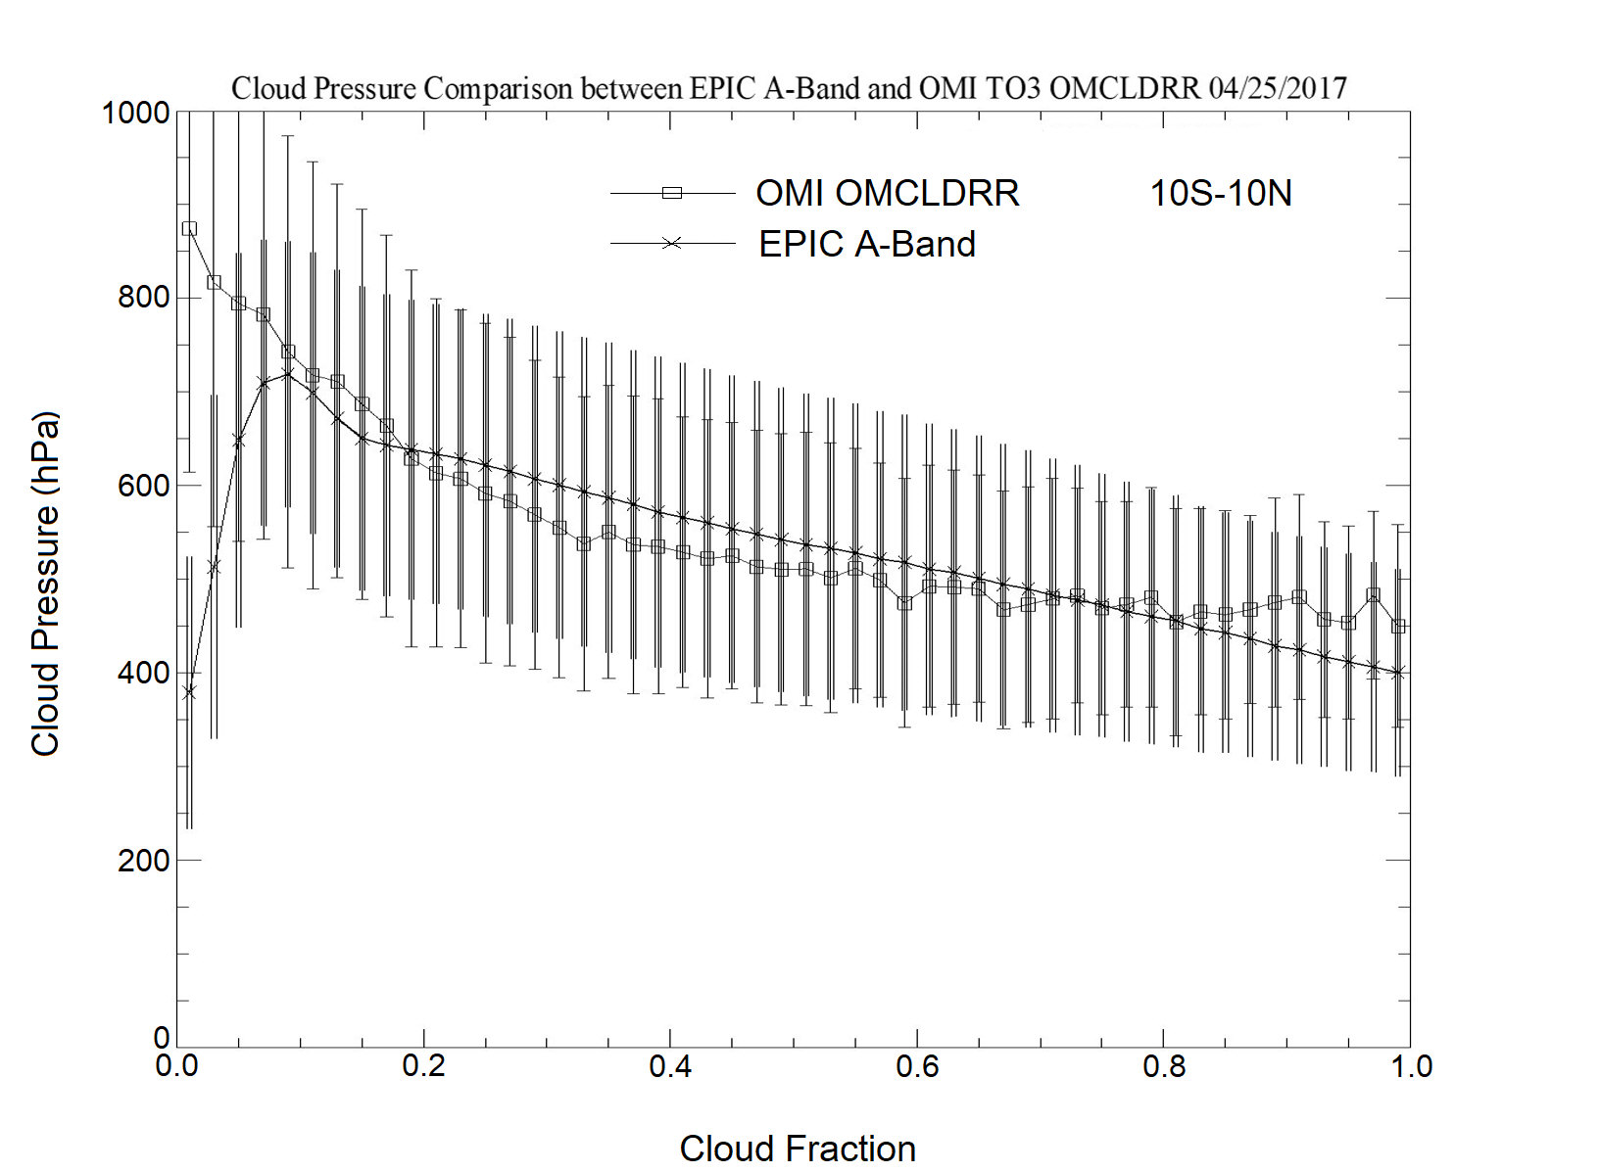
Cloud Height from EPIC A-Band
Notes:
Retrieved cloud-height pressure in the equatorial region (10$°$S-10°N) derived from EPIC A-Band and OMI OCP algorithms on April 25, 2017, as a function of cloud fraction. The uncertainty bars represent the spread (1-sigma standard deviation) in retrieved cloud pressures. EPIC A-Band cloud-height pressure agrees well with OMI OCP with differences less than 50 hPa over a wide range of cloud fraction values. A 50 hPa offset will result in ~ 1 DU error in retrieved total ozone. The differences are larger for small cloud fractions (<0.1) but have a very small effect on ozone retrievals.

Slide 16
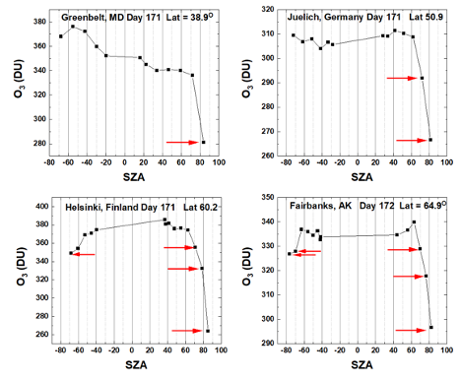
Evaluation of EPIC version 3 Total Ozone

Slide 17
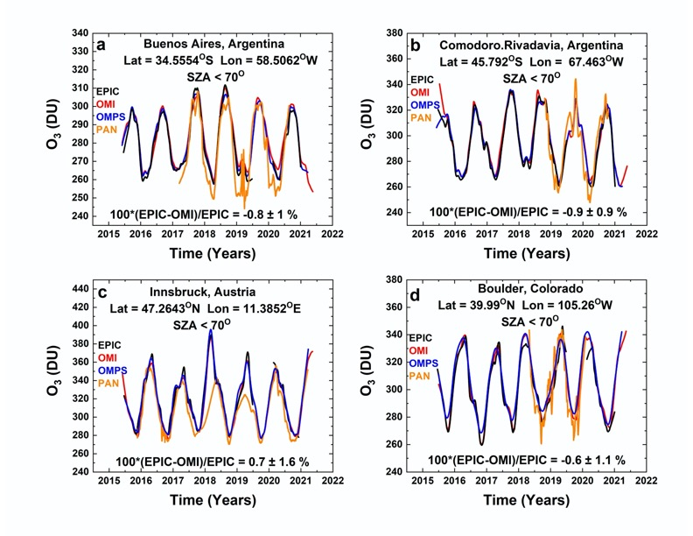
Evaluation of EPIC version 3 Total Ozone:
Comparisons with ground-based Pandora
The lines are a Local-Linear Least-Squares (LOESS) fit to the data (Cleveland, 1977) equivalent to approximately a 3-month running average.
Notes:
Figure 9 shows comparisons between EPIC and Pandora TOZ from 4 selected sites in the NH and SH where there is a long record of ground-based data from well-calibrated Pandora spectrometer instruments. We also compared with overpasses derived from OMI and OMPS NM. EPIC TOZ overpasses for each selected site include about 3 to 4 samples per day separated by 1 to 2 hours, while OMI and OMPS overpasses have only 1 to 2 points per day, with most samples consisting of 1 point per day. When there are two points from consecutive polar orbits, they are separated by about 90 minutes. The ground-based Pandora data consists of ozone samples obtained every 40 seconds throughout each day for solar zenith angles SZA less than 70^{O}. The time span of PGN Pandora data is much less than that for satellite data. Because of the different fields of view FOV (EPIC 20×20 km², OMI 13×24 km², OMPS 50×50km² and Pandora about 50×50 m²) and different sampling times (UT), the comparisons in Figure 9 are done for 3-month averages to verify calibration and retrieval algorithm rather than individual scene comparisons. The noise level in comparisons drop significantly depending on the averaging period (see Supplementary Figure 5). The 3-month averages (solid lines in Fig. 9) match closely for all four instruments. The mean differences between EPIC and OMI and OMPS are smaller than 1% at all stations and consistent with zonally averaged results shown in Fig. 6. Pandora TOZ measurements in the current version (PGN version 0P1) have significant differences with all three satellite instruments, but closely track the observed TOZ variation.

