Slide 1
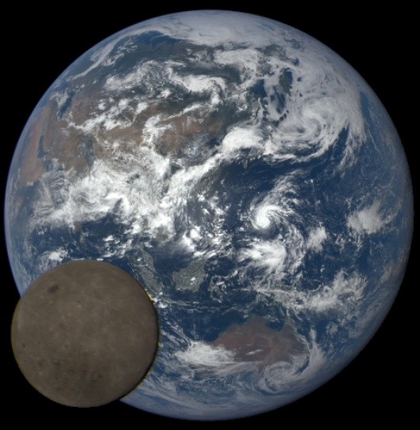
Earth imaging from the surface of the Moon
with a DSCOVR/EPIC-type camera (for Artemis)
Nick Gorkavyi, Simon Carn, Matt DeLand, Yuri Knyazikhin, Nick Krotkov, Alexander Marshak, Ranga Myneni and Alexander Vasilkov
In: “DSCOVR EPIC/NISTAR: 5 years of Observing Earth from the first Lagrangian Point”
https://www.frontiersin.org/articles/10.3389/frsen.2021.724074/full
The EPIC observes the entire Sun-illuminated Earth from the L1 Sun-Earth Lagrange point. EPIC has an aperture diameter of 30.5 cm, a field of view of 0.61°, and a spatial resolution of ~10 km/pixel. The camera produces 2048×2048 pixel images in 10 narrowband channels (317.5, 325, 340, 388, 443, 551, 680, 688, 764, and 779.5 nm) (NASA).
The L1 location, however, restricts phase angles to ~2°-12° (a nearly backscattering direction), depriving the observer of any information on bidirectional surface reflectance factors (BRFs) or on cloud/aerosol phase functions. A compact, lightweight, autonomous EPIC-type camera on the Moon’s surface offers a unique opportunity to overcome these limitations and advance Earth science in novel and potentially unanticipated ways.
DSCOVR EPIC and NISTAR STM, September 29, 2021

Slide 2
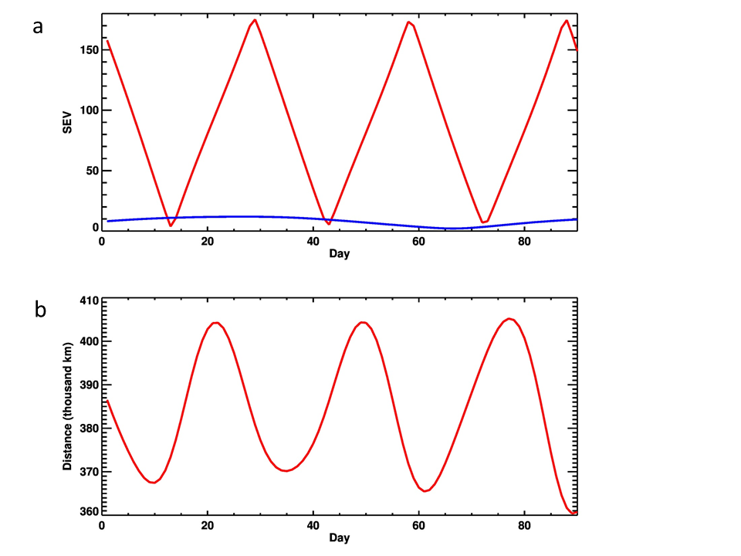
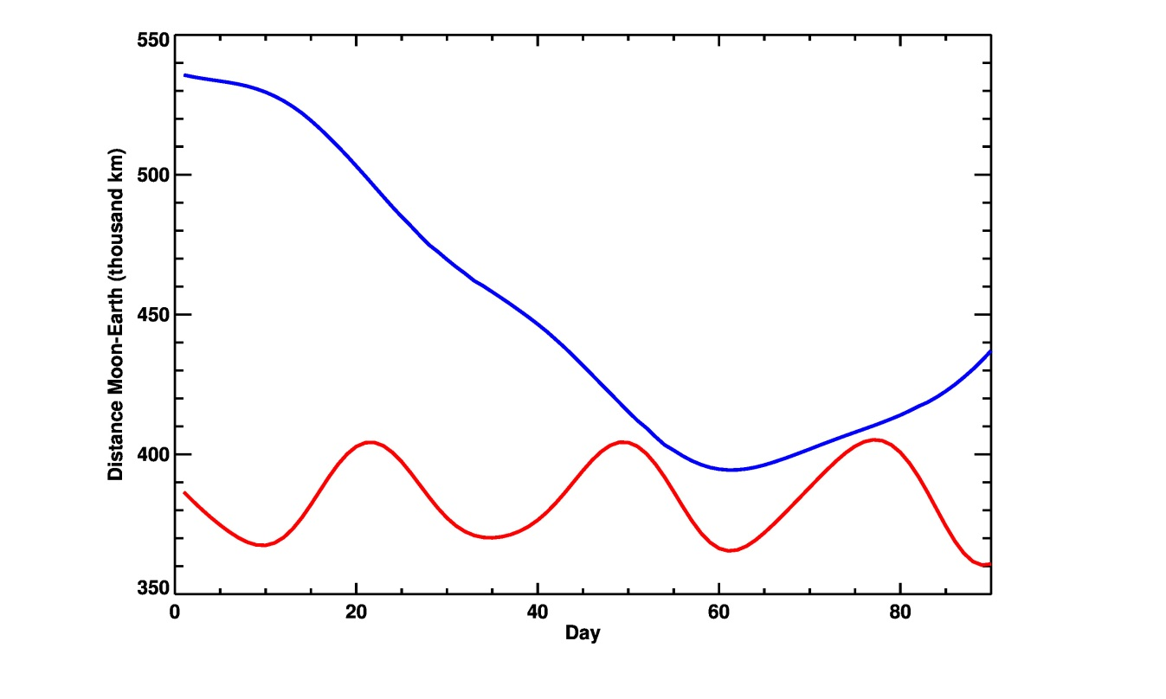
Sun-Earth-Vehicle (SEV) angle
MOON
Sun-Earth-Vehicle (SEV) angle for any sunlit Earth object observed from the Moon during the first 3 months of 2021
EPIC
b
Distance (thousand km) between the Moon and Earth during the same period
(EPIC-Earth distance ~1.5-1.4 million km)
EPIC
MOON

Slide 3
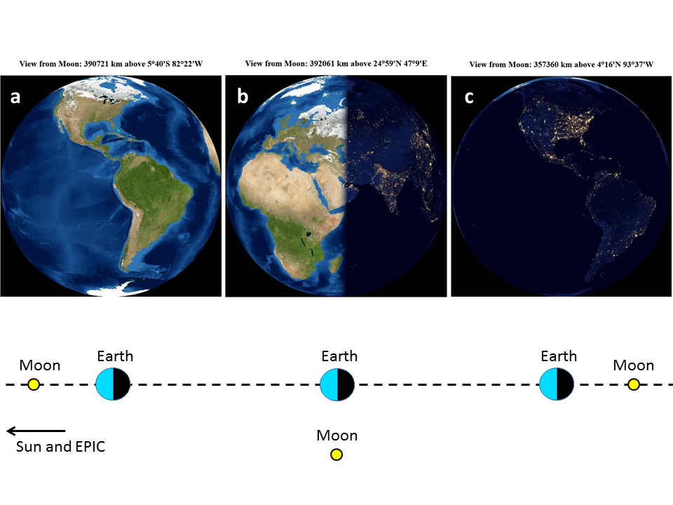
EARTH FROM THE MOON
Twilight zone

Slide 4
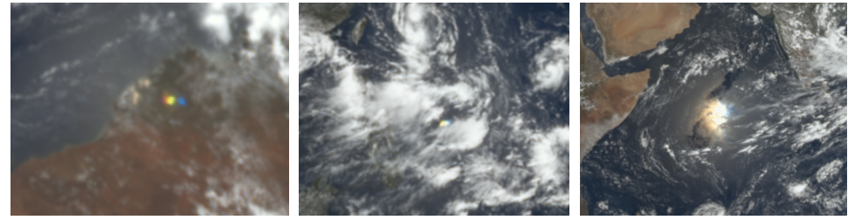
Solar glints
Three examples of glints captured by DSCOVR/EPIC in 2018. The Solar-Earth-Vehicle (SEV) angle is around 9 degrees. (left) Terrestrial glint over Australia from cloud ice crystals on February 13, 2018 (see https://epic.gsfc.nasa.gov/?date=2018-02-13); (middle) Terrestrial glint over the Pacific Ocean from marine cloud ice crystals on June 15, 2018 (see https://epic.gsfc.nasa.gov/?date=2018-06-15); (right) Ocean surface glint on September 17, 2018 (see https://epic.gsfc.nasa.gov/?date=2018-09-17).

Slide 5
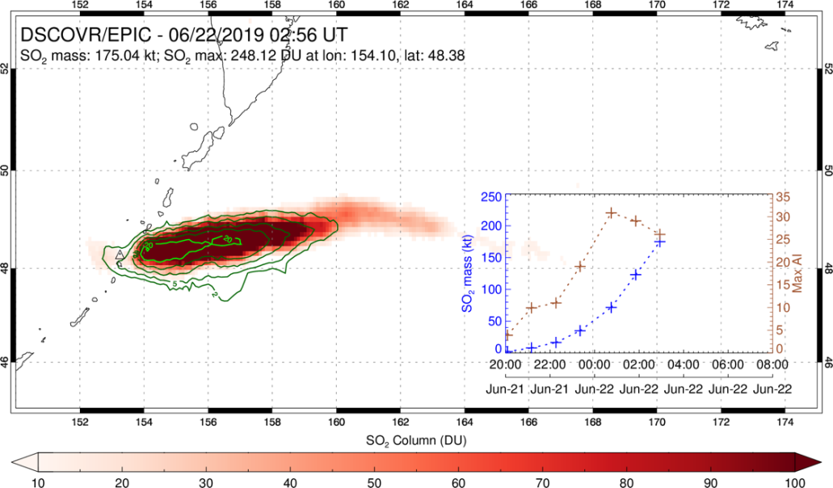
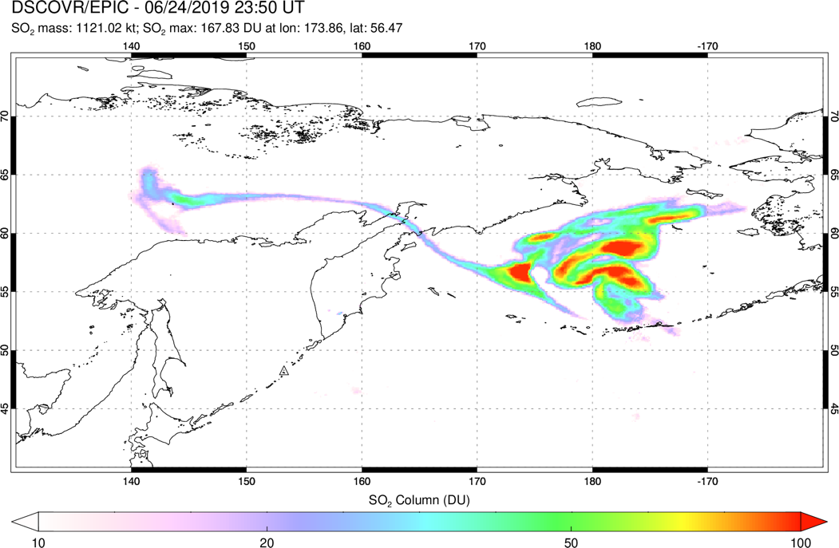
Volcanic and aerosol clouds
(Top) EPIC SO₂ and UV Aerosol Index (UVAI; green contours) measurements during the eruption of Raikoke volcano (Kuril Islands, Russia) on June 22, 2019 at 02:56 UT. The UVAI is used to detect volcanic ash. Inset shows a time-series of volcanic SO₂ mass and UVAI derived from EPIC measurements with hourly cadence during the eruption.
(Bottom) EPIC SO₂ retrieval for the high-latitude Raikoke volcanic cloud on June 24 at 23:50 UTC. EPIC was able to capture this extensive, high-latitude volcanic cloud in single synoptic images with hourly cadence, whereas such latitudes are towards the edge of the geostationary (GEO) field-of-view and can only be covered by multiple overpasses of polar-orbiting (LEO) instruments (with inter-orbit gaps of ~100 minutes).

Slide 6
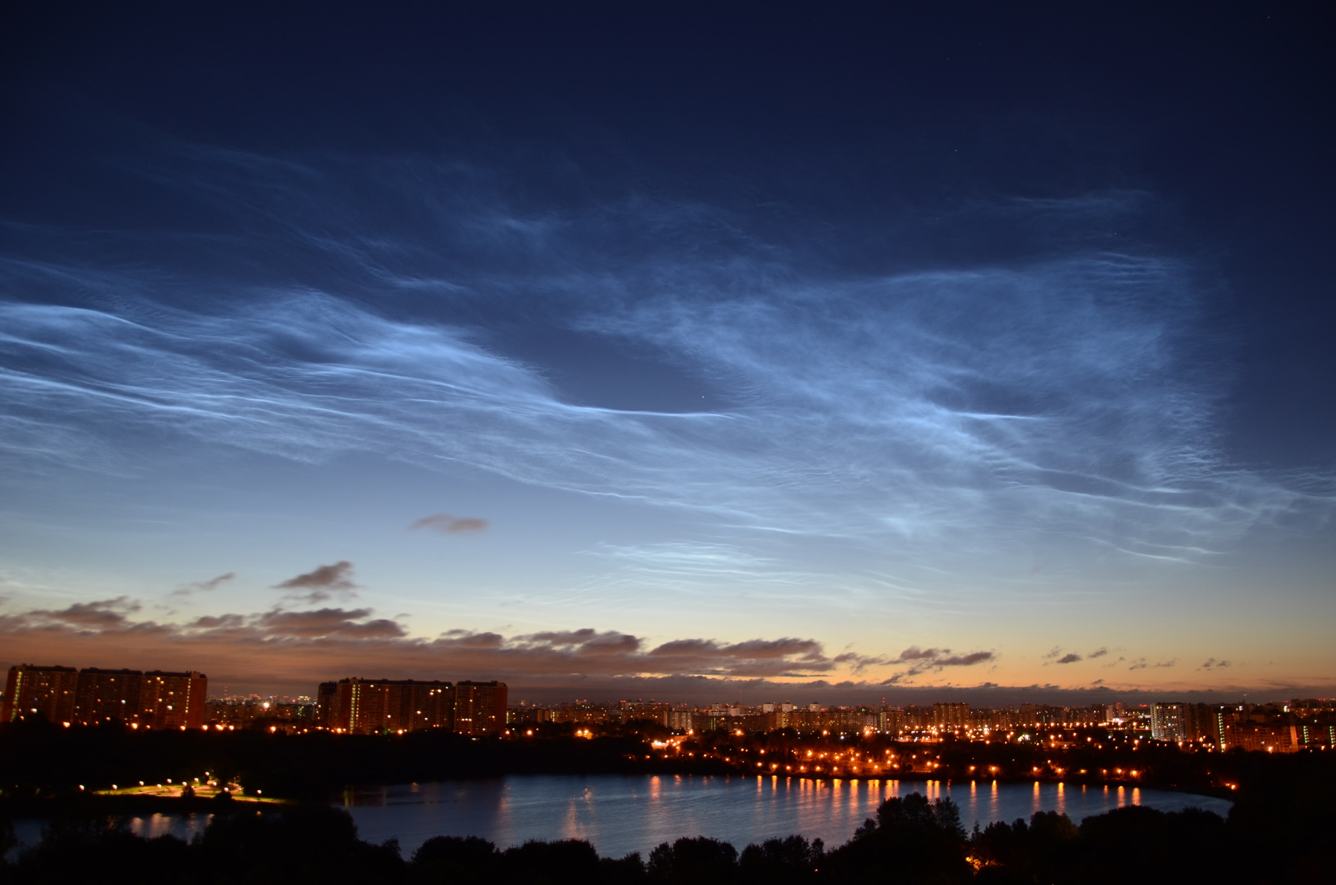
POLAR MESOSPHERIC CLOUDS
North
(80-85 km): on edge of space
Short waves
(move slowly to West)
Internal waves
(move ~ 100 m/s to ~East)
PMC (move quickly
to West)
Tropospheric clouds
(move to East)
Photo: Boris Nikashin, Local time July 30, 01:55 am

Slide 7
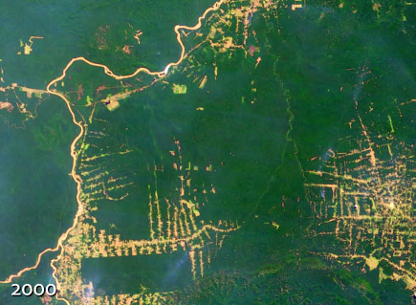
Monitoring vegetation
Amazon forest (NASA)
Near-infrared BRF of Amazonian forests confined between 0º to 10ºS and 60ºW to 70ºW from Terra MISR, Terra MODIS and Aqua MODIS sensors for the period between June 25 and July 10 accumulated over a 7-year period from 2001 to 2008.

Slide 8
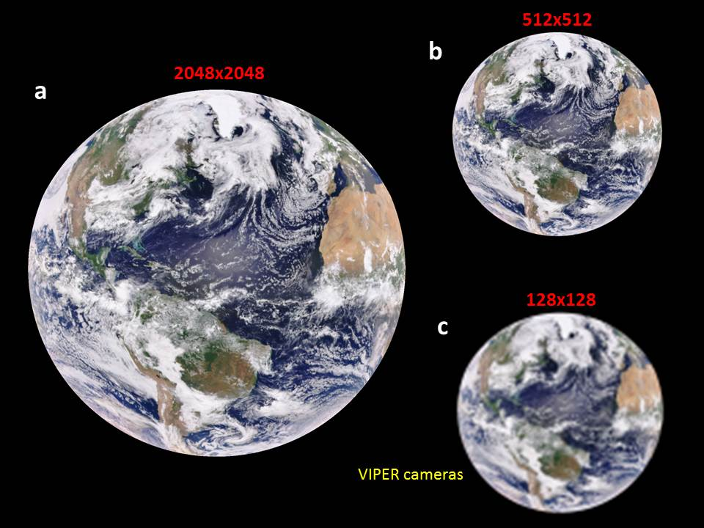

Slide 9
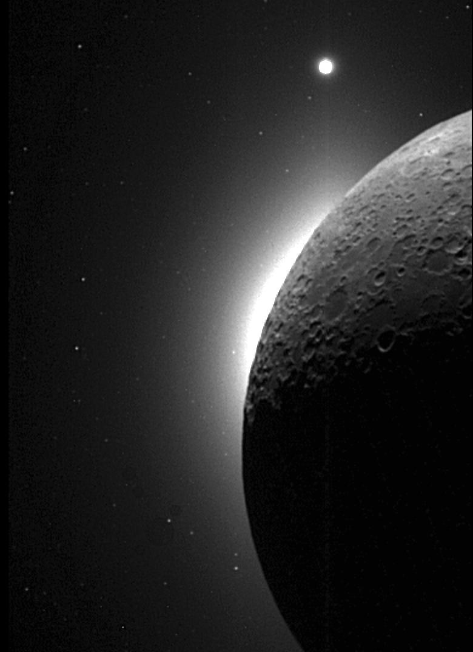
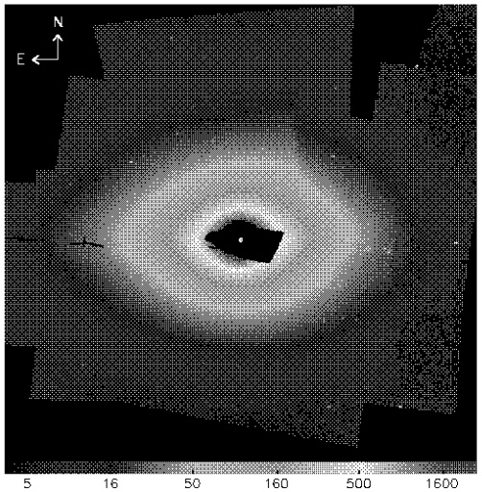
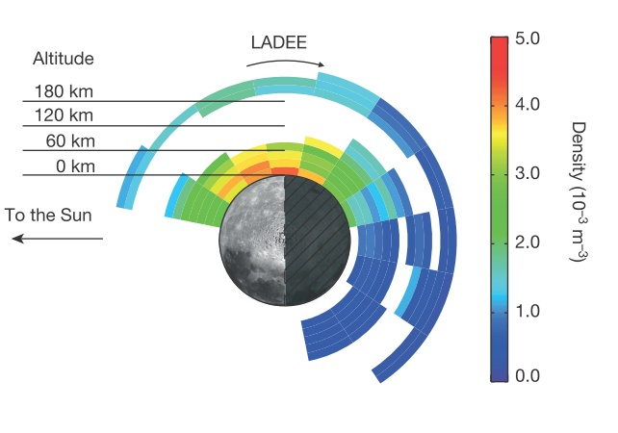
a
Lunar environment
b
ZODI LIGHT
CLEMENTINE
SOLAR CORONA
c
Using the Moon to occult the Sun, the Clementine spacecraft (1994) used its navigation cameras to map (a) the solar corona (NASA / JPL / USGS) and (b) inner zodiacal light (Hahn et al, 2002). (c) lunar dust exosphere according to LADEE data (Horányi et al, 2015 ).
DUST
EXOSPHERE

Slide 10
Conclusion
Deploying an analog of DSCOVR/EPIC on the Moon’s surface would offer a unique opportunity to image the full range of Earth phases, potentially advancing Earth science in many ways:
1. observing ocean/cloud glint reflection for different phase angles;
2. comprehensive whole-globe monitoring of transient volcanic and aerosol clouds (smoke, dust), including the strategically important (for climate studies) polar regions not covered by GEO missions;
3. detecting of polar mesospheric and stratospheric clouds via whole-Earth limb imaging;
4. estimating surface BRF and full phase-angle integrated albedo;
5. monitoring and quantifying changes in vegetated land;
6. simultaneous imaging of the day and night parts (i.e., the twilight zone) during crescent phases of the Earth and shadowed parts illuminated by the Moon.

