Slide 1

EPIC/DSCOVR as Pathfinder in Differential Oxygen Absorption Spectroscopy (DOAS) … from Space
Anthony B. Davis (JPL, Aerosol & Cloud Group)
Quentin Libois (CNRM, Météo-France, CNRS, U. de Toulouse, France)
Nicolas Ferlay (Laboratoire d’Optique Atmosphérique, Villeneuve d’Ascq, France)
Yuekui Yang and Alexander Marshak (NASA – GSFC)
DSCOVR Science Team Meeting, NASA – GSFC, Greenbelt, Md, Sept 28–30, 2021

Slide 2
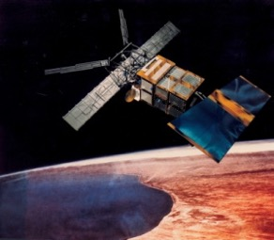
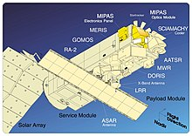

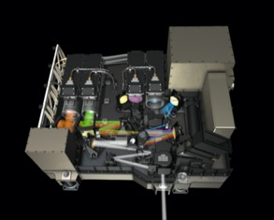
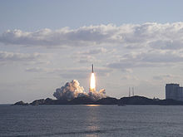
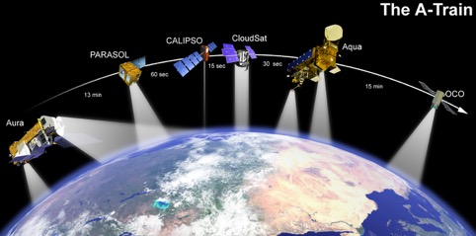
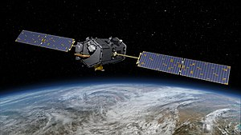

DOAS from space: A brief history
Moderate spectral resolution, very low spatial resolution:
Global Ozone Monitoring Experiment (GOME) / ERS-2, 1995-2011
SCIAMACHY / Envisat, 2002-2012
GOME-2 / MetOp-A/-B/-C, launches 2006/2012/2018
Bi-spectral, multi-angle, low spatial resolution:
POLDER / ADEOS I, 1996-1997
POLDER-2 / ADEOS II, 2002-2003
POLDER-3 / PARASOL, 2004-2013
Bi-spectral (A- & B-bands), low spatial resolution:
EPIC / DSCOVR, launched 2015 (to Lagrange-1)
High spectral resolution, moderate spatial resolution:
OCO-2, launched 2014
OCO-3 / ISS, launched 2019
Future missions:
OCI+SPEC / PACE (low spectral / moderate spatial resolutions)
MAIA (bi-spectral, multi-angle, moderate spatial resolution)
AOS-polar spectrometer (low spectral / moderate spatial resolutions)

Slide 3
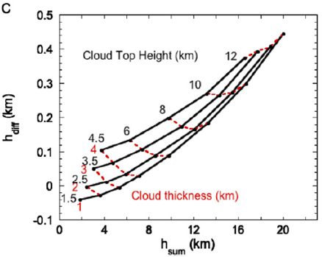
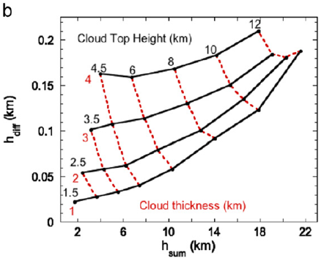
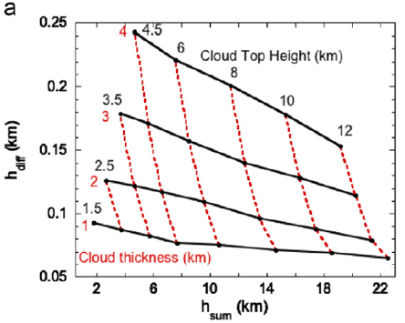
Axes are O₂ A- and B-band DOAS observations, recast as apparent cloud top heights
Nakajima–King-type algorithm: 2 observations → 2 cloud parameters
Good “orthogonality” of constant parameter curves → joint retrieval is feasible
No account of observation error: Is h_{dif} obtainable at 0.05 to 0.10 km accuracy?
Dark (water-like) surface

Slide 4
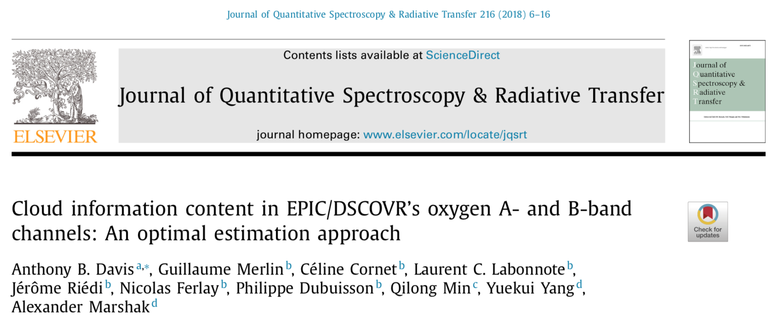
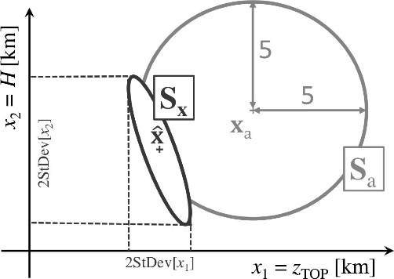
errors
model →
sensor →
not shown here: S_{y} = S_{ε}+S_{b}
Bayes’ theorem:
PDF of total cost function =
PDF of forward model prediction error on y
x PDF of prior uncertainty on state vector x
observations
→
likelihood of y, given x
prior uncertainty on x
p(x|y) = p(y|x) p(x) / p(y)
posterior uncertainty on x, given y
unimportant

Slide 5
Shannon information content / gain
Information Content (IC) gain or Degrees-Of-Freedom (DOF) per cloud property = ratio of the areas of S_{a} and S_{x}, projected onto one of the state/x-space axes
x = (z_{top},H)
y = (I_{abs,λ}/I_{ref,λ},
λ = A-,B-bands)
Total information content/gain = Ratios of ellipses areas |S|, i.e., of products of minor and major axes of the prior-to-posterior PDFs

Slide 6
Posterior uncertainty of the retrieved cloud properties
Errors expressed in %:
100 σ_{i}/x_{i}
“Nakajima-King” plots of DOAS ratios on (z_{top},H) look-up table (LUT)

Slide 7
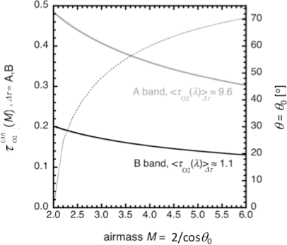
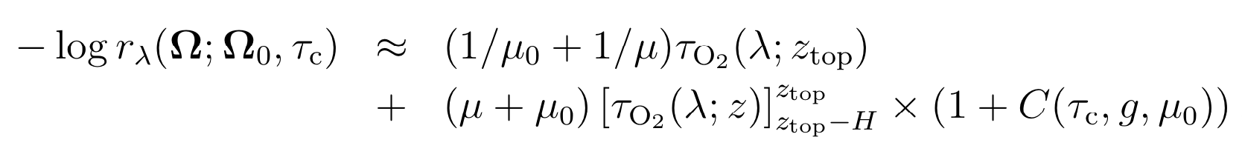
use here
→
DOAS ratio
… and here
a pre-asymptotic correction term

Slide 8
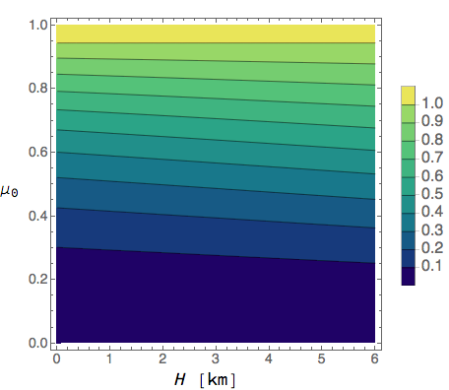
Gain physical insights …
e.g., retrieval bias from ignoring in-cloud path length
≈
[H]

Slide 9
Gain more physical insights …
[31] Blanco S, Fournier R. An invariance property of diffusive random walks. EPL (Europhys Lett) 2003;61:168. doi:10.1209/epl/i2003-00208-x.

Slide 10
Gain more physical insights …
Coming soon to a journal near you:
a new proof of <ct> = 4V/S in arbitrary geometry
what about higher order moments?
what about partially absorbing scatterers?

Slide 11
Summary
EPIC has broken new ground in DOAS
  extreme range at Langrange-1
  combination of A- and B-band sensitivities
  new applications to dust
    Xu X, Wang J, Wang Y, Zeng J, Torres O, Yang Y, Marshak A, Reid J, Miller S. Passive remote sensing of altitude and optical depth of dust plumes using the oxygen A and B bands: First results from EPIC/DSCOVR at Lagrange‐1 point. Geophysical Research Letters. 44, 7544-7554 (2017).
EPIC has inspired new algorithm development
  pairing statistical and physical approaches
  higher pathlength moments → COT from DOAS

