Slide 1

Validation and Comparison of Total O₃ and Volcanic SO₂ from DSCOVR EPIC
Kai Yang - UMCP
DSCOVR Science Team Meeting
GSFC Sept. 17 – 18, 2018
Acknowledgement: This work is supported by NASA.

Slide 2
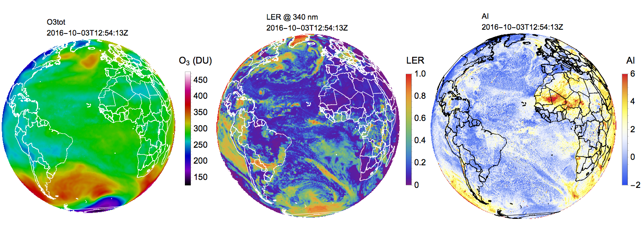
EPIC O₃ and SO₂ Product O3SO2AI Released
Direct Vertical Column Fitting (DVCF) Algorithm
O3SO2AI: O₃, LER, and AI
O₃
LER 340 nm
AI
Synoptic view of the sunlit Earth on October 3, 2016 at 12:54:13 UTC.

Slide 3
EPIC O₃ and SO₂ Product O3SO2AI Released
O3SO2AI – EPIC SO₂ retrieved using DVCF algorithm.
Volcanic SO₂ plumes from the eruption of Kilauea volcano in Hawaii on June 22 – 23, 2018. A series of SO₂ spatial maps are obtained about 65 minutes apart.

Slide 4
Validation and Comparison:
Total O₃
Validate the DVCF O₃ retrievals from EPIC using coincident ground-based Brewer spectrophotometer measurements and the assimilated O₃ product from MERRA-2.

Slide 5
﻿Coincident Measurements:
EPIC, MERRA-2, Brewer
Notes:
Large O3 range: 220 – 520 DU, 300 DU range, Brewer and Merra-2 data are interpolated to the time EPIC observations; All three independent data set track each other well.

Slide 6
﻿EPIC O₃ Validation:
EPIC vs. Brewer
ΔO₃ = EPIC – Brewer | VZA < 69°
﻿ –1.18 ± 3.05% or –4.19 ± 10.50 DU
R = 0.97

Slide 7
﻿EPIC O₃ Validation:
EPIC vs. MERRA-2
ΔO₃ = EPIC – MERRA-2 | VZA < 69°
﻿ 0.65 ± 2.39% or 2.13 ± 7.91 DU
R = 0.98

Slide 8
﻿EPIC O₃ Validation:
MERRA-2 vs. Brewer
ΔO₃ = MERRA-2 – Brewer | VZA < 69°
﻿ –1.80 ± 2.52% or –6.35 ± 8.90 DU
R = 0.98

Slide 9
Summary
Coincident O₃ Comparisons
Biases
  EPIC vs. Brewer : bias low by 1.18% or 4.19 DU
  MERRA-2 vs. Brewer: bias low by 1.80% or 6.35 DU
  EPIC vs. MERRA-2 : bias high by 0.65% or 2.13 DU
  * EPIC bias may be easily adjusted with soft calibration
Standard Deviation and Correlation
  EPIC vs. Brewer : std = 3.05%, R = 0.97 |Worst
  MERRA-2 vs. Brewer: std = 2.52%, R = 0.98 | Very good
  EPIC vs. MERRA-2 : std = 2.39%, R = 0.98 |Best
MERRA-2 contains realistic O₃ field, though it likely biases low by ~1.5%. Excellent O₃ reference for comparing spatial and temporal distribution.

Slide 10
Synoptic O₃ Comparisons:
EPIC vs. MERRA-2
EPIC O₃
MERRA-2 O₃
ΔO₃
ΔO₃ = EPIC – MERRA-2 | VZA < 69°
﻿ 0.29 ± 2.35% or 0.89 ± 6.70 DU

Slide 11
Validation and Comparison:
Volcanic SO₂
Validate DVCF SO₂ from EPIC, by comparing SO₂ mass loading with DVCF SO₂ from SNPP OMPS-NM for the same event.

Slide 12
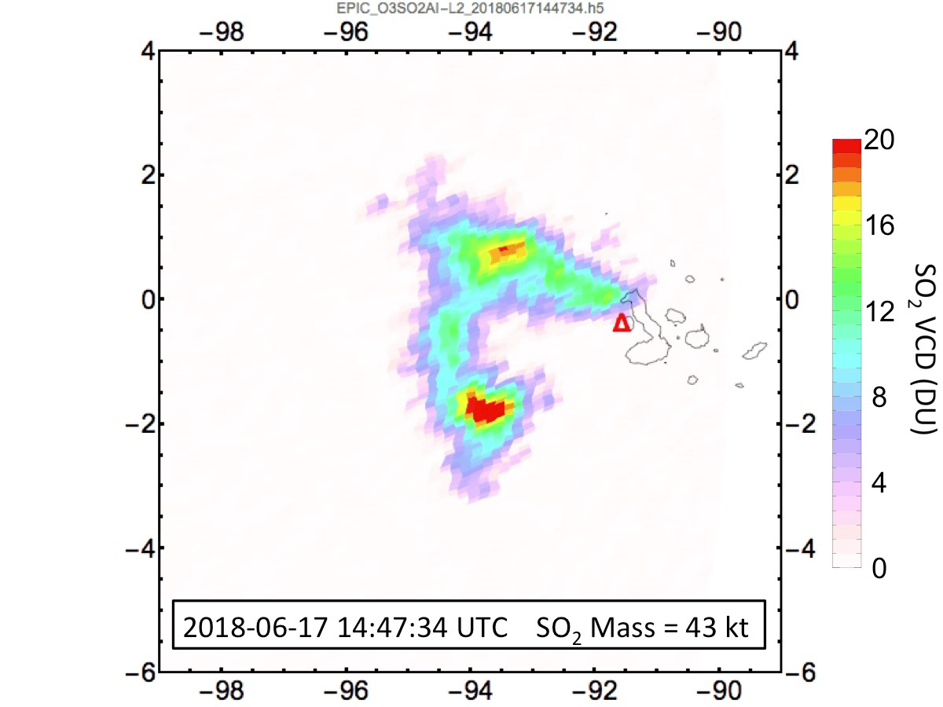
﻿SO₂ Validation:
EPIC vs. SNPP OMPS
June 17, 2018 Eruption of Fernandina, Galápagos Islands, Ecuador

Slide 13
﻿SO₂ Validation:
EPIC vs. SNPP OMPS
June 17, 2018 Eruption of Fernandina, Galápagos Islands, Ecuador
SO₂ Mass
SO₂ mass agreement better than 10%.

Slide 14
﻿SO₂ Validation:
EPIC vs. SNPP OMPS
SO₂ plumes from the eruption of Kilauea volcano, Hawaii
EPIC
OMPS
SO₂ mass agreement better than 10%.

Slide 15
EPIC O3SO2AI Product
Accuracy Characterization
O₃:
For VZA<69°, EPIC O₃ bias low on average by about −1 ± 2.35% or −3.5 ± 6.7 DU.
Volcanic SO₂:
Accuracy of individual pixel SO₂ (>10 DU) is about 25%
Accuracy mass loading (integrated over SO₂ pixels) is about 10%.

Slide 16
Summary
The O3SO2AI product is released
High accuracy of O₃ and SO₂ retrievals achieved by applying the DVCF algorithm.
Independent soft calibration, improved algorithm physics, and optimized inversion scheme, all have contributed to the high quality achieved for the EPIC O3SO2AI product.

Slide 17
New Scheme of O₃ Profile Representation:
New Column-Classified O₃ Profile Climatology
  O₃ profile = mean profile + Δprofile
  Δprofile = Σ Ω_{i} eigenvectors
  of covariance matrix

Slide 18
Algorithm Advances
Any location may be observed with high zenith (SZA and VZA) angles: O₃ Profile effect is important.
Direct Vertical Column Fitting (DVCF) Algorithm
Aerosol Index
M. Error
Measurement
O₃, SO₂
Reflection by Earth surface
or by Cloud/Aerosols
RT Simulation

Slide 19
DVCF Algorithm
Inversion: Optimal Estimation
All UV bands for profile adjustment
Constraint by measurement errors and parameter uncertainties.
Notes:
Multiple wavelengths.

