Slide 1
Characterizing ice clouds using EPIC observations of sun glint
Tamás Várnai^{1,2}, Alexander Marshak¹, Alexander Kostinski³
1: NASA GSFC, 2: UMBC JCET, 3: Michigan Technological University

Slide 2
EPIC images often feature glint from oceans
2016 03 23, 07:39 UTC

Slide 3
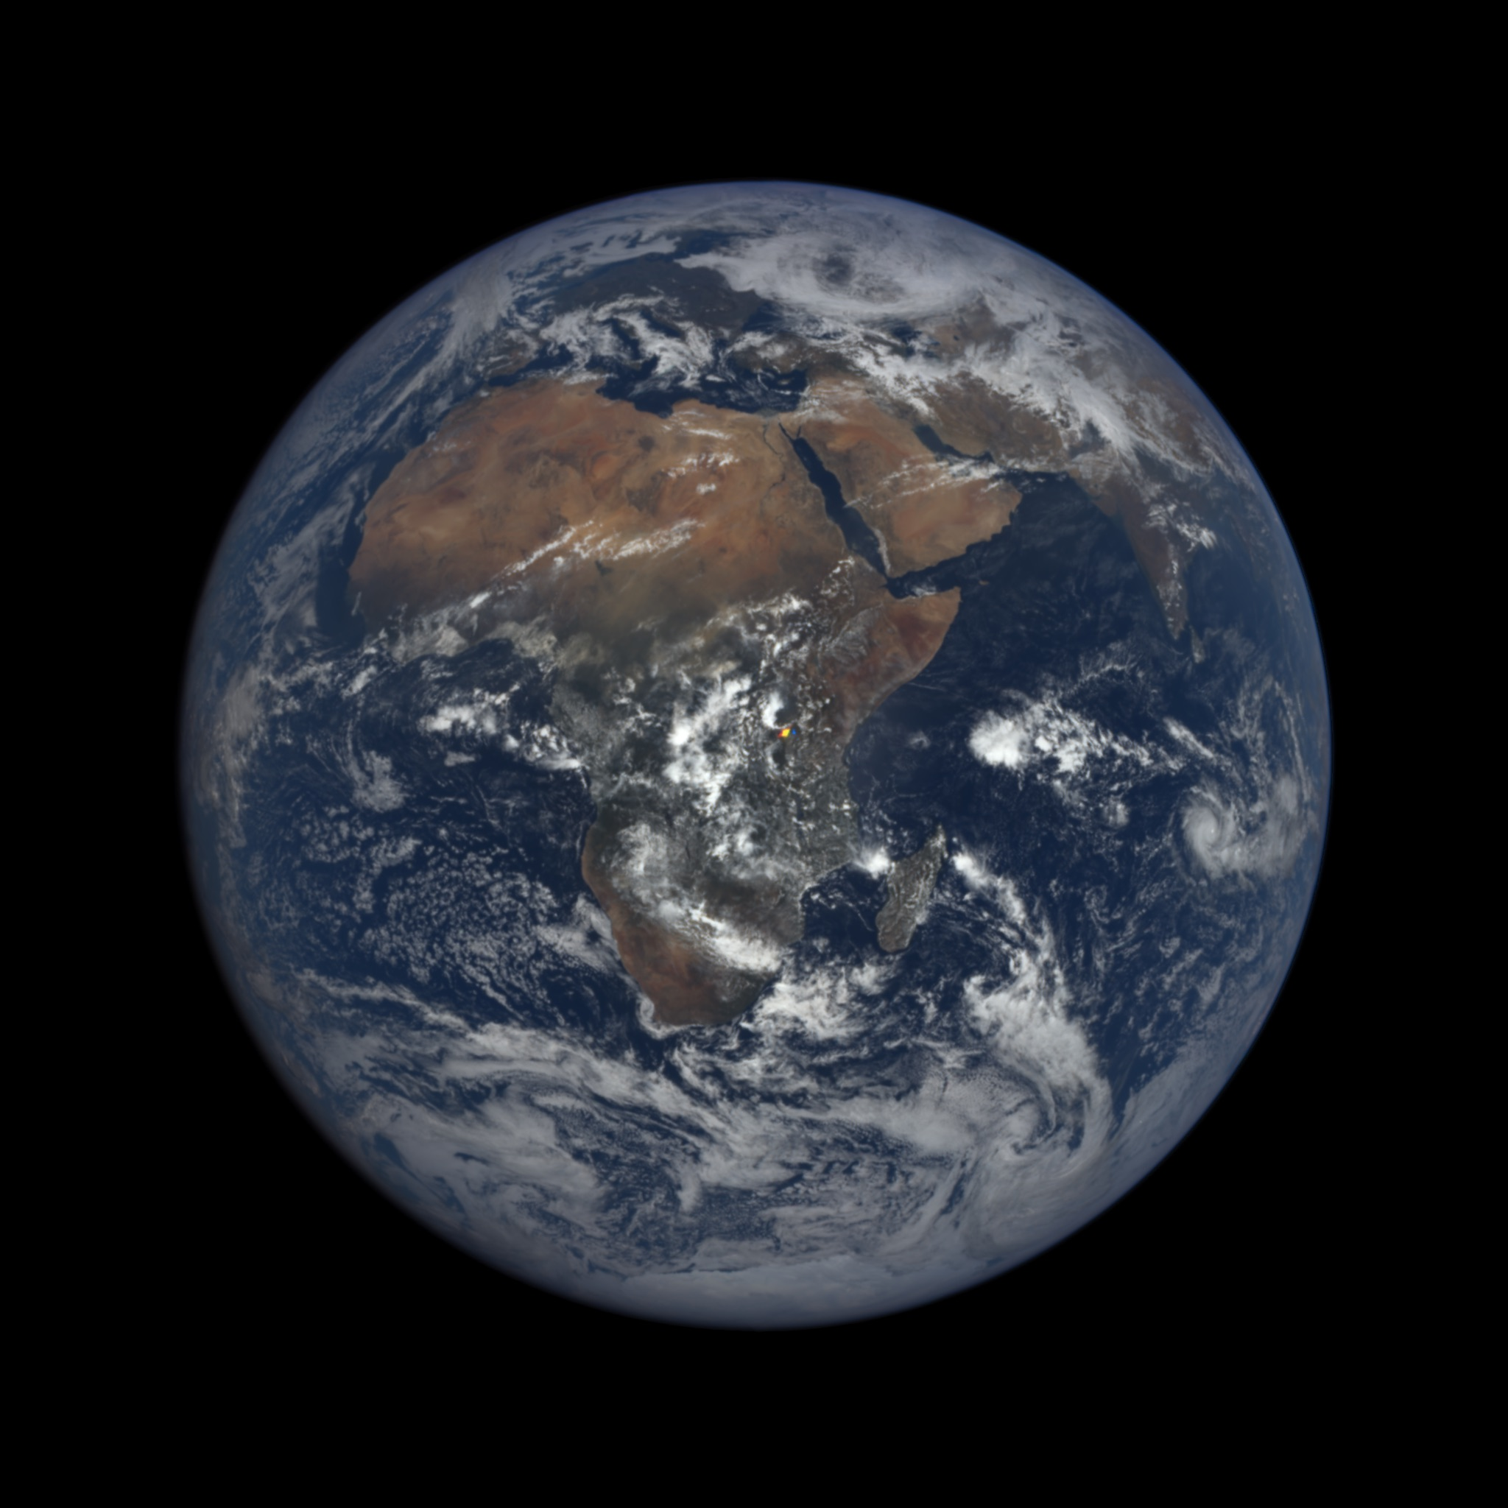
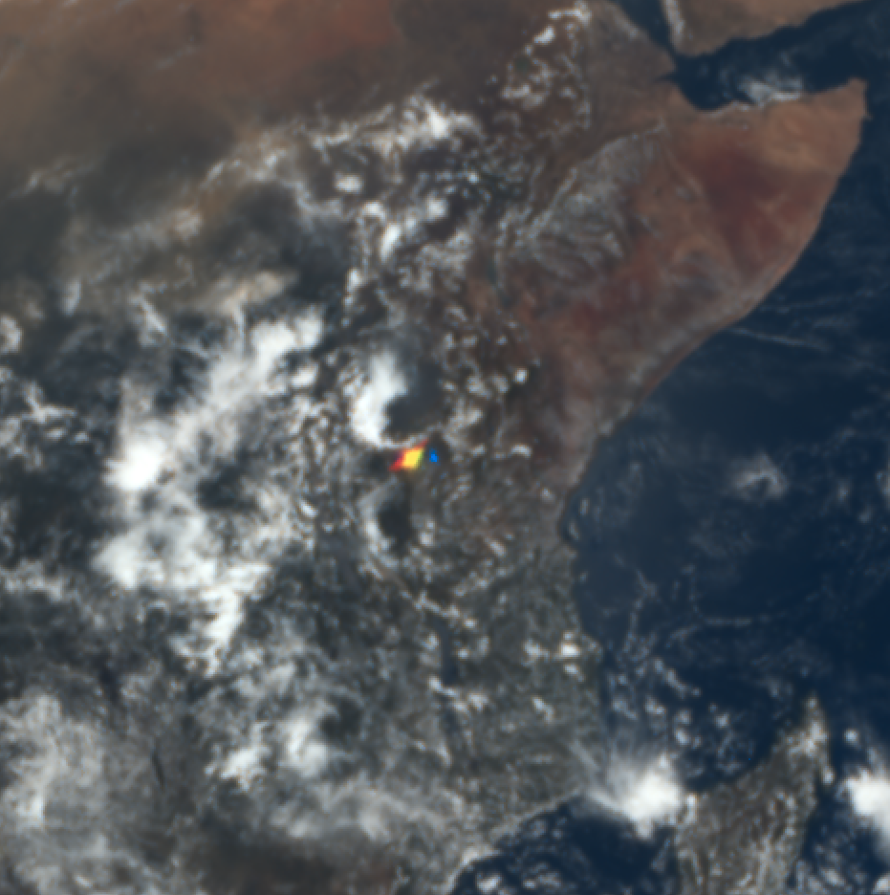
Colorful bright spots appear over land
2016 03 17, 09:46 UTC

Slide 4
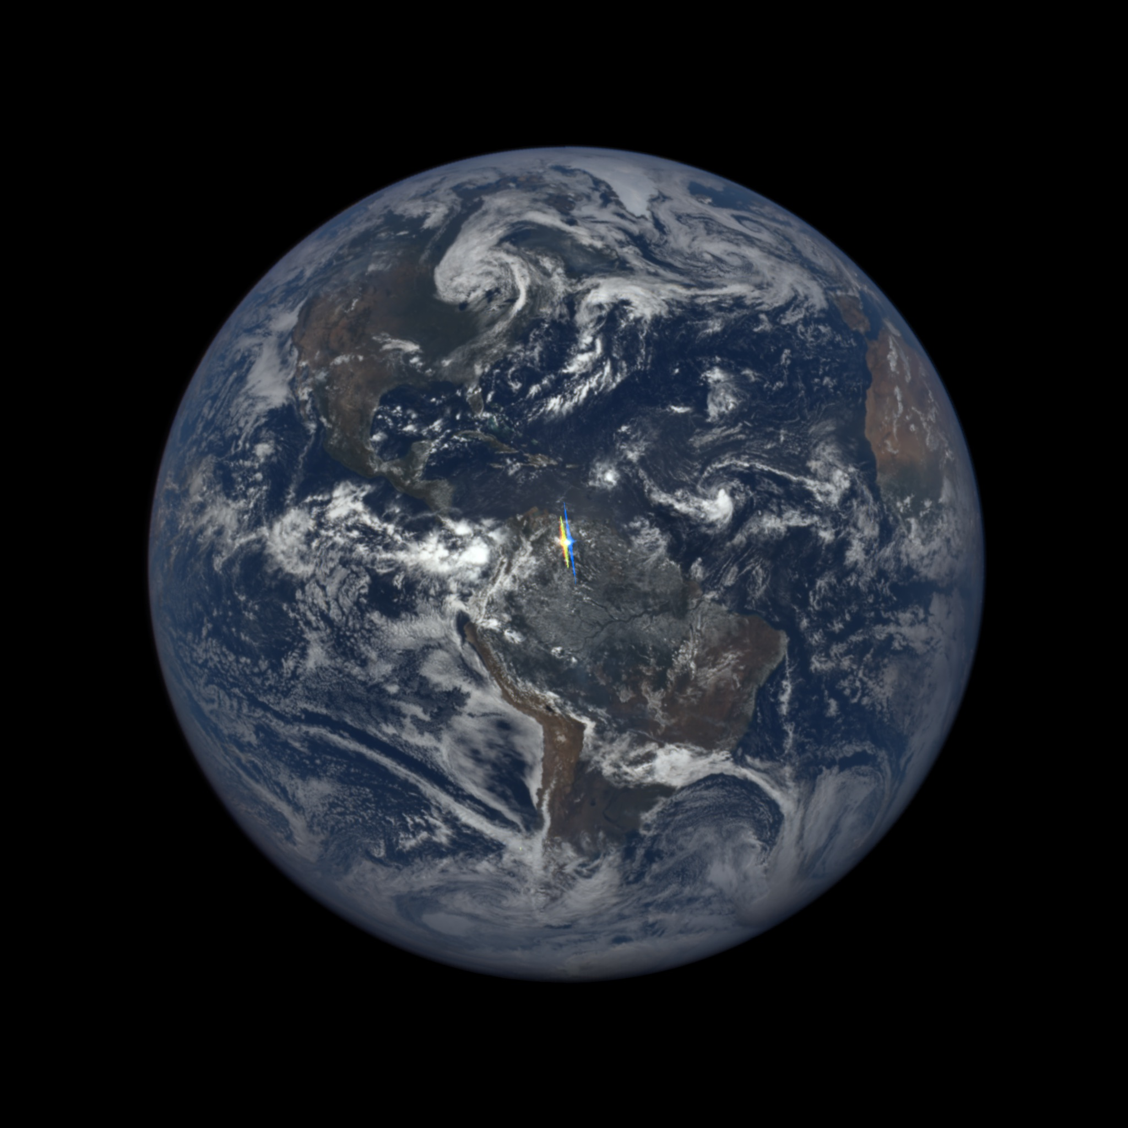
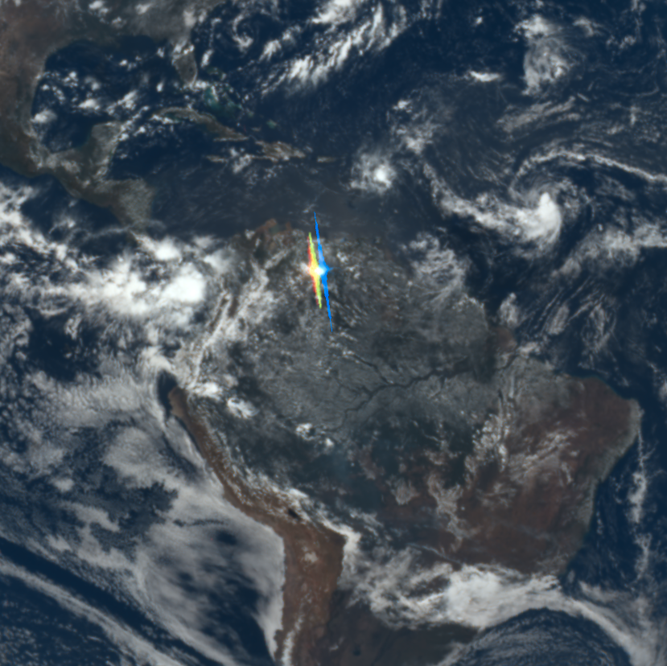
Bright spots can even saturate EPIC detectors
2015 08 24, 16:35 UTC

Slide 5
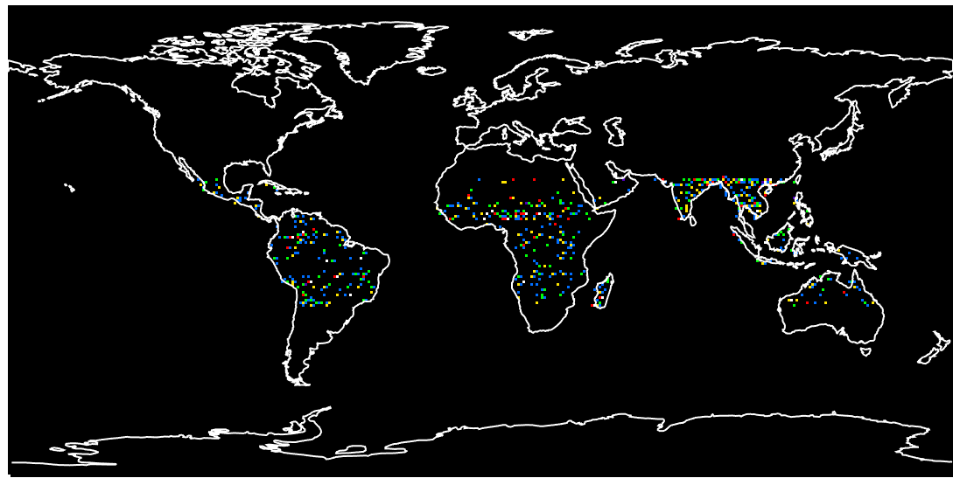
Spots appear over all tropical land areas
One third of images with land in center feature colorful spots

Slide 6
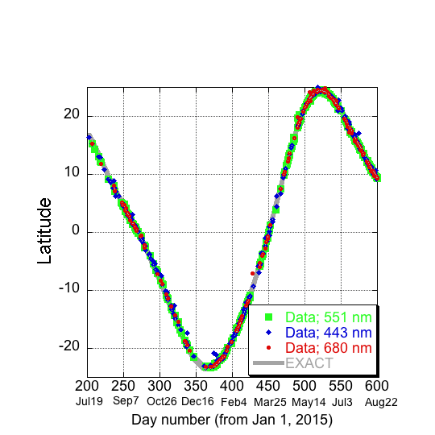
Location of spots confirms cause: specular reflection

Slide 7
Glint form horizontal ice crystals in clouds (subsun)
Photo from aircraft
EPIC image
Können (2017, BAMS)

Slide 8
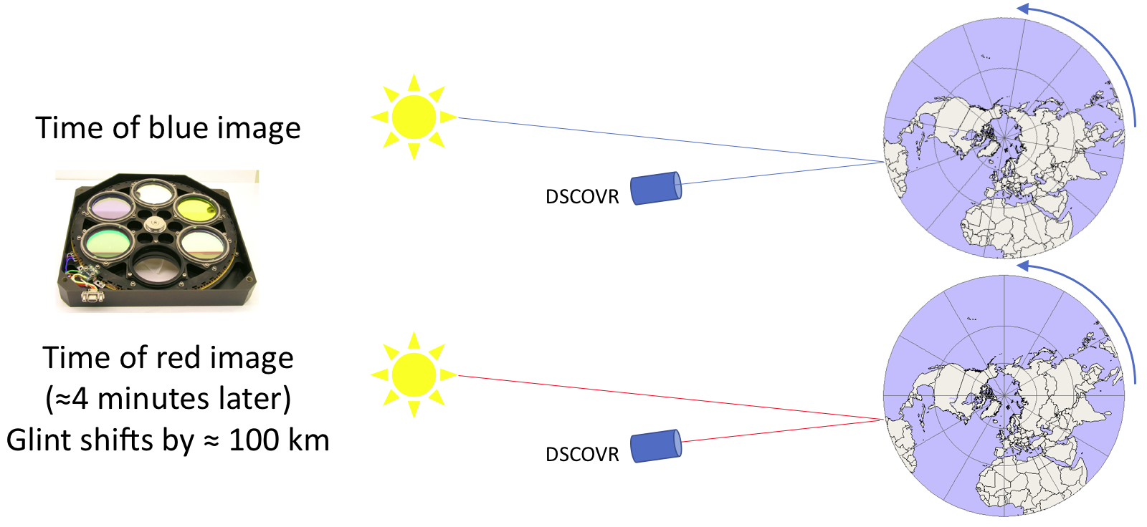
Glints appear colorful, as the Earth turns between blue & red images

Slide 9
EPIC can be used as a multiangle instrument This offers opportunities for ice cloud remote sensing

Slide 10
Oxygen absorption bands can reveal altitude of glints
Ratio = R_{abs} / R_{non-abs}
Spacecraft
Surface reflection:
Low reflectance ratio
High cloud reflection:
High reflectance ratio

Slide 11
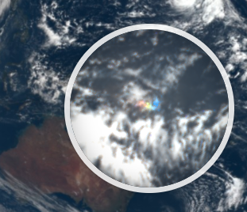
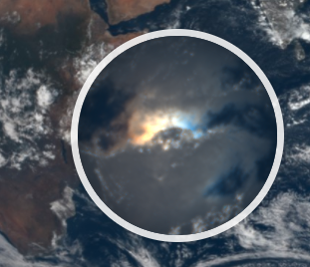
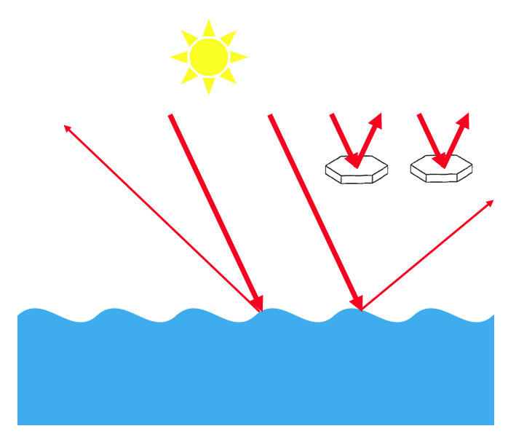
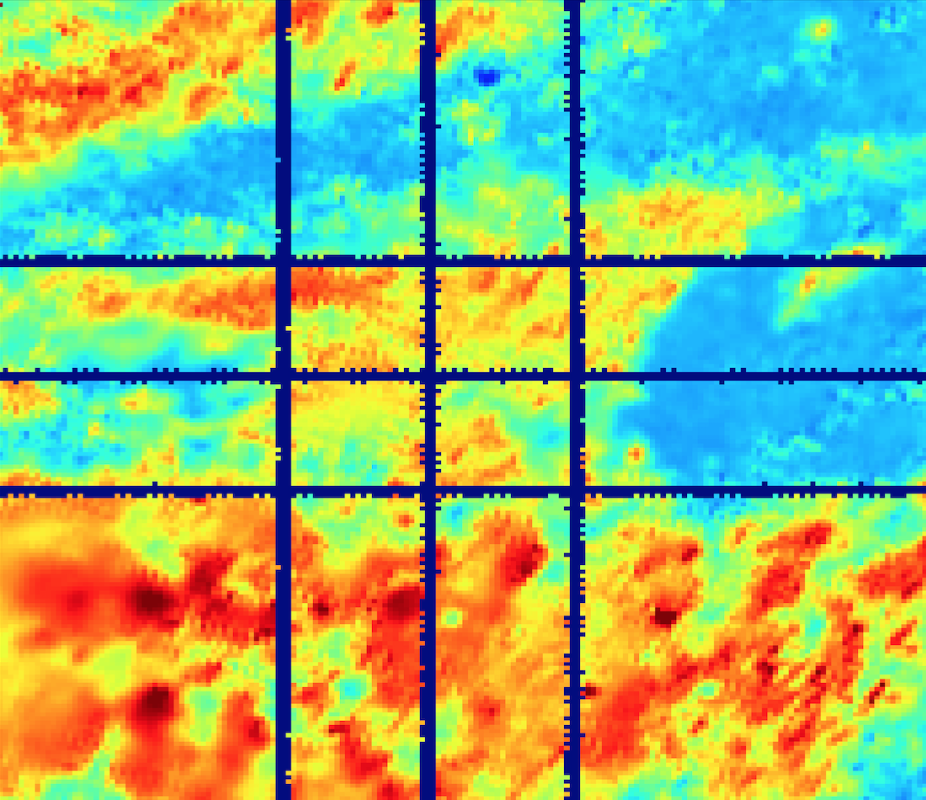
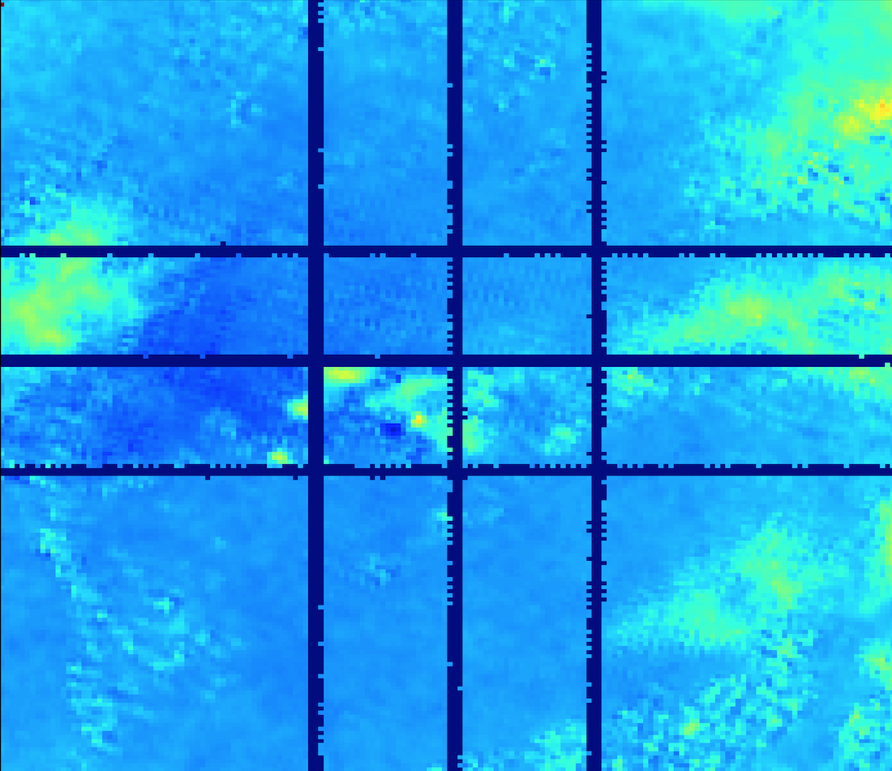
Comparison of a cloud glint and a surface glint
Cloud glint
Surface glint
c
2°N
60°E
0°
2°N
2°N
2°S
0°
0°
2°S
2°S
d
2°N
60°E
160°E
164°E
60°E
64°E
0°
2°S
large ratio
2°N
2°N
small ratio
R₇₆₄ / R₇₈₀
2°S
2°S
160°E
164°E
60°E
64°E
Oct. 3, 2015

Slide 12
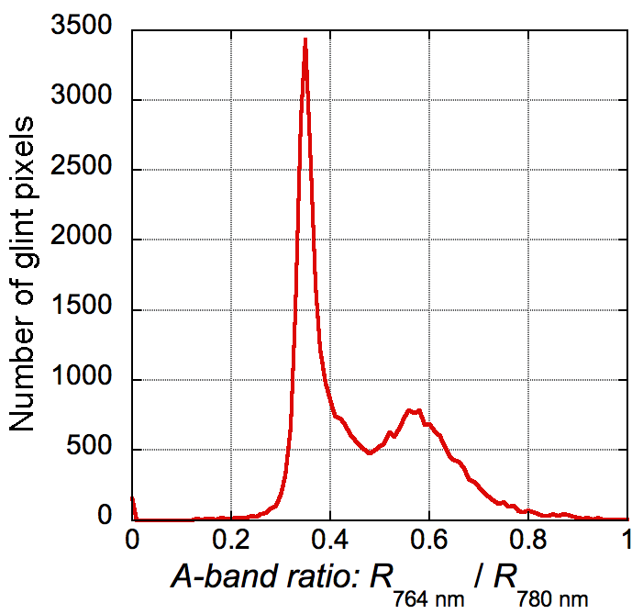
O₂ A-band ratios: glints from clouds & ocean
Ocean
Land
EPIC data + Yuekui Yang’s simulations:
most glints around 5-8 km altitude
Marshak et al. (2017)
yearlong dataset

Slide 13
EPIC glints can indicate the presence of clouds containing Horizontally Oriented Particles (HOPs)
Previous studies have provided estimates of the fraction of clouds containing HOPs using different methods and data sets, but the uncertainties remain quite large.
…considering HOPs in cloud property retrievals in future radiative transfer models may be important.
Zhou et al. (2013)

Slide 14
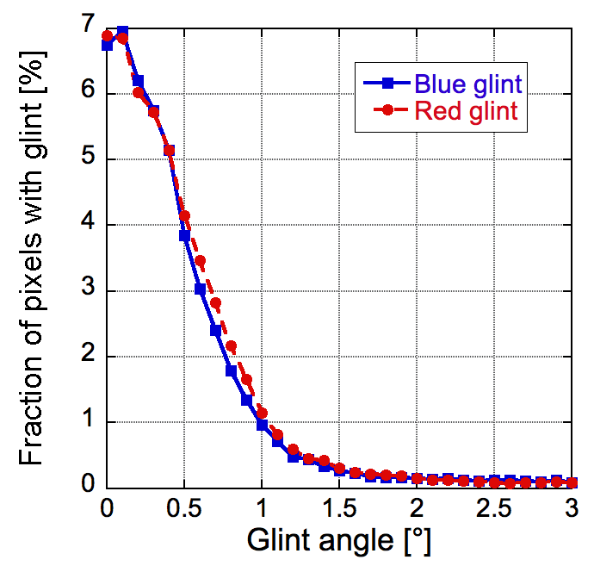
EPIC provides glint statistics at a high angular resolution
How bright and wide are the glints?
DSCOVR
Glint angle
yearlong dataset, land

Slide 15
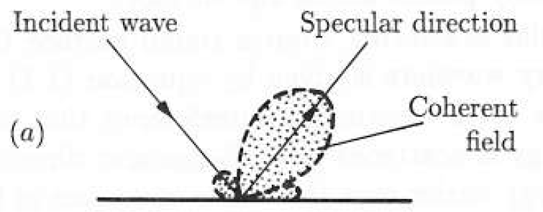
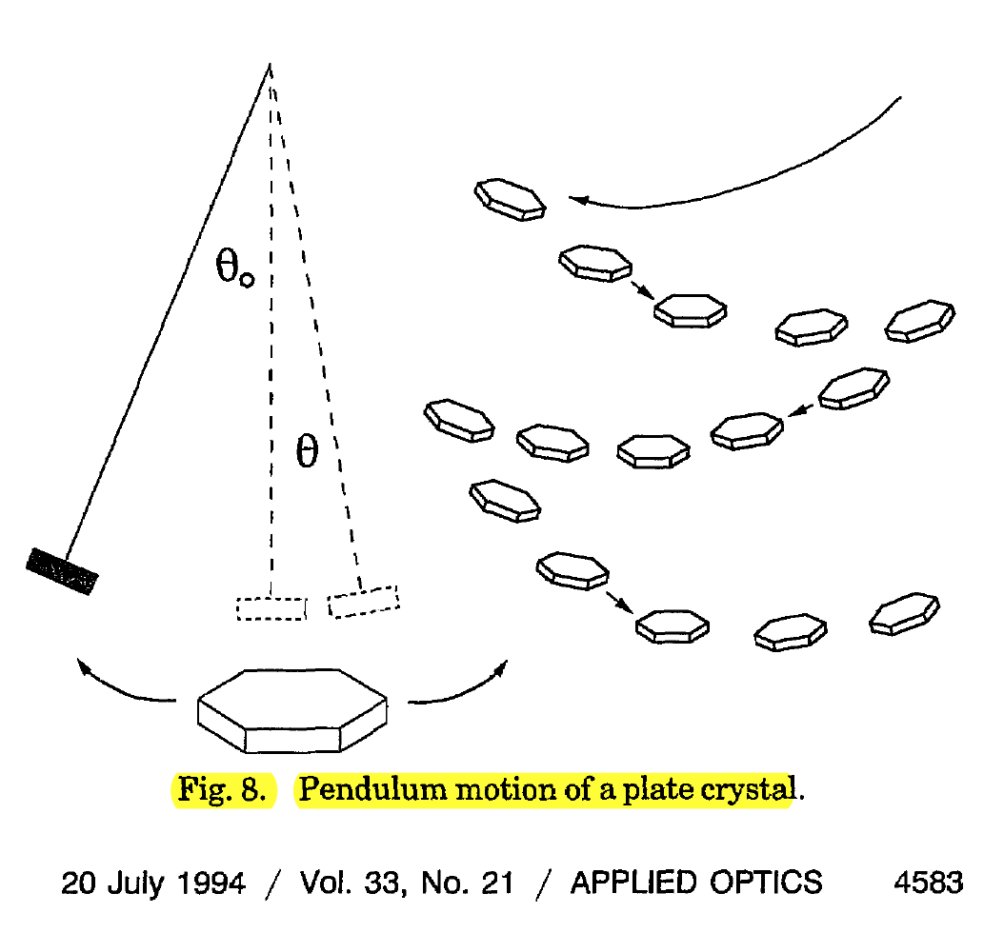
Key factors affecting the width of glints from ice clouds
Solar disc
Diffraction
Tilt
Θ = λ / D
Θ is half-width of the diffraction lobe
For λ = 0.5 μm and D = 50 μm, Θ = 10⁻² (≈ 0.6º)
from Lynch (1994, Appl. Optics)
Katz (1996, JAS): tilt depends on Reynolds number
Diameter is 0.5°
Bréon & Dubrulle (2004, JAS): tilt angle varies “between 0.5º and a few degrees from weak to strong turbulence.” for plate diameters between 100 μm and a few mm

Slide 16
EPIC can help address questions such as
What are the prevalence, size, and tilt of horizontally oriented ice crystals, and how do these crystals affect cloud albedo?
Combine glint statistics from EPIC with radiative transfer simulations

Slide 17
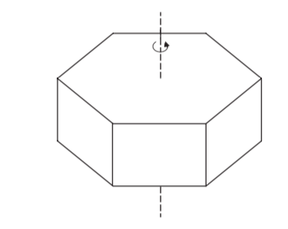
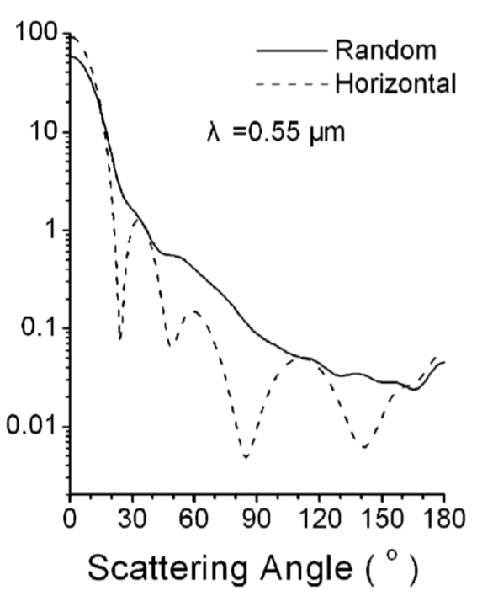
Radiative properties of oriented crystals
θ_{i} = 0°
log(P₁₁)
Scattering angle (°)
Chen et al. (2006)
Ping Yang: calculations for complex ice crystals in progress

Slide 18
Summary
Many DSCOVR/EPIC images contain colorful bright spots caused by specular reflection from horizontally oriented ice platelets floating in clouds.
EPIC offers excellent opportunities for studying horizontal crystals in ice clouds due to its quasi-multiangle data and O₂ absorption bands.
Cloud glints were detected in roughly 6-7% of pixels or 1/4 of ice clouds at the locations where EPIC can observe specular reflection.
Combining EPIC with simulations can help estimate the prevalence, size, and tilt of oriented ice crystals and their contribution to Earth’s albedo.
Marshak, A., T. Várnai, and A. Kostinski (2017), Terrestrial glint seen from deep space: Oriented ice crystals detected from the Lagrangian point, Geophys. Res. Lett., 44, doi:10.1002/ 2017GL073248.

