Slide 1
Using Deep Space Climate Observatory Measurements to Study the Earth as An Exoplanet
Jonathan H. Jiang¹, A.J. Zhai², J. Herman³, C. Zhai¹, Renyu Hu¹,
H. Su¹, V. Natraj¹, J. Li², F. Xu¹, Y. Yung²
¹Jet Propulsion Laboratory, California Institute of Technology, Pasadena, California
²California Institute of Technology, Pasadena, California
³NASA Goddard Space Flight Center, Greenbelt, Maryland

Slide 2
Exoplanet exploration moving from detection to characterization

Slide 3
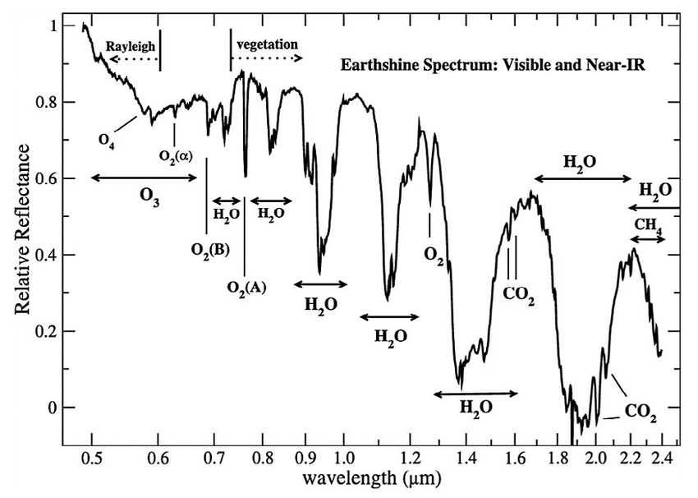
Earth is the baseline for characterizing terrestrial exoplanets
Turnbull et al. 2006

Slide 4
Principal components in broadband photometry of EPOXI
Cowan et al. 2009

Slide 5
Objective: Use Deep Space Climate Observatory (DSCOVR) measurements from L1 orbit to simulate imaging a planet from afar and study methods for determining the rotation, weather patterns, and surface terrain of an Earth-like exoplanet.
Approach:
Average DSCOVR images to a single point and generate timeseries for each wavelength. These novel measurements act as proxy for exoplanet data and can be used to learn how to study a planet from afar.
Examine possibility for separation of surface and cloud signal through linear combination of different wavelength channels.
Use Fourier analysis techniques to extract periodic behavior due to planetary rotation, weather (cloud) patterns, surface terrain (ocean, land, vegetation), and the moon.
Develop plans for comparing integrated single point DSCOVR data to potential exoplanet measurements.

Slide 6
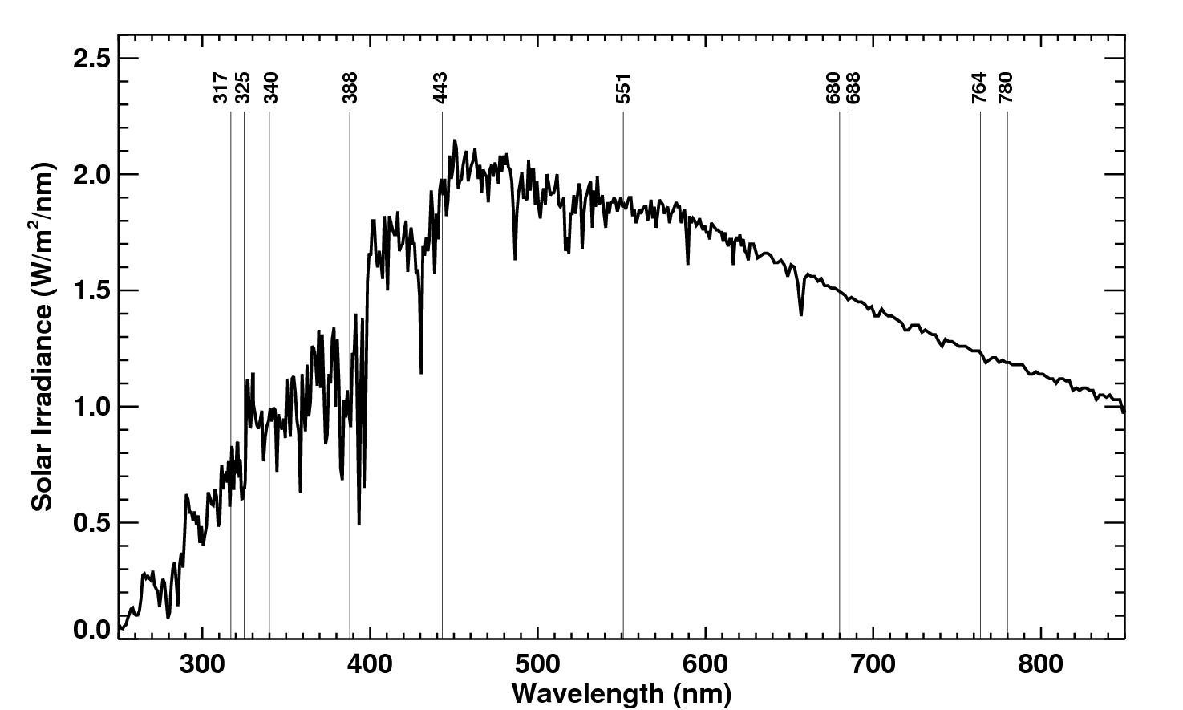
Solar Spectrum and DSCOVR/EPIC wavelength channels

Slide 7
The calibration factors K are obtained using in-flight scene matching calibration from Earth orbiting satellites for most of the EPIC channels, and from the Moon for the 2 oxygen absorbing channels (688 and 764 nm).

Slide 8
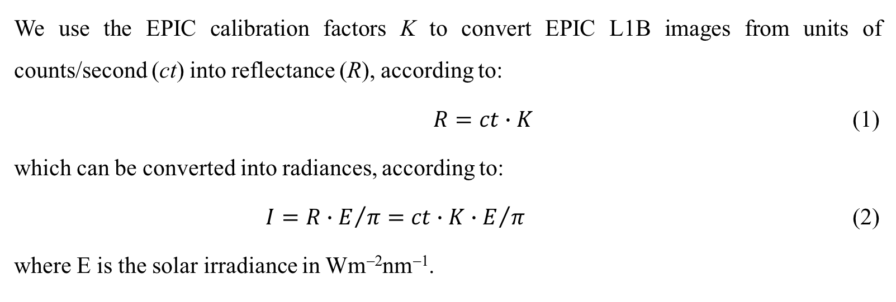
We use the EPIC calibration factors K to convert EPIC L1B images from units of counts/second (ct) into reflectance (R), according to:
$R=ct∙K$ (1)
which can be converted into radiances, according to:
$I=R∙E/π=ct∙K∙E/π$ (2)
where E is the solar irradiance in Wm⁻²nm⁻¹.

Slide 9
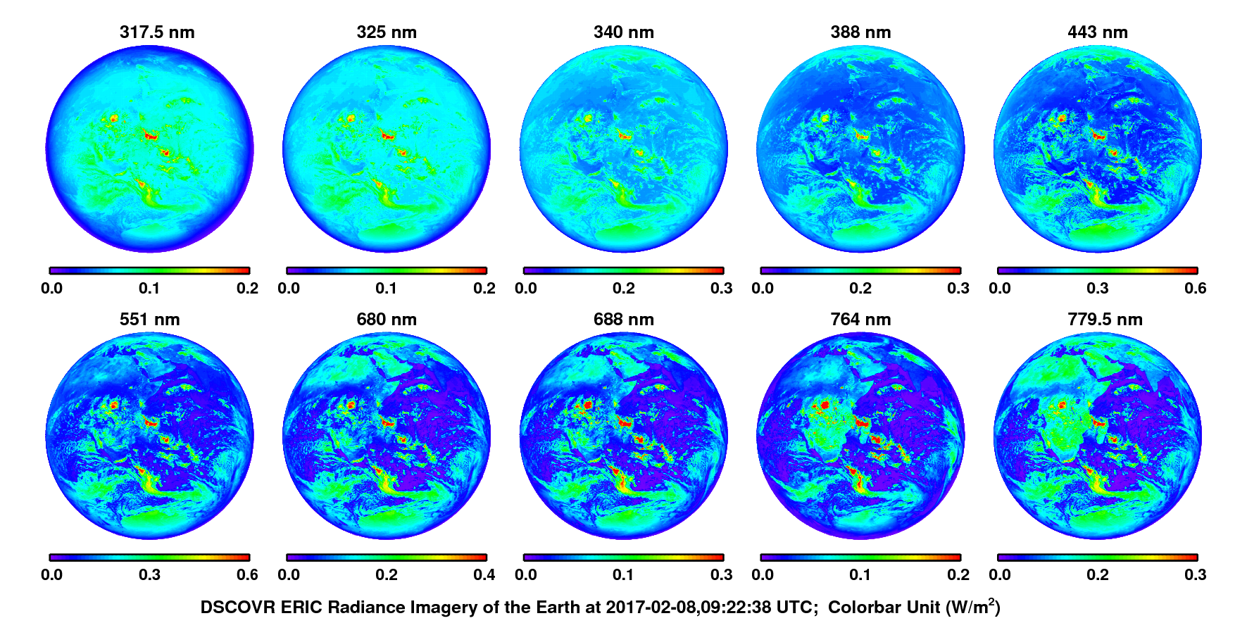
DSCOVR EPIC’s 10 wavelength imagery of the Earth and differences in reflectance across channels
Northern Hemisphere WINTER

Slide 10
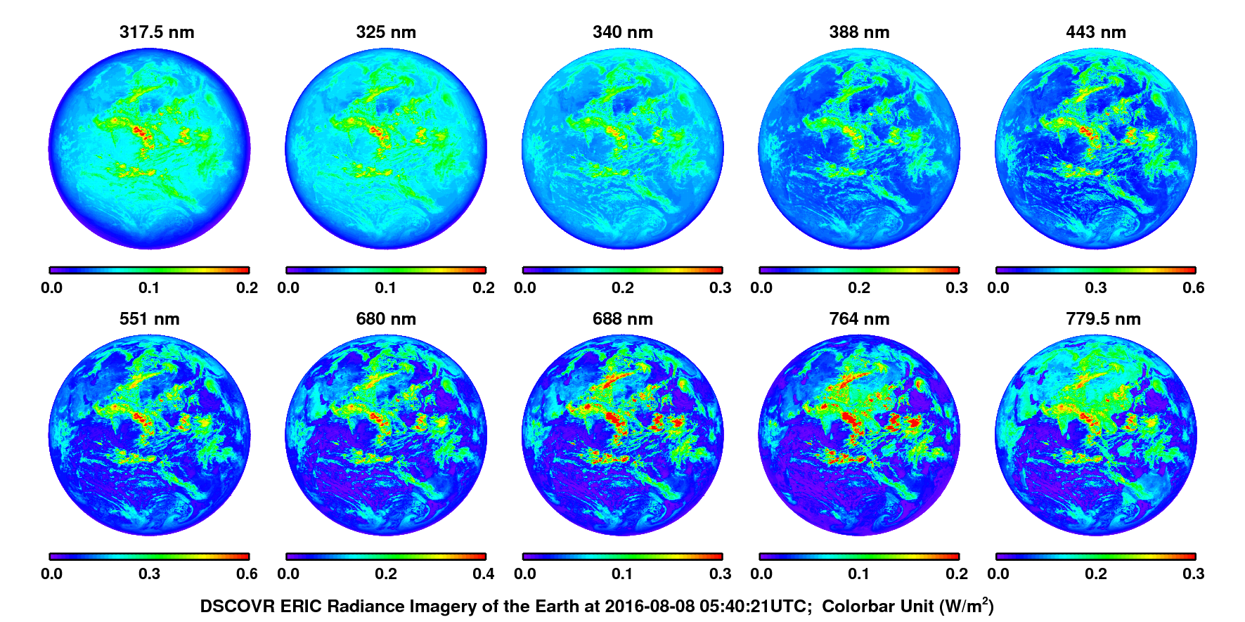
DSCOVR EPIC’s 10 wavelength imagery of the Earth and differences in reflectance across channels
Northern Hemisphere SUMMER

Slide 11
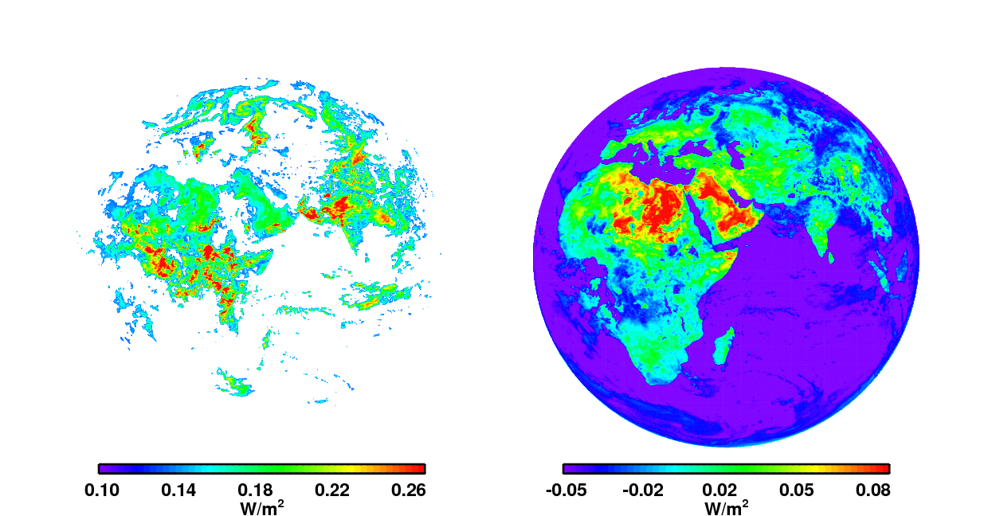
Separating Cloud and Surface Signatures
Cloud signature radiance (I_{c})
Surface signature radiance (I_{s})
The 75th percentile of pixel measurements for each image is a good approximation for a cutoff that maximizes cloud coverage while excluding all land.
By minimizing the values in these areas, ~90% of clouds can be removed.
f is a factor that computed to maximize the removal of cloud contribution.

Slide 12
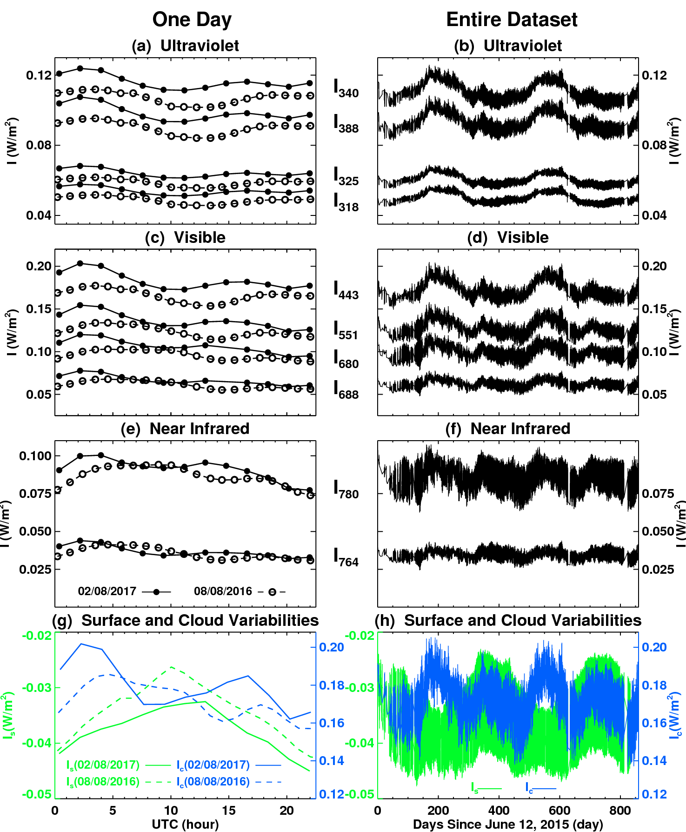
“Single-Point Observation” Time Series
Time variations of DSCOVR EPIC L1B radiances after averaging to single-point measurements for each wavelength bands, as well as surface and cloud signature radiances (I_{s} and I_{c}).
Left: measurements from February 8, 2017 (solid-lines and dots) and August 8, 2016 (dashed-lines and open circles)
Right: entire time series of the single-point measurements over the full dataset from June 12, 2015 to October 17, 2017.

Slide 13
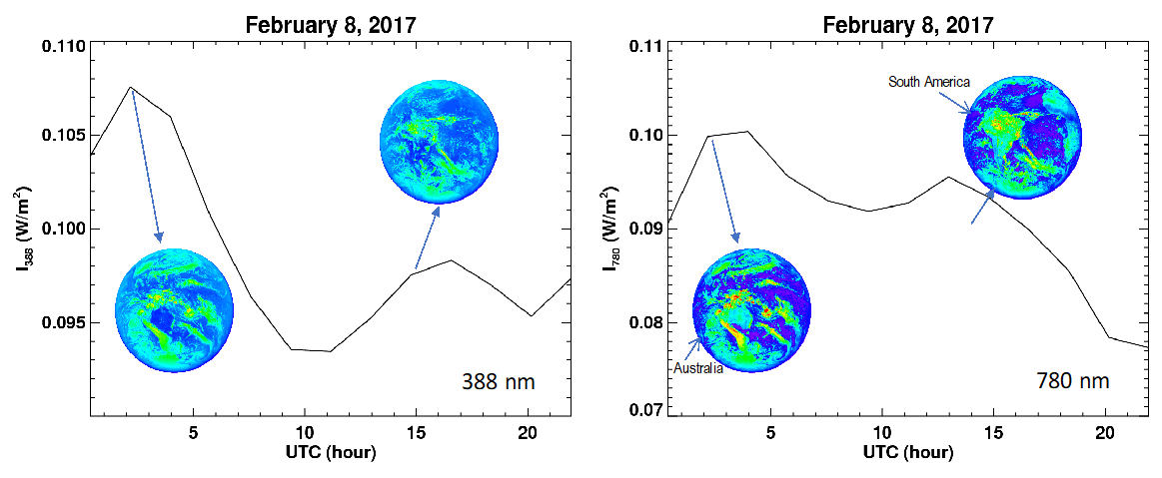
Daily variations are caused by cloud and land surface patterns
Variation of single-point averaged Earth reflectance on February 8, 2017 for I₃₈₈ (left-panel) and I₇₈₈ (right-panel) radiances, respectively.

Slide 14
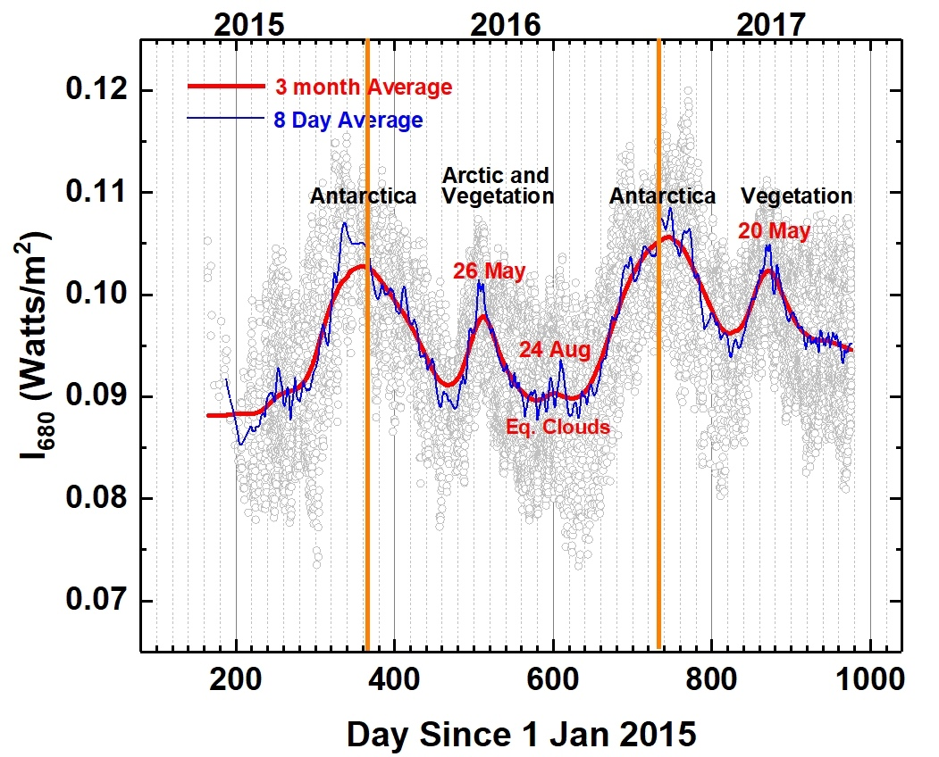
Longer term variations are related to seasonally/periodically varying clouds systems and surface/vegetation features
Geo-location reference of the Earth as seen from the DSCOVR’s L1 location on June 21 (left-panel) and December 21 (right-panel), 2016. The Earth’s orbital inclination angle changes annually relative to the Sun and the EPIC camera.
Time series of I₆₈₀ single-point radiances. The annual reoccurrence of typical surface features such as the Antarctica ice-cap is evident.

Slide 15
Fourier Analysis
1-day (24 h): Rotation of the Earth
0.5-day (12h): Two major continents Asia and North America is passing the EPIC FOV in 12 hours. China (Beijing) is 12 hours ahead of U.S.A (Washington, DC).
0.33-day (8h): Australia west coast is 8 hours ahead of (Cairo, Egypt). Australia is also 12h away from S. America.
0.25-day (6h): South America and Africa is passing EPIC FOV in 6 hours. S. America is 6 hours ahead of S. Africa.
90-day: Every 3-month (90 days), the DSCOVR spacecraft is on the opposite side of the Earth-Sun line; Most of the vegetable crops have a ~90 days growth cycle.
182-day: DSCOVR spacecraft has a 6-month (180 days) orbit about L1 point.
365-day: The Earth’s orbit around the Sun.
Jiang et al. 2018

Slide 16
Summary
DSCOVR EPIC Earth images are analyzed to explore possibilities of using EPIC observations to help future exoplanet studies.
We identified several Earth features by analyzing their spectral reflectance signatures.
We separated clouds and surface (land and ocean) signatures in the EPIC images using a linear combination of two wavelength channels (388 nm and 780 nm) to remove cloud contribution.
EPIC’s Earth images were averaged to single-point “measurements” that yielded information about the Earth’s rotation, seasons, and periodic variations due to weather (clouds) patterns, surface type (ocean, land, vegetation).

Slide 17
Backup slides

Slide 18
We also used the DSCOVR data to simulate the minimum data collection rate needed to determine the rotation period of an exoplanet. For Earth, we determined that the minimum sampling interval required for the detection is 10 hours.

Slide 19
Simulated edge-one phase angle changes of Earth images.

Slide 20
The simulated Earth image with face-on phase angle changes. This face-on case, however, is unlikely to be common since most of the exoplanets were discovered by transit or radial velocity methods, which cannot detect an exoplanet whose orbit is seen face-on.

