Slide 1
Average Cloud Properties
How representative are Terra and Aqua hours?
Alfonso Delgado-Bonal¹, Alexander Marshak²
¹ Universities Space Research Association (USRA)
² NASA Goddard Space Flight Center
Sept 18, 2018. GSFC

Slide 2
One per day
10:30 and 13:30

Slide 3
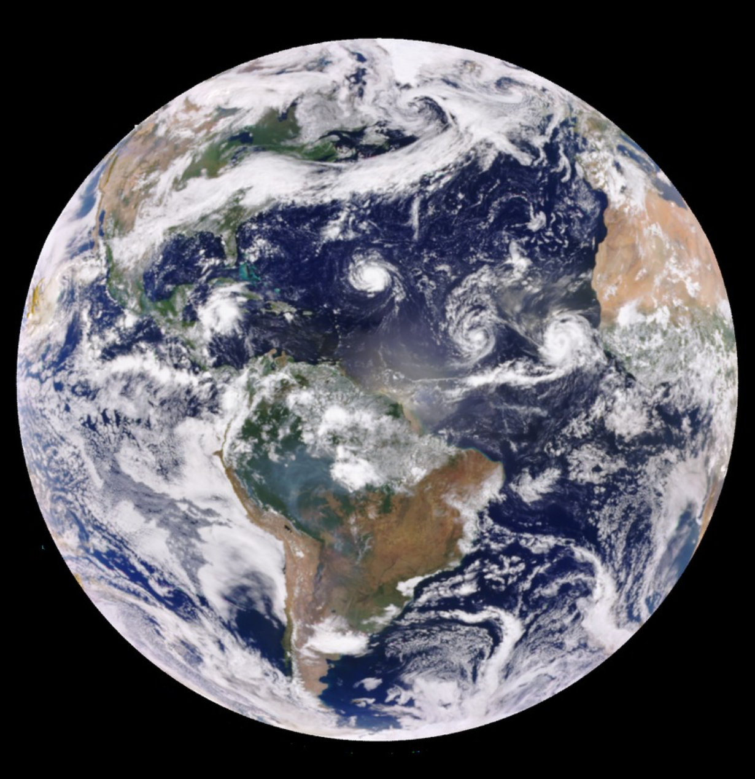
DSCOVR EPIC Cloud Products
2181 datasets for 2017
Several per day
Which one is the “most representative” one?

Slide 4
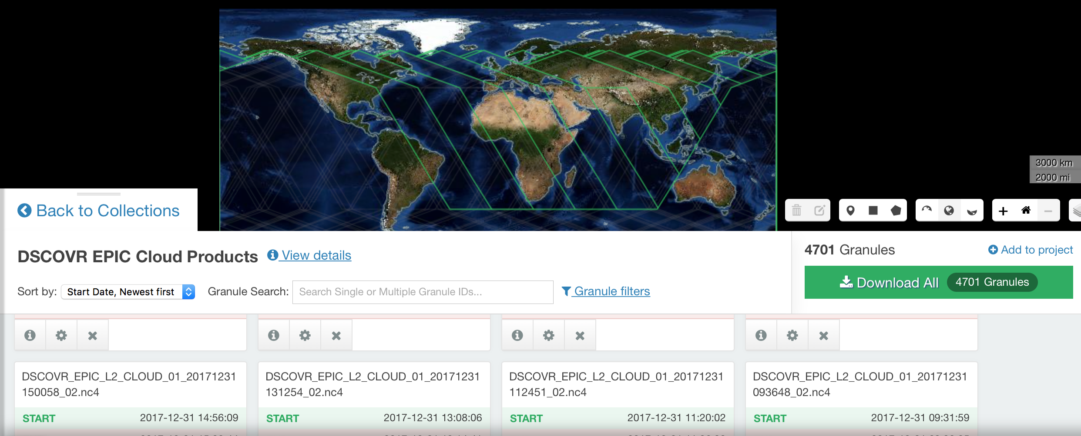
DSCOVR EPIC Cloud Products
2181 datasets for 2017
Several per day
Which one is the “most representative” one?
Preliminary analysis
Take it with a grain of salt

Slide 5
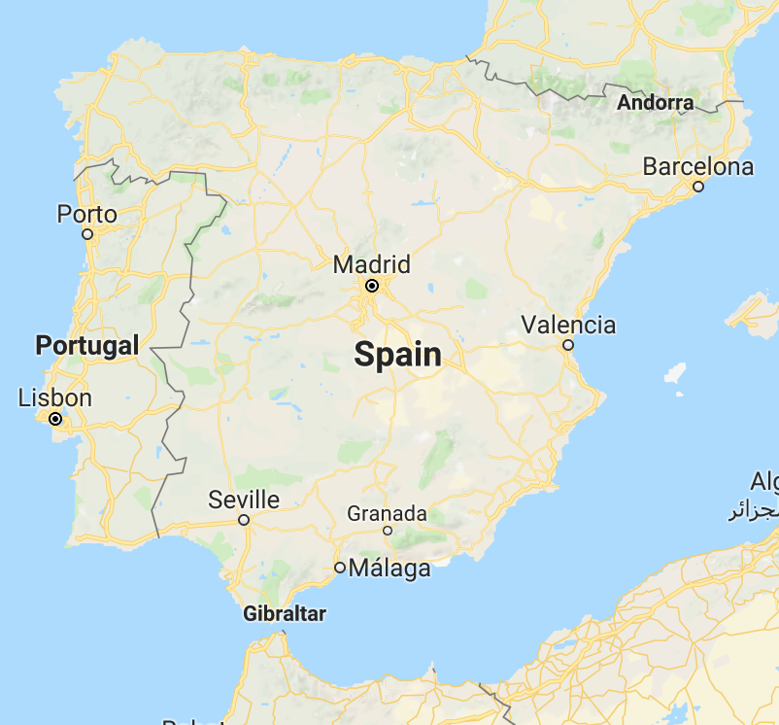
Case Study: Cloud Pressure over Spain
Lat +36 to +44
Lon -10 to +4
One single grid
A-band Effective_Cloud_Pressure
Year 2017

Slide 6
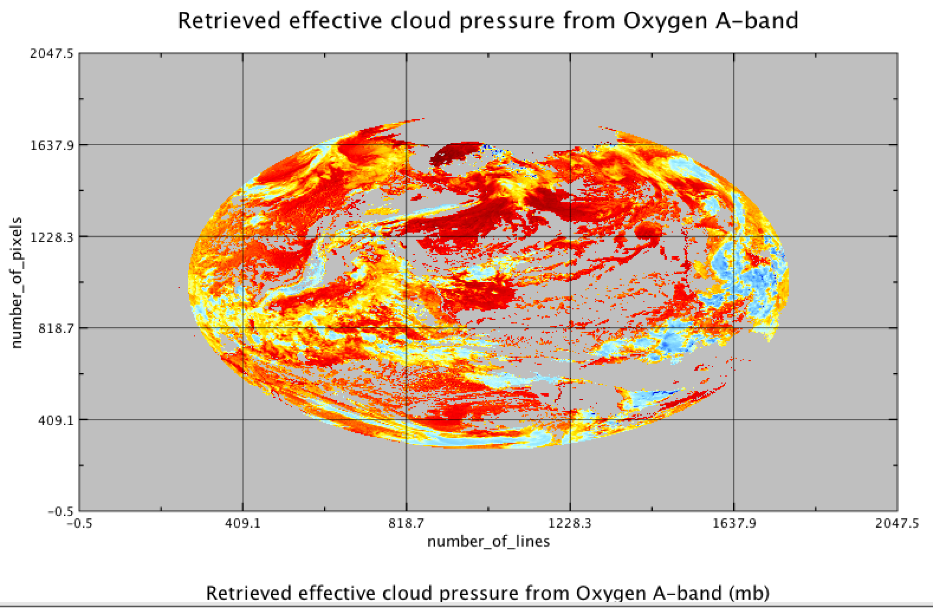
No cloud pressure
2048*2048 = 4194304 pixels

Slide 7
x-axis: Jan 2017 to Dec 2017
2181 datasets in 2017
Most of the pixels don’t have information about Spain or it is zero pressure

Slide 8
Same day
6:00
0 mb
9:00
700 mb
12:00
750 mb
15:00
720 mb
17:00
0 mb
Daily avg
723 mb
NOT considering zeros

Slide 9
2181 datasets in 2017
1002 with cloud pressure greater than zero
Average Pressure each day

Slide 10
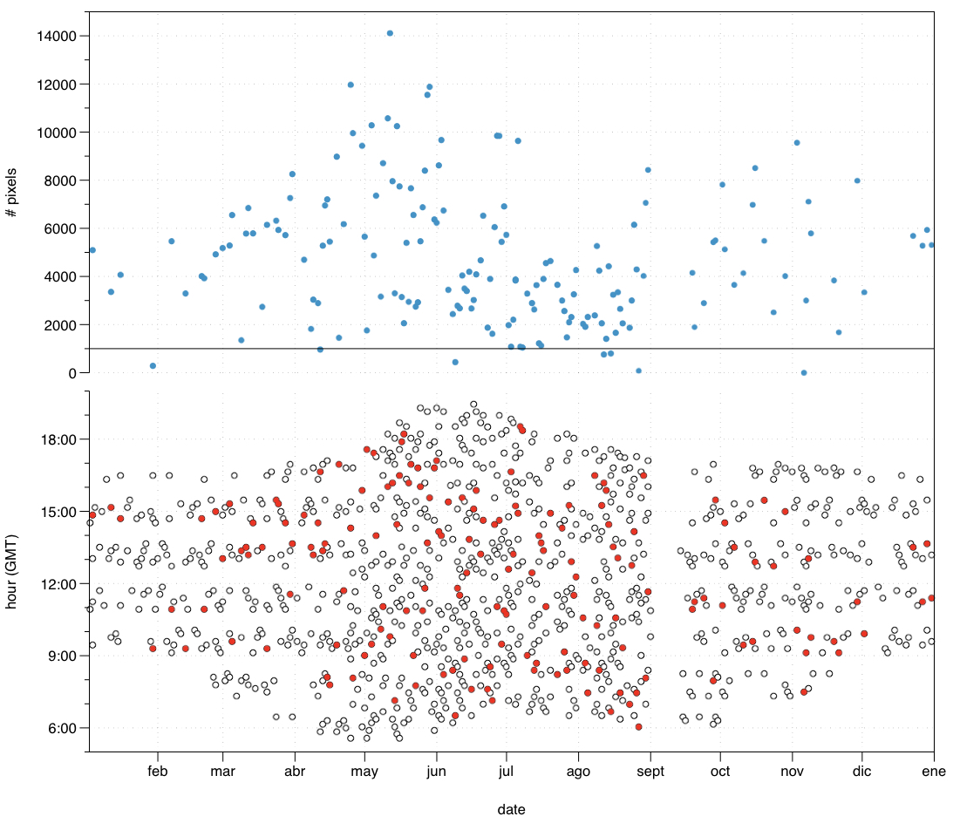
Hours of the datasets each day
Red points: Closest dataset when there are more than two datasets with cloud pressure over Spain that day
(if there is only one dataset, then that’s the most representative one, and if there are two the mean is in between)
NOT considering those datasets with zero cloud pressure
167 datasets with > 3 datasets per day
”Random” behavior

Slide 11
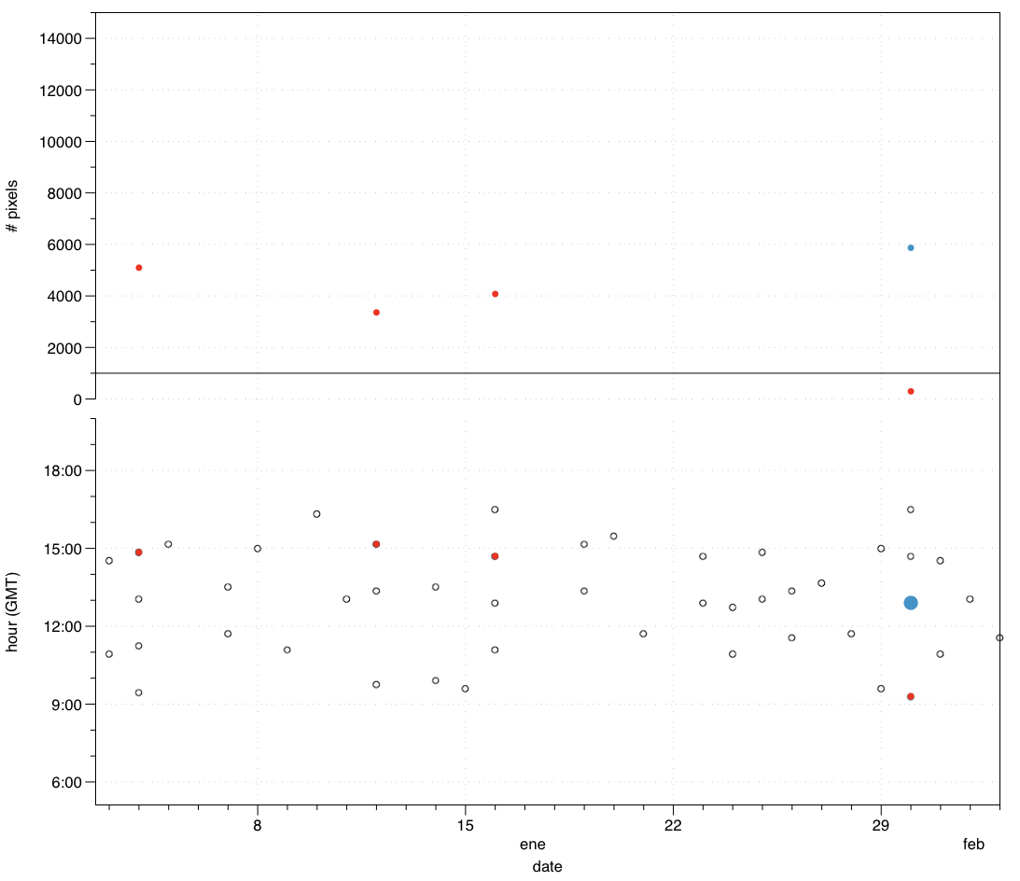
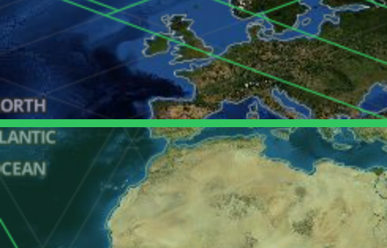
Date Avg pressure #pixels
Some datasets are not valid as representative

Slide 12
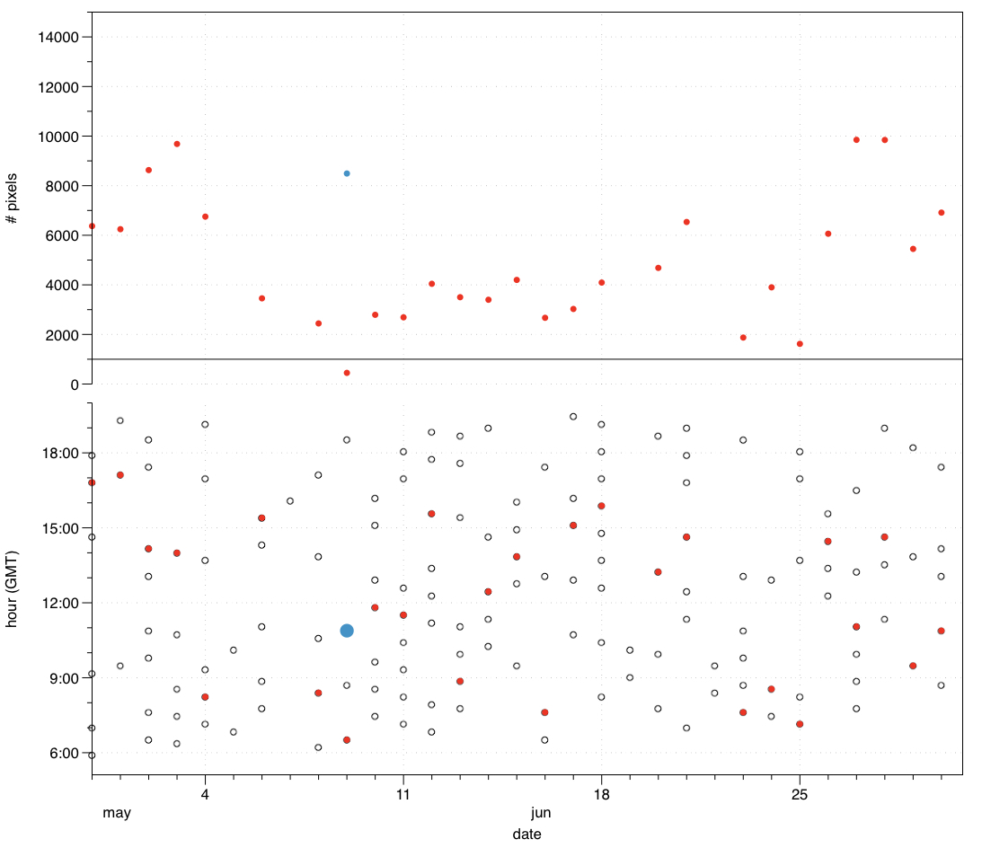
Introducing a bias due to the lack of enough datasets with the same hours
Inconclusive
Add up the dataset information

Slide 13
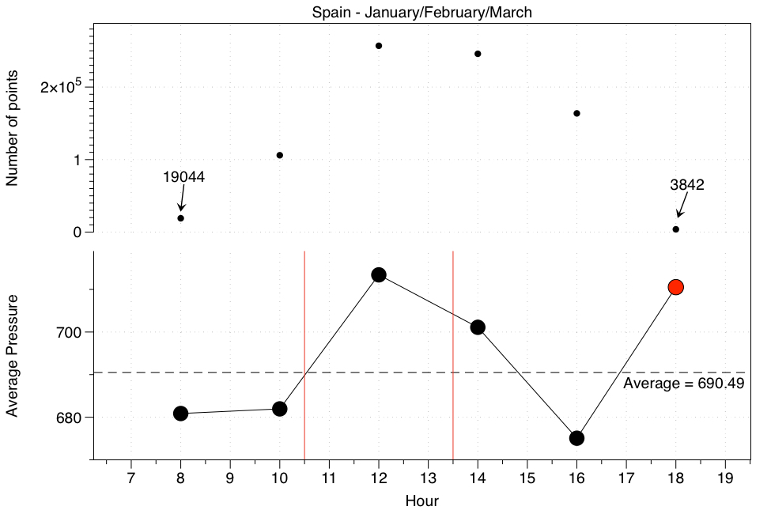
Seasonal Analysis
Cloud Pressure
For the first three months
Add up every two hours
10:30 is close to the mean
13:30 is overestimating the value
18:00 low number of data.

Slide 14
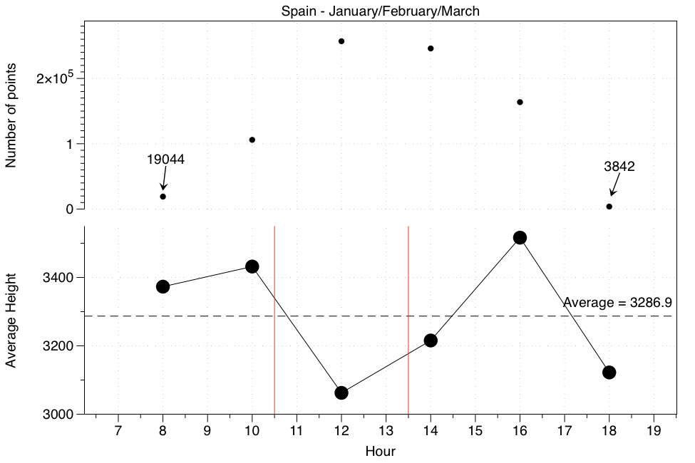
Seasonal Analysis
Cloud Height
For the first three months
Add up every two hours
10:30 is extremely close to the mean
13:30 is overestimating the value
18:00 low number of data.

Slide 15
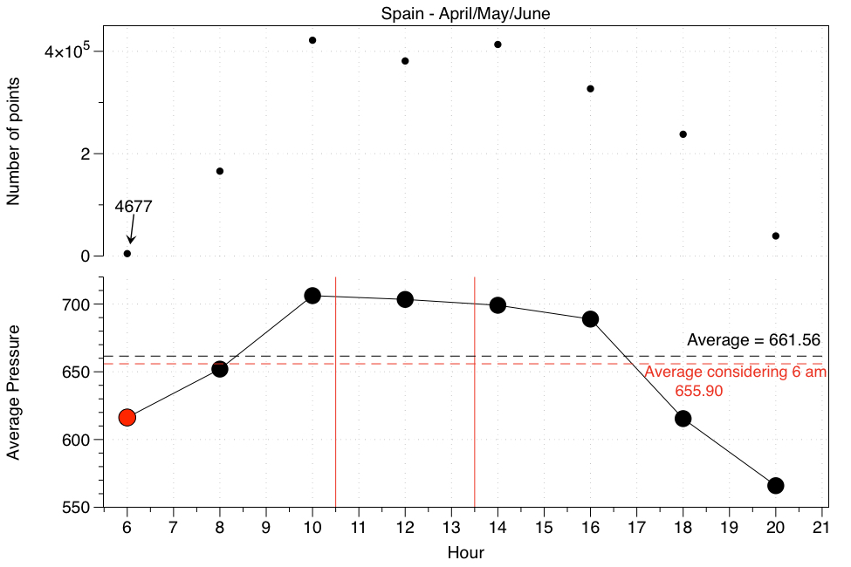
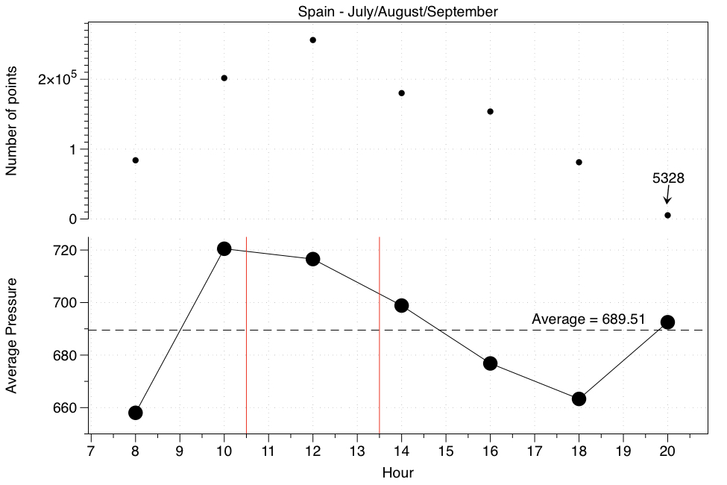
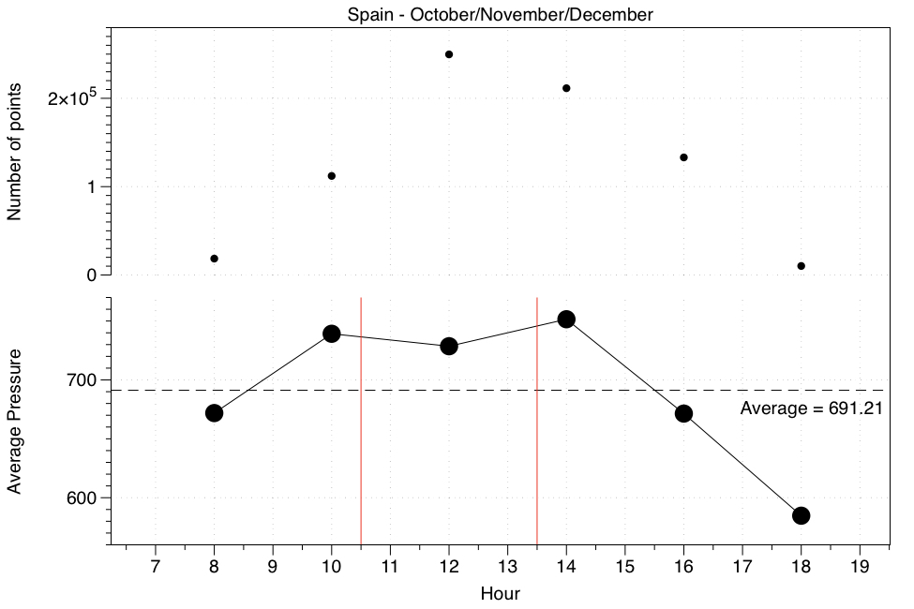
Seasonal Analysis

Slide 16
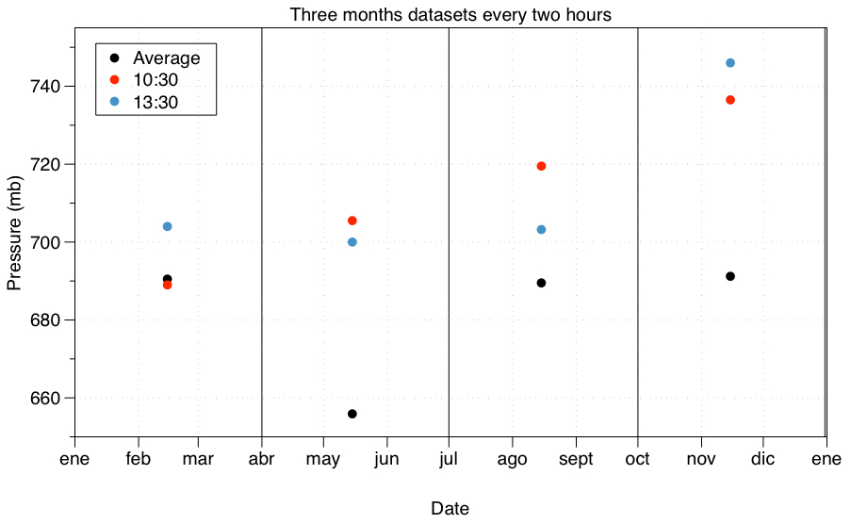

Slide 17
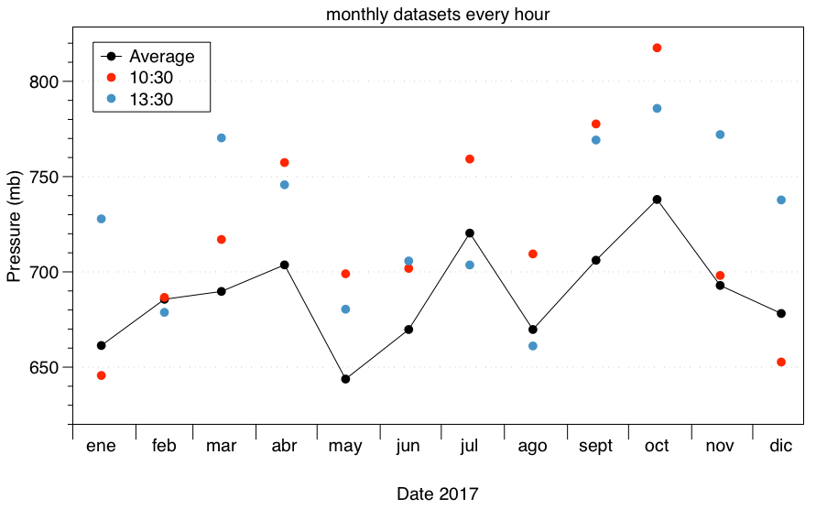

Slide 18
Summary
EPIC datasets can be use to determine average properties
A more detailed analysis including all datasets is required
When analyzing larger areas we are mixing latitudes/longitudes at different times

