Slide 1
EPIC Geolocation
Karin Blank
NASA/GSFC Code 586
September 17th, 2018

Slide 2
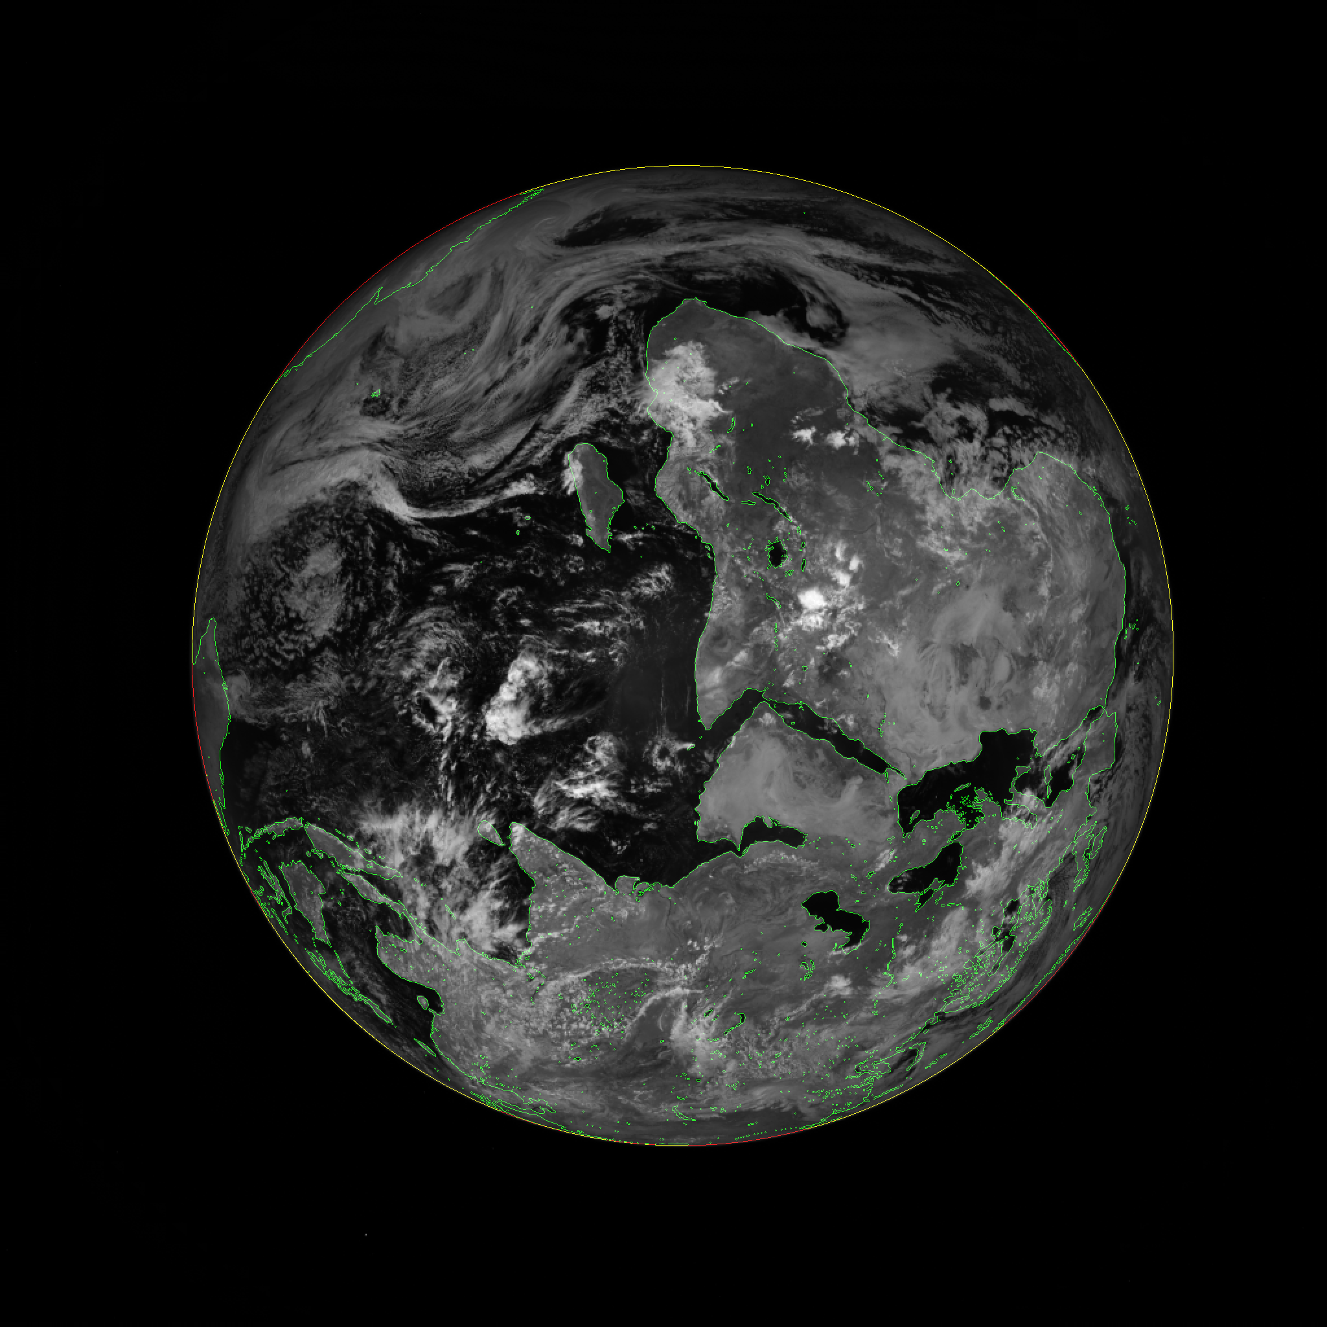
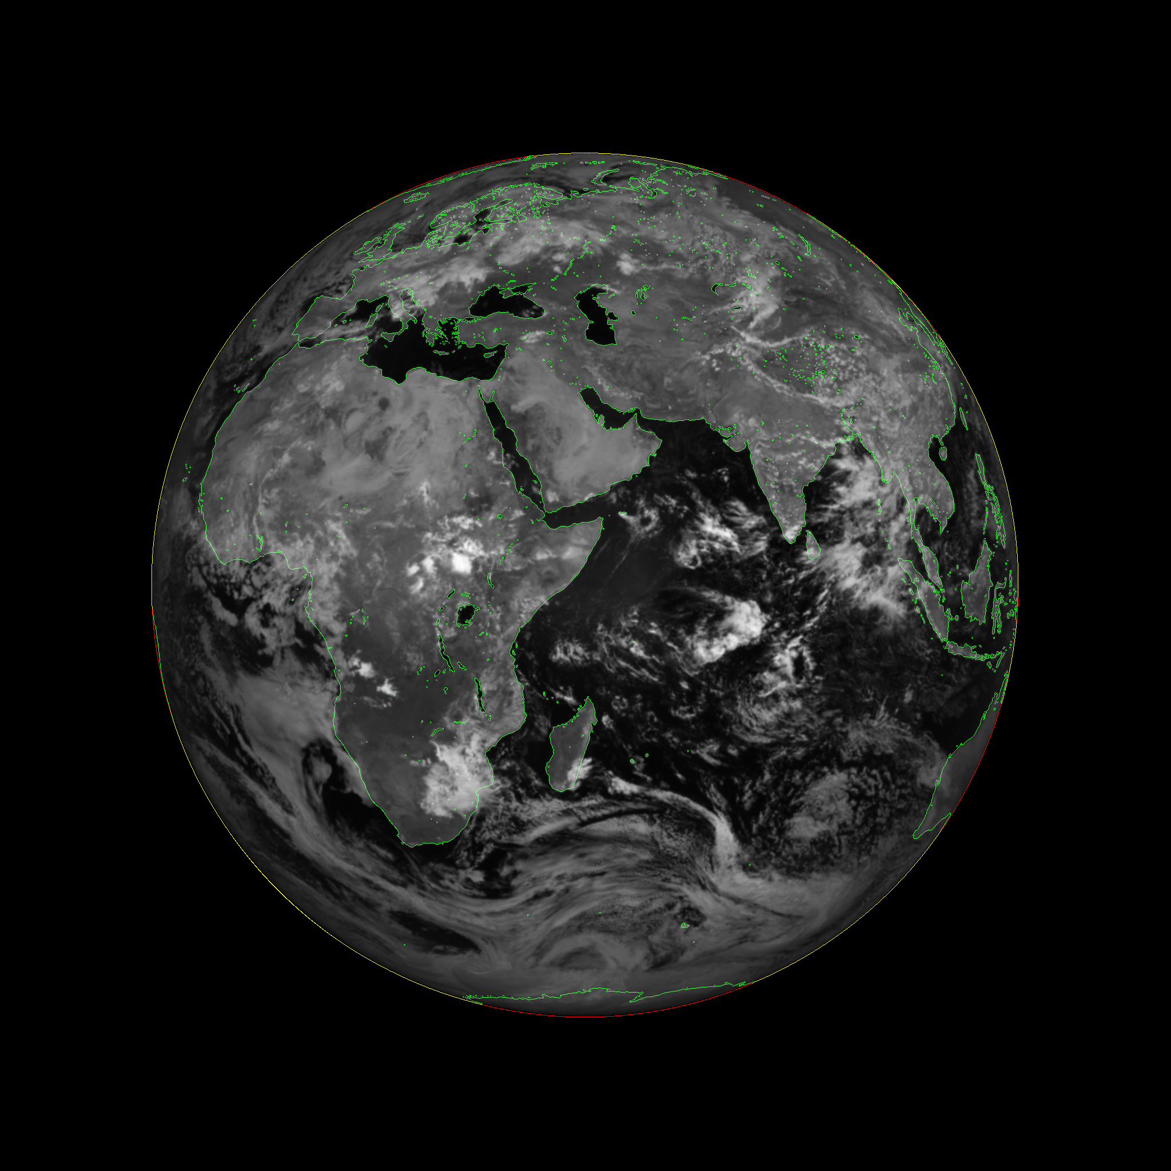
Level 1 Products
Level 1A
Level 1B
Images are calibrated counts in native sensor format
Geolocation provides per pixel
Latitude/Longitude coordinates
Spacecraft viewing angles
Sun angles
Images are georectified into a common reference frame
Geolocation in common reference frame
Latitude/Longitude coordinates
Spacecraft viewing angles
Sun angles

Slide 3
Algorithm Progress
Focus | Algorithm Version | Product Release Version | Features
Simulator | Revision 0 |  | Pre-launch simulator
Relative Geolocation | Revision 1 | Version 0 | First geolocation; website pictures
 | Revision 2 |  | Mitigation of issues with optical artifacts
 | Revision 3 |  | Improved cross-band registration
 | Revision 4 | Version 1 | Subpixel registration L1b (Kai Yang’s algorithm)
Absolute Geolocation | Revision 5 | Version 2 | Initial fixes for absolution geolocation
 | Revision 6 | Version 3 | Atmospheric refraction correction, improved optical model, attitude correction, improved lat/lon

Slide 4
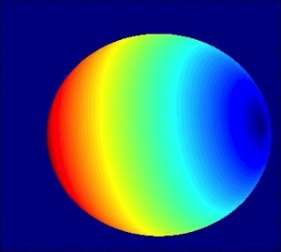
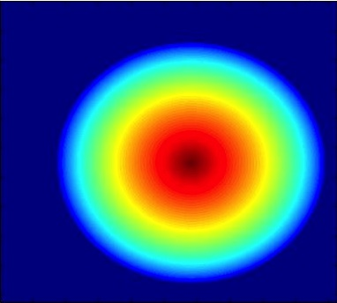
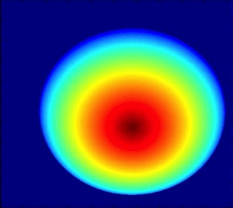
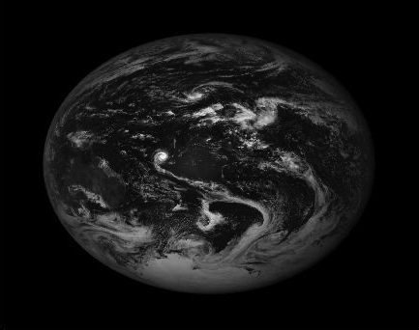
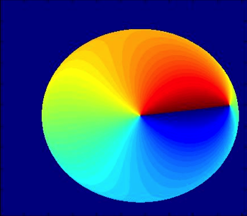
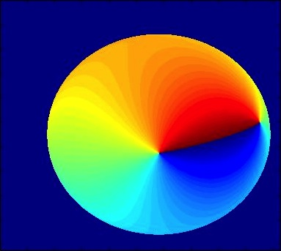
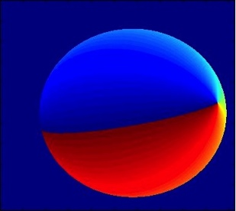
Geolocation anatomy
Geographic Model
Optical Model
Pose
3D Earth description
Geoid
Terrain model
Atmospheric refraction
Telescope prescription
Focal length (magnification)
Optical distortion
Position of Earth
Spacecraft attitude & ephemeris
Astronomical
2D Renderer
Lat/lon coordinates
View angles
Sun angles
Georectification

Slide 5
Spacecraft Attitude in DSCOVR– Star Tracker only
Star tracker
Only coarse attitude control
Wandering pitch/yaw
Roll accuracy less than .5 degrees
Images require minimum .05 degrees
R05
Has basic pitch/yaw correction
No roll correction

Slide 6
EPIC Optical Design
EPIC Schematic
Field Lens Group
Field Lens Group
CCD
Primary
Secondary

Slide 7
EPIC Optical Correction
Example of pincushion distortion
Requires
Focal Length
Optical distortion
Radial
Tangential
Chromatic aberration
Transverse
R05
Initial focal length correction
No optical distortion correction
No chromatic aberration correction

Slide 8
Fixed Value Inputs
Focal Length (f)
Earth Model (lat, lon, X, Y, Z, h)
Optical Distortion (K₁, K₂, K₃, P₁, P₂, P₃, P₄, X_{c}, Y_{c})
Time (t)
Astronomical Calc (r_{x}, r_{y})
Output
Spacecraft Orientation (r_{z})
2D Transform (x, y)
Latitude
Attitude(Q₁, Q₂, Q₃, Q₄)
Rotation to Spacecraft View (X_{r}, Y_{r}, Z_{r})
Dynamic Value Inputs
Longitude
SC Ephem (X, Y, Z)
Spacecraft/Earth distance (d)
Spacecraft View Angles
Sun Ephem (X, Y, Z)
Imaging Target (Body)
Sun View Angles
Moon Ephem (X, Y, Z)
Refraction Angles
Image
Earth Centroiding (x₀, y₀)

Slide 9
Problems for R06
Dynamic Unknowns
Positional accuracy below requirements
3 variables below needed accuracy
Within 0.05 degrees
Error up to 0.5 degrees in rotation
Static Unknowns
Undefined telescope prescription
11+ variables with unknown values
Within 0.5 pixels

Slide 10
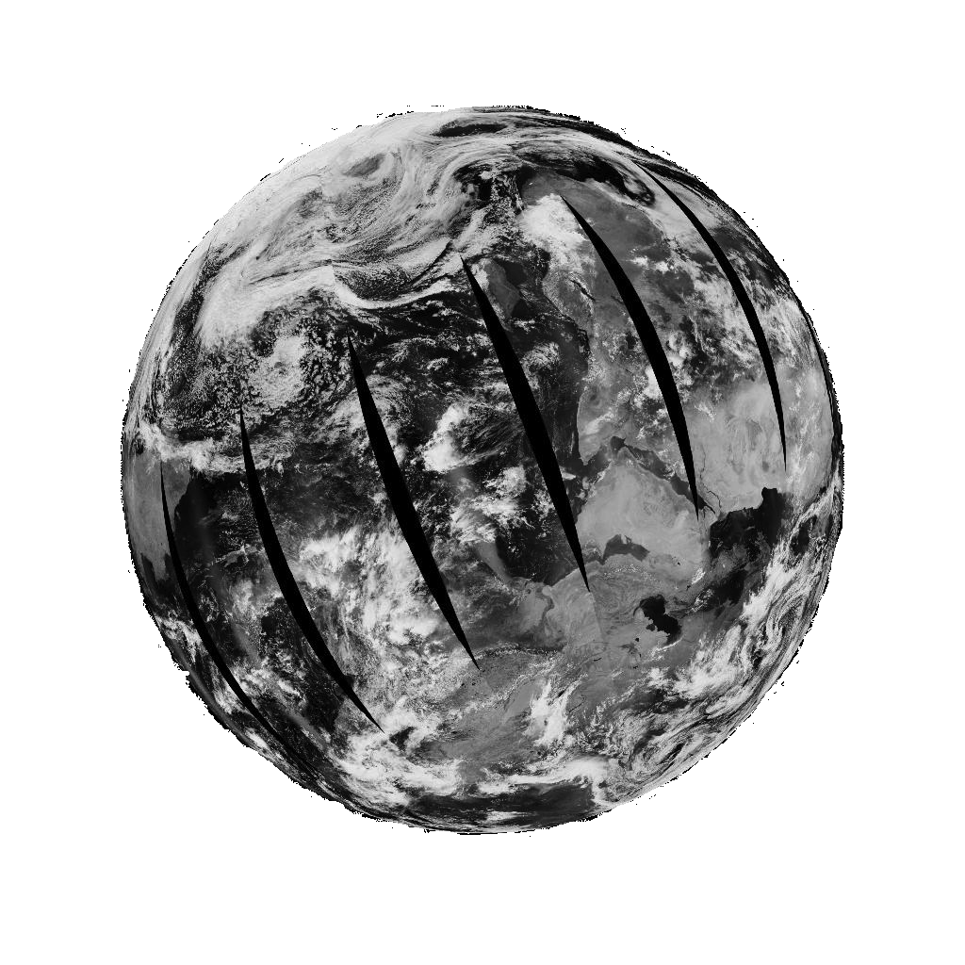
Solution – Forward/Back Propagation
Initial Coarse Input
Basic XY Offset Detection
Astronomical/
Star Tracker
Best Guess
Modified Input
Equation
2D XY Offset
3D XYZ Rotational Correction
Optical Distortion model
Results
Scoring

Slide 11
Forward/Back Propagation
Forward Propagation
Take coarse results and create a spread of different variations
Draw variation results with EPIC simulator using MODIS imagery
Score results against EPIC image
Back Propagation
Take inputs used for best scoring image and put it back as coarse inputs into the algorithm
Repeat forward propagation with finer variation
Algorithm teaches itself how to draw the EPIC image correctly, thereby deriving the correct geolocation solution

Slide 12
Example
EPIC Image
Forward/Back Propagation

Slide 13
Focal Length – Liang-Kang Huang Solution
Band | Focal Length (cm)
317nm | 282.70
325nm | 282.71
340nm | 282.73
388nm | 282.79
443nm | 282.85
551nm | 282.95
680nm | 282.98
688nm | 282.98
764nm | 282.98
780nm | 282.98
Limb profiling method
Shows difference due to chromatic aberration

Slide 14
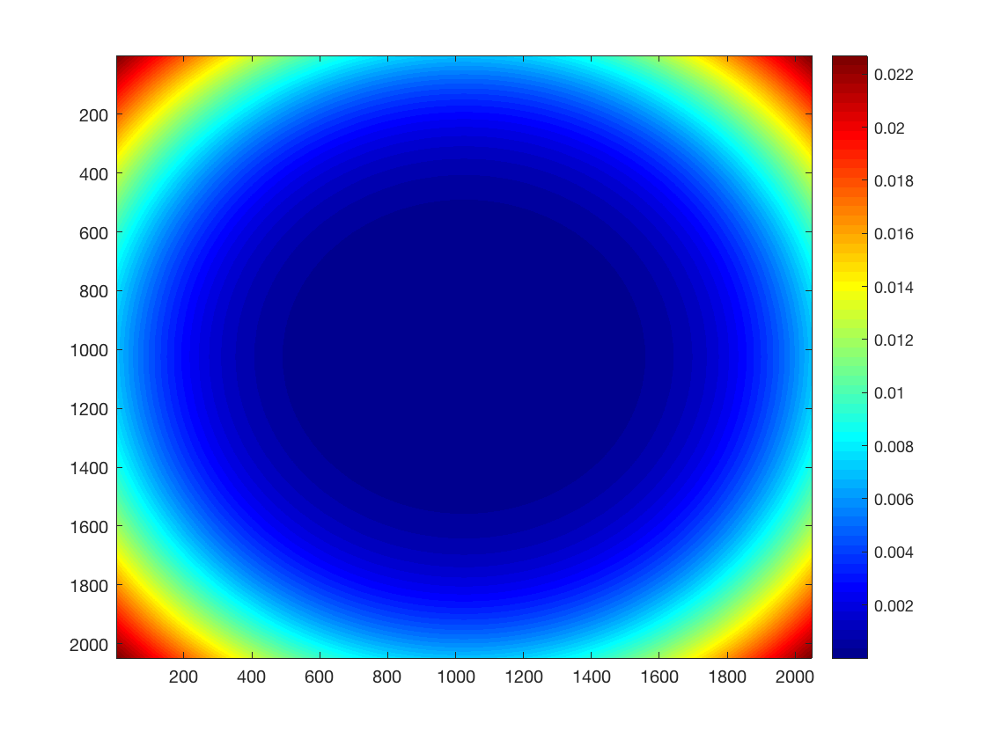
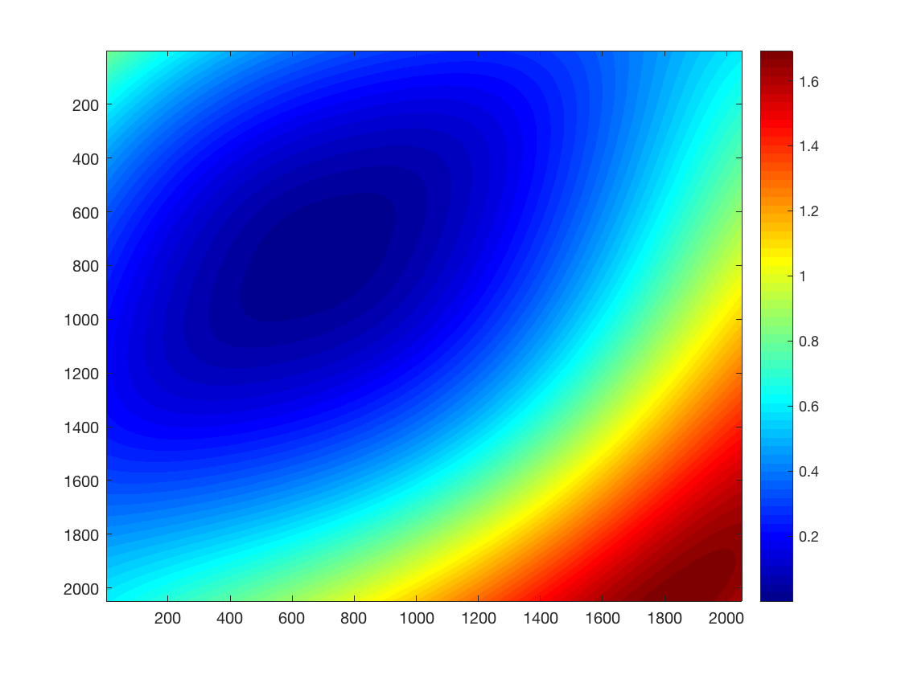
EPIC Optical Distortion Model
EPIC Theoretical (radial only)
EPIC Actual (radial + tangential)

Slide 15
R05 vs R06 – Horn of Africa (projection center)
R05
R06

Slide 16
R05 vs R06 – Asia (projection edge)
R05
R06

Slide 17
Status for R06
Corrections complete
Atmospheric refraction
2D XY Offset
X rotational (time)
Z rotational
Optical distortion correction
Chromatic aberration correction
Results
Nominally <1 pixel accuracy
Consistent results over entire globe

