Slide 1
The Future of L1 Observations
Omar Torres
Atmospheric Chemistry and Dynamics Laboratory
NASA Goddard Space Flight Center
10TH DSCOVR Science Team Meeting
NASA Goddard Space Flight Center
October 16, 2024

Slide 2

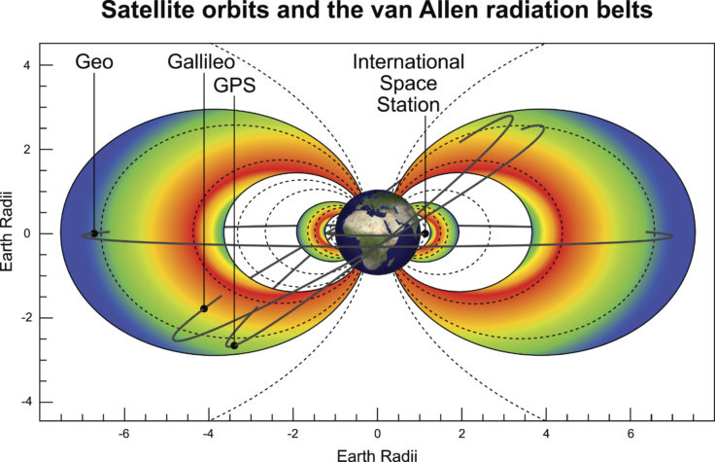
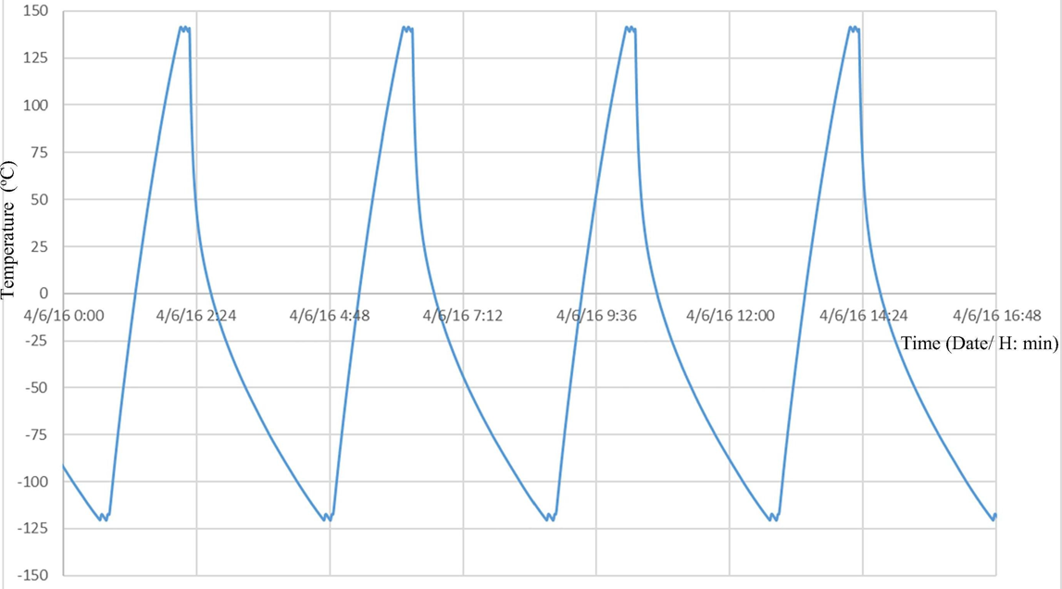
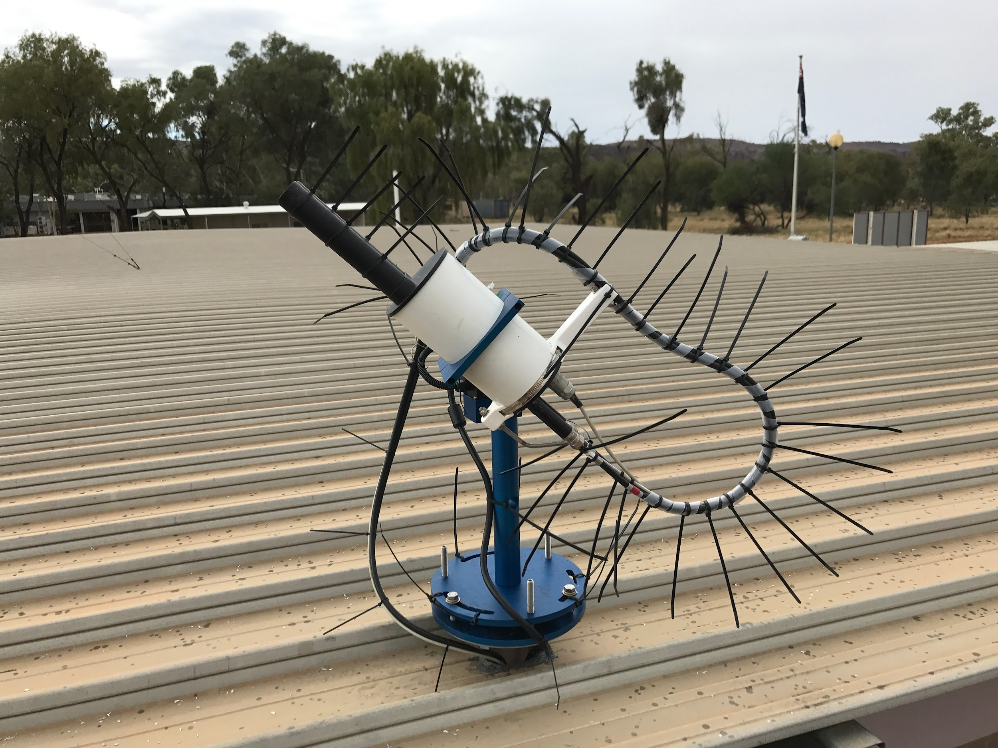
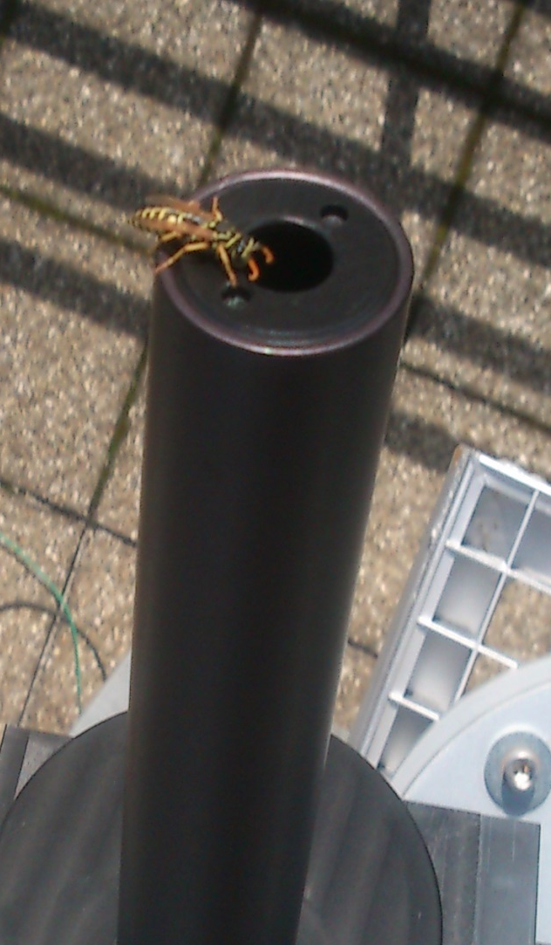
Lagrange 1:
“Observational and Instrumental Heaven”
Lagrange 1 HEAVEN
0% Nighttime
Small temperature variation
Outside Earth’s radiation belts
50% Nighttime
Large cyclic temperature variations
Inside Earth’s radiation belts
50% Nighttime
Large temperature variations
Weather, humidity, bugs, birds, humans …
LEO-GEO
PURGATORY
Ground-based
HELL

Slide 3
The DSCOVR-EPIC sensor: Lessons Learned
The applicability of air quality remote sensing techniques from the L-1 vantage point has been convincingly demonstrated by the EPIC sensor over the last decade.
The global diurnal cycle of important tropospheric components such as tropospheric ozone, aerosols and clouds is better understood thanks to EPIC observations.
Although GEO observations by recently deployed GEMS and TEMPO sensors on geostationary satellites can produce high resolution, accurate AQ hourly monitoring, their spatial coverage is limited to sub-continental areas.
L1 observations represent an important complementary, low-cost way of global AQ hourly monitoring.
The continuation of L1 observations using an improved L1 instrument, higher spatial resolution and enhanced spectral coverage, is recommended.

Slide 4
