Slide 1
Diurnal variability of atmospheric properties with DSCOVR/EPIC
Alfonso Delgado-Bonal
Alexander Marshak
Yuekui Yang
Lazaros Oreopoulos
DSCOVR meeting – Oct 18th 2024

Slide 2
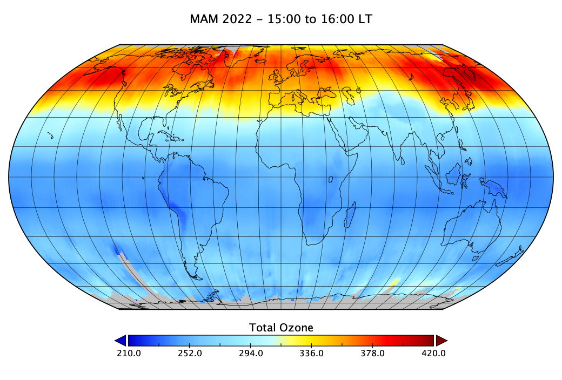
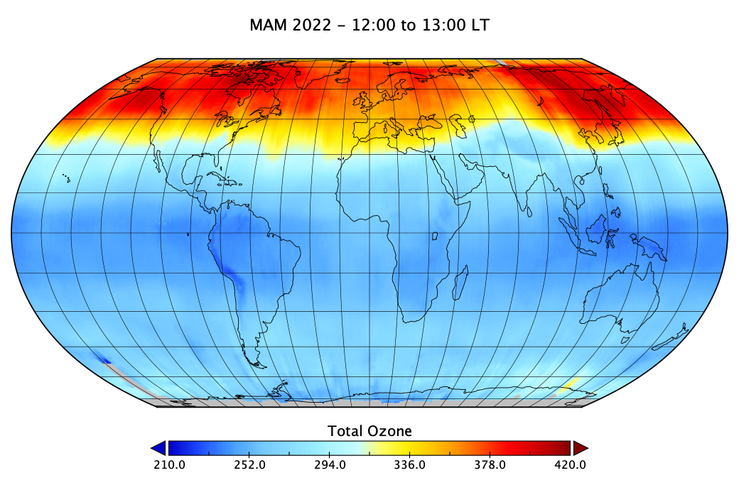
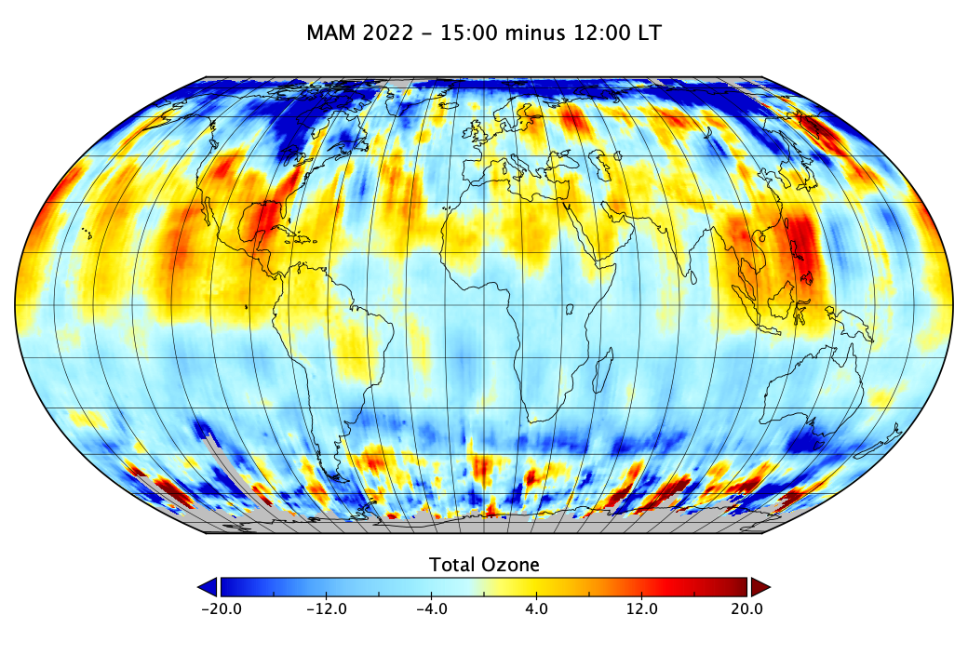

Slide 3
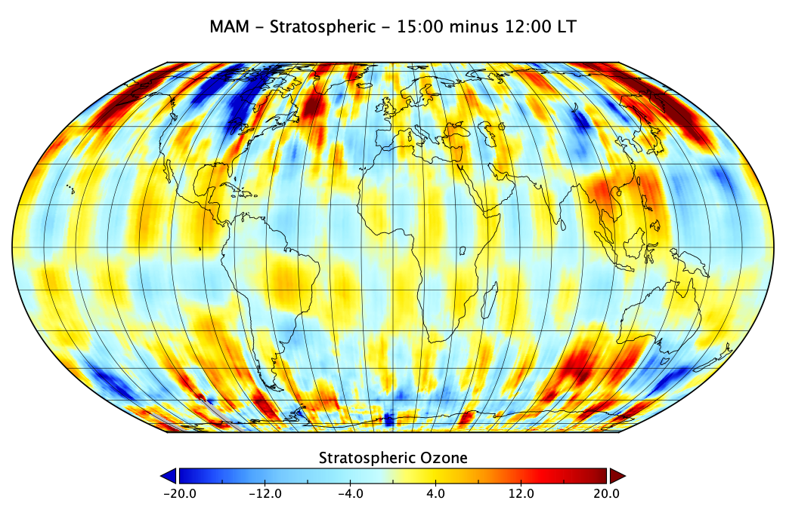
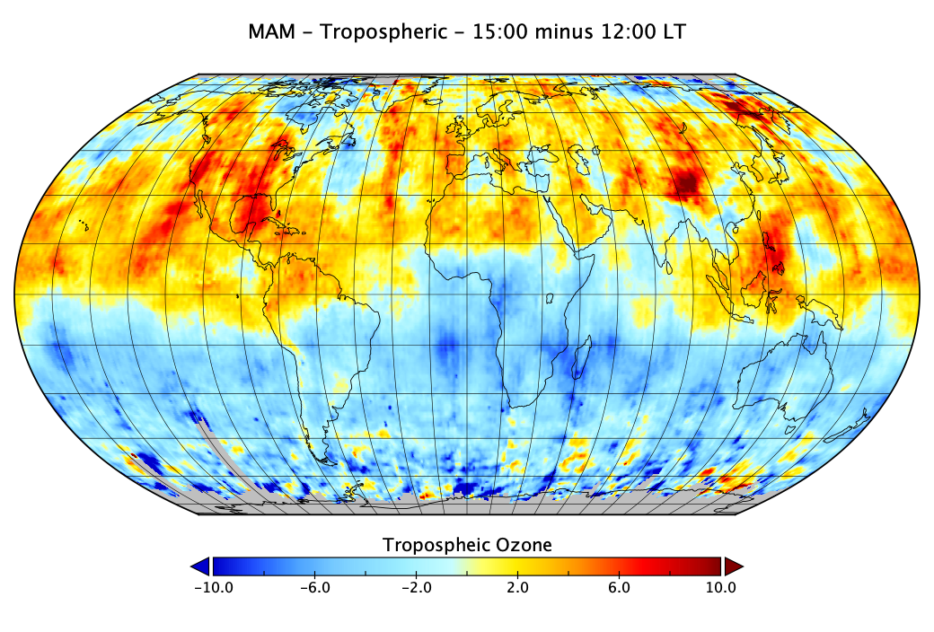
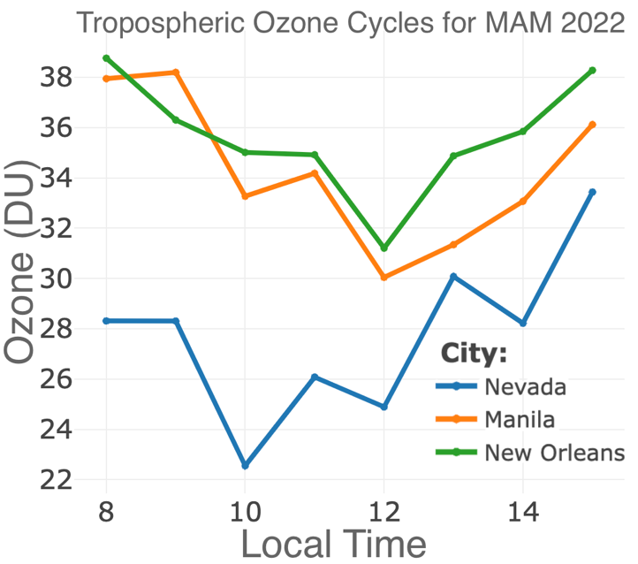

Slide 4
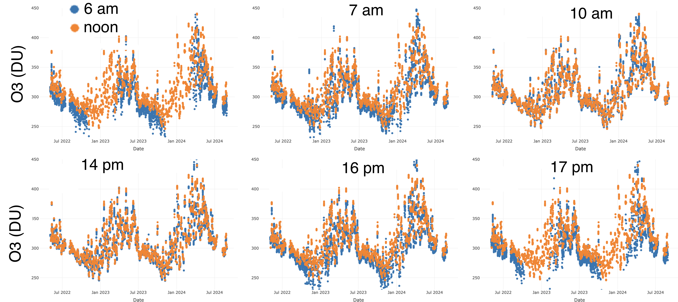
PANDORA – Edwards, CA
Ergodicity (is the mean meaningful?
Parametric vs non-parametric test (statistical significance of the differences)
Augmented Dickey–Fuller (is the system stationary)

Slide 5
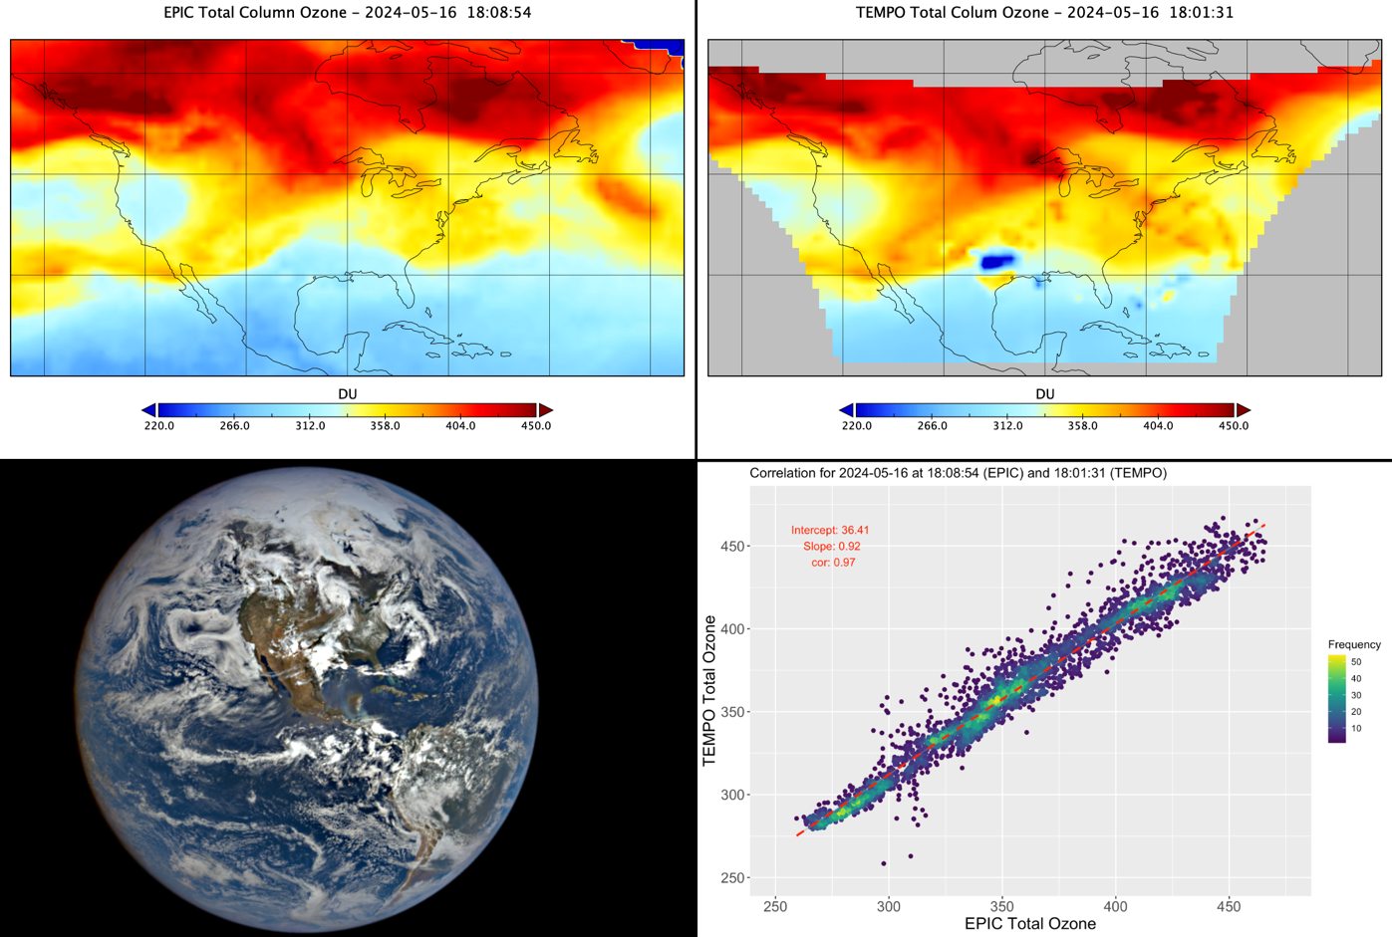
EPIC and TEMPO total column ozone

Slide 6
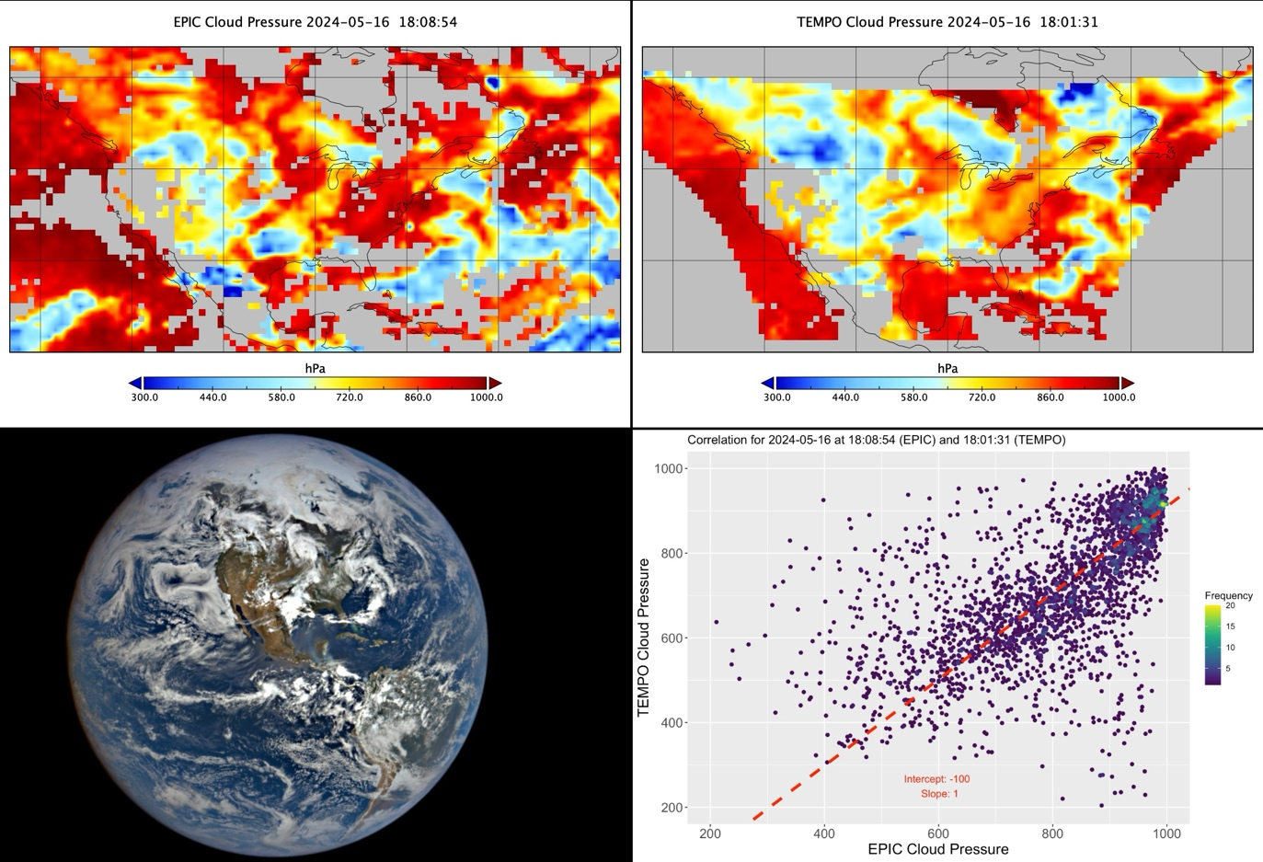
EPIC and TEMPO cloud mask

Slide 7
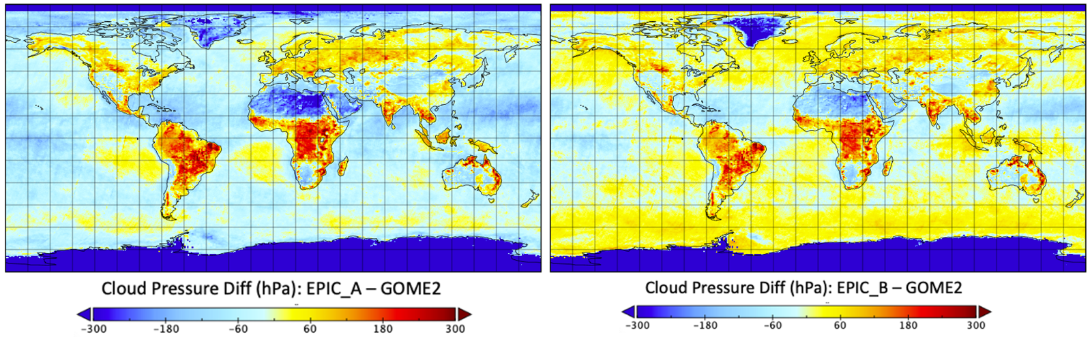
EPIC and GOME2 cloud mask average for 2016

Slide 8
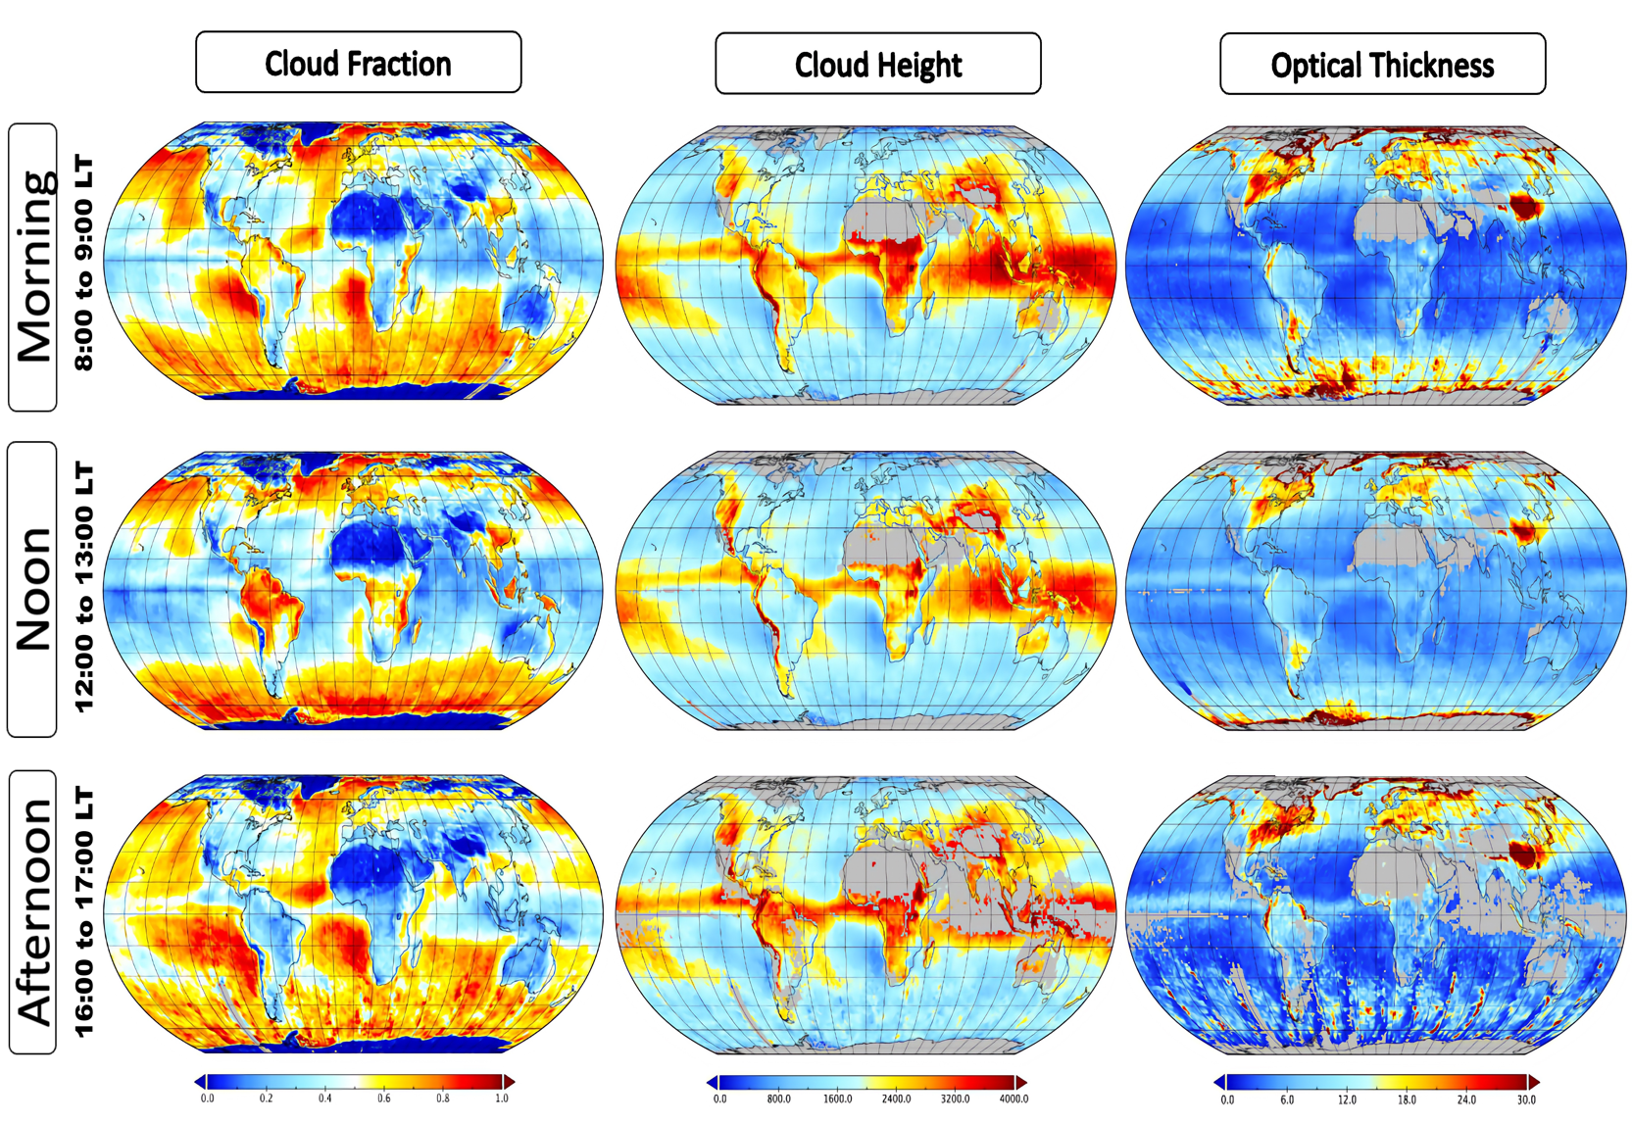

Slide 9
GOME-2 passing time is 9.30 am LT

Slide 10
Take home message:
Ozone diurnal variability is unclear.
Clouds are not unclear. We can compare with polar orbiters at their passing times, and TEMPO for North America.

