Slide 1
Evaluation of the stability and calibration of EPIC oxygen bands with observations and radiative transfer model simulations over South Pole
Yaping Zhou, Yuekui Yang, Pengwang Zhai
DSCOVR STM Meeting
Oct 16-17, 2023

Slide 2
Objectives
EPIC’s O₂ bands: A-band (764nm, 780nm) and B-band (688nm, 680nm) play significant roles in EPIC cloud (CM, CEP) and aerosol (height, cloud screening) retrieval algorithms.
Due to lack of inflight calibration, 680nm and 780nm calibration uses other in-space LEO/GEO instruments such as MODIS, MISR, and VIIRS. The 688nm and 764nm calibrations rely on calibrated 680nm and 680nm and lunar observations assuming pairs of O₂ bands have a constant reflectance ratio.
Monitoring O₂ band measurements over South Pole (SP) as a way of monitoring their stability.

Slide 3
Current moon-view O₂ band calibrations
(Geogdzhayev and Marshak, 2018)
$$\frac{R_{abs}}{R_{ref}}=\frac{K_{abs}{× R}_{abs}^{ct}}{K_{ref} × R_{ref}^{ct}}$$
$$F\left(λ_{abs,}λ_{ref}\right)=\frac{R_{ref}^{ct}}{R_{abs}^{ct}}$$
$$K_{abs}=K_{ref}×\frac{\frac{R_{abs}}{R_{ref}}}{F\left(λ_{abs,}λ_{ref}\right)}$$
Previous moon reflectance observation
$$\frac{R_{688}}{R_{680}}=1.008$$
$$\frac{R_{764}}{R_{780}}=0.984$$
EPIC Moon-view eCounts
of O₂ absorption bands
$$F\left(λ_{688,}λ_{680}\right)=0.466$$
$$F\left(λ_{764,}λ_{780}\right)=0.591$$
EPIC cross calibration of reference bands
$${\begin{aligned} \\ K\end{aligned}}_{680}=9.3e−6$$
$K_{780}=1.435e−6$
$$K_{688}=K_{680}×\frac{\frac{R_{688}}{R_{680}}}{F\left(λ_{688,}{ λ}_{680}\right)}$$
EPIC O₂ band calibration gain
$K_{688}=2.02e−5$
$K_{764}=2.36e−5$
$R_{abs}^{ct}$is not sensitive to small changes in instrument response without presence of O₂ in path.
$$K_{764}=K_{780}×\frac{\frac{R_{764}}{R_{780}}}{F\left(λ_{764,}{ λ}_{780}\right)}$$

Slide 4
O₂ band clear sky measurements over South Pole
South Pole location is chosen because of its uniform surface snow type and thinner layer of atmosphere. Ground and in-situ air measurements are available at the Amundsen–Scott South Pole (SP) Station.
Data are for the months of December and January from 2015 to 2022, except Dec. 2019 and Jan. 2020.
EPIC pixels are chosen within 0.25hr of ground observation and 0.1º to 90ºS.
Only clear sky observations are selected based on visual surface sky reports and EPIC cloud mask.
Small fluctuations and small but significant trends in all reflectance (except 764nm) are found. Both ratios have a significant positive trend.

Slide 5
Comparison of EPIC observations with RTM (EPIC simulator) simulations over South Pole (SP)
Clear sky selection requires both clear from ground observation and EPIC cloud mask
In-situ sounding at ~12UTC, EPIC granule is selected with 0.25 hr of the sounding, and pixels less than 0.1° to 90°S.
Observed spectrally varying albedos and BRDF from SP/Antarctic (new implementation to RTM)
Vertical profiles of total molecules, H₂O, O₂, CO₂, O₃ are modified based on radiosonde, and ozonesonde observations
SP ground height (2.839km)
The RTM uses improved pseudospherical shell (IPSS) approximation.

Slide 6
RTM Sensitivities
Uncertainty in surface spectral albedo and BRDF
Uncertainty in total O₃ and O₂ amount
Uncertainty in clear sky conditions (presence of thin ice crystals)
Earth Curvature
Uncertainty in instrument response function

Slide 7
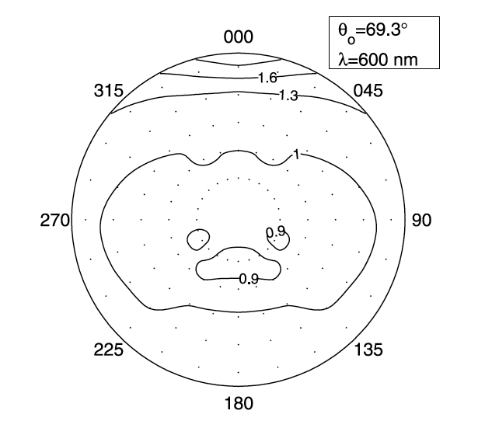
Surface Reflectivity sensitivity
SP spectral albedos in 4 channels:
𝛌 | 680 nm | 688 nm | 764 nm | 780 nm
albedo | 0.965 | 0.96 | 0.93 | 0.921
BRDF from SP
AF in SP direction: 1.3
Black: EPIC observations
Green: simulation with observed spectral albedo but Lambertian surface
Blue: simulations with snow BRDF but reduced spectral albedo (alb*0.98)
Red: simulations with snow BRDF and observed varying spectral albedo
Hudson et al. 2006

Slide 8
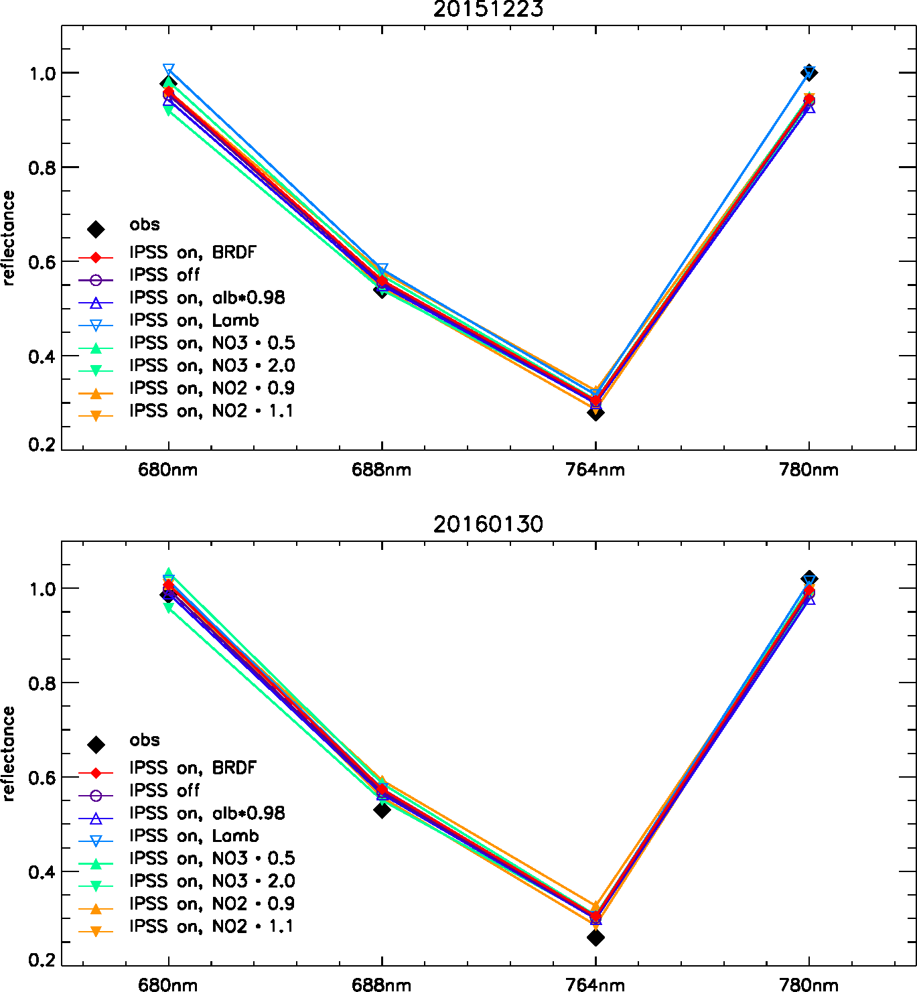
South Pole Clear Sky Sensitivities
Sensitivity case | B-band ratio | A-band ratio
IPSS on, BRDF | 0.583 | 0.323
IPSS off, BRDF | 0.582 | 0.322
IPSS on, BRDF, $α$ $∙$0.98 | 0.583 | 0.323
IPSS on, Lambertian Srf | 0.579 | 0.316
IPSS on, BRDF, $N_{O_{3}}∙0.5$ | 0.580 | 0.323
IPSS on, ${BRDF,N}_{O_{3}}∙2.0$ | 0.587 | 0.322
IPSS on, BRDF,${ N}_{O_{2}}∙0.9$ | 0.601 | 0.345
IPSS on, ${BRDF,N}_{O_{2}}∙1.1$ | 0.565 | 0.303
EPIC Observation | 0.553 | 0.280

Slide 9
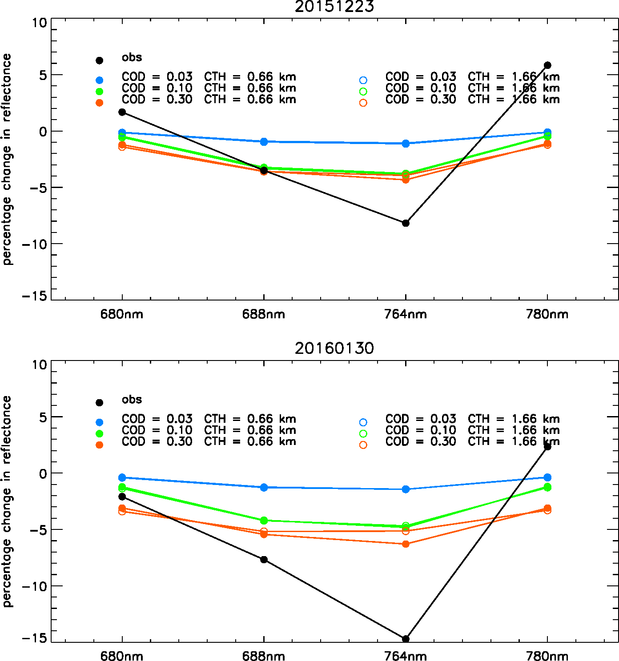
Sensitivity for
boundary aerosol and ice crystal
Sensitivity tests / Change in ratio | B-band ratio | A-band ratio
COD = 0.03, CTH=0.66 km | -0.0046 | -0.0031
COD = 0.10, CTH = 0.66 km | -0.0161 | -0.0108
COD = 0.30, CTH = 0.66 km | -0.0139 | -0.0105
COD = 0.03, CTH = 1.66 km | -0.0048 | -0.0033
COD = 0.10, CTH = 1.66 km | -0.0163 | -0.0110
COD = 0.30, CTH = 1.66 km | -0.0129 | -0.0089

Slide 10
Results from EPIC simulation vs. Observations Over SP without Considering IRF
Band | Percentage discrepancy
680 nm | 0.97%
780 nm | -0.50%
688 nm | 5.76%
764 nm | 15.63%
B-band ratio | 4.74%
A-band ratio | 16.09%

Slide 11
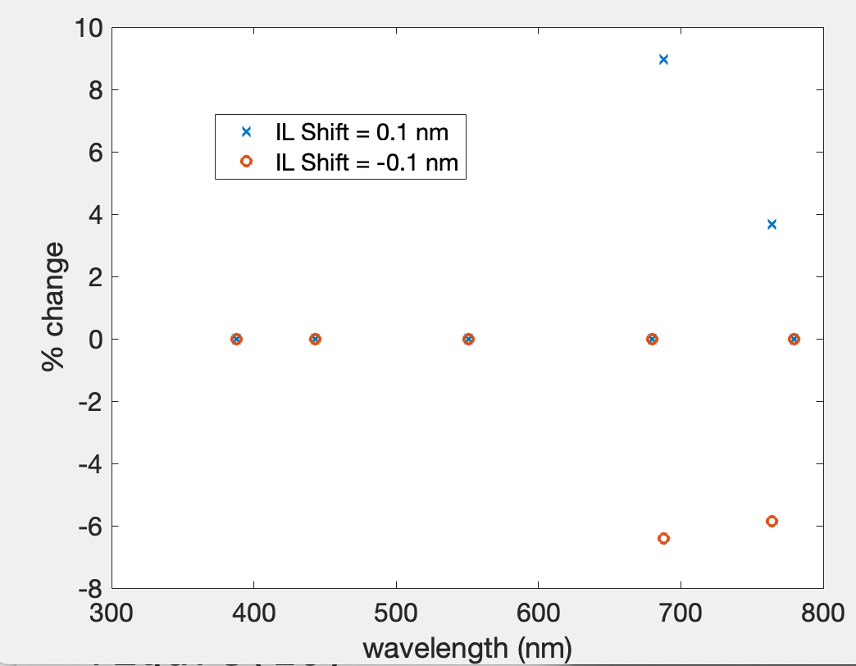
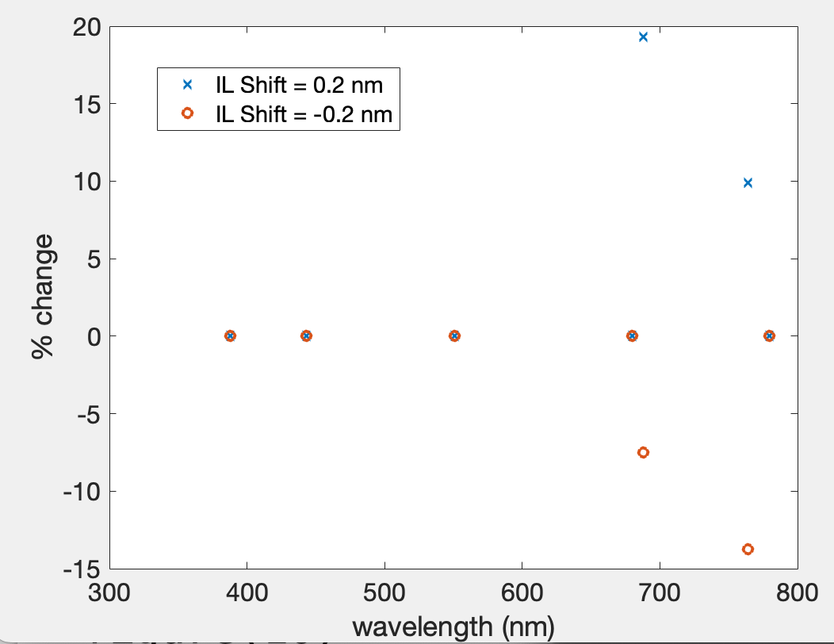
Sensitivities in Instrument Response Functions (IRF)
Sensitivity tests | B-band bias | A-band bias
No shift | 5.76% | 15.62%
Shift -0.2 nm | 0.51% | 5.91%
Shift -0.3 nm | 3.72% | 2.75%
Shift -0.4 nm | 10.49% | 2.85%
Shifting IRF -0.2 nm for B-band and -0.3 nm for A-band would greatly reduce the systematic bias.
Moon-view calibration would not detect this kind of IRF shift because there is no O₂ in the path.

Slide 12
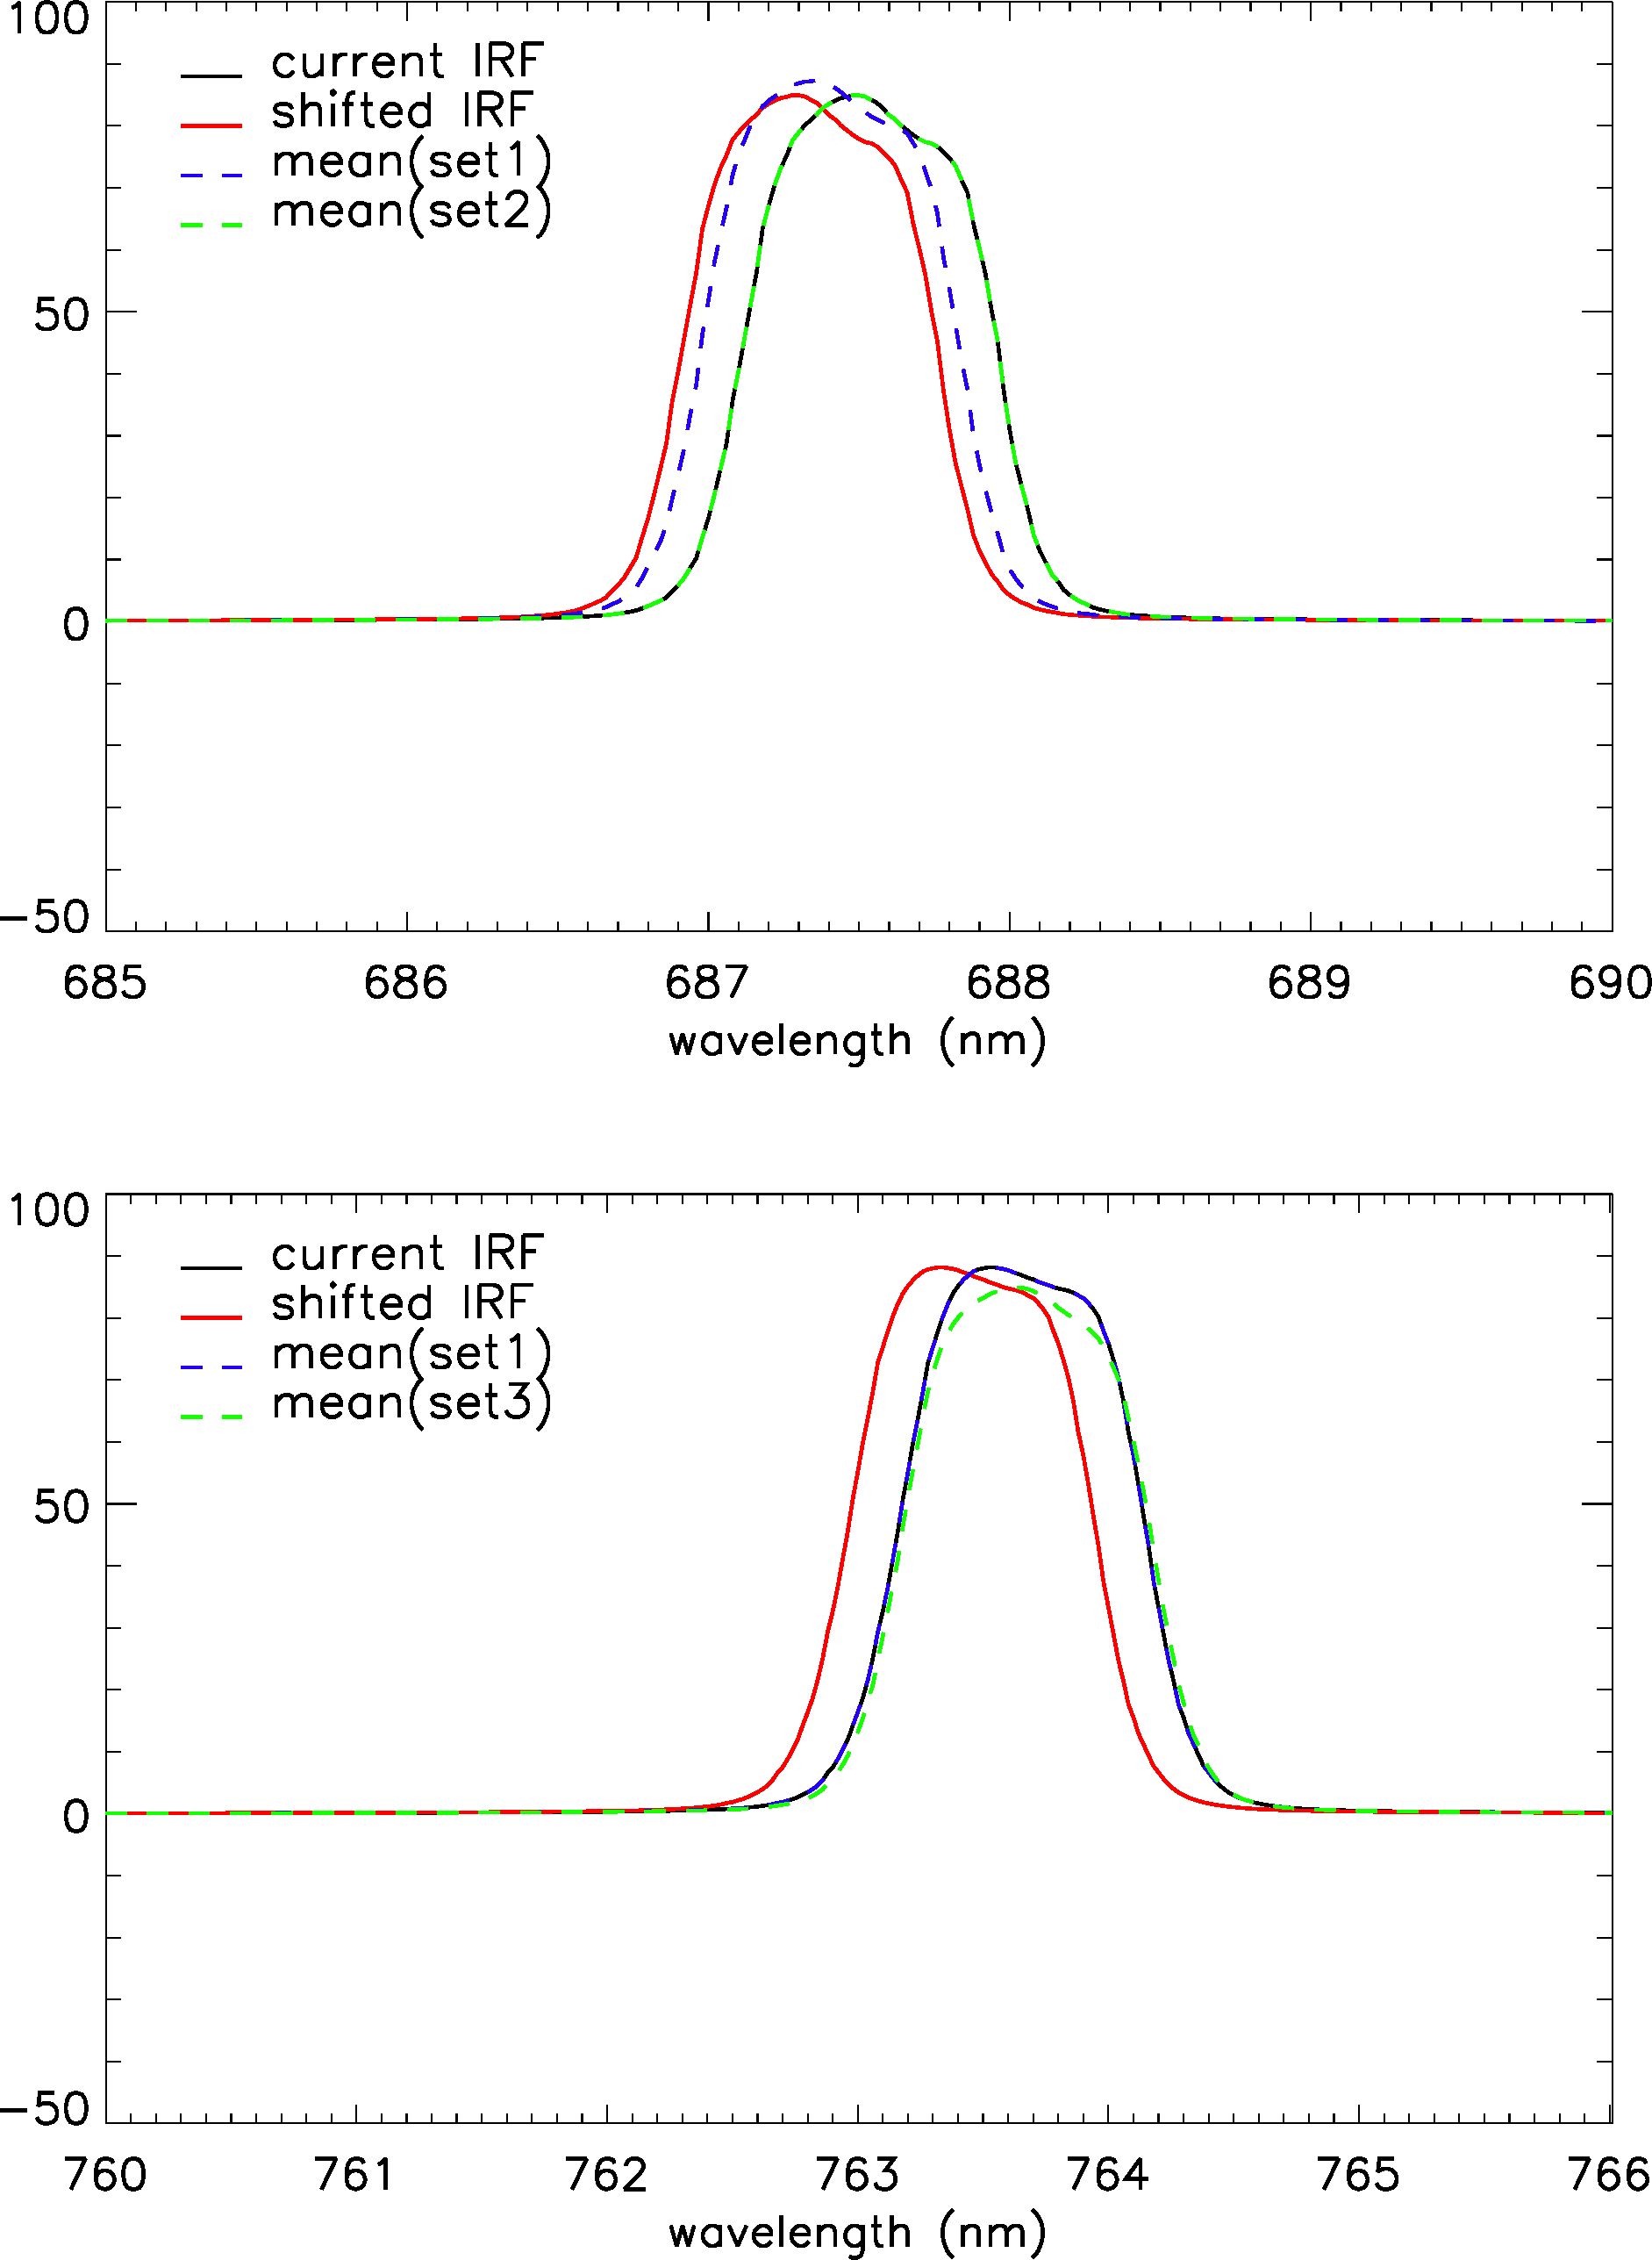
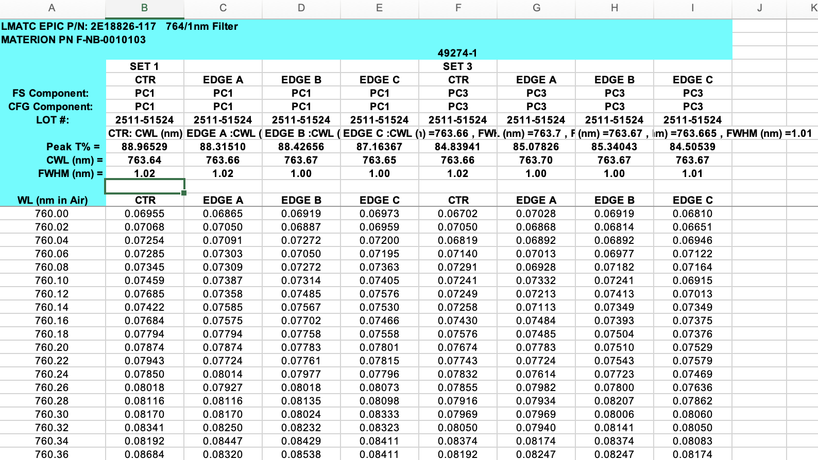
Did we miss-use the instrument response function?
Currently we are using mean of set-1 for A-band and mean of set-2 for B-band.
Mean of set-1 for B-band is close to shift -0.2 nm in IRF sensitivity.
But set-3 of A band is similar to set-1 and does not help A-band.

Slide 13
Changing Orbits/Geometry

Slide 14
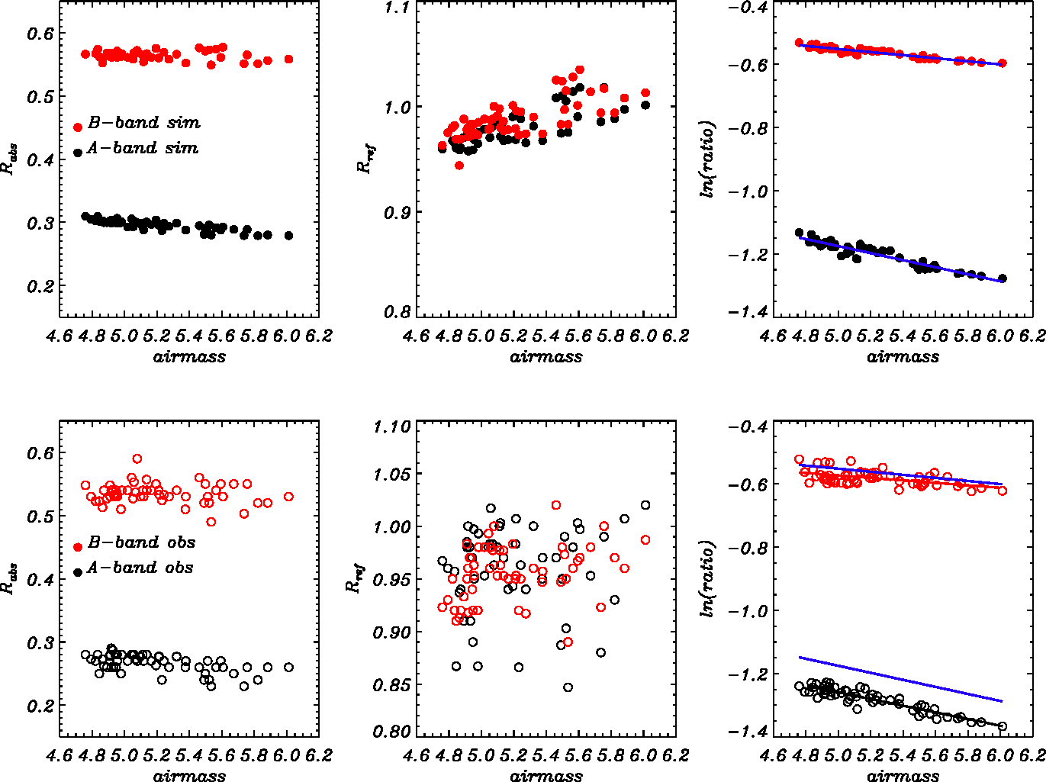
Reflectance as a function of angles
Physics of O₂ bands
$m=\frac{1}{μ}+\frac{1}{μ_{0}}=\frac{1}{\cos{θ}}+\frac{1}{\cos{θ_{0}}}$ (1) ${ R}_{abs}= α_{abs}e^{−\left(τ\left(ρ\left(z\right)\right)+τ_{ray}\left(ρ\left(z\right)\right)\right)∗m}$ (2)
$R_{ref}= α_{ref}e^{−τ_{ray}\left(ρ\left(z\right)\right)∗m}$ (3)
$\frac{R_{abs}}{R_{ref}}= α_{abs}/α_{ref} e^{−τ\left(ρ\left(z\right)\right)∗m}$ (4)
$\ln\left(\frac{R_{abs}}{R_{ref}}\right)= ln⁡(\frac{α_{abs}}{α_{ref}})−τ\left(ρ\left(z\right)\right) ∗m$ (5)
$\ln\left(\frac{R_{abs}}{R_{ref}}\right)= a+b ∗m$ (6)
${\left(\frac{R_{abs}}{R_{ref}}\right)}_{residual}={\left(\frac{R_{abs}}{R_{ref}}\right)}_{obs}−exp⁡(a+b∗m)$ (7)

Slide 15
How much variation (trend) of observation can be explained
by geometry (orbit) variation?
 | A_ratio_obs | A_ratio_sim | A_ratio_res | B_ratio_obs | B_ratio_sim | B_ratio_res
Student_test (slope) | 6.5e-05 | 6.2e-05 | 7.7e-06 | 5.7e-05 | 5.0e-05 | 1.3e-05
Confidence (%) | 96.3 | 84.6 | 73.9 | 98.3 | 85.0 | 69.1
Sen’s slope | 6.2e-05 | 6.5e-05 | 5.6e-06 | 4.0e-05 | 5.1e-05 | 2.3e-08
Man-Kendall (%) | 99.91 | 99.99 | 74.6 | 98.5 | 99.99 | 50.5
${\left(\frac{R_{abs}}{R_{ref}}\right)}_{residual}={\left(\frac{R_{abs}}{R_{ref}}\right)}_{obs}−exp⁡(a+b∗m)$
Most of observed trend in A-band and B-band can be attributed to orbit (geometry) change. Residual trend is insignificant.

Slide 16
Summary
Due to lack of in-flight calibration and other comparable in-space instruments for absolute calibration, current EPIC’s O₂ A-band and B-band use moon calibrations that are unable to detect small changes in IRF.
This study examines the O₂ band’s calibration and stability using a unique South Pole location and RTM simulations with in-situ sounding and surface spectral albedo and BRDF.
The results indicate EPIC simulations are within 1% of observations for non-absorption bands, but large discrepancies of 5.76% and 15.63% for O₂ B-band and A-band respectively exist. Sensitivities studies show the large discrepancies are unlikely caused by uncertainties in various input. The most likely cause is a shift or misrepresentation of IRF.
On the other hand, observed multi-year trends in O₂ band ratios in SP can be explained with orbital shift, which means the instrument is stable.
ZZhou et al., 2023, JQSRT

