Slide 1
EPIC Cloud Pressure: Algorithm and Comparison With Other Products
EPIC Cloud Team:
Yuekui Yang, Yaping Zhou, Alfonso Delgado-Bonal,
Peng-Wang Zhai, Gala Wind, Kerry Meyer
DSCOVR EPIC&NISTAR Science Team Meeting
Oct. 26-17, 2023, GSFC

Slide 2
Cloud Products Status Updates (since last STM in Sept. 2022)
Operational could products processing nominal.
Completed a study on EPIC O₂ A- and B-band stability using observations over the Amundsen–Scott South Pole Station.
Zhou et al., 2023, JQSRT
Study on cloud diurnal properties (Delgado-Bonal).
Conducted study on comparing version 3 EPIC cloud pressure with GOME2 products, which is the focus of this talk.

Slide 3
EPIC Cloud Pressure/Height are based on its O2 A- and B-bands observations
Before EPIC, cloud height retrieval with O2 absorption has been successfully applied to several missions, such as GOME, MERIS, POLDER, OMI, SCIAMACHY etc., as well as many other studies.
B-band
reference
A-band
reference
B-band
e.g., Daniel et al., 2003, Ferlay et al. 2010, Fischer and Grassl, 1991, Koelemeijer et al. 2001, , Kokhanovsky et al., 2005, Lindstrot et al. 2006, Stephens and Heidinger, 2000, Vanbauce et al. 2003, Vasilkov et al. 2008, Wang et al. 2008.
A-band
EPIC A-band absorption and reference channels: 764nm and 780nm, respectively.
EPIC B-band absorption and reference channels: 688nm and 680nm, respectively.
For the reference channels, only slight absorption from O3 and water vapor.
Yang et al., 2013

Slide 4
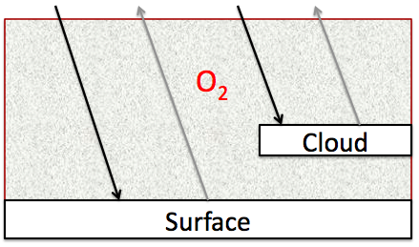
EPIC retrieves cloud effective pressure using the Mixed Lambertian-Equivalent Reflectivity (MLER) method
A pixel contains two Lambertian reflectors, the surface and the cloud;
Clouds are opaque; no photon penetration and transmission.
Variables:
R_{abs}: absorption channel radiance
R_{ref}: reference channel radiance
A_{c}: cloud fraction
α_{s}: surface albedo
α_{c}: cloud albedo
T_{abs} : absorption channel transmittance
T_{ref} : absorption channel transmittance
Cloud effective pressure is retrieved through iteration.
For EPIC, cloud pressures are retrieved for each pair of A- and B-band observations: two cloud pressures (p_{A} and p_{B})

Slide 5
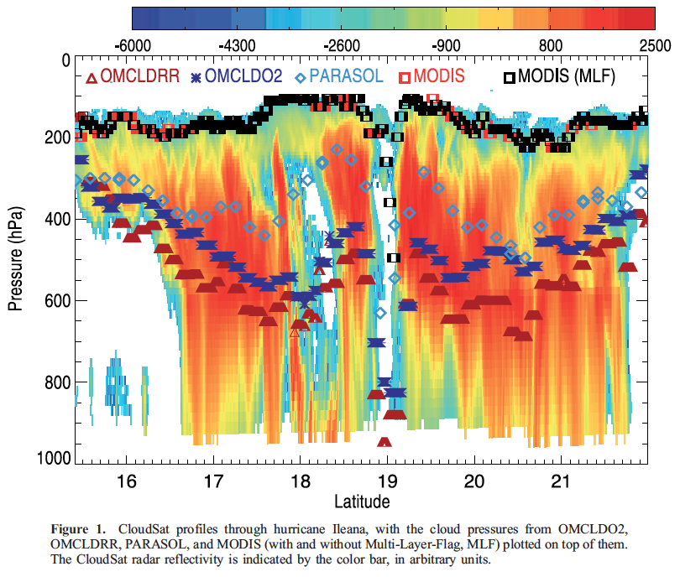
Cloud effective pressure from different algorithms
Products compared:
CloudSat
MODIS and MODIS with multi layer flag
OMCLDRR: OMI cloud pressure from Rotational-Raman scattering at 350 nm
OMCLDO2 OMI cloud pressure from collision induced absorption at 477 nm
PARASOL/POLDER A-band at 765 nm
Sneep et al, 2008

Slide 6
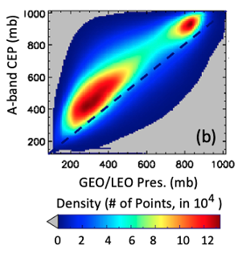
EPIC cloud height vs actual cloud top
Comparing with Langley Composite (MODIS IR cloud top) (Yang et al., 2019)
Comparing with Radar (Berry et al., 2022)
How does EPIC compare with other Effective Pressure Products?
Time: May 26, 2017
Location: Indian Ocean
CloudSat segment: 600 profiles
Collocated DSCOVR pixels: 95

Slide 7
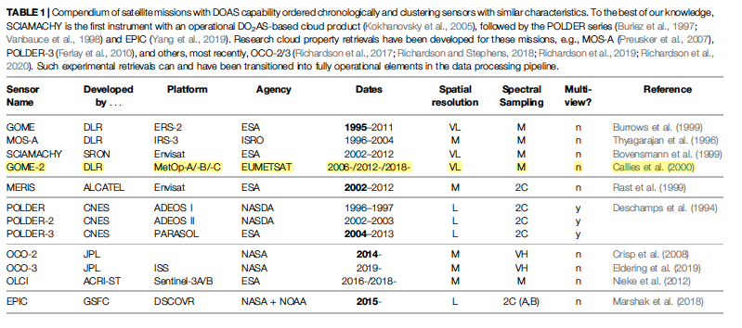
Satellite missions with Differential Oxygen Absorption Spectroscopy (DOAS) capability
Davis, A. B., Y. Yang, A. Marshak, 2022: EPIC/DSCOVR as a Pathfinder in Cloud Remote Sensing using Differential Oxygen Absorption Spectroscopy. Front. Remote Sens. 3:796273. doi: 10.3389/frsen.2022.796273

Slide 8
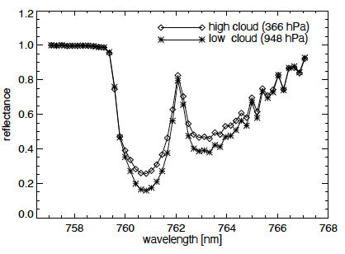
GOME2 Cloud Algorithm: FRESCO+
FRESCO: Fast Retrieval Scheme for Clouds from the Oxygen A-band
Uses three 1-nm wide wavelength windows at 758–759, 760–761, and 765–766 nm
Applied to observations from GOME (1995-2011), SCIAMACHY (2002-2012) and GOME2 (2006-present)
Thanks to Dr. Ping Wang of KNMI for help with accessing the GOME2 cloud products.

Slide 9
Comparing GOME2 and EPIC effective pressure: Method
GOME2 Basis:
Orbit Sun-synchronous, at an altitude of ∼ 820 km, with a descending node equator-crossing local solar time of 09:30am (hence tend to have low sun angle)
Swath width 1920 km
Spatial resolution 80 km across-track × 40 km along-track
Method:
Project both EPIC and GOME2 effective cloud pressure to a common 0.5⁰lat by 0.625⁰ lon grid
Apply restrictions on solar zenith and view zenith to reduce uncertainties (e.g., < 70⁰)
Conduct Monthly, seasonal and annual analysis

Slide 10
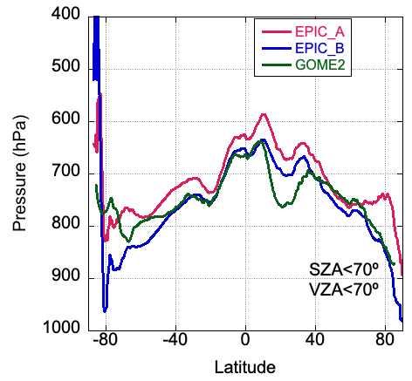
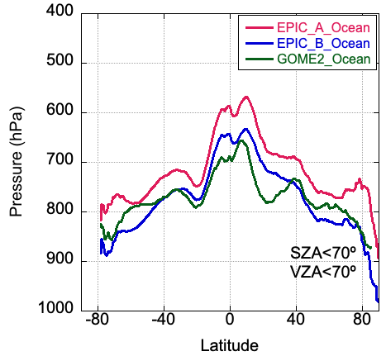
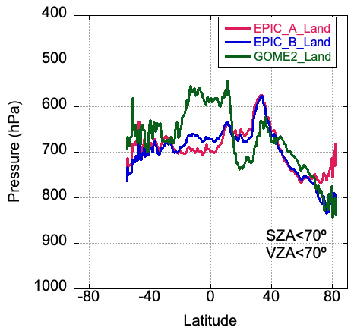
EPIC vs GOME2 cloud effective pressure: Annual zonal mean
Data for 2016
In general, the three cloud effective pressure datasets (EPIC A-band, EPIC B-band, and GOME2) match each other well;
More differences over land than over ocean, indicating sensitivity to land surface reflectivity contribution.
Compared to EPIC A-band pressure, B-band pressure is closer to GOME2.

Slide 11
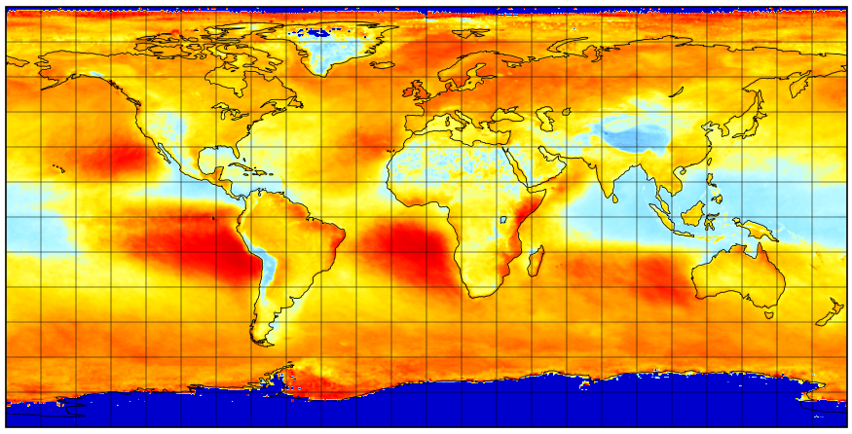
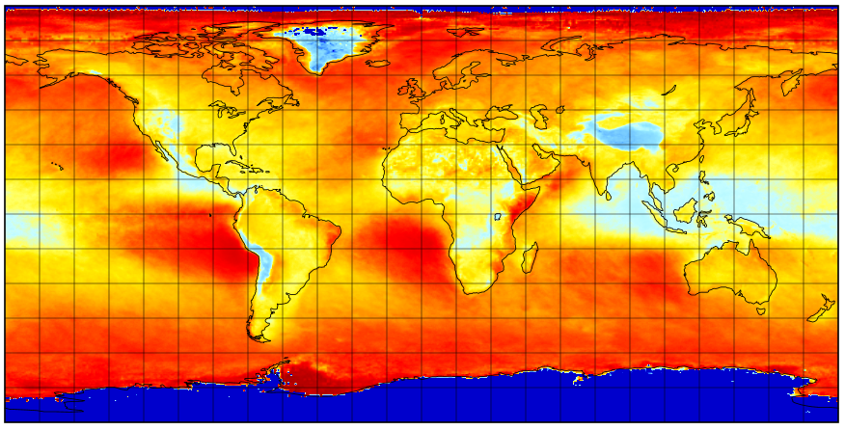
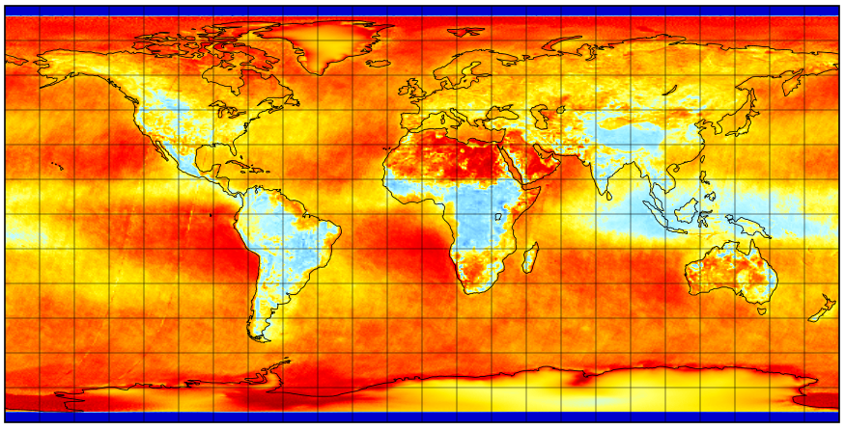
2016, EPIC A-band
2016, EPIC B-band
Annual mean cloud effective pressure
General patterns match well
Local differences exist, especially over land
2016, GOME2

Slide 12
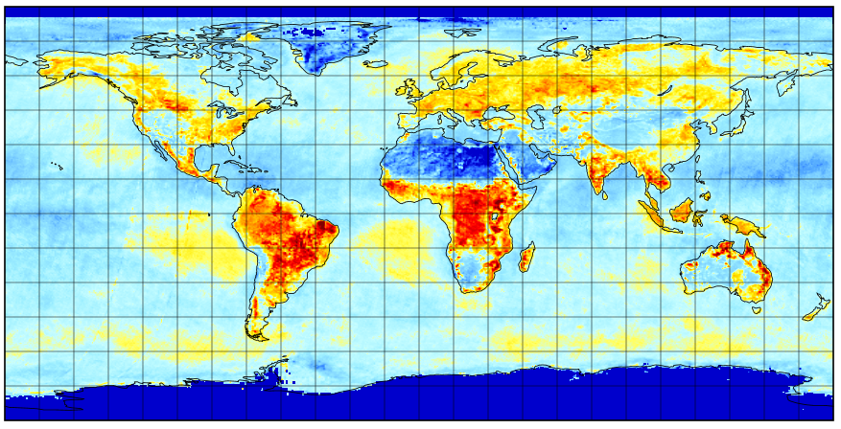
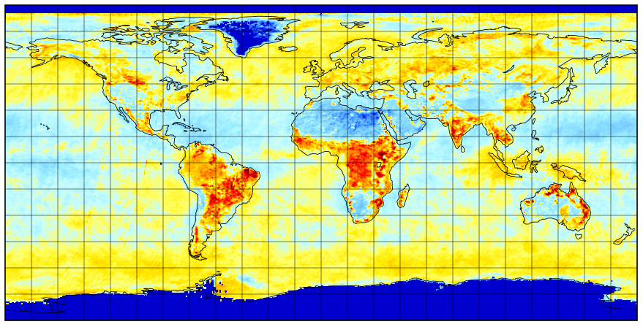
EPIC and GOME2 cloud effective pressure differences in annual mean
2016
2016
1) Over large portions of land, EPIC retrieve higher cloud pressure (lower cloud height) than GOME2.
2) Factors that can contribute to the differences include surface BRDF, spatial resolution, air mass, and sun-view geometry differences

Slide 13
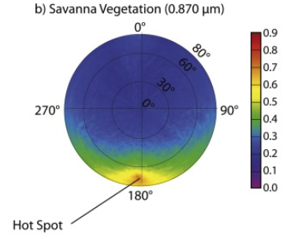
Higher directional reflectance due to EPIC’s near backscattering angle
Gatebe and King, 2016

Slide 14
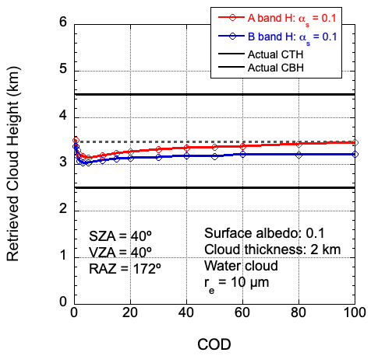
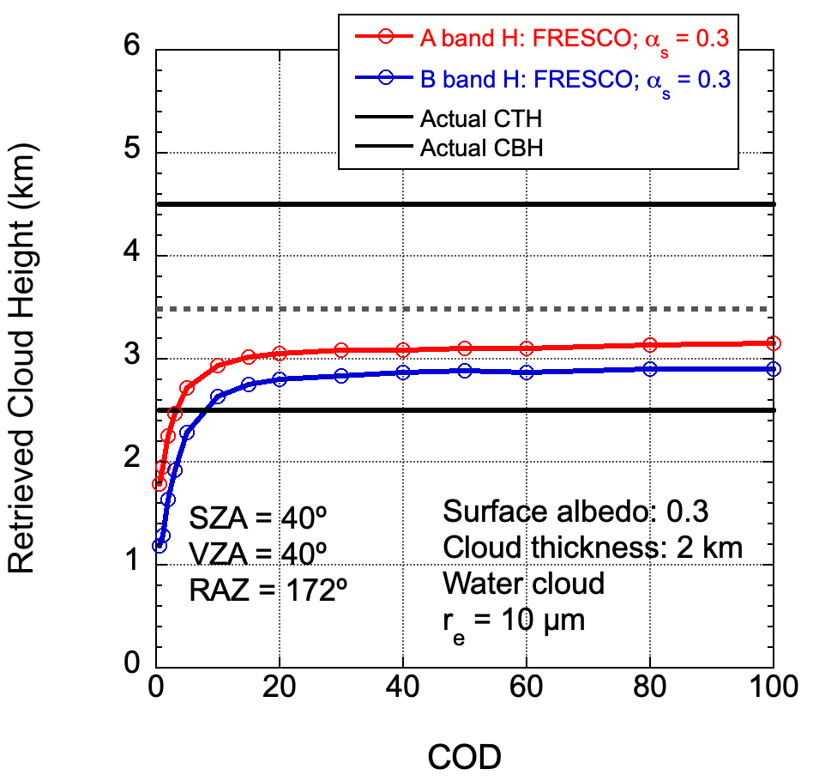
Higher surface reflectivity results in more photons coming from the surface; hence lower effective cloud height retrievals, especially for optically thinner clouds

Slide 15
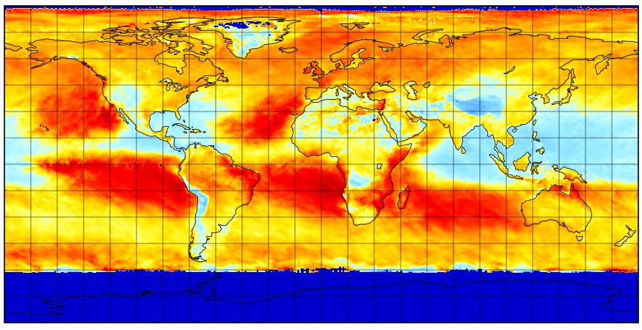
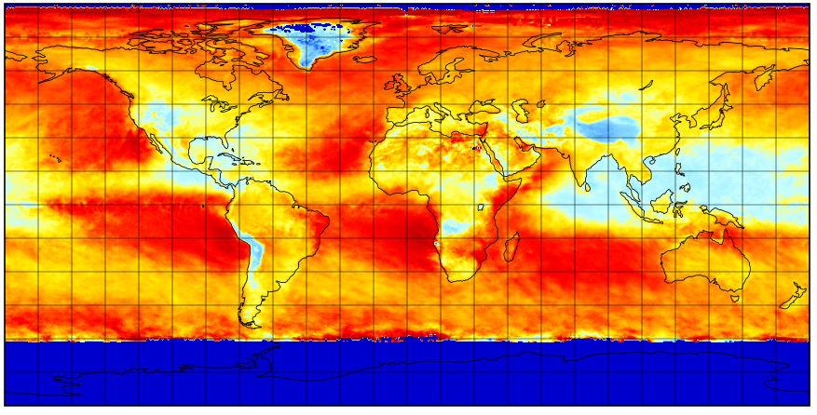
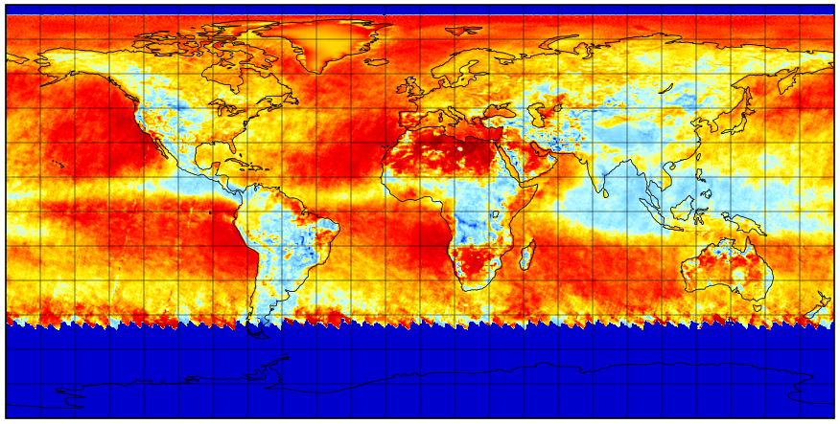
JJA, 2016, EPIC A-band
JJA, 2016, EPIC B-band
Seasonal mean cloud effective pressure
Similar patterns as the annual mean
Can see the sunlit region change from season to season
JJA, 2016, GOME2

Slide 16
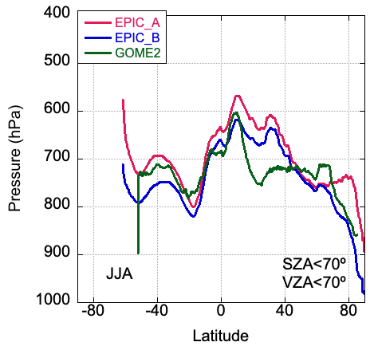
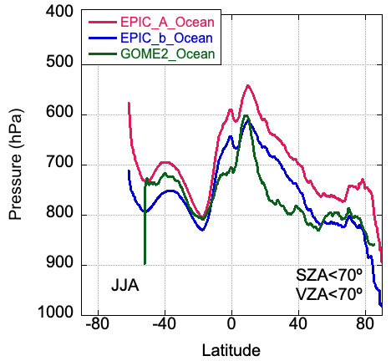
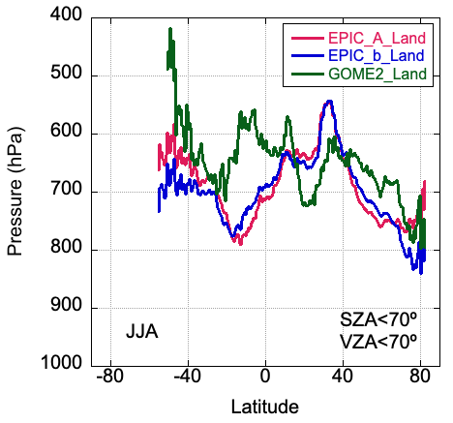
EPIC vs GOME2 cloud effective pressure: Seasonal zonal mean
Data for JJA, 2016
In general, the three cloud effective pressure datasets (EPIC A-band, EPIC B-band, and GOME2) match each other well;
Larger differences over land than over ocean, indicating sensitivity of land surface reflectivity contribution.
Compared to EPIC A-band pressure, B-band pressure is closer to GOME2.

Slide 17
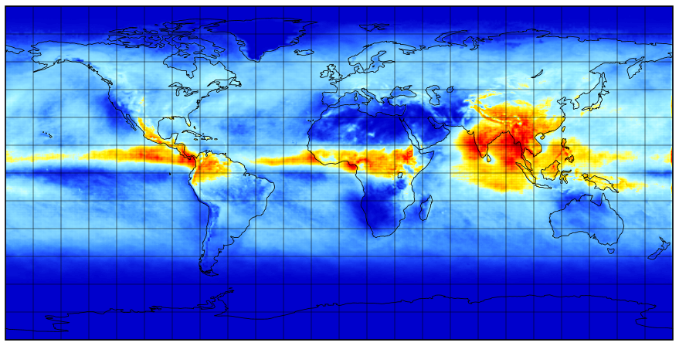
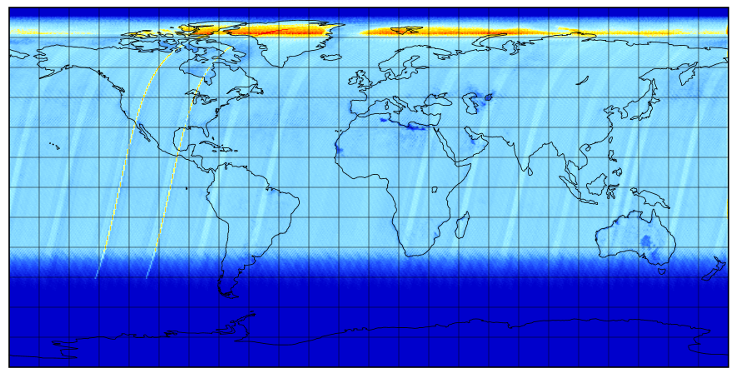
EPIC vs GOME2 cloud effective pressure: Number of samples
JJA, 2016
JJA, 2016
Data for JJA, 2016
EPIC has two orders of magnitude higher number of samples in the comparison. Low sample amount can lead to uncertainty

Slide 18
Summary
EPIC and GOME2 cloud pressure retrievals are based on the same physical concept.
Comparison show that the three cloud effective pressure datasets (EPIC A-band, EPIC B-band, and GOME2) match each other well.
More differences over land than over ocean, indicating sensitivity to land surface reflectivity contribution. Compared to EPIC A-band pressure, B-band pressure is closer to GOME2.
4) Over large portions of land, EPIC retrieve higher cloud pressure (lower cloud height) than GOME2. This may be partially explained by the surface BRDF effect.
5) Contributing factors to the differences between GOME2 and EPIC cloud pressure statistics include spatial resolution, surface BRDF, air mass, sun-view geometry, and sampling frequency.

Slide 19
Backup

Slide 20
Publications
18) Zhou, Y., P. Zhai, Y. Yang, 2023: Evaluation of EPIC Oxygen Band Stability and Calibration with Radiative Transfer Simulations Over the South Pole. J. Quant. Spectrosc. Radiat. Trans. 310, https://doi.org/10.1016/j.jqsrt.2023.108737.
17) Davis, A. B., Y. Yang, A. Marshak, 2022: EPIC/DSCOVR as a Pathfinder in Cloud Remote Sensing using Differential Oxygen Absorption Spectroscopy. Front. Remote Sens. 3:796273. doi: 10.3389/frsen.2022.796273.
16) Delgado-Bonal, A., A. Marshak, Y. Yang, L. Oreopoulos, 2022: Cloud height daytime variability from DSCOVR/EPIC and GOES-R observations. Front. Remote Sens. 3:780243. doi: 10.3389/frsen.2022.780243.
15) Zhou, Y., Y. Yang, P. Zhai, M. Gao, 2021: Cloud Detection over Sunglint Regions with Observations from the Earth Polychromatic Imaging Camera (EPIC), Front. Remote Sens. 2:690010. doi: 10.3389/frsen.2021.690010
14) Delgado-Bonal, A., A. Marshak, Y. Yang, L. Oreopoulos, 2021: Global daytime variability of clouds from DSCOVR/EPIC observations. Geophys. Res. Lett., 48, e2020GL091511. https://doi.org/10.1029/2020GL091511
13) Yin, B., Min, Q., Morgan, E., Yang, Y., Marshak, A., and Davis, A. B., 2020: Cloud-top pressure retrieval with DSCOVR EPIC oxygen A- and B-band observations, Atmos. Meas. Tech., 13, 5259–5275, https://doi.org/10.5194/amt-13-5259-2020.
12) Zhou, Y., Y. Yang, M. Gao, P. Zhai, 2020: Cloud Detection over Snow and Ice with Oxygen A- and B-band Observations from the Earth Polychromatic Imaging Camera (EPIC), Atmos. Meas. Tech., 13, 1575–1591, https://doi.org/10.5194/amt-13-1575-2020.
11) Delgado-Bonal, A., A. Marshak, Y. Yang, L. Oreopoulos, 2020: Daily variability of cloud amount from EPIC observations, J. Geophys. Res., 125(10), https://doi.org/10.1029/2019JD031488
10) Gao, M. P.-W. Zhai, Y. Yang, Y. Hu, 2019: Cloud remote sensing with EPIC/DSCOVR observations: a sensitivity study with radiative transfer simulations, J. Quant. Spectrosc. Radiat. Trans., 230, 56-60, doi: https://doi.org/10.1016/j.jqsrt.2019.03.022

Slide 21
Publications
9) Gao, B.-C., R.-R. Li, and Y., Yang, 2019: Remote Sensing of Water Surfaces over Sunlit Portions of Oceans and Large Inland Lakes from EPIC onboard the DSCOVR Spacecraft at Lagrange-1 Point, Sensors. 2019, 19(5), 1243; doi: 10.3390/s19051243.
8) Yang, Y., K. Meyer, G. Wind, Y. Zhou, A. Marshak, S. Platnick, Q. Min, A. B. Davis, J. Joiner, A. Vasilkov, D. Duda, and W. Su, 2019: Cloud Products from Earth Polychromatic Imaging Camera (EPIC) observations: Algorithm and Initial Evaluation, Atmos. Meas. Tech., 12, 2019-2031, https://doi.org/10.5194/amt-12-2019-2019.
7) Davis A., N. Ferlay, Q. Libois, A. Marshak, Y. Yang and Q. Min, 2018: Cloud information content in EPIC/DSCOVR's oxygen A- and B-band channels: A physics-based approach, J. Quant. Spectrosc. Radiat. Trans., 220, 84-96, https://doi.org/10.1016/j.jqsrt.2018.09.006
6) Davis, A. B., G. Merlin, C. Cornet, L. C. Labonnote, J. Riedi, N. Ferlay, P. Dubuisson, Q. Min, Y. Yang, and A. Marhsak, 2018: Cloud information content analysis of EPIC/DSCOVR’s oxygen A- and B-band channels: an optimal estimation approach, J. Quant. Spectrosc. Radiat. Trans. 216, 6-16, https://doi.org/10.1016/j.jqsrt.2018.05.007.
5) Marshak, A., J. Herman, A. Szabo, K. Blank, A. Cede, S. Carn, I. Geogdzhayev, D. Huang, L-K, Huang, Y. Knyazikhin, M. Kowalewski, N. Krotkov, A. Lyapustin, R. McPeters, O. Torres, and Y. Yang, 2018: Earth Observations from DSCOVR/EPIC Instrument, Bull. Amer. Meteor. Soc.99(9), 1829-1850, https://doi.org/10.1175/BAMS-D-17-0223.1
4) Xu, X., J., Wang, Y., Wang, J., Zeng, O., Torres, Y., Yang, A., Marshak, J., Reid, and S., Miller, 2017: Passive remote sensing of altitude and optical depth of dust plumes using the oxygen A and B bands: first results from EPIC/DSCOVR at Lagrange-1 point, Geophys. Res. Lett., 44, doi:10.1002/2017GL073939.
3) Meyer, K., Y. Yang, and S. Platnick, 2016: Uncertainties in cloud phase and optical thickness retrievals from the Earth Polychromatic Imaging Camera (EPIC), Atmos. Meas. Tech., 9, 1785-1797, doi:10.5194/amt-9-1785-2016.
2) Holdaway, D. and Y. Yang, 2016: Study of the Effect of Temporal Sampling Frequency on DSCOVR Observations Using the GEOS-5 Nature Run Results (Part II): Cloud Coverage. Remote Sens. 8(5), 431, doi:10.3390/rs8050431.
1) Holdaway, D. and Y. Yang, 2016: Study of the Effect of Temporal Sampling Frequency on DSCOVR Observations Using the GEOS-5 Nature Run Results (Part I): Earth’s Radiation Budget. Remote Sens. 8(2), 98, doi:10.3390/rs8020098.

Slide 22
EPIC L2 Major Cloud Product List
EPIC Cloud Mask
Oxygen A-band Cloud Effective Pressure
Oxygen A-band Cloud Effective Height
Oxygen B-band Cloud Effective Pressure
Oxygen B-band Cloud Effective Height
Cloud Optical Thickness – assuming liquid phase
Cloud Optical Thickness – assuming ice phase
Cloud Effective Temperature
Most likely cloud thermodynamic phase
Yang, Y., K. Meyer, G. Wind, Y. Zhou, A. Marshak, S. Platnick, Q. Min, A. B. Davis, J. Joiner, A. Vasilkov, D. Duda, and W. Su, 2019: Cloud Products from Earth Polychromatic Imaging Camera (EPIC) observations: Algorithm and Initial Evaluation, Atmos. Meas. Tech., 12, 2019-2031, https://doi.org/10.5194/amt-12-2019-2019.

Slide 23
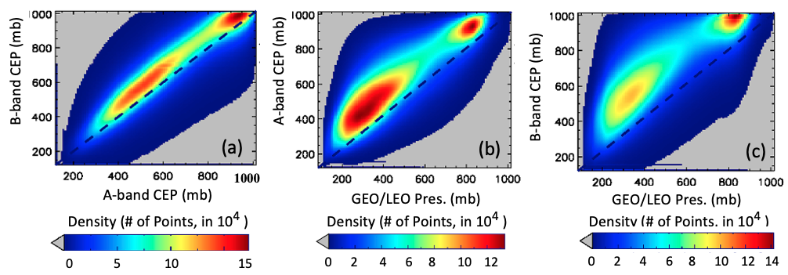
v3 A- and B-band Cloud Effective Pressure
Scatterplots for (a) EPIC A- vs. B-band CEP; (b) the Langley GEO/LEO composite cloud pressure vs EPIC A-band CEP; and (c) the Langley GEO/LEO composite cloud pressure vs EPIC B-band CEP. Data are from the year 2016.

Slide 24
EPIC Standard L2 Cloud Product System
EPIC L1B Products
Ancillary Data
Cloud Mask
Effective Height/Pressure
Cloud Optical Thickness
EPIC L2 Cloud Products

Slide 25
EPIC Channels Used for Cloud Retrievals
Product | Resolution | Description | EPIC Data Used
Cloud Mask | Original pixel size | Each EPIC pixel is classified as clear/cloudy with high/low confidence. | 388 nm, 680 nm, and the 780 nm reflectance, the 764/780 nm and the 688/680 nm ratios.
CEP/CEH | Original pixel size | Cloud effective pressure (CEP) is retrieved for both O2 A- and B-bands | O₂ A-band (780 nm and 764 nm), and B-band (680 nm and 688 nm), EPIC cloud mask
COT | Original pixel size | Cloud optical thickness is retrieved using a single-channel approach (680 nm over land and 780 nm over ocean) | 680 nm, 780nm, EPIC cloud mask, EPIC CEP
Observation time for each EPIC channel starting from the 443 nm channel. Red dots are the channels used for cloud retrievals.
EPIC cloud products and required EPIC observations
Yang, et al., 2019,, Atmos. Meas. Tech.

Slide 26
EPIC cloud effective pressure from Oxygen A- and B-band Cloud pressure can be converted to cloud height based on the atmospheric profiles
SZA=VZA; COT=30
Black Surface
Due to photon penetration, retrievals from a single band (h_{A,} h_{B}) are lower than the cloud top. (e.g., Yang et al., 2013, Vanbauce et al. 2003; Sneep et al. 2008, Vasilkov et al. 2008, and Ferlay et al. 2010).
h_{A}
h_{B}
Due to different absorption and different effective depth of light penetration into a cloud, h_{B} is generally lower than h_{A}
Yang et al., 2013

