Slide 1
Impacts of sun glint off ice clouds on DSCOVR/EPIC data products
Tamás Várnai^{1,2}, Alexander Marshak¹, Alexander Kostinski³, Yuekui Yang¹, Yaping Zhou^{1,2}
1: NASA GSFC, 2: UMBC GESTAR-II, 3: Michigan Technological University

Slide 2
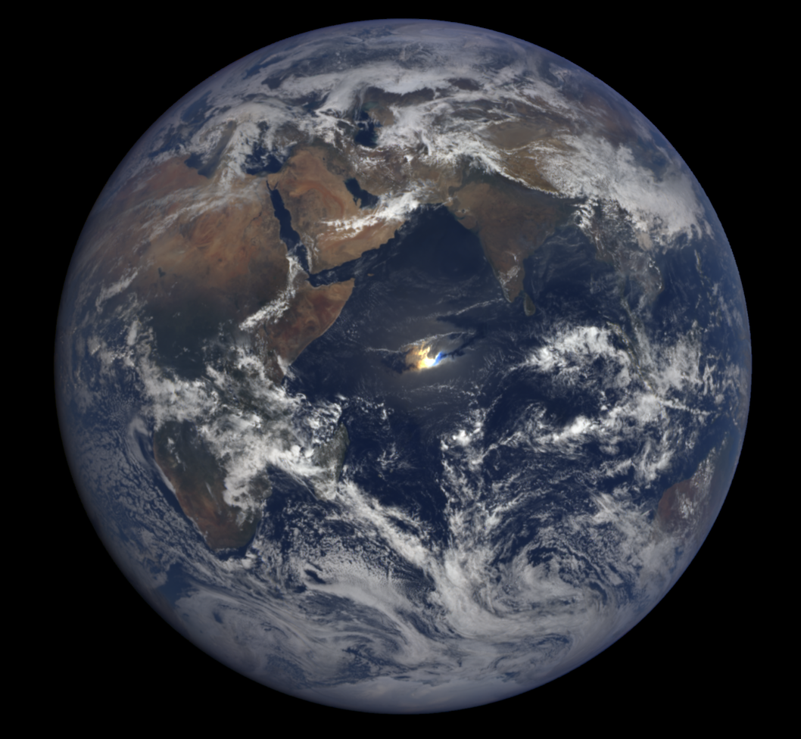
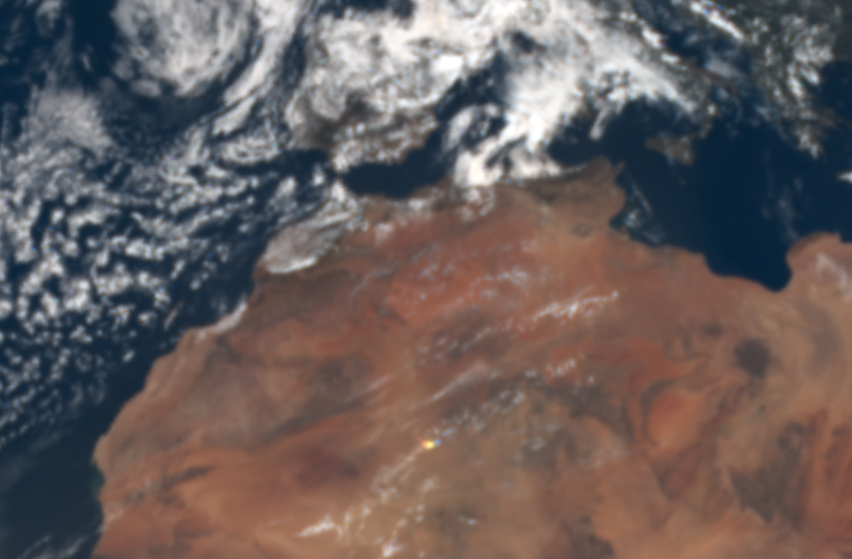
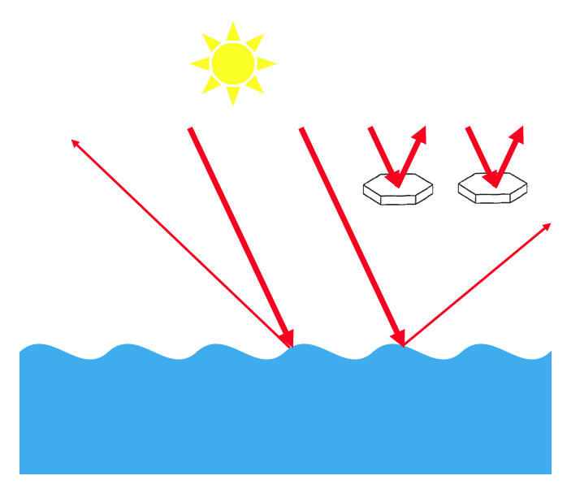
EPIC often observes sun glint
Glint from ocean surface
Glint from clouds
2016 03 23, 07:39 UTC
2016 03 17, 09:46 UTC

Slide 3
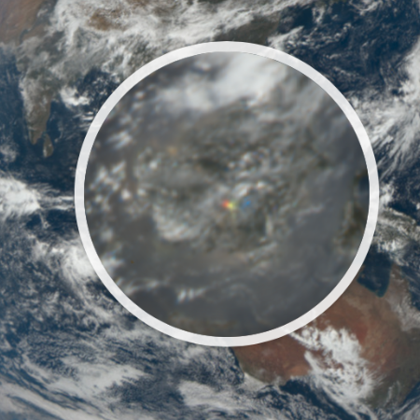
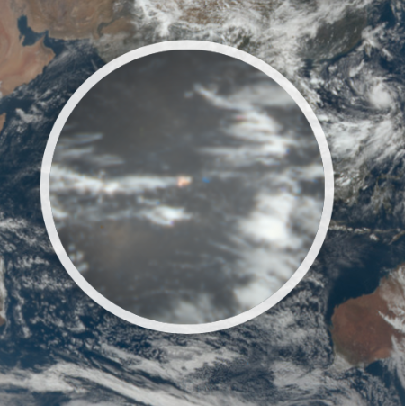
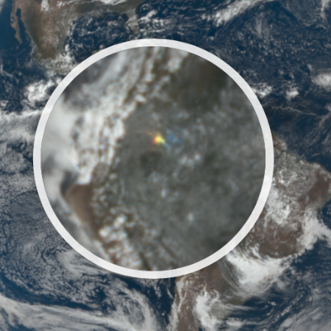
Three glints observed on the same day (9/25/2022)
04:40 UTC
06:28 UTC
17:16 UTC

Slide 4
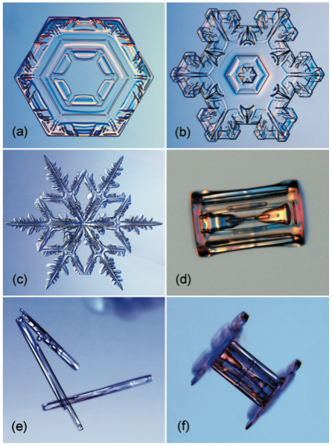
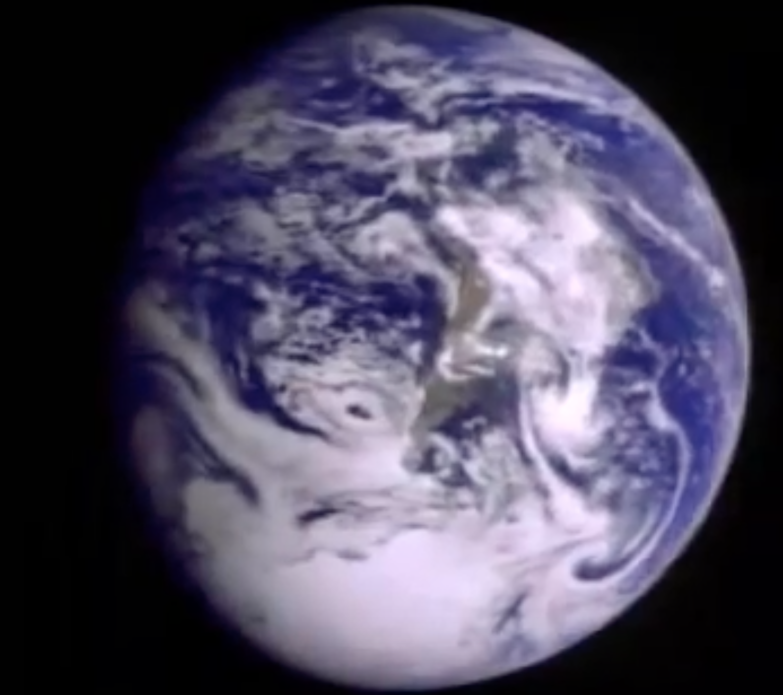
Cloud glints come mostly from plate-shaped crystals
Galileo
12/11/1990
1.3 mill. miles
Libbrecht (2005)
Können (2017, BAMS)
First few seconds of video at
https://www.youtube.com/watch?v=ceJOBFj3hKs

Slide 5
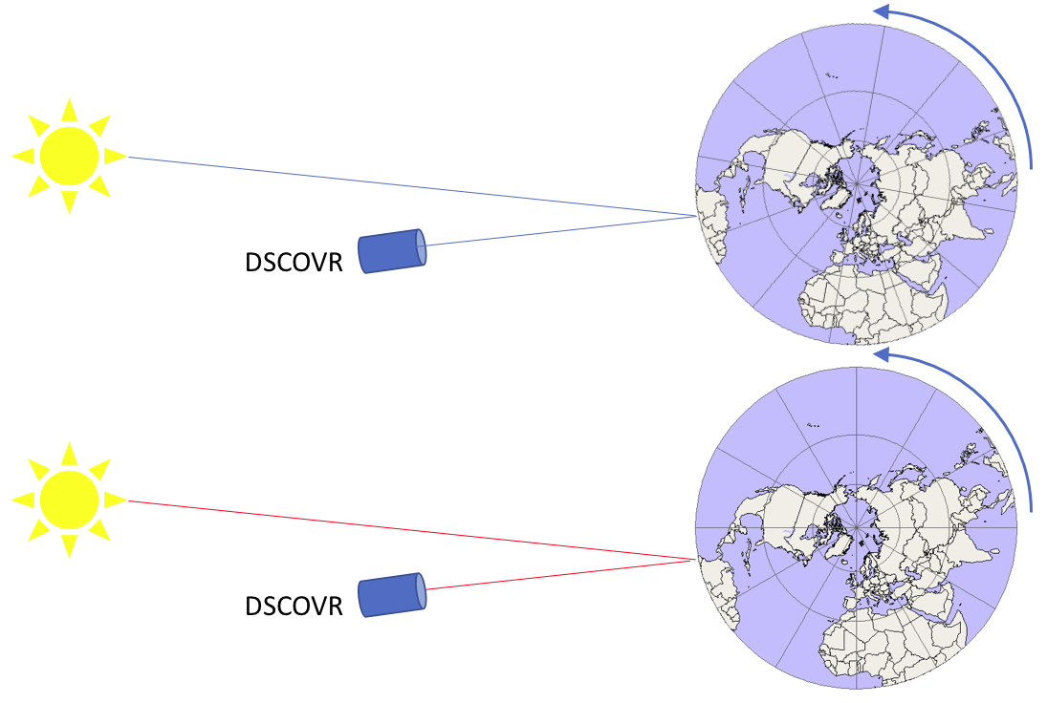
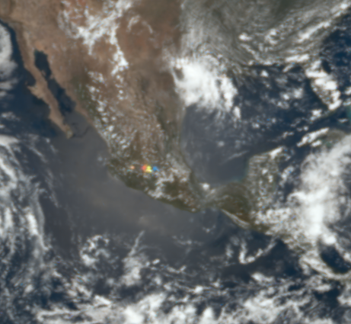
Cloud glints can be identified in EPIC images as they appear colorful (the Earth turns between blue & red EPIC images)
Time of blue image
Time of red image: ≈ 4 minutes later
2018 07 04 19:00:06 UTC

Slide 6
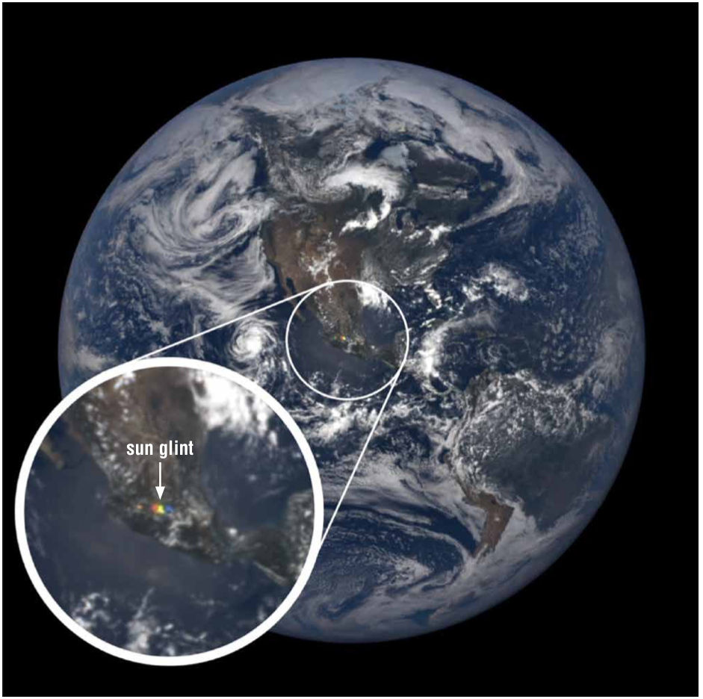
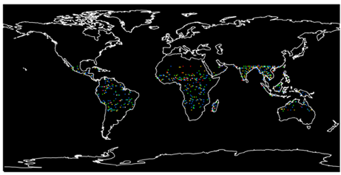
Cloud glints affect small parts of EPIC images…
…but glint data can provide broad statistics for the tropics
Glints detected over land in 2017
Based on Fig. 2 of Marshak et al. (2017)
2018 07 04 19:00:06 UTC
Front page of Earth Observer, July-August 2021
2018 07 04 19:00:06 UTC

Slide 7
Glint data can help reduce the uncertainties related to horizontally oriented ice crystals in
Calculations of cloud radiative effects (albedo)¹
Spaceborne microwave retrievals of cloud ice water path²
Calculations of crystal fall speed and cloud lifetime³
Cloud conditions (e.g., crystal size & shape, turbulence, radiative cooling)⁴
¹(Takano and Liu, 1989; Stillwell et al., 2019) ²(Gong and Wu, 2017)
³(Heymsfield and Iaquinta, 2000; Westbrook, 2008; Zeng et al., 2021) ⁴(Katz, 1998; Bréon and Dubrulle, 2004; Zeng et al., 2021)

Slide 8
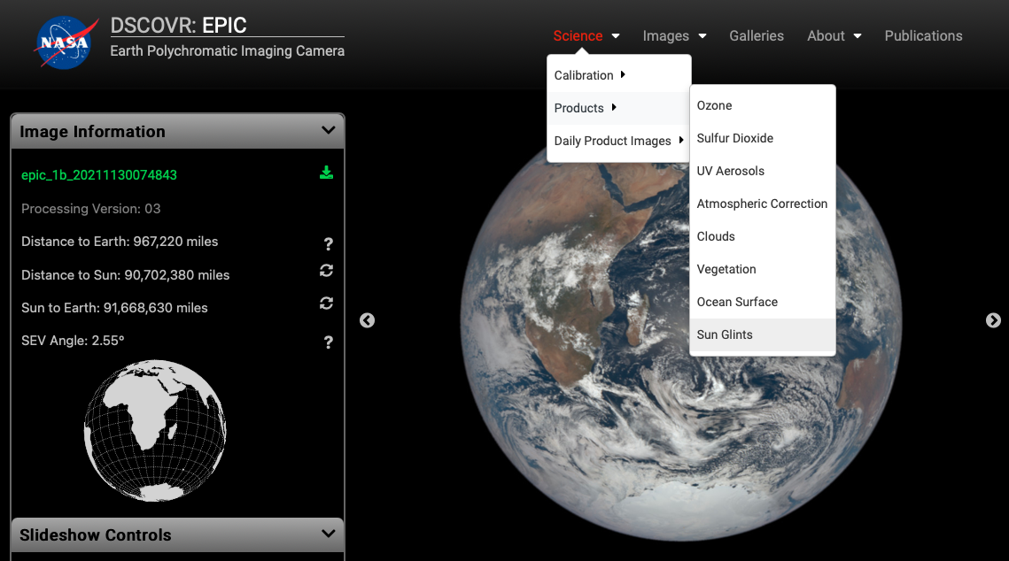
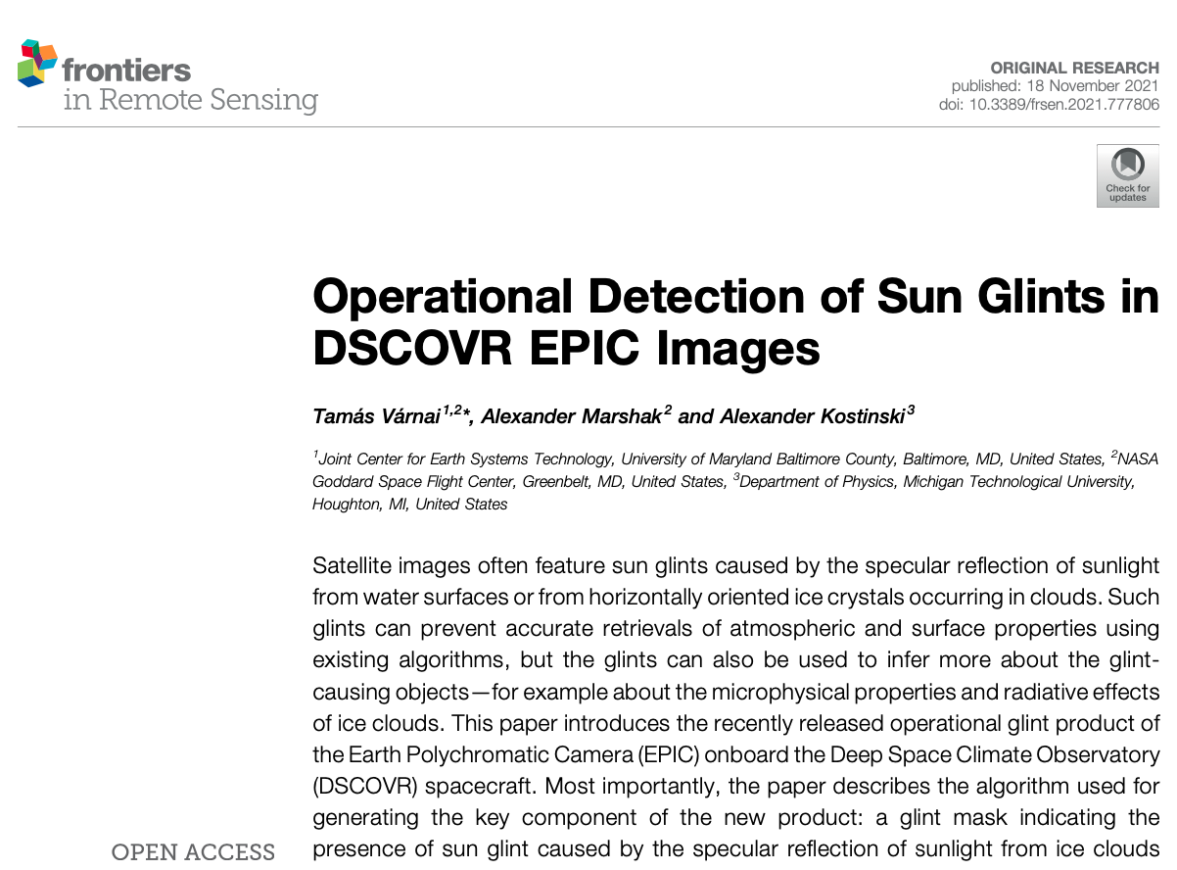
EPIC glint product is now available
EPIC website Frontiers in Remote Sensing
http://epic.gsfc.nasa.gov/
Várnai T., Marshak A., and Kostinski, A., 2021:
Operational detection of sun glints in DSCOVR EPIC images.
Frontiers in Remote Sensing doi: 10.3389/frsen.2021.777806

Slide 9
Glint mask examples over water
Pacific Ocean
Caribbean Sea
Pacific Ocean
Pacific Ocean
c
Aqua MODIS 13:40
θ ₀ = 29°, θ = 3°
2018 01 27 22:31:42 UTC
2018 06 20 17:54:36 UTC
2018 08 11 03:06:11 UTC
2018 08 04 00:55:15 UTC
2016 11 01, 03:44

Slide 10
Glint mask examples over land
c
Aqua MODIS 13:40
θ ₀ = 29°, θ = 3°
2018 01 02 16:20:59 UTC
2018 09 09 09:36:47 UTC
2018 08 05 04:58:24 UTC
2018 02 09 15:28:56 UTC
2016 11 01, 03:44

Slide 11
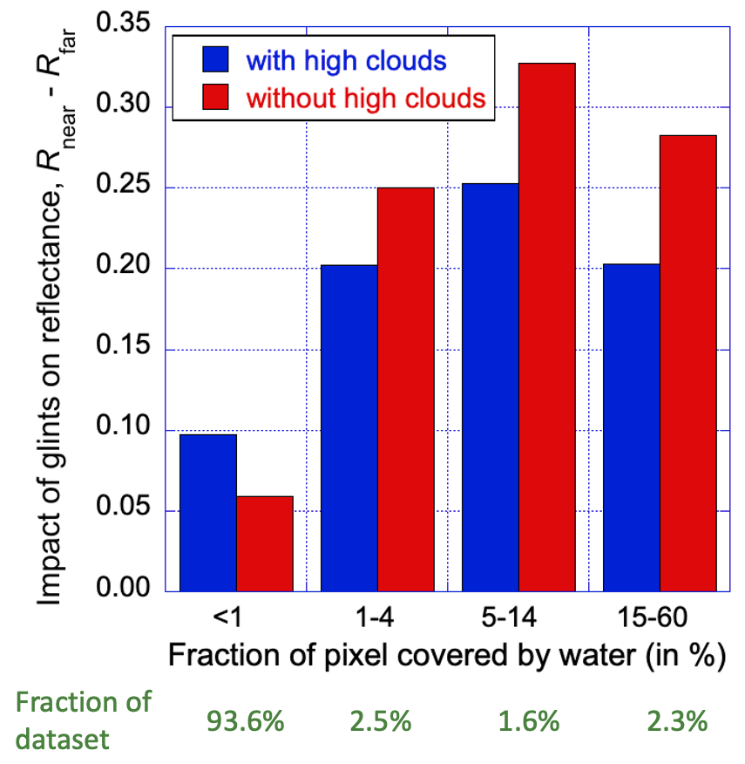
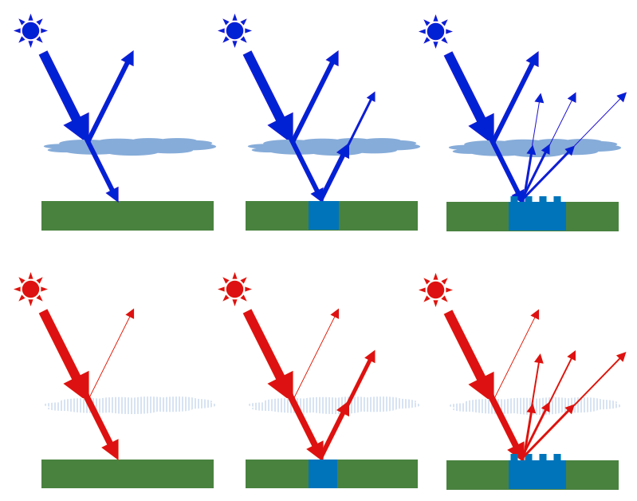
Lakes make glints stronger
2018 01 02 16:20:59 UTC
Paraguay
Far
Near
High
cloud
detected
Distance [pixel]
No high
cloud
detected
(Mean of enhancements at 443, 551, 680, & 780 nm)
Notes:
Ocean enhancements: High Cloud: 0.0255 No high cloud: 0.0085

Slide 12
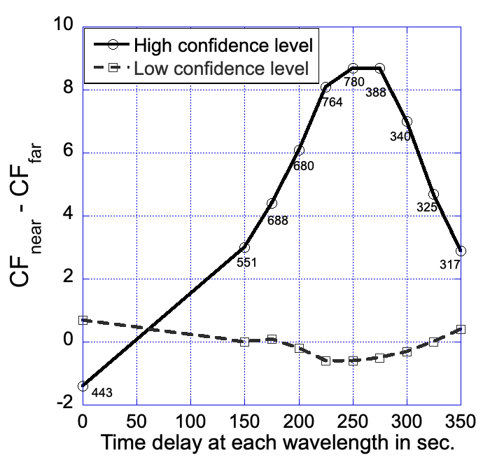
Glints increase retrieved cloud fraction
Distance of each wavelength’s specular spot
from that of the blue image [km]
0
69
81
93
104
116
127
139
150
162
CF_{Far}
High conf: 58%
Low conf.: 4%
Distance [pixel]
2018 01 02 16:20:59 UTC, Paraguay
Notes:
Ocean enhancements: High Cloud: 0.0255 No high cloud: 0.0085

Slide 13
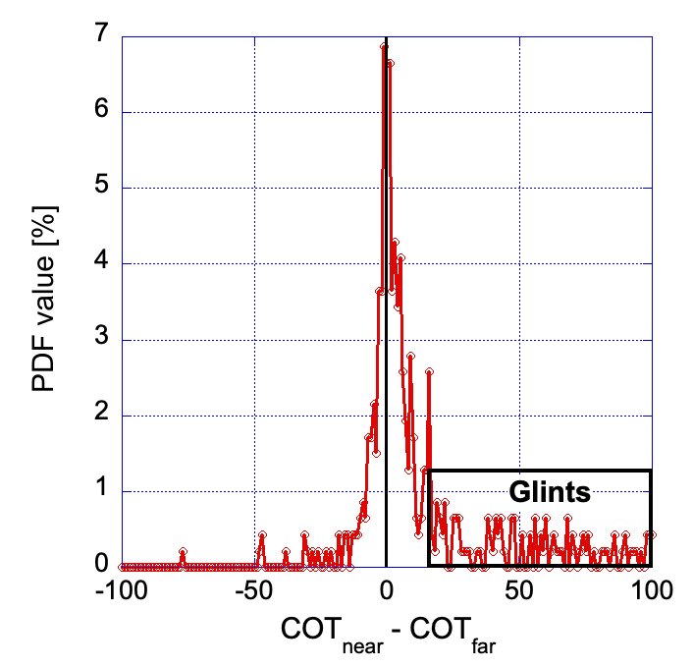
Retrieved COD often jumps in glints
2018 01 02 16:20:59 UTC
Mean COT
Far: 13
Near: 55
Mean COT of
unsaturated images
Far: 13
Near: 39
Paraguay
Far
Near
Distance [pixel]
Land pixels with no water, δ for 680 nm; Near: δ < 0.3°, Far: 1.5° < δ < 2°, At least 10 near & far pixels with COD or height data

Slide 14
Retrieved cloud height can also jump
Bolivia
B-band cloud height [m]
2017 02 13 16:30:18 UTC
Land pixels with no water, δ for 680 nm; Near: δ < 0.3°, Far: 1.5° < δ < 2°, At least 10 near & far pixels with COD or height data

Slide 15
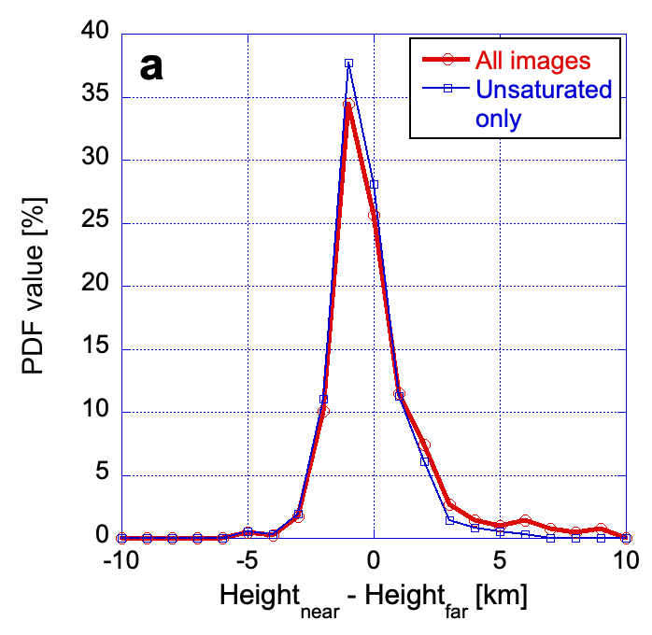
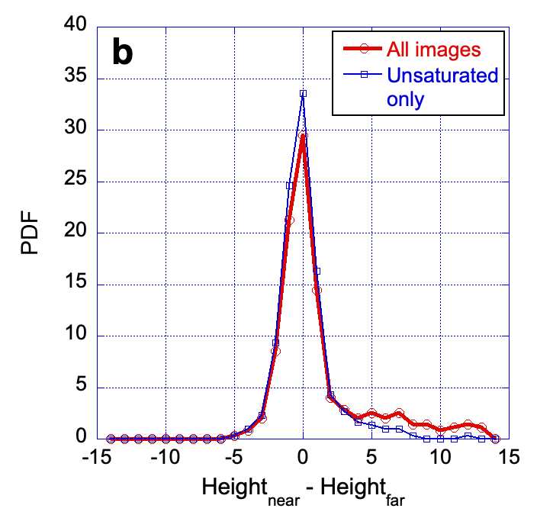
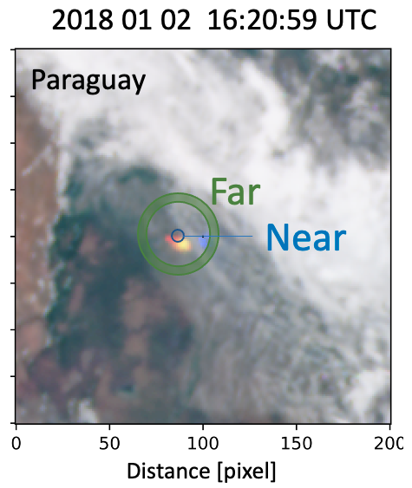
Retrieved cloud height often jump
A-band
B-band
Bolivia
Mean: 0.2 km
Mean: 1.4 km
Land pixels with no water, δ for 680 nm; Near: δ < 0.3°, Far: 1.5° < δ < 2°, At least 10 near & far pixels with COD or height data

Slide 16
Take-home messages
The EPIC glint product identifies glints from clouds and smooth water surfaces.
Glints from horizontally oriented ice crystals have strong impacts in EPIC cloud retrievals.
EPIC glint data can can improve our understanding of tropical ice clouds (prevalence, size, seasonal and diurnal cycle, radiative effect), which is important because horizontally oriented ice crystals are known to affect cloud albedo, lifetime, microwave remote sensing.
2016 11 01, 03:44

Slide 17
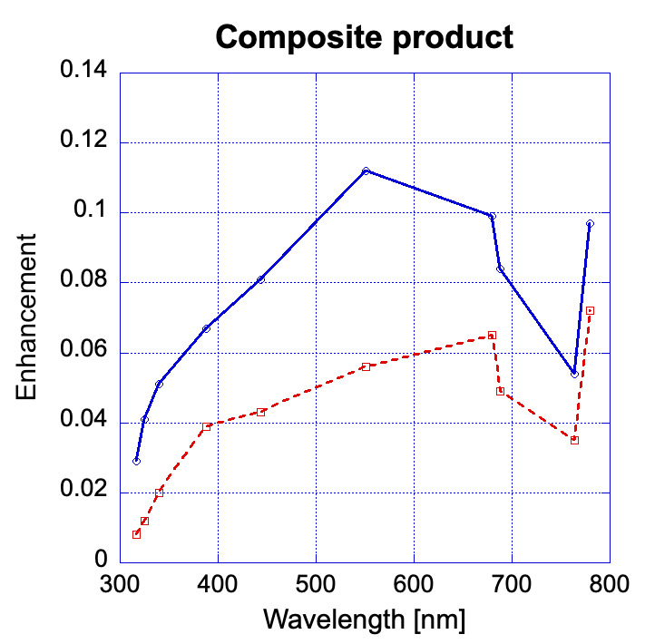
Glints over land are stronger when high clouds are detected by geostationary satellites
High clouds (above 3km) in collocated geostationary images?
High cloud detected
δ
R_{0-0.3°} - R_{1.5-2°}
Reflectance enhancement
No high cloud detected

