Slide 1
Welcome to the Ninth DSCOVR STM
Oct 16-17 2023

Slide 2
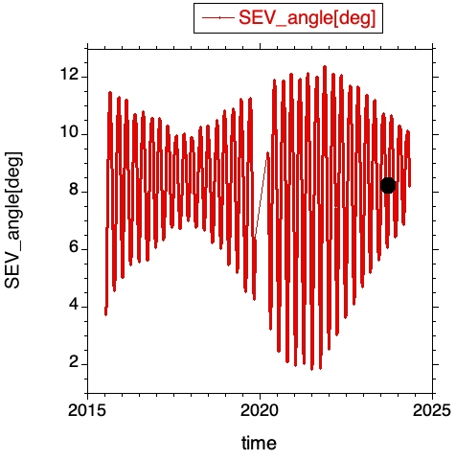
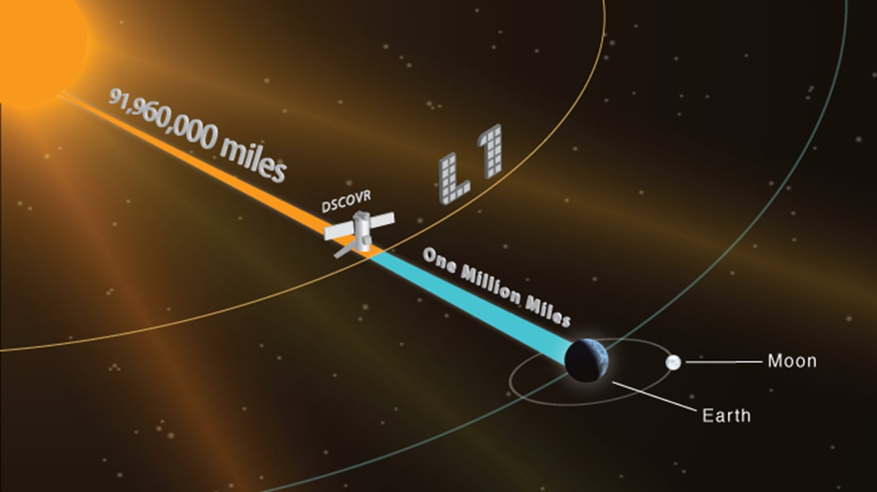
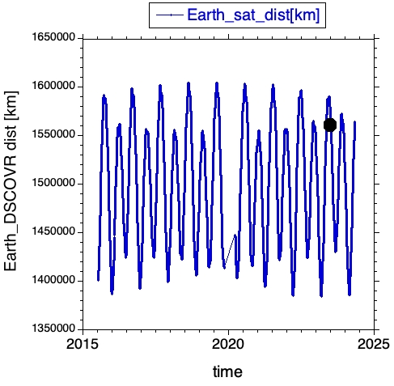
DSCOVR STM
Oct 16-17 2023
DAY_TOTAL SEV[deg] Earth_sat_dist [km] Velocity [km/s]
3048 8.06 1,572,429.4 0.226102
Got there
June 10, 2015

Slide 3
DSCOVR STM
Monday Oct 16
Chair: Alexander Marshak
Intro/Project/Web/Archive
10:00 Welcome and update (Adam Szabo / Alexander Marshak / Jay Herman)
10:10 GSFC (Tom Neumann, Steve Platnick) & HQ (Richard Eckman)
10:25 DSCOVR status (Adam Szabo)
10:35 DSCOVR mission operations (Amanda Raab)
10:45 ASDC update (Hazem Mahmoud)
EPIC Level 1 data and reprocessing
11:00 Karin Blank (Geolocation overview)
11:15 Alexander Cede (EPIC L1a status update)
11:30 Marshall Sutton (DSOC overview and Level 2 processing)
EPIC Calibration
11:45 Liang-Kang Huang (An update of EPIC flat field calibration with lunar measurements)
12:00 Igor Geogdzhaev (EPIC VIS-NIR calibration using GOES ABI and lunar views)
12:15 Conor Haney (Annual update of the EPIC radiometric scaling to VIIRS and MODIS and preliminary Himawari-8/EPIC intercalibration results)
Lunch
12:30-2:00
Chair: Marshall Sutton
NISTAR and EPIC observations
2:00 Smith/Yu/Lorentz (NISTAR Update)
2:15 Clark Weaver (Shortwave reflected energy from NISTAR and EPIC)
2:30 Andrew Lacis (Some unexpected results from 6 years of EPIC data)
Break
2:45-3:15
EPIC Products
3:15 Natalya Kramarova (Status of EPIC total ozone algorithm)
3:30 Jerry Ziemke (Current status of EPIC tropospheric ozone and anomalously low NH amounts in 2020-2022)
3:45 Kai Yang (Update and recent results of DSCOVR/EPIC O3 and volcanic SO2 products)
4:00 Simon Carn (EPIC observations of volcanic eruptions: SO2 data validation and development of UV ash mass retrievals)
EPIC Products (Aerosols)
4:15 Alexei Lyapustin (MAIAC v3 Algorithm for synergistic aerosol characterization including AOD, spectral absorption and height)
4:30 Sujung Go (Climatology analysis of global properties of smoke and dust from MAIAC EPIC)

Slide 4
Tue Oct 17
Chair: Jay Herman
EPIC Products (Aerosols)
9:00 Omar Torres (EPICAERUV algorithm: recent work and upgrades)
9:15 Hiren Jethva (Absorbing aerosols above clouds from DSCOVR-EPIC)
9:30 Jun Wang (EPIC Aerosol Optical Centroid Height (AOCH) product: progress and application)
EPIC Products (Clouds)
9:45 Yuekui Yang (Understanding DSCOVR/EPIC cloud height: algorithm and comparison with other products)
10:00 Yaping Zhou (Evaluation of EPIC oxygen bands stability with radiative transfer model simulations over south pole)
10:15 Alfonso Bonal (Diurnal evolution of cloud properties with DSCOVR/EPIC)
10:30 Elizabeth Berry (Cloud vertical structure derived from coincident DSCOVR-CloudSat observations and machine learning)
10:45 HQ view (Jack Kaye)
Break
10:55-11:15
EPIC Products (Ocean)
11:15 Robert Frouin (DSCOVR/EPIC ocean radiation products)
EPIC Products (Vegetation)
11:30 Yuri Knyazikhin (VESDR product: status and science)
11:45 Jan Pisek (The relationship between directional area scattering factor and foliage clumping based on DSCOVR/EPIC data over Australian TERN sites)
Lunch
12:00-2:00
Chair: Adam Szabo
Science with the DSCOVR EPIC observations
2:00 Tamas Varnai (Impacts of sun glint off ice clouds on DSCOVR/EPIC data products)
2:15 Alex Kostinski (On the fundamental optics of sun glints)
Break
2:30-3:00
Science with the DSCOVR EPIC observations
3:00 Guoyong Wen (The change of global spectral reflectance as EPIC observed sunlight approaching perfect backscattering)
3:15 Nick Gorkavyi (Earth observations from the lunar surface: scientific and technical advantages and dependence on lunar libration)
3:30 Jay Herman (EPIC validation of ozone trends since 2015)
Summary and Discussion
3:45 (Szabo, Marshak, Herman) Poster: Alexander Radkevich: A comparative analysis of air quality monitoring by orbital and suborbital NASA missions

