Slide 1
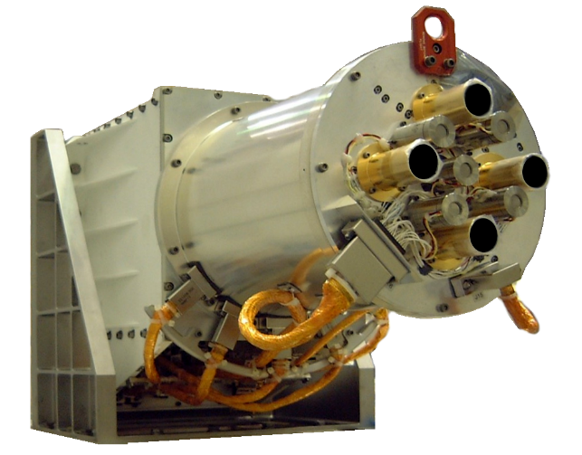
NISTAR Update
Steven Lorentz, Yinan Yu, and Allan Smith
L-1 Standards and Technology, Inc.
Band | Band (μm) | Description
Photodiode | 0.2 to 1.1 | UV-Vis-NIR
Band A | 0.2 to 100 | Total
Band B | 0.2 to 4 | Short-Wave
Band C | 0.7 to 4 | Near-IR SW

Slide 2
Outline
Minor changes in L1A and L1B processing
Intrusion of the Moon into the NISTAR Field-of-Regard (FOR)
  Frequent enough to impact Earth observation time (11%)
  A correction for the contaminating moonlight for most intrusions with the shortwave channel has been completed.
NISTAR SW and Photodiode Comparisons
  Orbital Evolution and Low Backscattering Angles
  Instrument has demonstrated a high degree of stability
Current NISTAR Uncertainties
Future Activities
  The out-of-phase component of the demodulated radiometer signals continues to be investigated
  It is an offset component, unaffected by Earth light—allows continuous tracking while observing the Earth

Slide 3
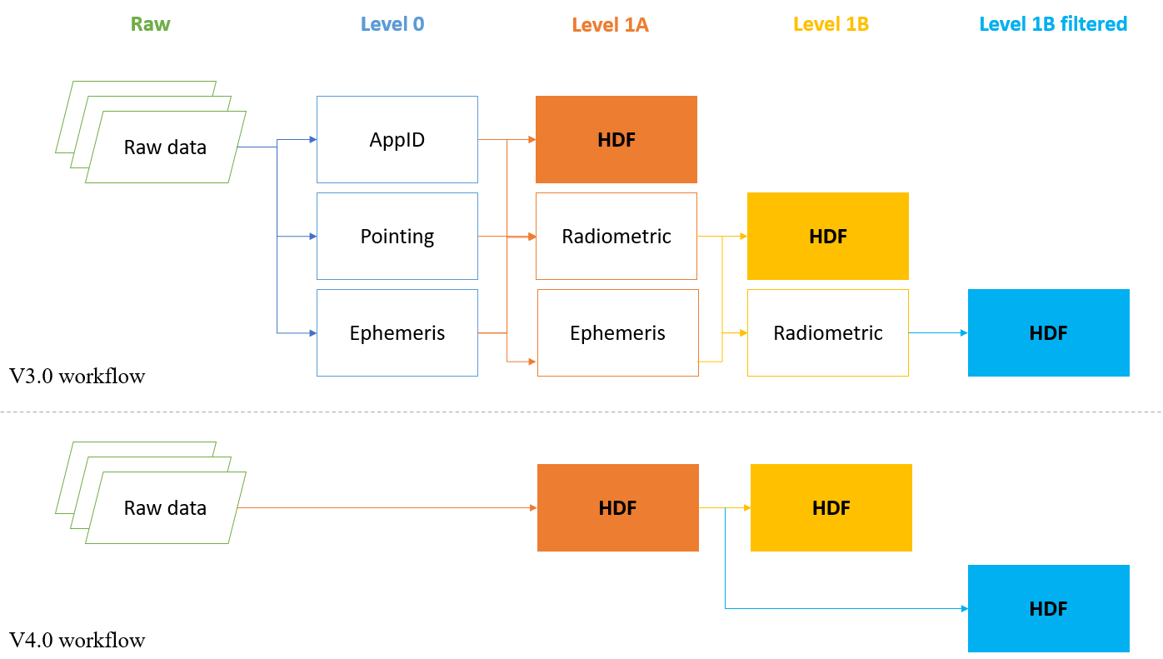
Current Status of Ground Processing Software
Version 3.0 (3.1 - Current)
  Long-term averaged / constant background power data for filtered channels
  Significantly reduced software-wise processing time (3.0 update)
  Monthly product of filtered Earth radiance (3.0 update)
  Correction for Lunar intrusions of the shortwave Earth radiance (3.1 update)
Version 4.0
  Enhanced background power data to capture the long-term variability for filtered channels
  Redesigned source code and user interface to improve runtime efficiency and reliability
  The beta version has been developed and delivered to DSOC for testing
V3.x processing generates intermediate text files before generating HDF products.
All read/write in V4.0 processing are within HDF files.

Slide 4
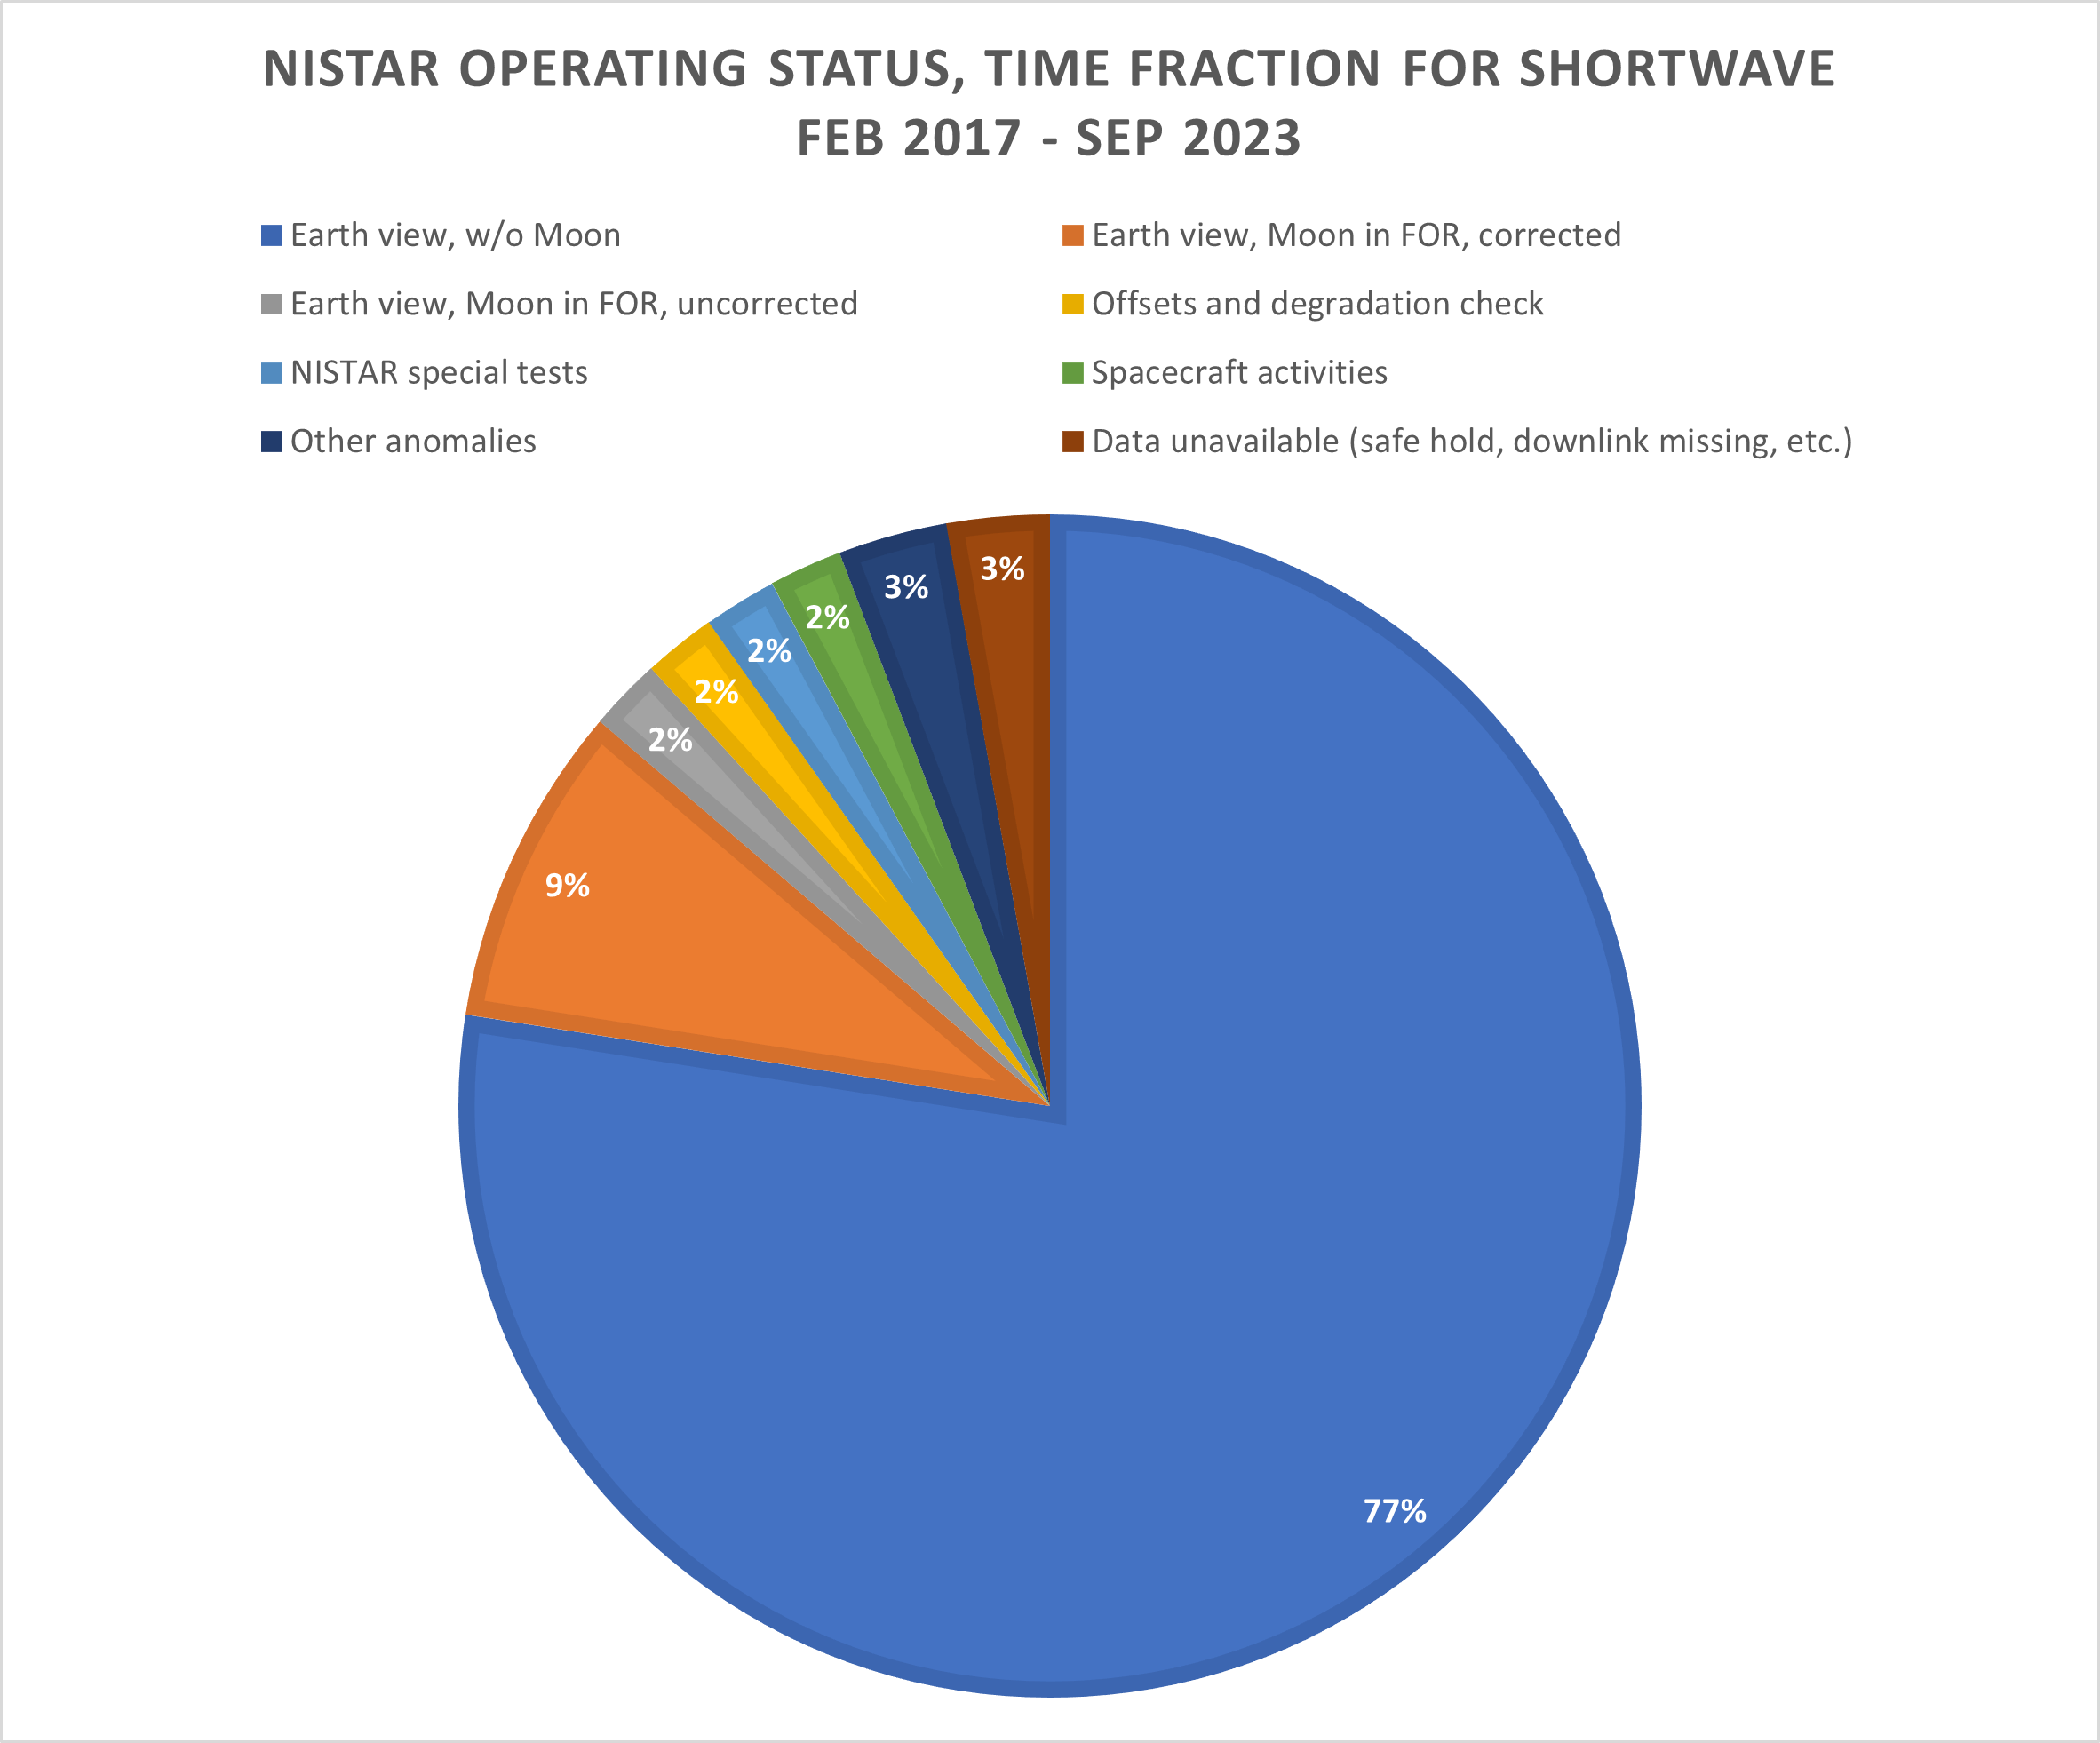
Current Time Fraction for Shortwave Data
About 86 % data present in the shortwave channel (77 % nominal Earth view + 9 % Moon intrusion correction)

Slide 5
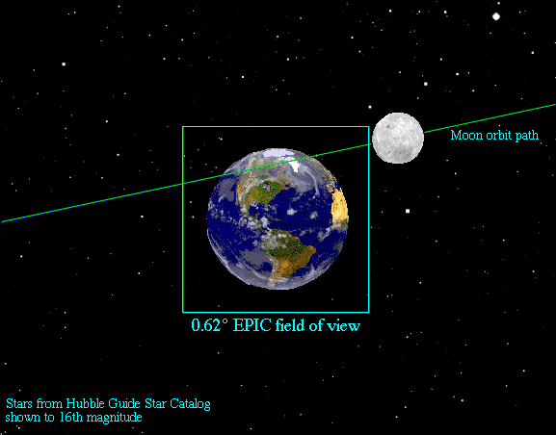
View of the Earth from L1
L1 is the neutral gravity point located 1.6 million km from Earth. The DSCOVR orbit spans ~200k km, tilts along the Sun-Earth line, and evolves over time.
NISTAR views the entire Earth from a synoptic vantage point; integrating flux from the entire disk in four separate bands.
NISTAR: FOV 1º
FOR 7º

Slide 6
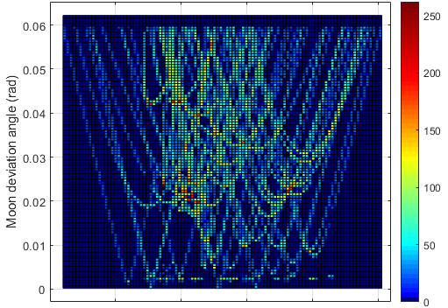
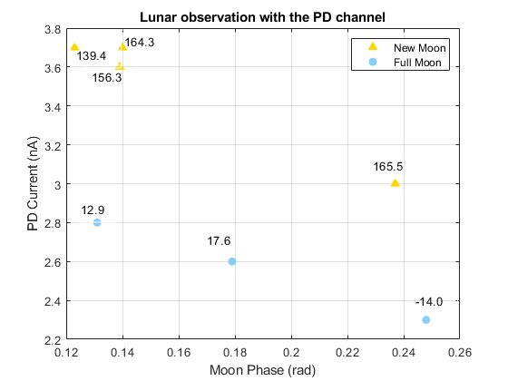
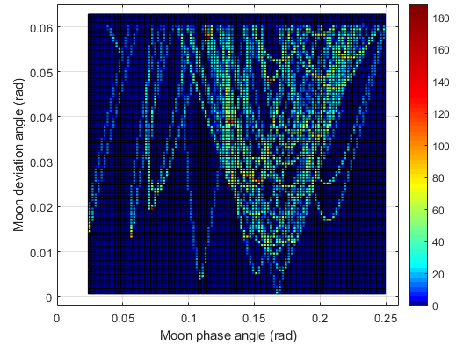
Correction Coverage of Moon Intrusion
Frequency of Intrusion
Lunar phase of most intrusions fall within 0.10 to 0.25 radians—a range spanned by direct lunar observations made in 2015, see plot below
Note: lunar PD currents are much smaller than during the 70 nA during Earth observations
Full moon
New moon

Slide 7
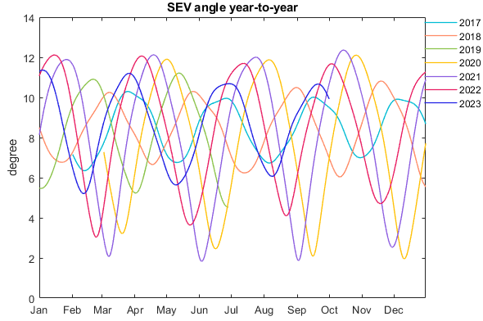
Evolution of NISTAR View Angle over Time
The 6-month period Lissajous orbit of DSCOVR has continually evolved over time. The plot below shows the backscattering angle as seen by NISTAR over the last 7 years.
In 2017, the DSCOVR sun-earth-vehicle (SEV) angle varied from 6.4 to 10 degrees. While in 2020 and 2021 the SEV angle varied from 2 to 12.1 degrees, which produces backscattering angles of 168 to 178 degrees.
August 2021, a spacecraft maneuver changed the orbit so that it will not approach 178 degrees again until 2027—too small an angle results in solar blinding the downlink stations.

Slide 8
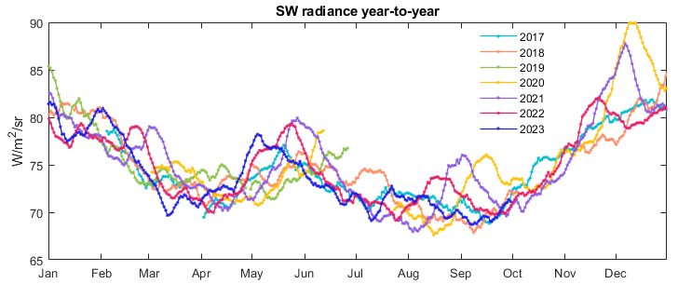
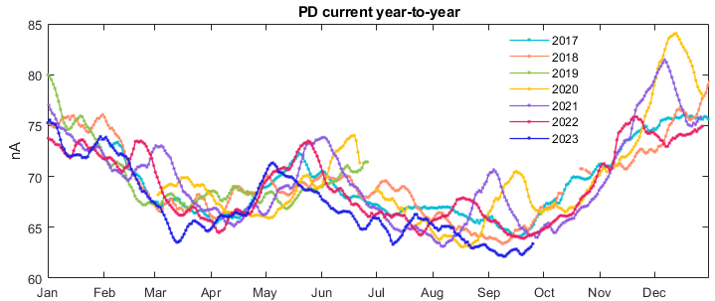
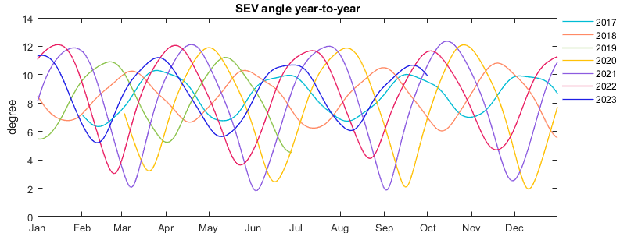
NISTAR Shortwave & PD Intercomparison
Daily average SW radiance (top panel) indicates a 10% increase in the SW radiance as the backscattering angle approaches 178 degrees in December 2020. A 6% increase is noted in September.
The middle panel shows the scaled current of the PD channel. The signal to noise in this channel is <0.1%. All of the fine structure is real daily variability of the Earth’s SW radiance.
The bottom panel show the backscattering angle viewed by NISTAR year to year. This plot is included to make it easier to see the correlation between backscattering angle and the measured radiance.

Slide 9
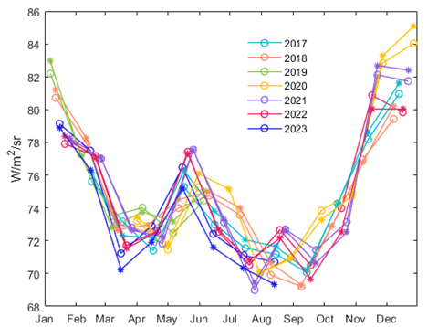
NISTAR Shortwave & PD Intercomparison
Comparison of SW to itself year-to-year and PD channel indicates variability in NISTAR SW offset is erroneous
Year-to-Year NISTAR Radiance
SW radiance (circles) are most consistent year-to-year with a constant background (bottom panel) vs monthly measurements (top panel)—note that each year is a different color
A relative comparison with the scaled PD channel (stars) implies long-term agreement below a percent with a constant background
→NISTAR is a very stable instrument, however, measurements of the offsets have measurement errors

Slide 10
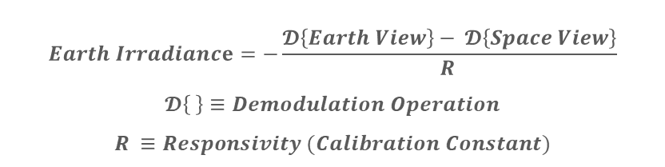
NISTAR Uncertainty Estimates
$$Earth Irradiance=−\frac{𝓓\left\{Earth View\right\}− 𝓓\left\{Space View\right\}}{R }$$
$$𝓓\left\{ \right\}≡Demodulation Operation$$
$$R ≡Responsivity (Calibration Constant)$$
All uncertainties are calculated at k = 1
Instrument noise is normalized to the Earth signal.
Noise reduced for the NIR and SW channels by averaging over 3 consecutive dark observations.
Averaged, separately over 4- and 24-hour time periods—source variability ignored.
Uncertainty components are from both the ESR receiver and the filter transmission. For the two filtered channels, SW and NIR, the uncertainty of the filter transmission dominates.
Estimate based from on-orbit inter-comparison between filters and receivers during Earth view.
Total uncertainties of daily averages is the quadrature sum of all listed components.

Slide 11
Future Activities – Imaginary Data
The out-of-phase component of the demodulated radiometer signals continues to be investigated
Using a constant offset does not capture real changes over time.
Offset changes over time track the heatsink power, as expected with stable shutter-modulated radiative coupling between heatsink and housing
There are some significant deviations between Band C and the heatsink power that are unexplained.
Time-dependent real offset corrections are possible—work is underway.

Slide 12
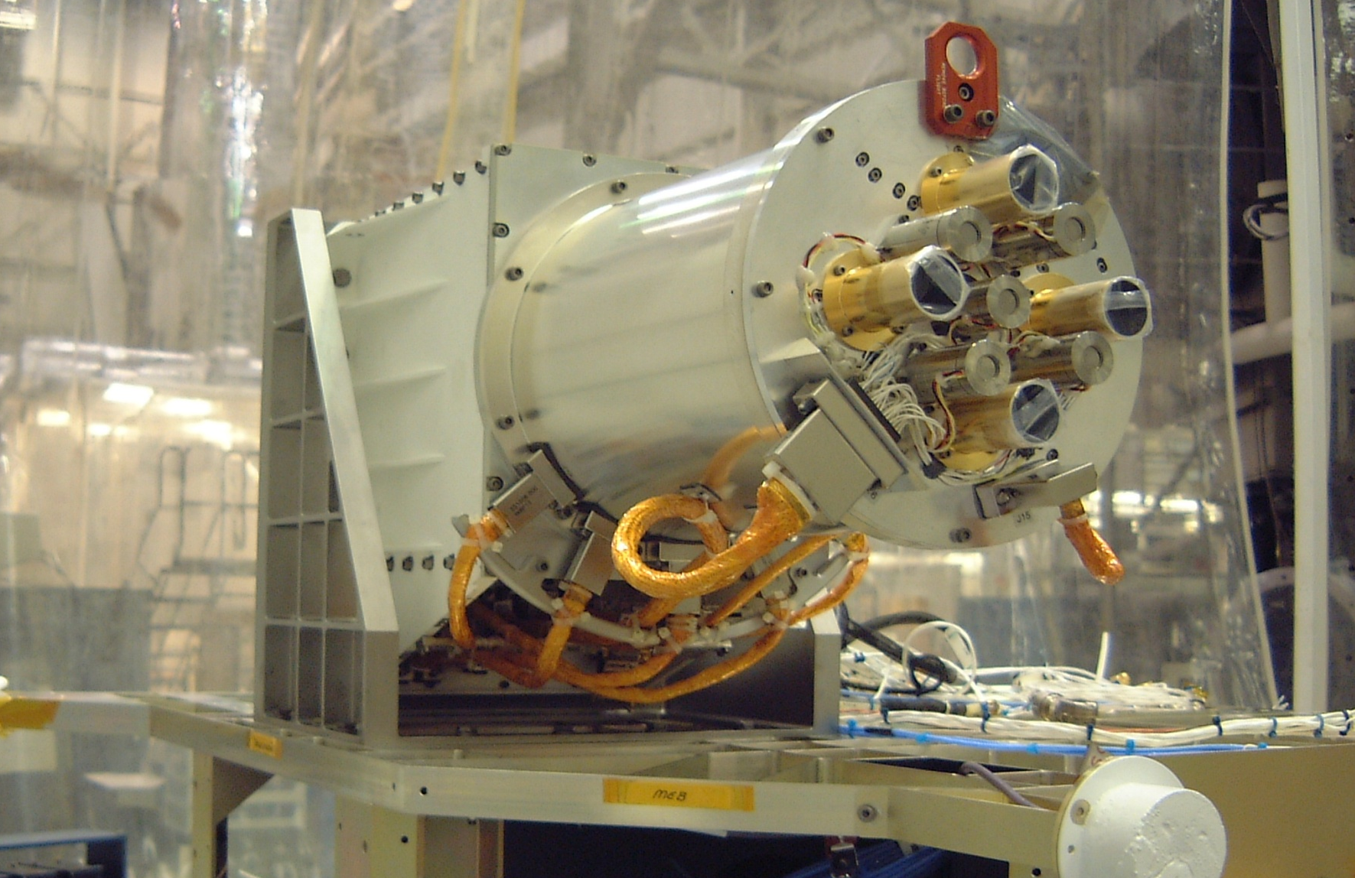
Thank you.

