Slide 1

DSCOVR EPIC L2 Vegetation Earth System Data Record: product status and science
  Yuri Knyazikhin
Boston University
jknjazi@bu.edu
  DSCOVR EPIC Science Team Meeting
  16-17 October,2023

Slide 2
VEGETATION EARTH SYSTEM DATA RECORD (VESDR): VERSION 2
  Version 2 (08_LUT02) VESDR product for the period from June-2015 to December -2021
  There was a small bug causing ambiguity in the QA information about the reason for the algorithm failure. A new cod version (08ALUT02) was delivered to NCCS. Since January 2022, the VESDR product has been generated using the new version of the code
  Data for the period from January 2015 to July-2023 is publicly available from the NASA ASDC.
  The VESDR parameters follows regularities expected from physics
  Our focus on Science with the DSCOVR EPIC observations

Slide 3
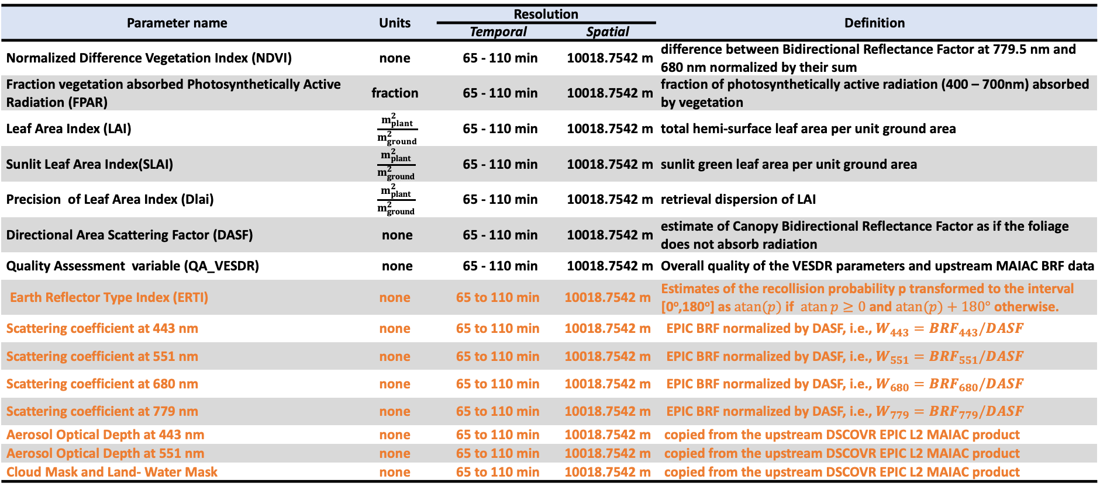
VERSION 2 VESDR: PRODUCT DESCRIPTION
Vegetation Parameter Suite in the Level 2 VESDR Product (derived from the upstream EPIC L2 MAIAC Product)
Parameter name | Units | Resolution |  | Definition
 |  | Temporal | Spatial
Normalized Difference Vegetation Index (NDVI) | none | 65 - 110 min | 10018.7542 m | difference between Bidirectional Reflectance Factor at 779.5 nm and 680 nm normalized by their sum
Fraction vegetation absorbed Photosynthetically Active Radiation (FPAR) | fraction | 65 - 110 min | 10018.7542 m | fraction of photosynthetically active radiation (400 – 700nm) absorbed by vegetation
Leaf Area Index (LAI) | $\frac{m_{plant}^{2}}{m_{ground}^{2}}$ | 65 - 110 min | 10018.7542 m | total hemi-surface leaf area per unit ground area
Sunlit Leaf Area Index(SLAI) | $$\frac{m_{plant}^{2}}{m_{ground}^{2}}$$ | 65 - 110 min | 10018.7542 m | sunlit green leaf area per unit ground area
Precision of Leaf Area Index (Dlai) | $$\frac{m_{plant}^{2}}{m_{ground}^{2}}$$ | 65 - 110 min | 10018.7542 m | retrieval dispersion of LAI
Directional Area Scattering Factor (DASF) | none | 65 - 110 min | 10018.7542 m | estimate of Canopy Bidirectional Reflectance Factor as if the foliage does not absorb radiation
Quality Assessment variable (QA_VESDR) | none | 65 - 110 min | 10018.7542 m | Overall quality of the VESDR parameters and upstream MAIAC BRF data
Earth Reflector Type Index (ERTI) | none | 65 to 110 min | 10018.7542 m | Estimates of the recollision probability p transformed to the interval [0º,180º] as $\operatorname{atan}{(p)}$ if $\operatorname{atan}{p}≥0$ and $\operatorname{atan}{(p)}+180°$ otherwise.
Scattering coefficient at 443 nm | none | 65 to 110 min | 10018.7542 m | EPIC BRF normalized by DASF, i.e., $W_{443}={BRF}_{443}/DASF$
Scattering coefficient at 551 nm | none | 65 to 110 min | 10018.7542 m | EPIC BRF normalized by DASF, i.e., $W_{551}={BRF}_{551}/DASF$
Scattering coefficient at 680 nm | none | 65 to 110 min | 10018.7542 m | EPIC BRF normalized by DASF, i.e., $W_{680}={BRF}_{680}/DASF$
Scattering coefficient at 779 nm | none | 65 to 110 min | 10018.7542 m | EPIC BRF normalized by DASF, i.e., $W_{779}={BRF}_{779}/DASF$
Aerosol Optical Depth at 443 nm | none | 65 to 110 min | 10018.7542 m | copied from the upstream DSCOVR EPIC L2 MAIAC product
Aerosol Optical Depth at 551 nm | none | 65 to 110 min | 10018.7542 m | copied from the upstream DSCOVR EPIC L2 MAIAC product
Cloud Mask and Land- Water Mask | none | 65 to 110 min | 10018.7542 m | copied from the upstream DSCOVR EPIC L2 MAIAC product
Added in version 2
The VESDR h5 file also includes Solar Zenith Angle (SZA), Solar Azimuthal Angle (SAA), View Zenith (VZA) and Azimuthal (VAA) angles at the same temporal and spatial resolutions. Granule size is below 37MB.

Slide 4
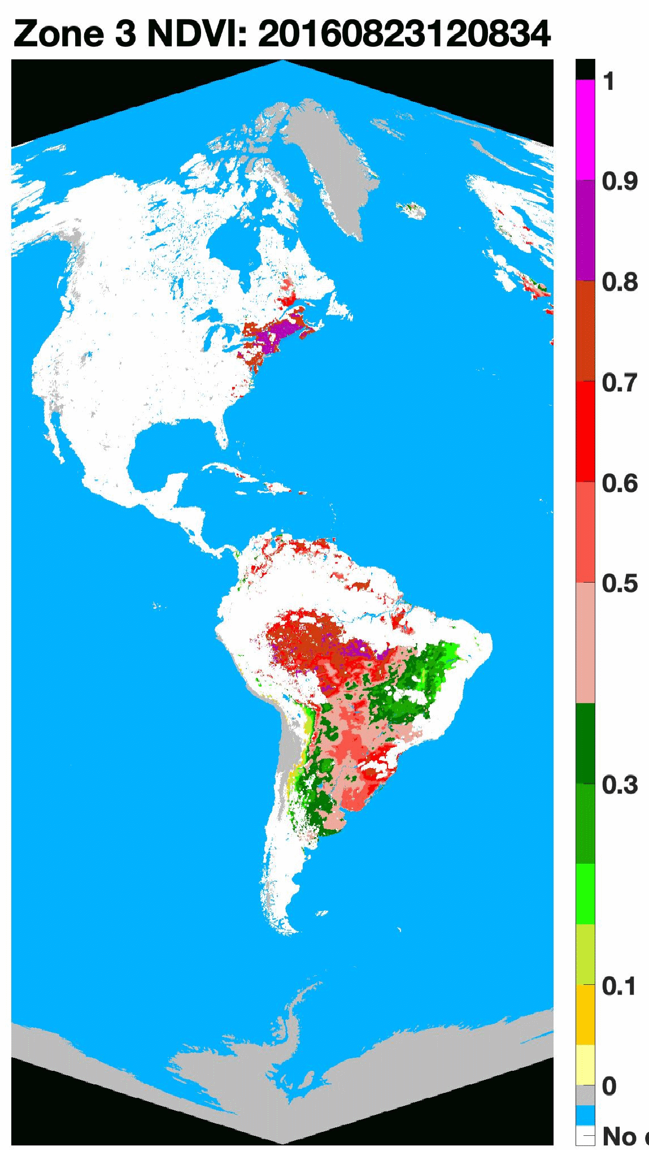
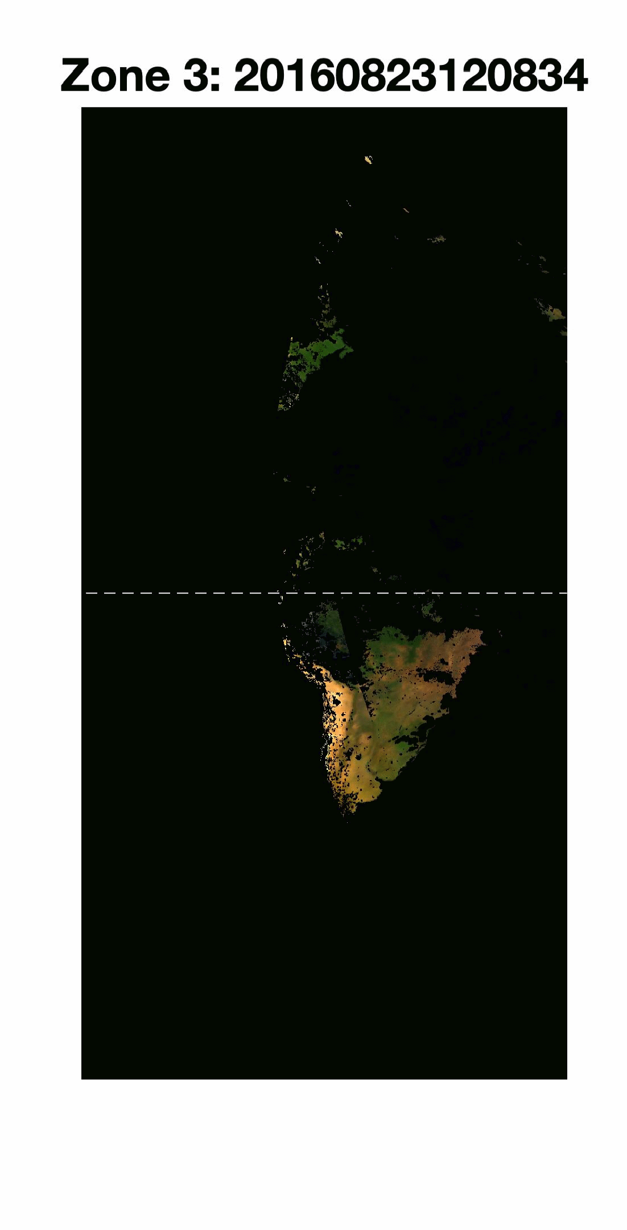
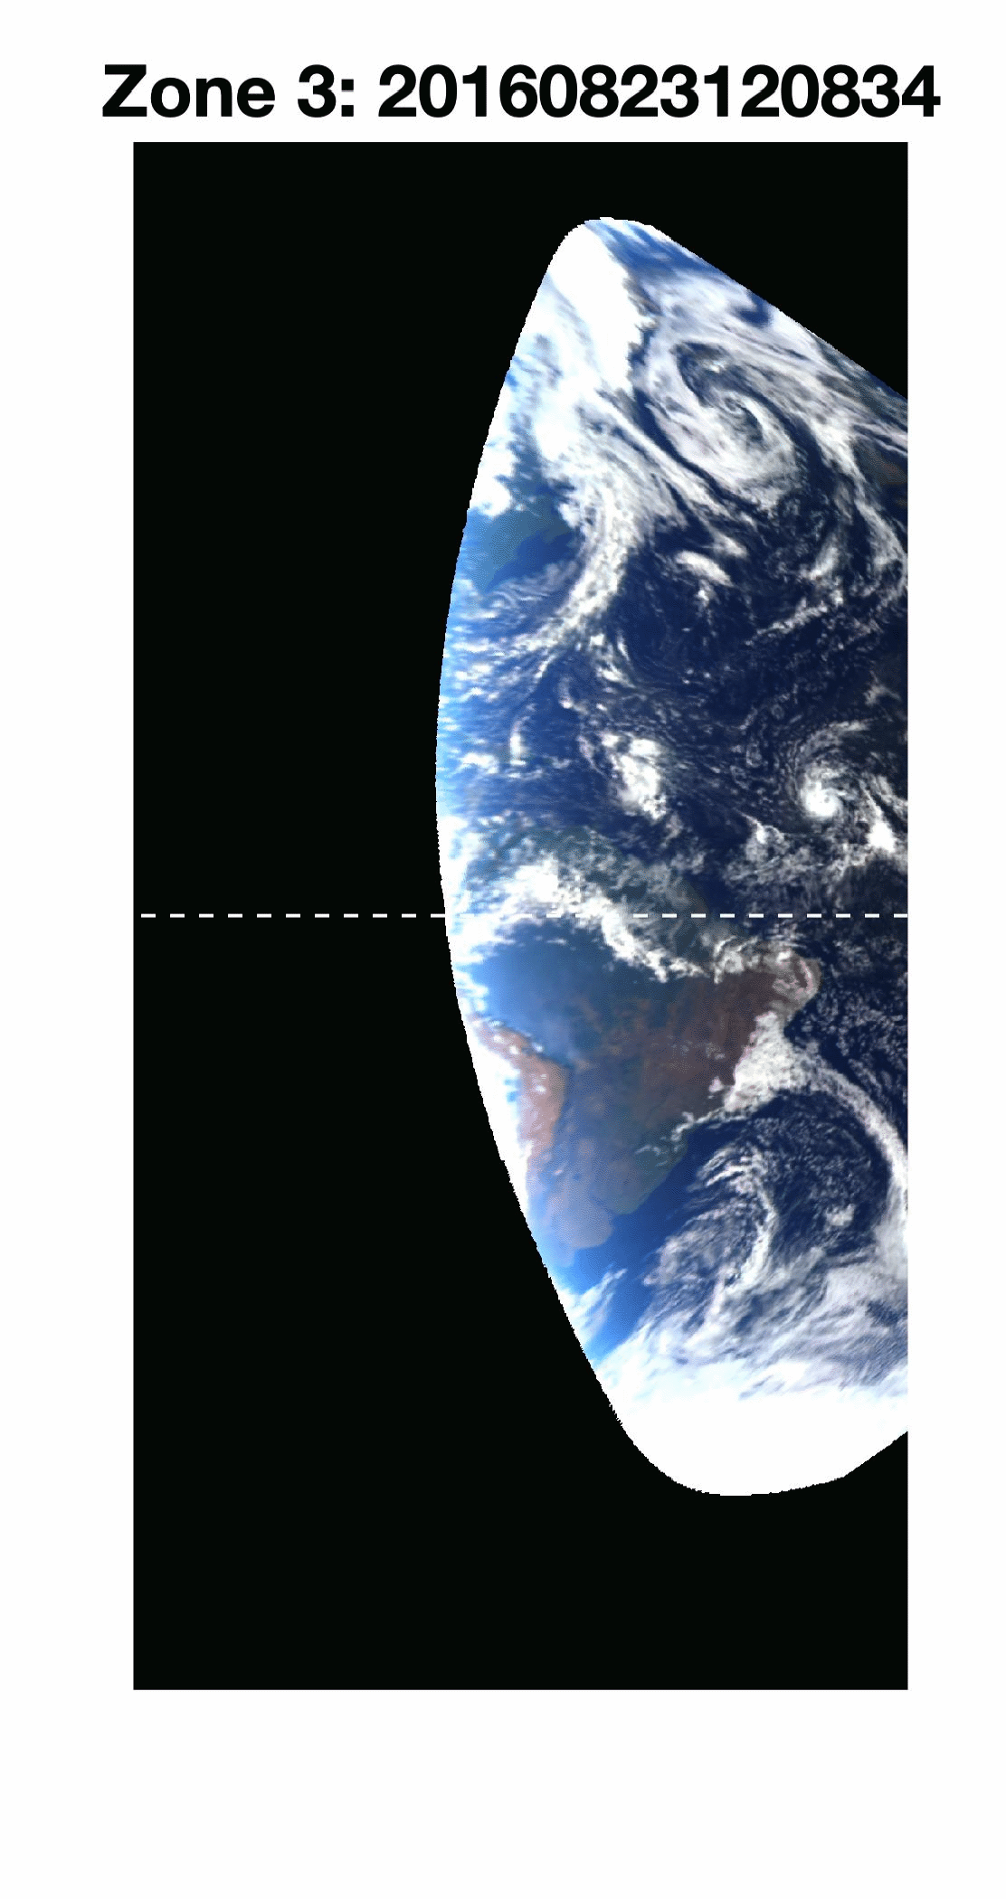
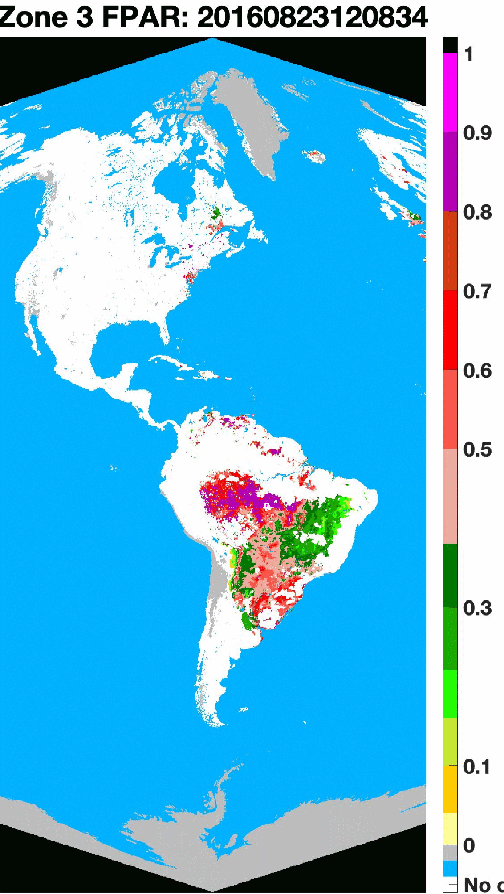
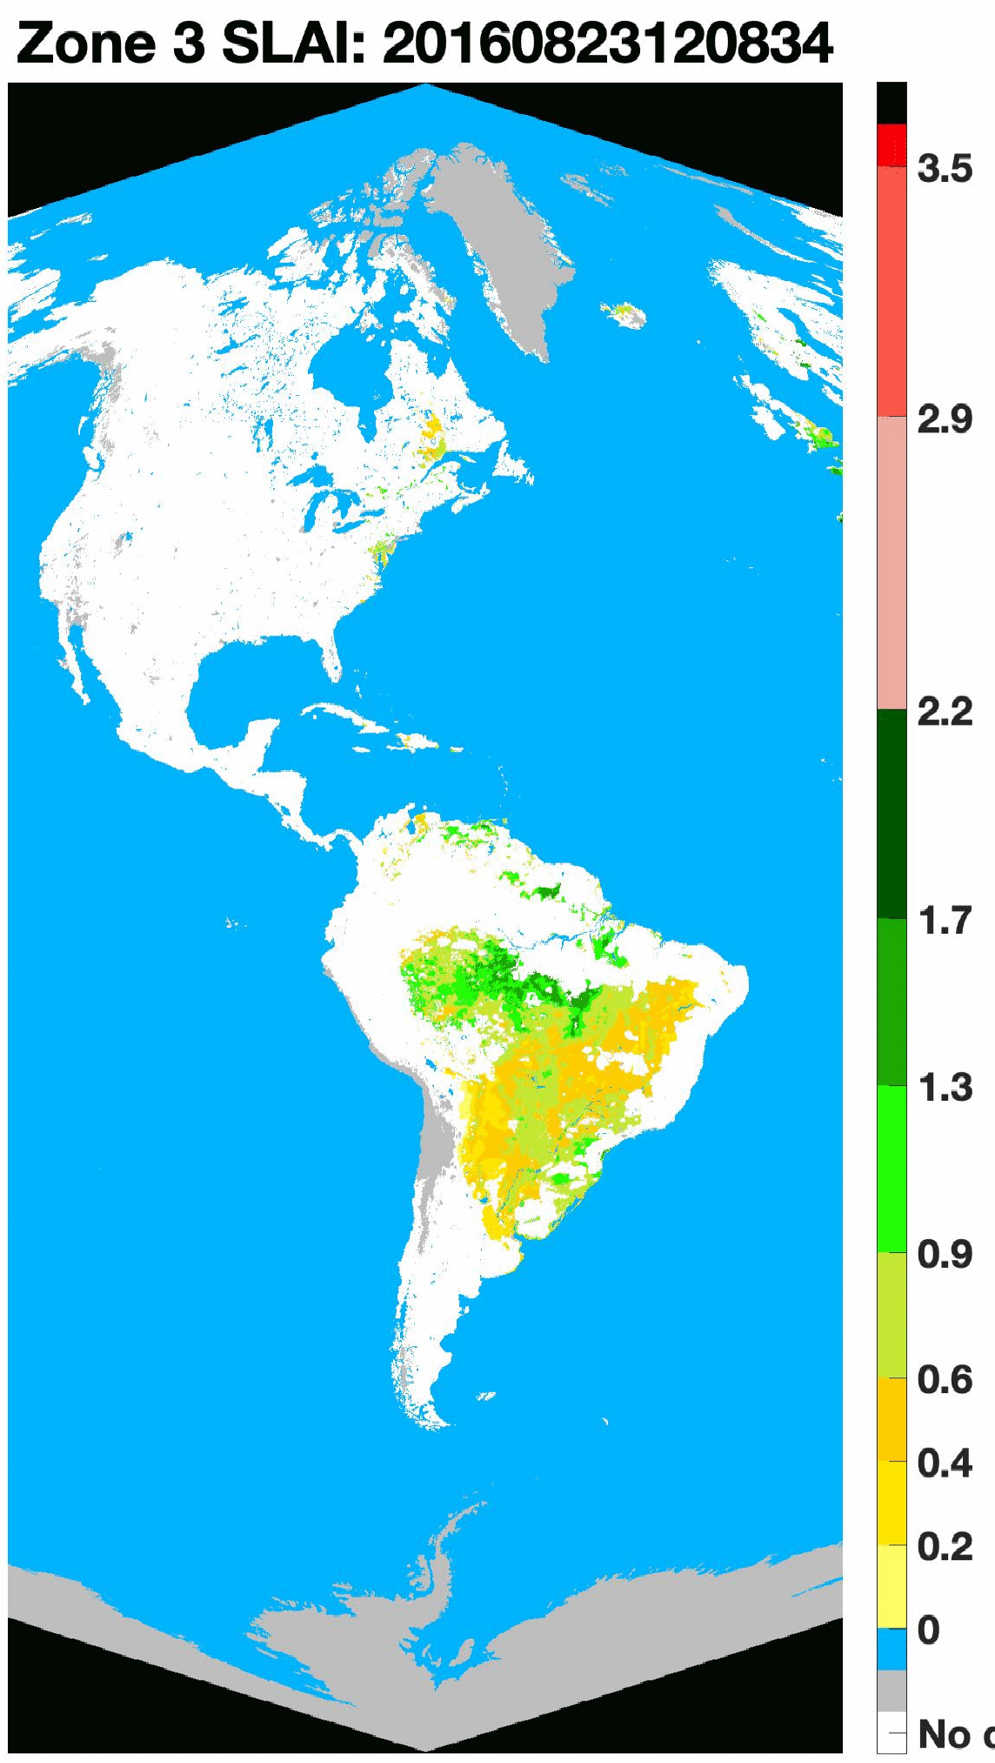
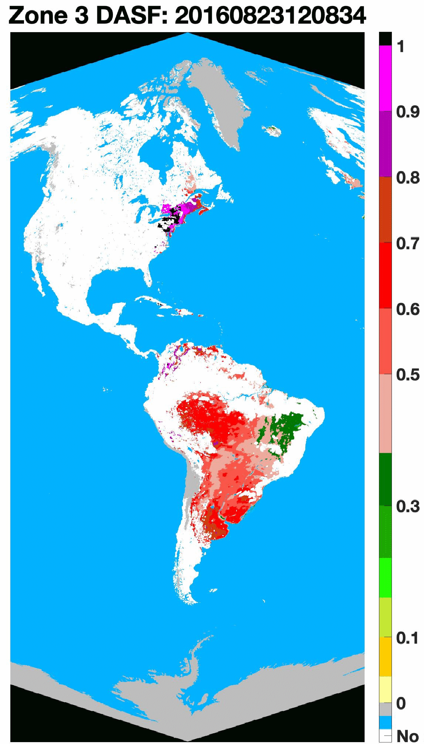
Version 2 VESDR: 10 km NDVI, FPAR, SLAI, DASF
23 August, 2016
Normalized Difference Vegetation Index (NDVI): difference bet-ween Bidirectional Re-flectance Factor (BRF) at 779.5 nm and 680 nm normalized by their sum
Fraction of Photosy-nthetically Active Ra-diation (400 – 700nm, FPAR) absorbed by vegetation
August-2016
NDVI
FPAR
Sunlit Leaf Area Index (SLAI): leaf area illuminated by the direct solar beam per unit ground area
MAIAC Surface Reflectance
MAIAC TOA Reflectance
Directional Area Scattering Factor (DASF): canopy BRF if the foliage does not absorb radiation
LAI, SLAI and FPAR are key state parameters in most ecosystem productivity models and carbon/nitrogen cycle. DASF provides information critical to accounting for structural contributions to measurements of leaf biochemistry from remote sensing.
SLAI
DASF

Slide 5
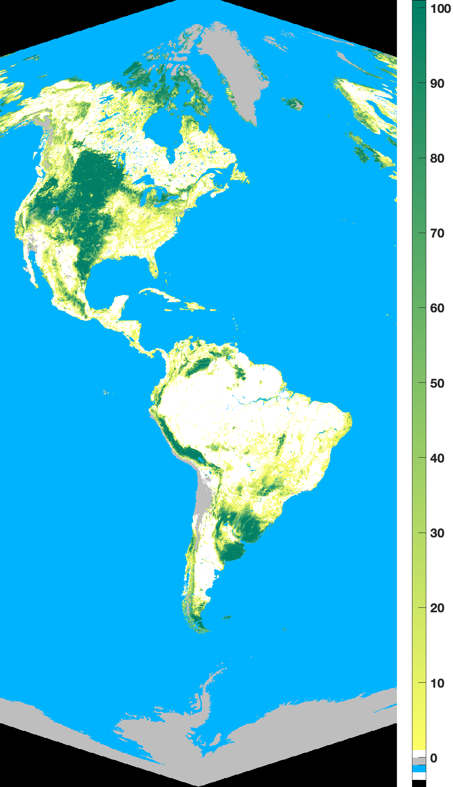
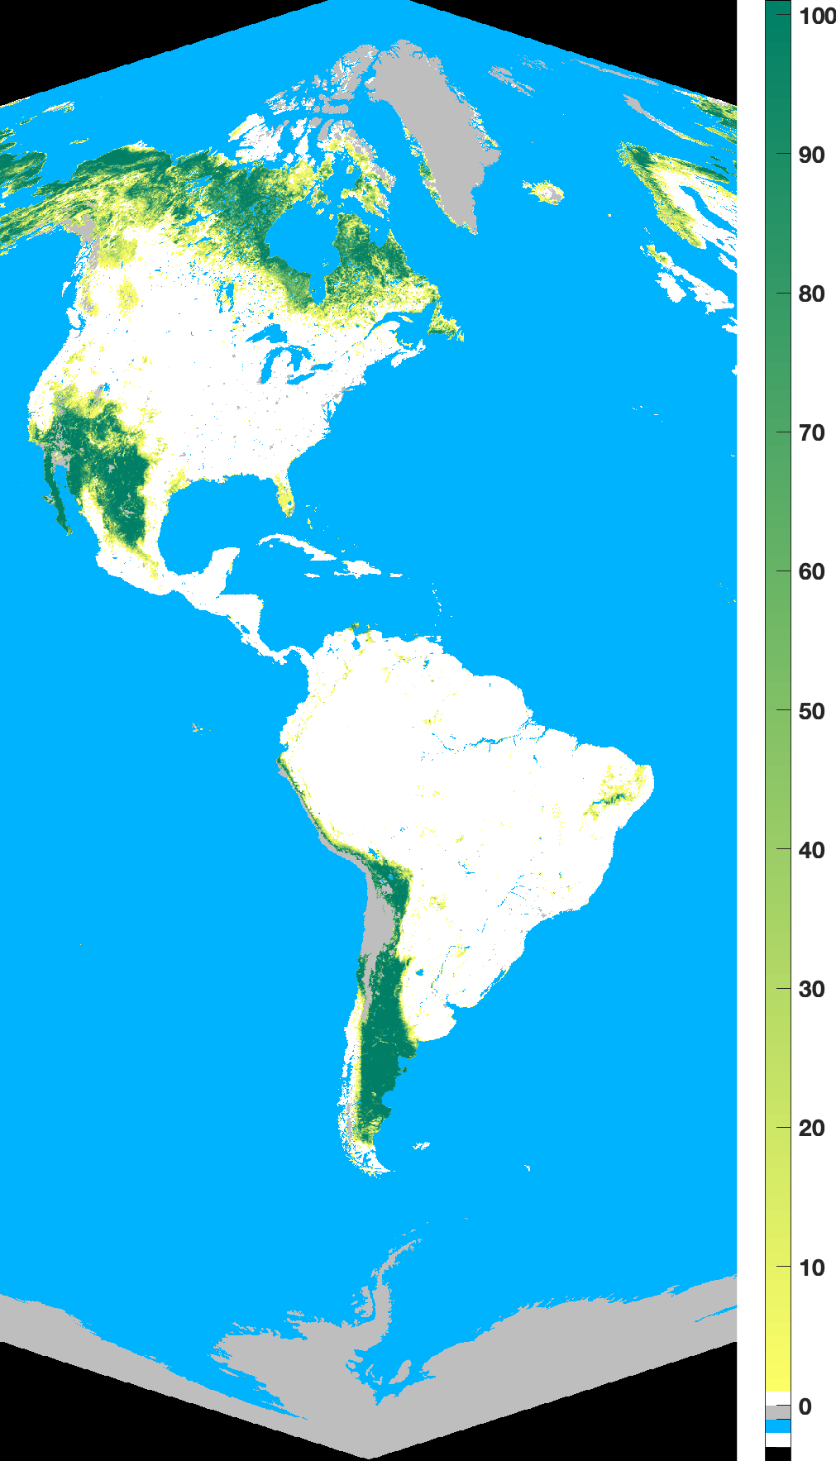
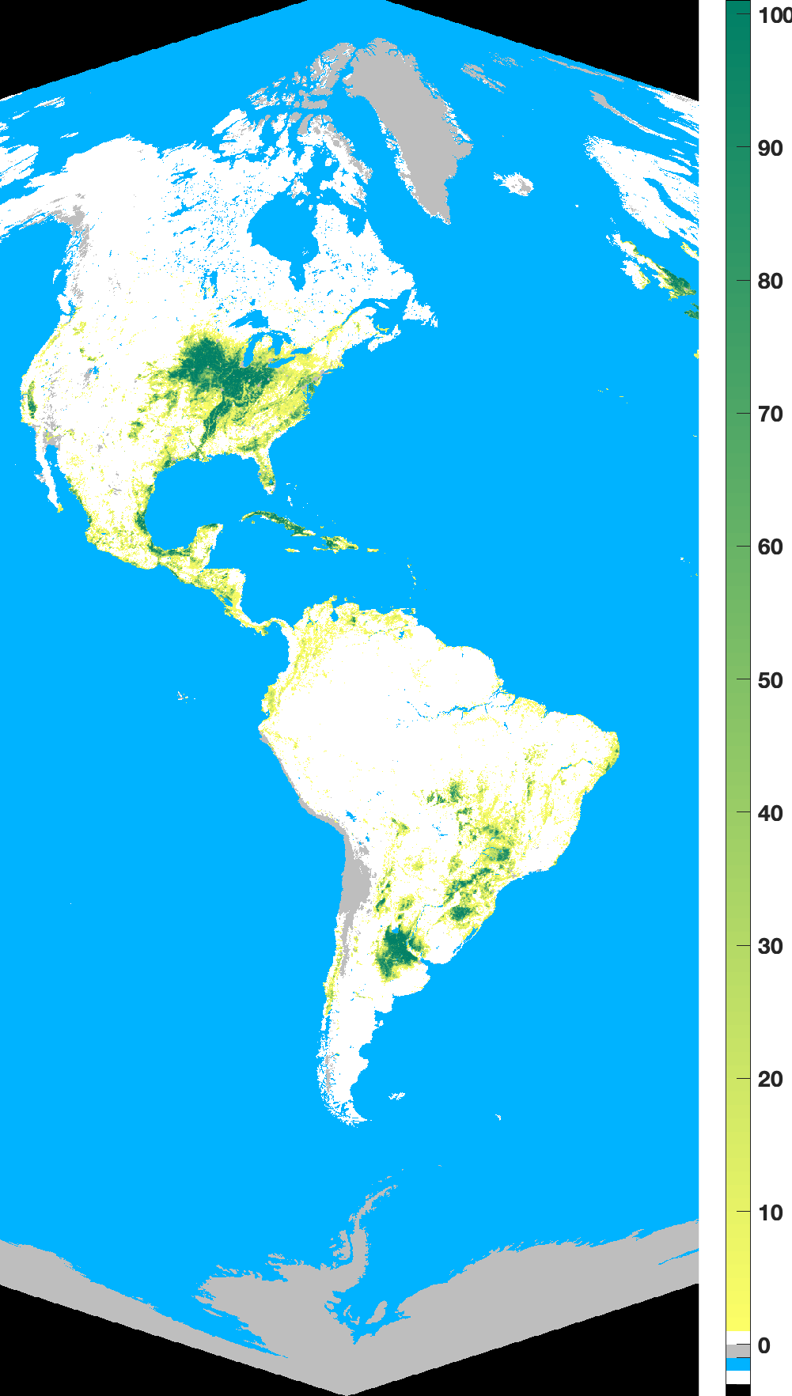
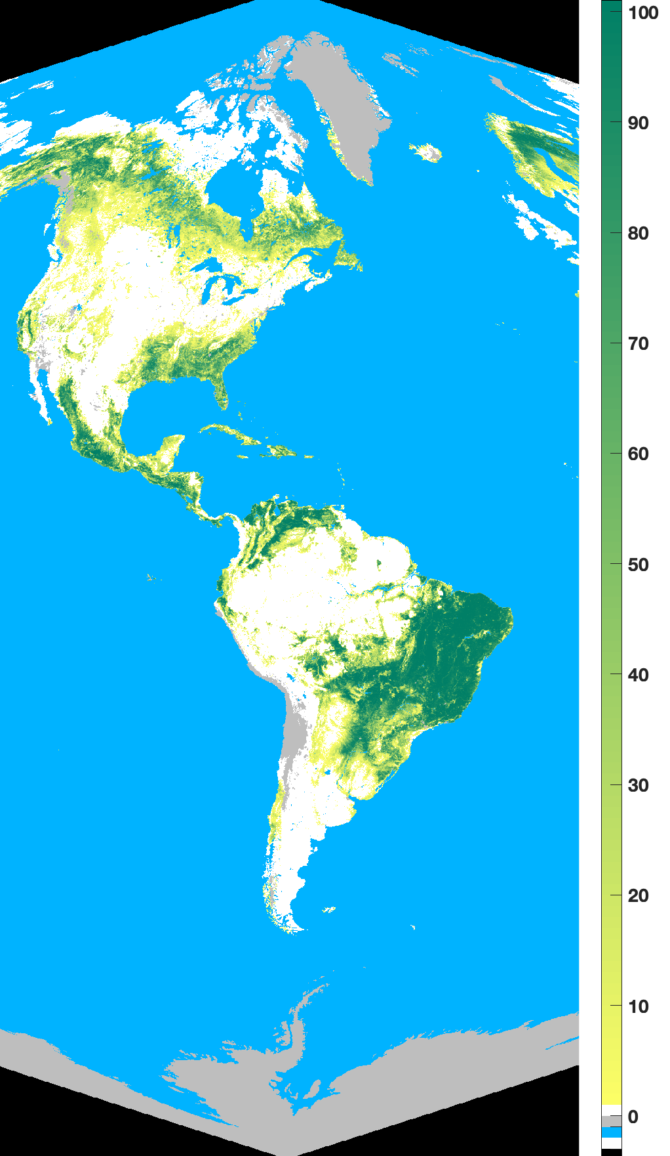
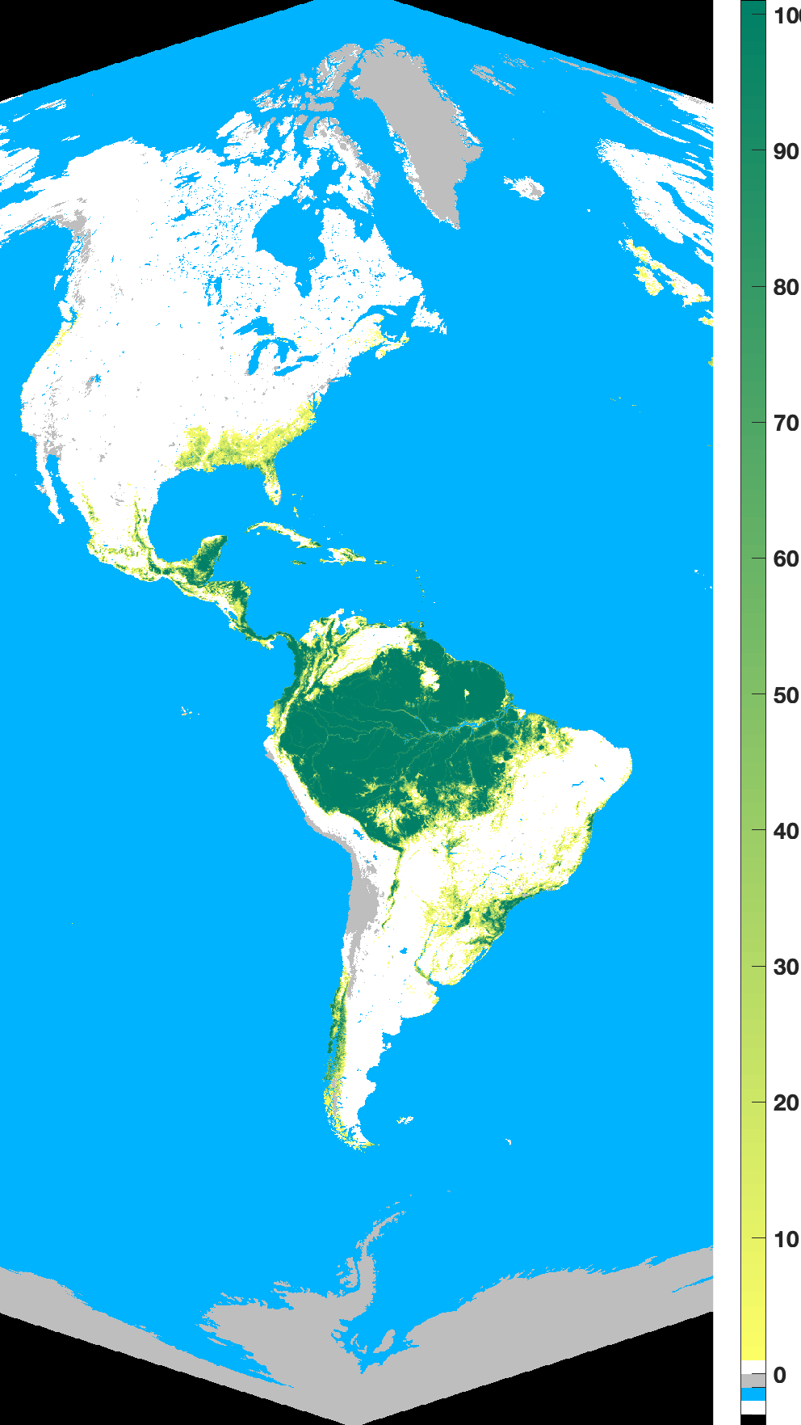
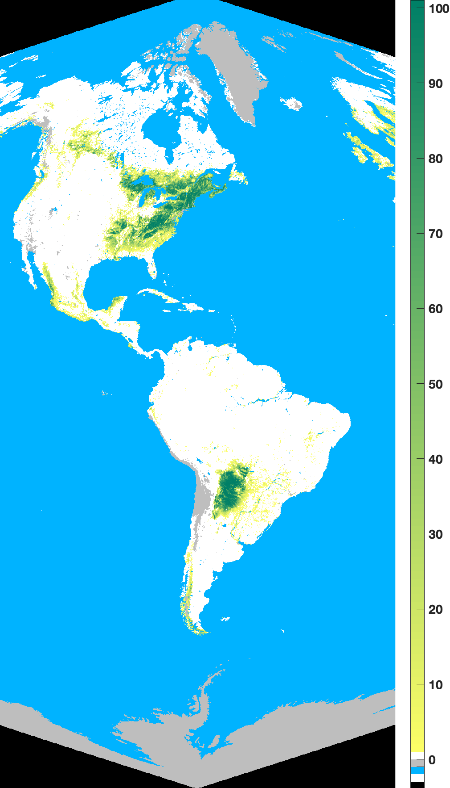
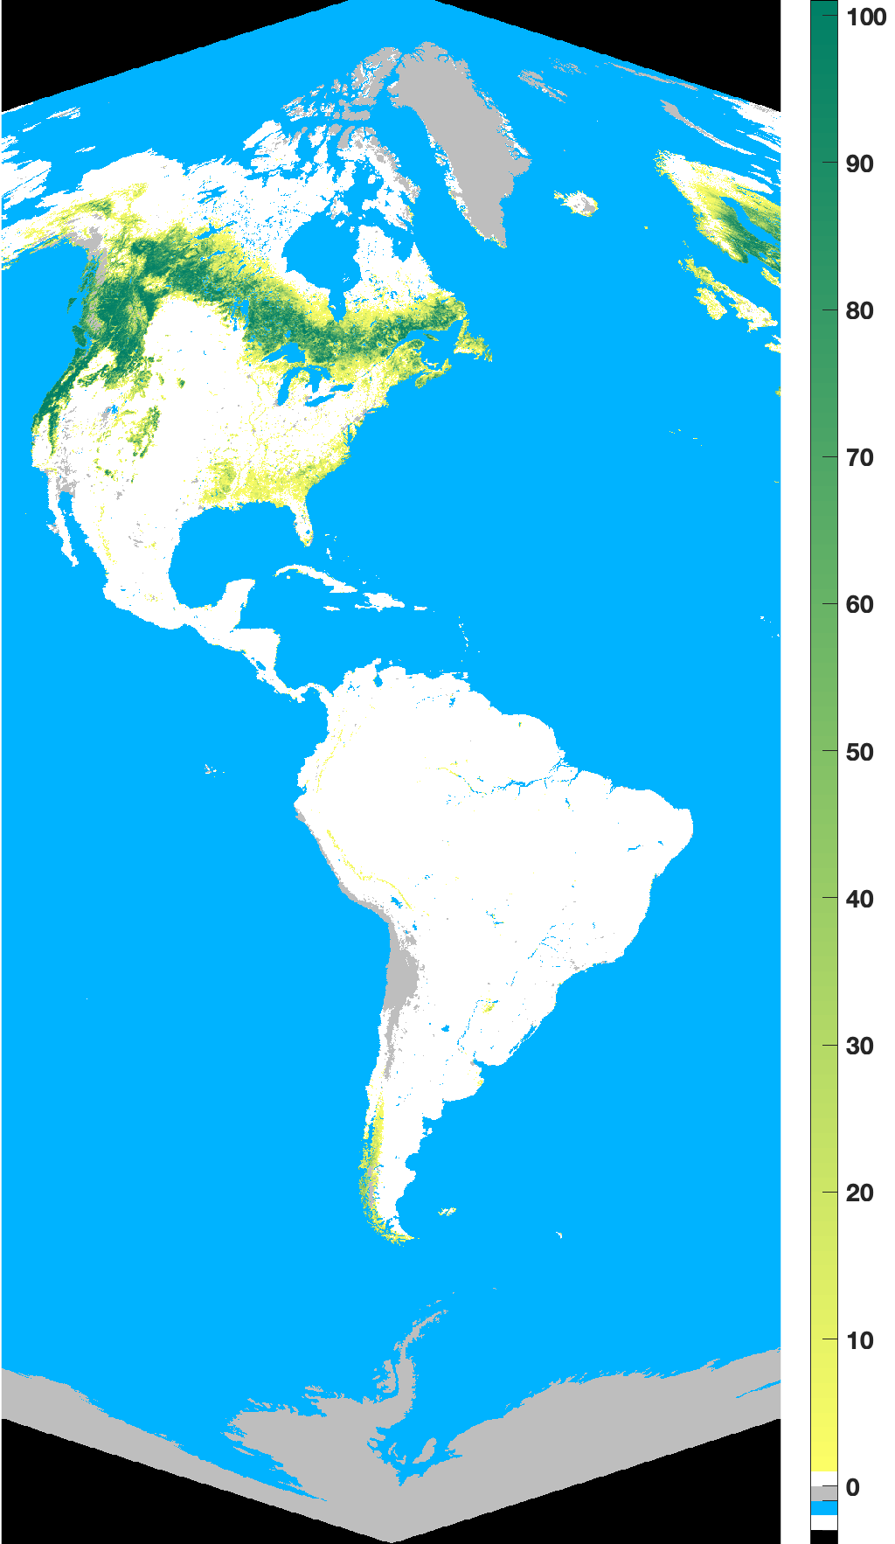
Version 2 Ancillary science data productS: 10 km Land Cover Map
We also provide ancillary science data products (derived from 500 m MODIS land cover product)
Parameter name | Units | Resolution |  | Comments
 |  | Temporal | Spatial
Land Cover Type | none | static | 10 km | 10 km SIN Land Cover type
Land Cover Type Distribution | none | static | 10 km | Distribution of land cover types within 10 km EPIC pixel
Land cover map
Grasses Cereal Crops
Shrubs
Broadleaf Crops
Savannas
Percentage of land cover types within 10 km EPIC pixel
Available from the NASA Langley Atmospheric Science Data Center (https://asdc.larc.nasa.gov/project/DSCOVR/DSCOVR_EPIC_L2_VESDR_02)
Evergreen Broadleaf Forests
Deciduous Broadleaf Forests
Evergreen Needleleaf Forests

Slide 6
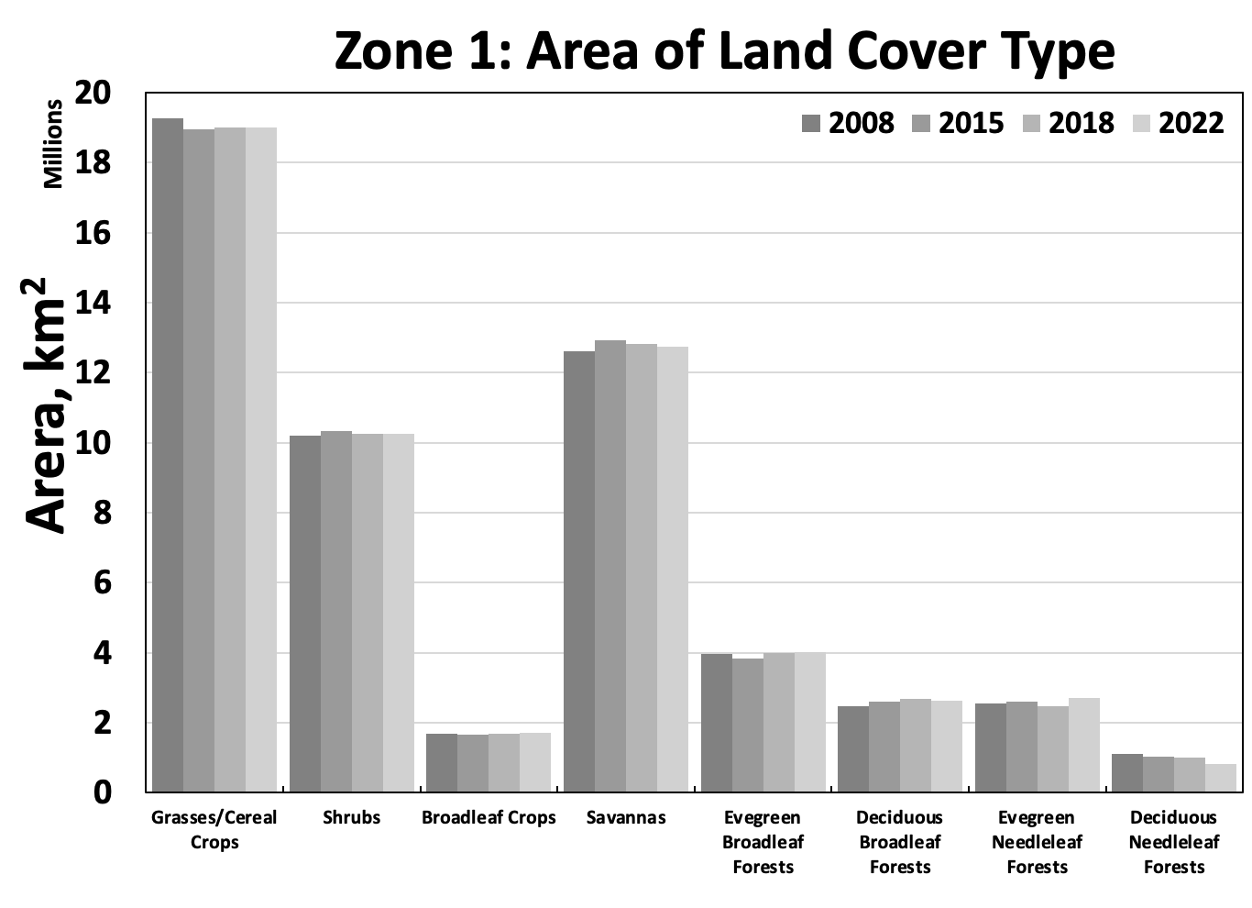
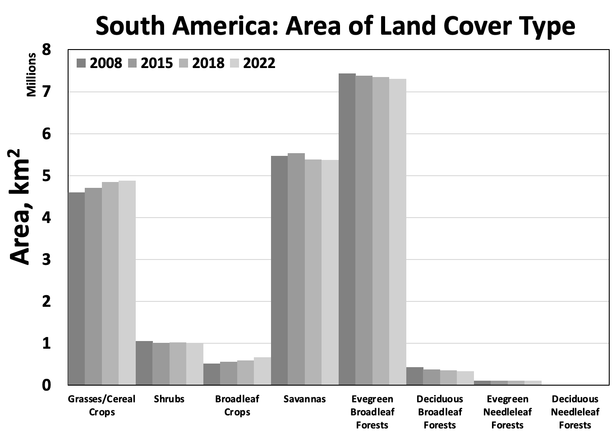
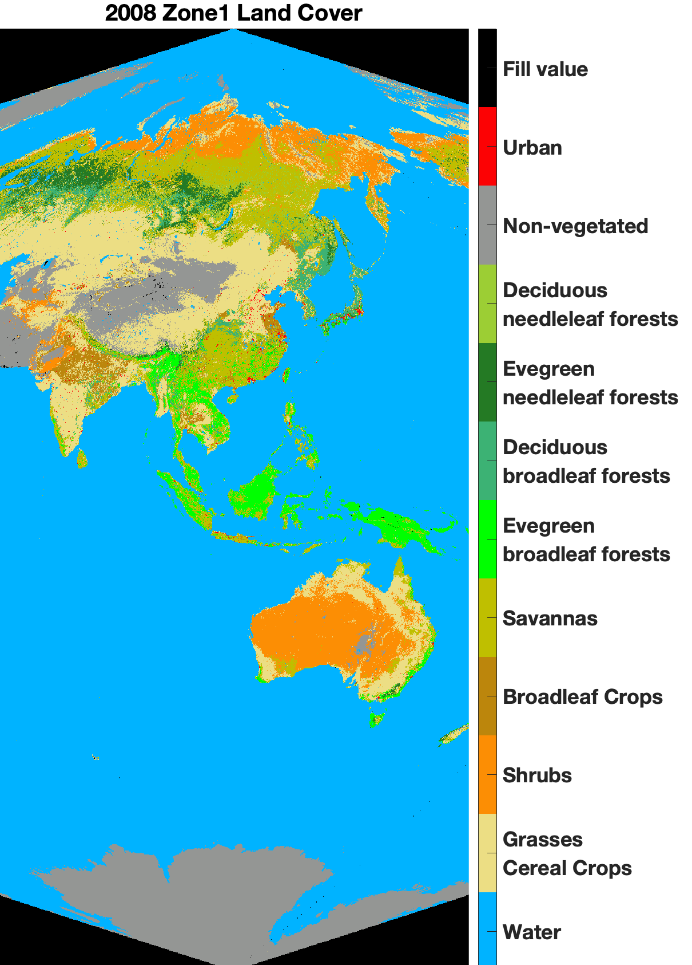
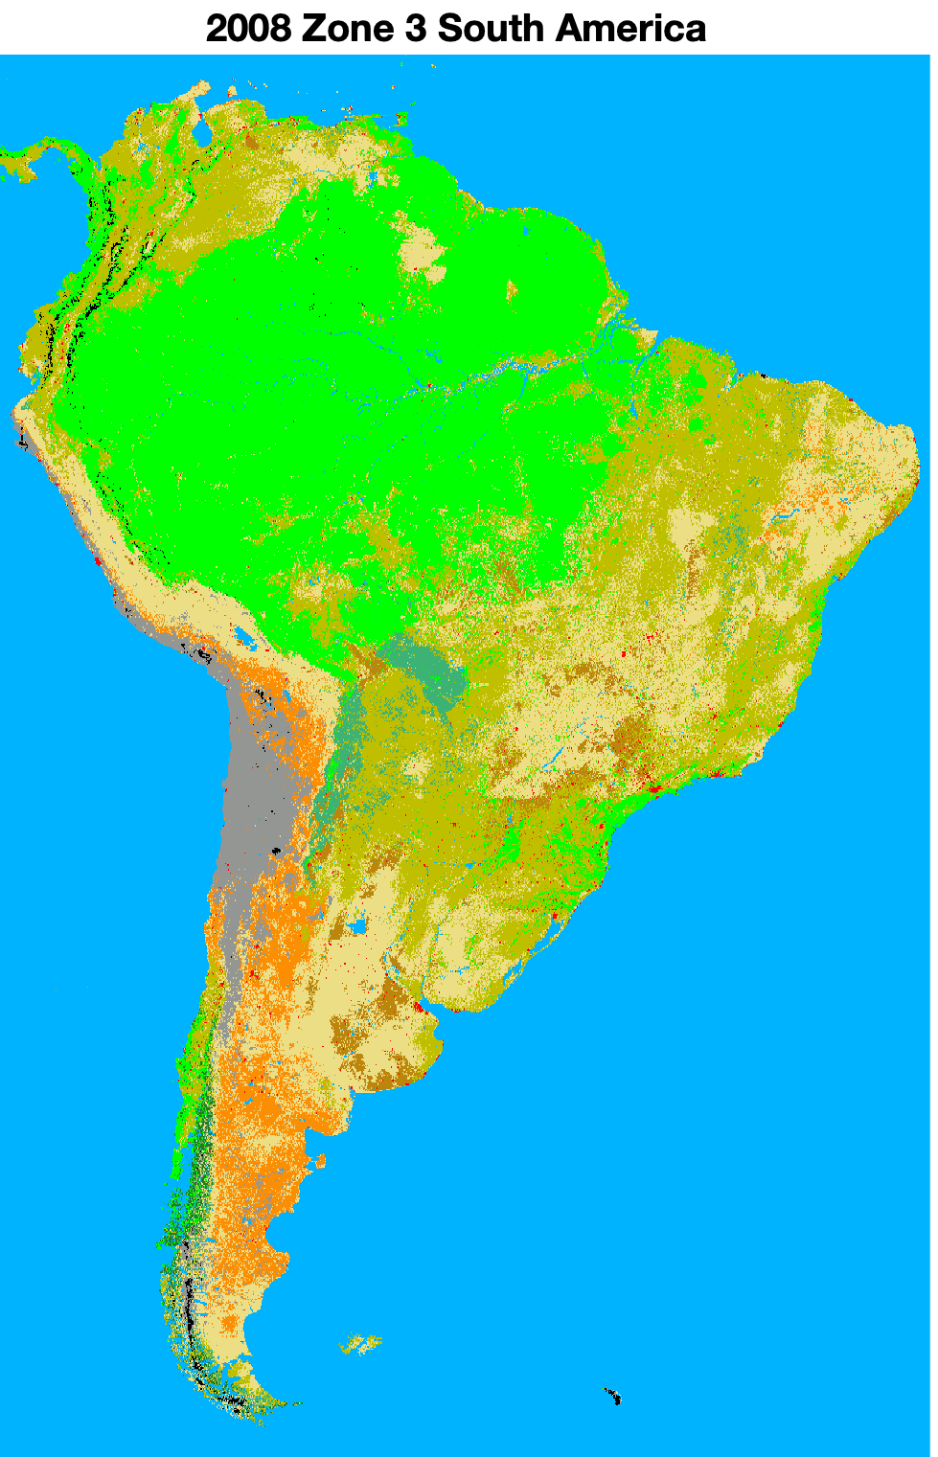
Version 2 Ancillary science data productS: 10 km Land Cover Map
Parameter name | Units | Resolution |  | Comments
 |  | Temporal | Spatial
Land Cover Type | none | static | 10 km | 10 km SIN Land Cover type
Land Cover Type Distribution | none | static | 10 km | Distribution of land cover types within 10 km EPIC pixel
Senior Review: “Figure 3.2.9b shows various land types observed by EPIC. What is the time period of this figure? Are there any plans to examine trends in land cover type using EPIC data? If so, over what time periods and time intervals”
Version 2 Ancillary Science Data Products were derived from 500m MODIS land cover type 3 product (MCDLCHKM), which was generated from 2008, 2009, and 2010 land cover products (MCD12Q1, v051)
This is a static land cover map
The map is important input used by the VESDR retrieval algorithm
-1.4%
-1.9%
-1.7%
~0%
+6%
~0%
+1.2%
-4.5%
+1.2%
+6%
+6%
-27%
+30%
-20%
We plan to replace this static land cover map with a dynamic 1-year temporal resolution map starting in 2015
Notes:
MCD12Q1 are available for the period 2001 to 2022. LAI retrieval errors at coarse resolution are inversely related to the proportion of the dominant land cover in such pixel. Large errors in LAI retrievals are incurred when forests are minority biomes in non-forest pixels compared to when forest biomes are mixed with one another, and vice versa.

Slide 7
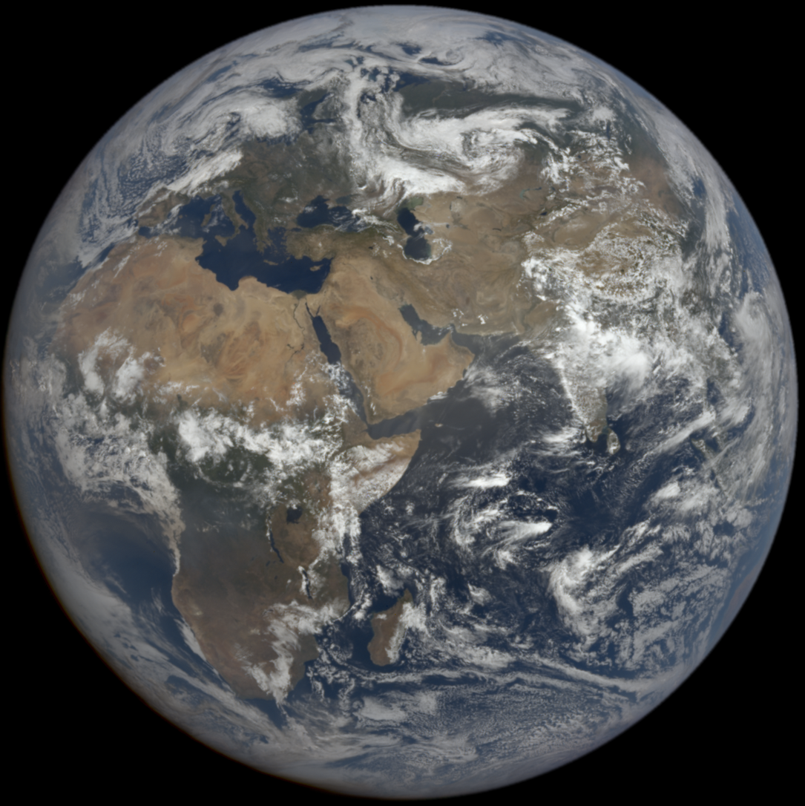
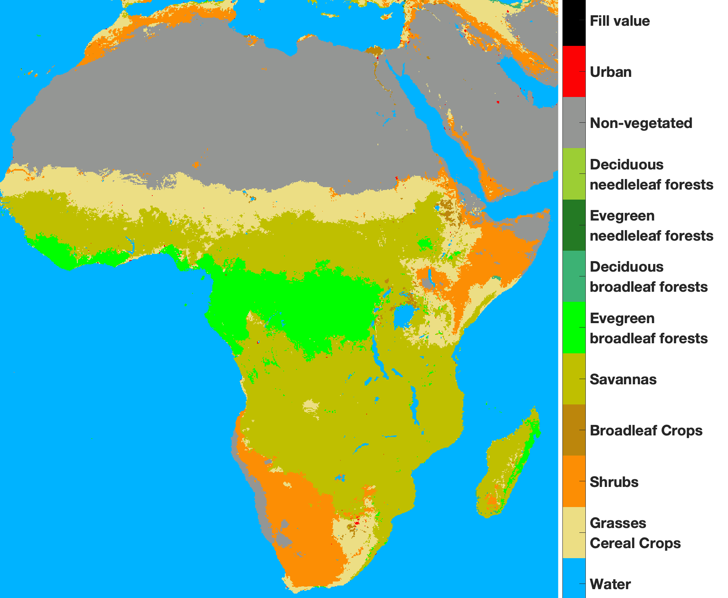
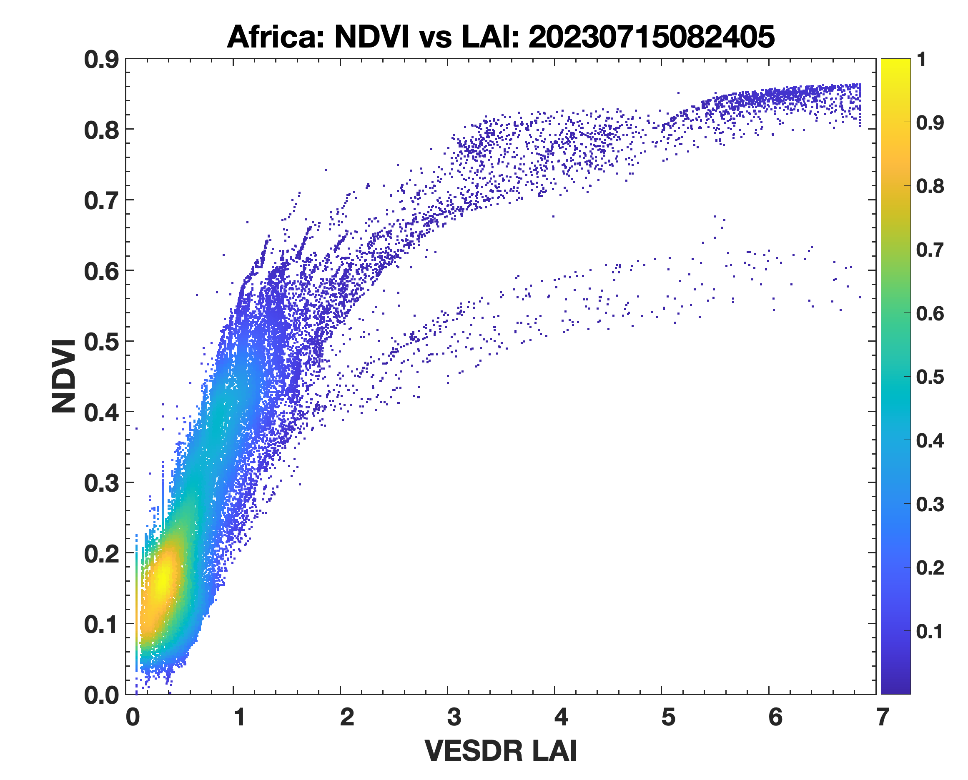
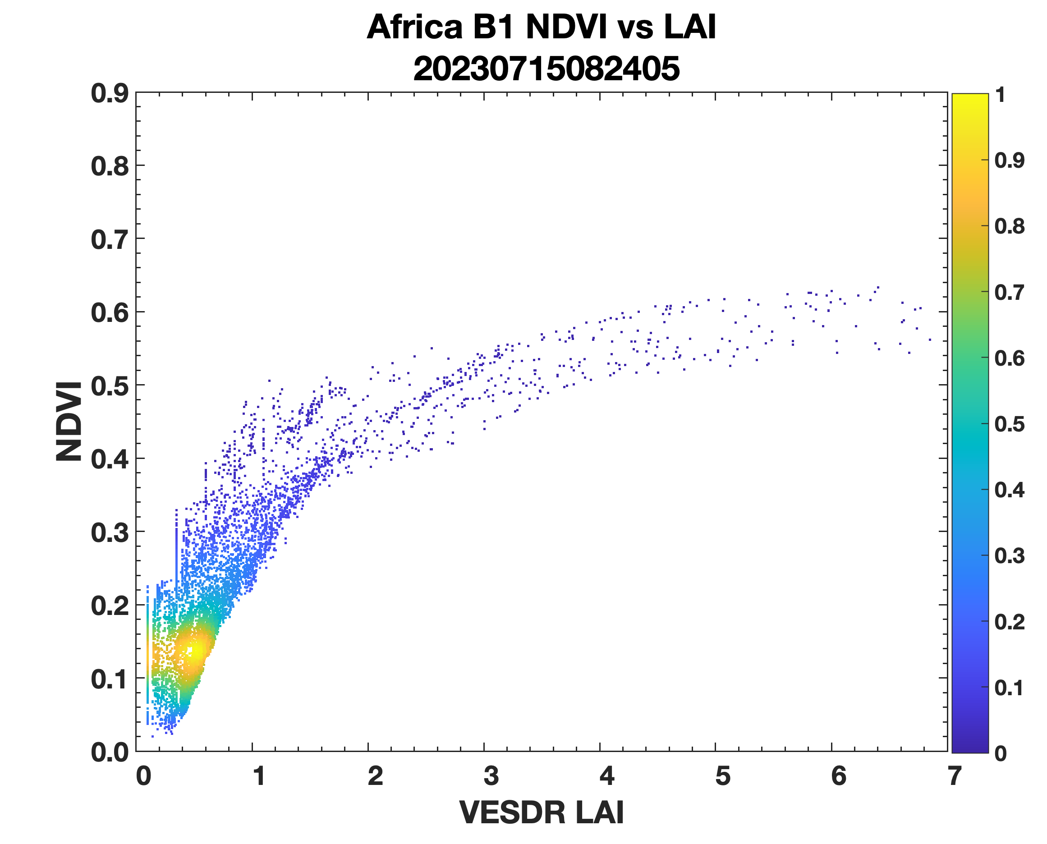
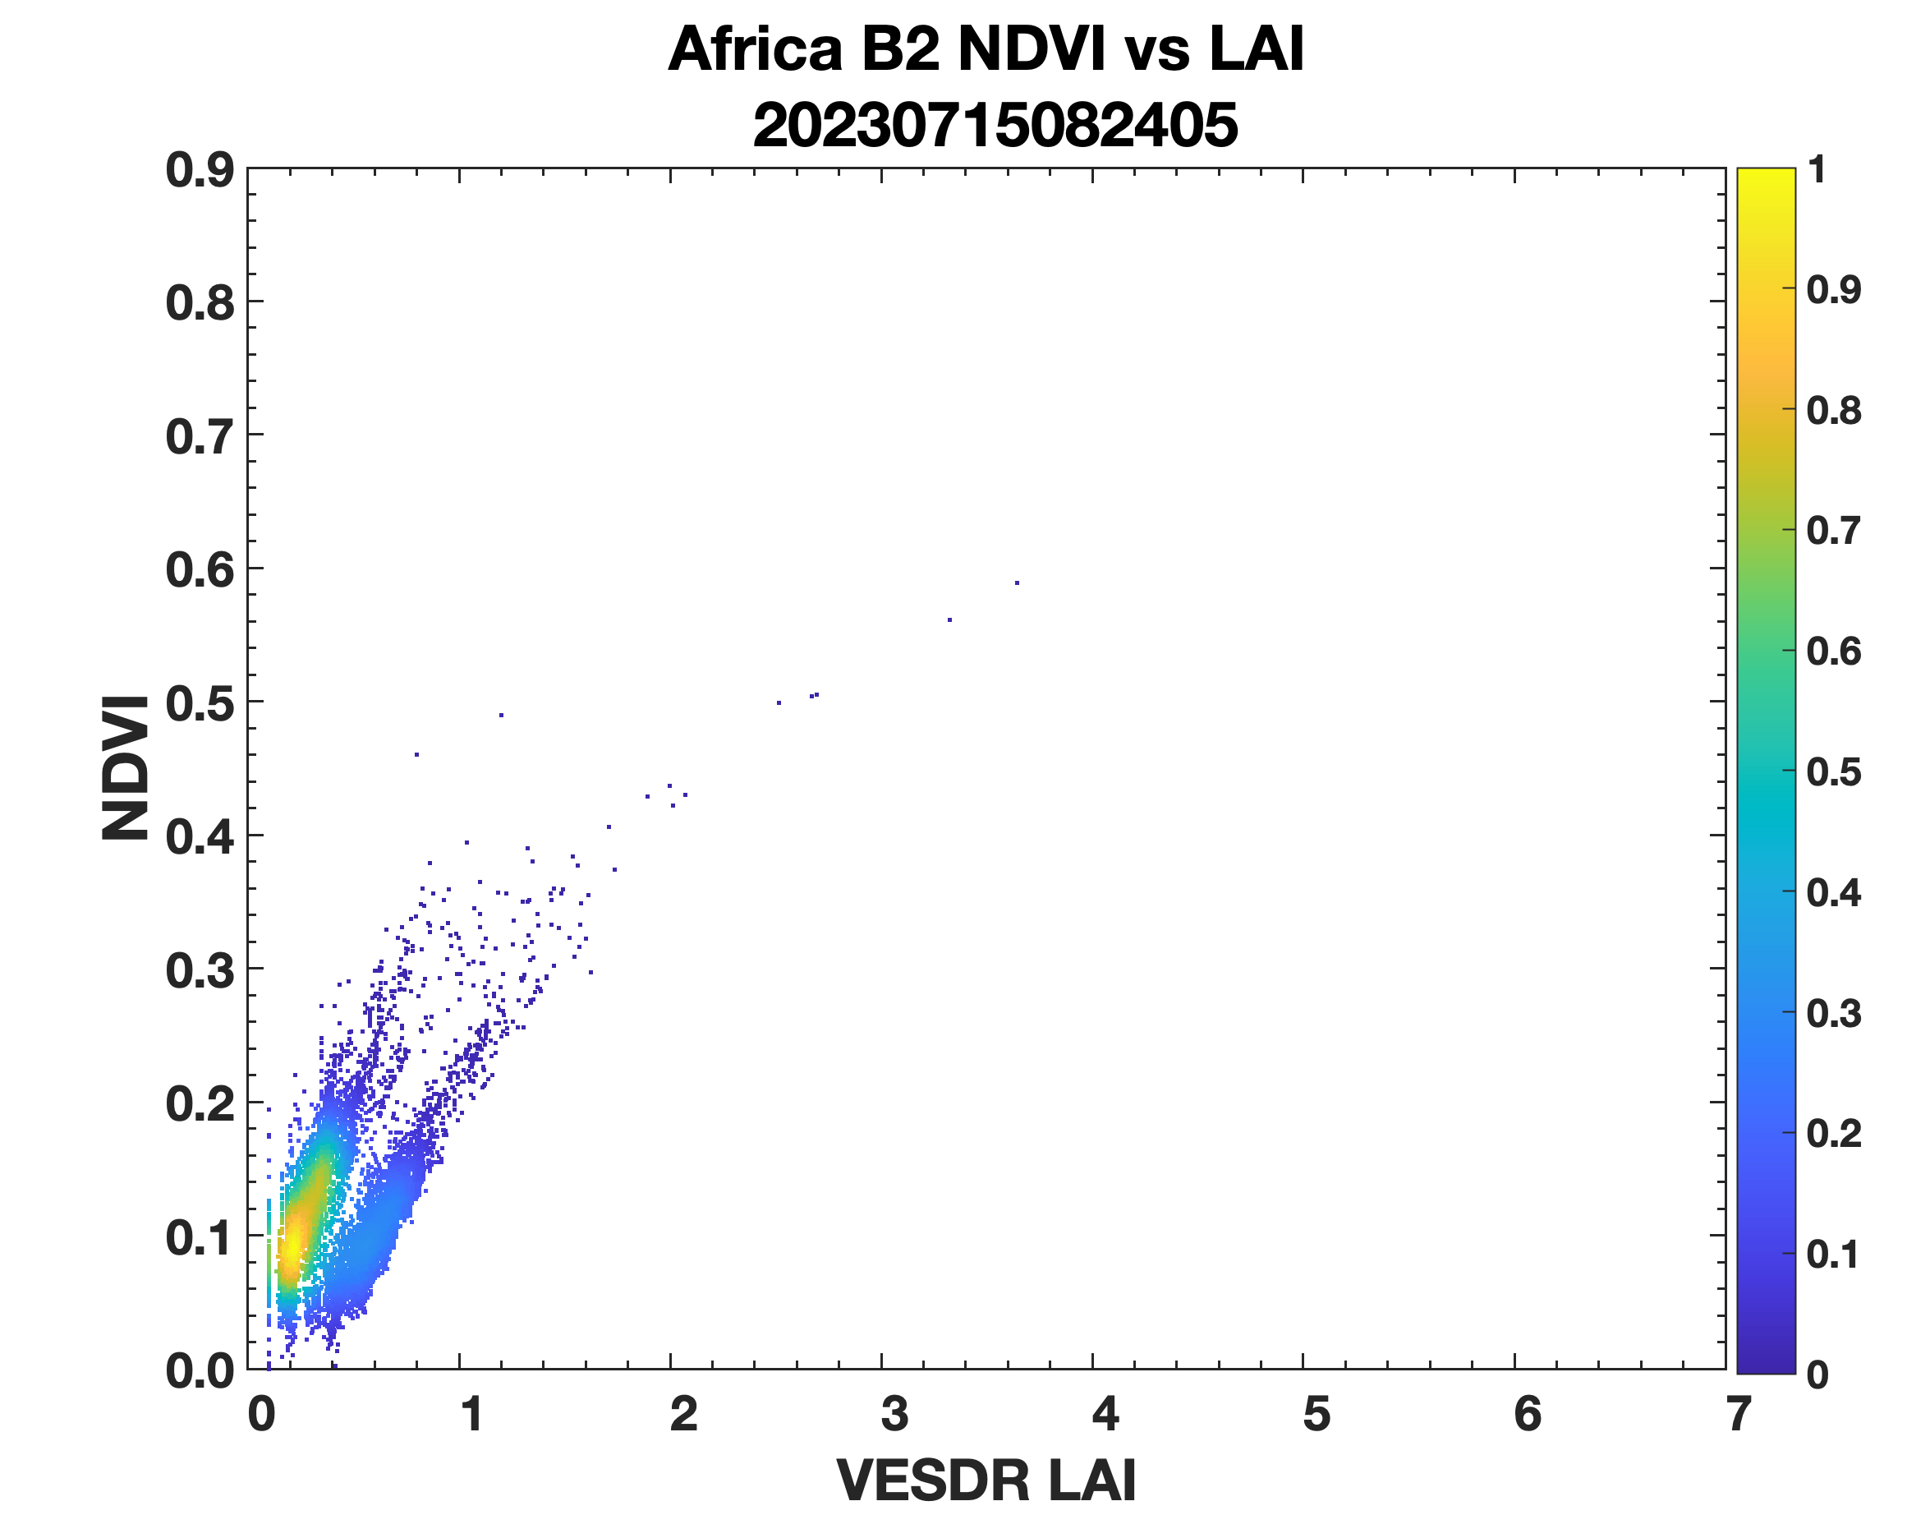
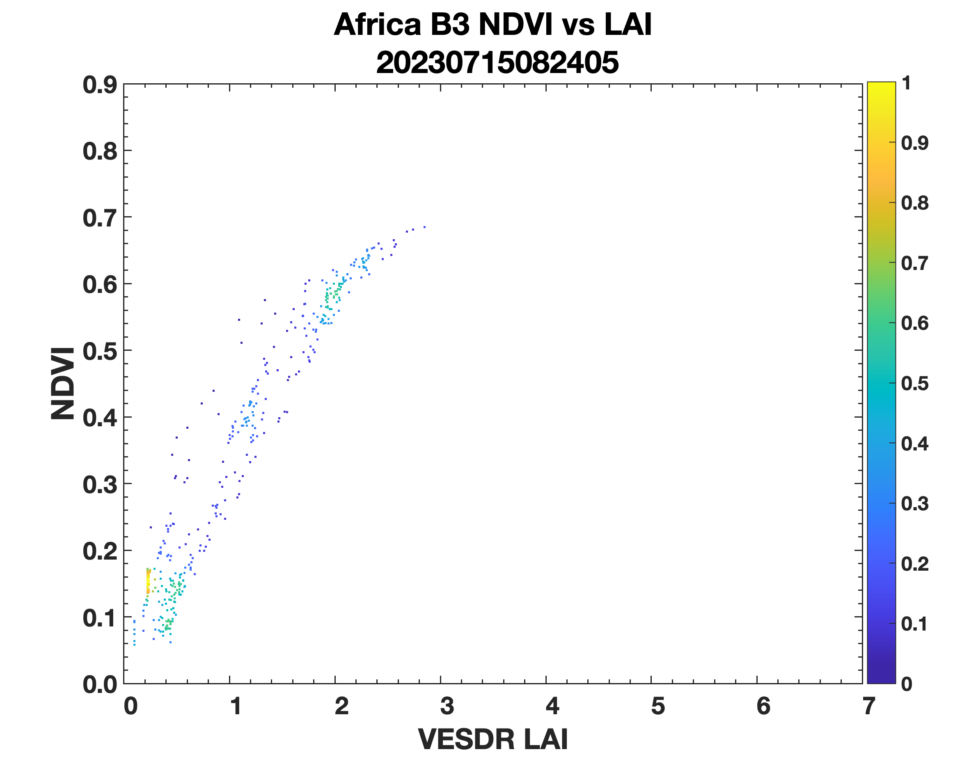
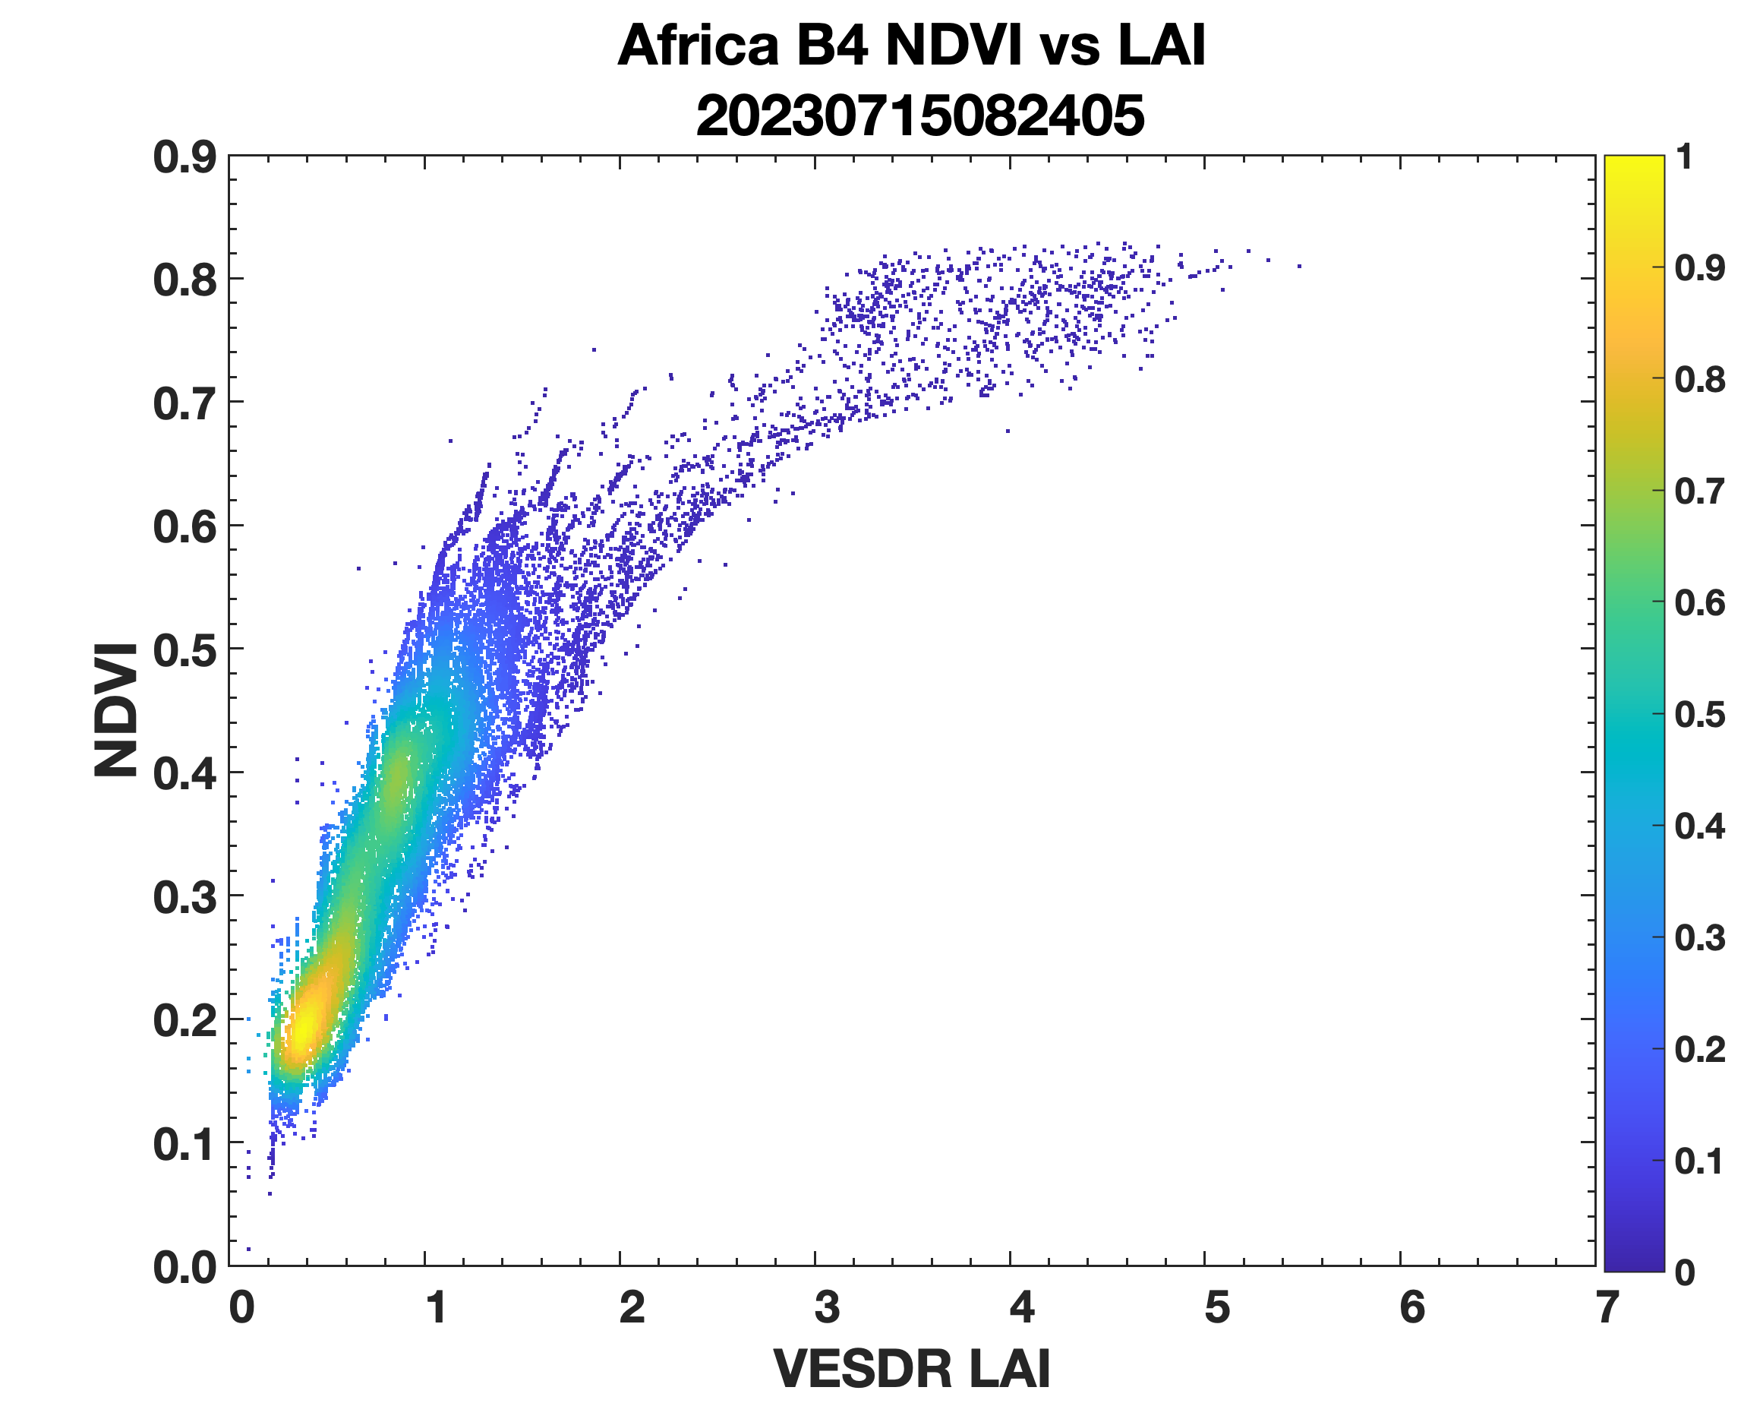
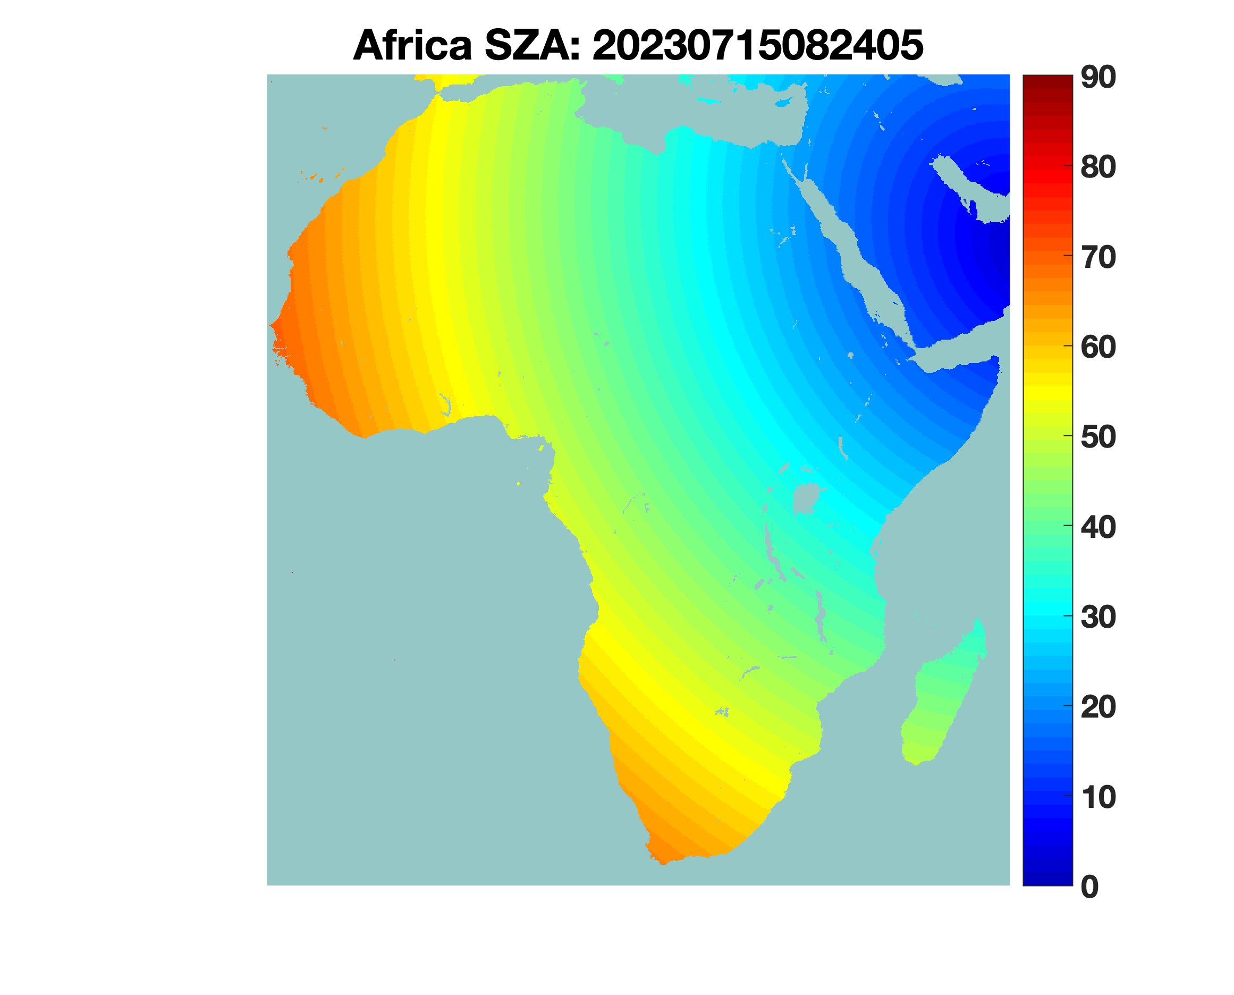
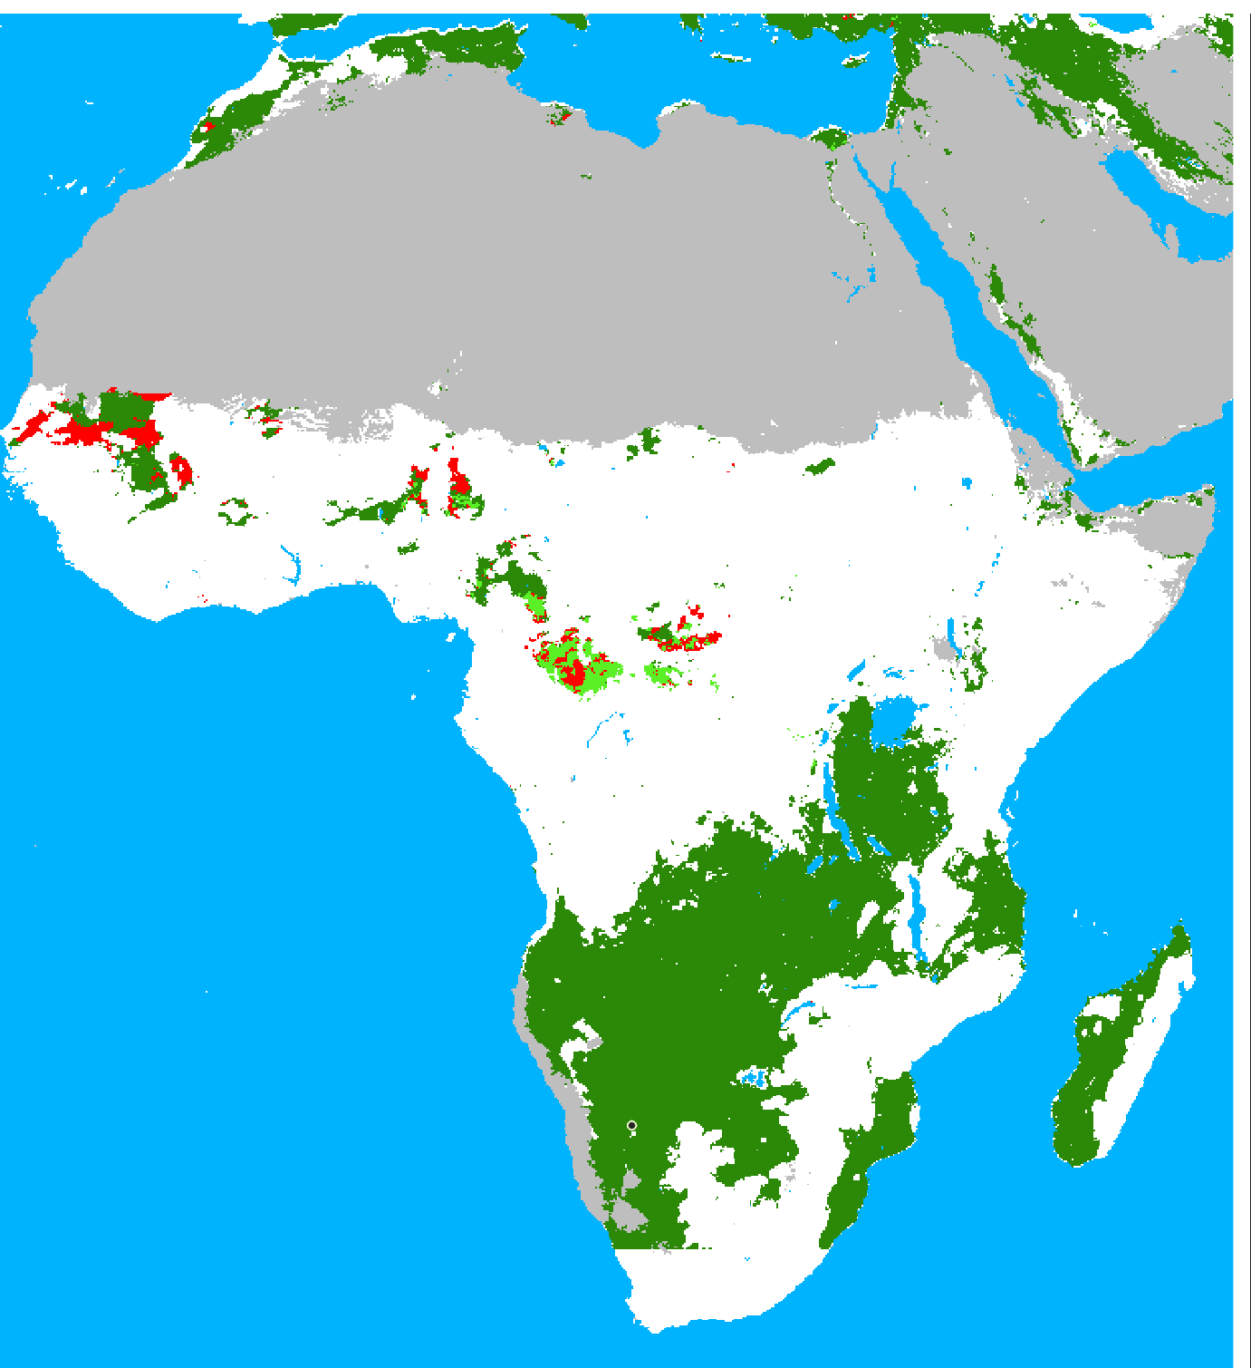
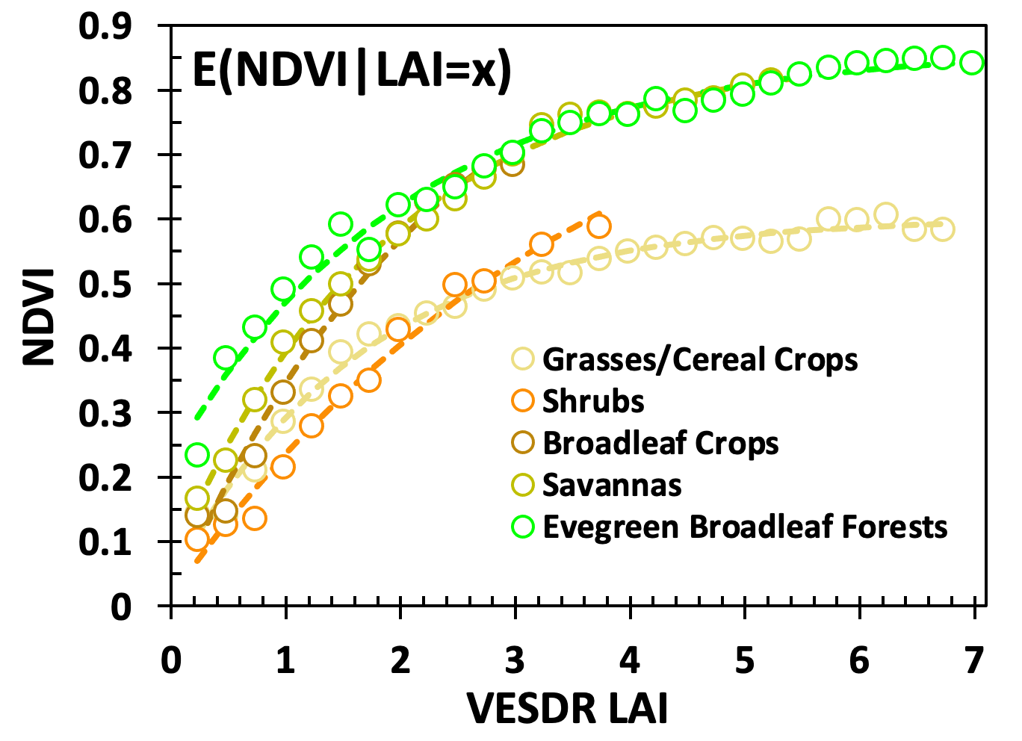

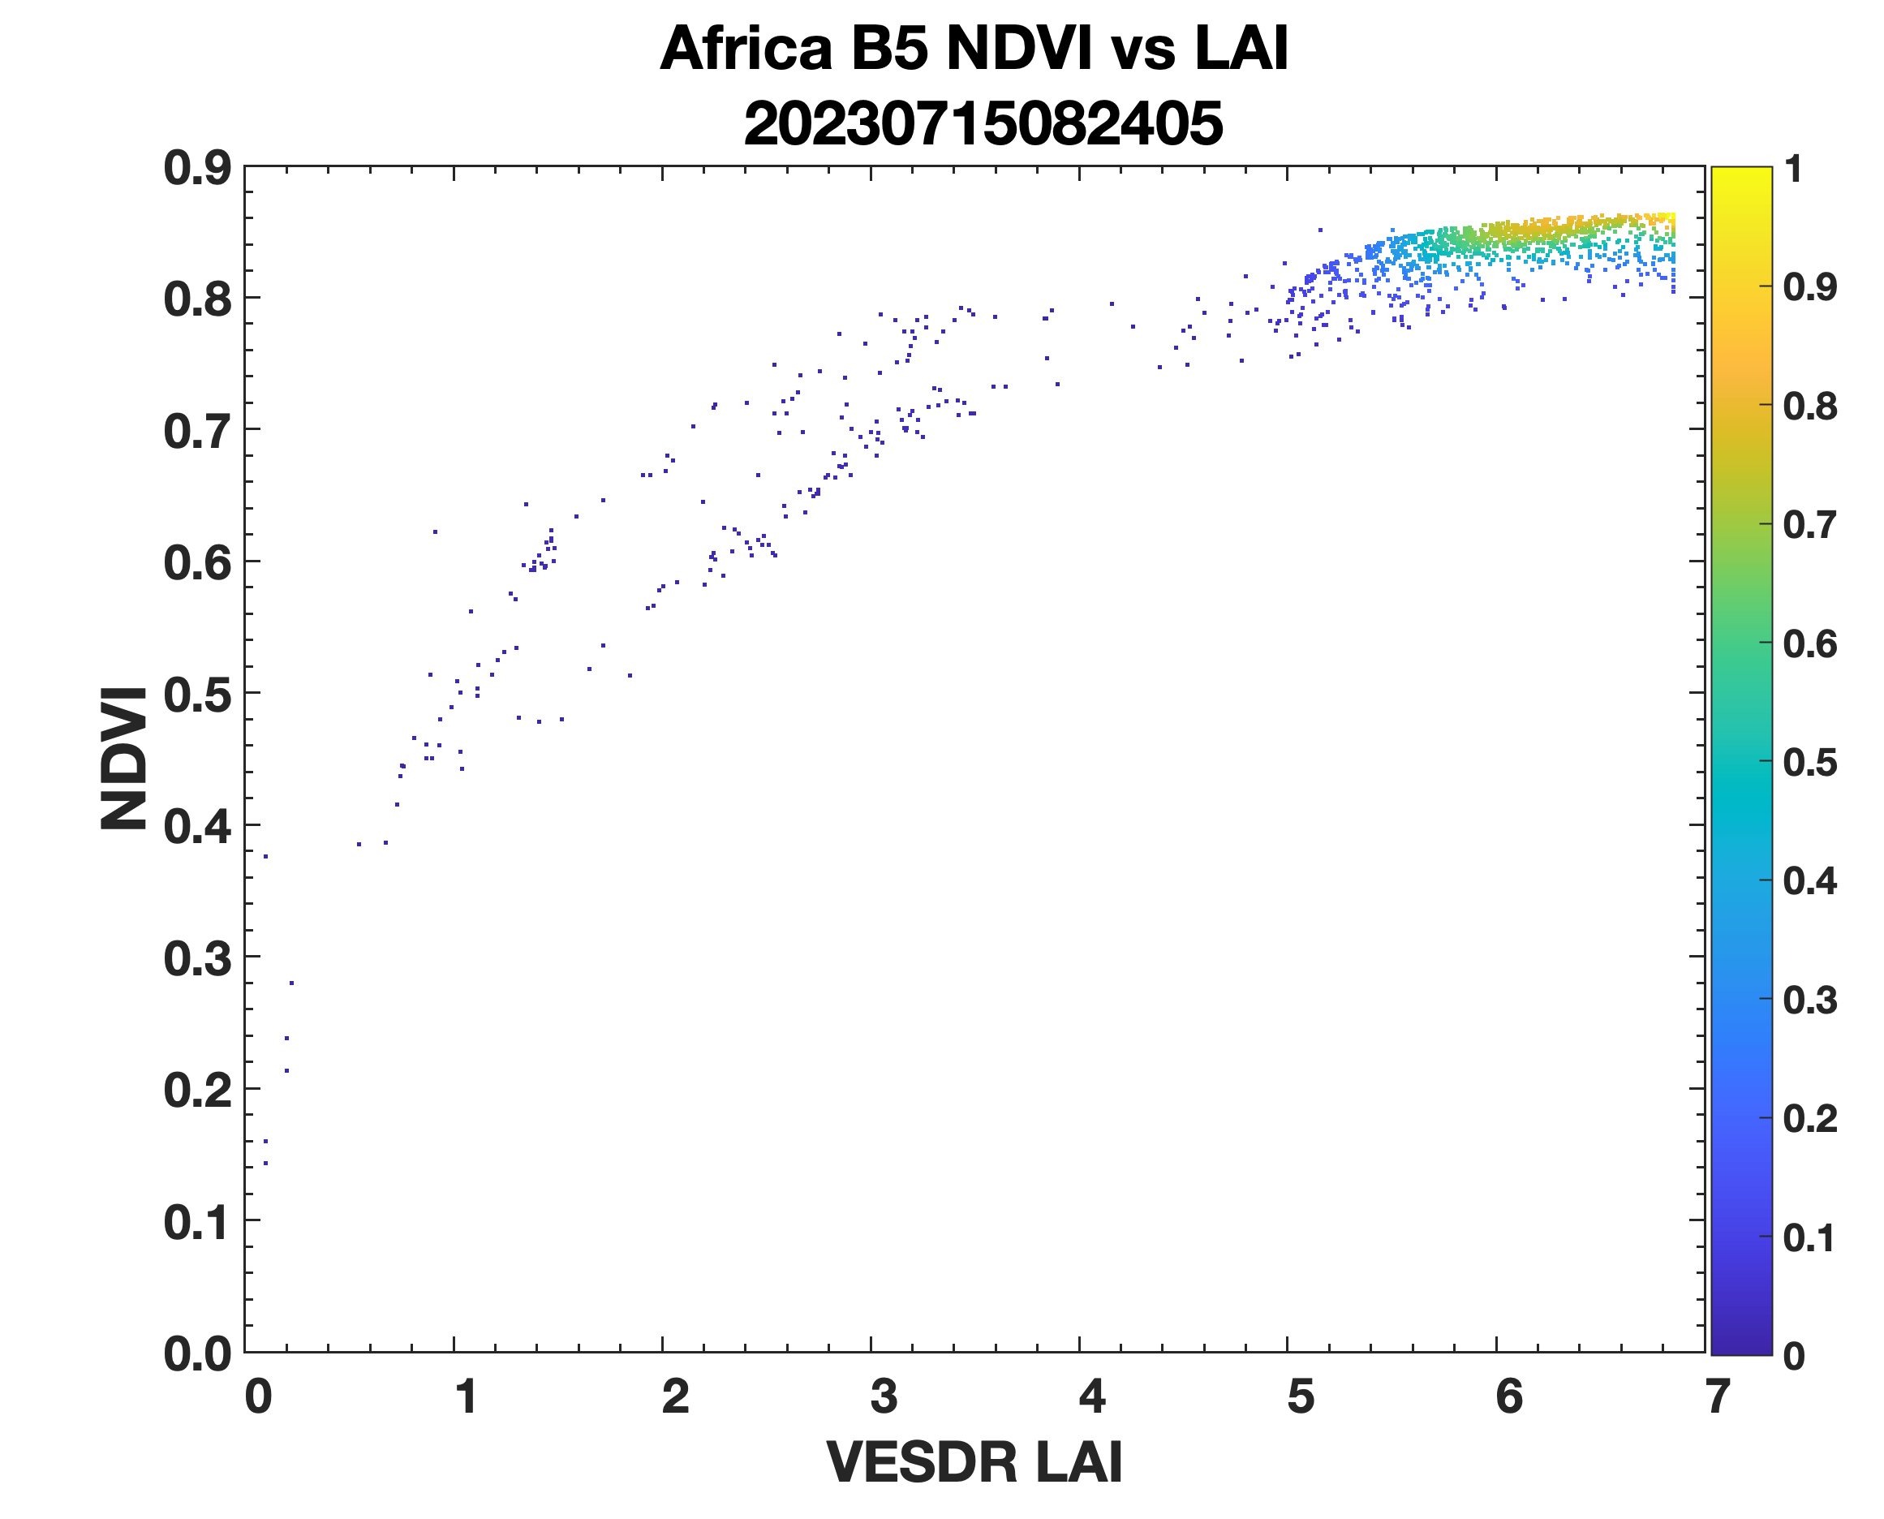
Test of physics: DSCOVR_EPIC_L2_VESDR_02_20230715082405_03.h5
Retrieval Index:85%
Retrieval Index: 99%
Retrieval Index: 96%
Retrieval Index: 100%
Retrieval Index: 99%
SZA
The VESDR LAI parameters follows regularities expected from physics
Retrieval Index: 69%
Notes:
MCD12Q1 are available for the period 2001 to 2022

Slide 8
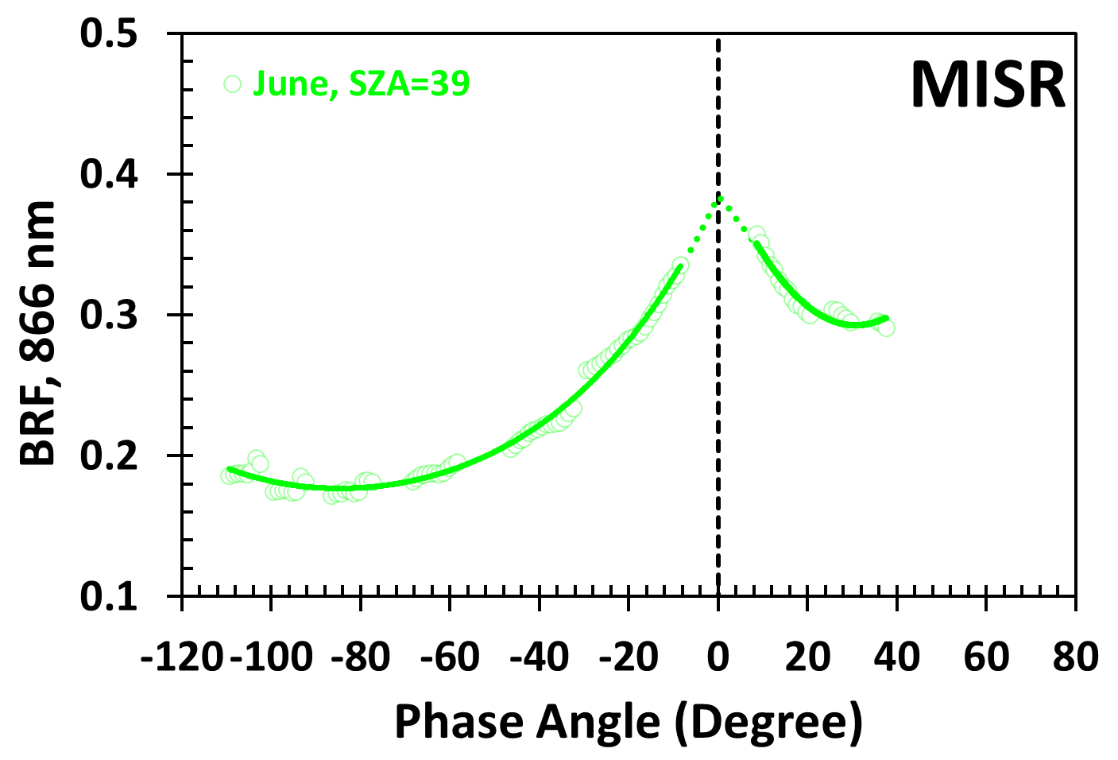
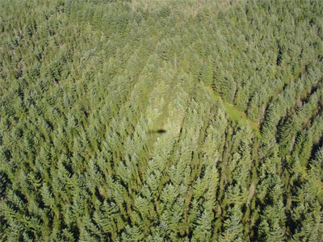
CANOPY HOT SPOT EFFECT
100% sunlit leaves
(SLAI)
100% shaded leaves
Photo by Mat Disney, NERC CTCD, UK, 2005
cross-shading between finite dimensional leaves leads to a peak in reflectance in the retro-illumination direction
the hotspot region represents the most information-rich directions in BRF
BRFs that include the hot spot region are critical to monitor phenological changes in dense vegetation such as equatorial forests

Slide 9
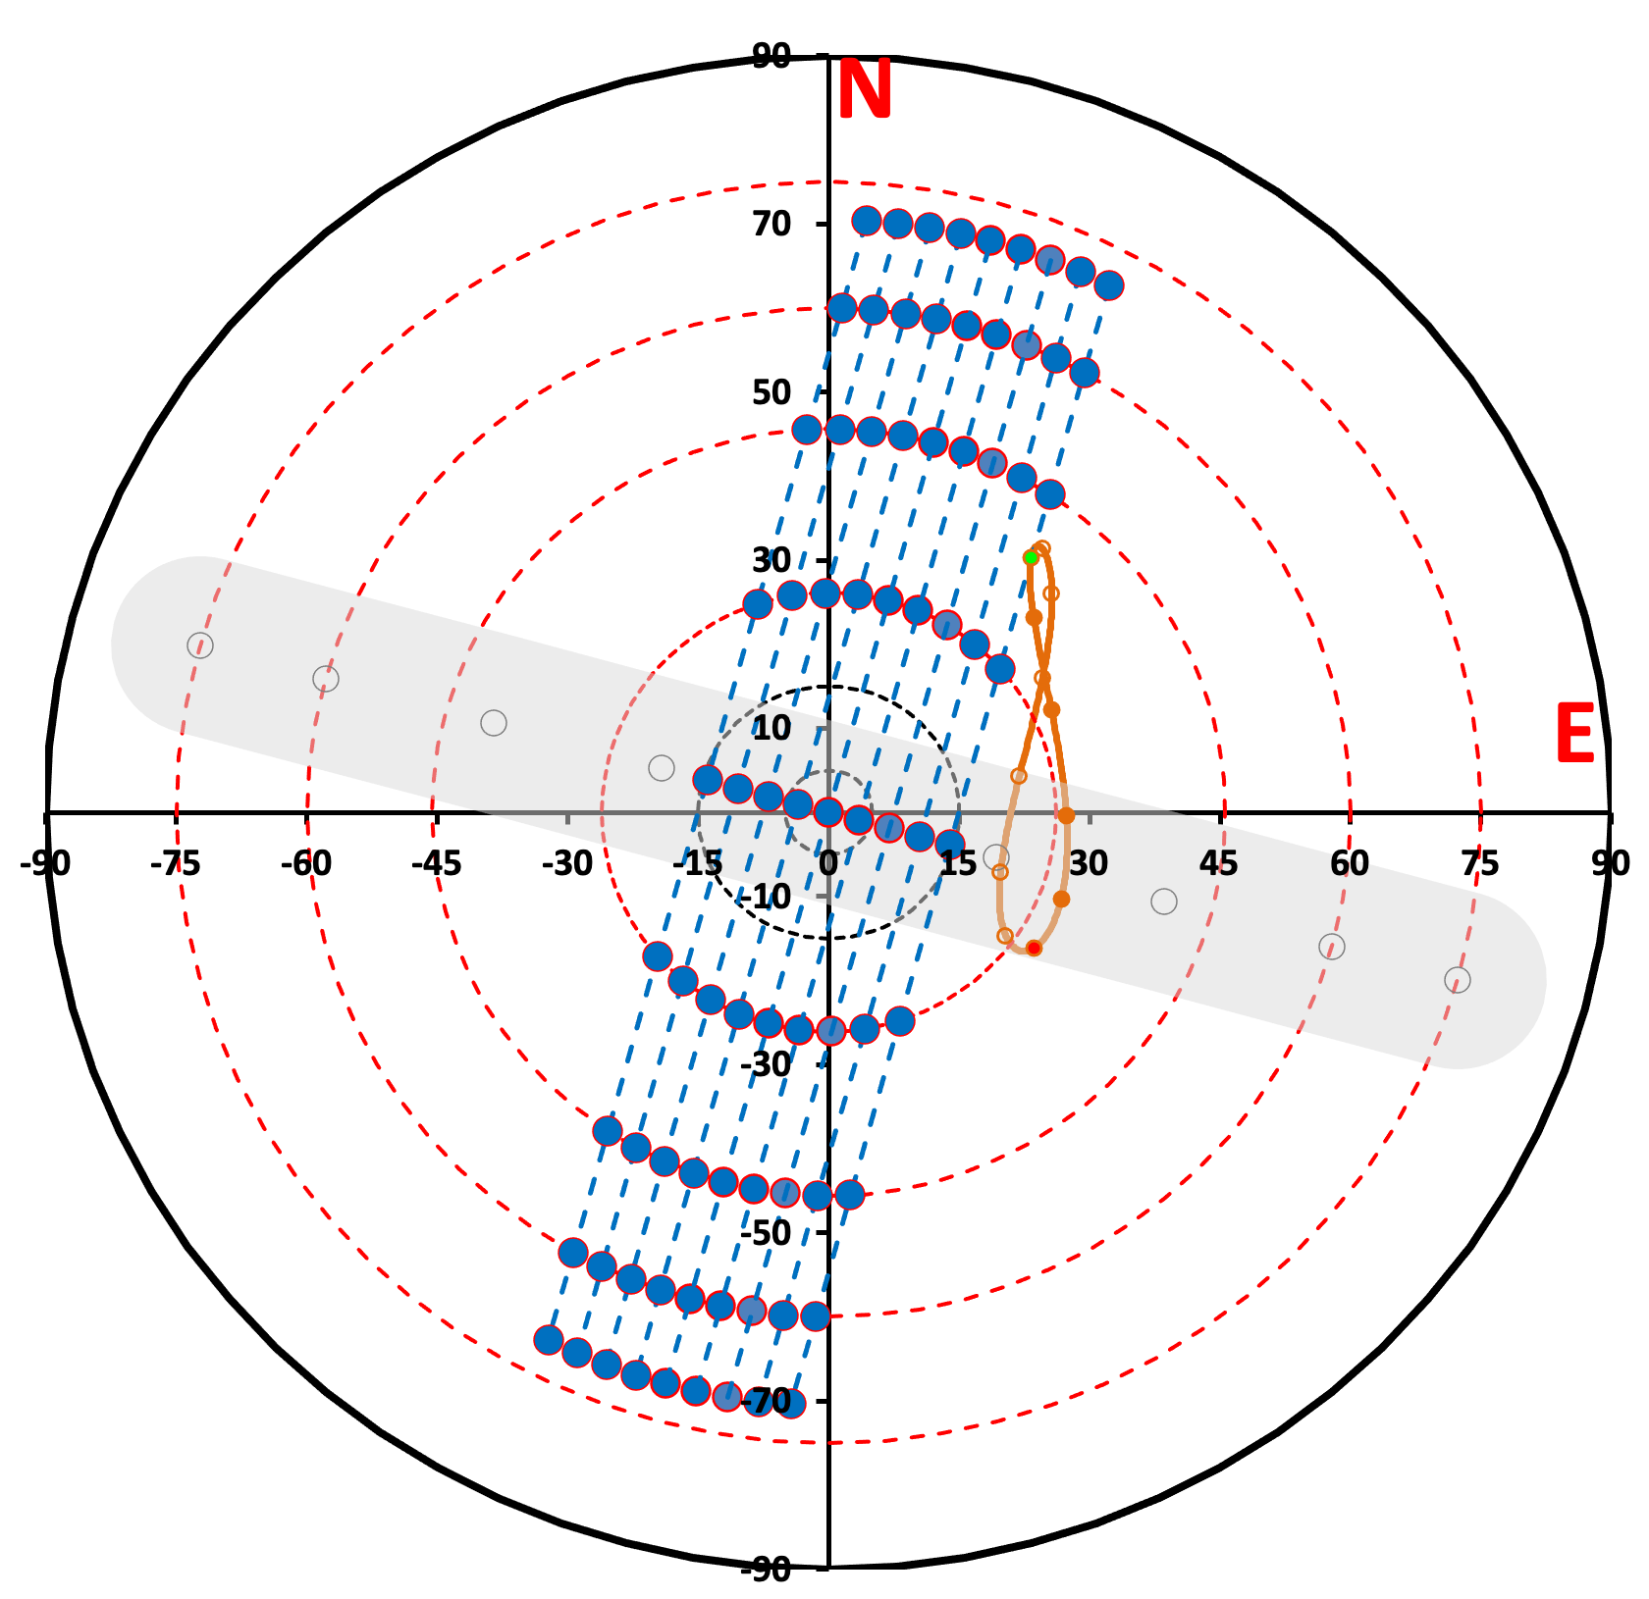
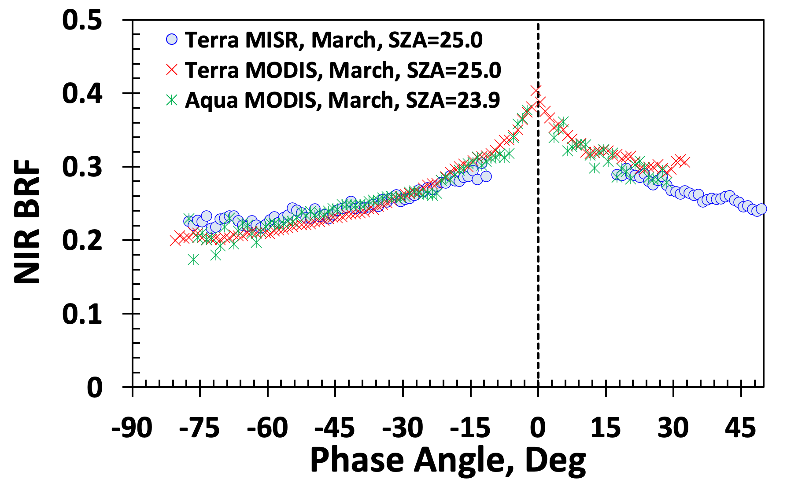
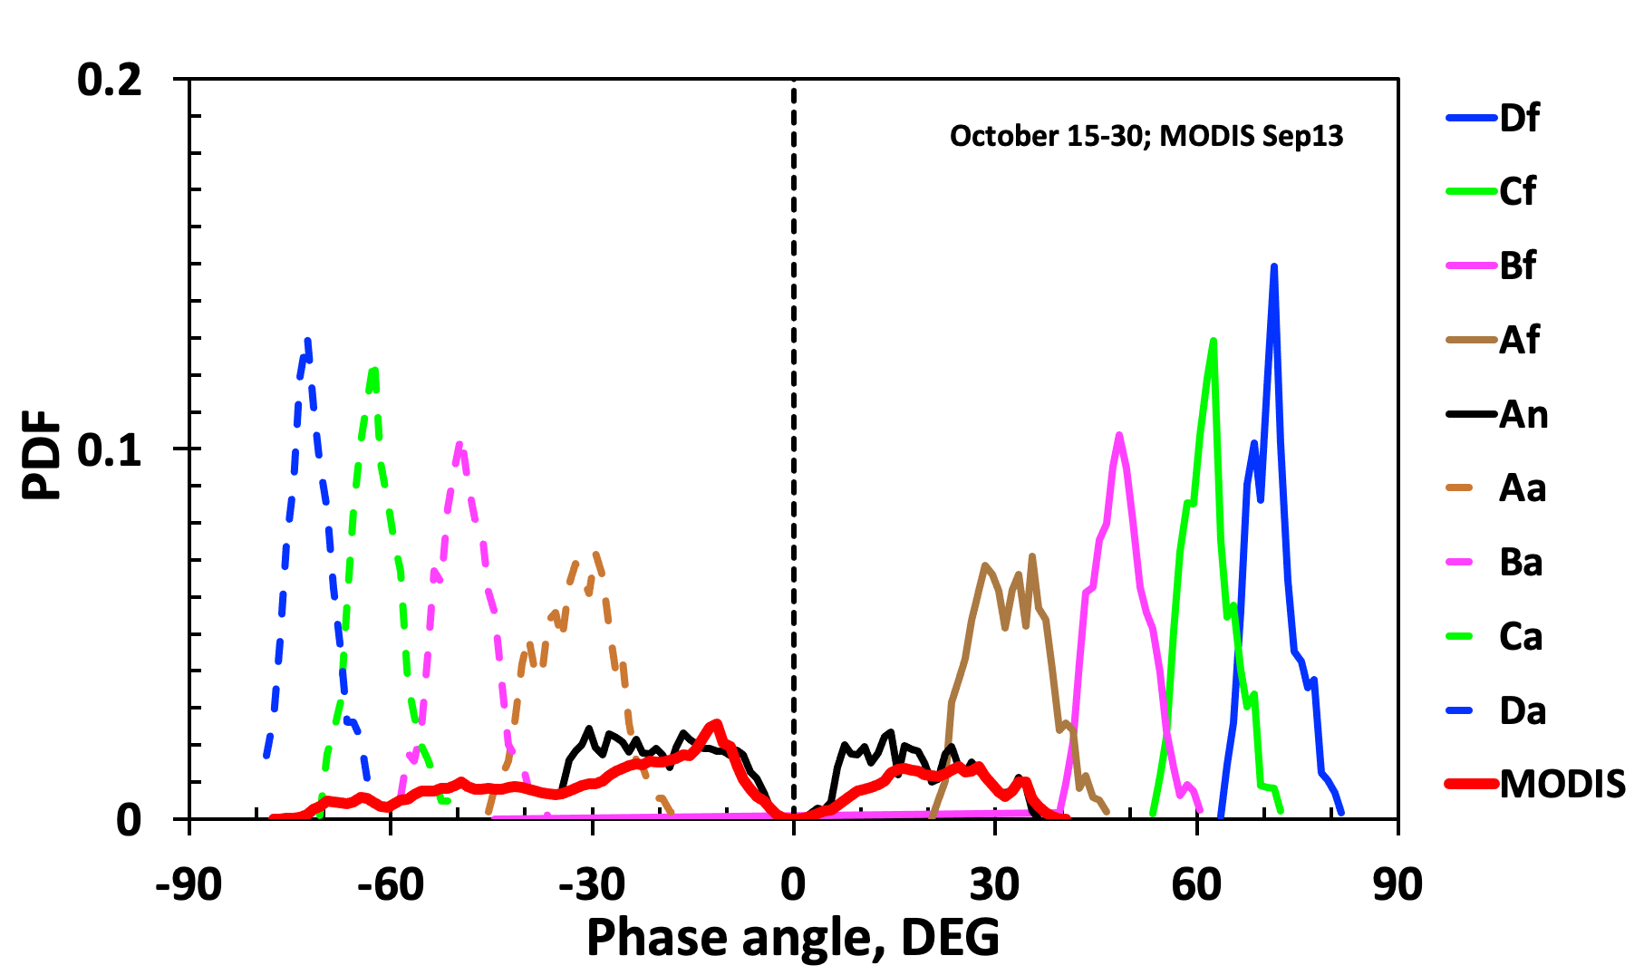
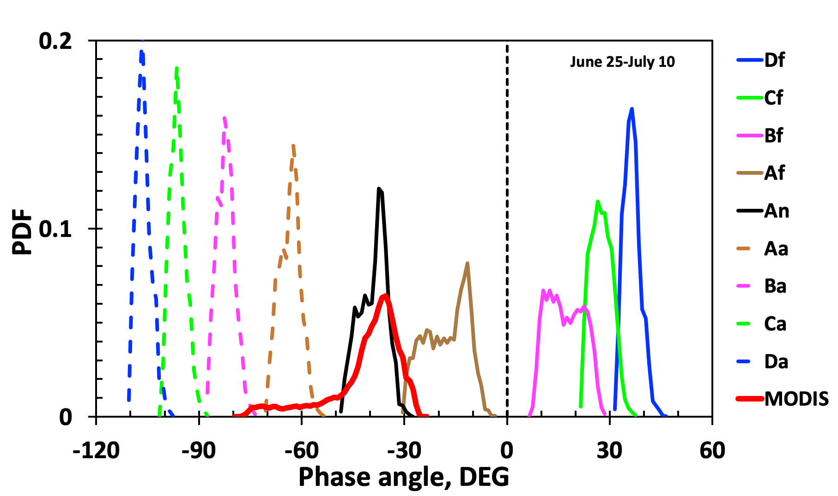
Monitoring of dense vegetation
Amazon: 8S, 62W; 10:30 LST
Along-track MISR
Across-track MODIS
Monitoring of dense vegetation such as equatorial forests represents the most complicated case in optical remote sensing
the satellite data are strongly influenced by changing sun-sensor geometry
Reflection of solar radiation saturates and becomes weakly sensitive to vegetation changes
difficult to discriminate between vegetation changes and sun-sensor geometry effects
The availability of hot spot data will enhance our ability to unambiguously detect and characterize changes in forests

Slide 10
Monitoring of dense vegetation
Amazon: 8S, 62W; 10:30 LST
Along-track MISR
Across-track MODIS
Monitoring of dense vegetation such as equatorial forests represents the most complicated case in optical remote sensing
the satellite data are strongly influenced by changing sun-sensor geometry
Reflection of solar radiation saturates and becomes weakly sensitive to vegetation changes
difficult to discriminate between vegetation changes and sun-sensor geometry effects
The availability of hot spot data will enhance our ability to unambiguously detect and characterize changes in forests

Slide 11
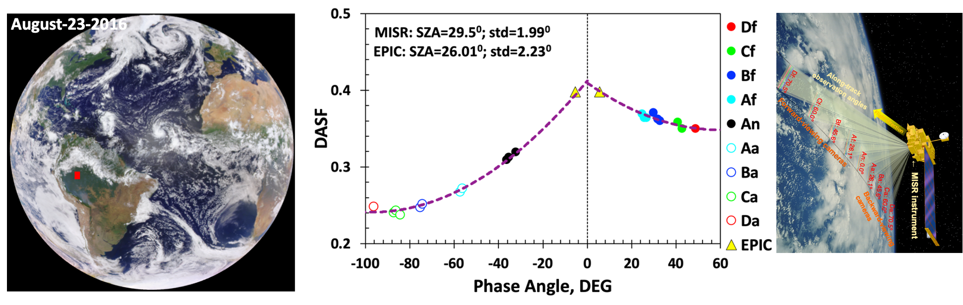
Vegetation Angular Signatures of Equatorial Forests From EPIC and Terra MISR
the Terra MISR provides simultaneous multiangle observations
sampling strategy allows for a good angular variation of surface reflectance in equatorial zone
spatially and temporally varying phase angle could be far from the hot spot region
The DSCOVR EPIC provides imageries in near backscattering directions
We generated a time series of DASF over equatorial forests using data from Terra MISR and DSCOVR EPIC data. Our model can accurately reproduce both MISR angular signatures acquired at 10:30 local solar time and diurnal courses of EPIC reflectance.

Slide 12
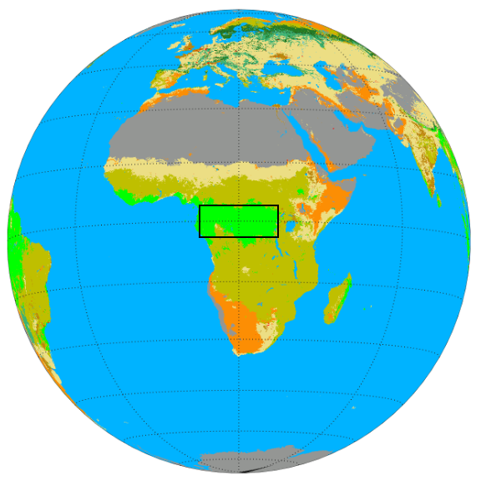
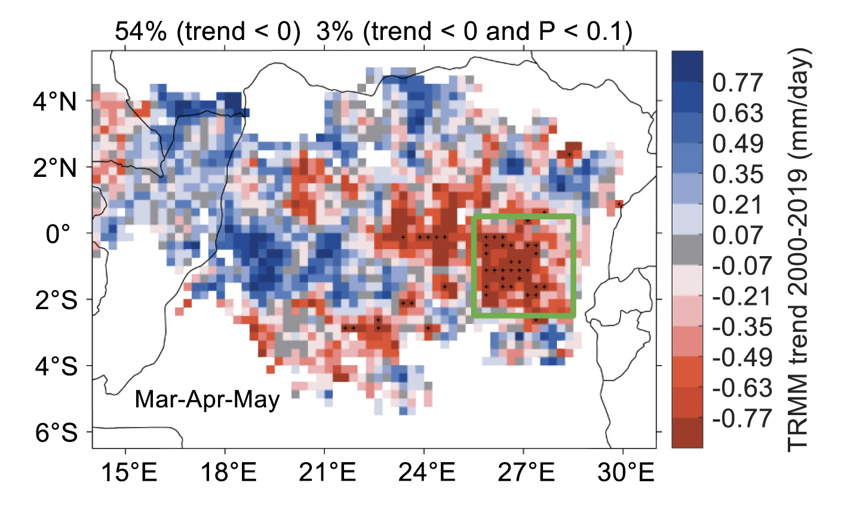
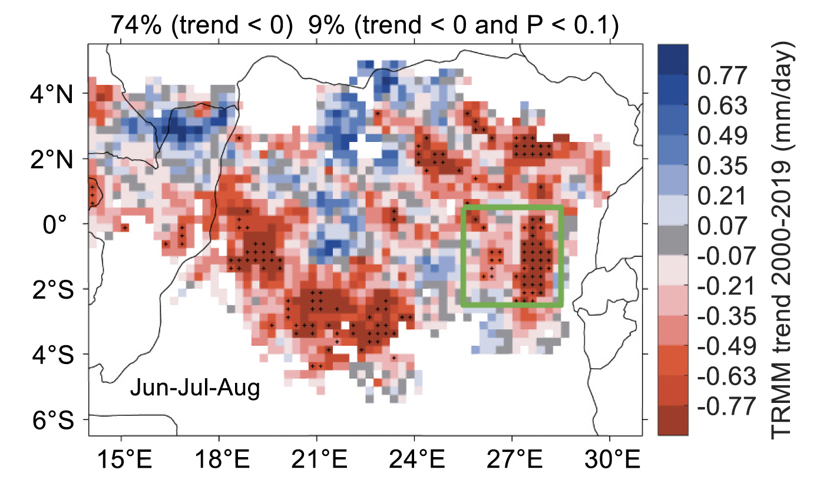
DRYING TRENDS IN CONGOLESE RAINFORESTS
Wet season (MAM)
Dry season (JJA)
A significant precipitation decline during the wet and dry seasons over the period of 2000-2019 is observed in the southeastern part of Congolese forests

Slide 13
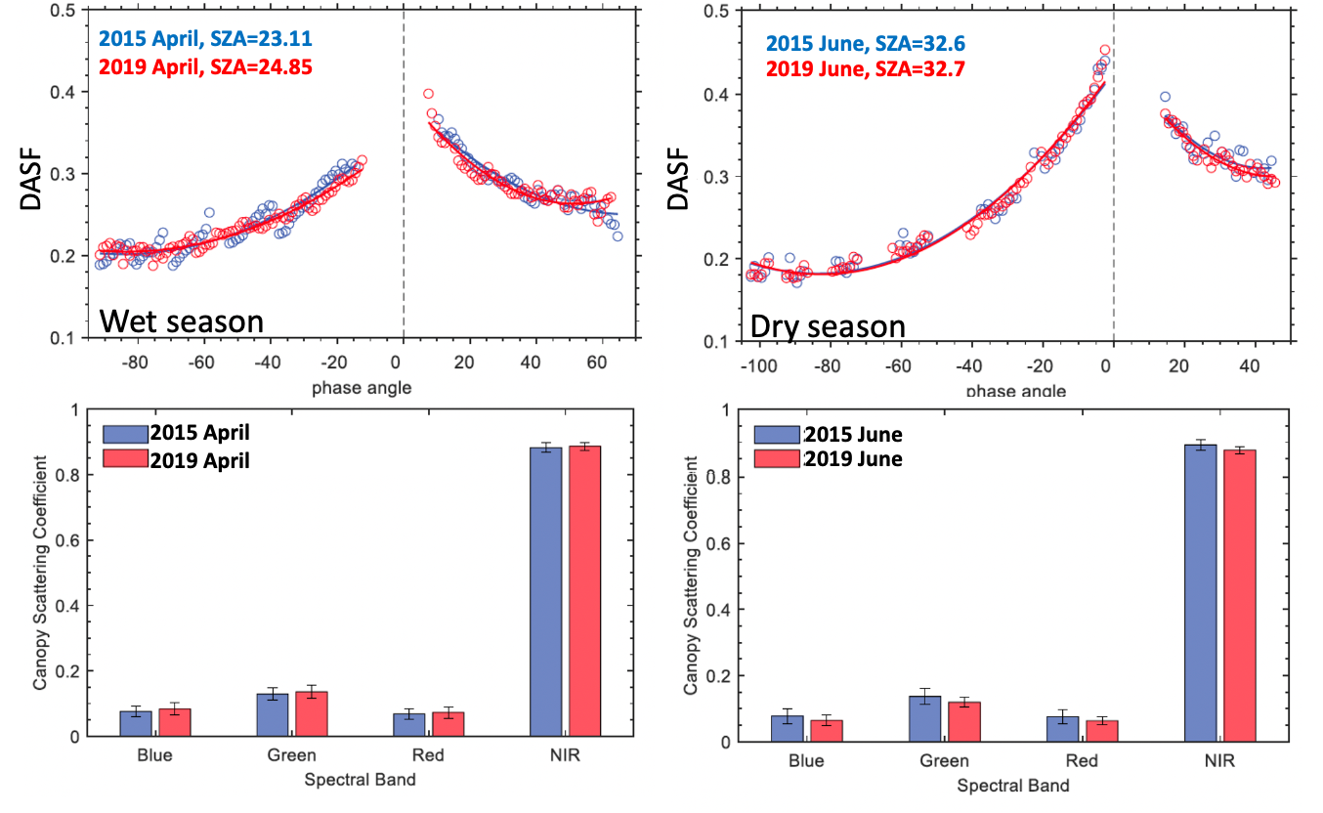
IMPACT OF DRYING TRENDS ON STRUCTURE AND LEAF OPTICS IN CONGO FORESTS
No significant differences in magnitude and shape of MISR-EPIC DASF in April 2015 and the end of the 2000-2019 observation period have been detected
no changes in the canopy spectral coefficient at all blue, green, red and NIR spectral bands are found
Time series of the MISR-EPIC DASF of forest reflected radiation show no signs of long-term drying impact on structure and leaf optics of the Congolese forest

Slide 14
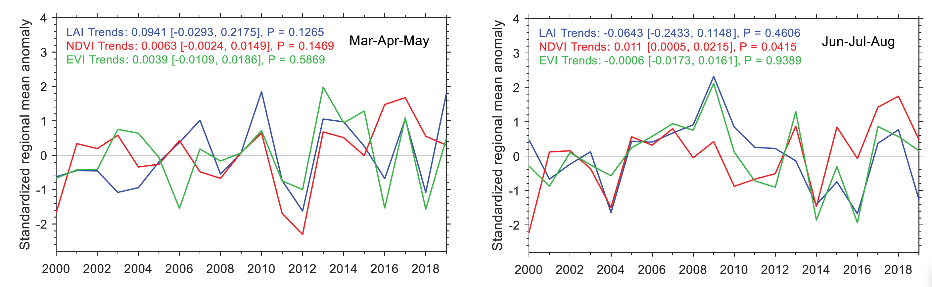
ANALYSES OF NDVI, EVI AND LAI CORROBORATE DASF-BASED RESULTS
With the exception of NDVI in the June to August dry season, no significant decline or increase in trends in regional mean NDVI, EVI and LAI over the past two decades are detected, suggesting no long-term drying impact on structure and leaf optics of the Congolese forests
Sun, Yuanheng, Yuri Knyazikhin, Xiaojun She, Xiangnan Ni, Chi Chen, Huazhong Ren, and Ranga B. Myneni. 2022. "Seasonal and long-term variations in leaf area of Congolese rainforest." Remote Sensing of Environment 268:112762. doi: 10.1016/j.rse.2021.112762.

Slide 15
SUMMARY
  Version 2 (08_LUT02) VESDR product for the period from June-2015 to December -2021 is publicly available from the NASA Langley Atmospheric Science Data Center (ASDC)
  A new cod version (08ALUT02) was delivered to NCCS. The VESDR version 2 (08ALUT02) product is being generated. Data for the period from January 2022 to July-2023 is publicly available from the NASA ASDC
    ambiguity in the QA information about the reason for the algorithm failure has been fixed
  The VESDR parameters follows regularities expected from physics
  Anew approach to detect changes in properties of the Congolese rainforest using angular variation of DASF as a source of diagnostic information

