Slide 1
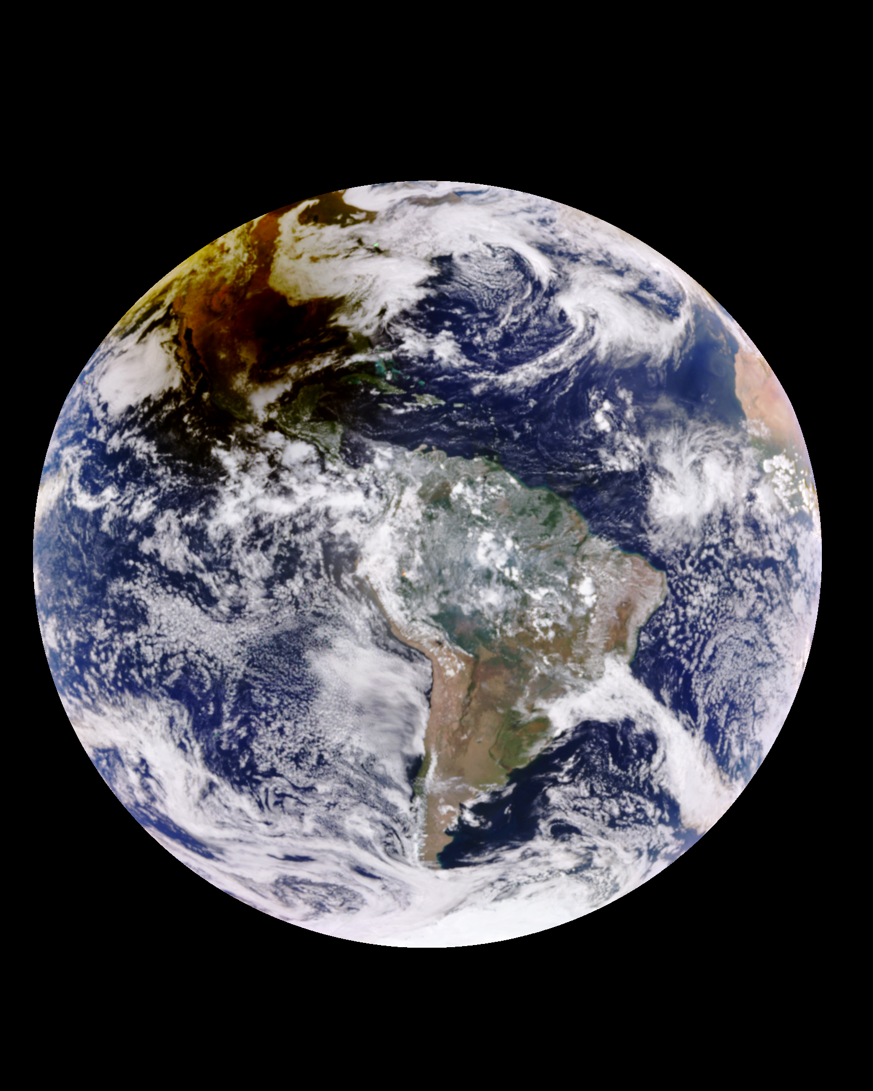
Absorbing Aerosols above Clouds from DSCOVR-EPIC
Solar eclipse
Hiren T Jethva^{1,2}, Omar Torres², Changwoo Ahn³
1) Morgan State Univ. GESTAR-II
2) NASA Goddard Space Flight Center
3) Science Systems & Applications
2023 EPIC STM
Oct 17, 2023
20231014165817

Slide 2
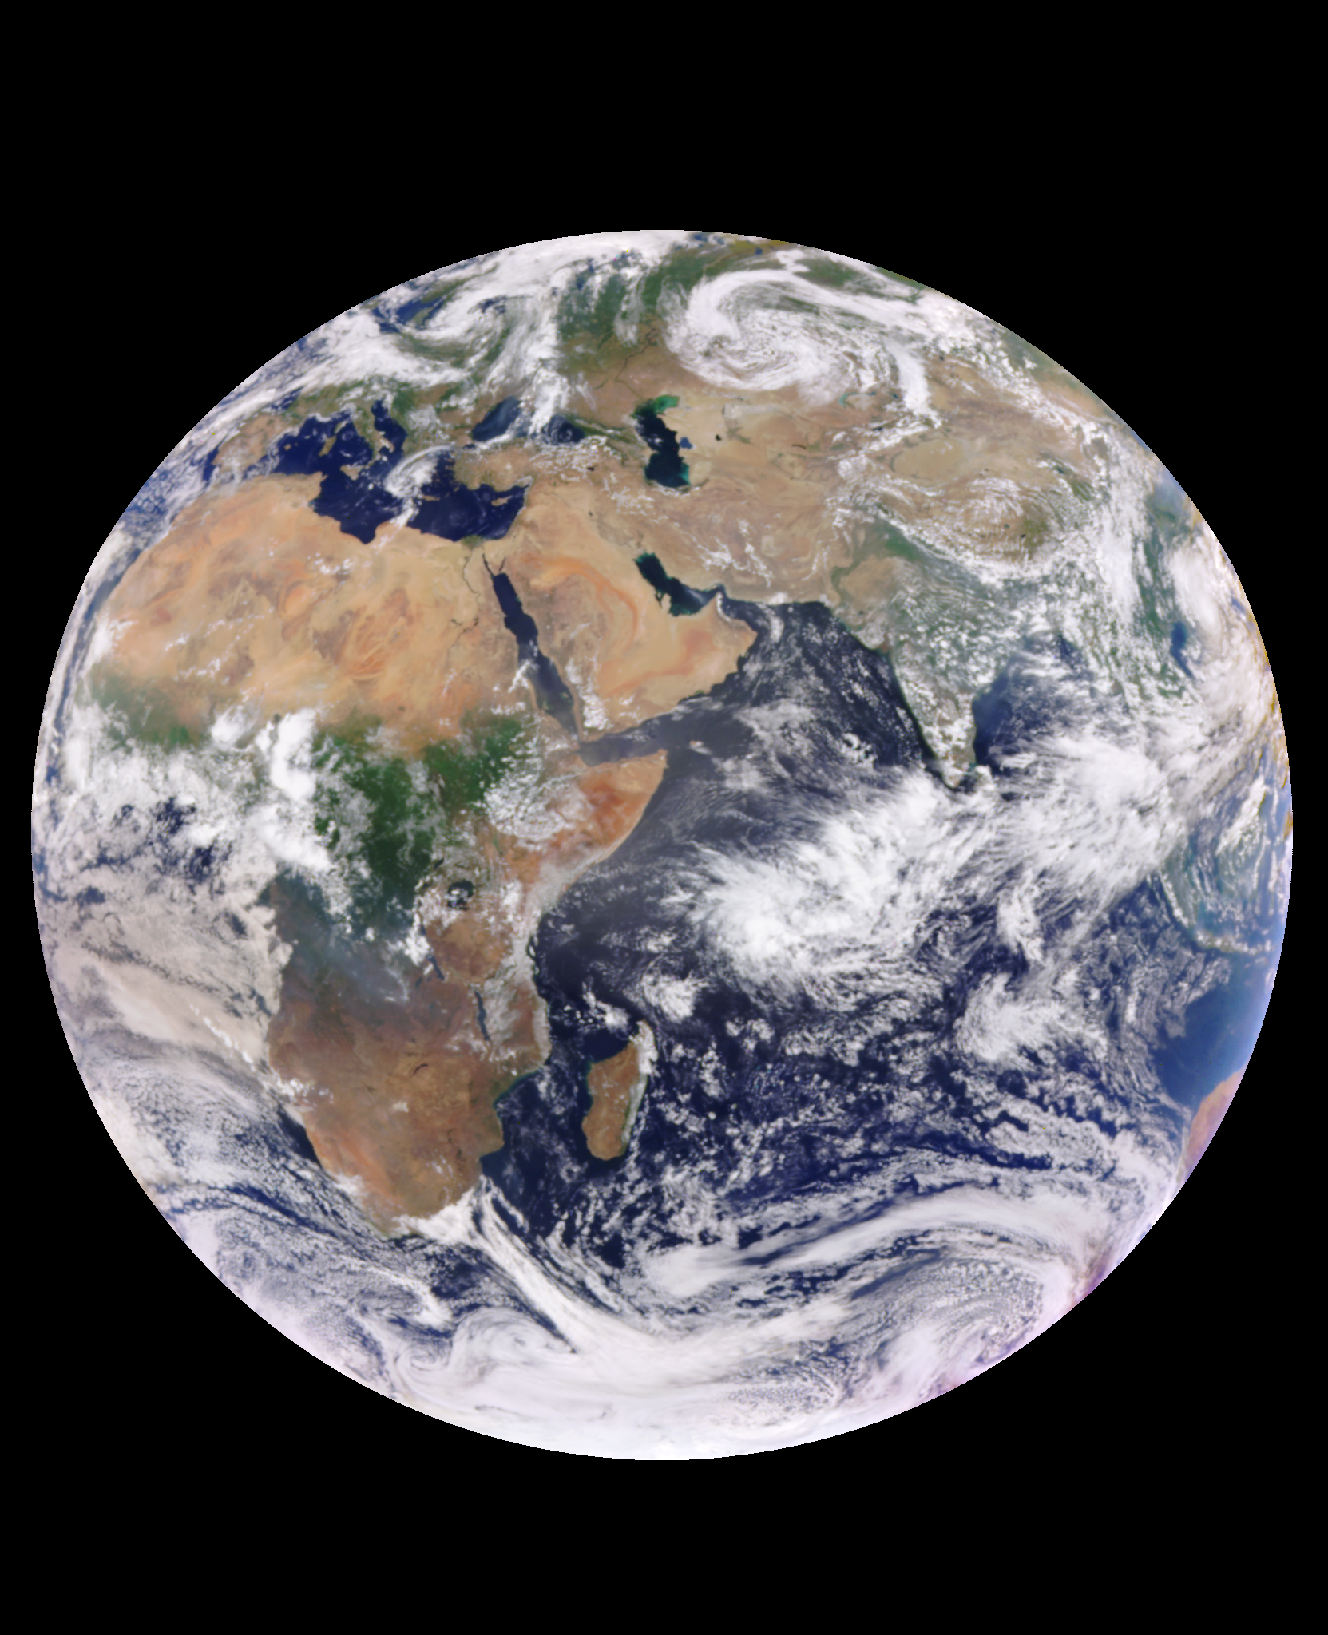
Cloud darkening produced by smoke absorption above clouds
Absorbing Aerosols above Clouds from DSCOVR-EPIC
Hiren T Jethva^{1,2}, Omar Torres², Changwoo Ahn³
1) Morgan State Univ. GESTAR-II
2) NASA Goddard Space Flight Center
3) Science Systems & Applications
2023 EPIC STM
Oct 17, 2023
20230901091052

Slide 3
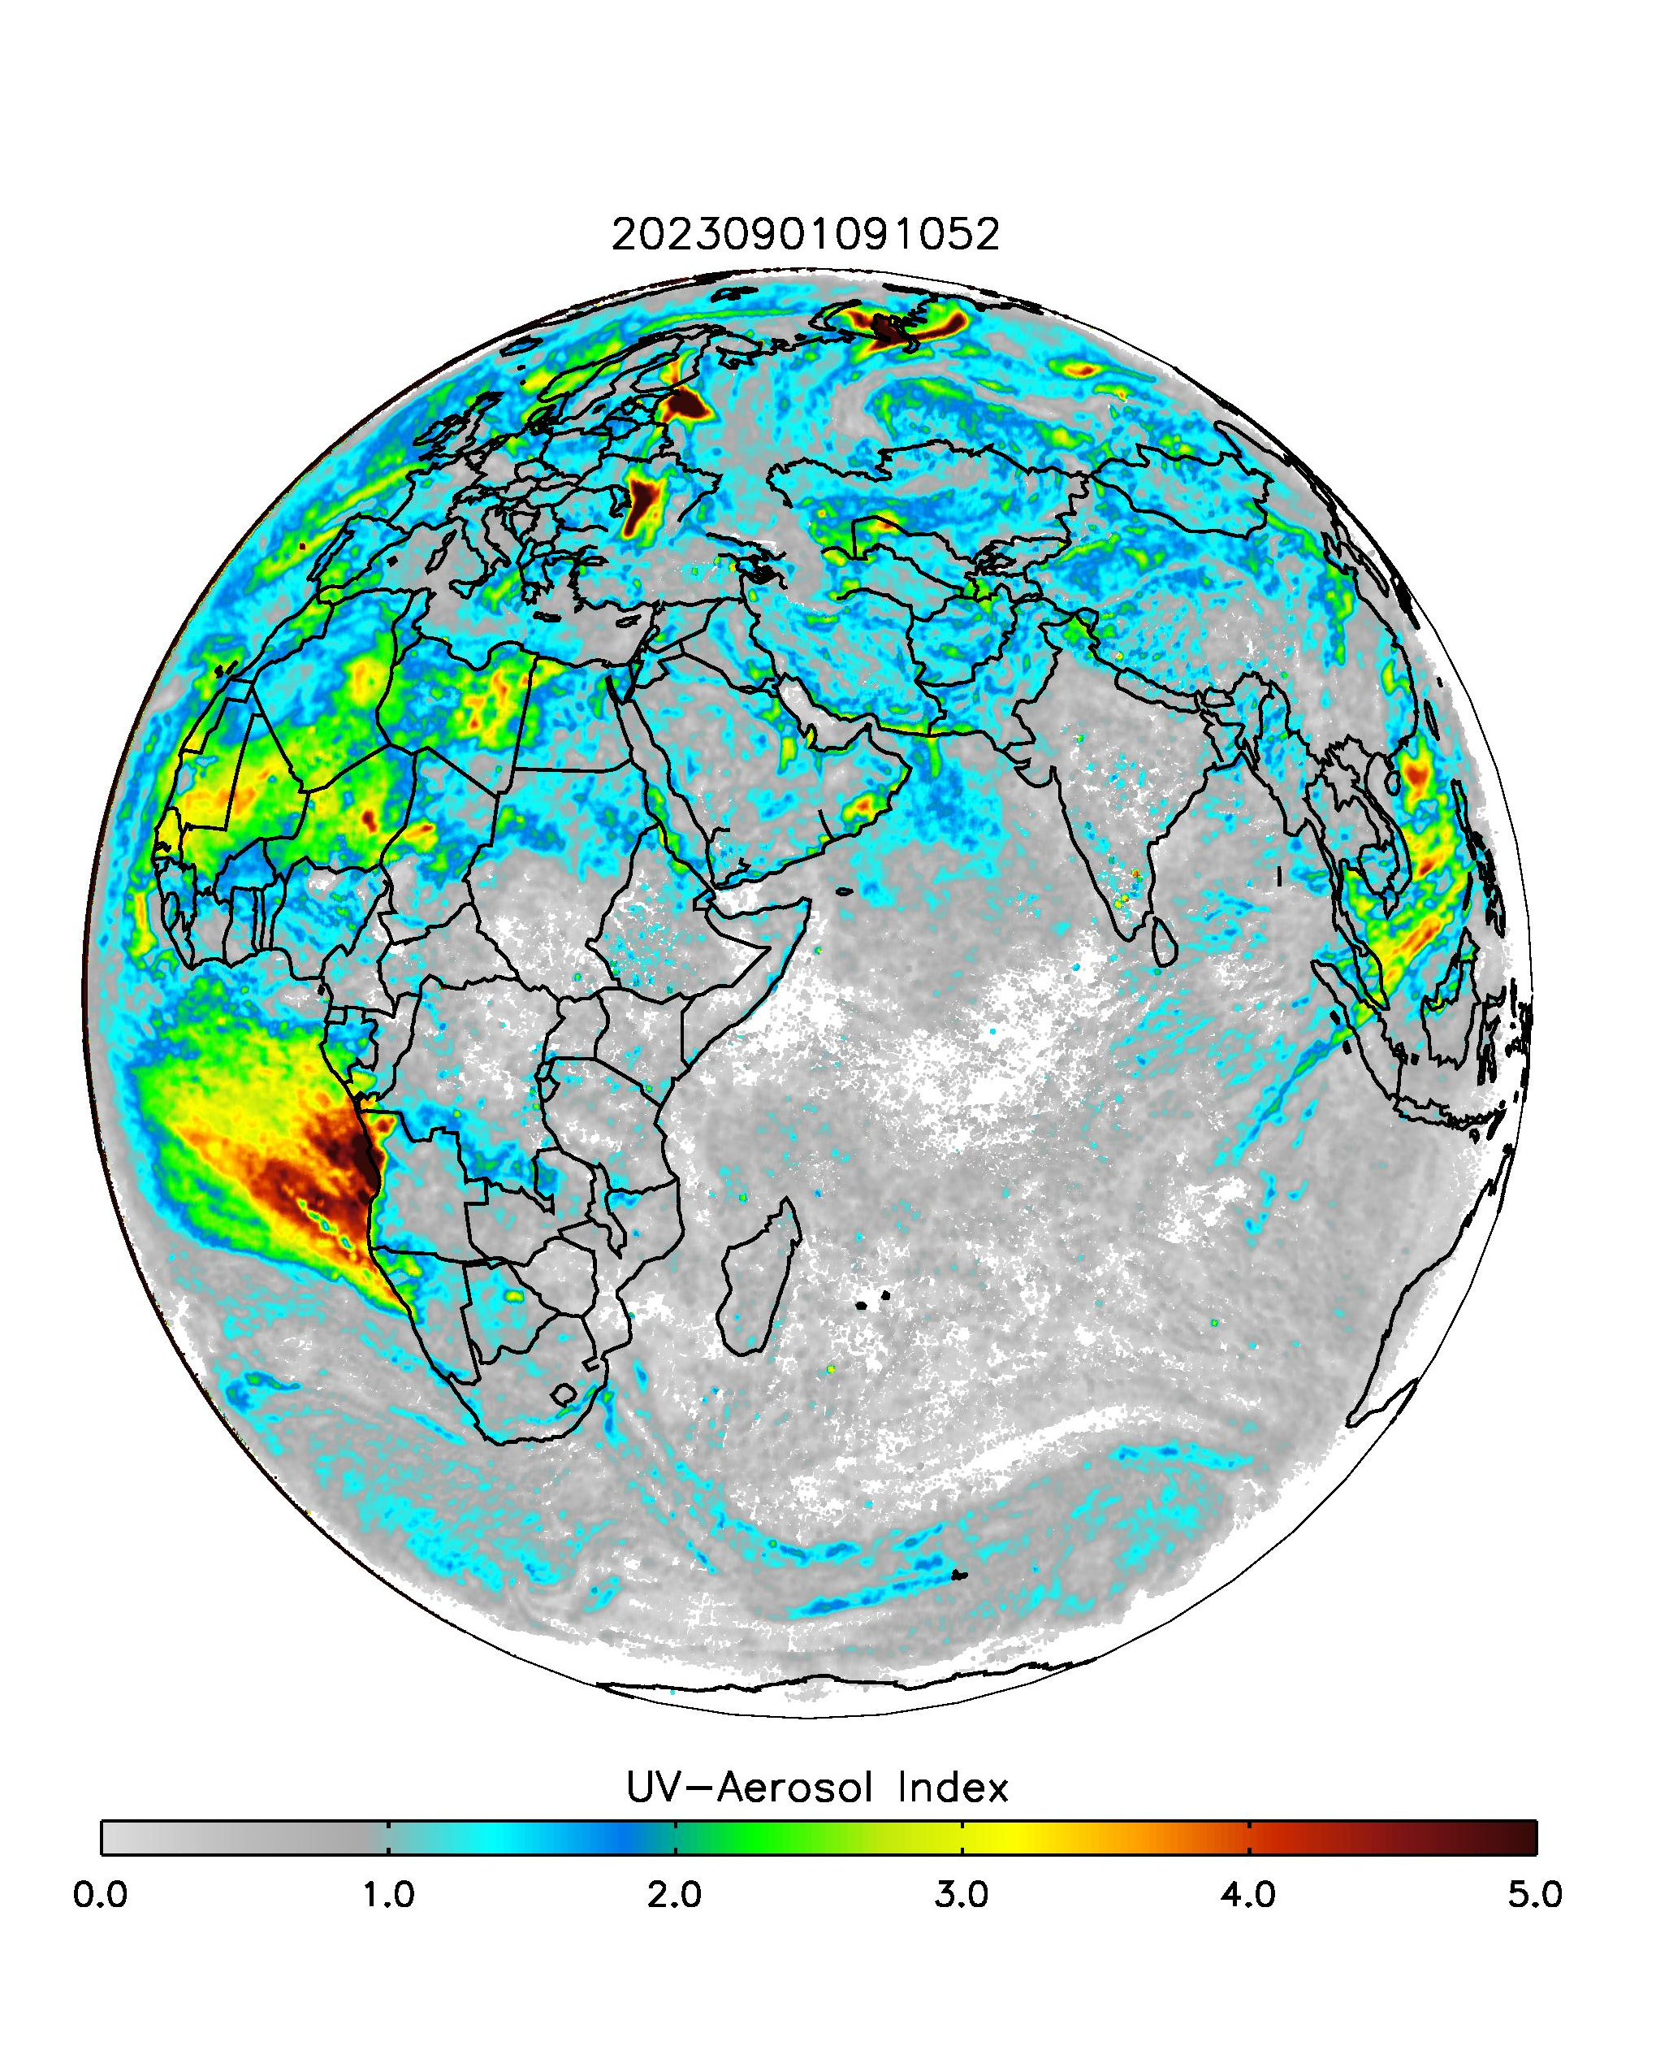
Cloud darkening produced by smoke absorption above clouds
Absorbing Aerosols above Clouds from DSCOVR-EPIC
Hiren T Jethva^{1,2}, Omar Torres², Changwoo Ahn³
1) Morgan State Univ. GESTAR-II
2) NASA Goddard Space Flight Center
3) Science Systems & Applications
2023 EPIC STM
Oct 17, 2023

Slide 4
Absorbing aerosols and Clouds: An unsolved connection
Large differences among AEROCOM models over aerosol-cloud overlap regions

Slide 5
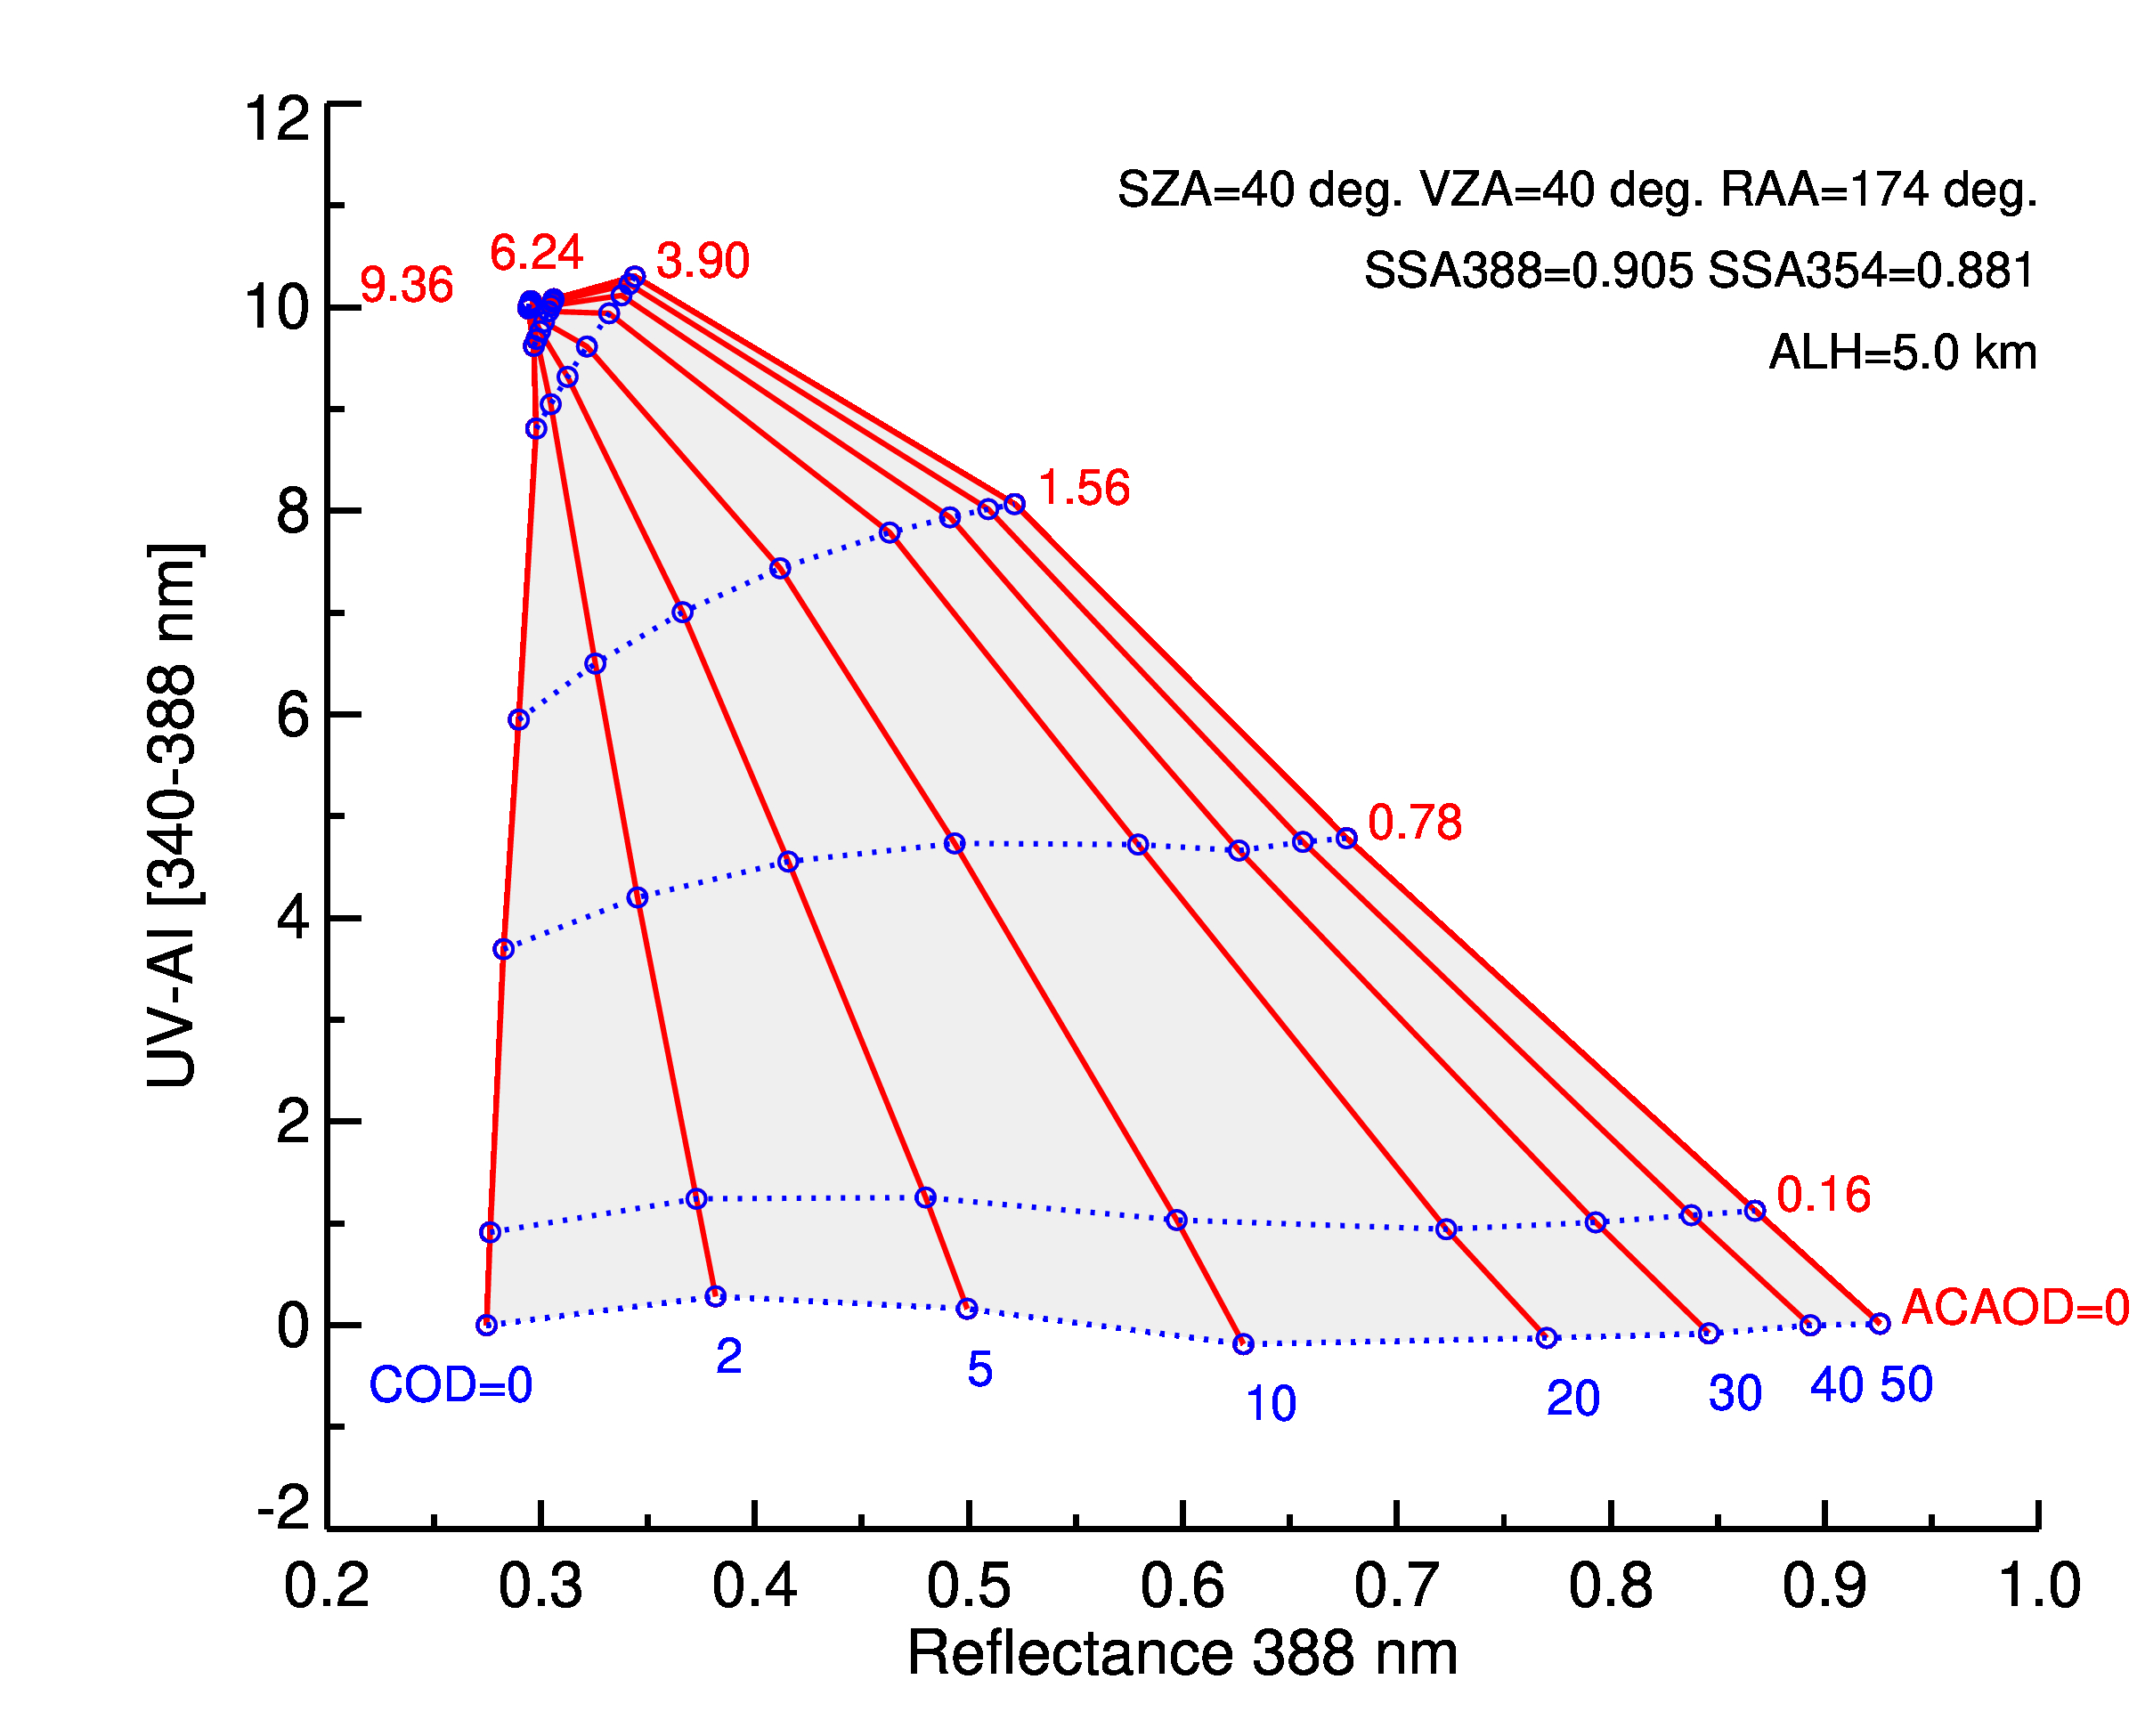
EPICAER-AC: Above-cloud aerosol algorithm for EPIC
EPICAER-AC is built upon the heritage OMI-OMACA above-cloud aerosol package.
Retrieves above-cloud aerosol optical depth and aerosol-corrected cloud optical depth simultaneously​.
​
Carbonaceous aerosols and mineral dust are considered.
ACAOD
COD

Slide 6
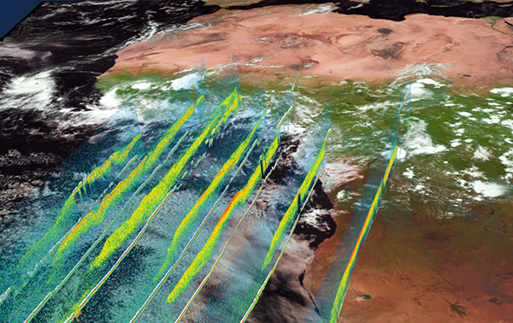
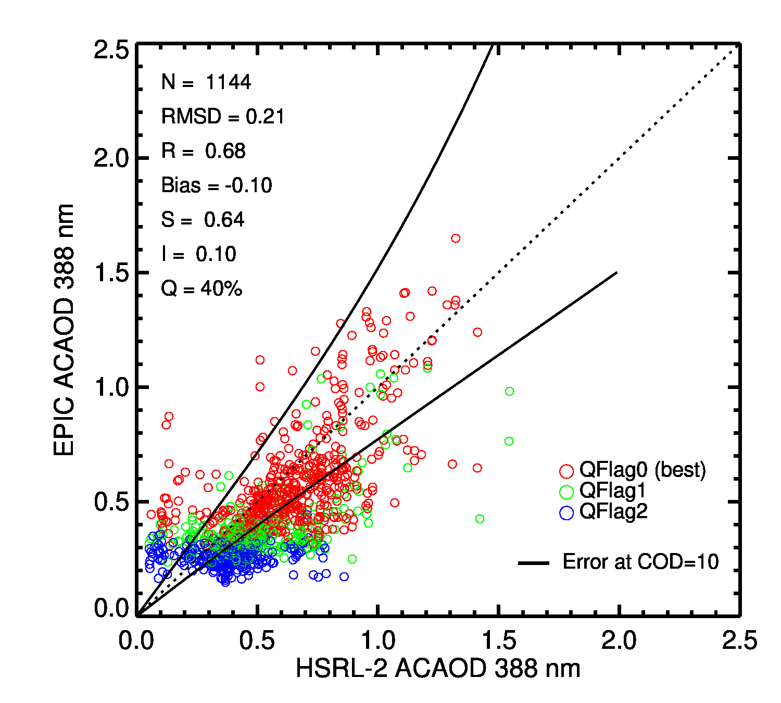
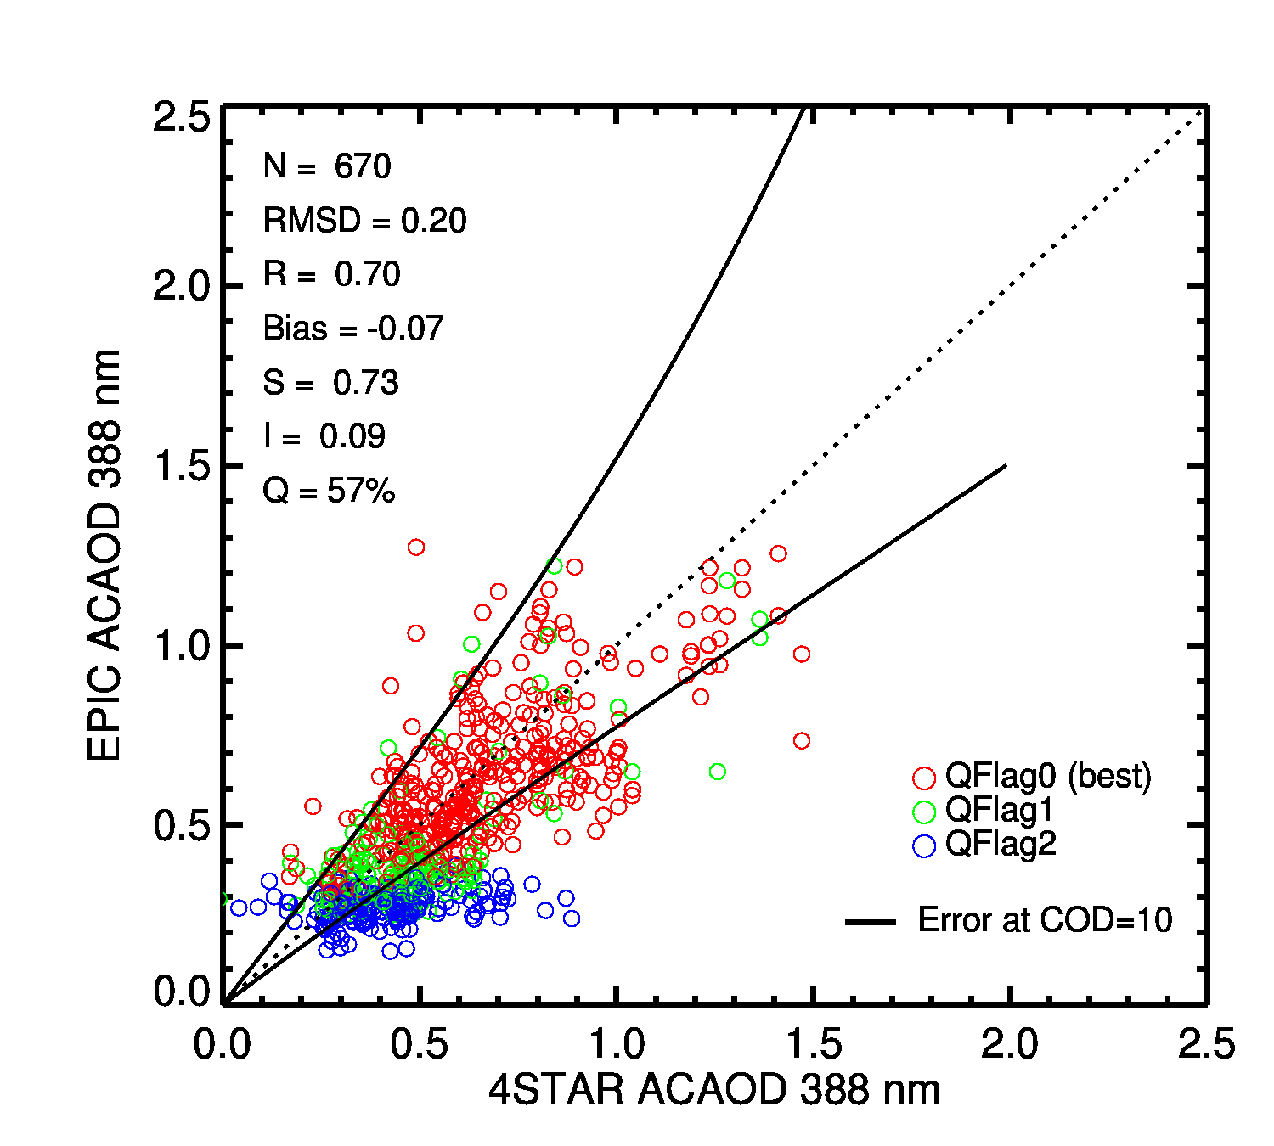
Validation of ACAOD against ORACLES Airborne Measurements
Majority of good quality retrievals are within the expected uncertainty

Slide 7
Monthly Distribution of AC-AOD

Slide 8
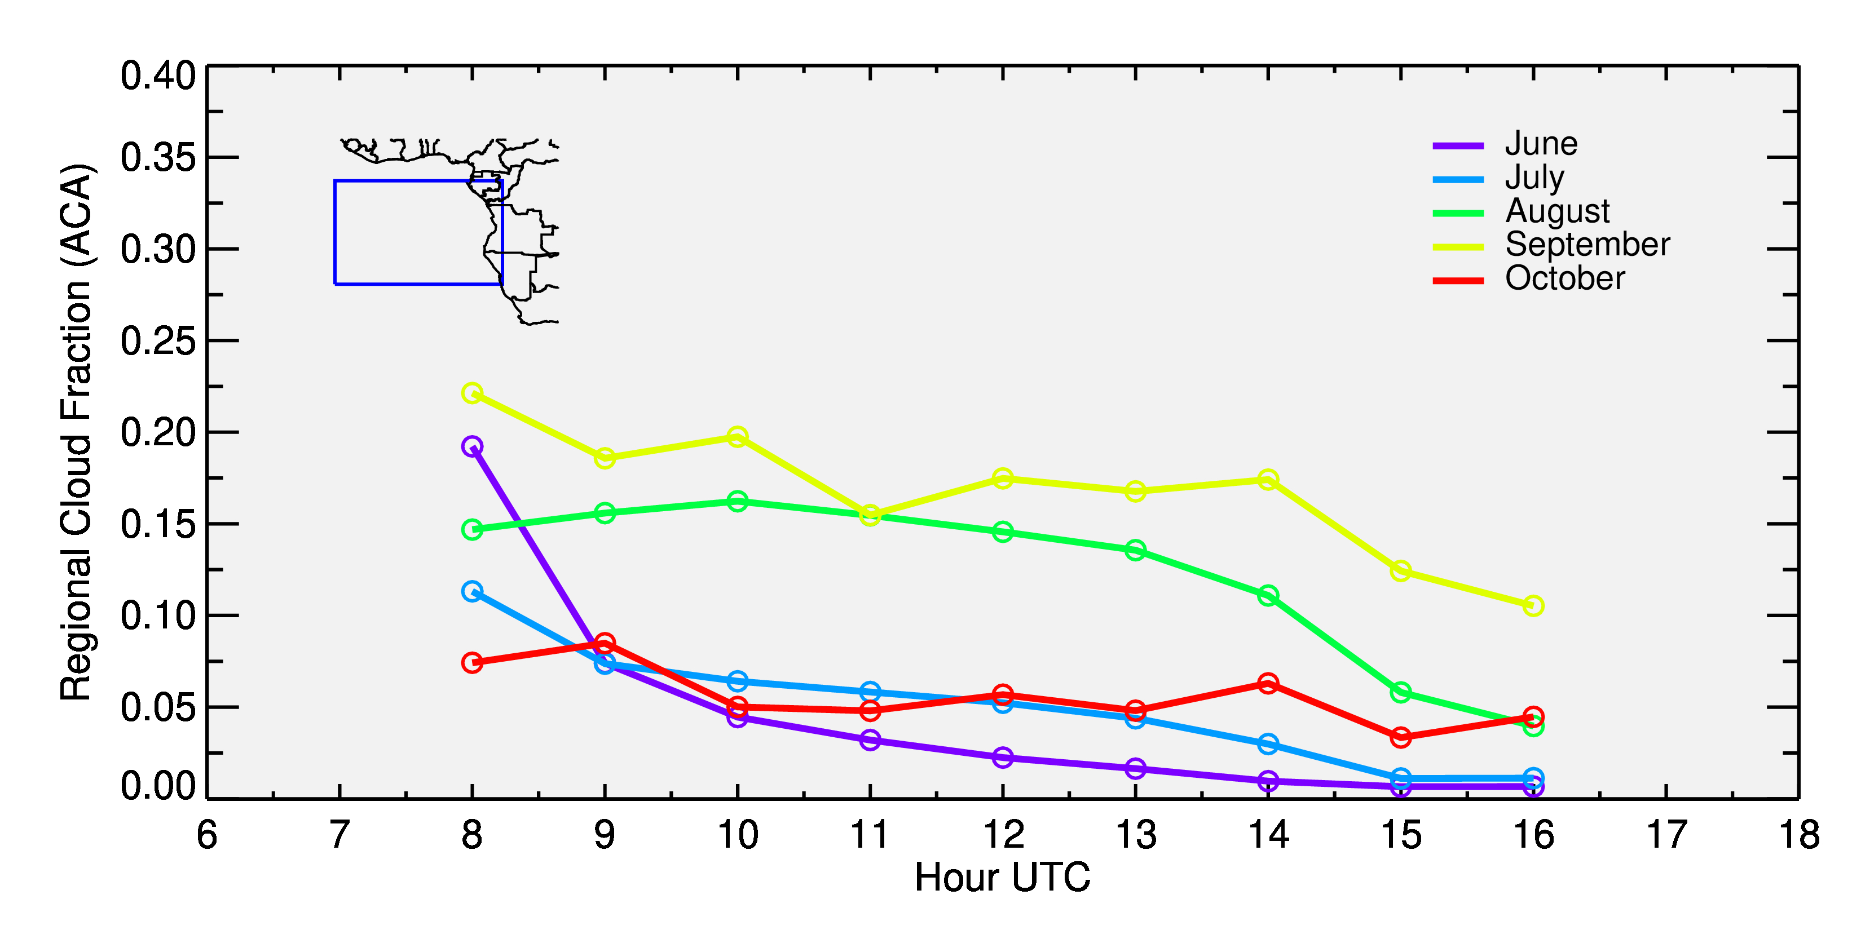
Near-hourly Evolution of Cloud Fraction and Above-cloud AOD
Southeastern Atlantic Ocean—A regional hotspot of above-cloud smoke aerosols

Slide 9
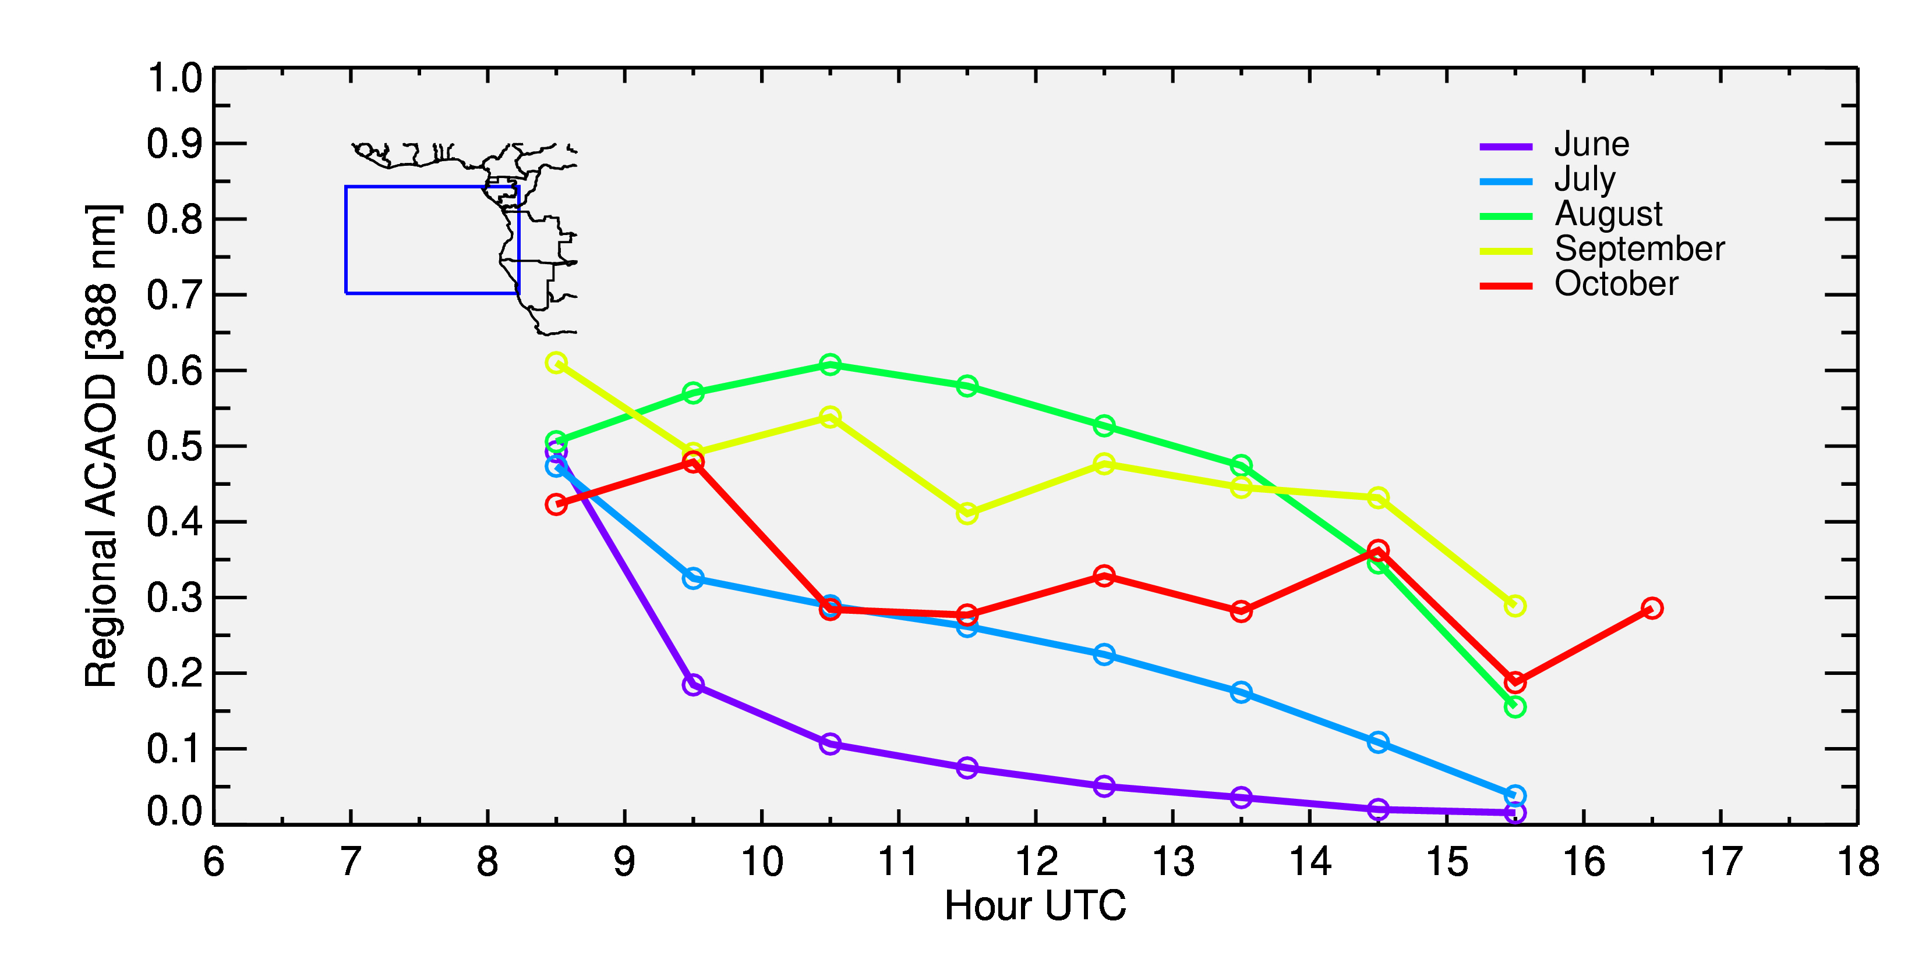
Near-hourly Evolution of Cloud Fraction and Above-cloud AOD
Southeastern Atlantic Ocean—A regional hotspot of above-cloud smoke aerosols

Slide 10
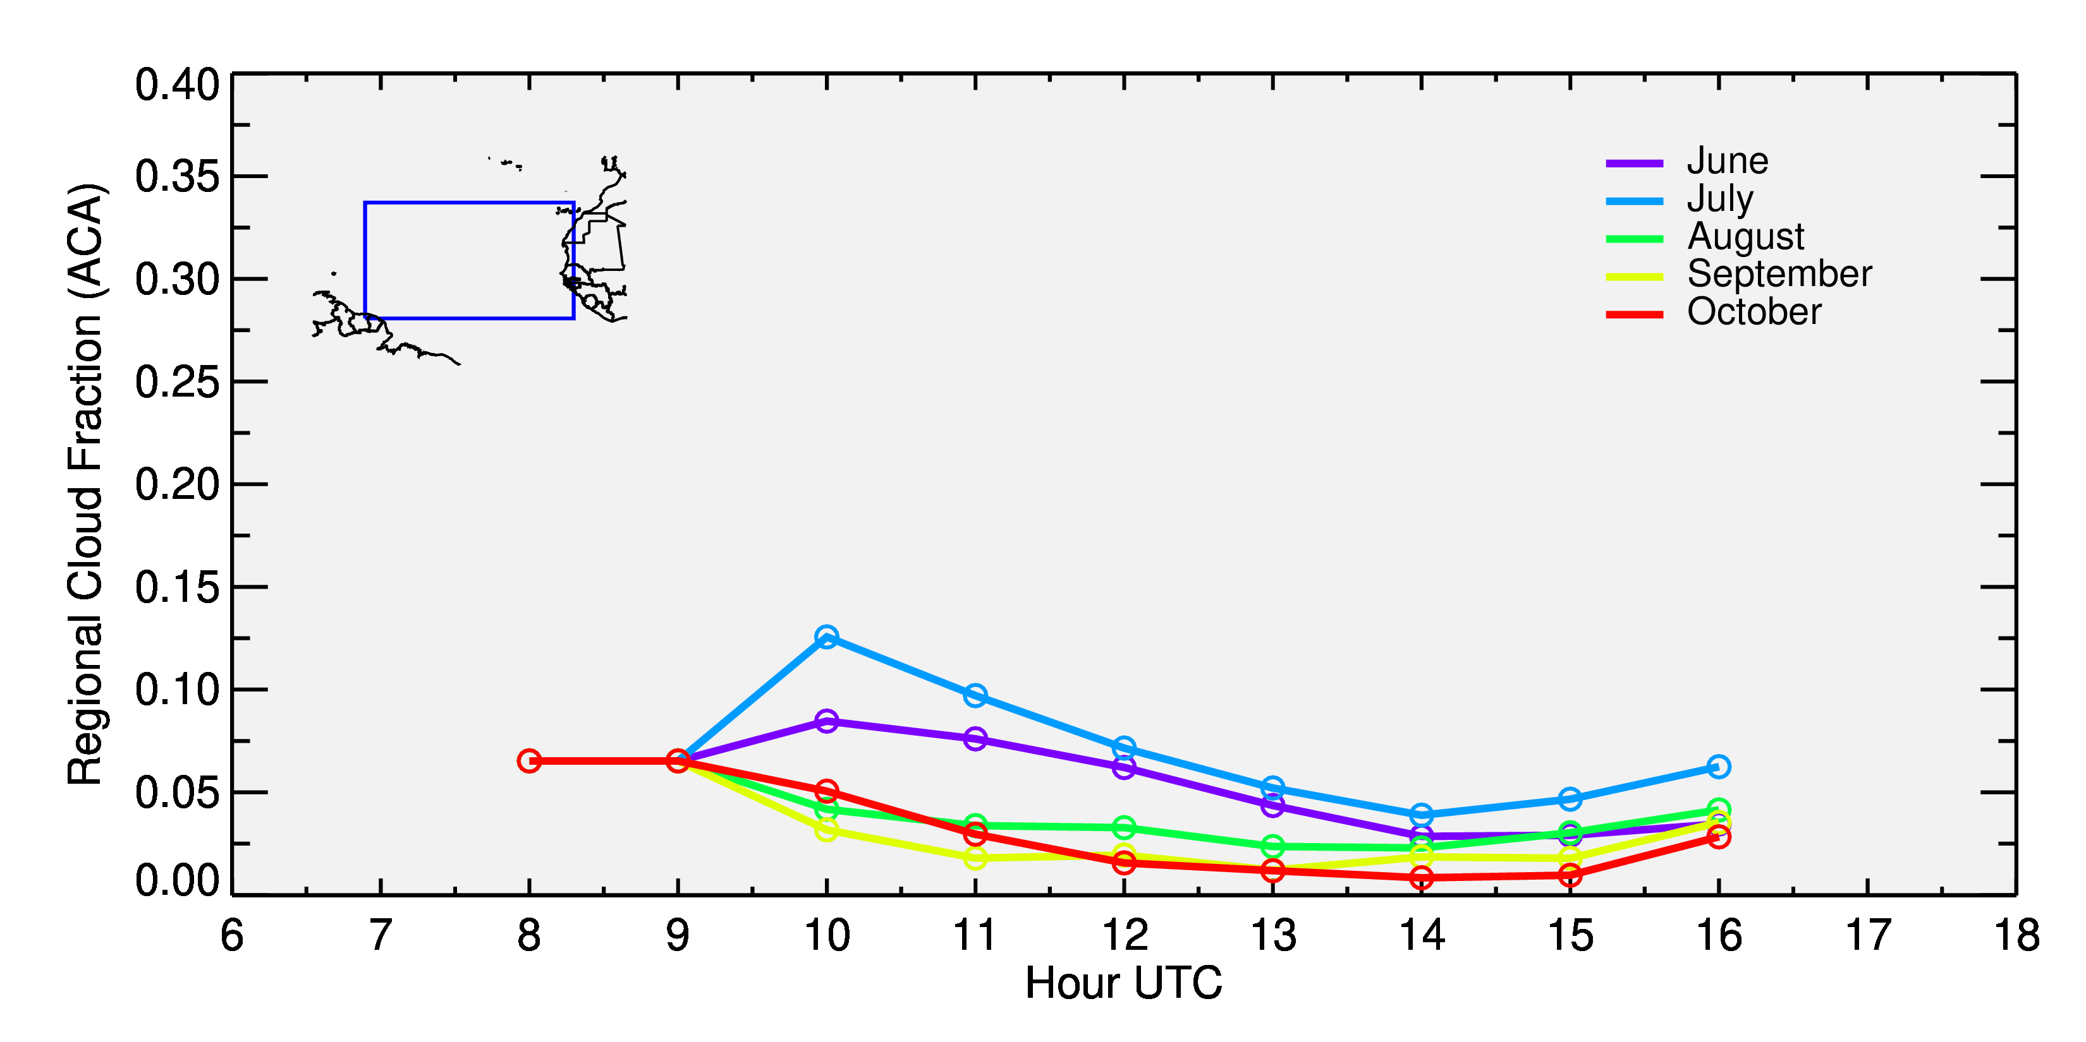
Near-hourly Evolution of Cloud Fraction and Above-cloud AOD
Tropical Atlantic Ocean—A regional hotspot of above-cloud smoke aerosols

Slide 11
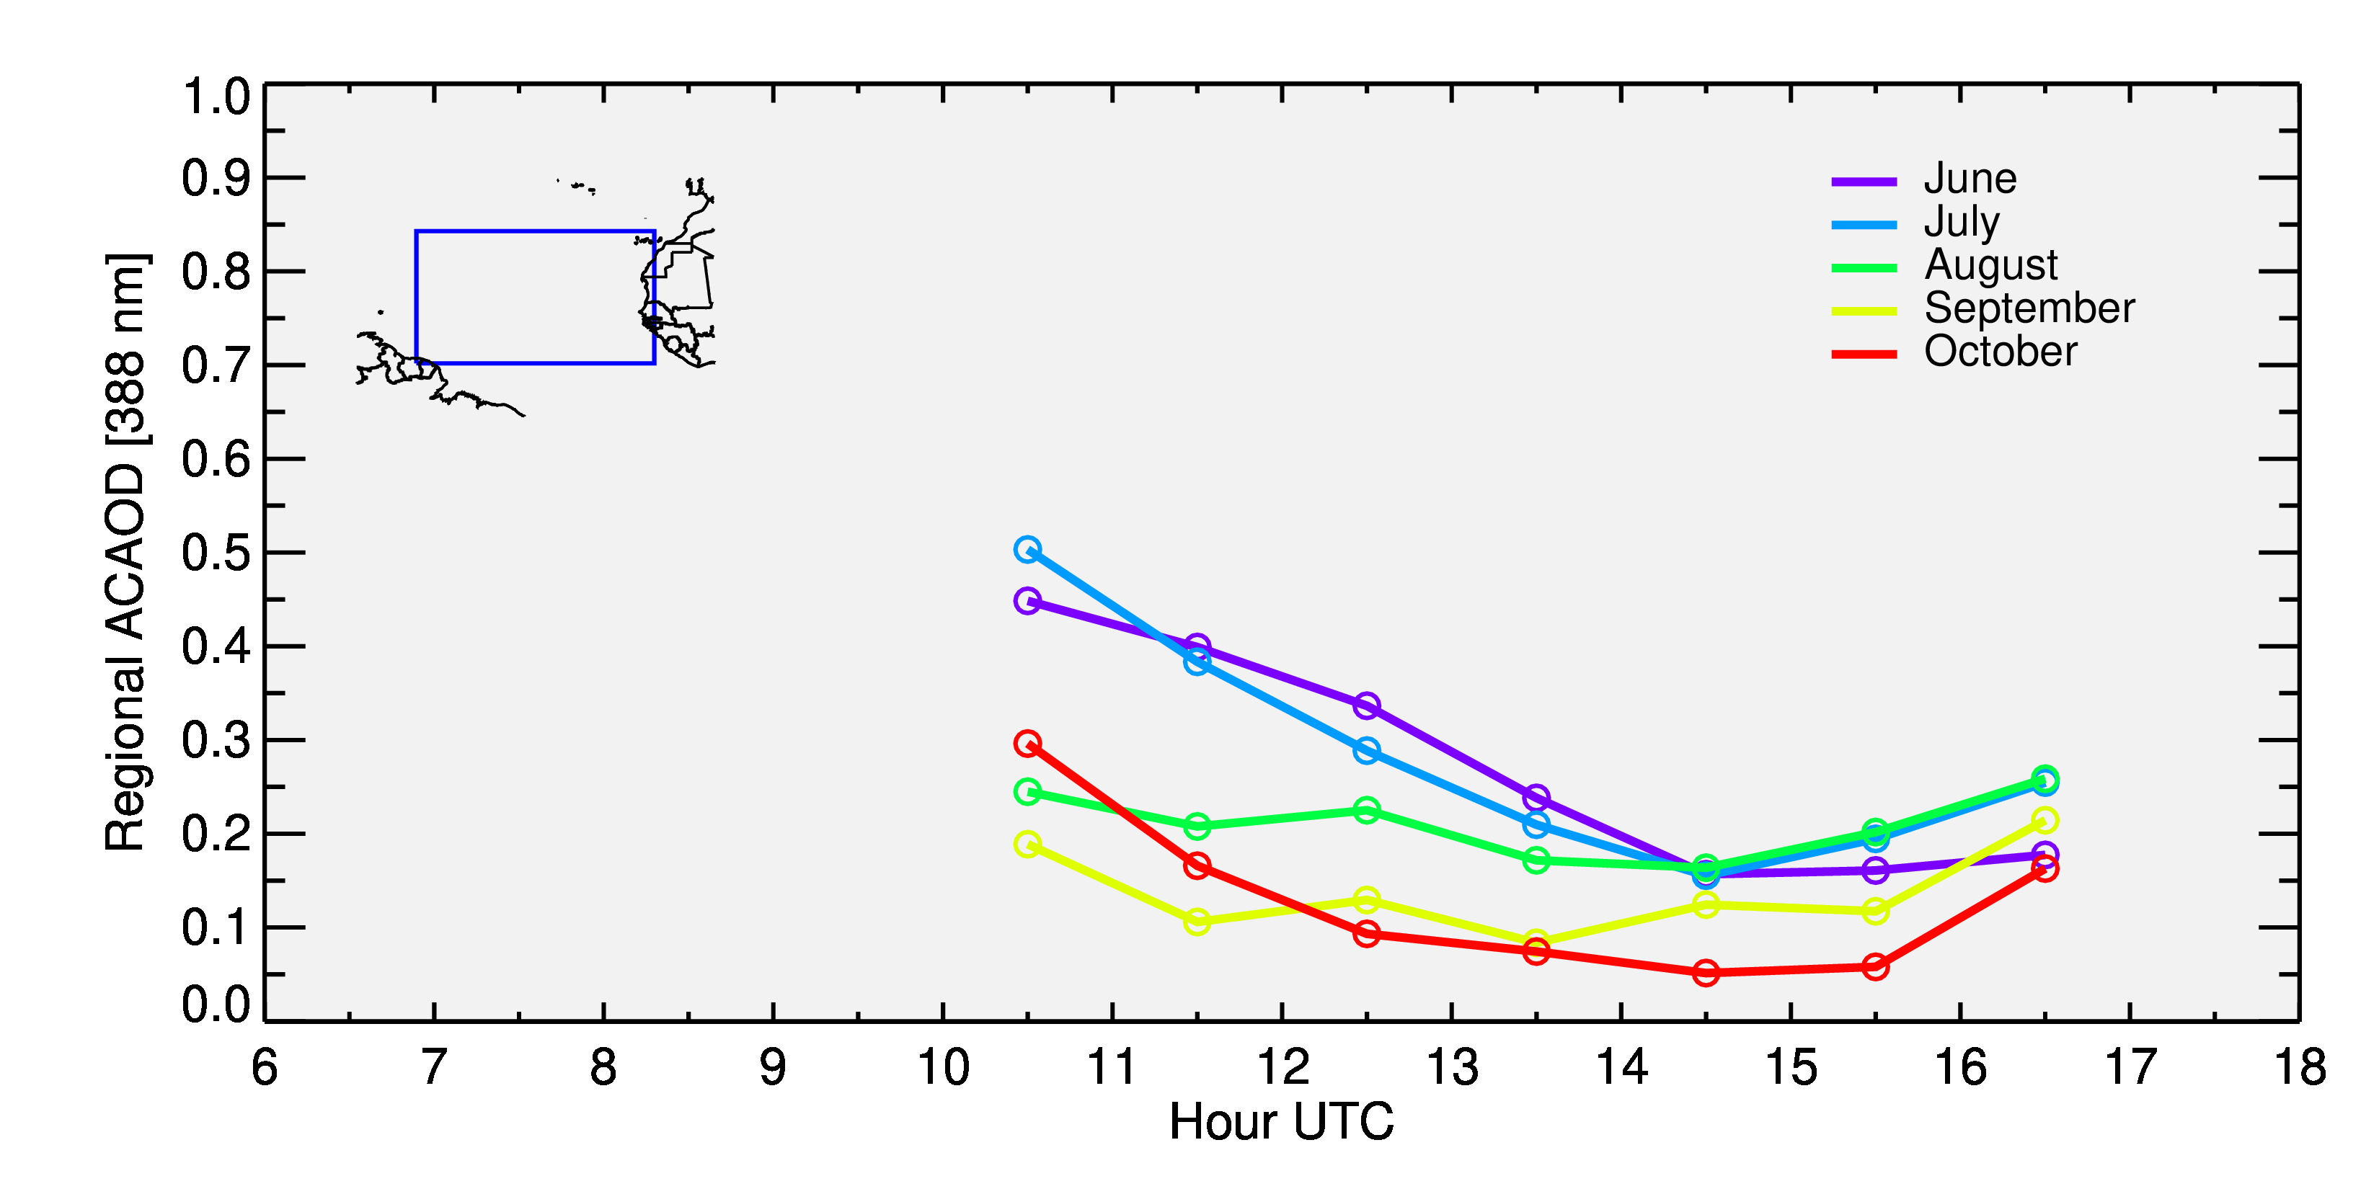
Near-hourly Evolution of Cloud Fraction and Above-cloud AOD
Tropical Atlantic Ocean—A regional hotspot of above-cloud smoke aerosols

Slide 12
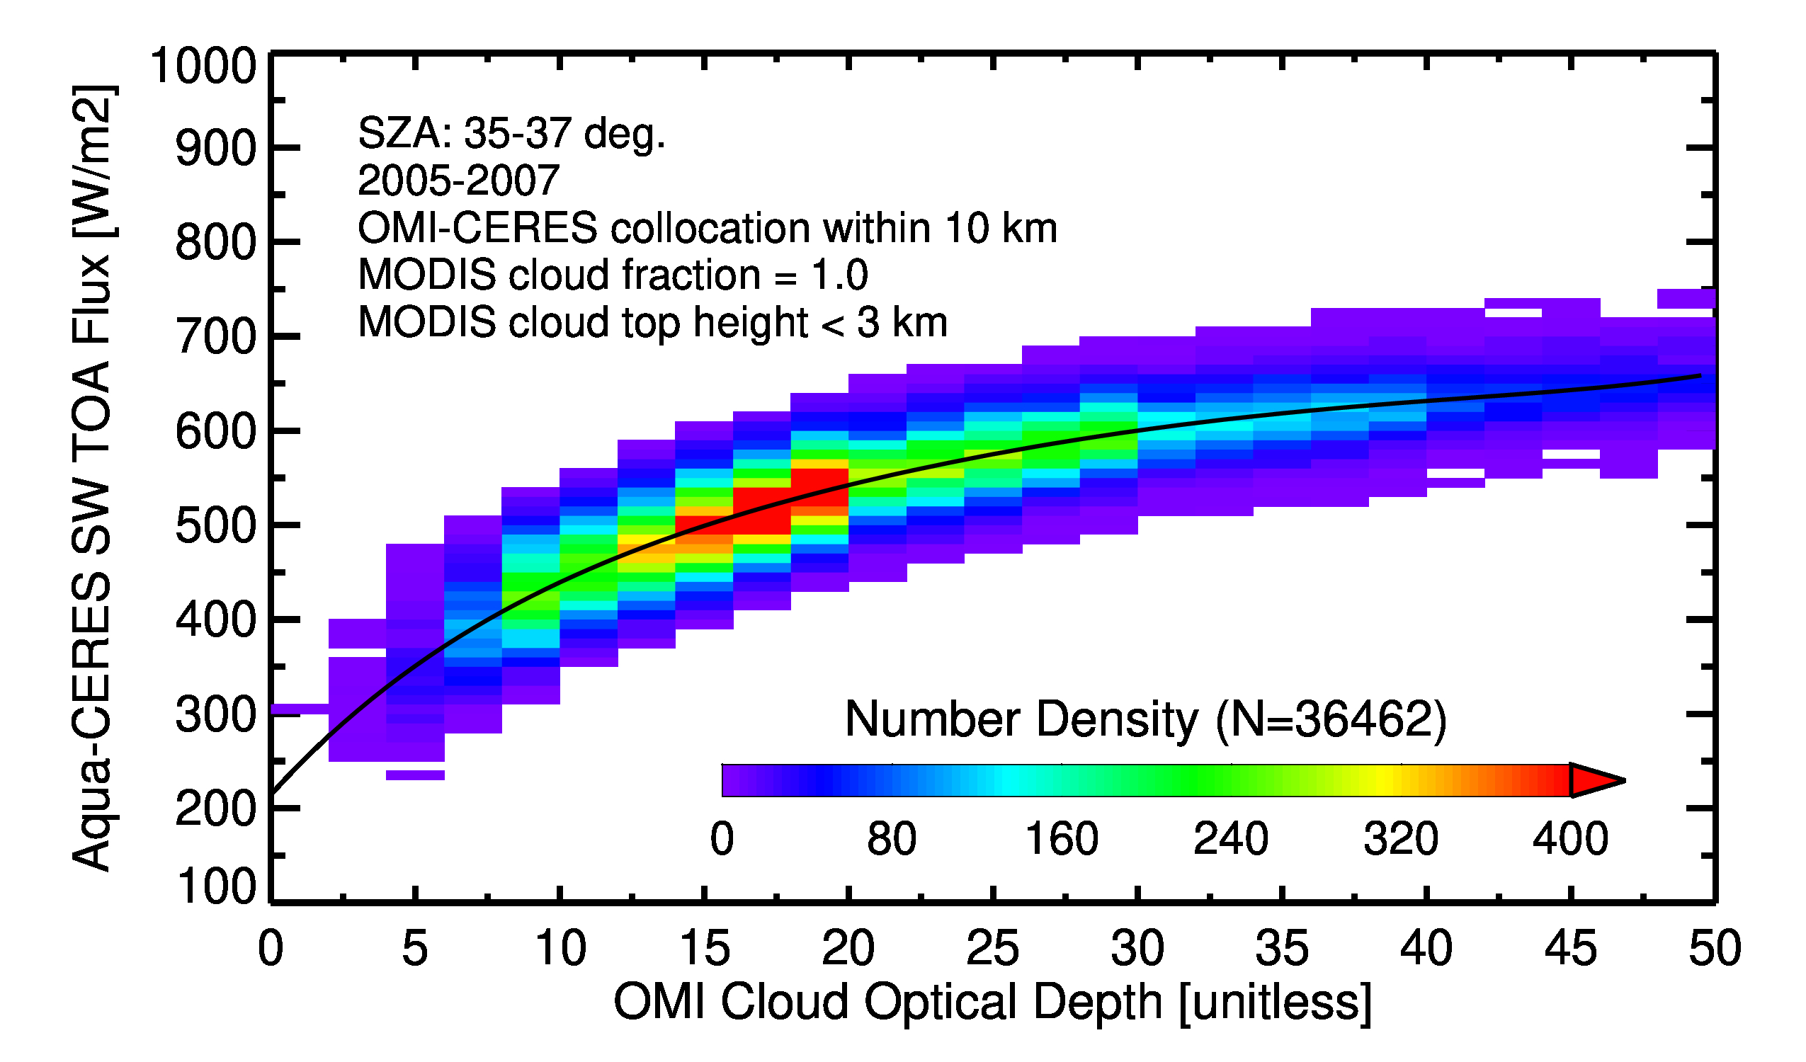
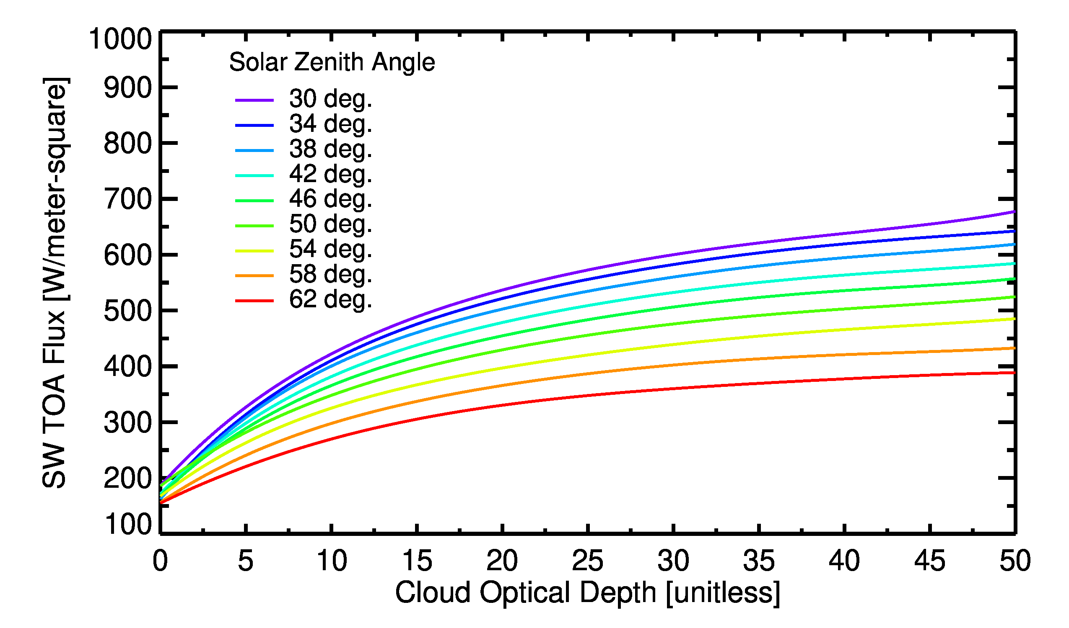
Direct Radiative Effects of Abs. Aerosols over Clouds
EPICAERUV L2 product delivers
1) Aerosol-corrected cloud optical depth (COD) 2) Apparent Cloud Optical Depth
OMI-CERES Synergy for TOA Flux vs. COD Relations

Slide 13
Direct Radiative Effects of ACA: Monthly Time-series
20-30 W/m2 during peak biomass burning season (Aug-Sep)
30-40 W/m² during peak biomass burning season (Mar-Apr)

Slide 14
Direct Radiative Effects of ACA: Monthly Time-series
10-20 W/m² during summertime dust transport season (JJA)
<10 W/m² during dust transport/Indian summer monsoon season (Jul-Aug)

Slide 15
Final Remarks
The EPIC near-UV aerosol product has been enhanced with added capabilities
O2-B band derived aerosol centroid height
Smoke and miner dust aerosol types
Use derived AH in the near-UV AOD/SSA inversion
Aerosol direct radiative effects over clouds
requires cloud optical depth with and without aerosol correction.
eliminates the need of assuming SW broadband aerosol optical-microphysical properties, thereby reducing uncertainties.
Future work
Synergy of EPIC and CALIOP (2016-2022) for retrieving above-cloud aerosol SSA
leveraging our recently completed Aura ST project of synergizing CALIOP-OMI-MODIS
Optimize ACAOD algorithm for extreme wildfire smoke events/transport

