Slide 1
An update of EPIC flat field calibration with lunar measurements
DSCOVR EPIC and NISTAR Science Meeting
Oct 16-17, 2023
Liang-Kang Huang, Alexander Cede and Jay Herman

Slide 2
EPIC flat field calibrations in v03 L1a were based on the prelaunch laboratory tests.
For the UV channels, comparisons of white field images between EPIC and SNPP OMPS NM, which were accumulated over 18 months in orbit, provided correction factors to the prelaunch calibration.
The lunar measurements for the flat field calibration were designed to determine the macroscopic changes from CCD center to edge. (While the white image comparisons delt with the microscopic changes from CCD pixel to pixel well, the atmospheric radiative transfer computation for the geometric differences in observations between EPIC and NM has significant errors at large solar/view zenith angles, which resulted in some offset from the center to edge in v03 L1.)
EPIC ran the lunar measurements in 2021 and 2022. Preliminary result for the flat field correction was reported in 2022 DSCOVR science meeting.
One more day of EPIC lunar data in July 2023 mapped out more area on CCD. That confirmed findings in the early years, provided better statistics, and enable us to derive a more detailed macroscopic sensitivity model.

Slide 3
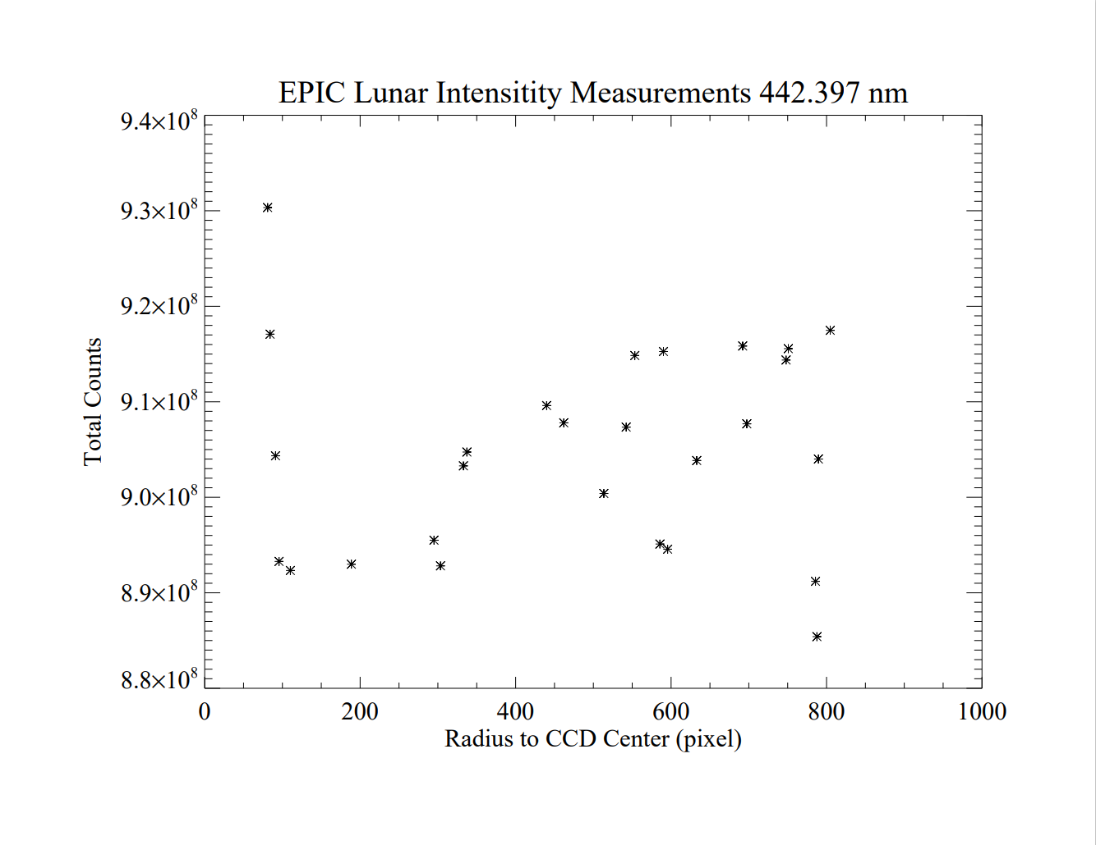
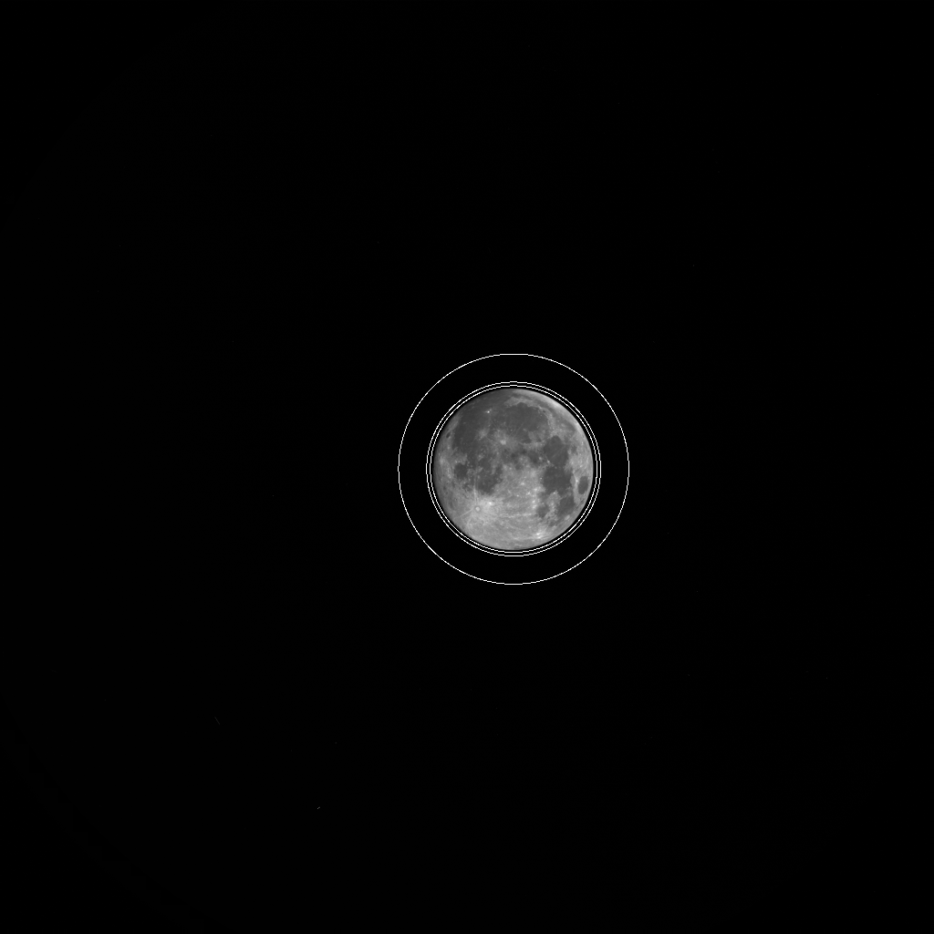
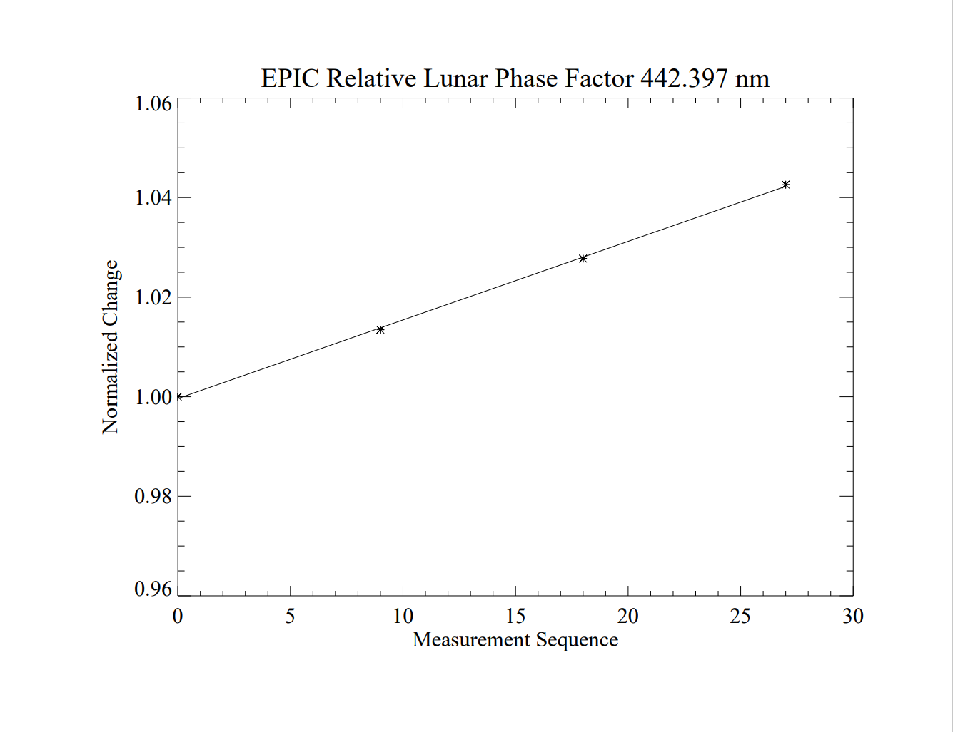
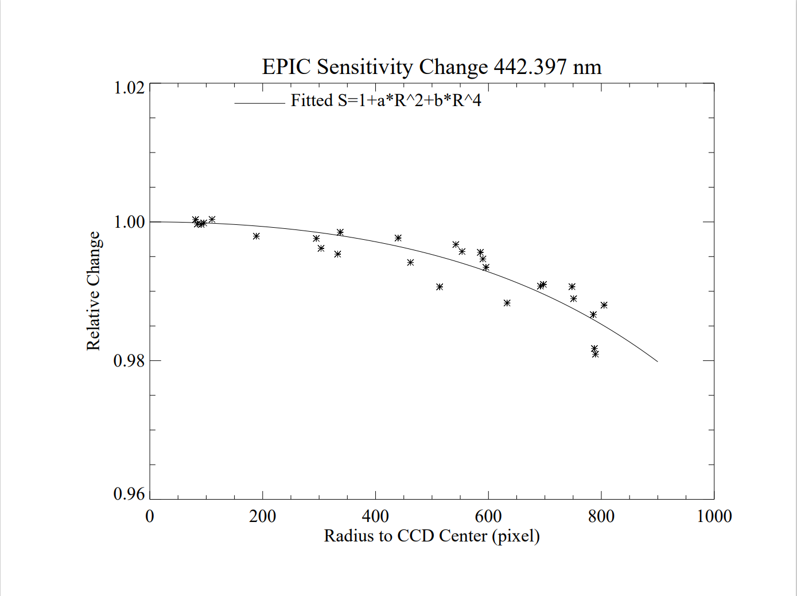
DSCOVR EPIC Lunar Measurements in 2021 & 2022
For Radial Dependence in Flat Field Calibration
Lunar phase changes
Back ground rim
Moon image centers
⋇ in 2021 ▢ in 2022
Large symbols were planned positions and small symbols were actual positions.

Slide 4
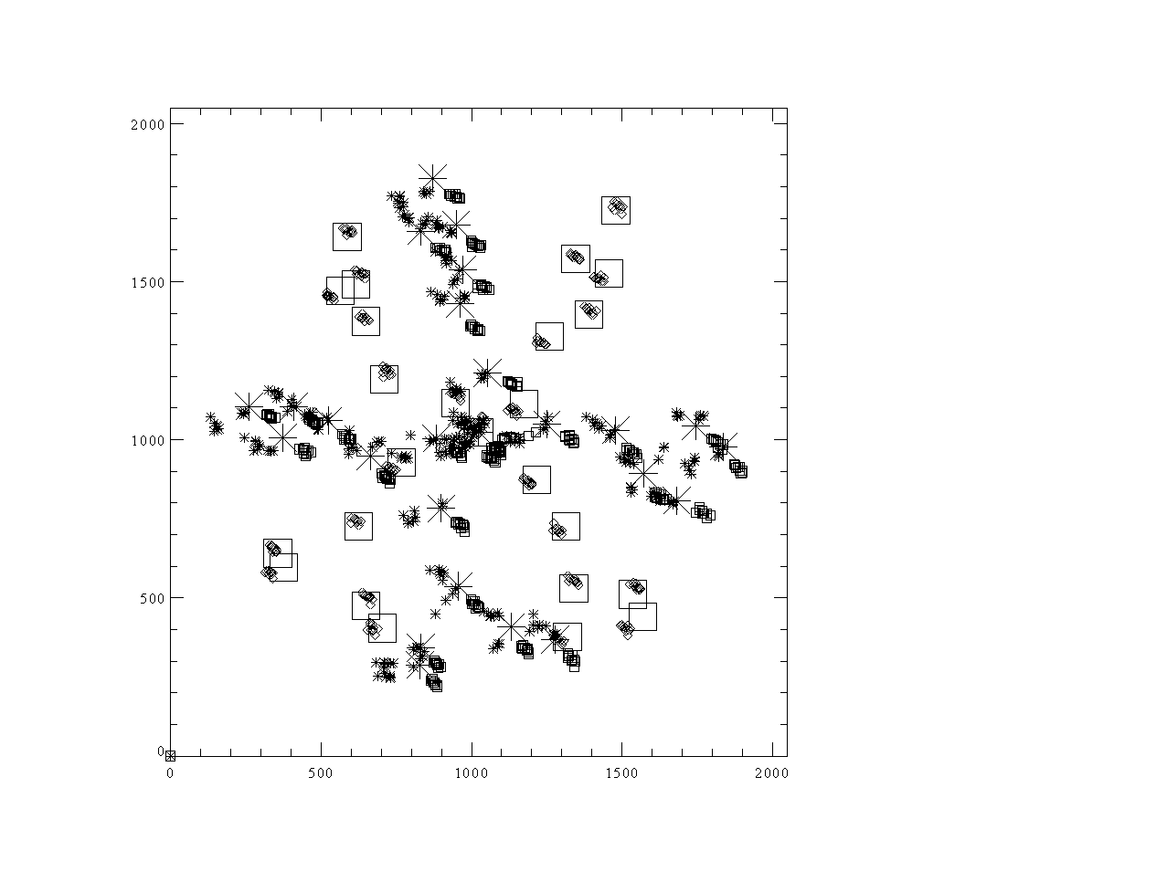
Lunar measurements in 2021 and 2022 were taken at “randomly” selected positions around x-y axes.
New measurements in 2023 were set with 45º rotation along the diagonal lines.

Slide 5
Adding One More Dimension to EPIC UV Flat Field Corrections in Lunar Measurements
F(R,ϕ)=1+c1*(R/1024)^2+c2*(R/1024)^4+b*(R/1024)*cos(ϕ+ϕ₀)
Measurements in 2021 (blue) and 2022 (red) are repeatable.
Significant separations of data points at given radius are in different quadrants.
Add a sloped plane in the fitting function for the angular dependence.
The new flat field correction can be applied to the UV channel sensitivity time dependence calibration in the coincidence comparison with SNPP OMPS NM.

Slide 6
Significant ~6 month cycles in the coincidence comparison are reduced with the lunar F(R,ϕ)
Before applying 1/F(R,ϕ) to EPIC Image
After applying 1/F(R,ϕ) to EPIC Image

Slide 7
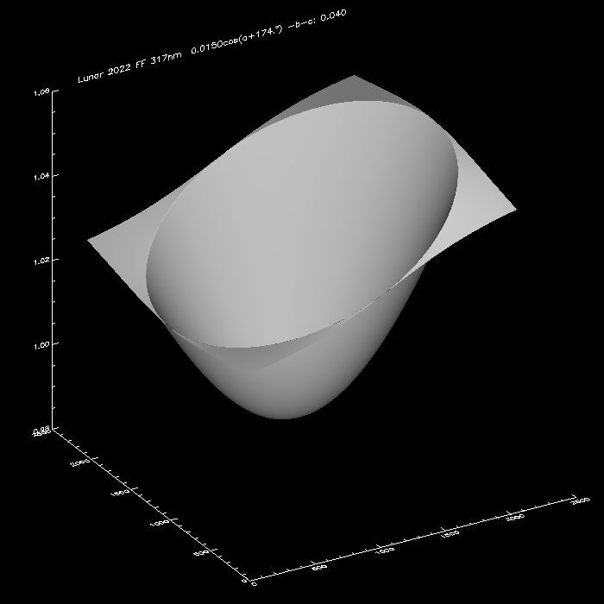
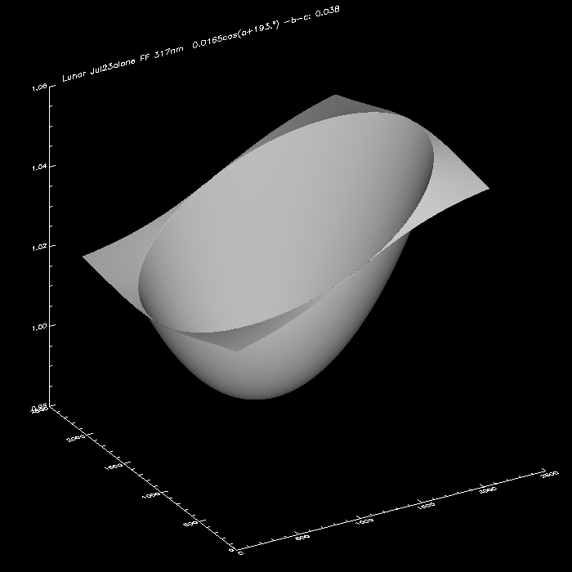
Fitted F(R,ϕ) with July 2023 data alone can replicate the results from 2021 & 2022 in Channels 317-551 nm
2021 & 2022
2023

Slide 8
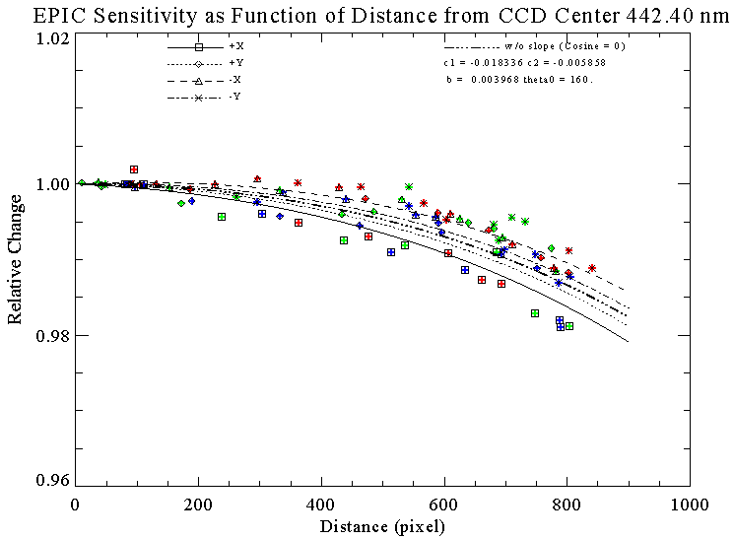
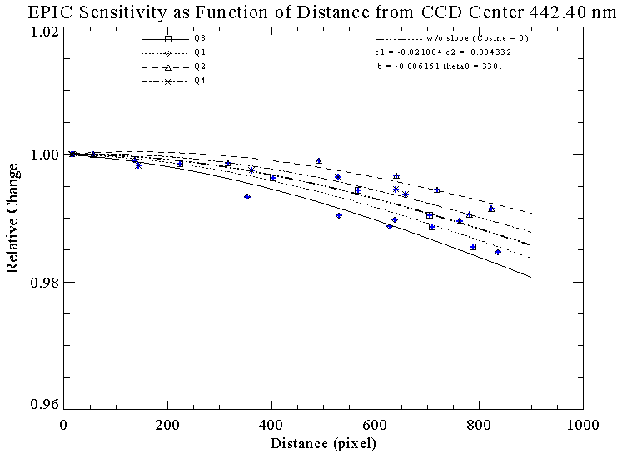
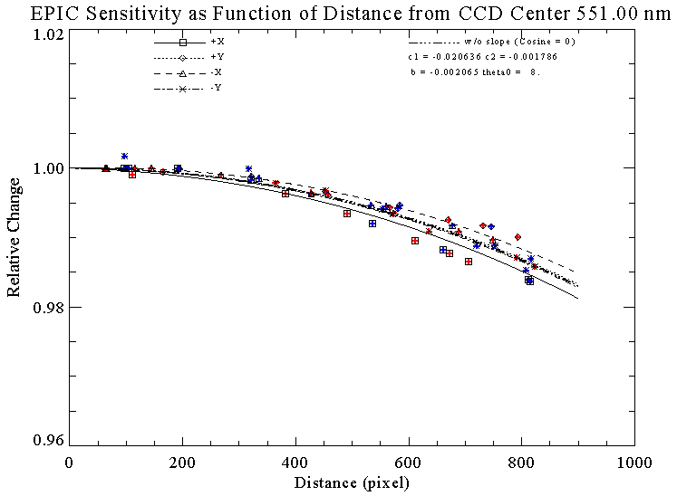
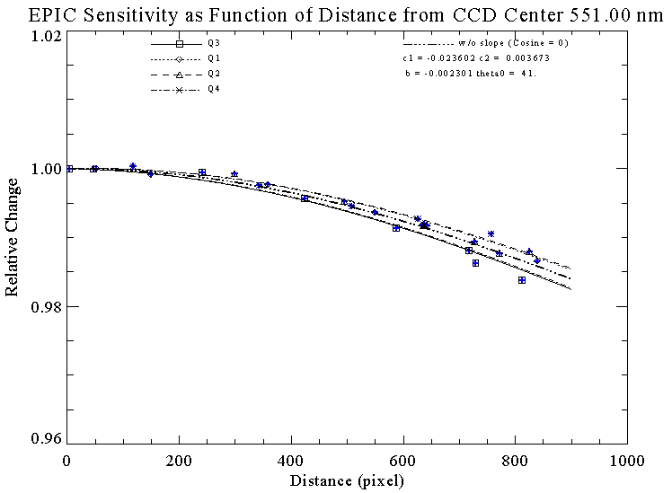
Fitted F(R,ϕ) with July 2023 data alone can replicate the results from 2021 & 2022 in Channels 317-551 nm.
2021 & 2022
2023

Slide 9
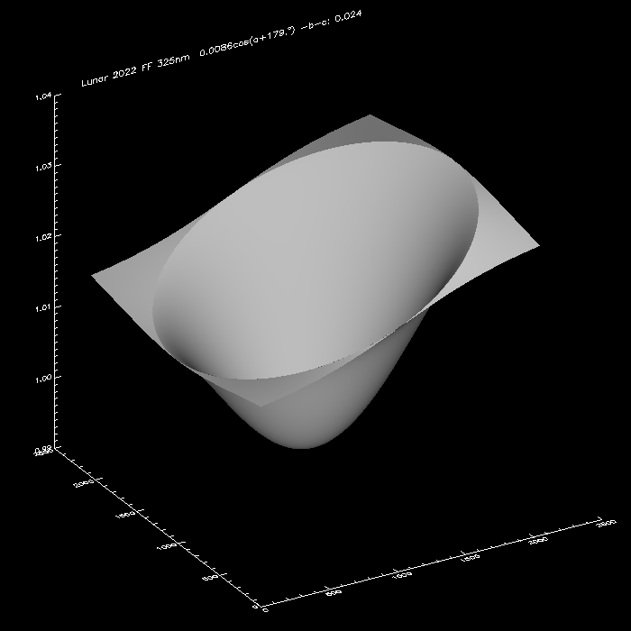
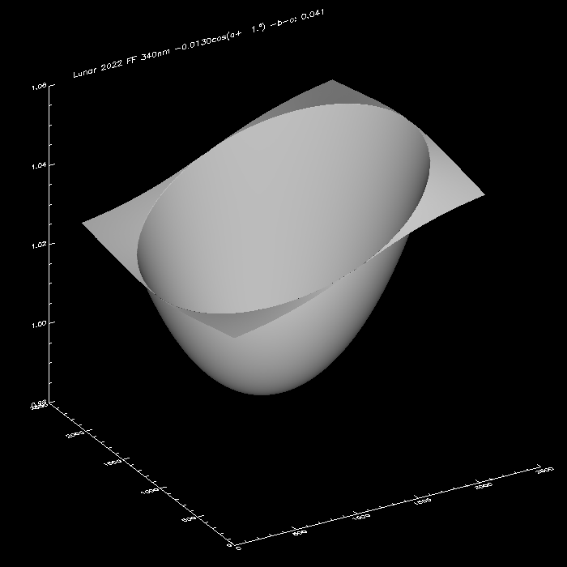
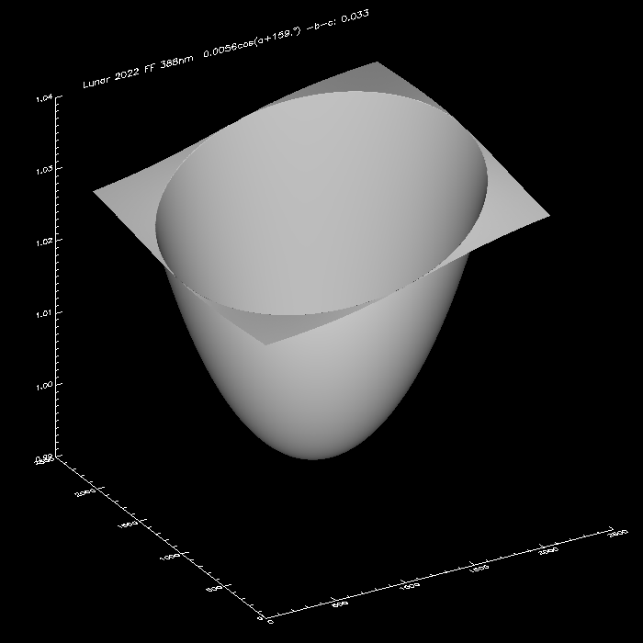
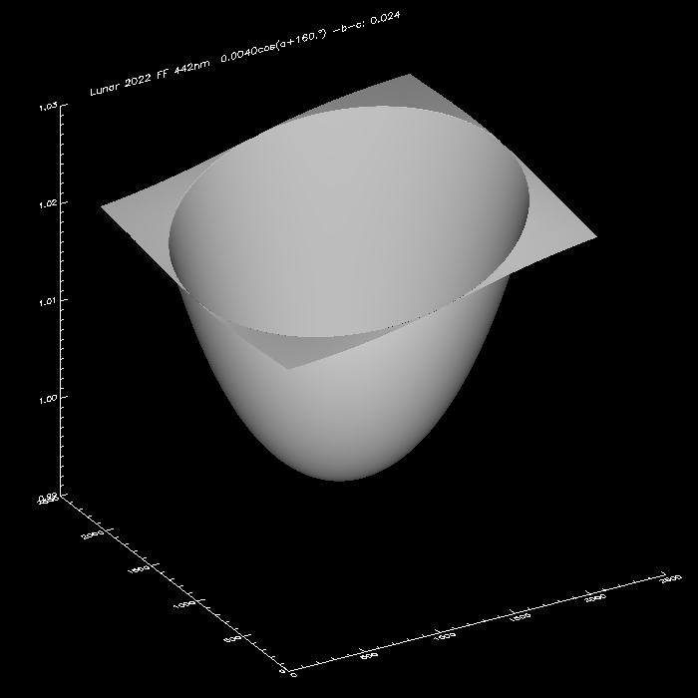
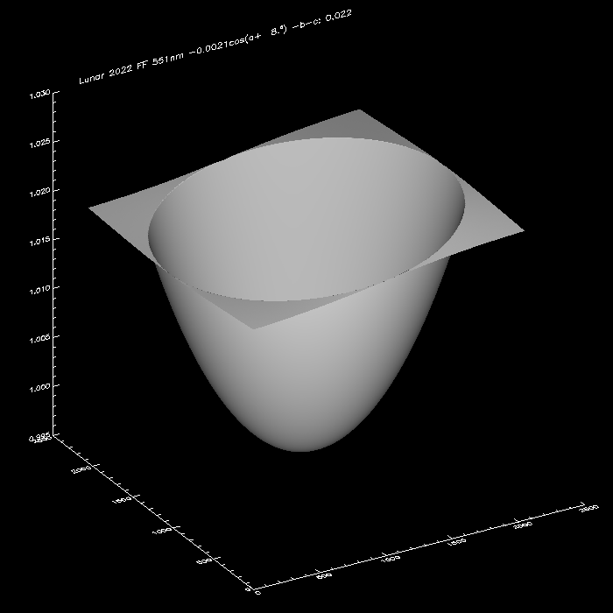
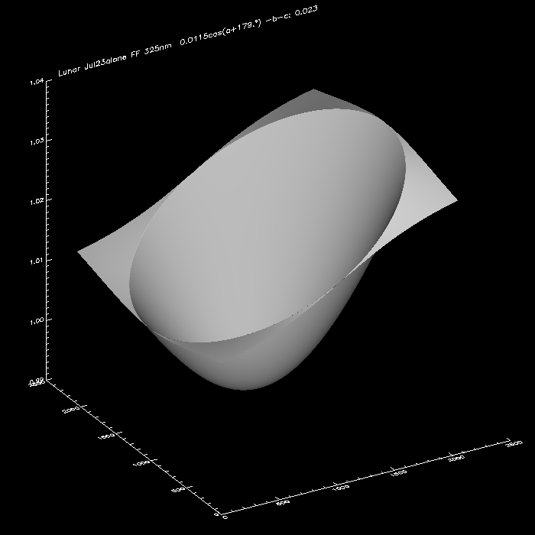
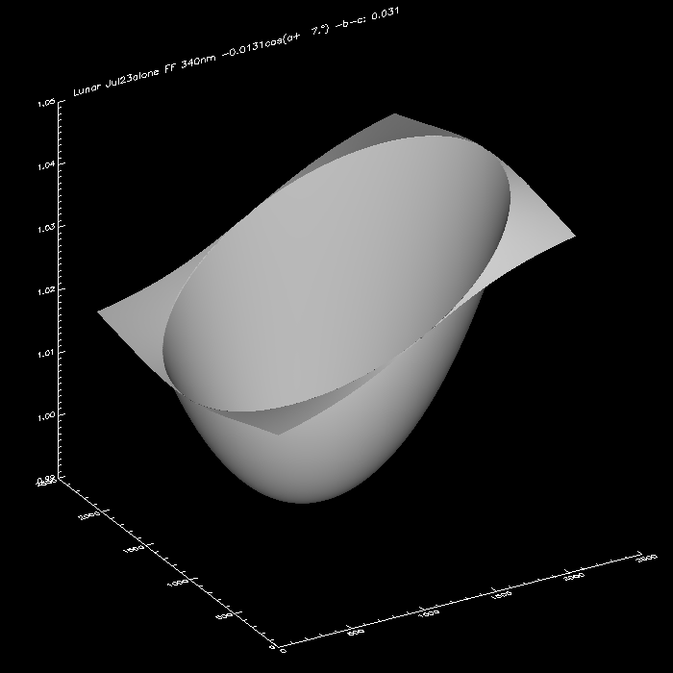
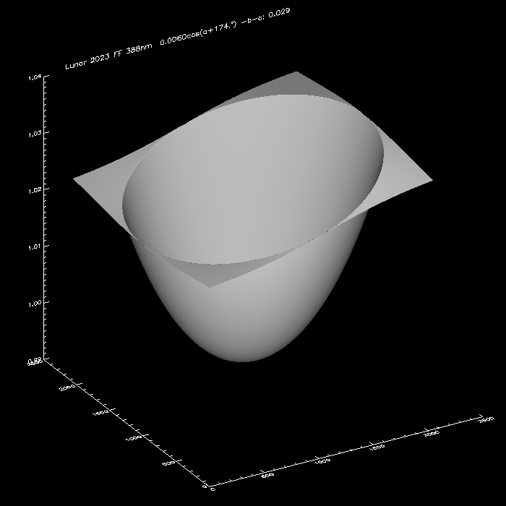
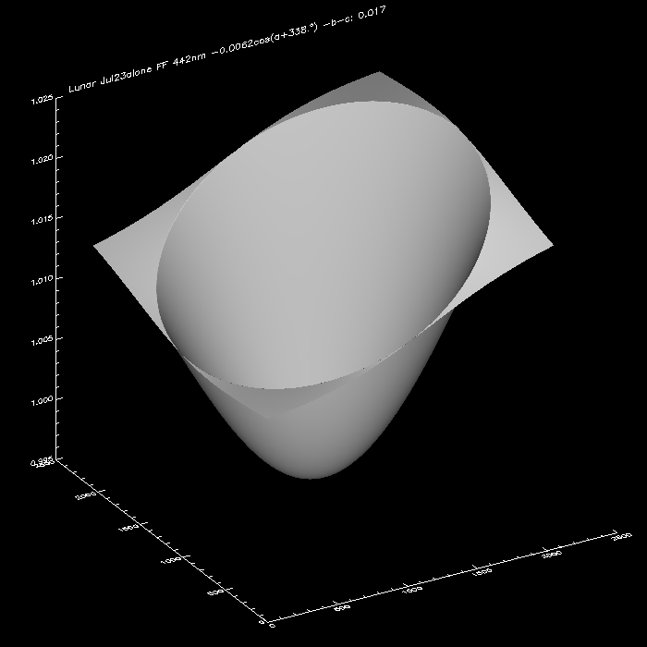
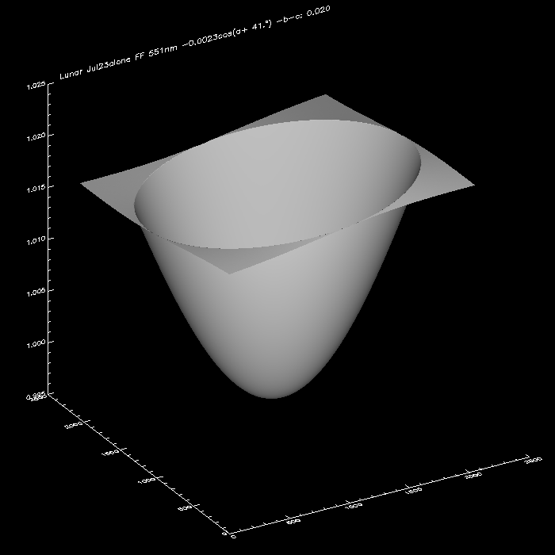
Consistency in Channels 317-551 nm are found between Early and 2023 data sets
Fitted F(R,ϕ) From 2021 & 2022 Lunar Data
317 nm 0.02/div
325 nm 0.01/div
340 nm 0.02/div
388 nm 0.01/div
442 nm 0.01/div
551 nm 0.005/div
Fitted F(R,ϕ) From July 2023 Lunar Data
317 nm 0.02/div
325 nm 0.01/div
340 nm 0.01/div
388 nm 0.01/div
442 nm 0.005/div
551 nm 0.005/div

Slide 10
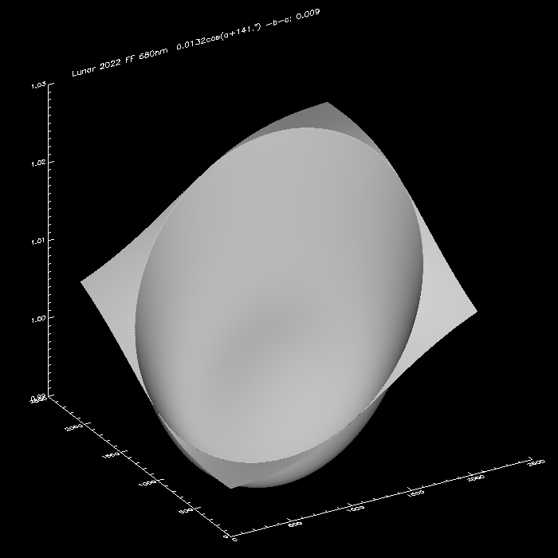
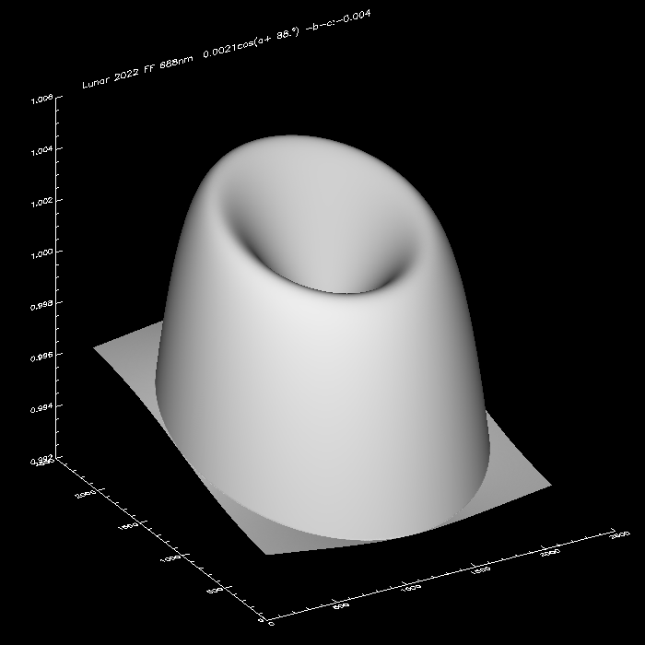
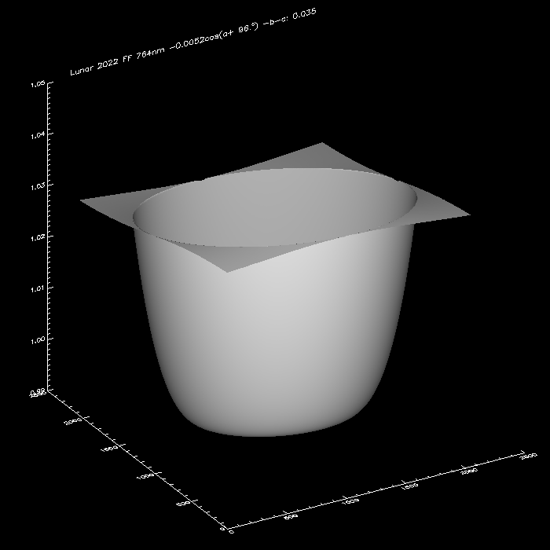
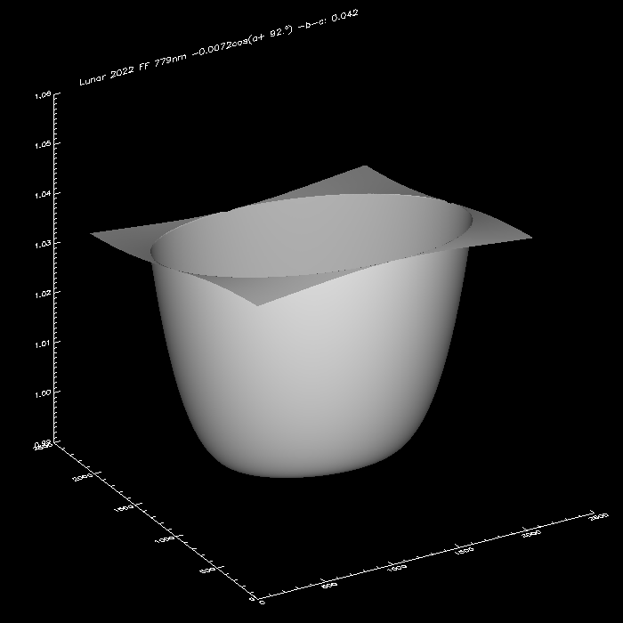
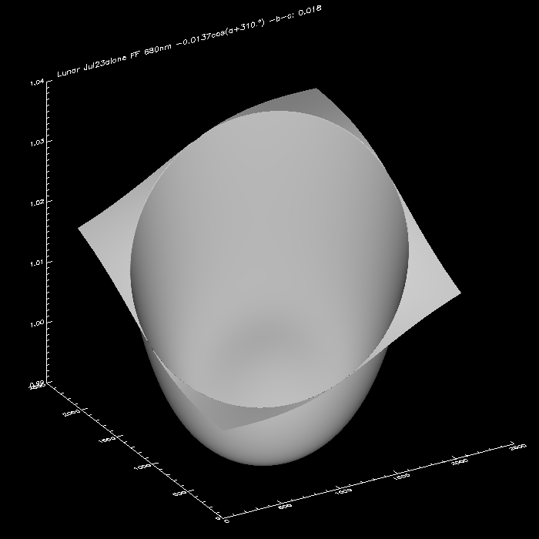
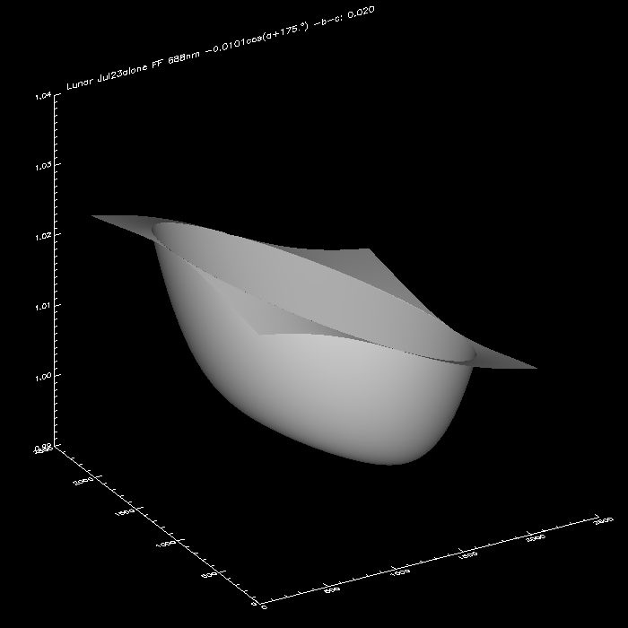
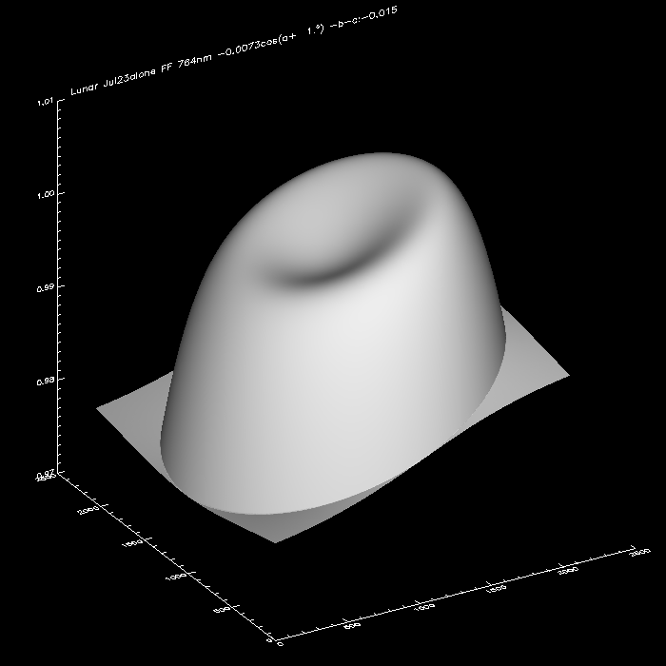
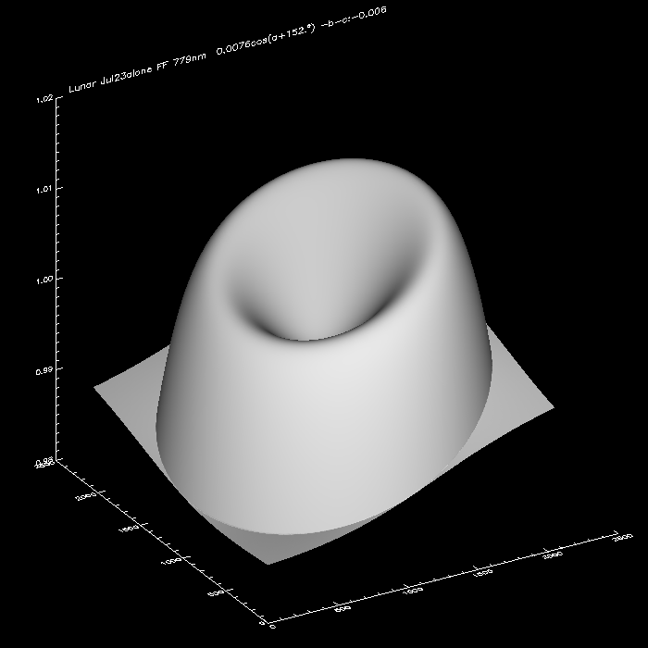
Fitted F(R,ϕ) From 2021 & 2022 Lunar Data
Four long wavelength channels show more complexities. Sensitivity distributions near the x-y axes are significantly different from that along the diagonal lines. Therefore, the given F(R,ϕ) function is too simple for the flat field macroscopic structures. More data and further investigations are needed. No lunar data based flat field corrections are recommended for Channels 680-779 nm at this moment.
680 nm 0.01/dev
688 nm 0.002/dev
764 nm 0.01/dev
779 nm 0.01/dev
Fitted F(R,ϕ) From 2021 & 2022 Lunar Data
680 nm 0.01/dev
688 nm 0.01/dev
764 nm 0.01/dev
779 nm 0.01/dev

Slide 11
All lunar measurements from 2021 to 2023 are fitted together with F(R,ϕ) functions. Six short wavelength (371-551 nm) images should be corrected with 1/F(R,ϕ) for the macroscopic nonuniformity on the top of the flat field corrections in the current v03 L1a processing.
Other four long wavelength (680-779 nm) channels need more investigations. No new corrections for the flat field are recommended at this moment.
F(R,ϕ)=1+c1*(R/1024)^2+c2*(R/1024)^4+b*(R/1024)*cos(ϕ+ϕ₀)
Wavelength (nm) | C1 | C2 | b | ϕ₀
317.478 | -0.04387 | 0.007452 | -0.01538 | 4
325.035 | -0.03647 | 0.01432 | 0.009869 | 180
339.858 | -0.03263 | -0.00205 | 0.013431 | 186
387.923 | -0.02522 | -0.00408 | 0.005952 | 174
442.397 | -0.02163 | 0.000139 | 0.004777 | 163
551 | -0.02189 | 0.000648 | -0.00212 | 24

Slide 12
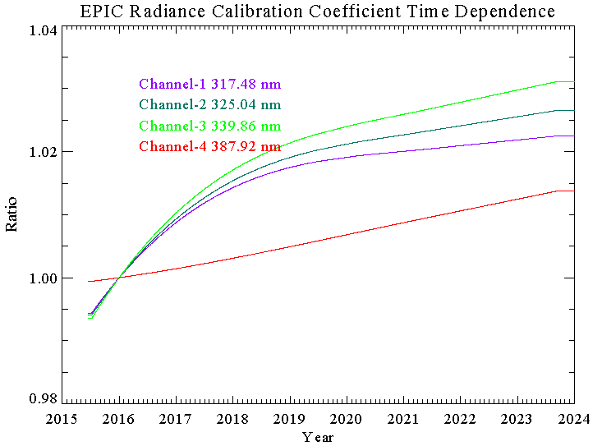
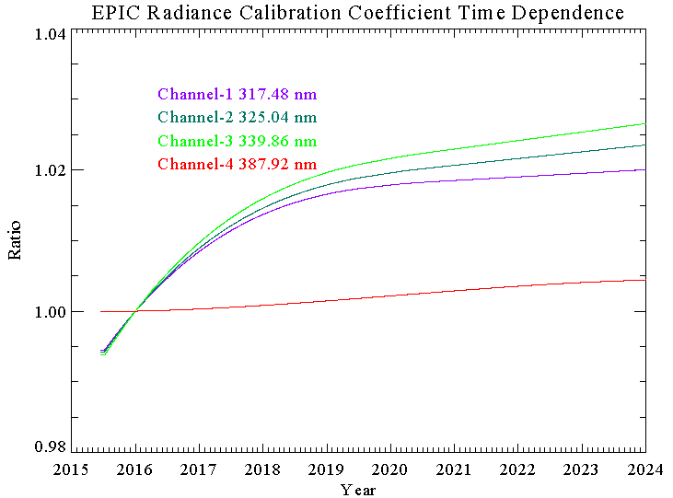
EPIC UV Channel Sensitivity Drifts Have Been Updated Using Coincidence Comparisons with SNPP OMPS NM.
EPIC’s lunar-data-based macroscopic flat field correction is included, which reduces ~6-month oscillations (pg 6).
NM sensor sensitivity drifts, which are not corrected in NMEV_L1B, were estimated from NM’s solar irradiance measurements with both working and reference diffusers. The NM sensitivity drifts are corrected in the coincidence comparison.
NM sensor drifts were not corrected
After applying NM sensor drift corrections

Slide 13
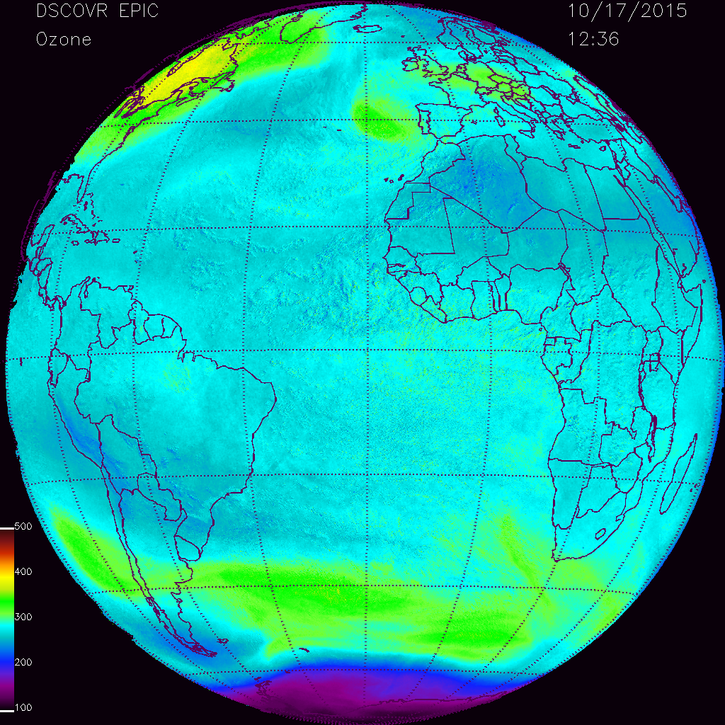
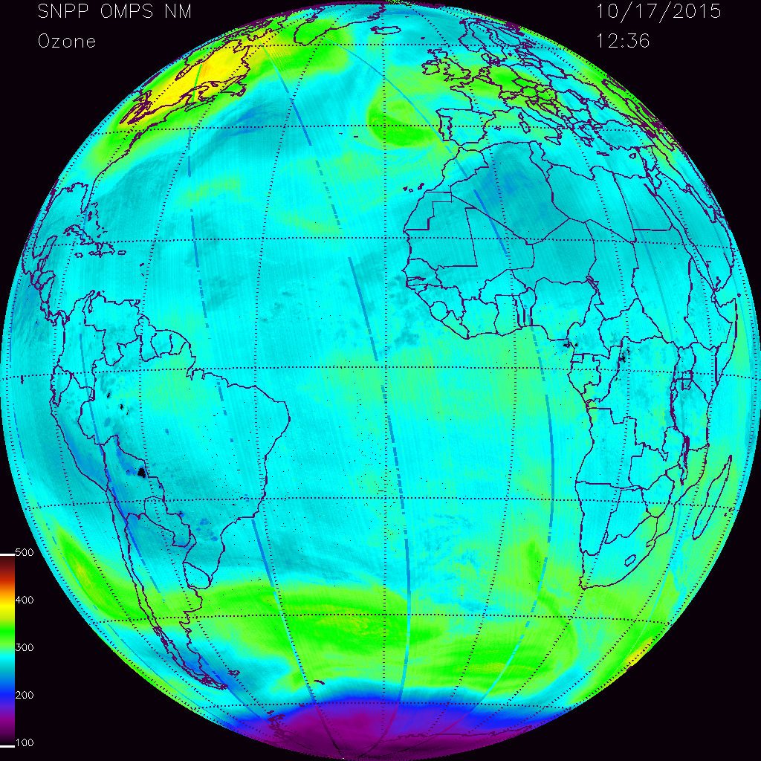
EPIC TO3 image on 10/17/205 in the latest testing.
Assembled SNPP OMPS NM V8 TO3 on 10/17/2015

