Slide 1
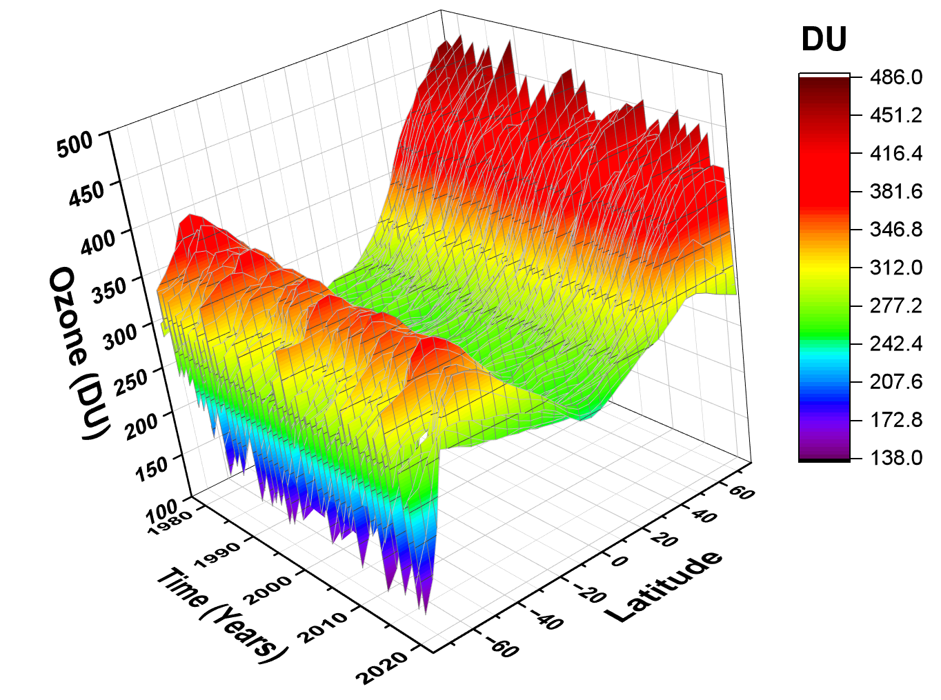
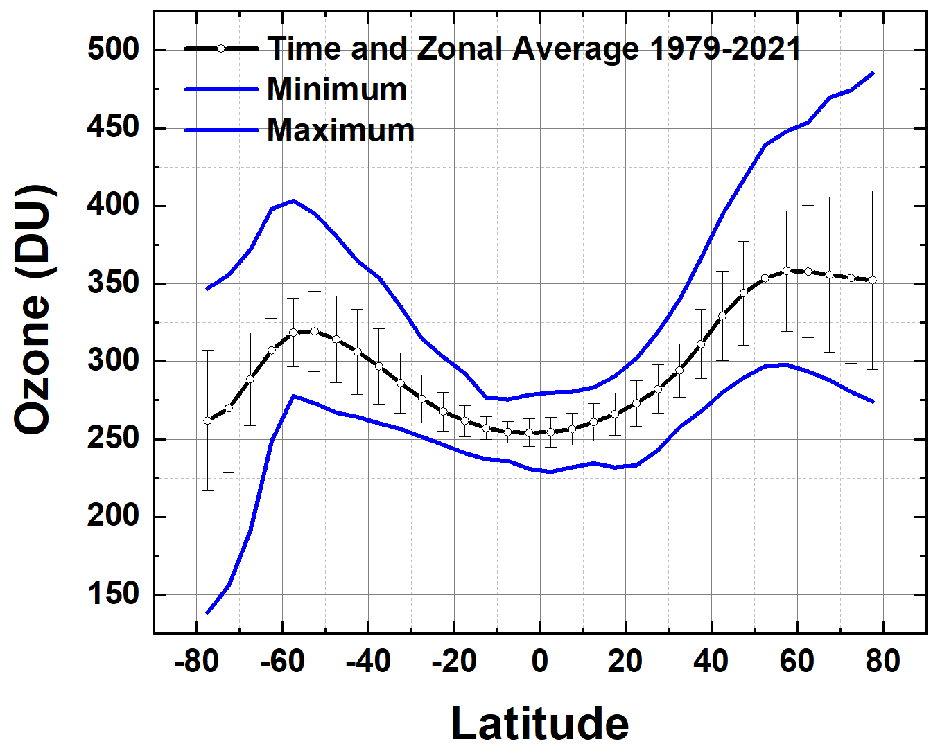
EPIC Ozone and Trends from SBUV + OMPS-NM
1979 - 2021
Jay Herman, Jerald Ziemke, and Richard McPeters

Slide 2
EPIC Ozone and Trends from SBUV + OMPS-NM
This talk is divided in two parts
EPIC compared to OMPS showing good agreement for moderate SZA
Long-Term O₃ Time Series (MOD) 1978 - 2021
Trends and Latitude Dependent Ozone Turn- Around Dates T_{A}(θ) 1994 – 1998
Global Models do not show this effect

Slide 3
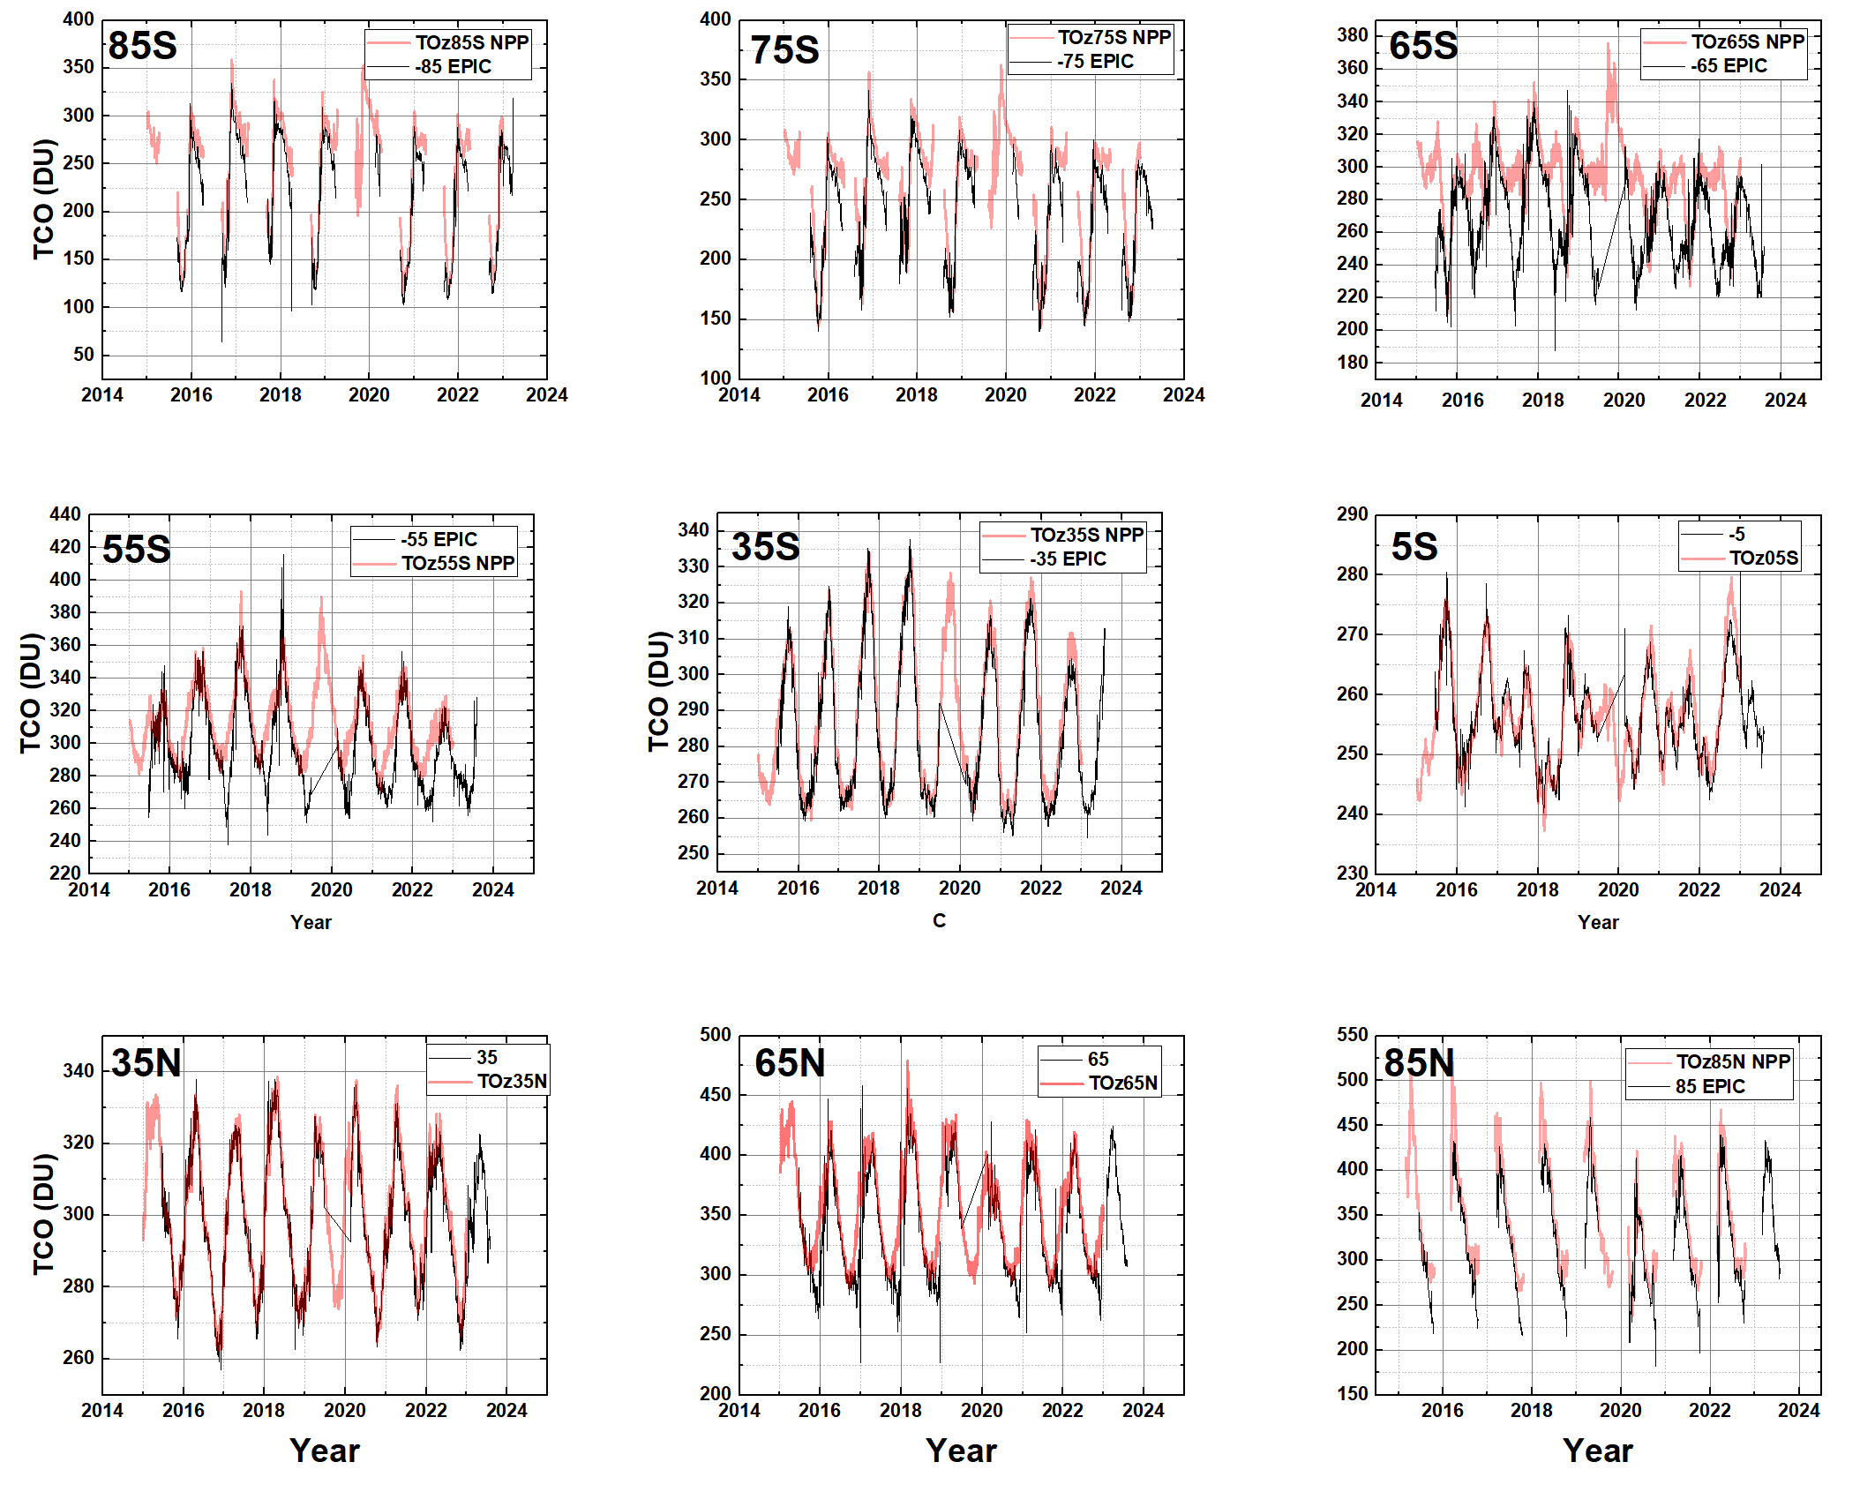
EPIC vs OMPS-NM
Summer values are good
65^{O}S shows a zenith angle problem with EPIC and OMPS

Slide 4
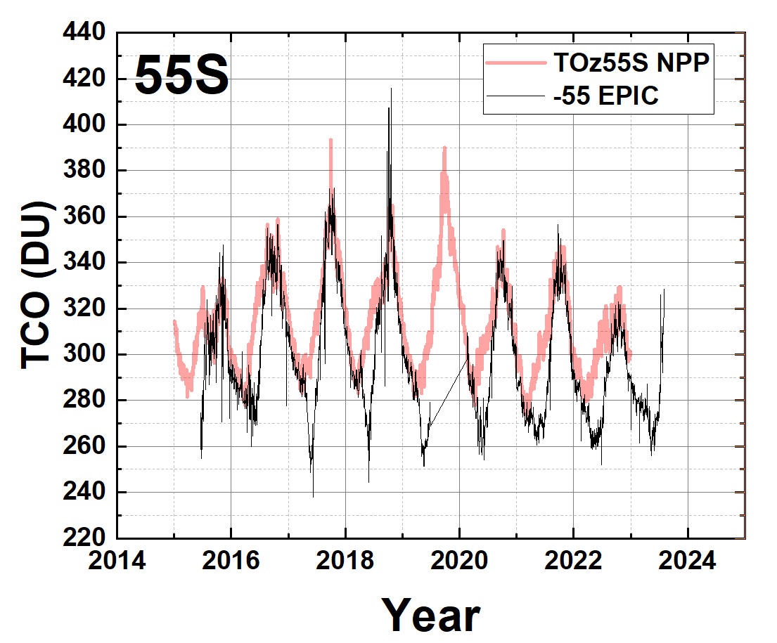
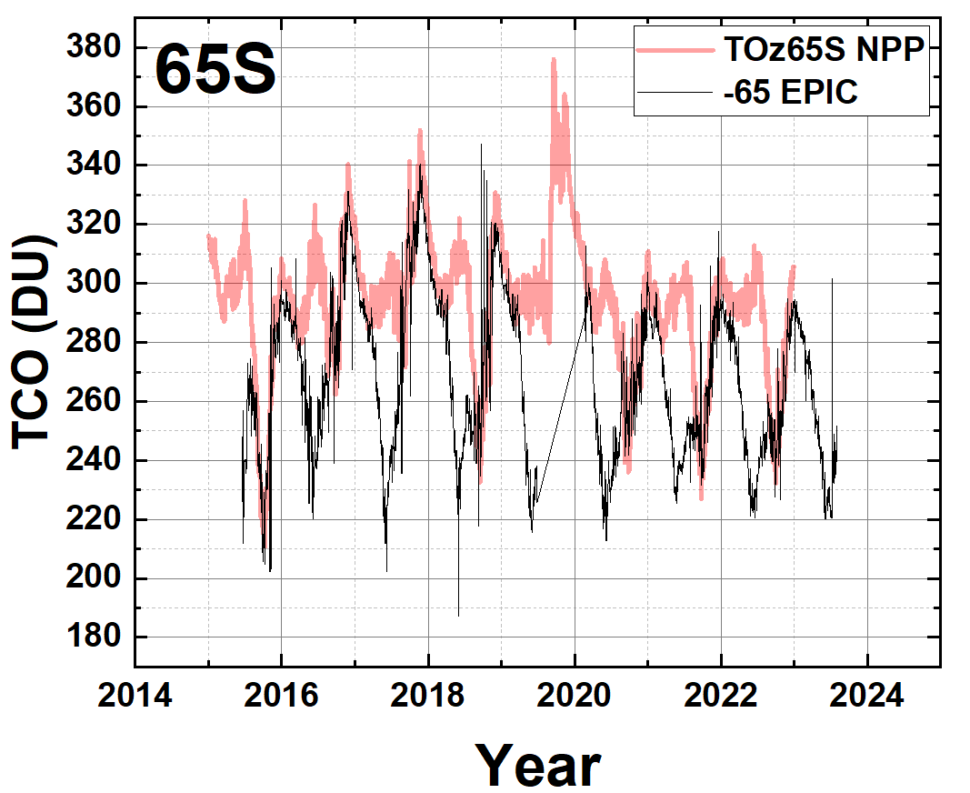
Solar Zenith Angle Problem at 65S
Spherical Geometry Radiative Transfer is Needed

Slide 5
EPIC Ozone
EPIC ozone agrees well with OMPS-NPP except where there are sampling problems near the Arctic and Antarctic circles
Summer values agree everywhere
The EPIC data record is not long enough for trend estimation but agrees with OMPS for 2016 – 2022. The missing 2019 data is a problem for trend estimation.

Slide 6
Trends and Turnaround dates from the MOD ozone data set
1978 - 2021
MOD consists of a merged ozone data set from
Nimbus 7 SBUV (1978 – 1990)
NOAA-9 SBUV-2 NOAA-17 SBUV-2
NOAA-11 SBUV-2 NOAA-18 SBUV-2
NOAA-14 SBUV-2 NOAA-19 SBUV-1
NOAA-16 SBUV-2
Suomi NPP OMPS (2012 – 2023)
https://acd-ext.gsfc.nasa.gov/Data_services/merged/

Slide 7
Multivariate Linear Regression Equations
Linear trend estimates for the long-term changes in Ω_{MOD}(t, θ_{i}) globally and as a function of latitude θ_{i} have been obtained using the multivariate linear regression (MLR) model. Trends B(θ_{i}) were determined for Ω_{MOD}(t, θ_{i}) using
Ω_{MOD}(t, θ_{i}) = A(θ_{I} t) + B(θ_{I},t)∙t + C(θ_{I},t)∙QBO₁(t) + D(θ_{I},t)∙QBO₂(t) + E(θ_{I},t)∙ENSO(t) + F(θ_{I},t)∙Solar(t) + R(t, θ_{I})
Statistical uncertainties for the trend variables A(t) and B(θ_{i}) were derived from the calculated statistical covariance matrix involving the variances and cross-covariances of the constants

Slide 8
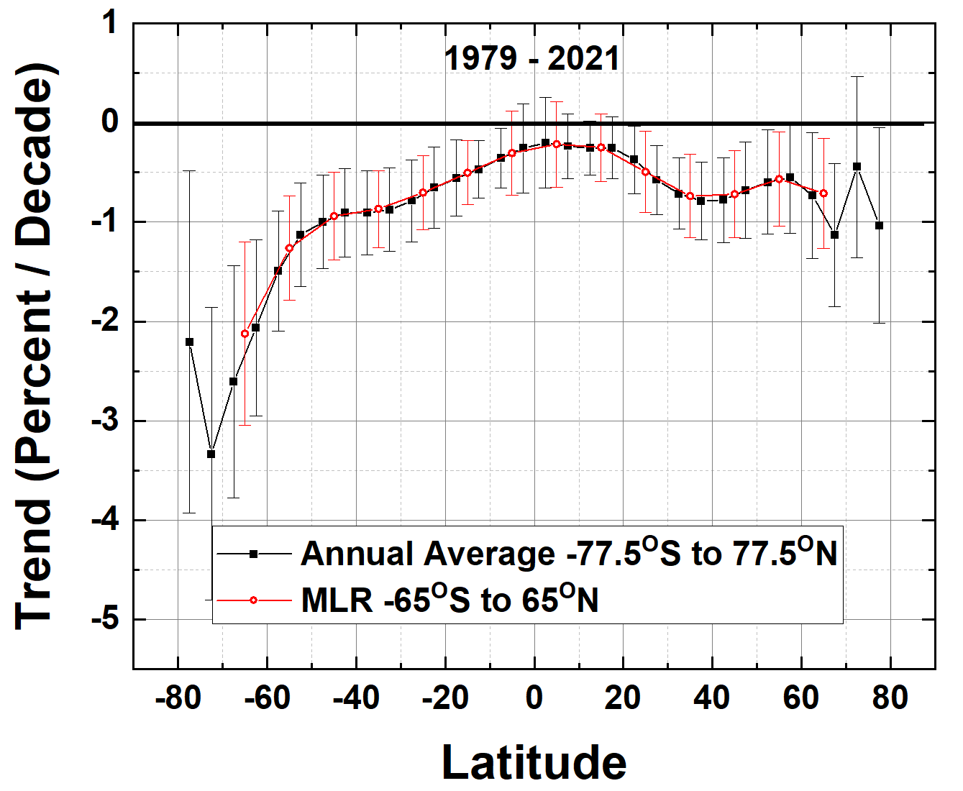
Long-term trends can be calculated from deseasonalized data, either from the MLR method or from simply forming annual averages. The two methods agree closely
Estimation of linear long-term trends since 1979 is misleading, since ozone showed significant annual declines until the mid-1990s and then increased slightly thereafter, meaning the average long-term time series is non-linear. Therefore, this trend estimate is misleading

Slide 9
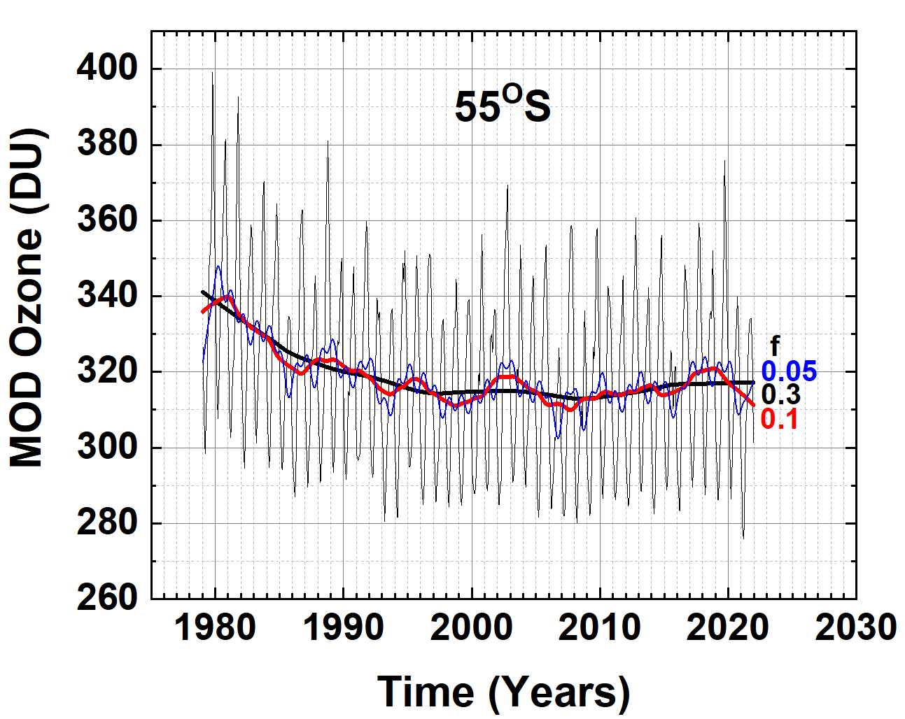
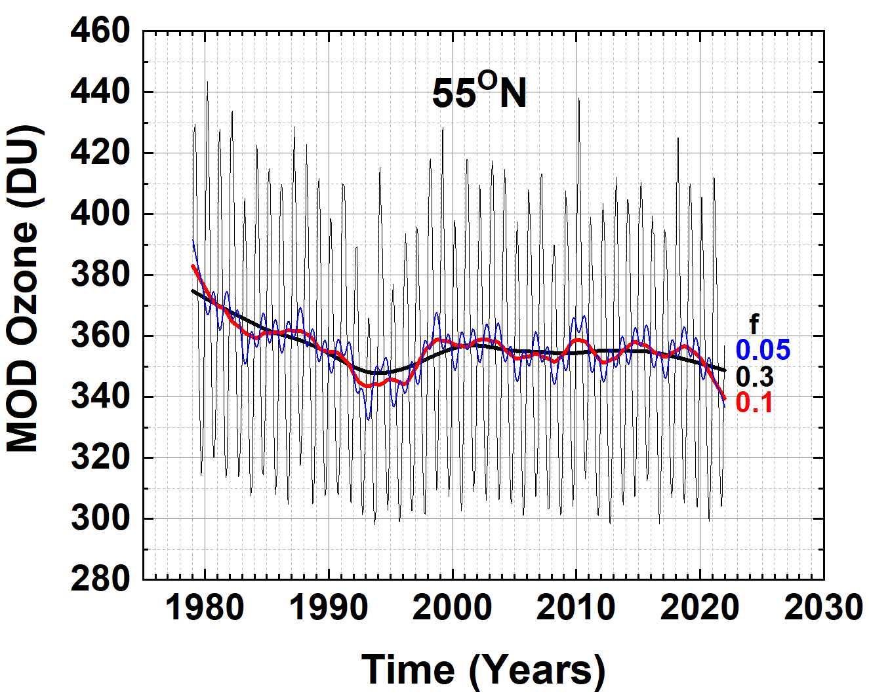
Non-Linear behavior of the Ozone time series
Ω_{MOD} in two latitude bands and Lowess(0.3) fitting functions (f = 0.3, black lines). Examples of different f = 0.1 (Red) and 0.05 (blue dots) are shown. Note the slight downturn since 2010 in the Lowess(0.3) at 55^{O}N.

Slide 10
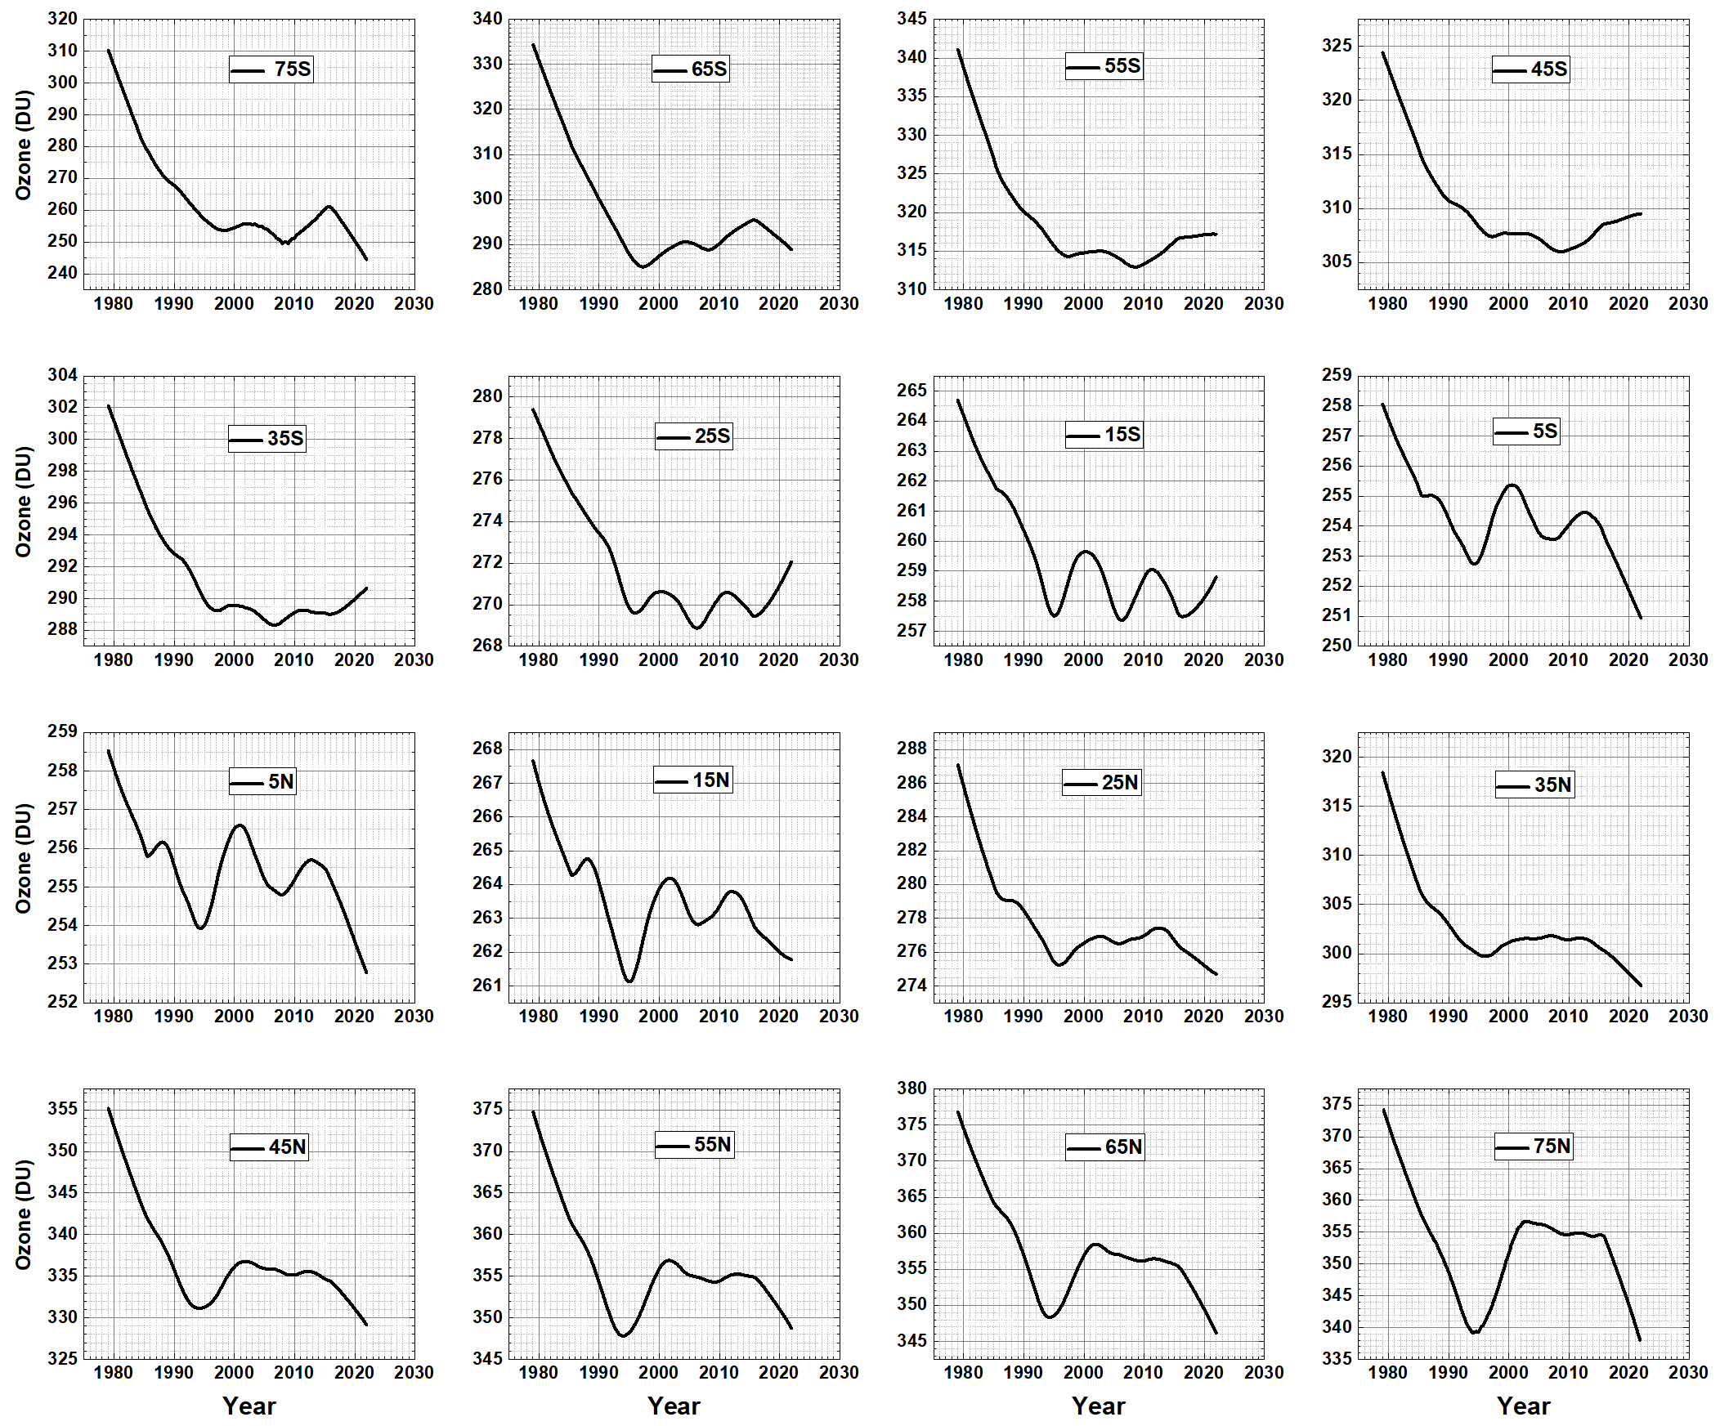
Expanded Scale
T_{A} is from 1st derivative
Lowess(0.3) fits to the Ω_{MOD} data for 16 latitude bands used to determine T_{A}(θ). Note that the ozone scale varies for each latitude.

Slide 11
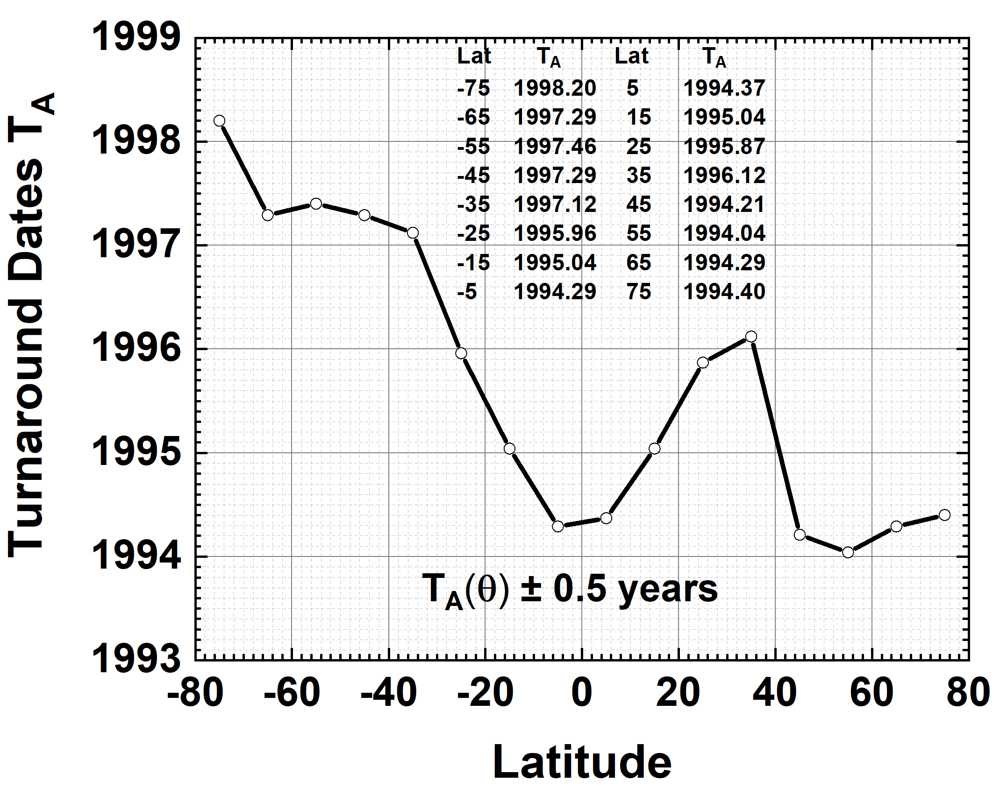
A test for atmospheric models
The general T_{A}(θ) pattern shown in Fig. 7 should appear in model calculations as a signature of the combined effects of photochemistry, dynamics, and volcanic eruptions on the cessation of decreasing ozone in the mid-1990s.
However, models do not show this behavior suggesting that the dynamics and chemistry are incomplete
Turnaround dates T_{A}(θ) as a function of latitude

Slide 12
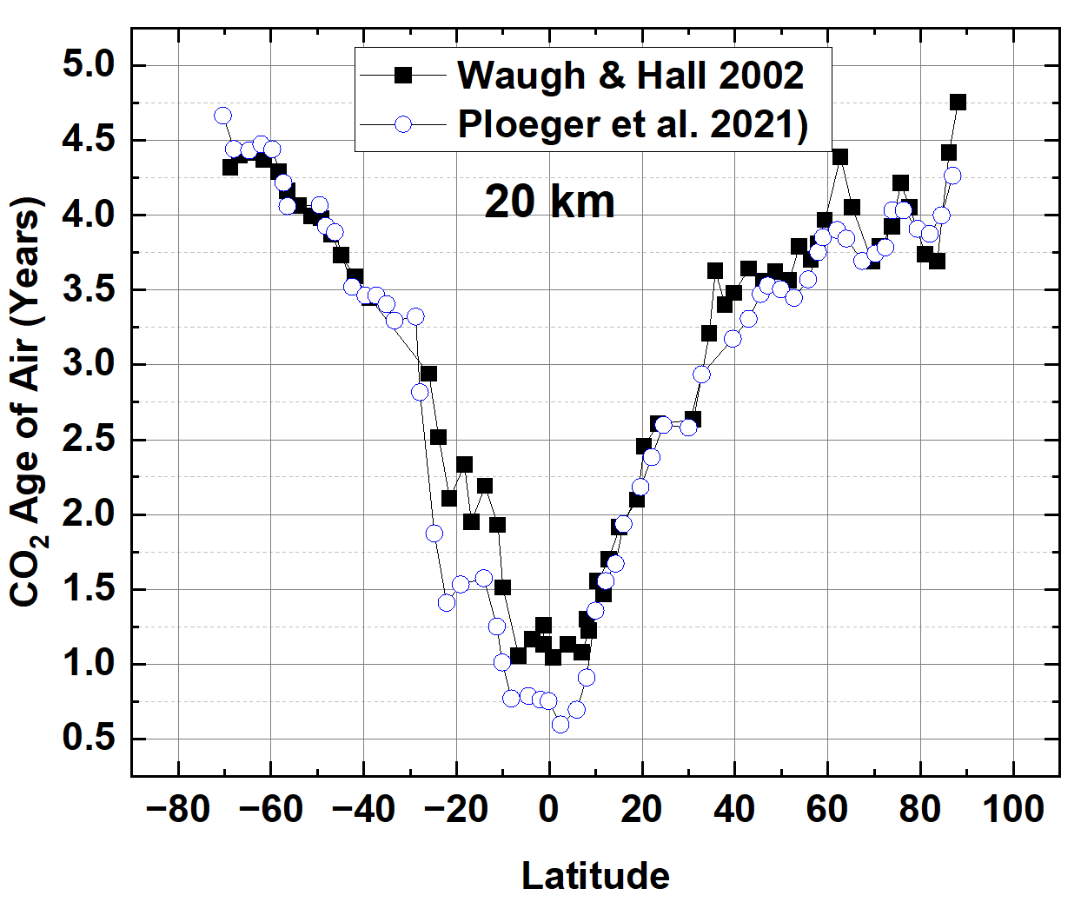
Age of Air and T_{A}
Equatorial region Dominated by upwelling Brewer Dobson circulation
South Hemisphere Mid- to High-latitudes dominated by Polar Vortex winds and summer Ozone hole backfilling
Northern Hemisphere Mid- to High latitudes: No Polar Vortex, No ozone hole, follows equatorial values

Slide 13
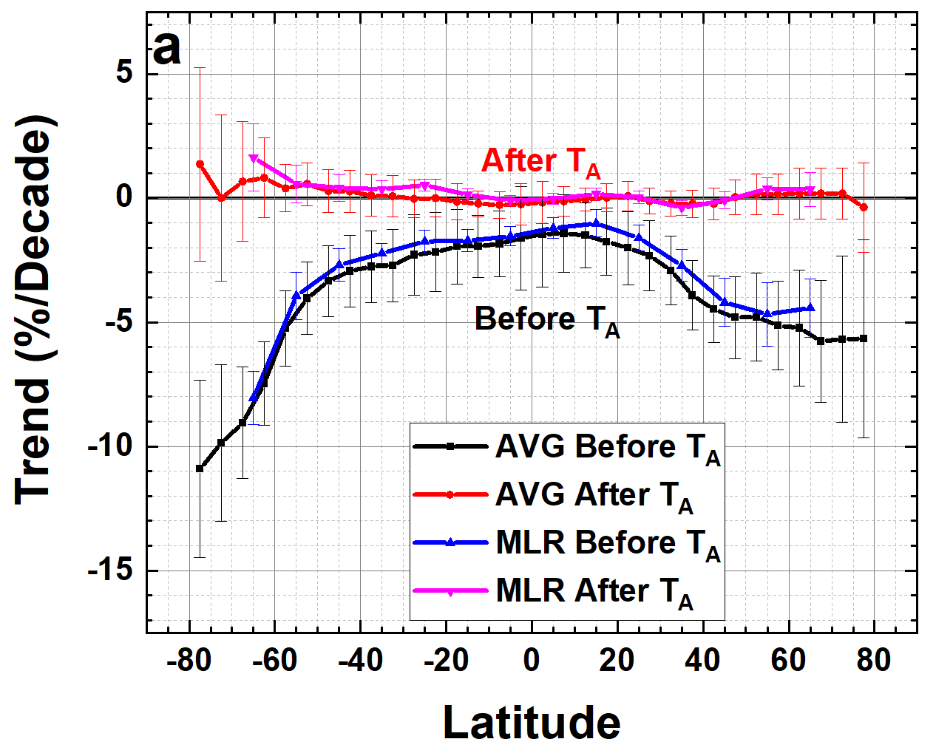
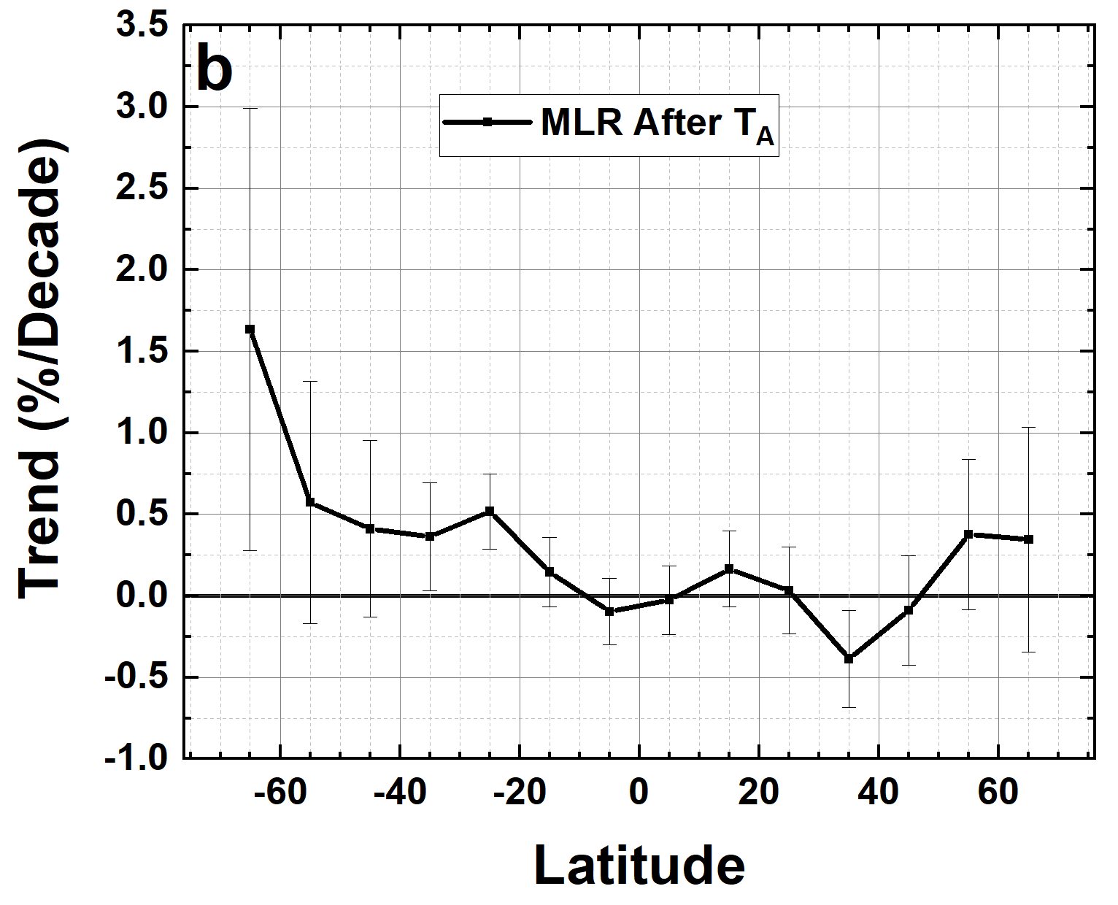
Ozone trends P_{D}(θ) (percent per decade)
Ozone trends P_{D}(θ) (percent per decade) using the MLR and Annual Average methods before and after T_{A}(θ). 6b A magnified version of the MLR estimated trends after T_{A} with 2σ uncertainties.

Slide 14
Summary
EPIC ozone agrees with OMPS-NM especially summer values
MOD data set shows latitude dependent T_{A}(θ)
Current Atmospheric Chemistry and Dynamics Models show T_{A} = 2000
T_{A}(θ) is a useful test of 3-D Models Ability to represent Atmospheric Chemistry, Dynamics, and Volcanic Effects
Herman, J., Ziemke, J., and McPeters, R.: Total Column Ozone Trends from the NASA Merged Ozone Time Series 1979 to 2021 Showing Limited Recovery to 1979 Amounts after Declining into the Mid 1990s, EGUsphere [Accepted], https://doi.org/10.5194/egusphere-2023-955, 2023.

