Slide 1
Earth observations from the lunar surface: scientific and technical advantages and dependence on lunar libration
Nick Gorkavyi ¹, Nickolay Krotkov ², and Alexander Marshak ²
¹ Science Systems and Applications, Inc., Lanham, MD, USA
² National Aeronautics and Space Administration (NASA), Goddard Space Flight Center (GSFC), Greenbelt, MD, USA

Slide 2
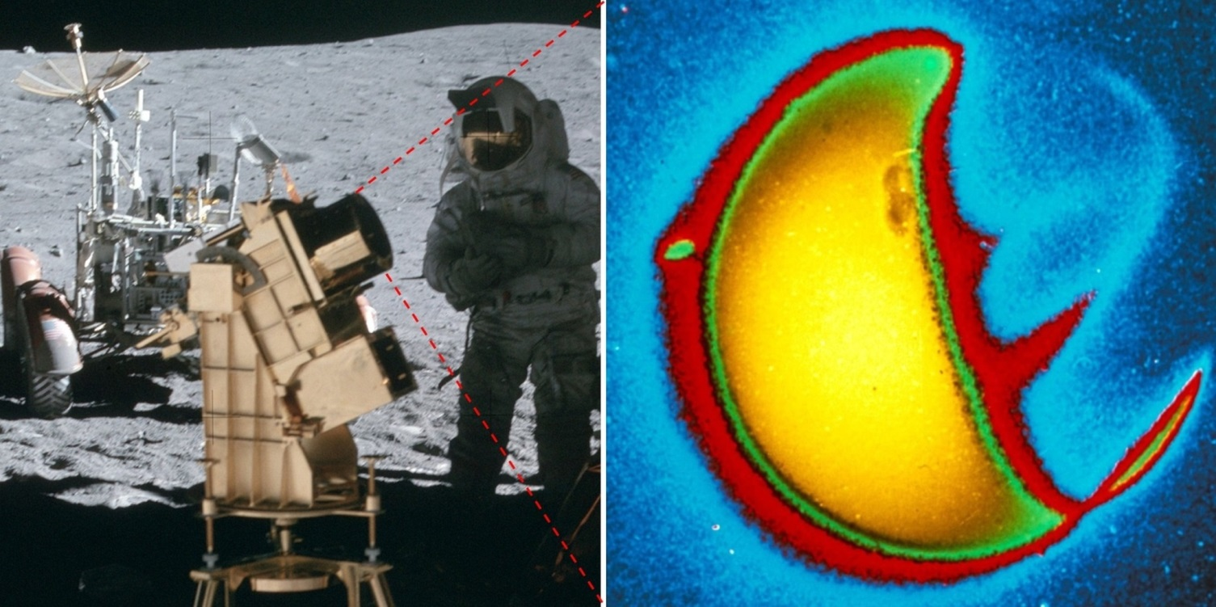
ABSTRACT. Observing the Earth from the Moon’s surface has important scientiﬁc and technical advantages. The apparent librational movement of the Earth in the Moon’s sky complicates observations of the Earth. The angular diameter of the Earth as seen from the Moon’s surface is 1.8–2.0°, depending on the Earth–Moon distance. The libration of the Moon in latitude reaches an amplitude of 6.68° and has a main period of 27.21 d. The libration of the Moon in longitude, reaching an amplitude of 7.9°, has a period of 27.55 d. This causes the center of the Earth to move in the Moon’s sky in a rectangle measuring 13.4°× 15.8°. The trajectory of the Earth’s motion in this rectangle has a period of 6 years (or 2190.34 d).
[1]. Gorkavyi, N., Carn, S., DeLand, M., Knyazikhin, Y., Krotkov ,N., Marshak A., Myneni, R. and Vasilkov, A.: Earth Imaging From the Surface of the Moon With a DSCOVR/EPIC-Type Camera. Front. Remote Sens. 2:724074. doi: 10.3389/frsen.2021.724074, 2021.
[2]. Gorkavyi, N., Krotkov, N., and Marshak, A.: Earth observations from the Moon's surface: dependence on lunar libration, Atmos. Meas. Tech., 16, 1527–1537, https://doi.org/10.5194/amt-16-1527-2023, 2023. Cumulative views and downloads: >8500.
Figure 1. (from [2]) Left: a far-ultraviolet camera and spectrograph was operated on the lunar surface during the Apollo 16 mission, April 1972 (credits: NASA, Apollo 16).
Right: the Earth, photographed in far-ultraviolet light (1304 angstroms) by astronaut John W. Young. Credits: George Carruthers (NRL) and Thornton Page (JSC), Far UV Camera, NASA, Apollo 16; based on the image AS16-123-19657 (Mason, 2019).

Slide 3
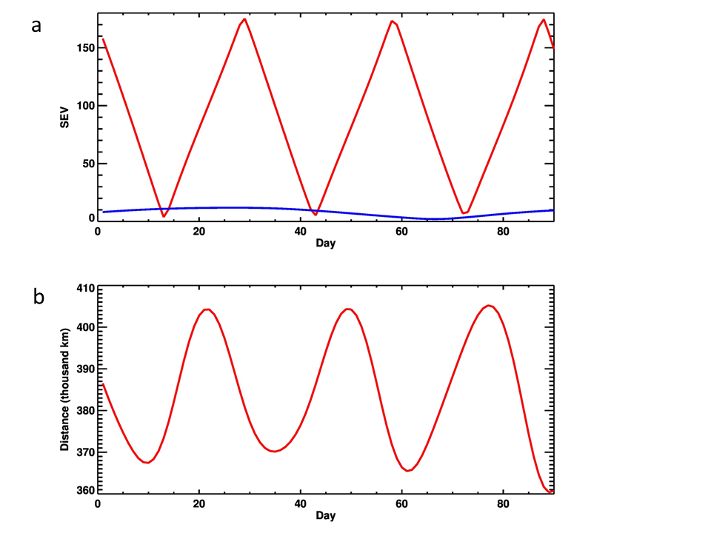
Range of phase angles when observed from the Moon
The L1 location restricts phase angles to ~2°-12° (a nearly backscattering direction), depriving the observer of any information on bidirectional surface reflectance factors or on cloud/aerosol phase functions. A compact, lightweight, autonomous EPIC-type camera on the Moon’s surface offers a unique opportunity to expand Earth’ observations for phase angles to 0°-180° and advance Earth science in novel and potentially unanticipated ways.
MOON
EPIC
Fig. 2. Sun-Earth-Vehicle (SEV) angle during the first 3 months of 2021 [1]
(data for the Moon from Espenak, 2021; for DSCOVR/EPIC - from https://epic.gsfc.nasa.gov/)

Slide 4
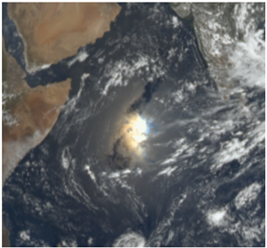
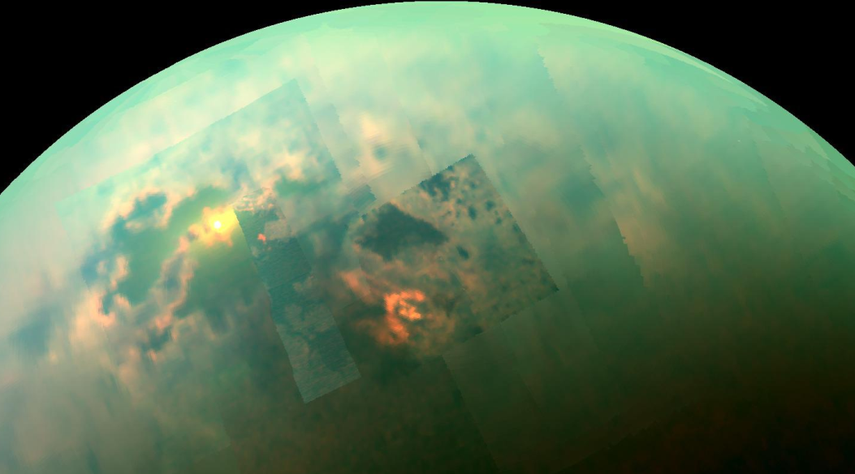
a
Scientific advantage of observations from the Moon on the example of solar glint
b
EPIC
MOON
EARTH
Motivated by EPIC observations of solar glints off the terrestrial atmosphere and the ocean, it is also important to explore the impact of starlight glints on the detection and characterization of exoplanets.
c
Fig. 3. (a) The example of glints captured by DSCOVR/EPIC: ocean surface glint on September 17, 2018 [1] (https://epic.gsfc.nasa.gov/?date=2018-09-17).
(b) Observations from the Moon will register solar glints more often than EPIC due to the wide range of phase angles.
(c) Near-infrared radiation from the Sun reflecting off Titan's hydrocarbon seas (NASA/JPL-Caltech/Univ. Arizona/Univ. Idaho)

Slide 5
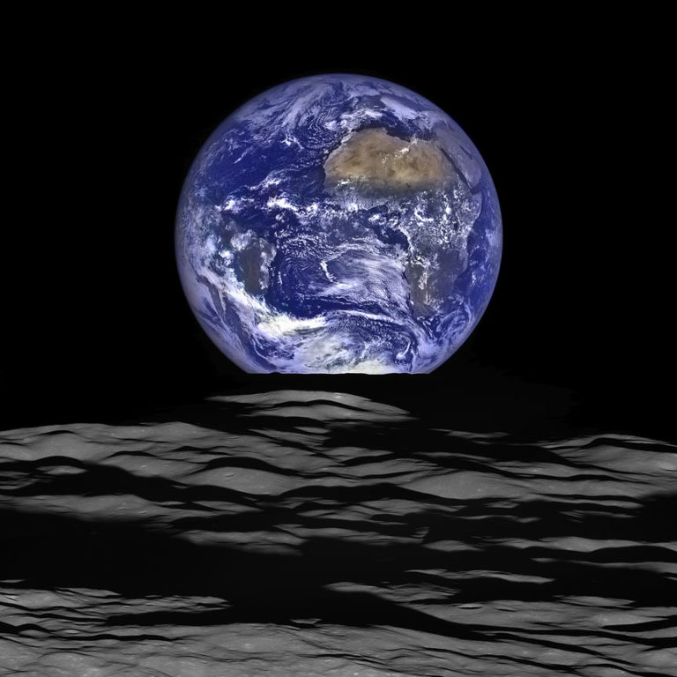
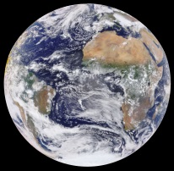
View from EPIC
(12 October 2015)
View from LRO
(12 October 2015)
Earth observations from
the Moon’s surface
compared to
L1 observations:
Scientific advantages
Smaller distance (~4 times)
Richer phase angles (0°-180°)
Night side and twilight zone of the Earth
“Use the Moon as a platform for Earth-observing studies . . . The observations from the Moon will have higher resolution than would similar observations made from L1. Myriad science investigations targeting topics such as lightning, Earth’s albedo, atmosphere, and exosphere . . . , the oceans, infrared emission, and radar interferometry may be accomplished from the surface of the Moon. The Moon also offers a unique vantage point for full-disk observations . . .”
(Artemis III Science, 2020).
Technical benefits
Orbital stability
Possibility for repair
Robust connection with the Earth

Slide 6
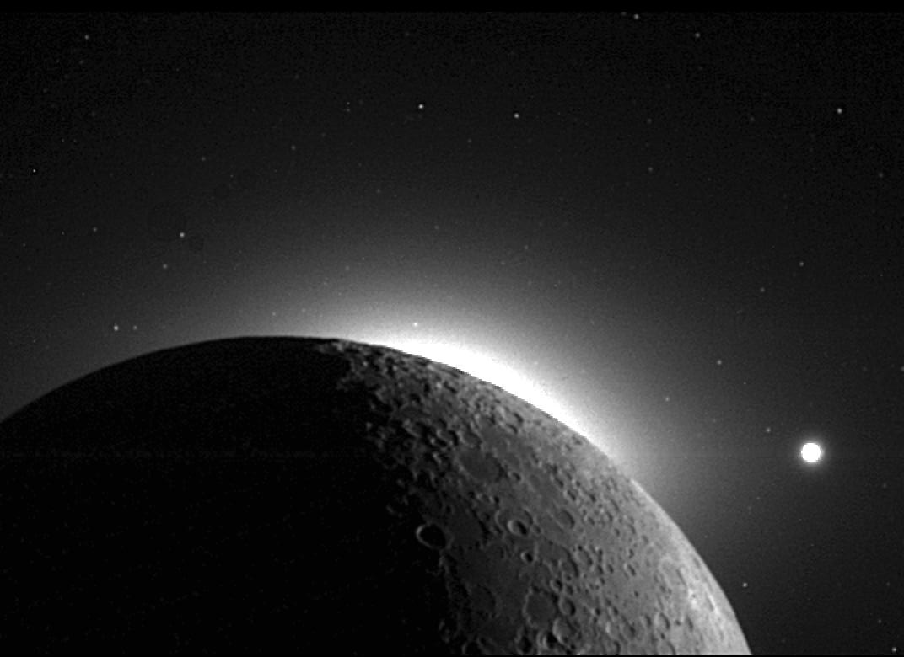
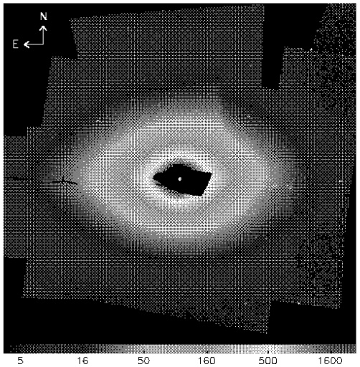
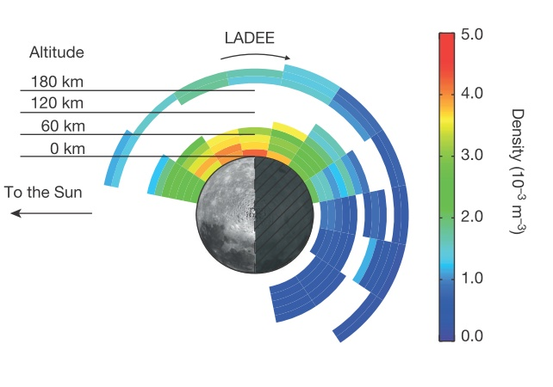
Observation of the solar corona and the lunar environment
CLEMENTINE
a
b
ZODI LIGHT
SOLAR CORONA
c
Fig.5. Using the Moon to occult the Sun, the Clementine spacecraft (1994) used its navigation cameras to map (a) the solar corona (NASA / JPL / USGS) and (b) inner zodiacal light (Hahn et al, 2002). (c) lunar dust exosphere according to LADEE data (Horányi et al, 2015 ).
Observations from the Moon’ surface of the solar corona, zodiacal light and lunar dust environment during total solar eclipses has a particular interest.
DUST
EXOSPHERE

Slide 7
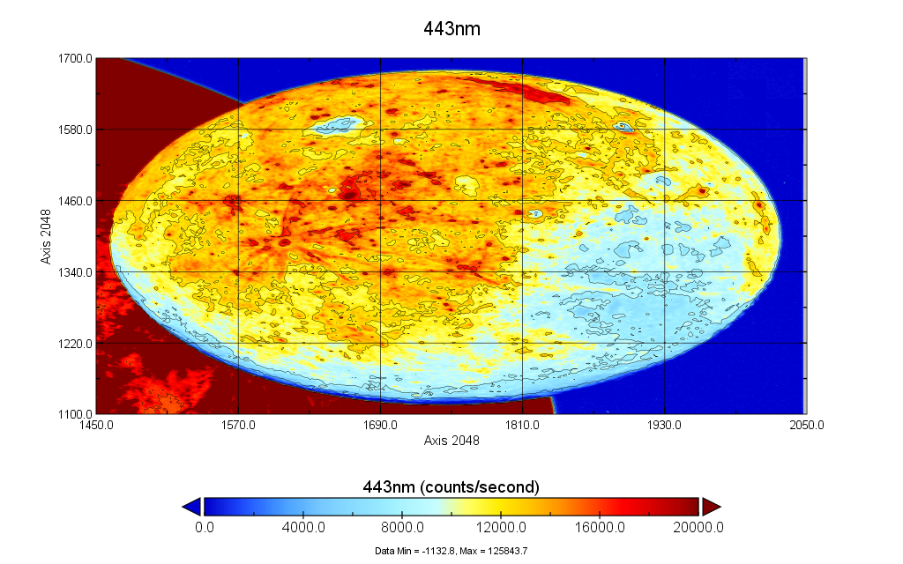
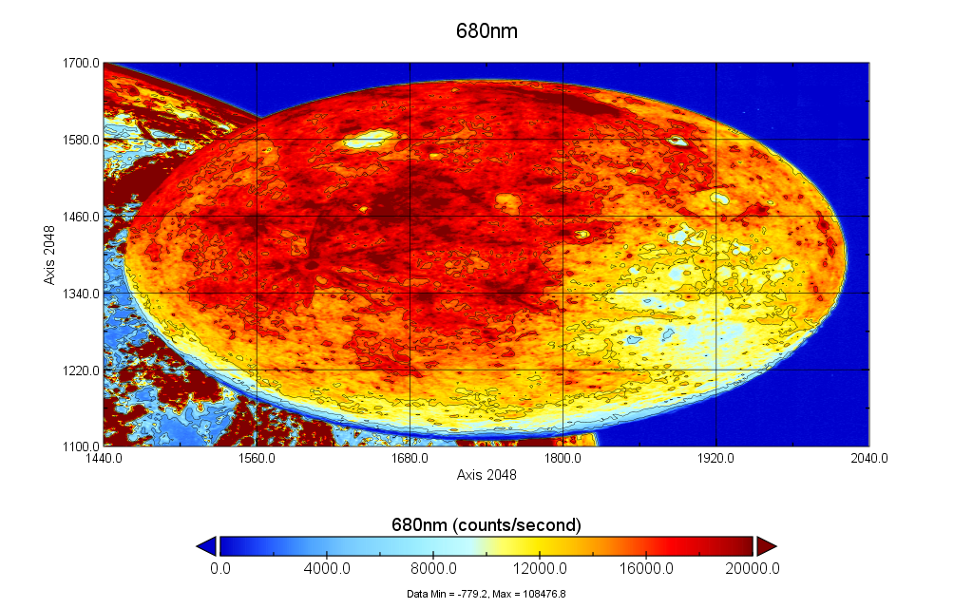
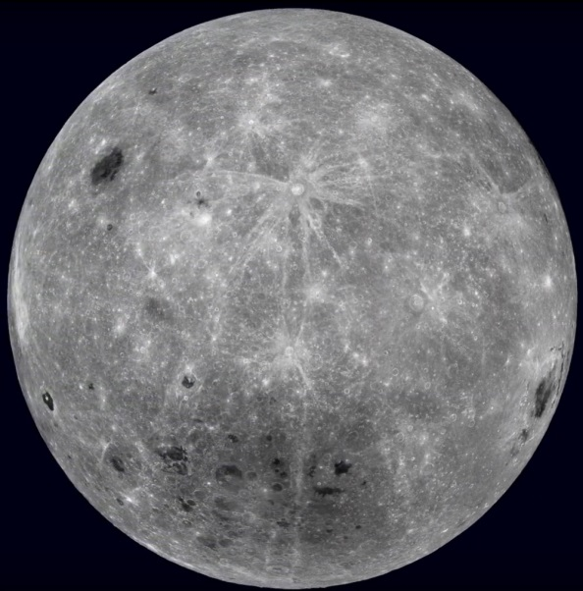
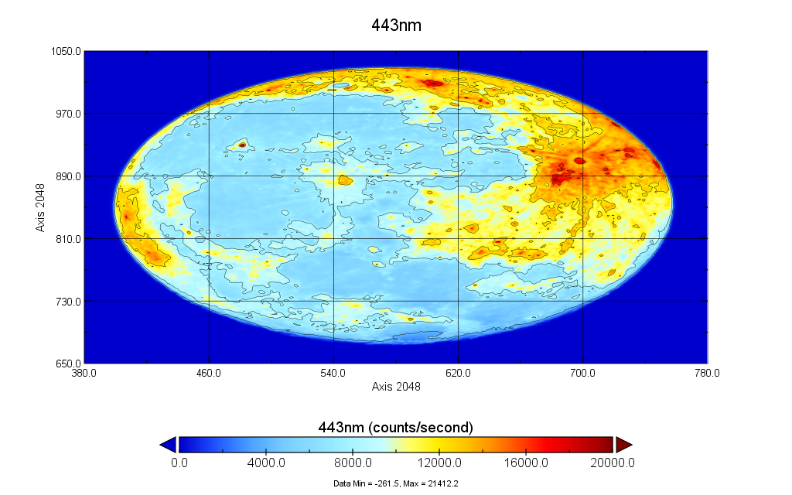
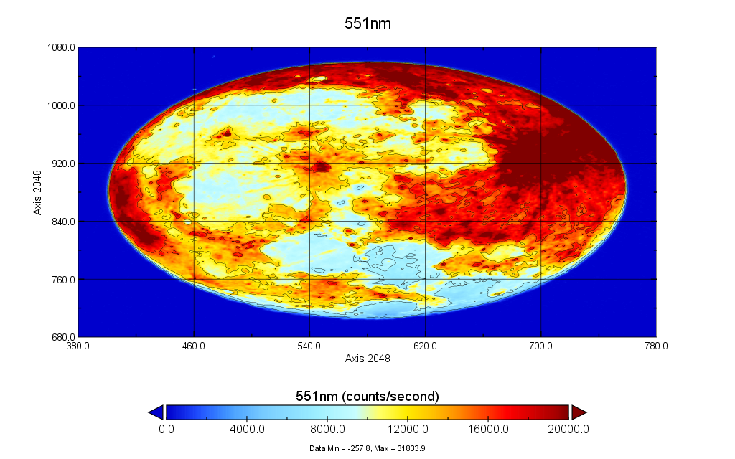
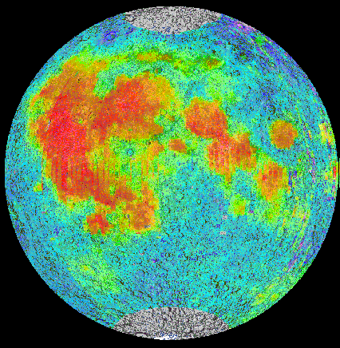
Blue
EPIC, July 5, 2016
Red
LRO
Far
side
Far
side
Far
side
Blue
EPIC, September 22, 2021
LRO
Green
Tycho

Slide 8
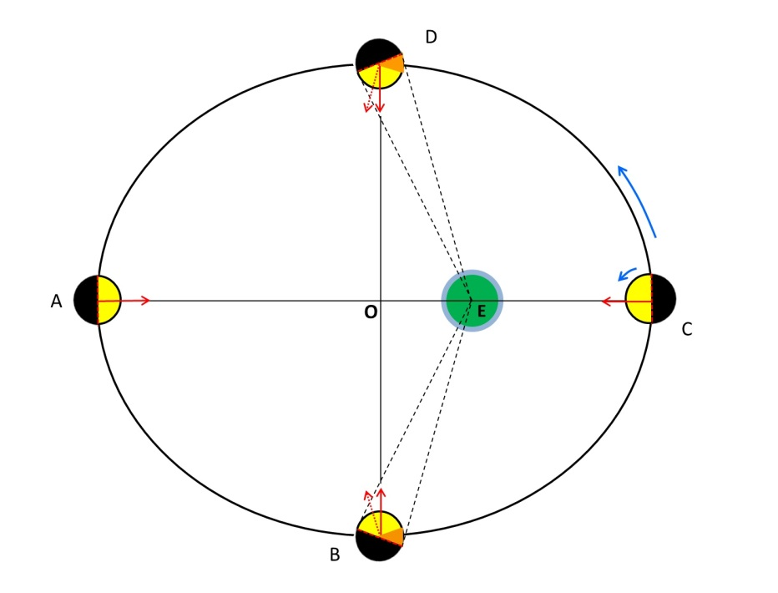
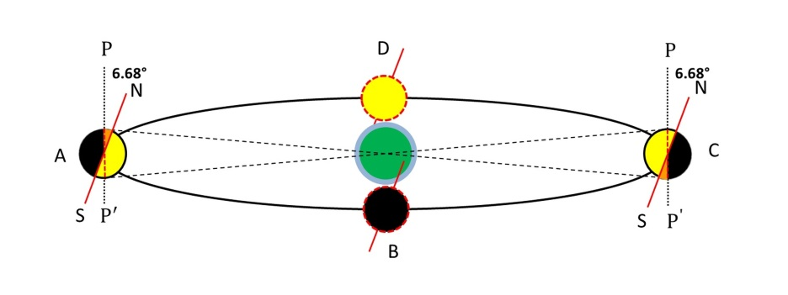
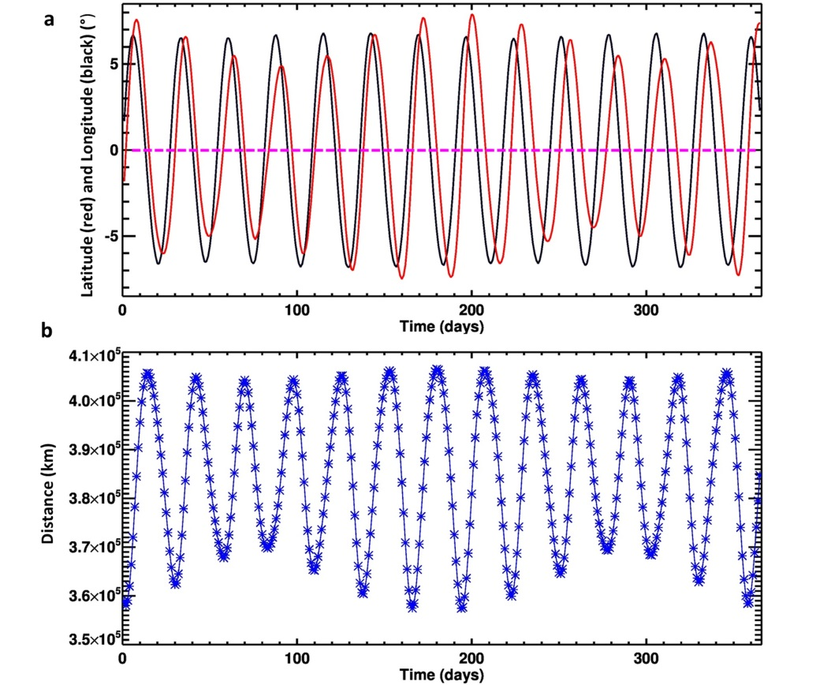
Lunar librations and the Earth-Moon distance
Figure 6. Libration in latitude results from an inclination of 6.68° between the Moon’s axis of rotation (NS) and the normal to the plane of its orbit around Earth (PP’) [2].
Figure 7. Libration in longitude results from the eccentricity of the Moon’s orbit. It can reach 7.9° in amplitude [2].
Figure 8. Variability of the Moon’s orientation and orbit during 2022, starting from 1 January 2022 [2]. The distance between the Earth and the Moon is measured between the centers of the bodies, so it does not depend on libration, which is measured in angles relative to the centers of the bodies.
Longitude libration (red) and latitude libration (black). The straight dashed line corresponds to the case of zero libration – that is, when the center of the visible lunar disk coincides with the zero point of selenographic longitude and latitude.
The Earth–Moon distance. The time-averaged distance between the centers of Earth and the Moon is 385 000 km; the minimal distance is 356 500 km, and the maximal distance is 406 700 km.

Slide 9
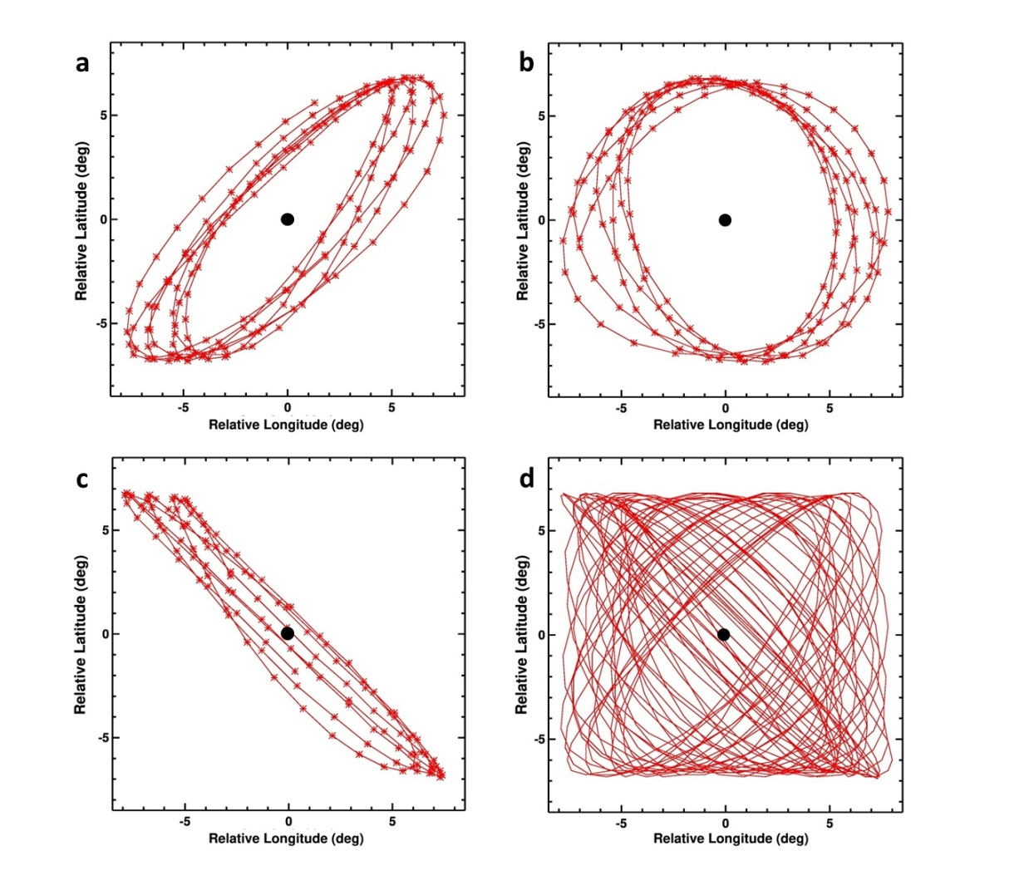
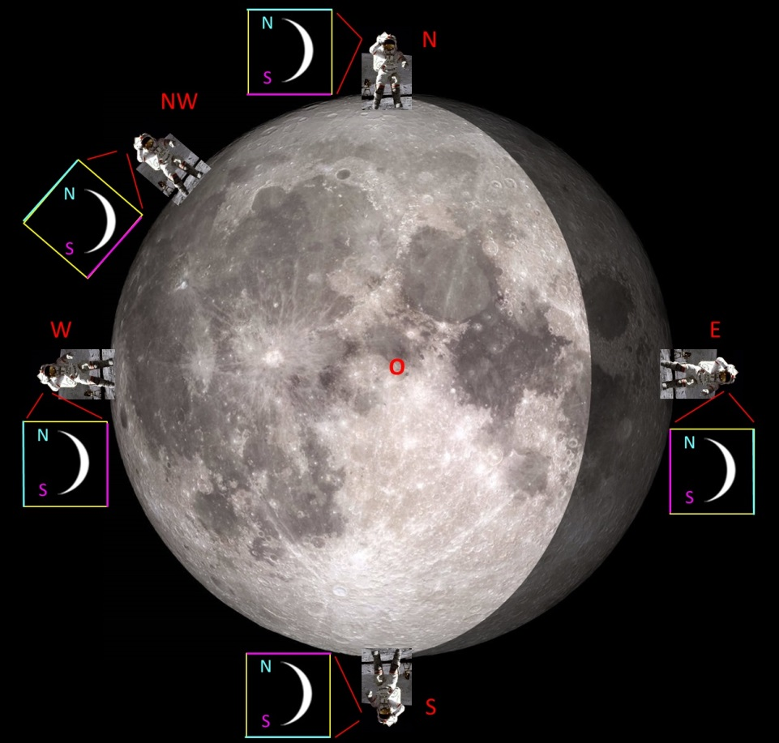
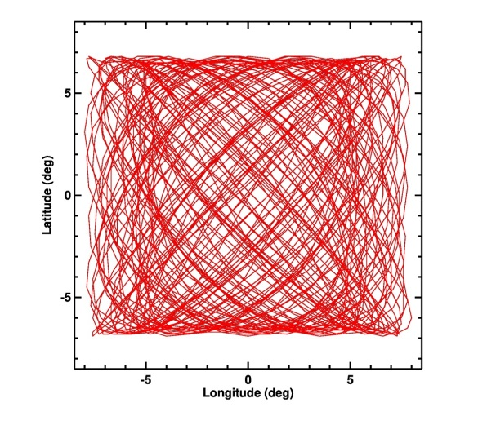
Visual librations of Earth in the Moon’s sky
d
Fig.9. Visual librations of Earth in the Moon’s sky during (a) the ﬁrst 6 months 2022, (b) the ﬁrst 6 months 2023, (c) July–October 2024, and (d) 2022–2027 (the dots are deleted) [2]. The latitude and longitude of the libration of the Moon (Giesen, 2018; Espenak, 2021) were converted to the relative Earth libration angles using a sign change. The positions of the Earth in the sky of the Moon are plotted in increments of a day. If there were no lunar libration, then the Earth would be at the black dot in the center of the ﬁgures.
Fig. 10. Observers in different points of the Moon’s visible hemisphere [2]. It is shown how, from the point of view of different observers on the Moon, the crescent of the Earth is oriented, indicating the Earth's poles. Image of the Moon – LRO (NASA/GSFC/Arizona State University). Observer: photo of J. W. Young
T_{D}=27.21222 d
T_{A} =27.55455 d
T_{DA} = 2190.34 d
or 5.99667 anomalistic years

Slide 10
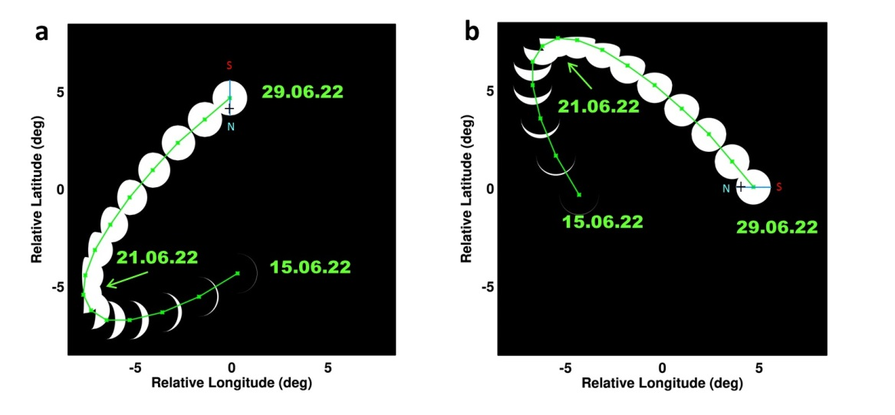
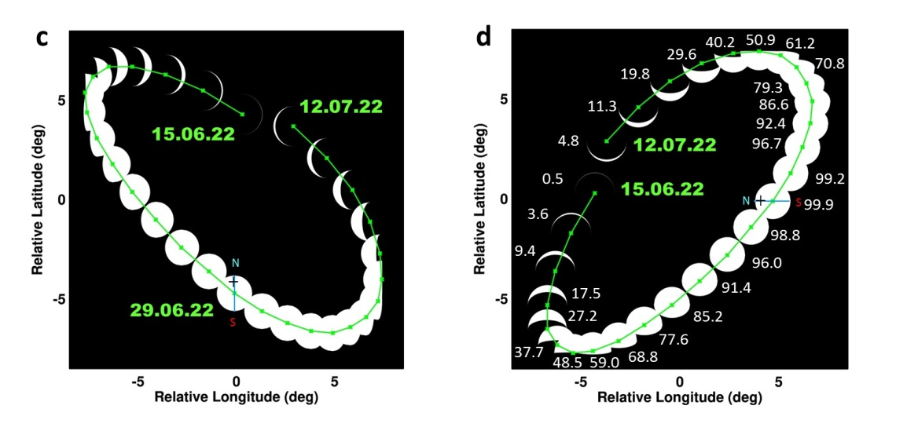
Fig.11. Positions and phases of the Earth for different Moon observers [2]
(a) Position of the Earth’s center and Earth’s phases during 15–29 June 2022 (15 points, green line) for an observer located on the lunar south pole. The Earth is almost completely illuminated
on 29 June 2022, while its axis is tilted to the Sun at an almost maximum angle (summer in the Northern Hemisphere), which creates good conditions for observing the Earth’s North Pole (marked with a cross and the letter N).
(b) Earth’s phases and visible trajectory for the same
period for an observer on the equator near longitude 90°W.
(c) Position of the Earth center and Earth’s phases during
15 June–12 July 2022 (28 points, green line) for an observer located on the lunar north pole.
(d) Earth’s phases and visible trajectory for the same period for an observer on the equator near longitude 90°E.

Slide 11
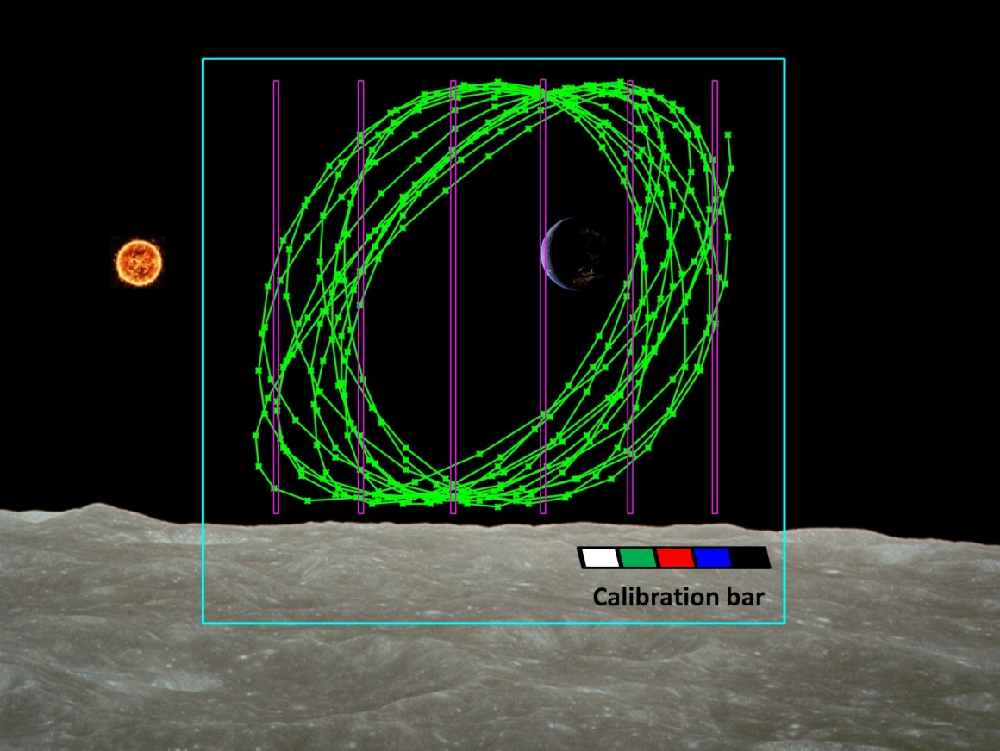
Fig. 12. Visual positions of the Earth’s center during 2026 (green
line) from the south pole of the Moon and possible positions of slits of the spectrometer (violet) [2]. The blue square is ~18°-20° FOV of ﬁxed-mount camera. The calibration bar is used to calibrate color images from a wide-angle camera. Lunar surface is from the photo taken by NASA (Apollo).
CONCLUSION
Deploying an analog of DSCOVR/EPIC on the Moon’s surface would offer a unique opportunity to image the full range of Earth phases, observing ocean/cloud glint reflection; transient volcanic and aerosol clouds (smoke, dust); polar mesospheric and stratospheric clouds; vegetated land; the twilight zone.
Due to lunar libration, the center of the Earth for an observer on the Moon moves in a rectangular area with dimensions of 13.4° × 15.8°.
The movement of the Earth in the sky of the Moon is characterized by quasi-periodicity with frequencies of ~27 days and 6 years. The rates of displacement of the Earth in the Moon sky reach two degrees per day.
Lunar libration must be taken into account when observing the Earth from the surface of the Moon and during Moon-Earth communications.
Observations of the lunar dust environment during total solar eclipses has a particular interest: the lunar dust glows from scattered sunlight.

