Slide 1
Diurnal evolution of cloud properties with DSCOVR/EPIC
Alfonso Delgado-Bonal, Alexander Marshak, Yuekui Yang, Lazaros Oreopoulos
DSCOVR STM, Oct 16th-17th 2023 NASA Goddard

Slide 2
Outline
Point #1: COT distribution changes latitudinally and temporally
Point #2: COT statistics
Point #3: COT diurnal cycle
Point #4: Non-linear correlation between albedo and COT

Slide 3
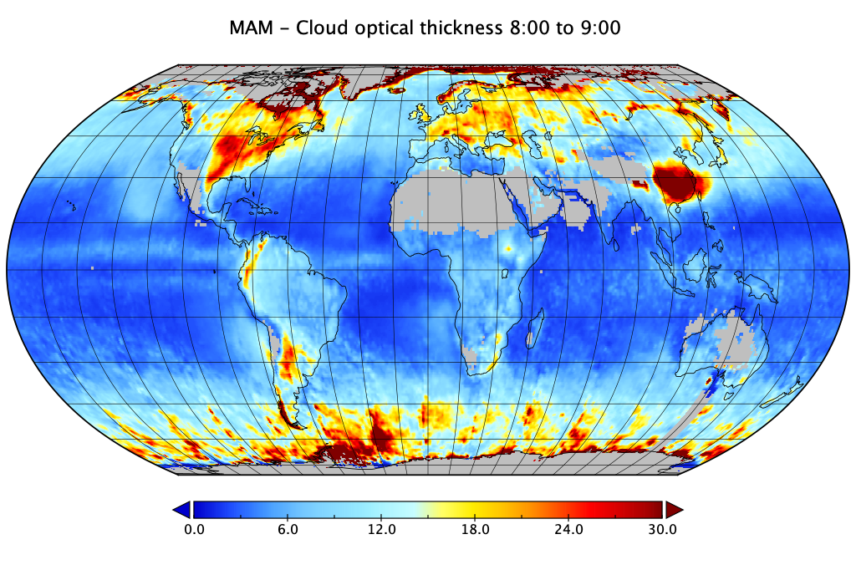
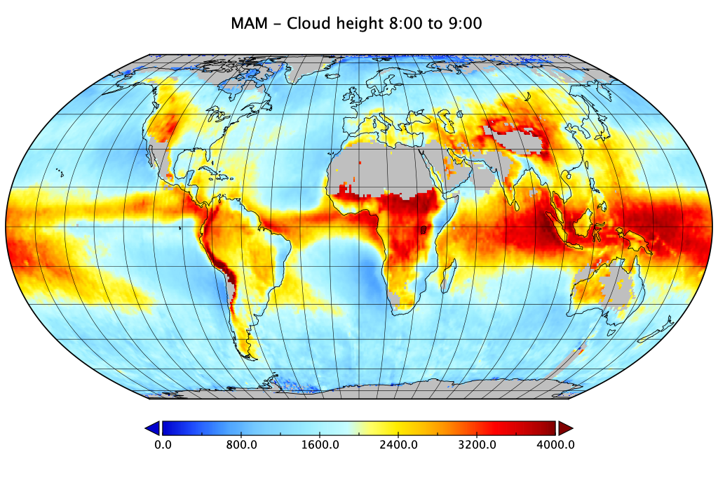
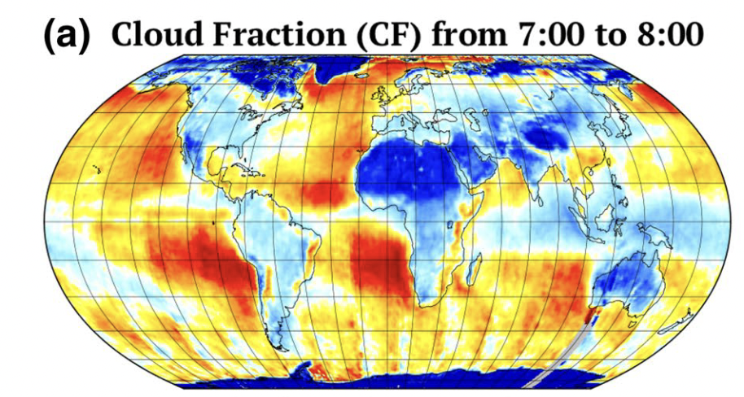
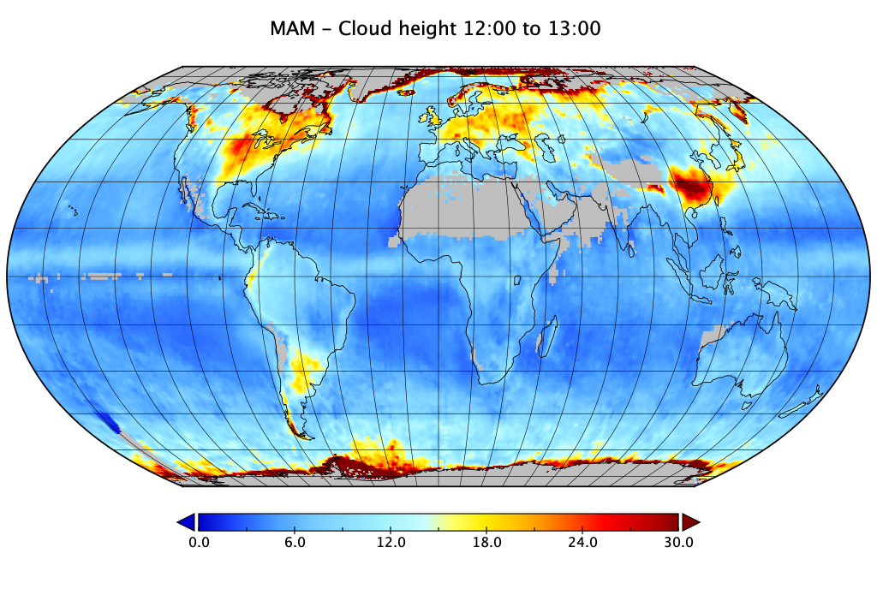
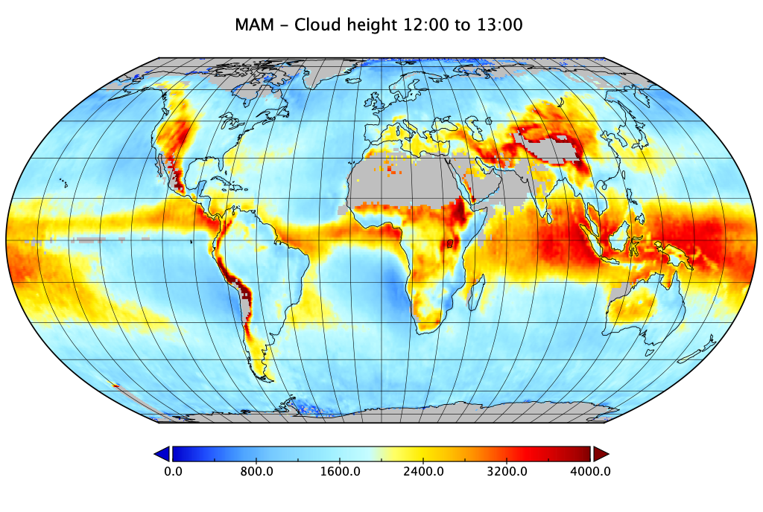
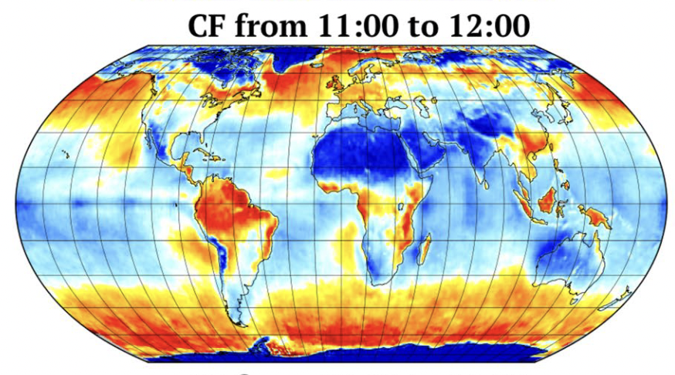
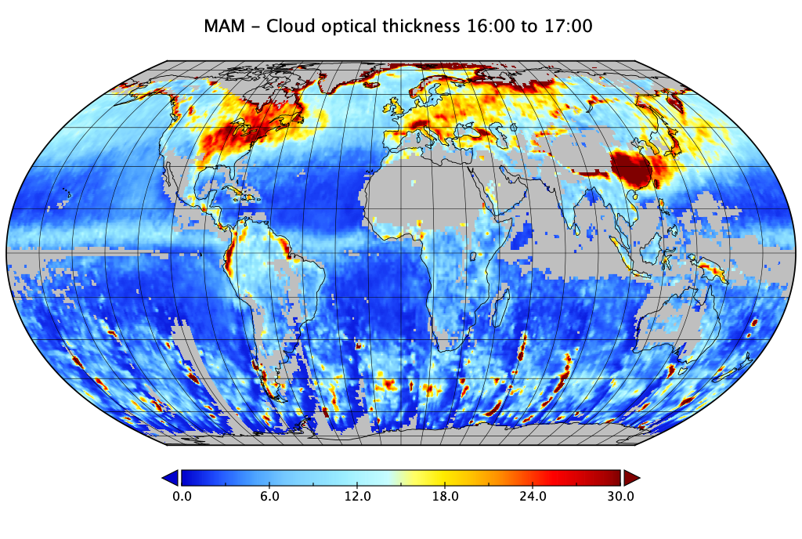
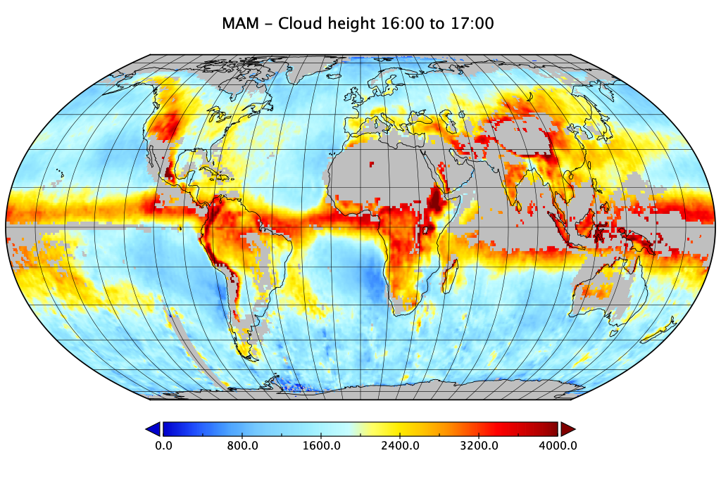
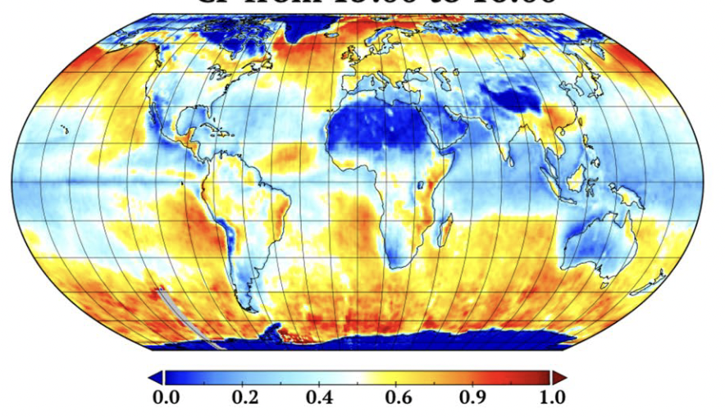
Optical Thickness
Cloud Height
Cloud Fraction
Liquid Clouds
Morning
Noon
Afternoon

Slide 4
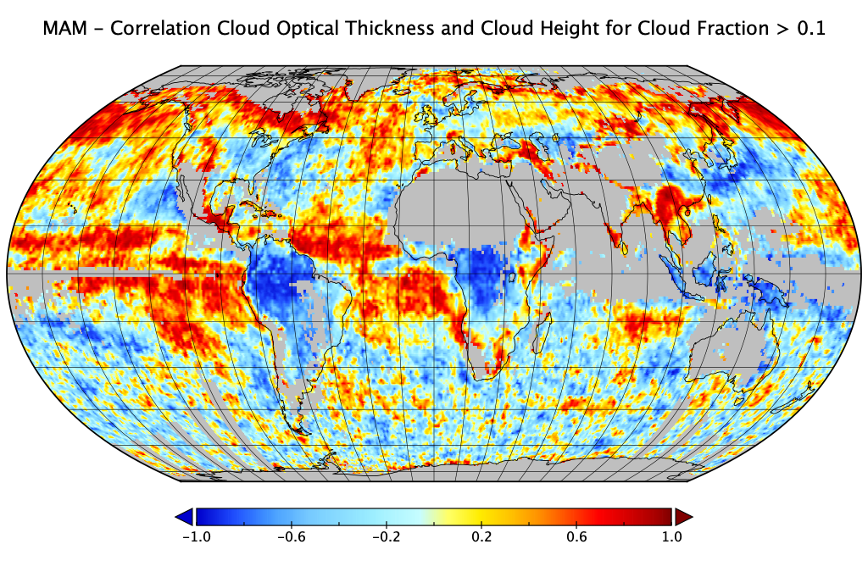
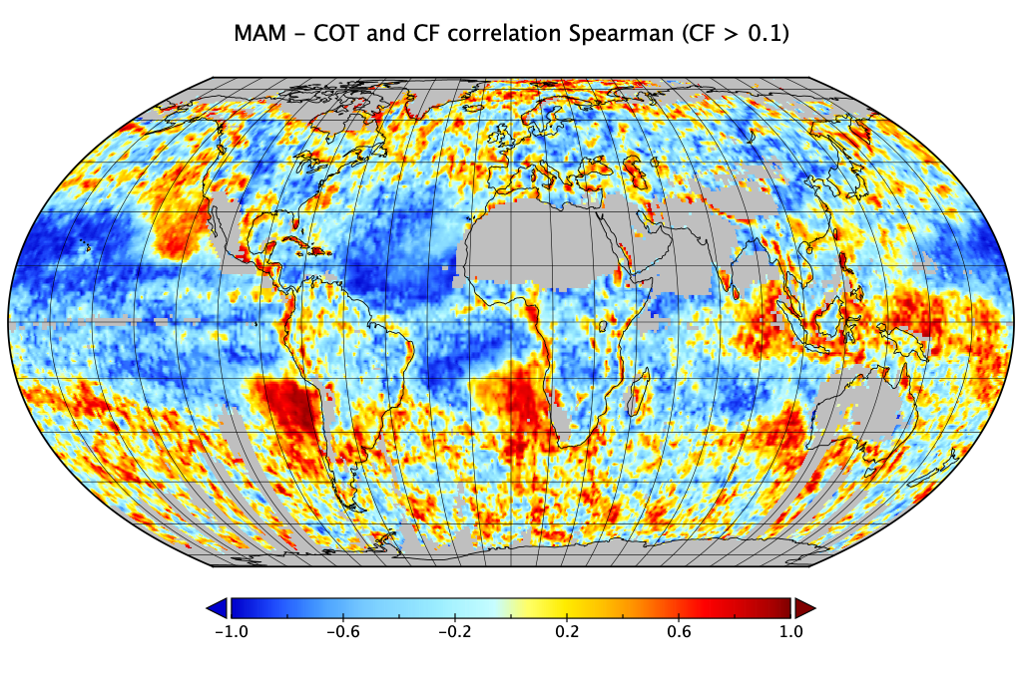
Spatial
correlation
analysis
Spearman correlation between liquid cloud optical thickness and cloud height for cloud fractions greater than 0.1.
Positively correlated over ocean, and regionally dependent over land
Spearman correlation between liquid cloud optical thickness and cloud fraction for cloud fractions greater than 0.1.

Slide 5
Point #1: COT distribution changes latitudinally and temporally

Slide 6
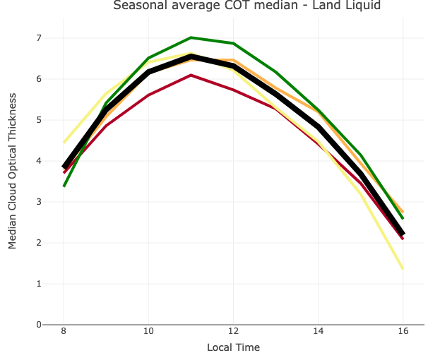
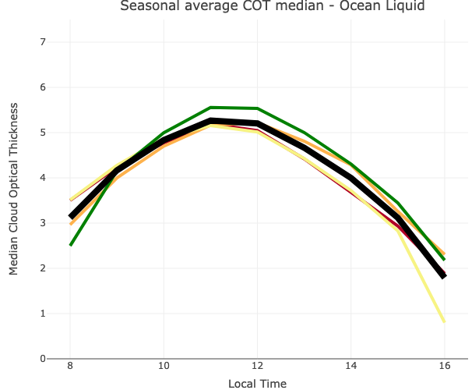
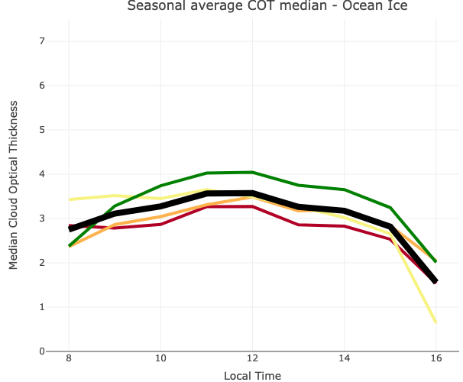
Point #1: COT daytime distribution
Land Liquid
Land Ice
Ocean Liquid
Ocean Ice

Slide 7
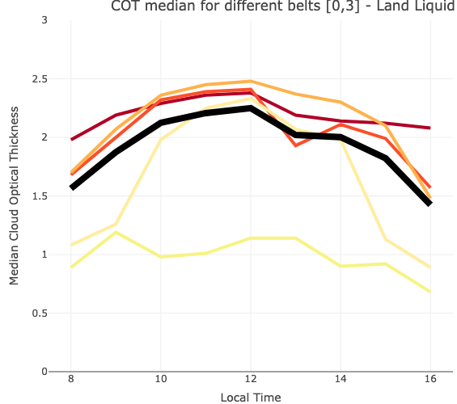
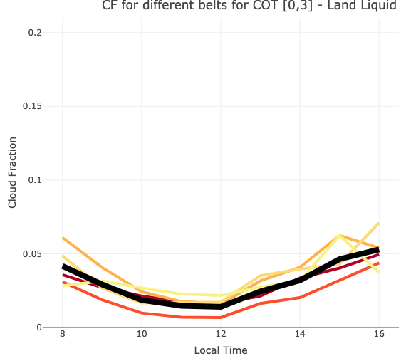
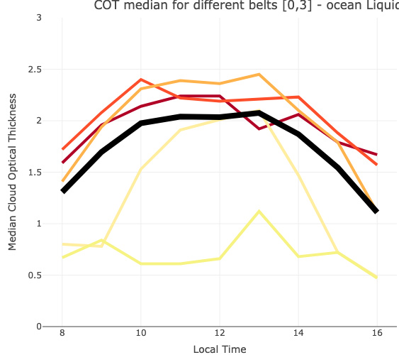
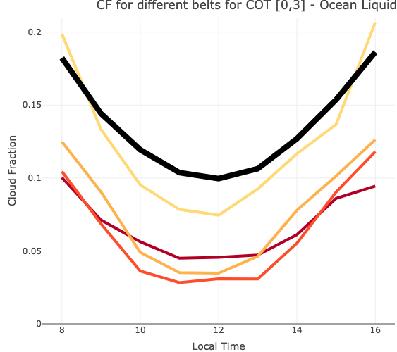
OPTICAL THICKNESS FOR THIN CLOUDS. COT [0,3]
CLOUD FRACTION FOR THIN CLOUDS. COT [0,3]
COT daytime and latitudinal distribution
Land liquid
Ocean liquid

Slide 8
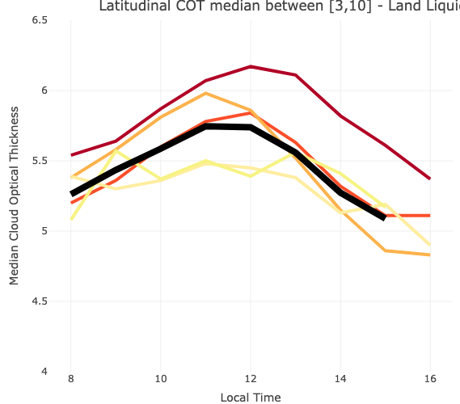
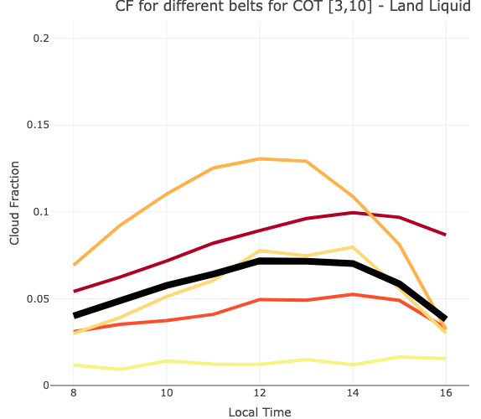
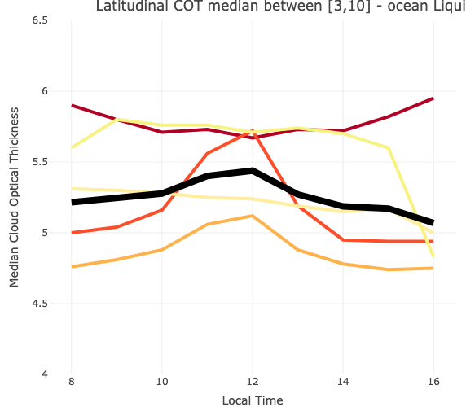
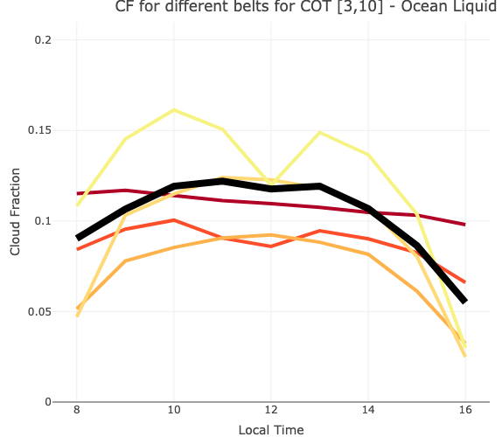
OPTICAL THICKNESS FOR MEDIUM CLOUDS. COT [3,10]
CLOUD FRACTION FOR MEDIUM CLOUDS. COT [3,10]
Land liquid
Ocean liquid

Slide 9
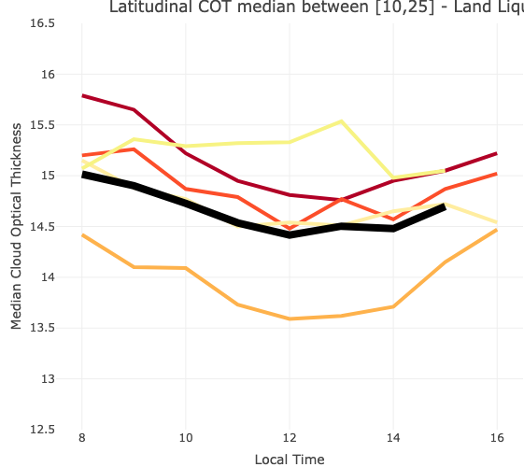
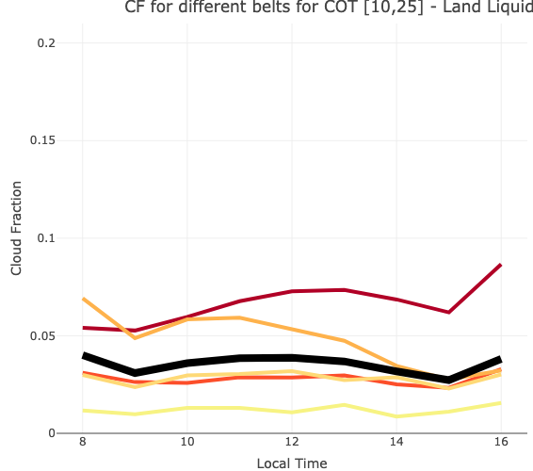
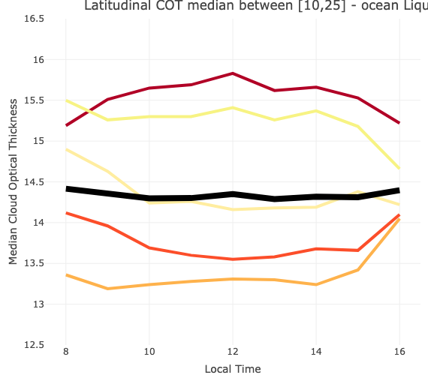
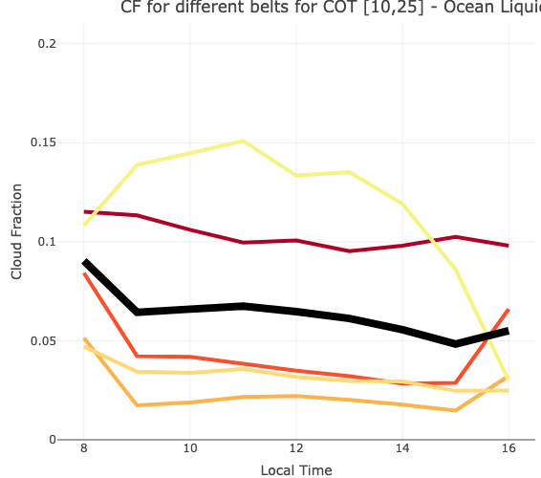
OPTICAL THICKNESS FOR THICK CLOUDS. COT [10,25]
CLOUD FRACTION FOR THICK CLOUDS. COT [10,25]
Land liquid
Ocean liquid

Slide 10
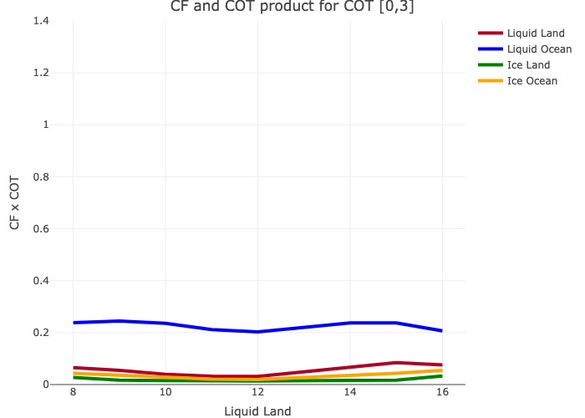
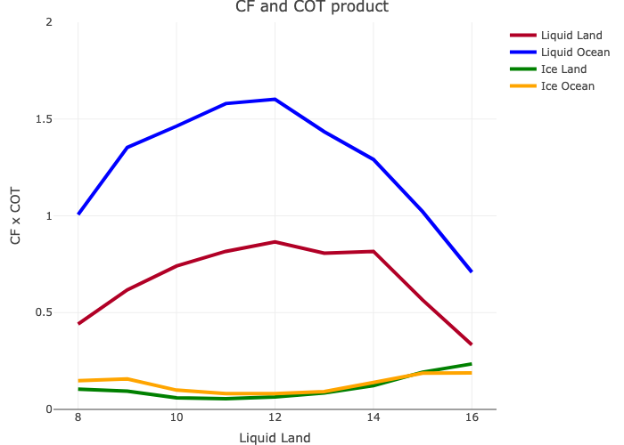
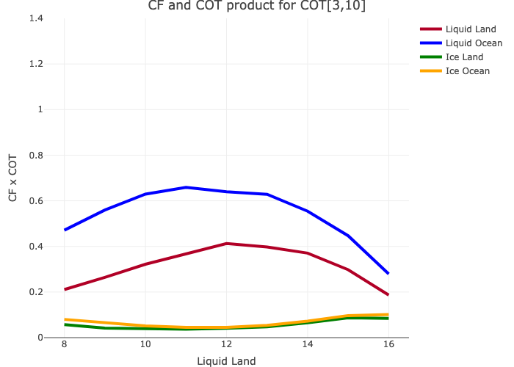
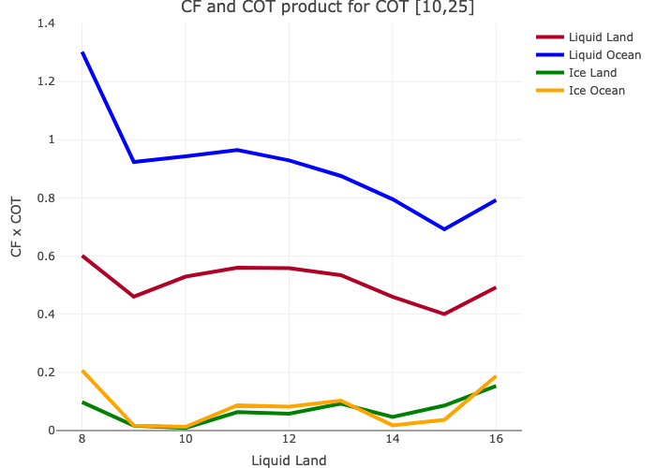
OPTICAL THICKNESS x CLOUD FRACTION
Thin
Medium
Thick

Slide 11
Point #1: COT distribution changes latitudinally and temporally
Point #2: COT statistics is lognormal → the mean and median behave differently → median is more representative

Slide 12
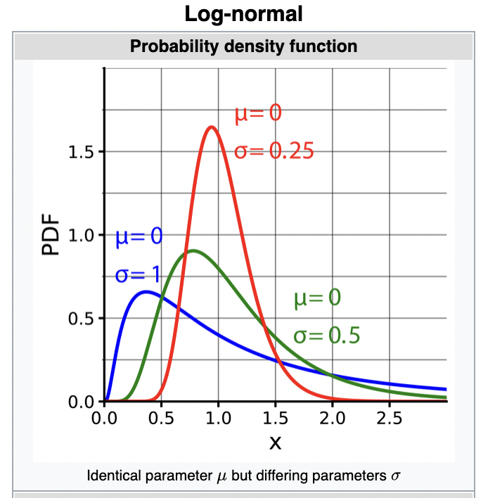
Addition → Gaussian distribution (x ± sd)
Multiplication → Lognormal (skewed) distribution

Slide 13
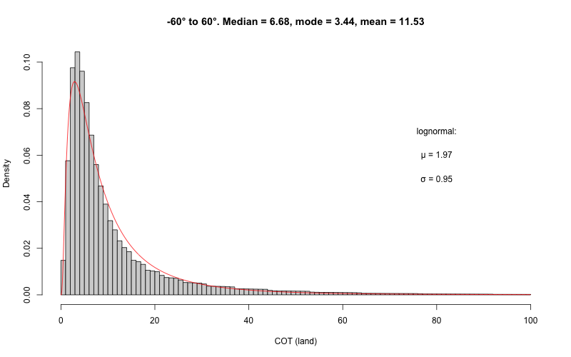

Slide 14
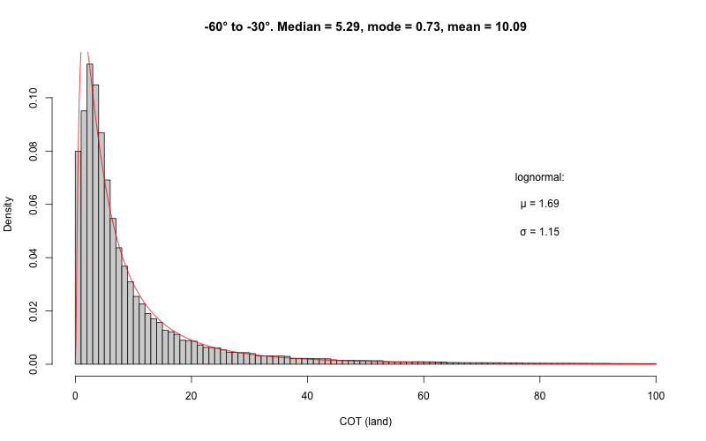
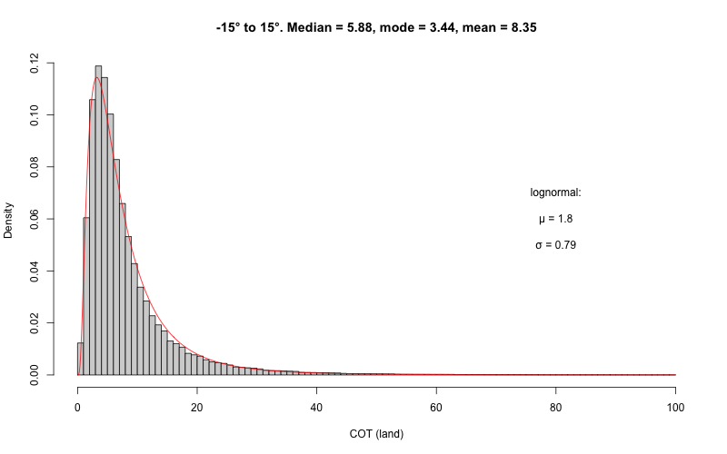
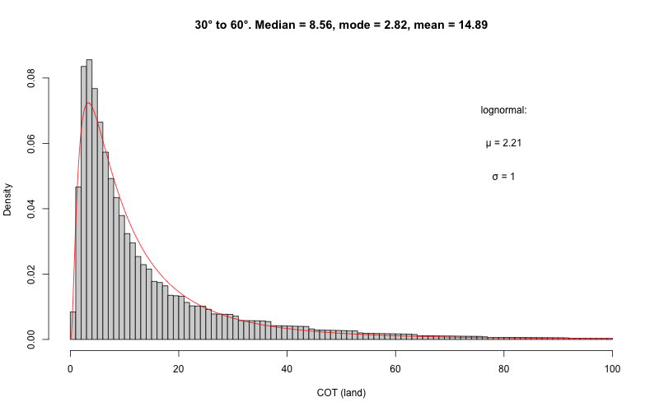

Slide 15
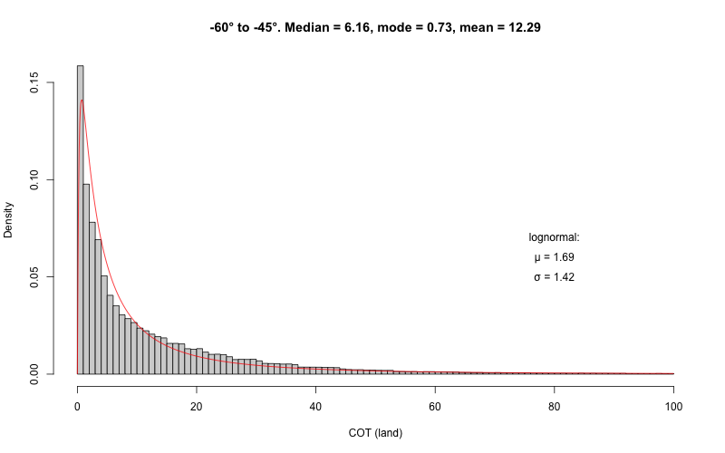
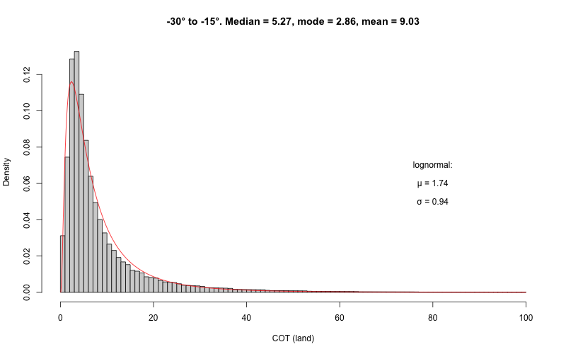
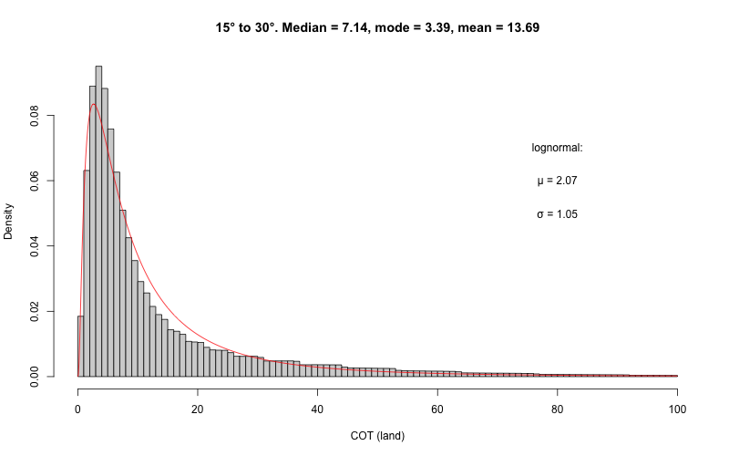
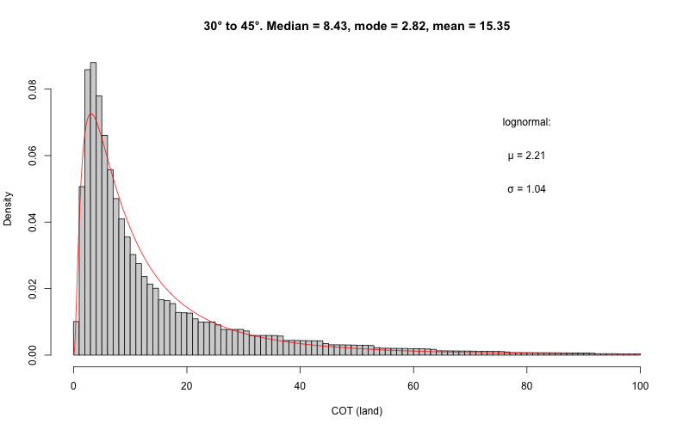
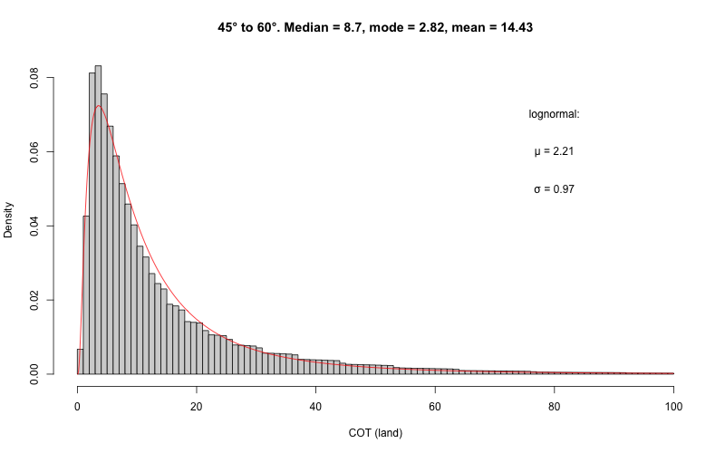
The COT follows a lognormal distribution for all the latitudinal zones
Lognormal mean follows the data median (monotonal)

Slide 16
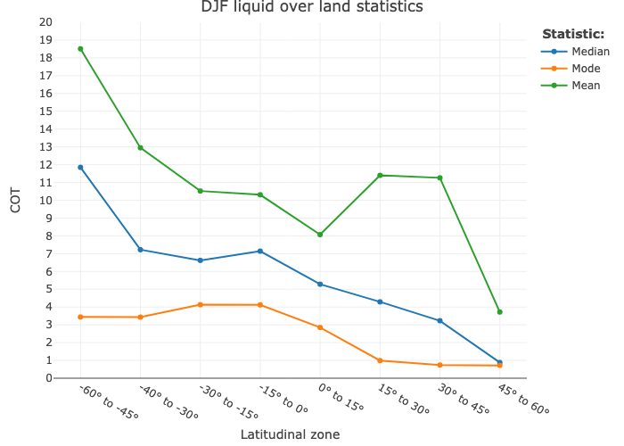
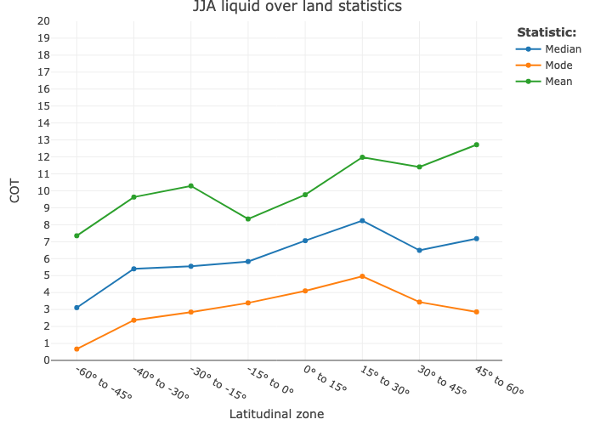
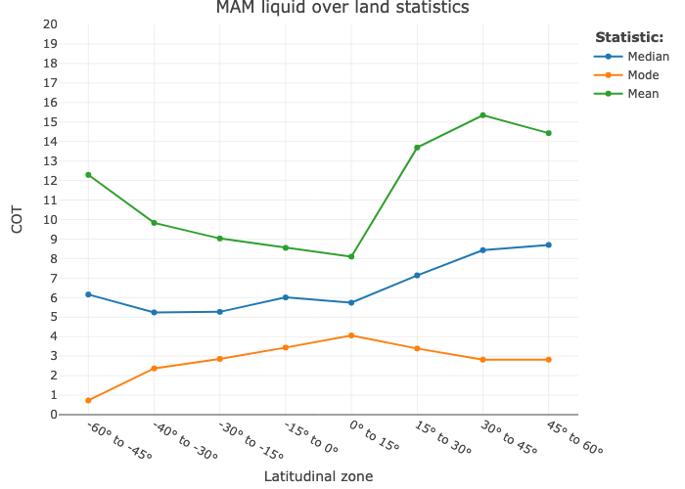
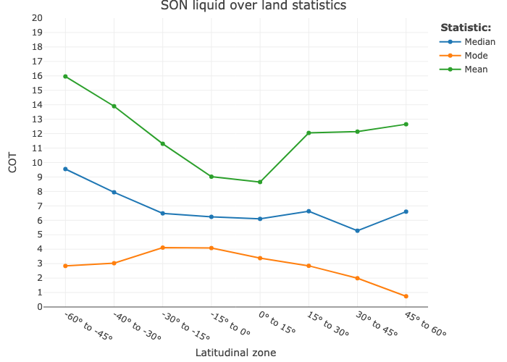
Point #2: COT statistics is lognormal →
the mean and median behave differently →
median is more representative

Slide 17
Point #1: COT distribution changes latitudinally and temporally
Point #2: COT statistics is lognormal → the mean and median behave differently → median is more representative
Point #3: COT has a diurnal cycle → Noon overestimates the diurnal average

Slide 18
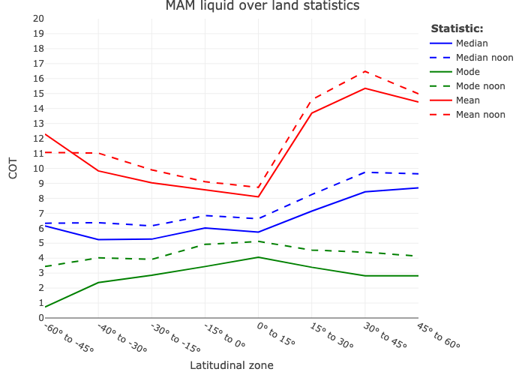
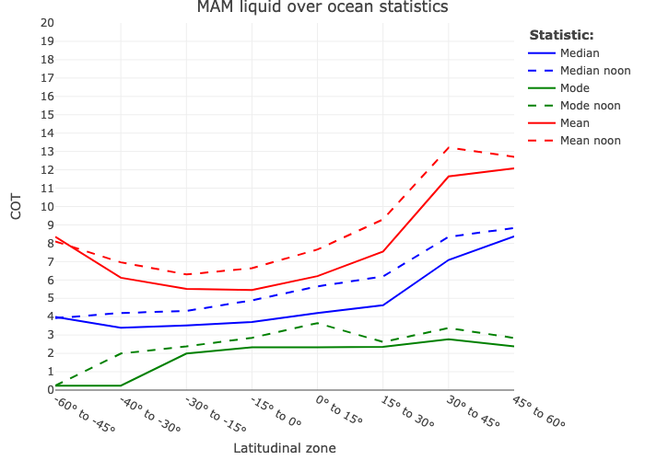
Noon overestimates the measurements of central tendency.
Point #3: COT has a diurnal cycle → Noon overestimates the diurnal average by ~15-20%

Slide 19
Point #1: COT distribution changes latitudinally and temporally
Point #2: COT statistics is lognormal → the mean and median behave differently → median is more representative
Point #3: COT has a diurnal cycle → Noon overestimates the diurnal average
Point #4: Non-linear correlation between albedo and COT because of lognormal distribution

Slide 20
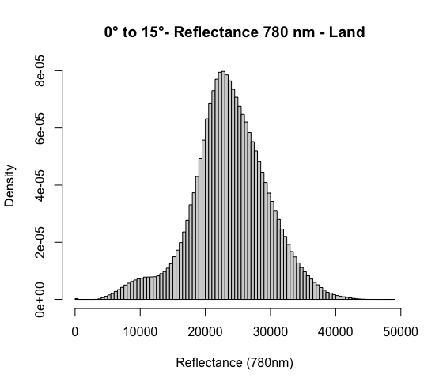
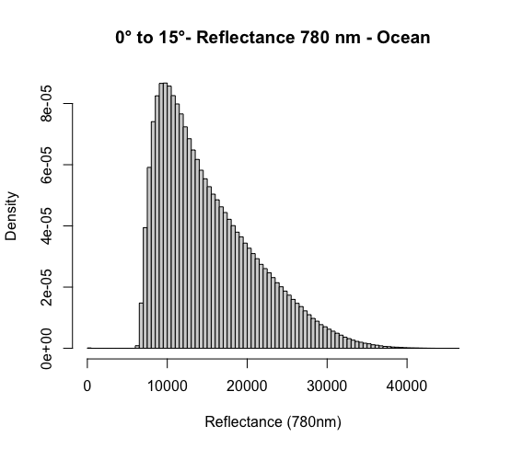
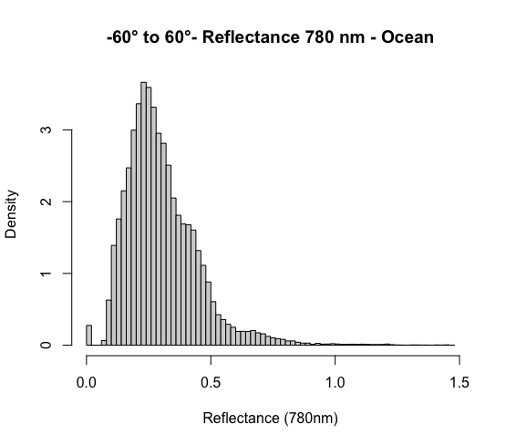
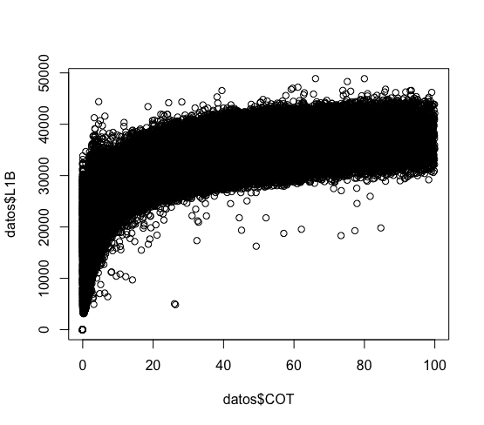
Point #4: Non-linear correlation between albedo and COT because of lognormal distribution
8 to 9 am - equator
Land
Ocean
reflectance
reflectance
COT
COT

Slide 22
Conclusions
Point #1: COT distribution changes latitudinally and temporally
Point #2: COT statistics is lognormal → the mean and median behave differently → median is more representative
Point #3: COT has a diurnal cycle → Noon overestimates the diurnal average
Point #4: Non-linear correlation between albedo and COT because of lognormal distribution

