Slide 1
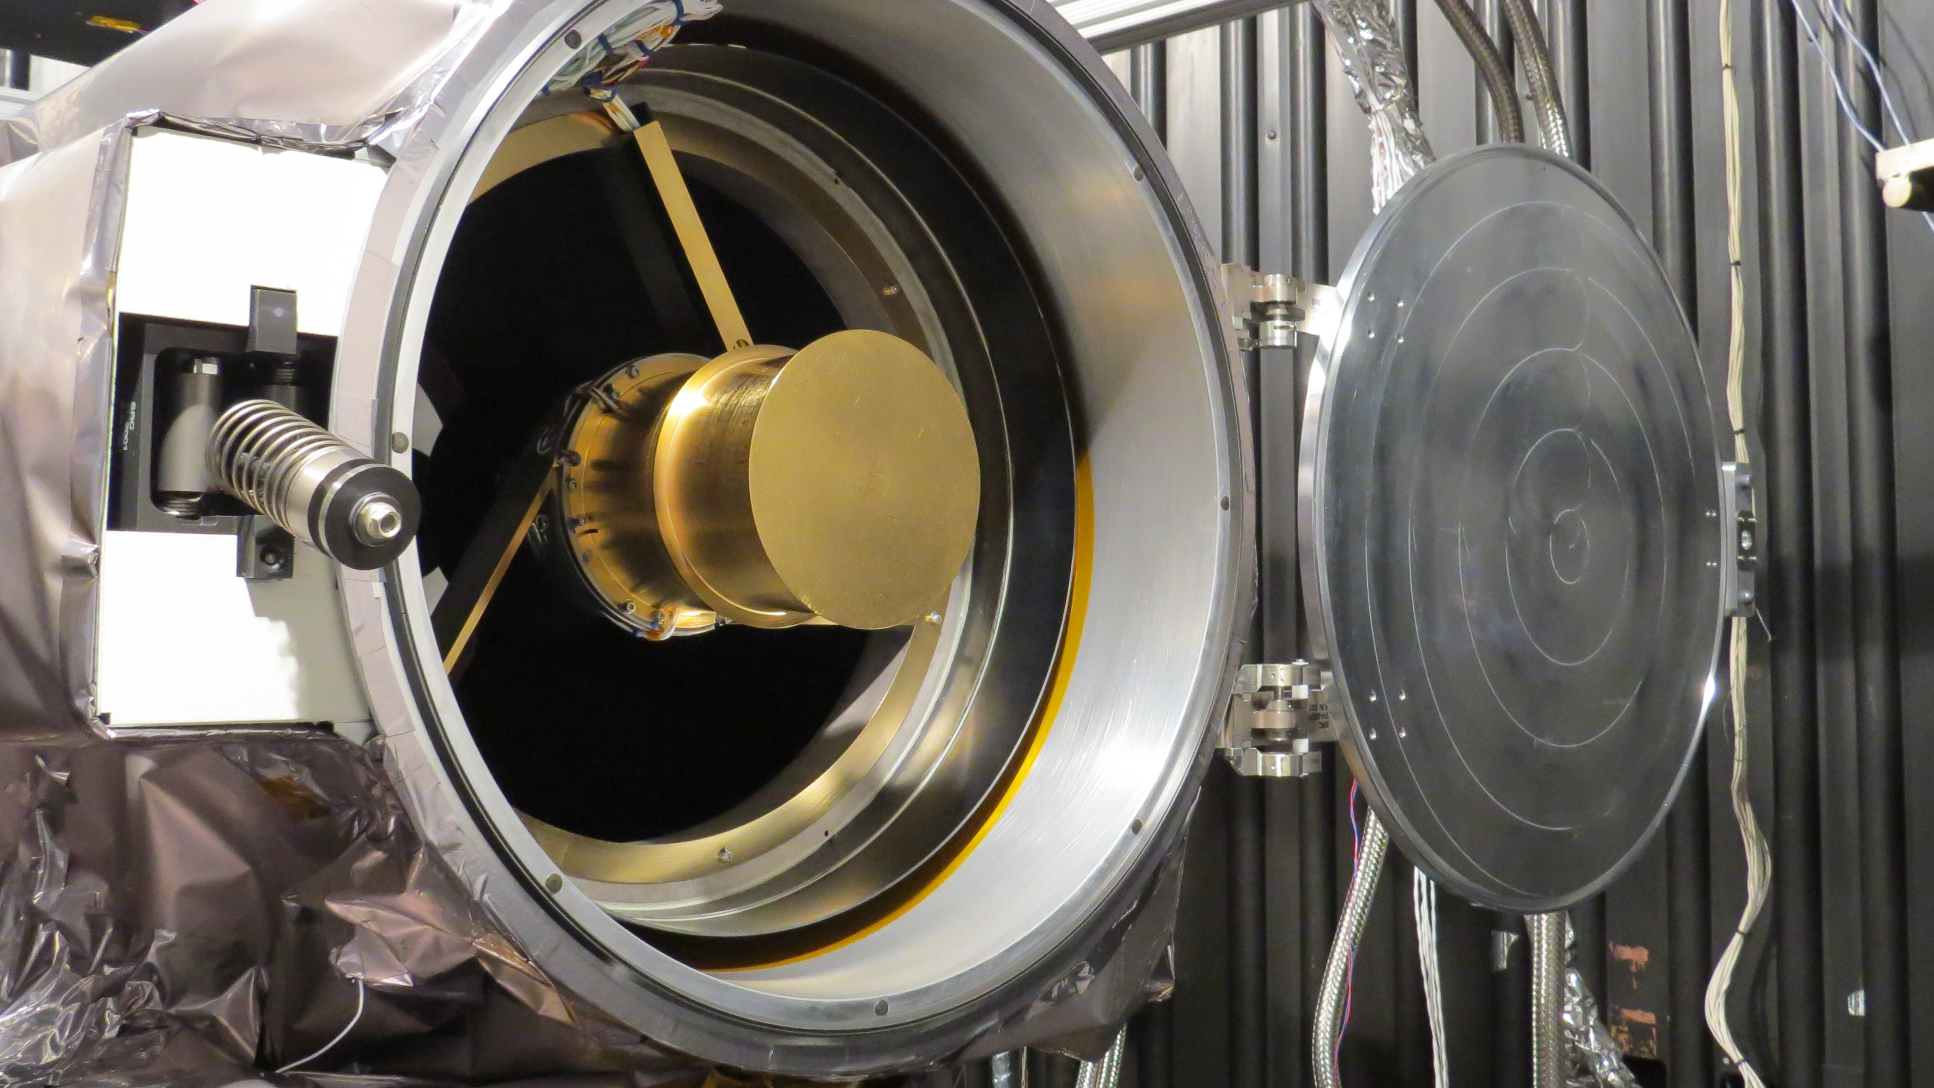
EPIC Geolocation
Karin Blank
NASA/GSFC 586

Slide 2
Algorithm Progress
Focus | Algorithm Version | Product Release Version | Features
Simulator | Revision 0 |  | Pre-launch simulator
Relative Geolocation | Revision 1 | Version 0 | First geolocation; website pictures
 | Revision 2 |  | Mitigation of issues with optical artifacts
 | Revision 3 |  | Improved cross-band registration
 | Revision 4 | Version 1 | Subpixel registration L1b (Kai Yang’s algorithm)
Absolute Geolocation | Revision 5 | Version 2 | Initial fixes for absolution geolocation
 | Revision 6 | Version 3 | Atmospheric refraction correction, improved optical model, attitude correction, improved lat/lon
 | Revision 7 | Version 4 | Updated parallax correction

Slide 3
EPIC…

Slide 4
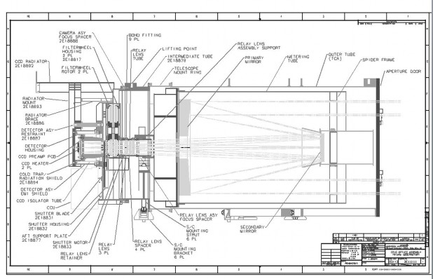

Slide 5
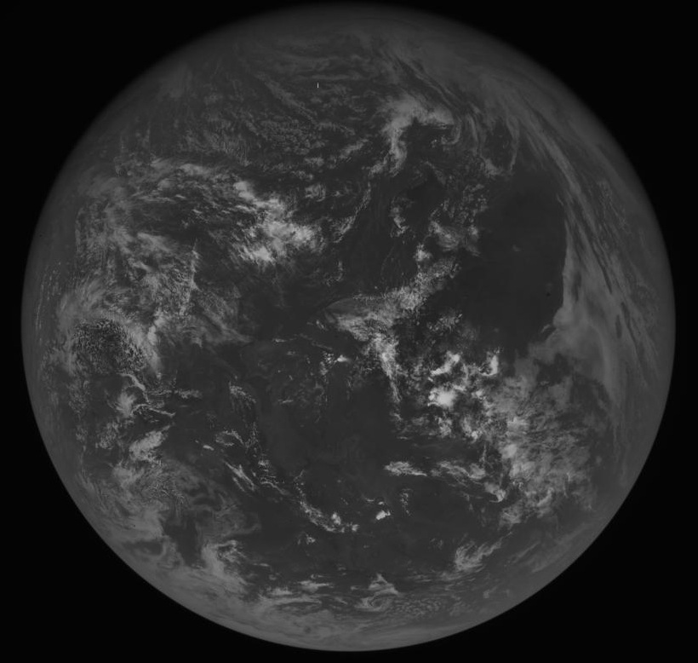
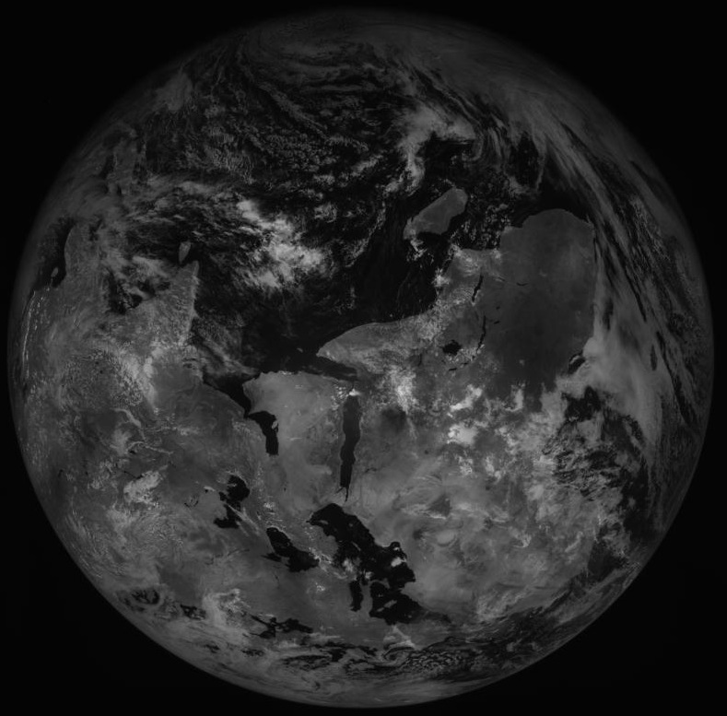
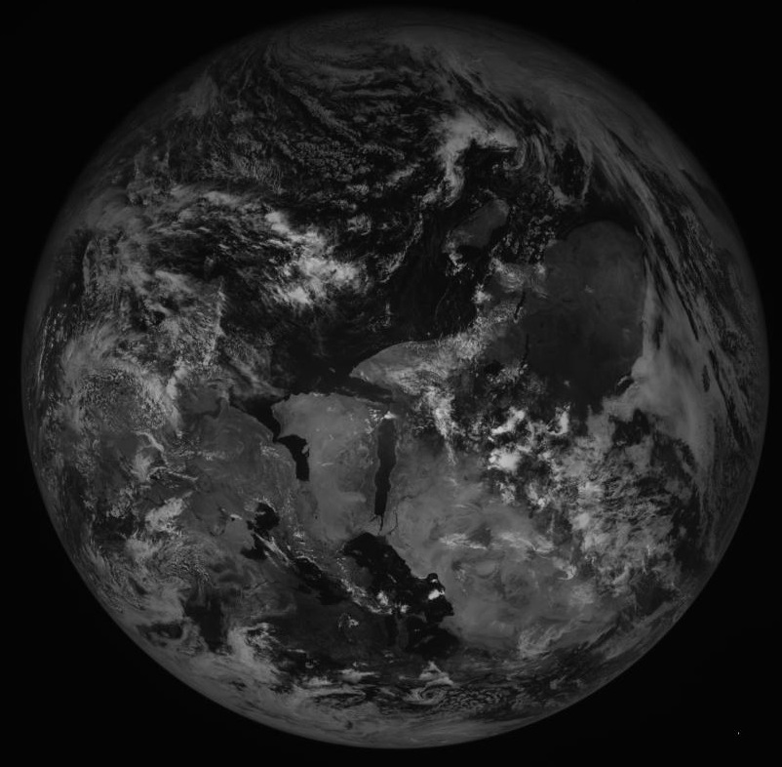
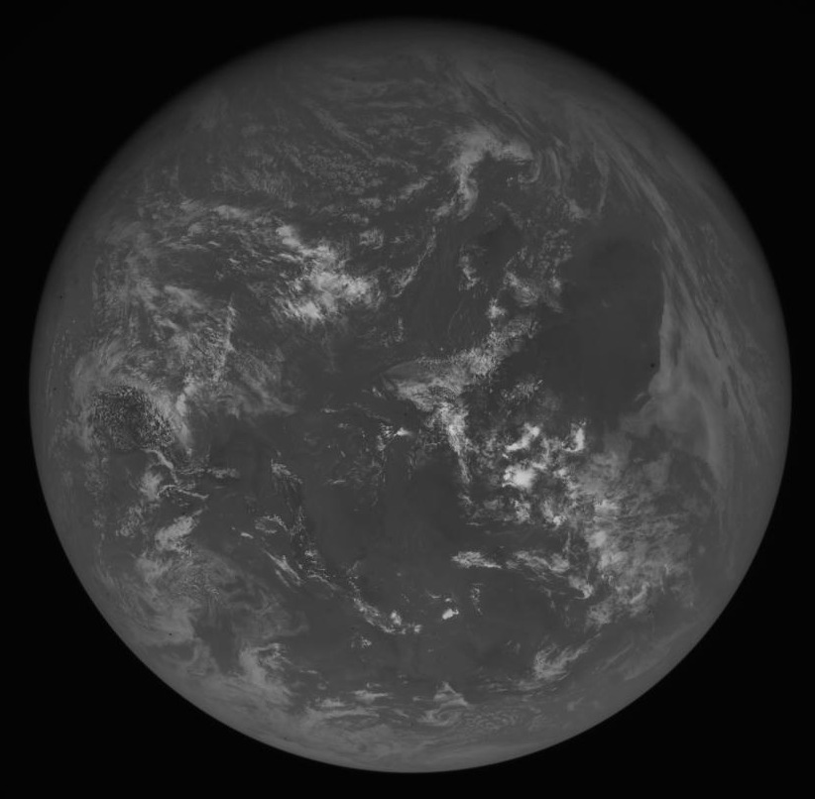
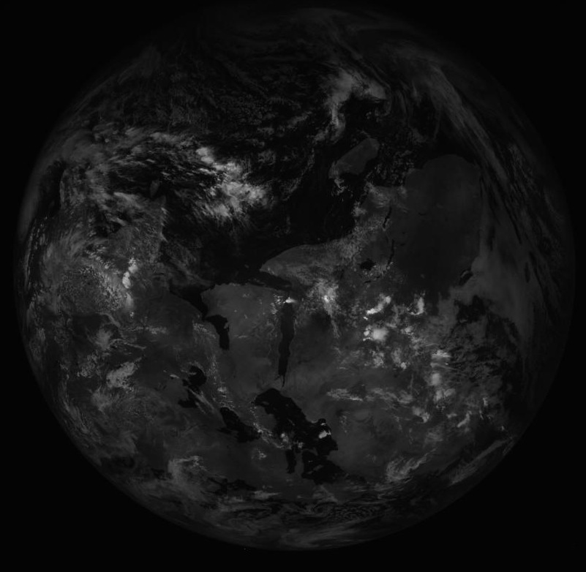
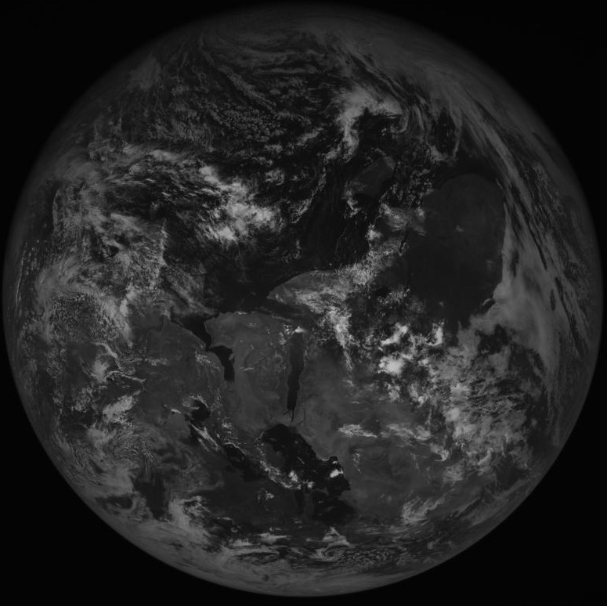
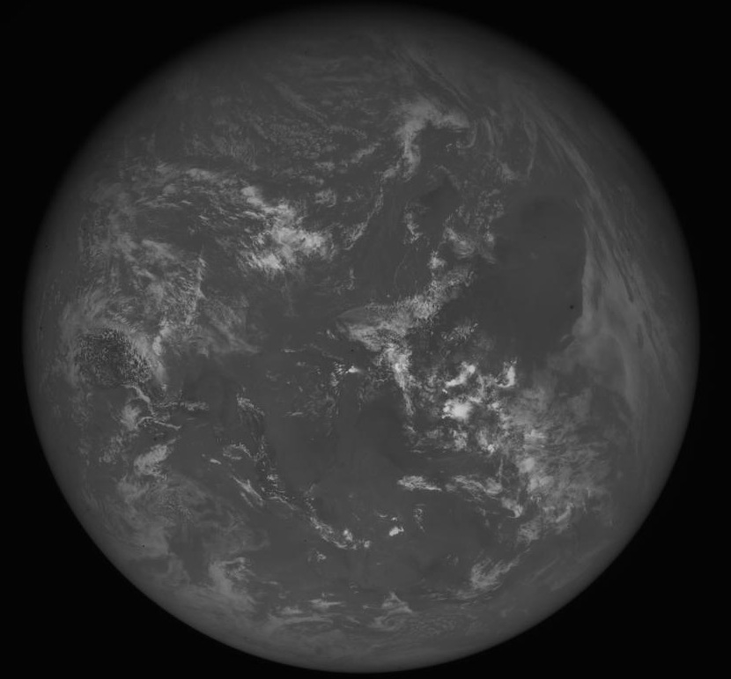
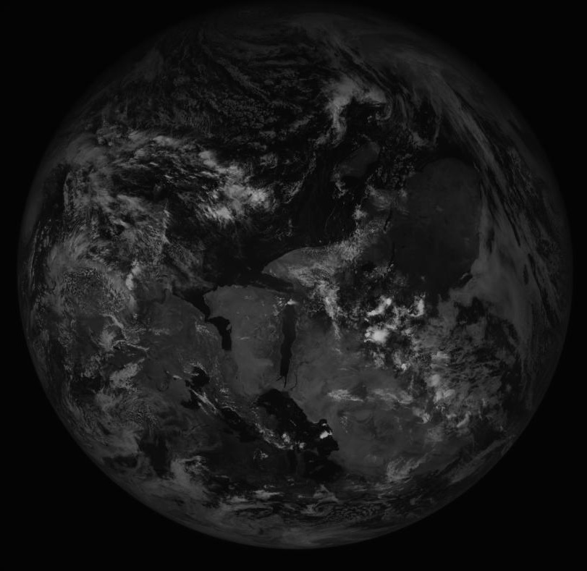
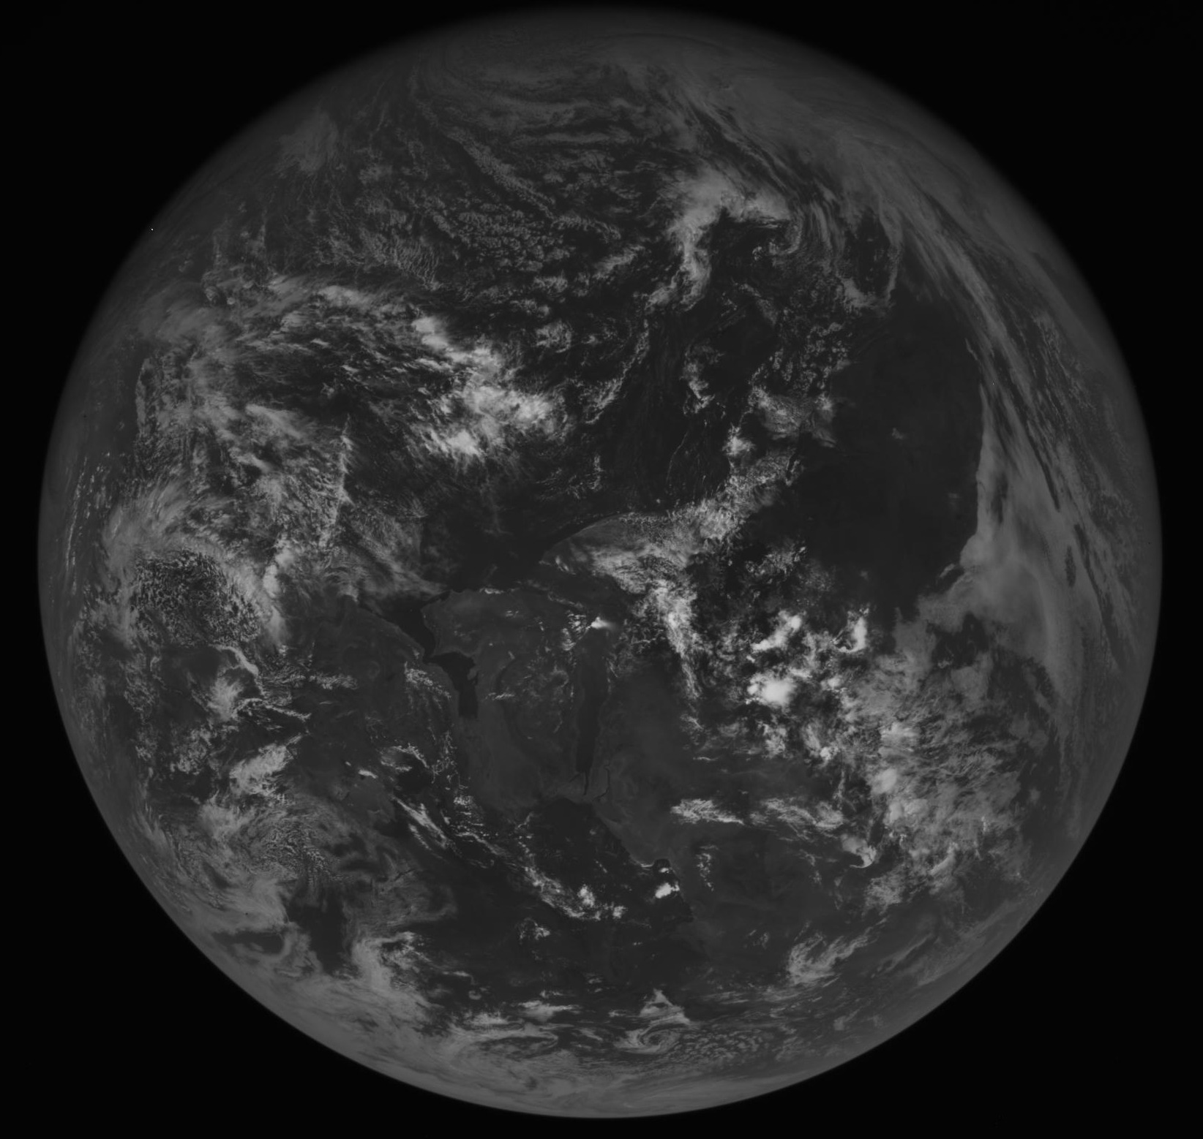
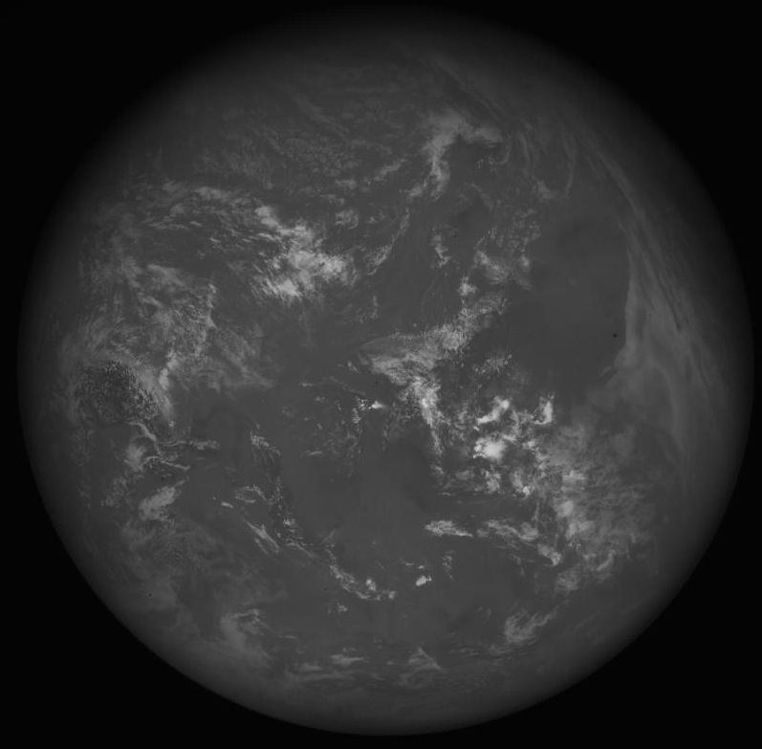
Wavelengths of EPIC
Ultraviolet
388 nm
Infrared
Visible
780 nm
680 nm
340 nm
764 nm
551 nm
325 nm
317 nm
688 nm
443 nm

Slide 6
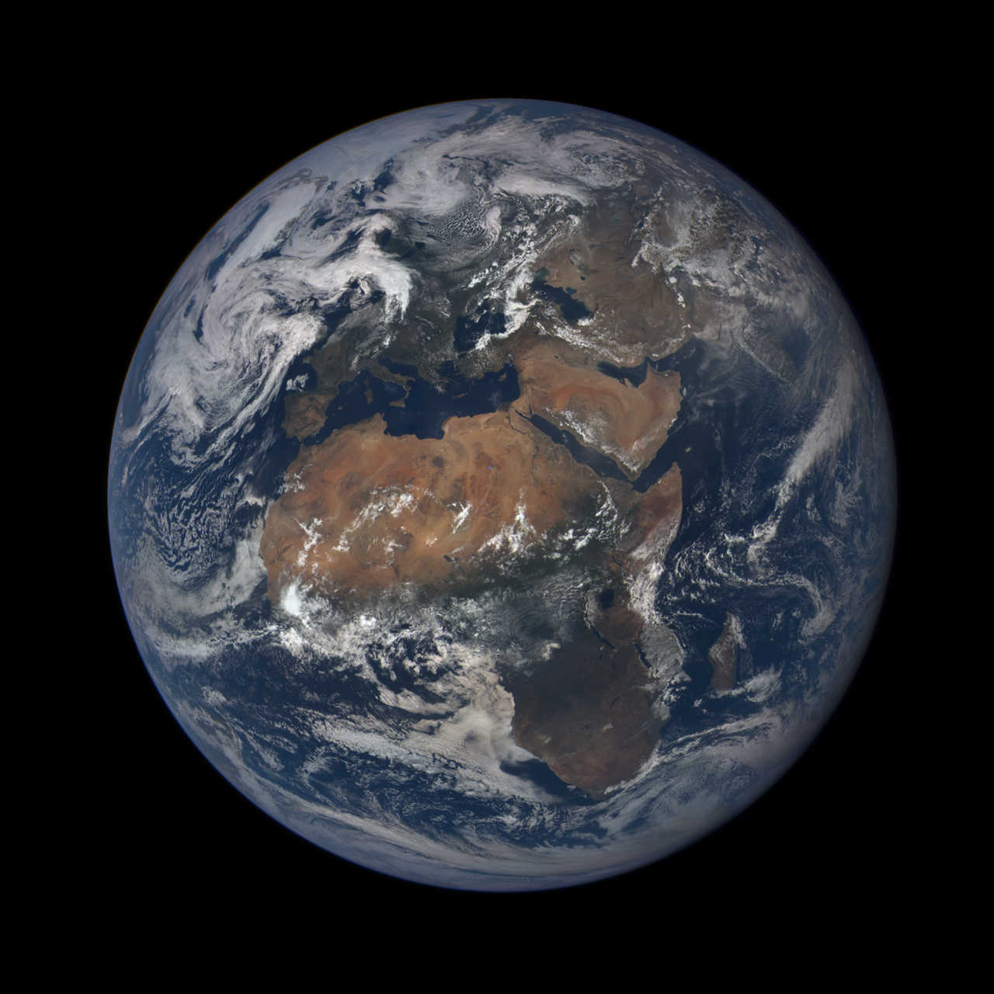

Slide 7
Spacecraft Rotation
3D Model (Earth)
- Geoid
- Terrain
Location (Ephemeris)
- Earth
- Spacecraft
Pose (Astronomical)
- Spacecraft
-Attitude (X,Y offset)
-Spacecraft->Earth orientation (Z rotation)
-Earth
  -Tilt (Y rotation)
    -Precession
    -Nutation
  -Sidereal Time (X rotation)
Time Rotation
Drawing (2D->3D)
-Telescope Optical Model
-Sensor Model
-Atmospheric Refraction

Slide 8

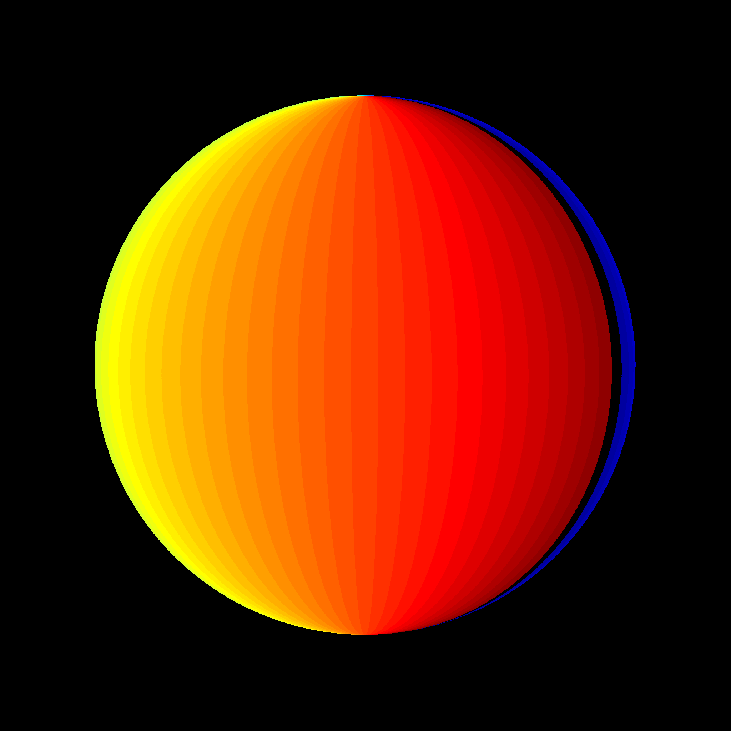
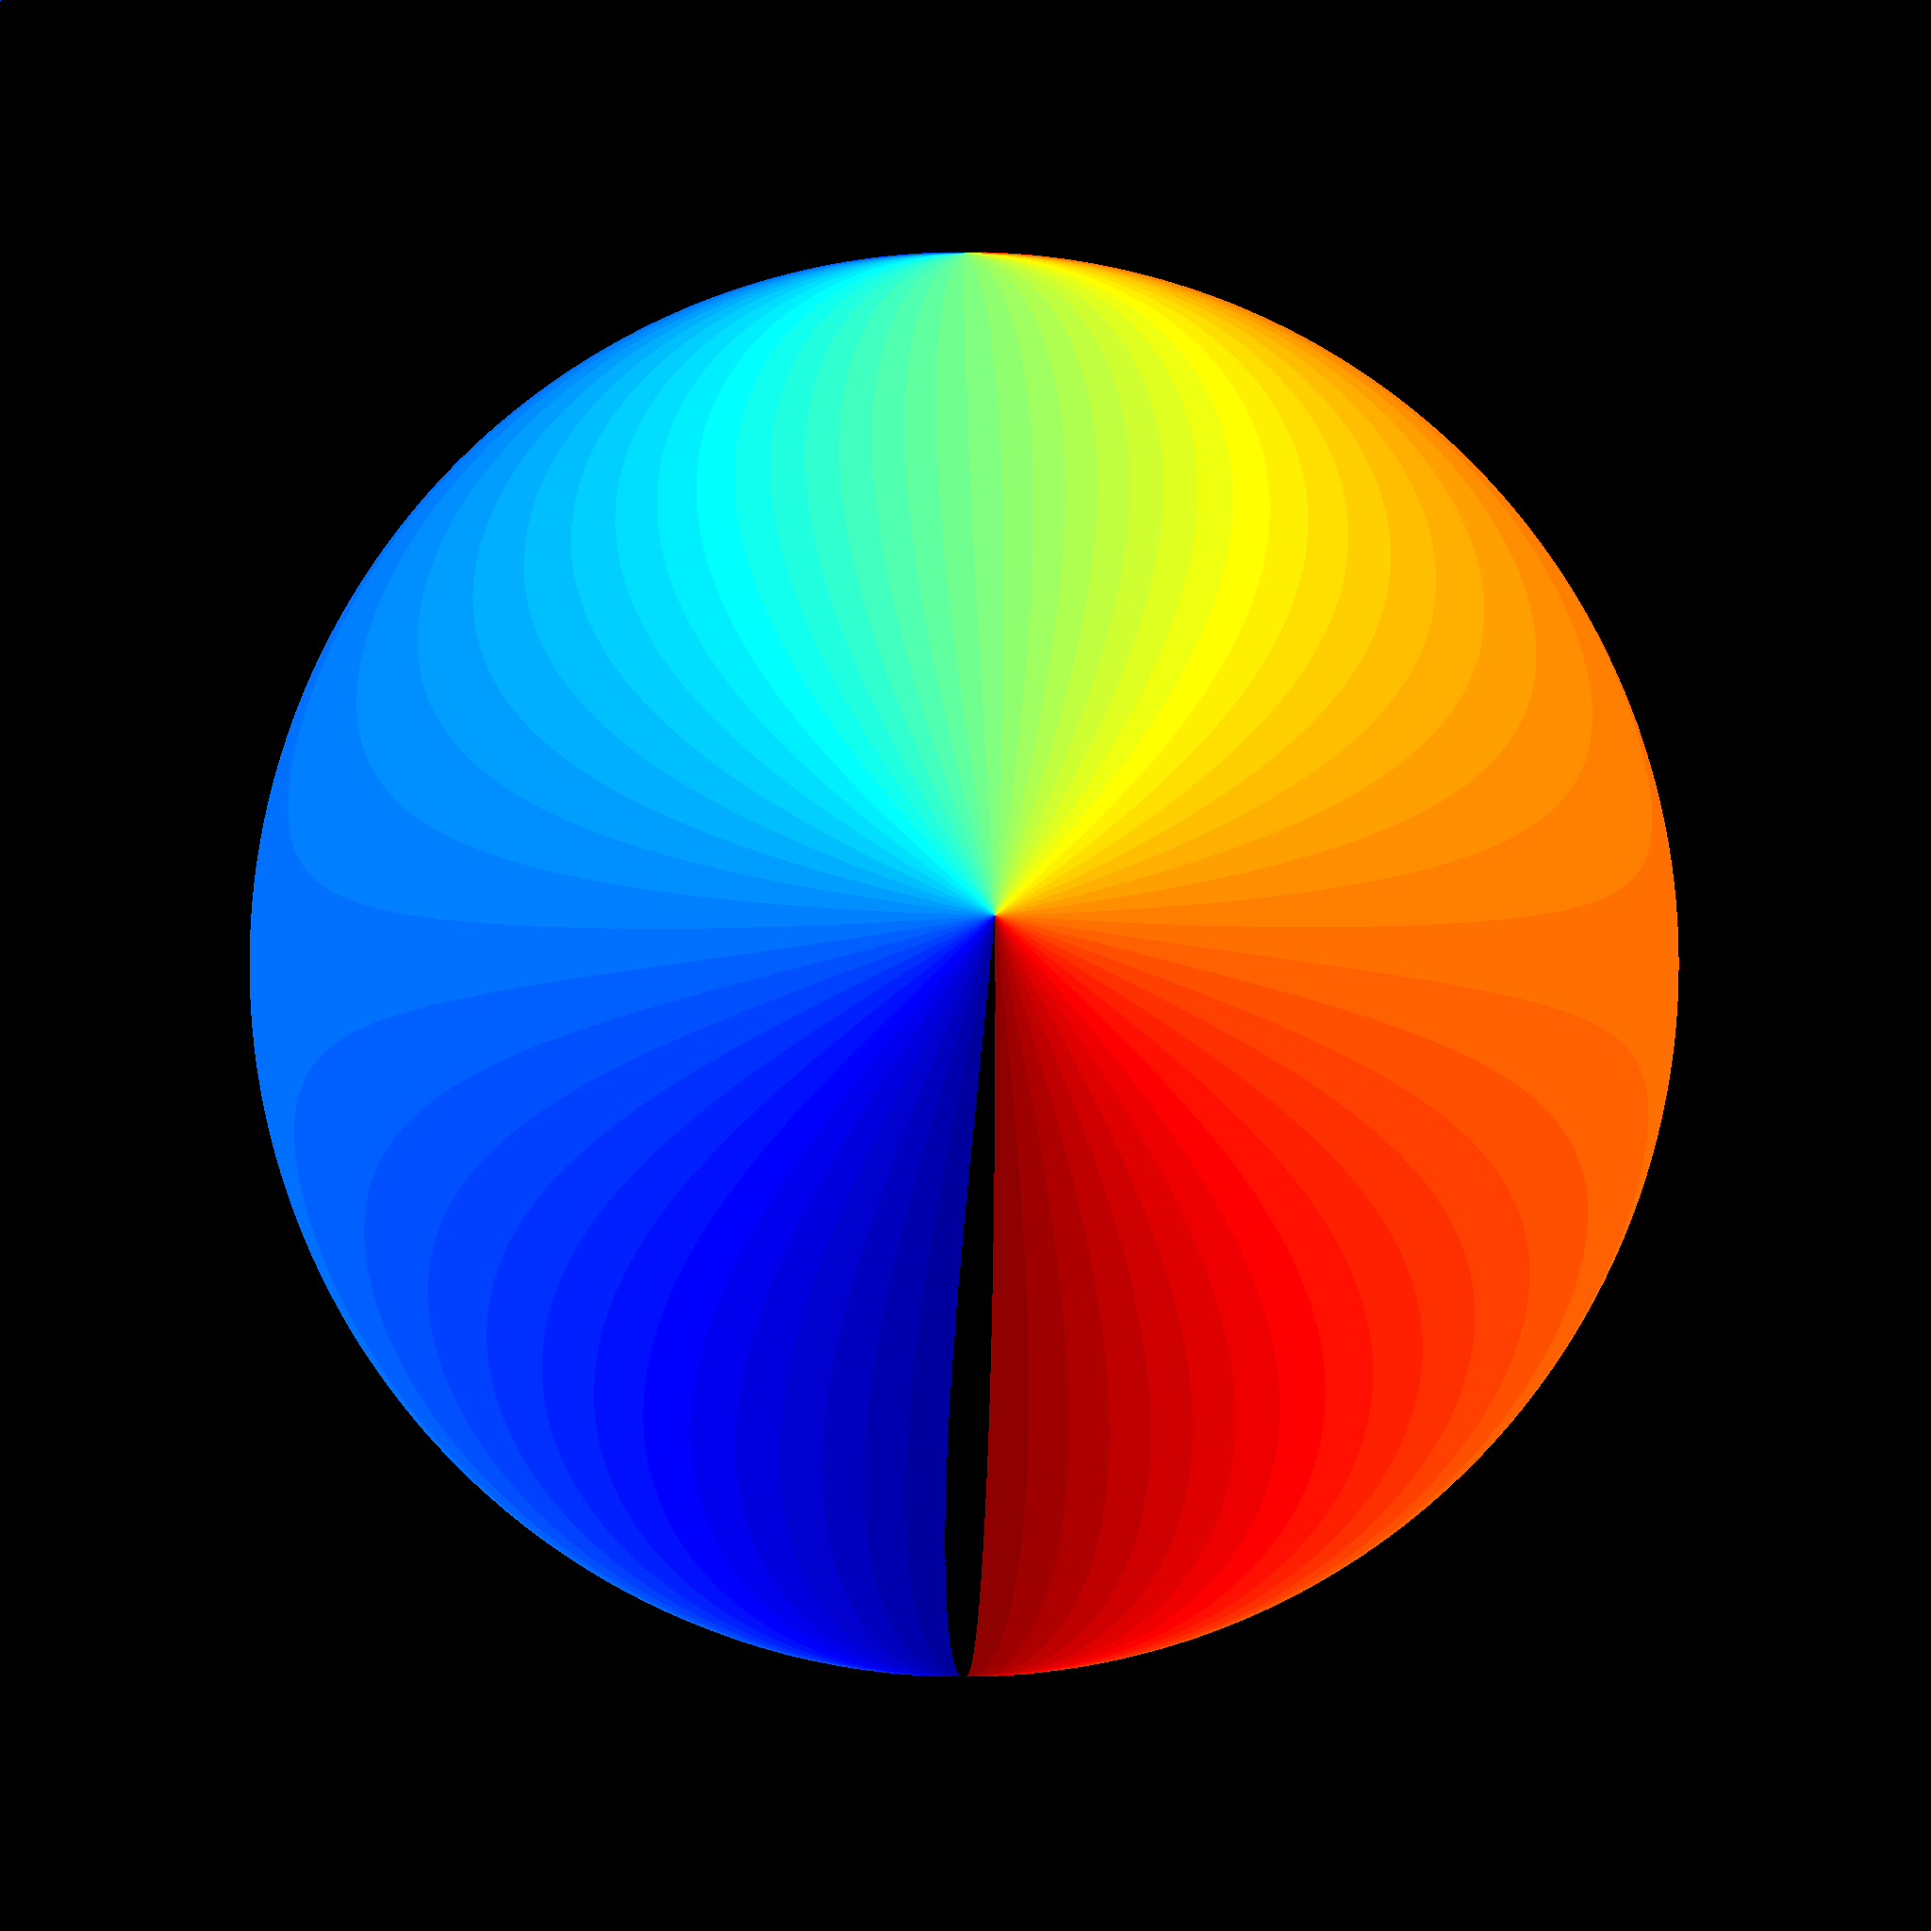
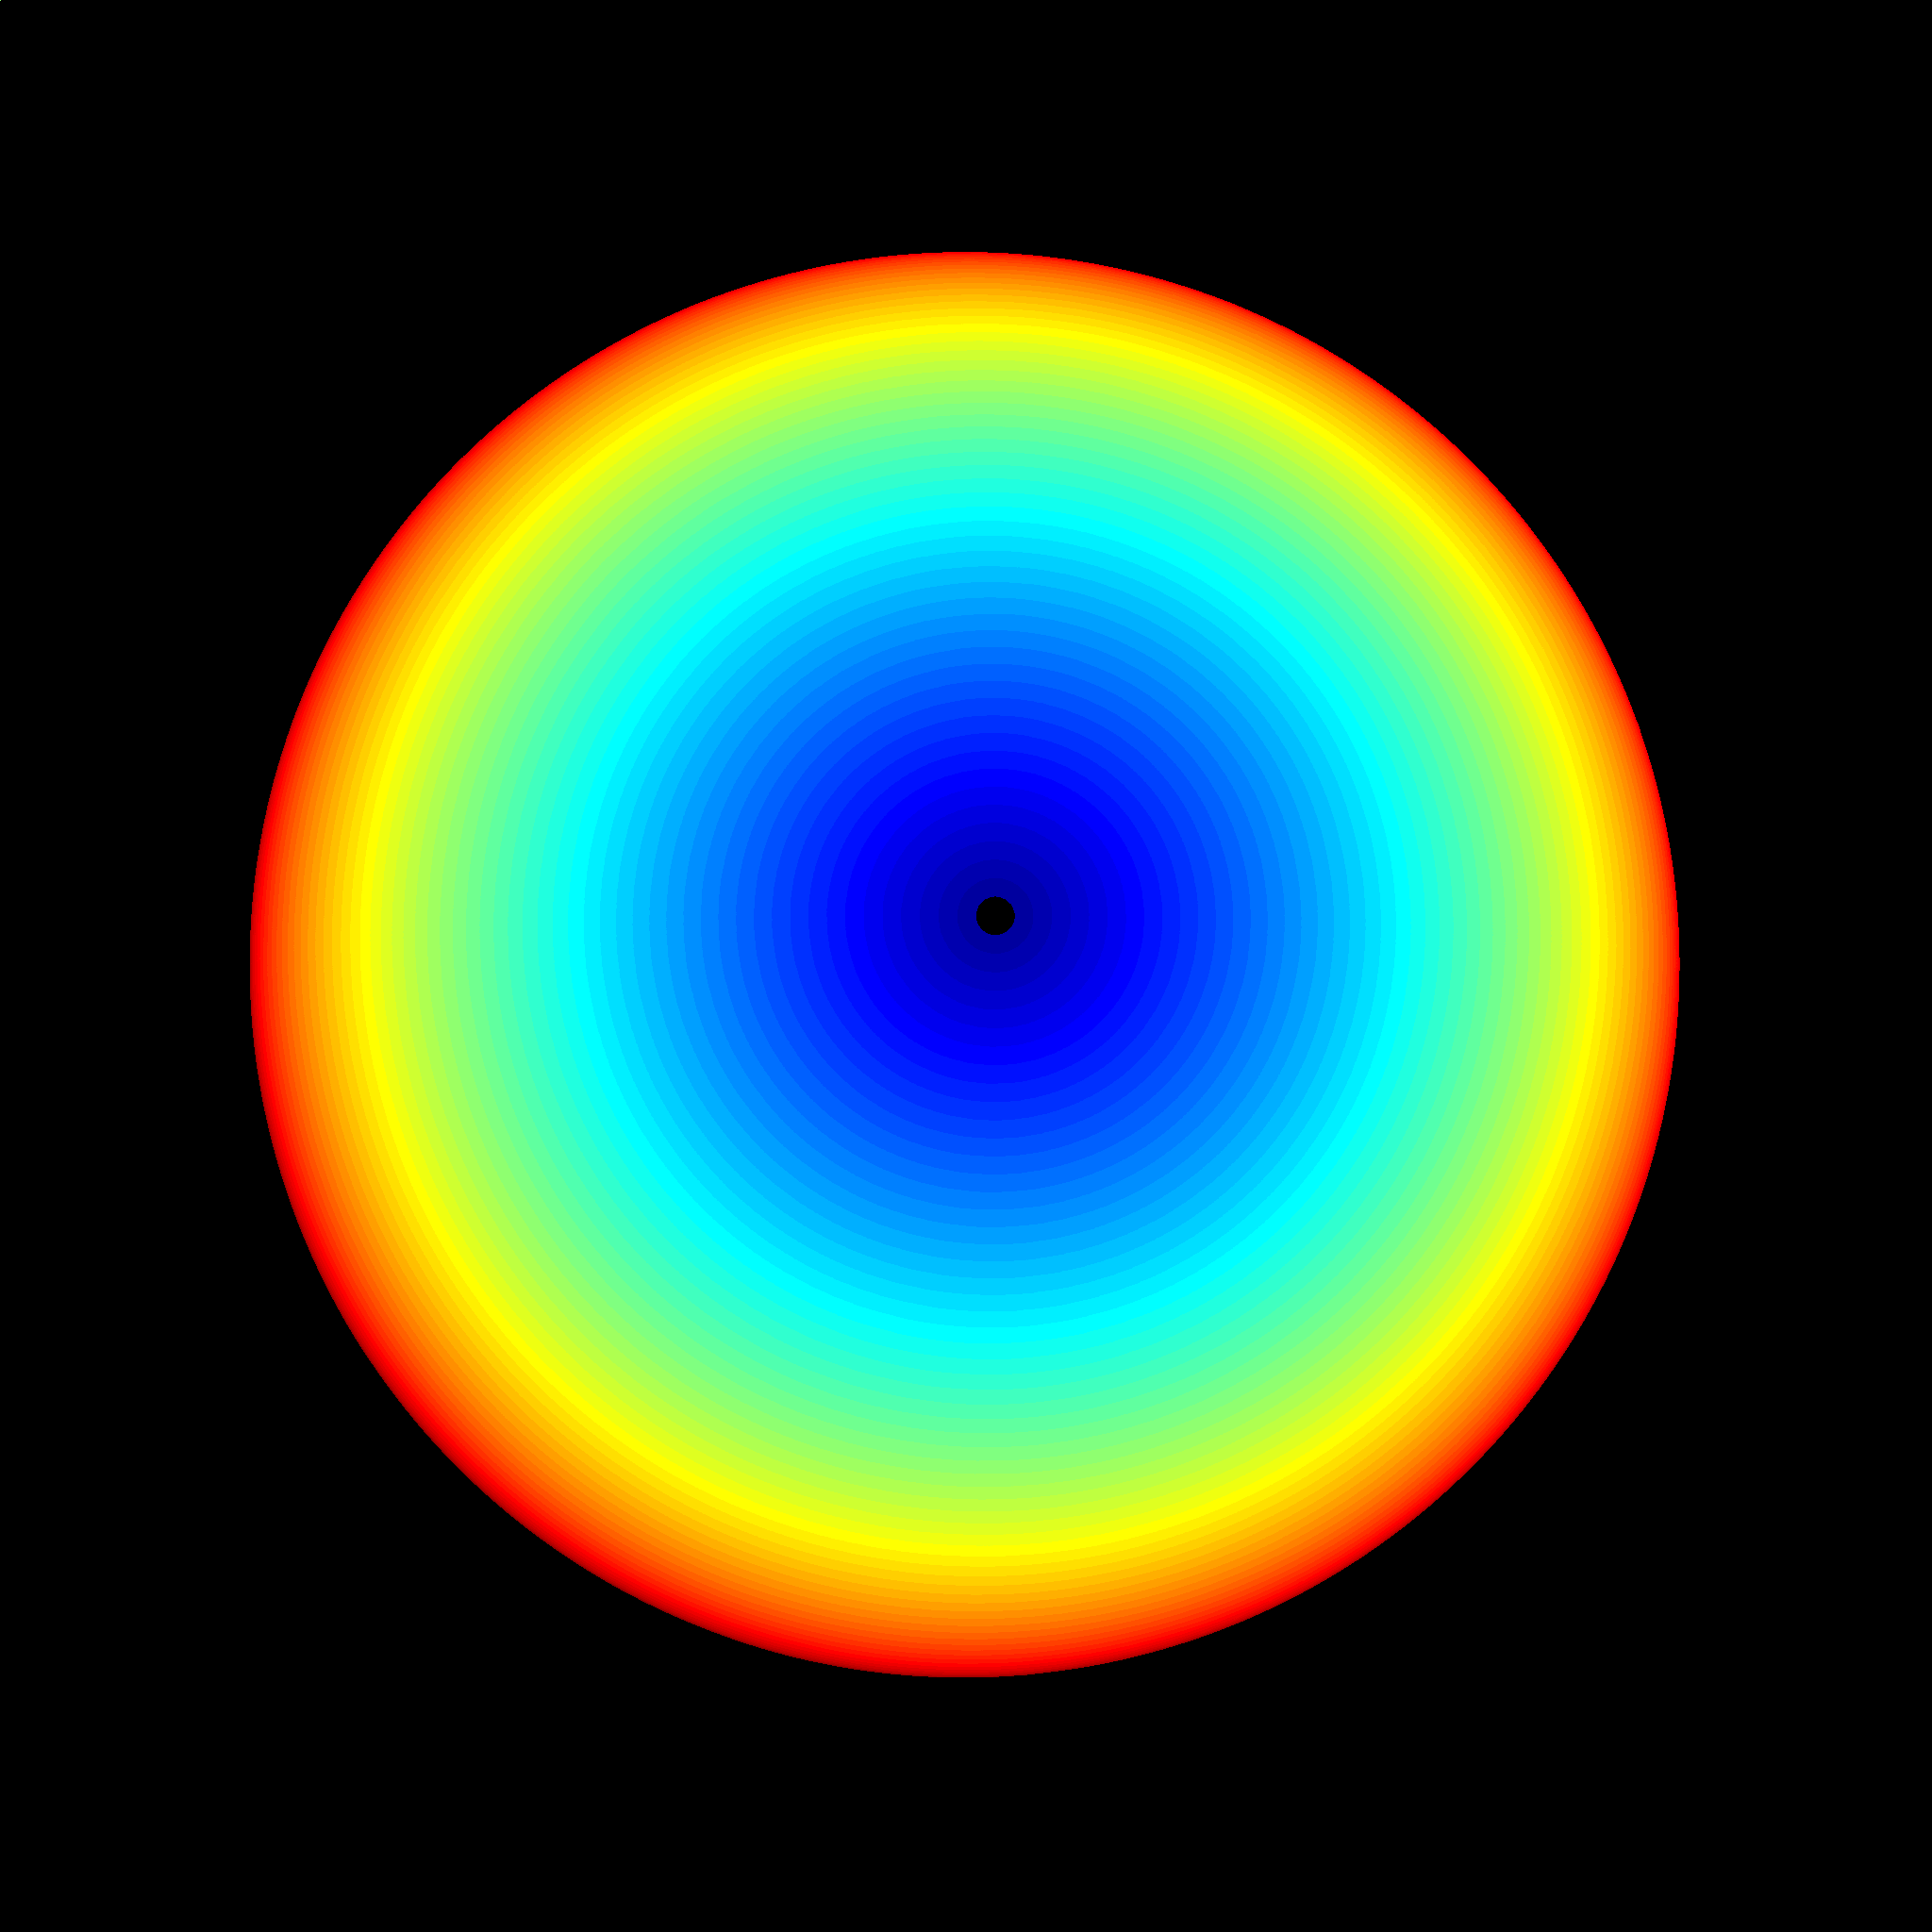
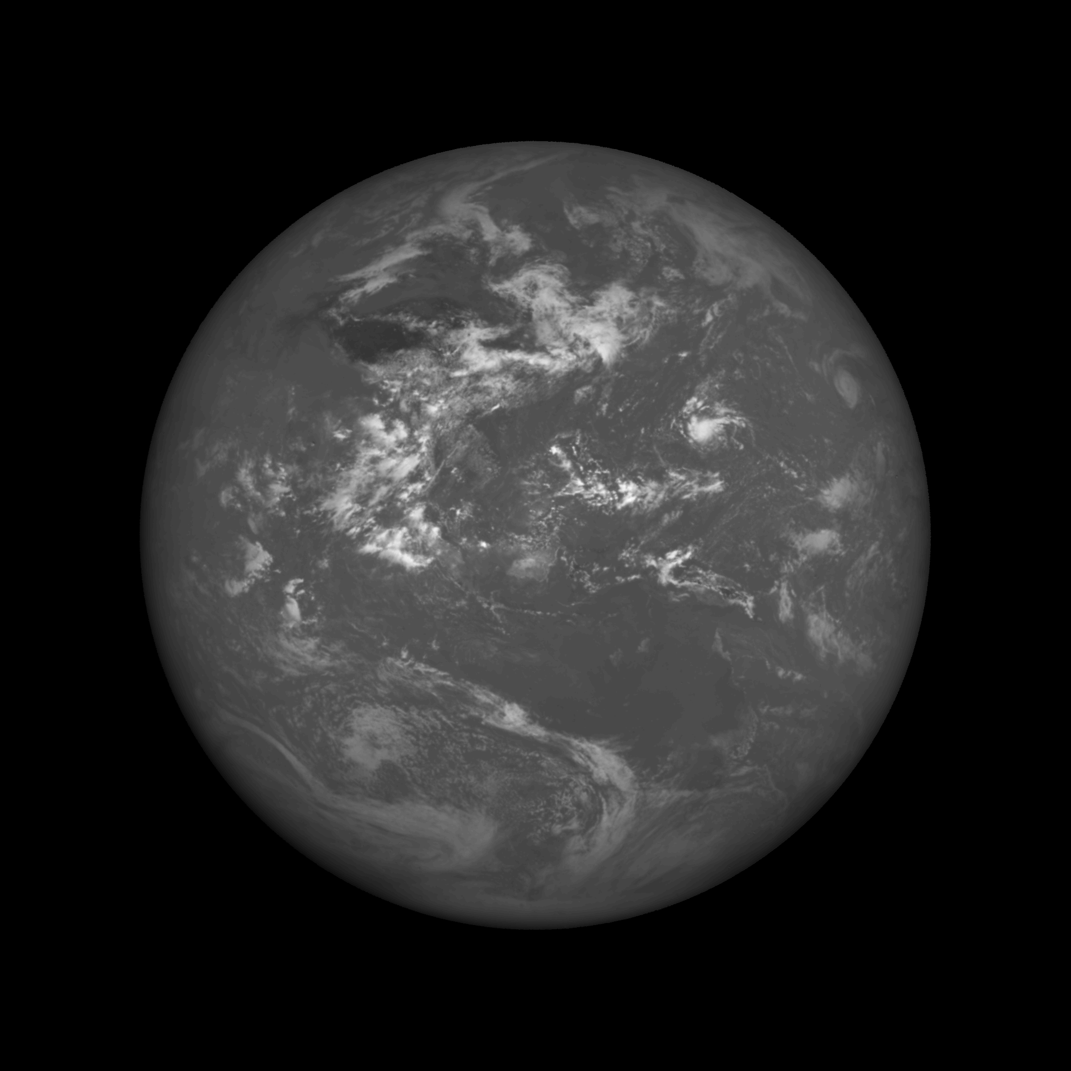
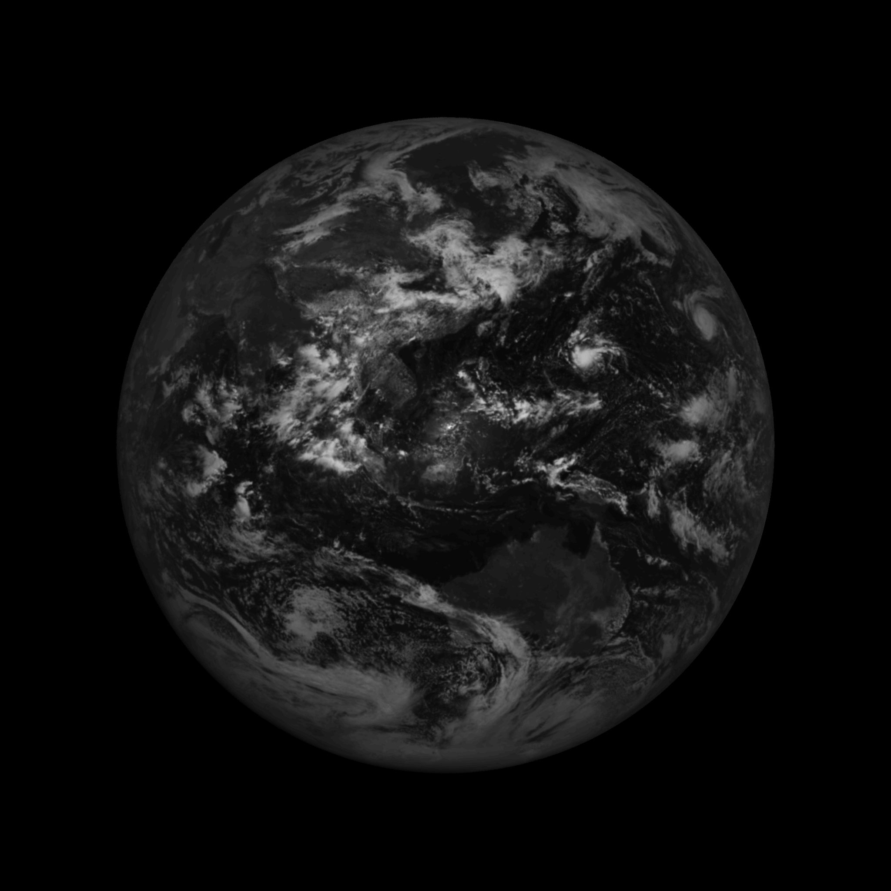
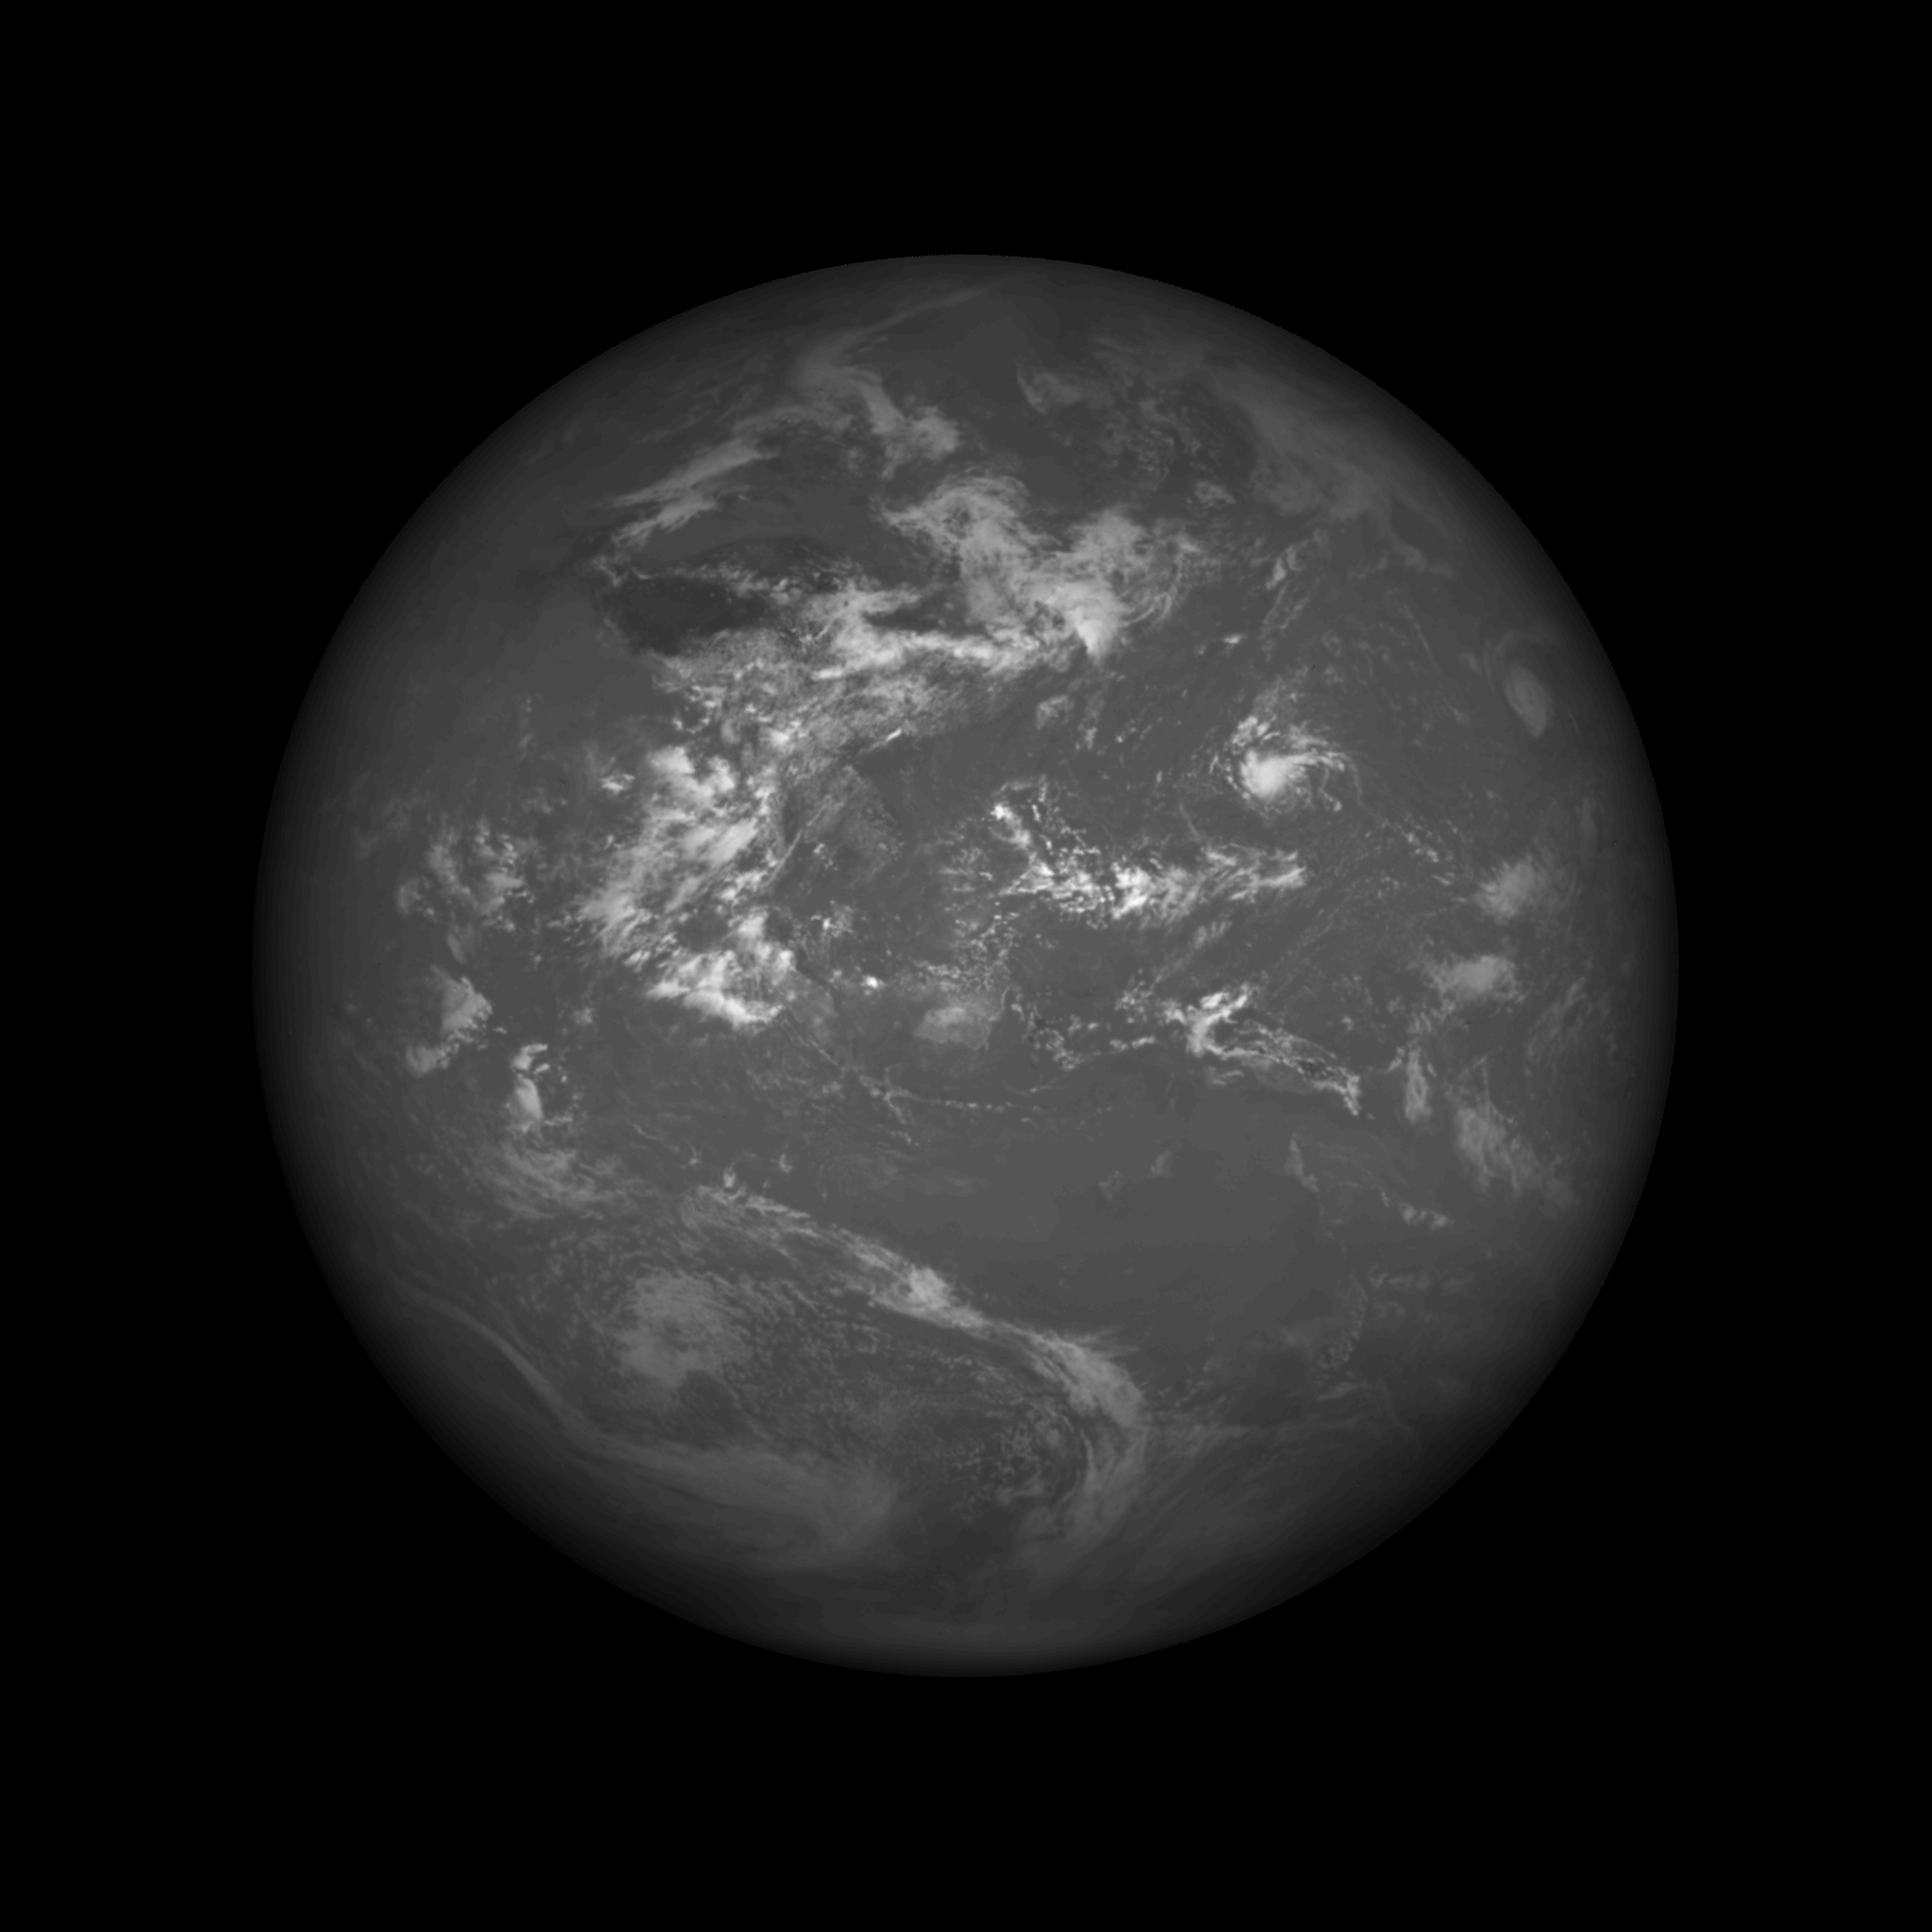
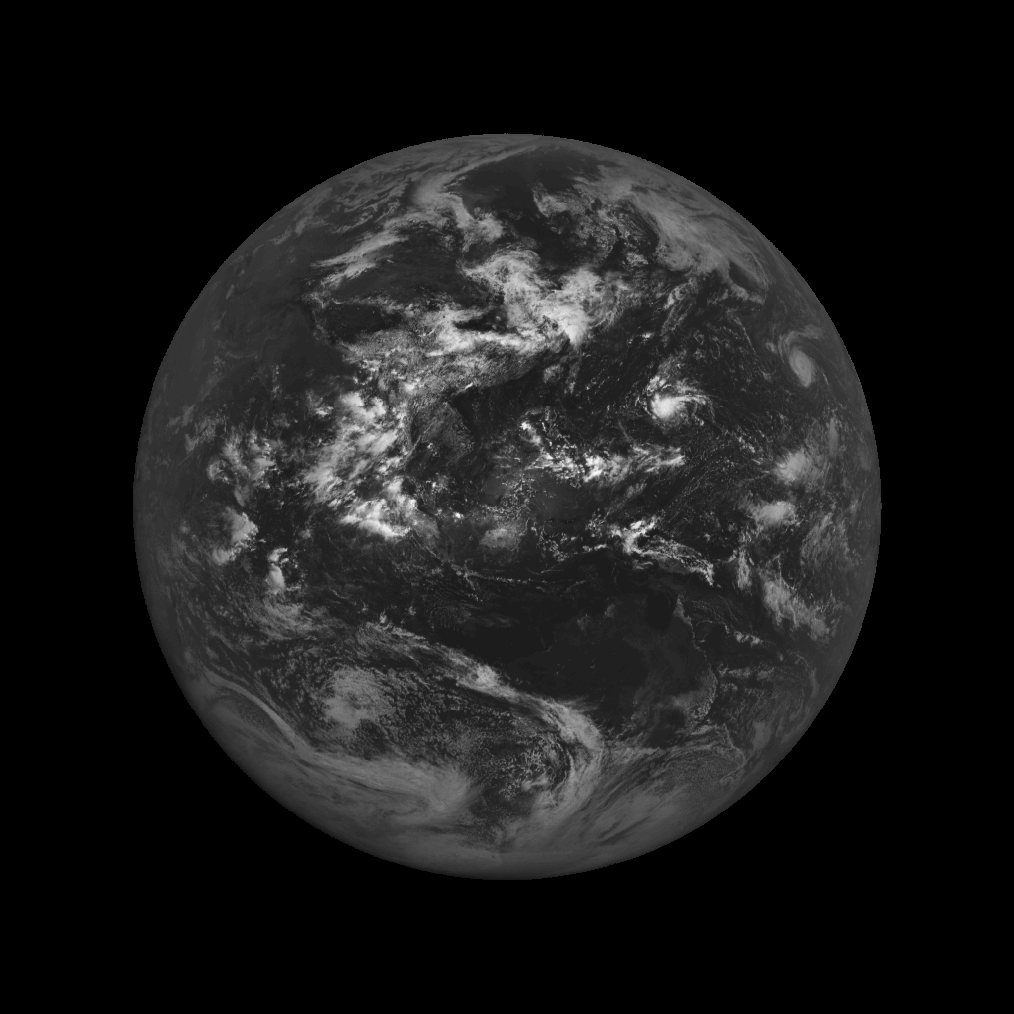
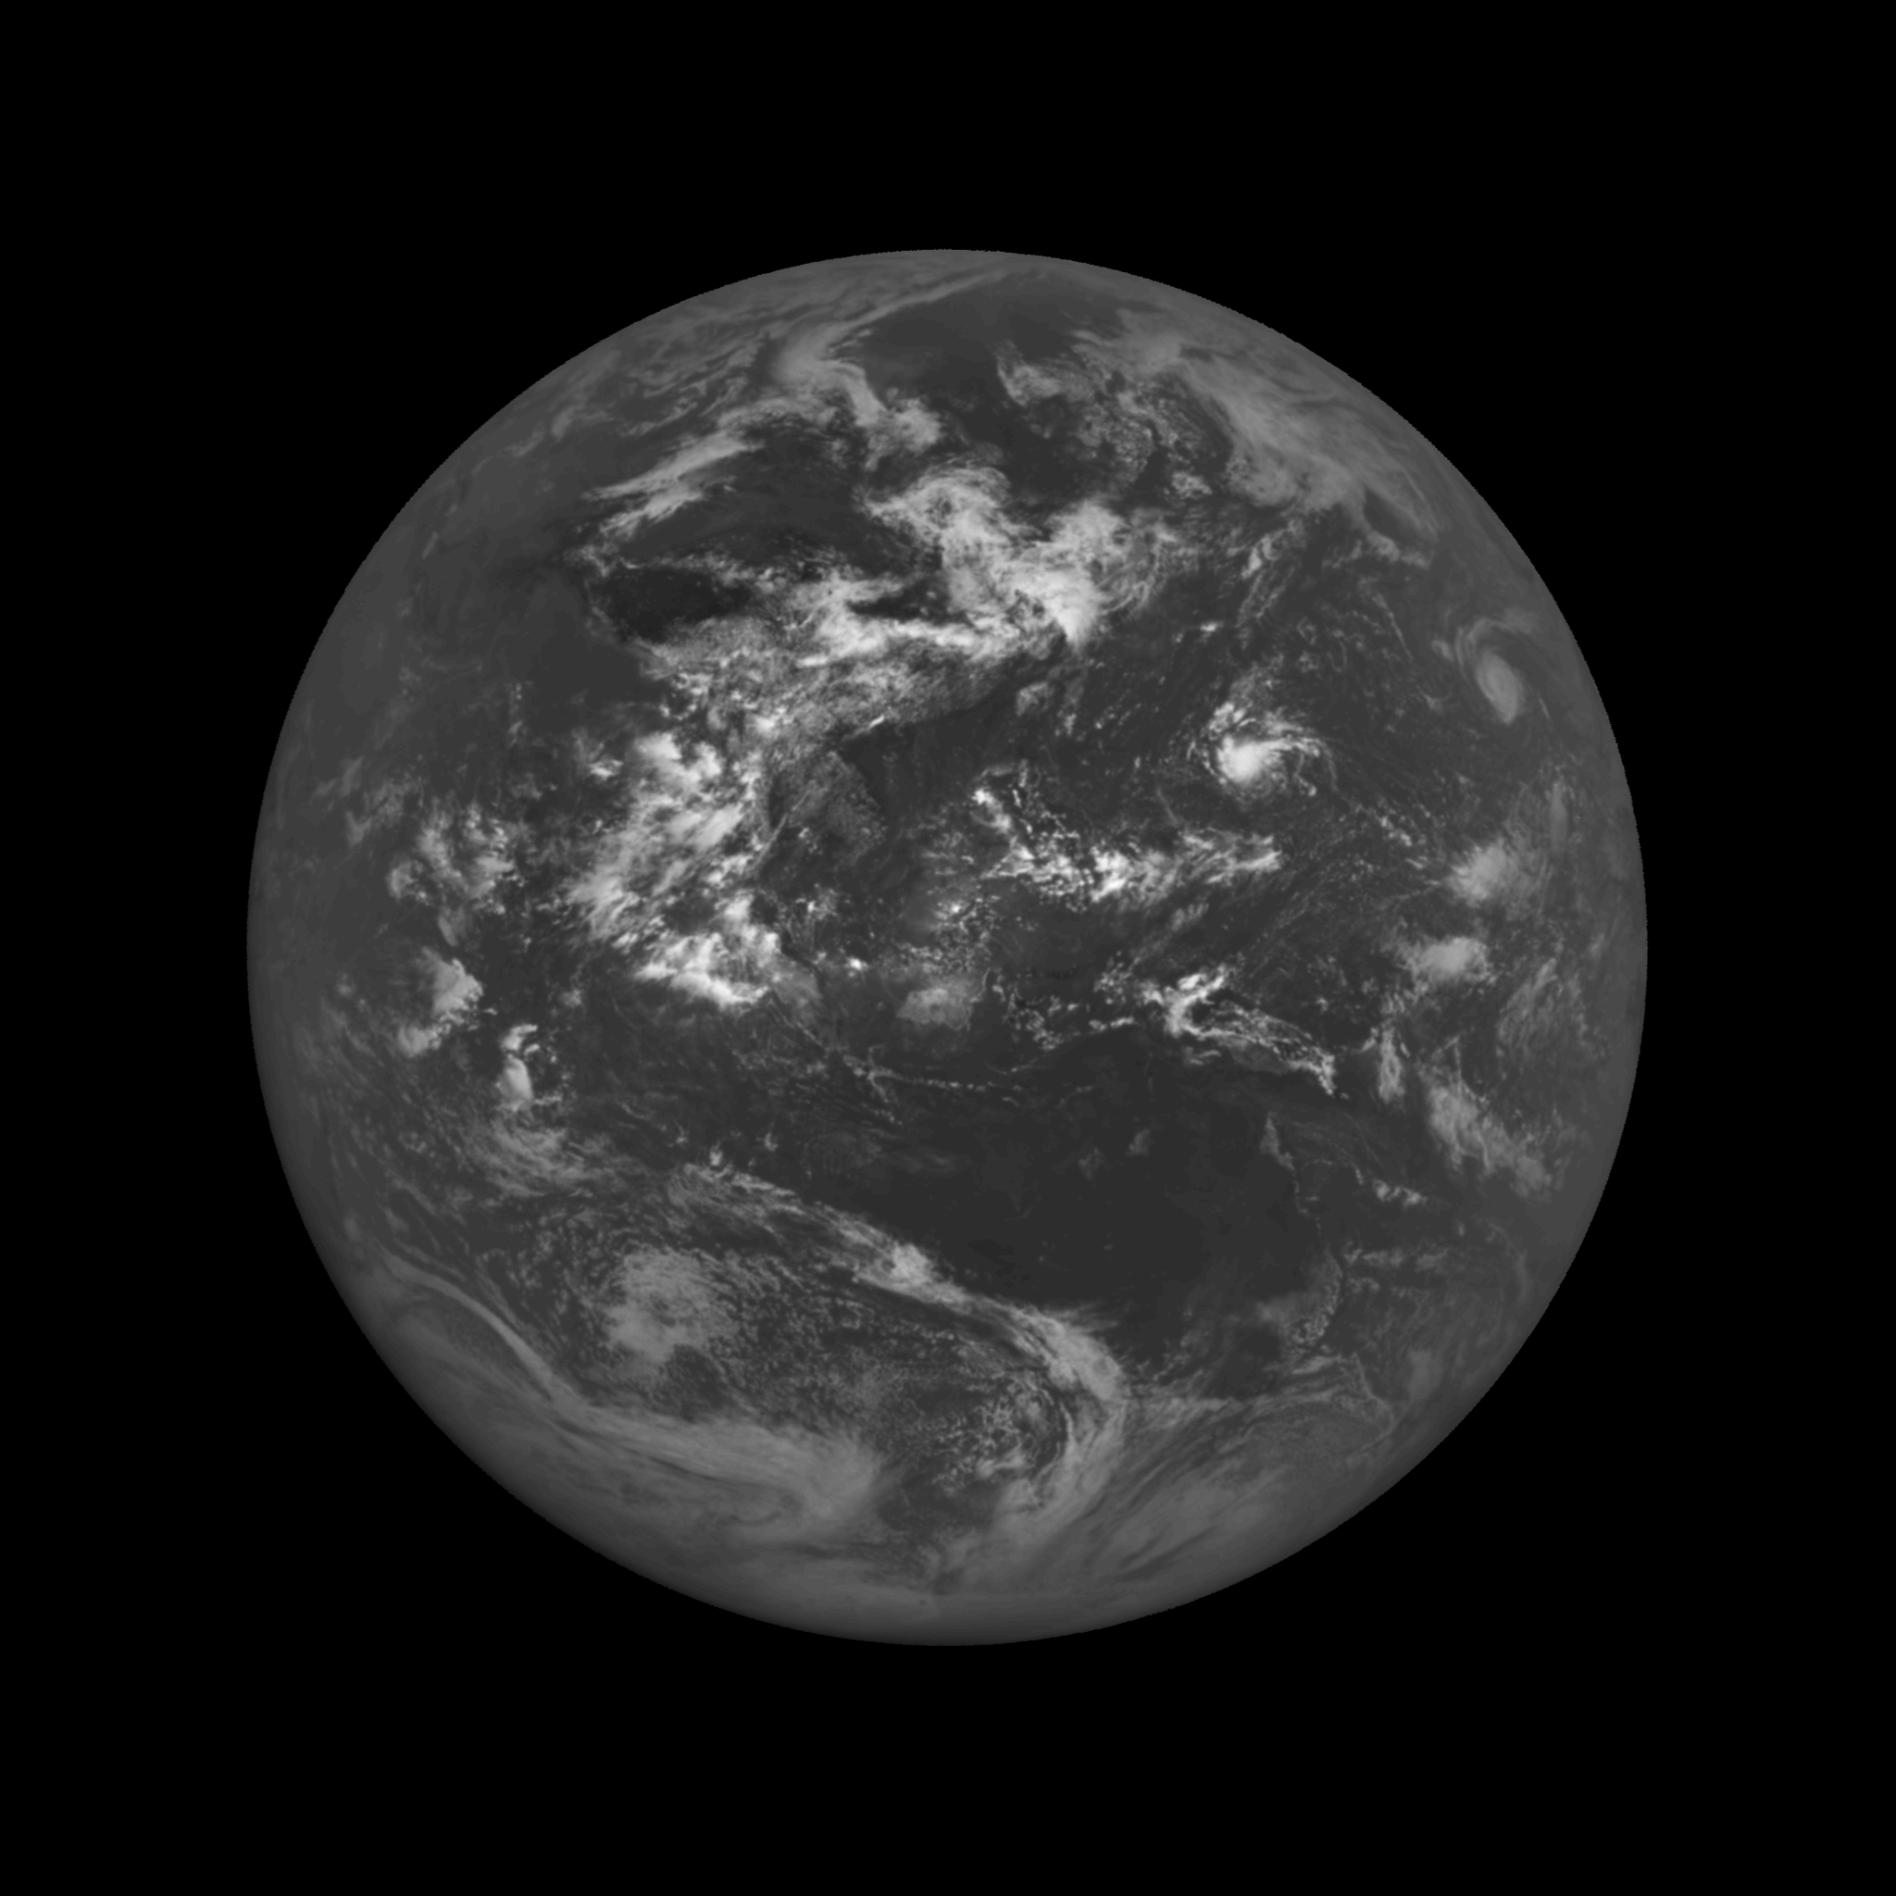
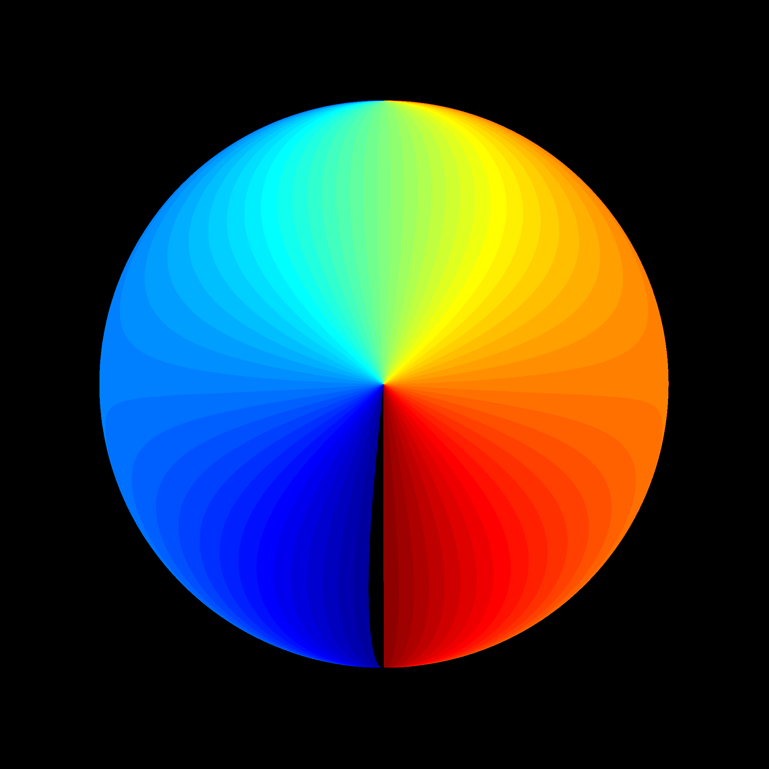
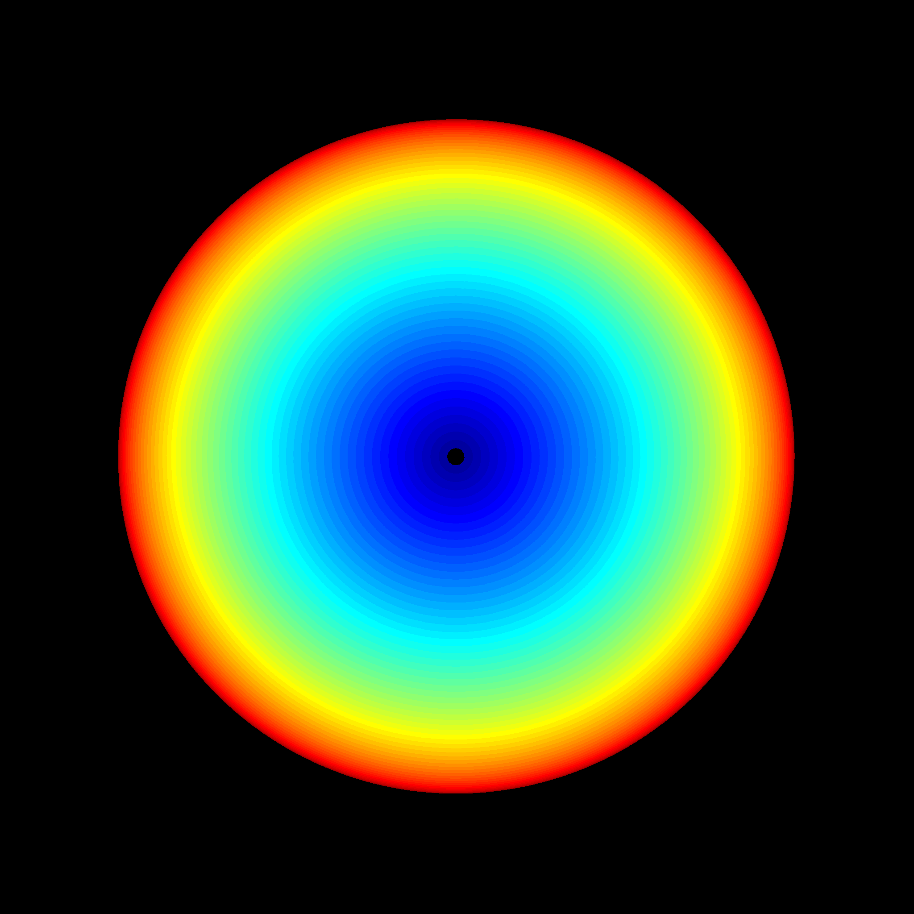
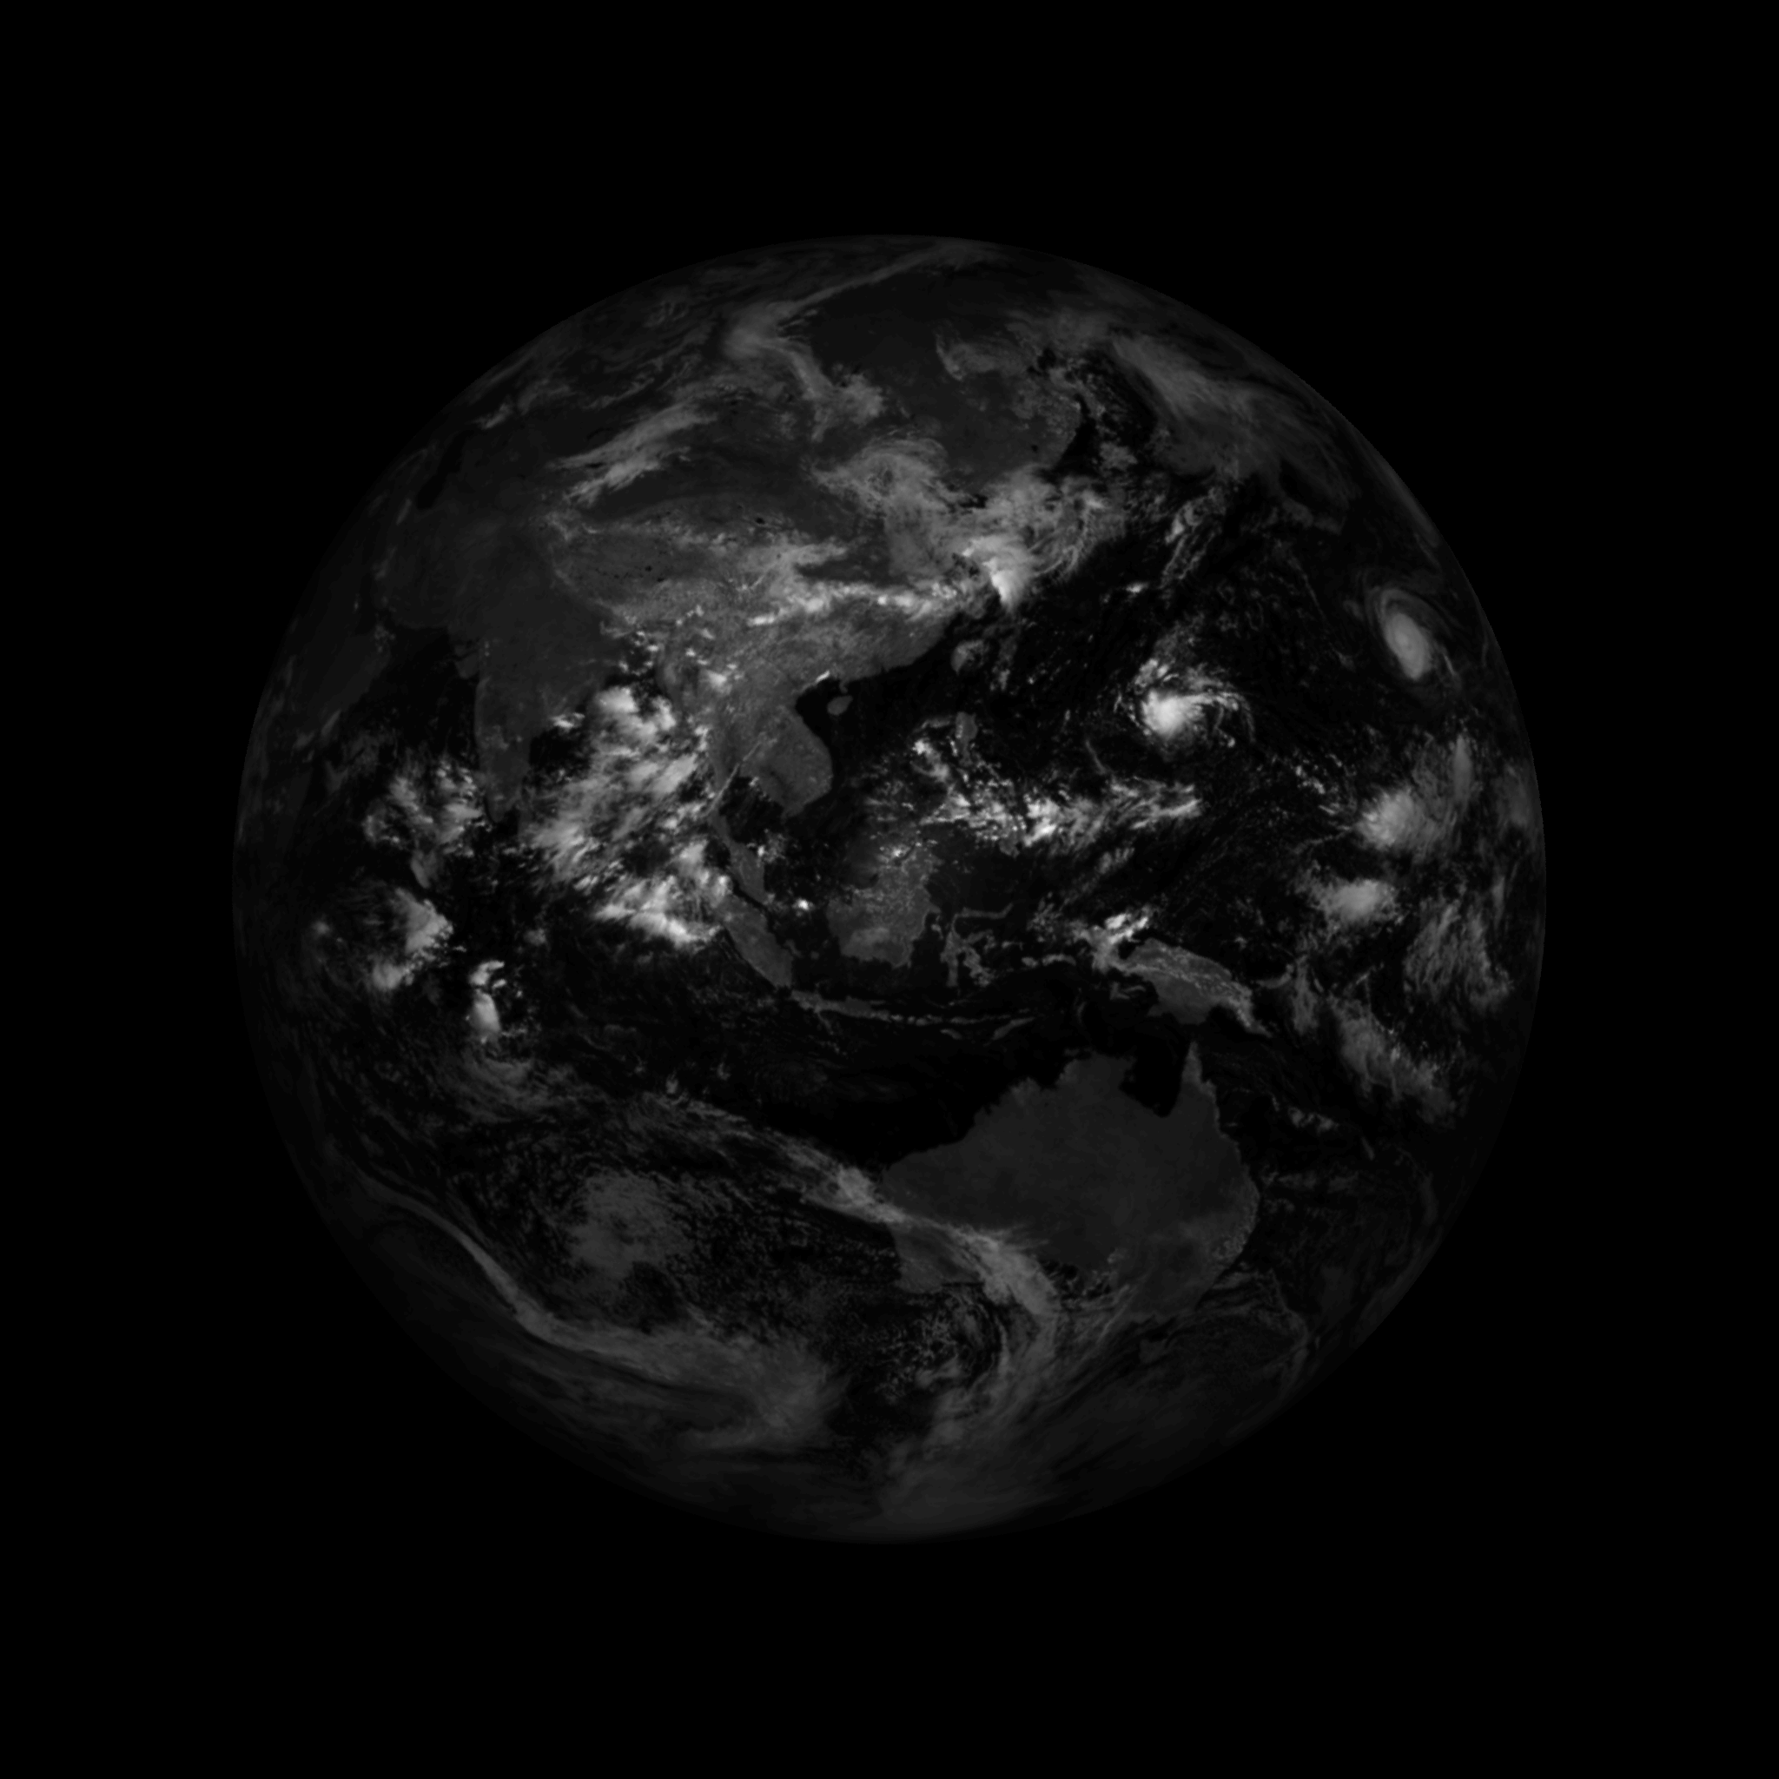
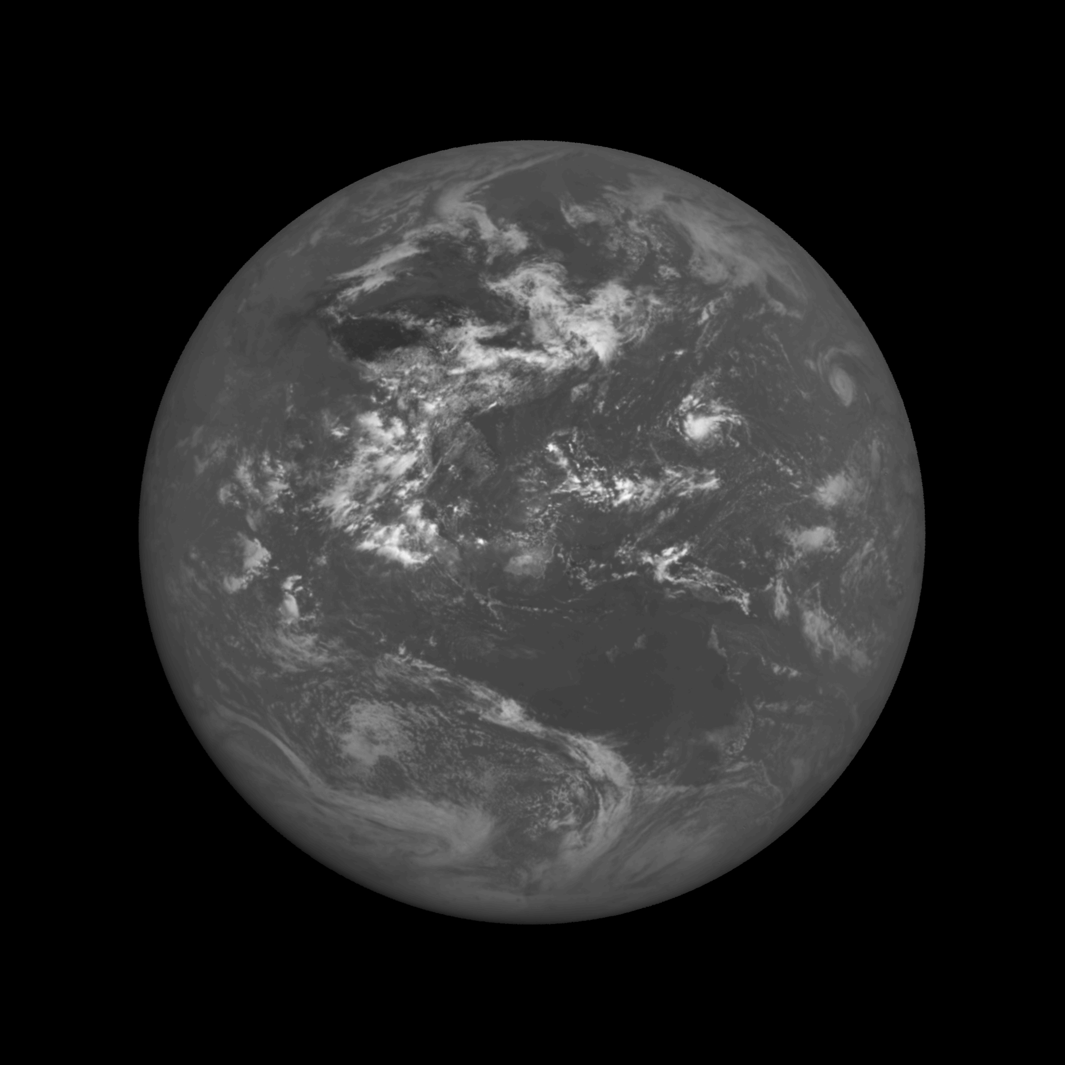
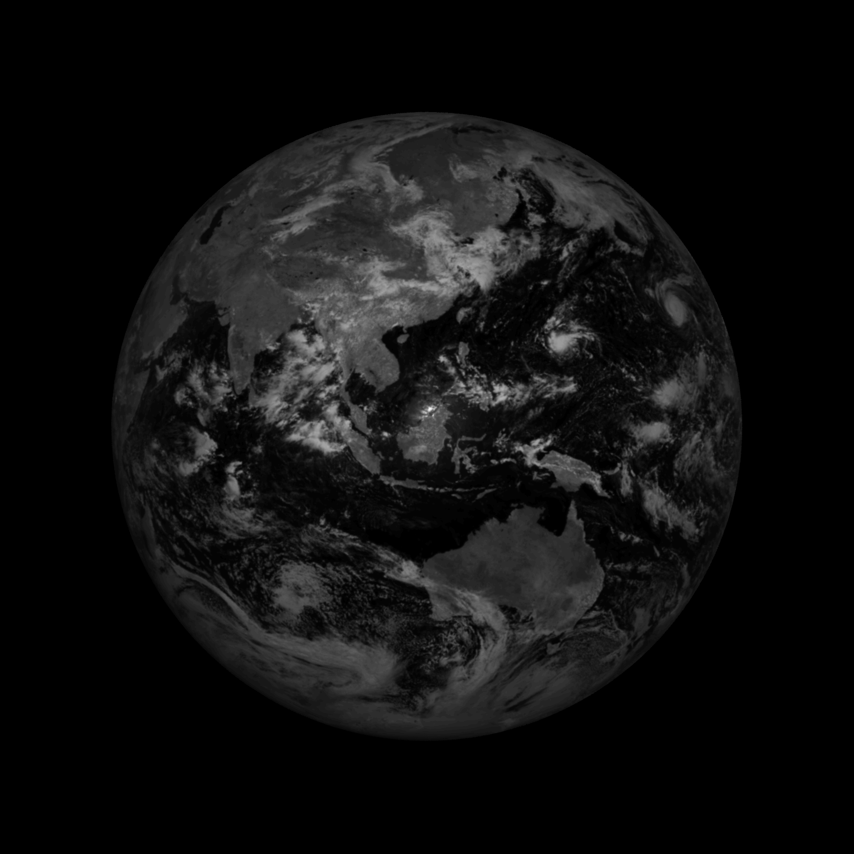
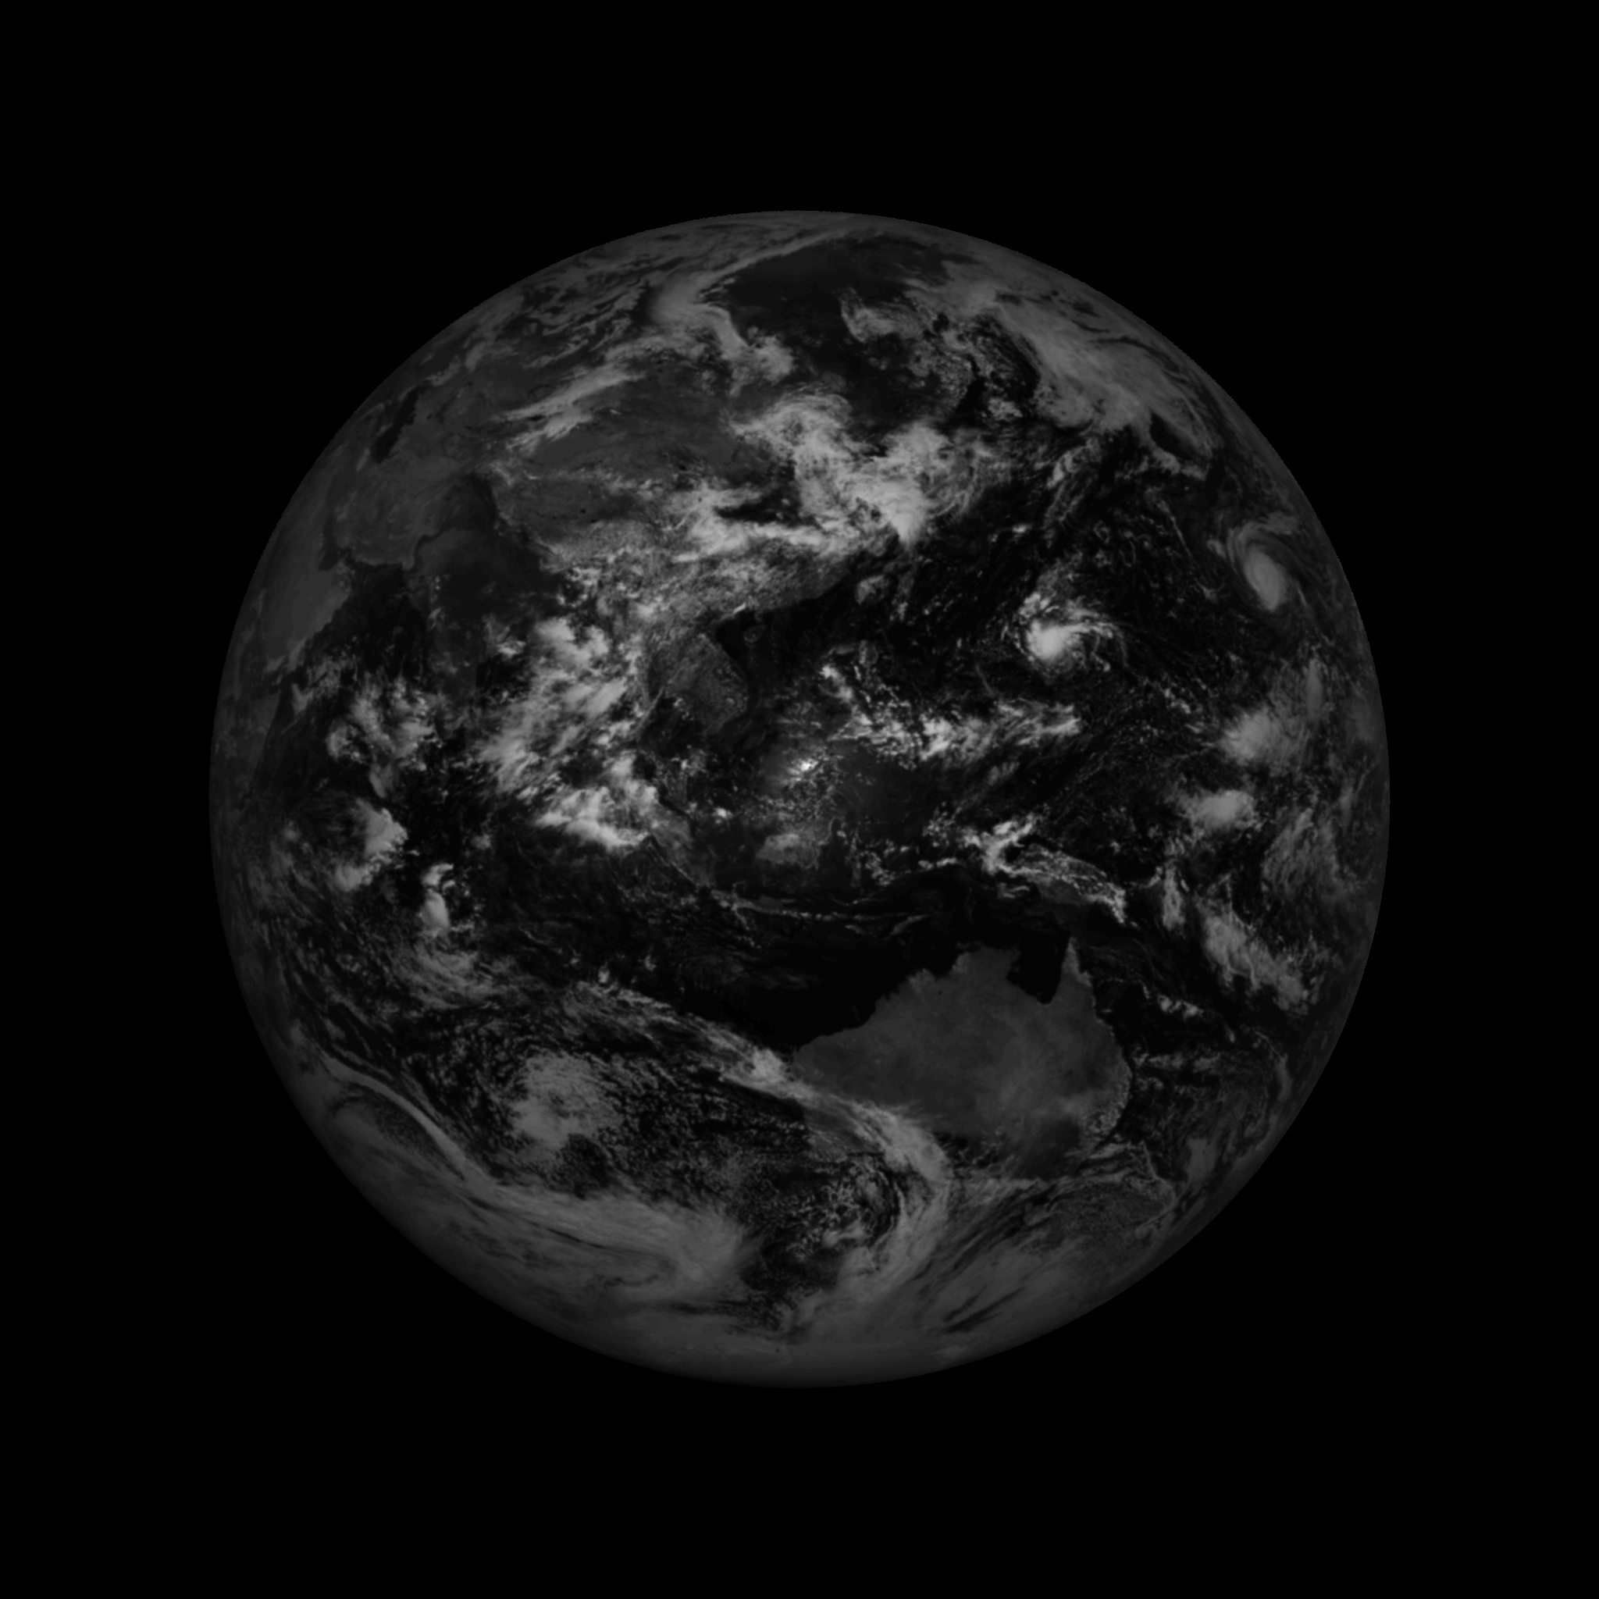
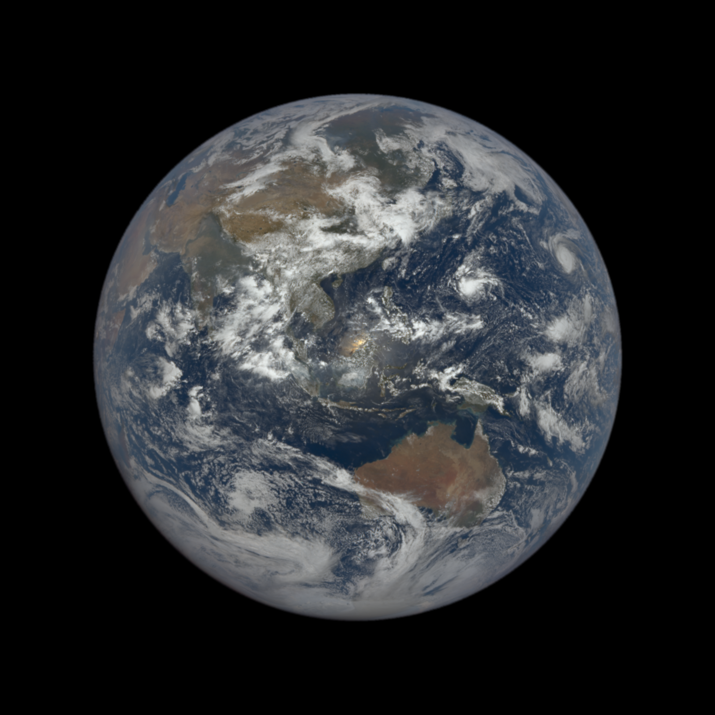
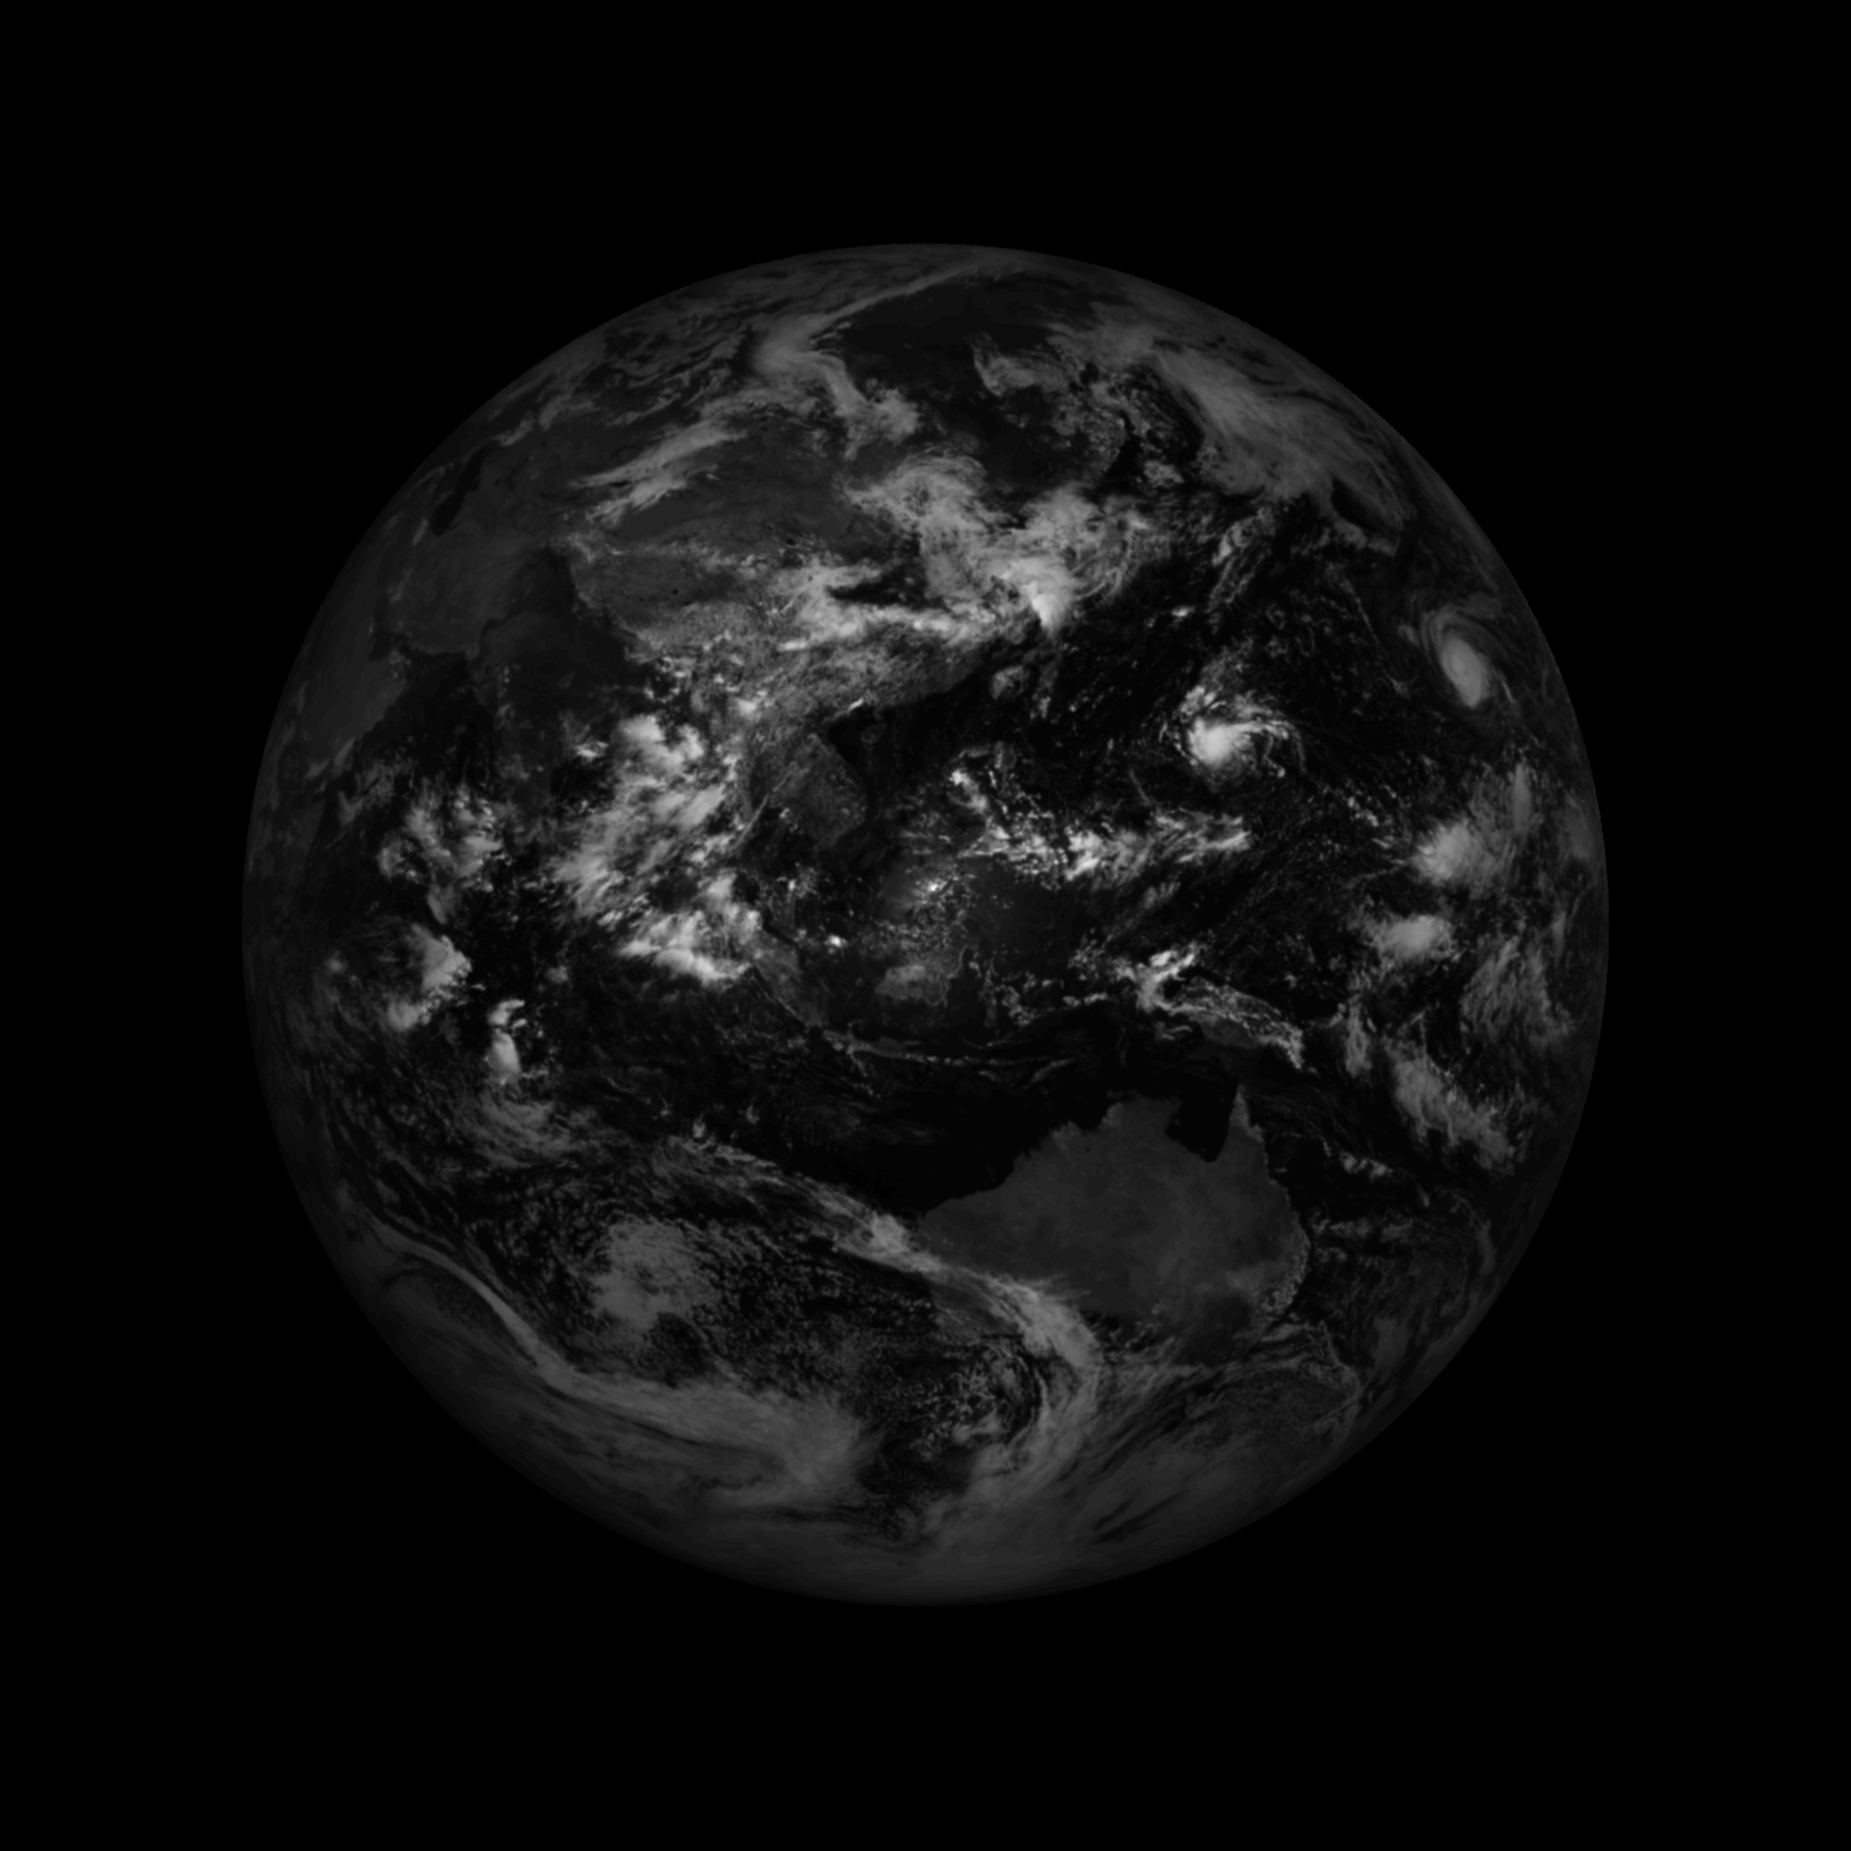
DSCOVR Geolocation Software
Latitude
Longitude
Sun Azimuth Angle
Sun Zenith Angle
Georectified and Color Imagery
View Azimuth Angle
View Zenith Angle

Slide 9
Goddard, we have a problem…

Slide 10
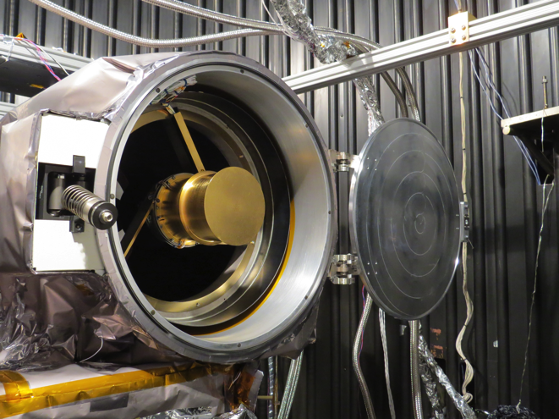
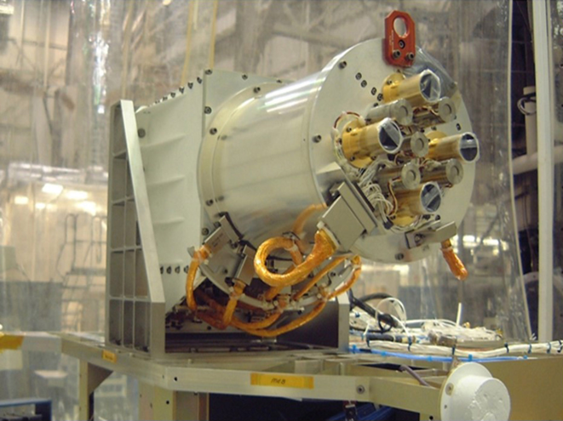
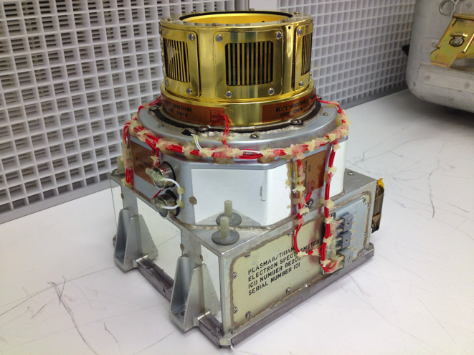
Instruments
EPIC
NISTAR
PlasMag
Name: Earth Polychromatic Imaging Camera
Instrument type: Imager
Subject: Earth
Science: Measures ozone, aerosols, cloud height, leaf area index
Name: NIST Advanced Radiometer
Instrument type: Cavity radiometer
Subject: Earth
Science: Measures Earth’s radiation budget
Name: Plasma-Magnetometer
Instruments: Faraday Cup, Electron Spectrometer, Electrostatic Analyzer
Subject: Sun
Science: Measures Solar wind

Slide 11
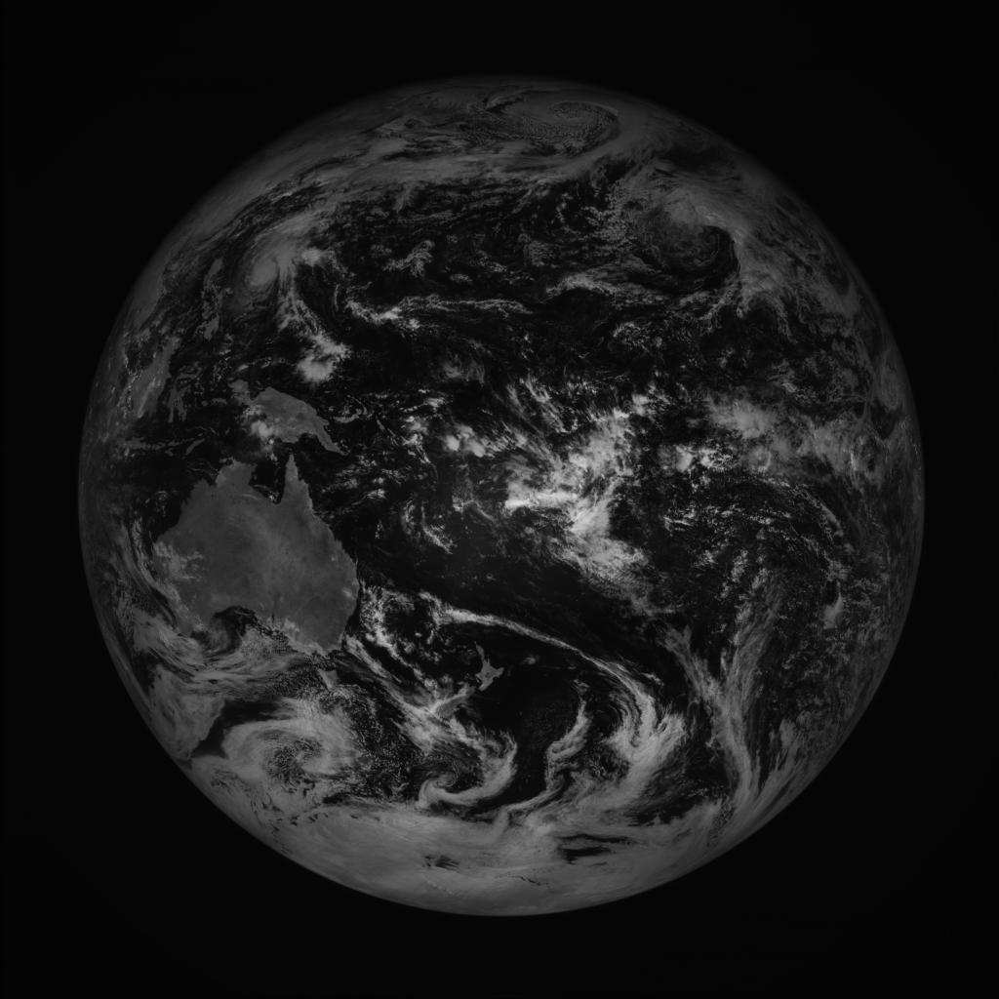
Segment
Segment Average
Computed Disk
Spokes from Computed Disk Center
Actual Disk

Slide 12
Star Tracker – Day in the life

Slide 13
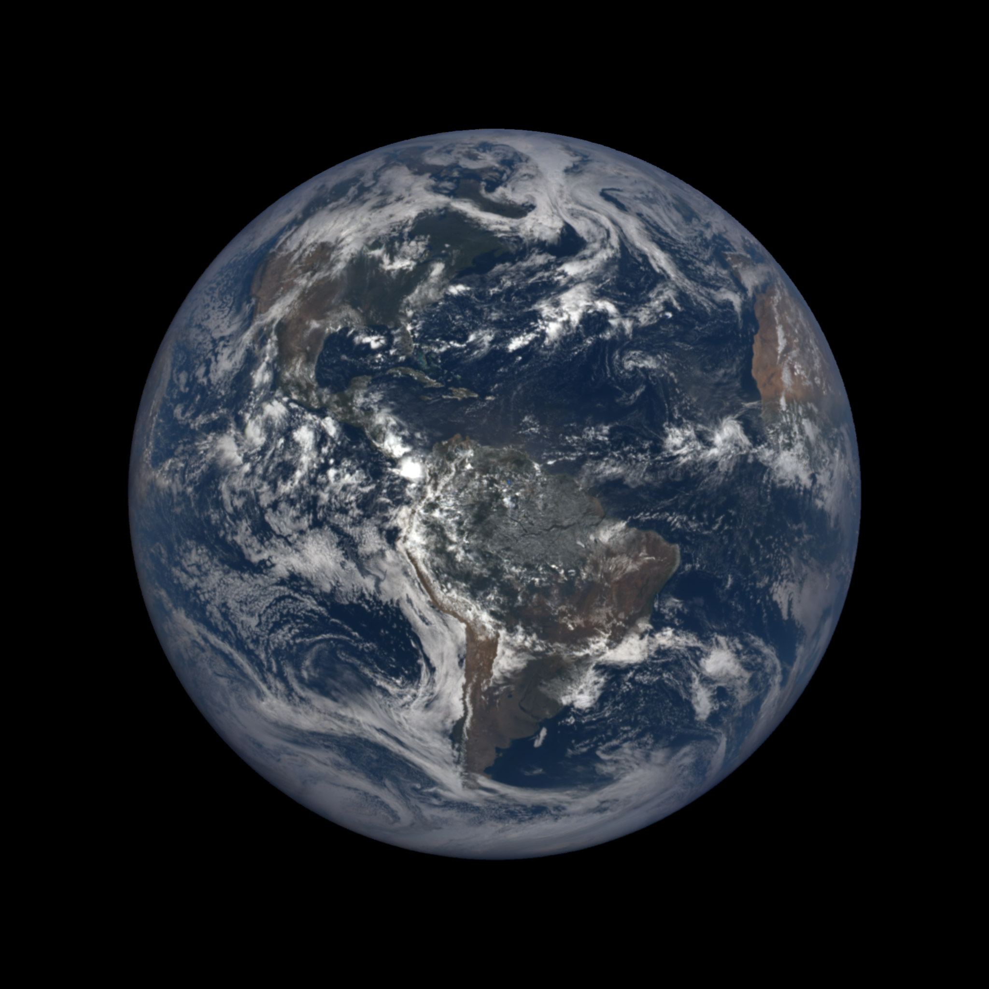

Focal Length
Object size on CCD
  $size=diameter ∗ \frac{focal_length}{distance}$
Diameter on CCD in pixels
  $pixels=\frac{size}{pixel_size}$

Slide 14
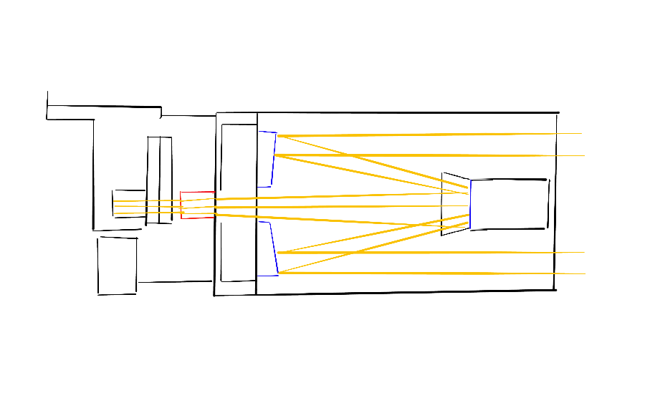
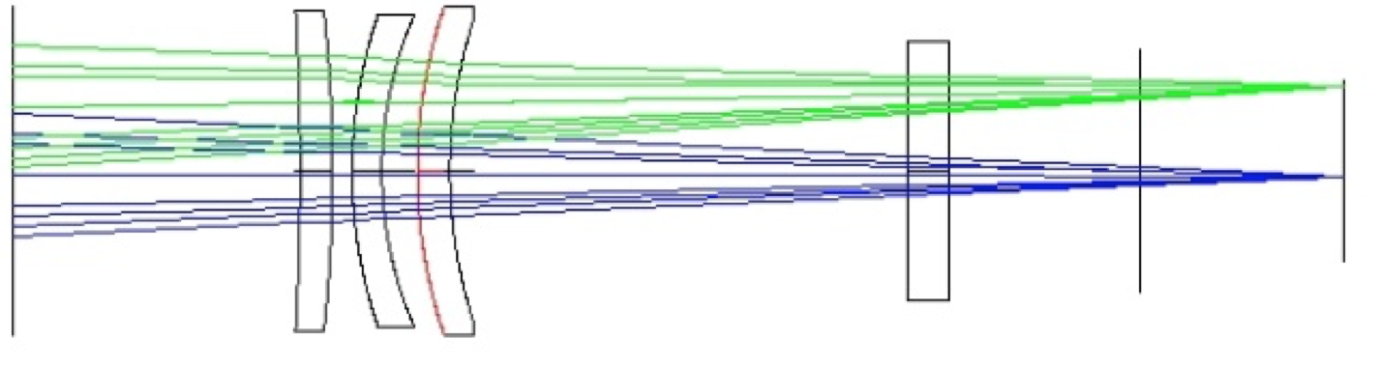
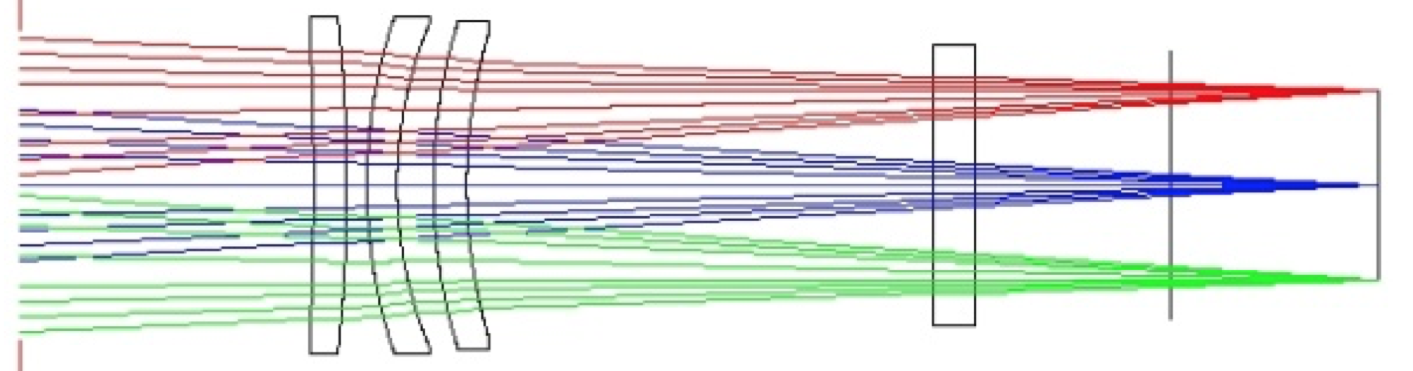
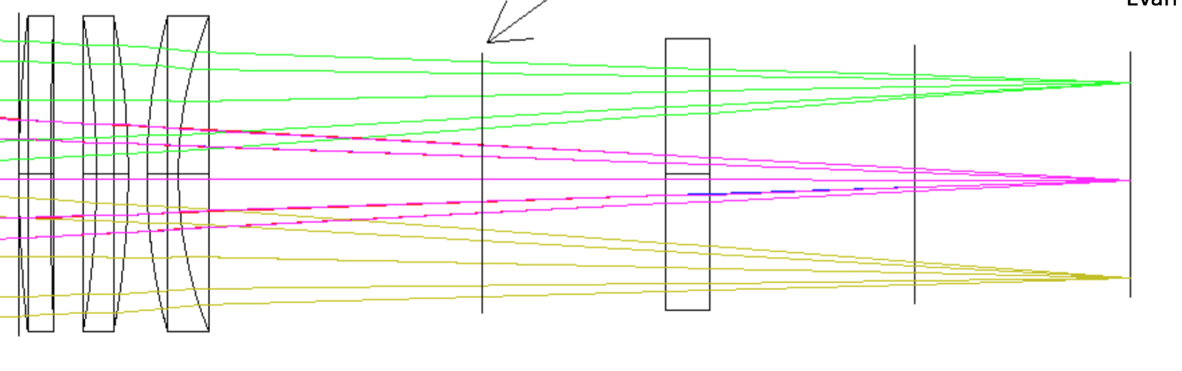
EPIC Optical Design
Field Lens Group
EPIC Schematic
Field Lens Group
CCD
Primary
Secondary

Slide 15
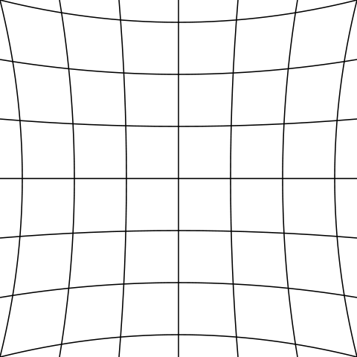
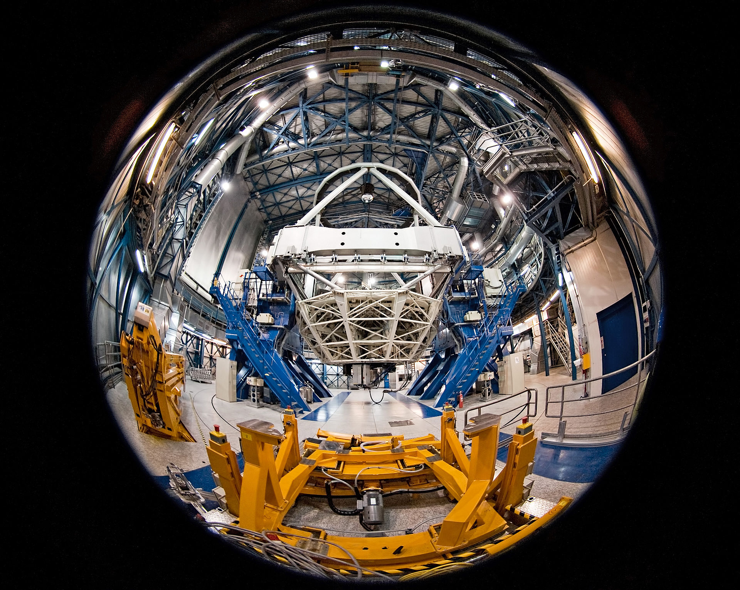
Optical Distortion
Wide angle lens distortion
Telephoto (pincushion) distortion

Slide 16
Optical distortion mathematical model
Corrected pixel location
Linear offset
Radial distortion
Distorted pixel location
Tangential distortion

Slide 17
Focal Length – Liang-Kang Huang Solution
Band | Focal Length (cm)
317nm | 282.70
325nm | 282.71
340nm | 282.73
388nm | 282.79
443nm | 282.85
551nm | 282.95
680nm | 282.98
688nm | 282.98
764nm | 282.98
780nm | 282.98
Limb profiling method
Shows difference due to chromatic aberration

Slide 18
Problems to be solved
Dynamic Unknowns
  Positional accuracy below requirements
    3 variables below needed accuracy
    Within 0.05 degrees
    Error up to 0.5 degrees in rotation
  Time
    May be off +/- 2 seconds
Static Unknowns
  Undefined telescope prescription
    11+ variables with unknown values
    Within 0.5 pixels
Total of 15 variables below requirements
Full solution is an O(n¹⁵) problem

Slide 19
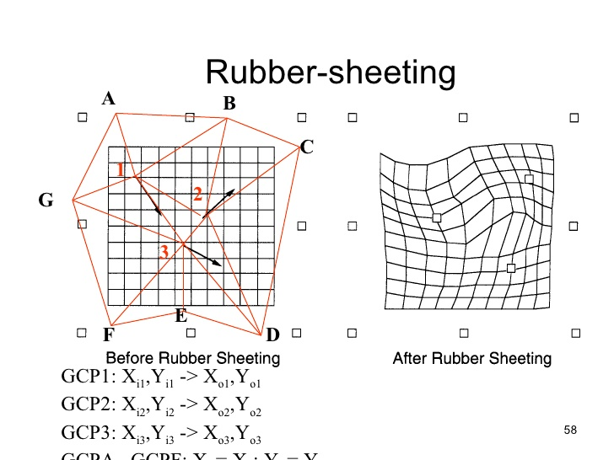
https://www.slideshare.net/cier/gis-concepts-35

Slide 20
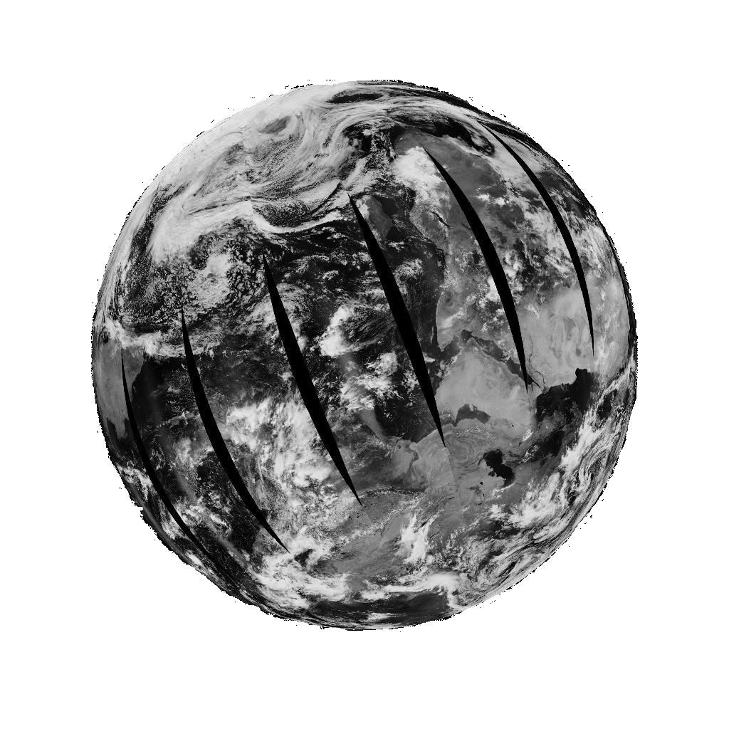
Solution – Forward/Back Propagation
Initial Coarse Input
Basic XY Offset Detection
Astronomical/
Star Tracker
Best Guess Optical Model
Modified Input
Simulator
2D XY Offset
3D XYZ Rotational Correction
Optical Distortion model
Results
Scoring

Slide 21
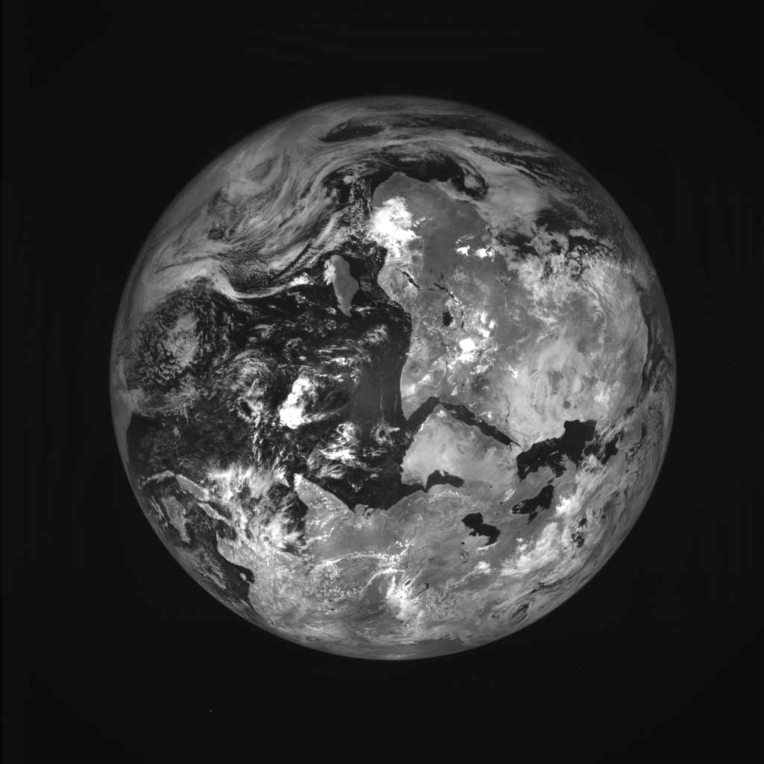
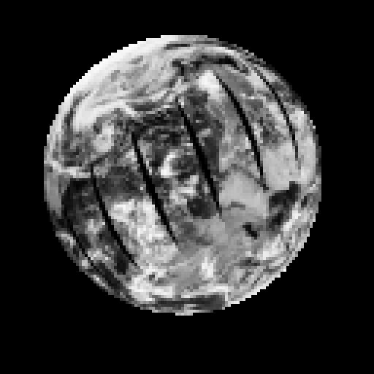
Example
EPIC Image
Forward/Back Propagation

Slide 22
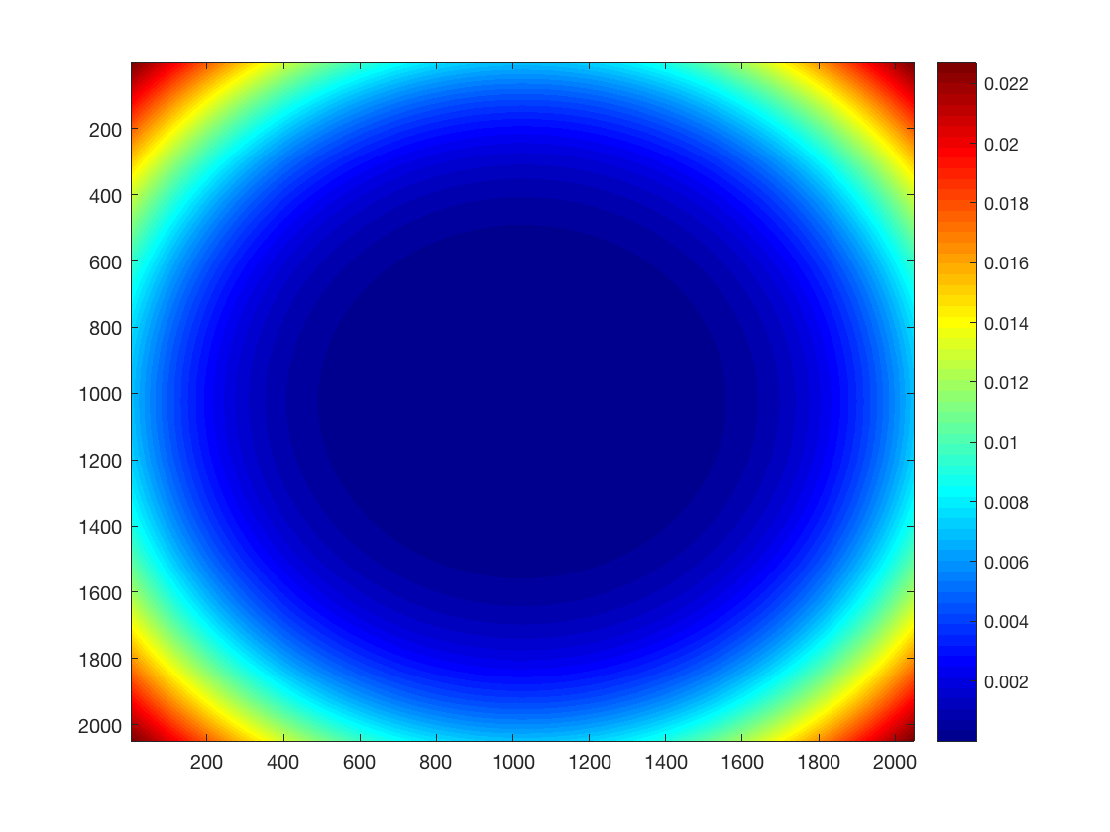
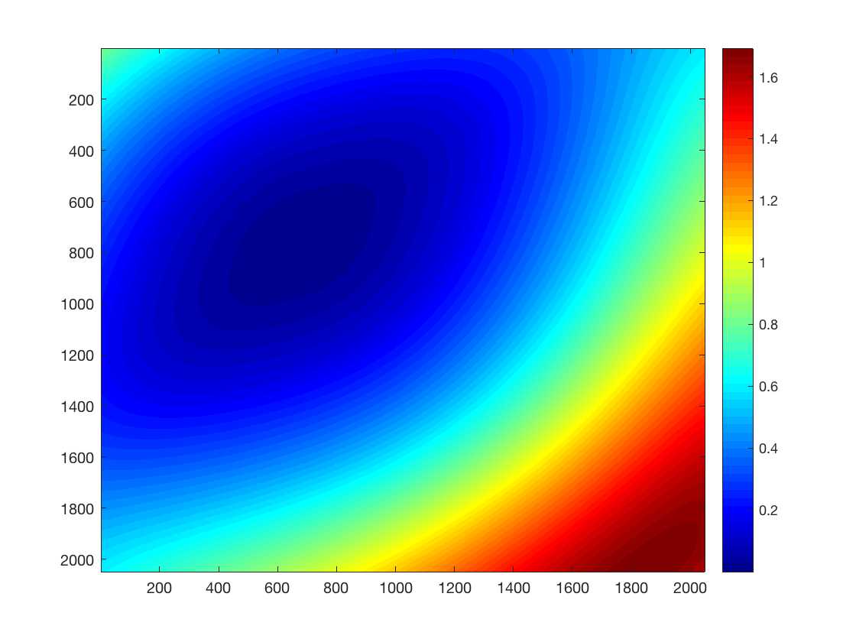
EPIC Optical Distortion Model
EPIC Theoretical (radial only)
EPIC Actual (radial + tangential)

Slide 23
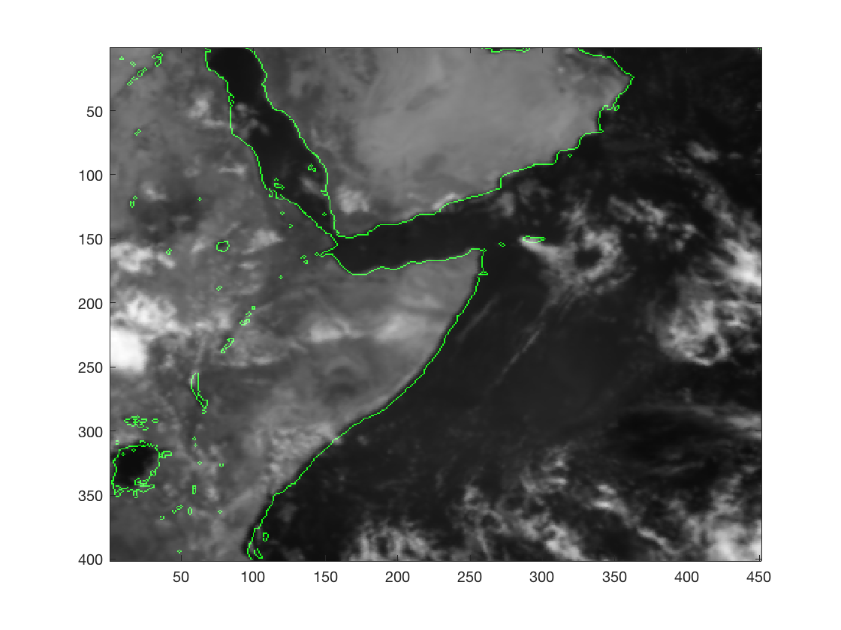

R05 vs R06 – Horn of Africa (projection center)
R05
R06

Slide 24
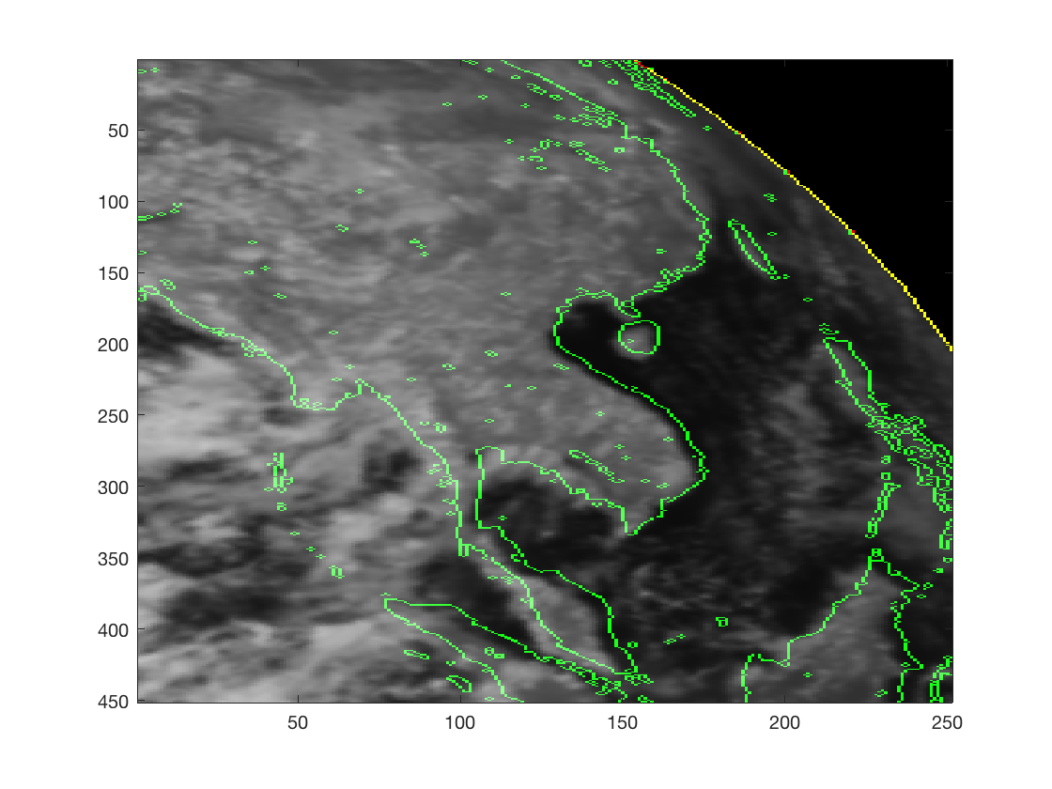
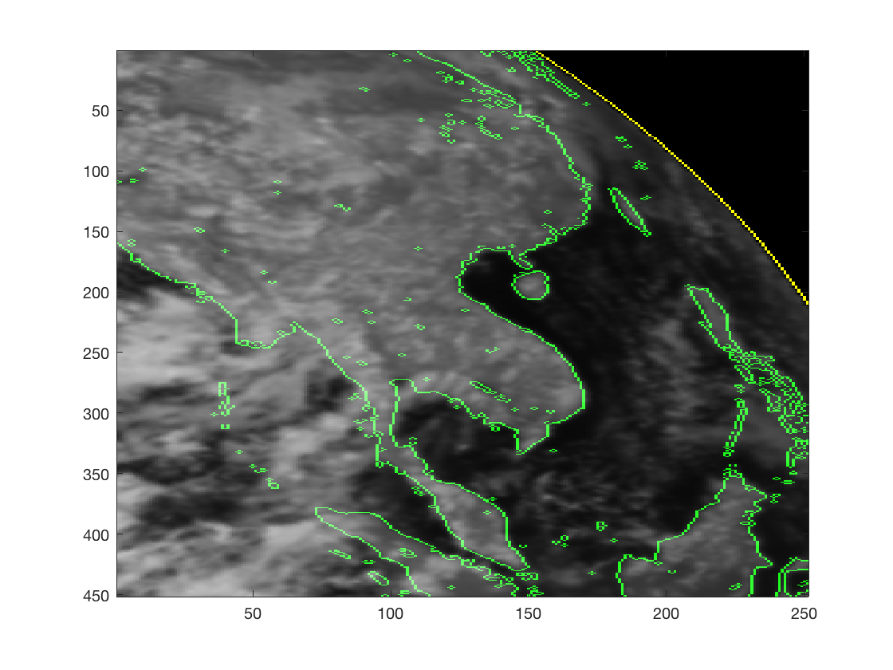
R05 vs R06 – Asia (projection edge)
R05
R06

Slide 25
New in R07 – Horizontal Parallax Correction
View Zenith Angle R06/R07 Delta
Sun Zenith Angle R06/R07 Delta
Pixel resolution - @60 degrees VZA - .17 degrees/pixel; @70 degrees VZA, .19 degrees/pixel; @80 degrees VZA, .35 degrees/pixel

Slide 26
Documentation
EPIC Geolocation Algorithm Description Document
  https://asdc.larc.nasa.gov/documents/dscovr/DSCOVR_EPIC_Geolocation_V03.pdf
EPIC Geolocation: Strategies to Reduce Uncertainty
  https://www.frontiersin.org/articles/10.3389/frsen.2021.715296/full

