Slide 1
Cloud vertical structure derived from coincident DSCOVR-CloudSat observations and machine learning
Betsy Berry, Rick Pernak, and Jeana Mascio
Presented to:
DSCOVR EPIC and NISTAR Science Team Meeting
October 17, 2023

Slide 2
Overview and Motivation: adding an active view to EPIC
1. Characterize the vertical structure of clouds for DSCOVR pixels that are collocated with
CloudSat/CALIPSO.
2. Apply ML methods to map the relationships between DSCOVR observed 2-D clouds and 3-D clouds from CloudSat/CALIPSO.
EPIC view on August 3, 2015 at 01:53 UTC
Cloud Effective Temperature

Slide 3
Case Study of coincident DSCOVR-CloudSat data
CloudSat Footprint: ~ 1.5km
EPIC pixel ~ 8km at nadir

Slide 4
Truth: CloudSat-CALIPSO (CC) vertical cloud mask
18 Km
1
Use 2B-GEOPROF-LIDAR CloudSat product to create a binary cloud mask from the radar cloud mask and lidar cloud fraction within the radar footprint
Reduce 75 vertical levels (240m resolution) to 25 vertical levels (720m resolution)
Cloud mask threshold = 33% for reduced vertical levels
Average CC cloud mask within EPIC pixels
Minimum of four CloudSat profiles per DSCOVR pixel
Cloud mask threshold = 50% for
horizontal averaging
0
0
1
0
2
0 Km
1 | 0 | 0 | 0
1 | 1 | 1 | 1
1 | 1 | 0 | 0
0
1
1
3

Slide 5
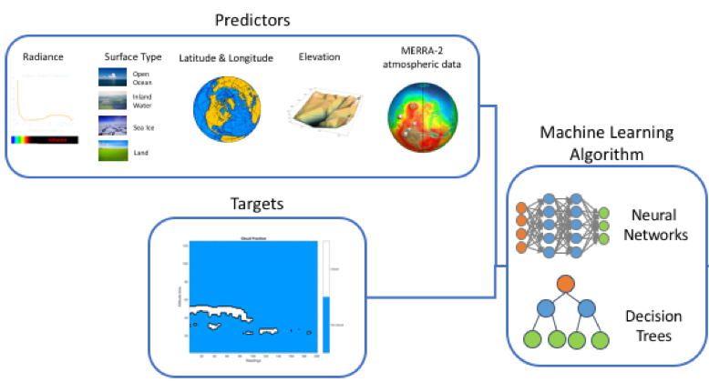
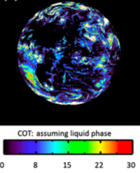
Machine Learning (ML) Method
Predictors (n_{features} = 25)
Reflectance measurements: 10 channels UV to near IR
EPIC Cloud retrievals: CEH, CET, CEP, Phase, COT
Geolocation: Latitude, surface_type, SZA
ECMWF Thermodynamics: atmospheric T, P, RH
ML Model
The eXtreme Gradient Boost (XGBoost) model (Chen and Guestrin 2016), an adaptation of gradient boosted decision trees that runs more efficiently
Target: Binary Cloud Mask vertical profile
Predictors
Reflectance Geolocation 2D Clouds. Atmosphere
Machine Learning Algorithms
Targets
Neural Networks
Decision
Trees

Slide 6
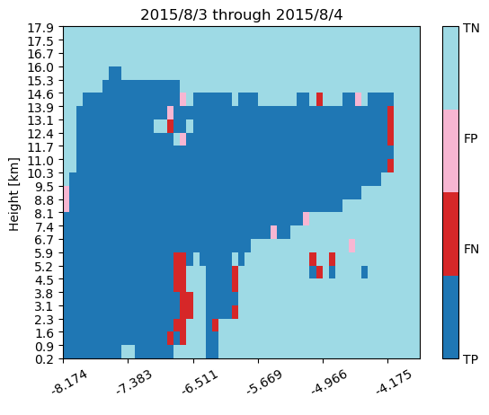
Visualization of ML results: example case
XGBoost Confusion Matrix Results
Actual
Cloudy | Clear
Predicted | Cloudy
 | Clear
True Positive | False Positive
False Negative | True Negative

Slide 7
Overall results for XGBoost August-December 2015
Precision: Out of all the positive predicted, what percentage is truly positive?
$$Precision=\frac{TP}{TP+FP}$$
Median precision 80%
Recall: Out of the total positive, what percentage are predicted positive (aka true positive rate)
$$Recall= \frac{TP}{Tp+FN}$$
Average recall is 71%
Height [km] | Precision | Recall
0.0 | 76.0 | 49.6
0.7 | 77.3 | 74.2
1.4 | 76.9 | 70.0
2.2 | 79.0 | 64.9
2.9 | 80.0 | 67.4
3.6 | 80.3 | 68.8
4.3 | 80.8 | 69.7
5.0 | 80.6 | 70.5
5.8 | 80.6 | 70.7
6.5 | 80.3 | 70.9
7.2 | 81.4 | 75.6
7.9 | 80.8 | 74.7
8.6 | 80.8 | 74.2
9.4 | 79.8 | 72.7
10.1 | 79.8 | 72.0
10.8 | 80.1 | 71.7
11.5 | 80.0 | 73.0
12.2 | 79.8 | 73.0
13.0 | 79.8 | 72.8
13.7 | 80.9 | 70.6
14.4 | 82.7 | 65.8
15.1 | 85.3 | 60.6
15.8 | 91.5 | 63.8
16.6 | 96.1 | 75.2
17.3 | 99.1 | 92.2
Notes:
Precision: when the model predicts cloud, 80% of those predictions are actual cloud.
Recall: 71% of the true cloudy obs are predicted as cloudy by the model. Which means the ML model is missing 29% of the cloudy observations. In these cases we are underestimating the vertical extent of the cloud layer in the column.
To improve performance we’re working on including additional information found to be instructive with respect to the potential structure of clouds such as integrated column quantities like CAPE, derivative quantities like lapse rate, and the presence of inversions.

Slide 8
Feature Importance
Coverage measures the relative quantity of observations concerned by a feature
Low Levels (< 7 Km): Temp, SZA, CEP, Lat
Upper Levels (> 7 Km): RH, Pres, 764nm
Gain is the improvement in accuracy brought by a feature to the branches it is on
Low Levels (< 7 Km): COT, CEP, surface type
Upper Levels (> 7 Km): RH, cloud phase, CEH
Notes:
A large coverage means the feature is used to split a large number of observations.

Slide 9
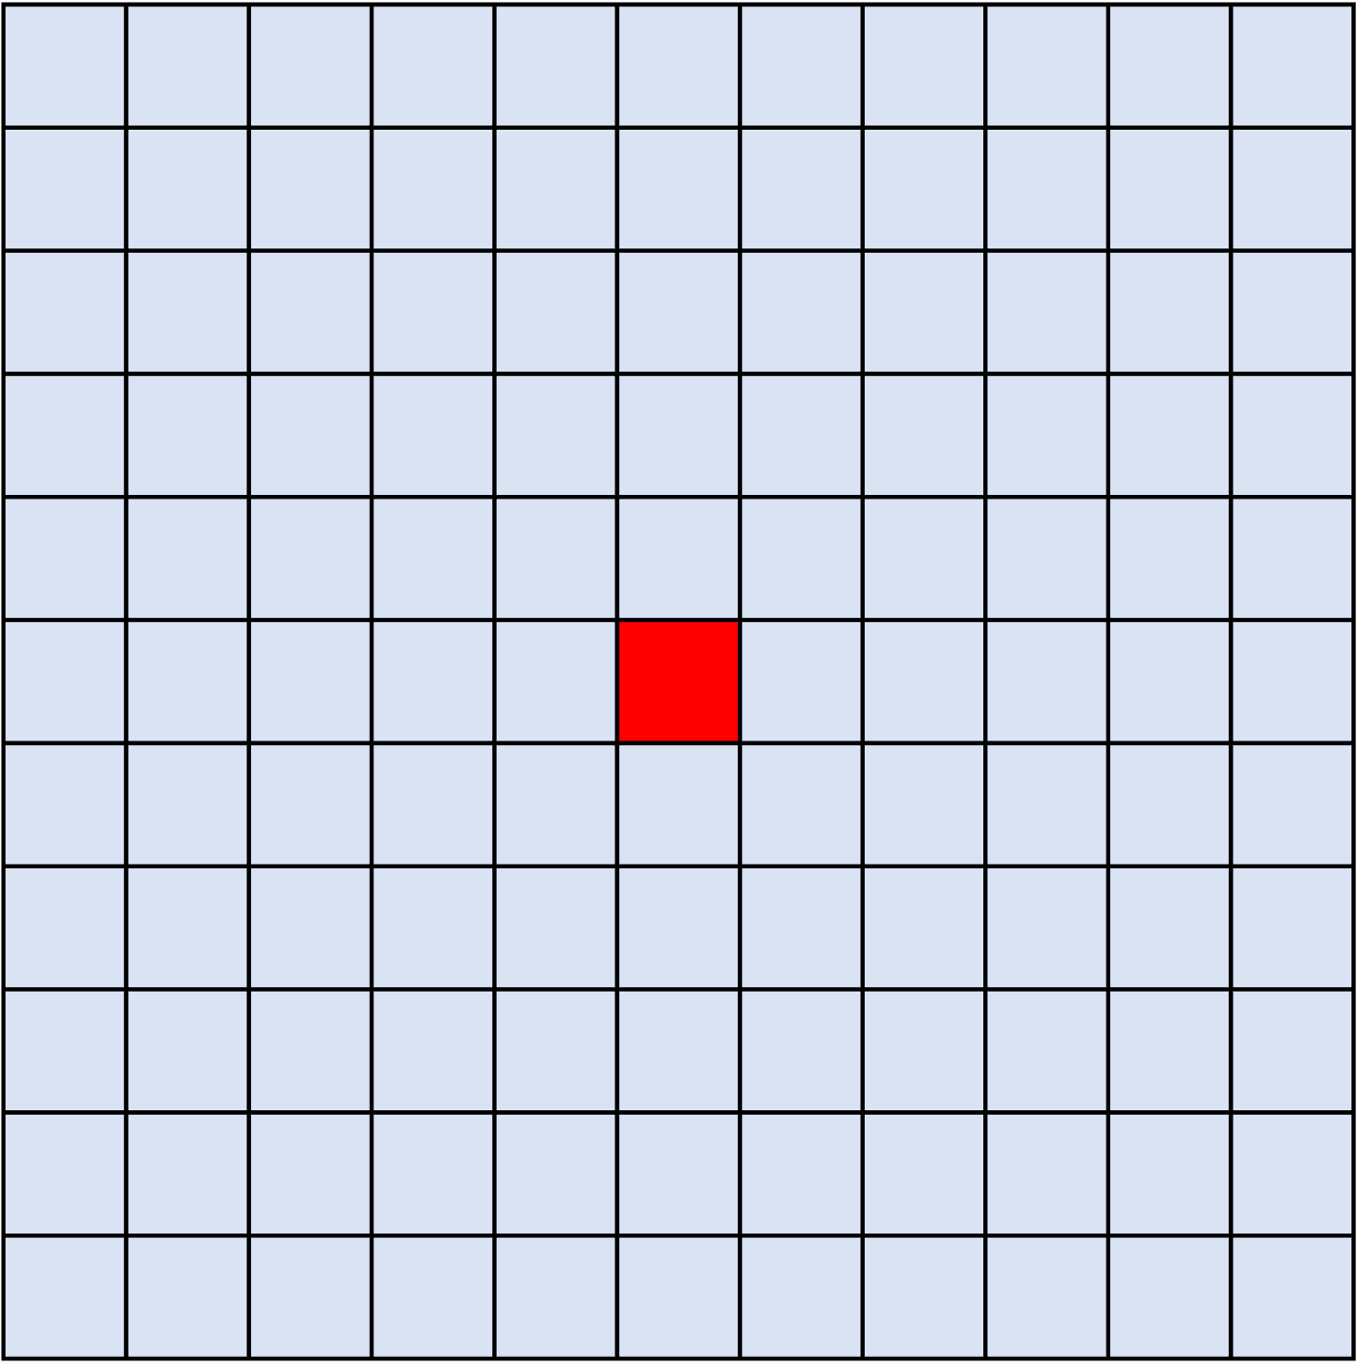
Next Steps
Expand XGBoost ML to the entire coincident dataset (August 2015 – August 2020)
Add features to improve skill
Also target cloud vertical structure class
Train a deep learning model
Convolutional Neural Network
Predictors 11x11 image centered on coincident pixels
Test ability of ML model to predict vertical cloud mask offset from the 1:30p overpass time of CloudSat
Use ARM ground data for truth
Oreopoulos et al. (2017) JGR: Atm
CNN Architecture

Slide 10
Thanks for your attention!
For more information, please contact
Betsy Berry
Staff Scientist I,
Radiation and Climate Group
eberry@aer.com

