Slide 1
EPIC L2 Cloud Products Update
Cloud Products Team:
Investigators: Yuekui Yang, Yaping Zhou, Kerry Meyer, Galina Wind
Collaborators: Steven Platnick, Wenying Su, Qilong Min, Anthony Davis
DSCOVR EPIC&NISTAR Science Team Meeting
Oct. 06-08, 2020, Online

Slide 2
List of updates (work since last STM in Sept. 2019)
NCCS discover operating system change from SLES11 to SLES12 (libraries used in the cloud product algorithms: hdf4, hdf5, nc4, fortran and c++)
Algorithm development and implementation:
-- cloud mask over ice and snow (paper published)
Zhou, Y., Y. Yang, M. Gao, P. Zhai, 2020: Cloud Detection over Snow and Ice with Oxygen A- and B-band Observations from the Earth Polychromatic Imaging Camera (EPIC), Atmos. Meas. Tech., 13, 1575–1591, https://doi.org/10.5194/amt-13-1575-2020.
-- cloud mask over sun glint regions: implemented
Thresholds tuning and improvements: cloud mask over snow-free land
Surface type and pressure from GEOS FPIT near real time
Other small fixes

Slide 3
EPIC Standard L2 Cloud Product System
EPIC L1B Products
Ancillary Data
Cloud Mask
Effective Height/Pressure
Cloud Optical Thickness
EPIC L2 Cloud Products

Slide 4
EPIC Channels Used for Cloud Retrievals
Product | Resolution | Description | EPIC Data Used
Cloud Mask | Original pixel size | Each EPIC pixel is classified as clear/cloudy with high/low confidence. | 388 nm, 680 nm, and the 780 nm relectances, the 764/780 nm and the 688/680 nm ratios.
CEP/CEH | Original pixel size | Cloud effective pressure (CEP) is retrieved for both O2 A- and B-bands | O₂ A-band (780 nm and 764 nm), and B-band (680 nm and 688 nm), EPIC cloud mask
COT | Original pixel size | Cloud optical thickness is retrieved using a single-channel approach (680 nm over land and 780 nm over ocean) | 680 nm, 780nm, EPIC cloud mask, EPIC CEP
Observation time for each EPIC channel starting from the 443 nm channel. Red dots are the channels used for cloud retrievals.
EPIC cloud products and required EPIC observations

Slide 5
EPIC L2 Major Cloud Product List
EPIC Cloud Mask
Oxygen A-band Cloud Effective Pressure
Oxygen A-band Cloud Effective Height
Oxygen B-band Cloud Effective Pressure
Oxygen B-band Cloud Effective Height
Cloud Optical Thickness – assuming liquid phase
Cloud Optical Thickness – assuming ice phase
Cloud Effective Temperature
Most likely cloud thermodynamic phase

Slide 6
EPIC Cloud Product Version Naming Convention
Versions 01
DSCOVR_EPIC_L2_CLOUD_01_20190627131403_02.nc4
16,676 granules
05/12/2016 – 06/27/2019
Cloud Product Version
L1b Version
Versions 02
DSCOVR_EPIC_L2_CLOUD_02_20190627131403_03.nc4
23,301 granules
05/12/2016 – present
Next: Versions 03
DSCOVR_EPIC_L2_CLOUD_03_20190627131403_03.nc4

Slide 7
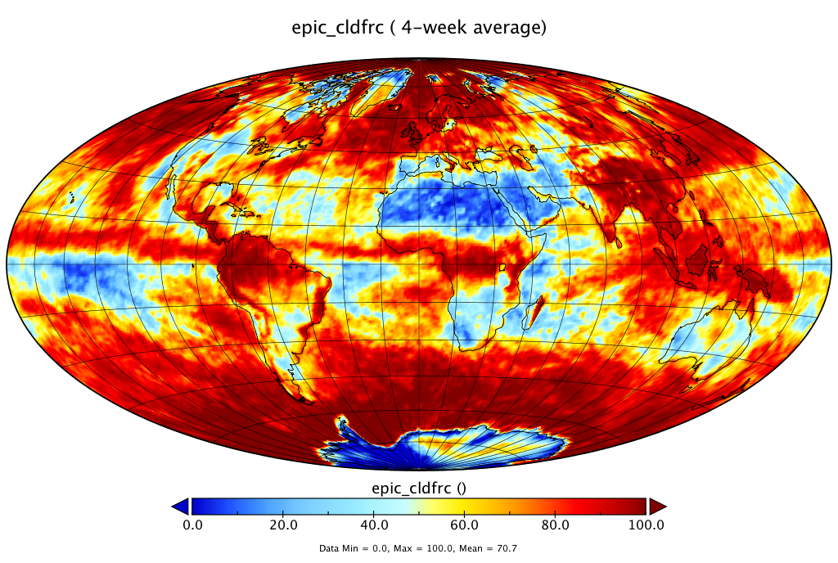
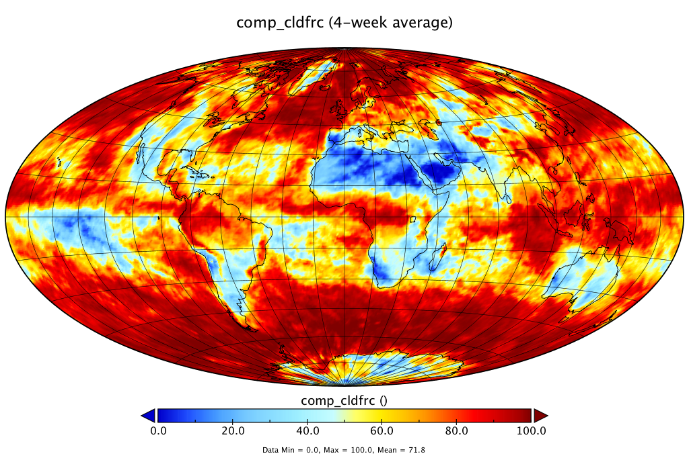
Issues with Version 1 EPIC L2 Cloud Products
EPIC
GEO/LEO
GEO/LEO
Comparison used four weeks of data from 2016 with one week for each season.
General patterns agree well, but problems exist over
-- snow/ice covered areas
-- sunglint areas

Slide 8
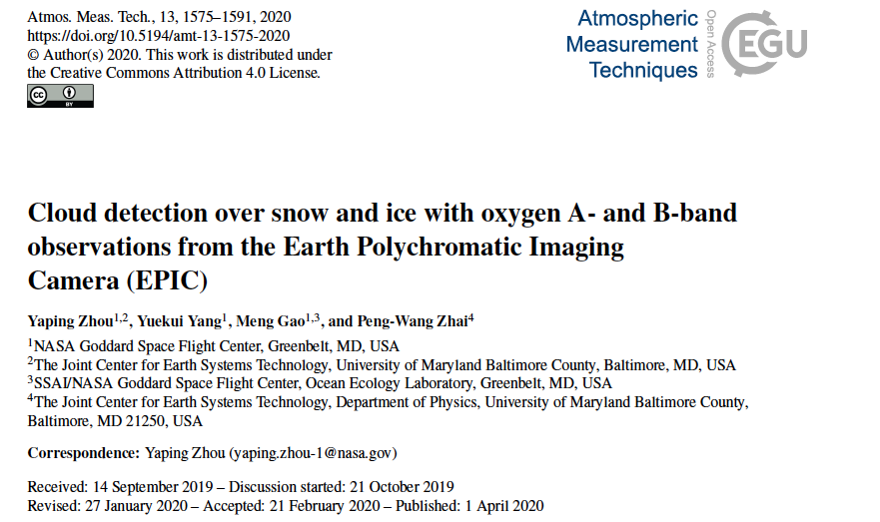
Improvements of cloud mask over snow/ice
Another paper supported by this project just published:
Yin, B., Min, Q., Morgan, E., Yang, Y., Marshak, A., and Davis, A. B., 2020: Cloud-top pressure retrieval with DSCOVR EPIC oxygen A- and B-band observations, Atmos. Meas. Tech., 13, 5259–5275, https://doi.org/10.5194/amt-13-5259-2020.

Slide 9
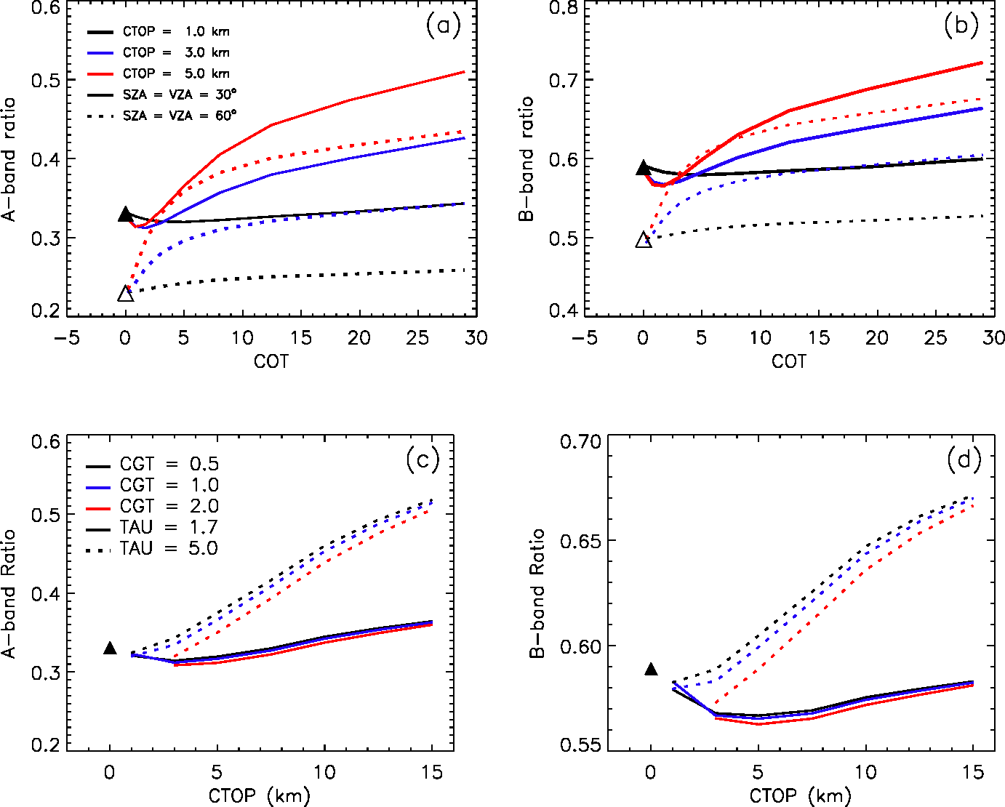
Cloud detection over snow/ice with O₂ bands
Model simulated Oxygen band ratios as a function of cloud optical thickness (COT) with cloud top height at 2.5 km (black), 5.0 km (blue) and 7.5 km (red) and solar zenith angles at 30° (solid line) and 60° (dotted lines), respectively.
Thresholds are developed as a function of surface height, solar zenith and view zenith angles.
Zhou et al., AMT, 2020

Slide 10
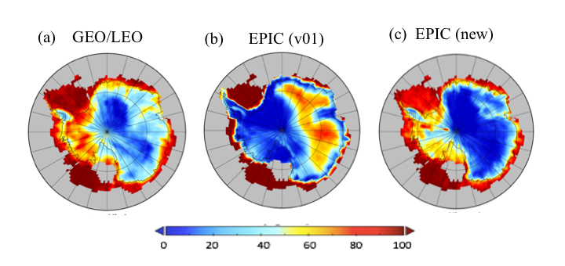
Improvements of cloud mask over snow/ice
(v03)
Cloud Fractions derived from (a) composite GEO/LEO retrievals, (b) original EPIC cloud mask, (c) new EPIC cloud mask over Antarctic in January 2017
Zhou et al., AMT, 2020

Slide 11
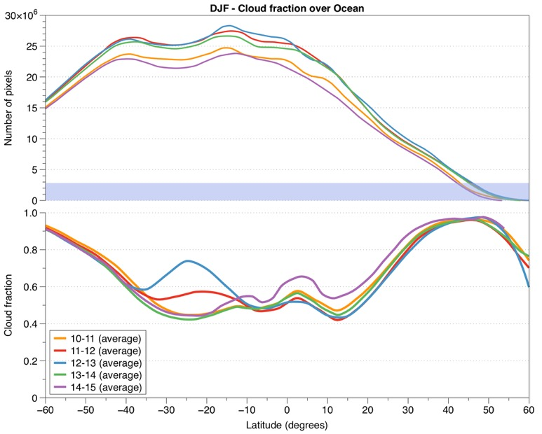
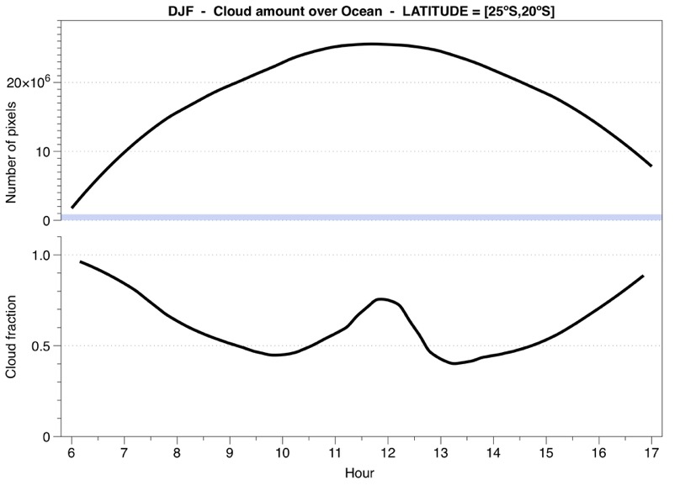
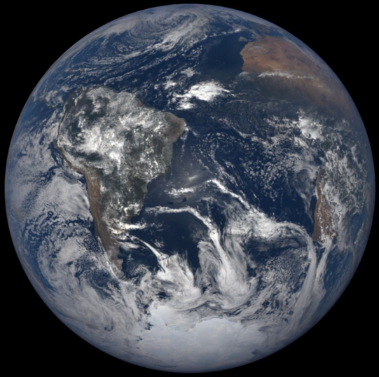
Problems around sunglint
Courtesy of Alfonso

Slide 12
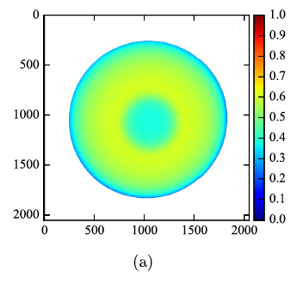
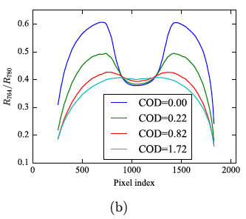
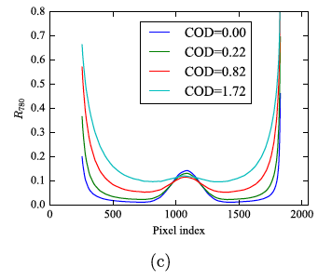
Cloud detection over sung lint
(a) R 764 / R 780 of a clear sky case for a typical Earth viewing geometry from EPIC. (b) R 764 / R 780 as a function of the pixel index on the horizontal line which intercept the image at y = 1024, where y is the vertical pixel index. CTH and CGT are 2.5 and 1 km, respectively. (c) R 780 on the same horizontal line
Gao et al., JQSRT, 2019
Thresholds are derived as a function of glint angle using O₂ A-band ratio and 780nm reflectance

Slide 13
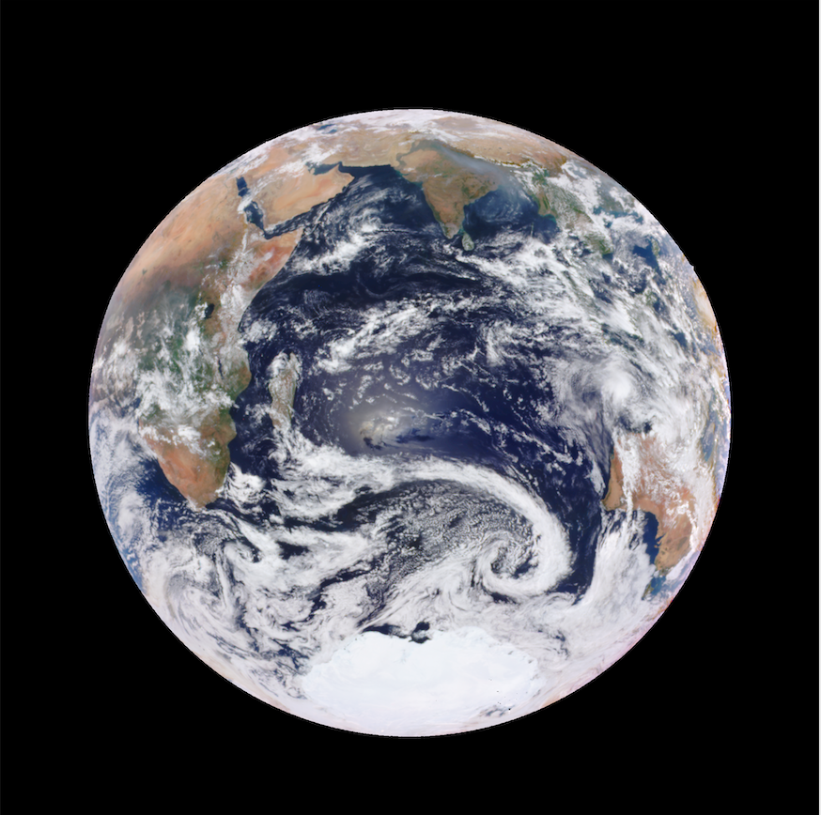
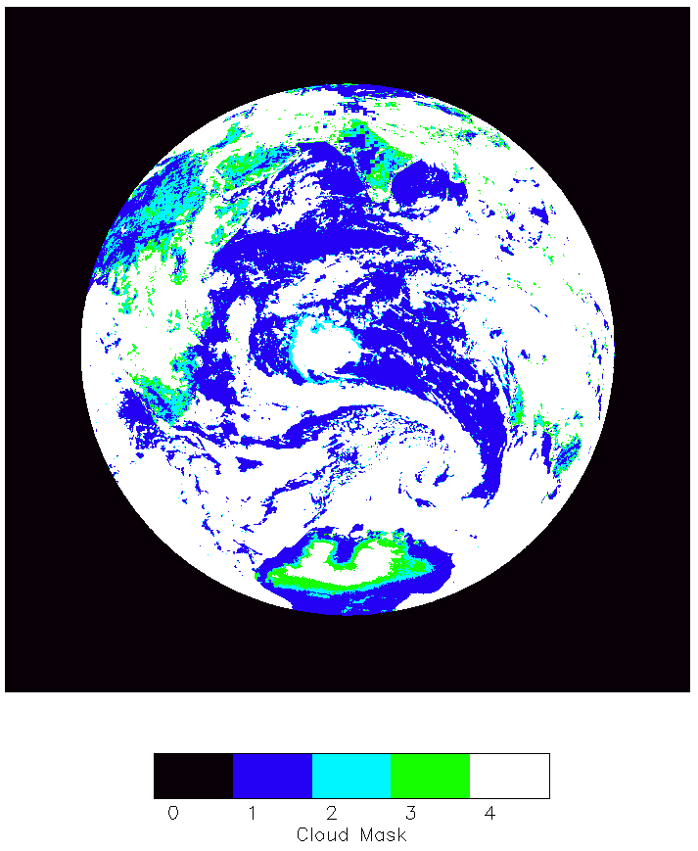
Example: DSCOVR_EPIC_L2_CLOUD_03_20161222075806_03.nc4
Cloud Version 2

Slide 14
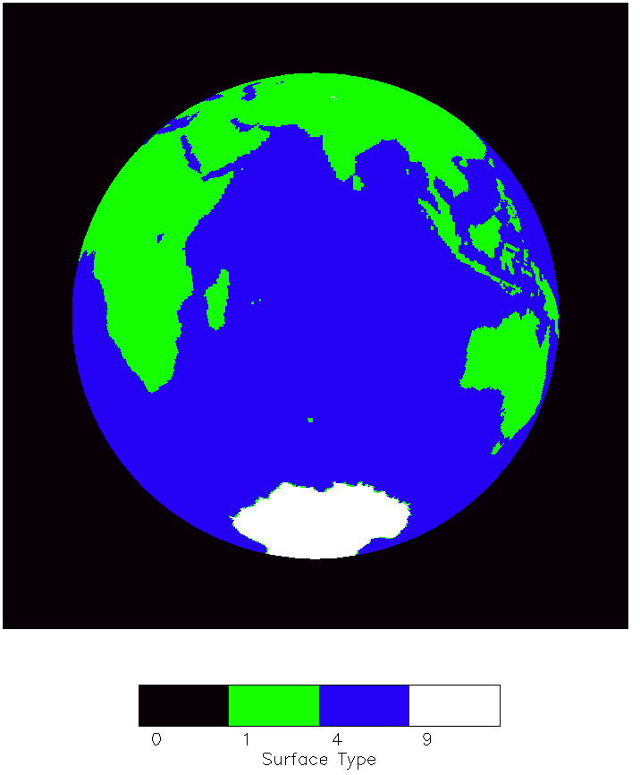
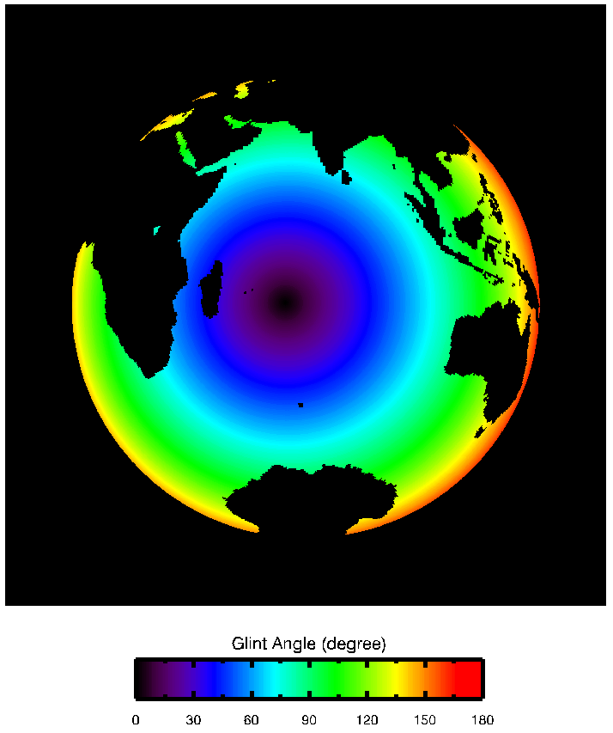

Slide 15
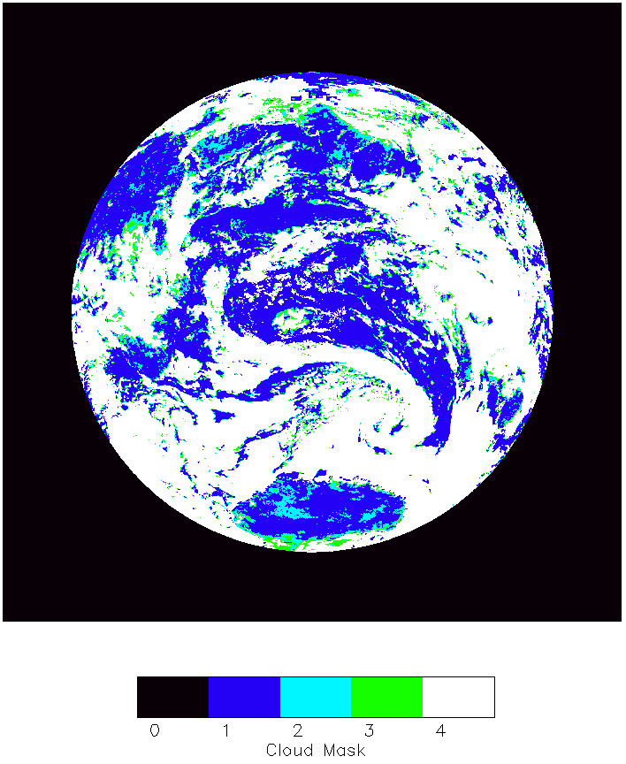
Example: DSCOVR_EPIC_L2_CLOUD_03_20161222075806_03.nc4
Cloud Version 3

Slide 16
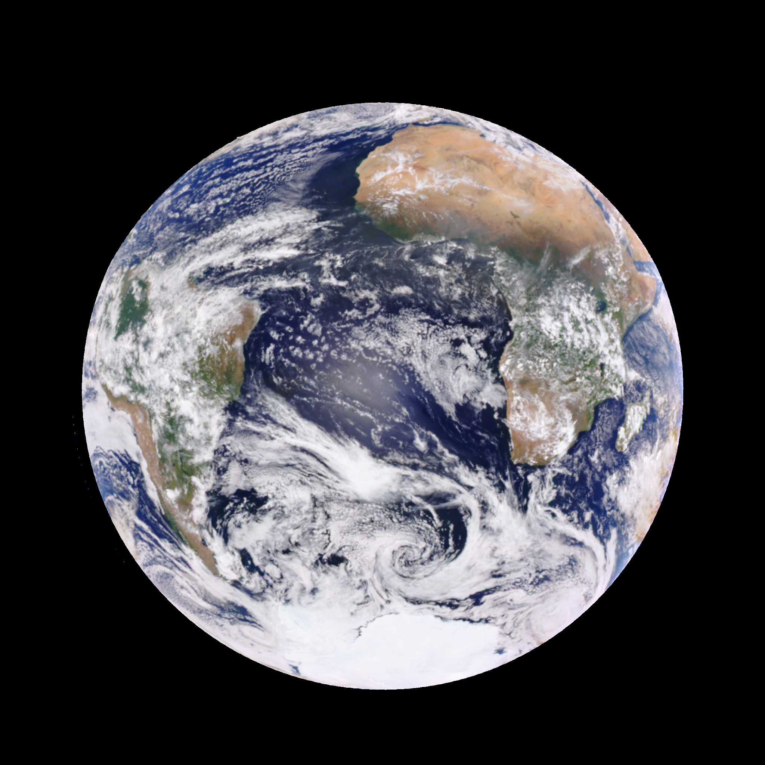
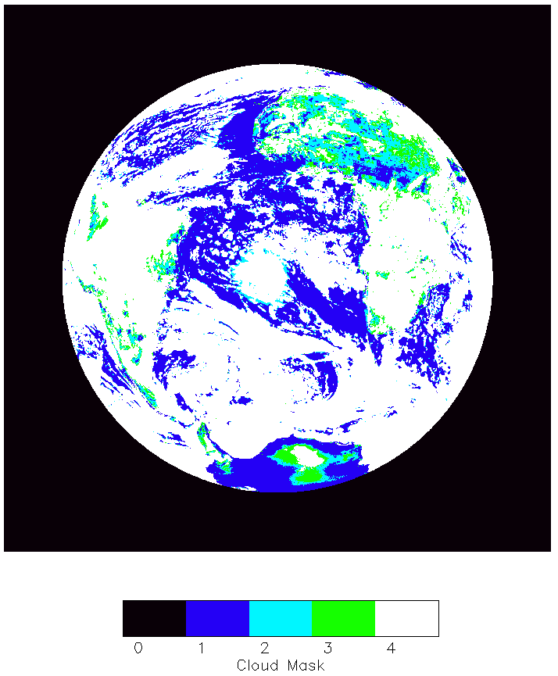
Another Example
Cloud Version 2
Example: DSCOVR_EPIC_L2_CLOUD_02_20160101133135_03.nc4

Slide 17
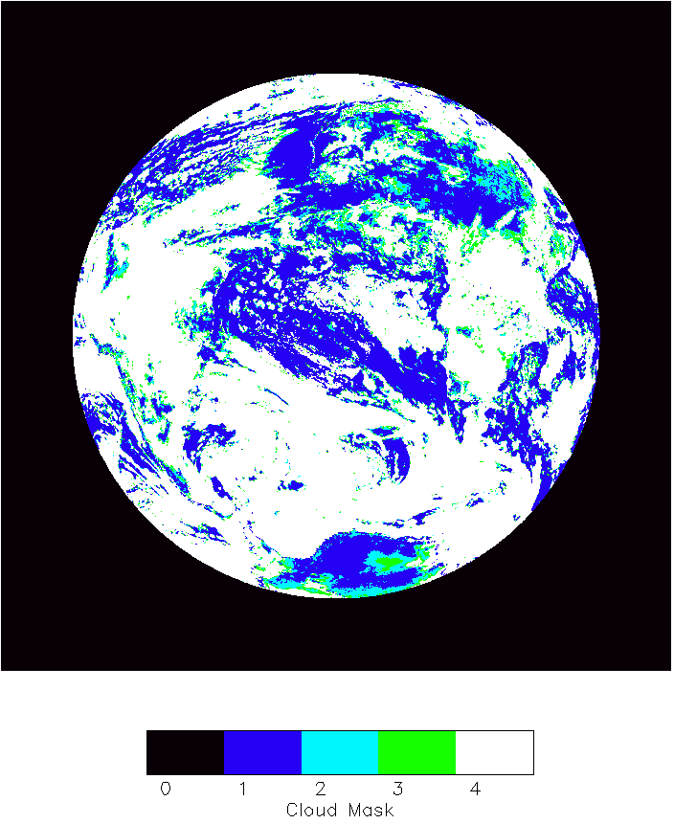
Cloud Version 3
Example: DSCOVR_EPIC_L2_CLOUD_02_20160101133135_03.nc4

Slide 18
List of updates (work since last STM in Sept. 2019)
NCCS discover operating system change from SLES11 to SLES12 (libraries used in the cloud product algorithms: hdf4, hdf5, nc4, fortran and c++)
Algorithm development and implementation:
-- cloud mask over ice and snow (paper published)
Zhou, Y., Y. Yang, M. Gao, P. Zhai, 2020: Cloud Detection over Snow and Ice with Oxygen A- and B-band Observations from the Earth Polychromatic Imaging Camera (EPIC), Atmos. Meas. Tech., 13, 1575–1591, https://doi.org/10.5194/amt-13-1575-2020.
-- cloud mask over sun glint regions: implemented
Thresholds tuning and improvements: cloud mask over snow-free land
Surface type and pressure from GEOS FPIT near real time
Other small fixes

Slide 19
EPIC Cloud Product Application Examples
Kramarova, Huang, et al. Ozone retrieval corrections
Kai Yang’s products

Slide 20
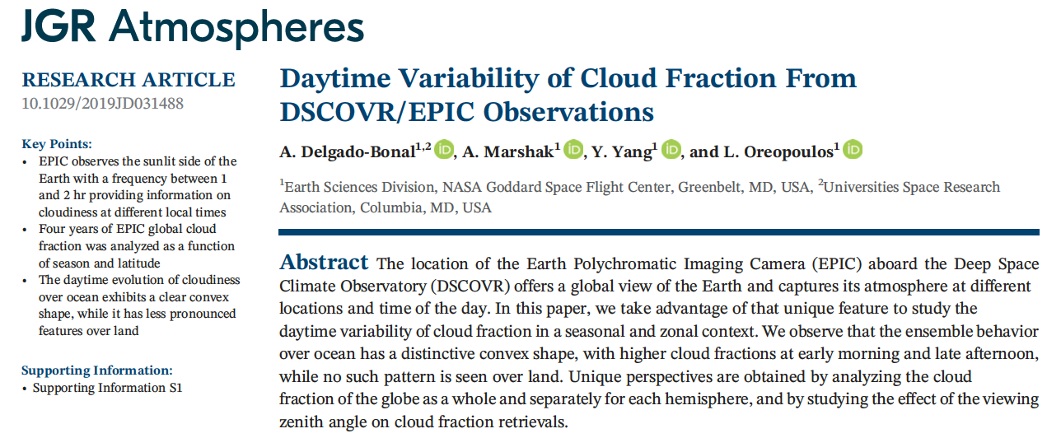
EPIC Cloud Product Application Examples (Cont.)

Slide 21
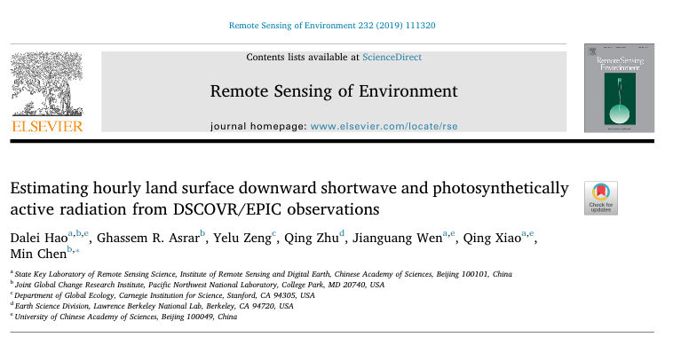
EPIC Cloud Product Application Examples (Cont.)

Slide 22
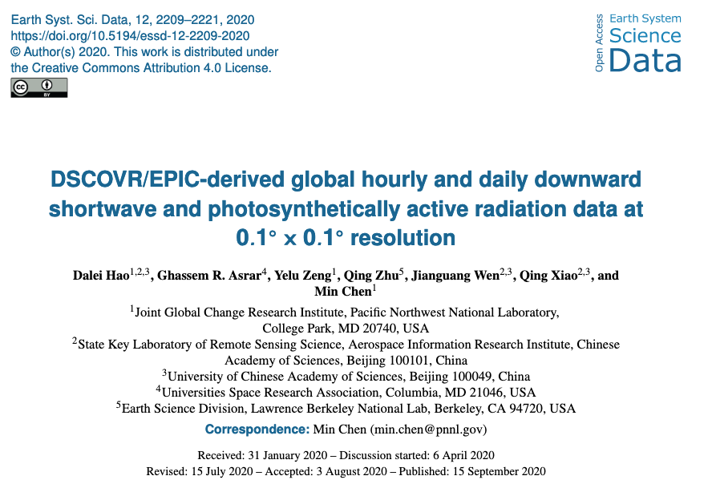
EPIC Cloud Product Application Examples (Cont.)

Slide 23
Summary
Since last STM, the cloud detection algorithm upgrade has been implemented. Results over ice, snow, snow-free land, and sung lint are improved.
EPIC L2 cloud products have seen some exciting applications, including trace gas corrections, surface solar energy calculation, and cloud diurnal cycle studies.
Future work include:
-- Oxygen A- and B-band absorption look up table update
-- Version 3 cloud product, testing, processing and validation.

Slide 24
Publications
Yin, B., Min, Q., Morgan, E., Yang, Y., Marshak, A., and Davis, A. B., 2020: Cloud-top pressure retrieval with DSCOVR EPIC oxygen A- and B-band observations, Atmos. Meas. Tech., 13, 5259–5275, https://doi.org/10.5194/amt-13-5259-2020.
Zhou, Y., Y. Yang, M. Gao, P. Zhai, 2020: Cloud Detection over Snow and Ice with Oxygen A- and B-band Observations from the Earth Polychromatic Imaging Camera (EPIC), Atmos. Meas. Tech., 13, 1575–1591, https://doi.org/10.5194/amt-13-1575-2020.
Delgado-Bonal, A., A. Marshak, Y. Yang, L. Oreopoulos, 2020: Daily variability of cloud amount from EPIC observations, J. Geophys. Res., 125(10), https://doi.org/10.1029/2019JD031488
Gao, M. P.-W. Zhai, Y. Yang, Y. Hu, 2019: Cloud remote sensing with EPIC/DSCOVR observations: a sensitivity study with radiative transfer simulations, J. Quant. Spectrosc. Radiat. Trans., 230, 56-60, doi: https://doi.org/10.1016/j.jqsrt.2019.03.022
Gao, B.-C., R.-R. Li, and Y., Yang, 2019: Remote Sensing of Water Surfaces over Sunlit Portions of Oceans and Large Inland Lakes from EPIC onboard the DSCOVR Spacecraft at Lagrange-1 Point, Sensors. 2019, 19(5), 1243; doi: 10.3390/s19051243.
Yang, Y., K. Meyer, G. Wind, Y. Zhou, A. Marshak, S. Platnick, Q. Min, A. B. Davis, J. Joiner, A. Vasilkov, D. Duda, and W. Su, 2019: Cloud Products from Earth Polychromatic Imaging Camera (EPIC) observations: Algorithm and Initial Evaluation, Atmos. Meas. Tech., 12, 2019-2031, https://doi.org/10.5194/amt-12-2019-2019.
Davis A., N. Ferlay, Q. Libois, A. Marshak, Y. Yang and Q. Min, 2018: Cloud information content in EPIC/DSCOVR's oxygen A- and B-band channels: A physics-based approach, J. Quant. Spectrosc. Radiat. Trans., 220, 84-96, https://doi.org/10.1016/j.jqsrt.2018.09.006
Davis, A. B., G. Merlin, C. Cornet, L. C. Labonnote, J. Riedi, N. Ferlay, P. Dubuisson, Q. Min, Y. Yang, and A. Marhsak, 2018: Cloud information content analysis of EPIC/DSCOVR’s oxygen A- and B-band channels: an optimal estimation approach, J. Quant. Spectrosc. Radiat. Trans. 216, 6-16, https://doi.org/10.1016/j.jqsrt.2018.05.007.
Marshak, A., J. Herman, A. Szabo, K. Blank, A. Cede, S. Carn, I. Geogdzhayev, D. Huang, L-K, Huang, Y. Knyazikhin, M. Kowalewski, N. Krotkov, A. Lyapustin, R. McPeters, O. Torres, and Y. Yang, 2018: Earth Observations from DSCOVR/EPIC Instrument, Bull. Amer. Meteor. Soc.99(9), 1829-1850, https://doi.org/10.1175/BAMS-D-17-0223.1
Xu, X., J., Wang, Y., Wang, J., Zeng, O., Torres, Y., Yang, A., Marshak, J., Reid, and S., Miller, 2017: Passive remote sensing of altitude and optical depth of dust plumes using the oxygen A and B bands: first results from EPIC/DSCOVR at Lagrange-1 point, Geophys. Res. Lett., 44, doi:10.1002/2017GL073939.
Meyer, K., Y. Yang, and S. Platnick, 2016: Uncertainties in cloud phase and optical thickness retrievals from the Earth Polychromatic Imaging Camera (EPIC), Atmos. Meas. Tech., 9, 1785-1797, doi:10.5194/amt-9-1785-2016.
Holdaway, D. and Y. Yang, 2016: Study of the Effect of Temporal Sampling Frequency on DSCOVR Observations Using the GEOS-5 Nature Run Results (Part II): Cloud Coverage. Remote Sens. 8(5), 431, doi:10.3390/rs8050431.
Holdaway, D. and Y. Yang, 2016: Study of the Effect of Temporal Sampling Frequency on DSCOVR Observations Using the GEOS-5 Nature Run Results (Part I): Earth’s Radiation Budget. Remote Sens. 8(2), 98, doi:10.3390/rs8020098.

