Slide 1
Improvement of SO₂ Algorithm and
Validation of Total O₃ from DSCOVR EPIC
Kai Yang – UMCP
DSCOVR Science Team Meeting
October 6 – 8, 2020

Slide 2
Algorithm improvement:
Background and Motivation
EPIC often provides multiple observations of volcanic clouds in a day and frequently captures the fresh clouds during or soon after eruptions.
Fresh volcanic clouds often contain both gases and ash particles injected into the atmosphere during eruptions.
The estimation of ash mass loading, in addition to the amount of SO₂, provides critical information for the study of the temporal evolution of a volcanic plume.
The presence of aerosols complicates the modeling scattered light paths required by the retrieval algorithm, leading to large uncertainty in SO₂ quantification.

Slide 3
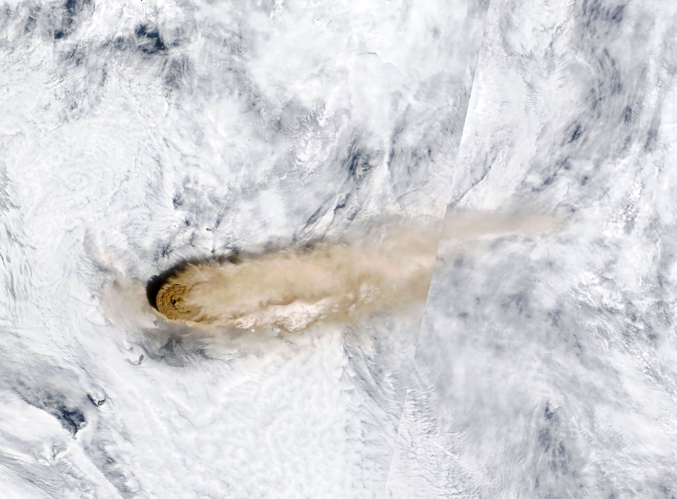
Volcanic Plume example: Raikoke Eruption
True Color Image from Terra MODIS on 06/22/ 2019
Fresh volcanic plumes often contain large amount of ash.
Notes:
﻿The Moderate Resolution Imaging Spectroradiometer (MODIS) on NASA’s Terra satellite acquired the second image on the morning of June 22. At the time, the most concentrated ash was on the western edge of the plume, above Raikoke. The

Slide 4
Simultaneous Quantification of
Volcanic SO₂ and Ash
Ash cloud model: mixture of ash particles and water/ice clouds, replacing the MLER treatment of elevated particles
Estimation of ash single scattering albedo and optical depth from long wavelength UV bands.
Extending the single scattering albedo and optical depth to short UV bands based on the ash cloud model.
Retrieval of O₃ and SO₂ amounts, with radiative transfer modeling of particle laden atmosphere to match radiance measurements from short UV bands.

Slide 5
Quantification of Volcanic Ash
Volcanic Cloud: Mixtures of Water/Ice Clouds and Ash Particles
Micro-physical properties of each component:
Particle shape (e.g. sphere/spheroid/irregular), mass density (e.g, ρ_{ash}=2.75 g/cm³)
Size distribution (e.g., Log-normal for ash particles, r_{eff} = 2μm, σ=1.6),
Refractive index (e.g. real = 1.5, imag = 0.005, independent of λ)
Model and Mie Calculations
Volcanic Cloud: Optical Properties
Mass Coefficients: Scattering (K_{sca}), Absorption (K_{abs}),
Extinction (K_{ext}=K_{sca}+K_{abs}), Single Scattering Albedo (ω₀=K_{sca}/K_{ext}),
and Scattering Phase Function
Vertical Distribution of Particles:
Layer height estimated from radiance measurements or trajectory analysis
Surface Albedo
Estimated from radiance measurements or based on climatology
Extinction Optical Depths for Each Components: estimated from satellite radiance spectra
Measurements and Retrievals
Ash Mass Concentration (g/m²)

Slide 6
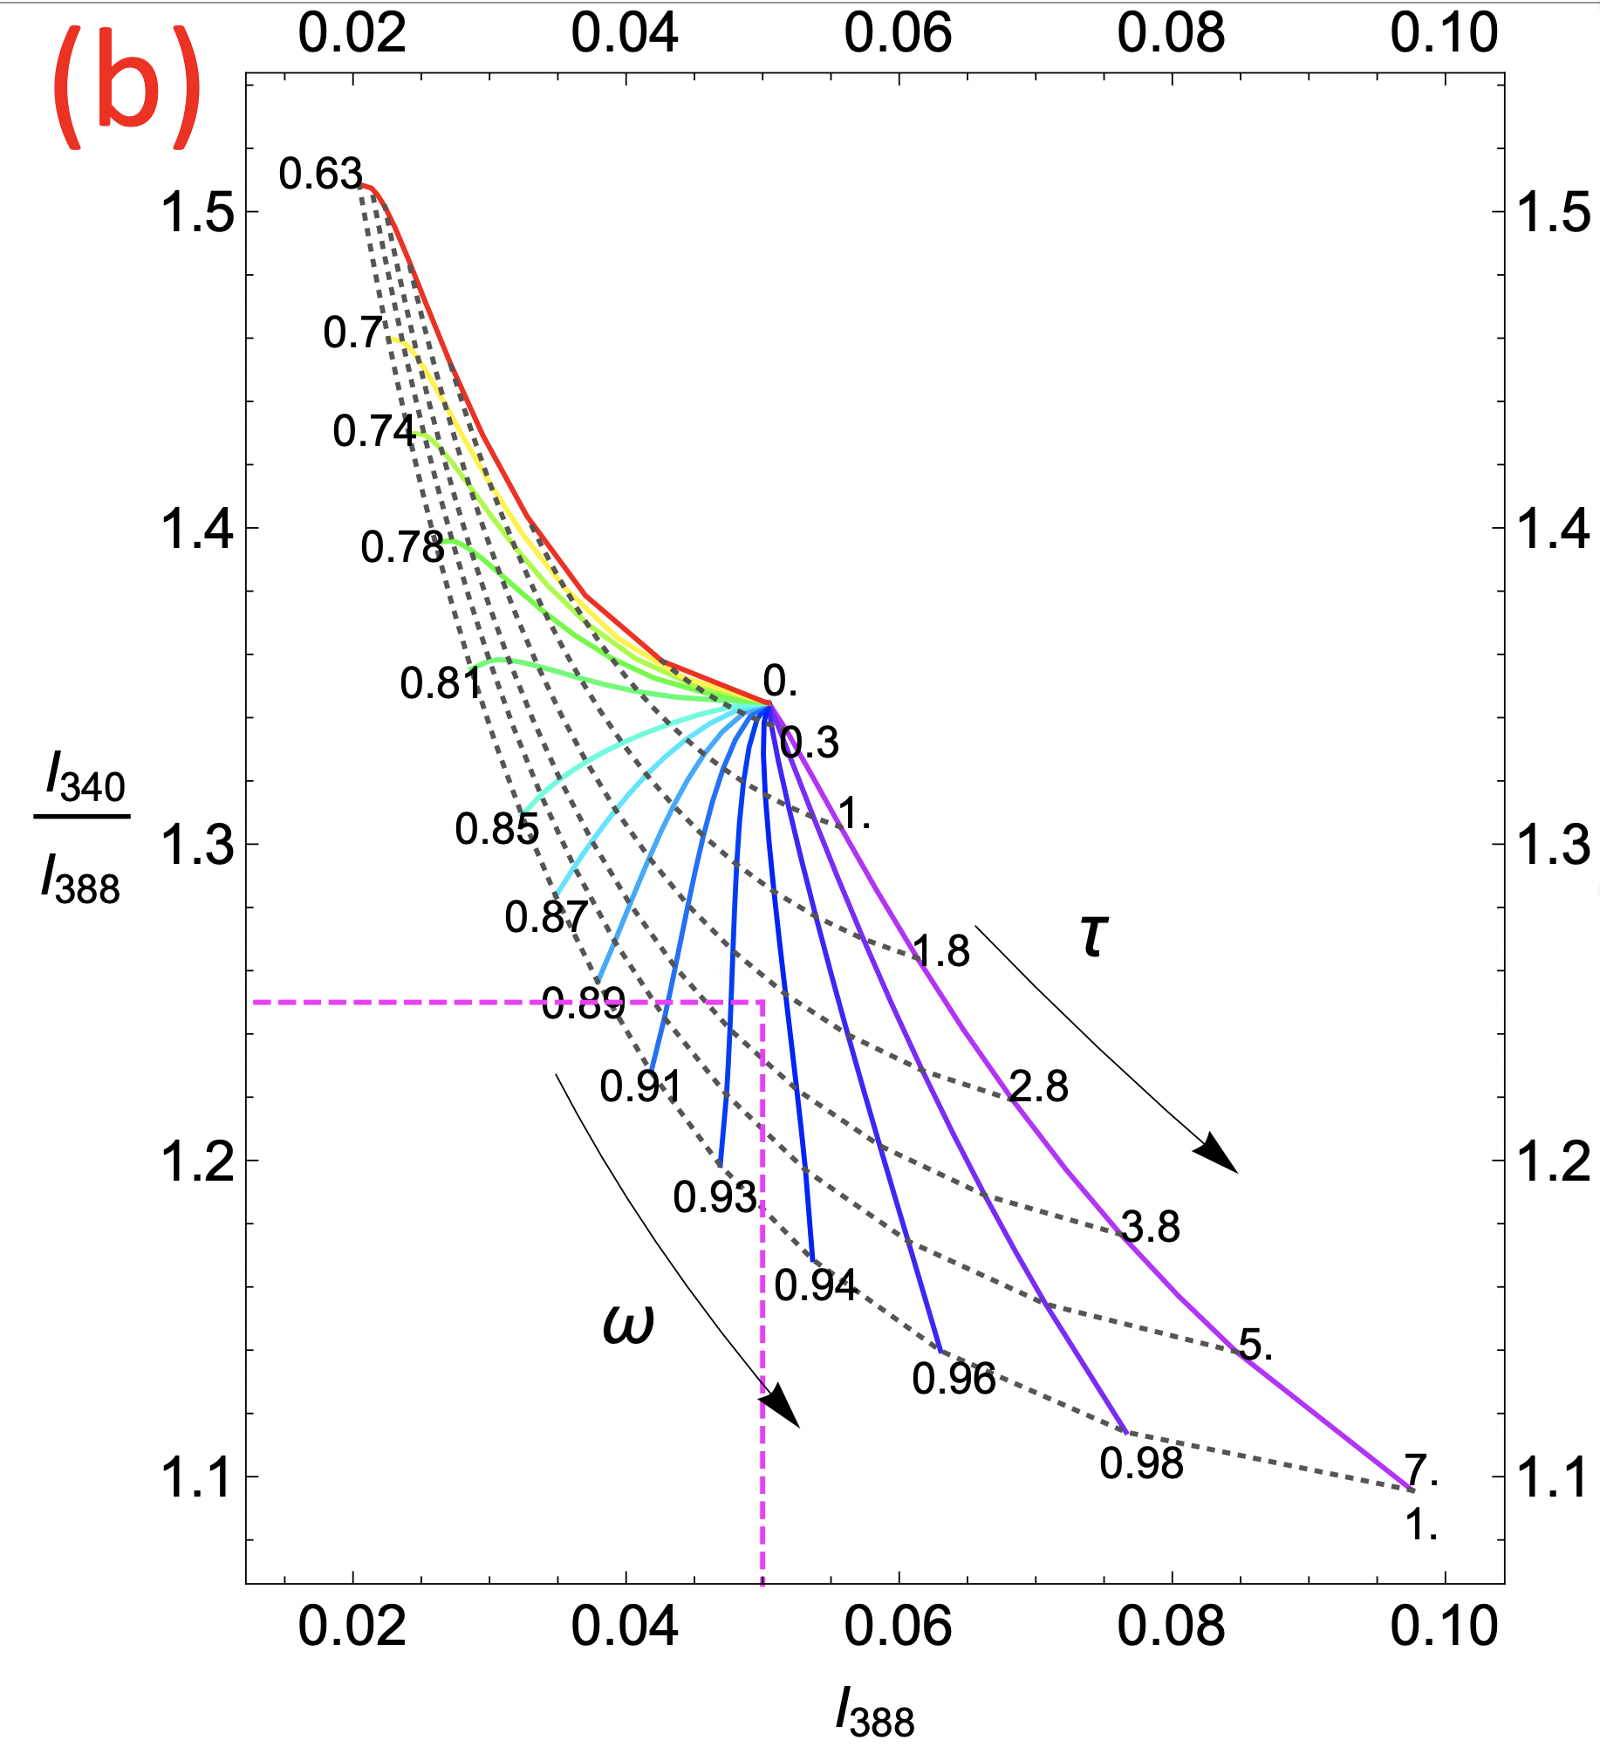
Ash cloud estimation:
single scattering albedo (ω) and optical thickness (τ)
SZA=45° VZA=0° surface reflectivity = 0.1 Ash layer height = 4 km
Pure water cloud ω_{w} = 1 pure ash ω_{a} = 0.63.
The ratio of EPIC band 3 - band 4 radiances as a function of band 4 radiance, calculated for different fractions of cloud and ash mixture, with optical properties determined from the microphysical properties

Slide 7
Examples from EPIC observations
Eruption of Etna (Italy) on December 3, 2015
Eruption of ﻿Ambae (Vanuatu) on July 26, 2018
Eruption of Raikoke (Kuril Islands) June 22-23, 2019

Slide 8
Eruption of Etna (Italy) on December 3, 2015
Aerosol Optical Depth
AOD

Slide 9
Eruption of Etna (Italy) on December 3, 2015
Single Scattering Albedo
SSA

Slide 10
Eruption of Etna (Italy) on December 3, 2015
SO₂ Column Amount
SO2
(DU)

Slide 11
Eruption of ﻿Ambae (Vanuatu) on July 26, 2018
Aerosol Optical Depth
AOD

Slide 12
Eruption of ﻿Ambae (Vanuatu) on July 26, 2018
Single Scattering Albedo
SSA

Slide 13
Eruption of ﻿Ambae (Vanuatu) on July 26, 2018
SO₂ Column Amount
SO2
(DU)

Slide 14
Eruption of Raikoke (Kuril Islands) June 22-23, 2019
Aerosol Optical Depth
AOD

Slide 15
Eruption of Raikoke (Kuril Islands) June 22-23, 2019
Single Scattering Albedo
SSA

Slide 16
Eruption of Raikoke (Kuril Islands) June 22-23, 2019
SO₂ Column Amount
SO2
(DU)

Slide 17
Summary of SO₂ Improvements
Explicit treatment of aerosol allow direct quantification of ash optical loading and optical properties from UV spectral measurements.
Simultaneous quantification volcanic SO₂ and ash greatly improve the accuracy of gas (O₃ and SO₂) retrievals.

Slide 18
Update Ozone Algorithm for V3 processing
Replacing climatological cloud pressure with EPIC cloud pressure product.
Update O₃ profile climatology to include spatial dependence, more accurate representation of tropospheric O₃ (see Yang and Liu, 2019, https://doi.org/10.5194/amt-12-4745-2019)

Slide 19
Ozone Validation with Brewer Measurements
Station Name | Latitude
Alter | 82.50
Eureka | 79.99
Resolute | 74.72
Churchill | 58.75
Edmonton | 53.55
Goose Bay | 53.31
De Bilt | 52.10
Thessaloniki | 40.63
Paramaribo | 5.806
South Pole | -89.99

Slide 20
High Northern Latitude

Slide 21
High-Mid Northern Latitude

Slide 22
Mid Northern Latitude

Slide 23
Low Northern Latitude

Slide 24
South Pole

Slide 25
V3 EPIC Total O₃ Validation Summary
Time series of O₃ difference between coincident EPIC and Brewer and EPIC and MERRA-2 are stable with similar moving average and standard deviation, showing EPIC O₃ are consistent over time, without noticeable drift.
The correlations between EPIC and Brewer (R>0.87) and EPIC and MERRA-2 (R>0.92) are high, demonstrating that EPIC captures the dynamical variability accurately. V3 has higher correlation and lower standard deviation with Brewers than V2.
Against Brewer data, EPIC O₃ has latitude dependent biases, which increases towards the poles. V3 has higher biases than V2, which exhibits less latitude dependence.
Calibration adjustments are expected to reduce biases against Brewers and will be developed for reprocessing and release of V3 O3SO2AI product.

