Slide 1
Deep Space Observations of Cloud Glints: Spectral and Seasonal Dependence
Tamás Várnai^{1,2}, Alexander Marshak¹, Alexander Kostinski³
1: NASA GSFC, 2: UMBC JCET, 3: Michigan Technological University

Slide 2
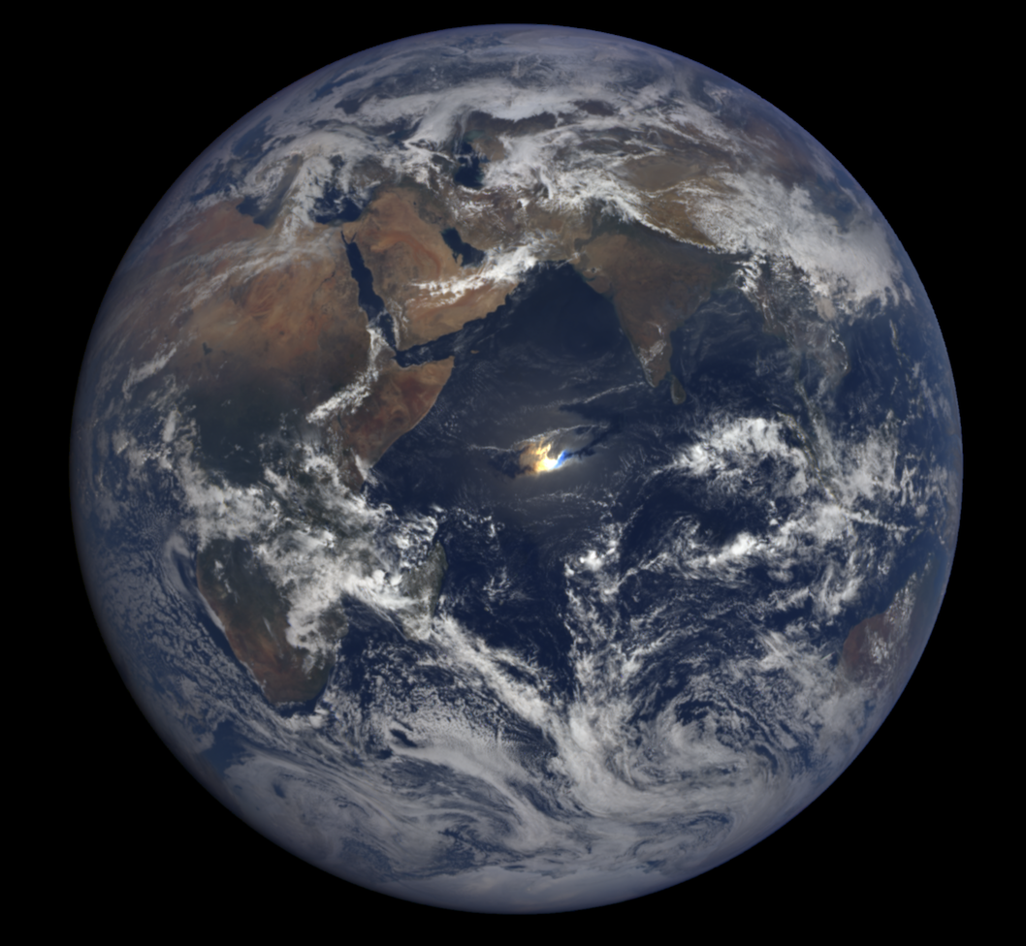
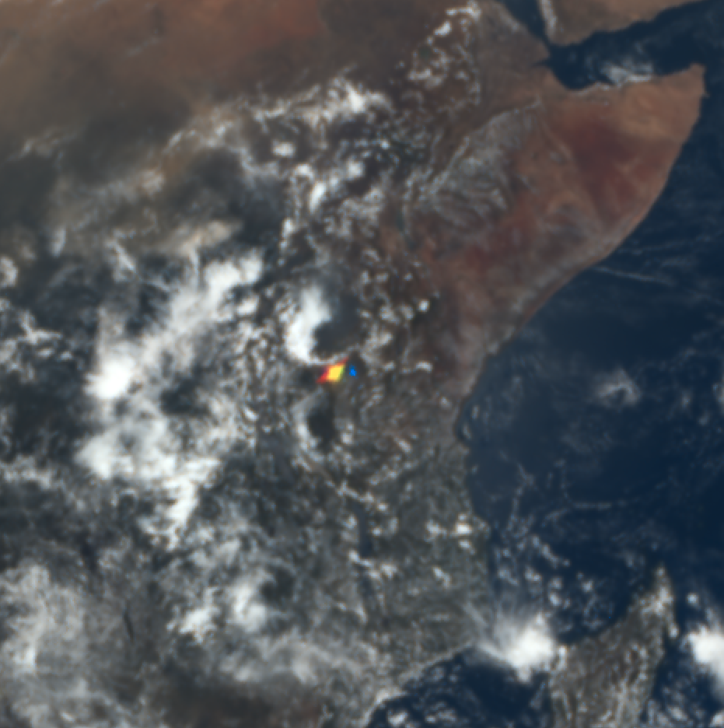
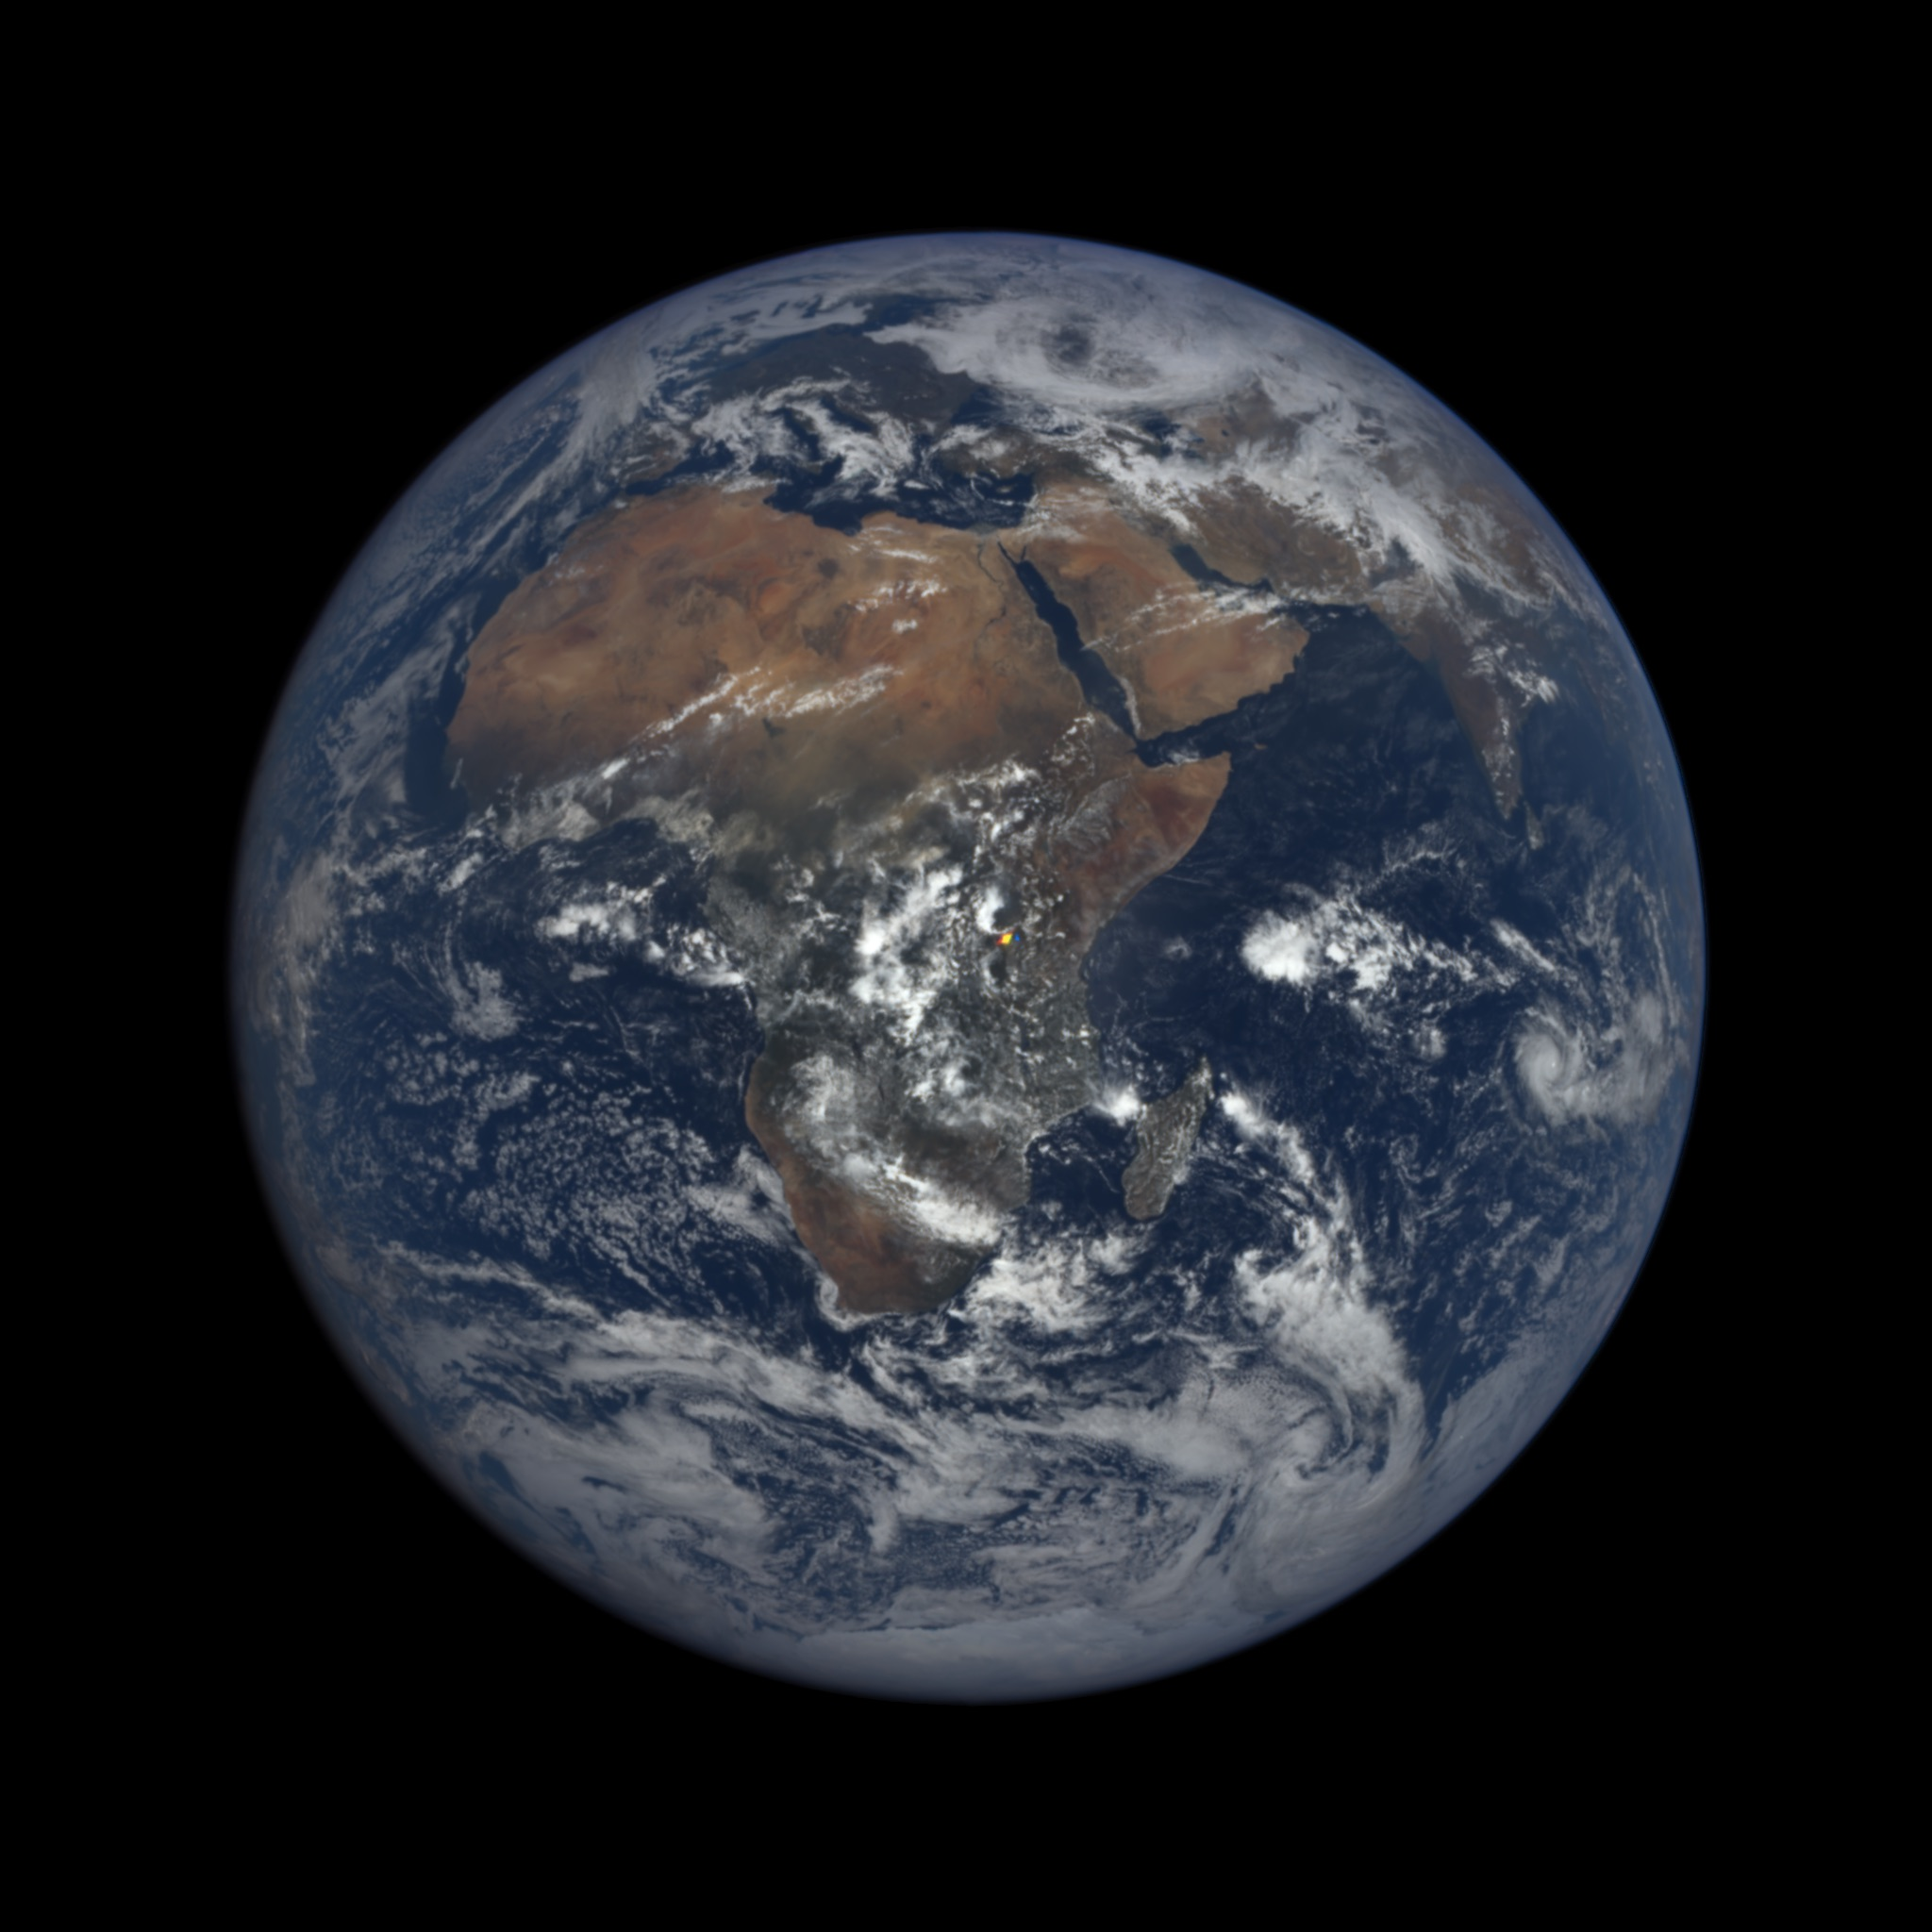
EPIC images often feature glints from ocean or clouds
Glint from ocean surface
Glint from clouds
2016 03 23, 07:39 UTC
2016 03 17, 09:46 UTC

Slide 3
Glint form horizontal ice crystals in clouds (subsun)
Photo from aircraft
EPIC image
Können (2017, BAMS)

Slide 4
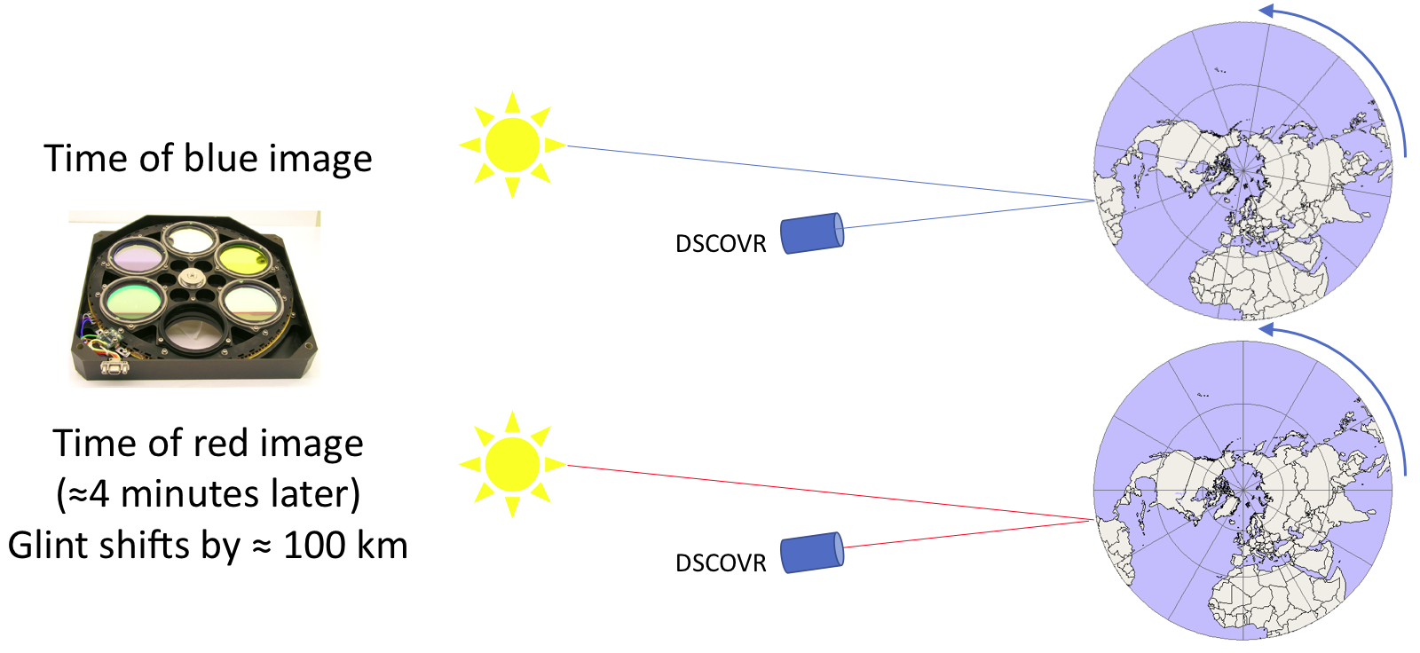
Glints appear colorful, as the Earth turns between blue & red images

Slide 5
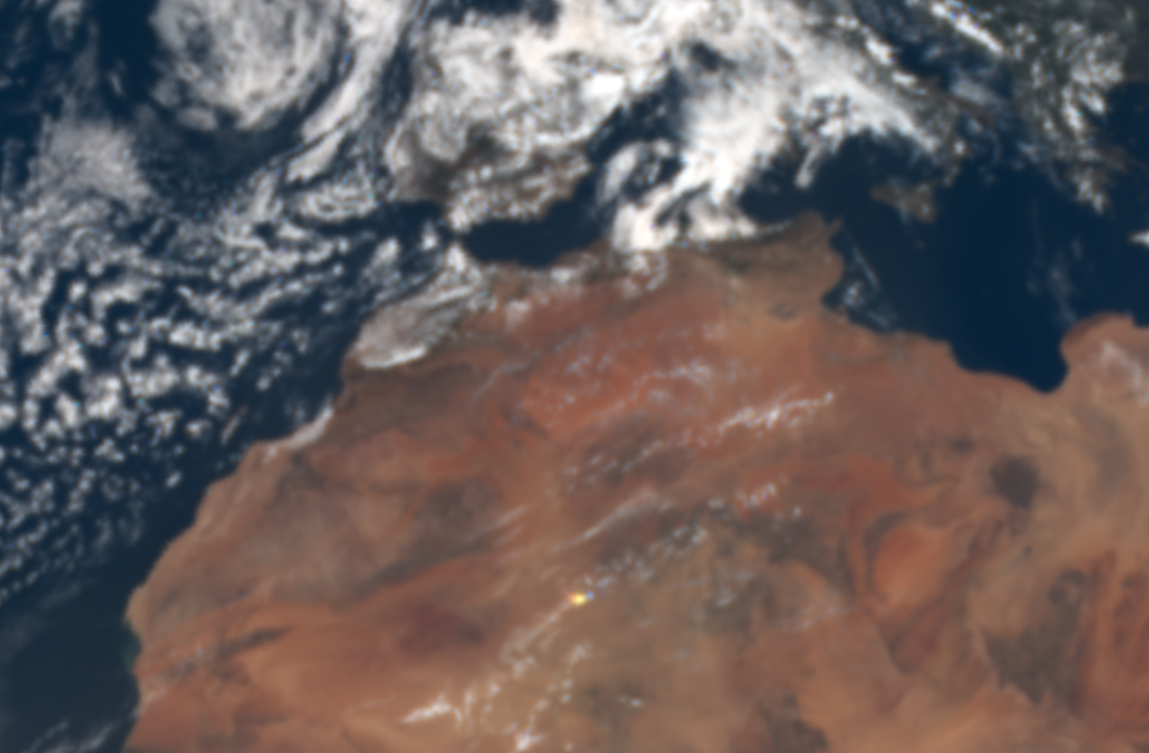
Proof that glint is from clouds: Oxygen A-band
Ratio = R_{abs} / R_{non-abs}
Spacecraft
Surface reflection:
Low reflectance ratio
High cloud reflection:
High reflectance ratio
2018-05-28, 12:17 UTC

Slide 6
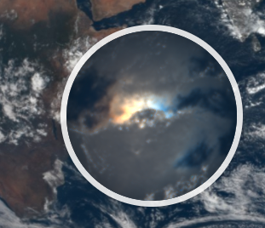
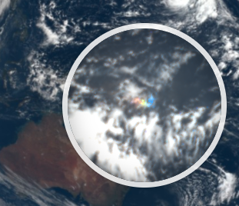
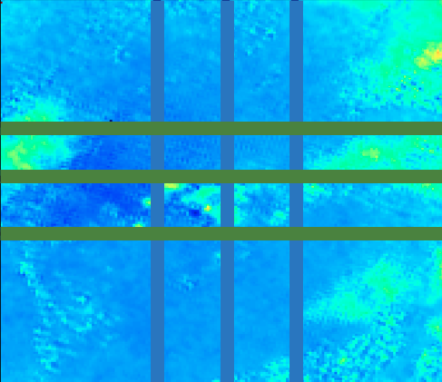
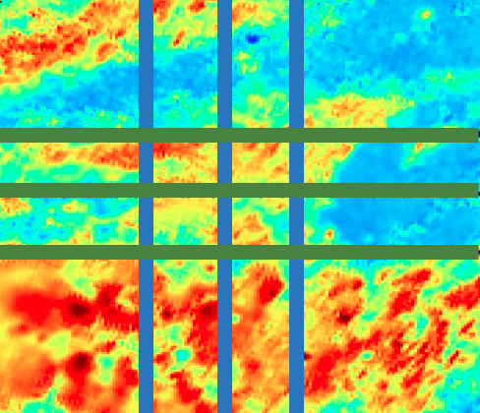
Sample ocean and cloud glints from October 3, 2015
Ocean surface glint
Indian Ocean, 07:27 UTC
Cloud glint
Pacific Ocean, 00:45 UTC
2°N
2°N
RGB images
0°
0°
2°S
2°S
60°E
64°E
160°E
164°E
small ratio
O₂ A-band ratios
2°N
2°N
0°
0°
2°S
2°S
60°E 64°E
large ratio
160°E
164°E
0.2 0.4 0.6 0.8
R_{764 nm} / R_{780 nm}

Slide 7
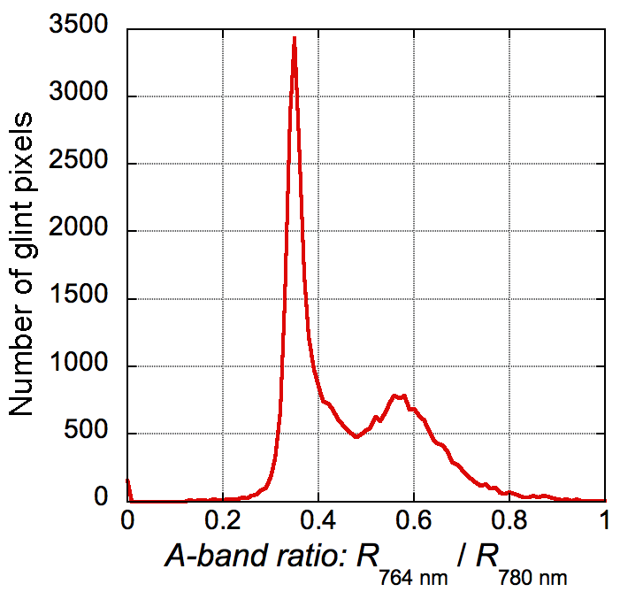
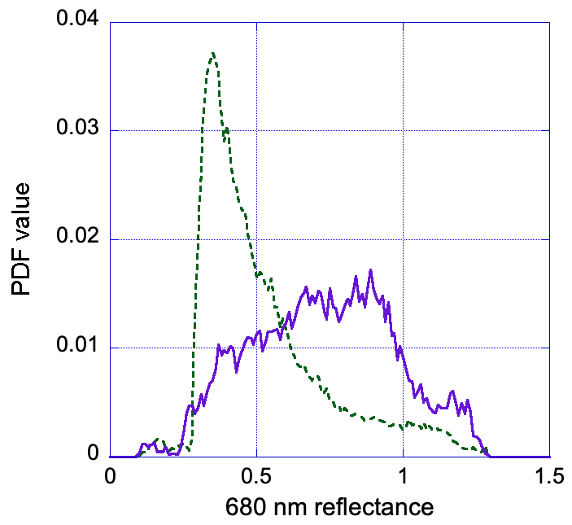
Cloud glints are frequent and bright
Land
About every third EPIC image contains a glint from clouds (or sometimes from lakes, etc.)
Ocean
Surface glints
Surface glints
Cloud glints
Cloud glints
Várnai et al. (2020), yearlong dataset

Slide 8
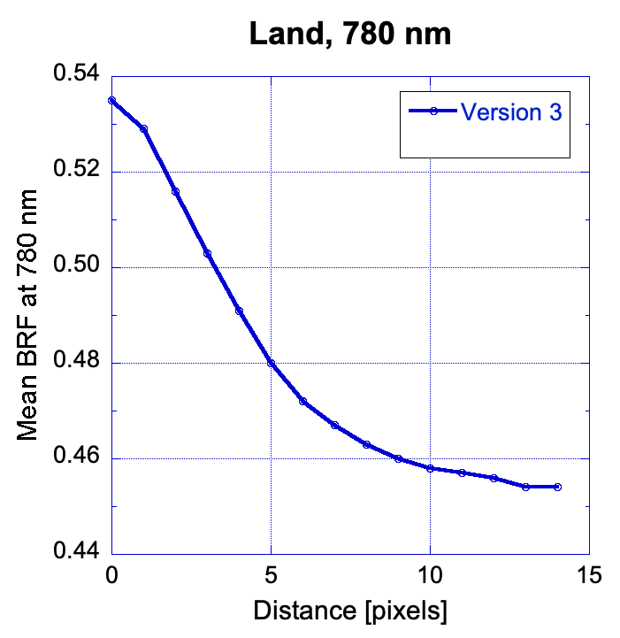
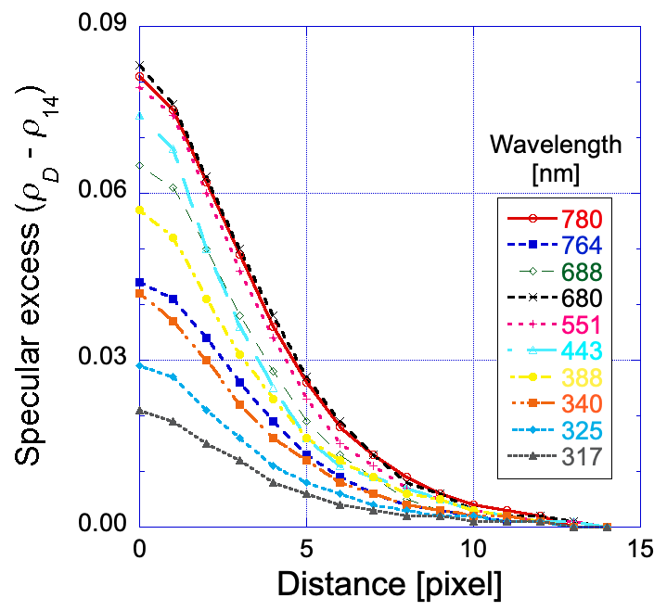
Width of cloud glint is similar for all EPIC bands
Enhancement
Mean 780 nm reflectance
Enhancement: Refl_{D} – Refl₁₄

Slide 9
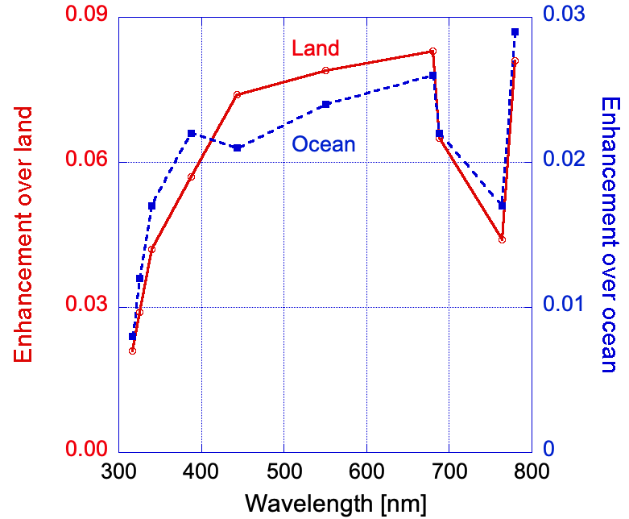
Two factors dominate wavelength dependence of enhancement
Enhancement = Refl₀ – Refl₁₄
Rayleigh scattering reduces E
Absorption reduces E

Slide 10
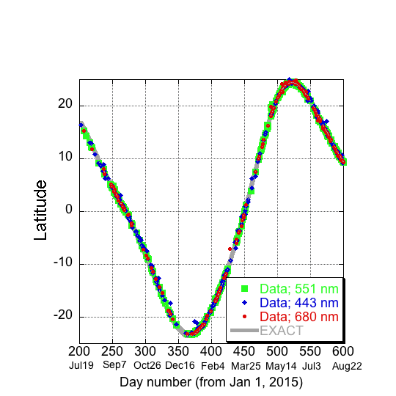
Location of glint varies with season
Location of cloud glints
Marshak et al. (2017)

Slide 11
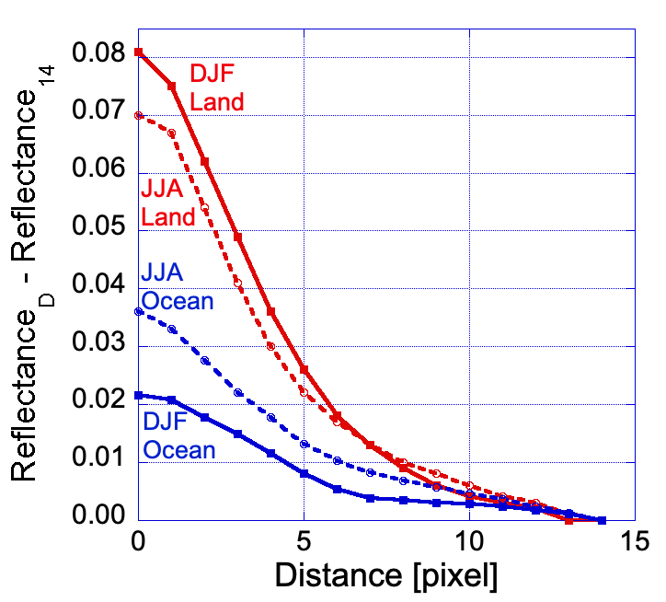
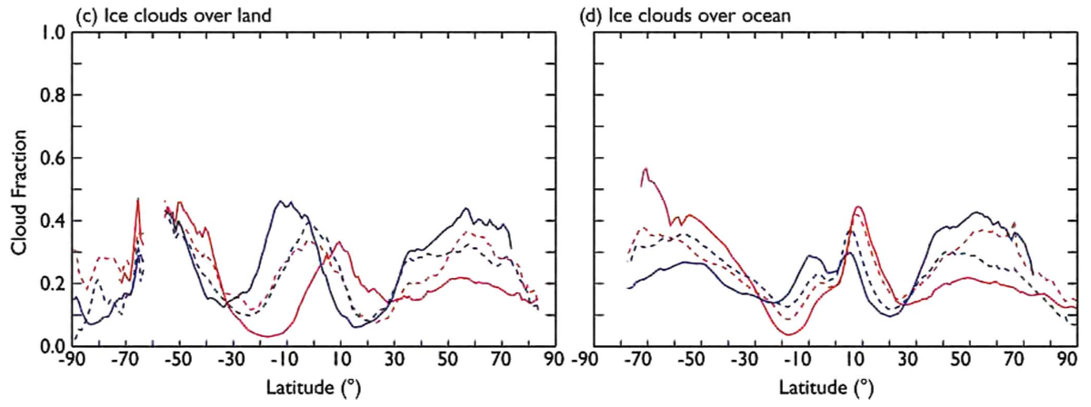
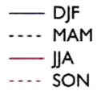
Seasonal variations are opposite over land & ocean
Land
Ice cloud fraction
DJF
JJA
Latitude [°]
Ocean
Ice cloud fraction
JJA
DJF
Latitude [°]
South North
King et al. (2013)

Slide 12
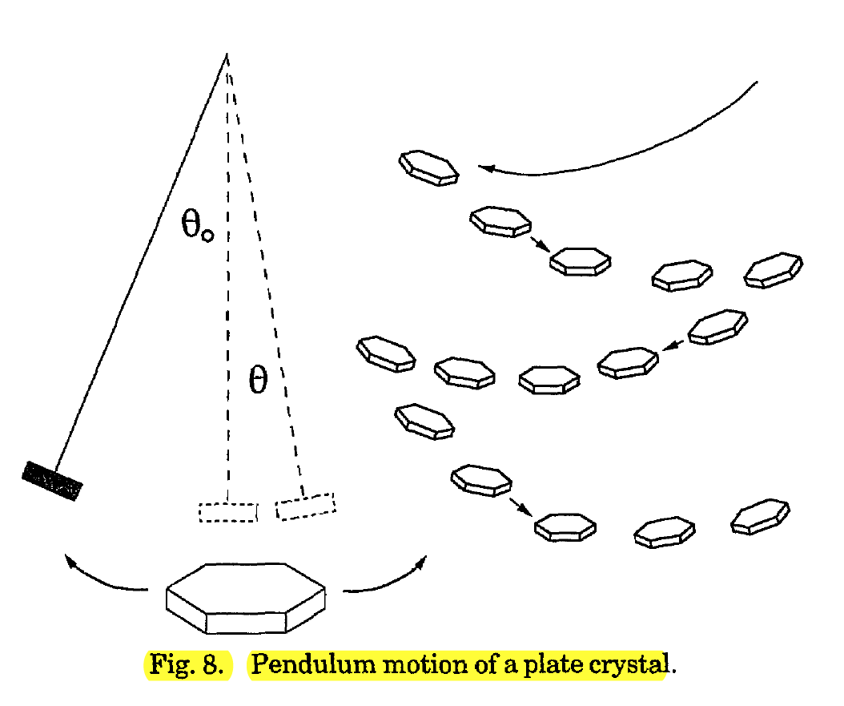
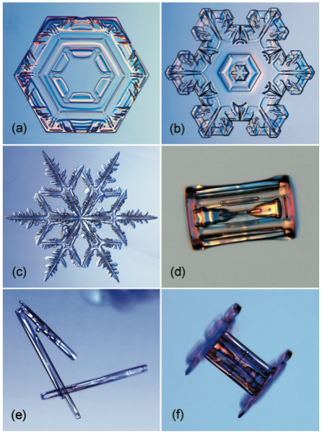
Cloud glints come mostly from plate-shaped crystals
Lynch (1994, Appl. Optics)
θ ≈1°
Libbrecht (2005)

Slide 13
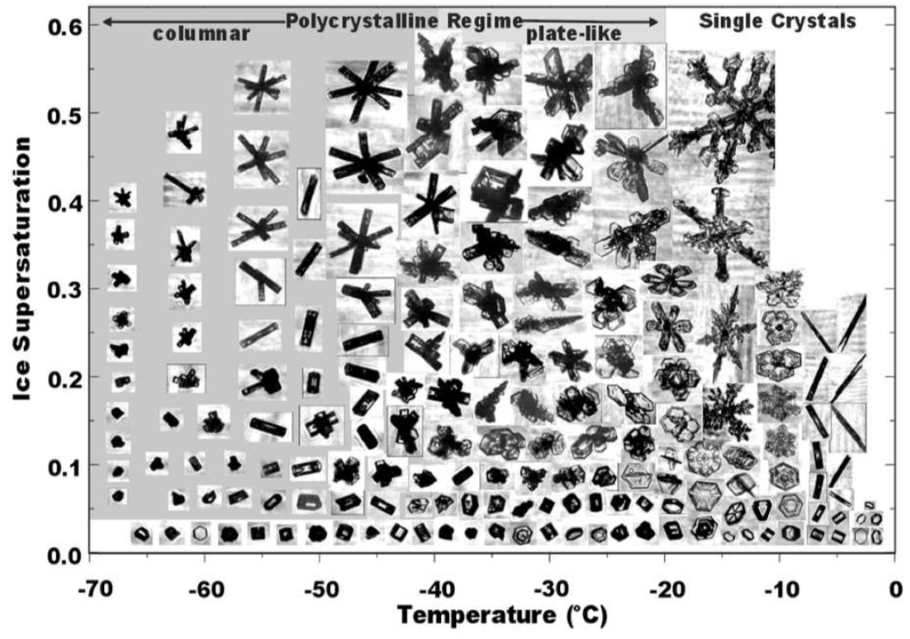
Plates occur mostly in not-too-cold ice clouds
Bailey and Hallett (2009)

Slide 14
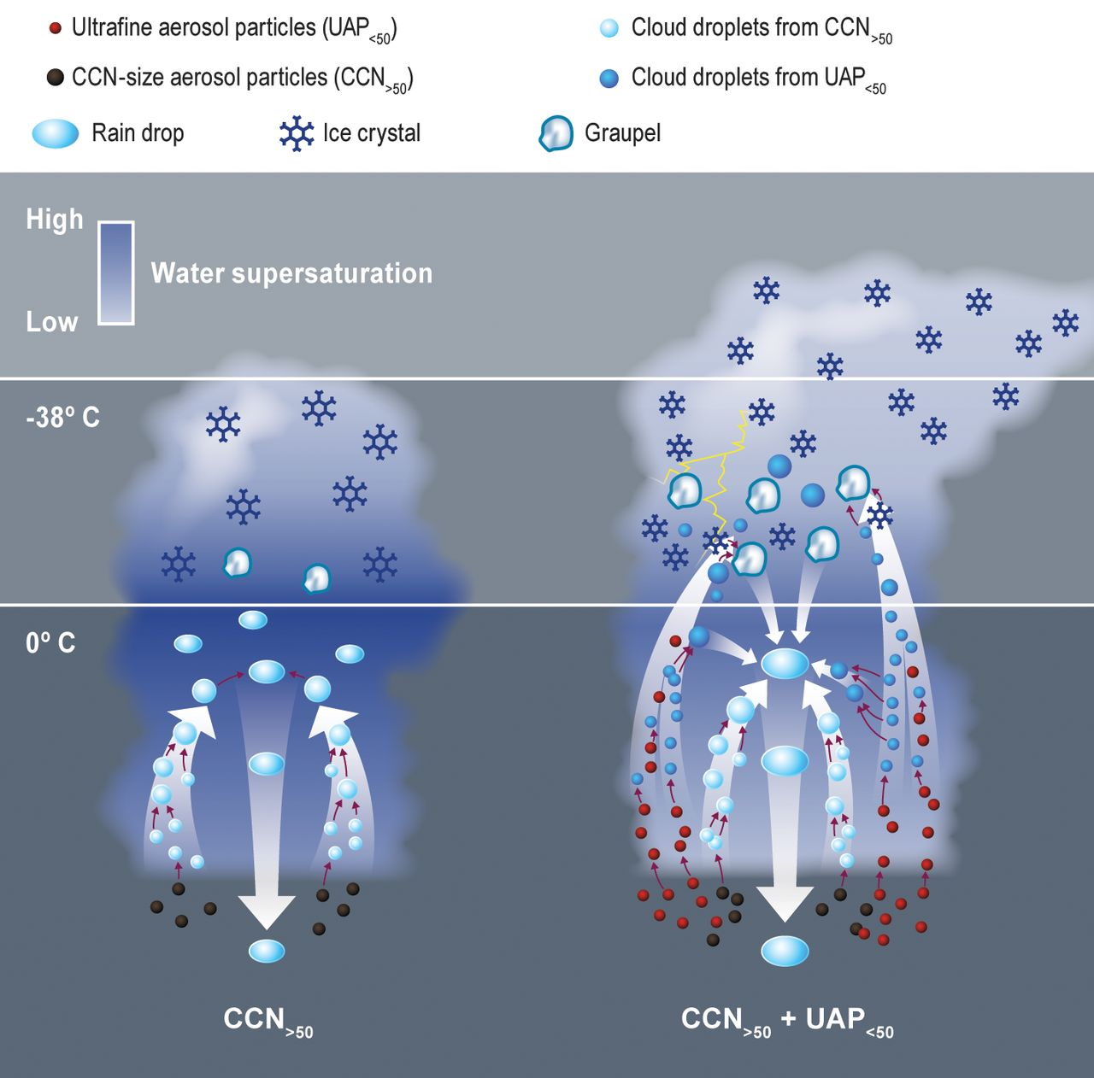
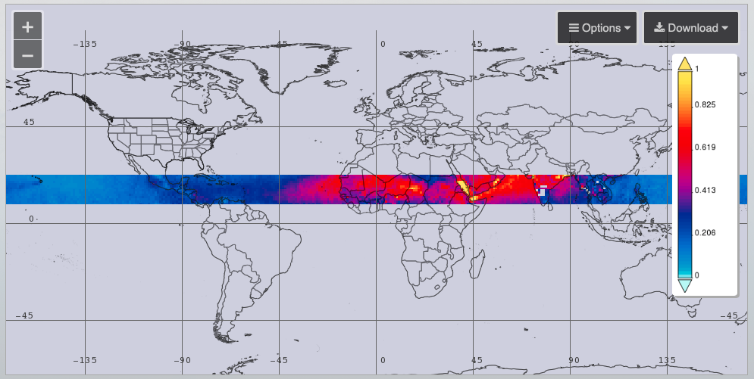
Higher aerosol content over land can help glints
Mean MODIS AOD for JJA, 2017
giovanni.gsfc.nasa.gov
Fan et al. (2018)

Slide 15
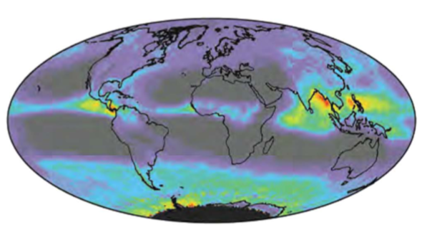
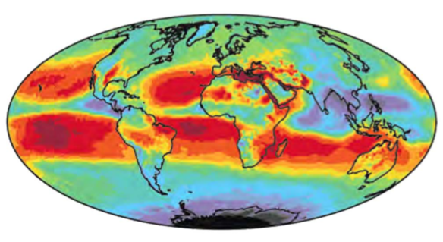
Oceanic clouds often colder
MODIS ice cloud fraction in JJA
MODIS cloud top temperature in JJA
King et al. (2013)

Slide 16
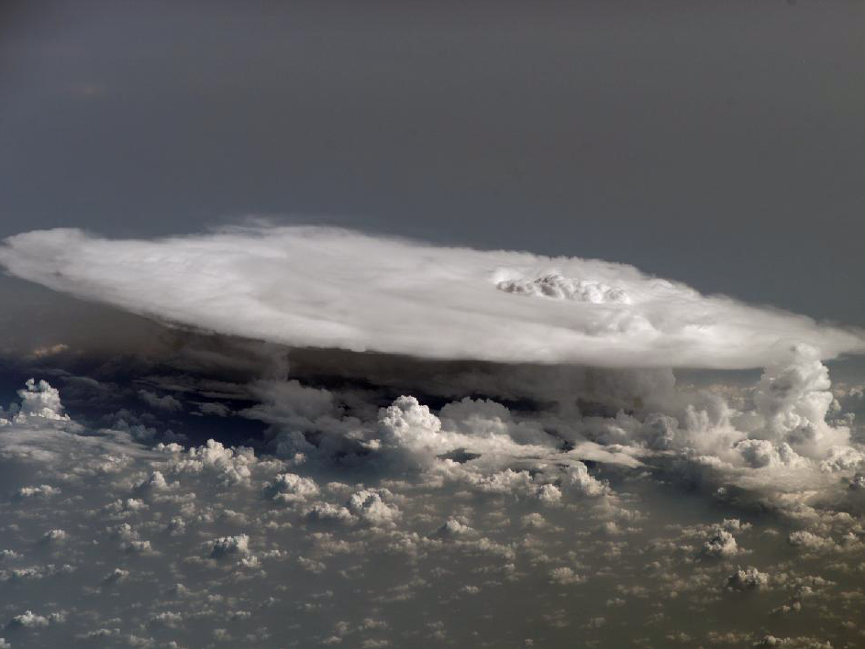
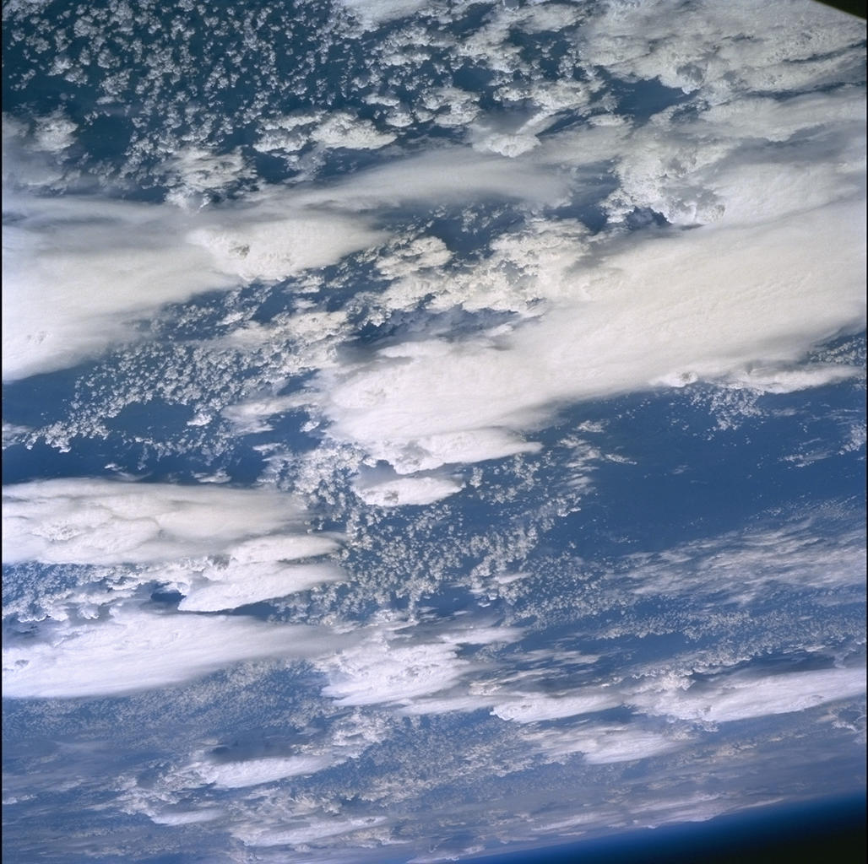
Anvil clouds over Africa (viewed by astronauts)
https://www.nasa.gov/topics/earth/features/astronauts_eyes/iss016e27426.html
https://eol.jsc.nasa.gov/SearchPhotos/photo.pl?mission=STS096&roll=724&frame=20
Notes:
Left: Senegal-Mali border area ISS, Feb. 4, 2008, ISS, https://www.nasa.gov/topics/earth/features/astronauts_eyes/iss016e27426.html
Right: Eastern Africa, ISS, https://eol.jsc.nasa.gov/SearchPhotos/photo.pl?mission=STS096&roll=724&frame=20

Slide 17
Anvils are lower and smaller over land
High-topped cloud occurrence
Rain Weak rain No rain
Ocean around
Philippines and
Indonesia
Altitude [km]
Africa
Normalized distance from thunderstorm center
Yuan and Houze (2010)
Notes:
https://earthobservatory.nasa.gov/images/78101/the-anatomy-of-a-thunderstorm

Slide 18
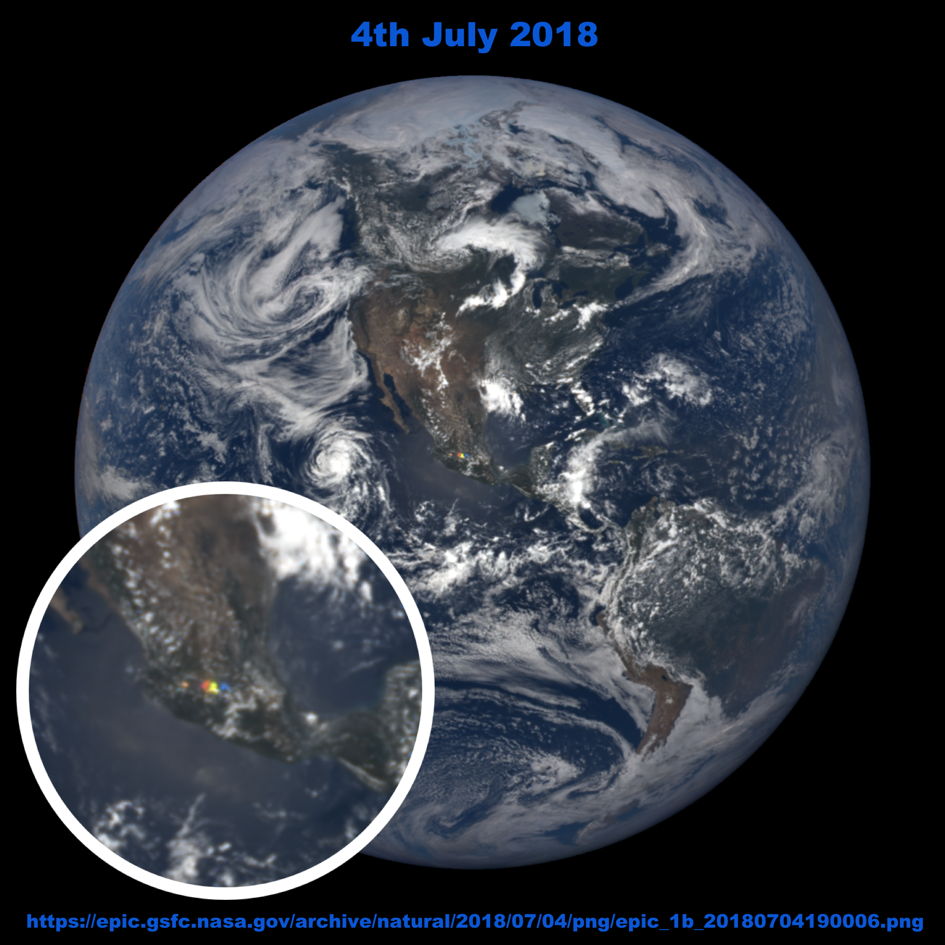
Possible next step: Include data on cloud glints into cloud product?
Identify glints caused by ice clouds
Estimate the reflectance enhancement caused by cloud glints and the impact on cloud optical depth retrievals
c
Aqua MODIS 13:40
θ ₀ = 29°, θ = 3°
2018 07 04 19:00:06 UTC
2016 11 01, 03:44

Slide 19
Summary
EPIC images often feature sun glint from the ocean surface, from ice clouds, and sometimes even from lakes.
The impact of cloud glints varies with wavelength mainly because of Rayleigh scattering and absorption by oxygen and ozone.
EPIC glint statistics reveal seasonal variations in cloud glints, and these variations are compatible with MODIS statistics on ice cloud cover and altitude.
Marshak, A., T. Várnai, and A. Kostinski (2017), Terrestrial glint seen from deep space: Oriented ice crystals detected from the Lagrangian point, Geophys. Res. Lett., 44, doi:10.1002/ 2017GL073248.
Várnai, T., A. Kostinski, and A. Marshak (2020): Deep space observations of sun glints from marine ice clouds. IEEE Geosci. Rem. Sens. Lett., doi: 10.1109/LGRS.2019.2930866.
Várnai, T., A. Marshak, and A. Kostinski (2020b): Deep space observations of cloud glints: Spectral and seasonal dependence. IEEE Geosci. Remote Sens. Lett., in review.

