Slide 1


Vegetation Hot Spot Signatures from Synergy of EPIC/DSCOVR and EOS/SUOMI Sensors to Monitor Changes in Global Forests
R.B. Myneni, Y. Knyazikhin, Y. Sun, X. Ni and X. She
rmyneni@bu.edu
Department of Earth and Environment
Boston University, Boston, MA, USA
DSCOVR EPIC and NISTAR STM
Oct 6-8, 2020

Slide 2
Outline
Motivation and Objectives
Data
Congolian Rainforests
  Seasonal variations
  Long-term trends
  Conclusions
Modeling Angular Signatures
  Conclusions
Papers in Progress
2
DSCOVR EPIC and NISTAR STM
Oct 6-8, 2020

Slide 3
Motivation and Objectives
Tropical forests host significant biodiversity, provide habitat to animals, support to indigenous peoples, play a prominent role in the terrestrial carbon cycle and climate, etc.
Our first study is focused on Congolian Forests with the goal of:
  Understanding the seasonal patterns of leaf area
  Whether there are any long-term trends in the same
Our second study is focused on modeling angular signatures of vegetation
3
DSCOVR EPIC and NISTAR STM
Oct 6-8, 2020

Slide 4
Data
MODIS LAI C6 + MODIS NDVI & EVI C6
Designed for vegetation monitoring
Long-term (20 y, 2000 to 2019) and moderate spatial resolution
New adjustment for sensor degradation
Version 1 EPIC MAIAC & MISR BRF (Version 23)
DSCOVR EPIC and NISTAR STM
Oct 6-8, 2020

Slide 5
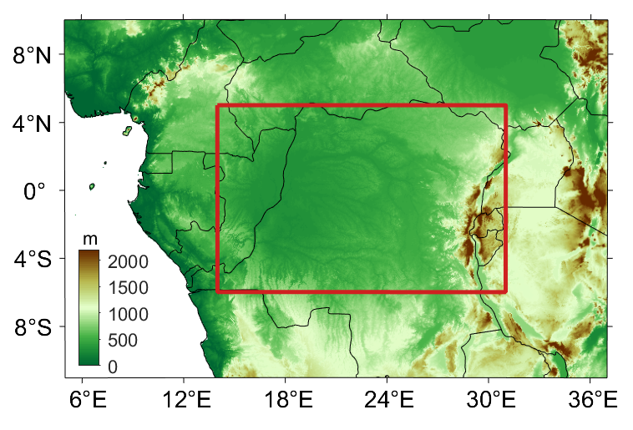
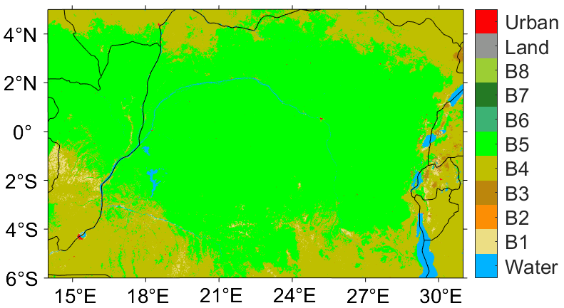
1. Congo Rainforests
The forests cover southeastern Cameroon, Gabon, the Republic of Congo, the northern and central Democratic Republic of the Congo, and portions of southern and southwestern Central African Republic.
To the north, south, and southwest, the forests transition to drier forest-savanna mosaic
To the east, the forests transition to the highland Albertine Rift montane forests (the rift is a branch of the East African Rift system)
Second-largest tropical forest
Contains a quarter of the world's remaining tropical forest
Lowest deforestation rate of any major tropical forest zone
cf. Wikipedia
Landcover
DSCOVR EPIC and NISTAR STM
Oct 6-8, 2020

Slide 6
1.A. Bimodal Seasonal Cycle
Bimodal seasonality of LAI & precipitation
These generally overlap (i.e., large precipitation corresponds to large LAI)
DSCOVR EPIC and NISTAR STM
Oct 6-8, 2020

Slide 7
1.A. Regional Variations
Four sub-regions identified
using 20-year monthly LAI
and climatic data
Region 1
Region 2
Bimodality stronger from N to S
Region 4 different (high altitude)
Region 3
Region 4
DSCOVR EPIC and NISTAR STM
Oct 6-8, 2020

Slide 8
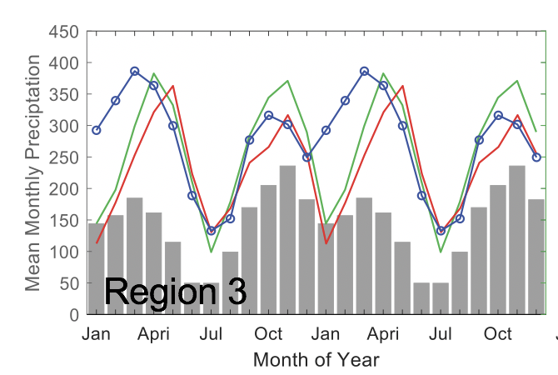
1.A. Seasonality confirmation with Angular Signatures
MISR and EPIC NIR angular signatures are higher in wet season (more leaf area) than in dry season for all 3 regions.
EPIC
MISR
DSCOVR EPIC and NISTAR STM
Oct 6-8, 2020

Slide 9
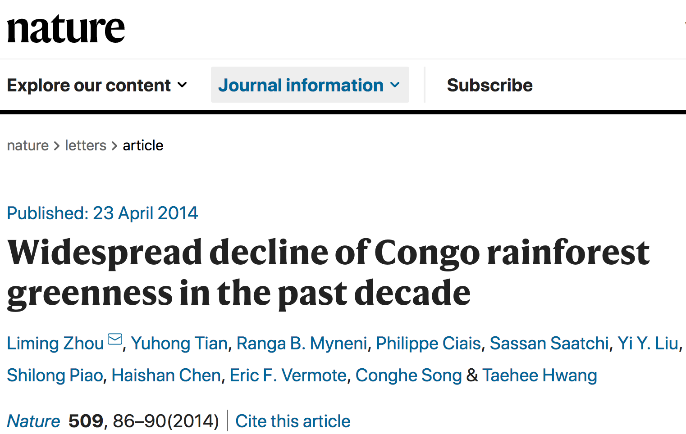
1.B. Long Term Trends
“Here we present observational evidence for a widespread decline in forest greenness over the past decade based on analyses of satellite data”
DSCOVR EPIC and NISTAR STM
Oct 6-8, 2020

Slide 10
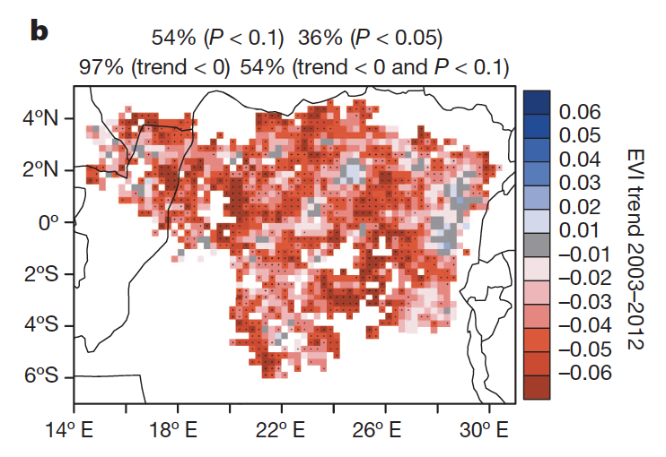
1.B. Long Term Decline?
MODIS EVI C5
2003-2012
Zhou et al., 2014
MODIS EVI C6
2000-2012
MODIS EVI C6
2000-2019
No widespread decline of leaf area is observed with MODIS C6
Remarkable difference exists between MODIS C5 and C6
Wet season (AMJ)
DSCOVR EPIC and NISTAR STM
Oct 6-8, 2020

Slide 11
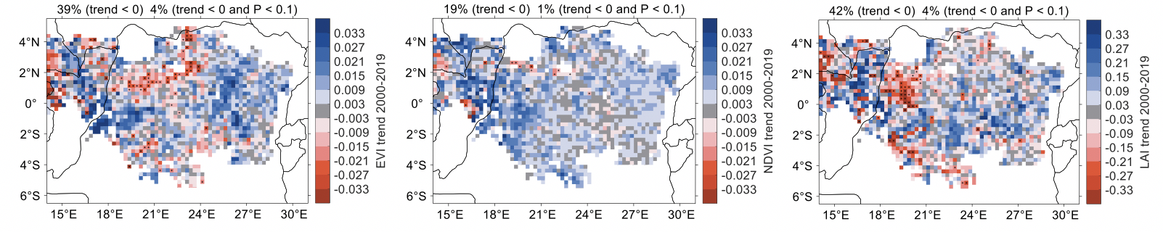
1.B. No Long Term Decline
MODIS EVI C6
2000-2019
MODIS NDVI C6
2000-2019
MODIS LAI C6
2000-2019
No widespread decline of leaf area is observed with MODIS C6 NDVI, EVI and LAI Products
DSCOVR EPIC and NISTAR STM
Oct 6-8, 2020

Slide 12
1.B. Drought Impacts Not Seen
wet season 1 (Mar-Apr-May)
dry season 2 (Jun-Jul-Aug)
No significant change in leaf area and leaf optical properties were observed even in the SE part of the basin (high altitude region) where a significant drought was observed
DSCOVR EPIC and NISTAR STM
Oct 6-8, 2020

Slide 13
Conclusions
Congolian Forests
Seasonal Variations
  Leaf area in Congolian forests exhibits bimodal seasonality
  Leaf area strongly linked to precipitation patterns (larger LAI in wet season)
  Bimodality gets stronger from N to S
    Seasonality of LAI in cycle 1 is mainly controlled by precipitation in regions 1 and 2, and controlled by radiation in region 3
    Seasonality of LAI in cycle 2 is controlled by both precipitation and radiation
Long Term Trends
  No long-term trends were observed in the latest version of multiple satellite products
  Published report of decline in greenness is likely an artifact of Terra MODIS sensor degradation
DSCOVR EPIC and NISTAR STM
Oct 6-8, 2020

Slide 14
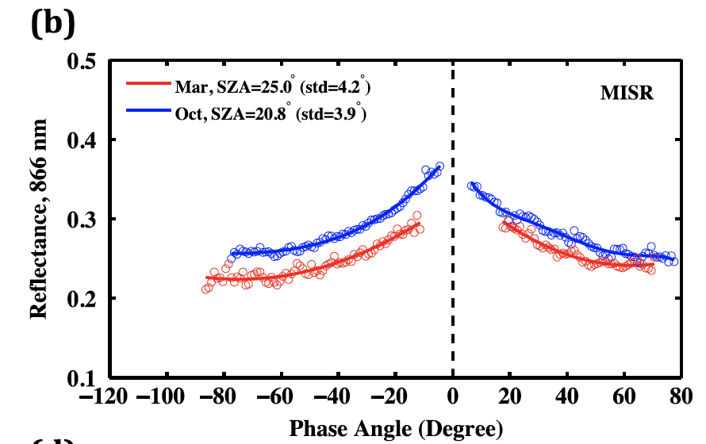
2. Angular Signatures
Powerful tools to argue for changes in vegetation structure due to seasonality, long-term trends, drought impacts etc.
Require simultaneous, or near-simultaneous, multi-directional spectral reflectance measurements
Understanding the physics underlying these signatures help unpack the embedded information content
Congolian Rainforests
Amazonian Rainforests
Transform of
Spectral BRFs
MISR+DSCOVR
Wet season
Dry season
Dry season
Wet season
Angle between solar
& View directions
Bi et al., ERL, 2015
DSCOVR EPIC and NISTAR STM
Oct 6-8, 2020

Slide 15
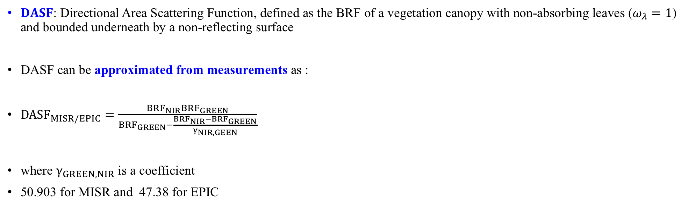
2. DASF
$DASF$: Directional Area Scattering Function, defined as the BRF of a vegetation canopy with non-absorbing leaves ($ω_{λ}=1$) and bounded underneath by a non-reflecting surface
DASF can be approximated from measurements as :
${DASF}_{MISR/EPIC}=\frac{{BRF}_{NIR}{BRF}_{GREEN}}{{BRF}_{GREEN}−\frac{{BRF}_{NIR}{−BRF}_{GREEN}}{γ_{NIR,GEEN}}}$
where $γ_{GREEN,NIR}$ is a coefficient
50.903 for MISR and 47.38 for EPIC
DSCOVR EPIC and NISTAR STM
Oct 6-8, 2020

Slide 16
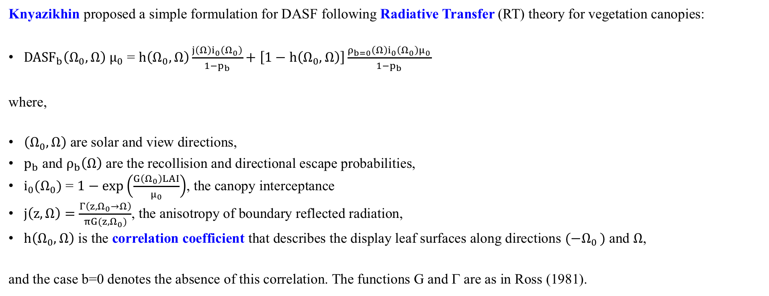
2. Formulation for DASF
Knyazikhin proposed a simple formulation for DASF following Radiative Transfer (RT) theory for vegetation canopies:
${DASF}_{b}\left(Ω_{0},Ω\right)$ $μ_{0}$ = $h\left(Ω_{0},Ω\right)\frac{j\left(Ω\right)i_{0}\left(Ω_{0}\right)}{1−p_{b}}+\left[1−h\left(Ω_{0},Ω\right)\right]\frac{ρ_{b=0}{\left(Ω\right)i_{0}\left(Ω_{0}\right)μ}_{0}}{1−p_{b}}$
where,
$\left(Ω_{0},Ω\right)$ are solar and view directions,
$p_{b}$ and $ρ_{b}\left(Ω\right)$ are the recollision and directional escape probabilities,
$i_{0}(Ω_{0})$ = $1−\exp\left(\frac{G\left(Ω_{0}\right)LAI}{μ_{0}}\right)$, the canopy interceptance
$j\left(z,Ω\right)=\frac{Γ\left({z,Ω}_{0}→Ω\right)}{πG(z,Ω_{0})}$, the anisotropy of boundary reflected radiation,
$h\left(Ω_{0},Ω\right)$ is the correlation coefficient that describes the display leaf surfaces along directions ${(−Ω}_{0 })$ and $Ω$,
and the case b=0 denotes the absence of this correlation. The functions G and Γ are as in Ross (1981).
DSCOVR EPIC and NISTAR STM
Oct 6-8, 2020

Slide 17
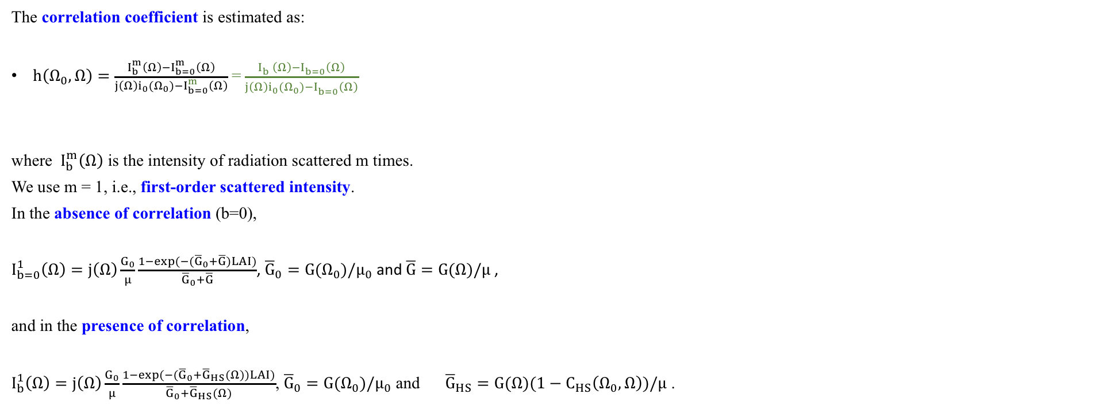
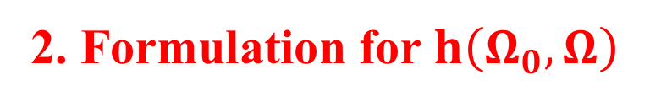
2. Formulation for $h\left(Ω_{0},Ω\right)$
The correlation coefficient is estimated as:
$h\left(Ω_{0},Ω\right)=\frac{I_{b}^{m}\left(Ω\right)−I_{b=0}^{m}\left(Ω\right)}{j\left(Ω\right)i_{0}(Ω_{0})−I_{b=0}^{m}\left(Ω\right)}$= $\frac{I_{b}^{}\left(Ω\right)−I_{b=0}^{}\left(Ω\right)}{j\left(Ω\right)i_{0}(Ω_{0})−I_{b=0}^{}\left(Ω\right)}$
where $I_{b}^{m}\left(Ω\right)$ is the intensity of radiation scattered m times.
We use m = 1, i.e., first-order scattered intensity.
In the absence of correlation (b=0),
$I_{b=0}^{1}\left(Ω\right)=j\left(Ω\right)\frac{G_{0}}{μ}\frac{1−\exp{(−({\overline{G}}_{0}+\overline{G})LAI)}}{{\overline{G}}_{0}+\overline{G}}$, ${\overline{G}}_{0}={G(Ω}_{0})/μ_{0}$ and$\overline{G}=G(Ω)/μ$ ,
and in the presence of correlation,
$I_{b}^{1}\left(Ω\right)=j\left(Ω\right)\frac{G_{0}}{μ}\frac{1−\exp{(−({\overline{G}}_{0}+{\overline{G}}_{HS}(Ω))LAI)}}{{\overline{G}}_{0}+{\overline{G}}_{HS}(Ω)}$, ${\overline{G}}_{0}={G(Ω}_{0})/μ_{0}$ and ${\overline{G}}_{HS}=G(Ω)(1−C_{HS}\left(Ω_{0},Ω\right))/μ$ .
DSCOVR EPIC and NISTAR STM
Oct 6-8, 2020

Slide 18
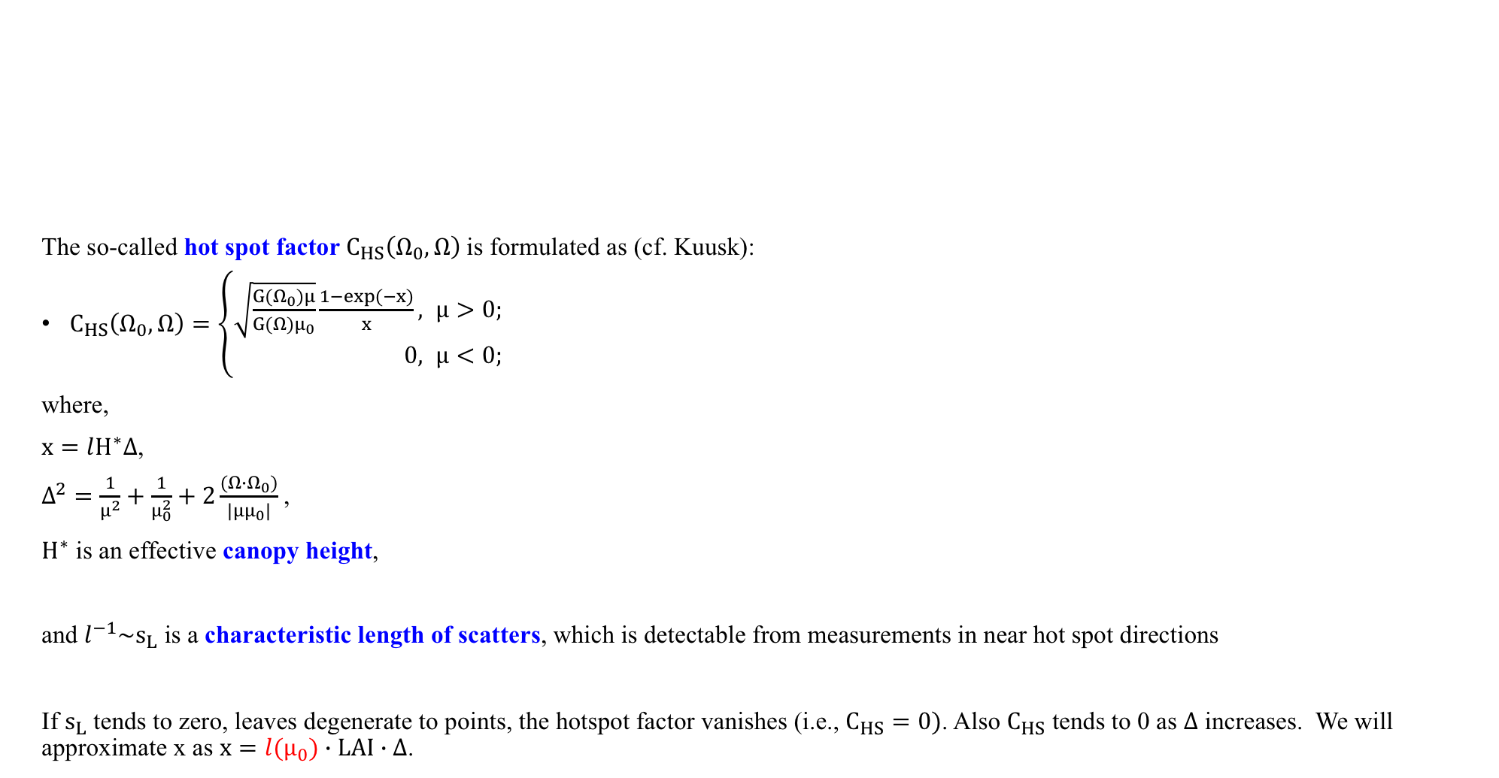
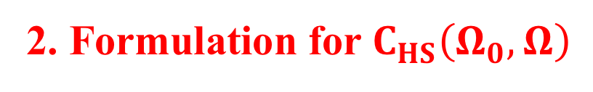
2. Formulation for $C_{HS}\left(Ω_{0},Ω\right)$
The so-called hot spot factor $C_{HS}\left(Ω_{0},Ω\right)$is formulated as (cf. Kuusk):
$C_{HS}\left(Ω_{0},Ω\right)=\left\{\begin{aligned}\sqrt{\frac{G(Ω_{0})μ}{G(Ω)μ_{0}}}\frac{1−\exp{(−x)}}{x}, &μ>0; \\ 0, &μ<0;\end{aligned}\right.$
where,
$x=lH^{∗}Δ$,
$Δ^{2}=\frac{1}{μ^{2}}+\frac{1}{μ_{0}^{2}}+2\frac{(Ω∙Ω_{0})}{|μμ_{0}|}$,
$H^{∗}$ is an effective canopy height,
and $l^{−1}\sim s_{L}$ is a characteristic length of scatters, which is detectable from measurements in near hot spot directions
If $s_{L}$ tends to zero, leaves degenerate to points, the hotspot factor vanishes (i.e., $C_{HS}=0)$. Also $C_{HS}$ tends to 0 as $Δ$ increases. We will approximate x as $x=l(μ_{0})∙LAI∙Δ$.
DSCOVR EPIC and NISTAR STM
Oct 6-8, 2020

Slide 19
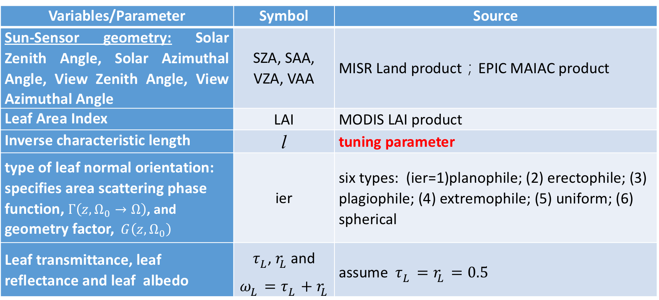
2. DASF Model variables/Parameters
Variables/Parameter | Symbol | Source
Sun-Sensor geometry: Solar Zenith Angle, Solar Azimuthal Angle, View Zenith Angle, View Azimuthal Angle | SZA, SAA, VZA, VAA | MISR Land product；EPIC MAIAC product
Leaf Area Index | LAI | MODIS LAI product
Inverse characteristic length | l | tuning parameter
type of leaf normal orientation: specifies area scattering phase function, $Γ\left({z,Ω}_{0}→Ω\right)$, and geometry factor, $G\left(z,Ω_{0}\right)$ | ier | six types: (ier=1)planophile; (2) erectophile; (3) plagiophile; (4) extremophile; (5) uniform; (6) spherical
Leaf transmittance, leaf reflectance and leaf albedo | $τ_{L}$, $r_{L}$ and $ω_{L}=τ_{L}+r_{L}$ | assume $τ_{L}=r_{L}=0.5$
DSCOVR EPIC and NISTAR STM
Oct 6-8, 2020

Slide 20
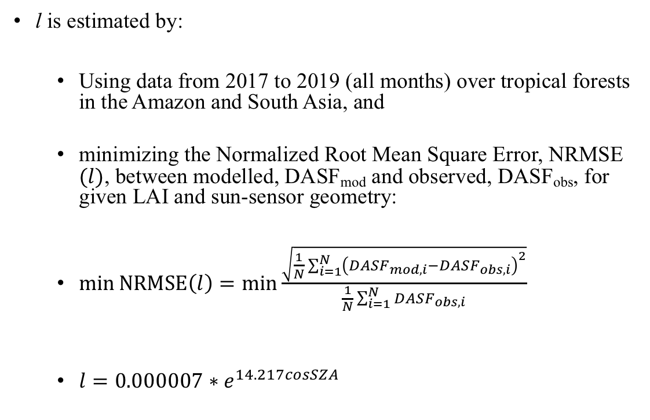
2. Estimating the Characteristic Length, l
l is estimated by:
  Using data from 2017 to 2019 (all months) over tropical forests in the Amazon and South Asia, and
  minimizing the Normalized Root Mean Square Error, NRMSE $(l)$, between modelled, DASF_{mod} and observed, DASF_{obs}, for given LAI and sun-sensor geometry:
  $\min{NRMSE\left(l\right)}=\min{\frac{\sqrt{\frac{1}{N}\sum_{i=1}^{N}{{\left({DASF}_{mod,i}−{DASF}_{obs, i}\right)}^{2}}}}{\frac{1}{N}\sum_{i=1}^{N}{{DASF}_{obs, i}}}}$
  $l=0.000007∗e^{14.217cosSZA}$
DSCOVR EPIC and NISTAR STM
Oct 6-8, 2020

Slide 21
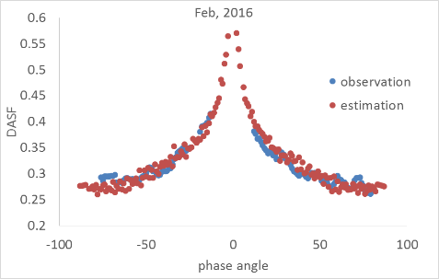
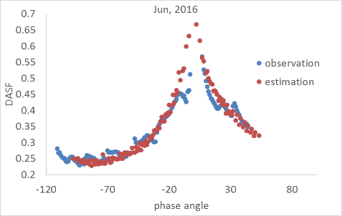
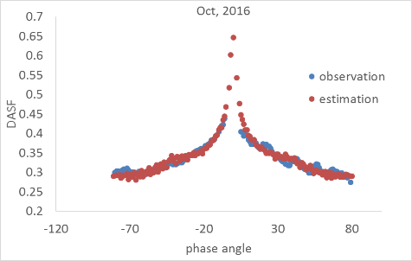
2. Model Evaluation: MISR Data
DSCOVR EPIC and NISTAR STM
Oct 6-8, 2020

Slide 22
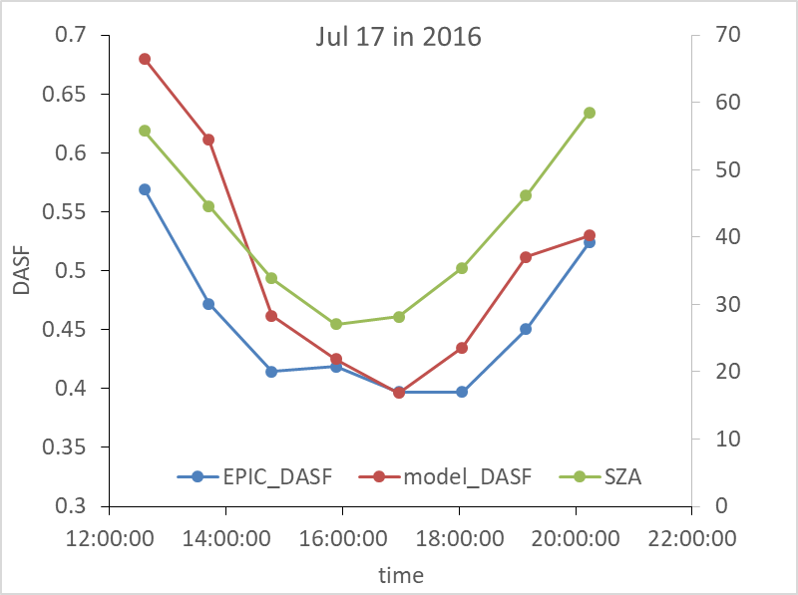
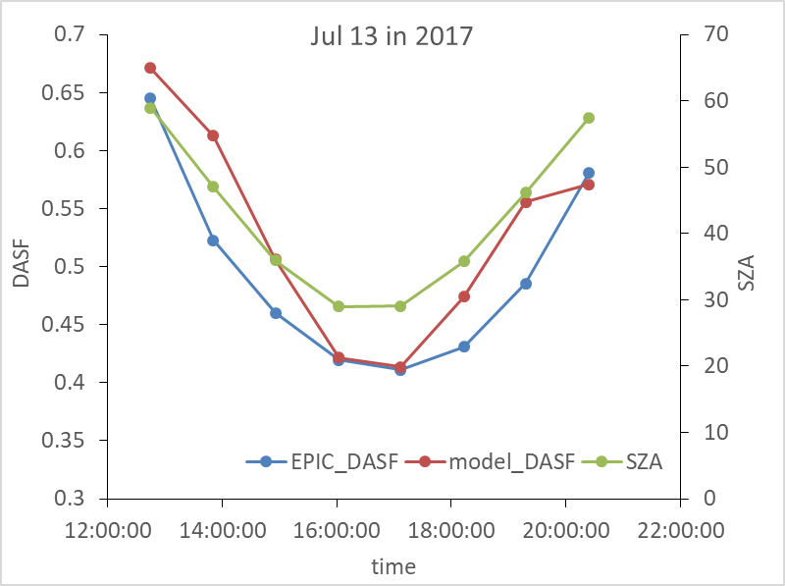
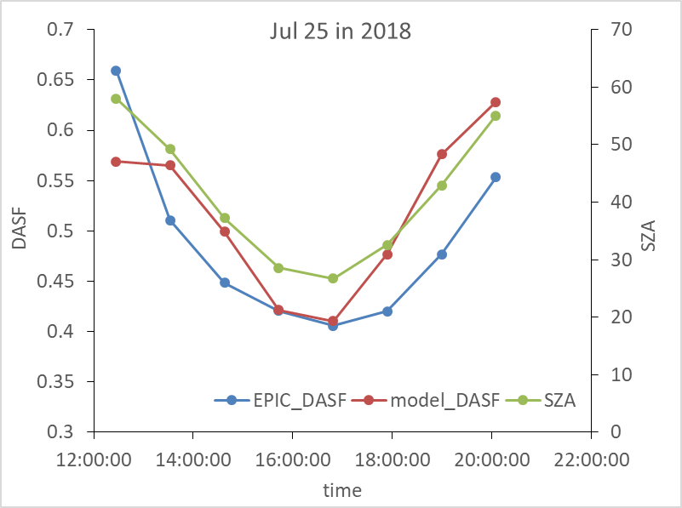
2. Model Evaluation: EPIC Data
The model works well in the hot spot direction when SZA<30º but poorly for SZA>30º
1
Modelled, DASF_{mod} vs observed EPIC DASF_{obs} at different times in one day over the Amazon forest
For SZA<45, error ~13%; Could be due to: (a) 1D model for the canopy interceptance (b) ignoring the sphericity of the atmosphere while atmospheric correction of data
DSCOVR EPIC and NISTAR STM
Oct 6-8, 2020

Slide 23
2. Model Evaluation: EPIC Data
The model works well in the hot spot direction when SZA<30º but poorly for SZA>30º
Modelled, DASF_{mod} vs observed EPIC DASF_{obs} in the Amazon forest
DSCOVR EPIC and NISTAR STM
Oct 6-8, 2020

Slide 24
2. Conclusions
Angular Signatures
Continuing progress on modelling angular signatures shows promise
The goal is to help attribute changes in angular signatures to changes in canopy structure and optics
This rigorous attribution will help
  diagnose ongoing changes in tropical forests
  prognose future changes
Guide future field data sampling to test model generated hypotheses
DSCOVR EPIC and NISTAR STM
Oct 6-8, 2020

Slide 25
Papers in Progress
Two papers currently in preparation and expected to be submitted by Dec-31-2020
  Sun, Knyazikhin, Myneni et al., Seasonal and long-term variations in leaf area of Congolian forests inferred from NASA’s Earth observation satellites
  Ni, Knyazikhin, Myneni et al., Modeling angular signatures of tropical forests with data from EPIC-DSCOVR and MISR sensors
DSCOVR EPIC and NISTAR STM
Oct 6-8, 2020

