Slide 1
Retrieval of cloud properties from EPIC/DSCOVR with ROCINN/OCRA: Status report
Víctor Molina García, Ronny Lutz, Dmitry S. Efremenko, Diego Loyola
Earth Observation Center (EOC)
Institut für Methodik der Fernerkundung

Slide 2
Contents
Science with the DSCOVR EPIC observations
EPIC OCRA algorithm: improvements
Degradation
Viewing geometry dependencies
Temporal dependencies
EPIC OCRA validation
Science because of the DSCOVR EPIC observations
EPIC ROCINN algorithm
Input space

Slide 3
EPIC OCRA improvements
0. Starting point
OCRA (Optical Cloud Recognition Algorithm) estimates the cloud fraction of a ground pixel by analysing the differences between the true reflectances of the pixel and the expected reflectances under clear-sky conditions
Requirements:
Set of EPIC channels used by OCRA (551 and 388 nm, GU)
Clear-sky maps
Scaling and offset parameters

Slide 4
EPIC OCRA improvements
1. Degradation analysis
Should we rewrite the calibration coefficients $k_{m}$ as functions of time?
$k_{m0}:$ original calibration coefficient for EPIC channel $m$
$c_{m}^{degr}:$ degradation ratio for EPIC channel $m$
$t_{0}:$ reference time (1 January 2016 12:00 UTC)

Slide 5
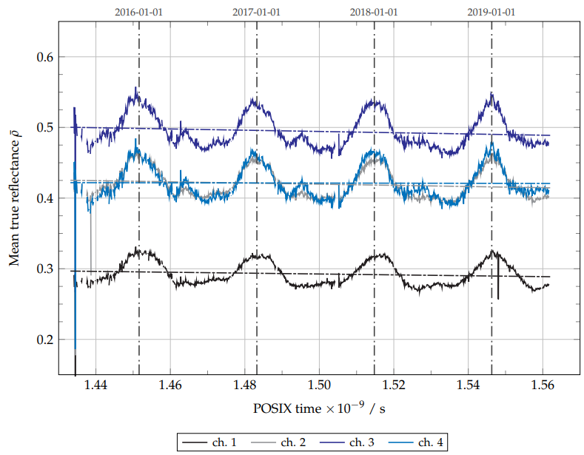
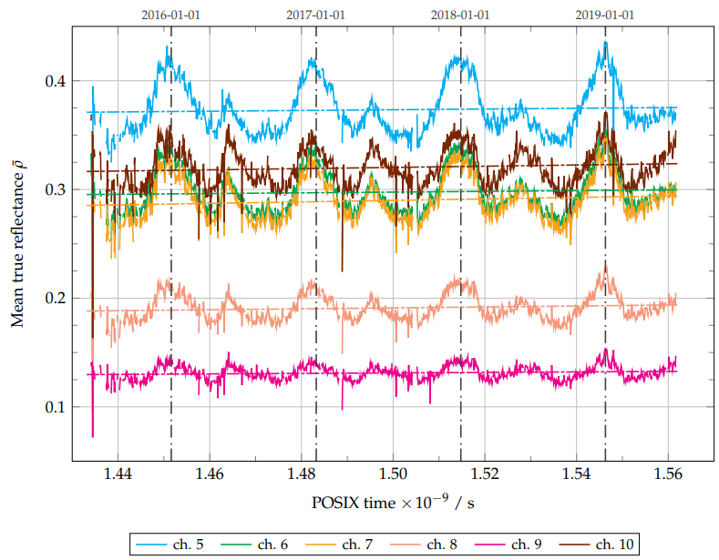
EPIC OCRA improvements
1. Degradation analysis
Time evolution of daily global true reflectance for the ten EPIC channels 12 June 2015 to 27 June 2019

Slide 6
EPIC OCRA improvements
1. Degradation analysis
Negative degradation ratio for the UV channels (about -0.6% per year), no clear degradation for channel 4
Positive degradation ratio for the VIS-NIR channels (about +0.3% to +0.8% per year)

Slide 7
EPIC OCRA improvements
2. Viewing dependencies of the EPIC measurements
What should we do to take into account BRF effects and Rayleigh scattering without calling the radiative transfer model?
$ρ_{m}:$ true reflectance for EPIC channel $m$
$ρ_{m}^{∗}:$ geometry-effective reflectance for EPIC channel $m$
$f_{m}^{view}(θ):$ viewing correction factor for EPIC channel $m$, which depends on the viewing zenith angle $θ$; they are computed separately for land and water bodies

Slide 8
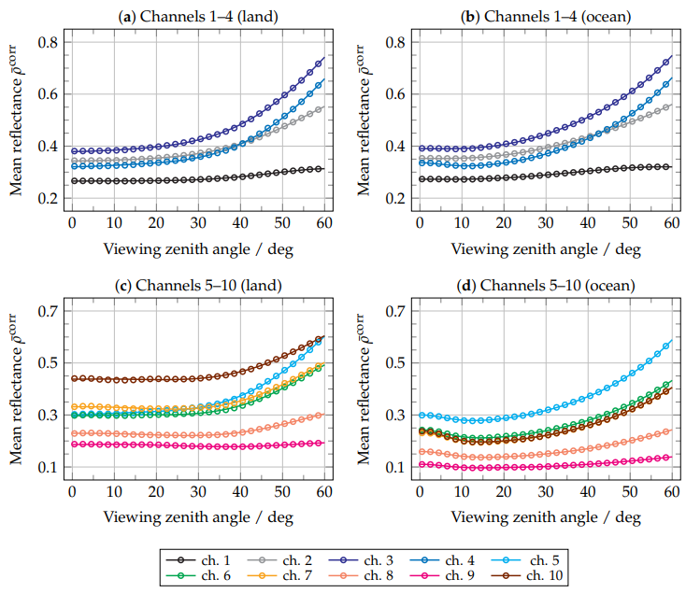
EPIC OCRA improvements
2. Viewing dependencies of the EPIC measurements
Global mean true reflectances versus $θ$ are fitted to 5th degree polynomials (without 1st degree monomial)
Part of the glint contribution may be observed in the VIS-NIR channels over water bodies
$ρ_{m}^{∗}$ (true reflectance corrected from degradation and viewing dependencies) is used as OCRA quantity instead of the true reflectance $ρ_{m}$

Slide 9
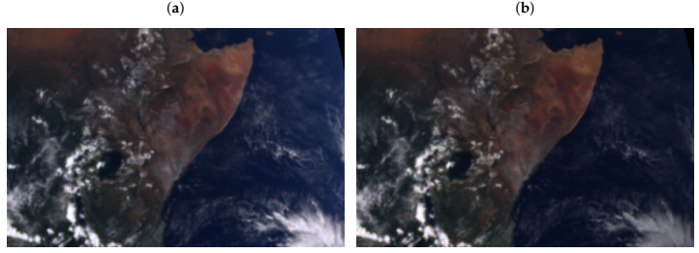
EPIC OCRA improvements
2. Viewing dependencies of the EPIC measurements
True reflectance
Geometry-effective true reflectance
Horn of Africa on 2019-03-20 11:15:31 UTC

Slide 10
EPIC OCRA improvements
3. Temporal dependencies
The cloud-free maps are recomputed on a daily basis instead of on a monthly basis.

Slide 11
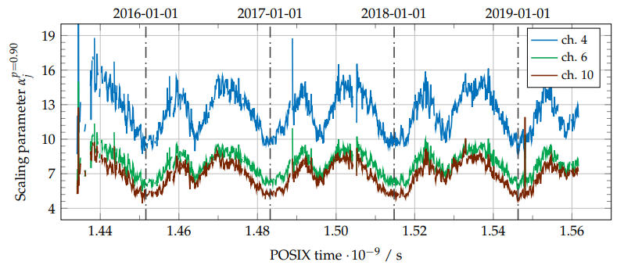
EPIC OCRA improvements
3. Temporal dependencies
The temporal variation of the mean global reflectances is reflected also in the OCRA scaling parameters $α_{j}$.

Slide 12
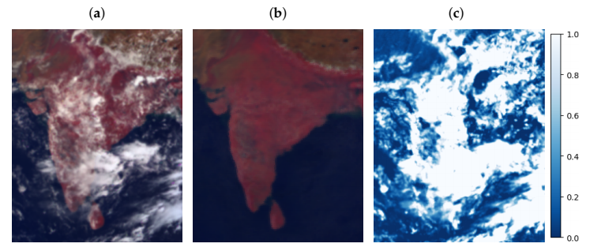
EPIC OCRA improvements
4. Examples
Geometry-effective true reflectance
Expected clear-sky scene
OCRA radiometric cloud fraction
India and Sri Lanka on 24 August 2017 05:07:46 UTC

Slide 13
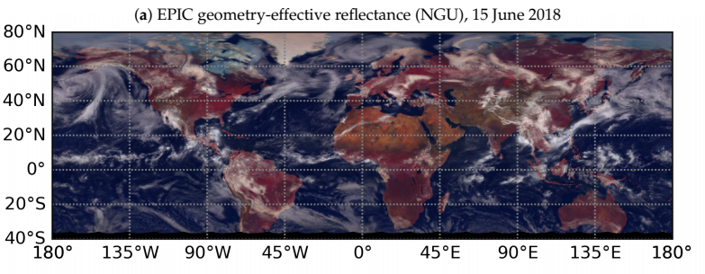
EPIC OCRA improvements
4. Examples
Daily product regridded to 0.2 deg x 0.2 deg

Slide 14
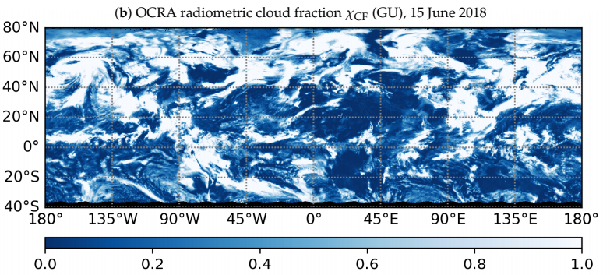
EPIC OCRA improvements
4. Examples
Daily product regridded to 0.2 deg x 0.2 deg

Slide 15
EPIC OCRA validation
Reference product: MODIS daily geometric cloud fraction (MOD08_D3)
Target product: EPIC OCRA cloud fraction
EPIC OCRA products generated from EPIC L1B v02 plus geolocation improvement
EPIC OCRA daily cloud fraction maps with 1 deg x 1 deg resolution (as MOD08_D3 datasets)
Period: 12 June 2015 to 27 June 2019
Matching of daily cells from MODIS and EPIC based on the mean local hour angles:
Absolute difference of mean local hour angles less than 15 deg
Standard deviation of the MODIS relative azimuth angle lower than a threshold (i.e. avoid cells mixing cloud fraction values from different orbits)

Slide 16
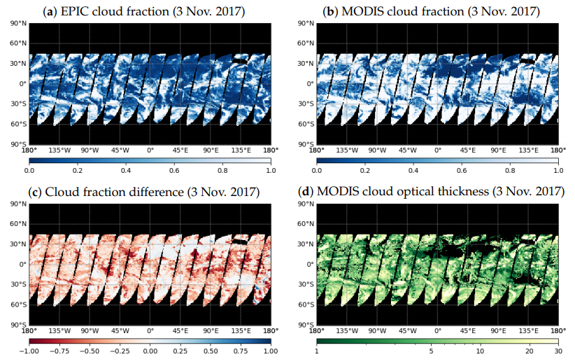
EPIC OCRA validation
OCRA cloud fractions are in general smaller than MODIS cloud fractions
Good performance over totally clear-sky scenes
Good performance over totally cloudy scenes if the clouds are optically thick
Intermediate scenes require further analysis

Slide 17
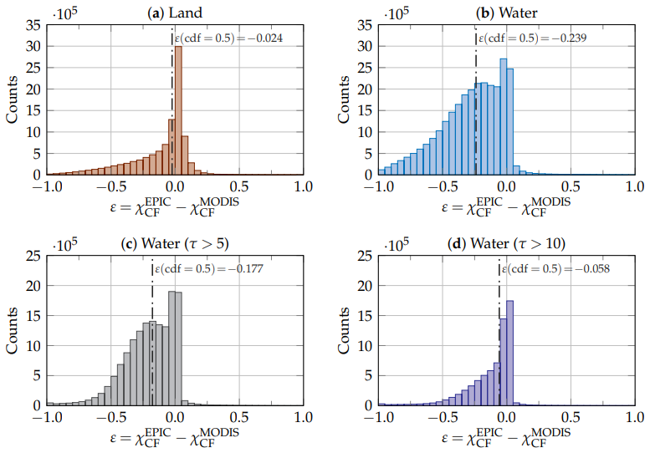
EPIC OCRA validation
Good results over land (median discrepancy -0.024)
Underestimation over water (median discrepancy -0.239)
The median discrepancy over water reduces to -0.177 if we only consider clouds with $τ>5$
The median discrepancy over water reduces to -0.058 if we only consider clouds with $τ>10$

Slide 18
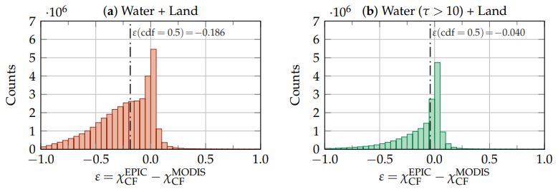
EPIC OCRA validation
Overall median discrepancy of -0.186
Overall median discrepancy of -0.040 when not considering optically-thin clouds over water
The EPIC UV channels used for the OCRA algorithm are not sensitive to this type of clouds

Slide 19
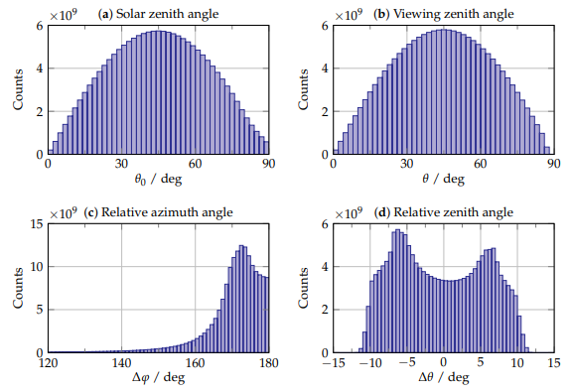
EPIC ROCINN algorithm
Some comments on neural network training and radiative transfer modelling
Should we use as input space of the neural network the same input space of the radiative transfer model?
No
A multilayer-perceptron neural network receives an input vector of independent parameters and returns an output vector using a small set of operations (addition, matrix multiplication and a transfer function such as tanh)
In the EPIC mission, some angles are highly correlated, so it is not recommended to choose them together as independent variables of the input space
EPIC distribution of geometric parameters
during the period from 12 June 2015 to 27 June 2019

Slide 20
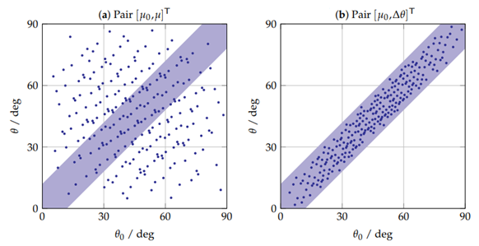
EPIC ROCINN algorithm
Some comments on neural network training and radiative transfer modelling
Should we use as input space of the neural network the same input space of the radiative transfer model?
No
Standard geometric description: ${\left[θ_{0},θ,Δφ\right]}^{T}$
It is better to replace the pair ${\left[θ_{0},θ\right]}^{T}$ with ${\left[θ_{0},Δθ\right]}^{T},$ since this configuration allows to preserve the correlation between the two zenith angles
It is better to replace the relative azimuth angle with the scattering angle, since the network does not know that $Δφ$ is undefined when $θ_{0}=0$ or $θ=0$
250 pseudorandom input points projected onto the space of zenith angles ${\left[θ_{0},θ\right]}^{T}$

Slide 21
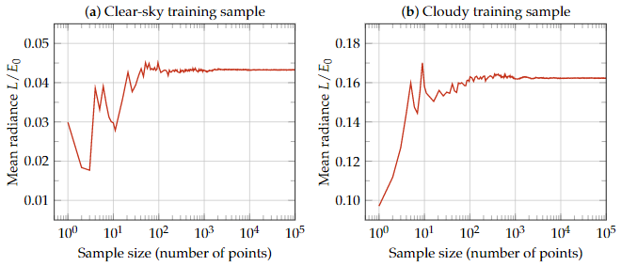
EPIC ROCINN algorithm
Some comments on neural network training and radiative transfer modelling
Should we use huge amounts of data points to train our neural network as approximator of a radiative transfer model?
Not necessarily
The complexity of the model can be inspected by analysing the convergence of the statistical moments of the output vector as a function of the number of training points
A training sample of about 10000 points is enough to give a first estimate the complexity of the neural network describing the EPIC radiative transfer models

Slide 22
EPIC ROCINN algorithm
Some comments on neural network training and radiative transfer modelling
Should we use huge amounts of data points to train our neural network as approximator of a radiative transfer model?
Not necessarily
Using huge amounts of training data without knowing the model complexity will cause a tendency to select too complex neural networks as the optimal ones during the model selection step of the training process

Slide 23
EPIC ROCINN algorithm
Some comments on neural network training and radiative transfer modelling
Should we use huge amounts of data points to train our neural network as approximator of a radiative transfer model?
Not necessarily
From DSCOVR Science Team Meeting 2019:
Clear-sky neural network: [40, 20] neurons
Cloudy sky neural network: [80, 20] neurons
Last optimal trained networks:
Clear-sky neural network: ~26 neurons
Cloudy sky neural network: ~64 neurons

Slide 24
Summary
Science with the DSCOVR EPIC observations
EPIC OCRA algorithm: improvements
Degradation and viewing geometry dependencies are considered
Better temporal resolution for the clear-sky maps and temporal parameterisation of the OCRA parameters
EPIC OCRA validation
Good agreement with MODIS for scenes of clear sky and optically-thick clouds
Underestimation of cloud fraction over water with optically-thin clouds due to lack of sensitivity in the UV
Science because of the DSCOVR EPIC observations
EPIC ROCINN algorithm
If possible, do not make your neural network learn what you already know a priori

Slide 25
Gracias!

