Slide 1
Update on EPIC MAIAC V2 Algorithm: Atmospheric Correction
Alexei Lyapustin, GSFC
Sujung Go (UMBC), Y. Wang (UMBC),
S. Korkin (USRA), O. Torres, A. Marshak
DSCOVR STM
NASA GSFC, Oct. 6-8, 2020

Slide 2
Overview
MAIAC v1 processed 2015 – 2019 data
Reported products: CM, QA, AOD_{0.44}, spectral BRF, and BRDF model parameters over land; AOD-FMF, water leaving reflectance over ocean
Global Sinusoidal Projection at 10km resolution (oversampling all bands except Blue)
MAIAC v2 re-processing started, expect to finish within 2-3 weeks
MAIAC V2 features:
Introduced regional Sinusoidal projection;
Added anisotropic atmospheric correction using ancillary MAIAC MODIS monthly BRDF (RTLS) database;
Introduced flexible aerosol algorithm retrieving AOD and spectral refIM(λ) for smoke and dust aerosol

Slide 3
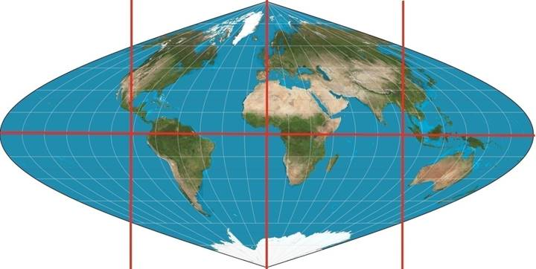
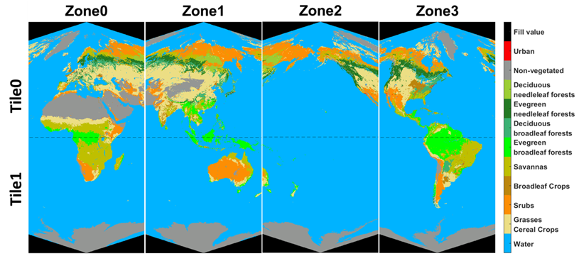
MAIAC v2: Projection
00 01 02 03
v1 Global Sinusoidal Projection
10 11 12 13
v2 Regional Sinusoidal Projection
The same # pixels
Some limited oversampling
Almost undistorted compared to global Sin
Can be re-projected in global projection without loss of information
(from Yuri Knyazikhin)

Slide 4
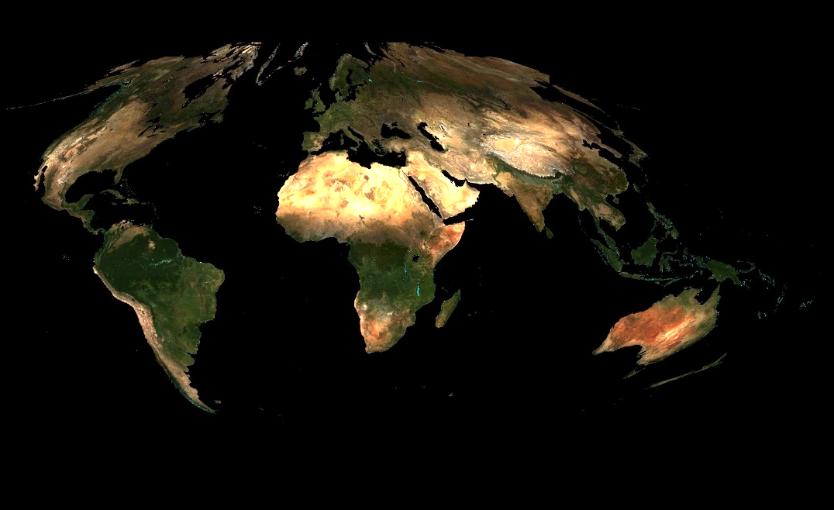
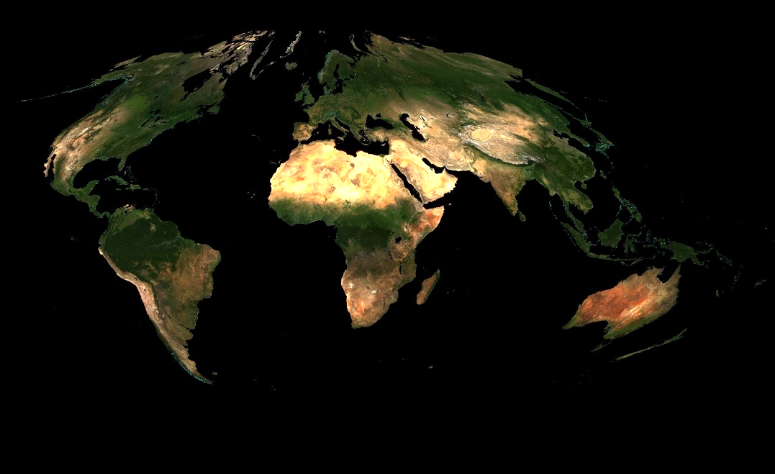
v2: Ancillary MAIAC_{MODIS} RTLS
February 2016
July 2016
Monthly average surface BRDF for every year in RGB and NIR bands from MAIAC MODIS MCD19A3 product

Slide 5
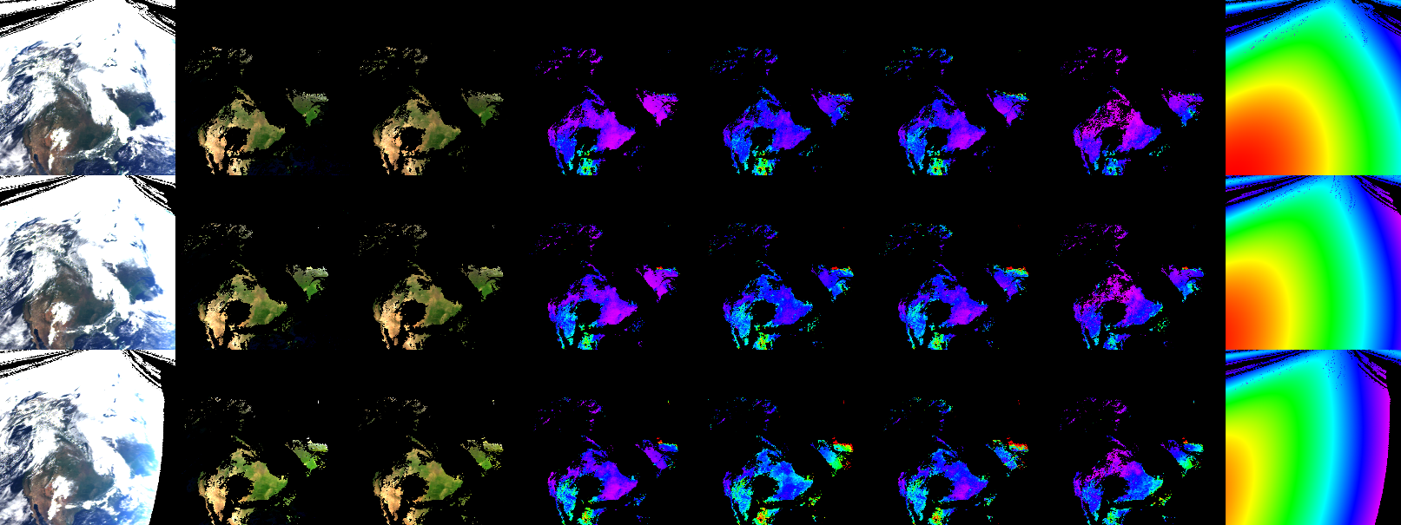
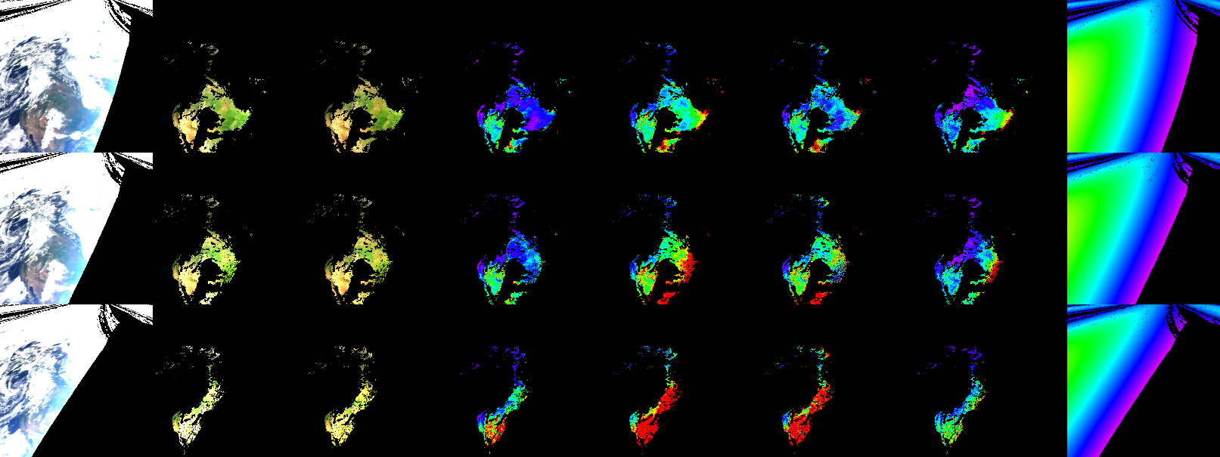
v2 - Atmospheric Correction:
Anisotropic vs Lambertian: Absolute Difference (June 3, 2018)
Anis Lamb Red Green Blue NIR cosSZA
0 0.05
0.15 1

Slide 6
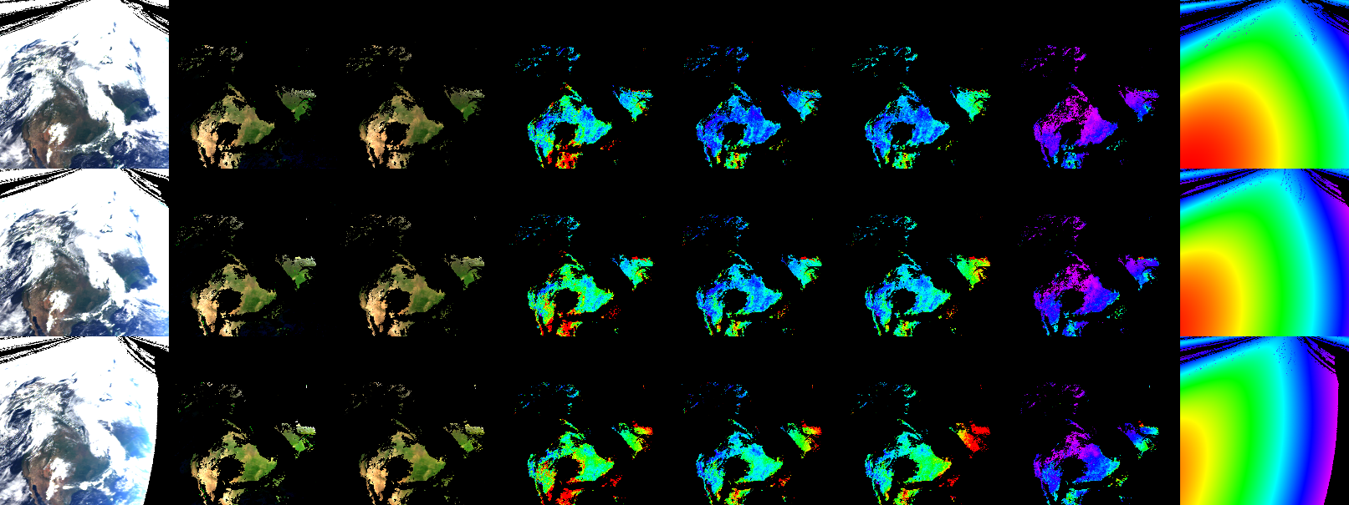
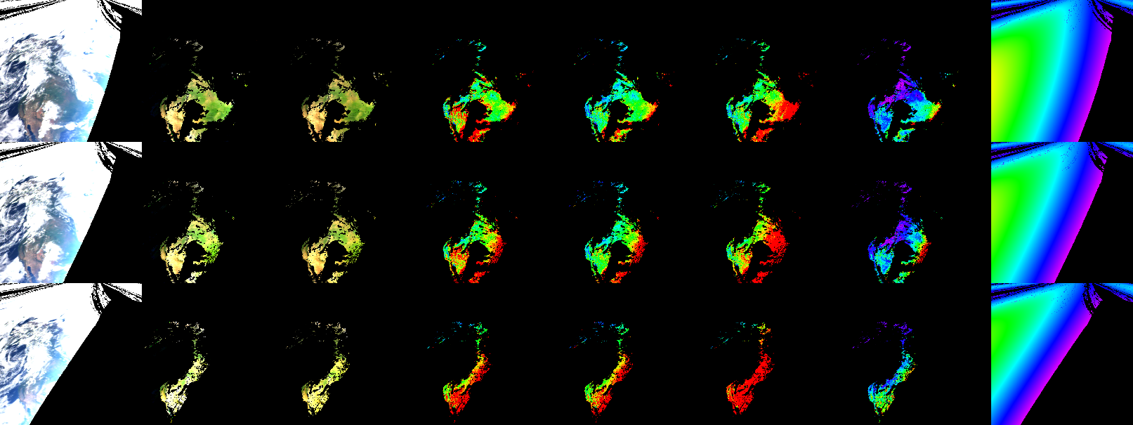
v2 - Atmospheric Correction:
Anisotropic vs Lambertian: Relative Difference (June 3, 2018)
Anis Lamb Red Green Blue NIR cosSZA
0 - 10% 0 – 25% 0 – 40% 0 – 5%
0.15 1

Slide 7
V2: Processing over Ocean
Aerosol is modeled by the fine and coarse modes which are mixed using Linear Mixing Method (LMM). The aerosol retrieval gives AOD and FMF (fine mode fraction) at 0.55 um using optimal fit to measurements at 443, 550, 680 and 780nm.
The atmospheric correction then provides water leaving reflectance at 6 bands, 340, 388, 443, 550, 680 and 780nm.
The LMM method is designed to mix the diffuse radiation components (e.g. path radiance, diffuse transmittance) only. In v2, we added a rigorous treatment of the direct spectral transmission improving the total accuracy.

Slide 8
v2: Retrieving AOD and Spectral Absorption
Aerosol absorption is a very important property for both direct and indirect (semidirect) aerosol effects. Uncertainty in aerosol absorption is one of largest sources of uncertainty in climate projections (IPCC 2013).
Knowledge of spectral aerosol absorption is a path to aerosol speciation. For instance, black-organic carbon partitioning for smoke is an essential information for the climate/RB models and for the air quality – epidemiology (health associations) studies.
TOMS, OMI were the first instruments providing initially qualitative (AI) and later quantitative (SSA) information on aerosol absorption from pioneering works of Torres et al (Herman et al., 1997; Torres et al., 1998, 2002, 2018; Jethva et al., 2014). UV channels are key.
The baseline OMAERUV algorithm (Torres et al., 2007) retrieves AOD-SSA from 2 channels 340-388nm assuming spectral dependence of absorption. Because of aerosol height sensitivity, it is reported for several heights (0, 1.5, 3, 6, 10 km). Later versions use ancillary information on spectral absorption (AERONET) and regional-seasonal height (CALIOP CALLIPSO) (Torres et al., 2013).
v2 algorithm:
Absorbing smoke and dust aerosols detection using AI (340-388);
New AOD-refIM-AAE retrieval using Levenberg-Marquart optimal fit of 340, 388, 443 and 680nm. Absorption model: k_{λ}= k₀ (λ/ λ₀)^{-b} for λ< λ₀ , where λ₀ = 680nm;
Real refIM and size distribution are fixed. The results are reported for Hª=1 and 4km.

Slide 9
Biomass Burning: NA, 2018
August 17, 2018
TOA AI AOD AOD_{LM} SSA₄₄₃ AAE k
2 6
0 2
0.85 1
0 4
0. 0.016

Slide 10
Effect of Aerosol Height
TOA AI AOD_{1km} SSA_{1km} SSA_{4km} AAE_{1km} AAE_{4km} k_{1km} k_{4km}
Aug-15-2018
Aug-16-2018
Aug-17-2018
2 6
0 2
0.85 1
0 4
0. 0.016
Retrieved aerosol absorption is lower for elevated aerosols (as it should be).
Knowledge of height is important for interpretation: an apparent increase of AAE and decrease of refIM (k) for elevated layer would point to more organic carbon and less black carbon in aerosol particles.

Slide 11
AOD Validation: NA, 2018
All sites (114)
Excluded 11 bright surface sites (103)
w/o LevMar
w/ LevMar
Excluded sites: Bakersfield; Goldstone; KeyBiscayne; Neon_ONAQ; Railroad Valley; Sandila_NM_PSEL; TableMountain_CA; Tucson; UACJ_UNAM_ORS, White_Sands_HELSTF, Yuma

Slide 12
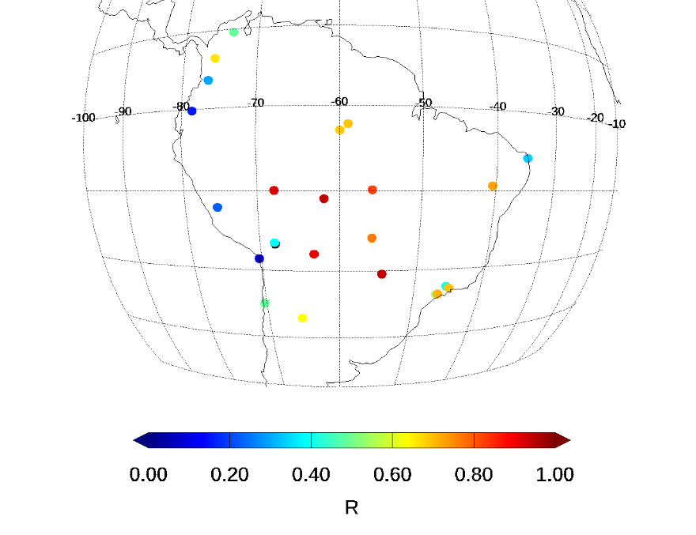
AOD Validation: NA-SA, v1 vs v2
v1
v2
Significant
improvement

Slide 13
SSA₄₄₃ Validation: NA, 2018
MAIAC AOT > 0.6, AERONET AOT > 0.6
Used SSA for Hª=1km

Slide 14
Mineral Dust, 2018
AOD Validation: Africa, v1 vs v2
v1
v2
improvement

Slide 15
SSA₄₄₃ Validation: 2018
MAIAC AOT > 0.6
AERONET AOT > 0.4
MAIAC AOT > 0.6
AERONET AOT > 0.6

Slide 16
SSA₄₄₃ Validation: 2018
MAIAC AOT > 0.6
AERONET AOT > 0.4
MAIAC AOT > 0.6
AERONET AOT > 0.6

Slide 17
SSA₄₄₃ Validation: 2018
MAIAC AOT > 0.6
AERONET AOT > 0.4
MAIAC AOT > 0.6
AERONET AOT > 0.6
Mixture of Dust and Biomass Burning
Biomass Burning

Slide 18
SSA₄₄₃ Validation: 2018
MAIAC AOT > 0.6
AERONET AOT > 0.4
MAIAC AOT > 0.6
AERONET AOT > 0.6
No MAIAC constraint
AERONET AOT < 0.2

Slide 19
Dust SSA₄₄₃ Validation: 2018
MAIAC AOT > 0.6
AERONET AOT > 0.6
Total
MAIAC AOT > 0.6
AERONET AOT > 0.6
MAIAC AOT > 0.8
AERONET AOT > 0.6

Slide 20
Dust Sources: Different Absorption
AI AOD₄₄₃ SSA₄₄₃ AAE k₀
Jan-1-2018
Mar-30-2018
May-29-2018
0.85 0.98
0 4
DOY-166-2018
2 6.
0 2.
0. 0.003

Slide 21
Conclusions
MAIAC v2 is entering re-processing
MAIAC v2 features:
Anisotropic atmospheric correction which is important in the EPIC’s backscattering sun-view geometry;
Improved aerosol retrievals vis-a-vis v1
New joint retrieval of AOD and spectral absorption
Near term plans:
2-3 publications in preparation
Compare with other sources and make global analysis of absorption data from EPIC
Study possibility of simultaneous aerosol height retrieval by adding A, B O₂-bands

Slide 22
(Back up)
IPCC: Climate Change 2013: The Physical Science Basis. Contribution of Working Group I to the Fifth Assessment Report of the Intergovernmental Panel on Climate Change, edited by: Stocker, T. F., Qin, D., Plattner, G. K., Tignor, M., Allen, S. K., Boschung, J., Nauels, A., Xia, Y., Bex, V., and Midgley, P. M., Cambridge University Press, Cambridge, United Kingdom and New York, NY, USA, 1535 pp., doi:10.1017/CBO9781107415324, 2013.
Herman, J. R., Bhartia, P. K., Torres, O., Hsu, C., Seftor, C., & Celarier, E. (1997). Global distribution of UV‐absorbing aerosols from Nimbus 7/TOMS data. Journal of Geophysical Research: Atmospheres, 102(D14), 16911-16922.
Torres, O., Bhartia, P. K., Herman, J. R., Ahmad, Z., & Gleason, J. (1998). Derivation of aerosol properties from satellite measurements of backscattered ultraviolet radiation: Theoretical basis. Journal of Geophysical Research: Atmospheres, 103(D14), 17099-17110.
Torres, O., Herman, J. R., Bhartia, P. K., & Sinyuk, A. (2002). Aerosol properties from EP-TOMS near UV observations. Advances in Space Research, 29(11), 1771-1780.
Jethva, H., Torres, O., & Ahn, C. (2014). Global assessment of OMI aerosol single‐scattering albedo using ground‐based AERONET inversion. Journal of Geophysical Research: Atmospheres, 119(14), 9020-9040.
Torres, O., Bhartia, P. K., Jethva, H., & Ahn, C. (2018). Impact of the ozone monitoring instrument row anomaly on the long-term record of aerosol products. Atmospheric Measurement Techniques, 11(5), 2701.
Torres, O., Tanskanen, A., Veihelmann, B., Ahn, C., Braak, R., Bhartia, P. K., ... & Levelt, P. (2007). Aerosols and surface UV products from Ozone Monitoring Instrument observations: An overview. Journal of Geophysical Research: Atmospheres, 112(D24).
Torres, O., Ahn, C., & Chen, Z. (2013). Improvements to the OMI near-UV aerosol algorithm using A-train CALIOP and AIRS observations. Atmospheric Measurement Techniques, 6(11), 3257-3270.

