Slide 1
Status of Ozone products from the DSCOVR EPIC Instrument
Natalya Kramarova¹, Liang-Kang Huang², Jerald R. Ziemke³, Jay Herman⁴ , David P. Haffner², Gordon Labow² ,Richard D. McPeters¹, P.K. Bhartia¹, and Luke Oman¹
¹NASA Goddard Space Flight Center, Greenbelt, MD
²Science Systems and Applications Incorporated, Lanham, MD
³Morgan State University, Baltimore, MD
⁴University of Maryland Baltimore County, MD
DSCOVR Science Team Meeting, October 6-8, 2020

Slide 2
EPIC Total Ozone version 3
The retrieval algorithm is based on EPIC version 2 [Herman et al, 2018] with few modifications:
Triplet 318 nm, 340 nm & 388 nm at low optical path (<1.5)
or 325 nm, 340 nm & 388 nm at high optical path
Reflectivity is based on 388 nm and changes linearly with wavelength;
Ozone absorption cross sections from Brion, Daumont, Malicet [1995];
Algorithm uses LUT based on TOMRAD: 26 ozone profiles (V8 SBUV climatology), 4 pressure levels [1.00, 0.70,0.40,0.20], 10 Solar Zenith Angles [0,30,45,60,70,77,81,84,86,88], and 11 Satellite View Angles [0,15,30,45,60,70,77,81,84,86,88].
DSCOVR Science Team Meeting, October 6-8, 2020

Slide 3
EPIC Total Ozone version 3
Modifications in version 3:
Switch to Version 3 Level 1 product that includes:
Improved geolocations (~ 1 CCD pixel) ==> improved Solar/View Angles;
Improved Flat Field Calibrations for UV channels (~0.5%) ;
New Dark Counts Correction for UV channels.
Switch to the cloud height product from EPIC A-Band to replaced OMI-based cloud height climatology (hybrid approach: if EPIC A-band not available then climatological height is used);
Update absolute calibrations using polar orbiting SNPP OMPS (static correction);
Added corrections for ozone profile shape and temperature;
Update algorithm flags to filter data;
Added column weighting functions for each observation.
DSCOVR Science Team Meeting, October 6-8, 2020

Slide 4
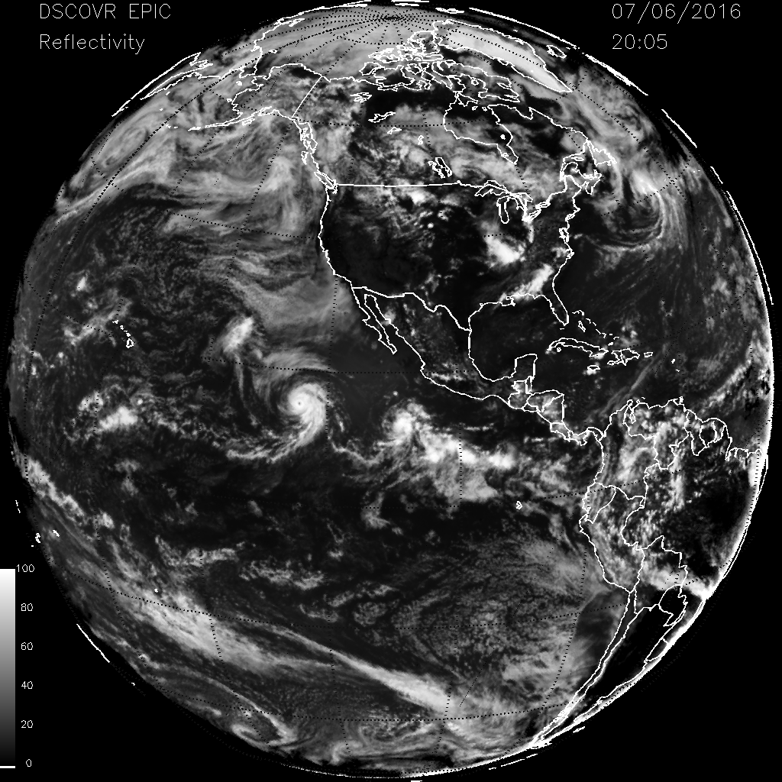
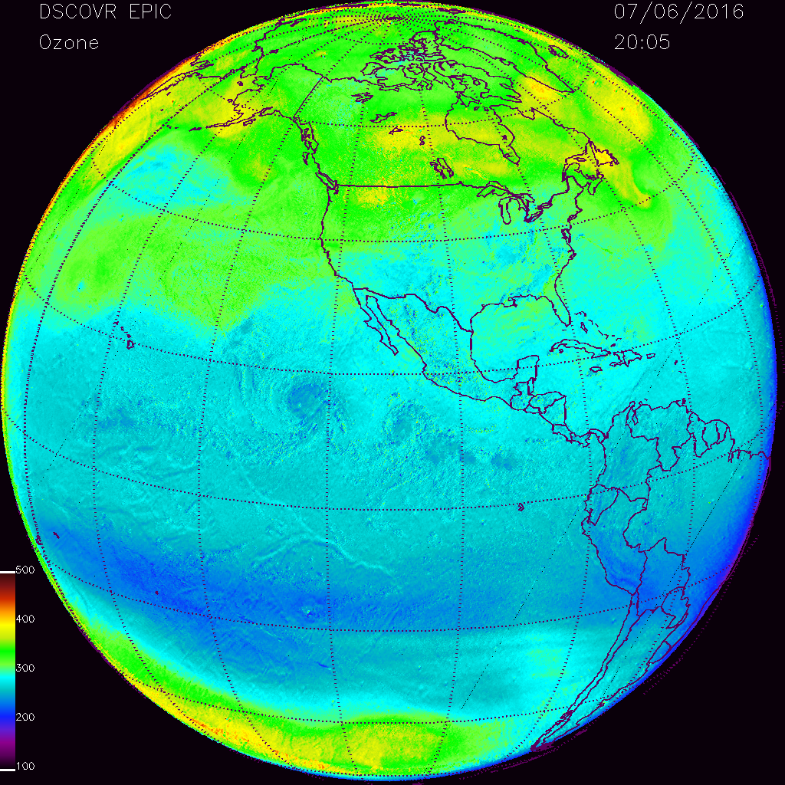
EPIC Total Ozone version 3
Improvements due to switch to simultaneous cloud height retrievals from EPIC A-band
With cloud climatology
With A-band cloud product
EPIC A-band cloud retrievals: [Yang et al, 2019]
DSCOVR Science Team Meeting, October 6-8, 2020

Slide 5
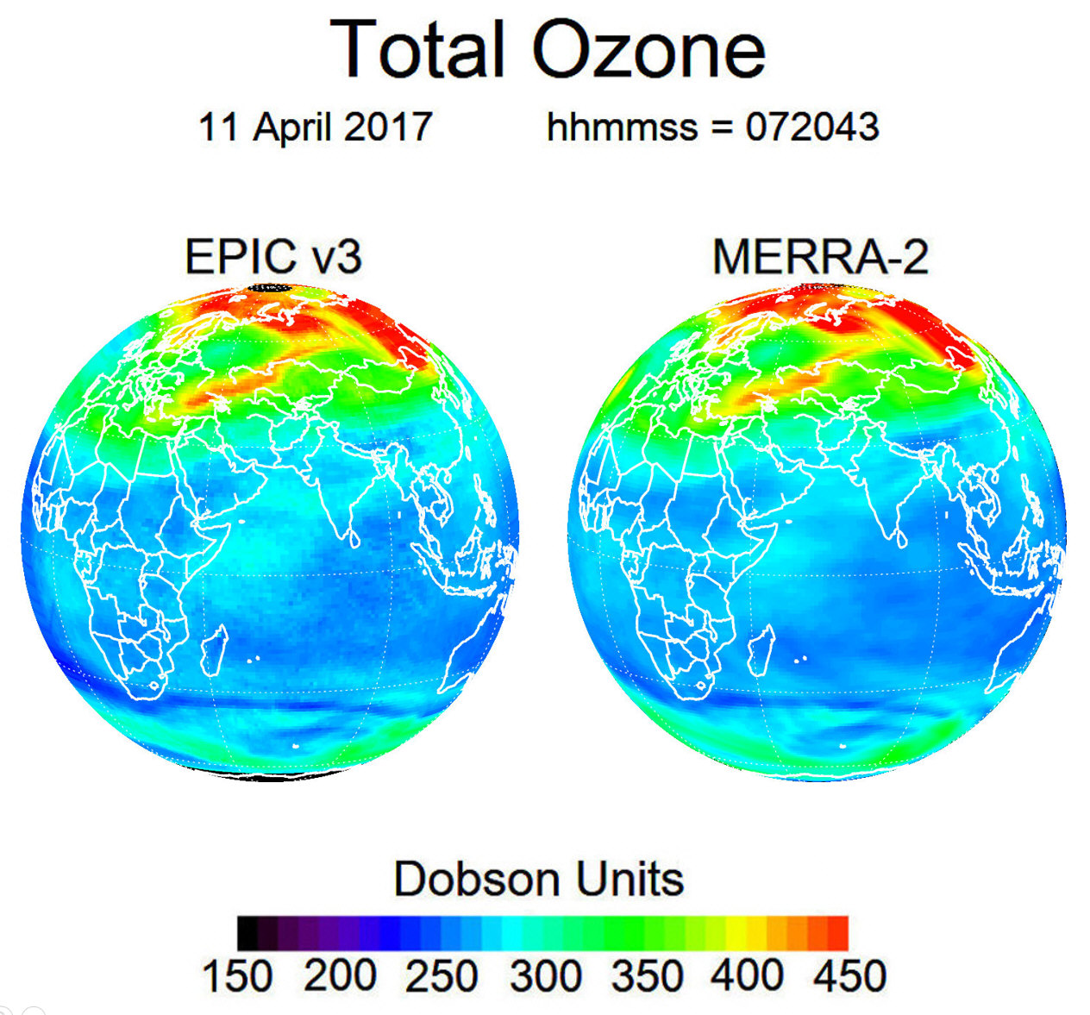
Synoptic ozone maps: EPIC v3 and MERRA-2
DSCOVR Science Team Meeting, October 6-8, 2020
Notes:
EPIC map is noisier than MERRA-2. Are these small structures artifacts of EPIC measurements or real geophysical noise? How we can determine that?

Slide 6
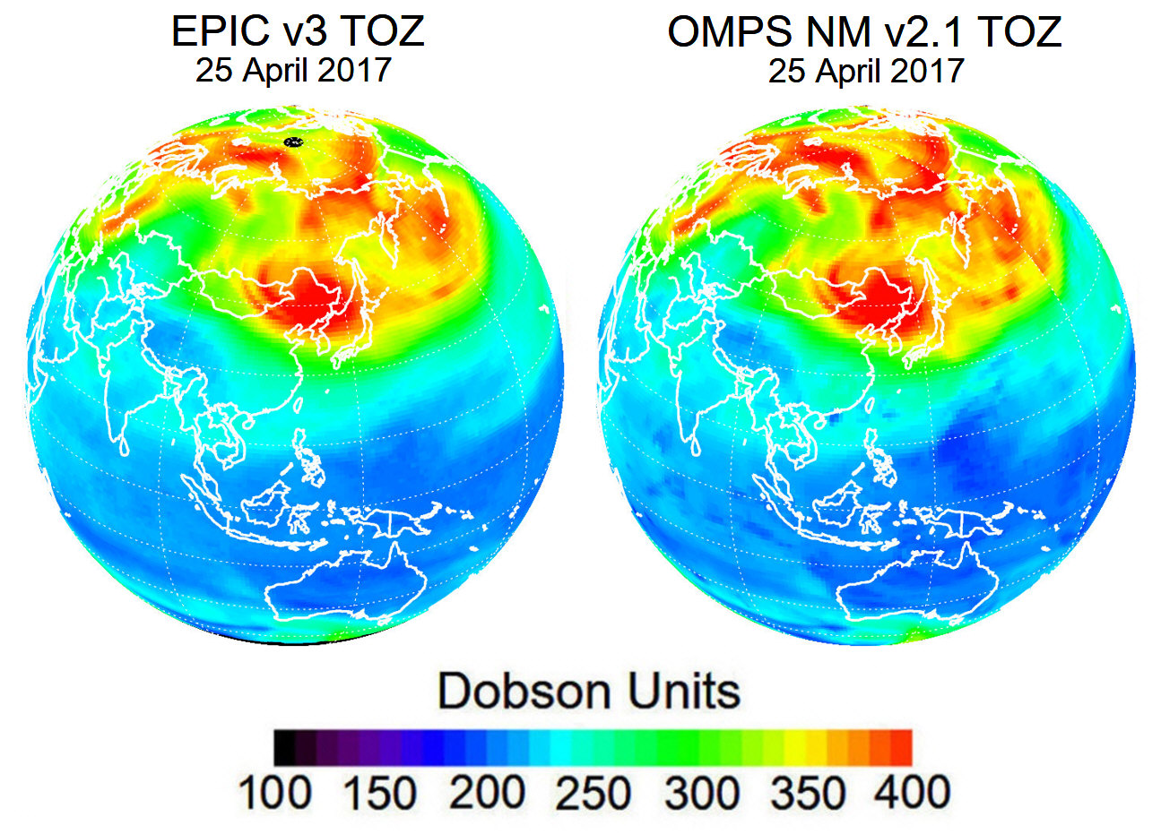
EPIC Total Ozone v3 vs SNPP OMPS NM v2.1
DSCOVR Science Team Meeting, October 6-8, 2020

Slide 7
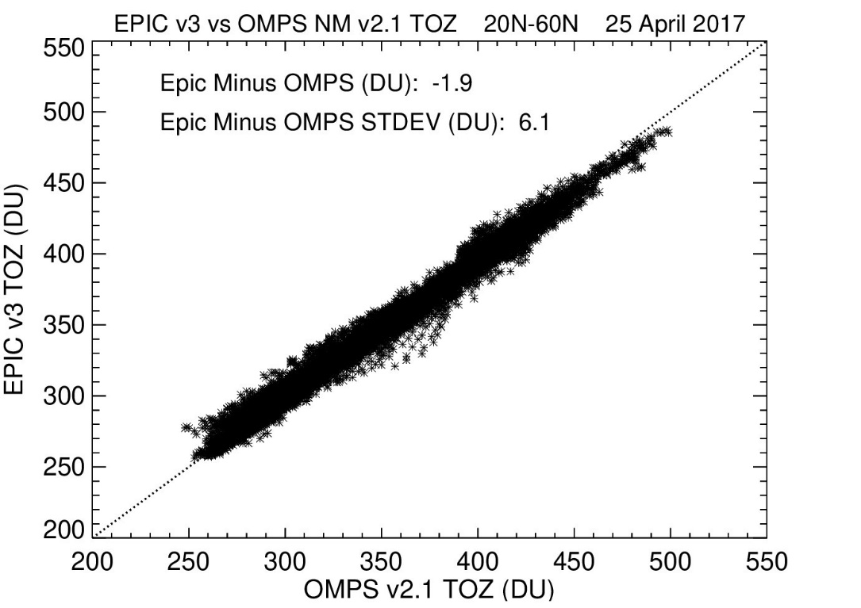
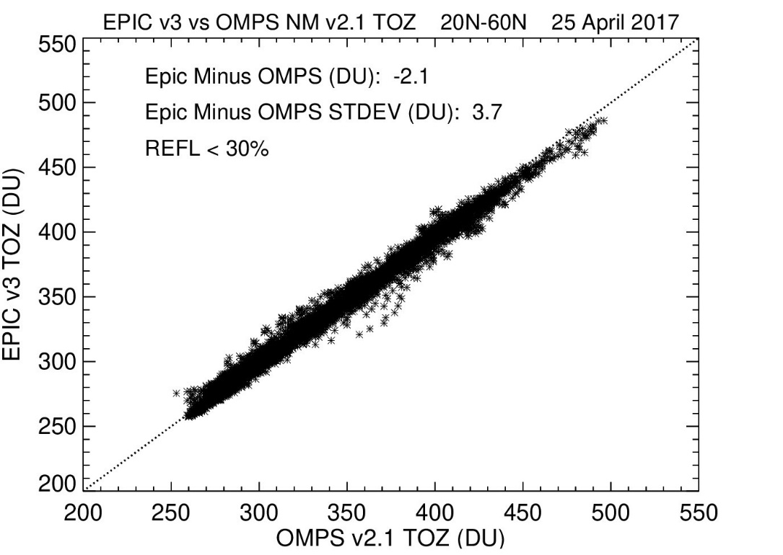
20ºN-60ºN, 25 April 2017
EPIC Total Ozone v3 vs SNPP OMPS NM v2.1
All Clouds
Cloud Free
DSCOVR Science Team Meeting, October 6-8, 2020

Slide 8
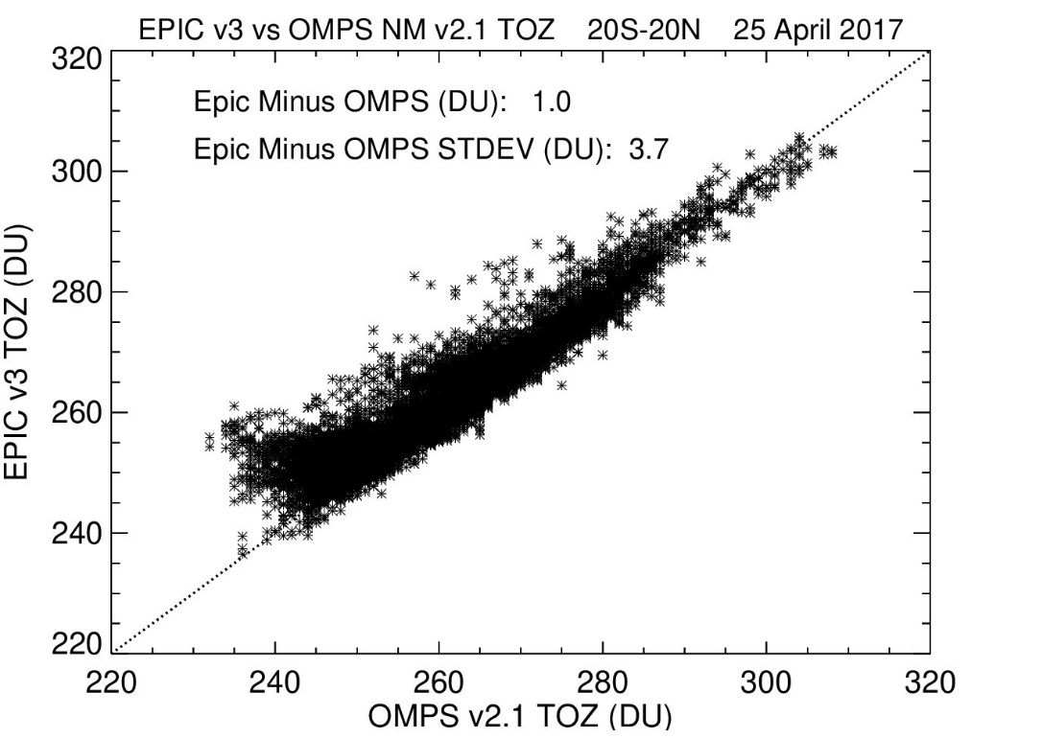
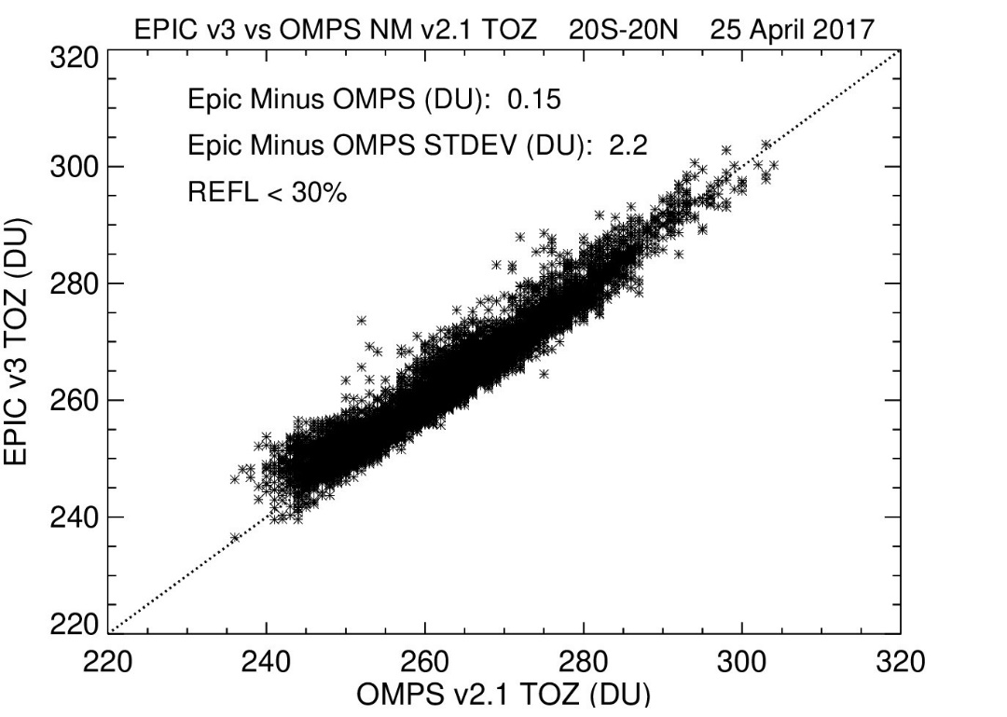
20ºS-20ºN, 25 April 2017
EPIC Total Ozone v3 vs SNPP OMPS NM v2.1
All Clouds
Cloud Free
DSCOVR Science Team Meeting, October 6-8, 2020

Slide 9
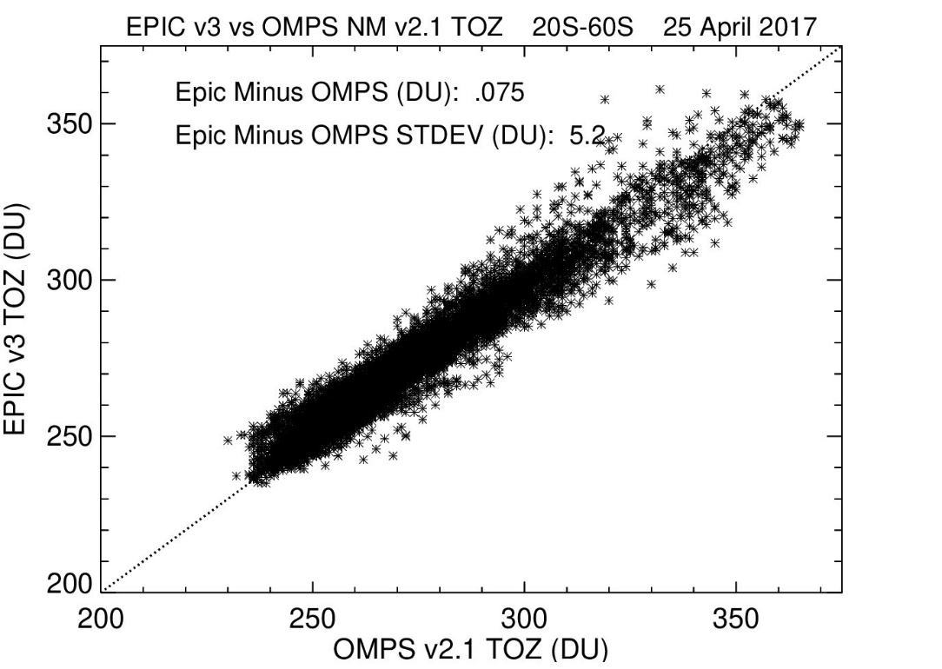
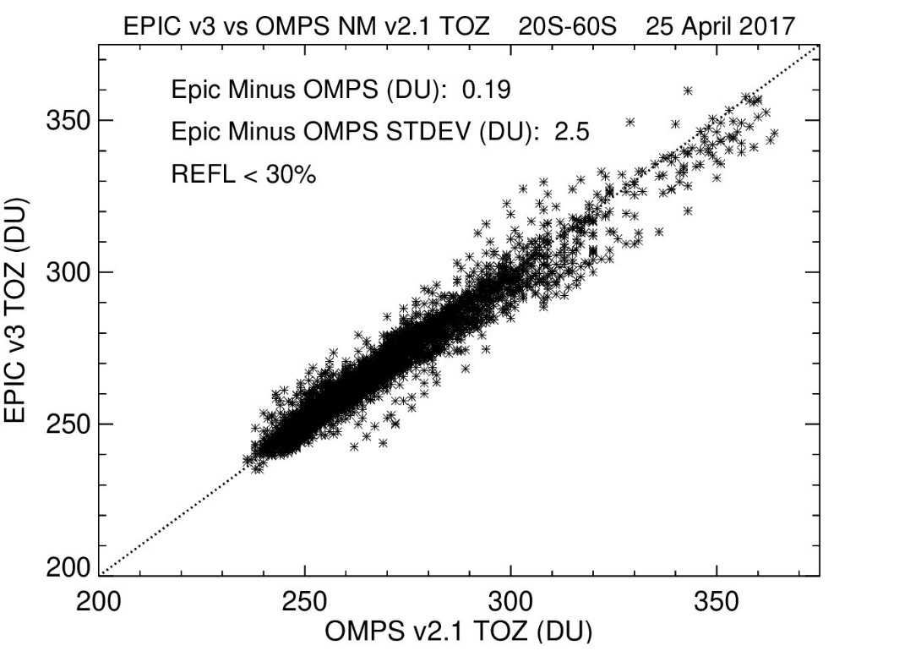
20ºS-60ºS, 25 April 2017
EPIC Total Ozone v3 vs SNPP OMPS NM v2.1
All Clouds
Cloud Free
DSCOVR Science Team Meeting, October 6-8, 2020

Slide 10
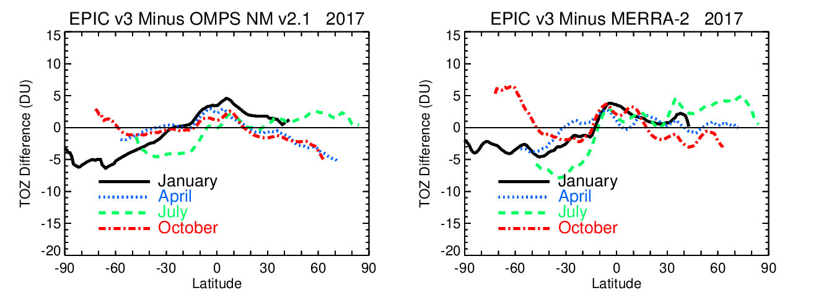
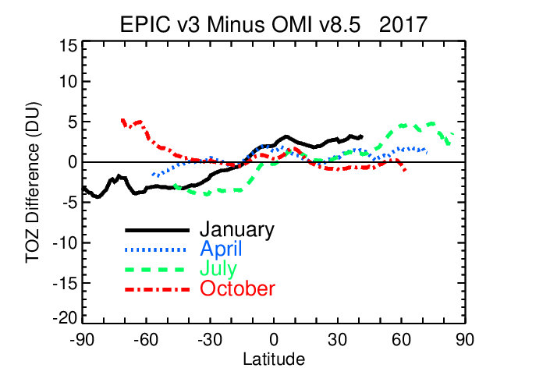
EPIC Total Ozone version 3 vs OMPS, OMI and MERRA-2
EPIC: Uses all
AlgorithmFlag and
ErrorFlag filtering
EPIC: Satellite
View Angles
< 70º
Agreement within +/- 5 DU or ~ +/-2%
DSCOVR Science Team Meeting, October 6-8, 2020

Slide 11
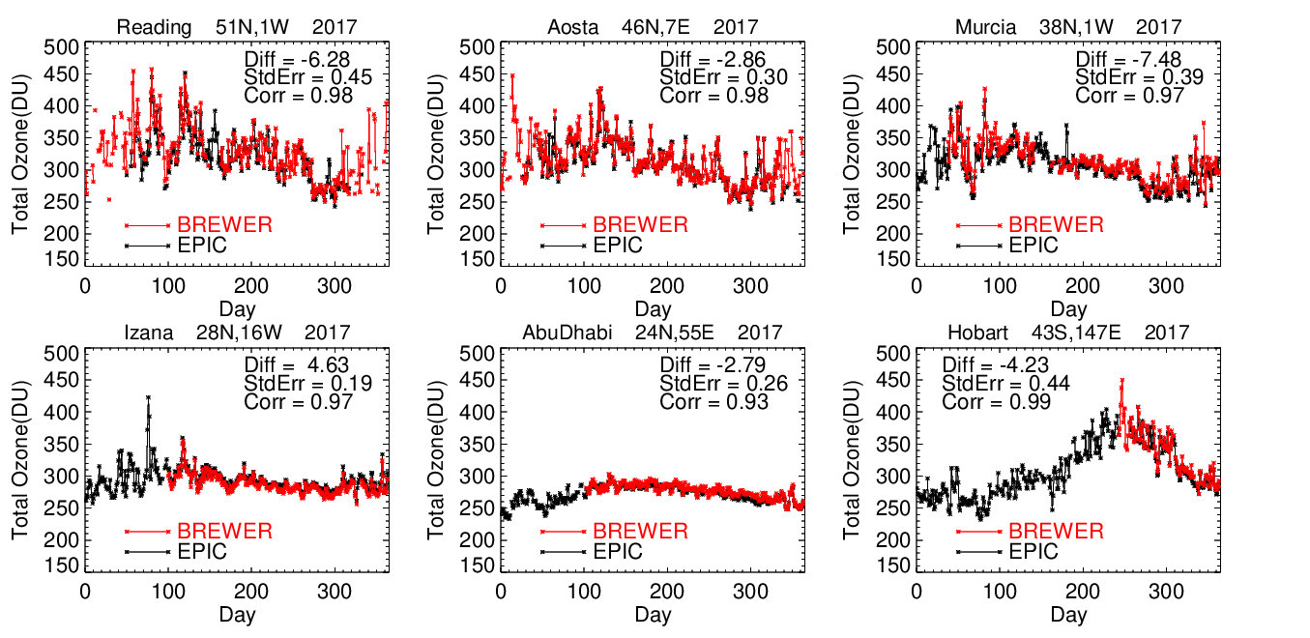
EPIC Total Ozone v3 vs ground-based Brewer network
DSCOVR Science Team Meeting, October 6-8, 2020

Slide 12
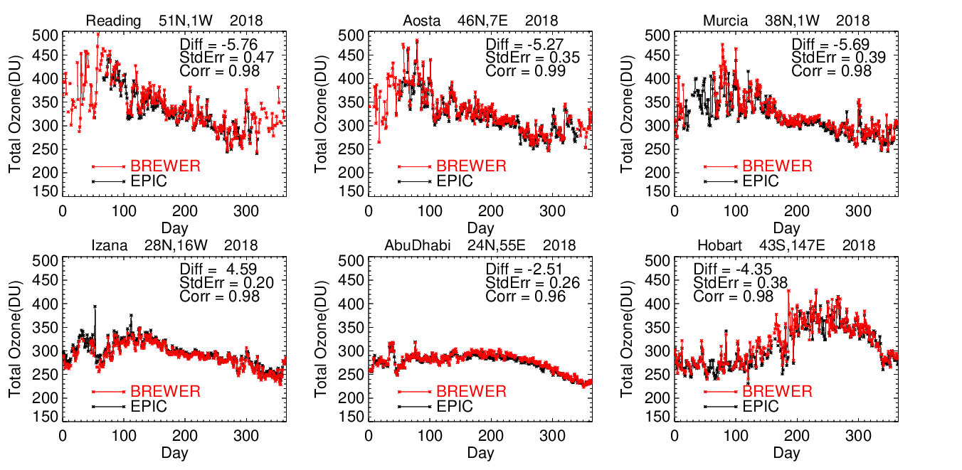
EPIC Total Ozone v3 vs ground-based Brewer network
DSCOVR Science Team Meeting, October 6-8, 2020

Slide 13
EPIC Total Ozone v3: Column Weighting Functions
UV measurements have reduced sensitivity to the boundary layer;
CWFs represent the weight of measurements in the boundary layer;
CWFs are determined by Jacobians (or sensitivity of measurements to O3 changes in the lower layers);
Important for tropospheric ozone product.
DSCOVR Science Team Meeting, October 6-8, 2020
Notes:
CWF depend on:
Terrain height
Viewing geometry
Surface reflectivity/cloud height

Slide 14
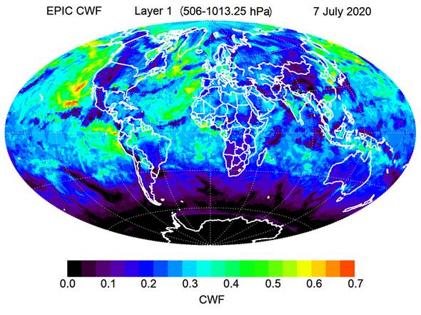
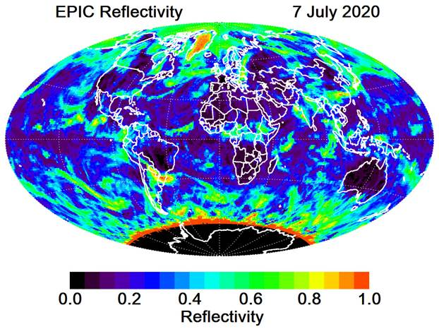
EPIC Reflectivity and CFW
EPIC: Satellite View Angles < 70º
DSCOVR Science Team Meeting, October 6-8, 2020
Notes:
CWF depend on:
Terrain height
Viewing geometry
Surface reflectivity/cloud height

Slide 15
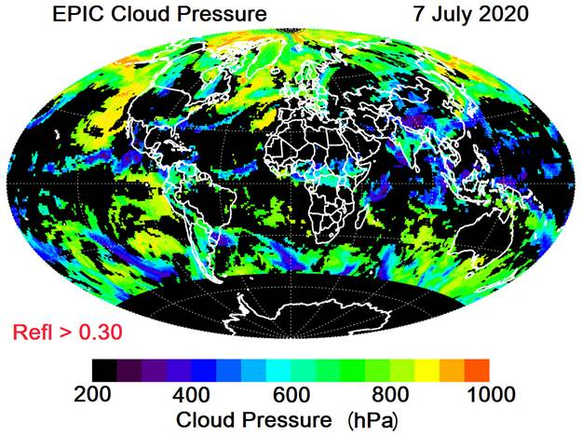
EPIC CFW and A-Band cloud height
EPIC: Satellite View Angles < 70º
DSCOVR Science Team Meeting, October 6-8, 2020

Slide 16
Correlative ozone measurements for EPIC’s validation
 | External Measurements | Validated EPIC Products
Satellite | Aura OMI, SNPP OMPS | Total Column
Ground-based | Ozone sonde (SHADOZ, NDACC, WOUDC) | Tropospheric profile/ Column
 | Brewer/Dobson, Pandora | Total Column
 | Tropospheric lidars | Tropospheric profile/ Column
Aircraft | Atmospheric Tomography (ATom) Missions (ATom-1: July-August 2016, ATom-2: Jan-Feb 2017, ATom-3: October 2017, ATom-4: April-May 2018) | Tropospheric profile/ Column
Model | GEOS-Replay | Tropospheric profile/ Column
DSCOVR Science Team Meeting, October 6-8, 2020

Slide 17
Summary
EPIC v3 total ozone data had been processed and released to DAAC;
Comparisons of EPIC’s total ozone with overlapping satellite instruments (SNPP OMPS and Aura OMI) demonstrated a good agreement with ±5 DU or ±1.5-2%;
Biases in ozone are smaller at equatorial latitudes and increase in mid- and high latitudes, where biases vary seasonally;
No apparent biases in total ozone due to switch to EPIC A-Band cloud product;
There are still larger biases for EPIC measurements at high angles (SZA/SVA). In our study we limit SZA/SVA <70;
Comparisons with ground-based Brewer network are consistent with satellite results.
DSCOVR Science Team Meeting, October 6-8, 2020

Slide 18
Future work
Prepare and release a User Guide for EPIC’s total ozone v3 to describe reported data, error flags and summarize data quality;
Validate EPIC’s tropospheric ozone maps using various ground-base and aircraft measurements and model simulations;
Publish a paper that summarizes validation results for v3 EPIC total and tropospheric ozone products;
Prepare and release synoptic and daily tropospheric ozone maps.
DSCOVR Science Team Meeting, October 6-8, 2020

Slide 19
EPIC Total Ozone version 3
EPIC total ozone data are available at:
https://epic.gsfc.nasa.gov/science/products/o3
https://cmr.earthdata.nasa.gov/search/concepts/C1707836925-LARC_ASDC.html
DSCOVR Science Team Meeting, October 6-8, 2020
Notes:
Summarize all flags, pixel averaging etc. that is relevant to the following analysis.

