Slide 1
Deep Space Observations of Terrestrial Glitter
Alexander Kostinski (Michigan Tech), Alexander Marshak (GSFC), Tamas Varnai (GSFC/UMBC)

Slide 2
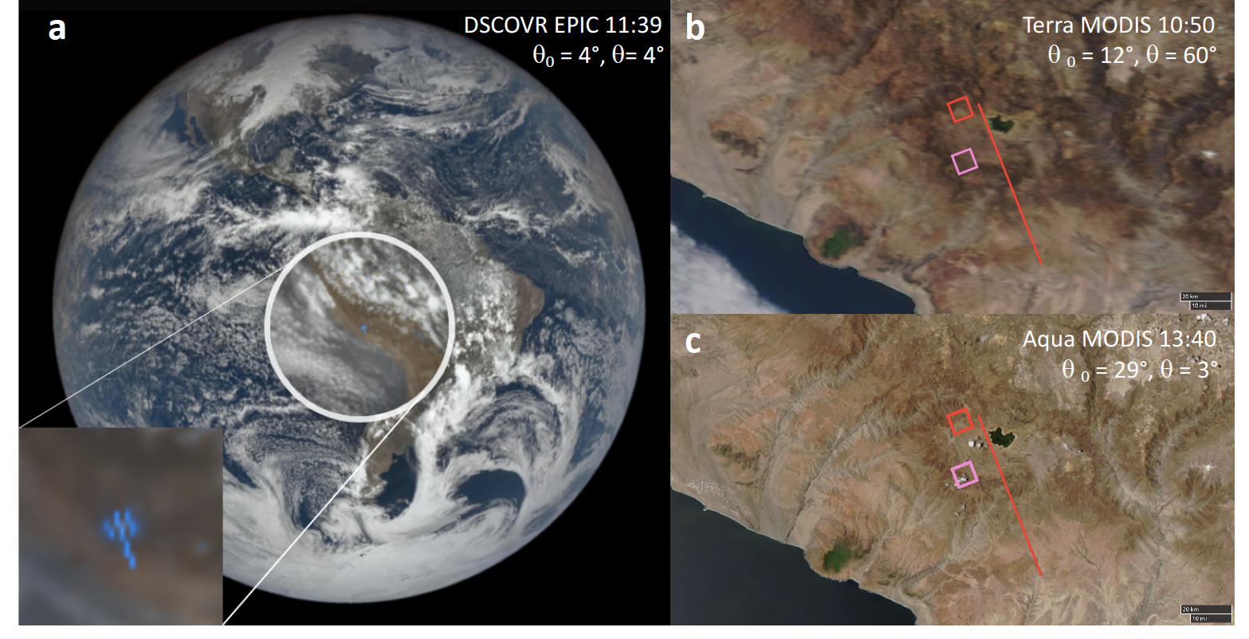
Superglint: detector saturated
11/17/15, 16:39 UTC
Blue channel (443 nm):
SZA=4:04
VZA=3:30
SEV=7.95
Lat.: 15:138 S, Long.: 74:085 W;

Slide 3
Reflectance distribution around specular spot: where is the peak?
Time-averaged reflectance slice of row 16 vs. column position.
Time-averaged reflectance slice of column 14 vs. row position.
Color-coded image of time-averaged reflectance vs. the image position. Black cross-hairs meet at the specular point while red ones at the maximum reflectance value.

Slide 4
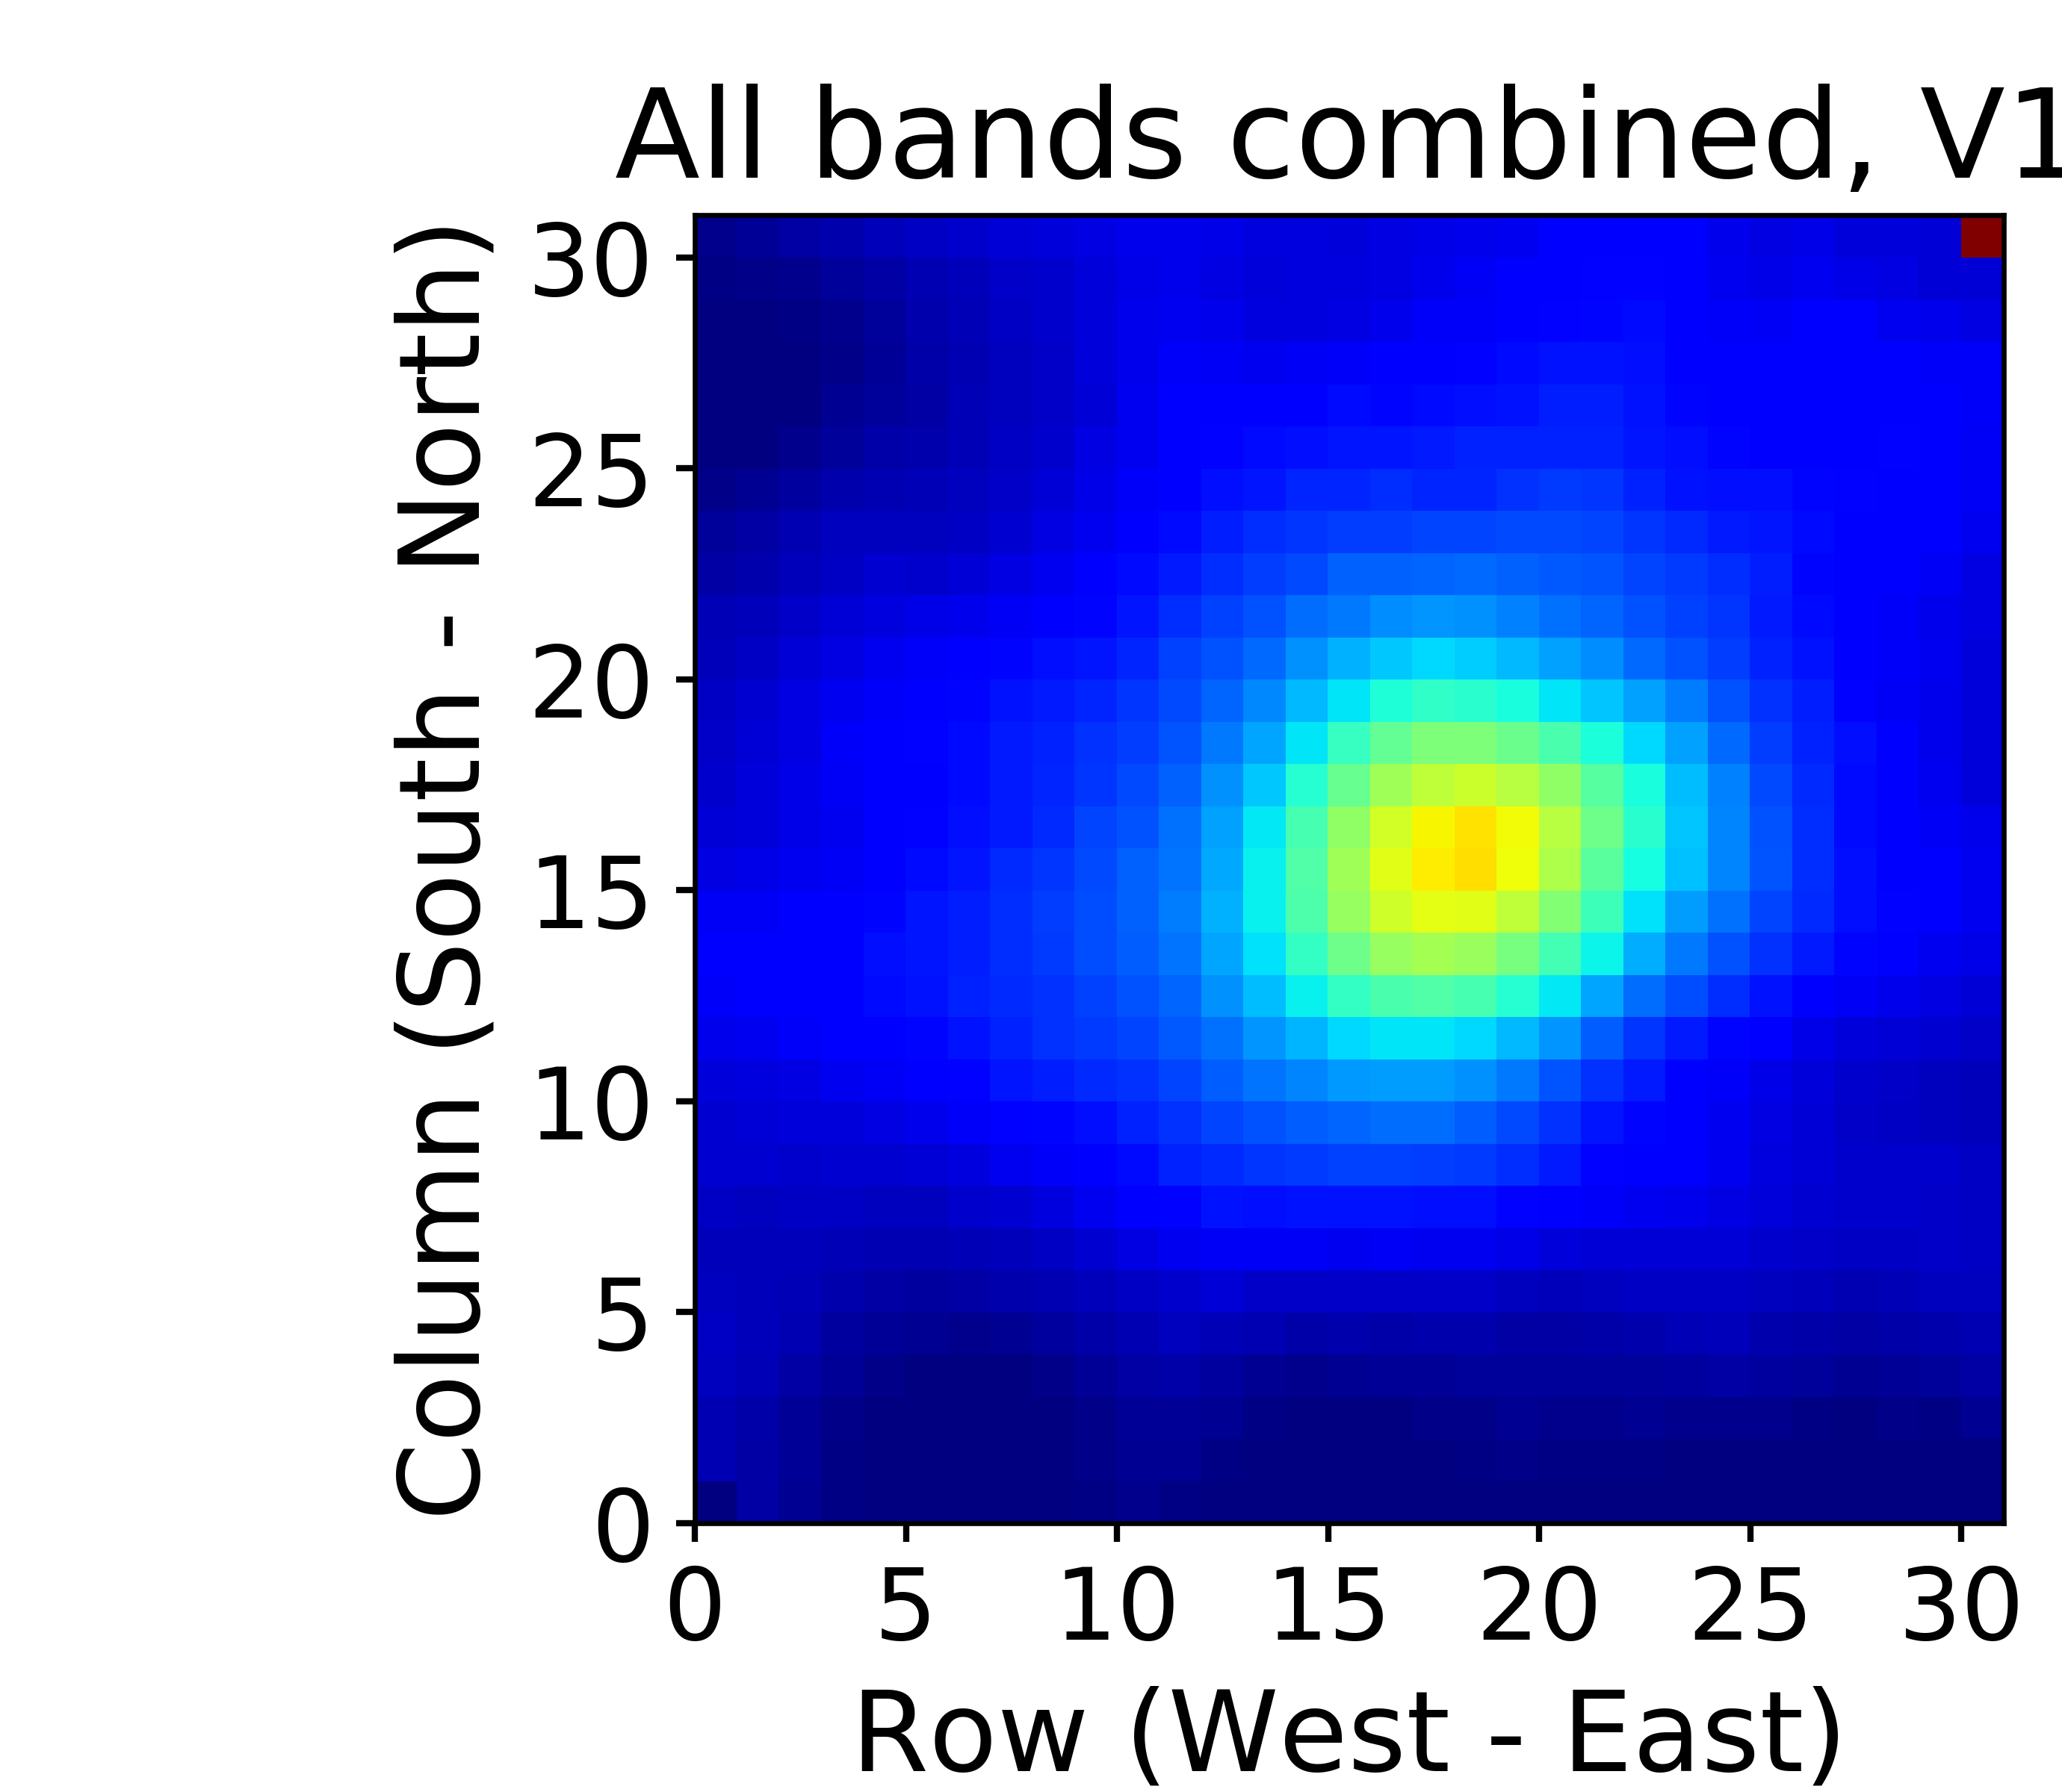
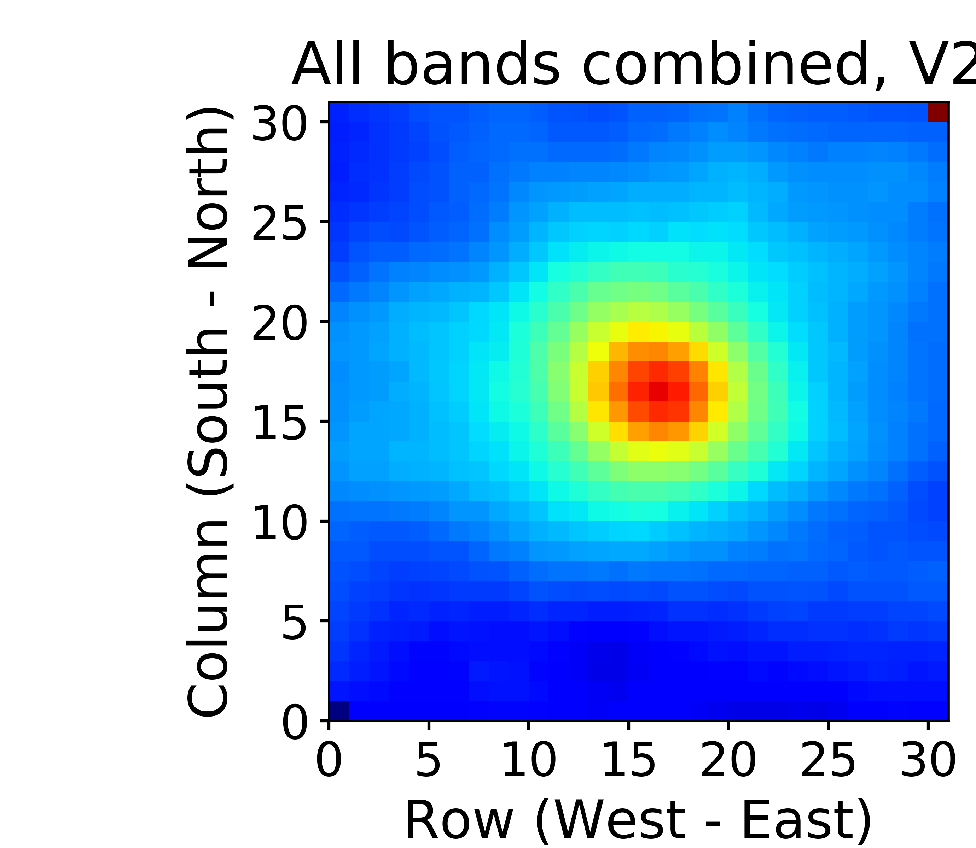
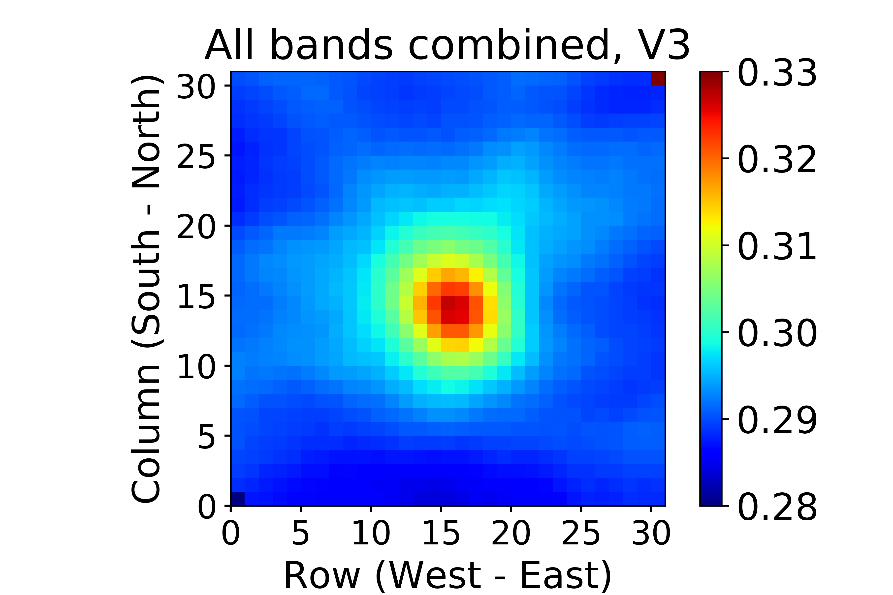
Three versions
Version 1
Version 2
Version 3
a
b
c
BRF
January-February 2017, cloud & sfc, land & ocean, all bands combined
To use glint pixels for calibration
Notes:
Figure shows that reflectances increased from V1 to V2 & V3, and that the enhancement around the specular point is stronger in V2 & V3 than in V1. It also shows that in V1, peak enhancement is off by several pixels, whereas it is much closer to the expected spot in V2 and V3.

Slide 5
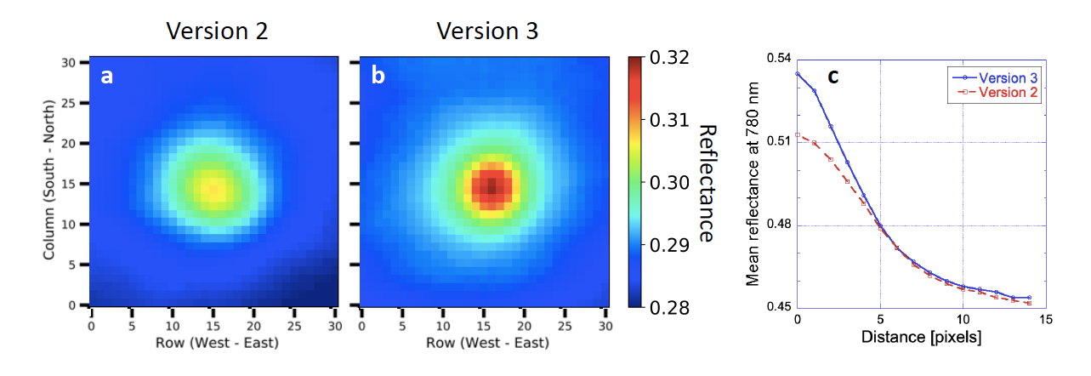
Reflectance excess, at the specular spot
Reflectance excess profile is narrower as the variance decreases from 2nd to 3rd version. Hence, improved geolocation is confirmed
by the diminishing random and deterministic errors. Thus glint-caused specular excess supplies a beacon to monitor geolocation on Earth and other planets.
Curves are for 780 nm channel over land (surface and cloud)

Slide 6
Specular Excess by Glints
Reflectance excess is observed in the vicinity (14 pixels) of the specular spot for all ten EPIC channels. Data for the entire 2017: land surface and cloud glints. Rayleigh scattering above clouds reduces the excess more at the shorter wavelengths, and so does absorption by oxygen (at 688 nm and 764 nm in particular) and by ozone (at 317 nm and 325 nm).

Slide 7
Glint on a lake

Slide 8
Glint on glass

Slide 9
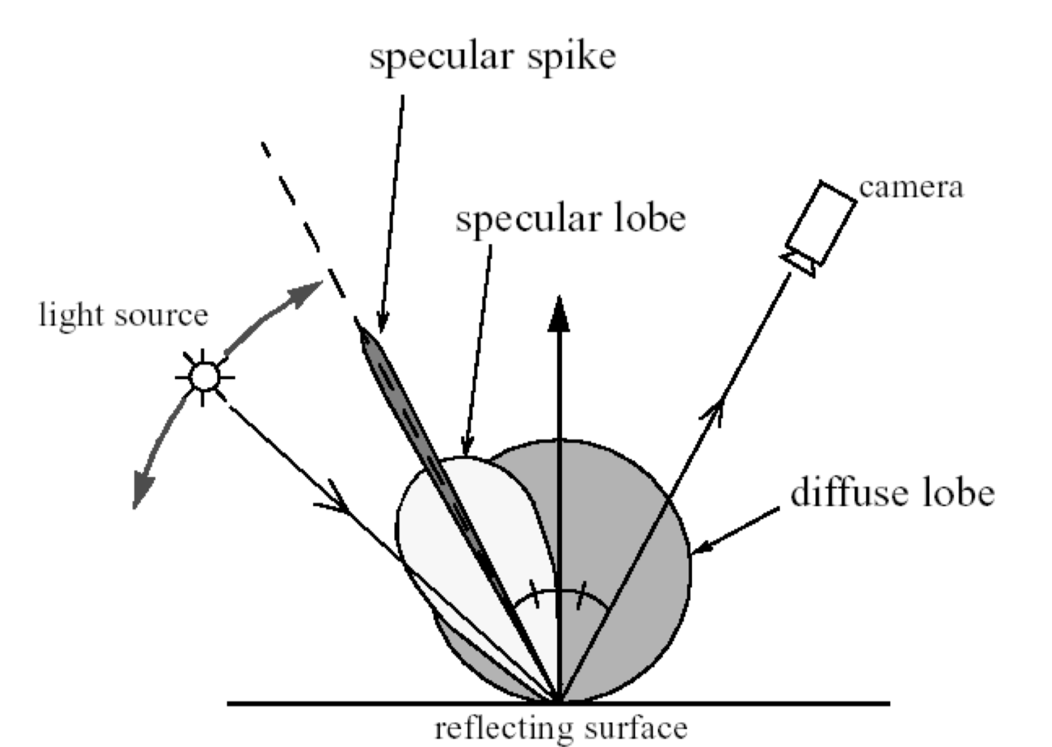
Components of Surface Reflection

Slide 10
Superglint: Neither ocean nor clouds. What is it?
11/17/15, 16:39 UTC
Blue channel (443 nm):
SZA=4:04
VZA=3:30
SEV=7.95
Lat.: 15:138 S, Long.: 74:085 W;

Slide 11
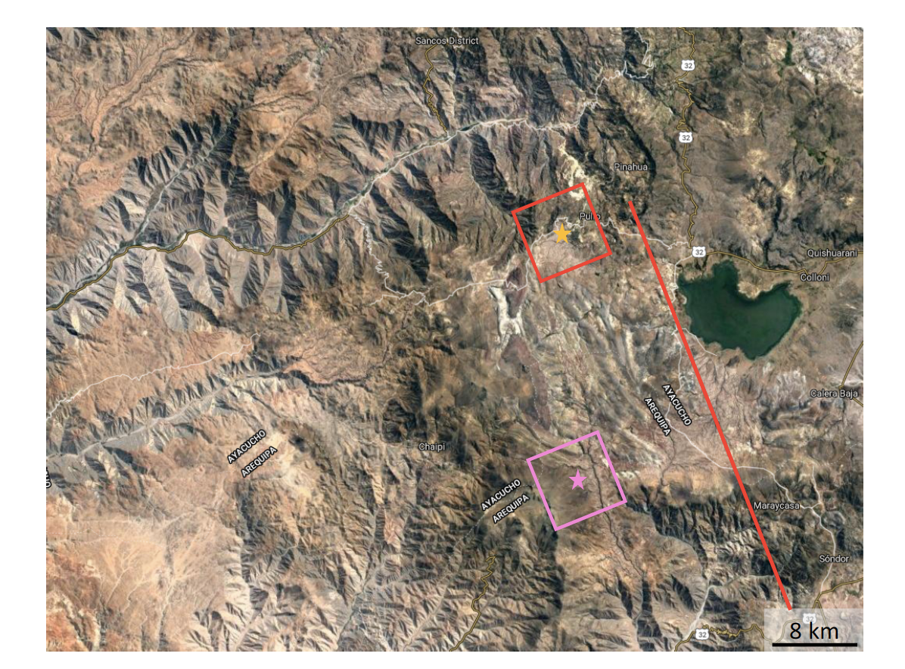
Google Earth image of the high EPIC reflectance region
altitude 3.4 km
The red pixel covers the specular spot and is centered at the yellow star. The pink star flags the puzzling spot of maximal reflectance. The areal extent of the mountain lake is comparable to the pixel area. Note more than a pixel separation between the red line and the 2nd super-glint, suggesting that the pink star reflectance is not merely an artifact of CCD spillage.

Slide 12
Superglint Cause?
Cloud-free MODIS images of glint scene taken about an hour before and after the EPIC image
Level 1A image had an exposure time of 46 msec (the Earth spun 13 m). Pink square marks 2nd reflectance peak. The red squares in panels (b) and (c) center on the specular spot.

Slide 13
Spatial and Temporal Coherence
d x D << λ x L
d and D are the detector and source sizes
and L are wavelength and Earth-satellite distance
3x10⁻¹ x 10⁴ ~ 0.5x10⁻⁶ x 1.5x10⁹ … 10³ (for both sides)
< I > = < [a₁(t)+(a₂(t)+…+a_{n}(t)]² > = < a₁(t)² > + < a₁(t)a₂(t) > +… < a_{n}(t)² >
a_{i} are the scattering amplitudes of n elements such as facets of a capillary wave.

Slide 14
Summary
Small lakes can project super-glints into deep space.
Such features cause statistically steady terrestrial glitter (many glints) enhancement.
Glints may serve as beacons for monitoring geolocation.
Should the coherent glint mechanism prove viable, it has the potential for detecting exosolar glitter, linking geoscience with astronomy.

