Slide 1

DSCOVR EPIC L2 VERSION 2 Vegetation Earth System Data Record: product status
  Yuri Knyazikhin¹, Yanheng Sun¹, Xiaojun She¹, Xiangnan Ni¹ Ranga Myneni¹, Matti Mõttus², Miina Rautiainen³,Jan Pisek⁴
¹Boston University, ²VTT Technical Research Center of Finland, ³Aalto University (Finland), ⁴Tartu University (Estonia)
jknjazi@bu.edu
  DSCOVR EPIC Science Team Meeting
  6-8 October,2020

Slide 2
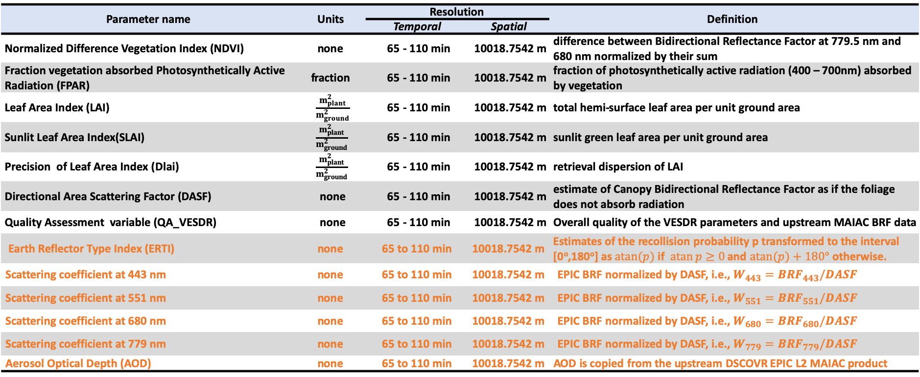
VERSION 2 VESDR: PRODUCT DESCRIPTION
Vegetation Parameter Suite in the Level 2 VESDR Product (derived from EPIC L2 MAIAC Product)
Parameter name | Units | Resolution |  | Definition
 |  | Temporal | Spatial
Normalized Difference Vegetation Index (NDVI) | none | 65 - 110 min | 10018.7542 m | difference between Bidirectional Reflectance Factor at 779.5 nm and 680 nm normalized by their sum
Fraction vegetation absorbed Photosynthetically Active Radiation (FPAR) | fraction | 65 - 110 min | 10018.7542 m | fraction of photosynthetically active radiation (400 – 700nm) absorbed by vegetation
Leaf Area Index (LAI) | $\frac{m_{plant}^{2}}{m_{ground}^{2}}$ | 65 - 110 min | 10018.7542 m | total hemi-surface leaf area per unit ground area
Sunlit Leaf Area Index(SLAI) | $$\frac{m_{plant}^{2}}{m_{ground}^{2}}$$ | 65 - 110 min | 10018.7542 m | sunlit green leaf area per unit ground area
Precision of Leaf Area Index (Dlai) | $$\frac{m_{plant}^{2}}{m_{ground}^{2}}$$ | 65 - 110 min | 10018.7542 m | retrieval dispersion of LAI
Directional Area Scattering Factor (DASF) | none | 65 - 110 min | 10018.7542 m | estimate of Canopy Bidirectional Reflectance Factor as if the foliage does not absorb radiation
Quality Assessment variable (QA_VESDR) | none | 65 - 110 min | 10018.7542 m | Overall quality of the VESDR parameters and upstream MAIAC BRF data
Earth Reflector Type Index (ERTI) | none | 65 to 110 min | 10018.7542 m | Estimates of the recollision probability p transformed to the interval [0º,180º] as $\operatorname{atan}{(p)}$ if $\operatorname{atan}{p}≥0$ and $\operatorname{atan}{(p)}+180°$ otherwise.
Scattering coefficient at 443 nm | none | 65 to 110 min | 10018.7542 m | EPIC BRF normalized by DASF, i.e., $W_{443}={BRF}_{443}/DASF$
Scattering coefficient at 551 nm | none | 65 to 110 min | 10018.7542 m | EPIC BRF normalized by DASF, i.e., $W_{551}={BRF}_{551}/DASF$
Scattering coefficient at 680 nm | none | 65 to 110 min | 10018.7542 m | EPIC BRF normalized by DASF, i.e., $W_{680}={BRF}_{680}/DASF$
Scattering coefficient at 779 nm | none | 65 to 110 min | 10018.7542 m | EPIC BRF normalized by DASF, i.e., $W_{779}={BRF}_{779}/DASF$
Aerosol Optical Depth (AOD) | none | 65 to 110 min | 10018.7542 m | AOD is copied from the upstream DSCOVR EPIC L2 MAIAC product
New parameters
Ancillary science data products (derived from 500 m land cover type 3 product)
Parameter name | Units | Resolution |  | Comments
 |  | Temporal | Spatial
Land Cover Type | none | static | 10 km | 10 km SIN Land Cover type
Land Cover Type Distribution | none | static | 10 km | Distribution of land cover types within 10 km EPIC pixel

Slide 3
4 rotated SIN projections with center meridian at 20º, 110º, -160º and -70º
In version 2 all parameters are projected on 4 regional 10 km SIN grids

Slide 4
Version 2 Ancillary science data product: 10 km Land Cover Map
Will be available from the NASA Langley Atmospheric Science Data Center
Derived from MODIS 500 m land cover type

Slide 5
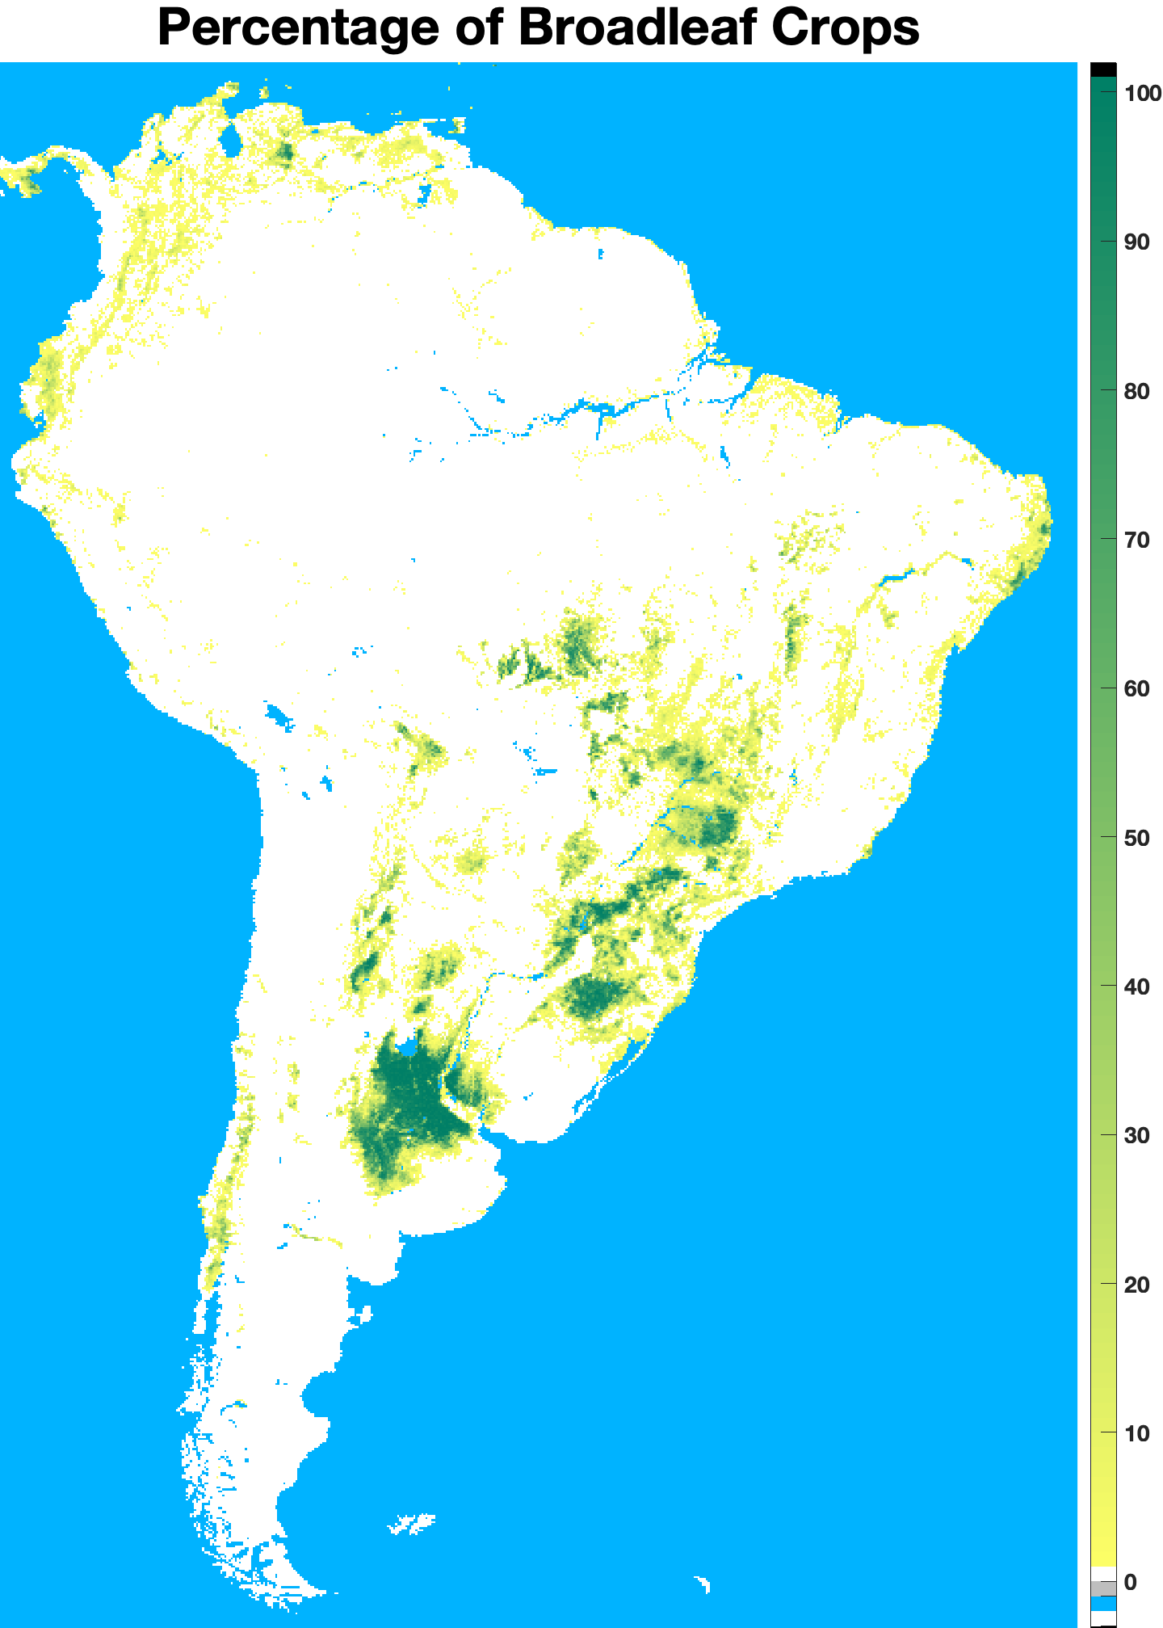
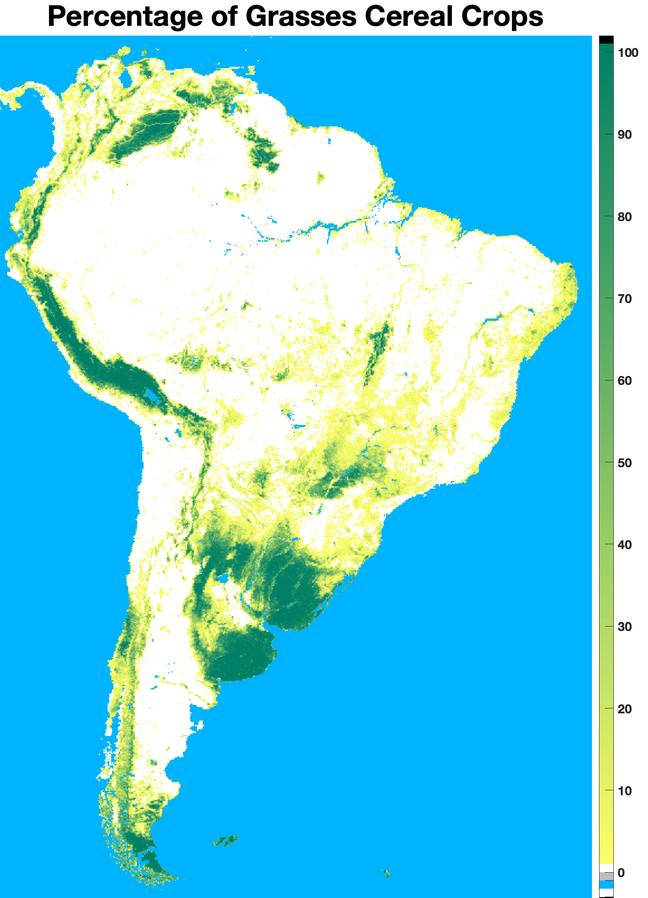
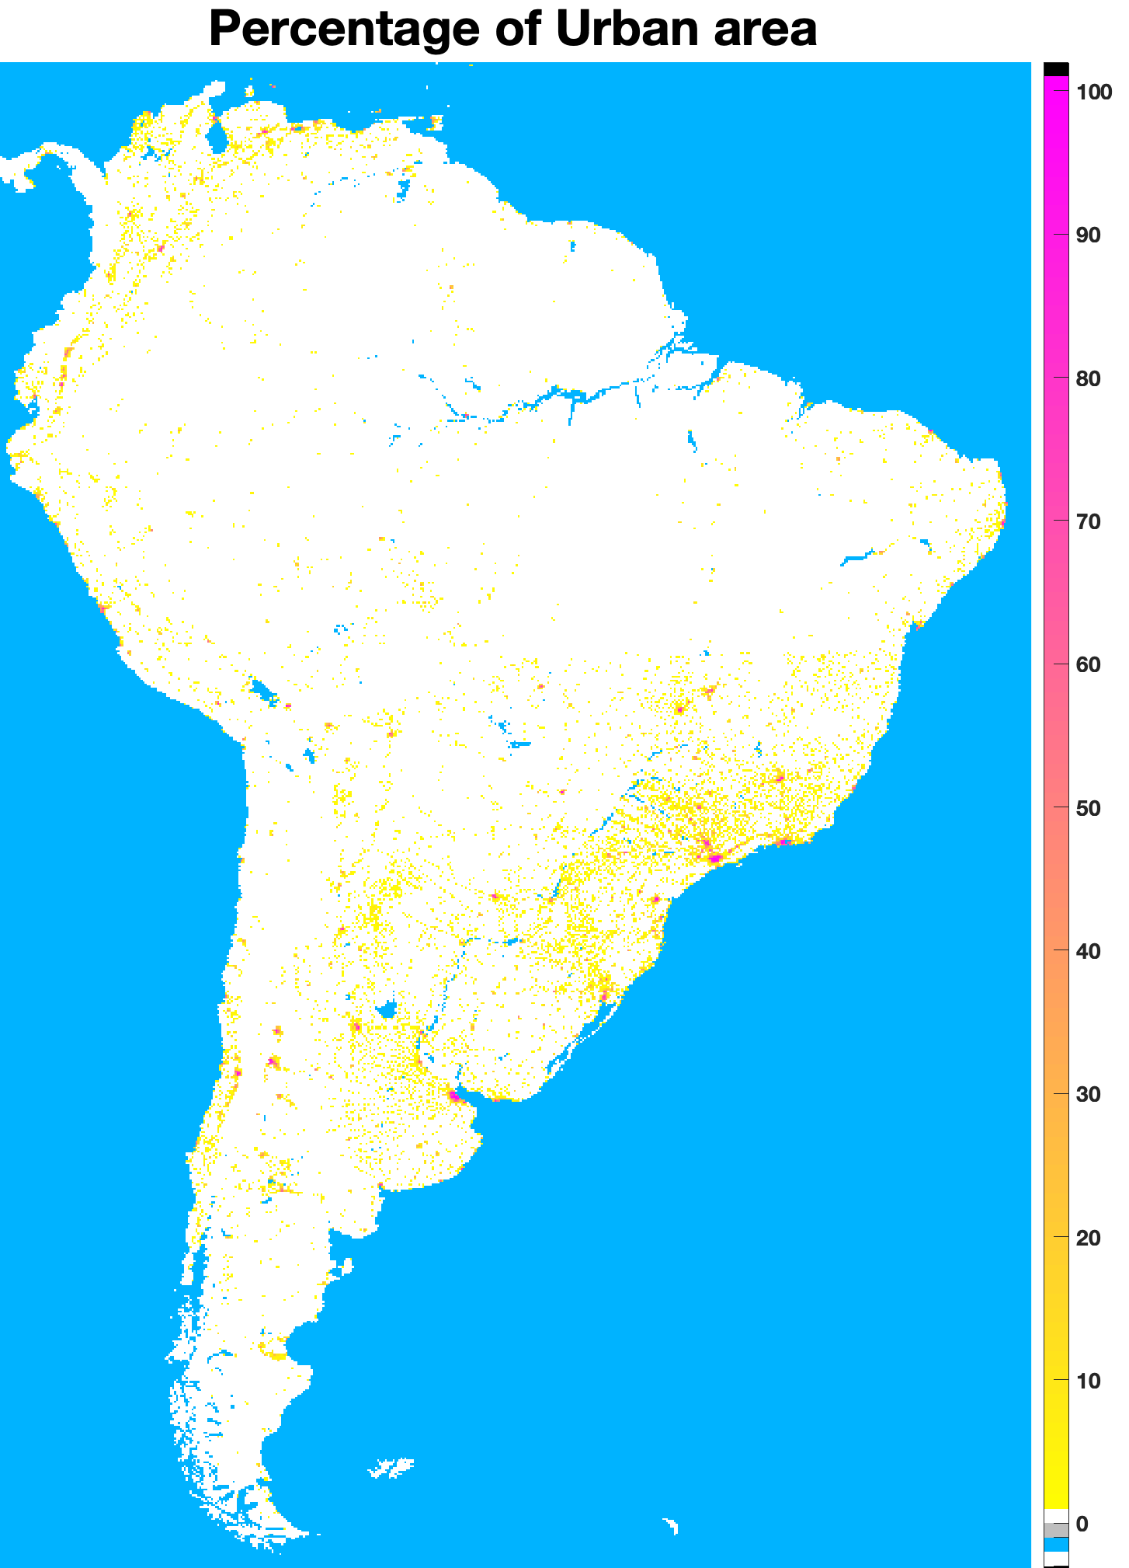
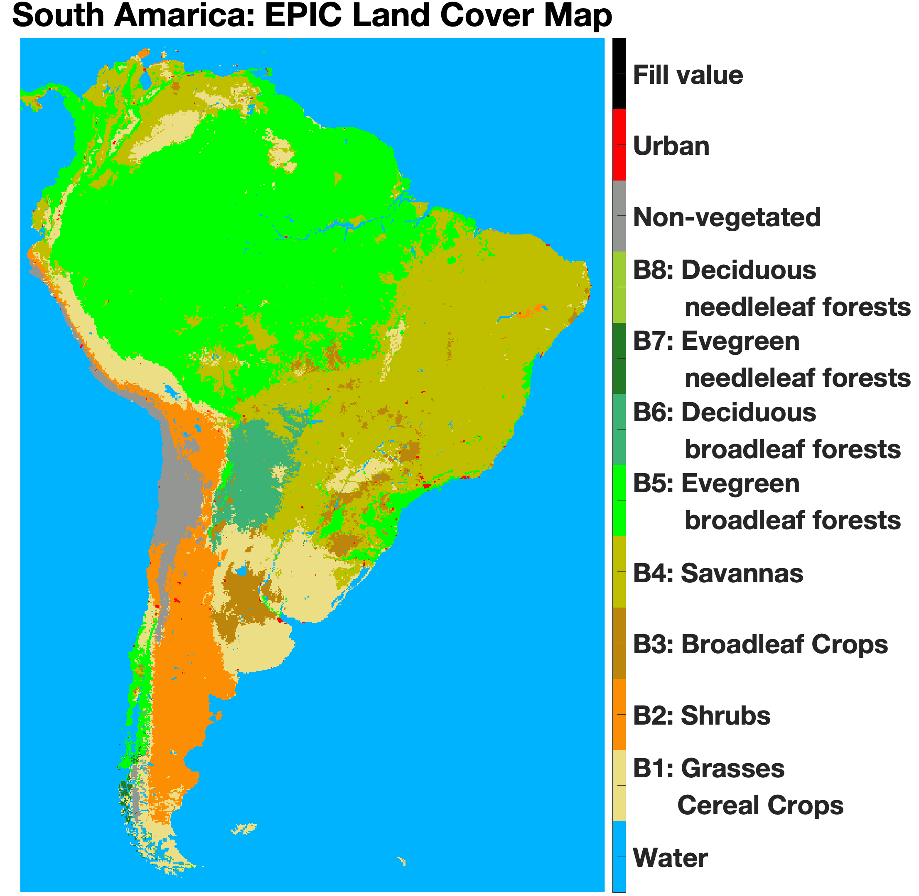
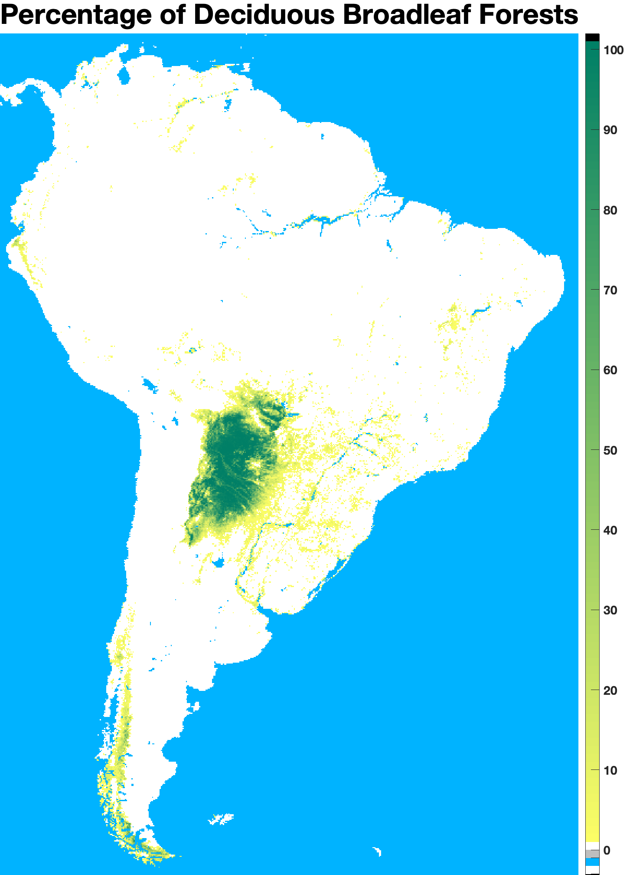
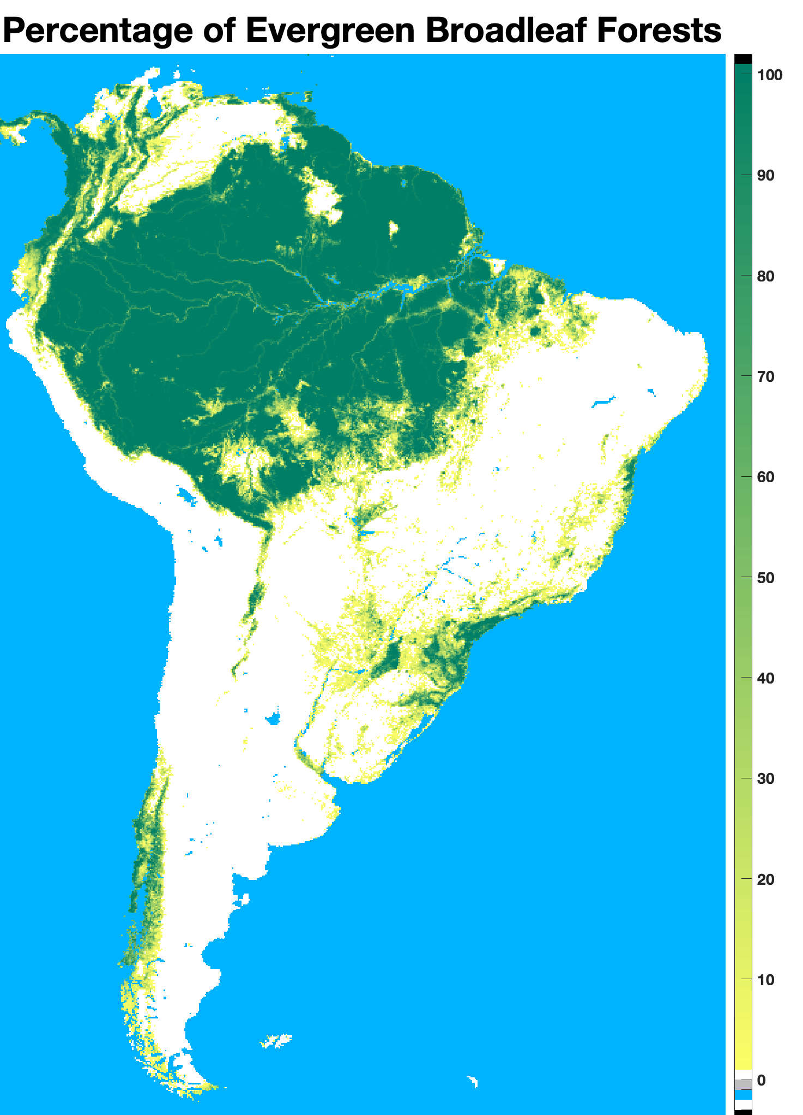
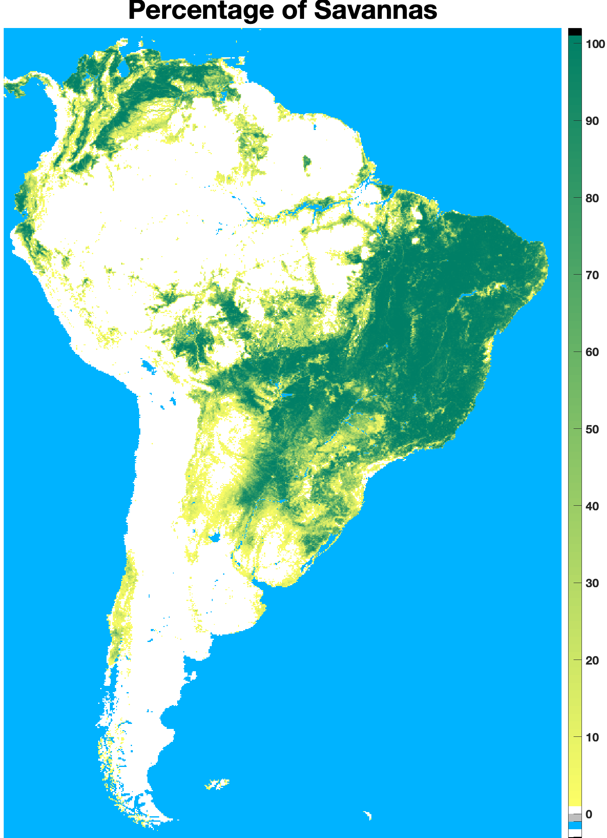
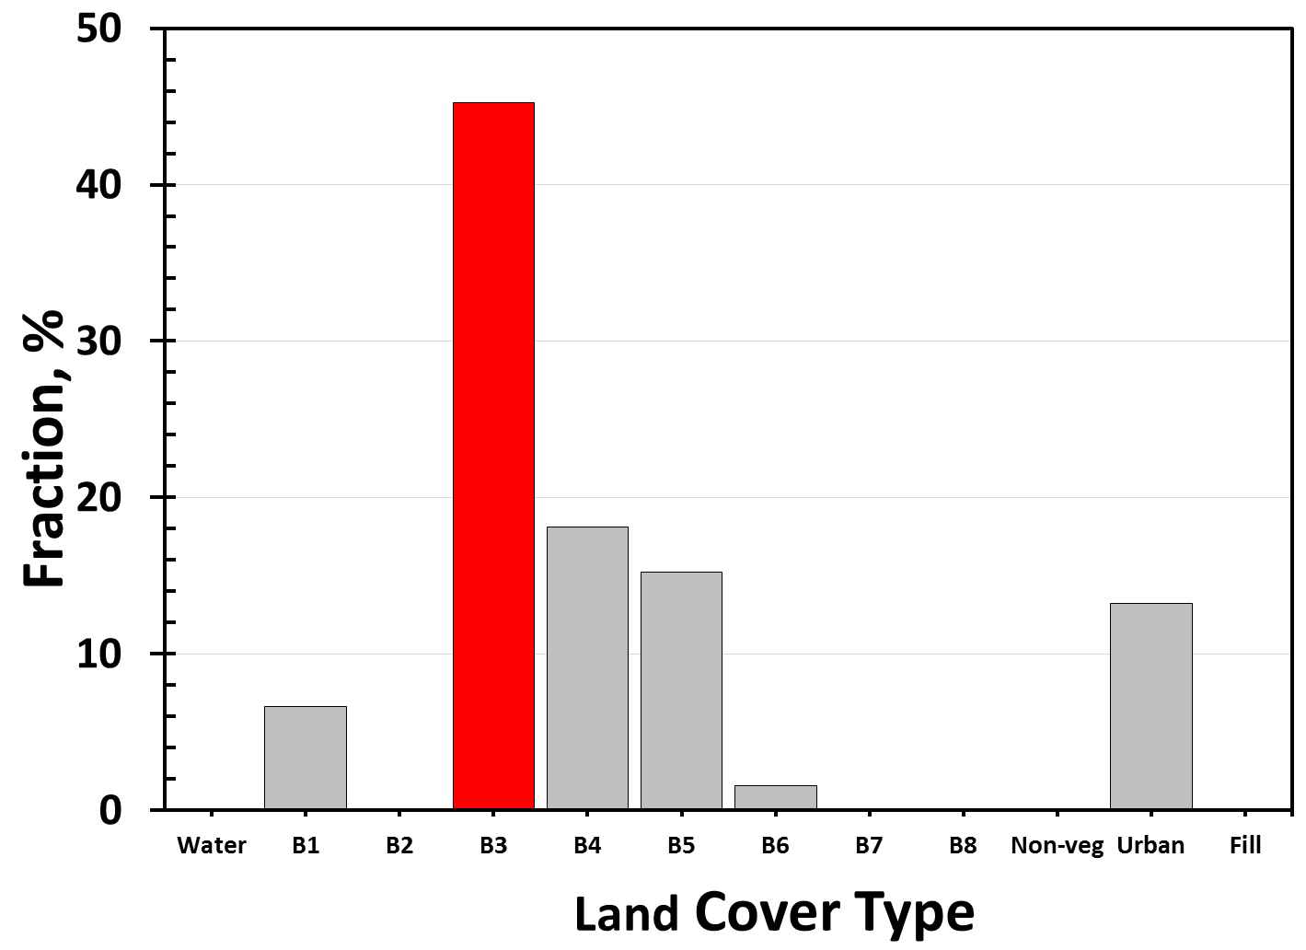
VERSION 2 ANCILLARY SCIENCE DATA PRODUCT: BIOME TYPES WITHIN 10 KM EPIC PIXEL
ZONE 3
Broadleaf Crops
Grasses & Cereal Crops
Urban Area
Deciduous Broadleaf Forest
Evergreen Broadleaf Forest
Savannas
Derived from MODIS 500 m land cover type

Slide 6
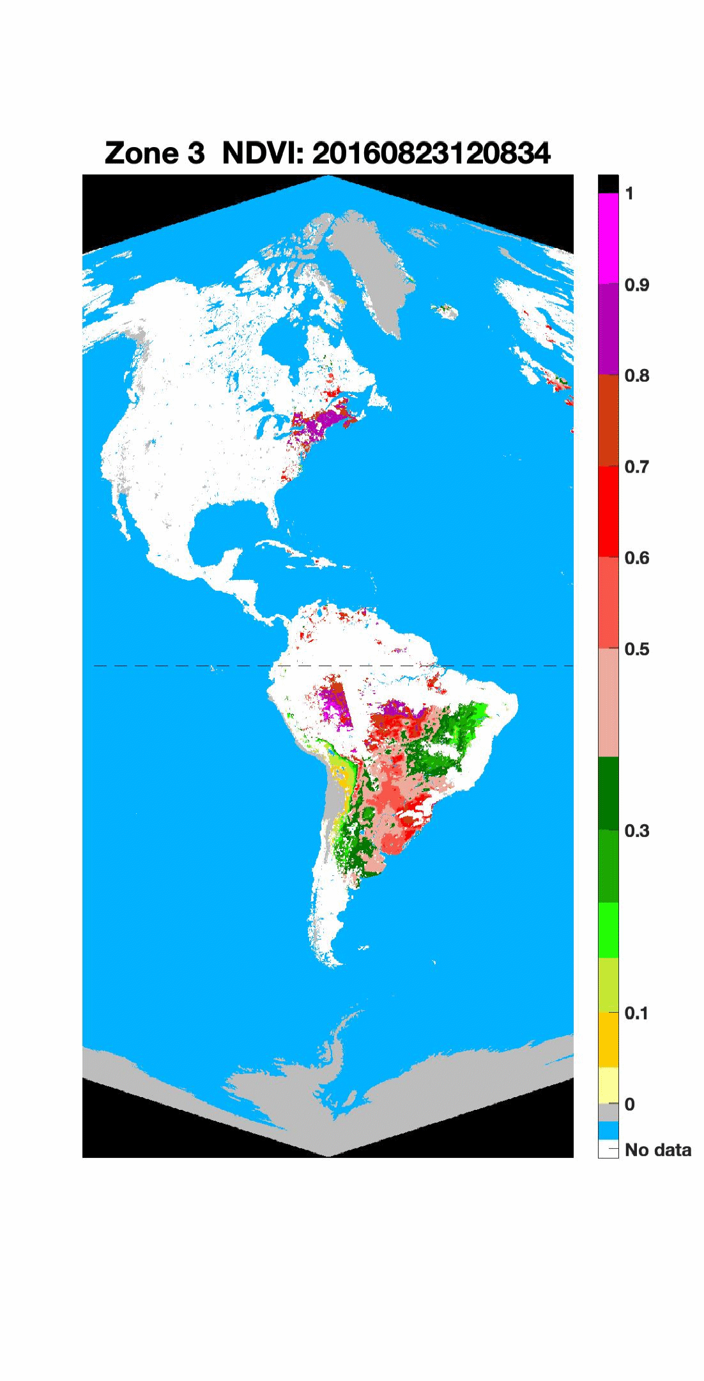
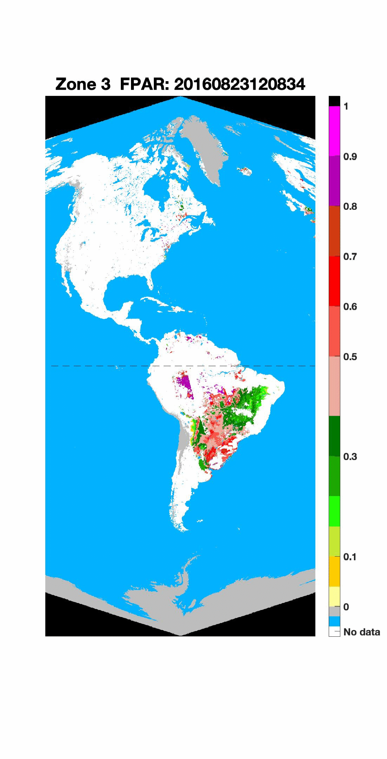
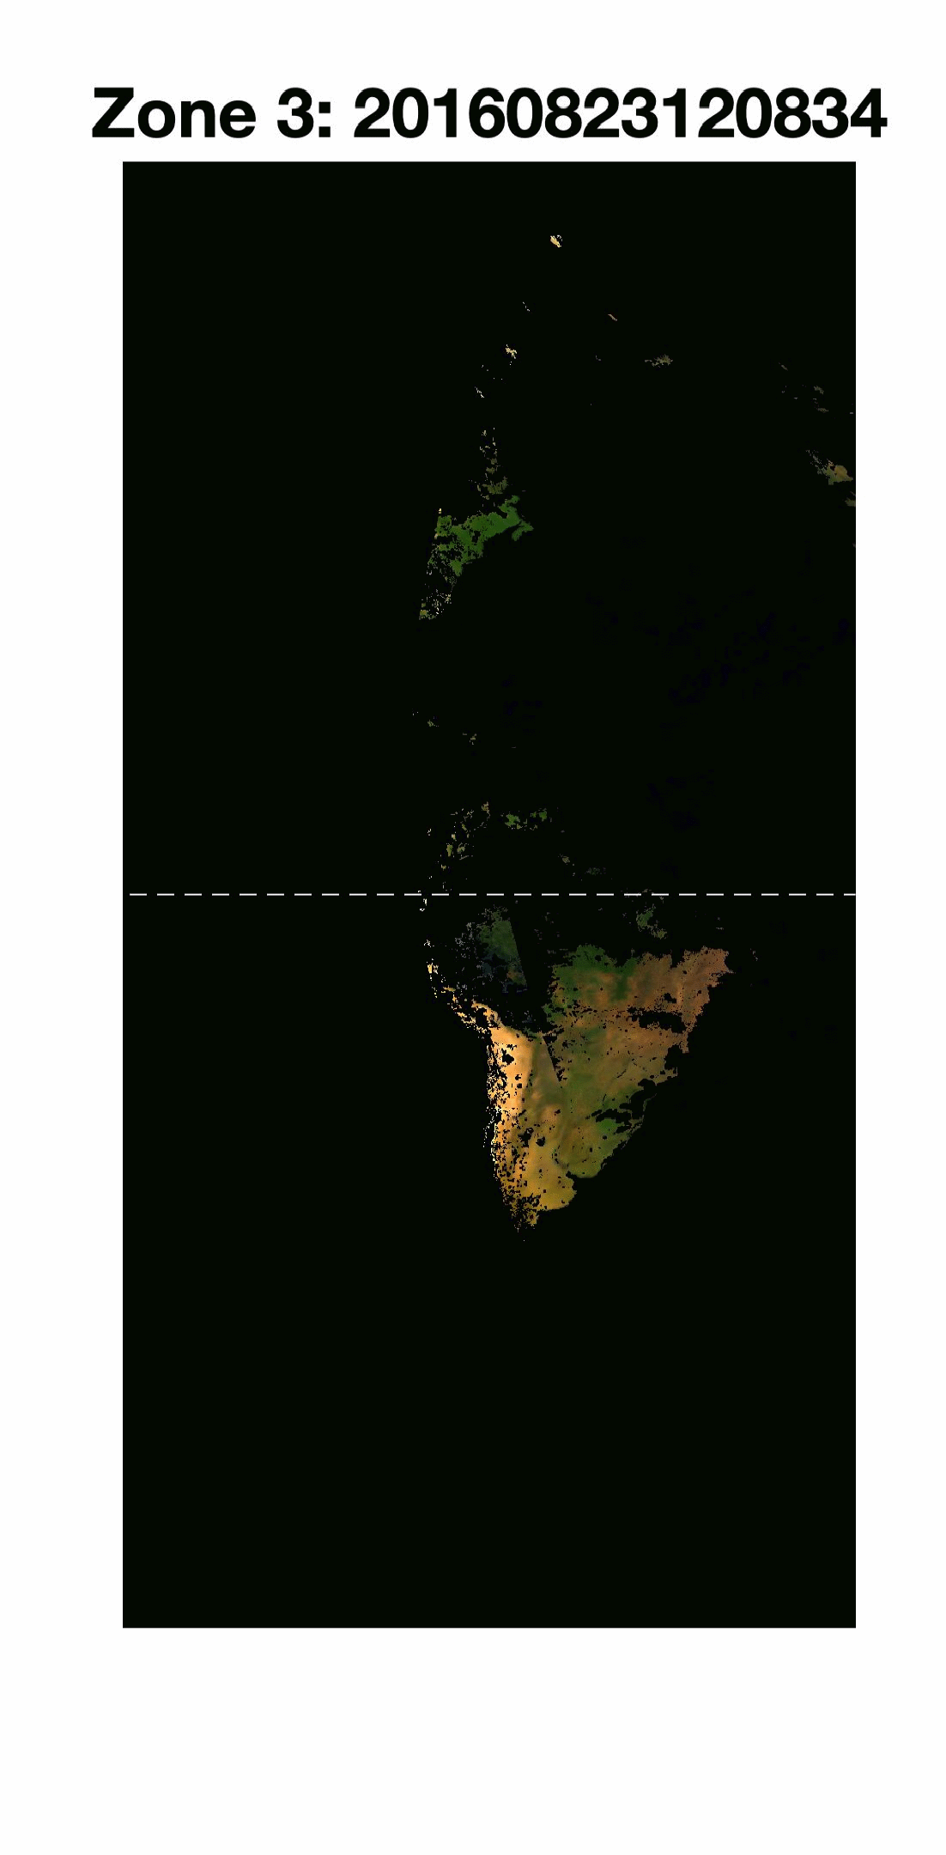
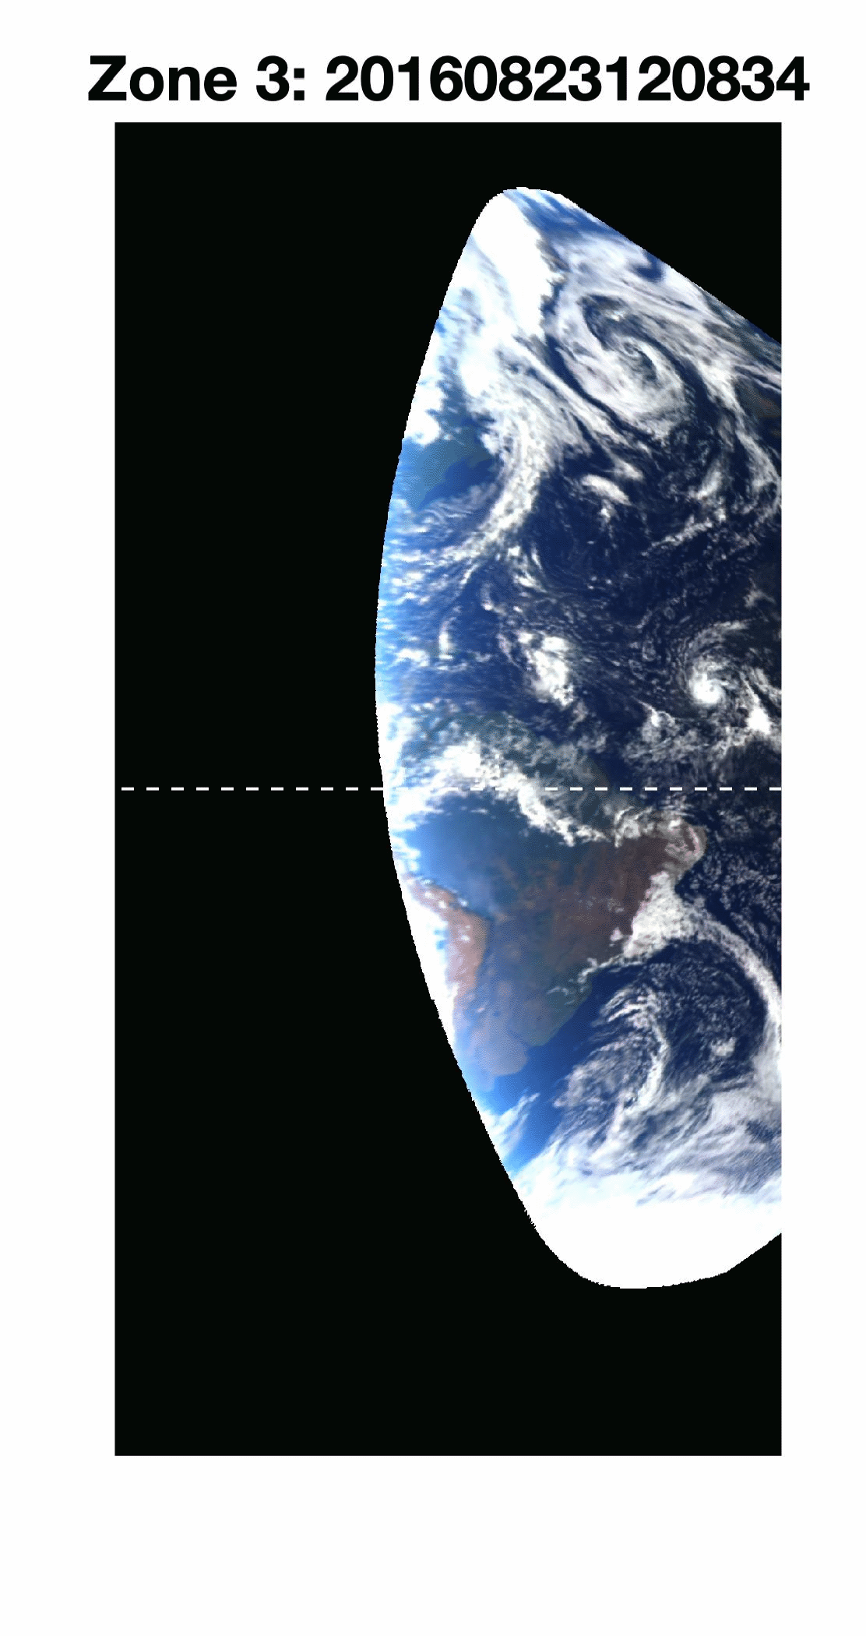
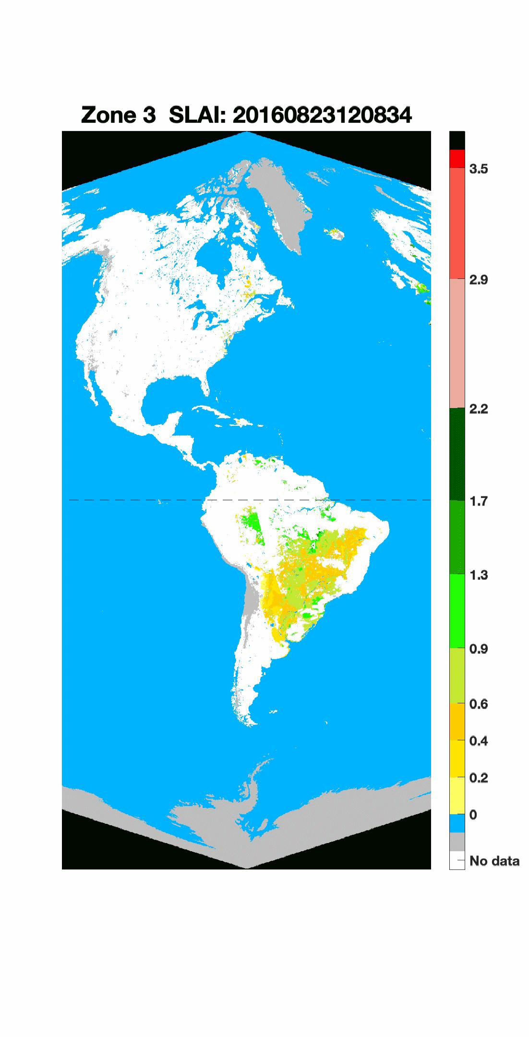
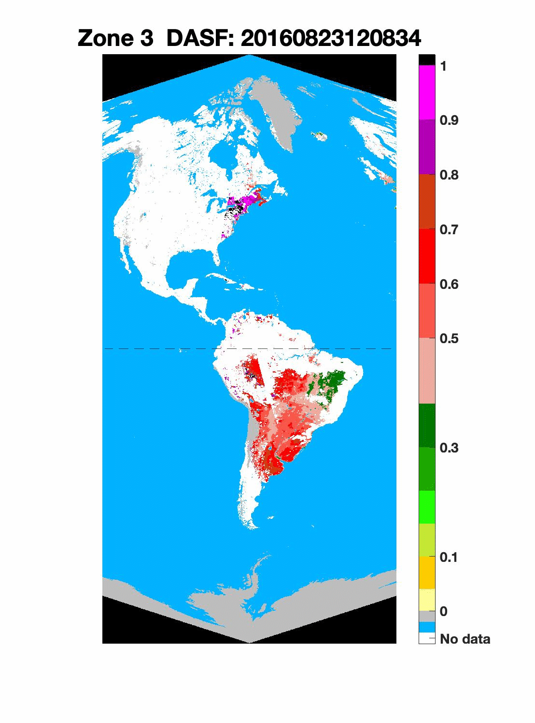
Version 2 EPIC VESDR: 10 km NDVI, FPAR, SLAI, DASF
23 August, 2016
Normalized Difference Vegetation Index (NDVI): difference bet-ween Bidirectional Re-flectance Factor (BRF) at 779.5 nm and 680 nm normalized by their sum
Fraction of Photosy-nthetically Active Ra-diation (400 – 700nm, FPAR) absorbed by vegetation
August-2016
FPAR
NDVI
Sunlit Leaf Area Index (SLAI): leaf area illuminated by the direct solar beam per unit ground area
MAIAC Surface Reflectance
MAIAC TOA Reflectance
Directional Area Scattering Factor (DASF): canopy BRF if the foliage does not absorb radiation
LAI, SLAI and FPAR are key state parameters in most ecosystem productivity models and carbon/nitrogen cycle. DASF provides information critical to accounting for structural contributions to measurements of leaf biochemistry from remote sensing.
DASF
SLAI

Slide 7
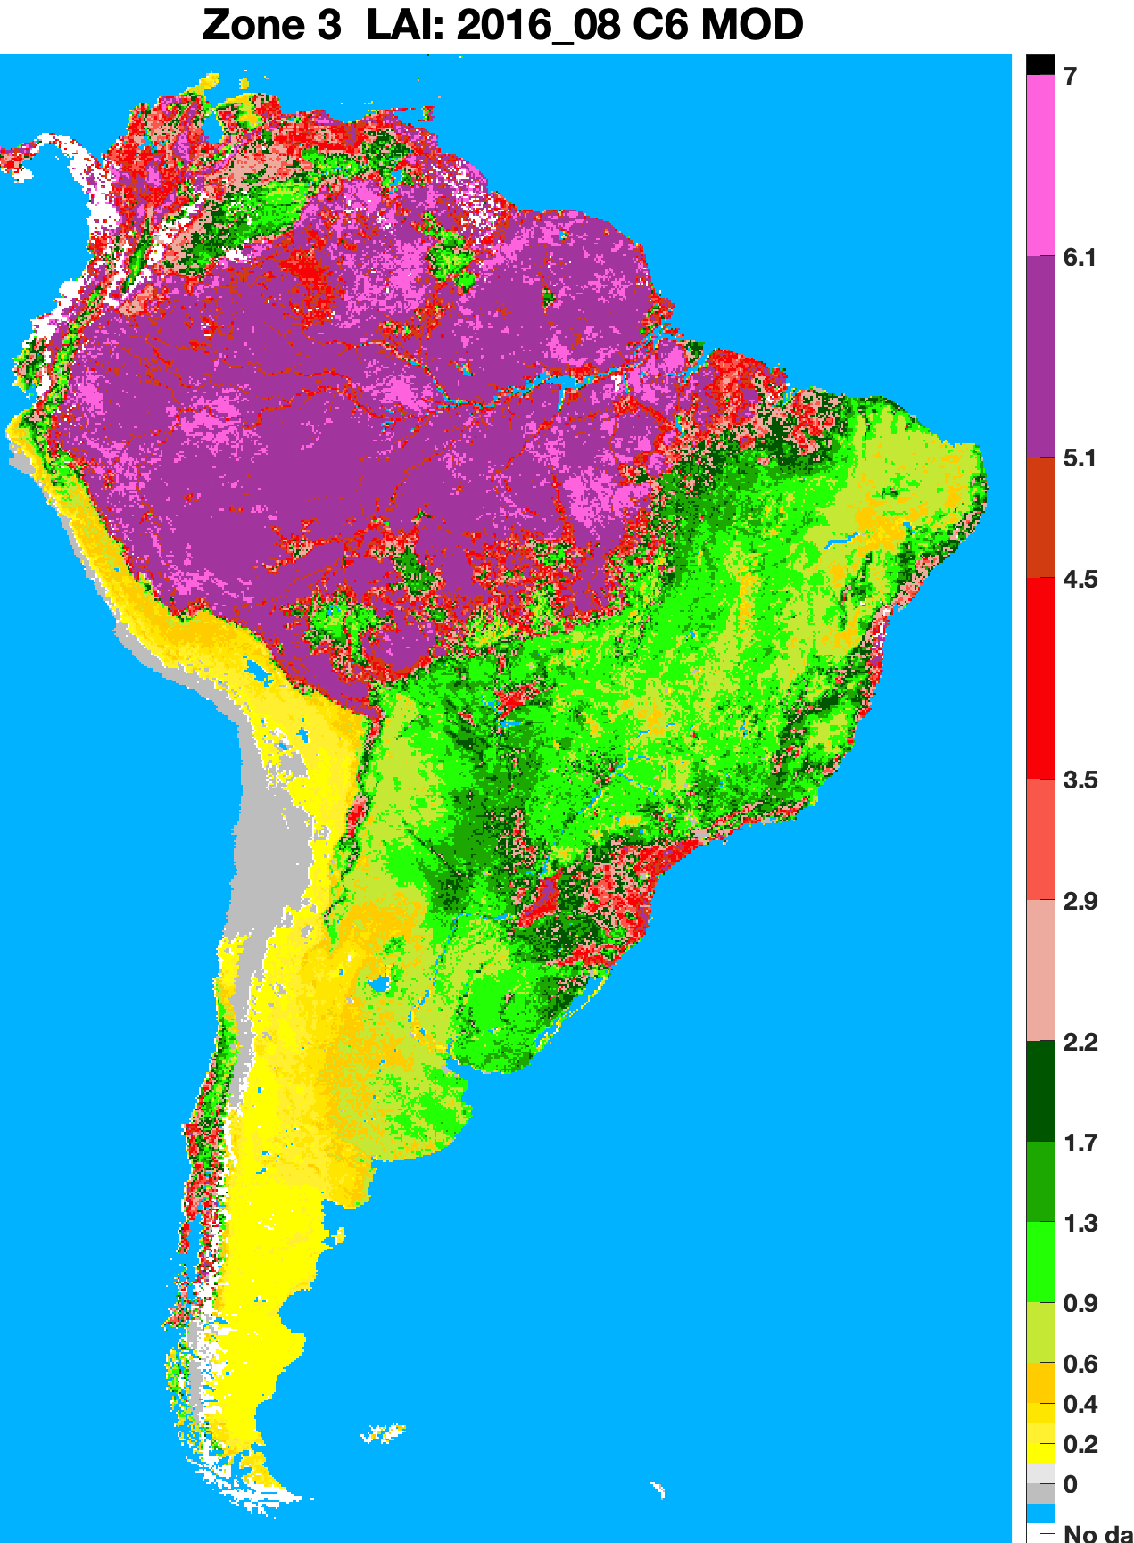
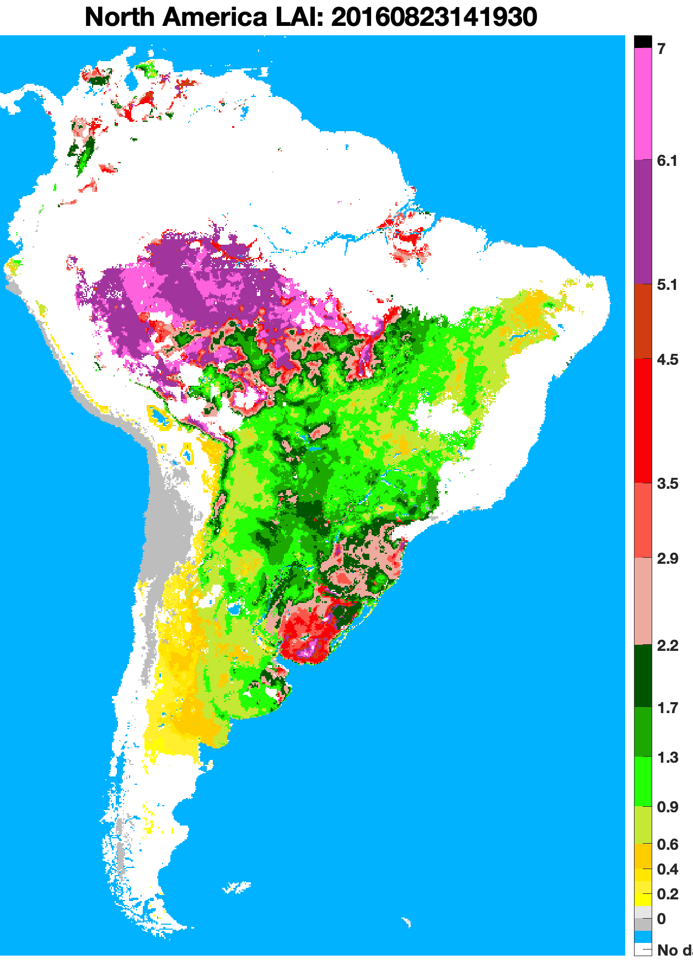
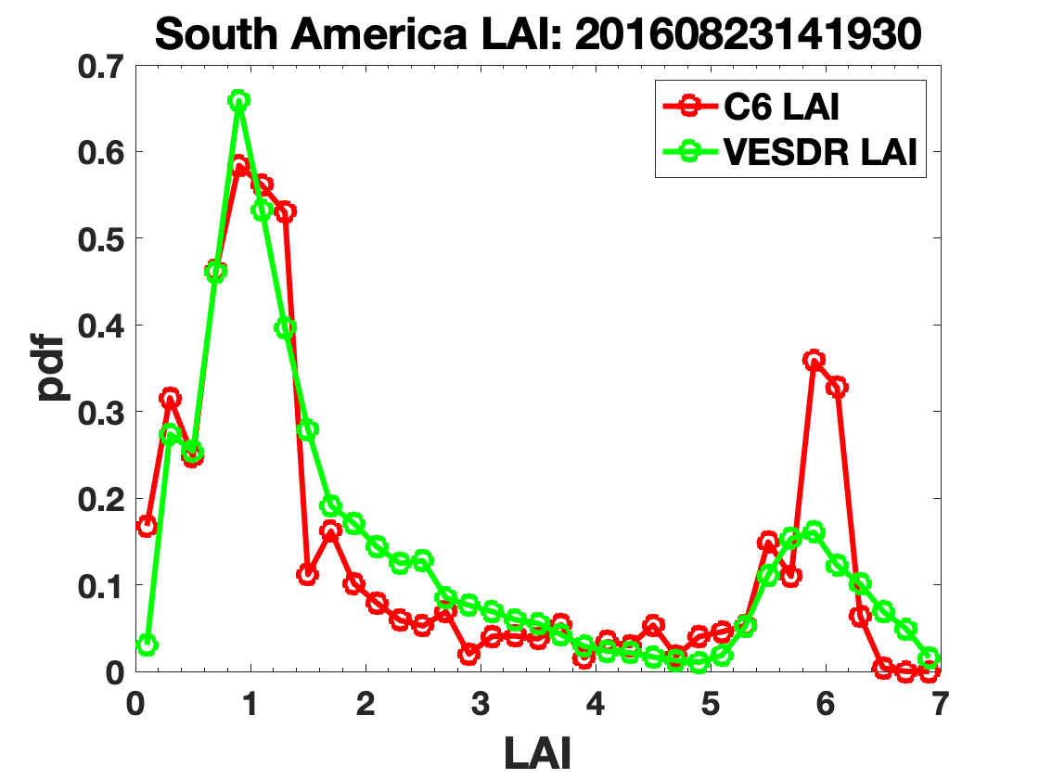
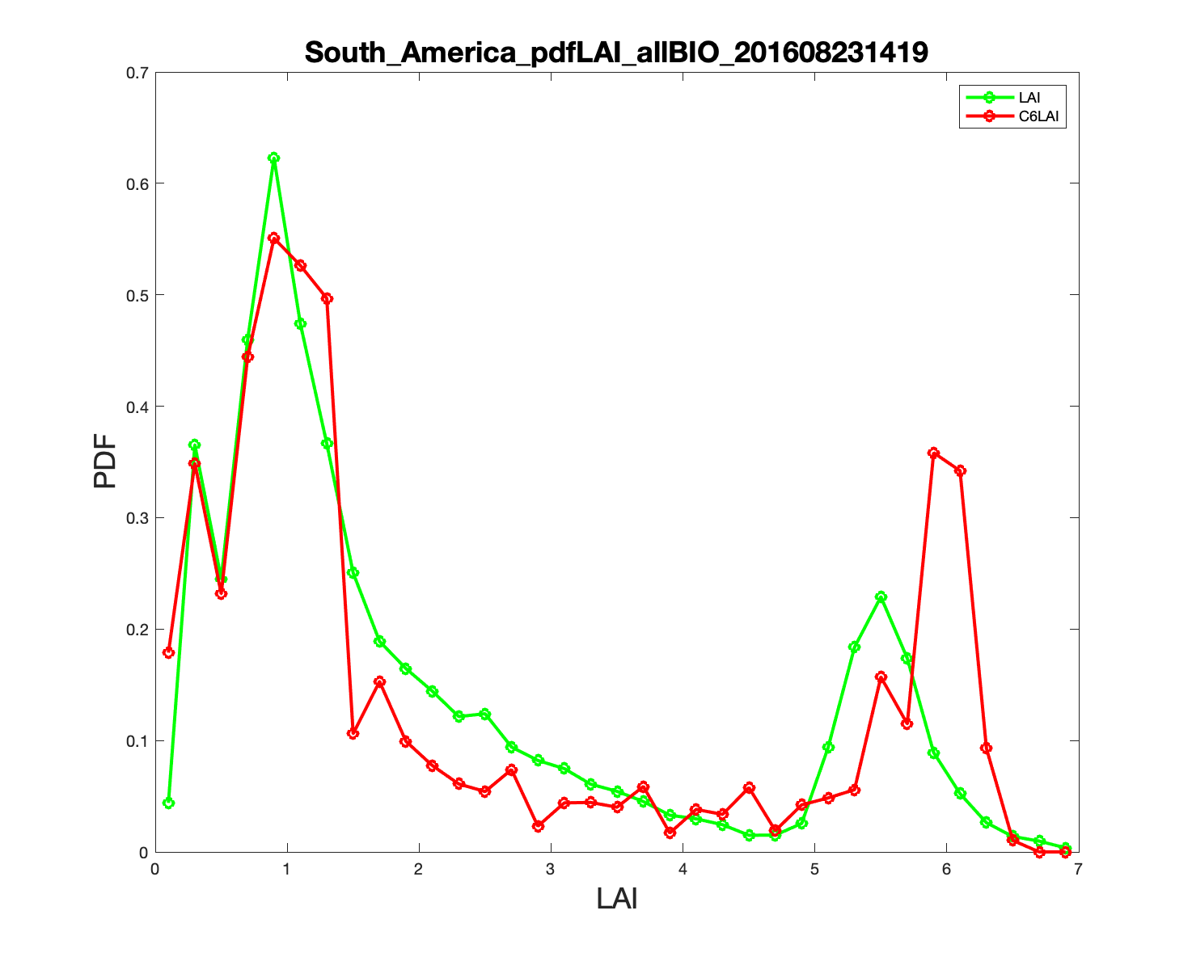
VESDR LAI: version 2 versus version 1
Version 2
Version 1
August-2016
C6 MODIS LAI
V2 EPIC LAI
Better agreement with MODI C6 LAI over equatorial forests

Slide 8
VESDR LAI: version 2 versus version 1
Version 2
August-2016
C6 MODIS LAI
V2 EPIC LAI
More LAIs between 2-3 in regions where EBF occupies ~50% of 10 km pixel
Notes:
More LAI~2-3 for for pixels with ~ 50 % of EBF; these areas are mixture of savannas and EBF

Slide 9
VERSION 2 EPIC VESDR EARTH REFLECTOR TYPE INDEX
Over the course of a year a distant observer sees about 59.7% of the sunlit Earth’s area covered by clouds, 26.4%, 12.5%, 1.4% for cloud-free ocean, bare land and vegetation¹
Contributions of clouds, cloud free ocean, land and vegetation to Earth reflectivity depend on wavelength and vary between 76% and 82%, 6% and 16%, 0.6% and 1.8%¹
Green vegetation contributes significantly to the NIR Earth reflectance when the South and North Americas appear on the sunlit Earth²
Spectrally invariant approximation of canopy BRF
We developed an Earth Reflector Type Index (ERTI) that reliably discriminate between major Earth components: clouds, cloud-free ocean, bare and vegetated lands. ERTI was used to analyze Earth spectral reflectivity.
[1] Song et al., (2018). Implications of Whole-Disc DSCOVR EPIC Spectral Observations for Estimating Earth's Spectral Reflectivity Based on Low-Earth-Orbiting and Geostationary Observations. Remote Sensing, 10, 10.3390/rs10101594
[2] Wen et al, (2019) A Relationship Between Blue and Near-IR Global Spectral Reflectance and the Response of Global Average Reflectance to Change in Cloud Cover Observed From EPIC. Earth and Space Science, 6, doi:10.1029/2019EA000664

Slide 10
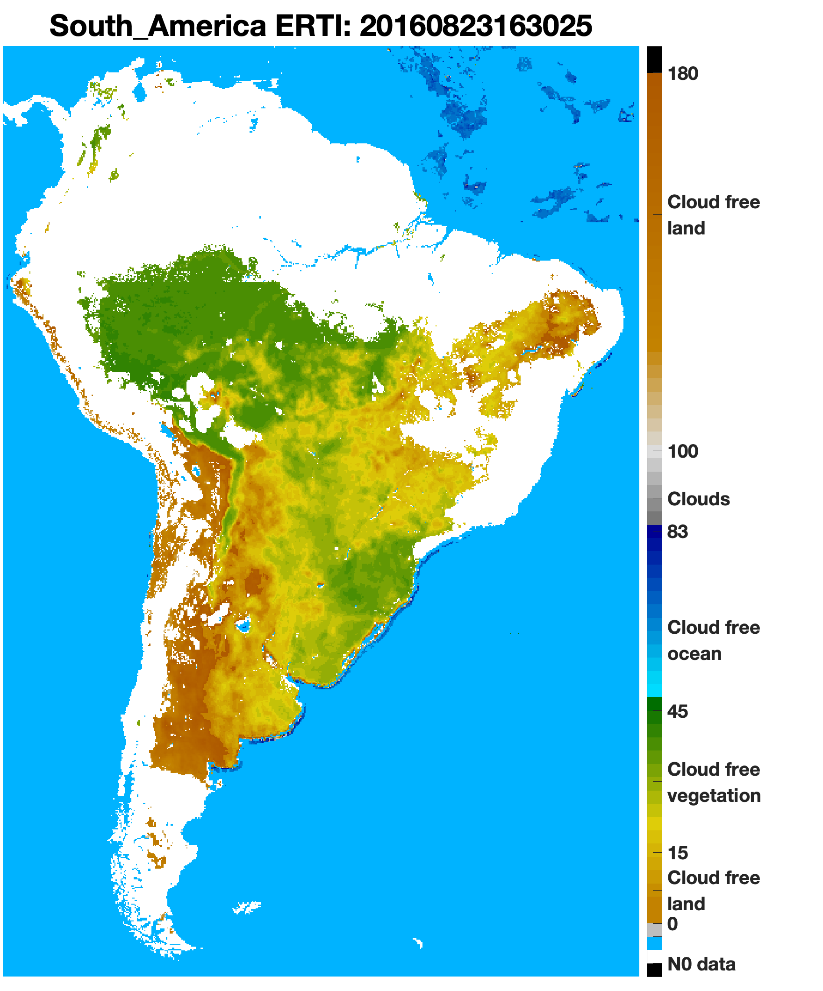
VERSION 2 EPIC VESDR EARTH REFLECTOR TYPE INDEX
ZONE 3
Version 2 EPIC ERTI discriminates between water, bare and vegetated lands

Slide 11
VERSION 2 EPIC VESDR EARTH REFLECTOR TYPE INDEX
ZONE 3
Version 2 EPIC ERTI discriminates between water, bare and vegetated lands

Slide 12
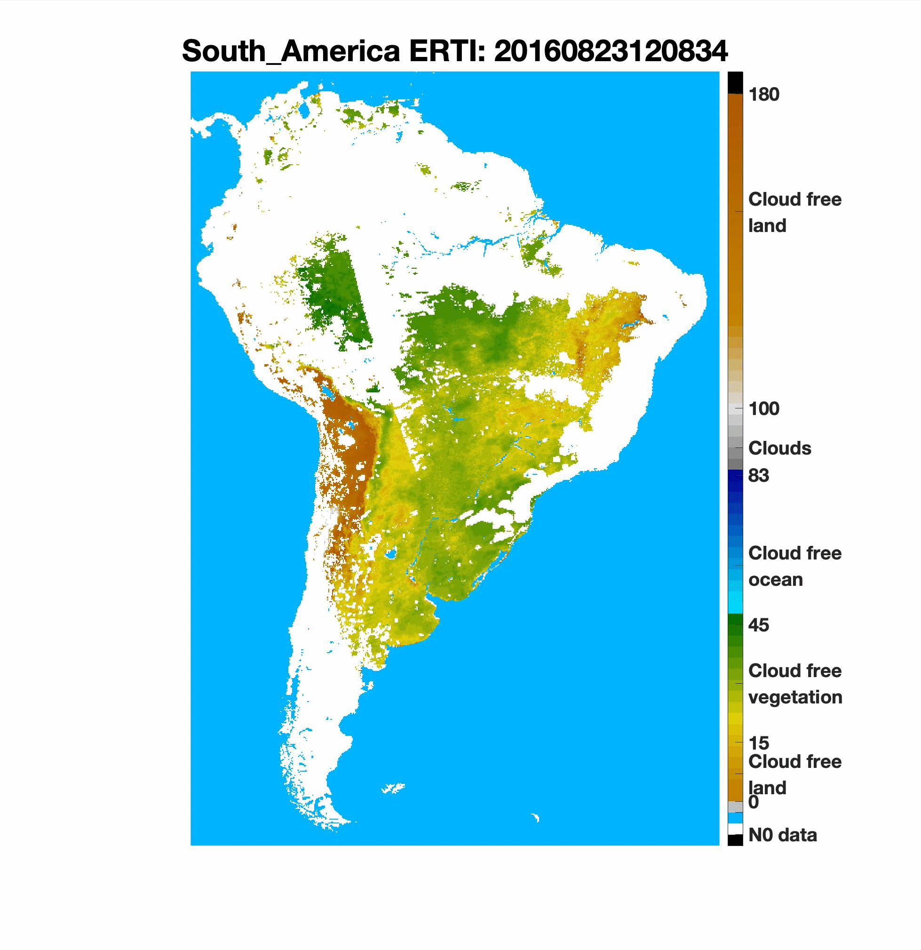
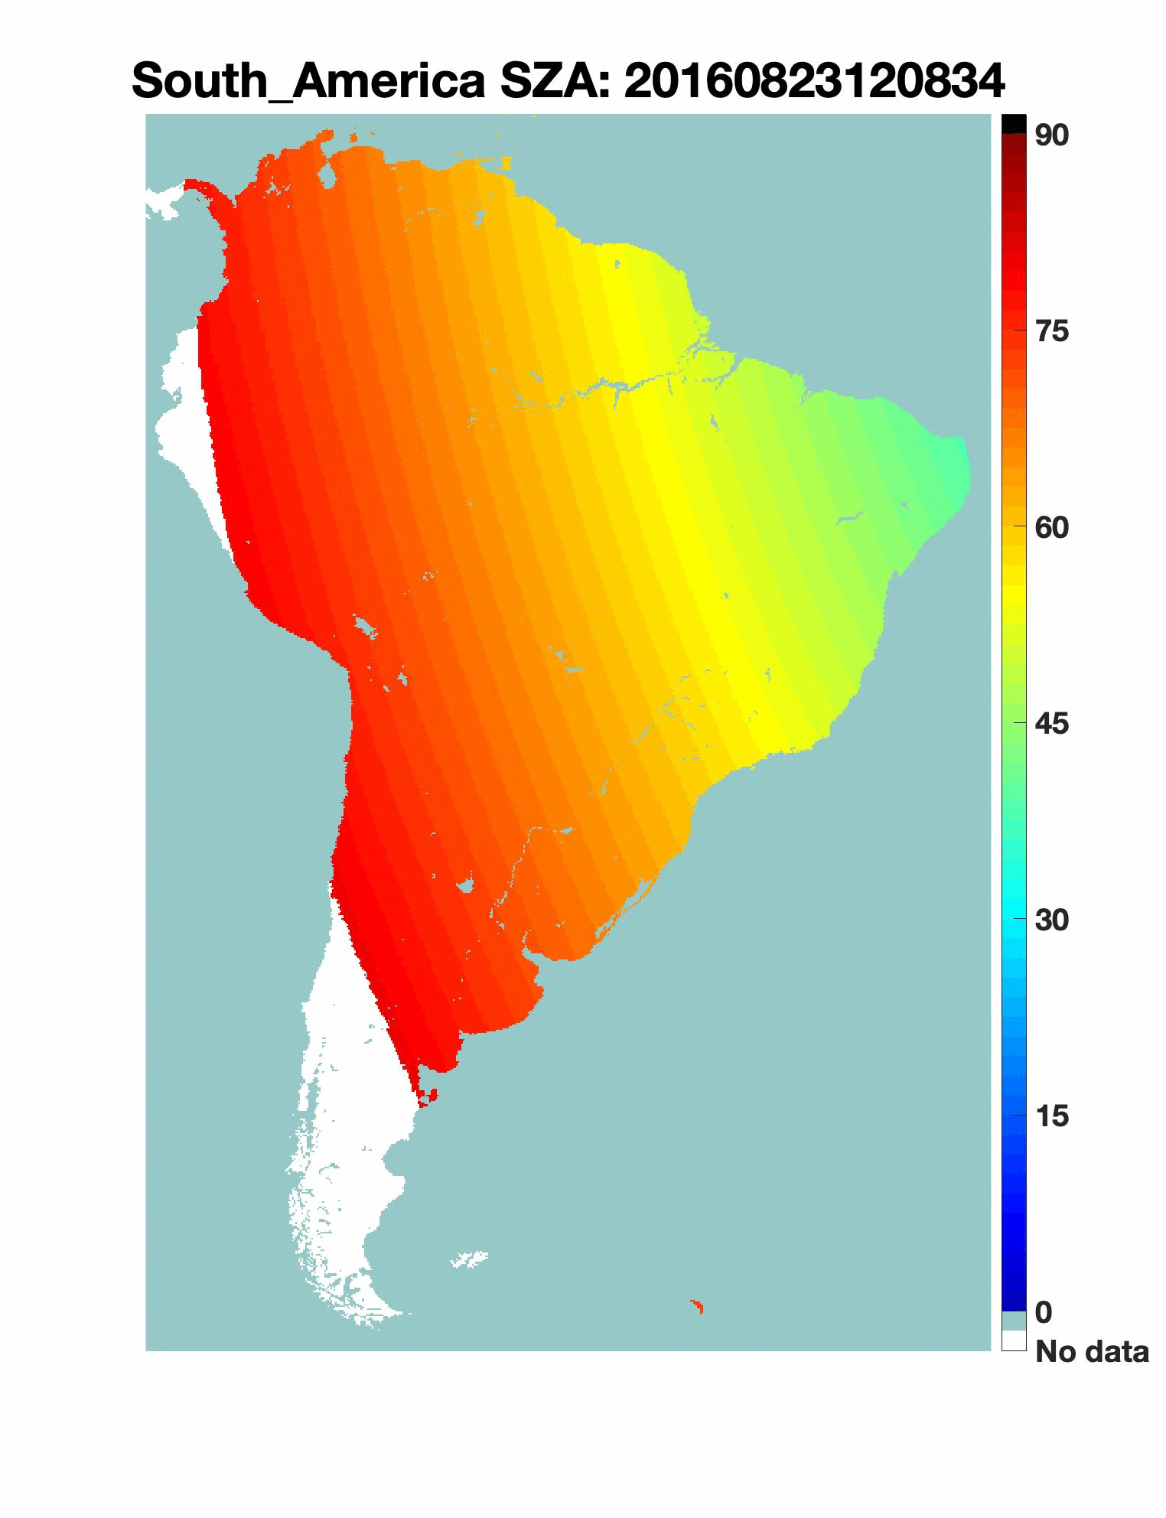
VERSION 2 EPIC VESDR EARTH REFLECTOR TYPE INDEX
Version 2 EPIC ERTI weakly sensitive to SZA, as expected

Slide 13
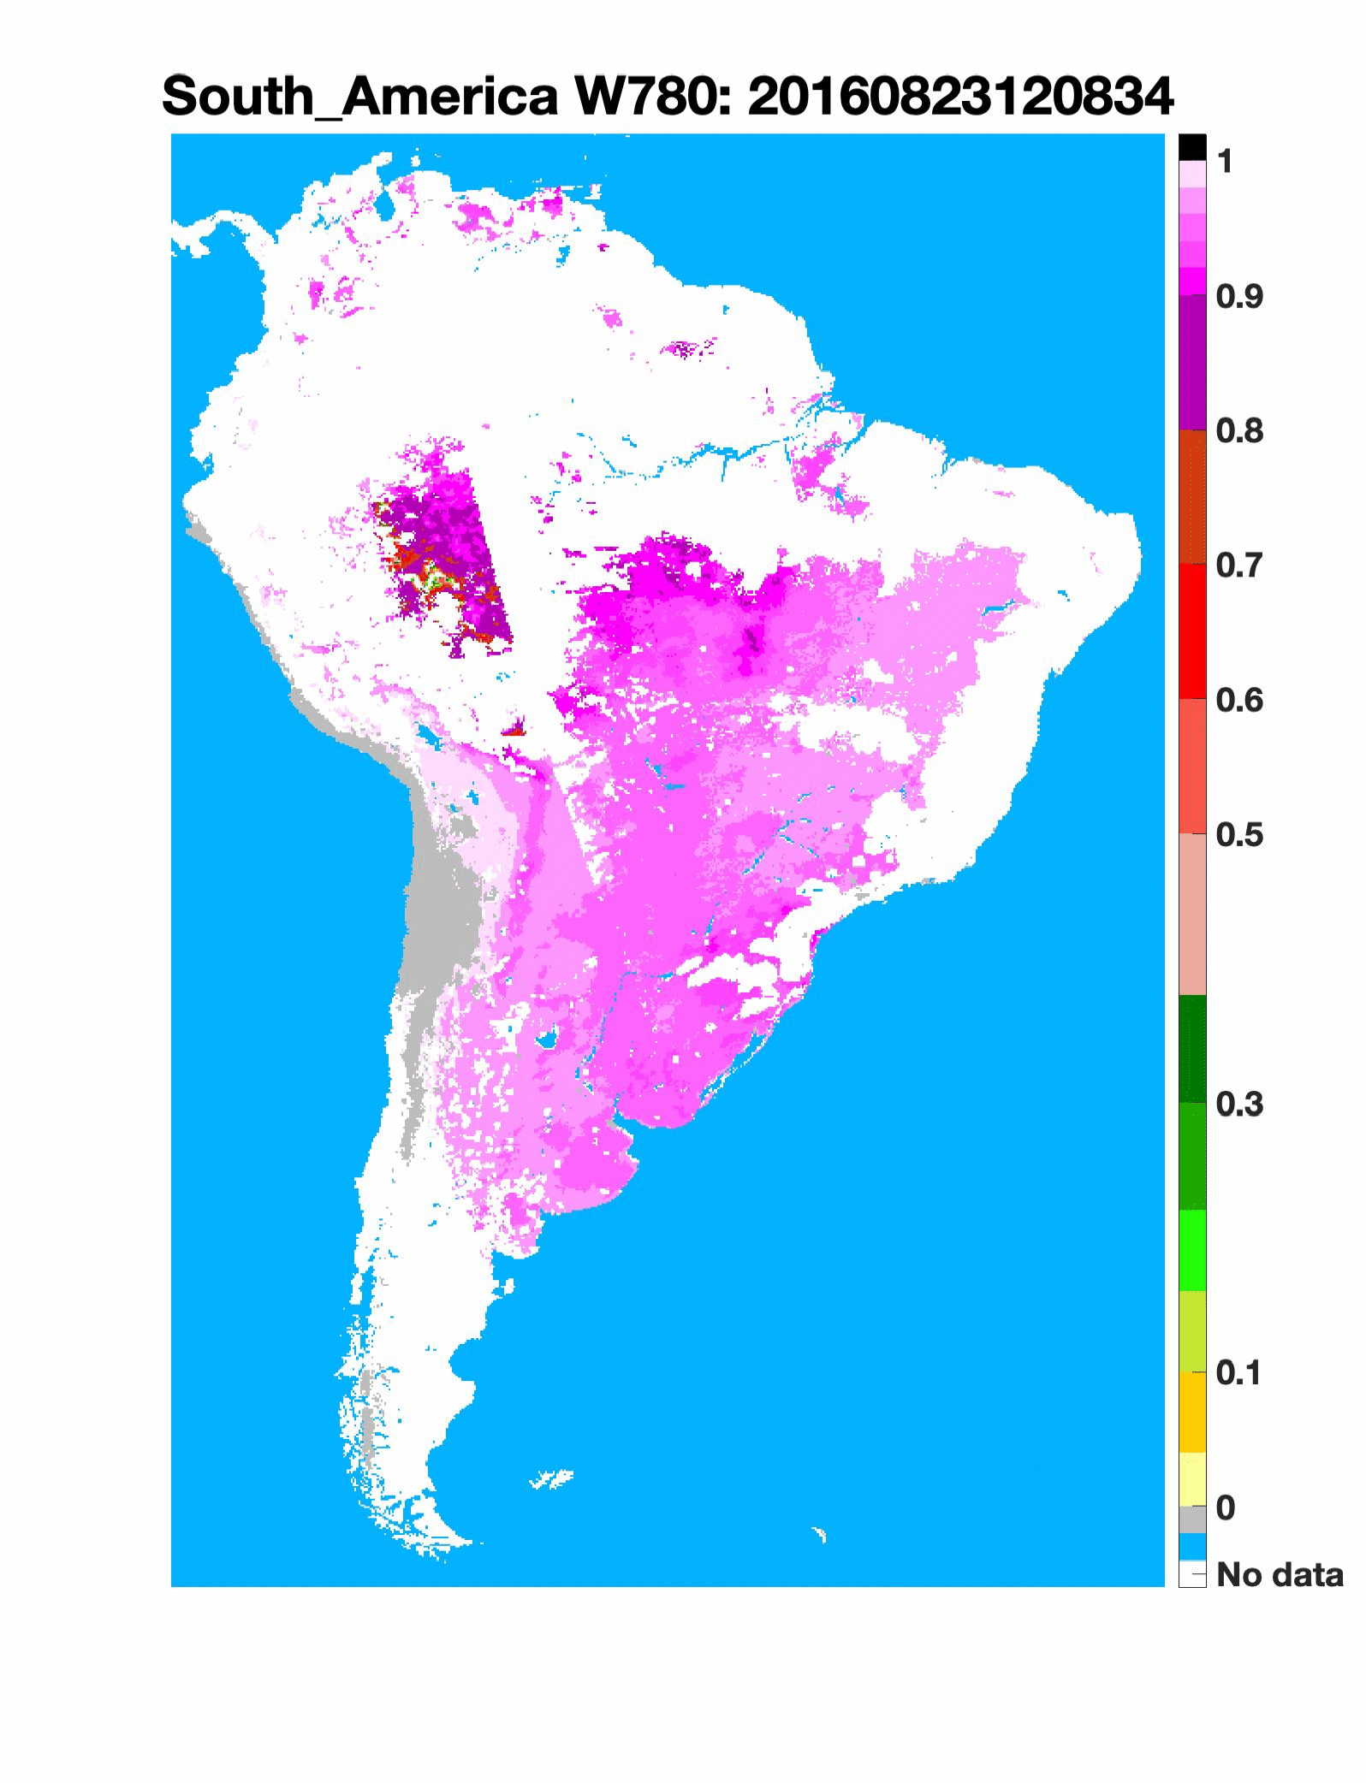
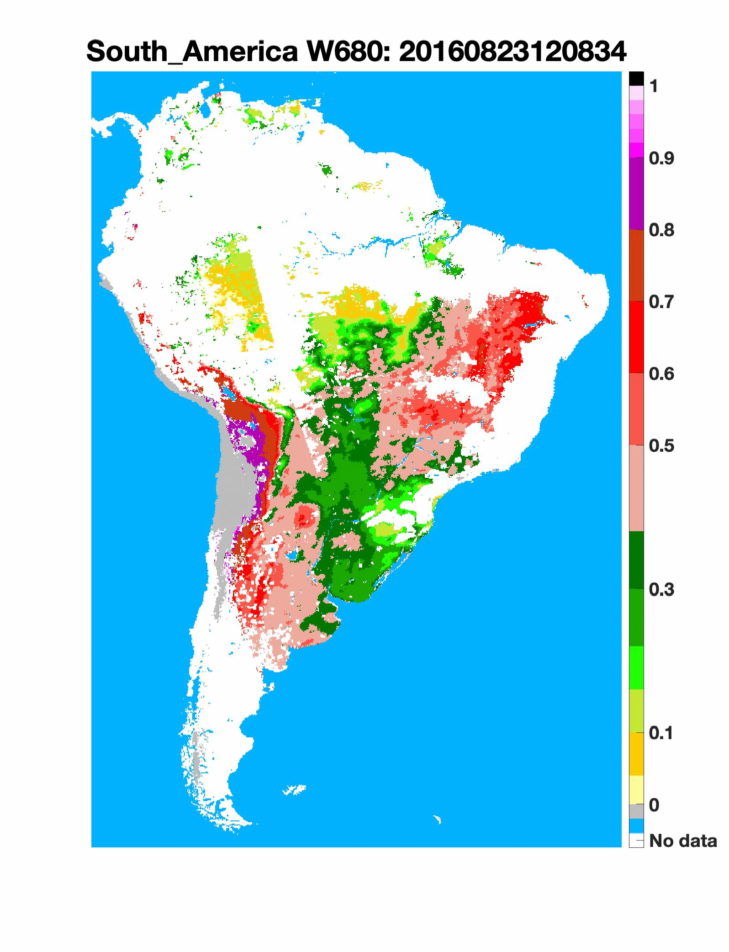
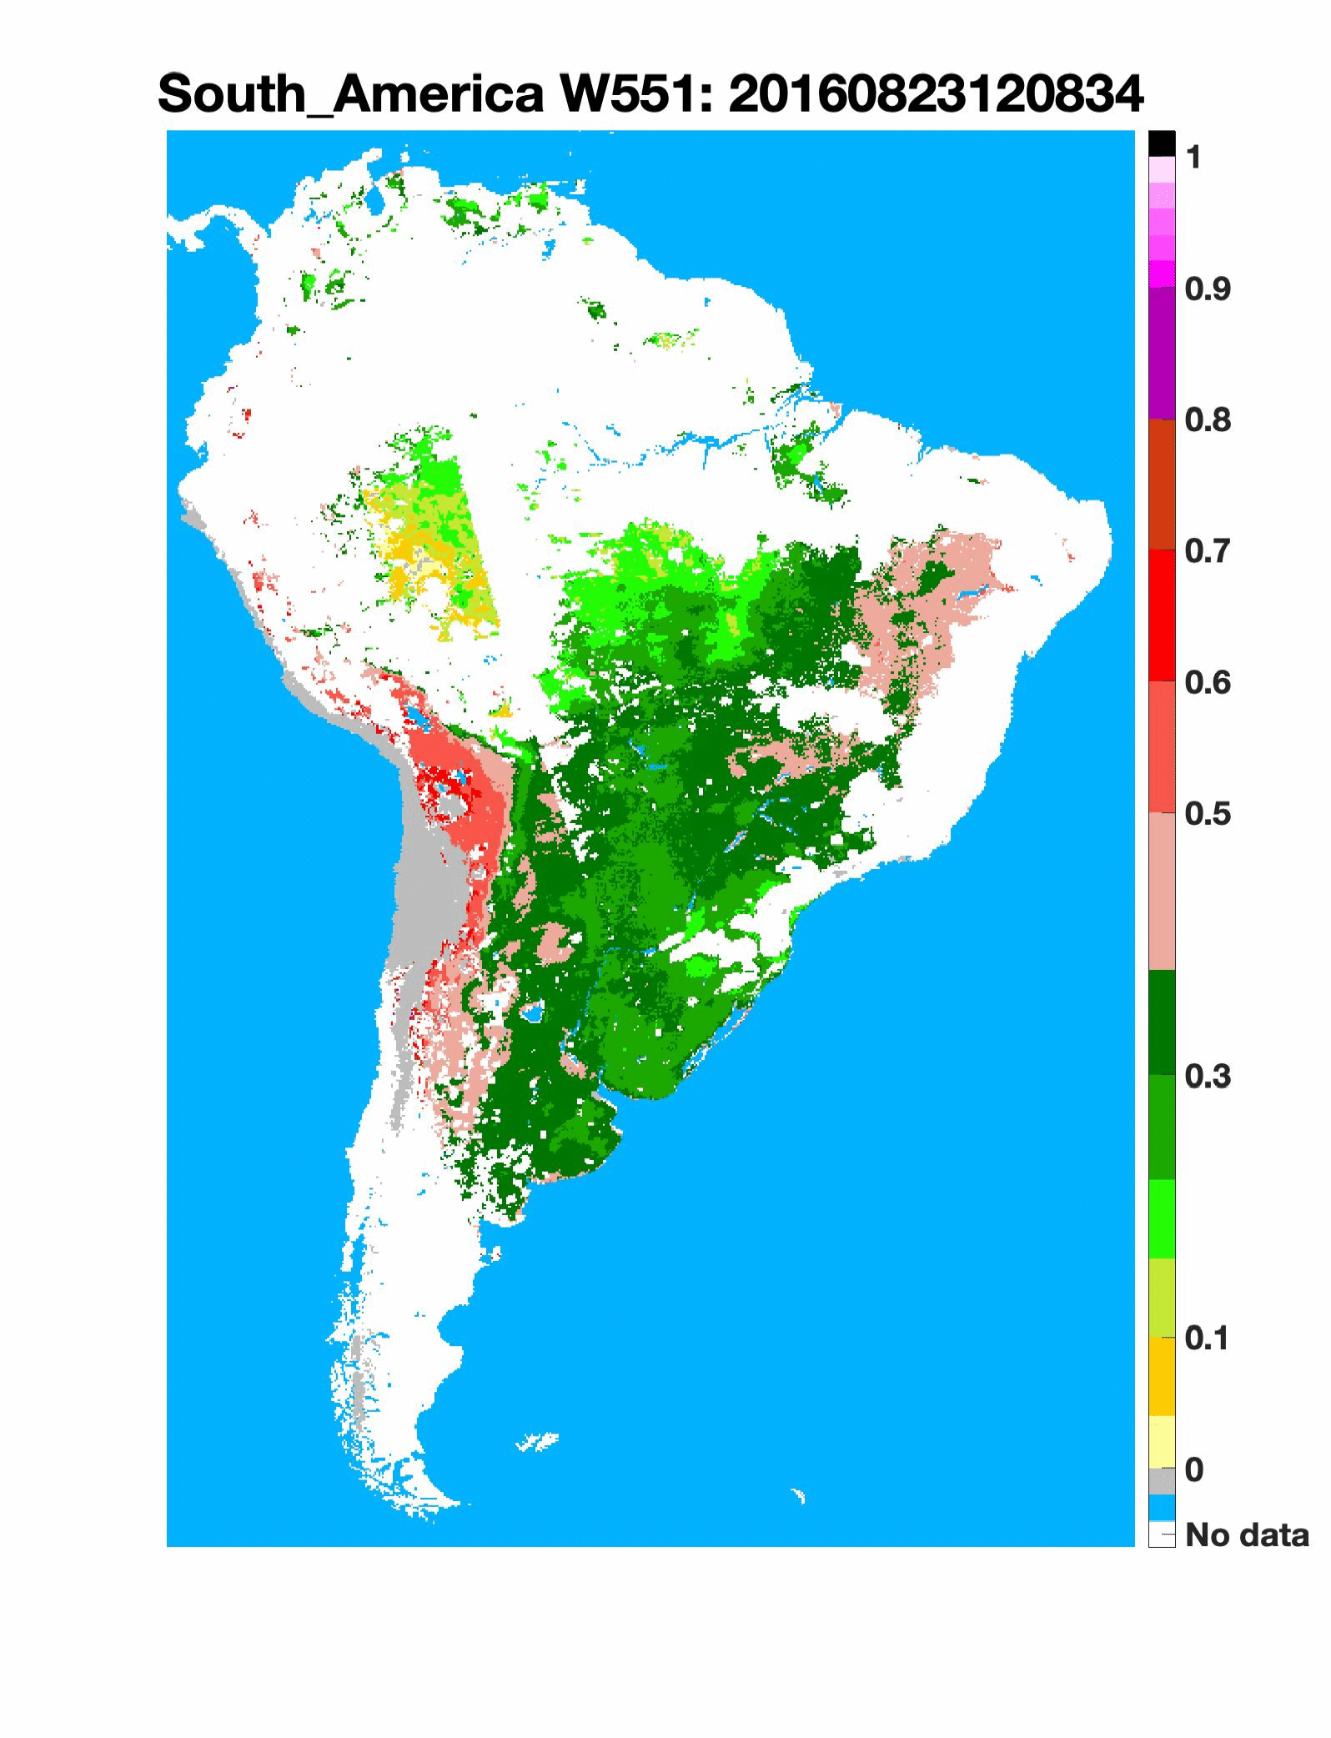
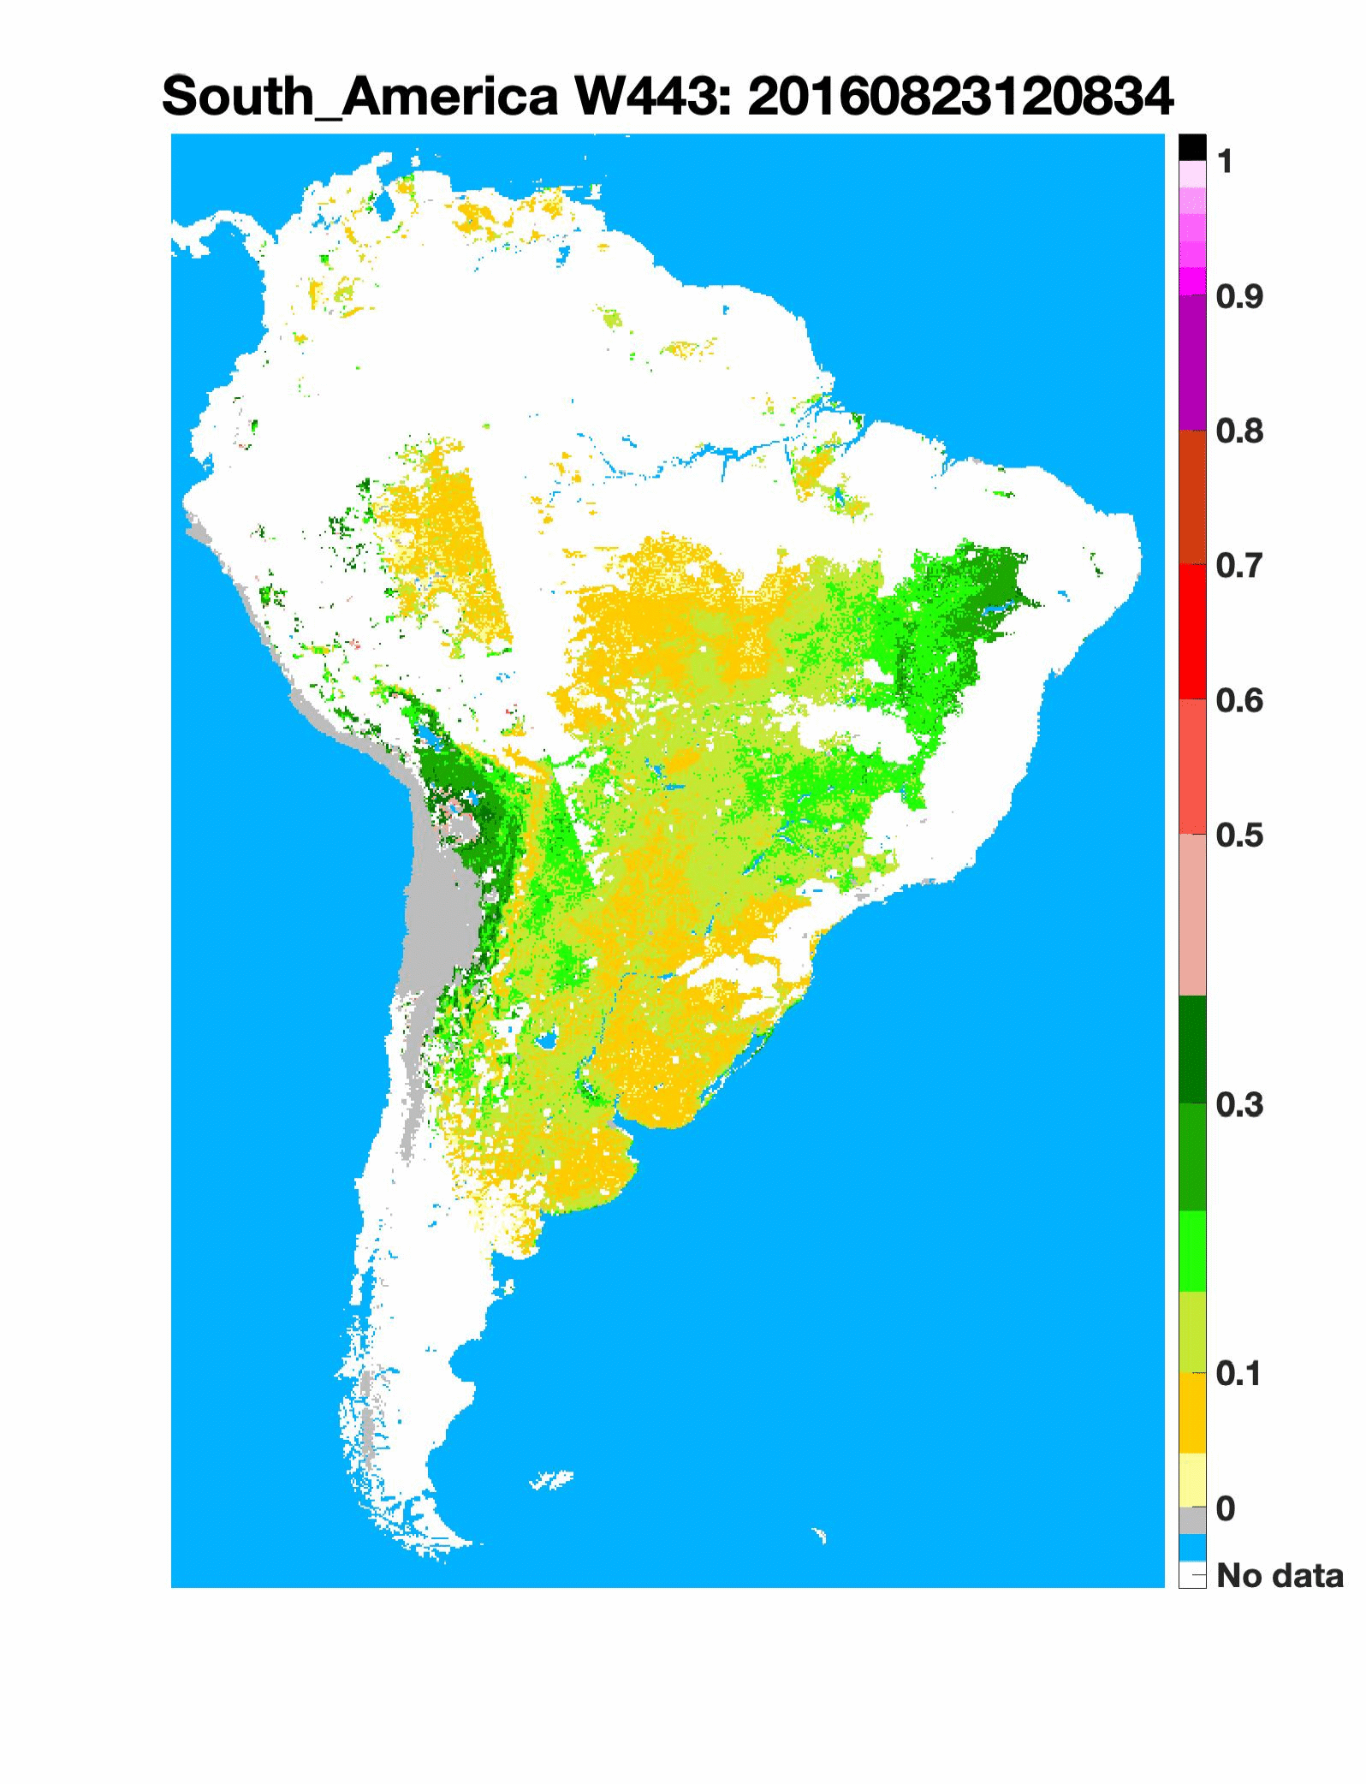
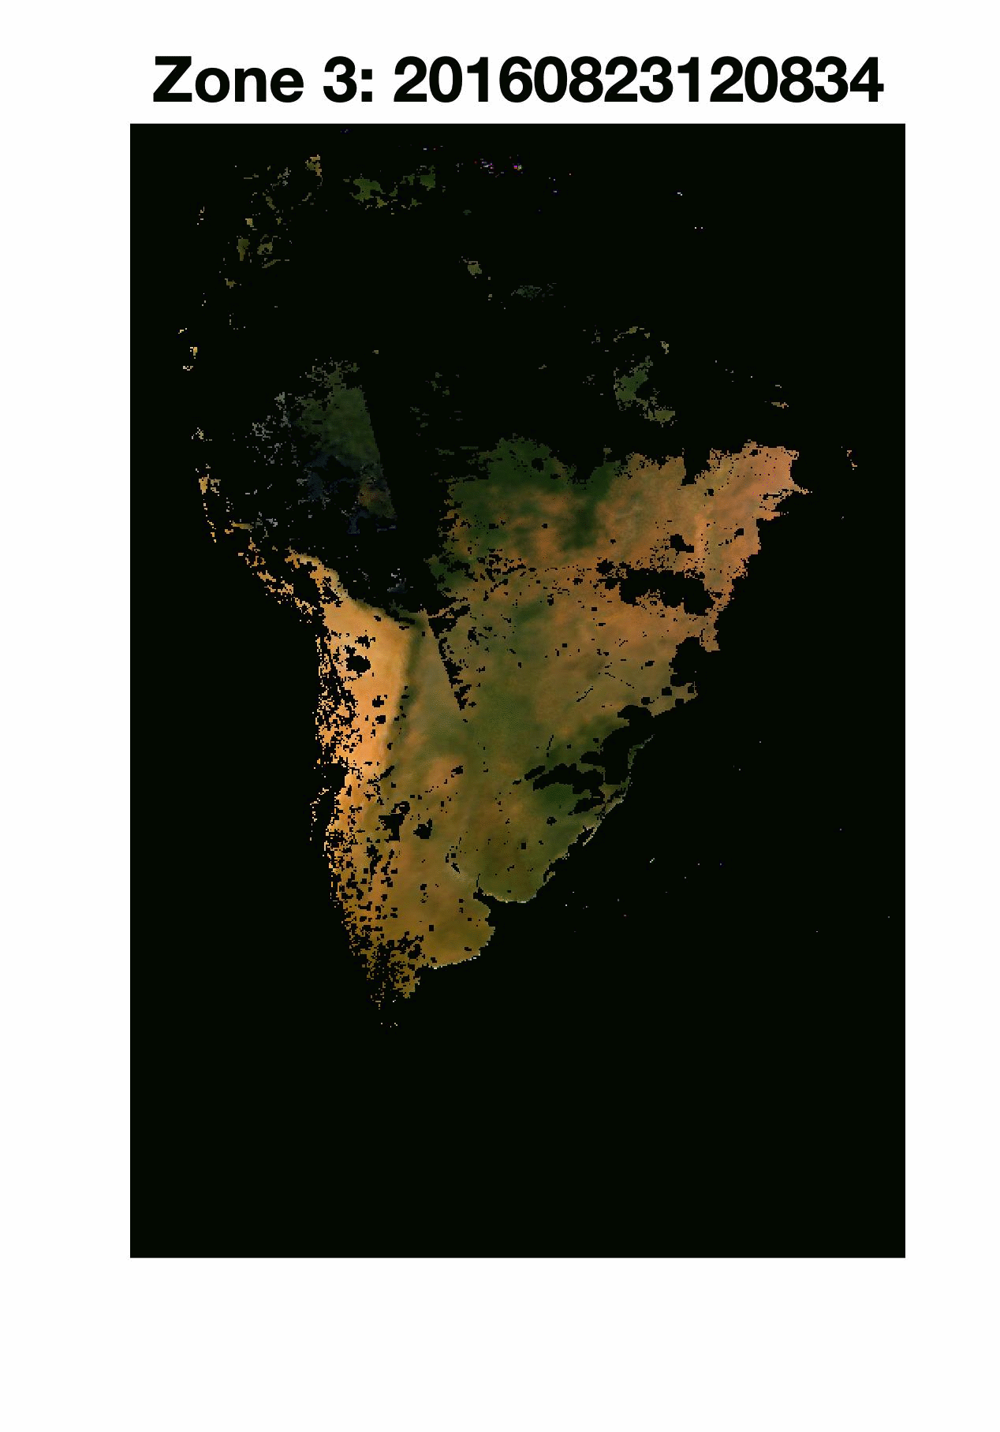
VERSION 2 EPIC VESDR SCATTERING COEFFICIENT
Scattering coefficient weakly sensitive to sun-sensor geometry
Mimics the shape and magnitude of typical leaf albedo spectra
Useful to monitor changes in leaf albedo
Spectrum of leaf scattering
EPIC scattering coefficient of Amazonian rainforest

Slide 14
VERSION 1 EPIC VESDR SCATTERING COEFFICIENT
Increase in CSC
Increase in DHR
Change in spectral DHR and Canopy Scattering Coefficient (CSC) of Congolese rainforest from November (wet season) to January (dry season)
LAI decreased from November (wet season) to January (dry season)
the lack of a decrease in vis DHR indicates an increase in leaf optics
Changes in Canopy Scattering Coefficient are caused by changes in leaf albedo
Sensitivity of Canopy Scattering Coefficient to (a) LAI; (b) SZA; (c) Chlorophyll concentration and (d) leaf Dry Matter content

Slide 15
SUMMARY
  Five new parameters have been developed and added to the V2 VESDR product
  All VESDR parameters and ancillary science data products are projected on 4 regional 10 km SIN grid. This significantly reduces distortion of parameter’s maps
  Operational VESDR algorithm has been finalized and ready to generate V2 VESDR product once v2 MAIAC product, input to the algorithm, will be available
  Algorithm performance evaluated on a limited set of data over South America suggests
    a better agreement with C6 MODIS LAI over equatorial forests
    new parameters follow regularities expected from theory

