Slide 1
Monitoring the calibration of the DSCOVR EPIC V3 L1b product using MODIS and VIIRS as a reference
Conor Haney, David Doelling, Wenying Su, Rajendra Bhatt, Ben Scarino, Arun Gopalan
DSCOVR EPIC and NISTAR STM
October 6-8, 2020 virtual meeting

Slide 2
ATO/DCC Ray-matching Overview
Grid both EPIC and MODIS/VIIRS pixels into a 0.25º grid cells from ±30º latitude
Identify MODIS or VIIRS granules within 15 minutes of an EPIC image
Spatially shift the EPIC image to best match the cloud features of the MODIS/VIIRS image based on R²
Match in viewing/solar geometry: ∆VZA<15º, ∆RZA<15º, ∆(Scat)<15º
Normalize by cosine SZA to remove SZA difference
Apply spatial homogeneity filter
Apply spectral band adjustment factor (SBAF) to take into account spectral response function differences
All-sky Tropical Ocean (ATO)
Ocean only
ATO-based SBAF
All ocean scene types, no glint
Pair 0.5º EPIC and MODIS grid cells
Deep Convective Cloud (DCC)
Land and ocean
DCC-based SBAF
MODIS/VIIRS 11 µm temperatures < 220K
Pair 0.25° EPIC and MODIS grid cells

Slide 3
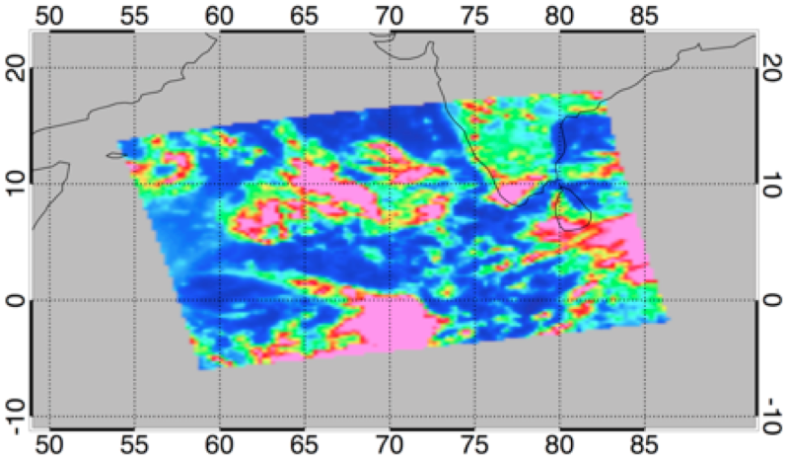
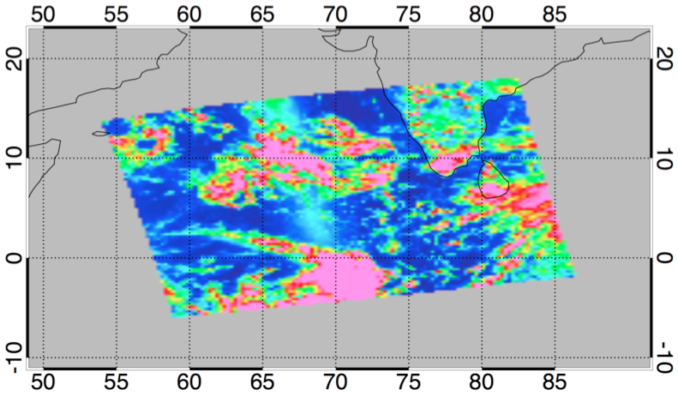
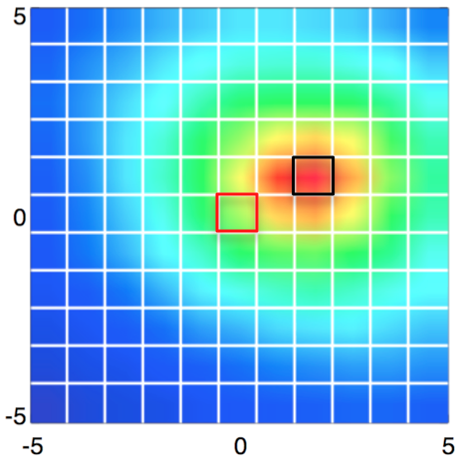
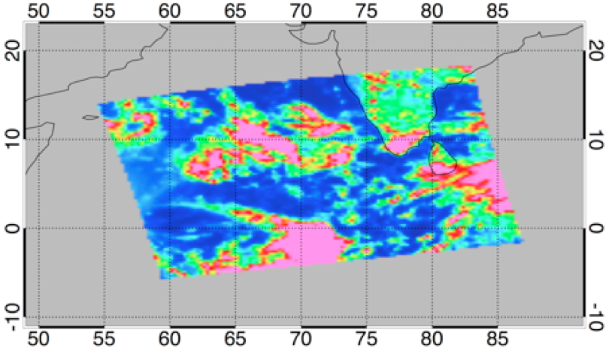
Navigation Correction Overview
E7 image, uncorrected
VIIRS-I1
Shift the EPIC image ±5 0.25º regions and find the shift that has the best R² correlation between the EPIC image and the MODIS/VIIRS granule.
E7 image, corrected
North
R² Field
Nominal navigation
Corrected navigation
East
Notes:
- R2 field: blue is closer to zero, red is closer to 1

Slide 4
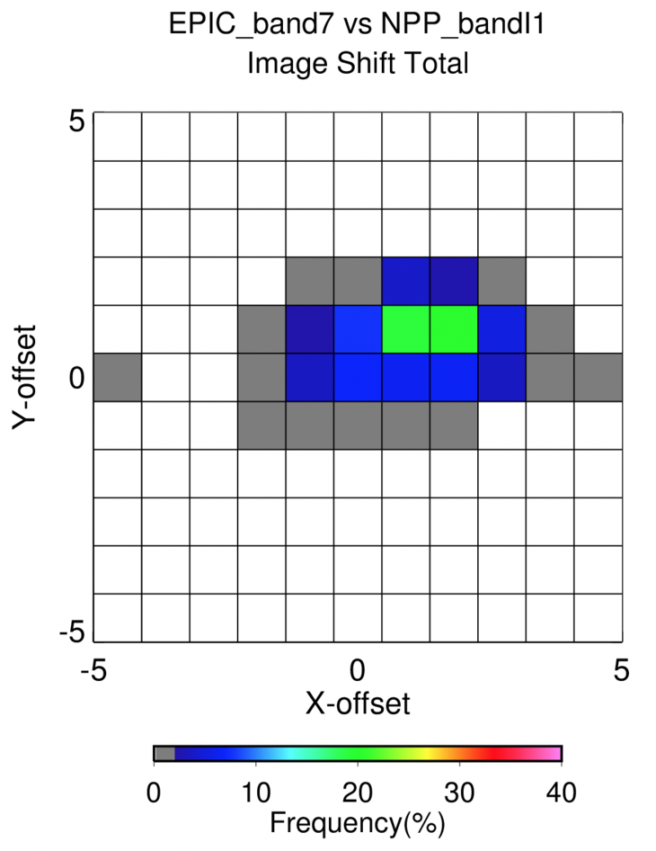
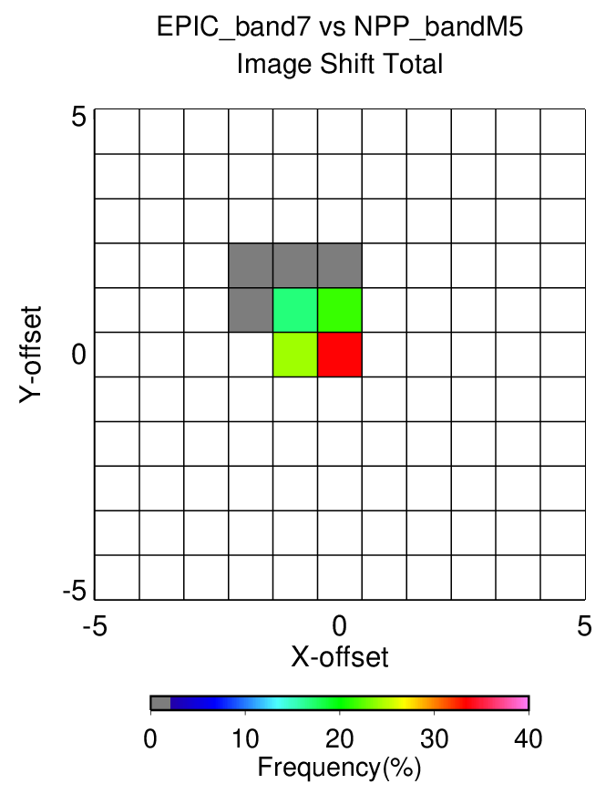
EPIC Image Shifts
V02
V03
Shift | V2 | V3
East-West | 31.8 ± 32.7 km | -11.5 ± 16.5km
North-South | 17.2 ± 19.7 km | 11.1 ± 15.2km
R² | 0.841±0.01 | 0.833 ±0.03
Navigation has improved dramatically going from V02 to V03

Slide 5
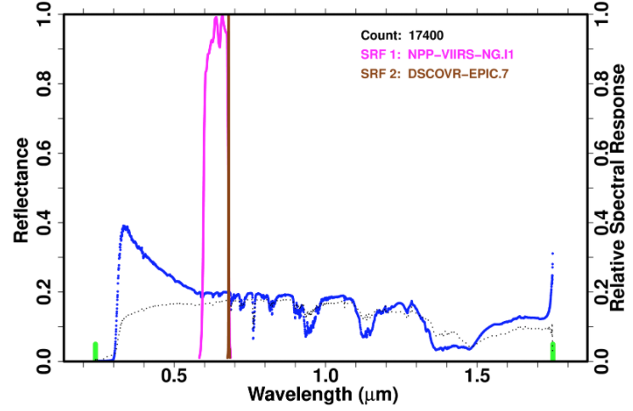
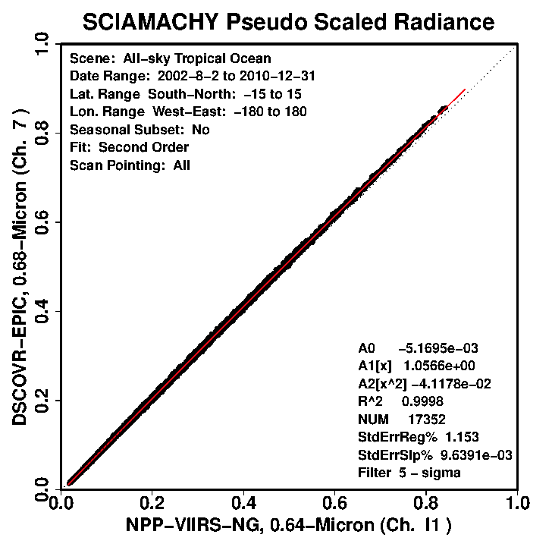
Spectral Band Adjustment Factor (SBAF)
All-sky tropical ocean (ATO) mean and sigma spectra from 17352 SCIAMACHY footprints
Apply 2nd order fit to the 17352 pseudo I1 and E7 ATO reflectance pairs
E7
A1
I1
M5
Channel reflectance
NPP-VIIRS I1 0.1960
EPIC E7 0.1985
SCIAMACHY-based hyper-spectral radiances are convolved with the EPIC and MODIS/VIIRS channel SRFs using the NASA-LaRC SCIAMACHY SBAF tool (https://satcorps.larc.nasa.gov/cgi-bin/site/showdoc?mnemonic=SBAF)
Perform SCIAMACHY pseudo-radiance pair regression on same Earth scene-types used in ATO and DCC ray-matching
Apply resulting coefficients to MODIS/VIIRS radiances

Slide 6
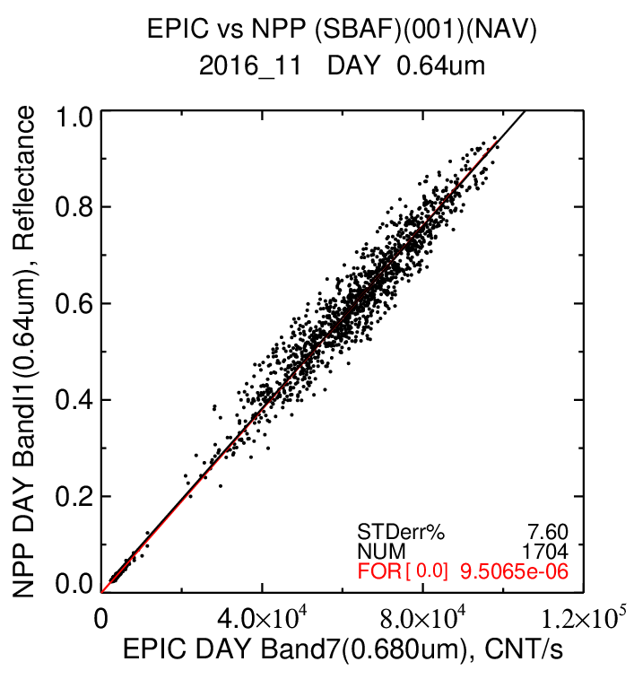
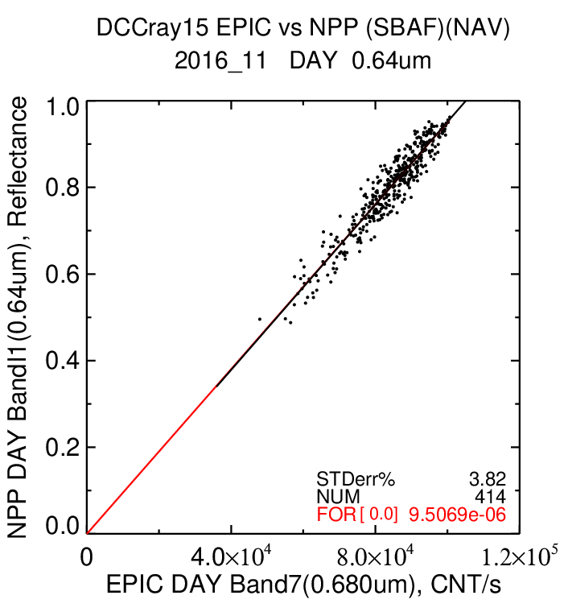
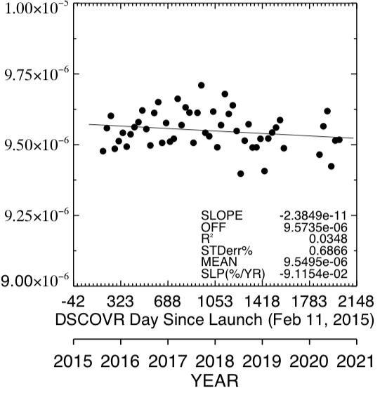
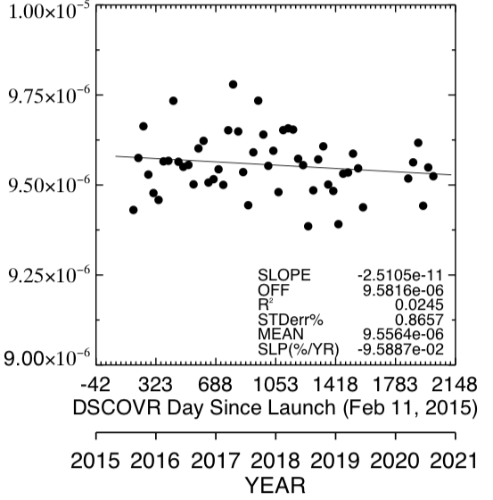
EPIC E7/NPP I1 (0.64µm)
November 2016
EPIC E7/NPP I1 (0.64µm)
November 2016
ATO
DCC
Linearly regress EPIC/NPP-VIIRS reflectance pairs on a monthly basis
ATO
DCC
Monitor the monthly EPIC gains over time and compute linear trend

Slide 7
Combine the Aqua-MODIS, NPP and N20 VIIRS based EPIC calibration gains
Perform ATO and DCC ray-matching between analogous EPIC and Aqua-MODIS, NPP-VIIRS, and N20-VIIRS channels
Radiometrically scale both NPP-VIIRS C1 and N20-VIIRS C2 to the Aqua-MODIS C6.1 calibration reference
Use ATO ray-matching, DCC invariant target (DCC-IT), and Libya-4 desert pseudo invariant calibration site (PICS) to transfer the Aqua-MODIS calibration to NPP-VIIRS and N20 VIIRS
Compare the monthly GOES-16 calibration gains from Aqua-MODIS and from NPP-VIIRS and N20-VIIRS that have been scaled to Aqua-MODIS
To demonstrate the validation method
Compare the monthly EPIC calibration gains from Aqua-MODIS and from NPP-VIIRS and N20-VIIRS that have been scaled to Aqua-MODIS

Slide 8
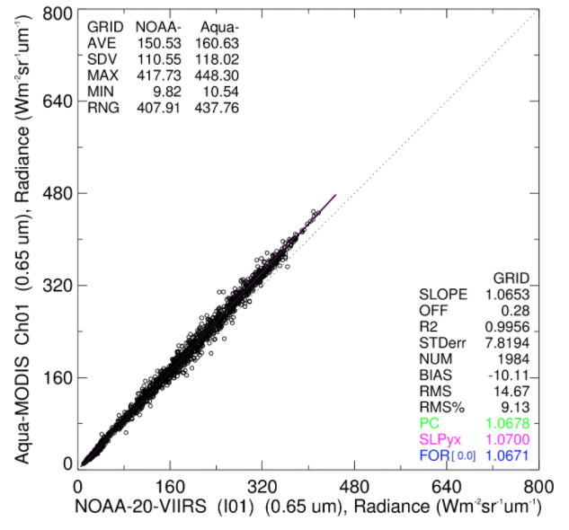
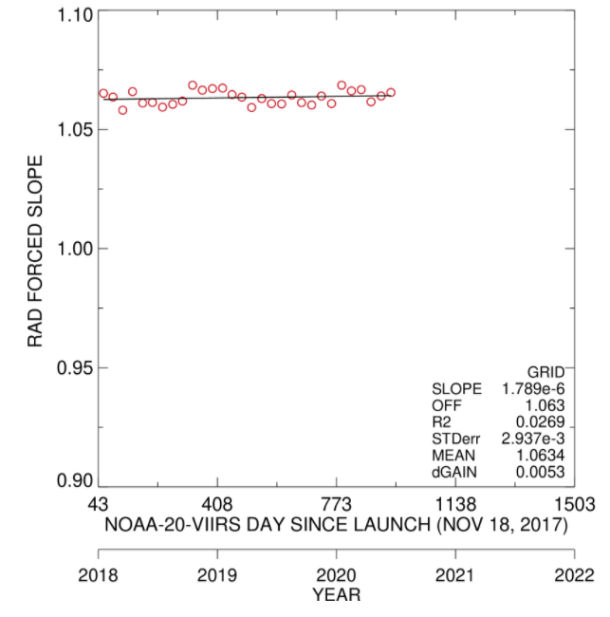
NOAA-20 VIIRS I1 and Aqua-MODIS B1 ATO-RM 0.64 µm inter-calibration
Coincident all-sky tropical ocean ray-matched (ATO-RM) radiance pairs
Dec 2018, scaling factor =1.0671
Dec 2018
The Aqua-MODIS C6.1 B1 and NOAA20-VIIRS C2 I01 calibration timeline difference is 1.0634

Slide 9
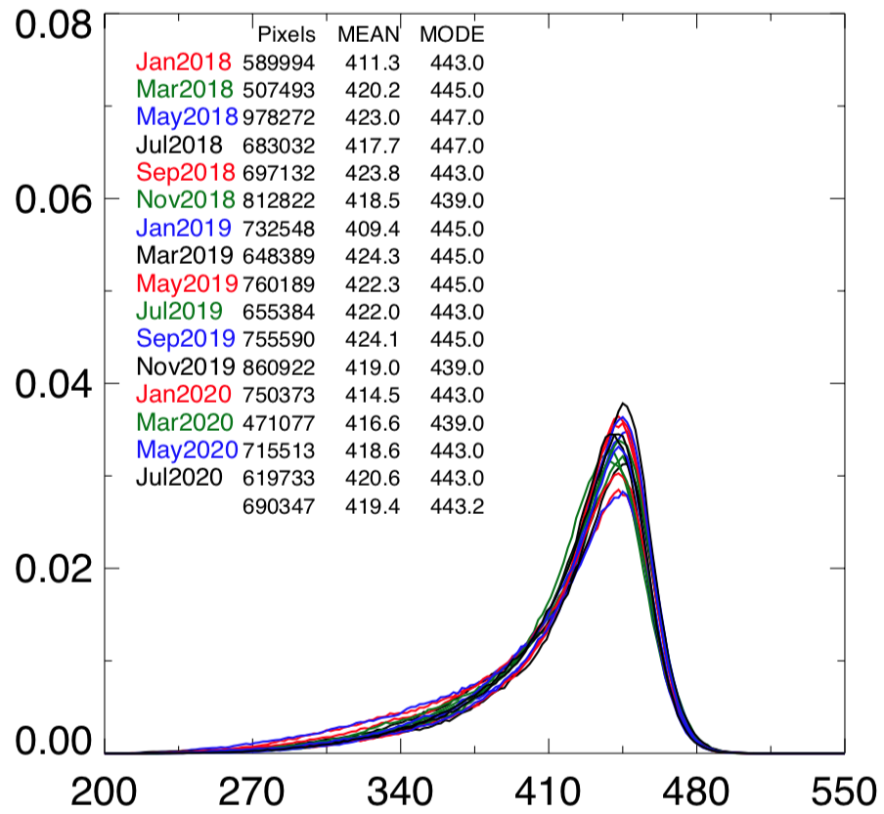
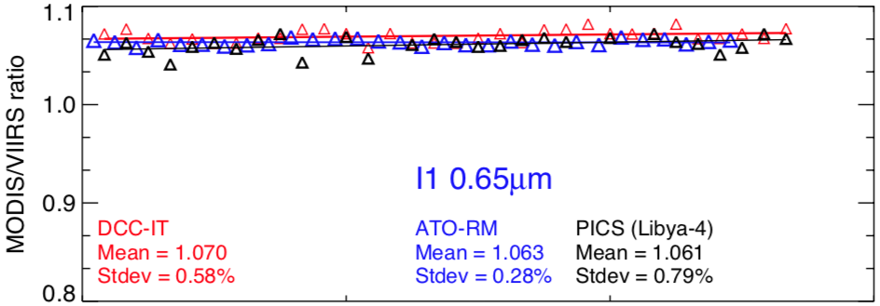
Comparison of Aqua-MODIS/N20-VIIRS inter-calibration methods
N20 VIIRS I01 Deep Convective Cloud (DCC) radiances, histogram all pixels with <205K
Frequency
All MODIS/N20 0.65µm scaling methods agree within 0.9%
DCC Pixel Radiance (Wm⁻²µm⁻¹sr⁻¹)
Ratio the N20-VIIRS and Aqua-MODIS DCC mode radiances to compute scaling factor

Slide 10
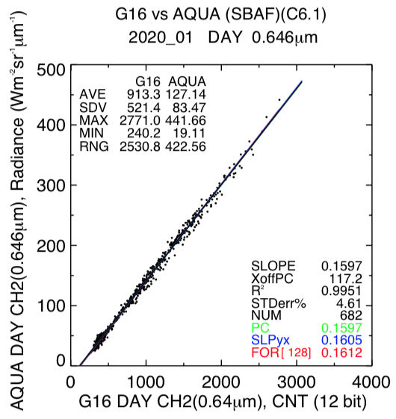
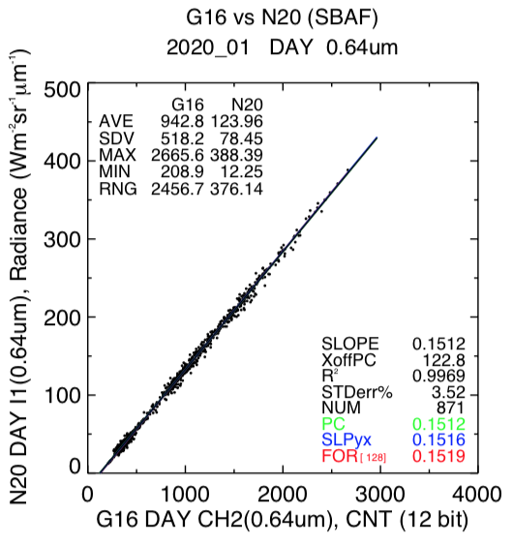
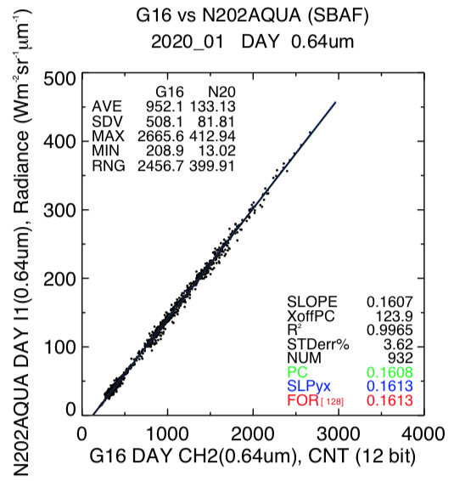
GOES-16/Aqua and GOES-16/N20 January 2020 scatter plot comparison
GOES-16/Aqua
Gain=0.1612
GOES-16/N20
Gain=0.1519
GOES16/N20 scaled to Aqua
Gain=0.1613
• The G16/N20 gain is 0.1519 and is -5.8% lower when compared to the Aqua gain of 0.1612
• After apply the N20/Aqua radiometric scaling factor, the Aqua and N20(scaled to Aqua) gain difference is +0.1%
• We can now use N20(scaled to Aqua) as the forward processing imager and maintain the Aqua calibration reference

Slide 11
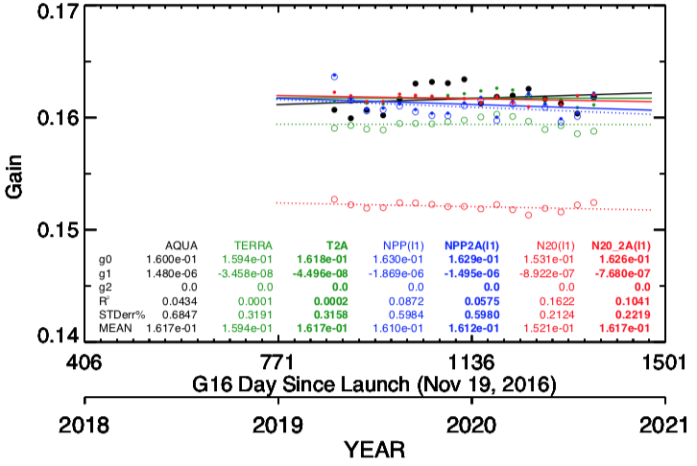
GOES-16 0.64µm ATO-RM gain comparison
G16 | unscaled | Scaled to Aqua
Aqua | 0.1617 | 0.1617
Terra | 0.1594 (-1.4%) | 0.1617 (0.0%)
NPP | 0.1610 (-0.4%) | 0.1612 (-0.3%)
N20 | 0.1521 (-5.9%) | 0.1617 (0.0%)
Compare dotted line (unscaled) with solid line (scaled to Aqua) with Aqua (solid black line)
• The GOES-16 calibration gain is within 0.3% of Terra-MODIS, NPP-VIIRS, and N20-VIIRS after radiometric scaling
• The Aqua/N20 ATO-RM calibration difference was 1.0634 and very close to the 5.9% based on GOES-16

Slide 12
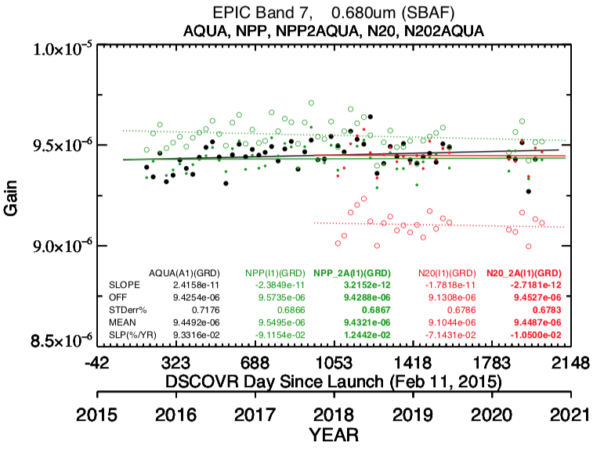
EPIC 0.68µm ATO-RM gain comparison
Compare dotted line (unscaled) with solid line (scaled to Aqua) with Aqua (solid black line)
E7 | unscaled | Scaled to Aqua
Aqua | 9.4492 | 9.4492
NPP | 9.5495 (+1.1%) | 9.4321 (-0.2%)
N20 | 9.1044 (-3.6%) | 9.4487 (0.0%)
• The EPIC calibration gains are within 0.2% of NPP-VIIRS, and N20-VIIRS after radiometric scaling
• The Aqua/N20 ATO-RM calibration difference was 1.0634 (radiance based) and 1.0376 (reflectance based) and agrees with 3.6% based on EPIC reflectances

Slide 13
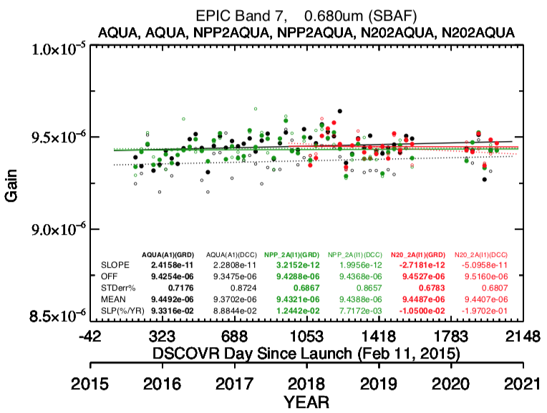
EPIC 0.68µm ATO-RM and DCC-RM gain comparison
Compare dotted line (DCC-RM) with solid line (ATO-RM)
NPP and N20 I1 bands shown
E7 | ATO-RM | DCC-RM
Aqua B1 | 9.4492 | 9.3702 (-0.8)
NPP I1 | 9.4321 (-0.2%) | 9.4388 (-0.1%)
NPP M5 | 9.4512 (0.0%) | 9.4377 (-0.1%)
N20 I1 | 9.4487 (0.0%) | 9.4407 (-0.1%)
N20 M5 | 9.4561 (+0.1) | 9.4443 (0.0%)
• The EPIC calibration gains are within 0.2% based on either ATO-RM or DCC-RM methods, or based on I1 or M5 bands, except for Aqua-MODIS DCC-RM
NPP and N20 have been scaled with Aqua

Slide 14
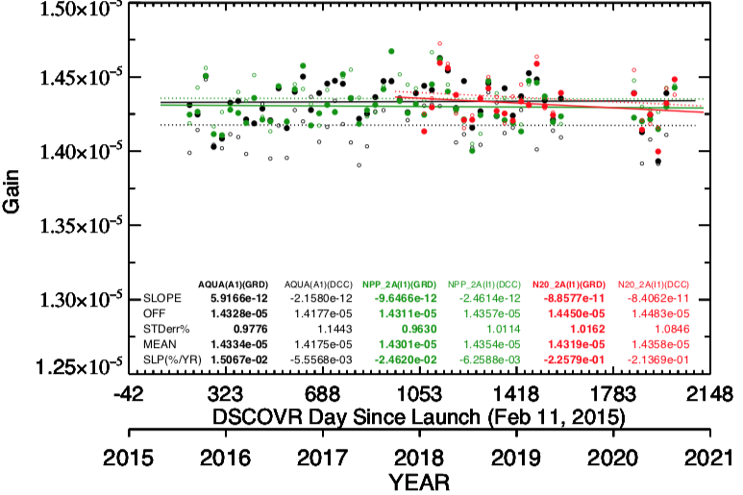
EPIC 0.78µm ATO-RM and DCC-RM gain comparison
E10 scaled to Aqua-MODIS B1, since B2 saturates for bright scenes
E10 | ATO-RM | DCC-RM
Aqua B1 | 1.4334 | 1.4175 (-1.1%)
NPP I1 | 1.4301 (-0.2%) | 1.4357 (+0.2)
NPP M5 | 1.4333 (-0.0%) | 1.4365 (+0.2%)
NPP M7
N20 I1 | 1.4319 (-0.1%) | 1.4358 (+0.2%)
N20 M5 | 1.4327 (-0.0%) | 1.4364 (+0.2%)
N20 M7
• The EPIC calibration gains are within 0.2% based on either ATO-RM or DCC-RM methods, or based on I1 or M5 bands, except for Aqua-MODIS DCC-RM
NPP and N20 have been scaled with Aqua

Slide 15
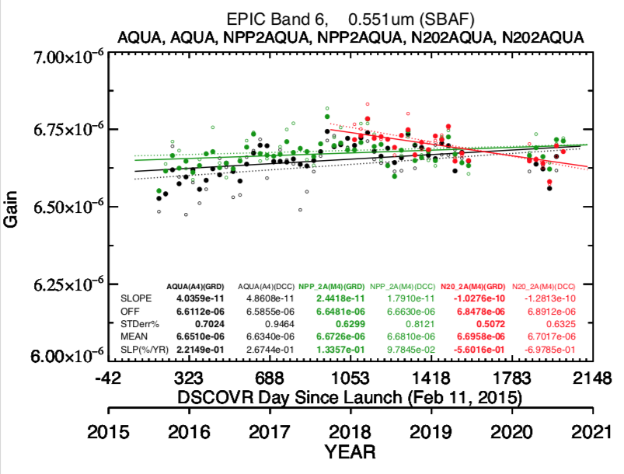
EPIC 0.55µm ATO-RM and DCC-RM gain comparison
E6 | ATO-RM | DCC-RM
Aqua B4 | 6.6510 | 6.6340 (-0.3%)
NPP M4 | 6.6726 (+0.3%) | 6.6810 (+0.5%)
N20 M4 | 6.6598 (+0.1%) | 6.7017 (+0.8)
• The EPIC calibration gains are within 0.8%
The Aqua/N20 radiometric scaling had a downward trend and is being looked at
NPP and N20 have been scaled with Aqua

Slide 16
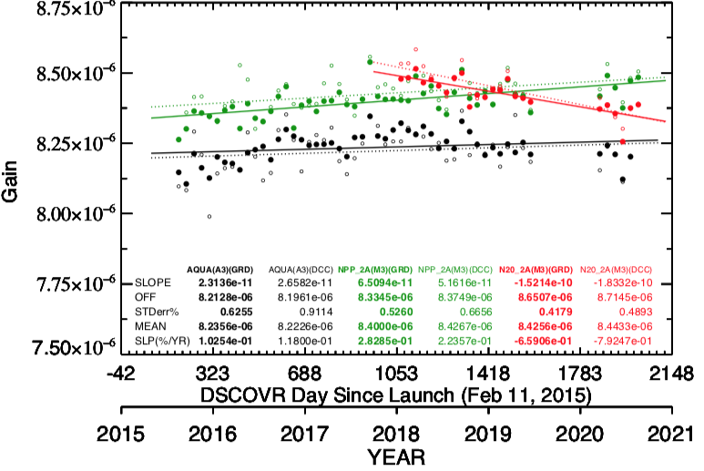
EPIC 0.44µm ATO-RM and DCC-RM gain comparison
E5 | ATO-RM | DCC-RM
Aqua B4 | 8.2356 | 8.2226 (-0.2)
NPP M4 | 8.4000 (+2.0%) | 8.4267 (+2.3%)
N20 M4 | 8.4256 (+2.3%) | 8.4433 (+2.5%)
• The EPIC calibration gains are within 2.5%
The Aqua/N20 radiometric scaling had a downward trend and is being looked at
Note the increasing calibration drift with shorter wavelengths
NPP and N20 have been scaled with Aqua

Slide 17
Conclusions
EPIC was calibrated against the Aqua-MODIS C6.1 calibration reference
NPP-VIIRS and N20-VIIRS were first radiometrically scaled to Aqua-MODIS
EPIC calibration gains based on NPP and N20 were within 0.2% for bands 7 and 10
The ATO-RM and DCC-RM calibration methods were within 0.3% for EPIC/NPP-VIIRS and EPIC/N20-VIIRS
The table below contains the EPIC calibration coefficients by band, the ± provides the range of gains by calibration method or by reference sensor
There is a very slight calibration trend for EPIC shorter wavelength bands
The 2020 EPIC observations are consistent with the 2015-2019 observations
Band Pair | GM 2018 gains | ATO-RM gains | Gain range | ATO_RM/GM | Trend %/year
E5/A3 | 8.34e-6 | 8.2356e-6 | ±2.5% | -1.3% | 0.1 - 0.3
E6/A4 | 6.66e-6 | 6.6726e-6 | ±0.8% | +0.2% | 0.1 - 0.2
E7/A1 | 9.30e-6 | 9.4492e-6 | ±0.2% | +1.6% | 0.1
E10/A1 | 1.435e-5 | 1.4334e-5 | ±0.2% | -0.1% | <0.05

