Slide 1
DSCOVR EPIC and NISTAR STM
October 6-8, 2020 (Virtual)
CONOPS for a Lunar observatory vs EPIC/DSCOVR
Nick Gorkavyi (SSAI)
The DSCOVR/EPIC imager observs the entire sun-illuminated Earth from the Lagrange L1 point. The L1 location, however, restricts the phase angles to ~2º-12º, a nearly backscattering direction, depriving the observer of any information about the bidirectional surface reflectance factor (BRF) and/or a cloud/aerosol phase function. A compact, lightweight, autonomic camera on the Moon’s surface offers unique opportunity to overcome these limitations and advance Earth science in ways difficult to predict.
Reference
A. Marshak, N. Krotkov, N. Gorkavyi, S. Marchenko, A. Vasilkov, Y. Knyazikhin, M. Kowalewski, O. Torres, M. DeLand, M. Ramsey, P. Christensen, V. Realmuto “Whole Earth imaging from the Moon South Pole (EPIC-Moon)” White Paper for ROSES-2021 (Artemis program)

Slide 2
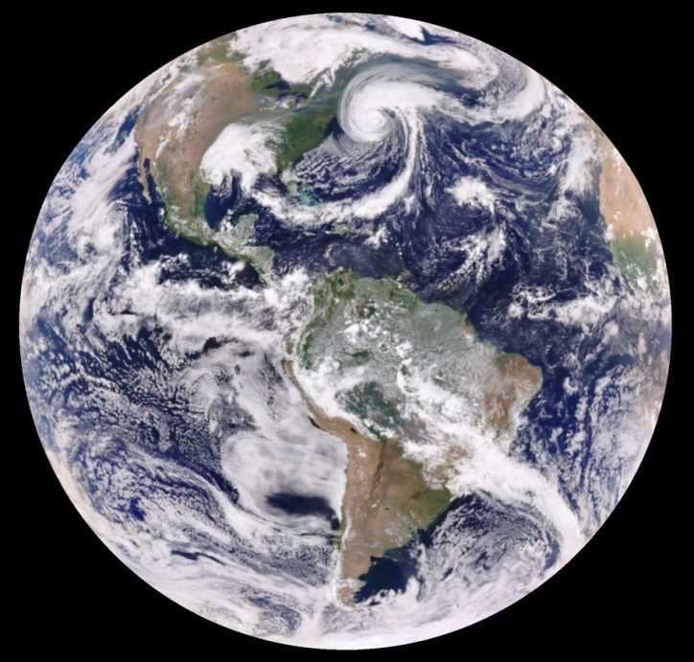
Seasonal variation of Earth from EPIC view
June 22
September 22, 2020
December 22
Figure 1. The phase angle or Solar-Earth-Vehicle (SEV) will be same for all seasons and for all illuminated surface of the Earth.

Slide 3
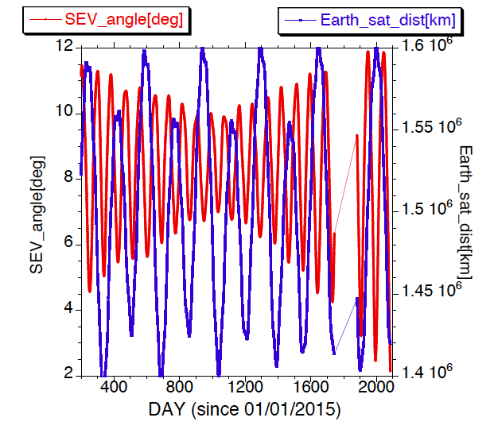
Phase angle or Solar-Earth-Vehicle (SEV)
Phase angle
or SEV
Figure 2. Solar-Earth-Vehicle
(SEV) for DSCOVR/EPIC vary from 2 to 12 deg.

Slide 4
Sun-Earth-Moon-system
N
N
R=(362.6–406.7)*10³ km
SIDE VIEW
1.5º
23.4°
EPIC
5.145º
150*10⁶ km
Synodic lunar month 29.53 day
Eccentricity
=0.0549
TOP VIEW
EPIC
E
A
3.7 day
D
Fig. 3. General view of the
Sun-Earth-Moon system
B
C

Slide 5
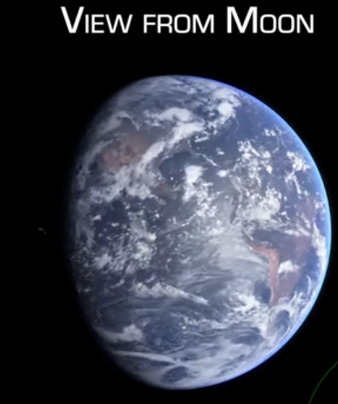
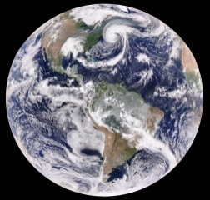
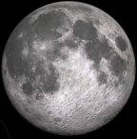
Phase angle or Solar-Earth-Vehicle (SEV)=45 deg
TOP VIEW
Earth
SEV=45°
Moon
Point B: 3.7 day after new Moon = full Earth
Figure 4. Top view and a view from Moon for phase angle 45 deg.
Credit for view from Moon: James O’Donoghue and PhysicsJ
“How Earth looks from the Moon… during April 2020”
https://www.youtube.com/watch?v=eV1ZXm3MH6I

Slide 6
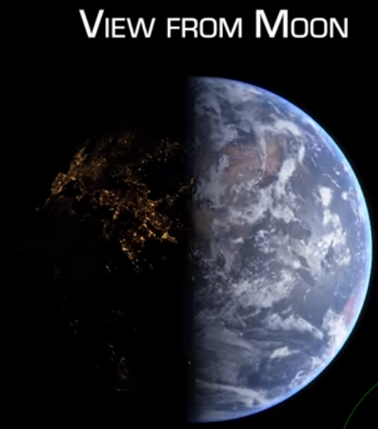
Phase angle or Solar-Earth-Vehicle (SEV)=90 deg
TOP VIEW
SEV=90°
Point C: 7.4 day after new Moon
Figure 5. Top view and a view from Moon for phase angle 90 deg. Adding TIR camera would allow continuous 24 hour whole Earth observations.
Credit for view from Moon: James O’Donoghue and PhysicsJ

Slide 7
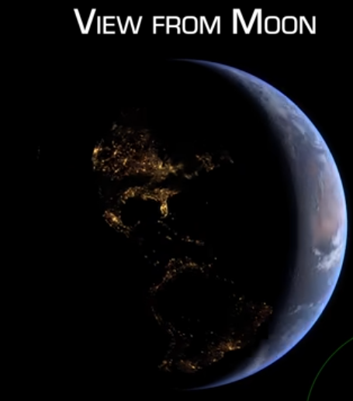
Phase angle or Solar-Earth-Vehicle (SEV)=135 deg
TOP VIEW
SEV=135°
Point D: 11.1 day after new Moon
Figure 6. Top view and a view from Moon for phase angle 135 deg.
Credit for view from Moon: James O’Donoghue and PhysicsJ

Slide 8
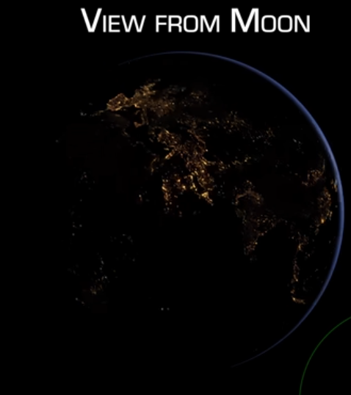
Phase angle or Solar-Earth-Vehicle (SEV)=180 deg
TOP VIEW
SEV=180°
Point E: 14.8 day after new Moon = full Moon
Figure 7. Top view and a view from Moon for phase angle 180 deg.
Credit for view from Moon: James O’Donoghue and PhysicsJ

Slide 9
180°
SEV for Moon
Observatory
90°
EPIC SEV
angular range
0°
0 7 14 21 28 Days
Fig.8 Phase angle or Solar-Earth-Vehicle angle for any daylight Earth’s object
from the Artemis location near Moon South Pole during lunar month,
compared to the EPIC’s 2º-12º yearly range.

Slide 10
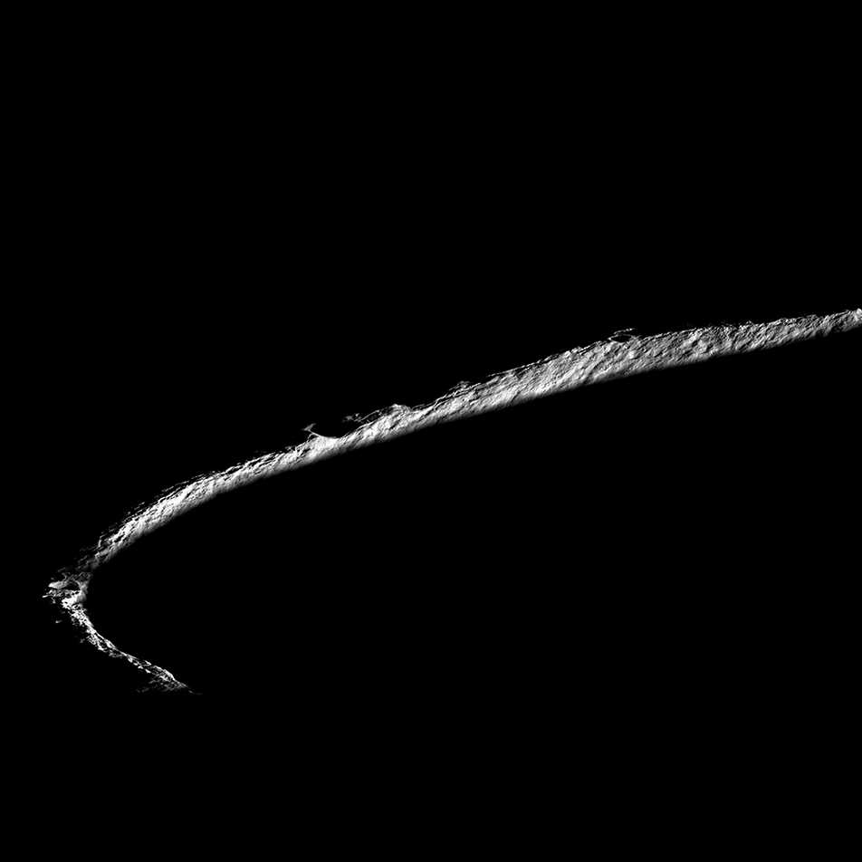
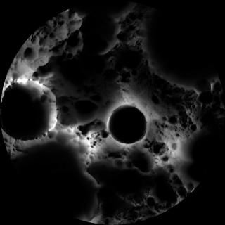
Lunar south pole
Rim of Shackleton crater
(NASA/GSFC/Arizona State University)
Three points on the rim remain
collectively sunlit for more than
90% of the year
S
20 km
Shackleton crater

Slide 11
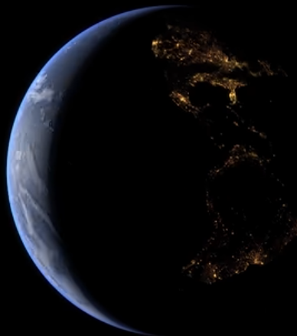
S
N
The Sun will be under horizon
~ 10% of the year
Figure 9. A view from Lunar south pole. For observer in equatorial lunar area the Earth will be in the zenith. (Photo of surface of the Moon: NASA/Apollon; View from Moon: James O’Donoghue)

Slide 12
Earth science goals for a Lunar observatory:
The combination of UV-TIR imaging from the lunar surface will allow:
comprehensive (both in time and space, compared to LEO) whole-globe monitoring of transient volcanic and aerosol clouds (smoke, dust), including the strategically important for climate studies polar regions not covered by GEO missions;
simultaneous imaging of the day and night parts (thus, the twilight zone);
better detection of circum-polar, high-altitude clouds (PMC) via the whole-Earth limb imaging;
subpixel image processing, allowing ~1 km vertical resolution of stratospheric aerosol limb profiles synergistically with ESD LEO missions: SNPP/OMPS-LP and ISS/SAGE-III;
monitoring of the vegetation characteristics and plant physiology (BRF), as well as vegetation stress and evapotranspiration (TIR channel), thus contributing to the global carbon cycle studies;
better (full phase-angle integrated) surface albedo estimates.

Slide 13
Lunar environment goals for a Lunar observatory:
The lunar dust exosphere is an important factor for the long-term stay of astronauts on the Moon, as well as for the functioning of scientific equipment on the moon surface and orbiters. Telescopic limb observations of the scattering of sunlight (or starlight) from a lunar dust cloud should help build a 3D model of the lunar dust exosphere.
Using the Earth's atmosphere as a detector, the EPIC-Moon imaging of night-side as well as limb of the Earth will detect atmospheric impacts (either by a flash or dispersion of meteoritic dust clouds) from the potentially threatening small (<10 m) asteroids in the circum-Earth space, thus improving the current highly uncertain estimates.

