Slide 1
DSCOVR EPIC & NISTAR Science Team Meeting,
Telecon, Oct 6-8, 2020
EPIC L1a status update
Gavin McCauley, Alexander Cede

Slide 2
L1a processing steps
This talk focuses on the dark correction and detector performance.
No updates to stray light corrections since last STM (Sep 2019).
See Huang’s talk for updates to UV flat field correction.
Processing step | Average impact | Affected pixels impact
Dark correction | Moderate | Extreme
Enhanced pixel detection | Small | Large
Read wave correction | Small | Small
Latency correction | Moderate | Significant
Non-linearity correction | Small | Small
Temperature correction | Small | Small
Conversion to count rates | Small | Small
Flat fielding | Significant | Large
Stray light correction | Significant | Large
Conversion to radiances* | Significant | Significant
* Not done by SciGlob

Slide 3
L1a Processor
Input Updates
Submitted L1a processor version 16, incorporated into v03
Includes one flat field adjustment from Huang
Also includes a backfix in one of the processing steps, which was needed due to a newer version of the python/numpy module:
Notes:
Submitted level 1a processor version 16 that includes backfix

Slide 4
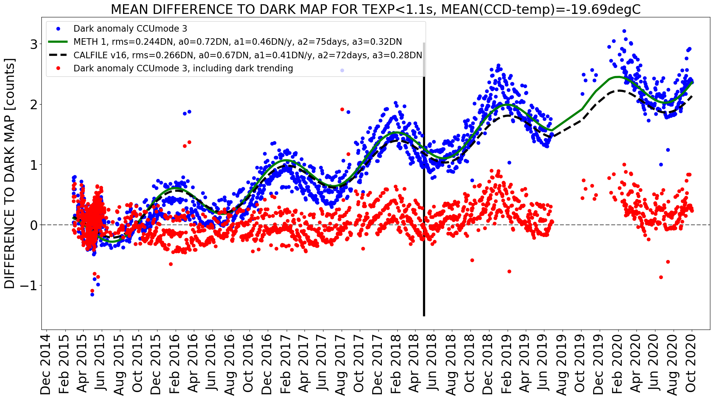
Dark count
Characterization
Measured dark anomaly (blue points) represents difference between in-flight darks and pre-launch dark characterization.
Red data points are residuals between measured dark anomaly (blue) and CALFILE V16 fit.
Previous versions of the dark rate map implemented in v01 of the L1a differed from the weekly measured dark count exhibiting a seasonal cycle and drift (blue).
Seasonal cycle and linear drift were characterized (green and black dashed) and used to improve dark rate correction for v02 and v03 of L1a. The performance of the characterization is given by the difference between latest dark rate map and weekly measured dark count (red).
However, this characterization really began to break down as 2020 data came in. So…
Notes:
Dark_Trending_FIT1_FITv16

Slide 5
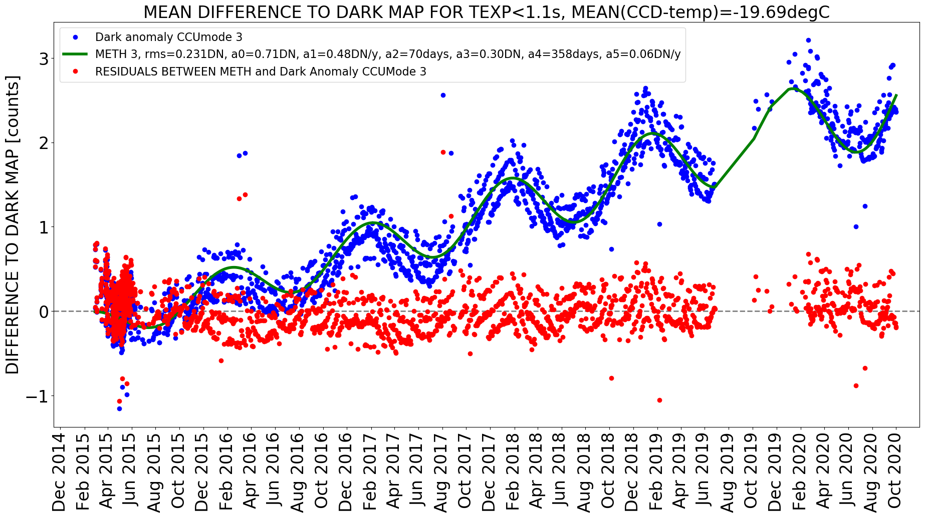
Dark count
Characterization
Measured dark anomaly (blue points) represents difference between in-flight darks and pre-launch dark characterization.
Red data points are residuals between measured dark anomaly (blue) and CALFILE V16 fit.
Further refinement to the characterization improved the performance, particularly in the two most recent peaks (including 2020 data).
The difference between the methods on this slide and the last are illustrated above: the sinusoidal is given free period and linear amplitude in time.
Notes:
Dark_Trending_FIT3_RESIDUAL

Slide 6
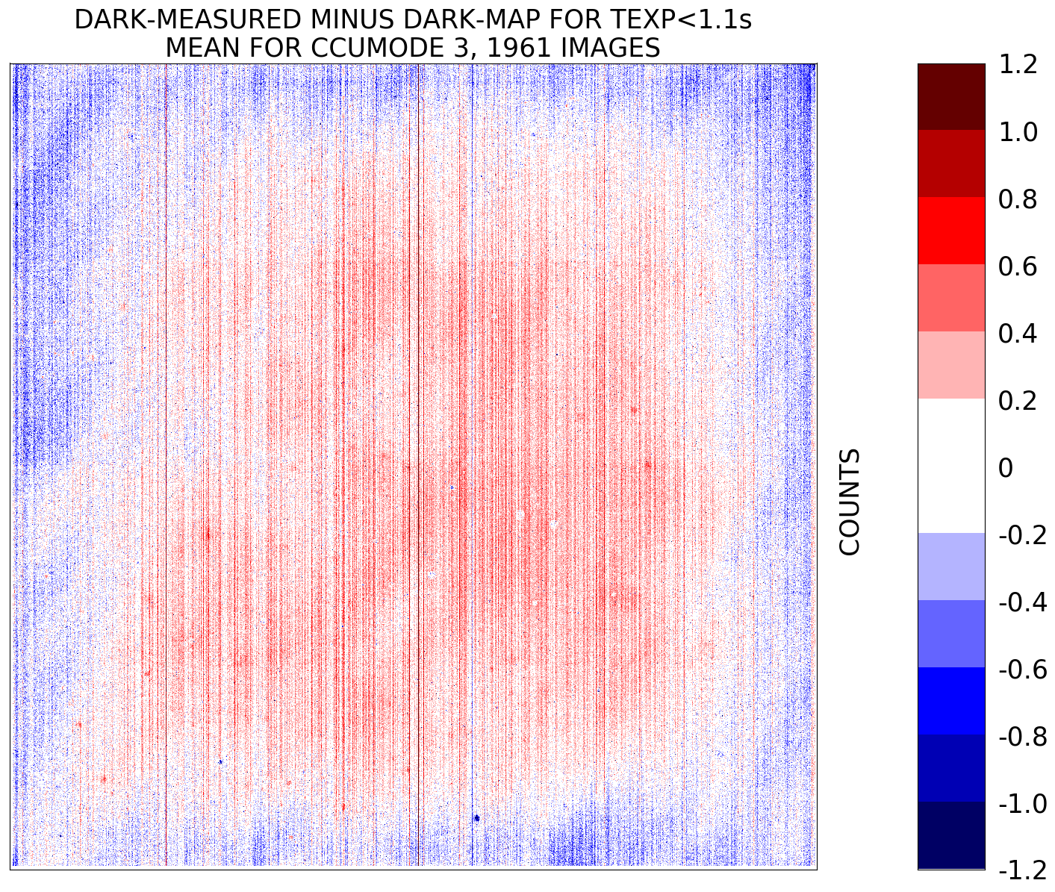
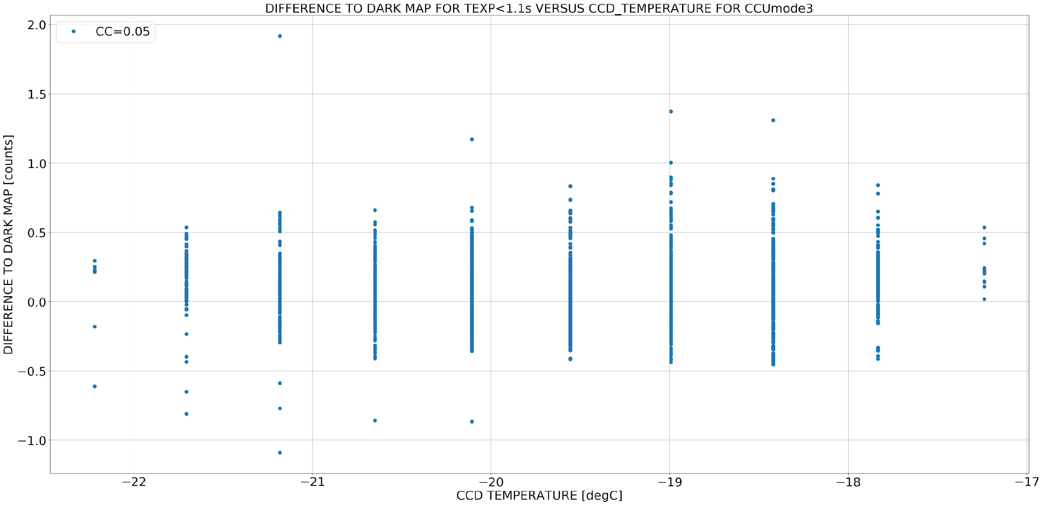
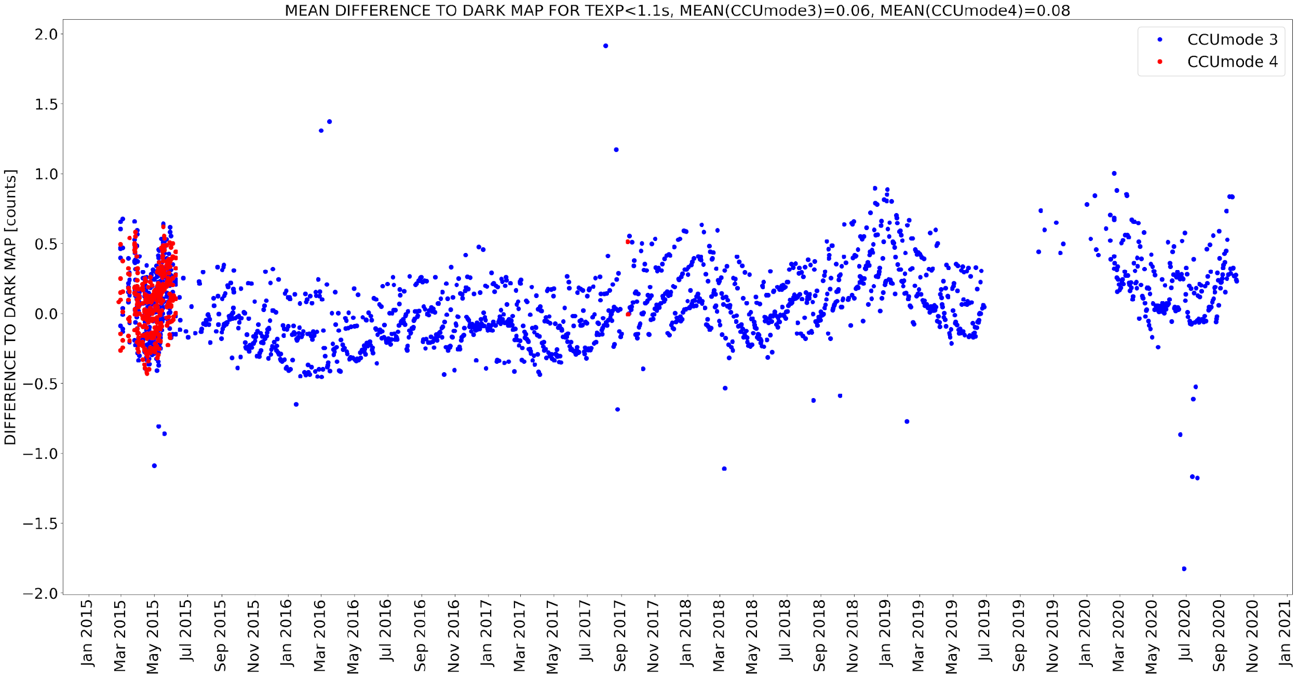
V3 Dark count
correction results
Notes:
Dark_DIFF2MAP-TEMP, Dark_m3, Dark_DIFF2MAP

Slide 7
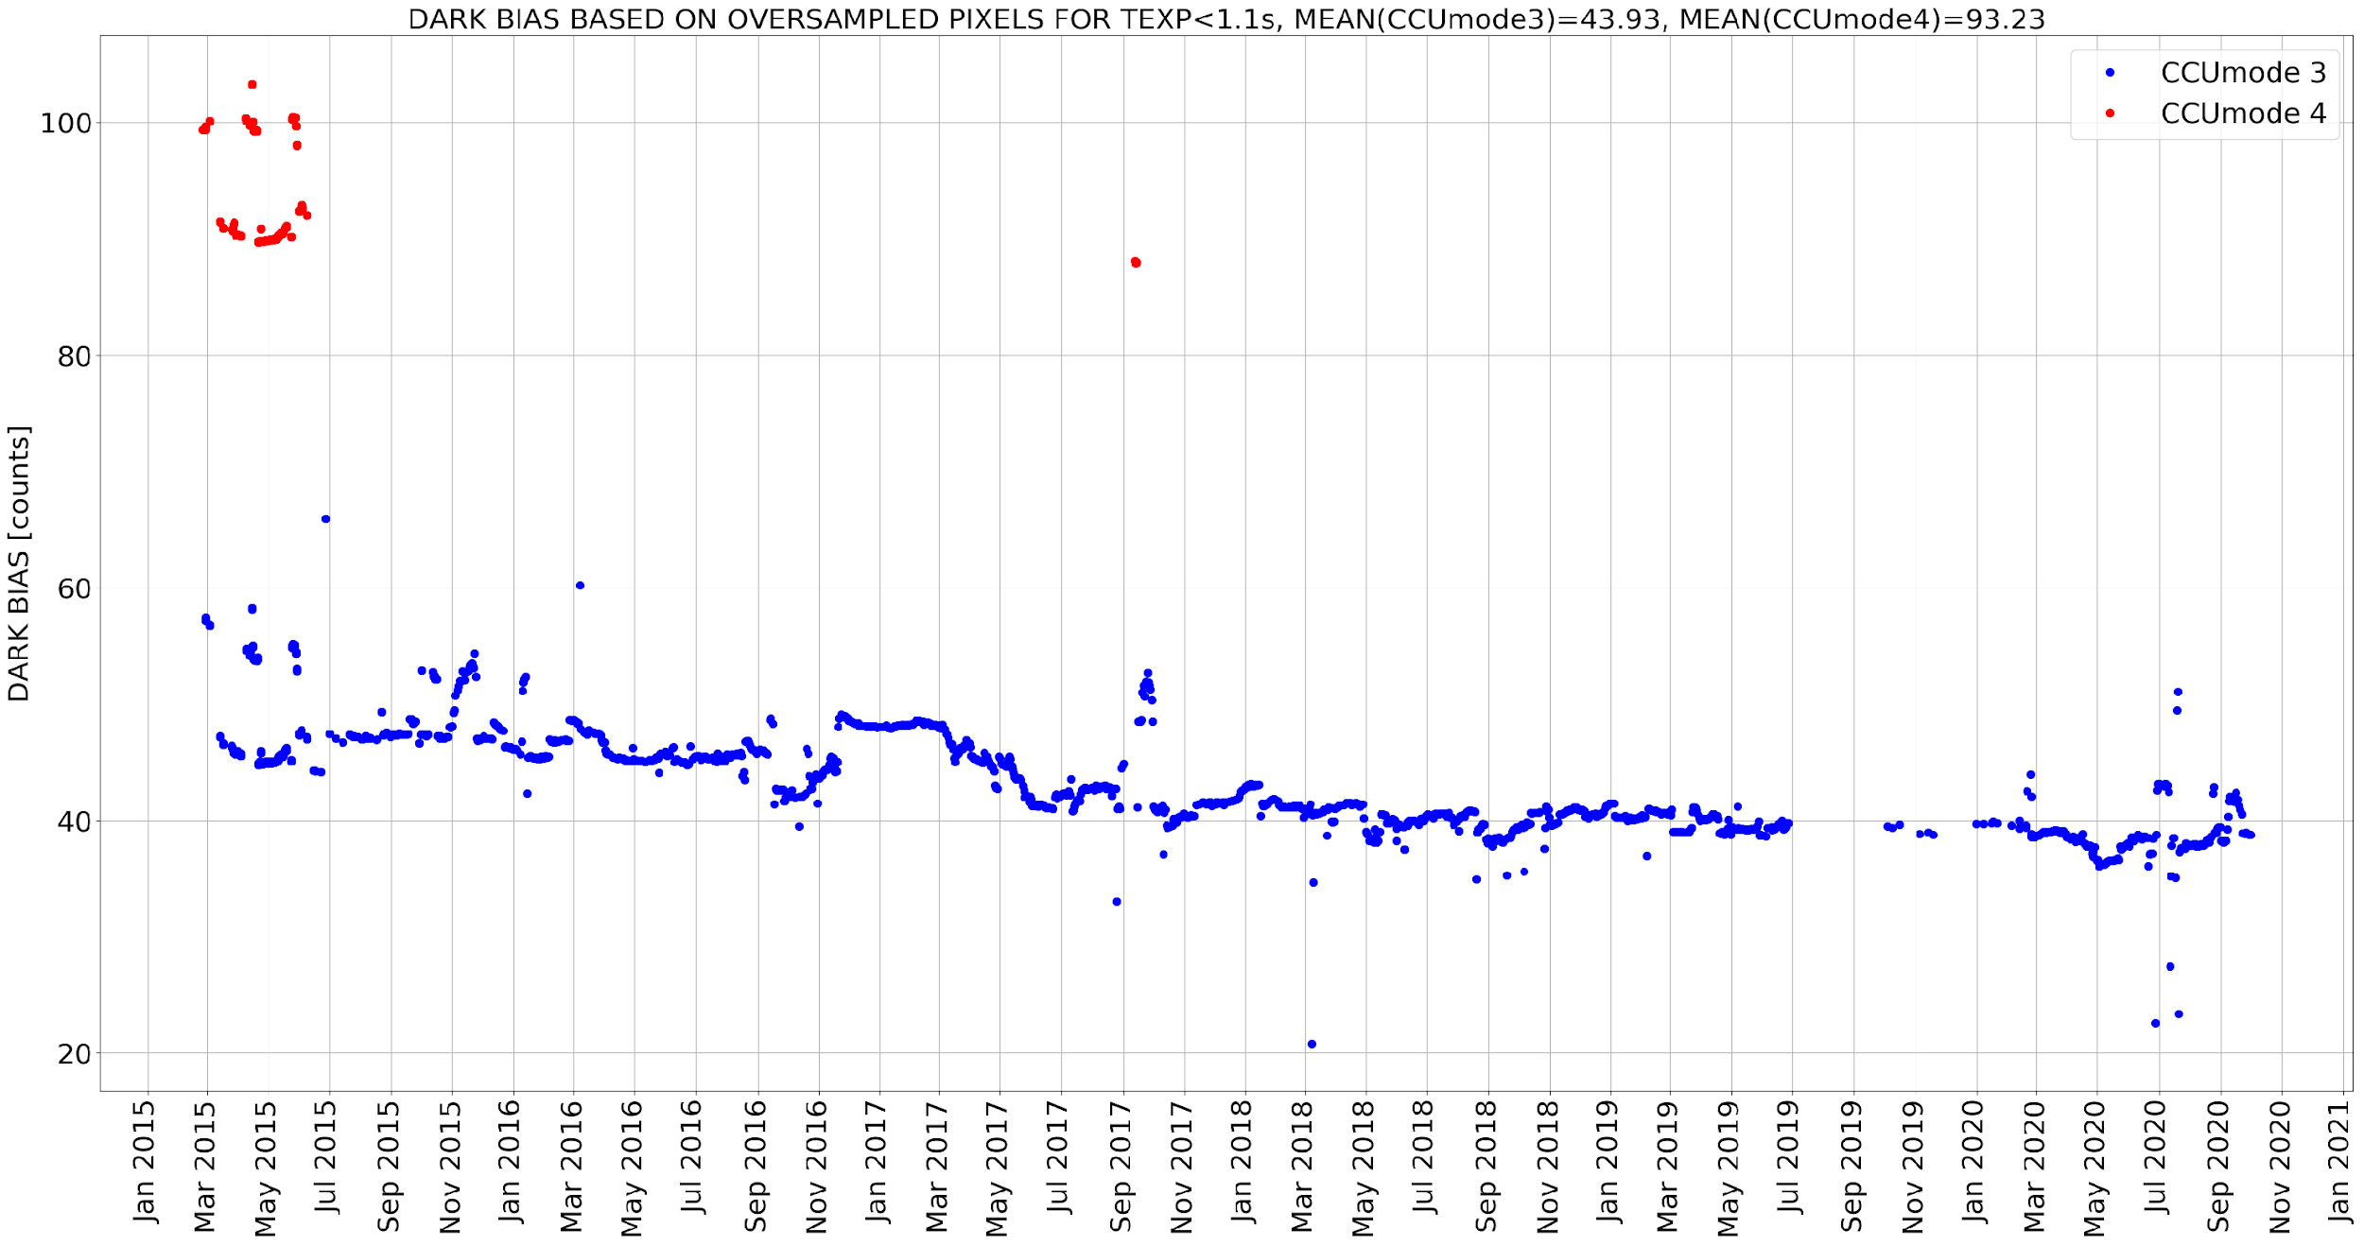
Dark bias
The dark bias continues to change in an "unpredictable way". However this has no consequences in the dark correction, since the information of the oversampled pixels is included in the dark map.
Notes:
Dark_BIAS, Pixels at edge of CCD, never receive light, whatever happens is incorporated into correction.

Slide 8
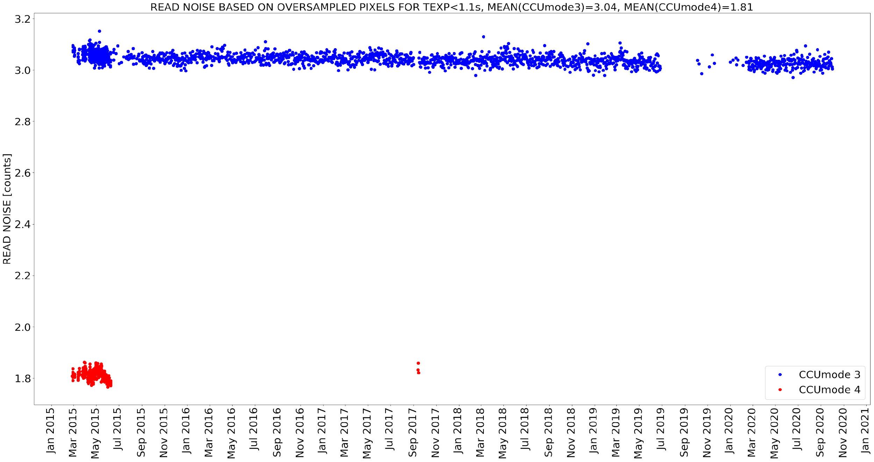
Read Noise
Read noise, or the signal variations induced during the clocking and readout process of the CCD, remains stable in CCUMODE 3 (blue dots). CCUMODE 4 read noise not sampled enough to make a definitive assessment.
Notes:
Dark_READNOISE

Slide 9
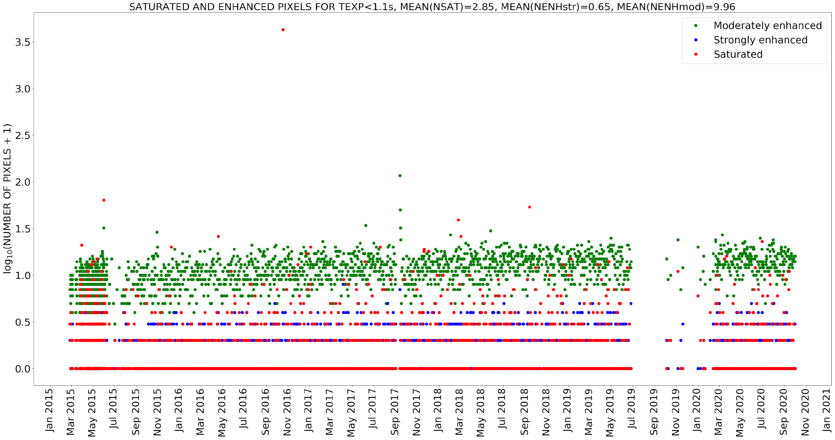
Saturated and Enhanced Pixels
In-flight dark calibration observations also used to monitor pixel behavior. Saturated pixels are those that return values at pixel full well and/or ADC maximum while moderately and strongly enhanced pixels are N-sigma from mean of normal distribution.
Notes:
Dark_SATENH

Slide 10
Summary
L1a-processor version with updated flat fielding and backfix incorporated into the existing EPIC processing chain (v03).
CCD detector remains healthy as evidenced by nominal dark counts, dark bias, and read noise trends as well as stable levels of saturated and enhanced pixels.
The dark count correction incorporated in the current EPIC processing chain v03 still describes the dark trend in a satisfactory way. We have been working on a somewhat better dark count characterization, which we can include in a potential v04.
Please contact us (gmccauley@sciglob.com, alexander@sciglob.com) if you discover any suspected calibration effects in your L2 science products.

