Slide 1
Development of a Science Quality Ocean Surface PAR Product from EPIC/DSCOVR Data (Update)
Robert Frouin, Jing Tan
Scripps Institution of Oceanography, University of California San Diego,
La Jolla, California
_____________________________________________________________________________________________________
DSCOVR Science Team Meeting, 6-8 October 2020

Slide 2
Update
-Improved parameterization of atmospheric reflectance at large Sun and view zenith angles.
-Developed additional products, i.e., direct and diffuse PAR, PAR below surface, UV fluxes.
-Tested algorithm on many days; Compared monthly EPIC products with MODIS products.
-Code ready for production.

Slide 3
Atmospheric Reflectance
-Quasi-single scattering approximation was used; but does not work well at large Sun and view angles (actual reflectance is overestimated).
-New parameterization combines exact single scattering and quasi-single scattering approximations:
R_{a} = f_{SS}(m, τ_{aer}) R_{aSS} + f_{QSS}(m, τ_{aer}) R_{aQSS}
where m is air mass and τ_{aer} aerosol optical thickness at 550 nm. Unique f functions for all aerosol models.
-Edge effects in daily PAR product are eliminated with new parameterization.

Slide 4
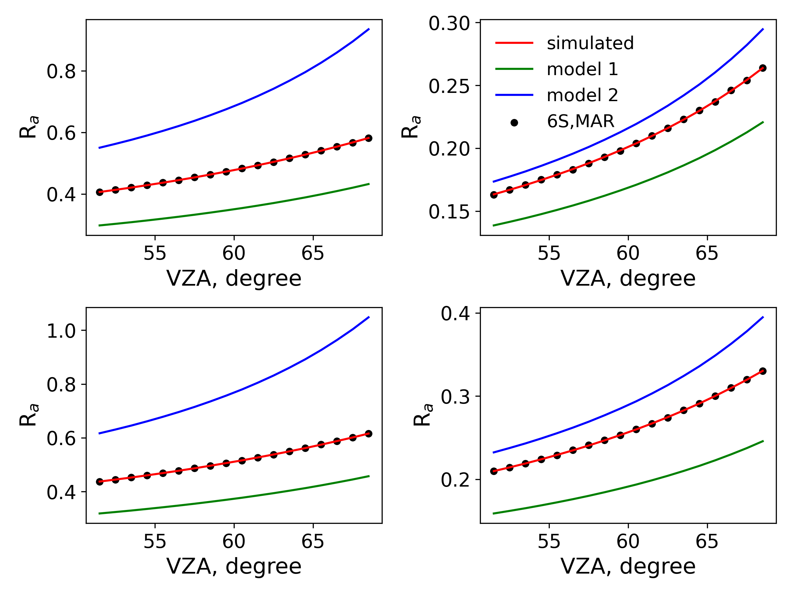
R_{a} parameterization, SCAT = 171.5 deg., SZA = 60 deg., Maritime aerosols
𝜏_{aer}=0.2, 388 nm
Modeled
SS
QSS
“Exact”
𝜏_{aer}=0.2, 551 nm
𝜏_{aer}=0.4, 388 nm
𝜏_{aer}=0.4, 551 nm

Slide 5
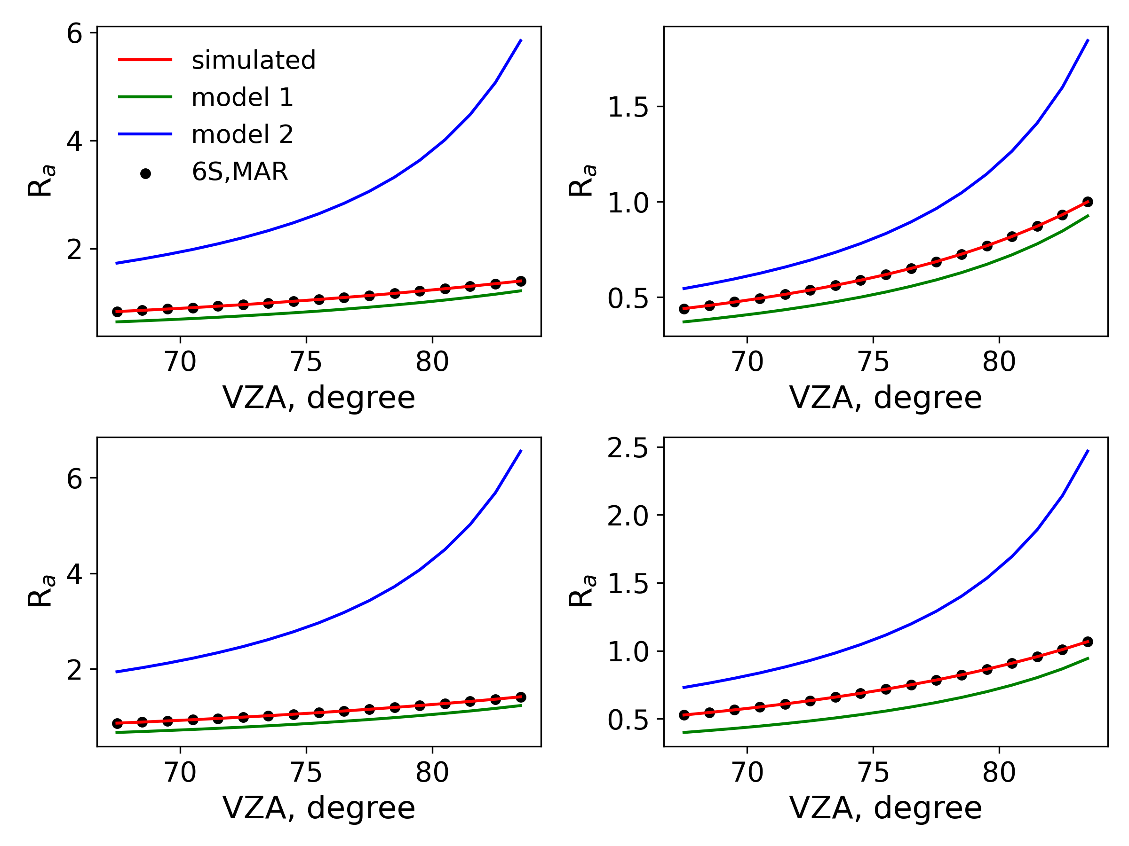
R_{a} parameterization, SCAT = 171.5 deg., SZA = 75 deg., Maritime aerosols
Modeled
SS
QSS
“Exact”
𝜏_{aer}=0.2, 551 nm
𝜏_{aer}=0.2, 388 nm
𝜏_{aer}=0.4, 388 nm
𝜏_{aer}=0.4, 551 nm

Slide 6
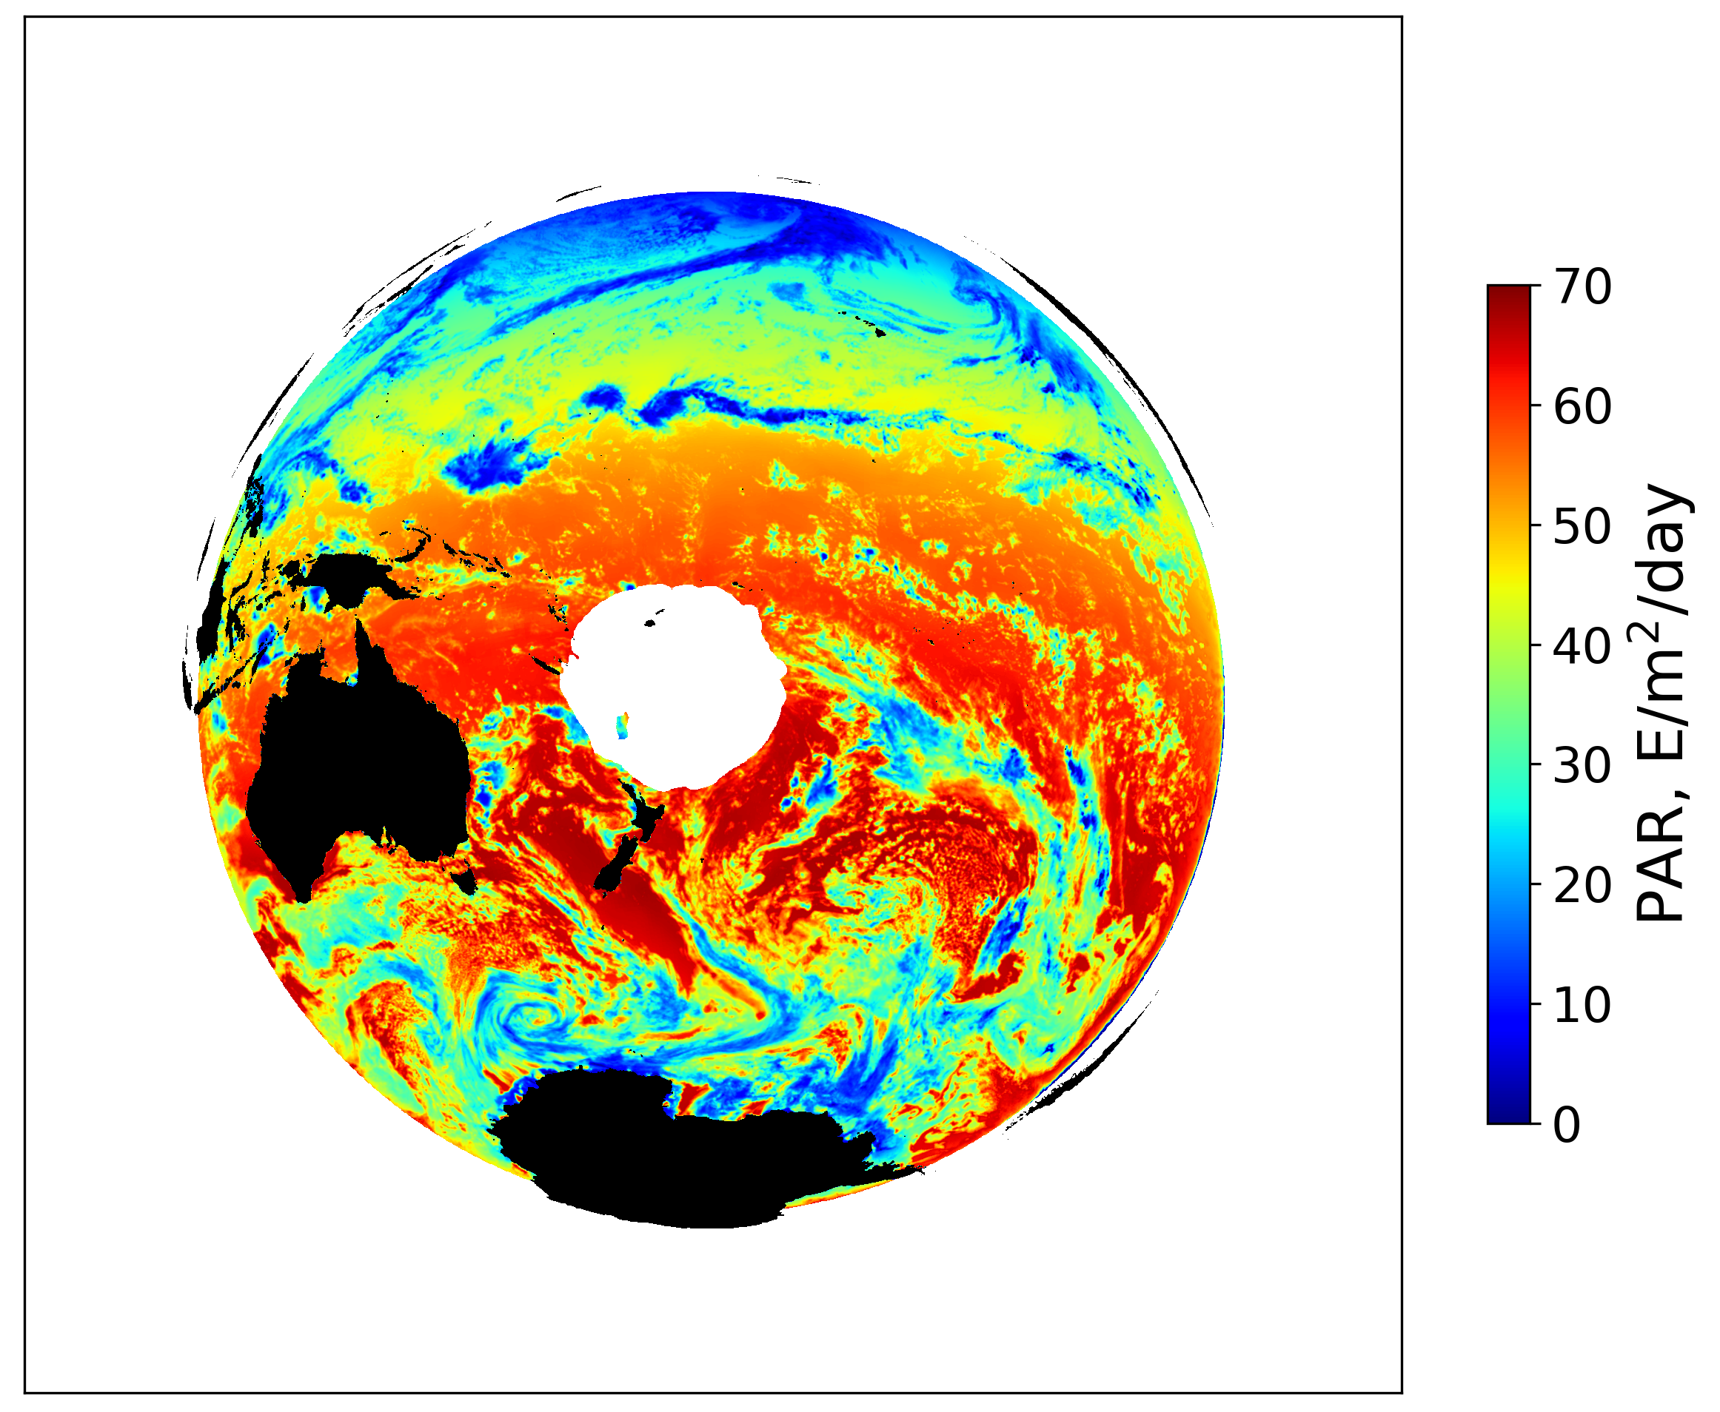
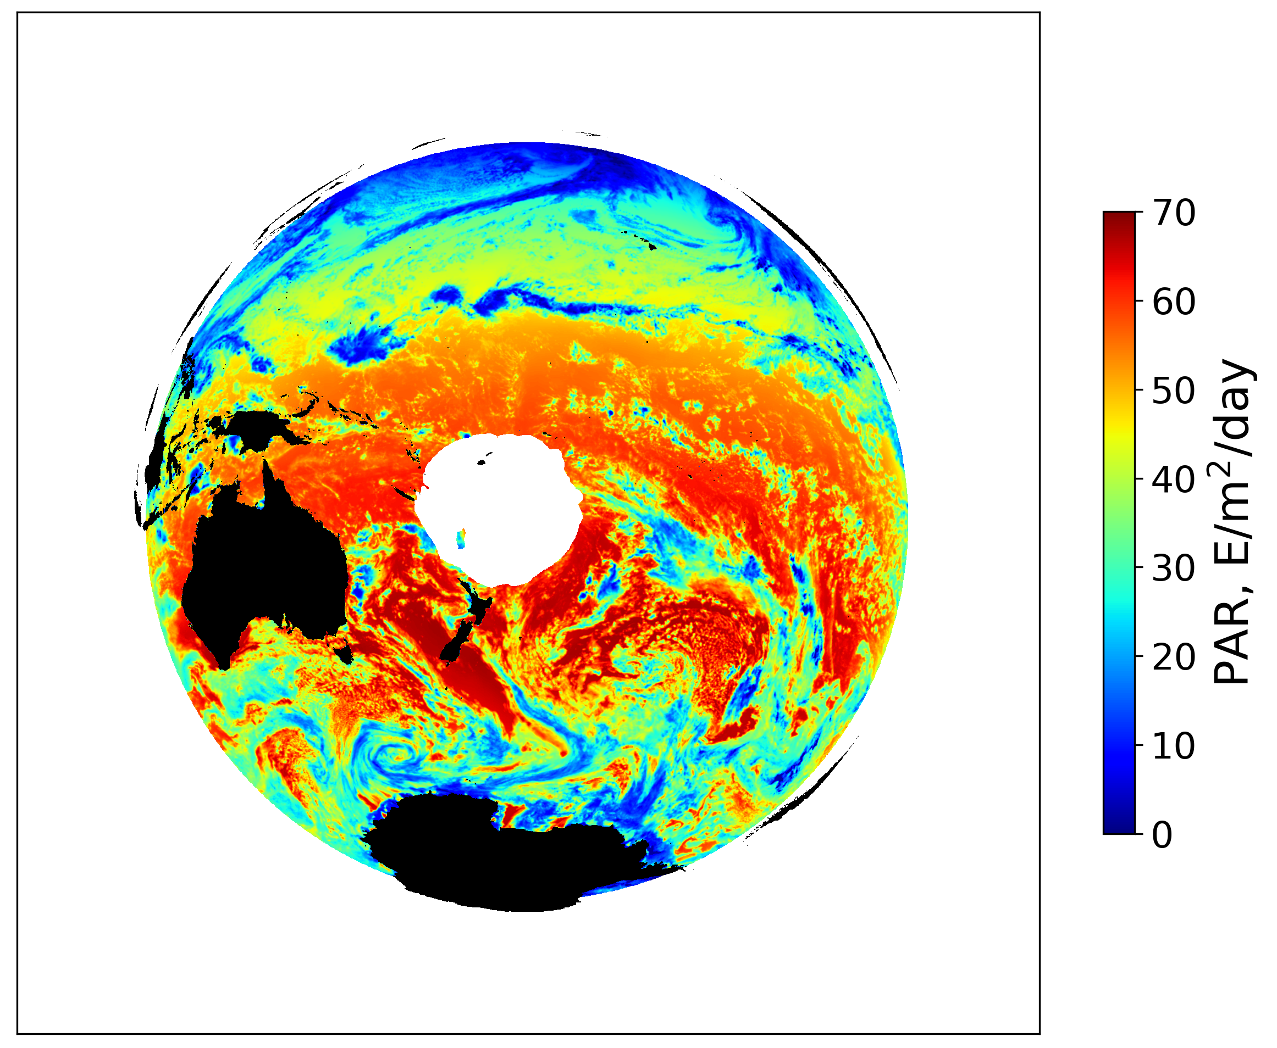
Daily mean PAR, January 1, 2018, obtained using EPIC imagery at 00:17:51 UTC with new and old R_{a} parameterizations (SZA<85 deg.; VZA<75 deg.)
Old
New
Daily mean PAR reduced by -1.4 E/m²/day on average (3.6%) with new R_{a} parameterization.

Slide 7
Radiation Products Suite
-Daily mean downwelling PAR just above ocean surface (E/m²/Day) Basic product
-Daily mean direct downwelling PAR just above ocean surface (E/m²/Day)
-Daily mean diffuse downwelling PAR just above ocean surface (E/m²/Day)
-Daily mean downwelling PAR just below ocean surface (E/m²/Day)
-Daily mean downwelling UV flux at 340 nm just above ocean surface (mW/cm²/µm)
-Daily mean downwelling UV flux at 388 nm just above ocean surface (mW/cm²/µm)
-All products are generated on both Plate Carrée (18.4 km resolution at Equator) and equal-area (18.4 km resolution) grids compatible with those of NASA OBPG ocean color products.

Slide 8
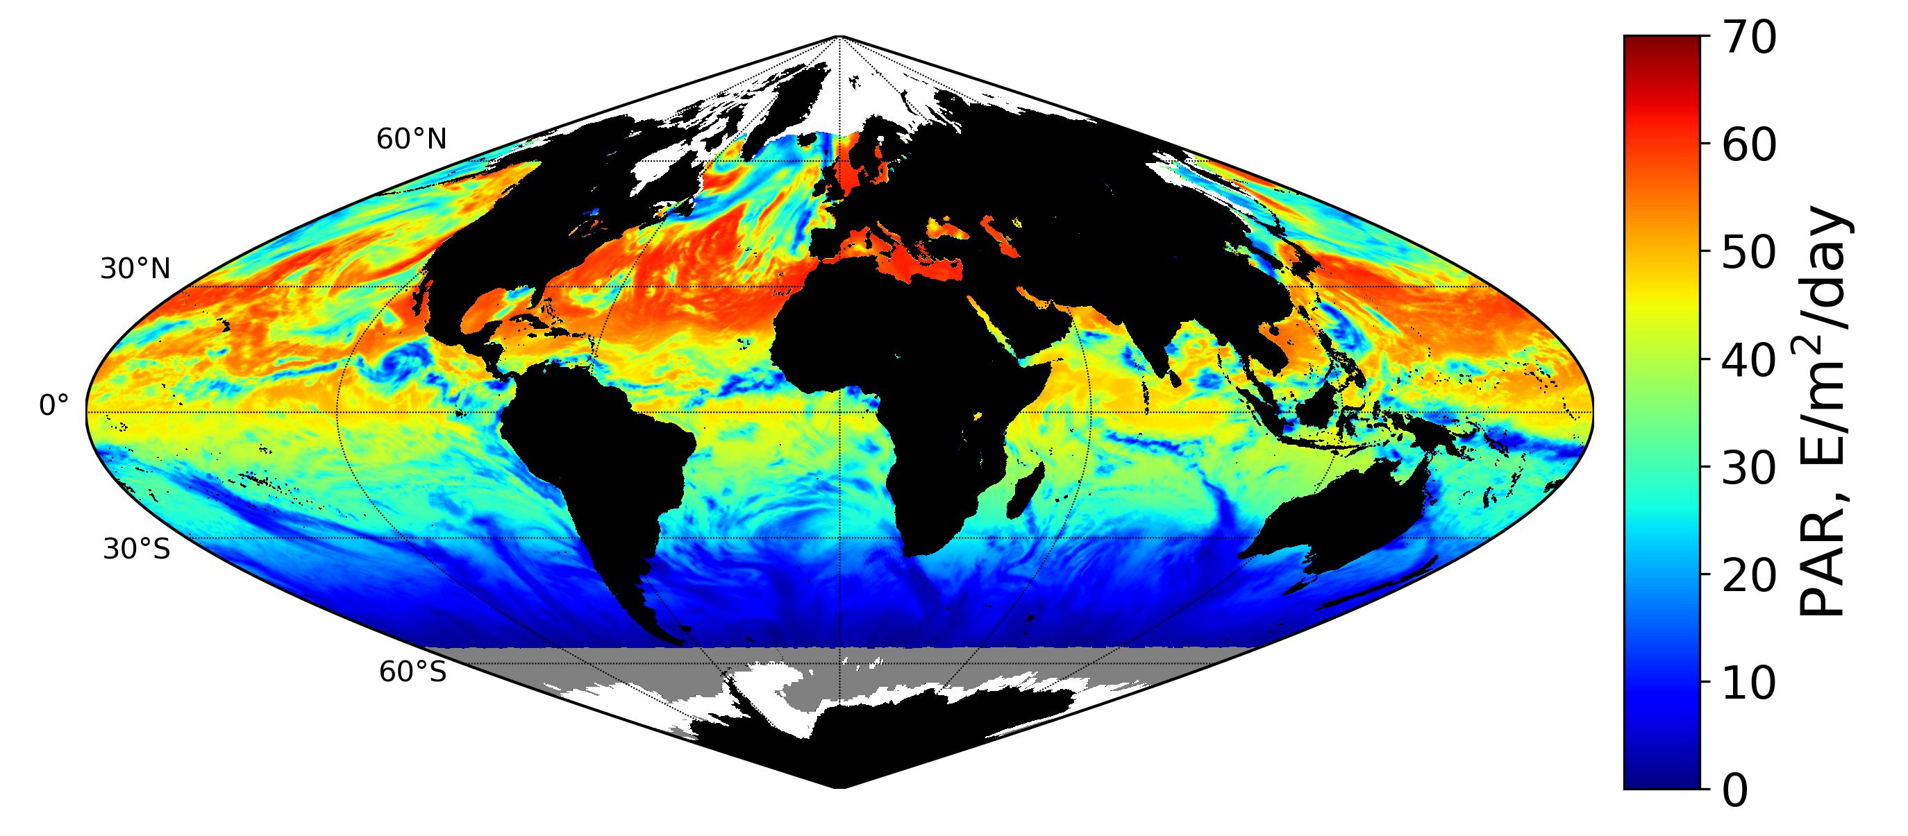
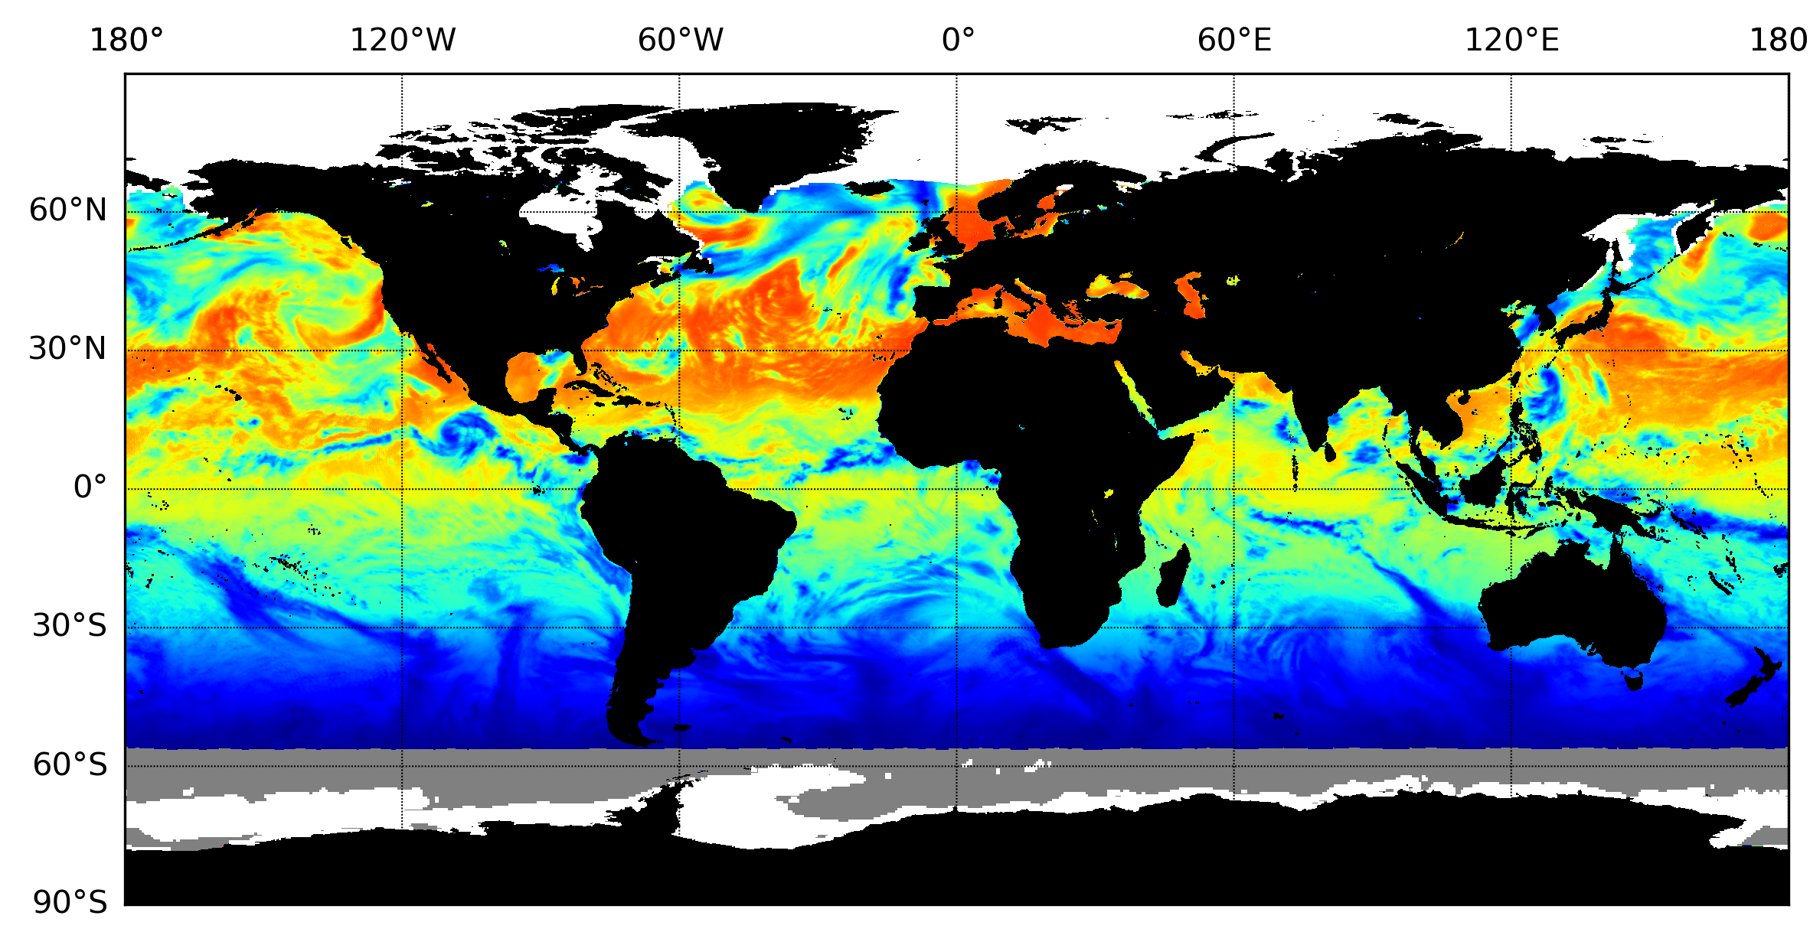
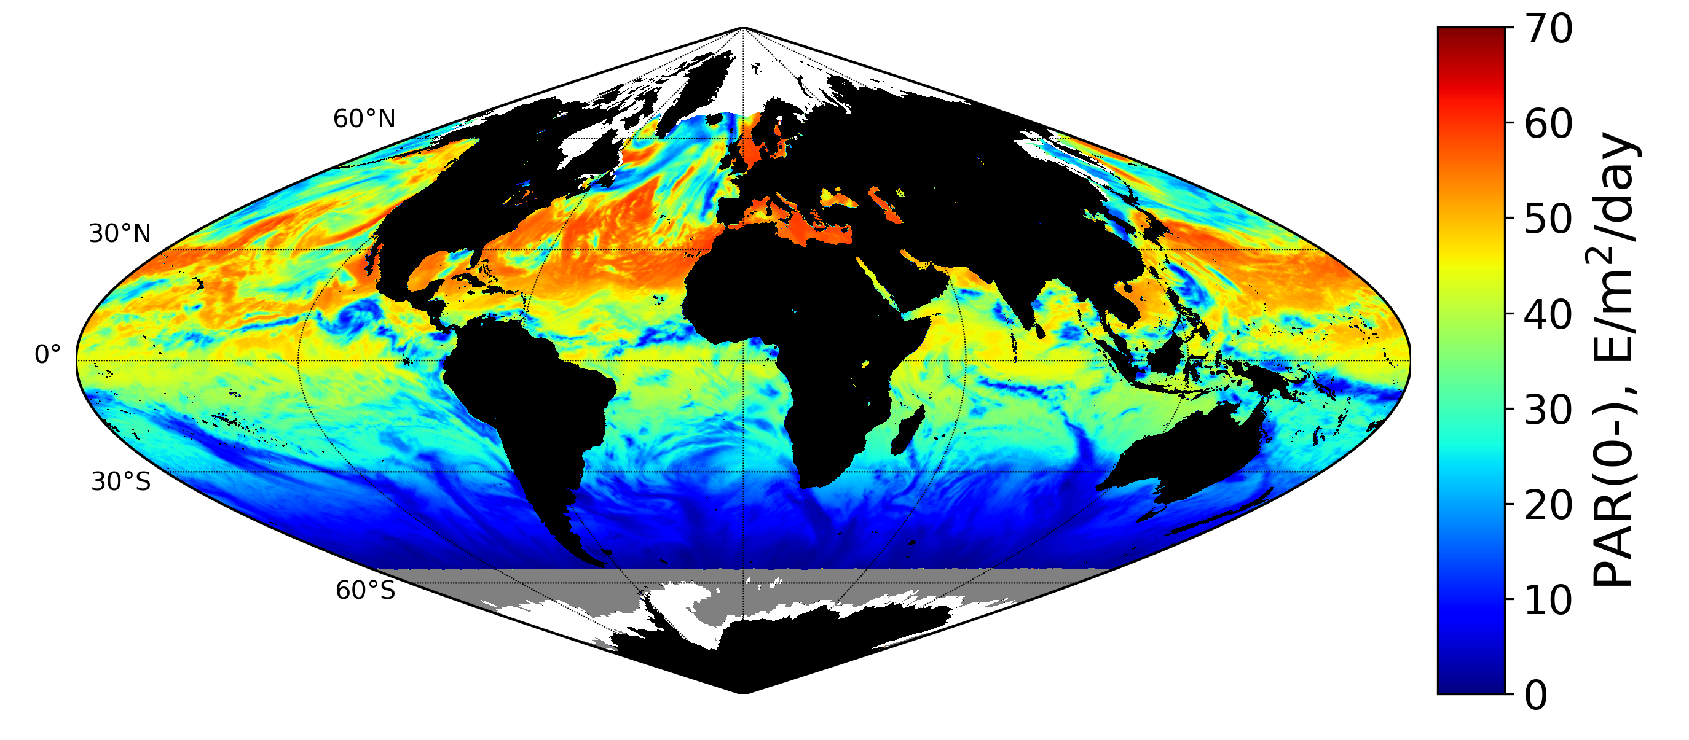
EPIC Daily mean PAR just above surface, July 1, 2018
EPIC Daily mean PAR just below surface, July 1, 2018

Slide 9
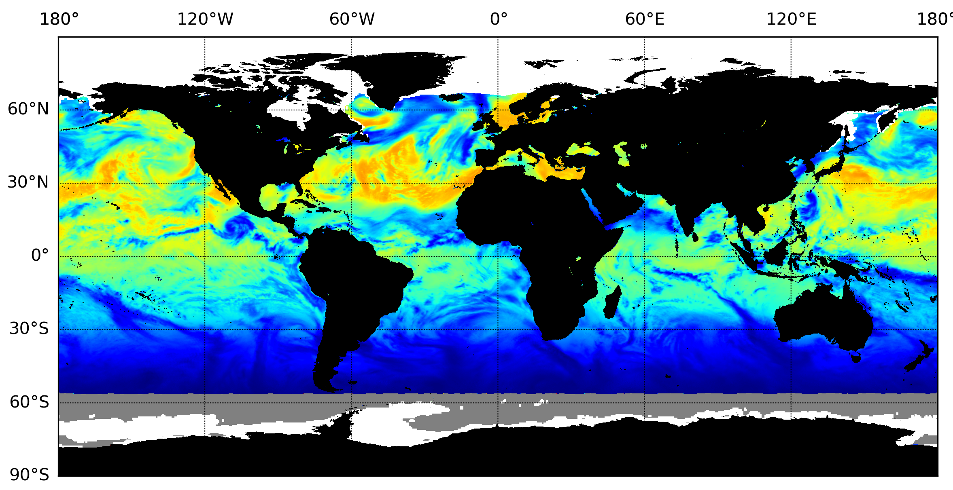
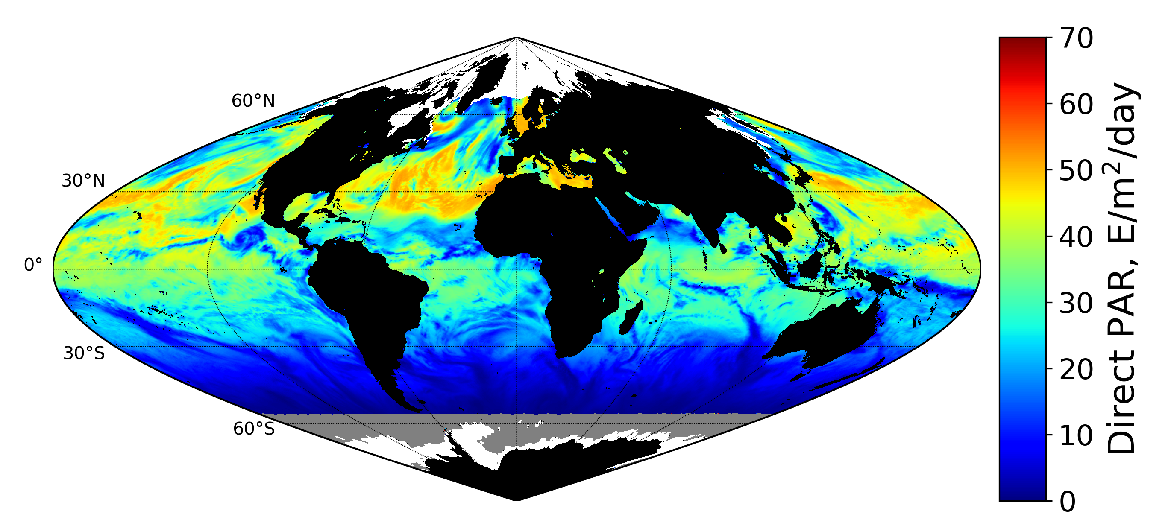
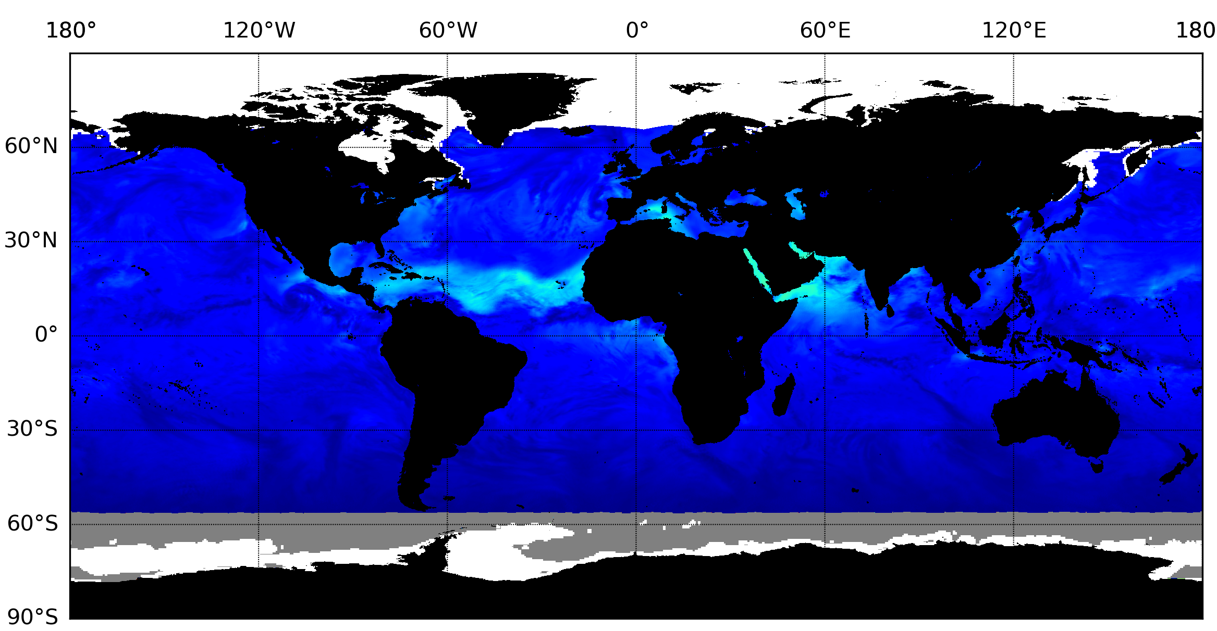
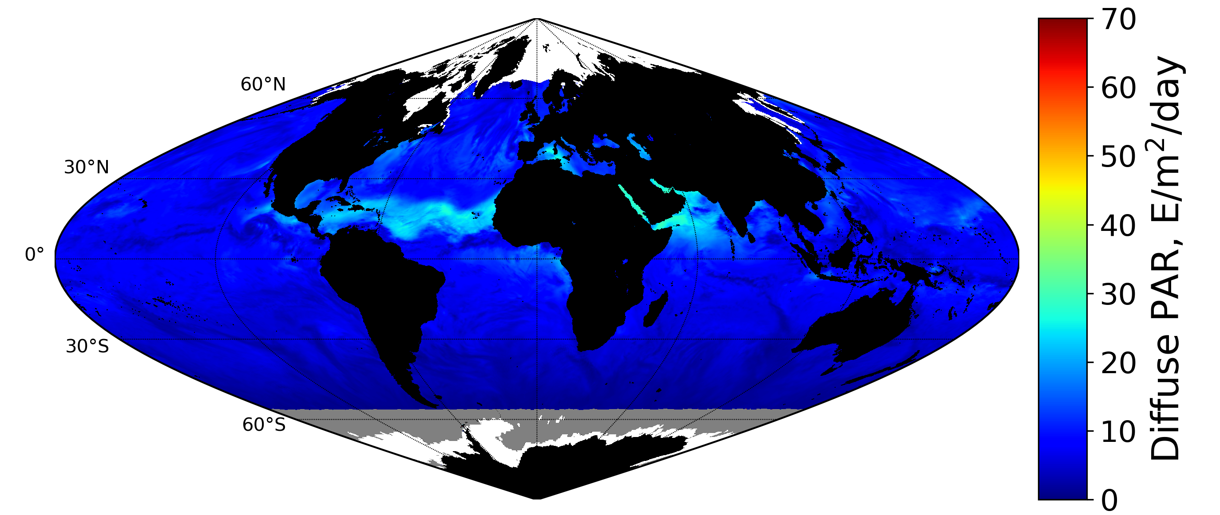
EPIC Daily mean direct PAR just above surface, July 1, 2018
EPIC Daily mean diffuse PAR just below surface, July 1, 2018

Slide 10
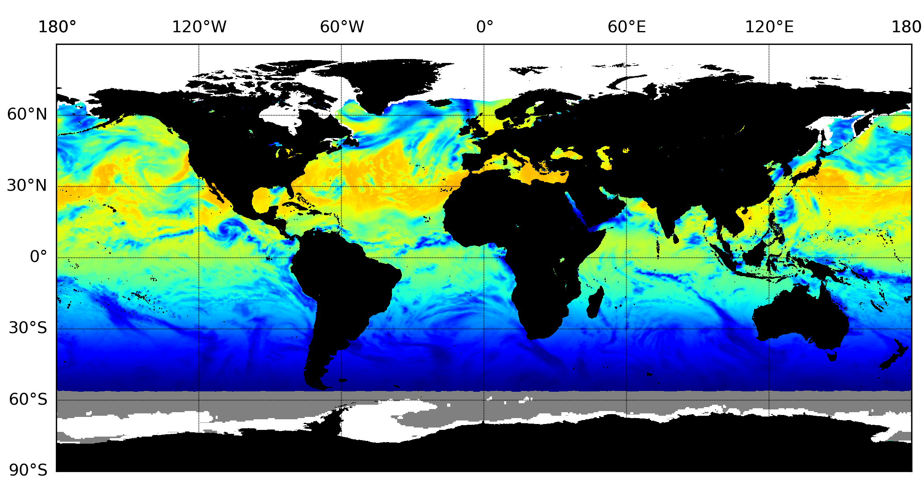
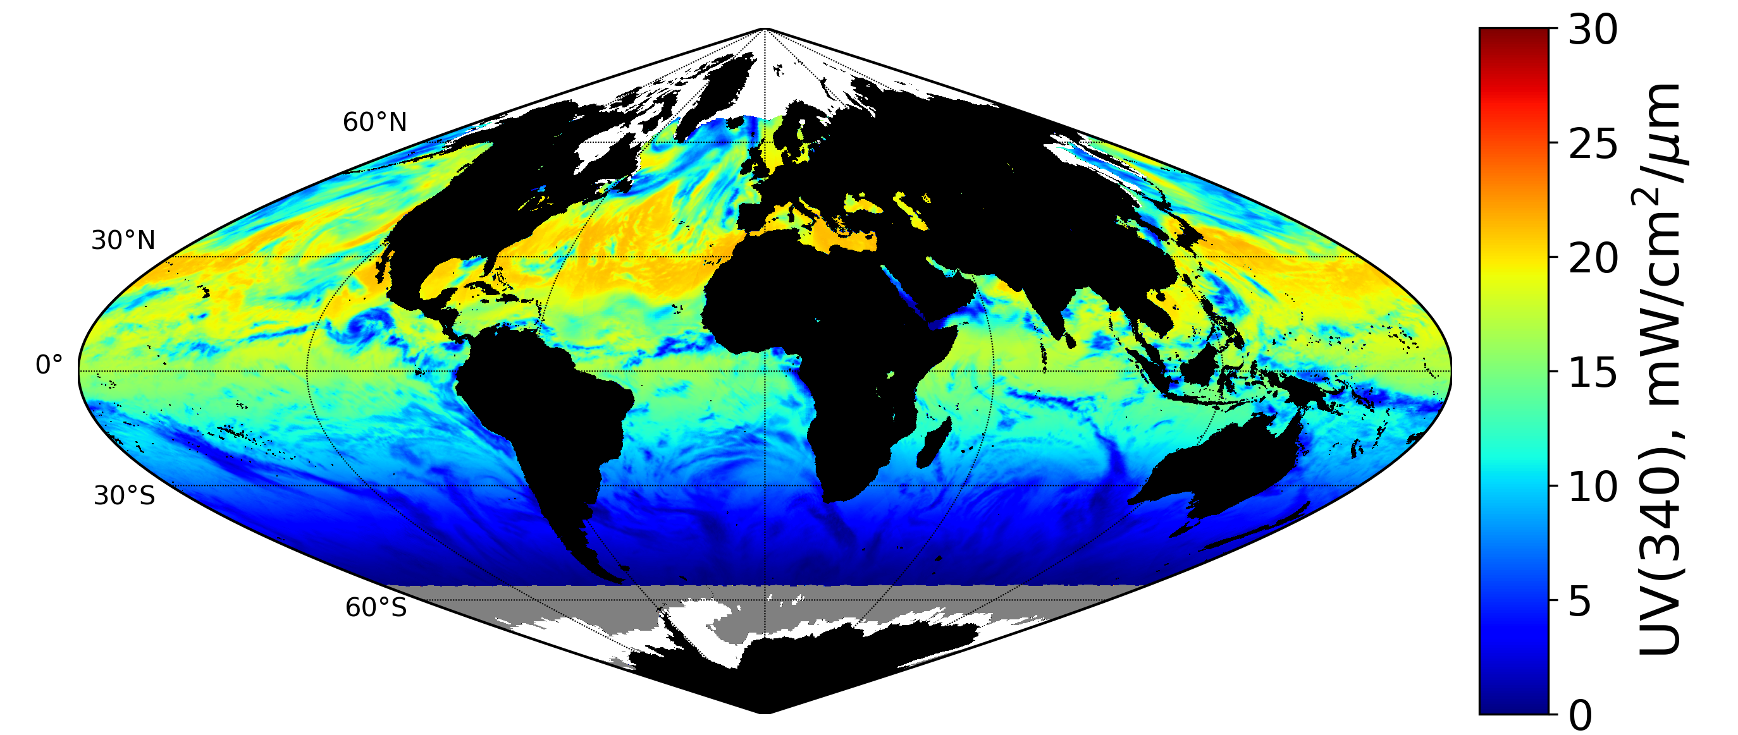
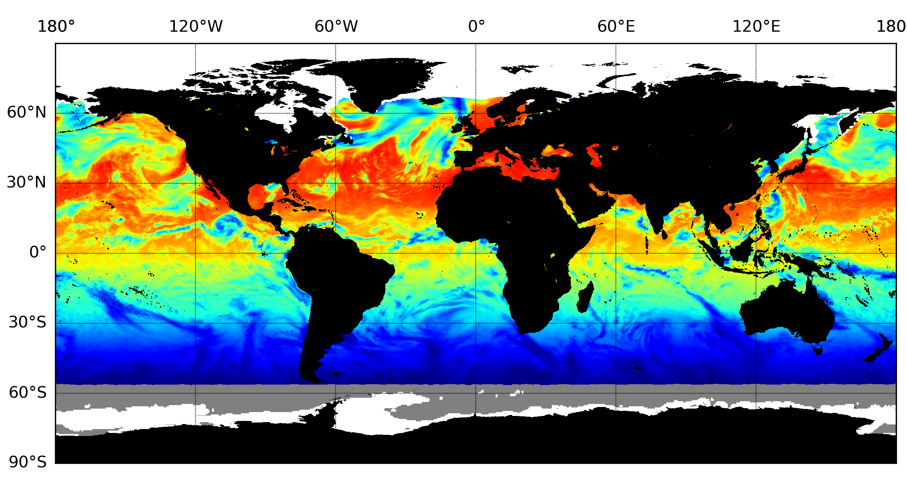
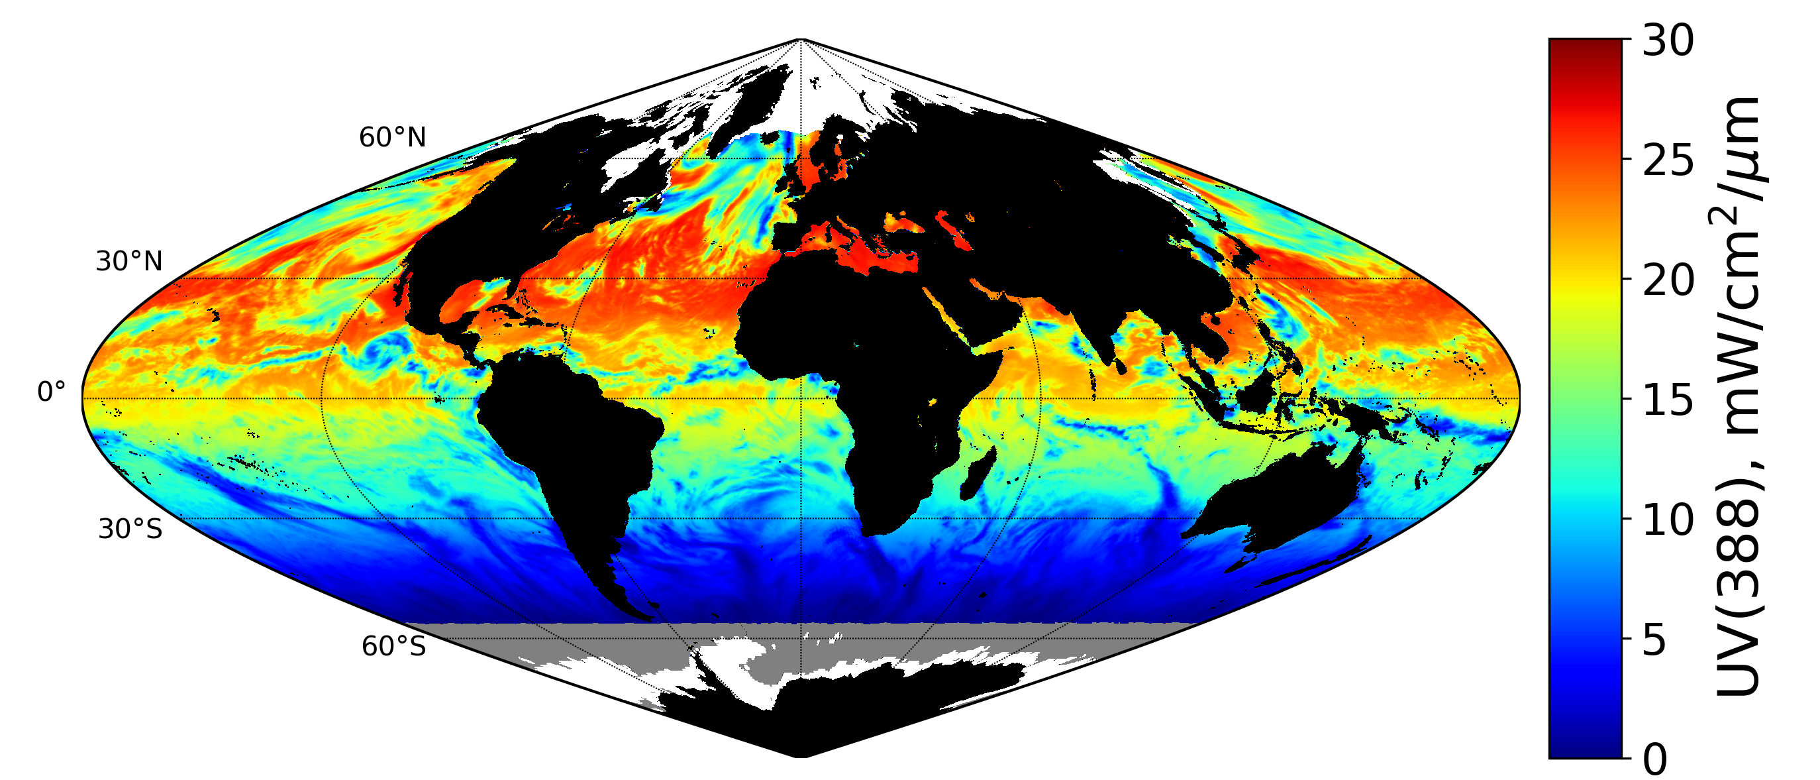
EPIC Daily mean UV(340 nm) flux just above surface, July 1, 2018
EPIC Daily mean UV(388 nm) flux just below surface, July 1, 2018

Slide 11

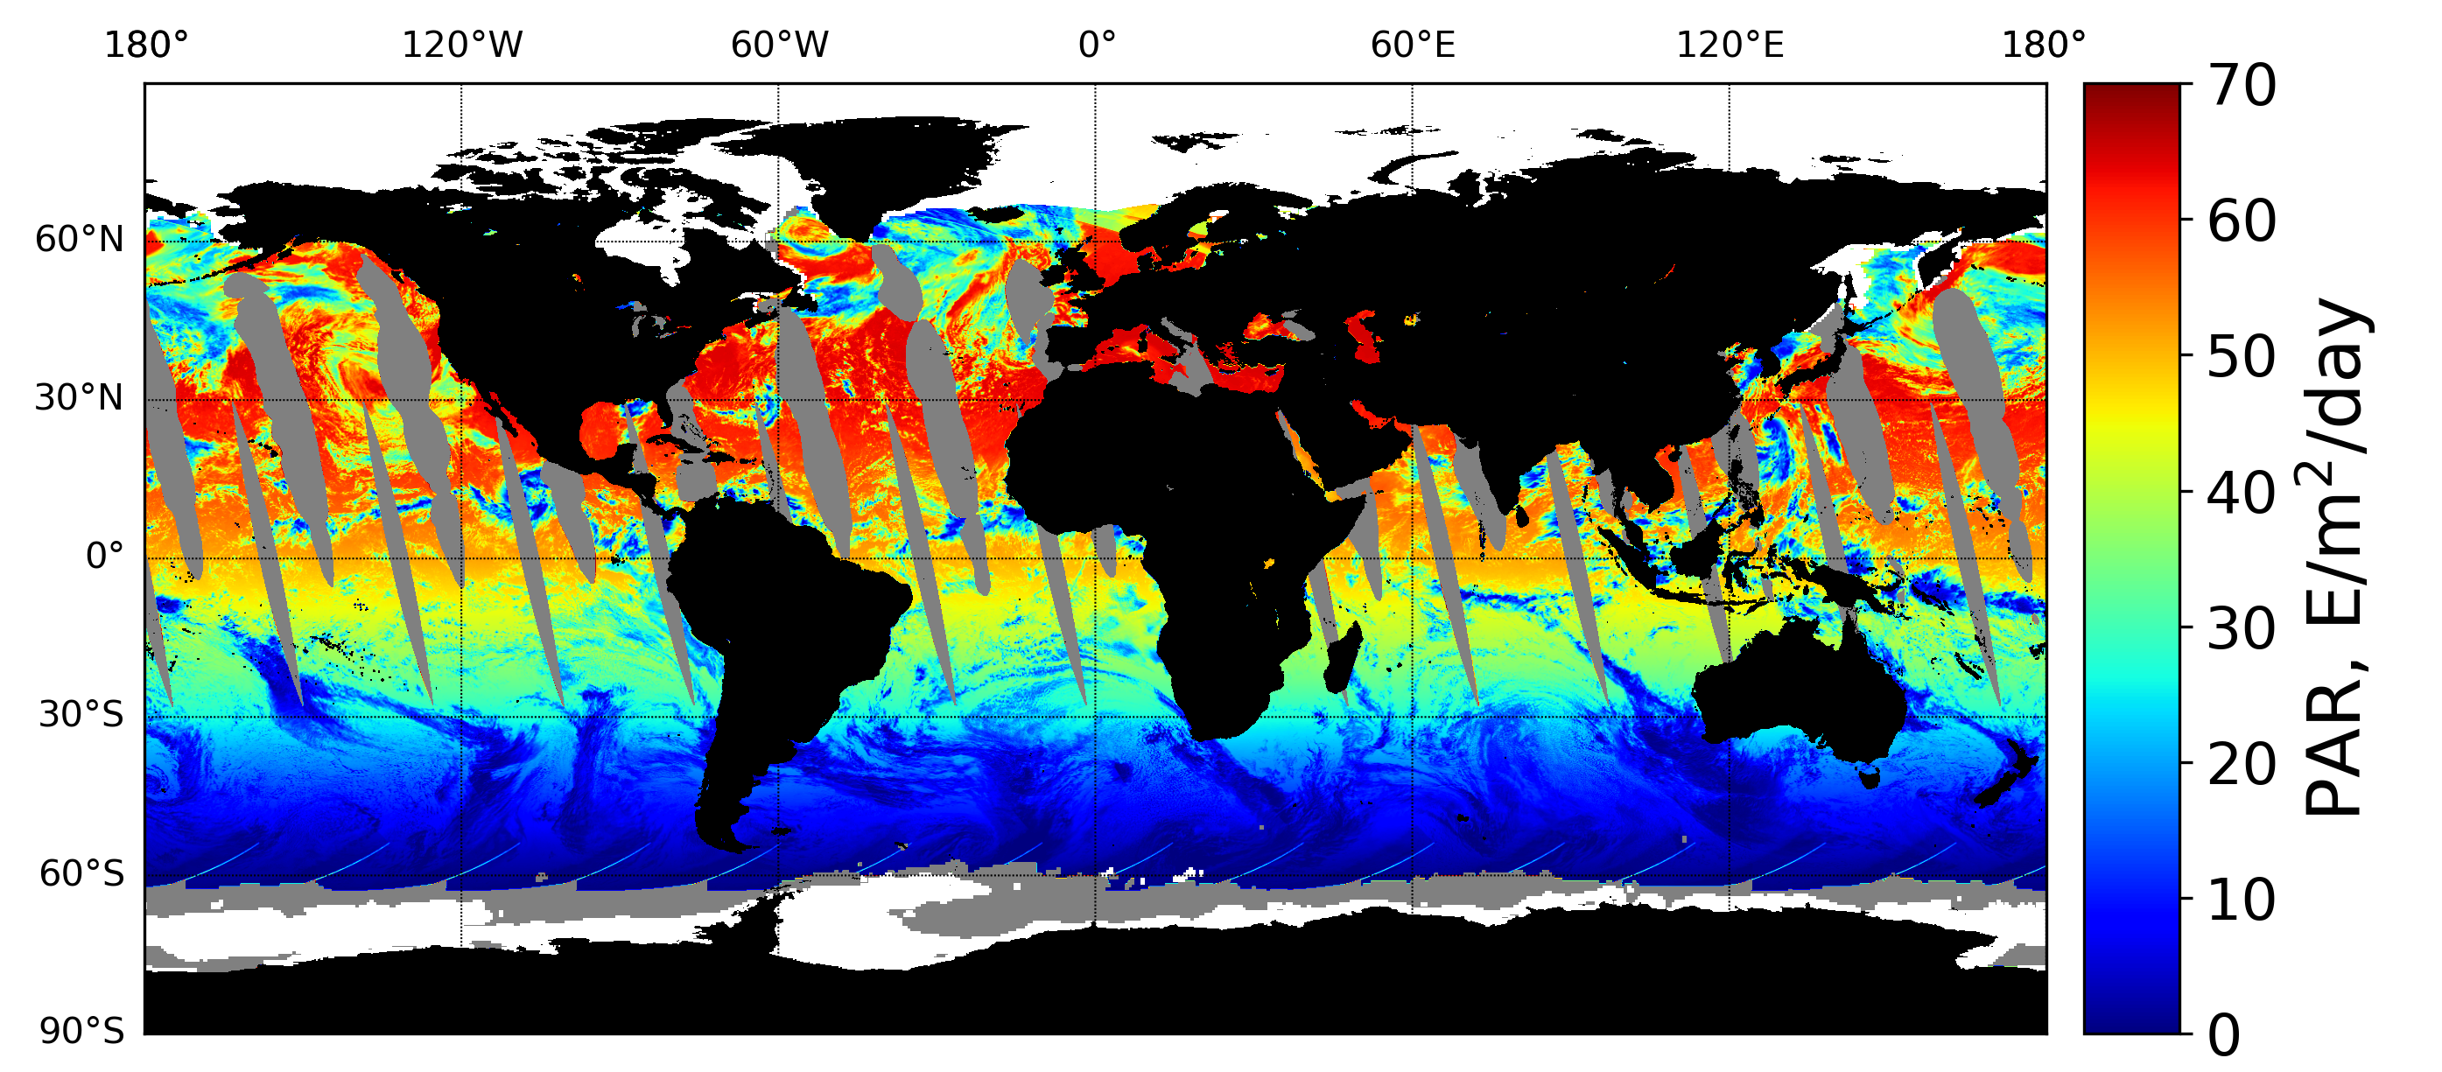
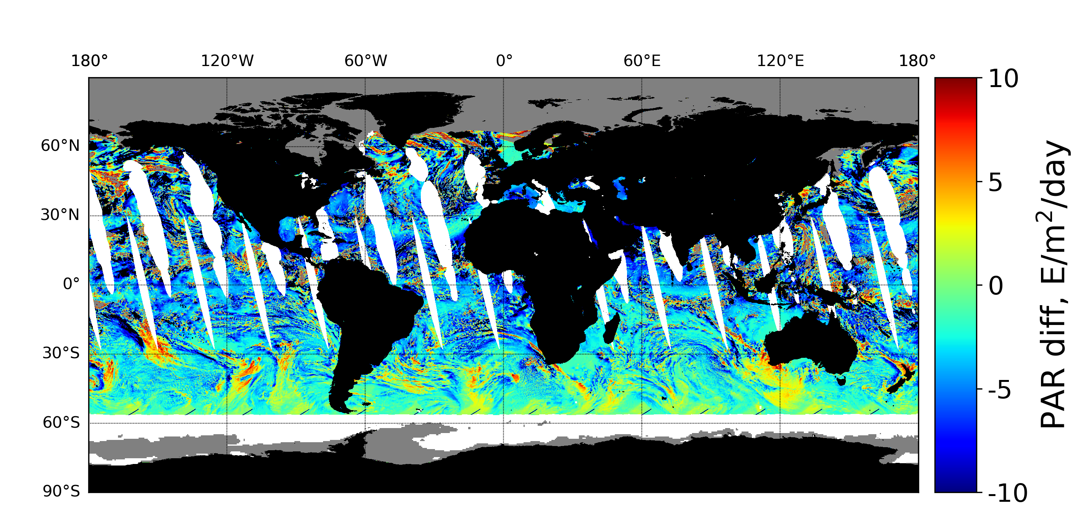
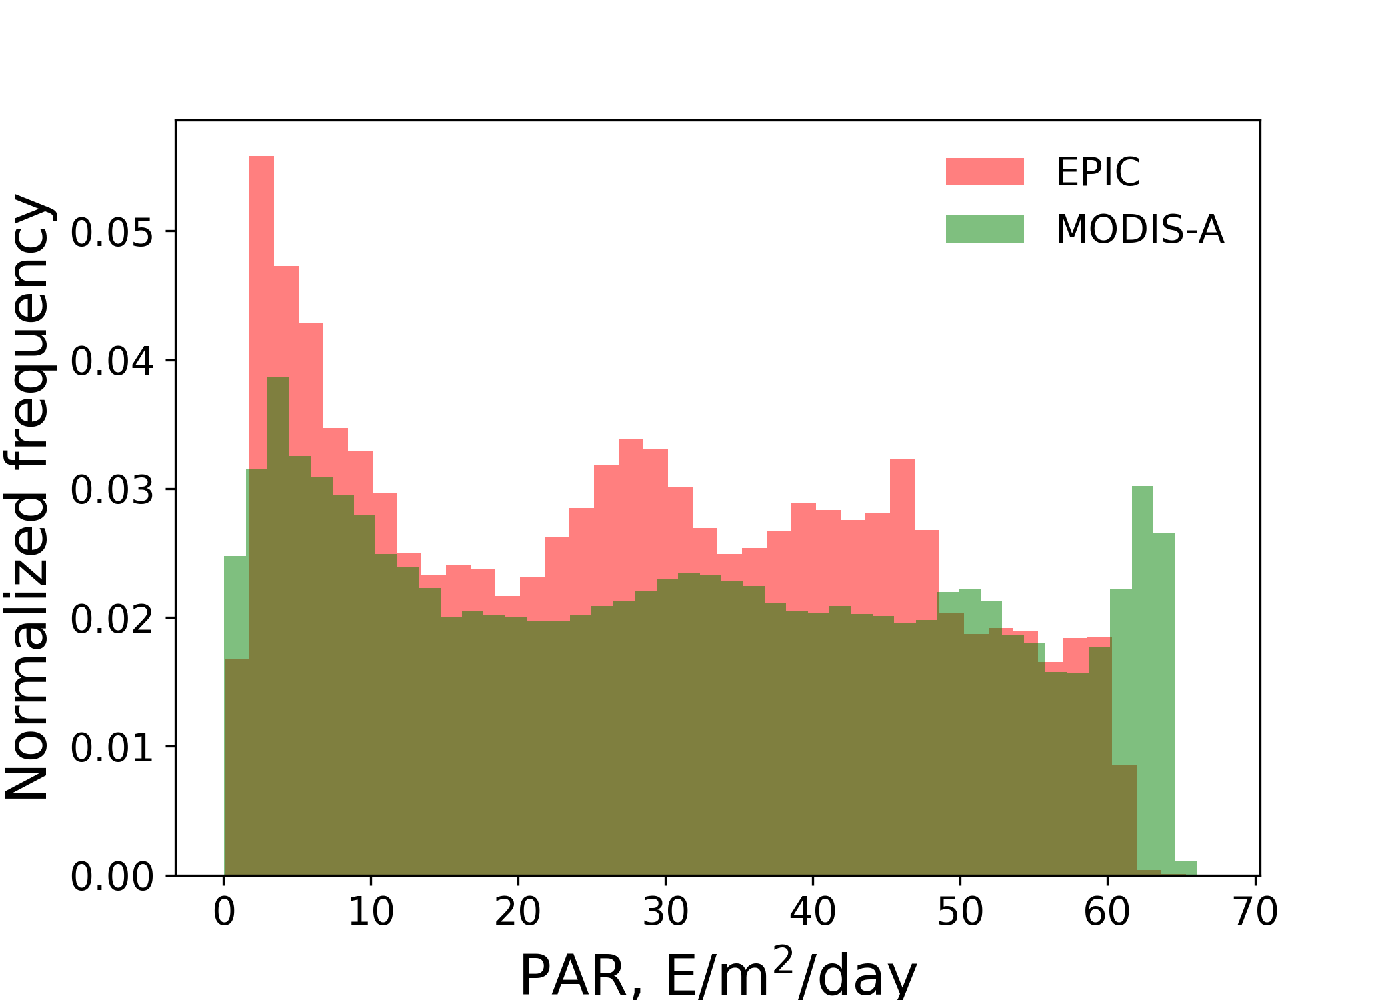
Comparison between EPIC and MODIS-A daily mean PAR(0⁺), July 1, 2018
EPIC
MODIS-A
Difference (EPIC – MODIS)
R² = 0.926
Bias = -2.8(9.1%)
E/m²/day
RMSD = 6.1(20.0%)
E/m²/Day

Slide 12
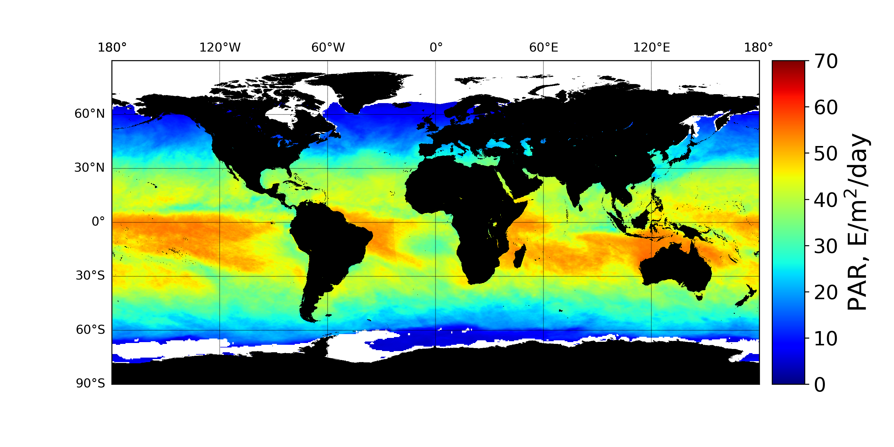
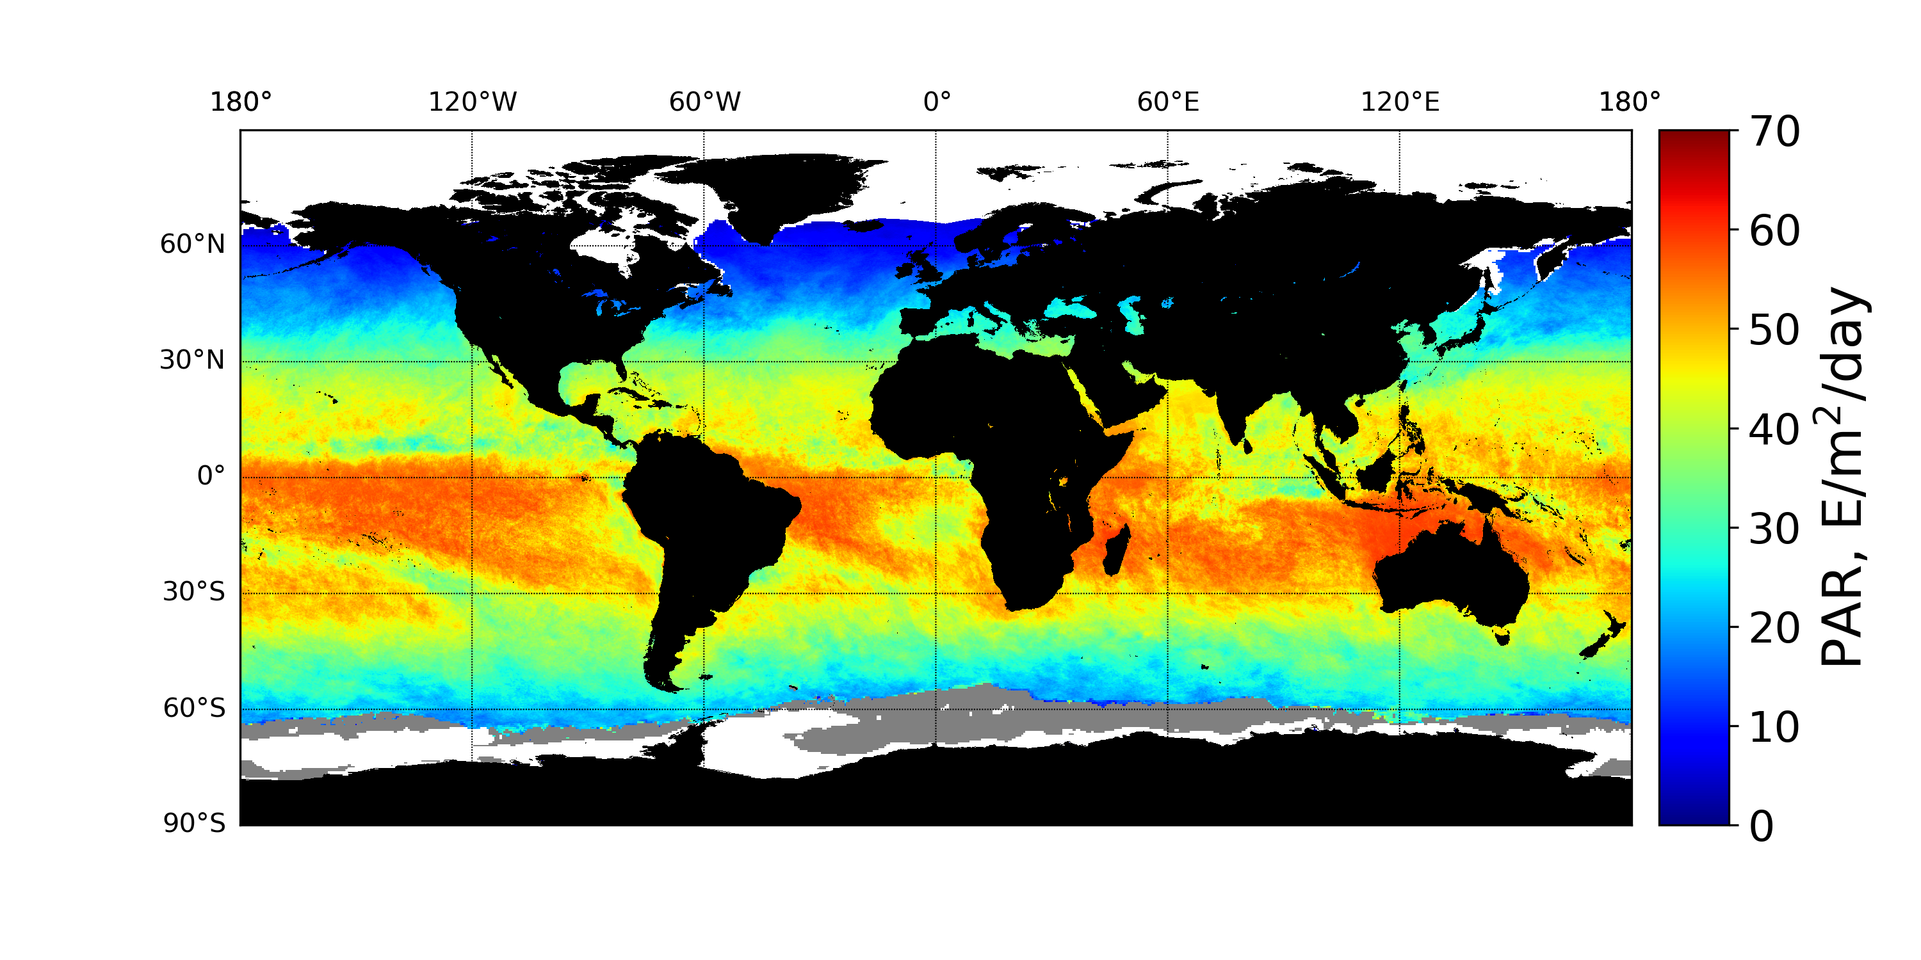
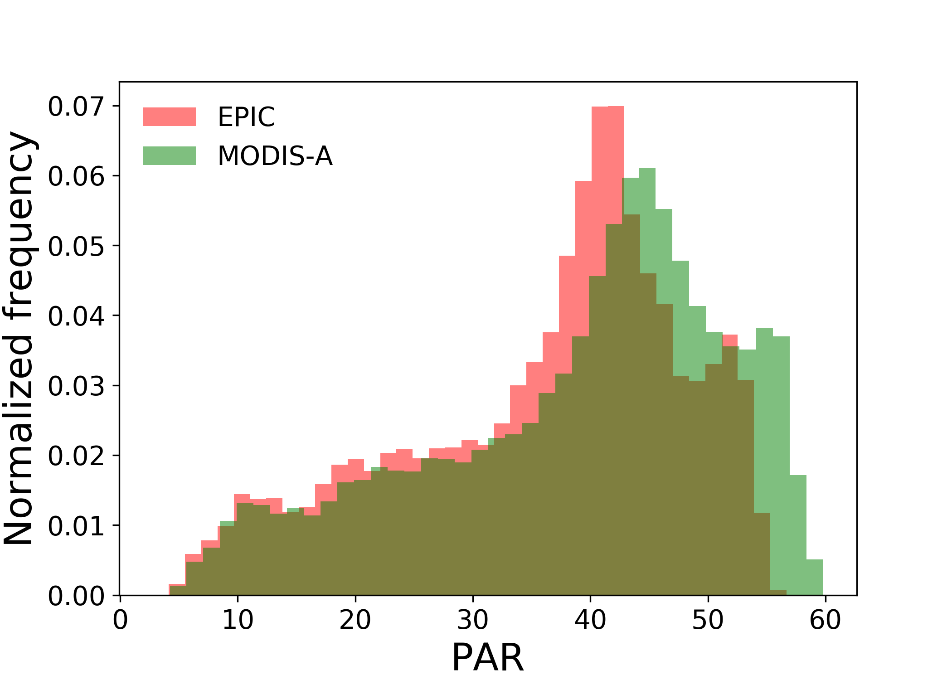
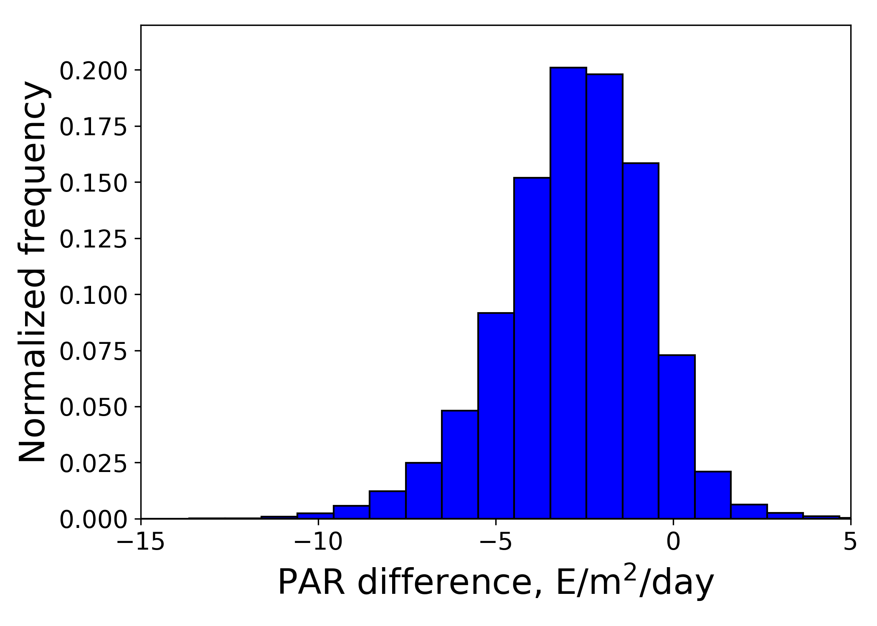
Comparison between EPIC and MODIS-A monthly mean PAR(0⁺), October 2018
EPIC
MODIS-A
EPIC - MODIS
R² = 0.978
Bias = -2.8(7.1%) E/m²/day
RMSD = 3.5(8.9%) E/m²/Day
EPIC PAR field less noisy
EPIC PAR range larger
EPIC values lower

Slide 13
Future Work
-Production/release of daily mean PAR products (+ATBD).
-Further evaluation (LEO and GEO estimates, in-situ measurements, RT model simulations with spherical-shell atmosphere) and quality checks.
-Association of uncertainties (bias, standard deviation) to each grid point.
•Simulations of noisy EPIC measurements and corresponding surface
fluxes for wide range of situations (MERRA-2, SMART-G code)
•Parameterization as a function of clear sky value and cloud factor
•GAM with varying coefficients depending on geographic location,
day of year, auxiliary variables.

