Slide 1
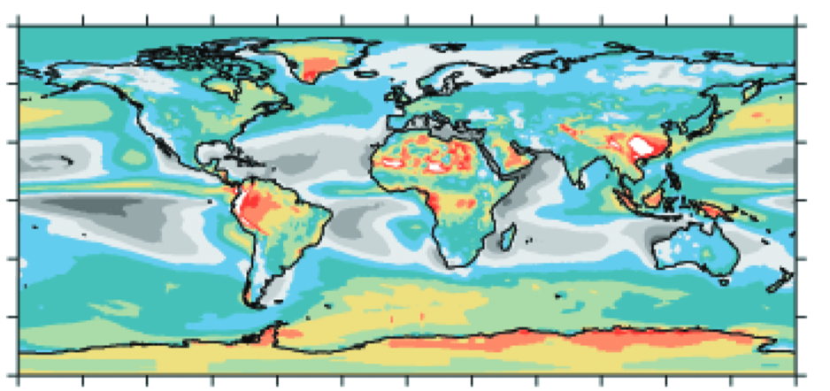
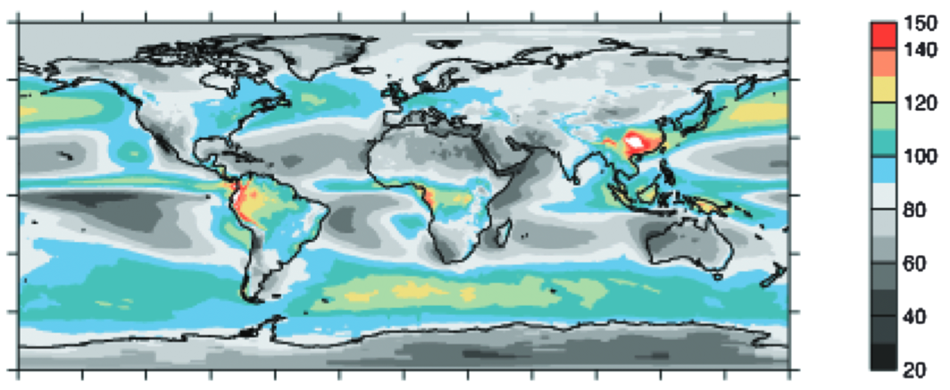
Sub-diurnal to seasonal analysis of NISTAR, EPIC, and CERES shortwave flux observations and comparisons with models
Daniel Feldman¹, Wenying Su², Pat Minnis²
Lawrence Berkeley National Laboratory
NASA Langley Research Center
California Department of Water Resources
Water storage and Investment Program
May 1, 2018
TOA Annual Average SW Upwelling
Atmospheric Contribution
Stephens et al, Rev. Geophys., 2015

Slide 2
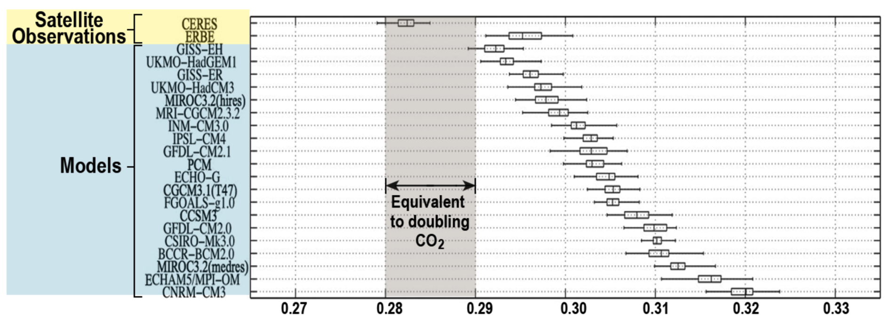
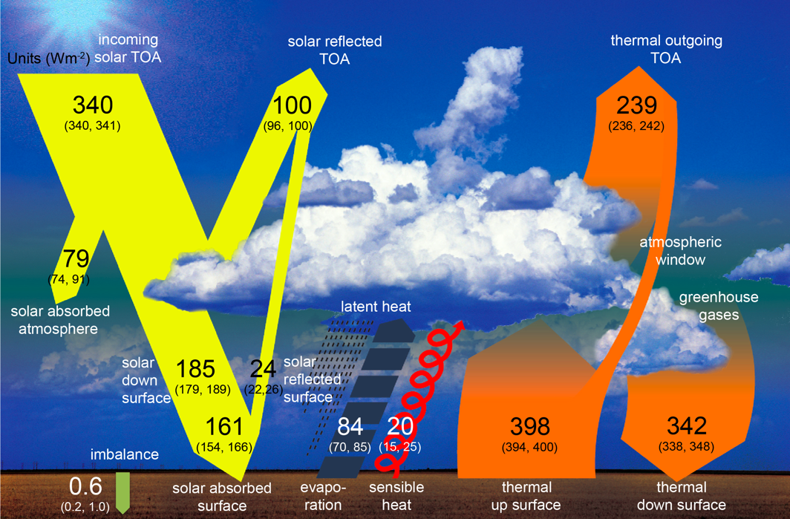
Scientific Motivation
The scientific understanding of how atmospheric processes interact to stabilize planetary albedo on interannual time-scales is not mature.
Can measurements and models be used to advance the understanding of this phenomenon?
The tuning of models with measurements complicates the advancement of this understanding.
Models can exhibit disagreement with observed TOA reflected shortwave radiation. Why?
IPCC AR5, 2013
Trenberth et al, JGR, 2015
Bender et al, Tellus, 2006

Slide 3
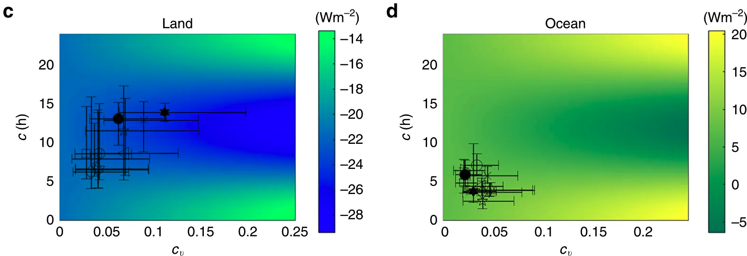
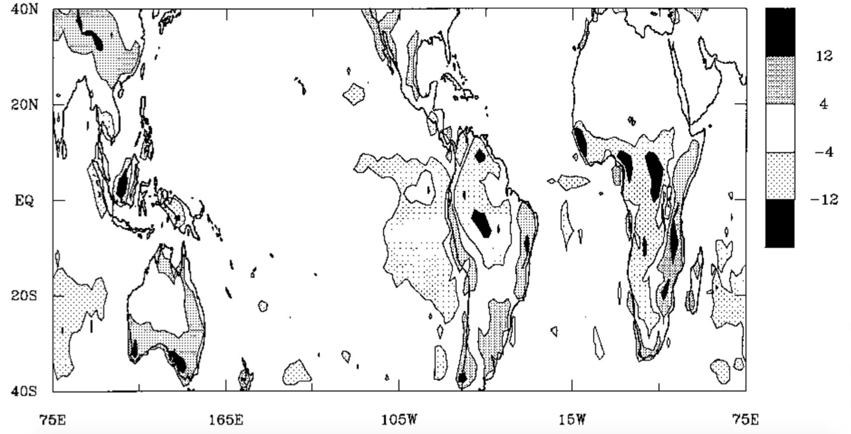
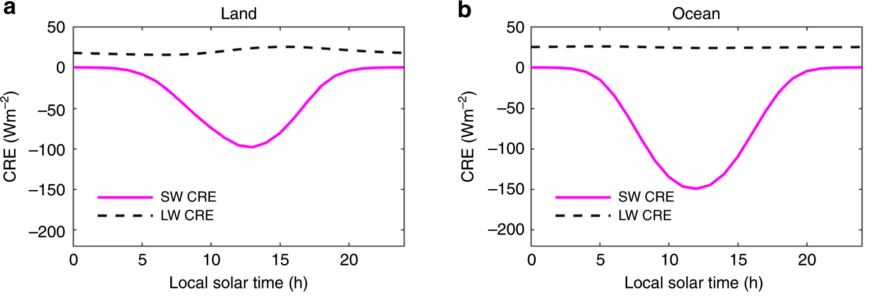
Importance of the Diurnal Cycle of Clouds
Biases in albedo can arise from surface reflection and time-mean cloud properties. One understudied source of bias is cloud diurnal cycles.
Diurnal variability in clouds modulates the diurnal cycle of solar insolation.
Monthly-mean shortwave fluxes are influenced unevenly by the diurnal cycle of clouds.
Cloud Diurnal Cycle Contribution to Monthly-Mean SW Flux
Yin and Porporato, Nature Communications, 2017
Bergman and Salby, Journal of Climate, 1997

Slide 4
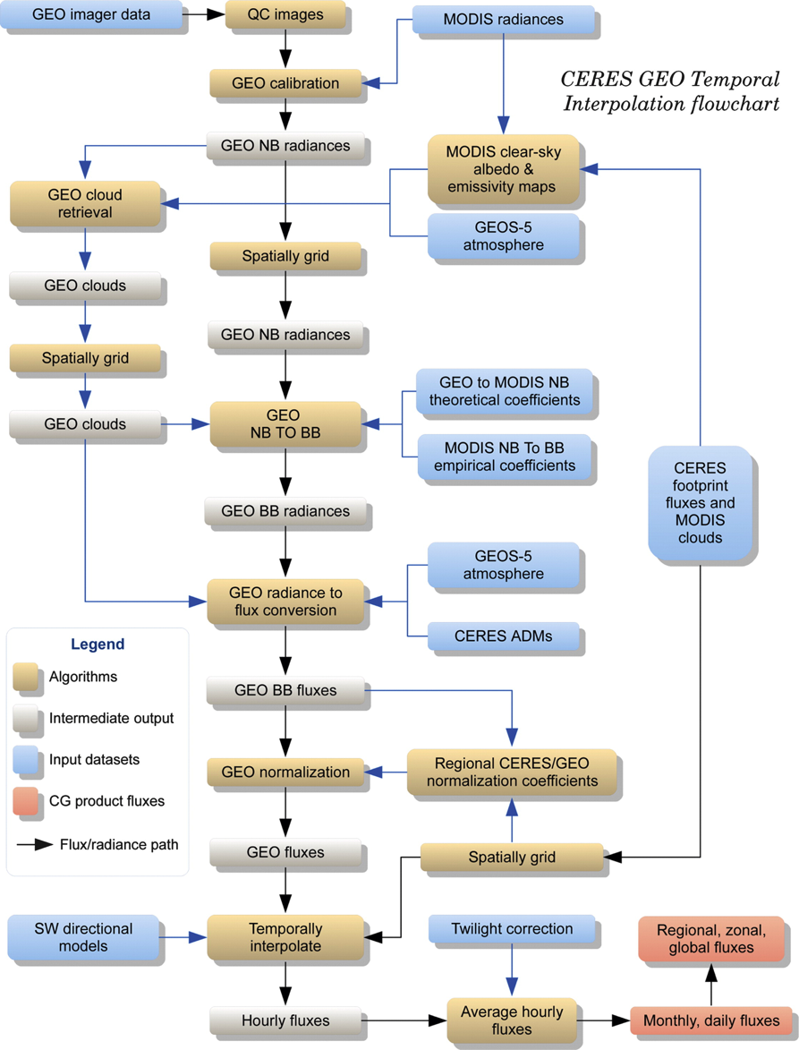
RSR Diurnal Variability
But how well do we know diurnal variations in SW radiation?
CERES monthly-averaged flux estimates require an estimate of the diurnal cycle in RSR, even though observations are made at fixed local solar hours.
The process-chain for diurnal filling has numerous components, relying primarily on a network of geostationary cloud observations.
The diurnal filling of fluxes has not independently tested.
EPIC and NISTAR fluxes provide that independent tests of CERES SYN.

Slide 5
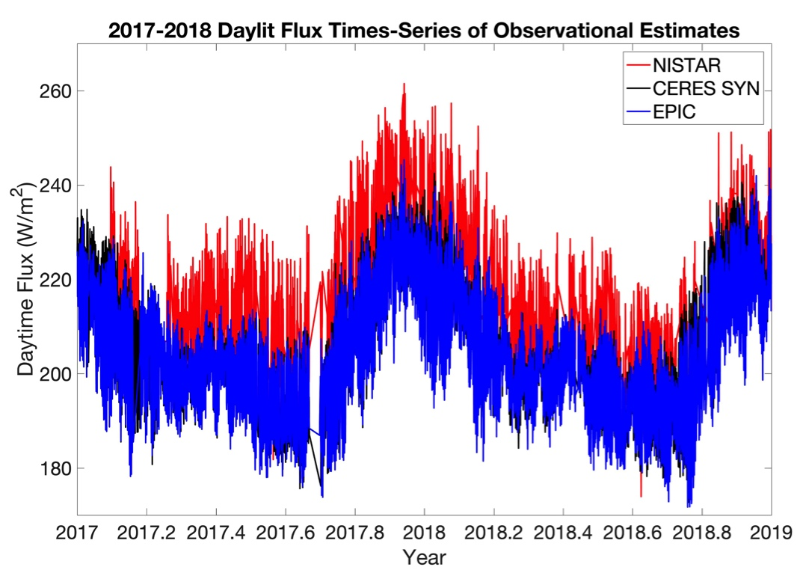
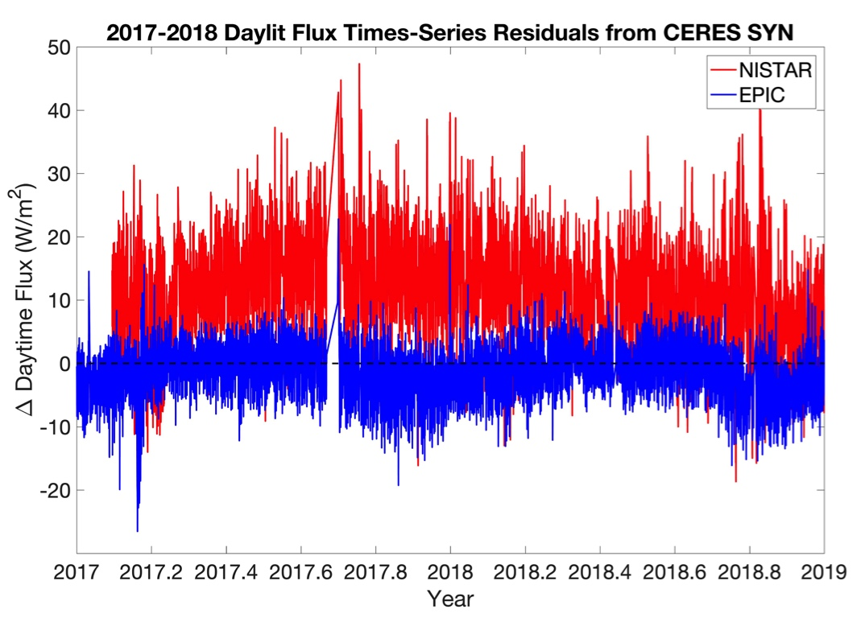
DSCOVR/CERES Flux Comparisons
High-frequency observationally-based estimates of RSR have been developed from NISTAR and EPIC and can be compared against CERES flux estimates.
EPIC fluxes vs. CERES SYN: +1.1±3.9 (1σ) W/m²)
NISTAR fluxes vs. CERES SYN: +11.9±7.9 (1σ) W/m²
Feldman et al, GRL, In Review

Slide 6
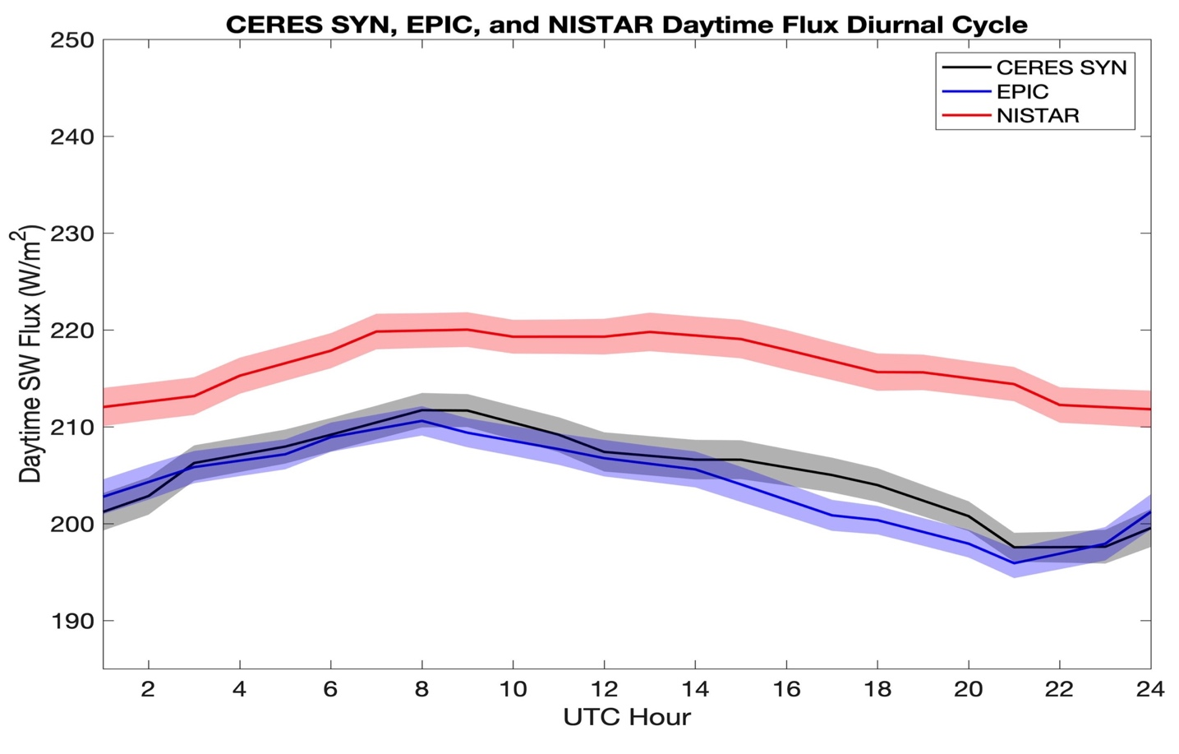
Observations of RSR Diurnal Variability
One of the distinguishing features of the DSCOVR platform is its high-frequency observations: The data reveal a regular diurnal cycle that varies seasonally.
Sunlit Prime Meridian
Sunlit International Date Line
Feldman et al, GRL, In Review

Slide 7
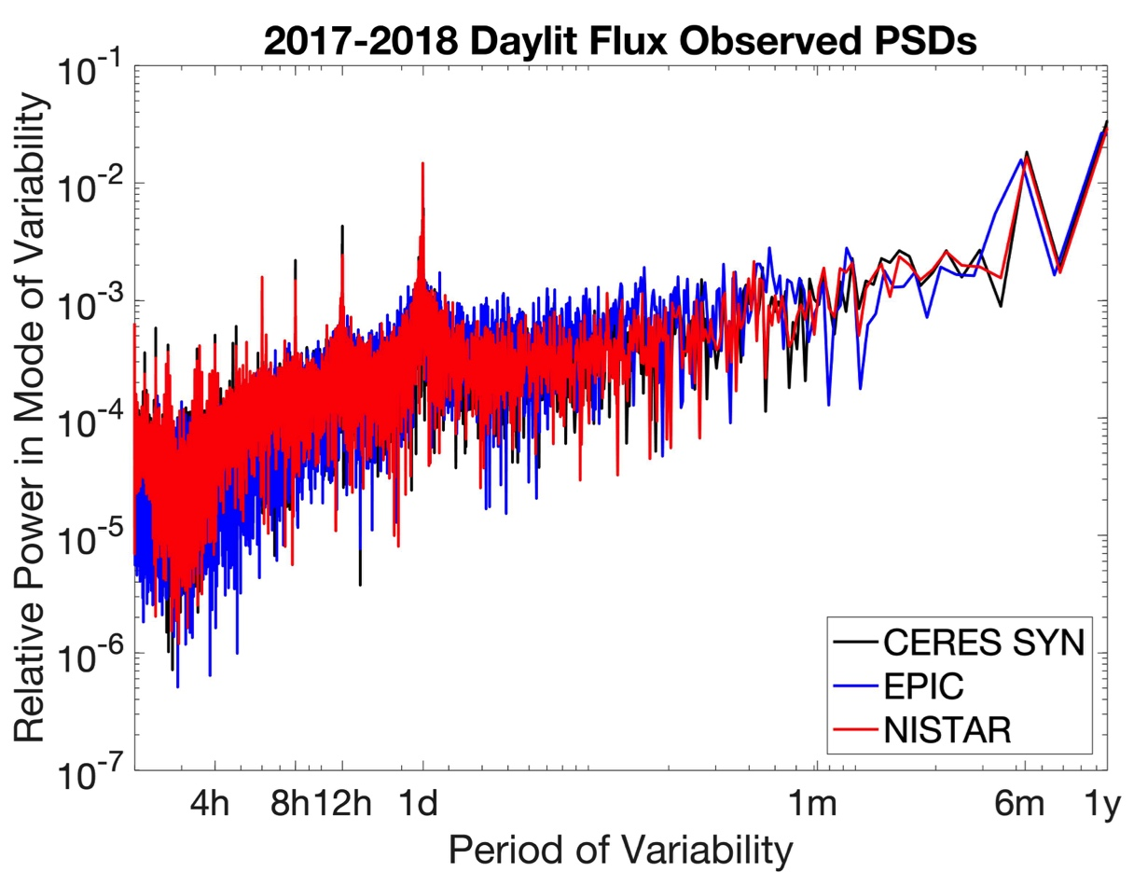
RSR Modes of Variability
RSR variability from 3 NISTAR, EPIC, and CERES substantially agree.
The observations show that the diurnal-filling process chain does not have discernible biases.
Diurnal mode primarily driven by Africa/Pacific surface reflection, modulated by clouds.
Sub-diurnal modes driven by zonal variations in the surface reflection of the daylit portion of Earth, modulated by clouds.
Feldman et al, GRL, In Review

Slide 8
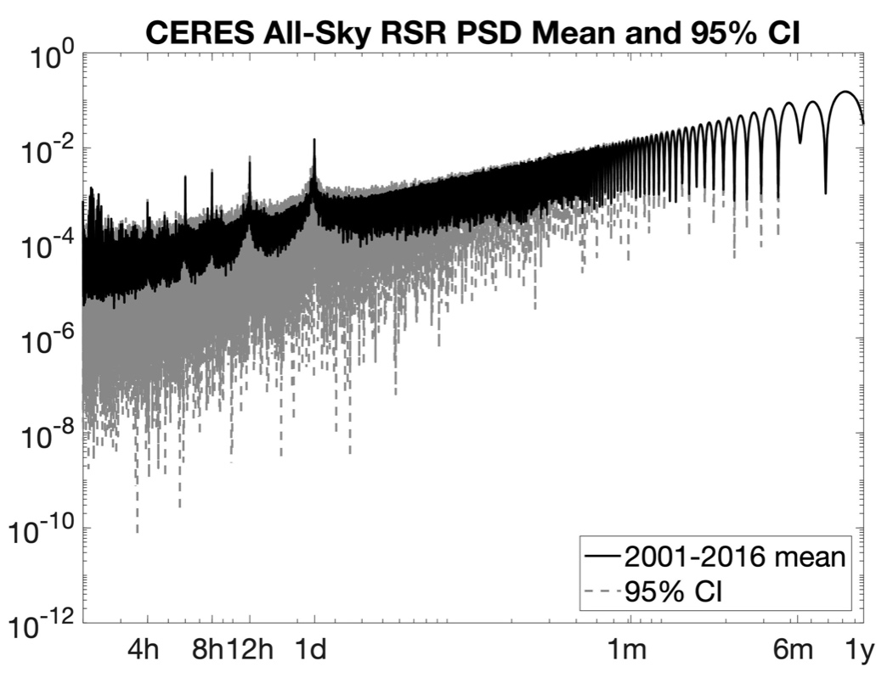
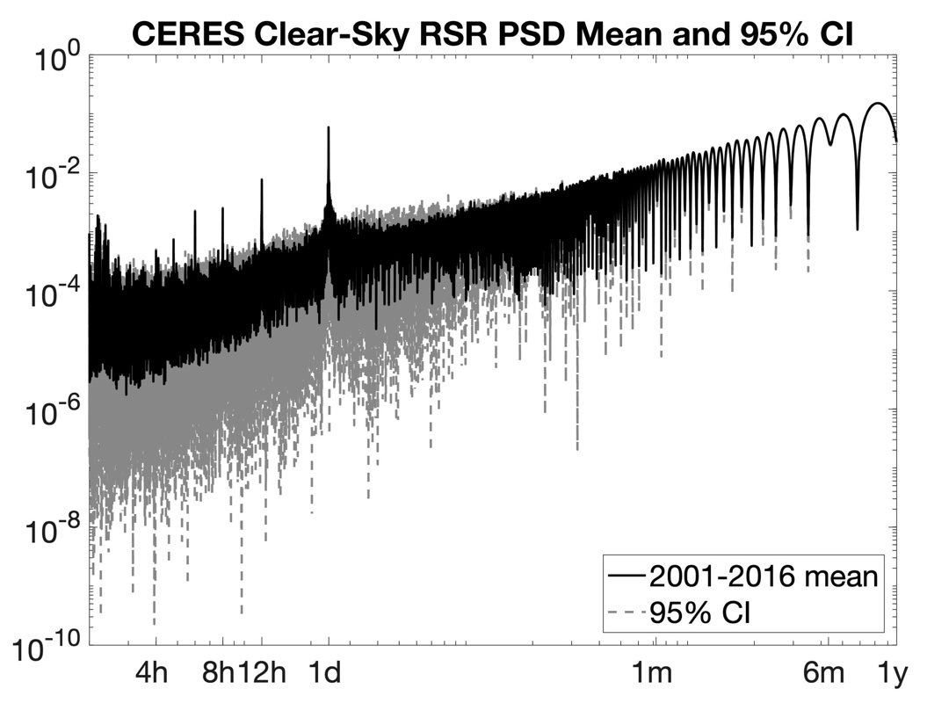
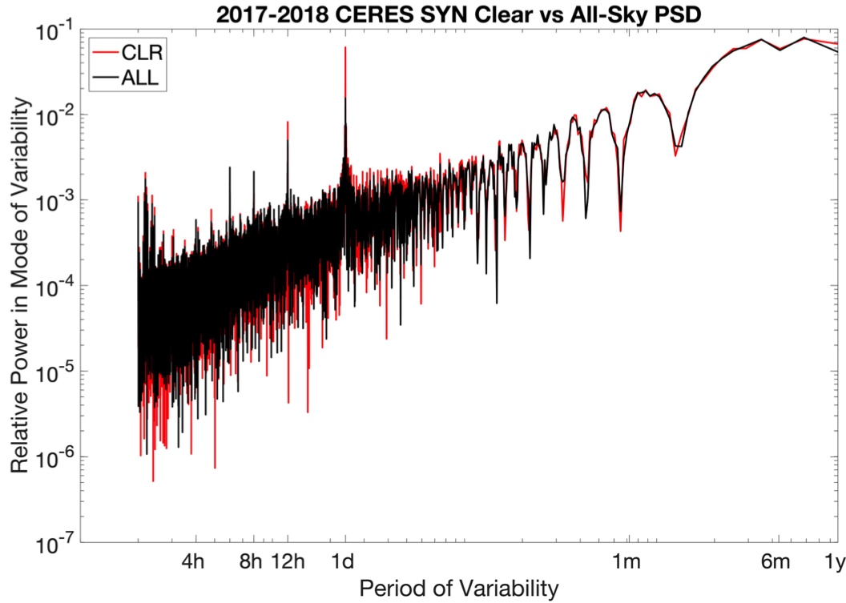
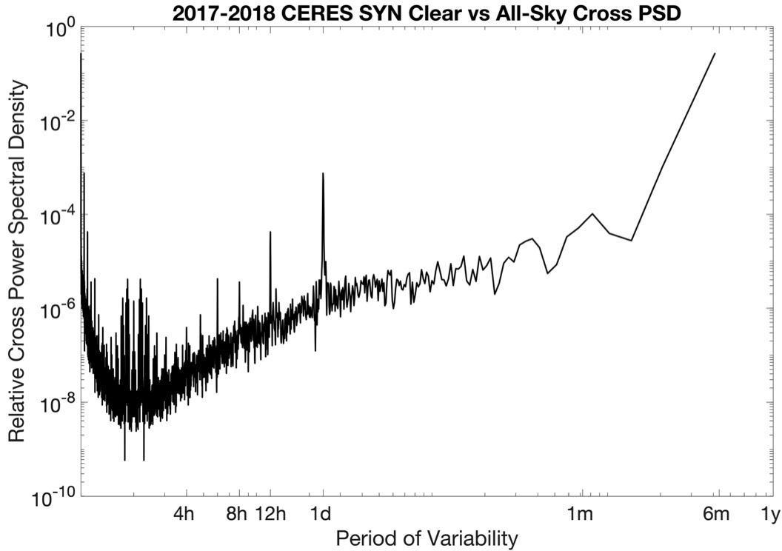
Cloud Contributions to RSR Variability
We do not have clear-sky fluxes, except from CERES SYN estimates.
Analyzing CERES SYN flux modes of variability reveals that clouds tend to mute the prominence of diurnal and sub-diurnal modes of variability caused by surface reflection.
The Cross PSD shows the frequency variability of how this muting occurs.
Feldman et al, GRL, In Review

Slide 9
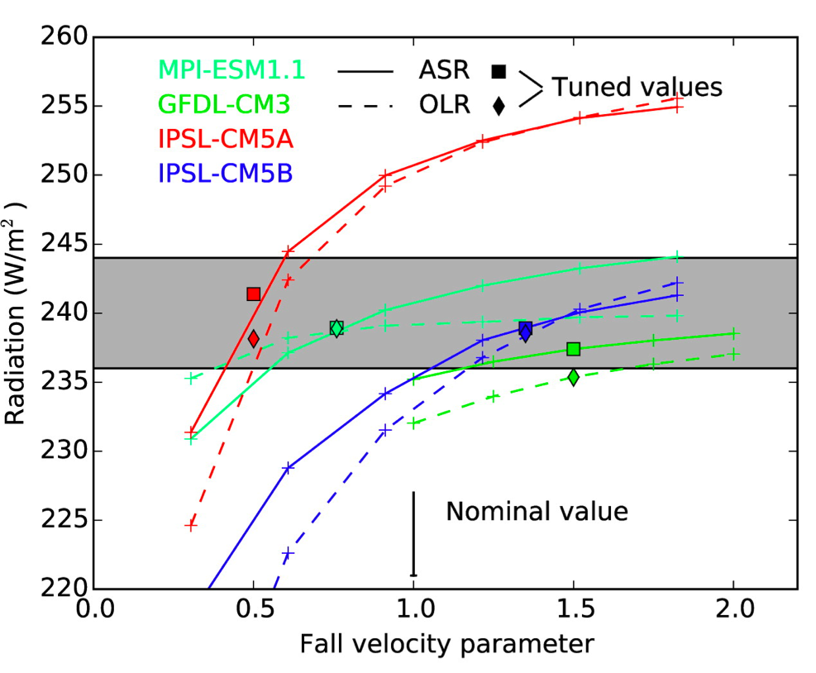
Opportunities for Model Confrontation
There is concurrence in observations about sub-diurnal to seasonal variability in RSR.
The distribution of surface reflection and how clouds modulate that variability produces distinct patterns in frequency-space.
These observations show a pathway by which RSR occurs, not just a value to reproduce, and enable tests of second-order behavior in RSR. We propose it be considered in tuning exercises.
Mauritsen et al, JAMES, 2012

Slide 10
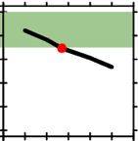
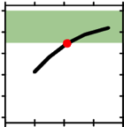
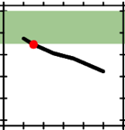
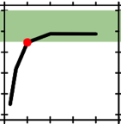
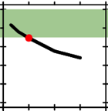
Model TOA Energy Balance
Models are calibrated/tuned to achieve TOA energy balance on long time-scales.
This process involves balancing a number of competing model performance goals by adjusted parameters to which models are sensitive but which are poorly or unconstrained.
There is a question of whether this juggling act is getting the right answer for the wrong reason.
Convective mass-flux above level of non-buoyancy
Entrainment rate for shallow convection
Entrainment rate for deep convection
Homogeneity factor for liquid clouds
Convective cloud conversion rate from water to rain
0.50 0.60 0.70 0.80 0.90 1.00 1.10
0.0000 2e-4 4e-4 6e-4 8e-4 1e-3 1.2e-3
0.00 0.10 0.20 0.30 0.40
0.0000 2e-4 4e-4 6e-4 8e-4 1e-3
0.0000 2e-4 4e-4 6e-4 8e-4 1e-3 1.2e-3
244
240
236
232
228
224
TOA Shortwave Radiation (W/m²)
Mauritsen et al, JAMES, 2012

Slide 11
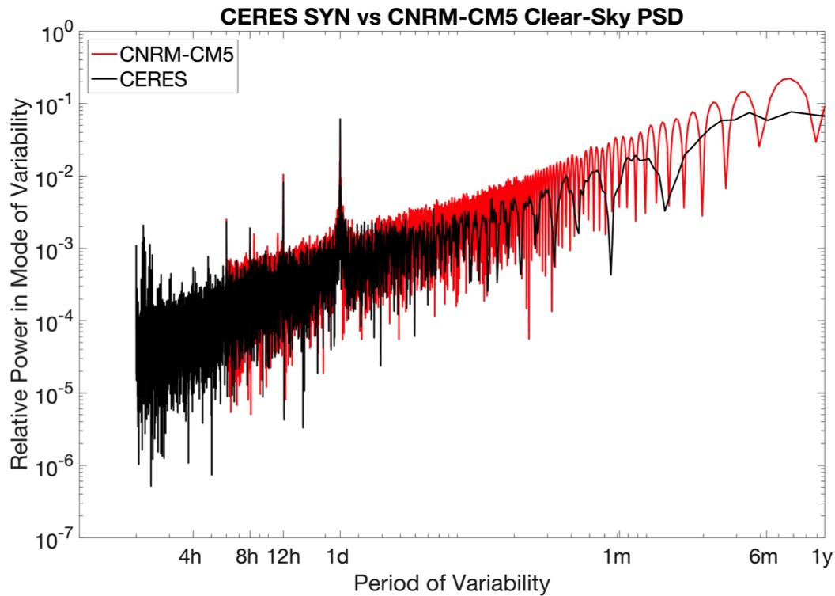
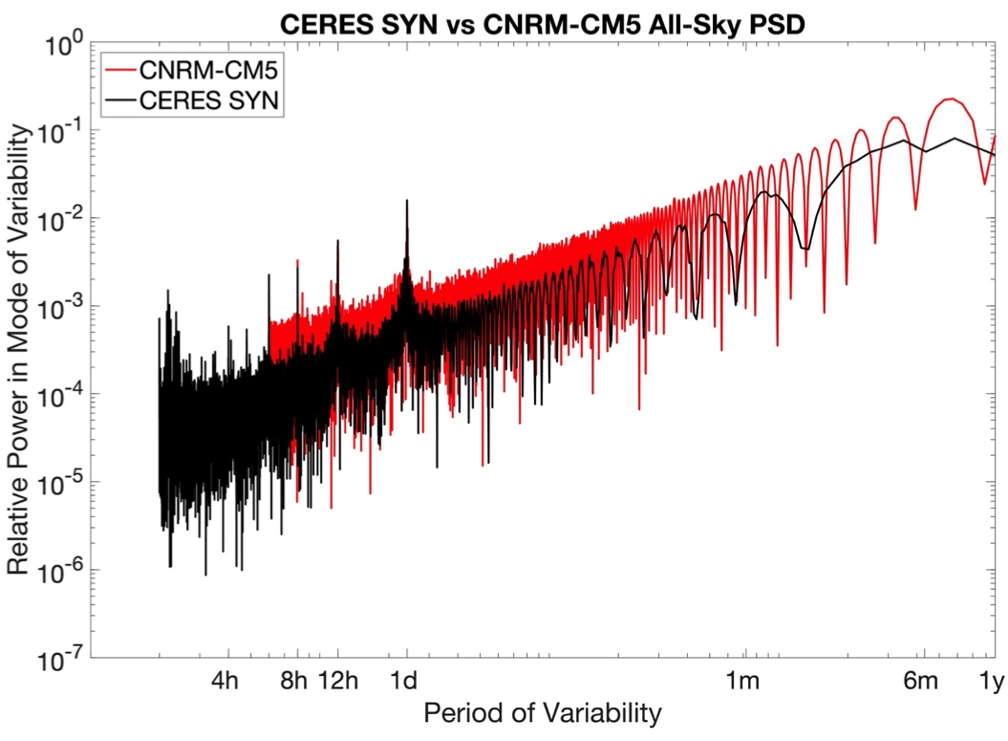
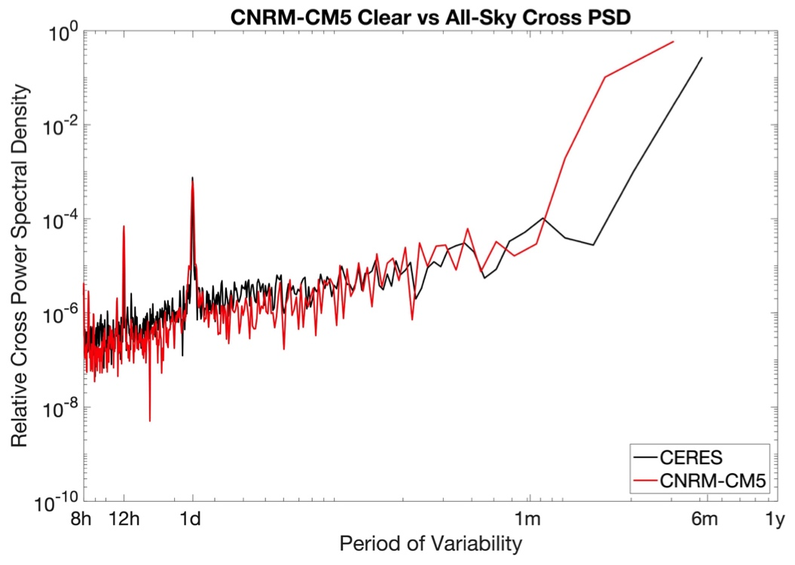
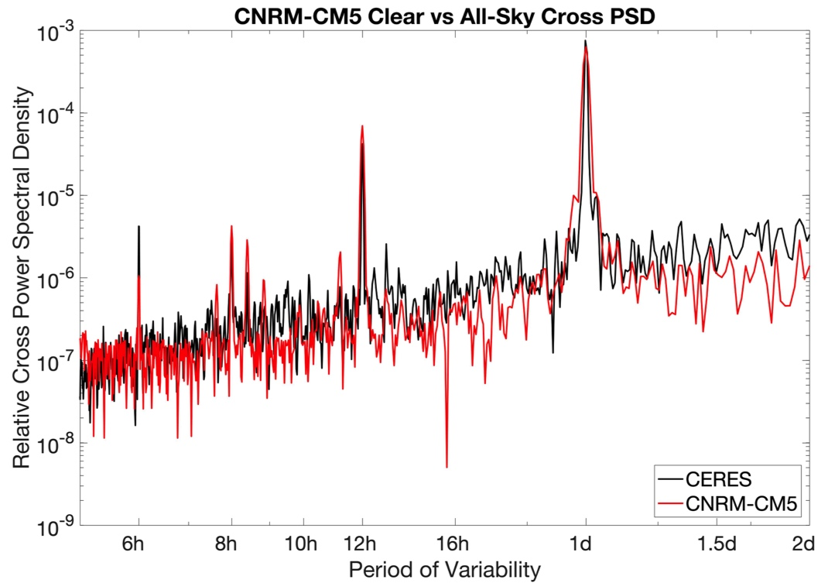
Measurement/Model Intercomparison
The comparison of the CNRM-CM5 model and CERES-SYN observations shows:
The model allocates amounts of power to prominent diurnal and sub-diurnal modes that generally agree with observations.
The model allocates too much power to super-diurnal modes compared to observations.
Cross PSD shows model clear vs. all-sky RSR variability is too low at non-prominent modes: the relationship between all-sky and clear-sky is under-correlated in models at these time-scales.
Feldman et al, GRL, In Review

Slide 12
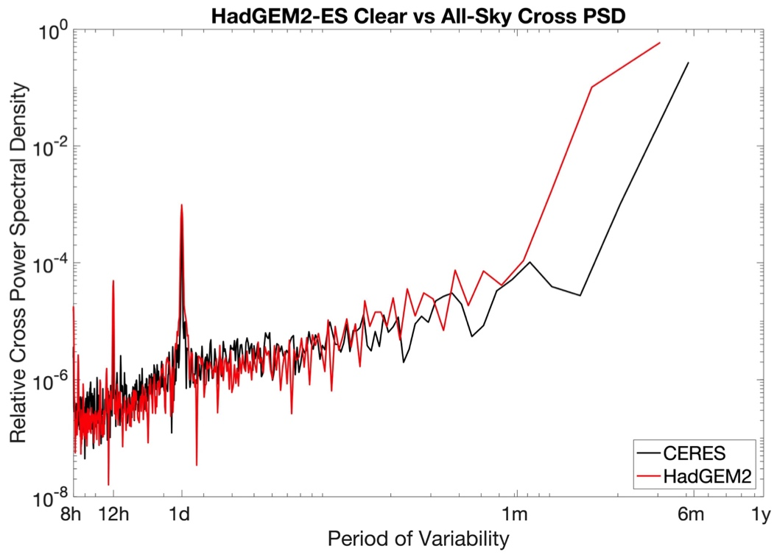
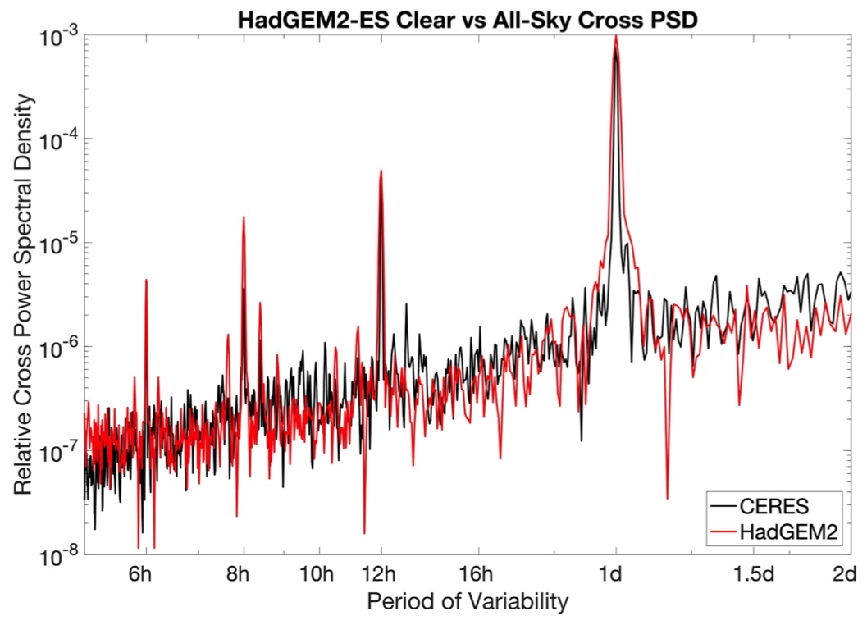
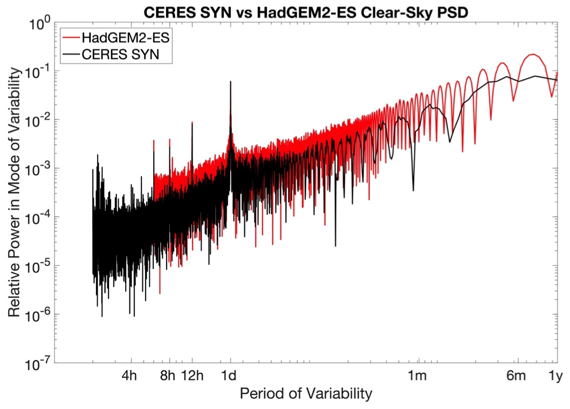
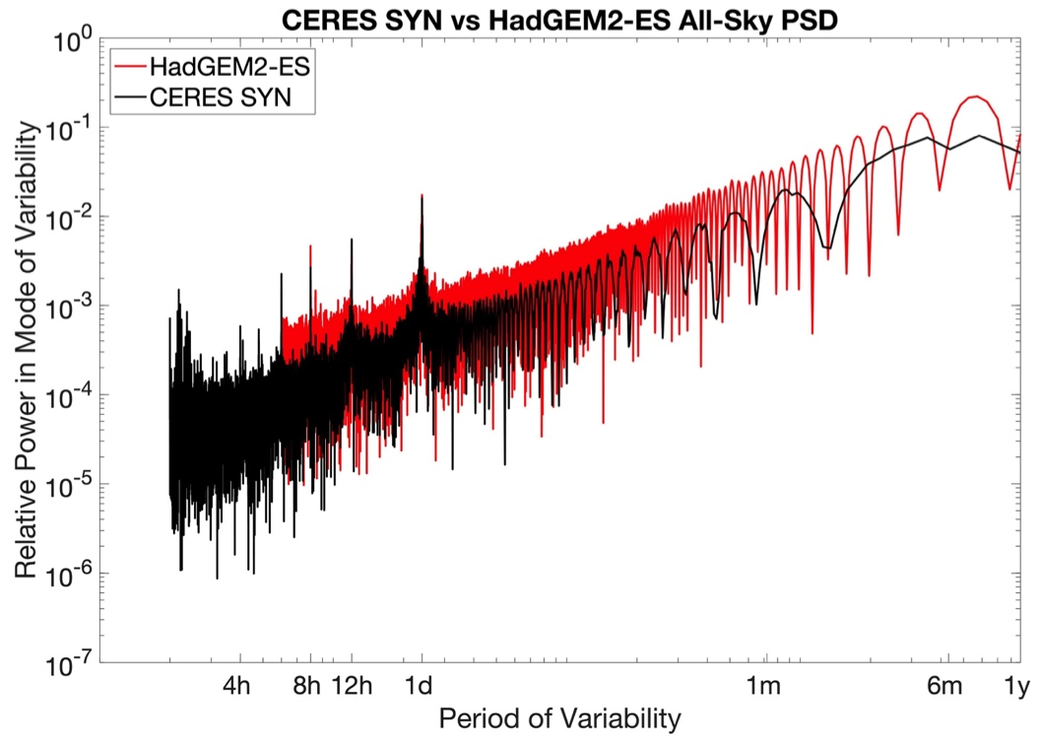
Measurement/Model Intercomparison
The performance of 4 models was tested: CNRM-CM5, HadGEM2-ES, CanAM4, MRI-CGCM3.
All performed similarly relative to CERES SYN in Clear-Sky and All-Sky PSD and Cross-PSD.
Differences suggest:
Models over-correlate RSR at short time-scales with RSR at longer time-scales.
Models slightly under-estimate correlation of clear- and all-sky RSR at diurnal to synoptic time-scales.
Mauritsen et al, JAMES, 2012

Slide 13
Examining CMIP6 Models
The Coupled Model Intercomparison Project – Phase 6 (CMIP6) is underway, with many models having already reported results.
Several experiments report TOA shortwave upwelling fluxes at hourly or sub-hourly intervals.
Dozens of models can be tested in limited cases.

Slide 14
Summary
For radiation budget observations, one of DSCOVR’s distinguishing feature is its frequency of observations.
SW flux estimates constructed from EPIC and NISTAR suggest that previously-untested diurnal filling is not problematic for long-term estimates of SW fluxes.
Frequency analysis can help constrain not just long-term SW fluxes, but how they are achieved by models.
Analysis suggests models overestimate variability of RSR in super-diurnal frequencies and therefore overestimate how RSR is correlated between shorter and longer time-scales.
Causes for model biases should be investigated.

