Slide 1
EPIC L2 Cloud Products Update
Yuekui Yang, Kerry Meyer, Alexander Marshak, Qilong Min, Anthony Davis, Steven Platnick, Daniel Holdaway, Gala Wind, Alexei Lyapustin, Lazaros Oreopoulos, Zhibo Zhang
DSCOVR Earth Science Team Meeting
Oct. 31 – Nov 1, 2016, Goddard Space Flight Center

Slide 2

Cloud Product System
EPIC L1B Products
Ancillary Data
Cloud Mask
Effective Height/Pressure
Cloud Optical Thickness
Cloud Top Height/Pressure
EPIC L2 Cloud Products

Slide 3
Current Status
Cloud mask, cloud effective height and cloud optical thickness subsystems running.
Cloud mask subsystem improvements undergoing.
Cloud effective height/pressure subsystem implemented and running.
Cloud optical thickness: single channel retrieval using MODIS infrastructure.
Theoretical studies published (no DSCOVR data involved): 1) potential uncertainties in EPIC cloud optical thickness retrieval (Meyer, Yang and Platnick, 2016, AMTD); 2) EPIC temporal sampling effect study with GEOS-5 Nature Run (Holdaway and Yang, 2016a, 2016b, Remote. Sens.)

Slide 4
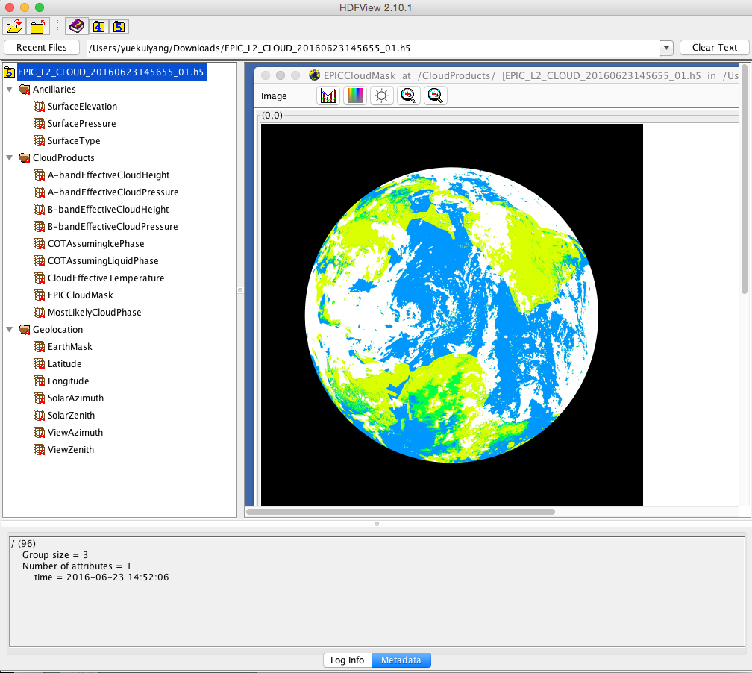
L2 Cloud Product File Overview

Slide 5
EPIC Channels Currently Used for Cloud Products
l (nm) | Dl (nm) FWHM | Purpose
317.5±0.1 | 1±0.2 | Ozone
325±0.1 | 2±0.2 | Ozone
340±0.3 | 3±0.6 | Ozone, Aerosols
388±0.3 | 3±0.6 | Aerosols, Clouds
443±1 | 3±0.6 | Aerosols
551±1 | 3±0.6 | Aerosols, Vegetation
680±0.2 | 2±0.4 | Aerosols, Vegetation, Clouds, O₂ B-Band Reference
687.75±0.2 | 0.8±0.2 | O₂ B-Band Cloud Height
764.0±0.2 | 1±0.2 | O₂ A-Band Cloud Height
779.5±0.3 | 2±0.4 | O₂ A-Band Reference, Vegetation

Slide 6
1. Cloud Mask

Slide 7
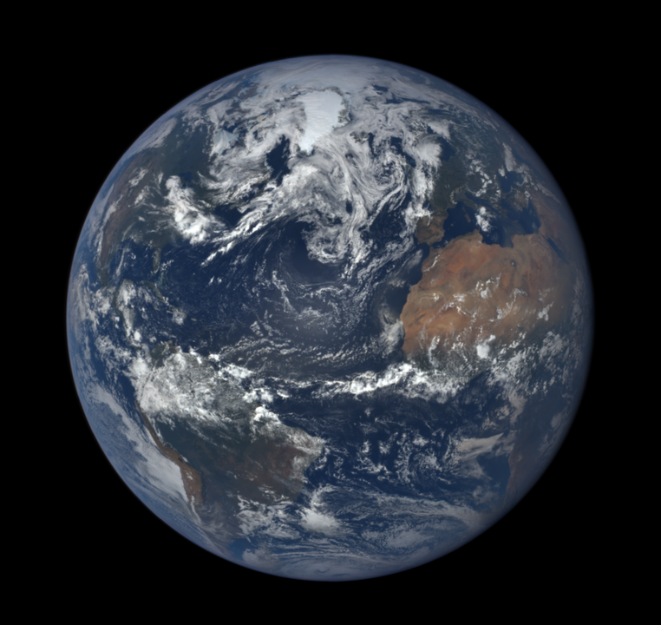
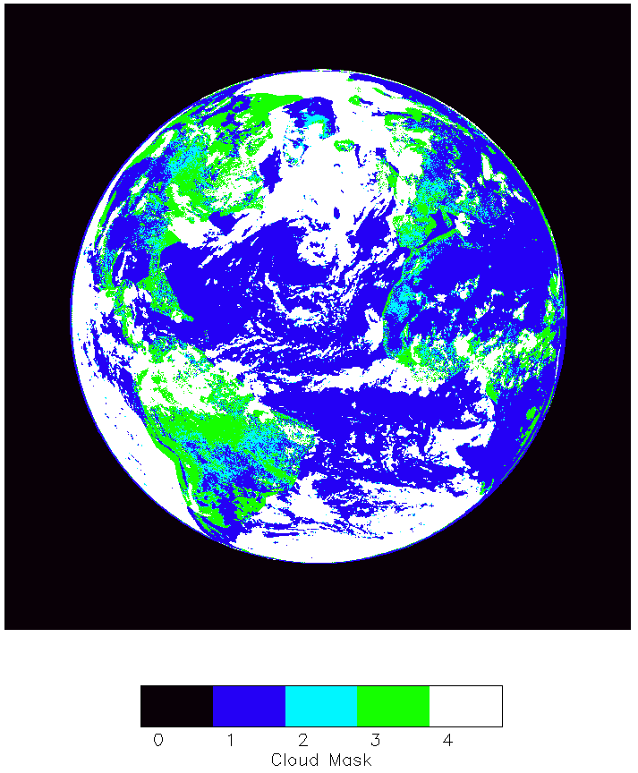
Cloud mask example
epic_1b_20160623145655_01.h5

Slide 8
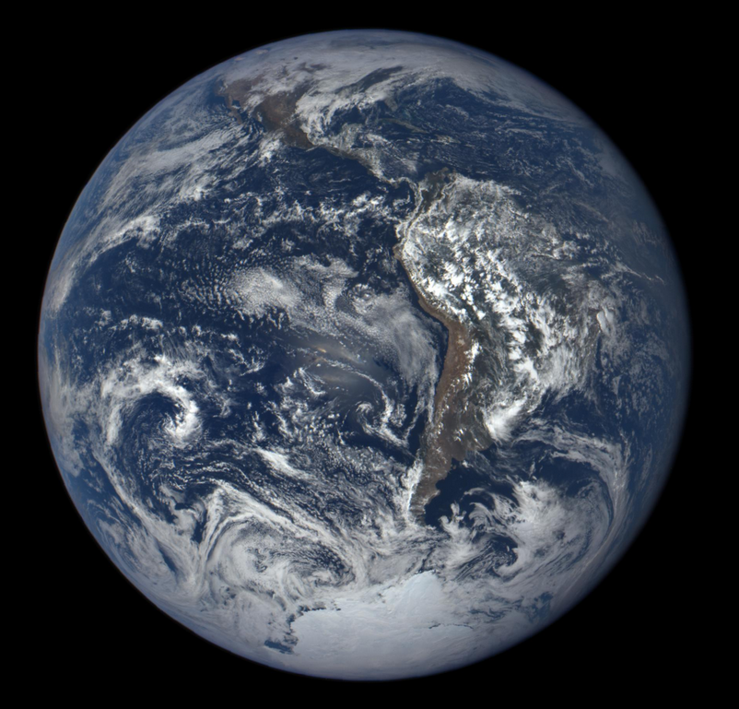
Difficulties in cloud detection with only shortwave channels, especially over ice/snow
No IR channels; no SWIR channels

Slide 9
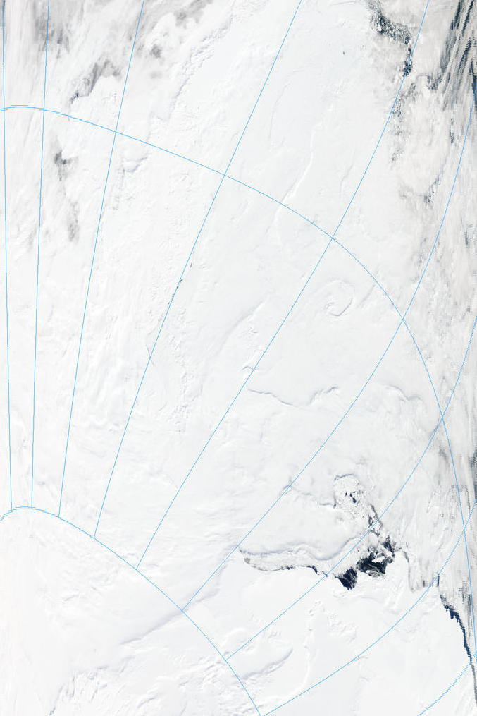
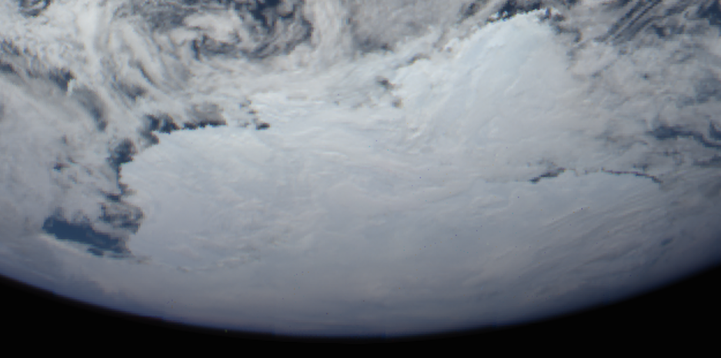

Difficulties in cloud detection over ice/snow
EPIC image time: 12/29/2015 18:27 GMT
Aqua MODIS time: 19:00 to 19:05 GMT

Slide 10
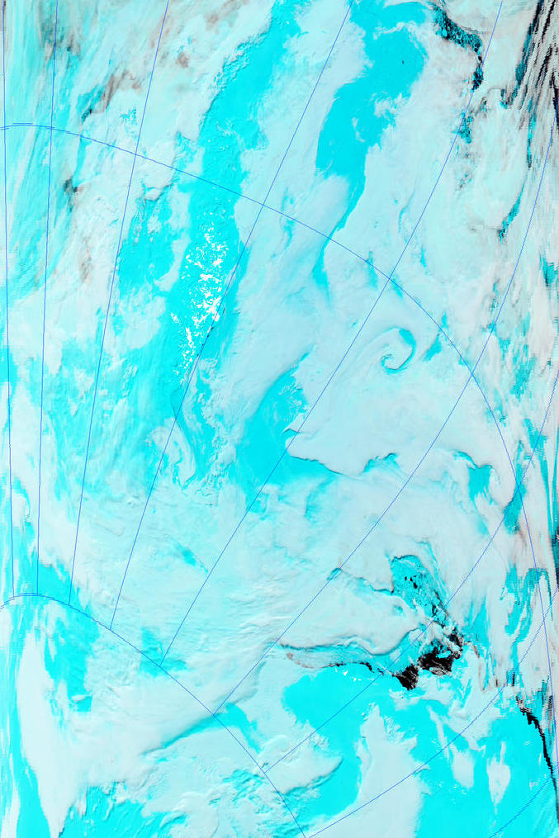
Difficulties in cloud detection over ice/snow
EPIC image time: 18:27 GMT
But
MODIS has SWIR channels
0.47, 1.6, 2.1 µm as RGB
Aqua MODIS time: 19:00 to 19:05 GMT

Slide 11
Cloud signal in EPIC A-band over different surface types

Slide 12
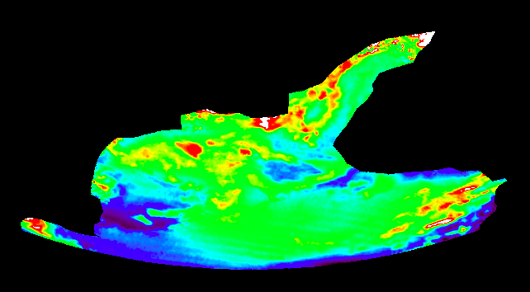
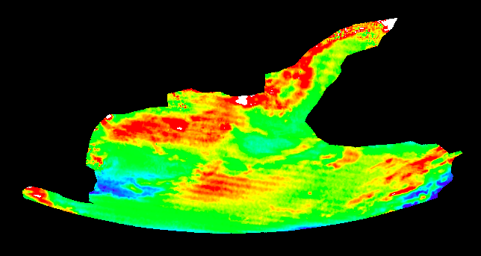
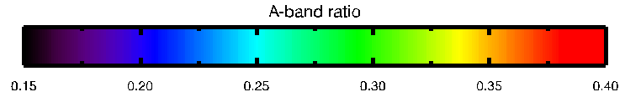
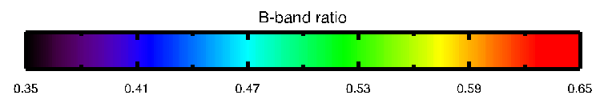
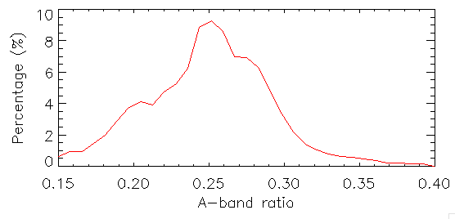
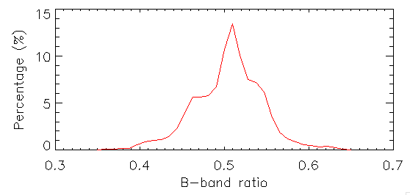
Cloud signal in EPIC A- and B-bands over ice/snow
A-band Ratio
B-band Ratio

Slide 13
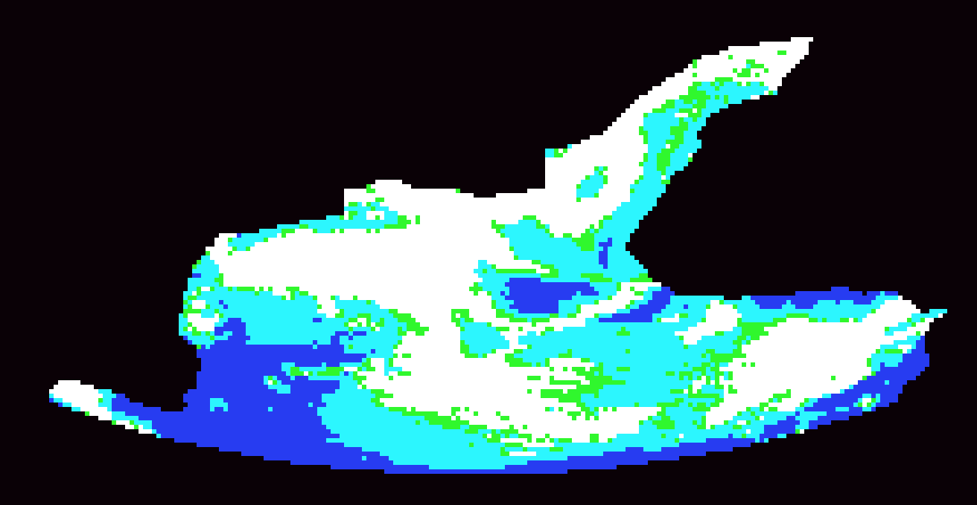


Cloud Mask from A- and B-bands
MODIS time: 19:00 to 19:05 GMT
EPIC time: 18:27 GMT

Slide 14
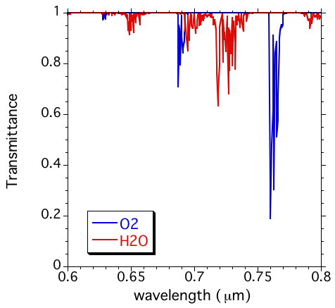
2. Cloud Effective Height/Pressure
B-band
reference
A-band
reference
B-band
A-band

Slide 15
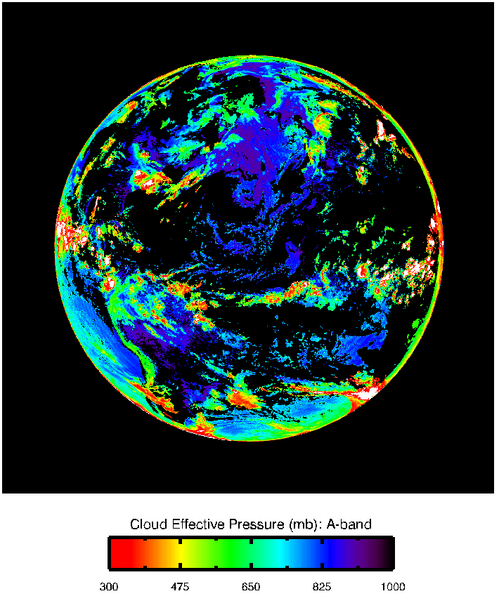
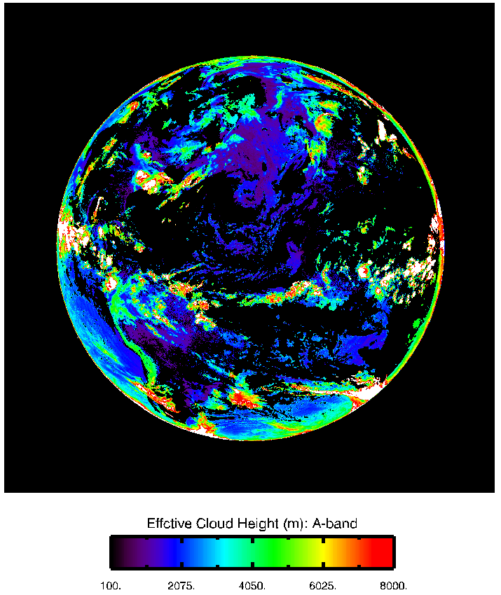
Cloud Effective Pressure/Height

Slide 16
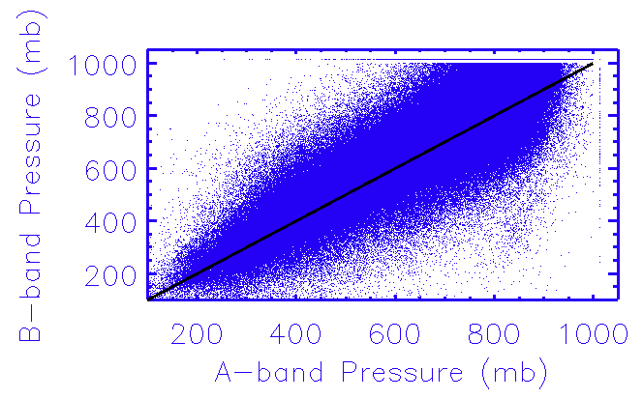
A-band vs B-band

Slide 17
3. Cloud Optical Thickness Retrieval
EPIC Cloud Mask
EPIC Cloud Height
Look-up Tables
EPIC L1B Data
Geolocation, angles, reflecantce
Cloud Optical Depth Retrieval
Single channel retrieval
Fixed particle size
Ancillary Data
Atmospheric Profiles, IGBP map, surface albedo, surface type.
1) Cloud optical depths:
all liquid
all ice
2) Likely cloud phase

Slide 18
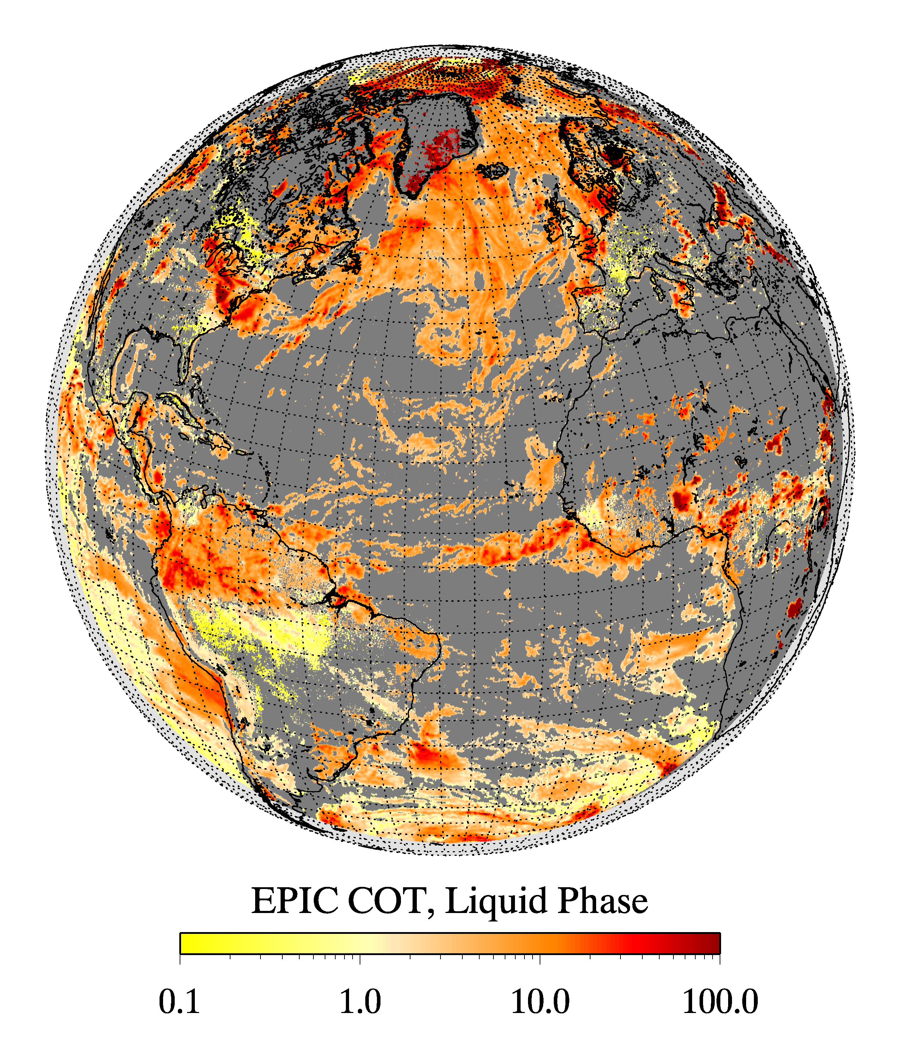
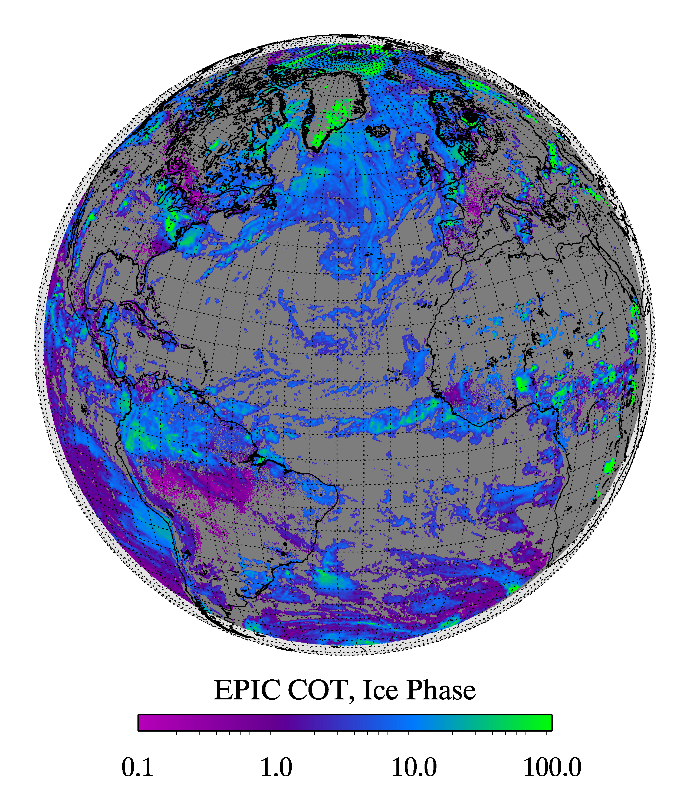
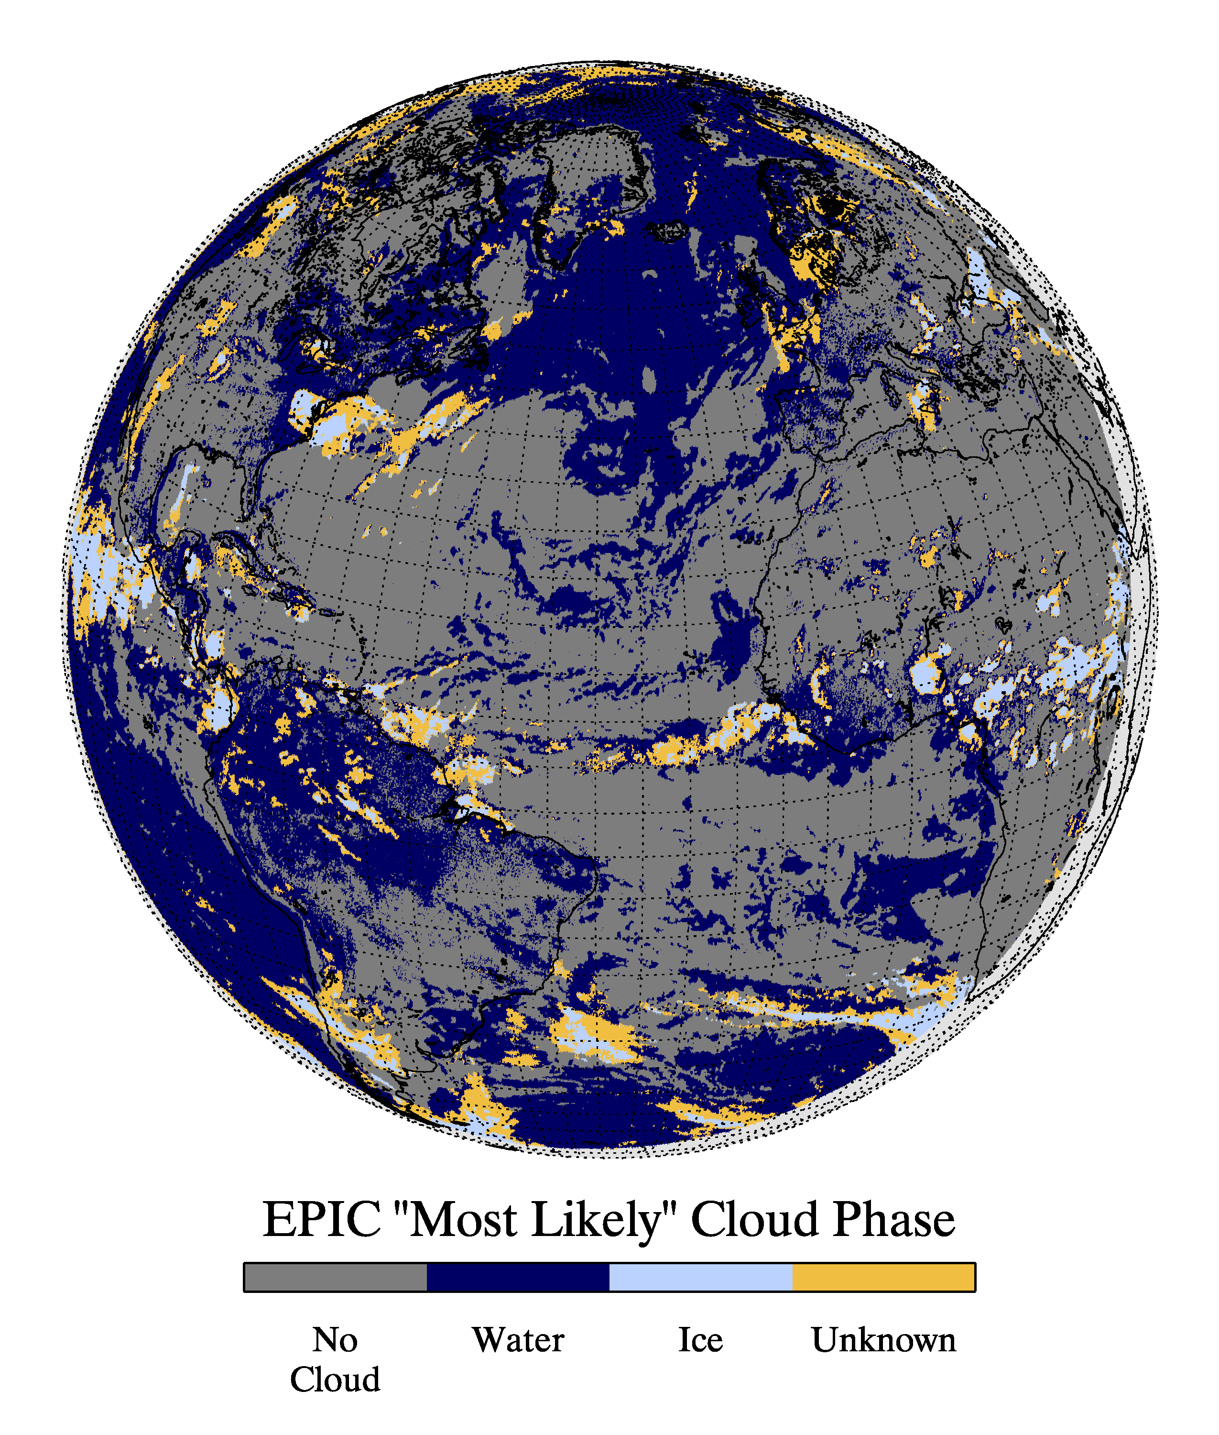
Cloud optical thickness retrievals
Cloud phase determination is based on the cloud temperature converted from the EPIC cloud height retrievals, which has large uncertainty.
L2 cloud products include COT assuming liquid phase, COT assuming ice phase and the likely cloud phase.

Slide 19
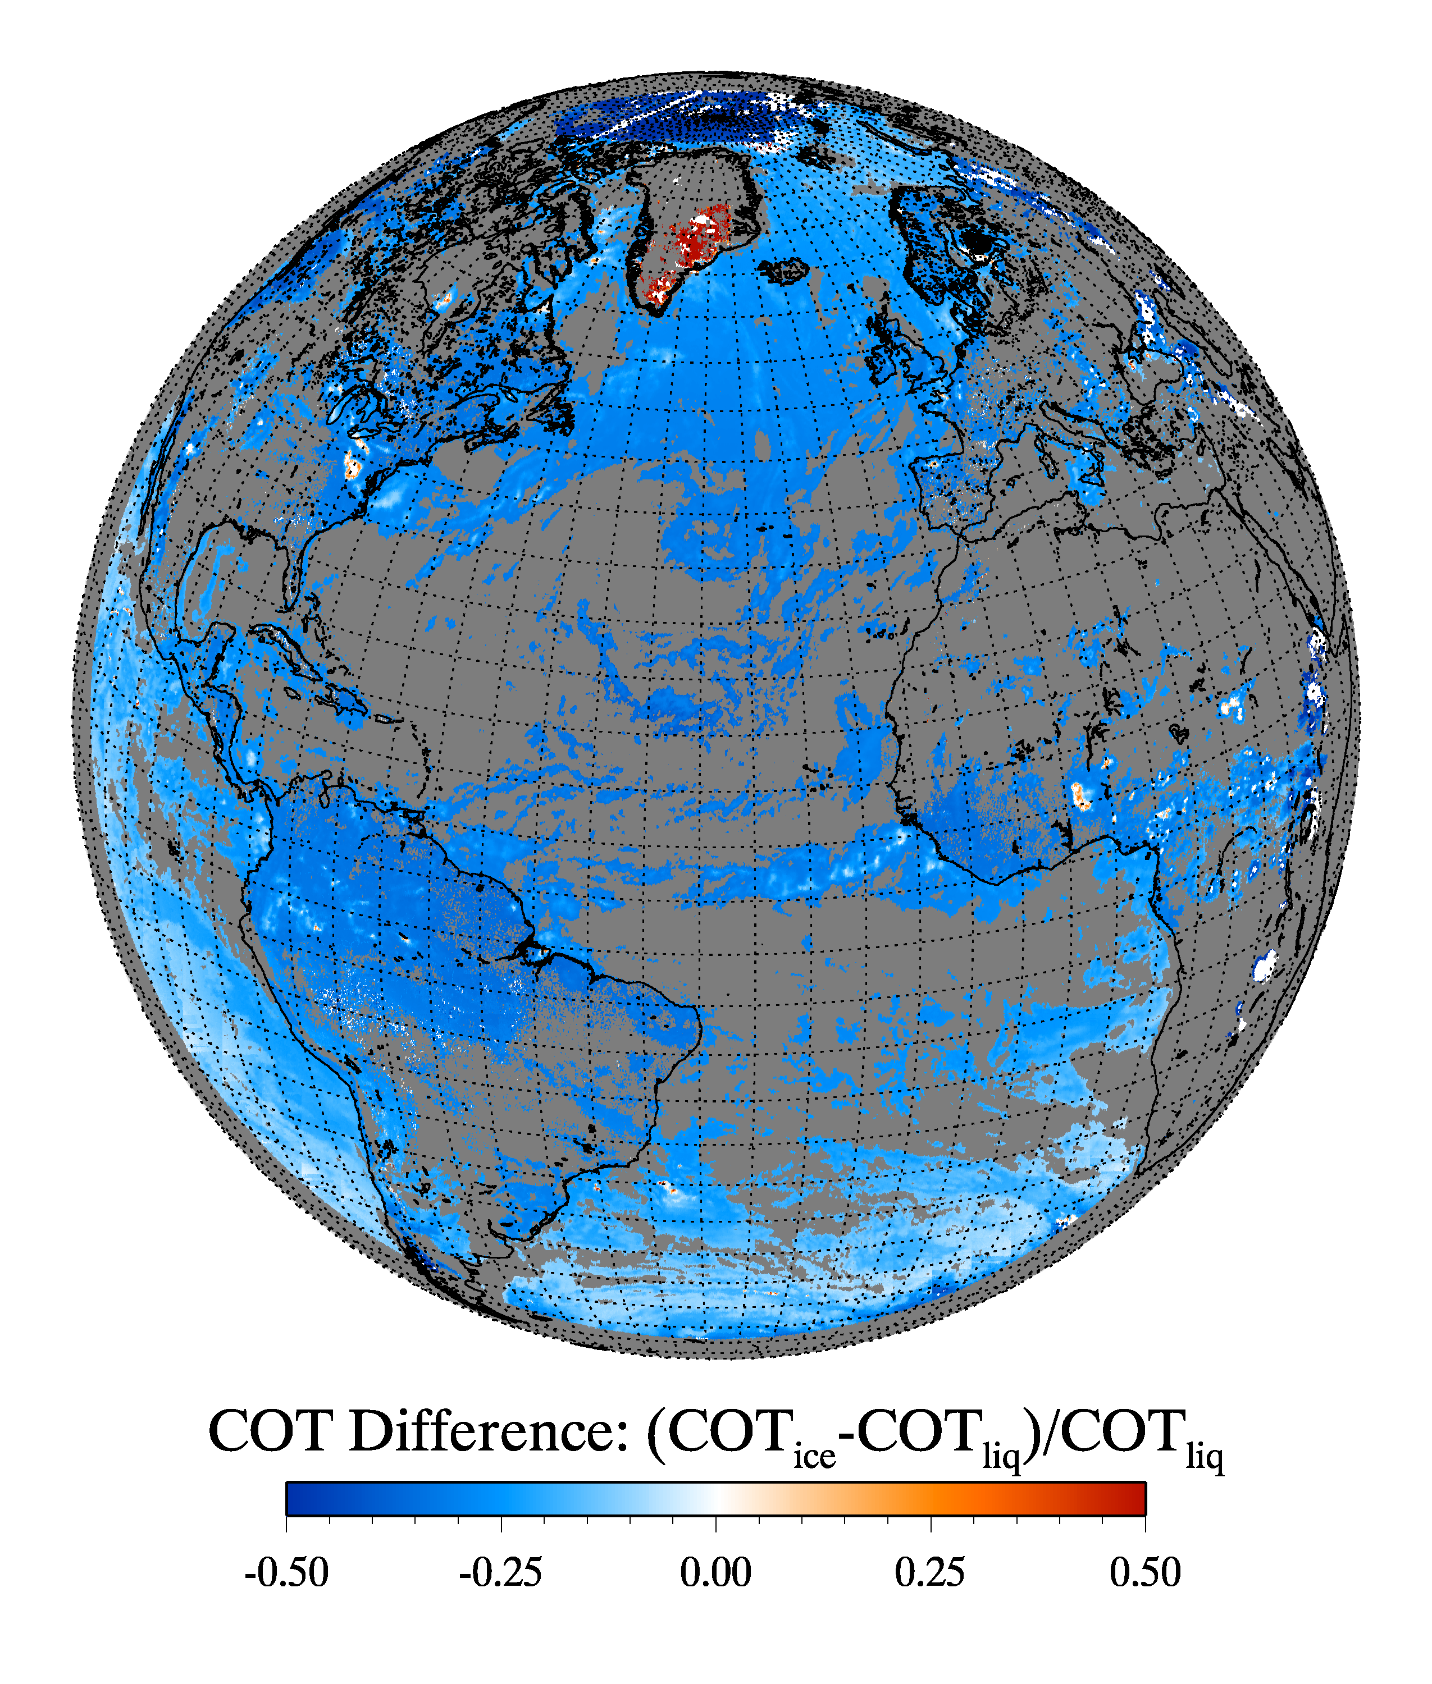
Cloud optical thickness retrievals
Cloud phase determination is based on the cloud temperature converted from the EPIC cloud height retrievals, which has large uncertainty.
L2 cloud products include COT assuming liquid phase, COT assuming ice phase and the likely cloud phase.

Slide 20
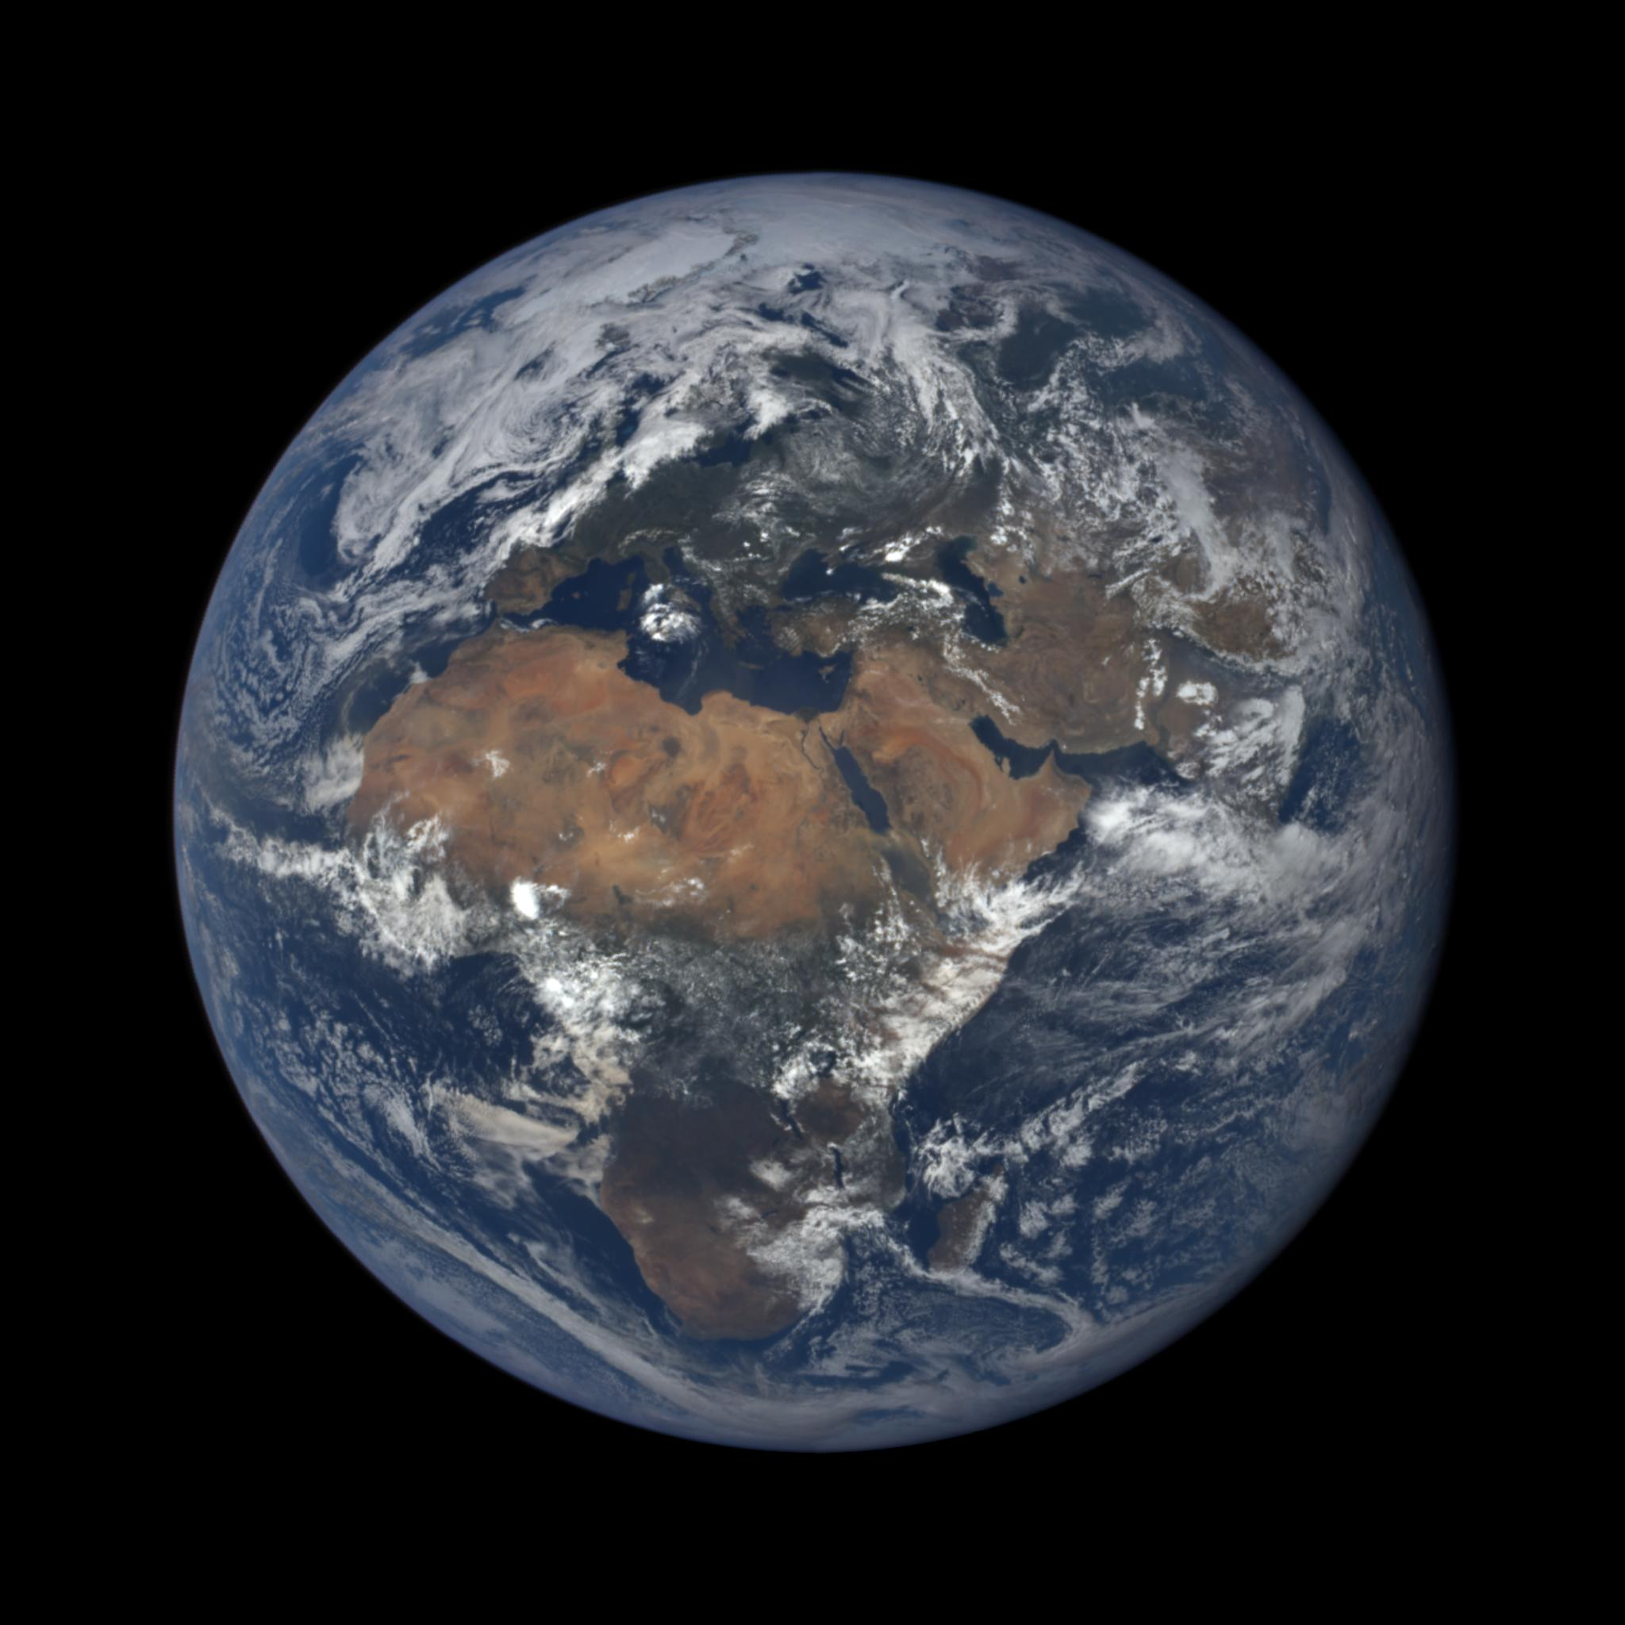
Potential Science (I): ice sheet reflectivity at near backscattering direction
EPIC can provide many observations for one location for different solar angles, e.g. the much interested Greenland.

Slide 21
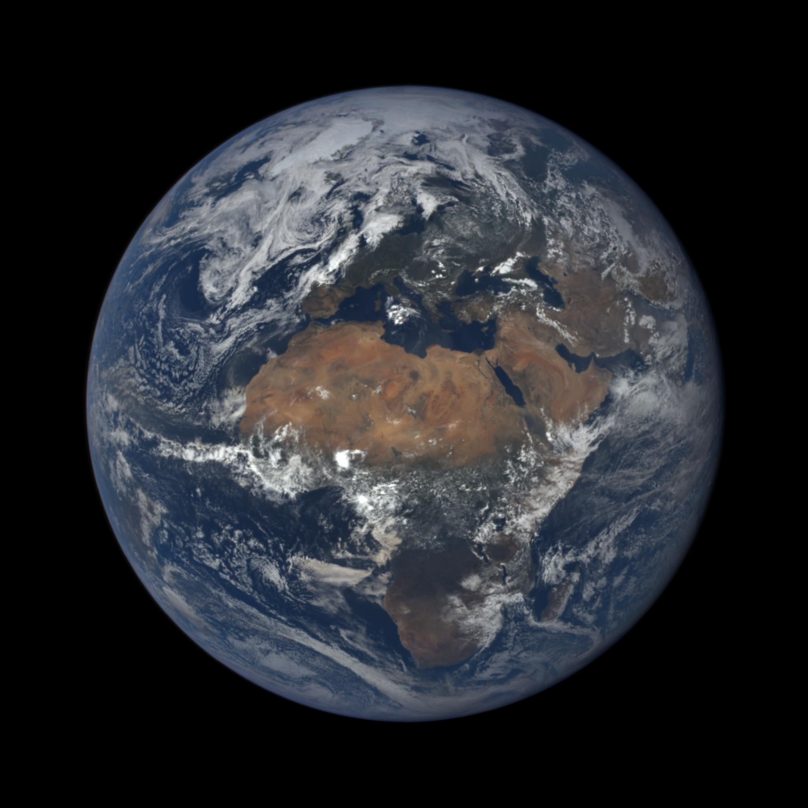

Slide 22
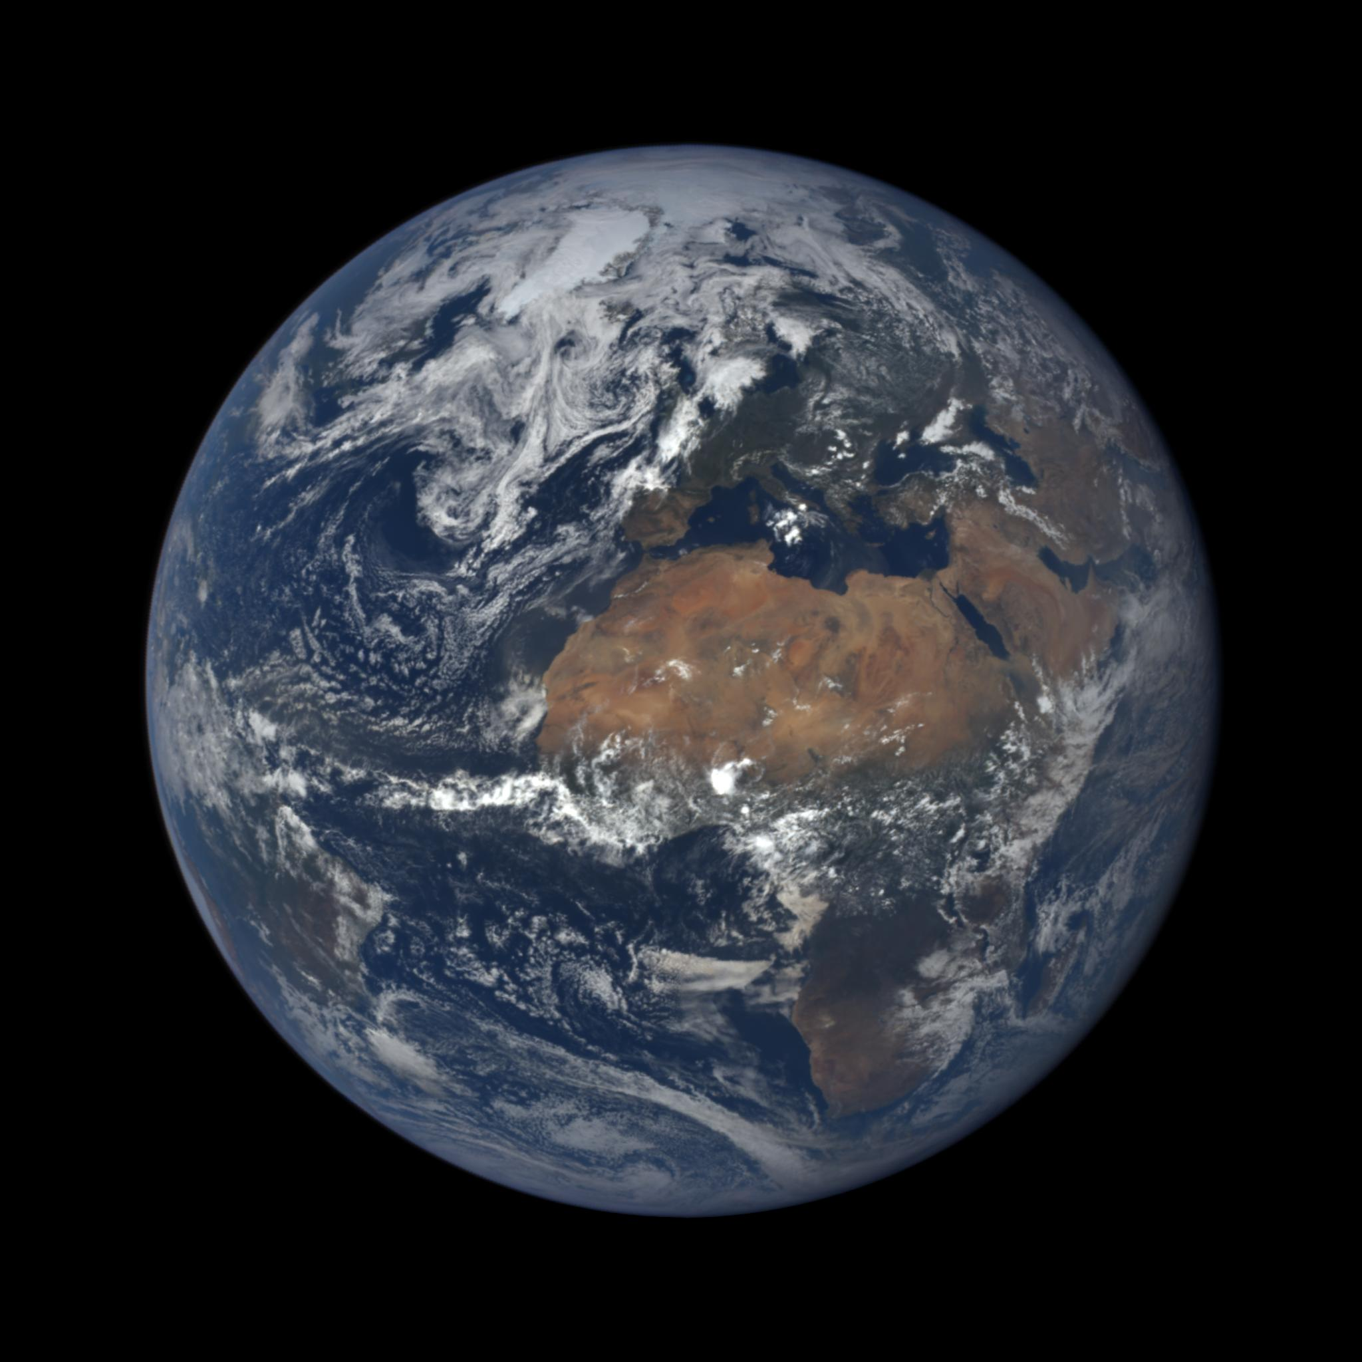

Slide 23
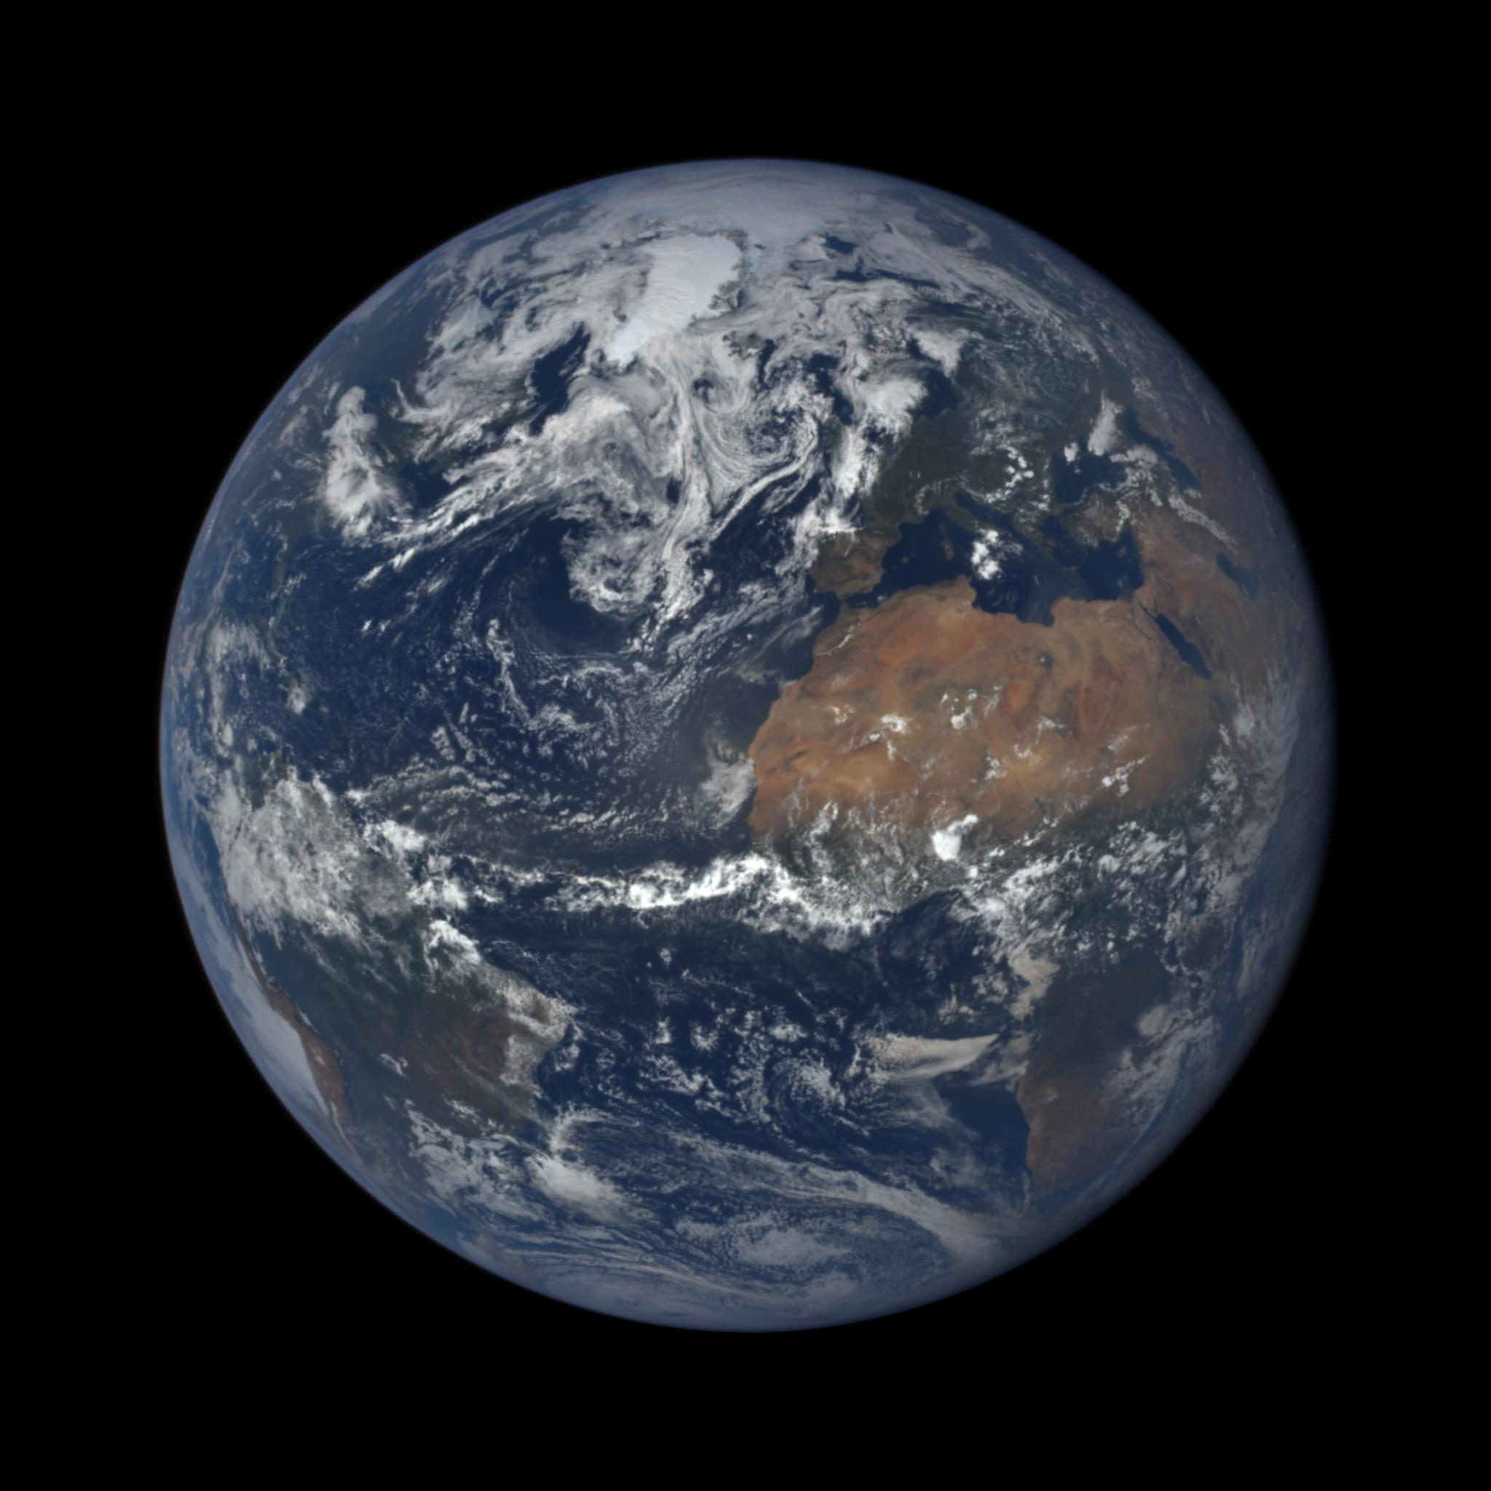

Slide 24
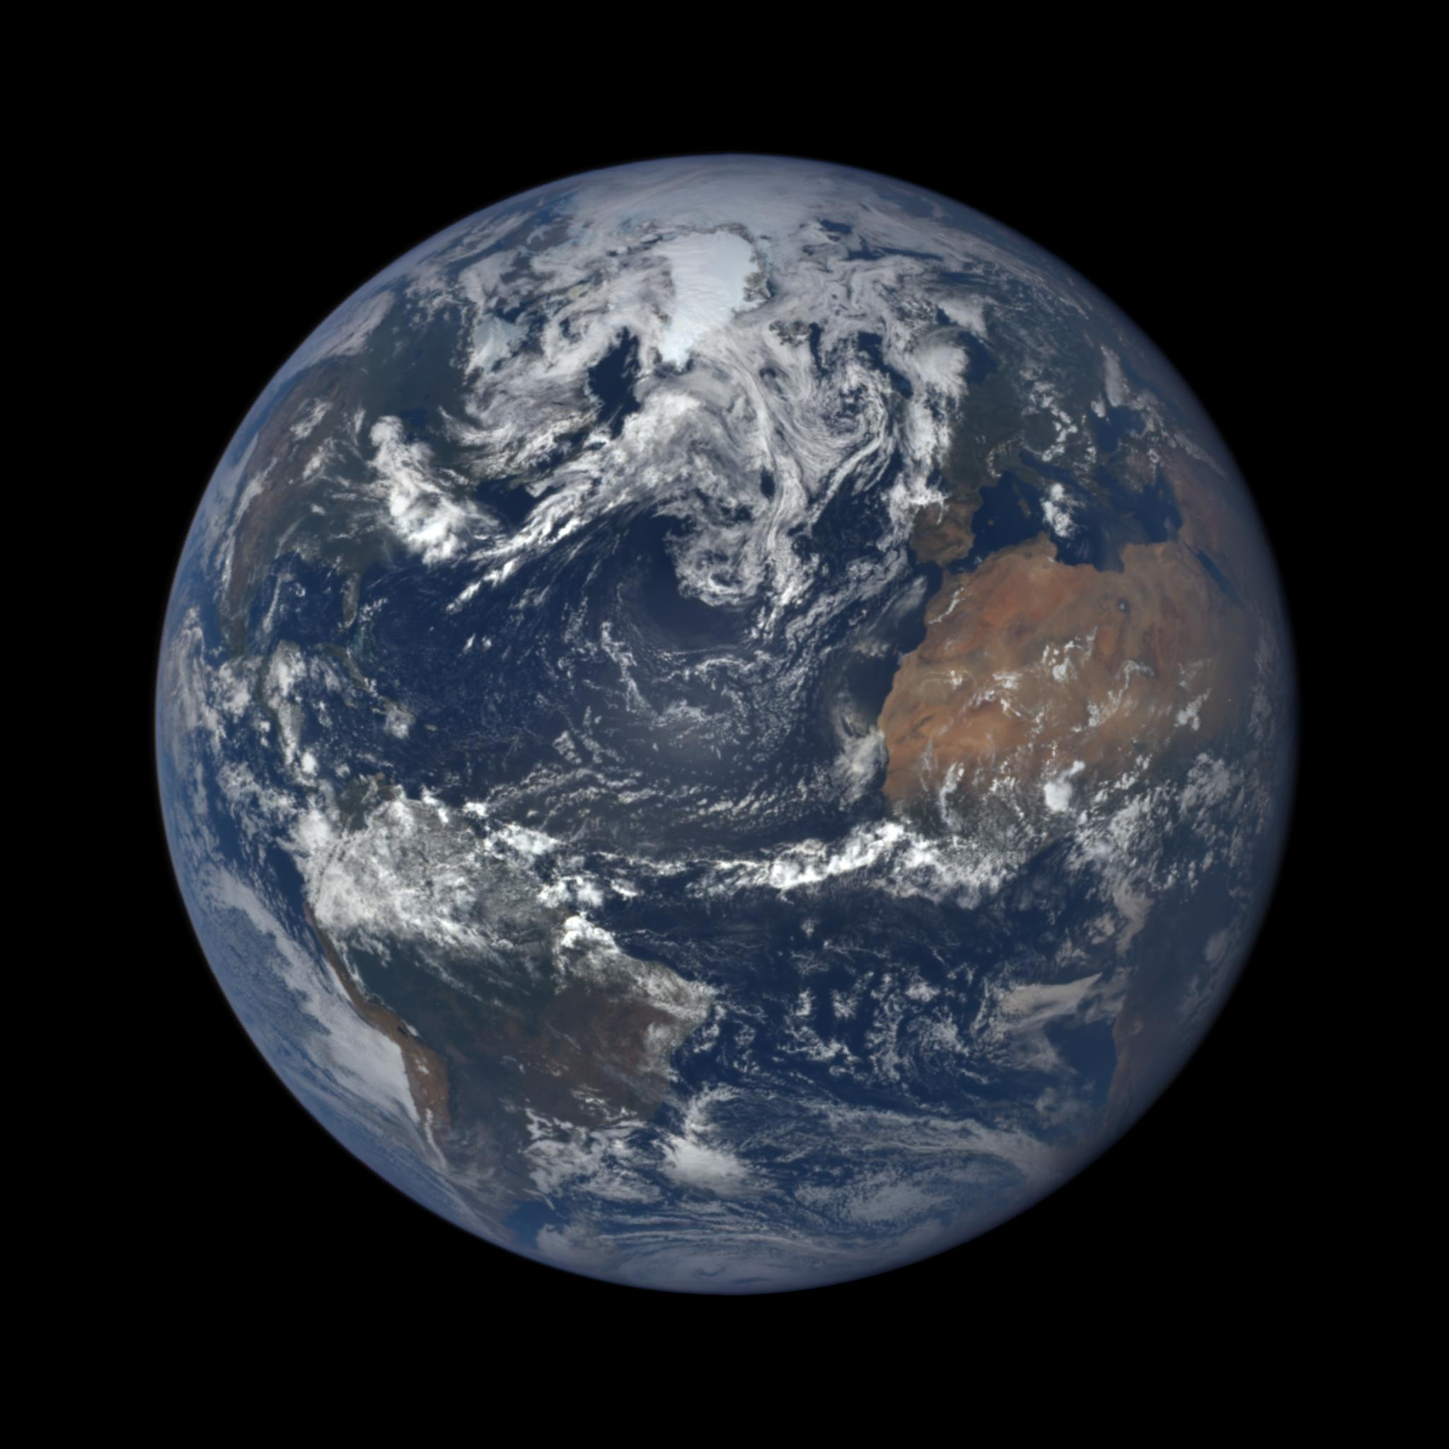

Slide 25
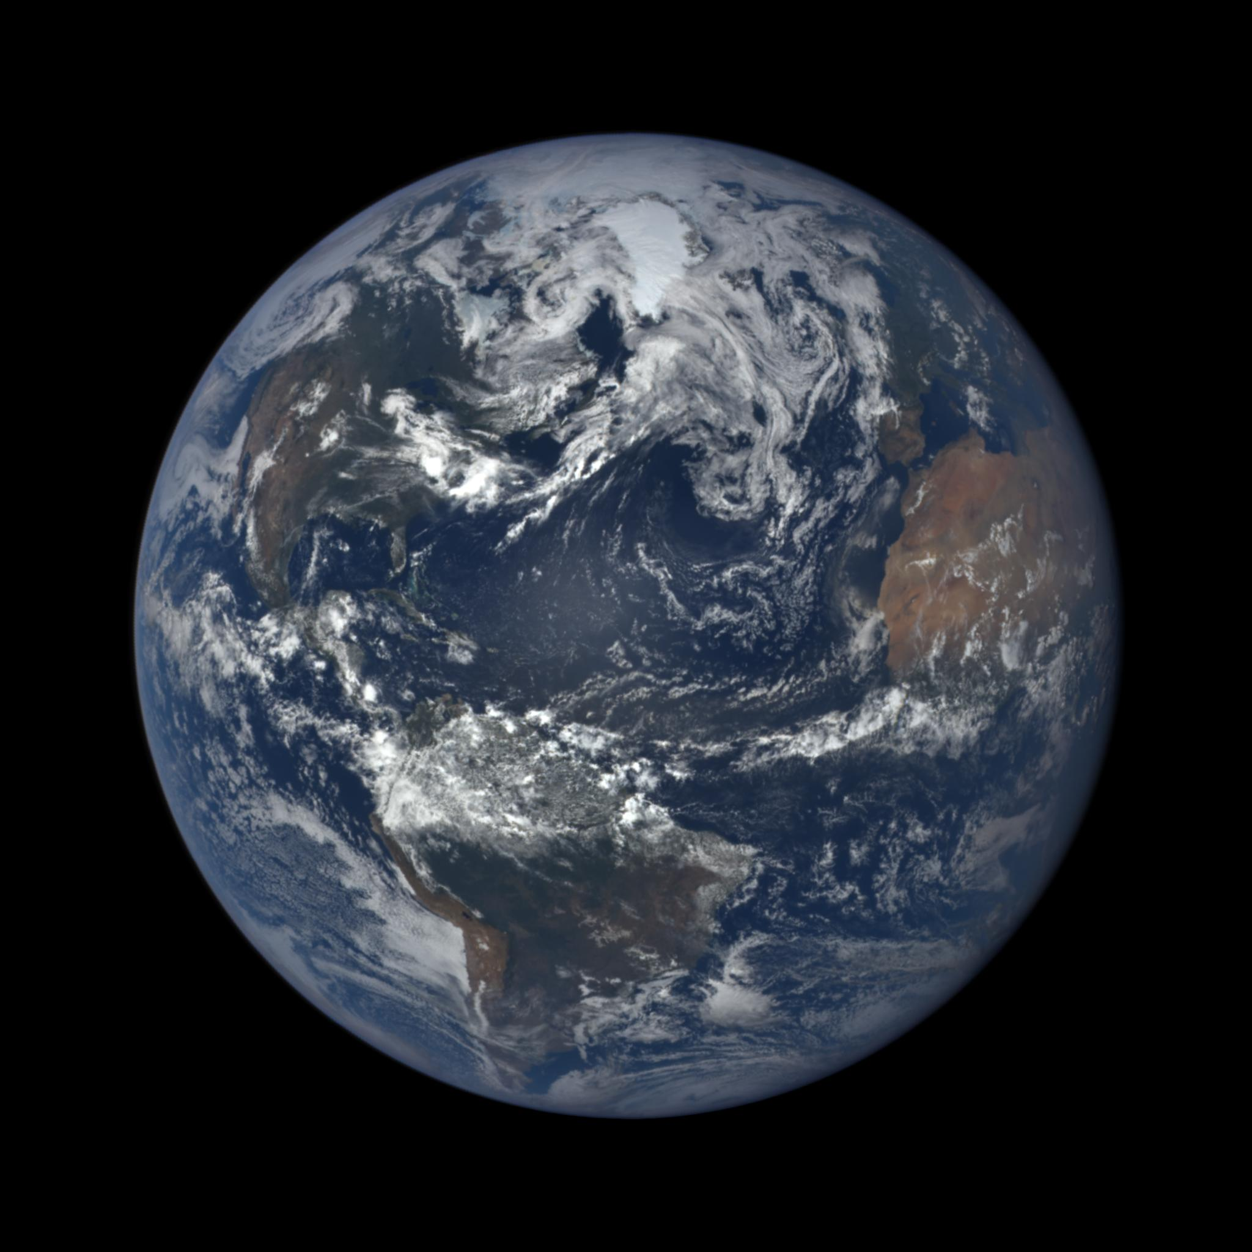

Slide 26
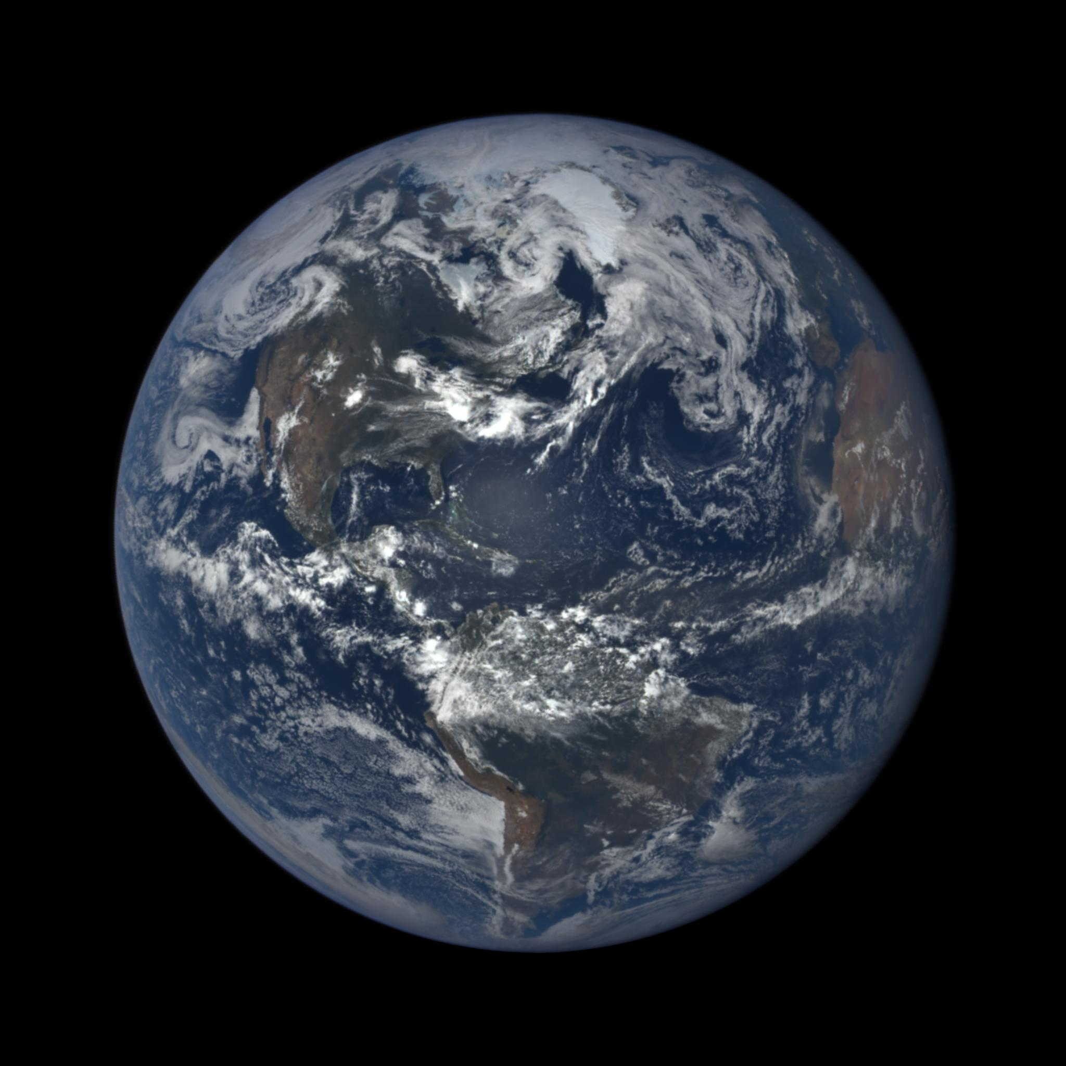

Slide 27
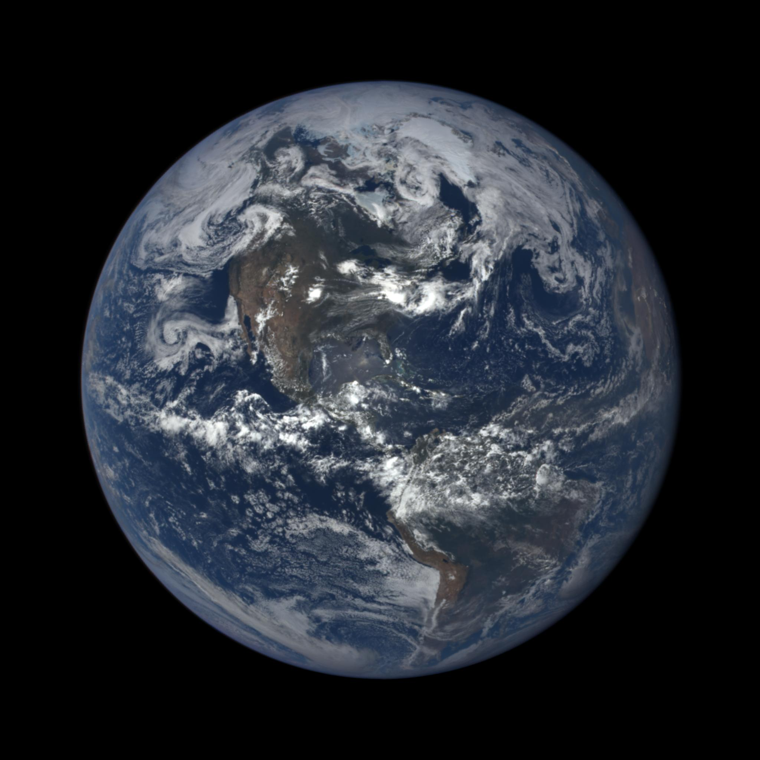

Slide 28
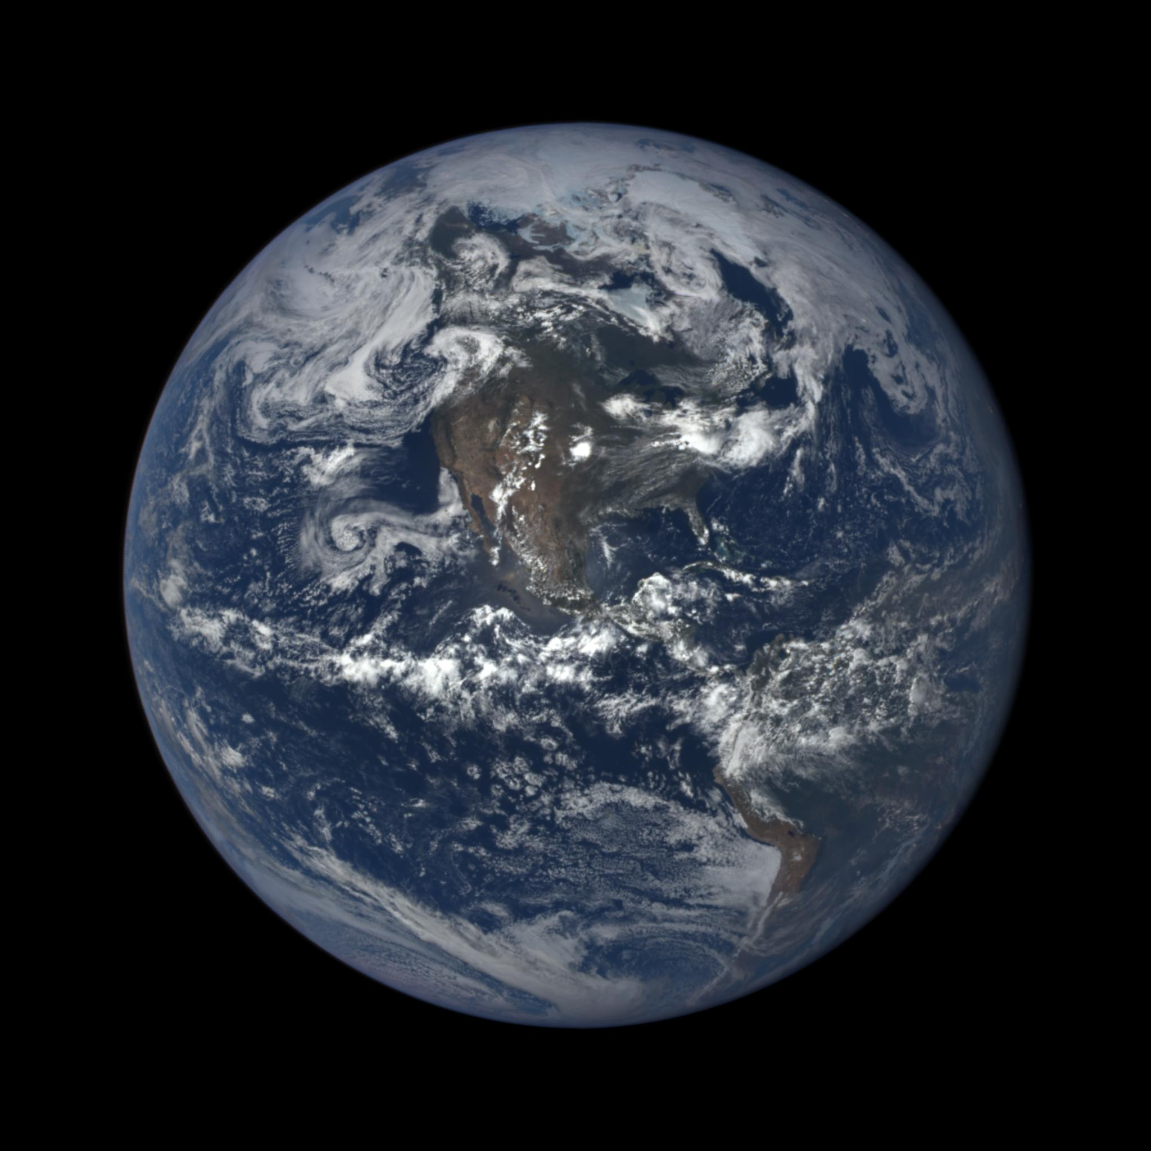

Slide 29
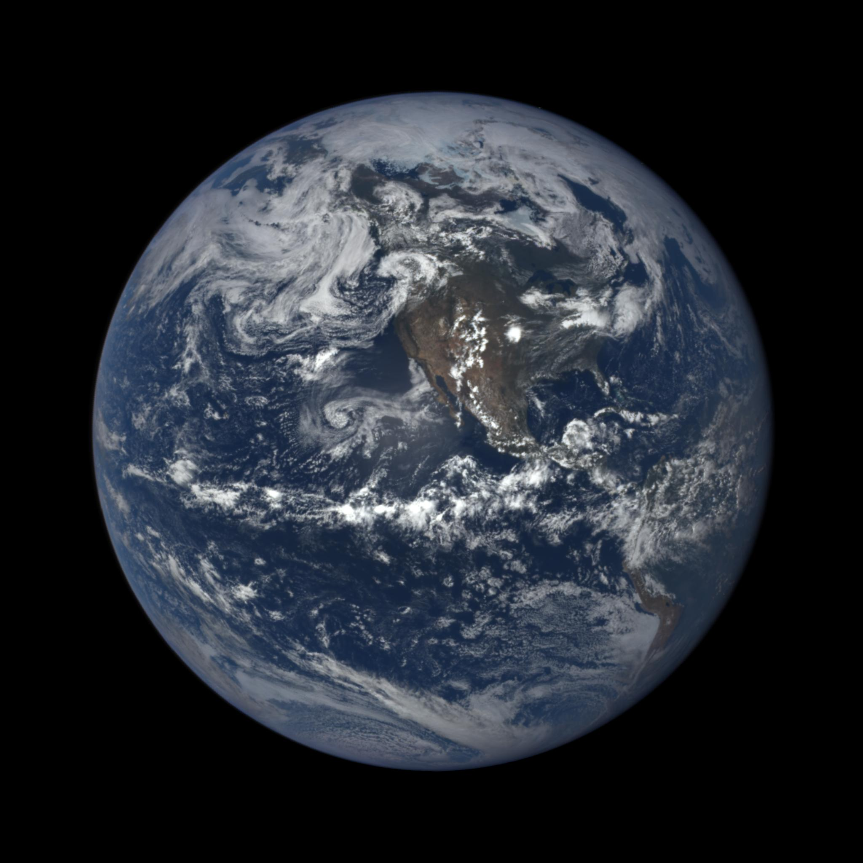

Slide 30
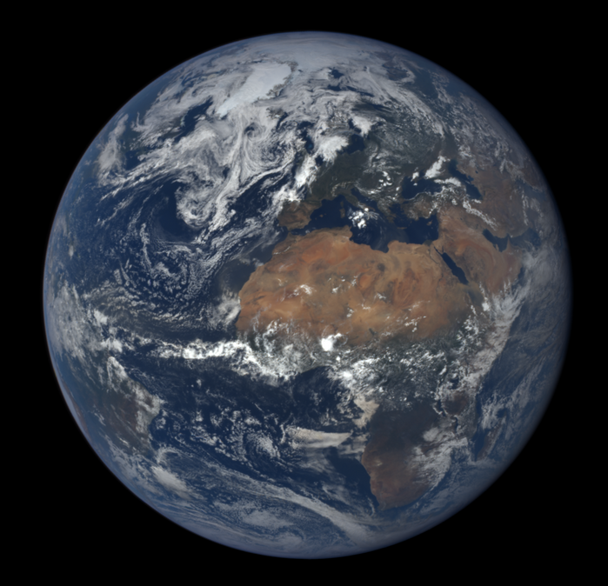
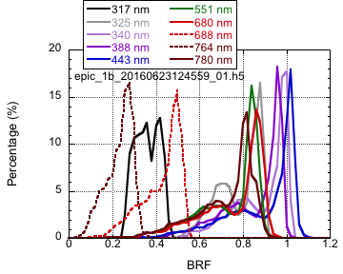
Potential Science (I): ice sheet reflectivity at near backscattering direction
Greenland
Compensates other sensors in providing ice sheet reflectivity at unique scattering angles multiple times within a day.
Can be helpful in improving the ice/snow BRDF model and polar radiation budget calculations.

Slide 31
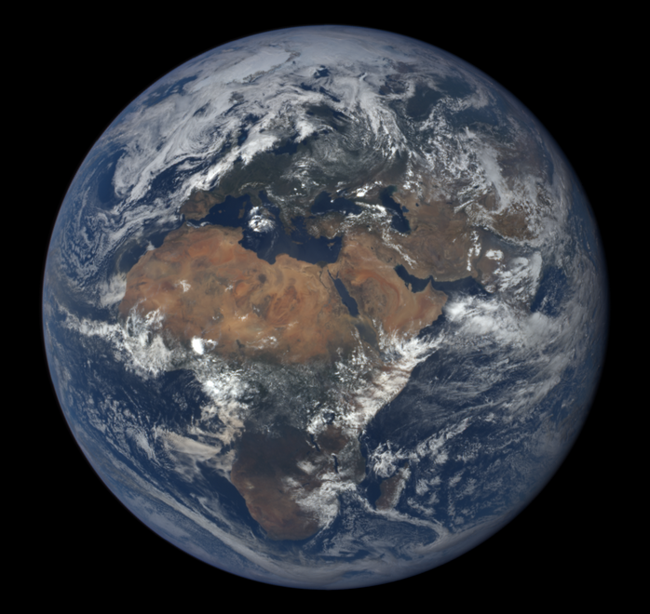
Potential Science (I): ice sheet reflectivity at near backscattering direction
Greenland
Greenland
Greenland

Slide 32
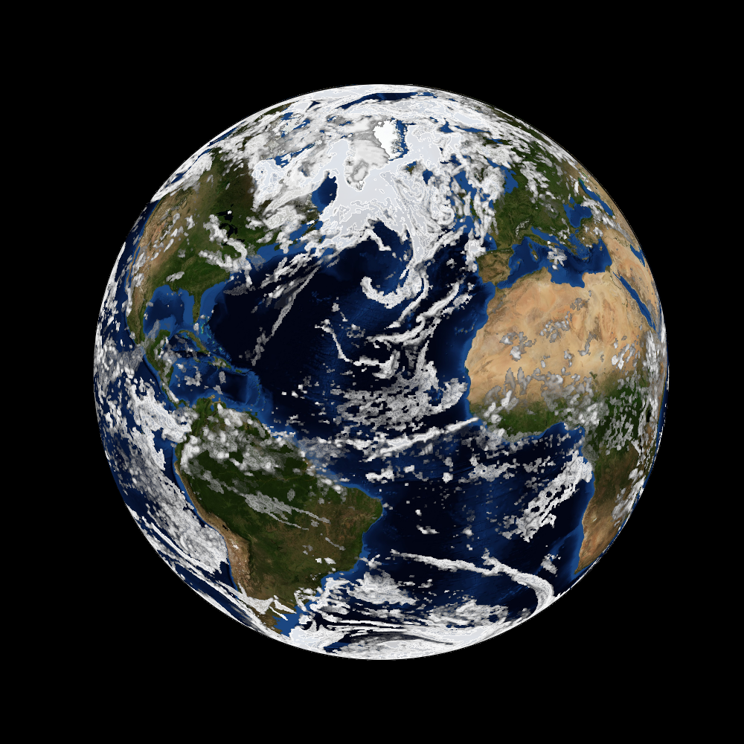
Potential Science (II): helping in understanding climate model cloud fields
epic_1b_20160623145655_01.h5
EPIC RGB
Cloud field simulated by GEOS-5
Once validated, EPIC cloud mask can be helpful to the understanding the GEOS-5 cloud simulations.

Slide 33
Summary
Cloud mask, cloud effective height and cloud optical thickness subsystems running.
Cloud mask subsystem improvements undergoing.
Cloud effective height/pressure subsystem implemented and running.
Cloud optical thickness: single channel retrieval using MODIS infrastructure.

Slide 34
Next Step
Cloud mask threshold selection procedure improvement.
Integrating GOES-5 atmosphere profiles, and surface type classification.
Cloud mask validation.

Slide 35
Cloud Top Pressure Retrievals:
EPIC oxygen A- & B-bands Issues
Qilong Min
State University of New York at Albany
EPIC Cloud algorithm team

Slide 36
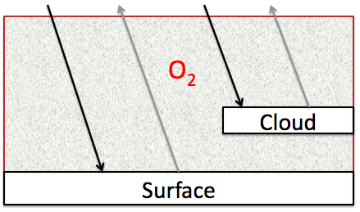

Cloud Top Information:
oxygen A- and B-bands and photon path length
Mixed Lambertian Equivalent Reflectivity (MLER) Model

Slide 37
Cloud Top Information:
oxygen A- and B-bands and photon path length
Clouds:
  Cloud Top Pressure (Height)
  Cloud Optical Property
  Cloud Thickness
  Cloud Faction
Atmospheric Profiles
      Maximizing information content
      Minimizing inconsistent assumptions for all cloud retrievals

Slide 38
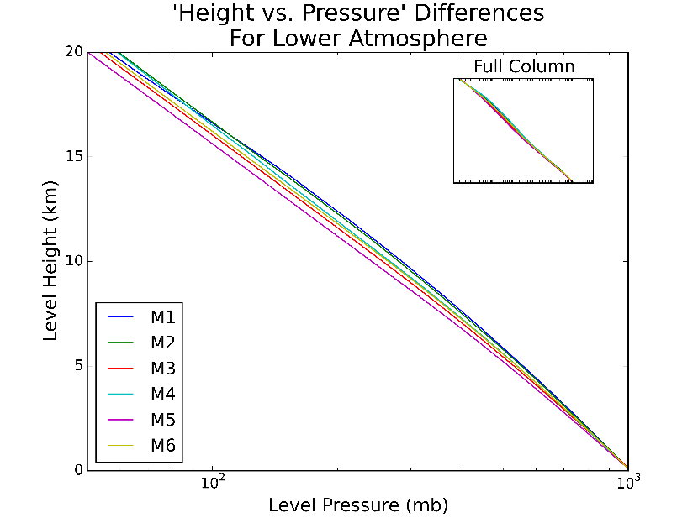
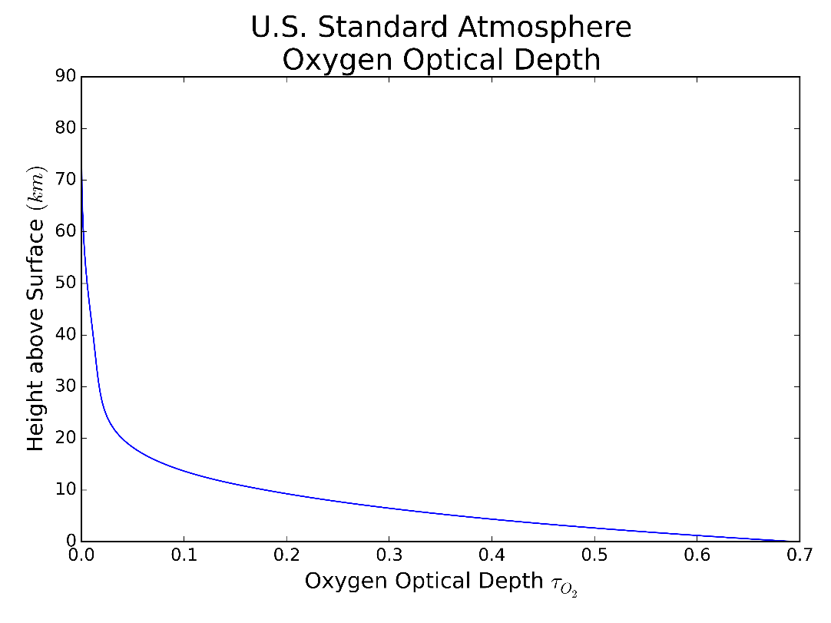
Oxygen Absorption Optical Depth Coordinate (pressure): a simple/fast conversion function from pressure to altitude
All information retrieved from oxygen A- and B-bands are in terms of pressure, as oxygen absorption coefficients are pressure and temperature dependent (or pressure square for absorption depth).
For the cloud level at the same pressure, the cloud height (km) can be substantial different for different atmospheric profiles
LBLRTM (time consuming) for each atmospheric profile: different pressure and temperature profile

Slide 39











Equivalence theorem: to separate absorption from scattering
        Absorption: Weak/strong absorption approximation
        Scattering: Single scattering or asymptotic approximation
μ=${\text{}}_{0}$
No or few scattering
f(${\text{t}}_{O2}^{Above−Cloud}, {\text{μ}}_{0}$,μ, ϕ)
${\text{t}}_{O2}^{Above−Cloud}$=${\text{t}}_{O2}^{Top}$
$${\text{}}_{0}$$
$${{\text{t}}_{O2}^{Top} }^{}$$
Cloud scattering
$${\text{t}}_{O2}^{Cloud}$$
f(${\text{t}}_{O2}^{Top}$, ${\text{t}}_{O2}^{Cloud},{\text{μ}}_{0}$,μ, ϕ)
$${{\text{t}}_{O2}^{Base}}^{}$$
Few scattering
(Aerosol & Rayleigh)
Surface reflection
A_{Surf}
$${\text{t}}_{O2}^{Cloud}$$
f(${\text{t}}_{O2}^{Below−Cloud}, {\text{μ}}_{0}$,μ, ϕ)
$${{\text{t}}_{O2}^{Surface}={\text{t}}_{O2}^{Total}}^{}$$

Slide 40
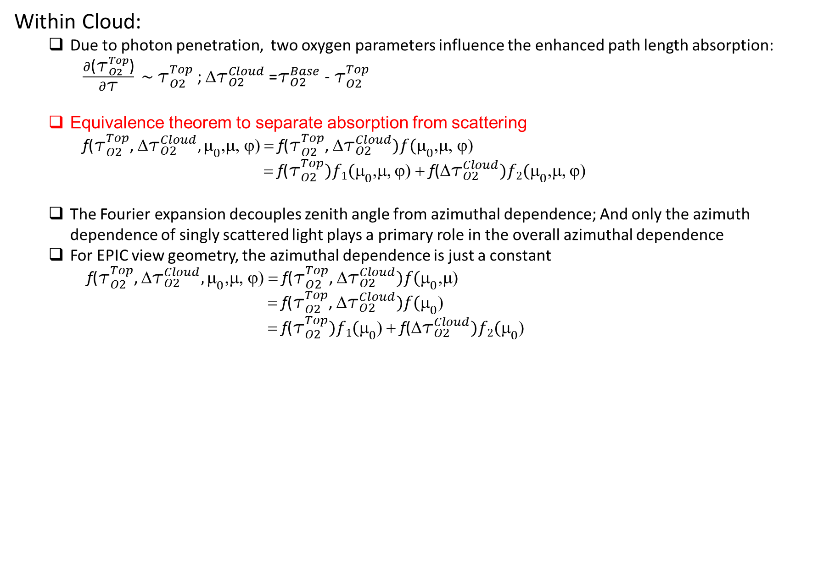
Above Cloud:
  Equivalence theorem to separate absorption from scattering
f(${\text{t}}_{O2}^{Above−Cloud}, {\text{μ}}_{0}$,μ, ϕ) = f(${\text{t}}_{O2}^{Above−Cloud})f({\text{μ}}_{0}$,μ, ϕ) = ${\text{t}}_{O2}^{Top}(\frac{1}{\text{μ}}+\frac{1}{{\text{μ}}_{0}}$) = $\frac{2}{{\text{μ}}_{0}}{\text{t}}_{O2}^{Top}$
Within Cloud:
    Due to photon penetration, two oxygen parameters influence the enhanced path length absorption:
    $\frac{∂\text{(}{\text{t}}_{O2}^{Top}\text{)}}{∂\text{t}} \sim {\text{t}}_{O2}^{Top}$ ; ${\text{t}}_{O2}^{Cloud}$ =${\text{t}}_{O2}^{Base}{\text{ − }\text{t}}_{O2}^{Top}$
    Equivalence theorem to separate absorption from scattering
    f(${\text{t}}_{O2}^{Top}$, ${\text{t}}_{O2}^{Cloud},{\text{μ}}_{0}$,μ, ϕ) = f(${\text{t}}_{O2}^{Top}$, ${\text{t}}_{O2}^{Cloud})f({\text{μ}}_{0}$,μ, ϕ)
              = f(${\text{t}}_{O2}^{Top})f1({\text{μ}}_{0}$,μ, ϕ) + f(${\text{t}}_{O2}^{Cloud})f2({\text{μ}}_{0}$,μ, ϕ)
    The Fourier expansion decouples zenith angle from azimuthal dependence; And only the azimuth dependence of singly scattered light plays a primary role in the overall azimuthal dependence
    For EPIC view geometry, the azimuthal dependence is just a constant
    f(${\text{t}}_{O2}^{Top}$, ${\text{t}}_{O2}^{Cloud},{\text{μ}}_{0}$,μ, ϕ) = f(${\text{t}}_{O2}^{Top}$, ${\text{t}}_{O2}^{Cloud})f({\text{μ}}_{0}$,μ)
    = f(${\text{t}}_{O2}^{Top}$, ${\text{t}}_{O2}^{Cloud})f({\text{μ}}_{0}$)
    = f(${\text{t}}_{O2}^{Top})f1({\text{μ}}_{0}$) + f(${\text{t}}_{O2}^{Cloud})f2({\text{μ}}_{0}$)

Slide 41

Within Cloud:
    Strong ( ~ $\sqrt{{\text{t}}_{O2}^{Top}}$ ) and weak ( ~ ${\text{t}}_{O2}^{Top}$ ) absorption dependences
    $\text{f}\text{(}{\text{t}}_{O2}^{Top})$ = a1 $\sqrt{{\text{t}}_{O2}^{Top}}$ + b1 ${\text{(}\text{t}}_{O2}^{Top}\text{)}$
    Based on asymptotic approximation,
    R$({\text{t}\text{,}\text{μ}}_{0}\text{,μ, ϕ})$ = R∞$\left({\text{t}\text{,}\text{μ}}_{0}\text{,μ, ϕ}\right)−T\text{K}($μ)K(${\text{}}_{0}$)
    = R∞$\left(\text{t}, f1({\text{μ}}_{0})\right)$ $−Tf\text{2}({\text{μ}}_{0})$
    Where T$=\frac{1}{0.75\text{t}\left(1−g\right)+1.072} and b$oth functions have quadratic form
  Below Cloud:
    Similar reasoning as to within cloud
    f(${\text{t}}_{O2}^{Below−Cloud}, {\text{μ}}_{0}$,μ, ϕ) = ${\text{t}}_{O2}^{Below−Cloud}\text{∗}\frac{A_{Surf}}{1+{\left(e4∗T+f4\right)∗A}_{Surf}}∗ \text{(}\text{a}\text{4∗}\text{T}\text{+}\text{b}4{\text{∗}\text{μ}}_{0}\text{+}\text{c}\text{4∗}\text{T}\text{∗}{\text{μ}}_{0}$+d4${\text{}}_{0}{\text{μ}}_{0}$)
    f(${\text{t}}_{O2}^{Top}$, ${\text{t}}_{O2}^{Cloud},{\text{μ}}_{0}$,μ, ϕ) = (a1 $\sqrt{{\text{t}}_{O2}^{Top}}$ + b1 ${\text{(}\text{t}}_{O2}^{Top}\text{))(}\text{a}\text{2∗}\text{T}\text{+}\text{b}\text{2}{\text{∗}\text{μ}}_{0}\text{+}\text{c}\text{2∗}\text{T}\text{∗}{\text{μ}}_{0}$+d2${\text{}}_{0}{\text{μ}}_{0}$)
    + ${\text{t}}_{O2}^{Cloud}\text{(}\text{a}\text{3∗}\text{T}\text{+}\text{b}3{\text{∗}\text{μ}}_{0}\text{+}\text{c}\text{3∗}\text{T}\text{∗}{\text{μ}}_{0}$+d3${\text{}}_{0}{\text{μ}}_{0}$)

Slide 42
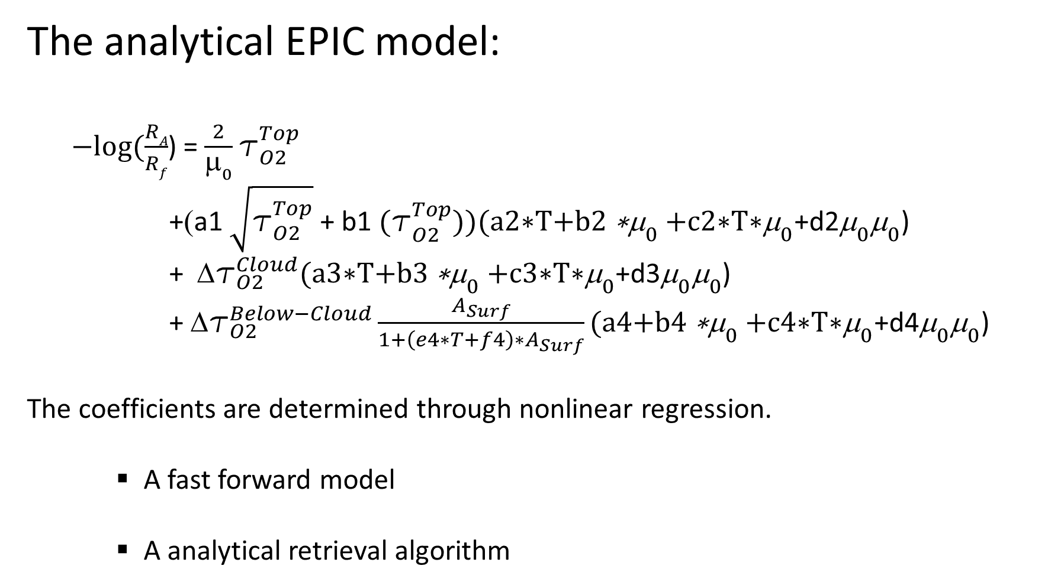
  The analytical EPIC model:
    $−log⁡(\frac{RA}{Rf}$) = $\frac{2}{{\text{μ}}_{0}}{\text{t}}_{O2}^{Top}$
    +(a1 $\sqrt{{\text{t}}_{O2}^{Top}}$ + b1 ${\text{(}\text{t}}_{O2}^{Top}\text{))(}\text{a}\text{2∗}\text{T}\text{+}\text{b}\text{2}{\text{∗}\text{μ}}_{0}\text{+}\text{c}\text{2∗}\text{T}\text{∗}{\text{μ}}_{0}$+d2${\text{}}_{0}{\text{μ}}_{0}$)
    + ${\text{t}}_{O2}^{Cloud}\text{(}\text{a}\text{3∗}\text{T}\text{+}\text{b}3{\text{∗}\text{μ}}_{0}\text{+}\text{c}\text{3∗}\text{T}\text{∗}{\text{μ}}_{0}$+d3${\text{}}_{0}{\text{μ}}_{0}$)
    + ${\text{t}}_{O2}^{Below−Cloud}\frac{A_{Surf}}{1+{\left(e4∗T+f4\right)∗A}_{Surf}}\text{(}\text{a}\text{4+}\text{b}4{\text{∗}\text{μ}}_{0}\text{+}\text{c}\text{4∗}\text{T}\text{∗}{\text{μ}}_{0}$+d4${\text{}}_{0}{\text{μ}}_{0}$)
  The coefficients are determined through nonlinear regression.
      A fast forward model
      A analytical retrieval algorithm

Slide 43
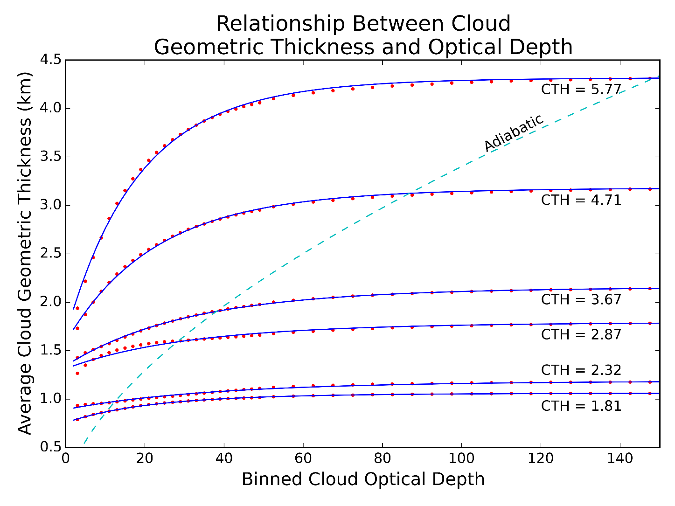
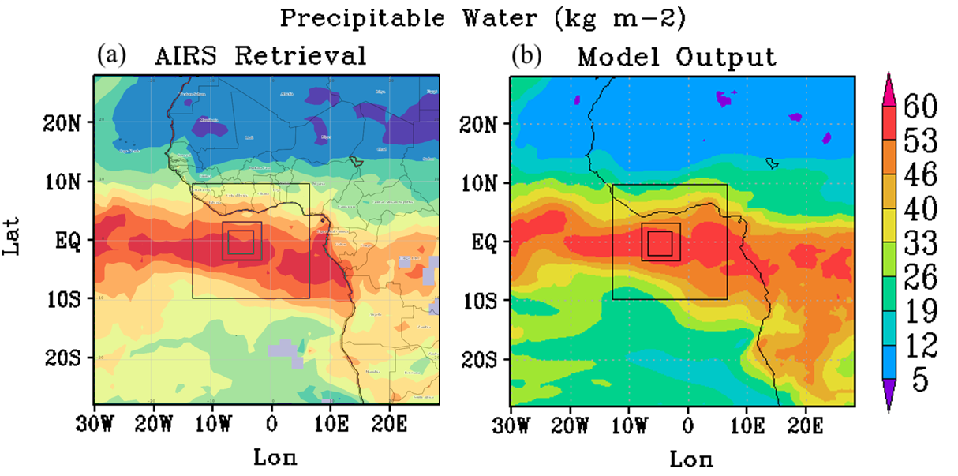
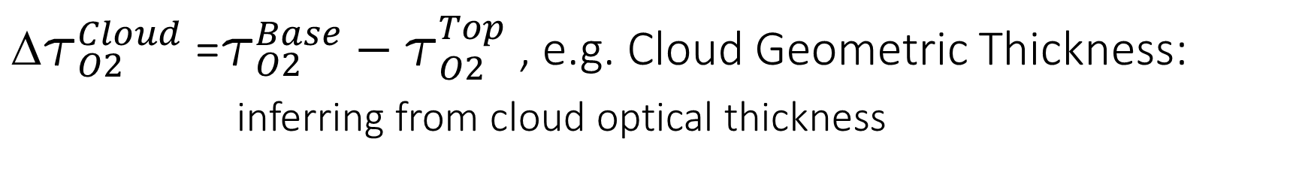
${\text{t}}_{O2}^{Cloud}$ =${\text{t}}_{O2}^{Base}{\text{ − }\text{t}}_{O2}^{Top}$ , e.g. Cloud Geometric Thickness: inferring from cloud optical thickness
WRF-SBM (Spectral Bin Model) simulation

Slide 44
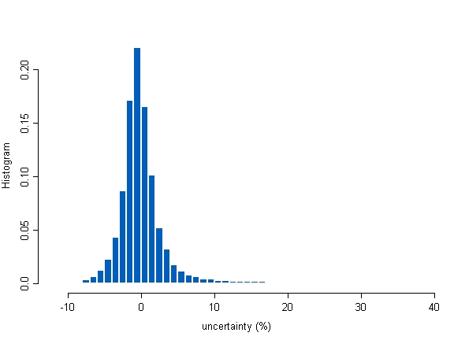
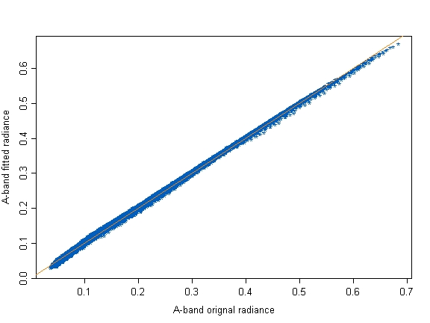
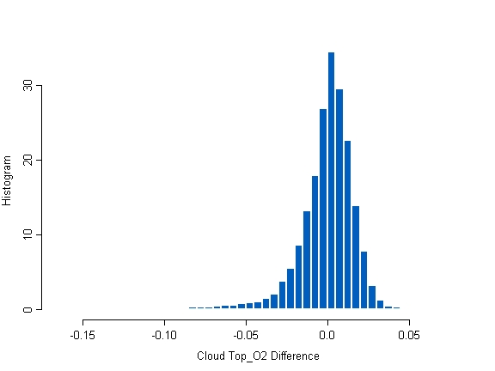
Results:

Slide 45
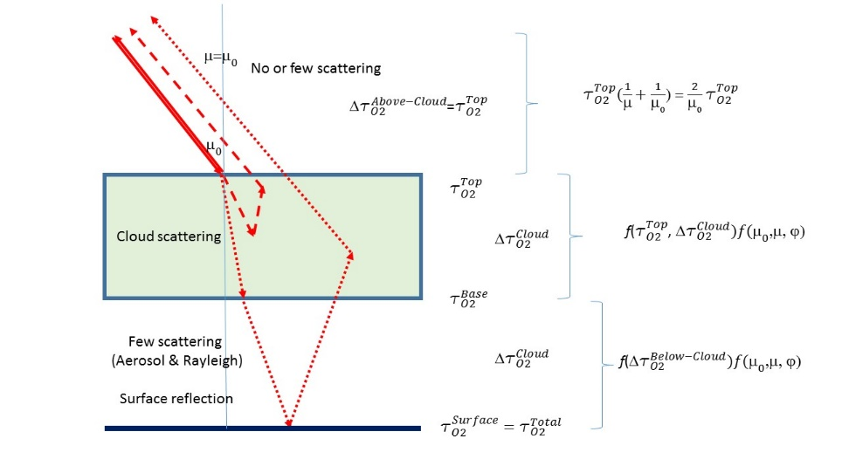
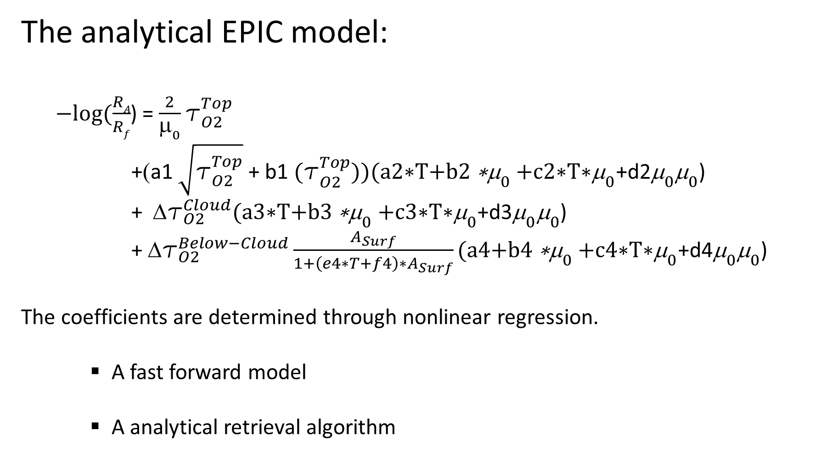
  The analytical EPIC model:
    $−log⁡(\frac{RA}{Rf}$) = $\frac{2}{{\text{μ}}_{0}}{\text{t}}_{O2}^{Top}$
    +(a1 $\sqrt{{\text{t}}_{O2}^{Top}}$ + b1 ${\text{(}\text{t}}_{O2}^{Top}\text{))(}\text{a}\text{2∗}\text{T}\text{+}\text{b}\text{2}{\text{∗}\text{μ}}_{0}\text{+}\text{c}\text{2∗}\text{T}\text{∗}{\text{μ}}_{0}$+d2${\text{}}_{0}{\text{μ}}_{0}$)
    + ${\text{t}}_{O2}^{Cloud}\text{(}\text{a}\text{3∗}\text{T}\text{+}\text{b}3{\text{∗}\text{μ}}_{0}\text{+}\text{c}\text{3∗}\text{T}\text{∗}{\text{μ}}_{0}$+d3${\text{}}_{0}{\text{μ}}_{0}$)
    + ${\text{t}}_{O2}^{Below−Cloud}\frac{A_{Surf}}{1+{\left(e4∗T+f4\right)∗A}_{Surf}}\text{(}\text{a}\text{4+}\text{b}4{\text{∗}\text{μ}}_{0}\text{+}\text{c}\text{4∗}\text{T}\text{∗}{\text{μ}}_{0}$+d4${\text{}}_{0}{\text{μ}}_{0}$)
  The coefficients are determined through nonlinear regression.
      A fast forward model
      A analytical retrieval algorithm

