Slide 1
Cloud Properties for EPIC and Radiation Budget from DSCOVR
P. Minnis, W.-Y. Su, D. R. Doelling, K. Bedka
NASA Langley Research Center, Hampton, VA
K. Khlopenkov, D. P. Duda, M. K. Thiemann, C. O. Haney, R. Palikonda, S. Sun-Mack
SSAI, Hampton, VA
F. Valero
Scripps Institution of Oceanography, La Jolla, CA
DSCOVR Science Team Meeting, GSFC, 31 October – 1 November 2016

Slide 2
OBJECTIVES
• Convert NISTAR radiances to daytime ERB
- Use EPIC & CERES ADMs to account for anisotropy; LEO/GEO clouds
- Determine missing light (SW) correction
- Determine missing LW correction
- Determine NIR albedo
• Match EPIC pixels with GEO & LEO radiances & cloud products
- Calibrate EPIC non-UV channels using MODIS/VIIRS
- Provide scene ID for each EPIC pixel
• Compare daytime ERB with CERES results
- CERES out of balance by 6 Wm⁻²
- NISTAR an independent measure of daytime global fluxes
• Compute ratio of Albedo(NIR)/Albedo(SW)
- open question of cloud SW absorption & impact on climate
• Estimate regional ERB from EPIC data
- use NB-BB equations to convert EPIC radiances to SW flux
- use NB-BB equations to convert GEO-LEO IR radiances to LW flux

Slide 3
EPIC CLOUD MATCHING OBJECTIVES & APPLICATIONS
• Produce well-characterized consistent regional & global cloud and surface property datasets covering all time & space scales to match with EPIC
- Intercalibrate non-UV EPIC channels
- provide hi-res independent scene ID for each EPIC pixel
- convolve with EPIC radiances & CERES ADMS to compute flux from NISTAR radiances
- serve as comparison source for EPIC cloud retrievals
- provide cloud mask for other retrievals based on EPIC radiances
- key parameters for each pixel: cloud fraction, phase, OD, Z, Re
MODIS cloud fraction accuracy same as MODIS Team product,
GEO/AVHRR accuracy a little less (4 km vs 1 km)

Slide 4
Calibration
• Use MODIS and any other reference satellite to calibrate non-UV channels
- Match as in Minnis et al. (2002)
- correct for spectral differences using SBAFs (Scarino et al. 2016)
www-pm.larc.nasa.gov/SBAF
• Gridded ray-matching (ATO)
- ΔVZA & ΔRAA < 15°, ±15 min, 0.5° regions
- R²-based automated navigation correction applied at 0.25° res, then aggregated up to 0.5°
- SZA normalization
- Tropical ocean scenes only, 30°S – 30°N, all-sky tropical ocean SBAF
- Spatial heterogeneity filters and graduated angle matching (GAM)
Deep convective cloud (DCC) ray-matching
  - Similar process to gridded ray-matching except:
  R² navigation correction, left at 0.25° regions
  MODIS/VIIRS BT(11µm) < 220K
  Tropical land and ocean scenes, DCC SBAF, no GAM

Slide 5
Calibration Summary
Temporal degradation analysis of version 01 data from ~1 year of data
 | DCC | ATO
EPIC/ MODIS | Mean gain | σ (%) | Trend %/yr | Mean gain | σ (%) | Trend %/yr | DCC/ ATO (%)
E5/B3 | 5.364e-3 | 0.9 | -0.1 | 5.302e-3 | 0.4 | -0.2 | +1.2
E6/B4 | 4.151e-3 | 1.2 | 0.0 | 4.112e-3 | 0.5 | -0.4 | +0.9
E7/B1 | 4.988e-3 | 1.2 | -0.3 | 4.943e-3 | 0.8 | -0.1 | +0.9
*E8/B1 | 1.163e-2 | 1.0 | -1.1 | 1.191e-2 | 1.6 | +2.8 | -2.4
*E9/B1 | 1.120e-3 | 1.1 | -3.3 | 1.156e-3 | 1.9 | +7.4 | -3.1
E10/B1 | 5.709e-3 | 1.3 | -2.2 | 5.627e-3 | 1.1 | -2.3 | +1.5
λ (µm)
443
551
680
688
764
780
*Visible absorption bands
• DCC and ATO mean gains differ by ~1%, being investigated
E5, E6, E7 show minimal/no degradation, E10 shows a bit more
Absorption bands are tough to work with and need more investigation
  use cloud height information to account for O2 absorption?

Slide 6
EPIC Version 5 geolocation issues

Slide 7
Samples of version 5 navigation
Order of imagery in following slides:
Close-ups of 443 nm, 551 nm, and 780 nm images of a coastline show quality of collocation between channels
Two RGB images (w/o and w/ map) show overall geo-location of image
Final image is map of pixel centers near the image centroid. Ideally, pixel centers should line up as squares in this part of the image.

Slide 8
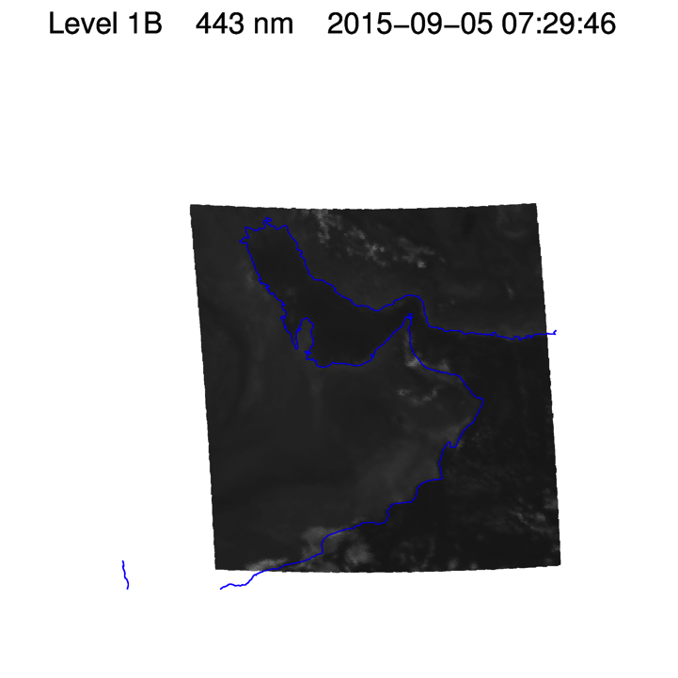
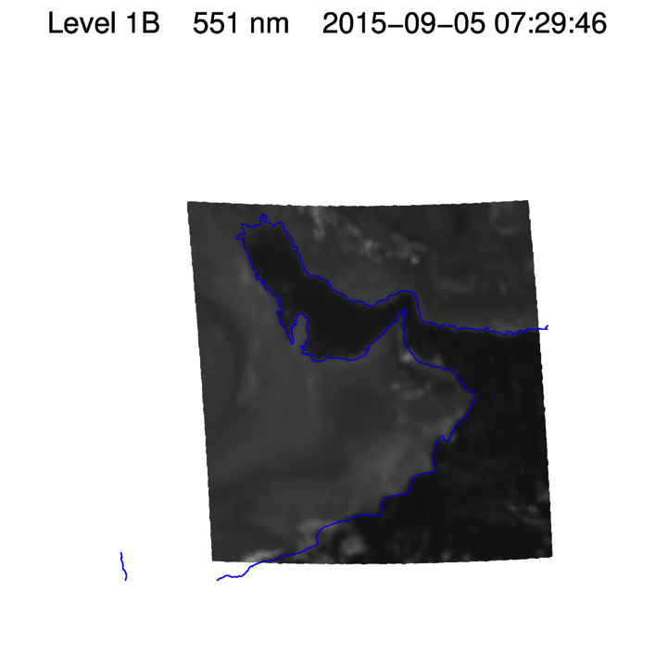

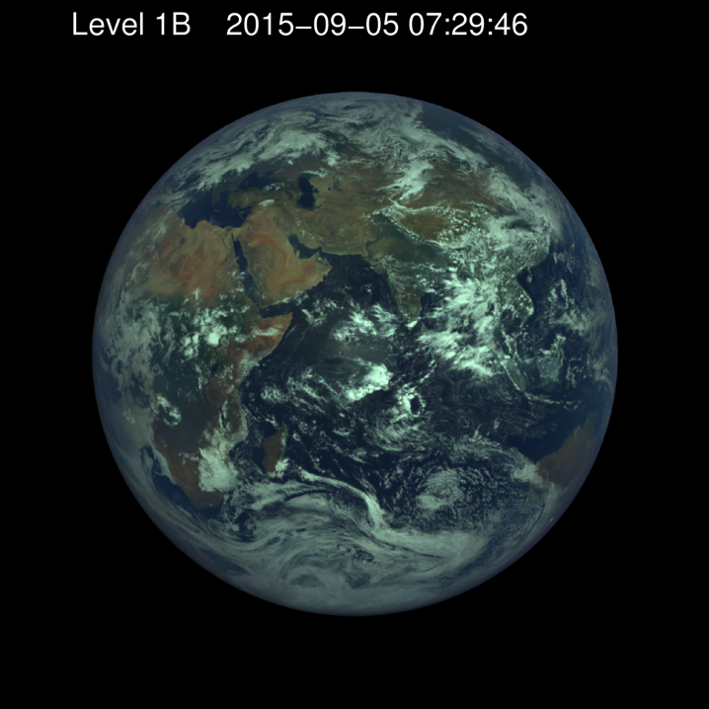
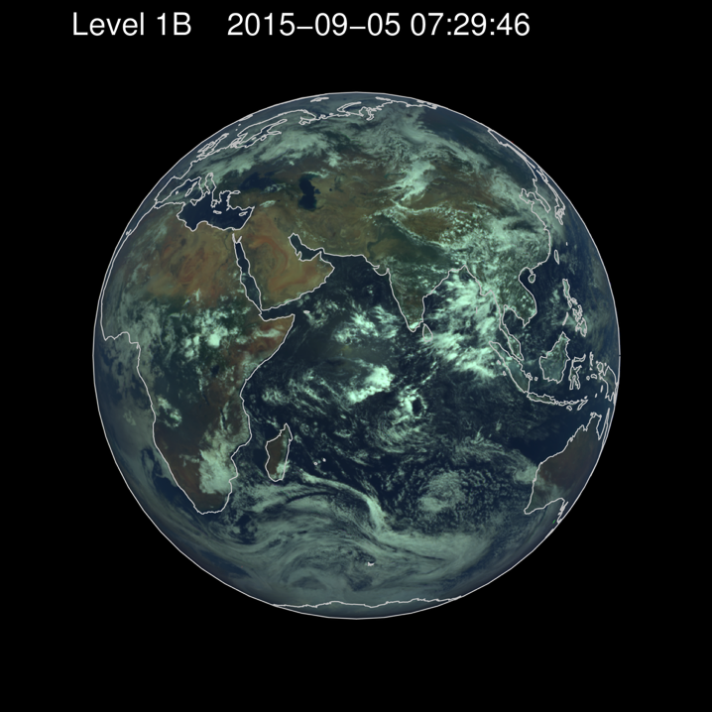
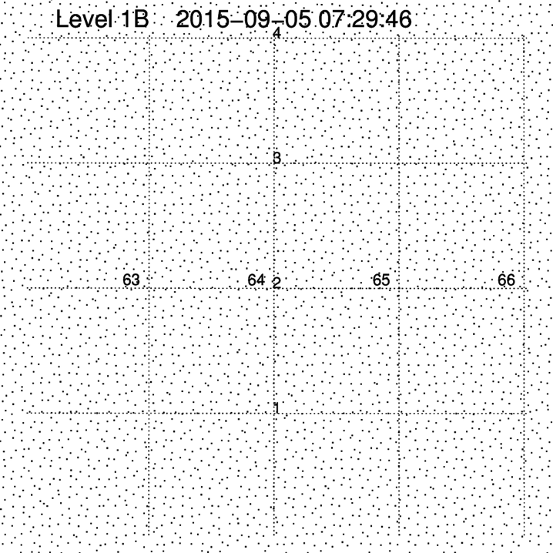

Slide 9
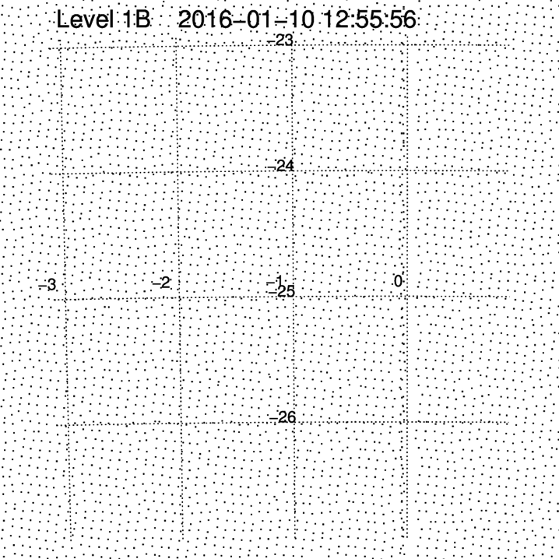
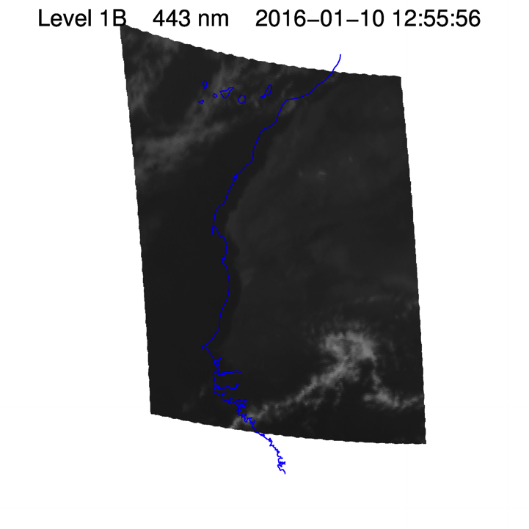

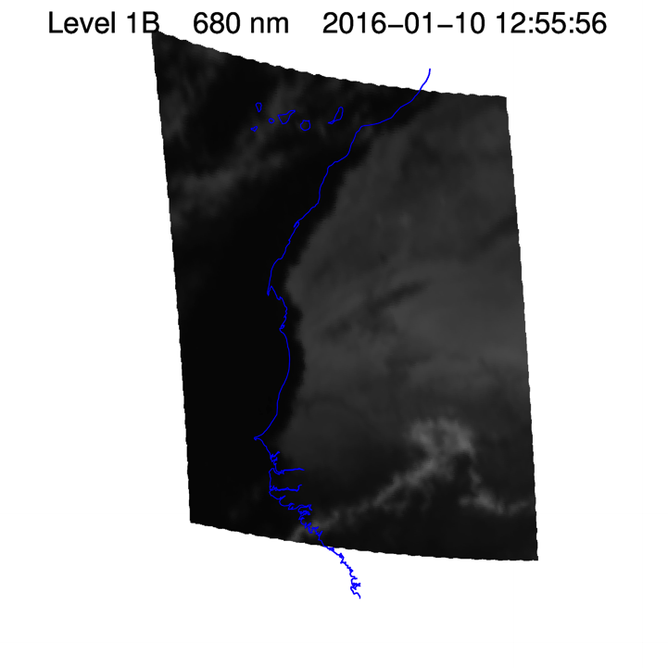
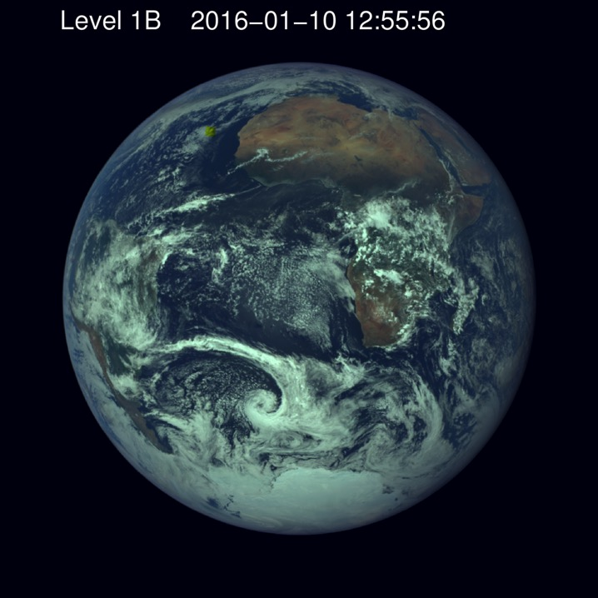
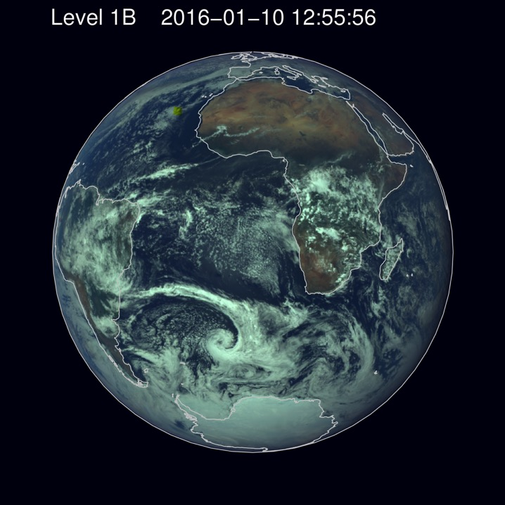
North-west
coast of Africa

Slide 10
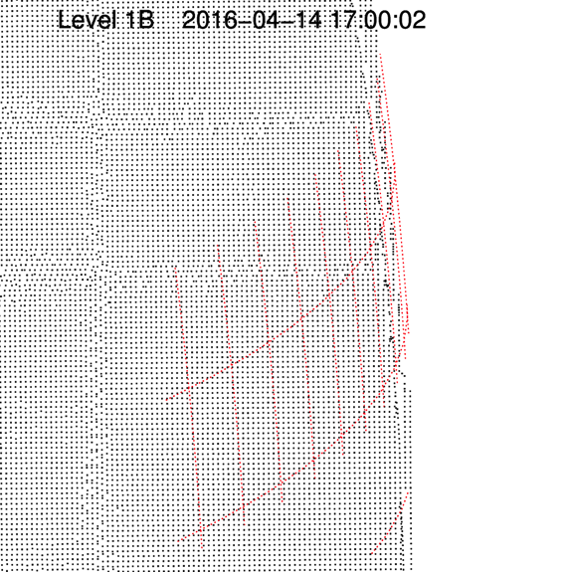
Version 5 has changed how pixels are represented at edge of Earth’s disk
Near the edge of the Earth, the pixel
spacing in version 4 was roughly
equal lat/lon so the spacing between
pixels decreased near the horizon.
In version 5 it is uniform and regular (as
it should be, if the CCD array on EPIC
is uniform and regular). But note that
at the horizon the regular spacing is
broken…

Slide 11
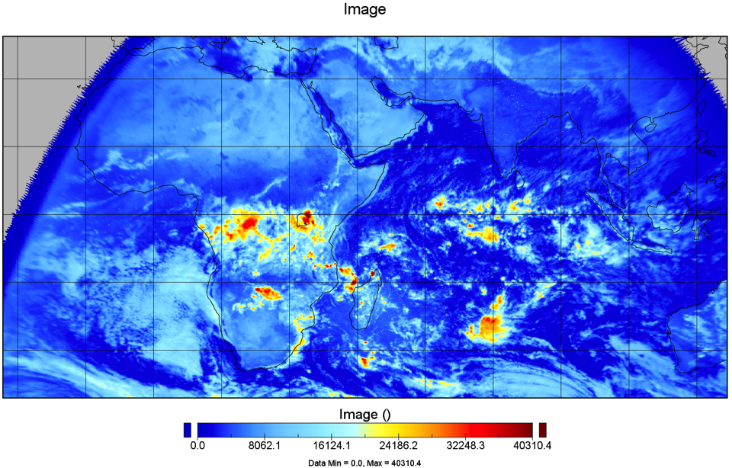
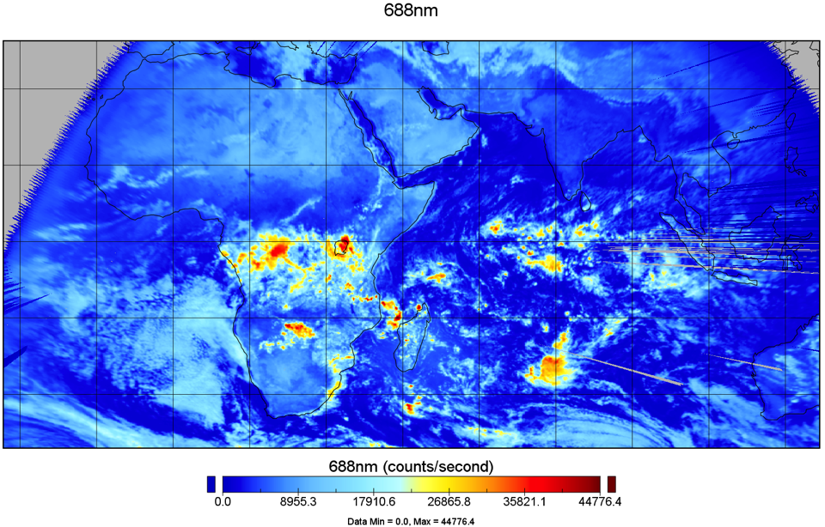
Version 4
Version 5
The pixel location problem at the
horizon produces artifacts in our
composites.
The biggest differences
between version 4 and 5
are near the horizon
Q: Note the change in the 688 nm values between
version 4 and 5, is this due to flat fielding? The
difference is 10 percent!

Slide 12
Summary
RGB channel collocation is generally consistent between these samples. Note that 443 nm channel is higher resolution, and that cloud features may drift between channels due to time delay between images.
Geo-location of image is variable between samples and within each image time. Some coastlines match up well, others don’t.
Regularity of the lat/lon of each pixel center varies between image times. Arrangement of pixels in center of April 14, 2016 image appears to be close to ideal, but geo-location is not ideal.

Slide 13
Scene ID & Radiance Weighting
Use of LEO/GEO and EPIC data

Slide 14
Overview of EPIC & NISTAR Processing
GEO products
Merge & fill to grid
Match to EPIC pixels, compute pixel properties & radiances
Global hi-res cloud & radiance product
LEO products
EPIC radiances
Archive hi-res Global Composite
Compute EPIC weights & ADMs
2048x2048 EPIC clouds radiances
Merge hi-res products & EPIC
Take closest to EPIC time
Convolve & compute global ADMs
Compute observed fluxes
F_{NSW}, F_{NLW}, F_{NNI}
Archive EPIC Composite & Observed Fluxes
NISTAR radiances

Slide 15
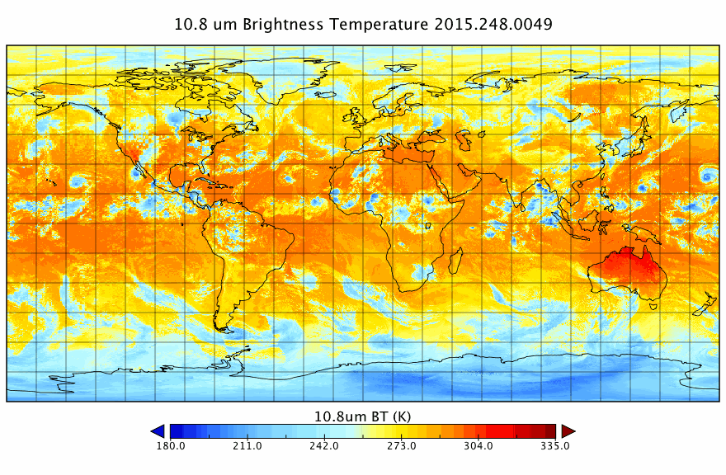
Global GEO/LEO composite data available on 5-km grid

Slide 16
Producing Global Multi-Sensor Composites
AVHRR
MODIS
GEOs
GAC @ 4km/pix
sampled @ 2km/pix
8 km/pix
Angles, Refl., BT,
Angles, Refl., BT,
Angles, Refl., BT,
SW / LW Fluxes,
SW / LW Fluxes,
SW / LW Fluxes,
Cloud properties
Cloud properties
Cloud properties
SkinT,
Rel.time...
SkinT
,
Rel.time...
SkinT,
Rel.time...
Reproject
Reproject
Reproject
Compare Rating
Pixel in Global Composite
7920×3960 pixels @ 5 km/pix

Slide 17
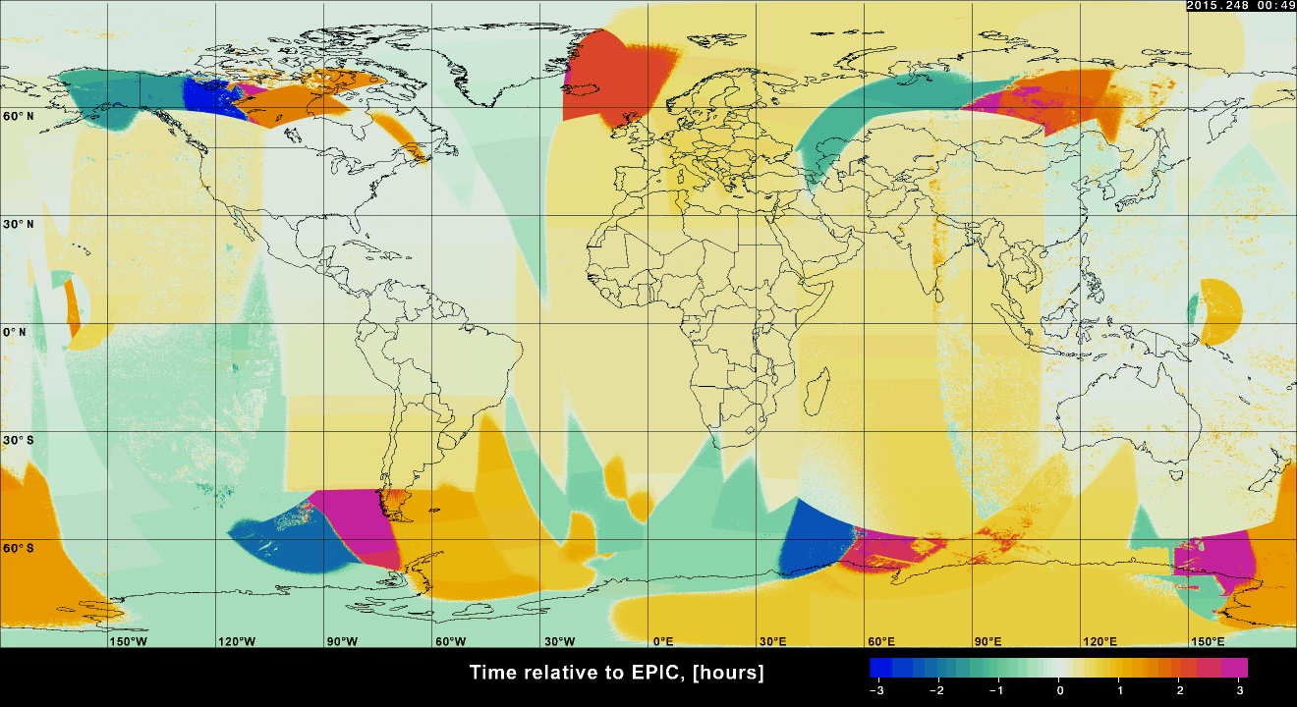
Relative time of satellite scans to reference (EPIC image time)
Over 72 percent of satellite scan times within 1 h of reference time
92 percent of scan times are within 2 h of reference time
• Issues with INSAT infrared channels affects retrievals, replace with Meteosat-8

Slide 18
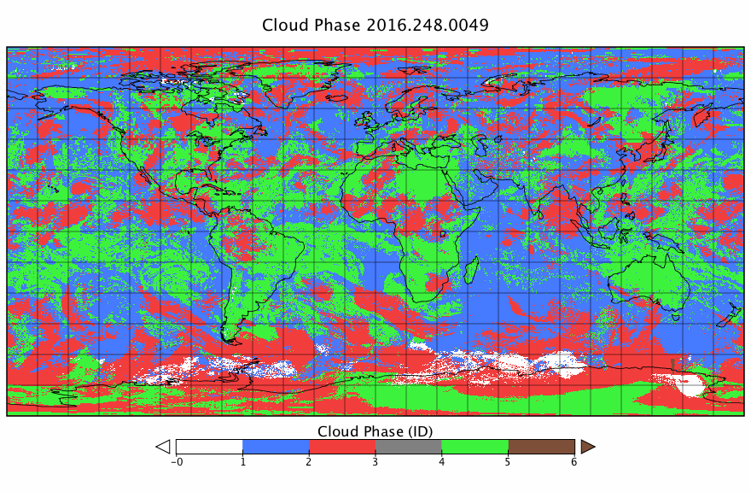
Satellite radiance/BT and cloud properties
snow liq cld ice cld no ret clear bad

Slide 19
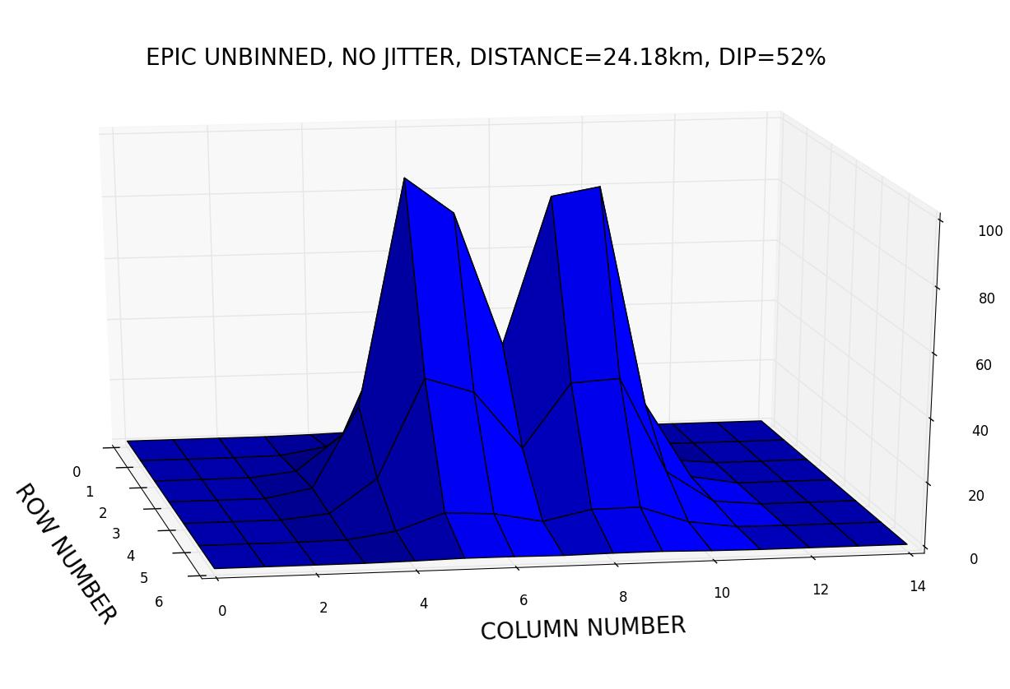
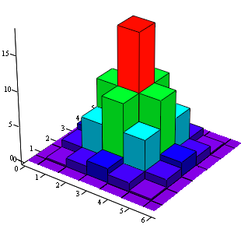
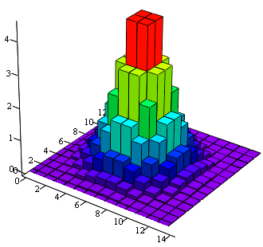
Producing EPIC Composites
Information we had:
PSF we derived:
PSF weights, %
Convert the original
EPIC Lat/Lon grid
2048×2048
at 7.8 km/pix
to
Subpixel Lat/Lon
4096×4096
at 3.9 km/pix
PSF weights, %
Half-pixel weights, %
1. Half-pixel weights are more accurate;
2. Subpixel grid preserves spatial resolution of the global composite.

Slide 20
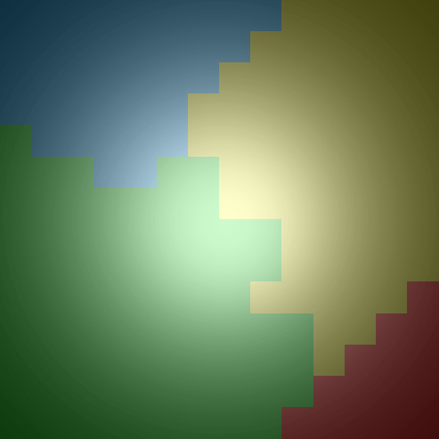
Producing EPIC Composites
Subpixel grid 4096x4096 at 3.9 km/pix
7920 × 3960 at 5 km/pix
Convert a data layer in Global Composite
from 2-byte integer to 4-byte float and
Convert to Plank’s function, or cos(Angle), or Log(COD), etc. if applicable.
Reprojection
Because of the finer grid
sampling as Nearest-Neighbor
does not loose spatial accuracy
Weighting the remapped samples by masks
Ice Cloud
Weighted average value for each EPIC pixel is stored in the corresponding data subset:
Clear-sky
Water cloud
Ice cloud
Total cloud
No retrieval
Water Cloud
Apply inverse conversion
and scaling if applicable
Clear Sky
Fill Values

Slide 21
Summary of parameters available in
global composites and EPIC composites
• Standard NetCDF-4/HDF-5 format
* GOES-12,-13, -14, -15 have 13.5 µm band instead of 12.0 µm

Slide 22
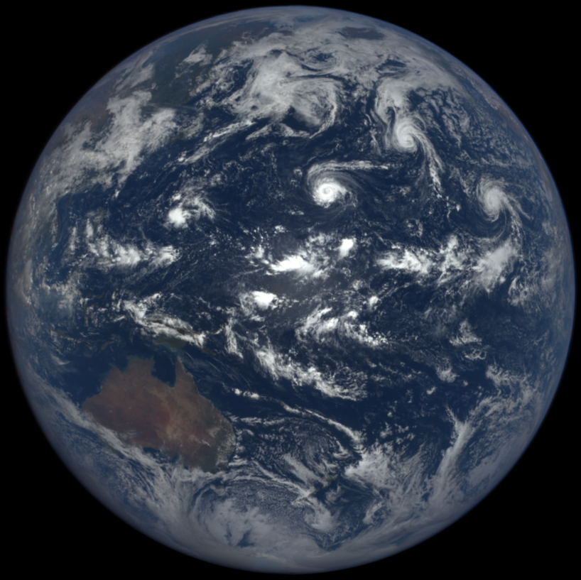
EPIC RGB, 00:49 UTC, 5 Sept 2015

Slide 23
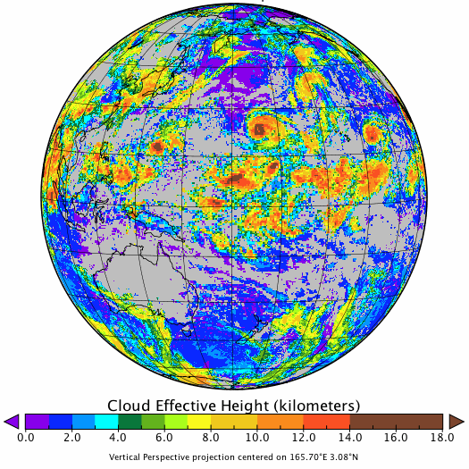
EPIC Composite: Cloud Effective Height
00:49 UTC, 5 Sept 2015

Slide 24
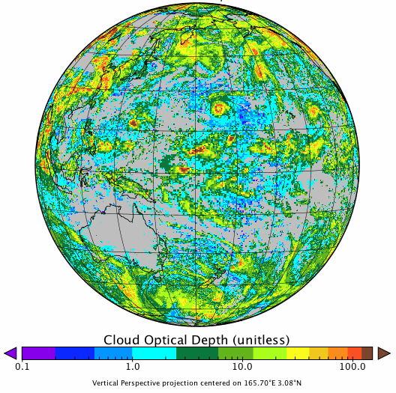
EPIC Composite: Cloud Optical Depth
00:49 UTC, 5 Sept 2015

Slide 25
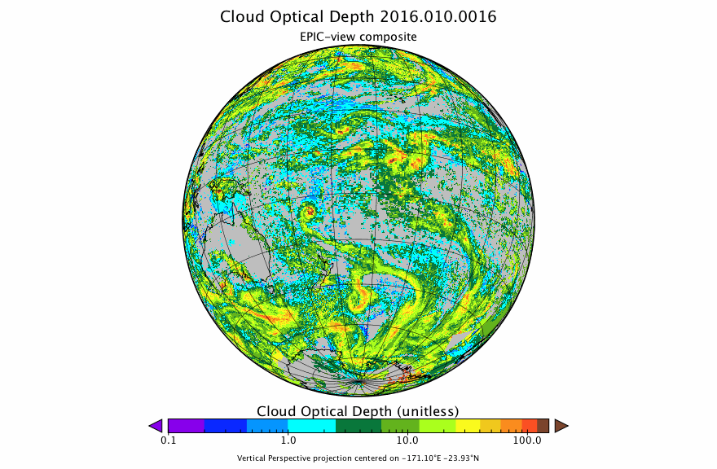
Cloud Optical Depth (10 Jan 2016)

Slide 26
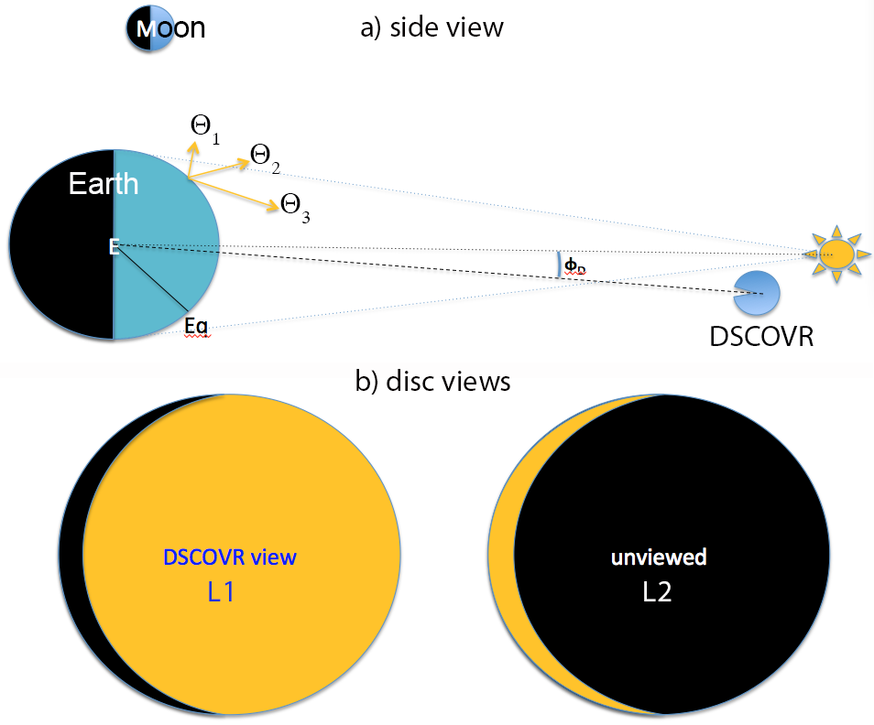

Daytime Global Radiation Budget
Ac
• Account for radiation exiting at all angles, not just at φ_{o}
• Account for SW radiation reflected into L2 view
• Account for daytime LW radiation emitted in L2 view
• Remove nighttime LW viewed from L1

Slide 27
Computing the Radiation Balance from NISTAR
• EPIC composite cloud properties weighted by EPIC radiances used to determine Anisotropic Directional Models to correct NISTAR irradiances for anisotropy
• LEO/GEO radiances converted to broadband fluxes to provide missing light and dark crescent corrections
- also used to simulate NISTAR radiances

Slide 28
Creating Broadband Albedo & OLR from GEO-LEO Satellite Radiances
GEO, AVHRR, & MODIS (SW only):
SW albedo: A_{SW} = a₀ + a₁*A_{nb} + a₂*A_{nb}² + a₃*ln(1/µ_{o})
OLR: M_{LW} = b₀ + b₁*M_{nb} + b₂*M_{nb}²+ b₃*M_{nb}*ln(colRH)
MODIS LW:
OLR: M_{LW} = b₀ + b₁*L_{nb11} + b₂*L_{nb12}
A_{nb}: visible channel albedo M_{nb}: 11-µm channel flux L_{nb11}: 11-µm radiance
a_{i} & b_{i} determined from matched CERES & LEO/GEO data
µ_{o}: cos(SZA) colRH: column relative humidity from GEOS-5
GEO BBLW & BBSW in 2015: fits developed for CRYSTAL-FACE
(GOES/Meteosat) & TWP-ICE (MTSAT)
GEO BBLW and BBSW in 2016: all CRYSTAL-FACE fits (no MTSAT)
AVHRR BBLW, BBSW: 2008 AVHRR-CERES Aqua fits
MODIS BBLW: MODIS-CERES SSF matched 2-channel monthly fits
MODIS BBSW: used 2008 AVHRR-CERES Aqua fits

Slide 29
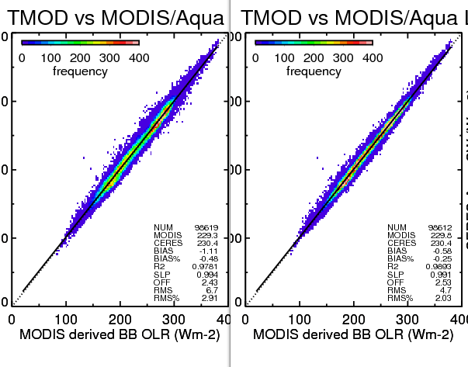

Slide 30
EPIC RGB Image
00:41 UTC 5 September 2015

Slide 31
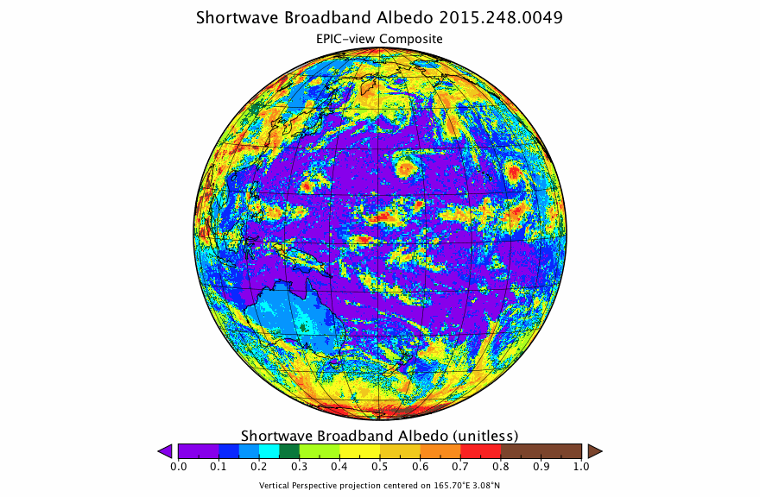
EPIC-view composites are derived from global composites using PSF weighting
Mean SW albedo
for EPIC-viewed
region: 0.2849
(albedo averaged
in area where
SZA<88.5 [area
fraction 0.4505)
Before averaging,
SW albedo is
normalized to
EPIC’s SZA by
multiplying by
COS(EPIC_SZA)/
COS(pixel_SZA)
Mean SW albedo
for lit region hidden
from EPIC: 0.2156
(albedo averaged
In area where
SZA<88.5 and not
visible from EPIC
[area fraction 0.0448])

Slide 32
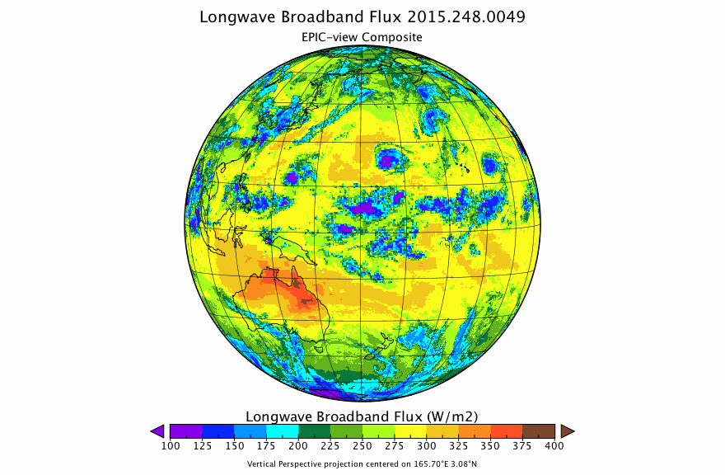
EPIC-view composite – LW flux
Mean LW flux
for EPIC-viewed
region: 244.68 Wm⁻²
(averaged in area visible to EPIC
VZA < 87.0 [area
fraction 0.4576])
Mean LW flux for dark region viewed
from EPIC: 212.36 Wm⁻²
(averaged in area
where SZA>88.5° and
visible from EPIC
[area fraction 0.0071])
Mean LW flux
for lit region hidden
from EPIC: 223.49 Wm⁻²
(averaged in area
where SZA<88.5 and
not visible from EPIC
[area fraction 0.0448])

Slide 33
Shortwave flux from DSCOVR
Use scene identification from LEO/GEO clouds & EPIC or LEO/GEO radiance I_{j} (e.g., 0.65 µm) to determine anisotropic factor for NISTAR view:
Convert the NISTAR measured radiance to flux
EPIC
From GEO/LEO
EPIC
Values from combo of TRMM & Terra/Aqua models

Slide 34
Longwave flux from DSCOVR
Use the scene identification from our LEO/GEO cloud retrieval & LEO/GEO radiance I_{j} (e.g., 11 µm) to determine anisotropic factor for NISTAR view:
Convert the NISTAR measured radiance to flux
GEO/LEO
From GEO/LEO
EPIC
Values from combo of TRMM & Terra/Aqua models

Slide 35
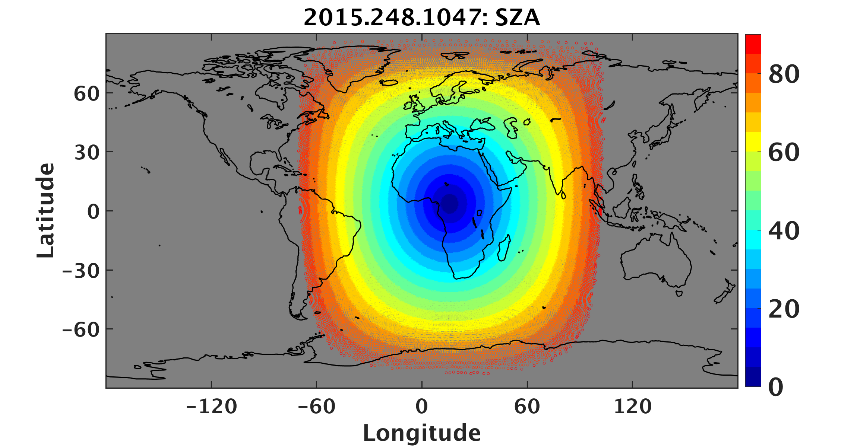
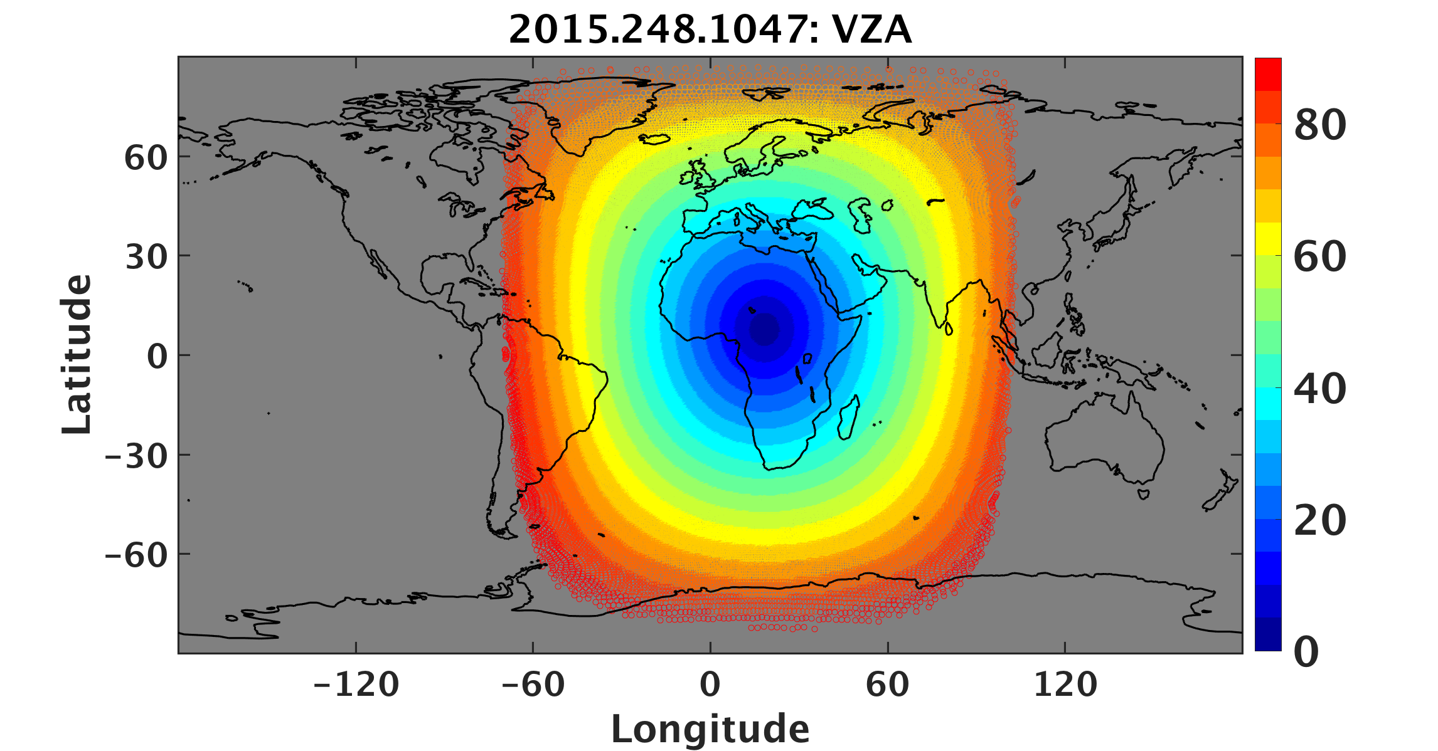
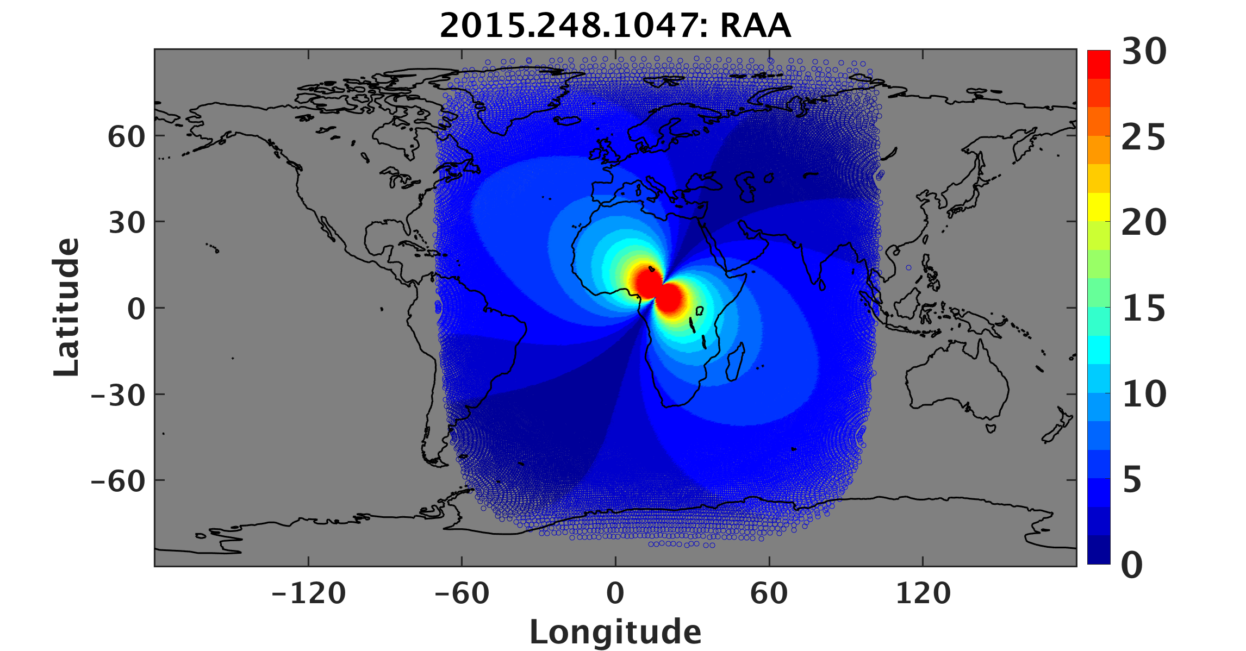
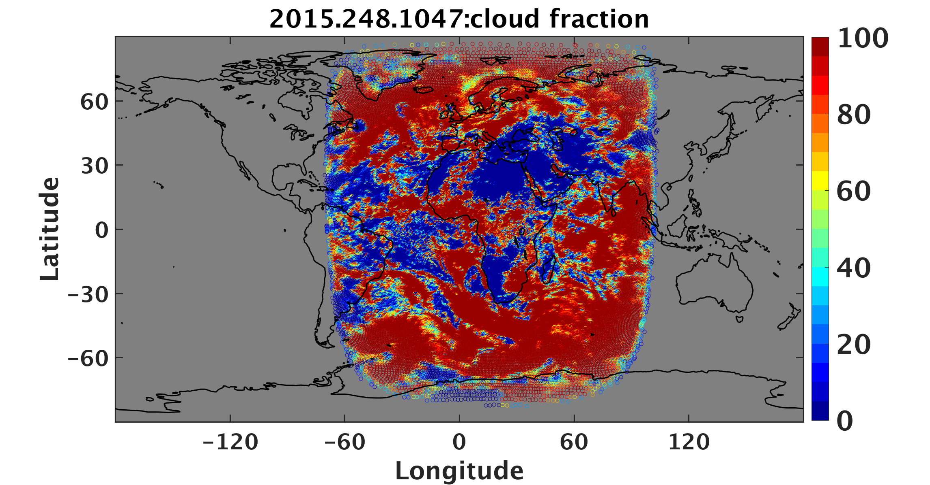
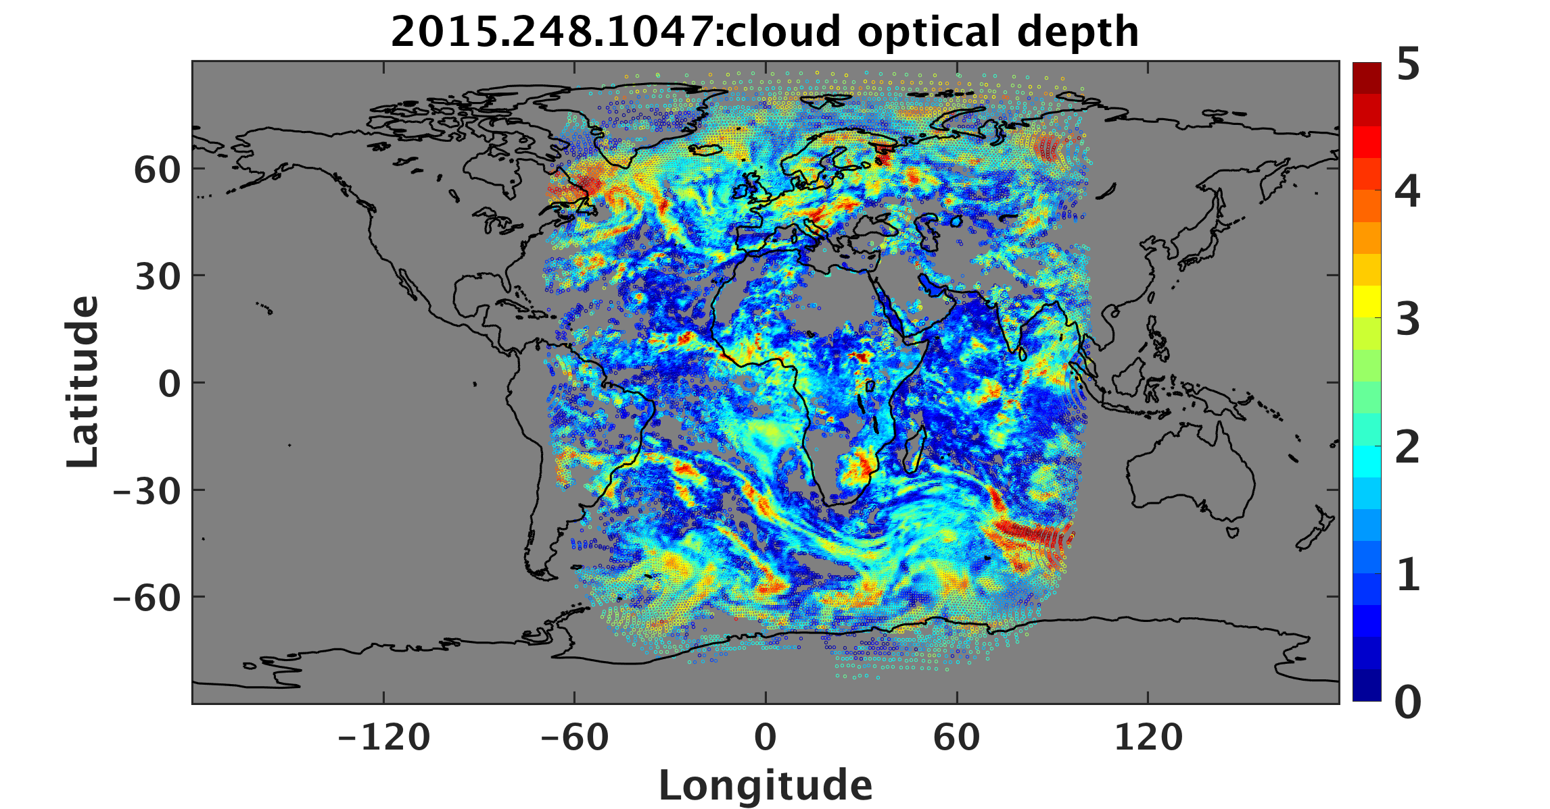
Angles and clouds for 2015.248.1047

Slide 36
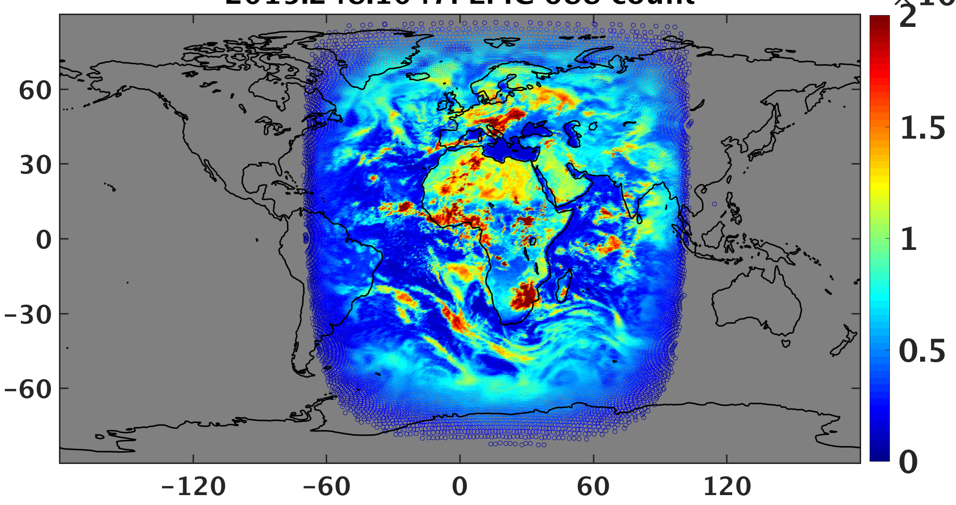
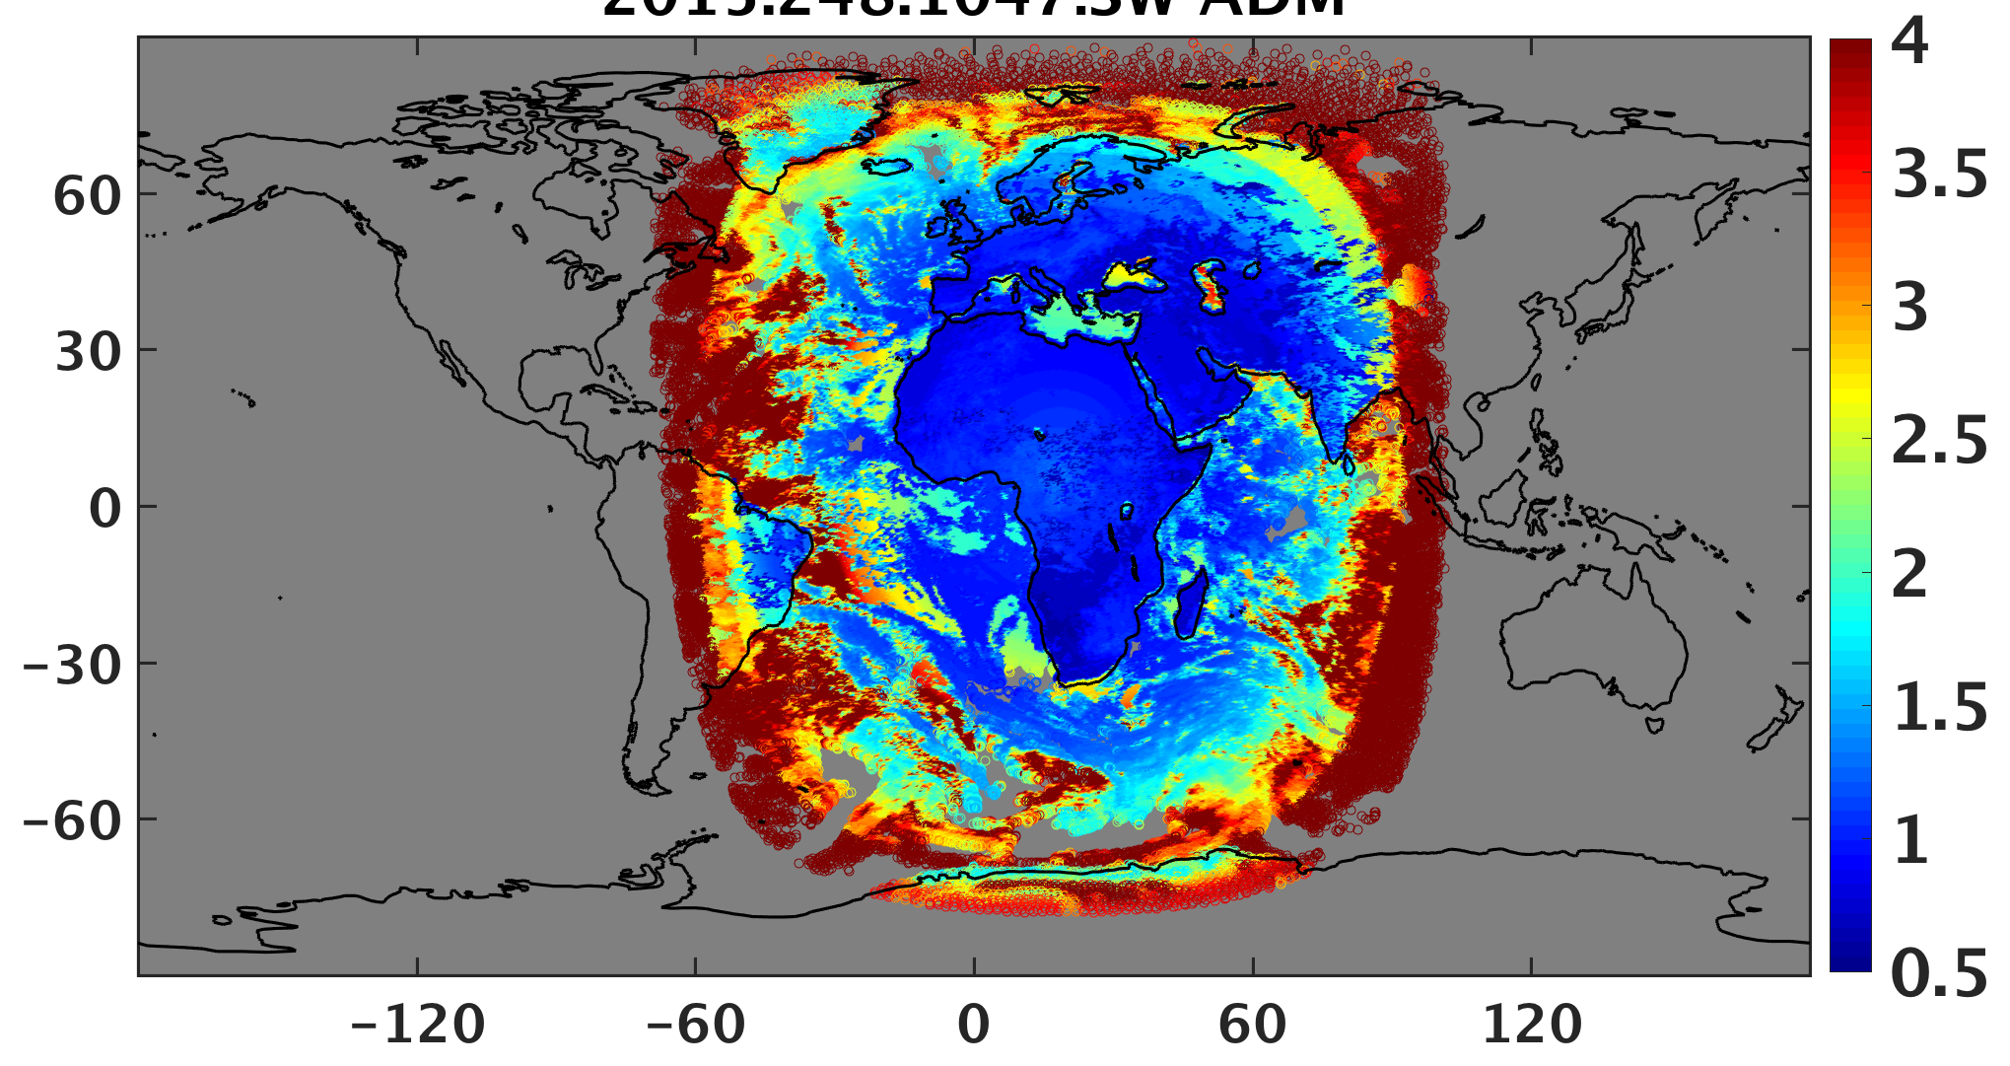
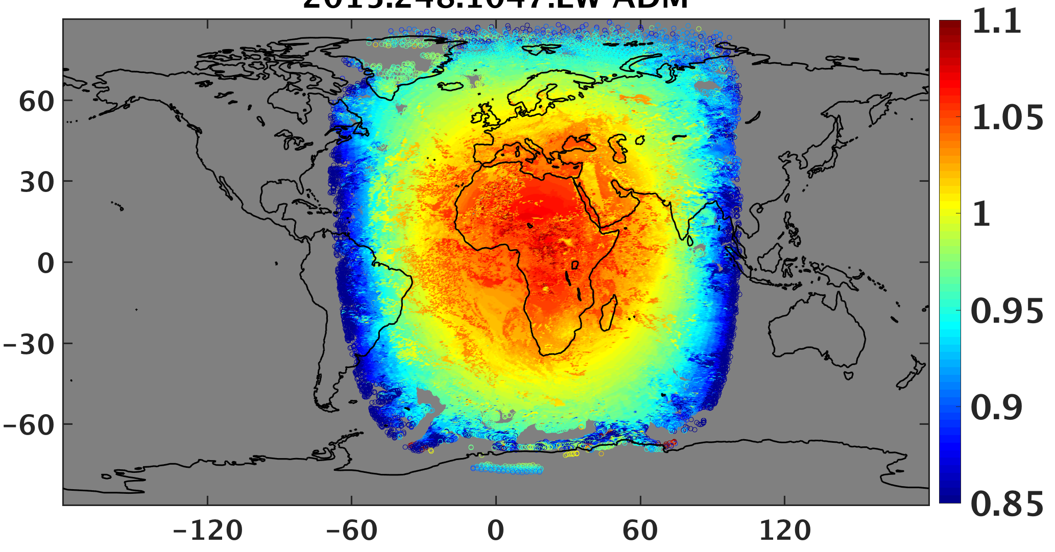
ADMs, 2015.248.1049
EPIC 0.680-µm counts
SW ADM
LW ADM
Mean SW anisotropic factor = 1.389
SW radiance at 20 km reference level is 112.0 Wm⁻²sr⁻¹, which is ~2.10 mWm⁻²sr⁻¹ at L1.
Mean LW anisotropic factor = 1.012
LW radiance at 20 km: 78.61 Wm⁻²sr⁻¹.
Combined SW & LW => total channel radiance: ~ 11.0 mWm⁻² at L1.

Slide 37
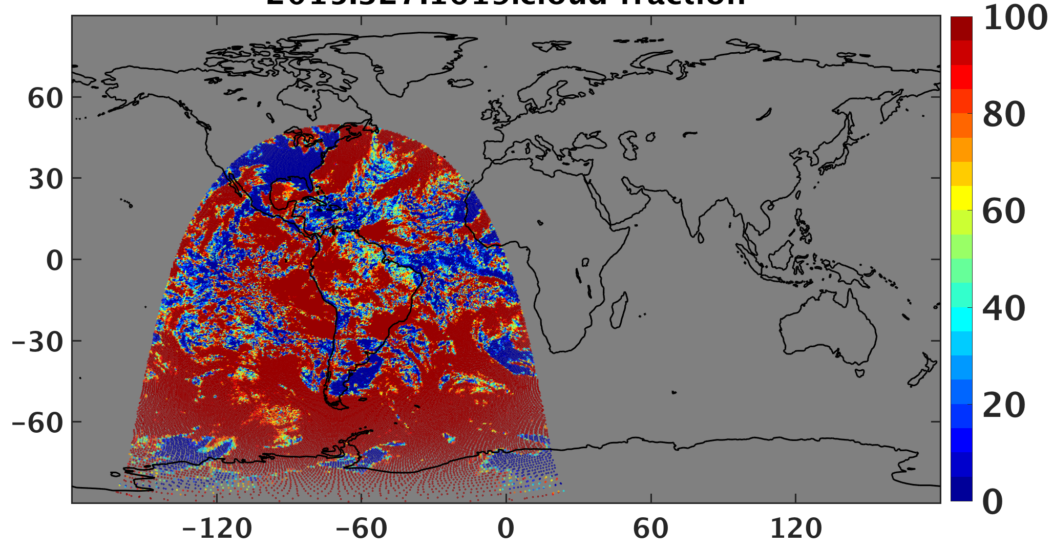
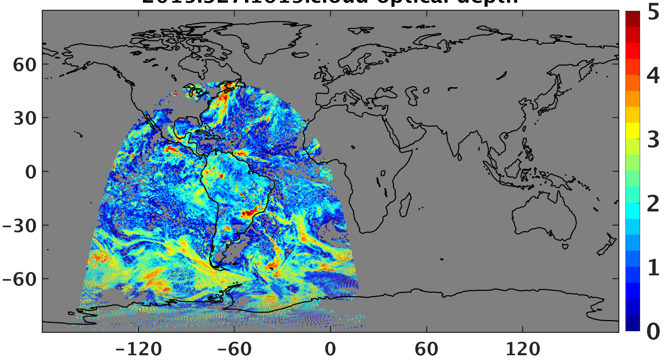
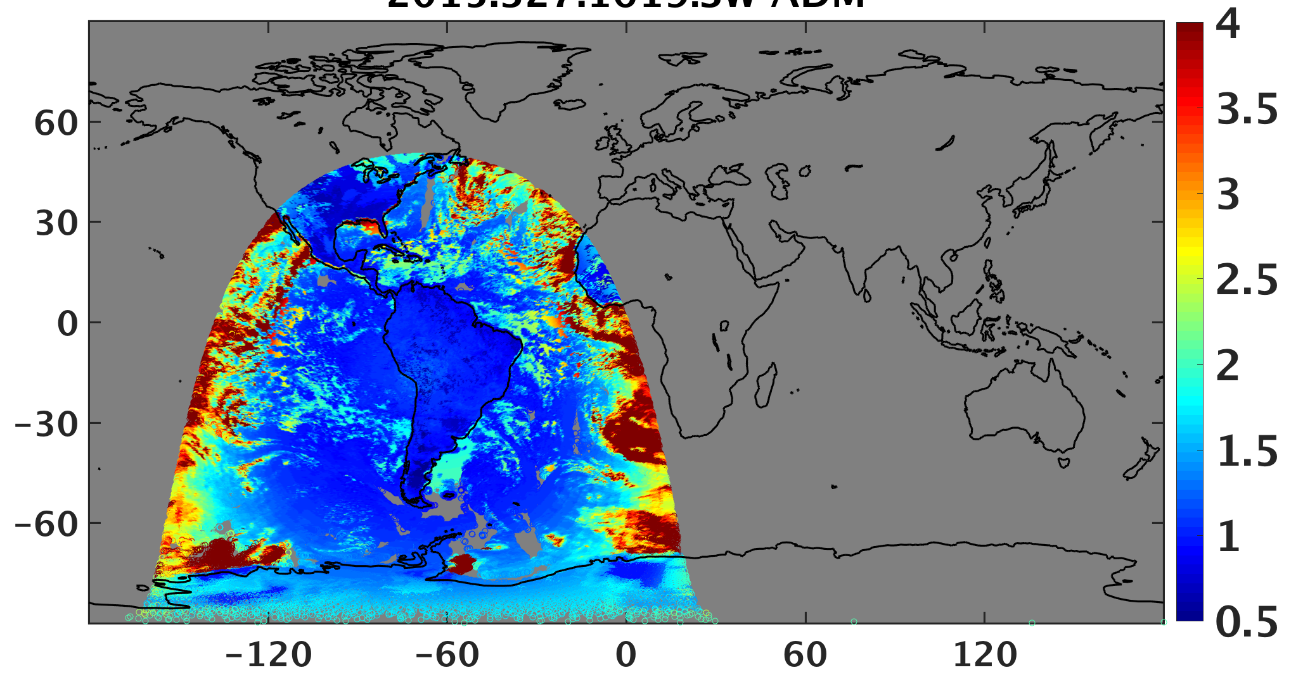
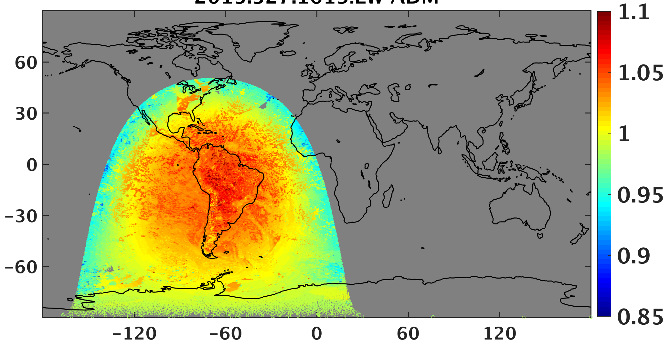
Clouds and ADMs: 2015.327.1619
Cloud Fraction
Cloud Optical Depth
SW ADM
LW ADM
Mean SW anisotropic factor = 1.392
SW radiance at 20 km reference level is 112.0 Wm⁻²sr⁻¹, which is ~2.02 mWm⁻²sr⁻¹ at L1.
Mean LW anisotropic factor = 1.010
LW radiance at 20 km: 77.57 Wm⁻²sr⁻¹.
=> Total at L1 = 3.42 mWm⁻²sr⁻¹

Slide 38
ERB Flux Summary
• Initial code developed for convolving ADMs and weights to compute NISTAR
SW and LW fluxes, preliminary results:
- SW ADM 19% > initial Triana factors based on ERBE ADMs
- LW ADM 3% > initial Triana factors
• Work out remaining bugs before AGU meeting
- use L1B NISTAR results to compute albedo
• Need to develop scheme to interpolate ADMs between EPIC times
- generate ERB every 16 minutes

Slide 39
Future
• Continue calibration of EPIC non-UV channels
- use MODIS & DCC
- monitor trends, work with project to get consensus
• Complete testing of code to average LEO/GEO data into EPIC pixels
- eliminate remaining small bugs
- institute full-scale processing (3 test days currently at ASDC)
- view at http://ceres-iprod.larc.nasa.gov/CERESVis/
- add simple marine aerosol AOD for clear areas
- begin documentation
• Revise code for NISTAR analysis
- continue debugging of ADM computations from EPIC composite
- test new L1B data from NISTAR
- develop methods to interpolate ADM, light/dark corrections between EPIC times
- generate ERB every 16 minutes
• Begin work on NIR albedo

Slide 40
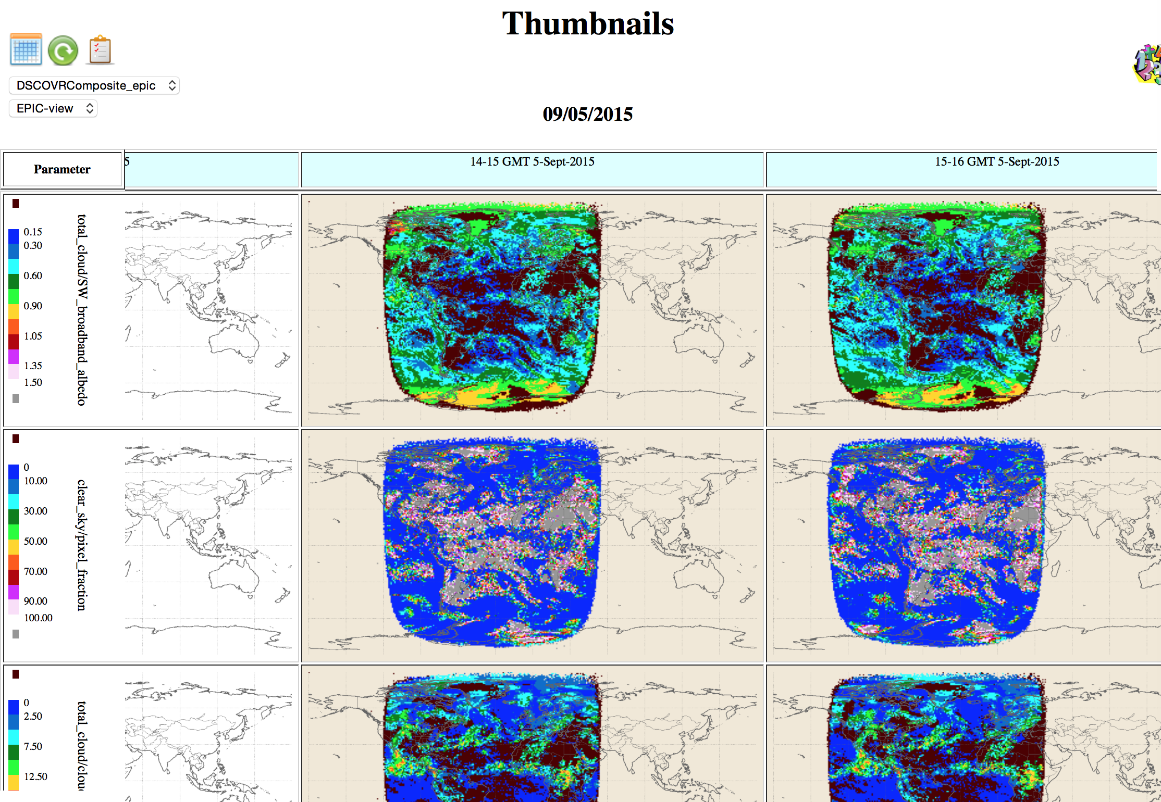
http://ceres-iprod.larc.nasa.gov/CERESVis/

