Slide 1
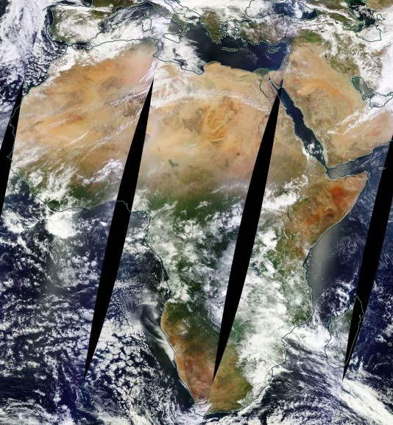
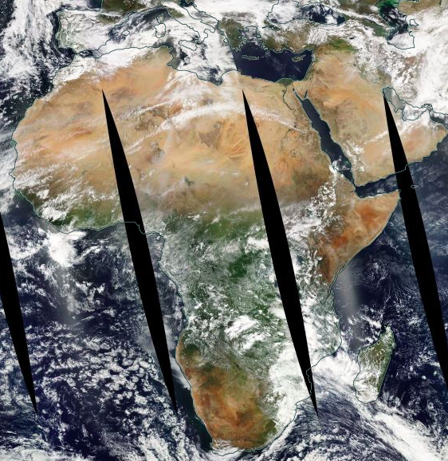
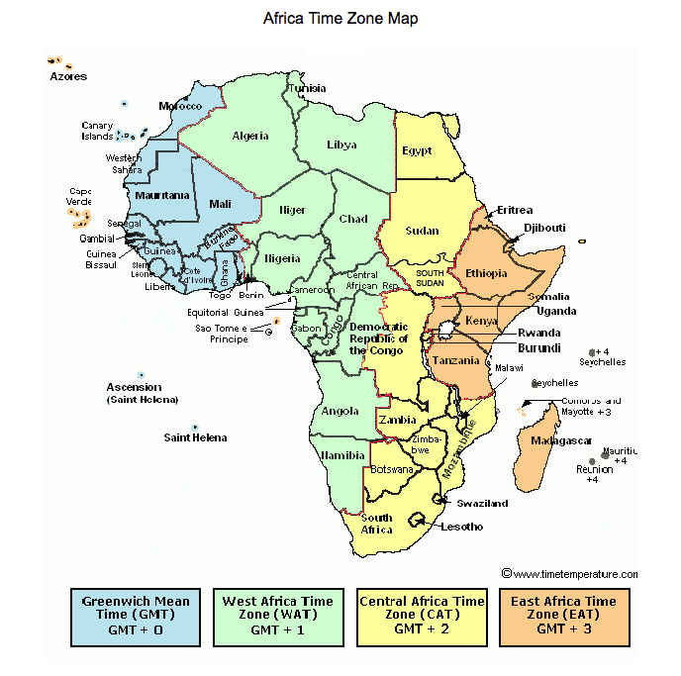
MODIS/Terra&Aqua and EPIC/DSCOVR
MODIS Terra
10:30 equatorial crossing time
EPIC 10:56 UTC
MODIS Aqua
13:30 equatorial crossing time

Slide 3
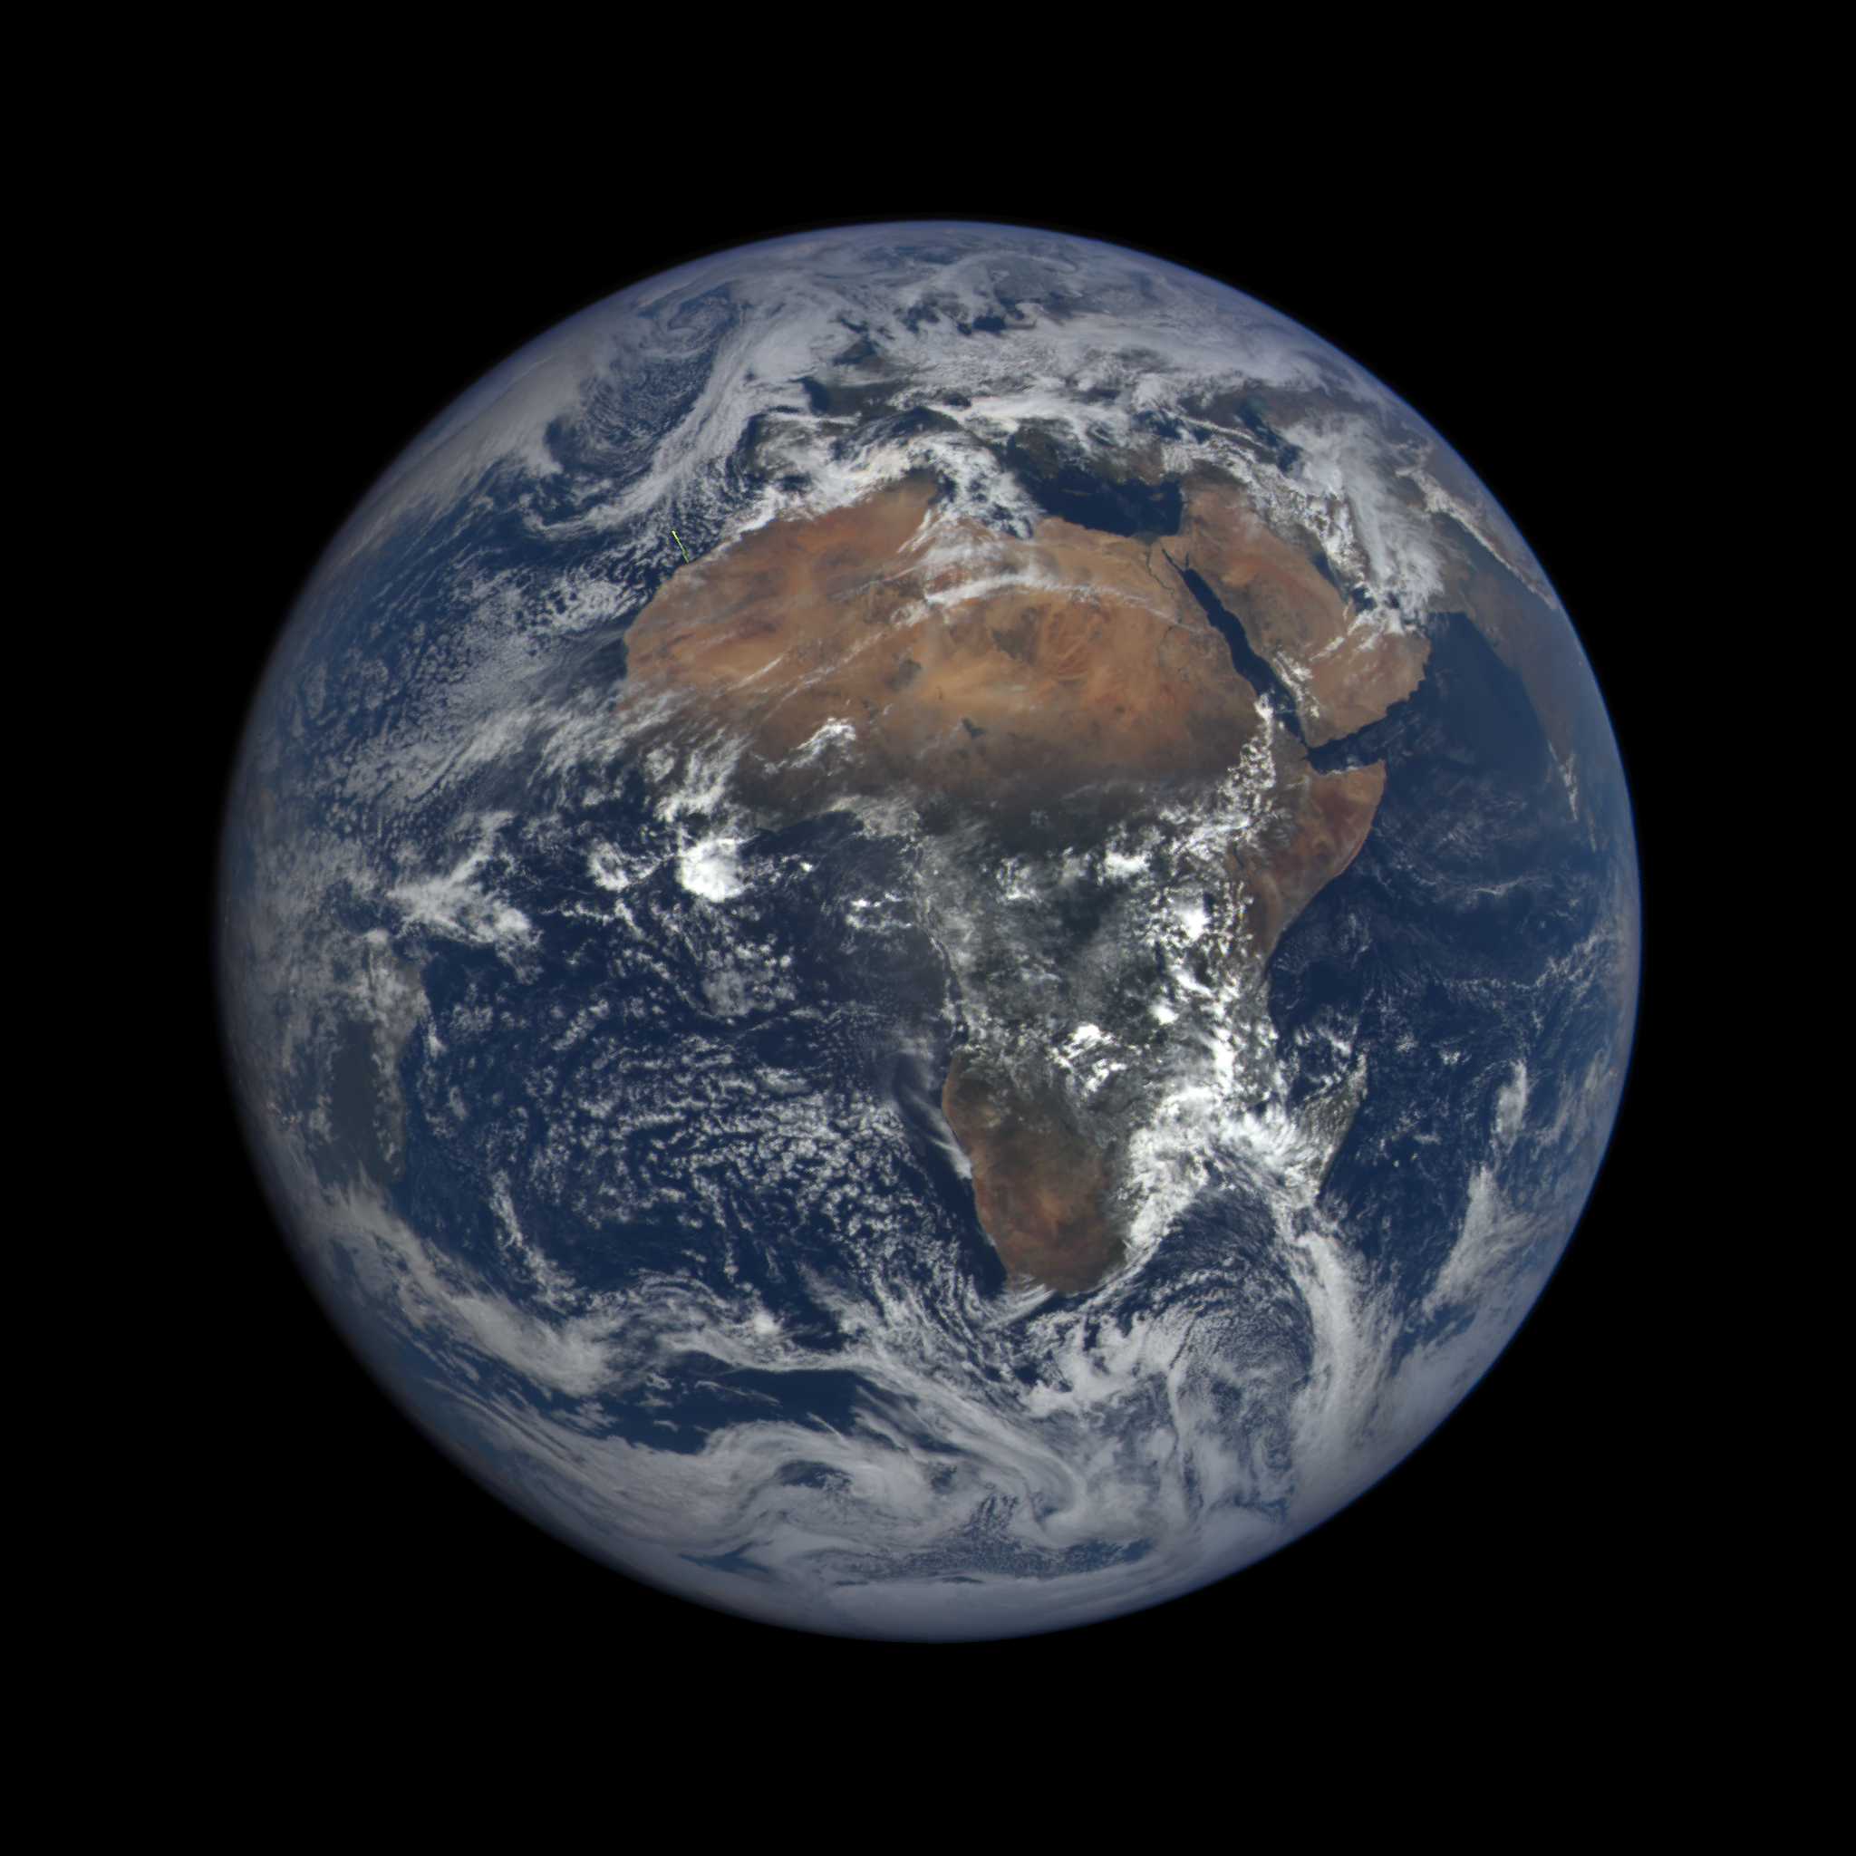
Using the EPIC O2 B-band for monitoring vegetation
Yuri Knyazikhin (Boston University) and Alexander Marshak (GSFC)
March 22, 2016@10-56-44

Slide 4
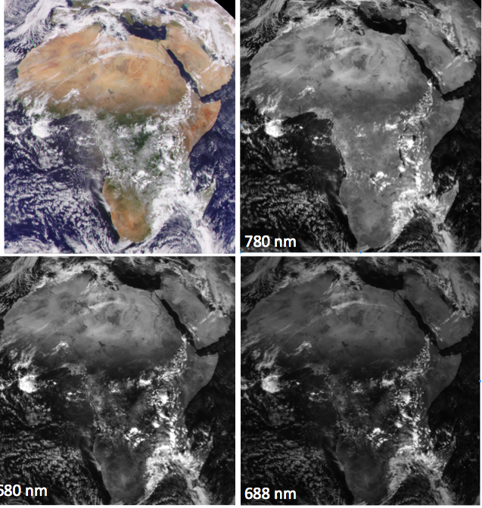
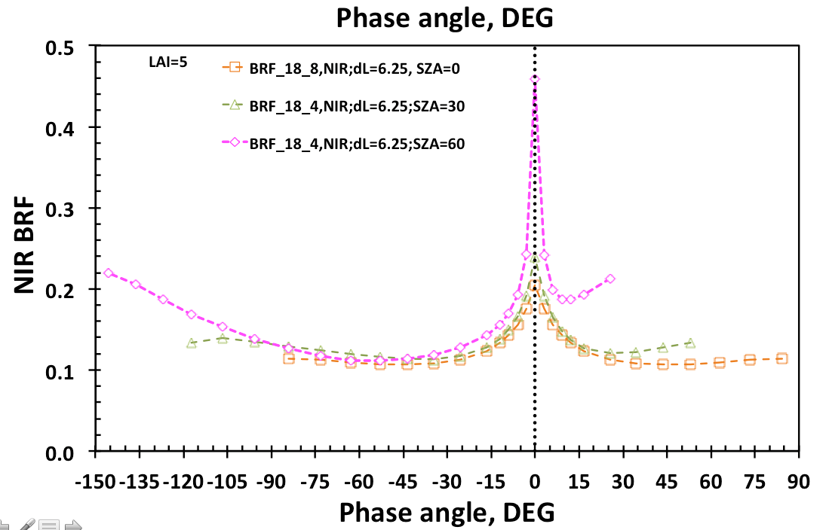
RGB image and three bands used for NDVI:
red (680 nm), O2 B-band (688 nm) and NIR (780 nm)
Back-scattering region
4º-12º phase angle
Reduced multiple scattering
@ 688 compared to 680 nm

Slide 5
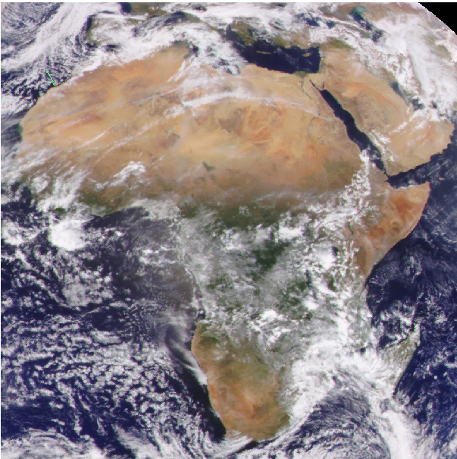
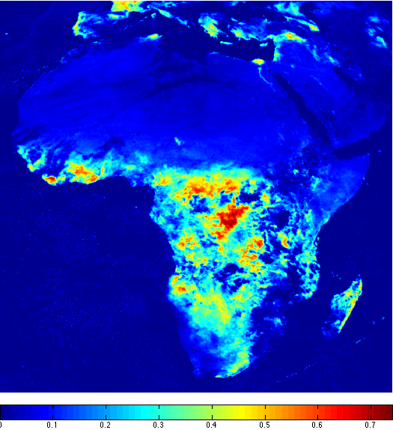
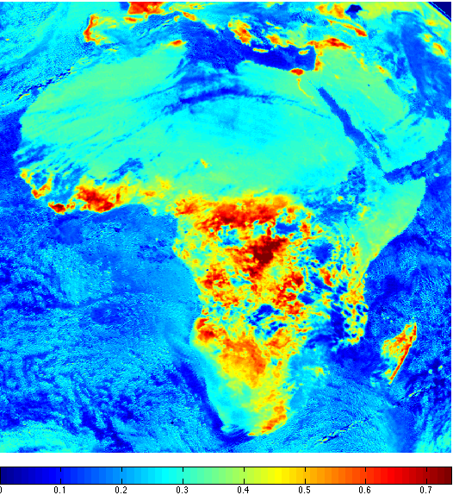
NDVI (Normalized Difference Vegetation Index)
The EPIC NDVI is defined as the difference between NIR and ‘red’ channels normalized to their sum
NDVI
780&680
NDVI
780&688
The use of the O2 B-band instead of the ‘red’ channel mitigates the effect of atmosphere on remote sensing of surface reflectance because O2 reduces contribution from the radiation scattered by the atmosphere.

Slide 6
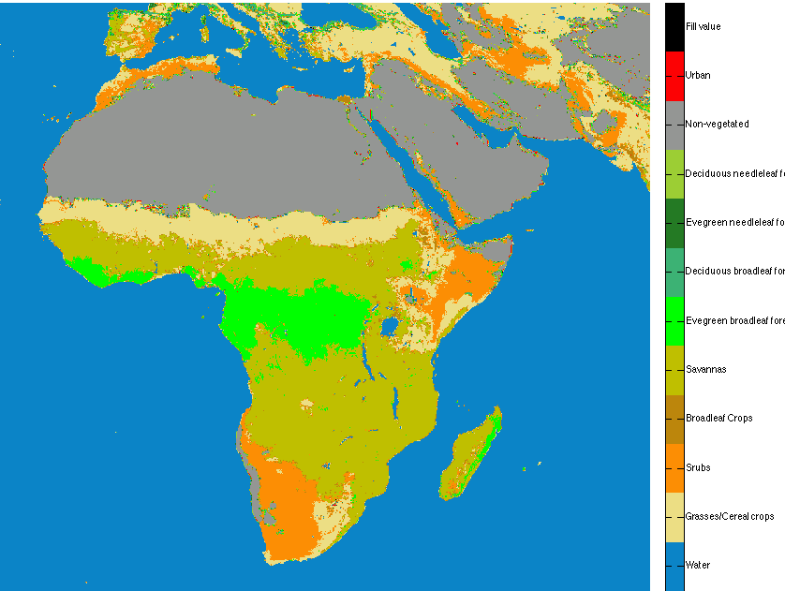
NDVI (Normalized Difference Vegetation Index)
The EPIC NDVI is defined as the difference between NIR and ‘red’ channels normalized to their sum
Land Cover Map, 10 km
NDVI
780&688
The use of the O2 B-band instead of the ‘red’ channel mitigates the effect of atmosphere on remote sensing of surface reflectance because O2 reduces contribution from the radiation scattered by the atmosphere.

Slide 7
NDVI (Normalized Difference Vegetation Index)
The EPIC NDVI is defined as the difference between NIR and ‘red’ channels normalized to their sum
Land Cover Map, 10 km
~0.1
~2
~5.5
Annual mean LAI
~2
~0.1
NDVI
780&688
The use of the O2 B-band instead of the ‘red’ channel mitigates the effect of atmosphere on remote sensing of surface reflectance because O2 reduces contribution from the radiation scattered by the atmosphere.

Slide 8
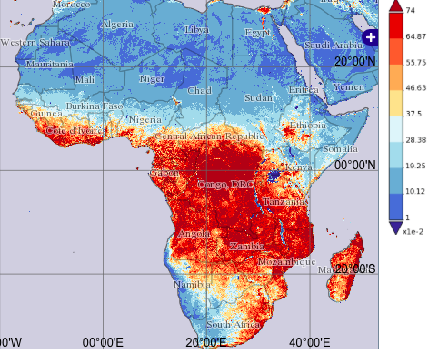
NDVI (Normalized Difference Vegetation Index)
The EPIC NDVI is defined as the difference between NIR and ‘red’ channels normalized to their sum
MODIS NDVI
March 2016
NDVI
780&688
The use of the O2 B-band instead of the ‘red’ channel mitigates the effect of atmosphere on remote sensing of surface reflectance because O2 reduces contribution from the radiation scattered by the atmosphere.

Slide 9
NDVI (Normalized Difference Vegetation Index)
The EPIC NDVI is defined as the difference between NIR and ‘red’ channels normalized to their sum
MODIS NDVI
March 2016
NDVI
780&680
NDVI
780&688
The use of the O2 B-band instead of the ‘red’ channel mitigates the effect of atmosphere on remote sensing of surface reflectance because O2 reduces contribution from the radiation scattered by the atmosphere.

Slide 10
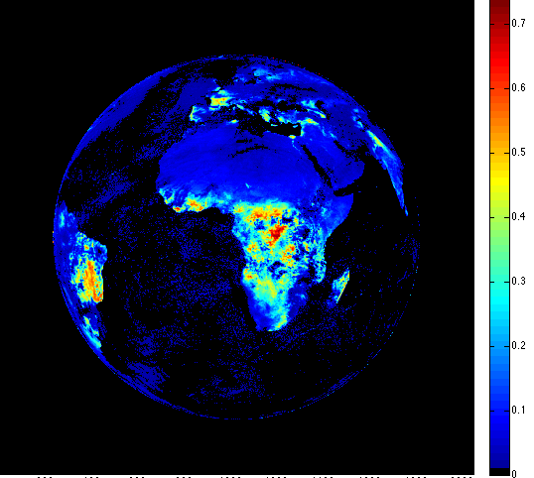
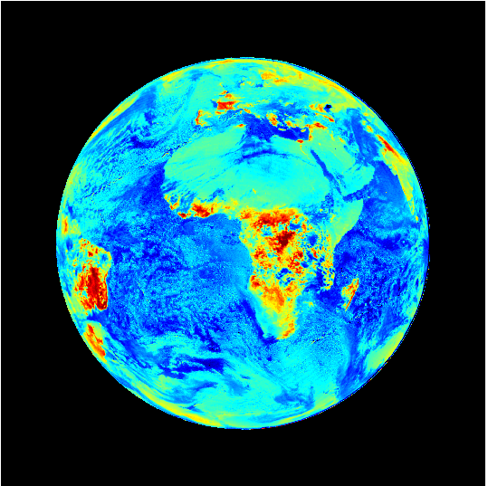
NDVI (Normalized Difference Vegetation Index)
The EPIC NDVI is defined as the difference between NIR and ‘red’ channels normalized to their sum
NDVI
780&680
NDVI
780&688
The use of the O2 B-band instead of the ‘red’ channel mitigates the effect of atmosphere on remote sensing of surface reflectance because O2 reduces contribution from the radiation scattered by the atmosphere.

Slide 11
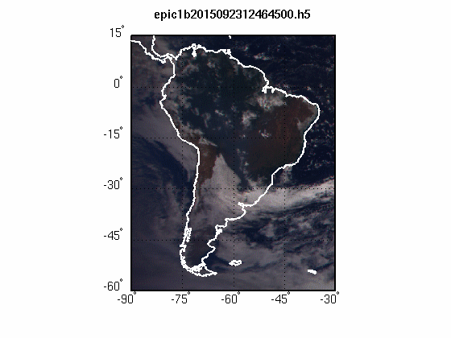
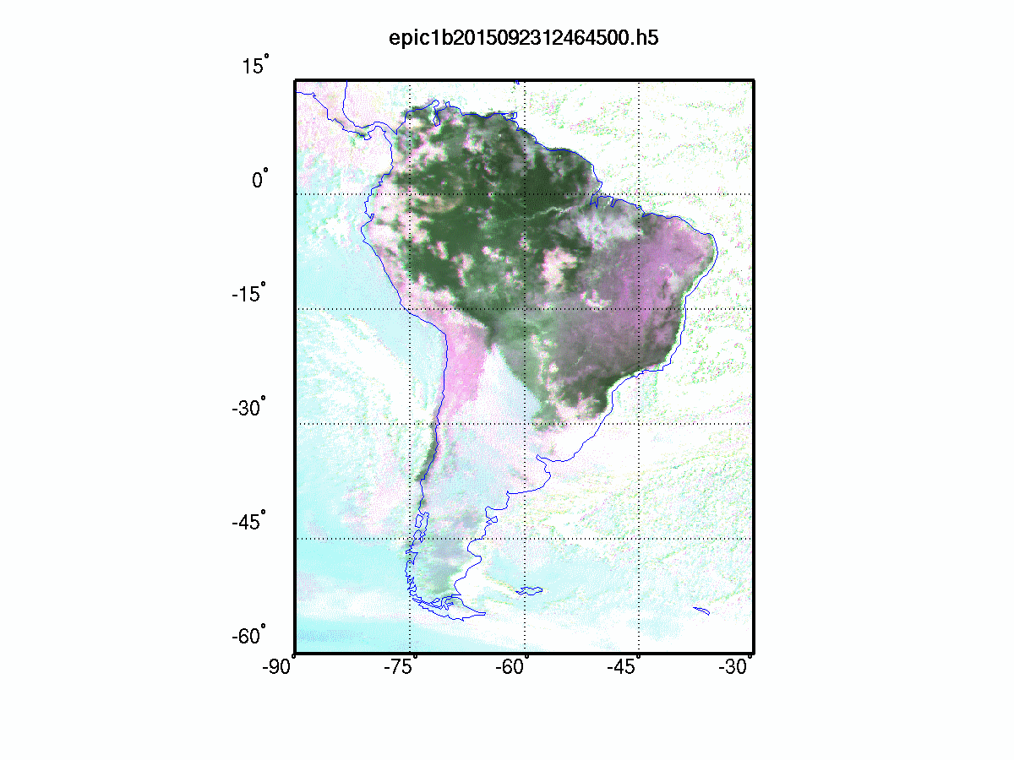
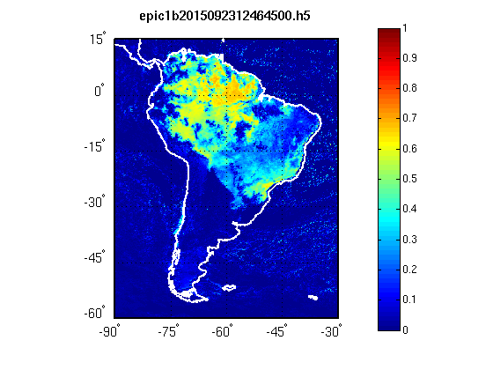
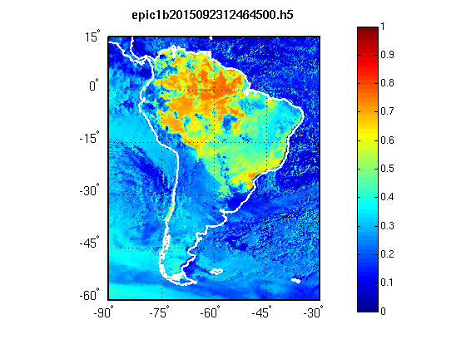
Leaf albedo and NDVIs
South America: dry season (Sep. 23, 2015)
True Color(680-551-443)
False Color W(688-551-680)
Courtesy of
Yuri Knyazikhin
NDVI(780,680)
NDVI(780,688)

Slide 13
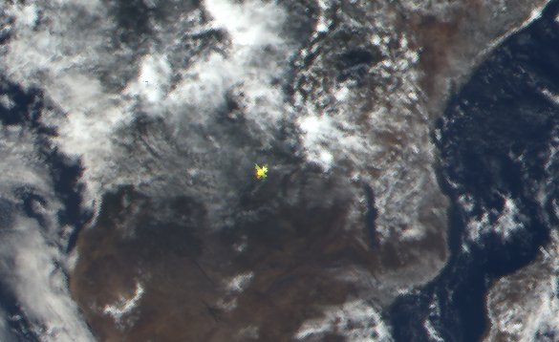
Specular reflection
from horizontally oriented ice crystals
in EPIC observations over land
Alexander Marshak (GSFC) and Tamás Várnai (UMBC)
2015-10-28 09:41

Slide 14
Examples
EPIC images often reveal bright colorful spots near the center of the images.
The spots are of different colors because of a time lag between the images for dif. wavelengths:
- ~3 min dif. between blue and green,
- ~4 min dif. between blue and red,
- 54 s dif. between green and red.

Slide 15
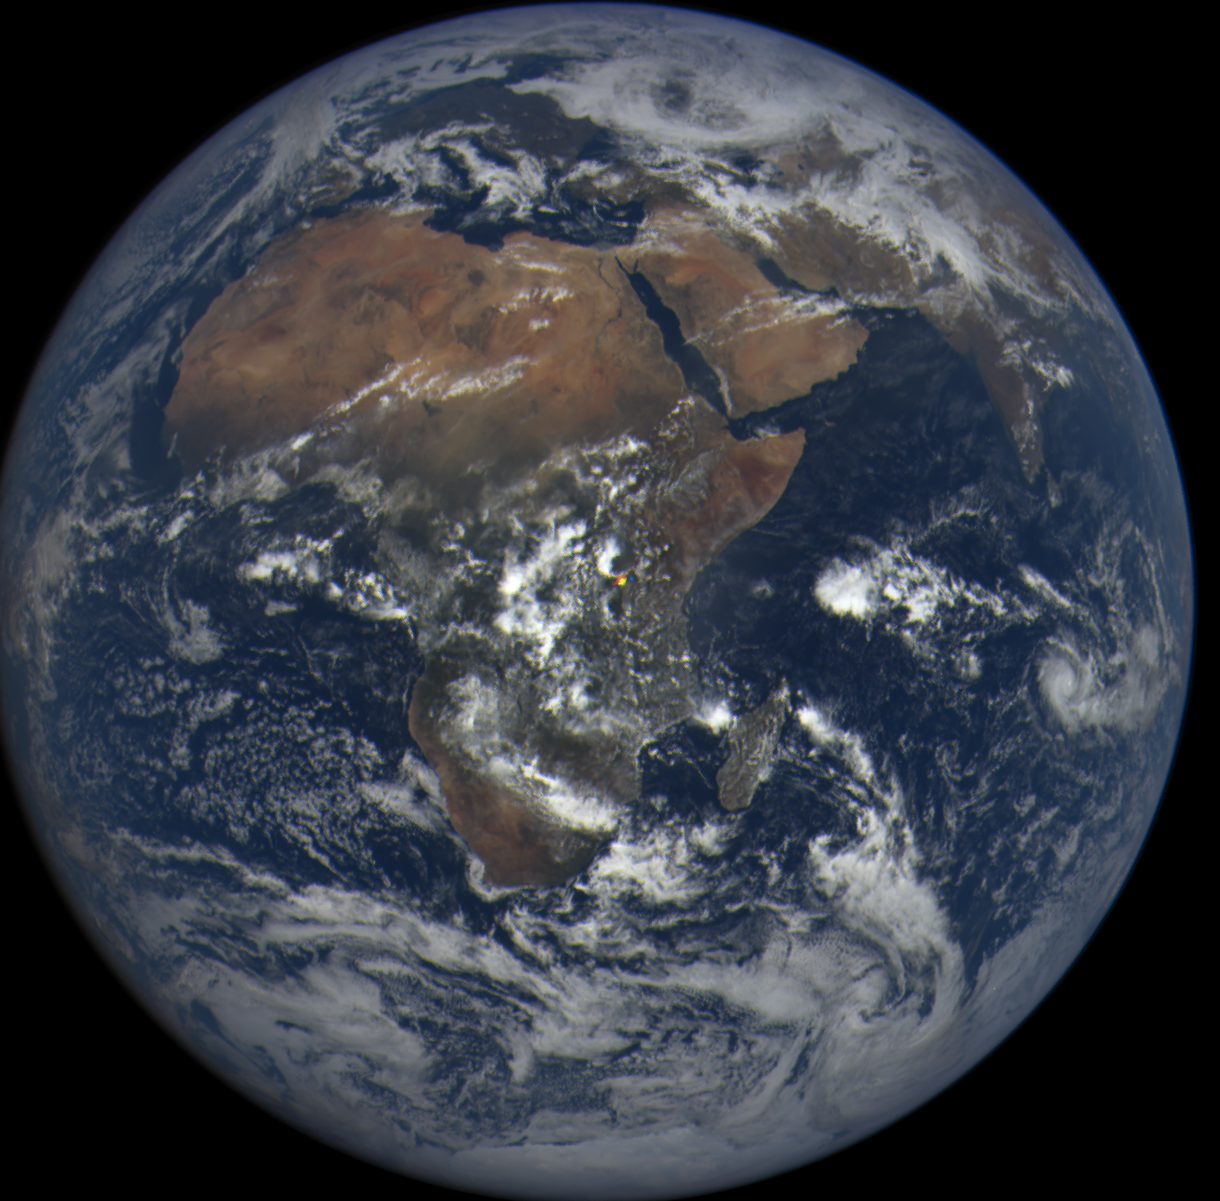
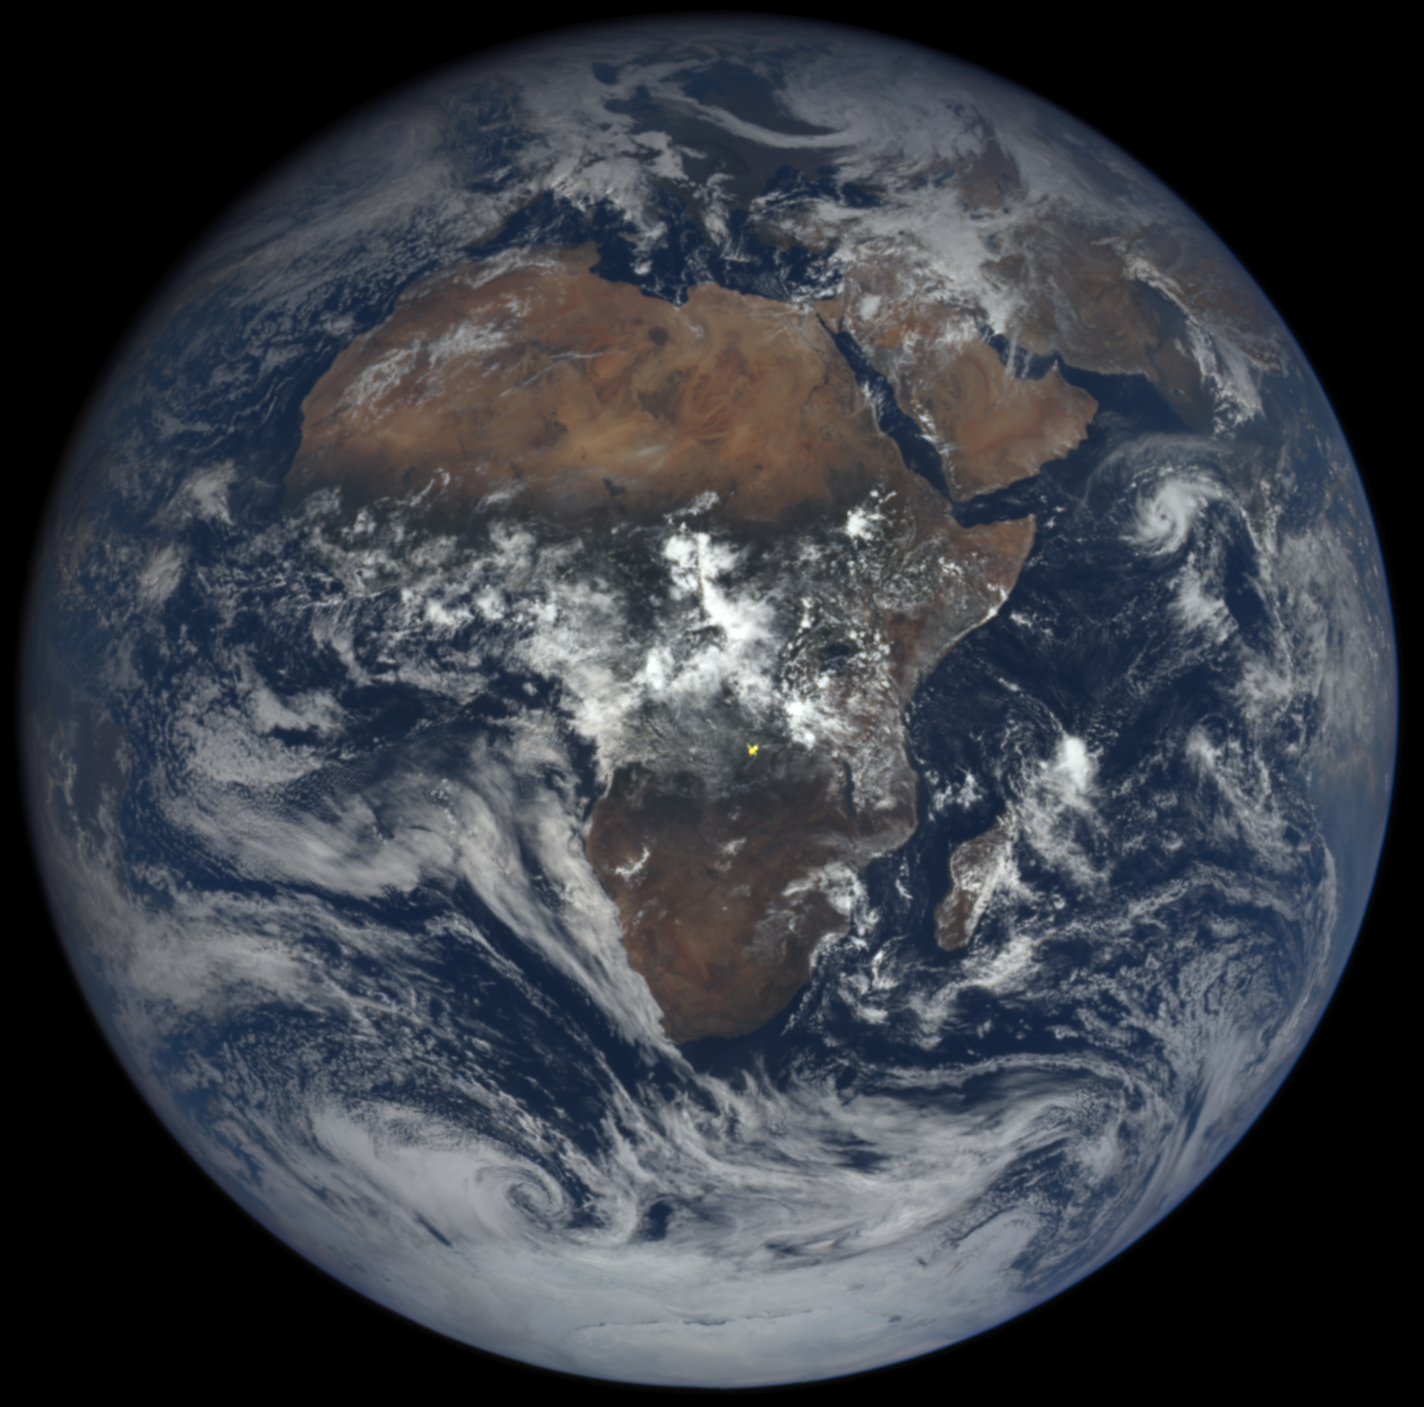
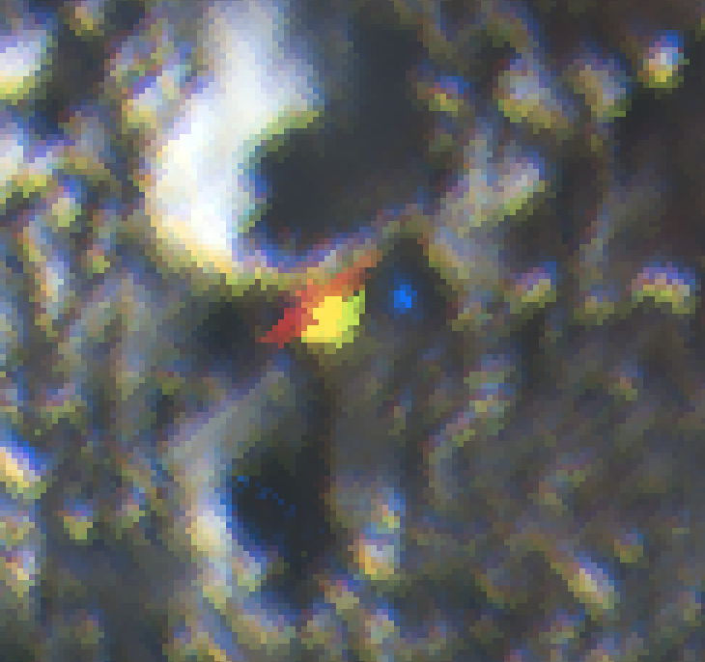
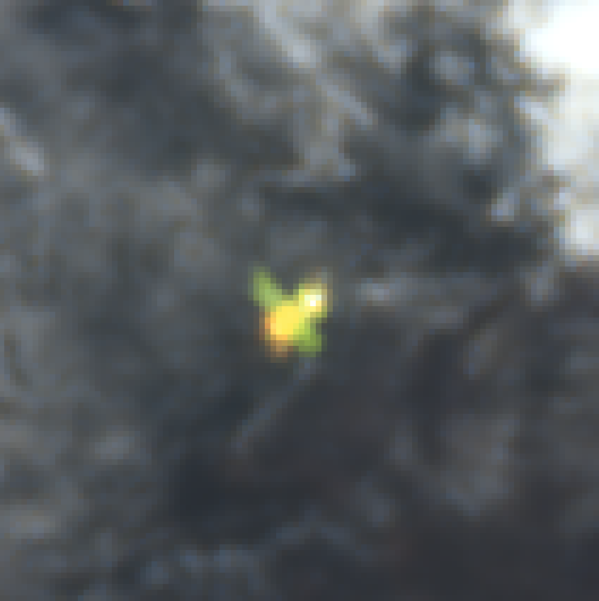
20160317094607
20151028094609
20160317094607
zoom
20151028094609
zoom

Slide 16
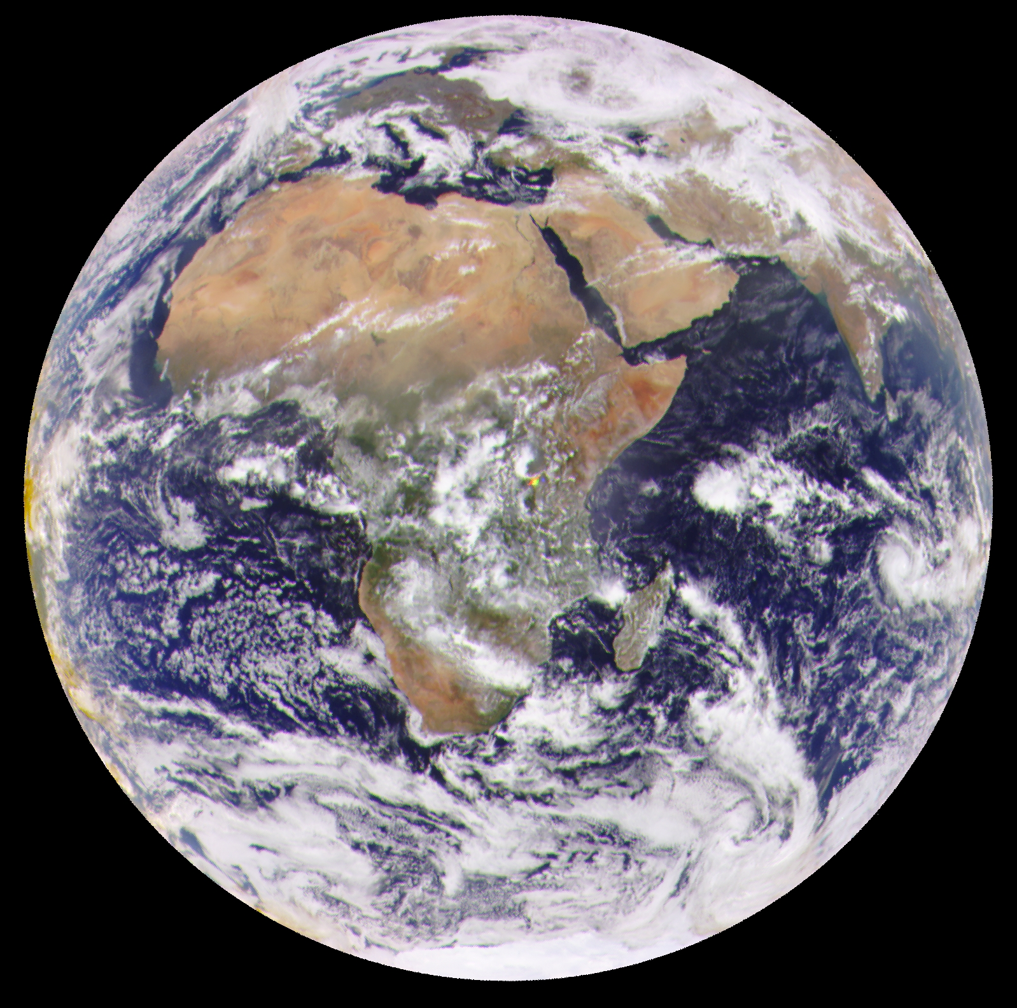
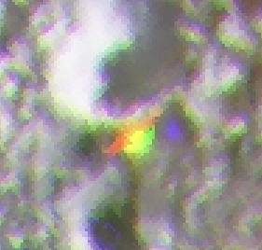
20160317094607
20160317094607
20160317094609
zoom
20160317094609
zoom

Slide 17
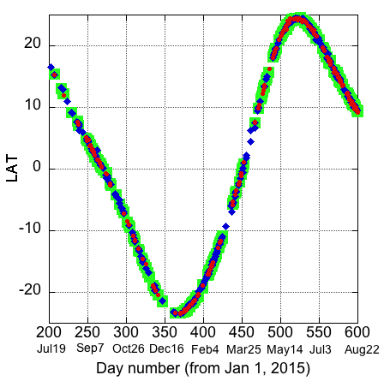
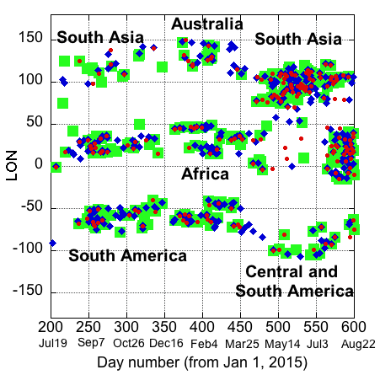
Latitude and Longitude
Because of the Earth’s axial tilt (23.4º), the subsuns reach the most southern latitude in the S. Hemisphere (~25° S) around Dec 22, while they reach ~25° N around June 22.

Slide 18
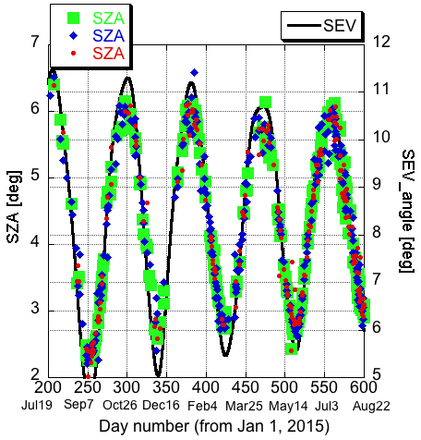
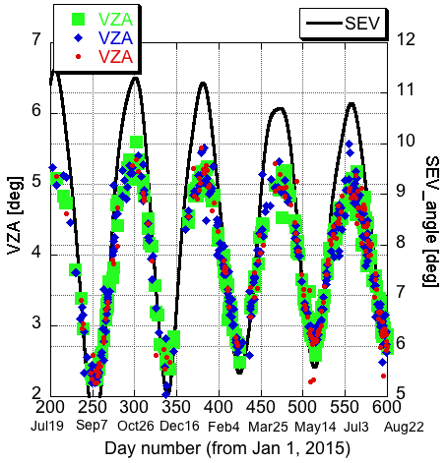
SZA and VZA
VZA
SZA
SEV
SEV = Sun – Earth – Vehicle

Slide 19
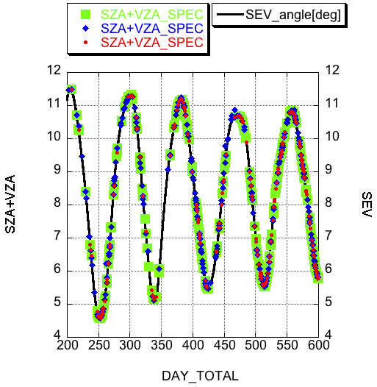
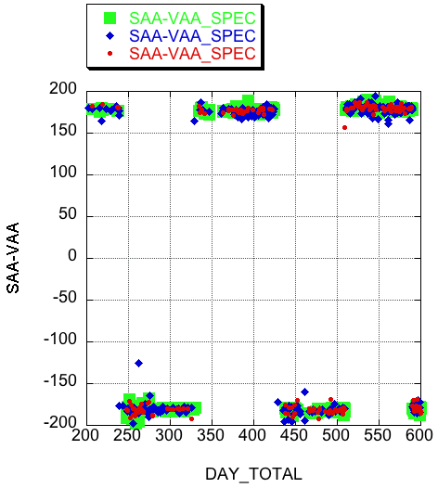
SZA + VZA = SEV
SAA - VAA = ±180
VZA
SZA
SEV
The location of the detected subsuns is very close to the sunglint location

Slide 20
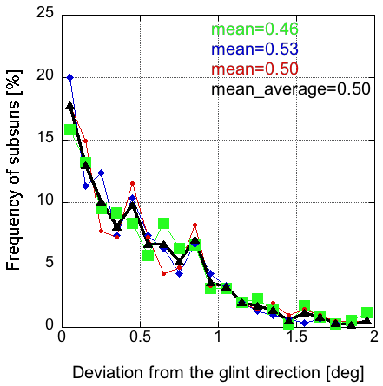
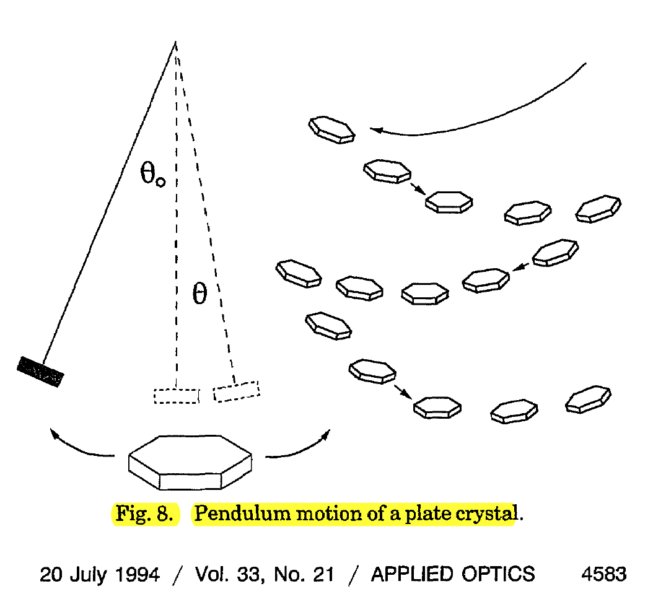
Deviation from the direction of specular reflection
from Lynch, 1994
~90% of all cases have the deviation angle < 1º while ~99% cases < 2º.
The aerodynamic model predicts that a typical tilt angle varies “between 0.5º and a few degrees from weak to strong turbulence.”

Slide 21
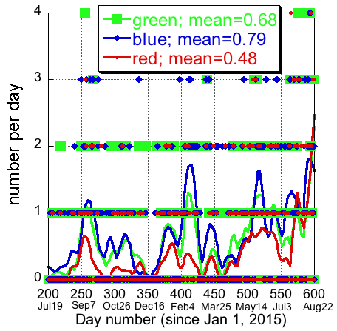
Number of detected subsuns per day
The averaged number of images per day is ~10.3; thus the frequency of detecting a subsun per image is ~7.7%

Slide 22
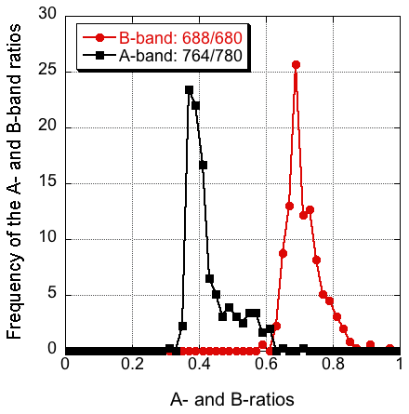
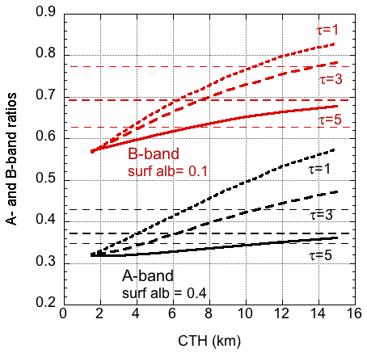
Height of the subsuns
As was detected by POLDER, the clouds that are higher than 5.5 km (~500 hPa) have less horiz. oriented plates than clouds between 3.5 and 5.5 km (~ 500-700 hPa). This is consistent the CALIPSO results: the presence of the horiz. oriented crystals is most frequent between -30ºC and -10ºC and they are almost nonexistent in ice clouds colder than -30ºC.

Slide 23
Frequency of horizontally oriented crystals
Based on
(i) # of detected subsuns as a function of deviation from a direction of specular reflection;
(ii) average size of a subsun;
(iii) # of subsuns per day and per image;
(iv) fraction of over land pixels between 25S and 25N;
(v) fraction of ice clouds;
we estimated the frequency of horizontally oriented ice crystals as ~3-4%
If crystals are horizontally oriented, there is a very strong specular reflection which increases cloud albedo by ~40% compared to randomly oriented crystals [Yang et al., 2003].

Slide 25
EPIC Calibration using MODIS and Moon Geogdzhayev (Columbia University) and Marshak (GSFC)
MODIS Aqua and Terra L1B 1km reflectance for four EPIC visible and NIR channels. Measurements made between June 2015 and June 2016 are employed.
EPIC channel | MODIS Band (Bandwidth)
443 nm | 3 (459-479nm)
551 nm | 4 (545-565nm)
680 nm | 1 (620-670nm)
780 nm | 2 (841-876nm)

Slide 26
Pixel matching
For each EPIC image MODIS pixels are identified as:
scattering angle should match to within 0.5 deg;
temporarily collocated to within 10 min;
spatially collocated to within 25 km radius;
relative std dev. is found for each EPIC pixel using 5x5 pixel neighborhood and for collocated MODIS pixels;
std dev. is used to select the most homogeneous scenes.
Two methods are used to determine calibration factors:
linear regression between EPIC counts and MODIS refls;
mean MODIS/EPIC ratio for MODIS reflectance > 0.6.

Slide 27
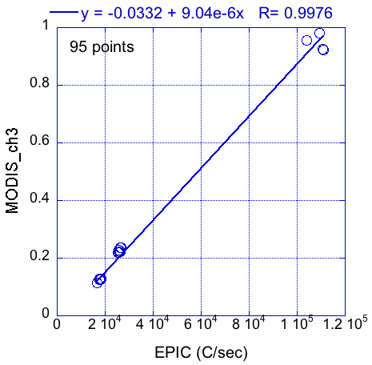
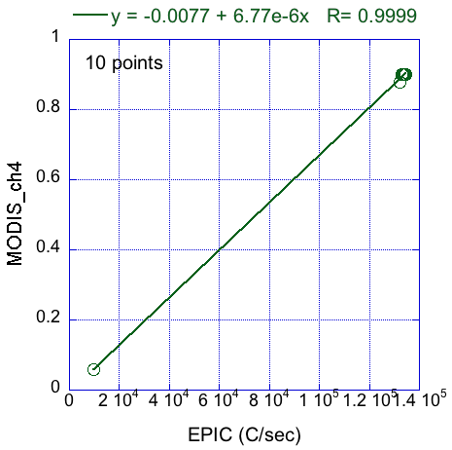
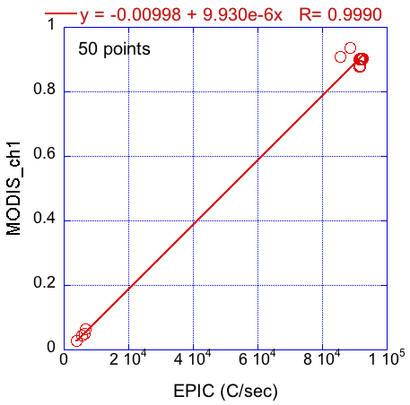
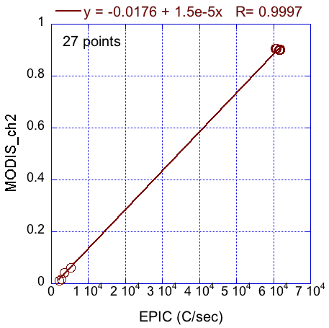
Regression analysis

Slide 28
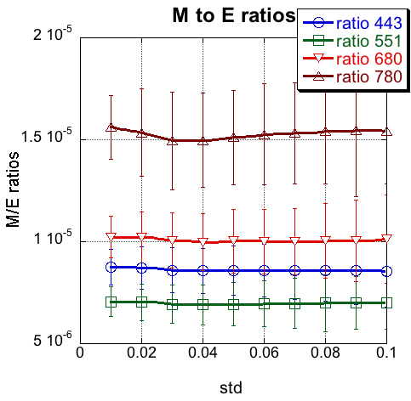
MODIS to EPIC ratio

Slide 29
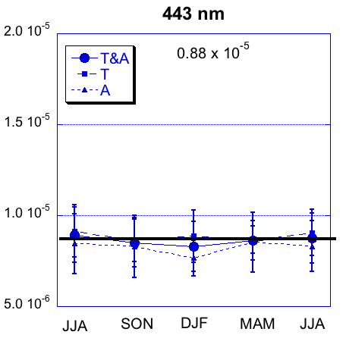
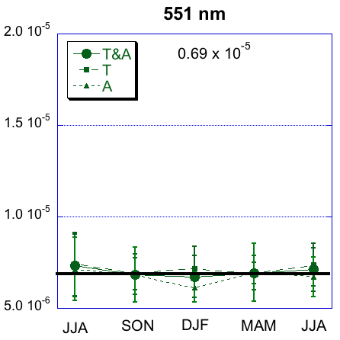
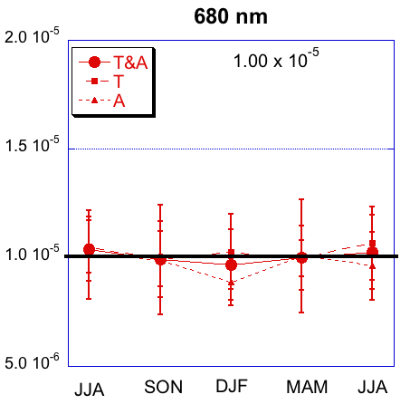
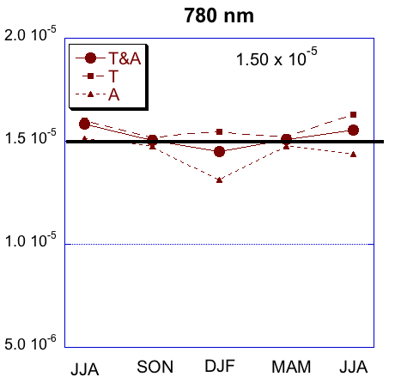
Seasonal dependence
Seasonal dependence of the regression coefficients derived from M/E ratios for points with relative standard deviation < 0.1

Slide 30
Error estimates
EPIC Channel | Calibration coefficient | Ratio-regression difference, % | Seasonal variability, %
443 | 8.80E-6 | 2.79 | 2.8
551 | 6.90E-6 | 1.98 | 3.4
680 | 1.00E-5 | 1.01 | 2.84
780 | 1.50E-5 | 0.41 | 3.33
Conclusion
The accuracy of the calibration coefficients to be better than 3%

Slide 31
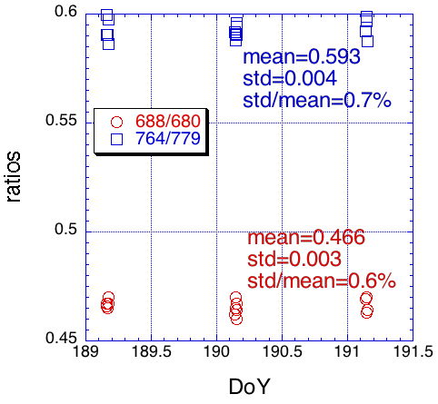
O2 bands calibration using Moon
Only one Full Moon event was used for calibration

Slide 32
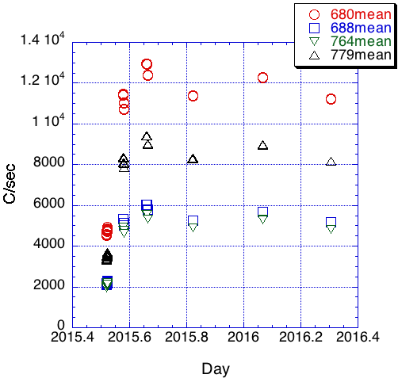
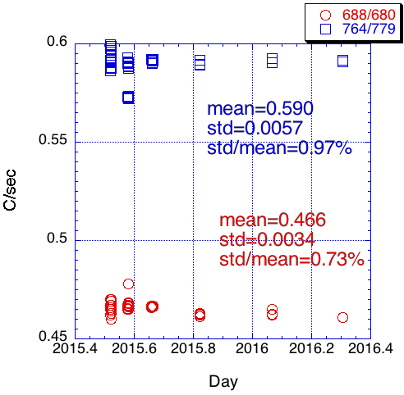
O2 bands calibration using Moon
680 MODIS 1.00 x 10-5
688 Moon 2.16 x 10-5
764 Moon 2.52 x 10-5
780 MODIS 1.50 x 10-5
Better than 3%

Slide 34
Reflectance values for the detected green, blue and red subsuns
R₅₅₁>R₆₈₀
R₅₅₁<R₆₈₀

Slide 35
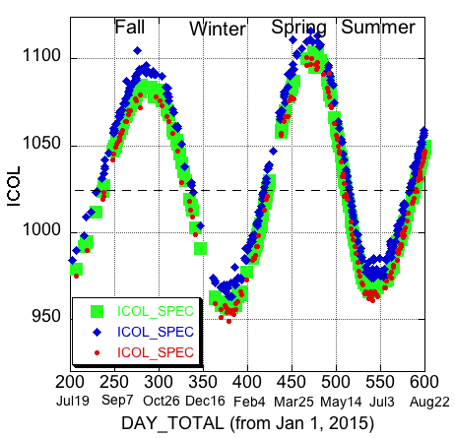
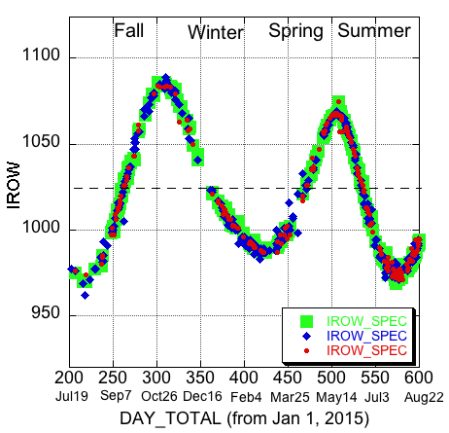
Location in CCD

Slide 36
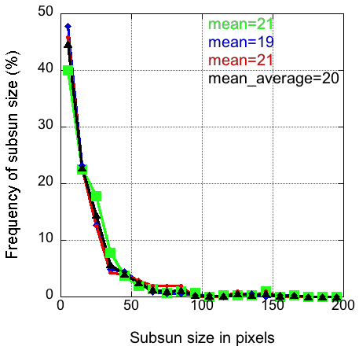
Size of the subsuns
The mean value is ~20 or ~4-5 pixels on each side. 9% of all subsuns consists of only 1 pixel, 45% have <10 pixels while 97% have <80 pixels, which is ~1º in the range of deviation from the direction of specular reflection of the horizontally oriented crystals.

Slide 37
DSCOVR Land Cover Map, 10 km, SIN

